Slide 1
1
General Information
Frank Zimmermann
213th FCC-ee Accelerator Design Meeting

Slide 2
brief topics
minutes & items from last meeting
topics arising
upcoming seminar
today’s agenda

Slide 3
topics arising
- WS beam-beam simulations for all 4 FCC-ee modes including full lattice without and with errors ! (X. Buffat, R. Tomas, T, Pieloni, L. Van Riesen Haupt,…
- Thermal photon scattering at FCC-ee (O. Bruning)
- Polarisation with laser scattering (V. Ranjbar)
- Preserving polarisation on the booster ramp – scheme for imperfection correction (V. Ranjbar)
- No spin rotators before or after the damping ring!?! (EIC concept)
- Heating of lead shielding during chamber bakeout (EIC)

Slide 4
special FCC seminar this Friday, 26 Sept., 10h00, 18/3-008
Injection Status and Issue of SuperKEKB
Naoko Iida, KEK
https://indico.cern.ch/event/1588327/
https://cern.zoom.us/j/69349316235?pwd=LjTTWYQwWViFq9djlmC0RqUF8bGU66.1
SuperKEKB achieved a peak luminosity of 5.1x10^34/cm^2/s in December 2024. The next milestone is 1x10^35/cm^2/s. However, one of the major limitations on achievable luminosity is the maximum accumulated current, which is determined by the balance between beam injection and beam lifetime. Beam injection involves many factors. The most important improvements to increase the maximum accumulated current are listed below. 1) Investigation of the e- emittance growth in the beam transport line 2) HER synchrotron injection 3) Improve the dynamic aperture of HER by correcting QCS cancel coil error 4) Improve the LER injection beams and alignment of the injection region

Slide 5
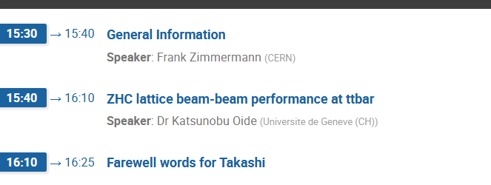
today’s agenda

