Slide 1
Polarizer Ring Status
Siddhi Keskar Christian Carli
Special thanks to : K.Skoufaris, Y.Wu

Slide 2
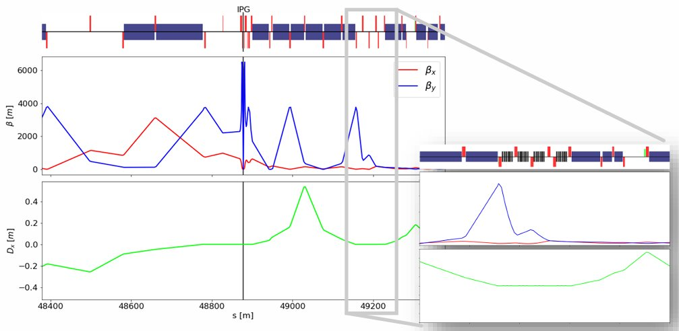
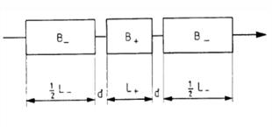
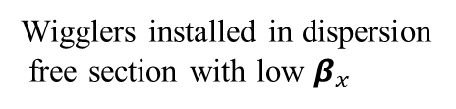
Baseline Strategy: Polarization inside Collider
Natural polarization time at $Z pole →250 h$ (wigglers improve it significantly $\sim 12 h$)
Natural polarization time at 𝑍 𝑝𝑜𝑙𝑒 →250 ℎ (wigglers improve it significantly ~ 12 ℎ)
Operational scenario :
Inject pilot bunches
Wigglers on $→$ build $\sim 5−10\%$polarization
Wigglers on → build ~5−10% polarization
Wigglers off $→$inject full physics bunches
Wigglers off →inject full physics bunches
Pilot bunches used for RDP during physics fills (every $10−15 min$)
Pilot bunches used for RDP during physics fills (every 10−15 min)
Limitations:
Polarization must be rebuilt in collider; slow recovery after beam aborts
Orbit deformation due to wigglers increases synchrotron radiation
Photons with critical energy (MeV) can generate neutrons
Radiation protection challenges
Wigglers installed in dispersion
free section with low $β_{x}$
Fig 2. Polarization time reduction using asymmetric wigglers : M. Hofer, FCC-ee Wiggler Studies, indico.cern.ch/event/1080577)
Fig 1. Wiggler straight optics : M. Hofer: indico.cern.ch/event/1080577/

Slide 3
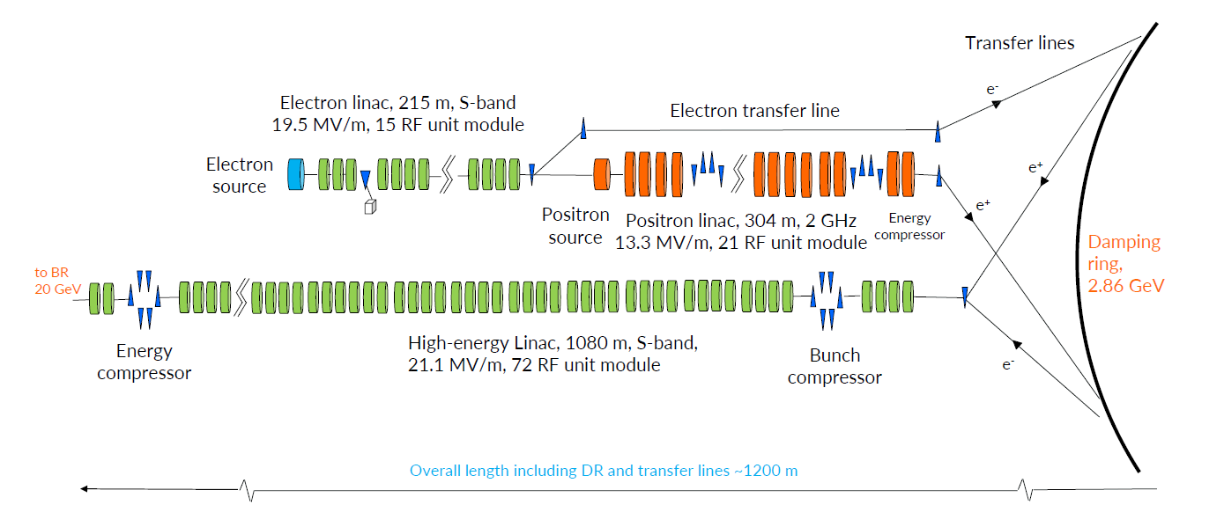
Proposed Polarizer ring : Overview
Decouples polarization from collider
Collider runs at full luminosity
Radiation from wigglers confined to the separate ring
Enables frequent calibration
Operates in parallel with the collider
Optimized optics – fast polarization build up ($τ_{pol}≪collider)$
Optimized optics – fast polarization build up (𝜏_𝑝𝑜𝑙≪𝑐𝑜𝑙𝑙𝑖𝑑𝑒𝑟)
Frequent supply of polarized pilot bunches to collider
Fig 3. A schematic of the FCC-ee injector complex where the polarizer ring is proposed to be integrated

Slide 4
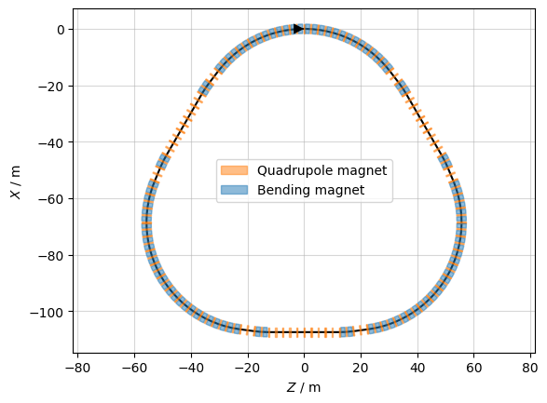
Polarizer Ring Lattice Design
Goal : short $τ_{pol},$small emittance, large acceptance
Goal : short 𝜏_𝑝𝑜𝑙, small emittance, large acceptance
Quadrupole families tuned for phase advance & dispersion control
Straights host wigglers, RF cavities, injection and extraction hardware
FODO-based cells, stable periodic optics
Built from arc, dispersion suppressor, and straight sections
Circumference $≈345 m,$matched to FCC injector timing
Circumference ≈345 m, matched to FCC injector timing
Fig 4. A layout of the proposed lattice

Slide 5
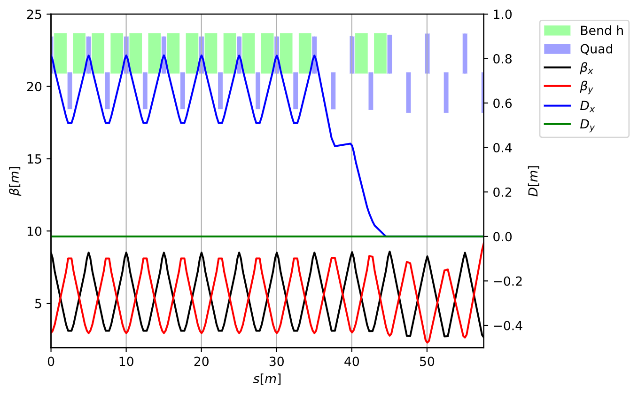



Optics of the Polarizer Ring
Chosen to balance $β$-function & stability
Chosen to balance 𝛽-function & stability
Dispersion suppression
Straight sections
Chosen to balance 𝛽-function excursions & stability
FODO structure with 60$°$phase advance per cell
FODO structure with 60° phase advance per cell
arc→ suppressor → straight) matched to periodic solution
Periodic solution structure
Implemented with the missing-bend scheme
Works particularly effectively with $60 °$ optics
Ensures $D_{x}→0$ at straight entrances
Arc cells
arc$→$ suppressor $→$straight
dispersion-free, symmetric $→$host wigglers, RF, diagnostics
Fig 5. Periodic Solution repeated to build the full ring

Slide 6
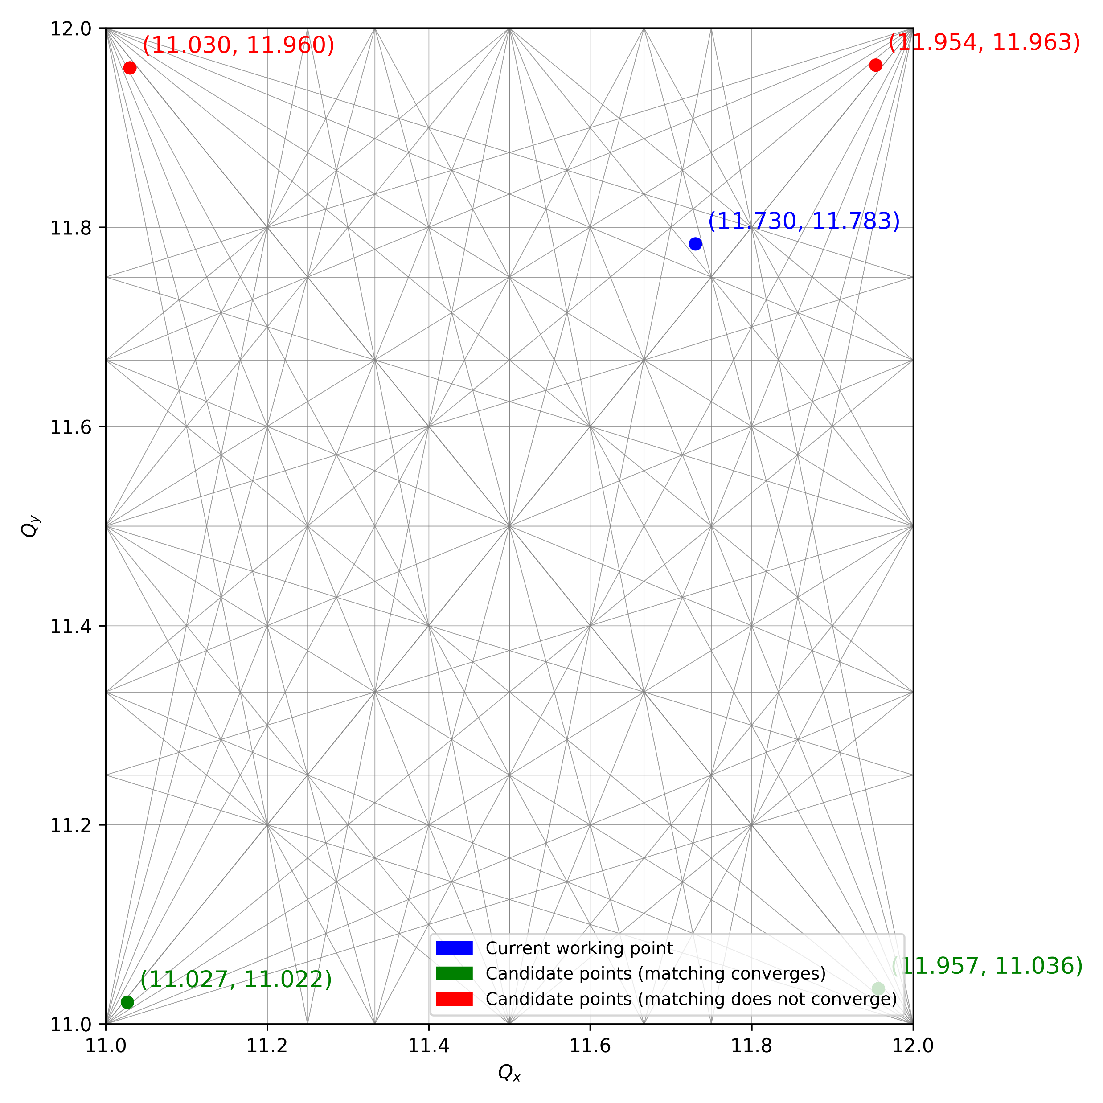
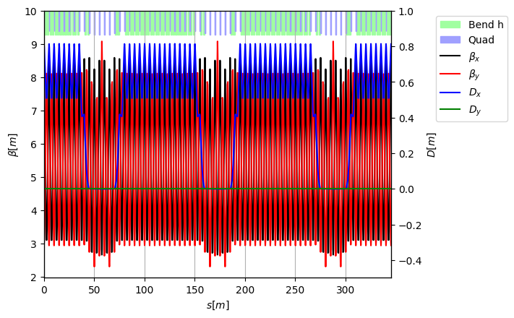
Full Ring Assembly & Working point
Six matched modules $→$ closed ring with periodic optics
Fig 7. Working Point assessment
Nominal tunes: $Q_{x}≈11.73, Q_{y}≈11.78$
Tunability checked by matching to nearby working points
Fig 6. Full ring twiss

Slide 7
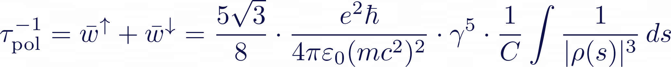
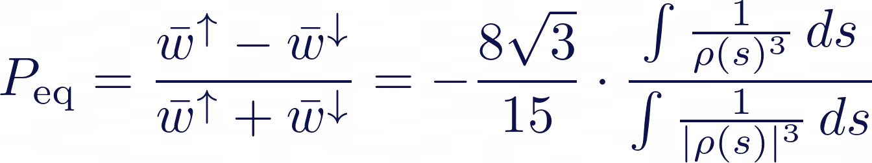


‘Polarizing’ Wigglers
Polarization build up by the Sokolov-Ternov effect* :
Goal : Enhance transverse polarization build-up via synchrotron radiation
$$τ_{pol}^{−1}$$
$$P_{eq}$$
Asymmetric Wigglers
Symmetric Wigglers
Would strongly reduce the equilibrium polarization
Would strongly reduce the equilibrium polarization
* Full spin dynamics are governed by the Derbenev–Kondratenko formalism, which accounts for optics and spin–orbit effects.

Slide 8
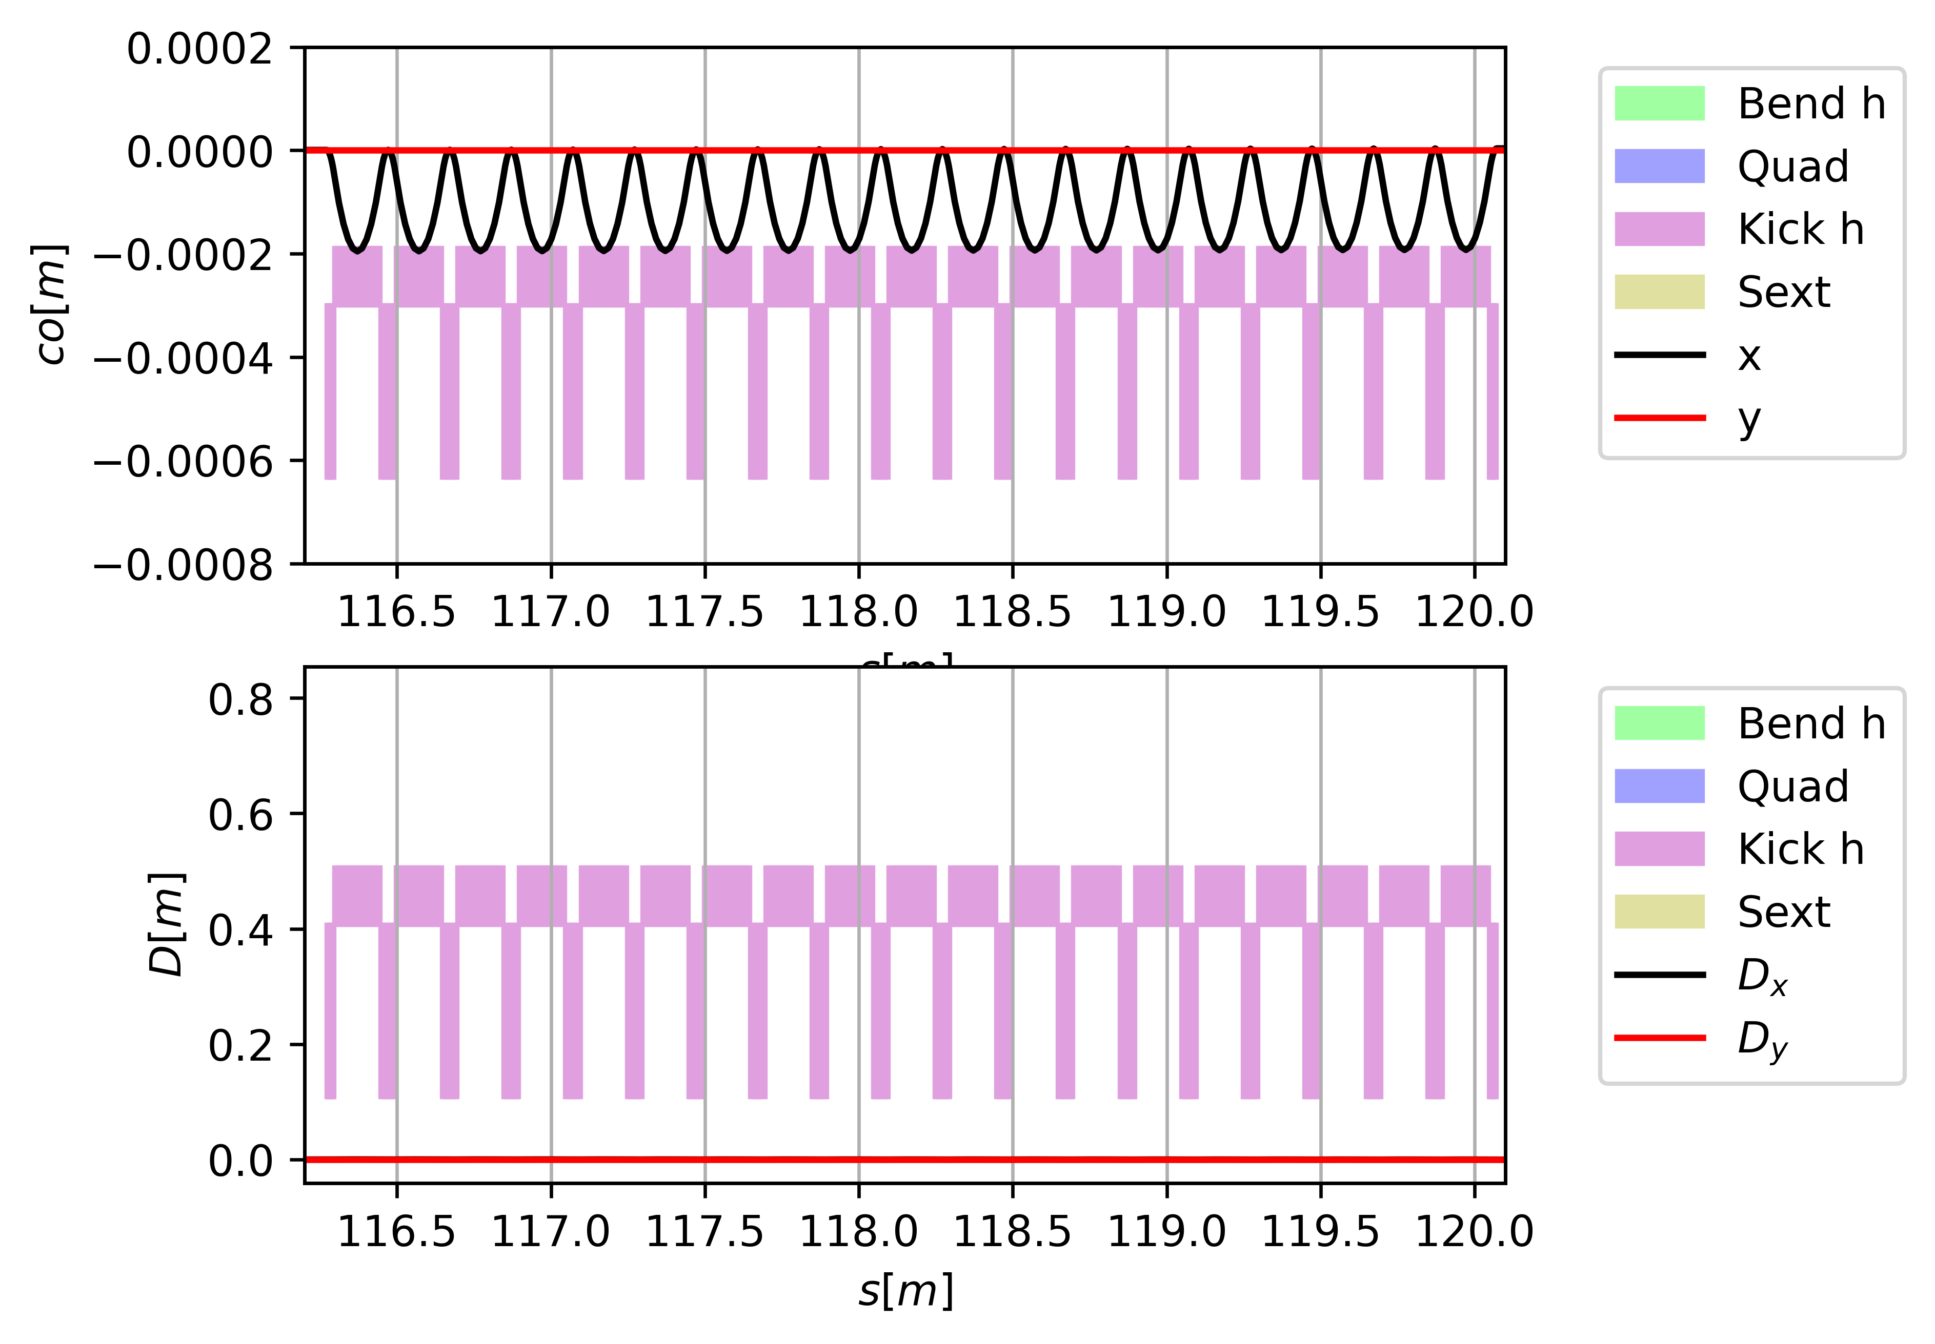
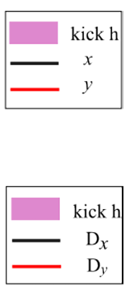
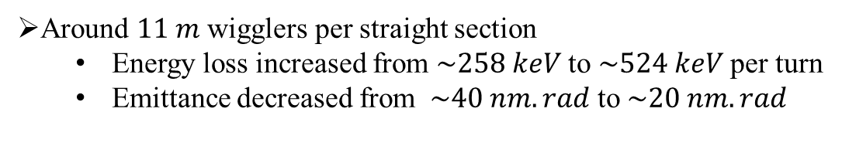
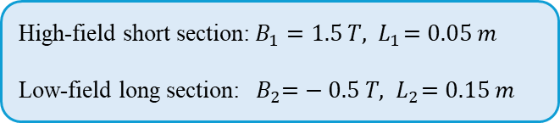
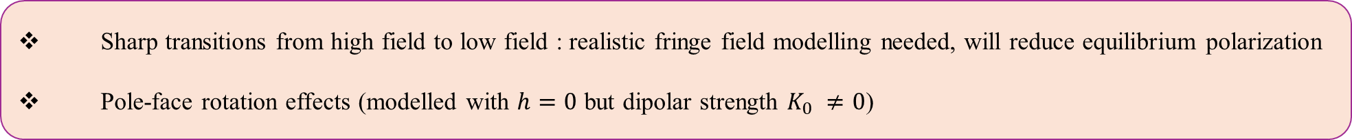
Implementation
Inserted in the dispersion-free straight sections
One period :
High-field short section: $B_{1}=1.5 T, { L}_{1}=0.05 m$
Low-field long section: ${ B}_{2}=− 0.5 T, { L}_{2}=0.15 m$
Around $11 m$ wigglers per straight section
  Energy loss increased from $\sim 258 keV$ to $\sim 524 keV$ per turn
  Emittance decreased from $\sim 40 nm.rad$ to $\sim 20 nm.rad$
Fig 8. Wiggler closed orbit and dispersion functions
Sharp transitions from high field to low field : realistic fringe field modelling needed, will reduce equilibrium polarization
Pole-face rotation effects (modelled with $h=0$ but dipolar strength $K_{0} ≠0$)

Slide 9
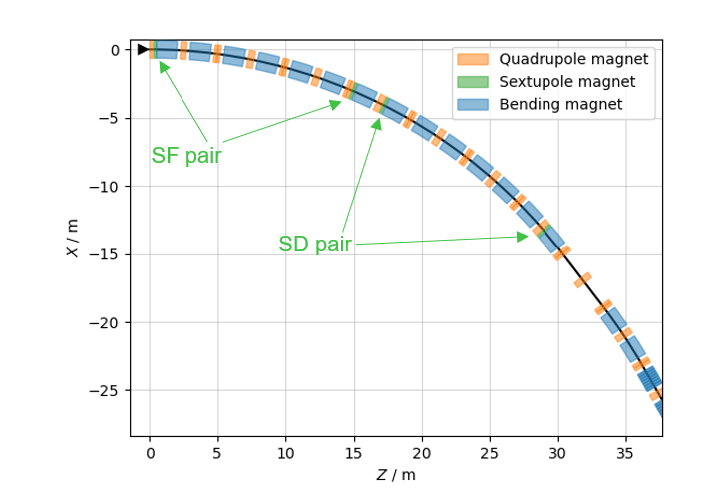
Chromaticity Correction with Sextupoles
Natural Chromaticity: ${ ξ}_{x}^{nat}=−14.1,$
$ξ_{y}^{nat}=−12.6$
Natural Chromaticity: 〖 𝜉〗_𝑥^𝑛𝑎𝑡=−14.1,
𝜉_𝑦^𝑛𝑎𝑡=−12.6
Sextupoles at dispersive locations $→$momentum dependent focusing
Sextupoles at dispersive locations → momentum dependent focusing
Two families:
SF at focusing quads $(D_{x}, β_{x}$ large)
SD at defocusing quads $(D_{x}, β_{y}$ large)
Two families:
SF at focusing quads (𝐷_𝑥, 𝛽_𝑥 large)
SD at defocusing quads (𝐷_𝑥, 𝛽_𝑦 large)
Placed in symmetric pairs $→$ cancellation of non-linearities
Placed in symmetric pairs → cancellation of non-linearities
12 such pairs distributed around arcs
Fig 9. Sextupole placement scheme on the layout

Slide 10
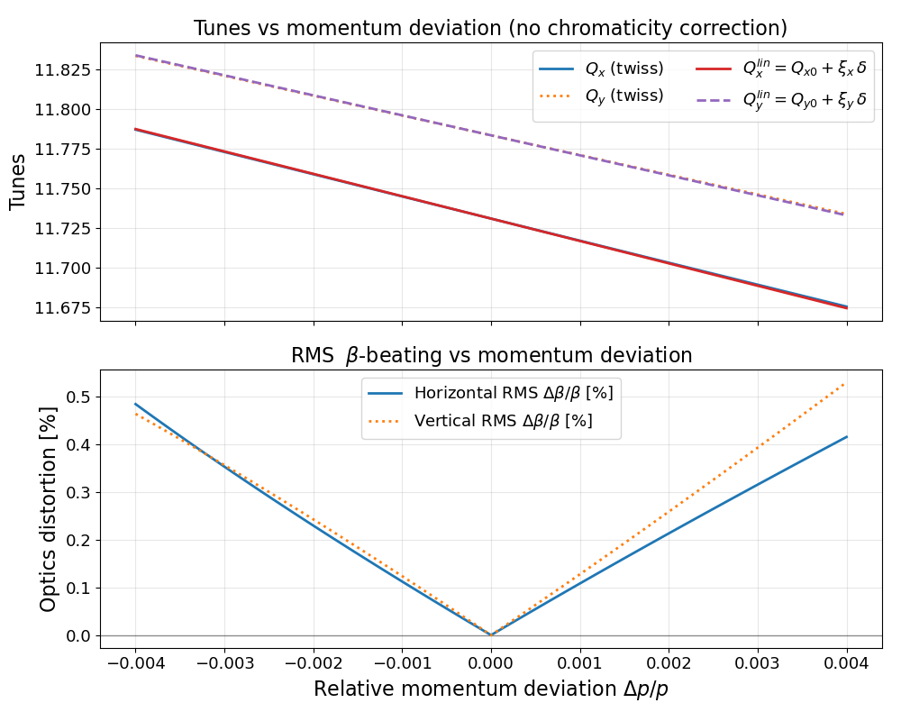
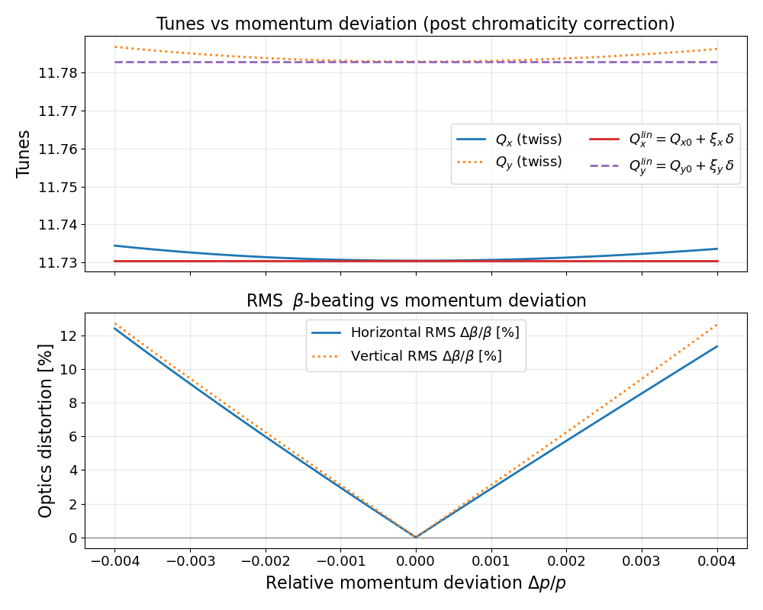
Chromaticity Correction: Results
Before correction:
Strong tune slope with $δ →ΔQ≈0.1$ over $±0.4\%$
Strong tune slope with 𝛿 →Δ𝑄≈0.1 over ±0.4%
Minimal optics distortion $\left(<0.5\%\right)$
Minimal optics distortion (<0.5%)
After correction:
Tunes nearly flat ${(ξ}_{x}, ξ_{y}≈0)$
Tunes nearly flat 〖(𝜉〗_𝑥, 𝜉_𝑦≈0)
Off-momentum $β$-beating rises significantly $→\sim 12\%$ at $±0.4\%$
Off-momentum 𝛽-beating rises significantly →~12% at ±0.4%
Trade-off: Stable chromatic behaviour $v/s$ stronger non-linear optics

Slide 11
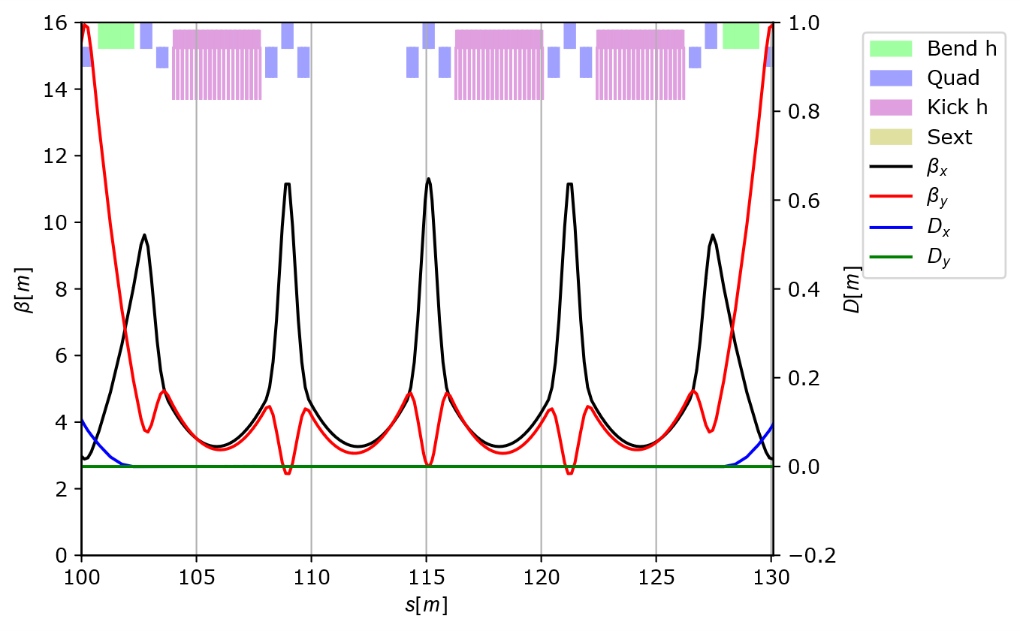
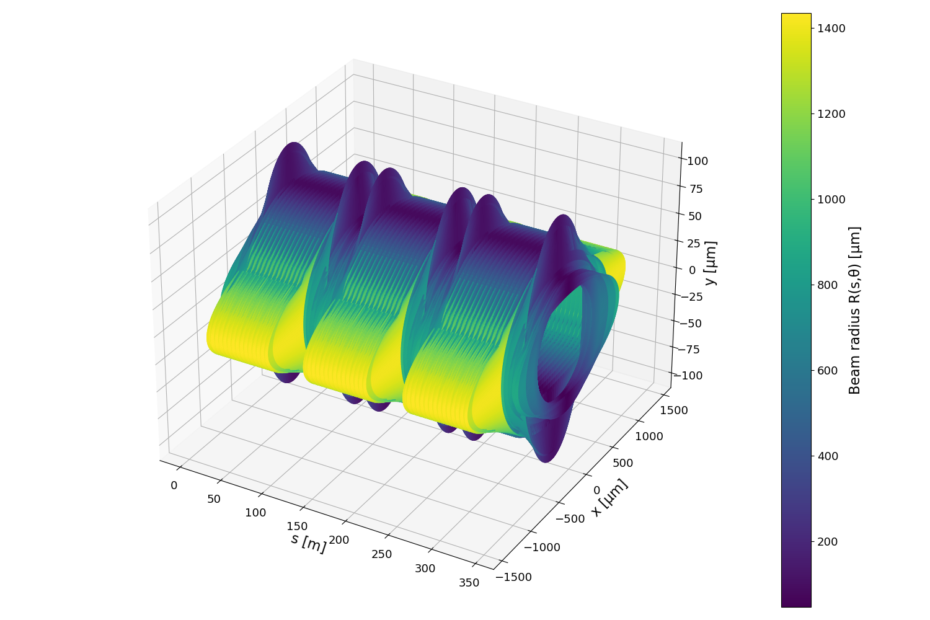
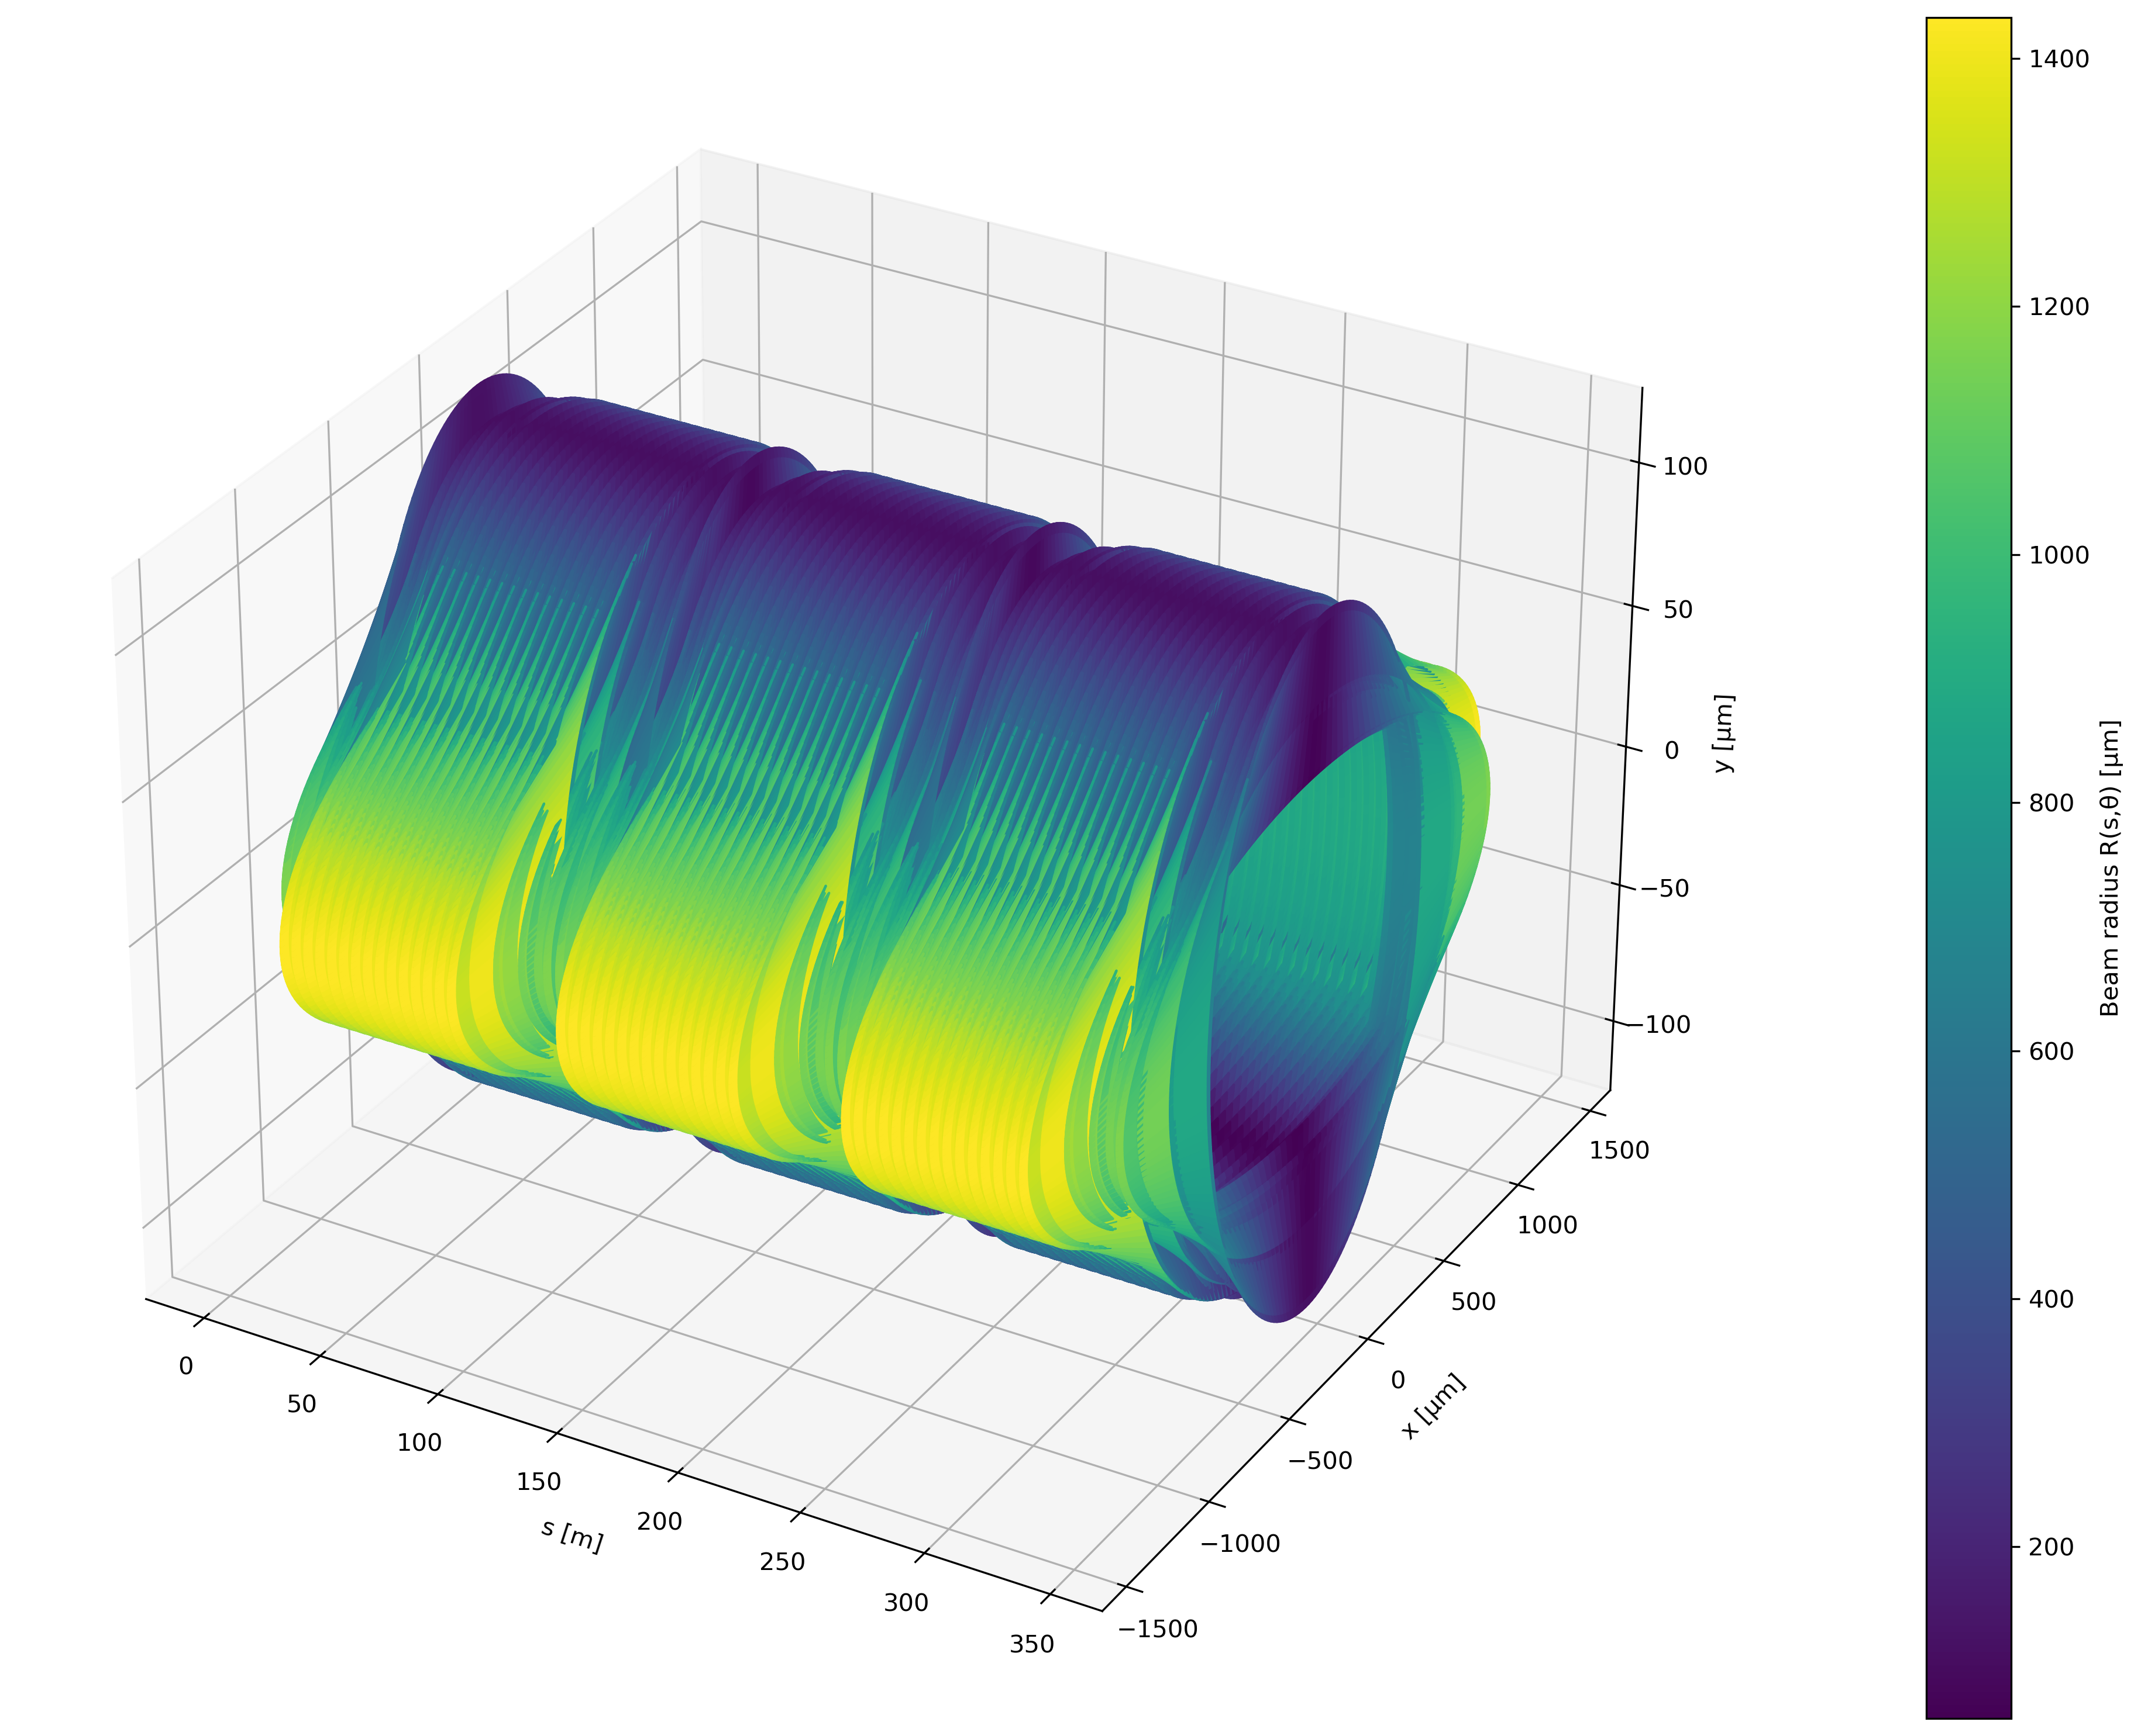
Triplet Insertions for Compact Wigglers
Straights re-designed with triplet focusing
Small $β_{x} \left(\sim 3.5 m\right)$ at wiggler sites
smaller beam size$→$reduce aperture
Enables realistic wigglers with sharp pole transitions
Small 𝛽_𝑥 (~3.5 𝑚) at wiggler sites
smaller beam size → reduce aperture
Enables realistic wigglers with sharp pole transitions
Symmetric about central triplet$→$ preserves optical continuity
Symmetric about central triplet → preserves optical continuity
Reserved for RF, injection/extraction
Fig 11. Triplet focusing in the straight section
Fig 12. A comparison schematic showing the reduced beam sizes in the straight section (left)
compared to that with only FODO cells throughout the ring (right)

Slide 12
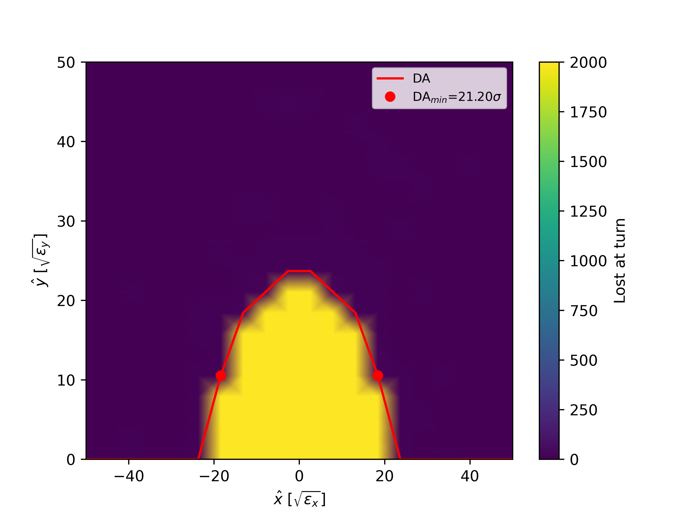
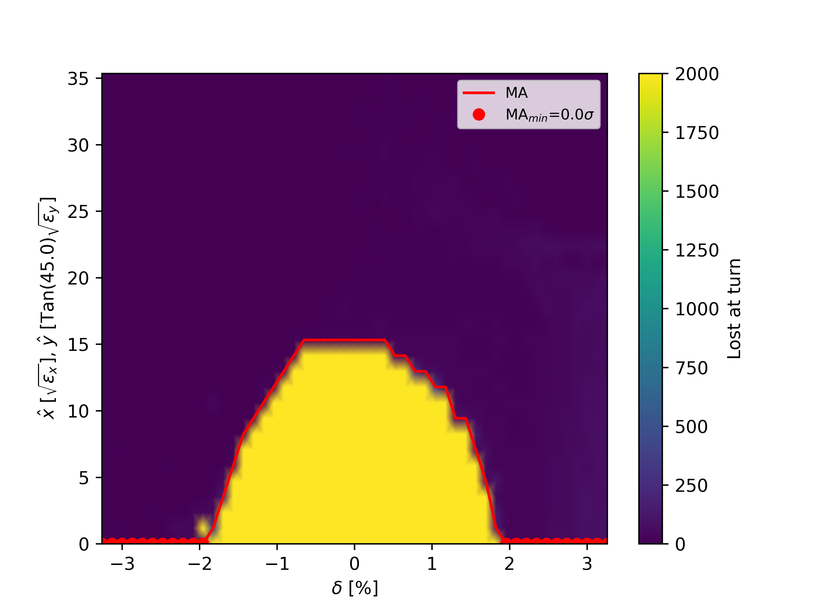
Dynamic Aperture & Momentum Acceptance
Normalization uses injected positron emittances (from production source): $ε_{x}=13, 000 μm⋅rad$, $ε_{y}=12, 000 μm⋅rad$
Fig 13. Dynamic aperture and momentum acceptance scans. Colour scale shows the turn of particle loss

Slide 13
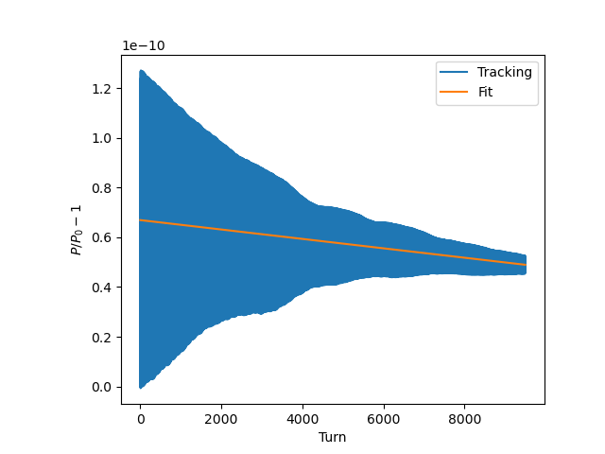
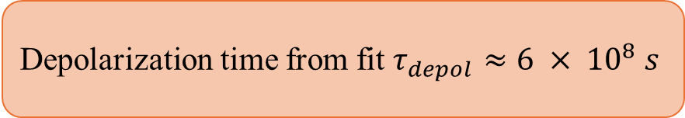
Spin Tracking for the Perfect Lattice
Spins initialized along invariant spin axis ${\hat{n}}_{0}$
Spins initialized along invariant spin axis 𝑛 ̂_0
300 macroparticles tracked
Fig 14. Normalized polarization decay curve from spin tracking (blue) with single-exponential fit (orange).
Equilibrium Polarization : 78.4 %
Build up time ~ 3640 s
Depolarization time from fit $τ_{depol}≈6 × {10}^{8} s$

Slide 14
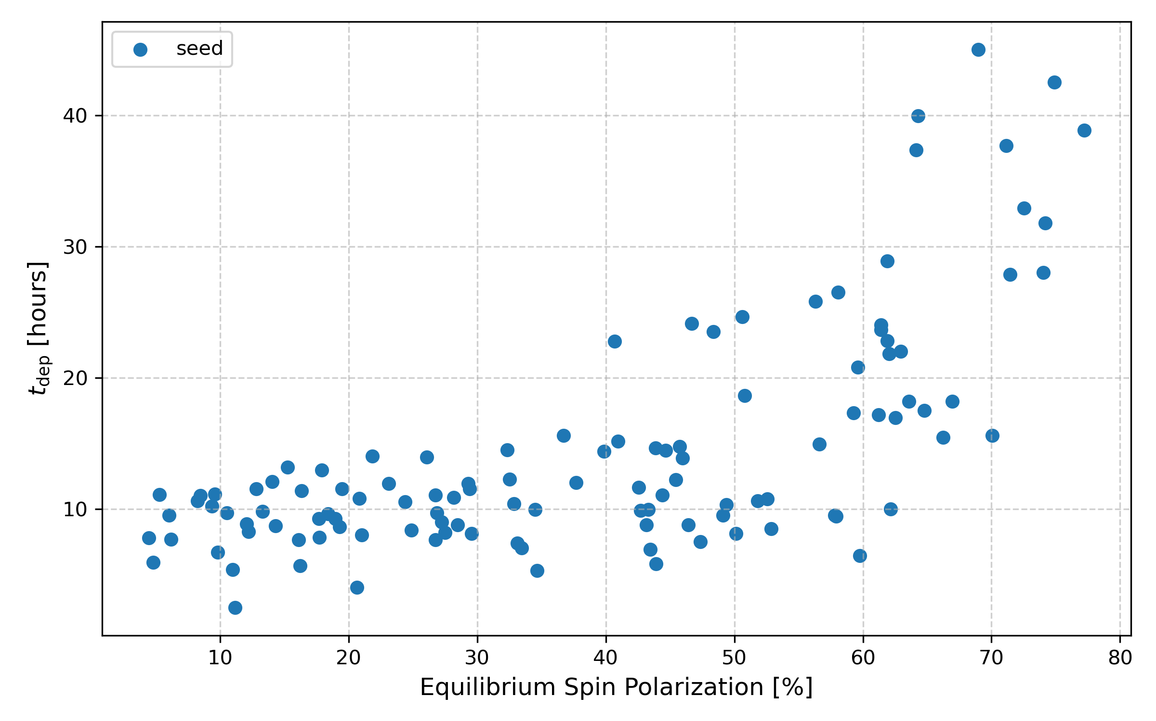
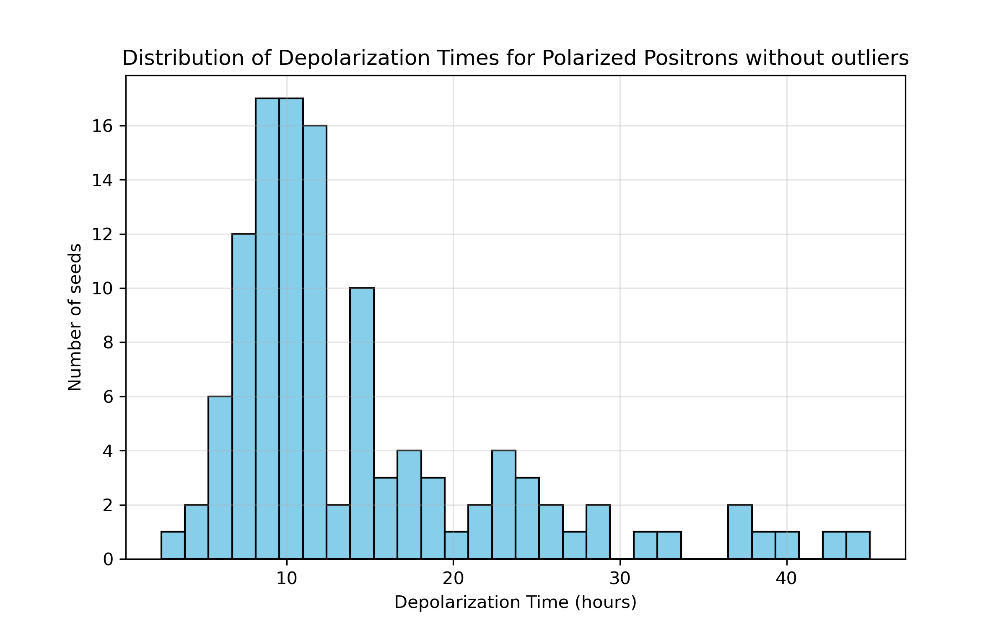
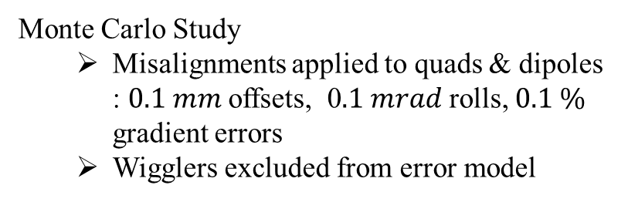
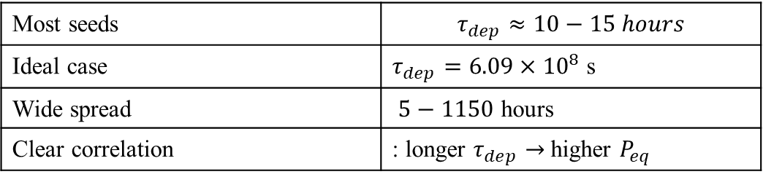
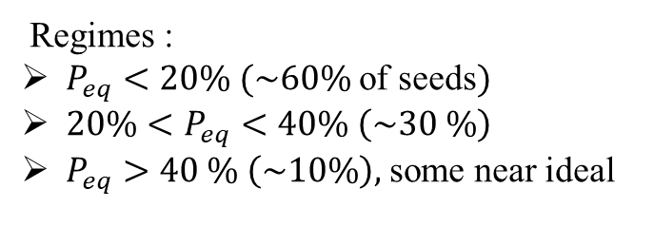
Spin Tracking with Machine
imperfections - I
Monte Carlo Study
  Misalignments applied to quads & dipoles : $0.1 mm$ offsets, 0$.1 mrad$ rolls, $0.1 \%$ gradient errors
  Wigglers excluded from error model
*Orbit has not been corrected yet.
Fig 16. Equilibrium polarization versus depolarization time
Key Results
Most seeds | $$τ_{dep}≈10−15 hours$$
Ideal case | $τ_{dep}=6.09×{10}^{8}$ s
Wide spread | $5−1150$ hours
Clear correlation | : longer $τ_{dep}→$higher $P_{eq}$
Regimes :
$P_{eq}<20\% (\sim 60\%$ of seeds$)$
$20\%<P_{eq}<40\% \left(\sim 30 \%\right)$
$P_{eq}>40 \% \left(\sim 10\%\right),$ some near ideal
Fig 15. Depolarization times, excluding outliers above 50 hours

Slide 15
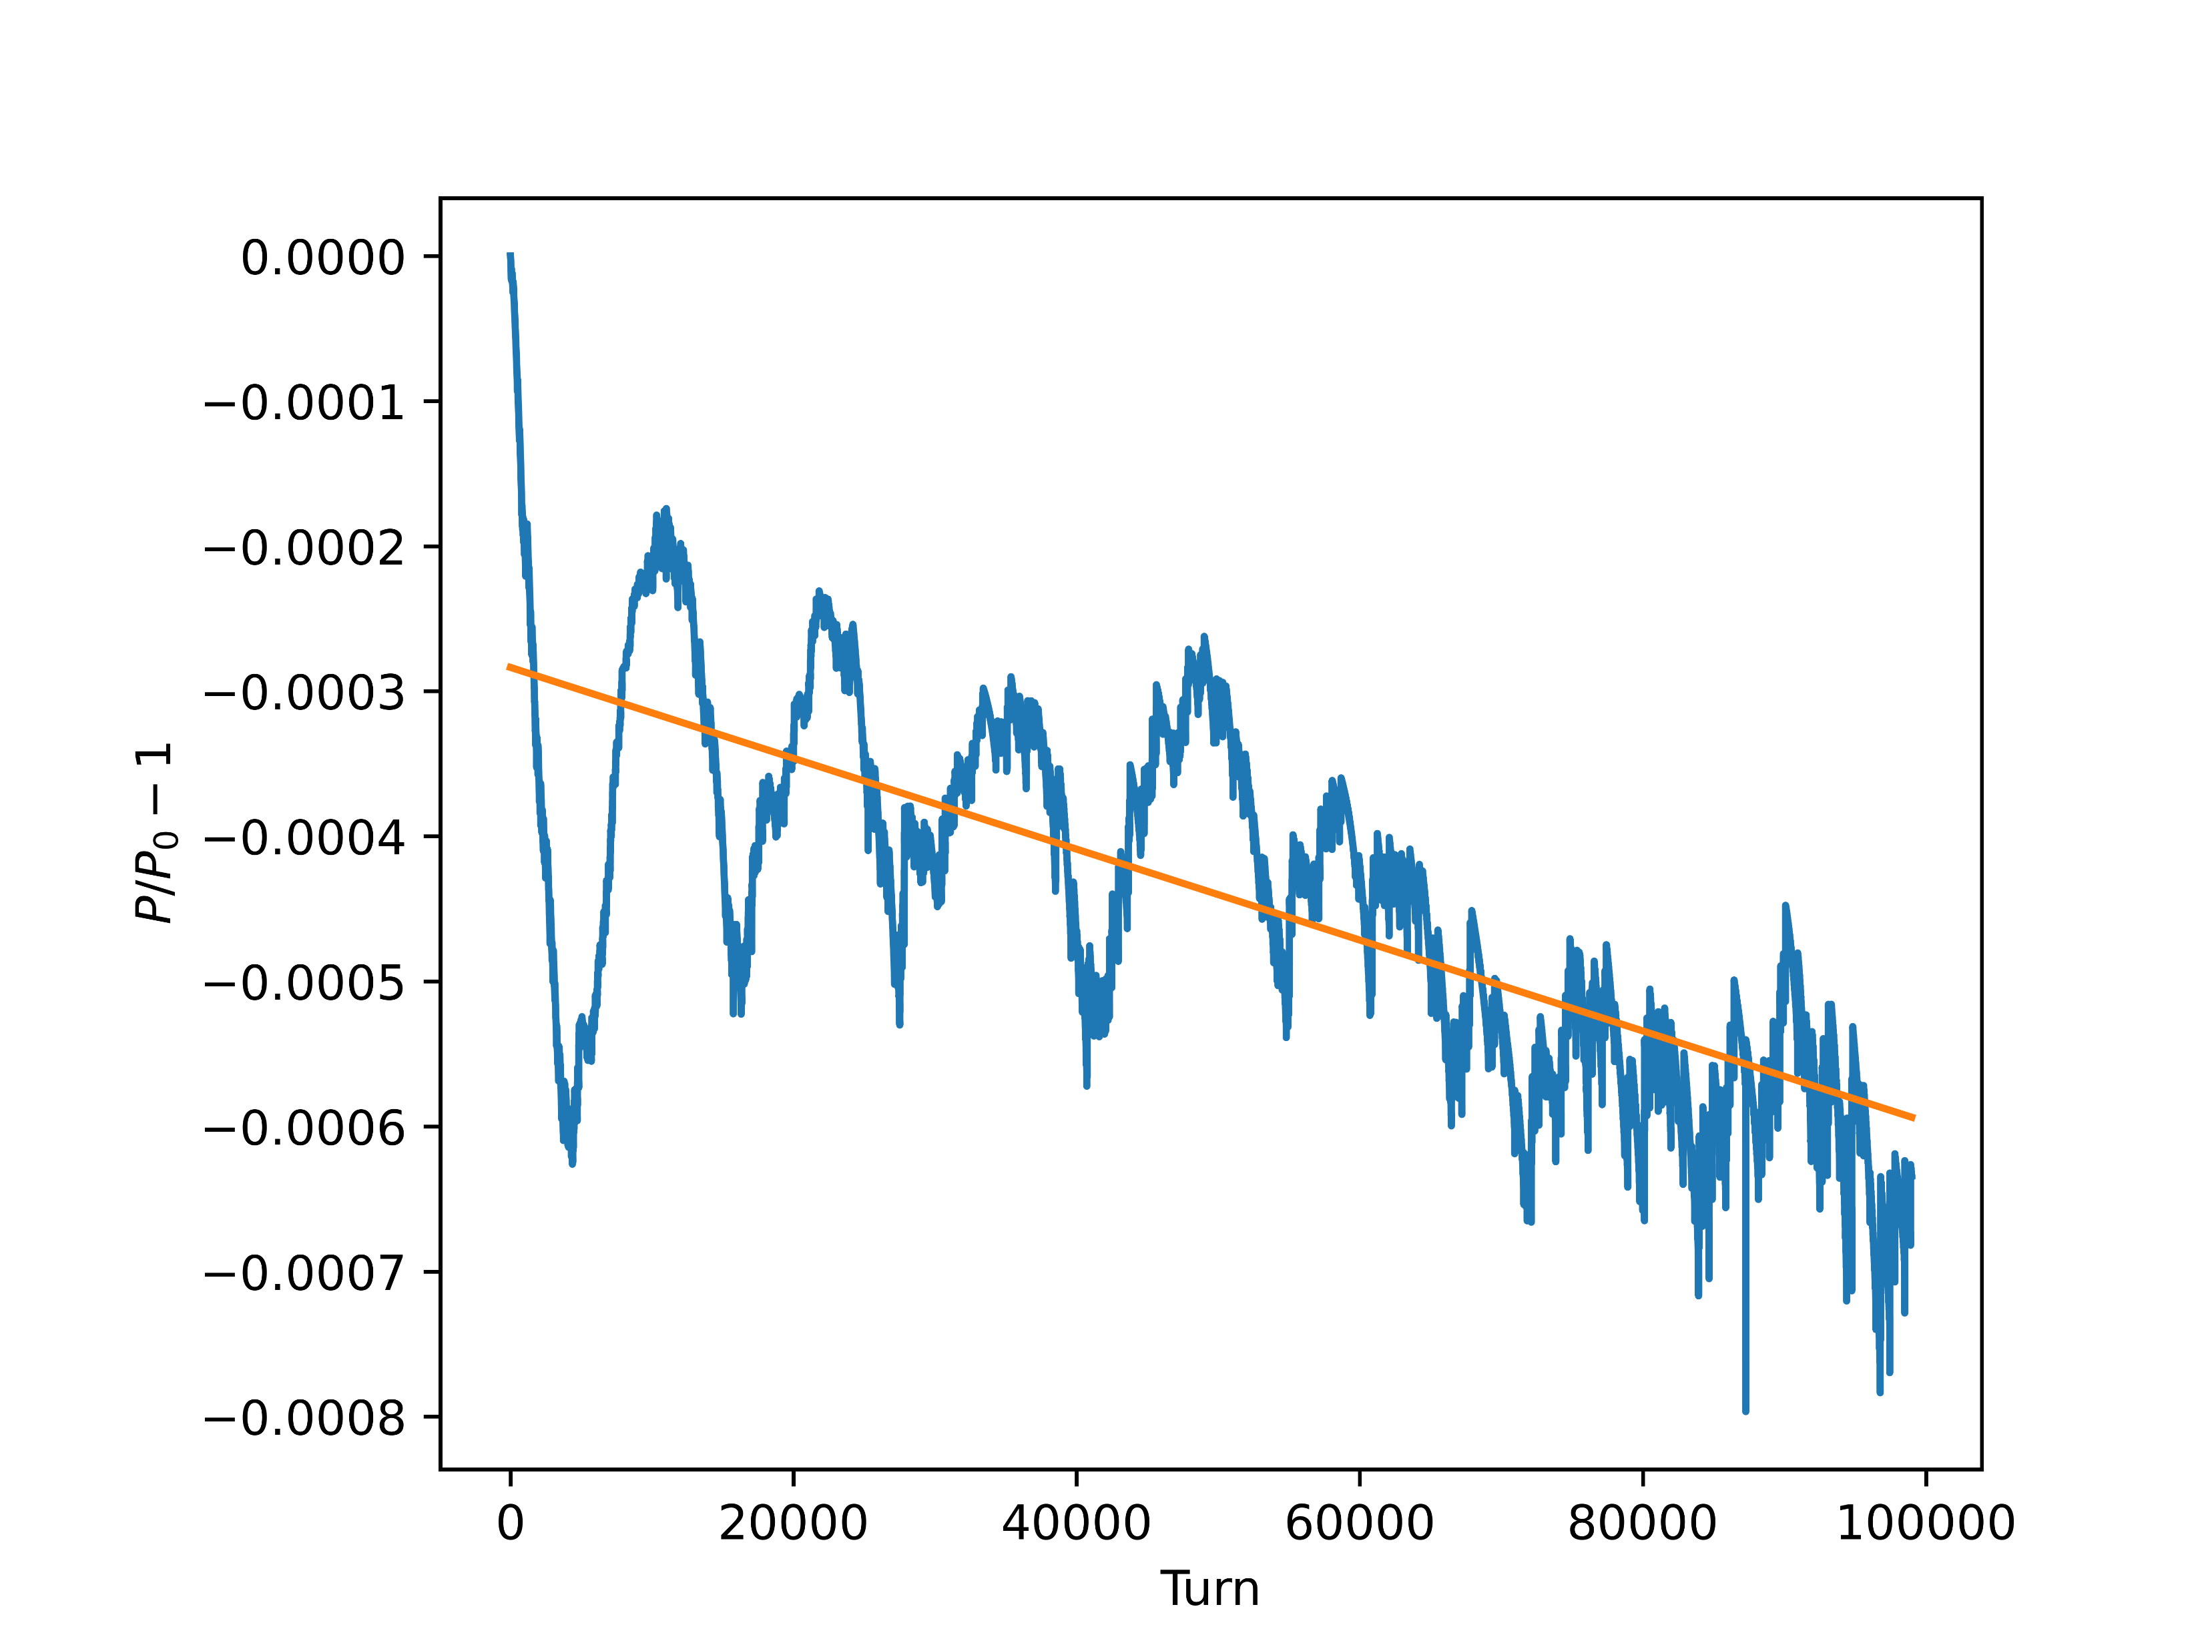
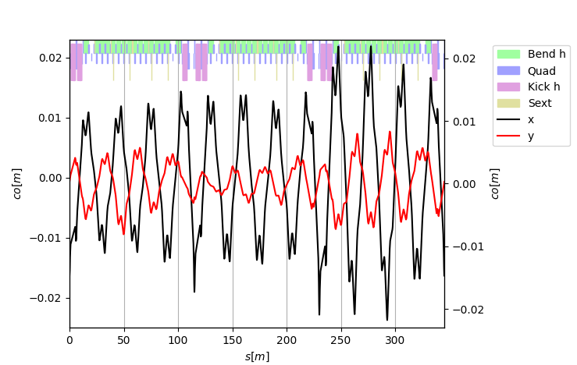
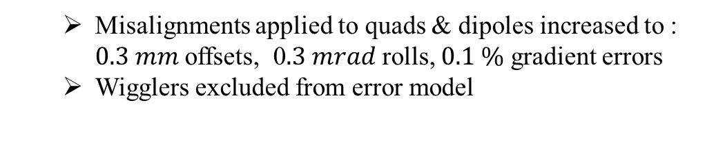
Spin Tracking with Machine imperfections - II
  Misalignments applied to quads & dipoles increased to : $0.3 mm$ offsets, 0$.3 mrad$ rolls, $0.1 \%$ gradient errors
  Wigglers excluded from error model
Discussion of a specific seed # with a low equilibrium polarization :
Fig.17 Closed orbit after adding specified misalignments
Fig.18 Spin tracking that yielded an equilibrium polarization of ~11 %

Slide 16
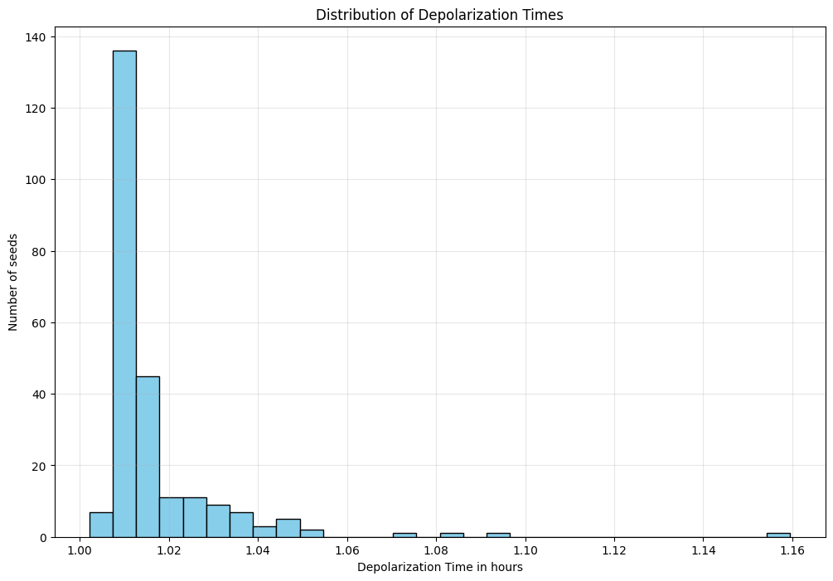
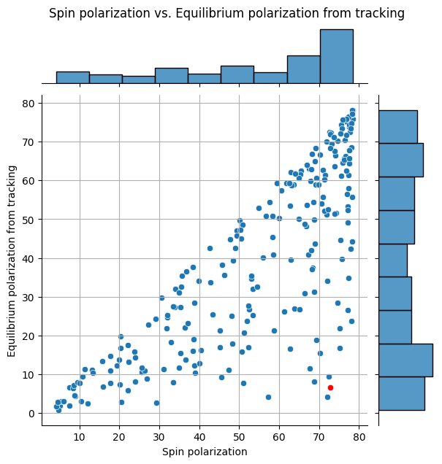
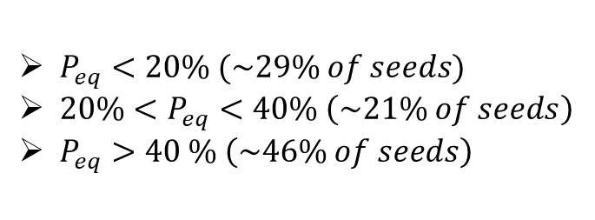
Spin Tracking with Machine imperfections - II
Fig.20 Depolarization times histogram
$P_{eq}<20\% (\sim 29\% of seeds)$
$20\%<P_{eq}<40\% \left(\sim 21\% of seeds\right)$
$P_{eq}>40 \% \left(\sim 46\% of seeds\right)$
Fig.19 Equilibrium polarization vs Polarization from integral for several seeds.
Red point represents case discussed on slide 15.

Slide 17
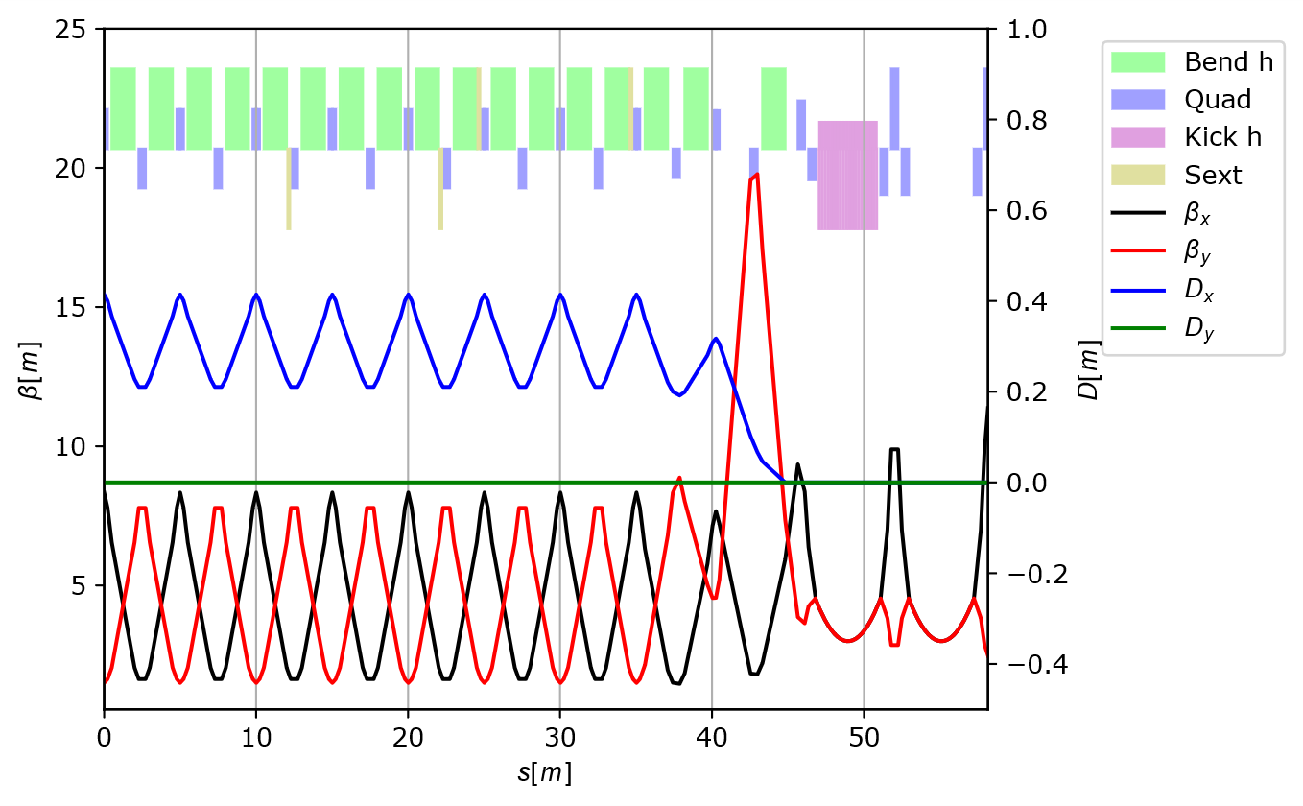
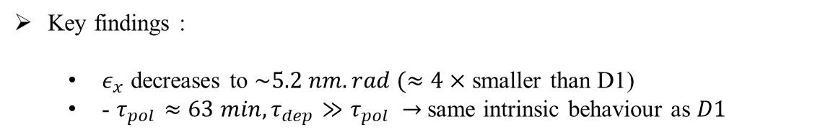
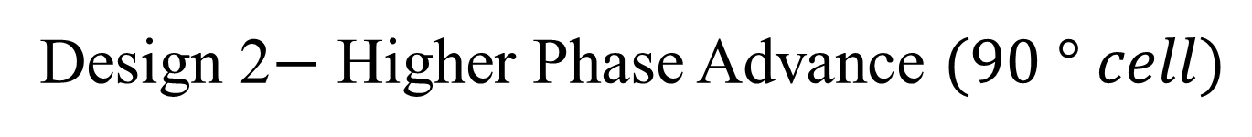

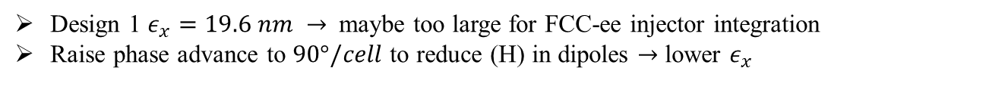
Design 2$−$ Higher Phase Advance $(90 ° cell)$
Design 1 $ε_{x}=19.6 nm →$ maybe too large for FCC-ee injector integration
Raise phase advance to $90°/cell$ to reduce (H) in dipoles $→$ lower $ε_{x}$
Dispersion suppression strategy:
D1: full missing-bend cell (well-suited for $60 °$ optics)
D2: half missing-bend cell in suppressor $→$ shorter suppressor, preserves $D_{x}$ control, smoother hand-off to arcs
Working point: provisional $/$ not matched
$Q_{x}≈16.65, Q_{y}≈15.63 −$tune optimization deferred
Straight-section targets: $β_{x}=β_{y}=3 m, α_{x,y}=0, D_{x}=D_{x}^{′}=0$
RF unchanged from D1; $C≈349 m$
Fig 21. Higher phase advance periodic solution
Key findings :
  $ε_{x}$ decreases to $\sim 5.2 nm.rad (≈4×$ smaller than D1)
  - $τ_{pol}≈63 min, τ_{dep}≫τ_{pol} →$same intrinsic behaviour as $D1$

Slide 18
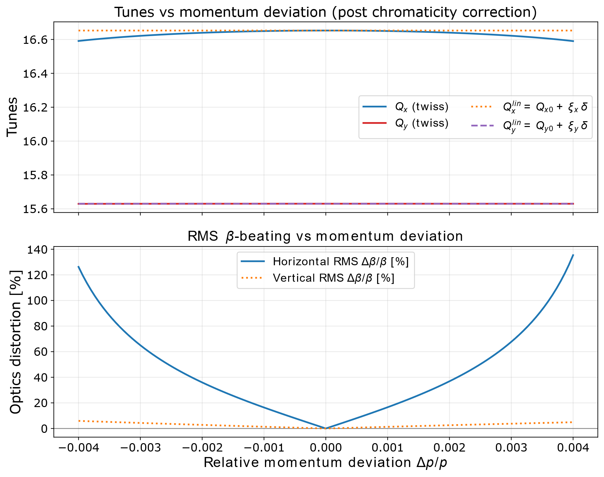
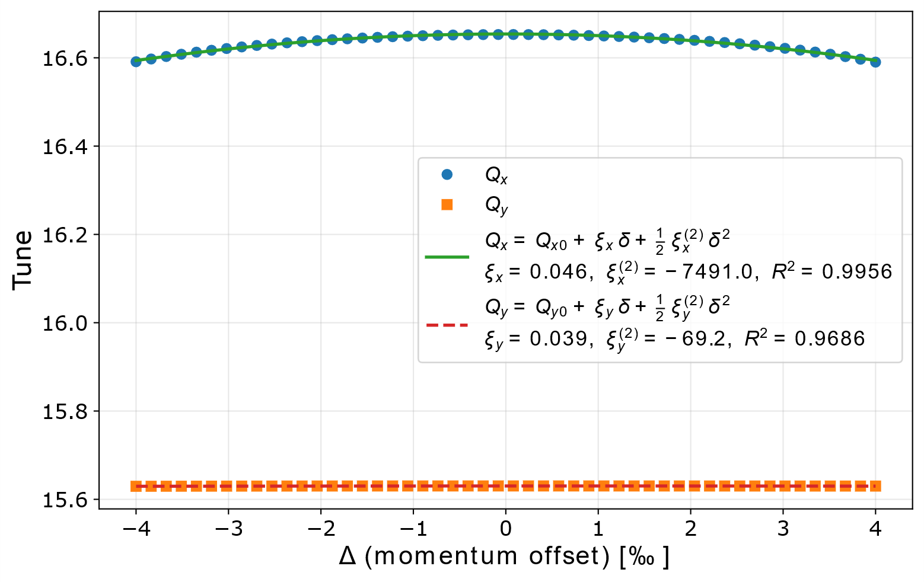
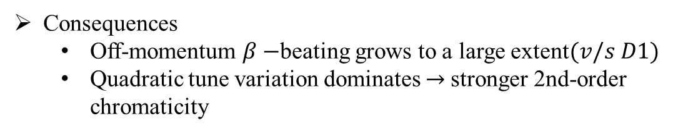
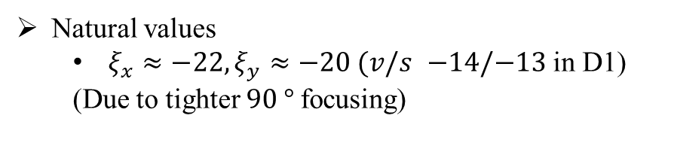
Chromaticity Correction in the higher phase advance design
Natural values
  $ξ_{x}≈−22, ξ_{y}≈−20 (v/s$ $−14/−13$ in D1)
  (Due to tighter $90 °$focusing)
Consequences
  Off-momentum $β−$beating grows to a large extent$(v/s D1)$
  Quadratic tune variation dominates $→$stronger 2nd-order chromaticity
Fig 22. Design 2 post chromaticity correction
Fig 23. Design 2: quadratic fit of corrected tune

Slide 19
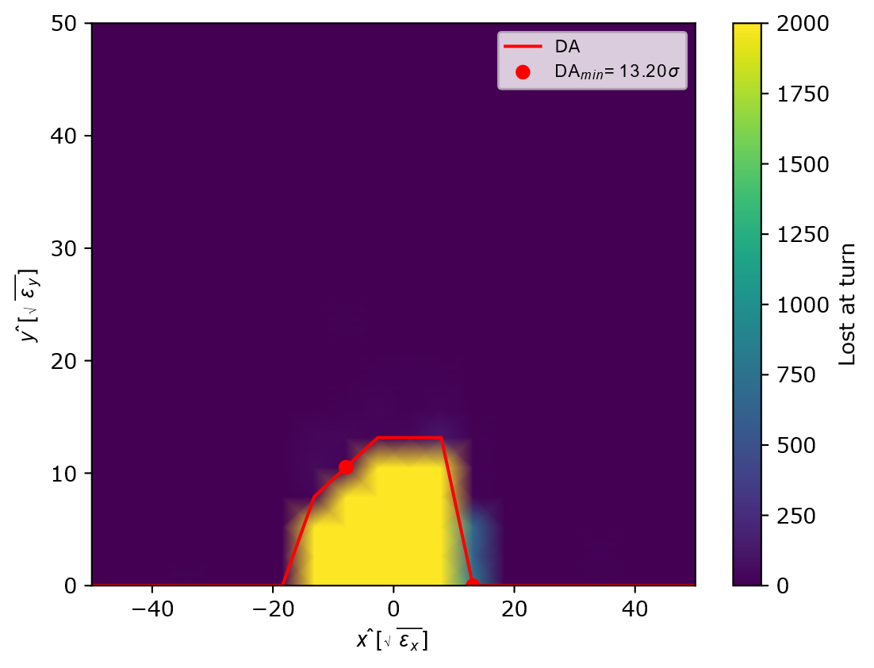
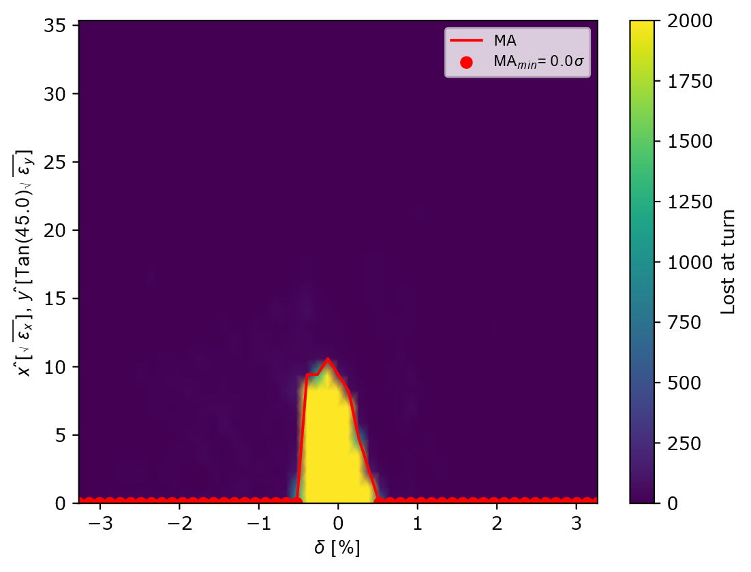
Dynamic Aperture & Momentum Acceptance
DA
Stable radius: $13.2 \sqrt{ε} (v/s$ $21.2 √ε$ in D1)
Stable radius: 13.2 √𝜖 (𝑣/𝑠 21.2 √𝜖 in D1)
Envelope remains symmetric $→$nonlinearities balanced
Envelope remains symmetric → nonlinearities balanced
Reduced margin due to tighter focusing + stronger sextupoles
MA
Symmetric stability window $< ±1 \%$
Symmetric stability window < ±1 %
Adequate for injection/storage, but smaller transverse acceptance at off-momentum
Nonlinear stability margins reduced compared to D1
Far less headroom for operation compared to D1
Fig 24. DA for Design 2
Fig 25. MA map for Design 2

Slide 20


Design 3 : Compact Lattice for Faster Polarization Build-up
Goal: shorten polarization build-up time
Structural changes
  circumference $↓345 m →237 m$
  FODO cell length $↓5 m →3 m$
  dipoles $↓1.5 m →0.7 m$
phase advance & missing-bend scheme: same as design 1
working point unchanged
Fig 26. Full ring twiss for Design 3
Performance highlights
$ε_{x}≈34 nm.rad (↑v/s$ d1/d2)
Damping times $≈2×$faster than d1/d2
$σδ≈0.079 \%$(similar)
𝜖_𝑥≈34 𝑛𝑚.𝑟𝑎𝑑 (↑𝑣/𝑠 d1/d2)
Damping times ≈2× faster than d1/d2
𝜎𝛿≈0.079 %(similar)
$τ_{pol}≈22$ min ($3×$ faster than d1/d2
$P_{ST}≈85 \% (↑vs$ d1/d2)
- $τ_{dep}≫τ_{pol} →$negligible depolarization (perfect case)
𝜏_𝑝𝑜𝑙≈22 min (3× faster than d1/d2
𝑃_𝑆𝑇≈85 % (↑𝑣𝑠 d1/d2)
- 𝜏_𝑑𝑒𝑝≫𝜏_𝑝𝑜𝑙 → negligible depolarization (perfect case)

Slide 21


DA and MA for Design 3
Fig 27. Dynamic Aperture and Momentum Acceptance for the compact lattice (Design 3)

Slide 22

Summary & Conclusions
First studies indicate feasibility of polarizer ring

Slide 23
Future Work
Orbit Correction Strategies
Further in-depth investigation of the impact of misalignments on :
  Eq. polarization
  DA, MA
Optimization of the optics for the designs :
  Working point
  DA, MA, …
Exploring designs other than FODO
  Shorter ring
Realistic wiggler modelling
  Optimizing wigglers
  higher fields?
  Longer periods?(would help mitigate loss from sharp transitions)
Operational scenario
beam injected from positron production / damping ring
Benchmarking of spin tracking
results
Still a work in progress and lots to be done! We are learning everyday ☺

Slide 24
Thank you!

Slide 25
Back up slides

Slide 26





Polarization Build-up in Storage Rings
Equilibrium Polarization (ideal planar ring):
Polarization time $τ_{pol}$ governed by Baier-Katkov-Strakhovenko (BKS) formula:
Polarization risetimes at LEP and FCC-ee
(from bending dipoles only)
The difference between the two machines is
due to the difference in bending radius (3 km
for LEP versus 11 km for FCC-ee).
Depends on: beam energy, bending radius, optics
At FCC-ee Z pole:
  Natural $τ_{pol}\sim 250 h$
  With wigglers: reduced to $\sim 10−12 h$
Wigglers speed up polarization but increase energy spread $→$ not compatible with collisions

Slide 27



LEP vs FCC Wigglers

Slide 28


Higher-Order Chromaticity Design 1
After linear correction, residual tune variation is quadratic in $δ$
Fit confirms dominance of second-order chromaticity
Practical impact: limits large momentum acceptance
Possible future remedies: additional sextupole families

Slide 29


Design 1 : DA and MA without tune optimization
Impact of the unoptimized working point on DA and MA
Results from before optimizing tunes ($Q_{x }=12.05 , Q_{y}=12.06$

Slide 30
Design 1 : Dynamic Aperture Scan across Tunes

Slide 31


Design 2 : Beam Sizes across the ring

Slide 32


Design 3 : Chromaticity Correction Results

Slide 33

Fig. Wiggler closed orbit and dispersion functions for the perfect lattice design 1

Slide 34






Some ‘Good’ seeds
$$P_{eq}=61.5 \%$$
$$P_{eq}=74.7 \%$$
$$P_{eq}=66.5 \%$$

