Slide 1

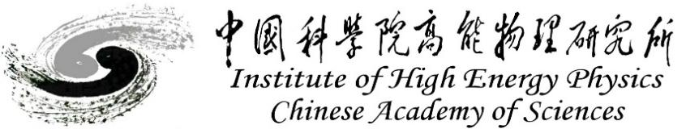
ReBCO model dipole R&D at IHEP-CAS
A review of the progress in the past 2 years
Qingjin XU
for the Superconducting Magnet Group
Accelerator Division, IHEP-CAS
Oct 2025

Slide 2


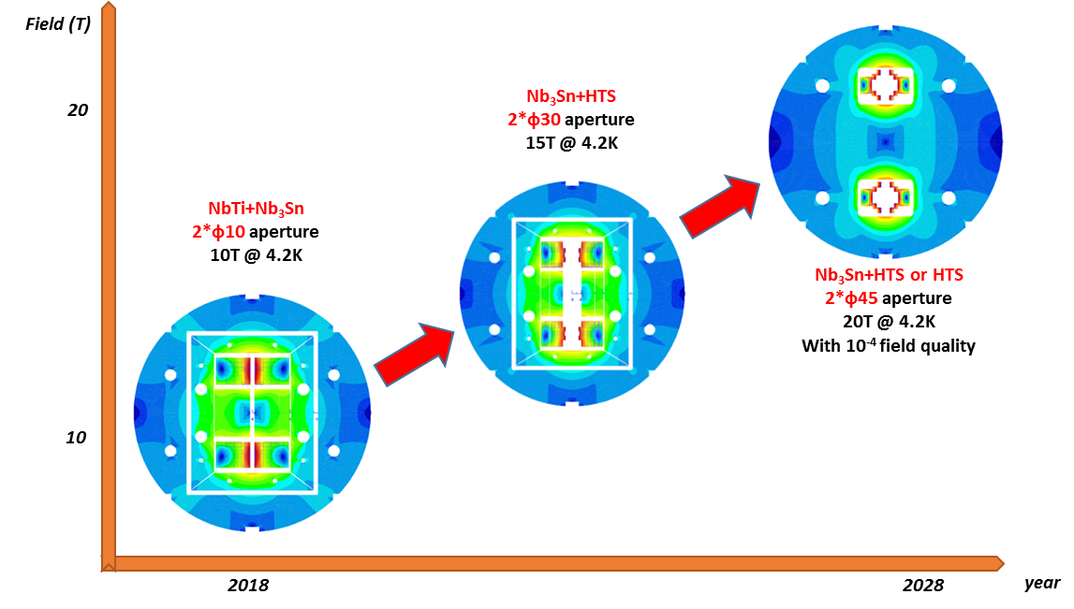
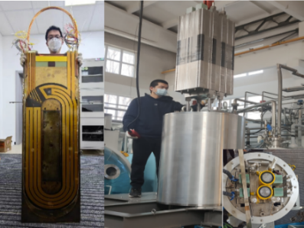
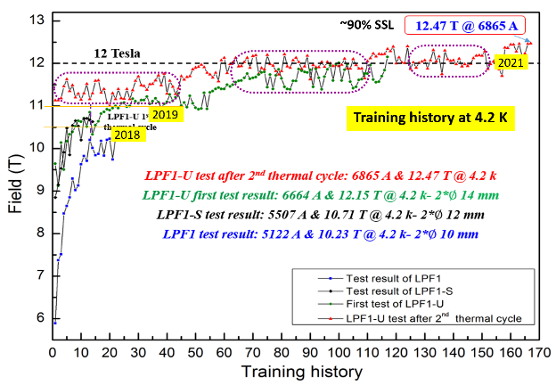
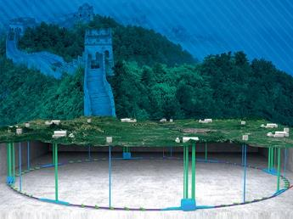
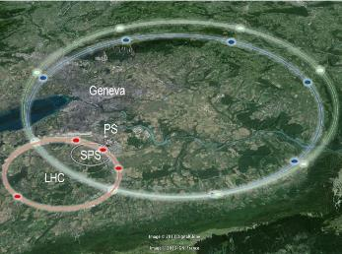
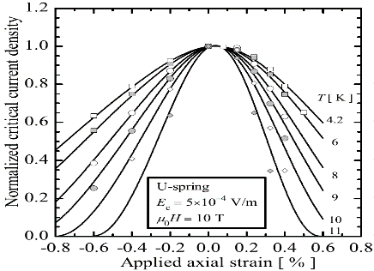
Roadmap of the High Field Magnet R&D at IHEP
2021-2025 16T @ 4.2K
NEXT-GENERATION PARTICLE ACCELERATORS
2018-2021, 12.47T @4.2K
NbTi + Nb₃Sn
CEPC-SPPC
FCC
Challenges: Stress control, quench protection, field quality control,……
2

Slide 3
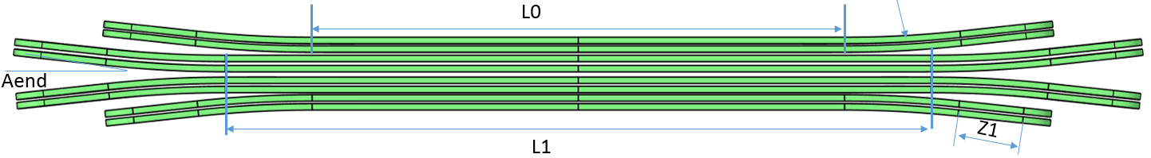
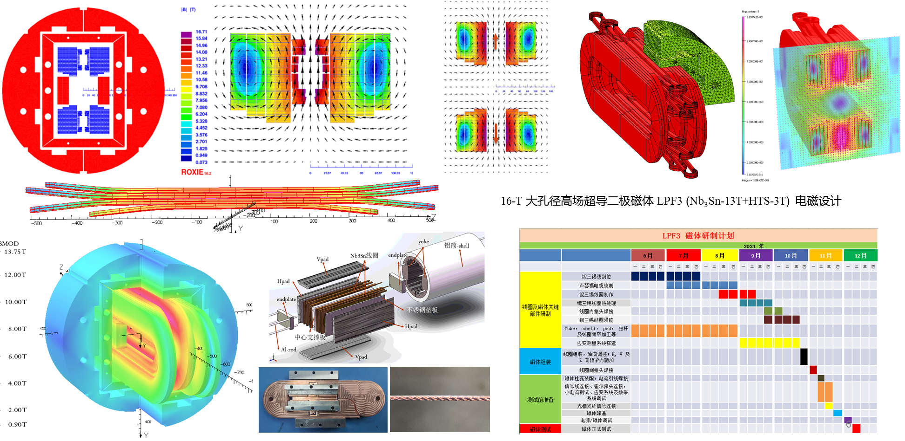
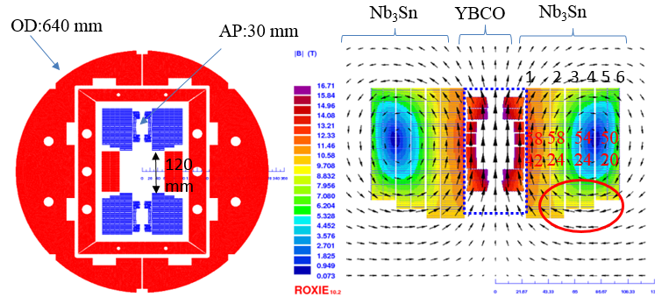
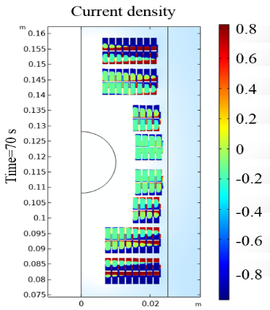
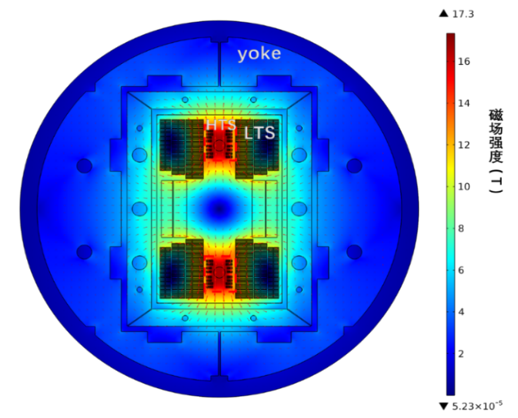
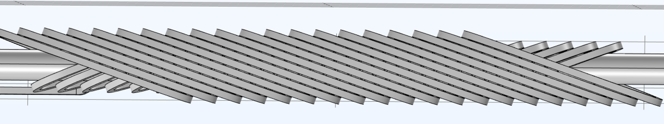
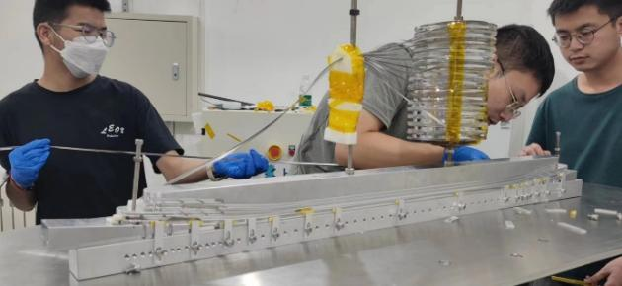
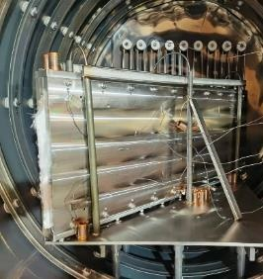
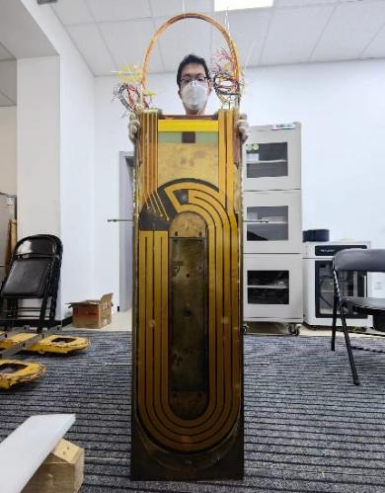
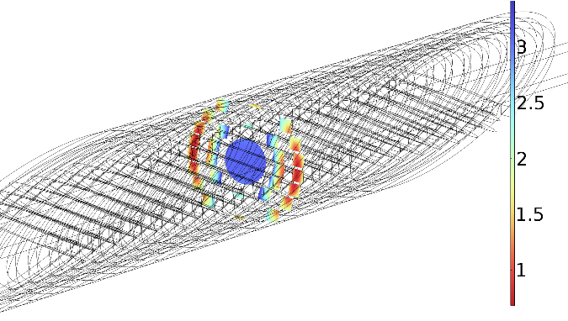
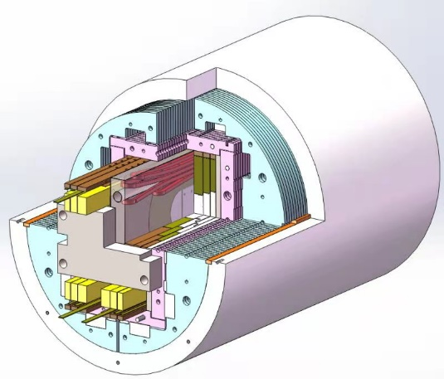
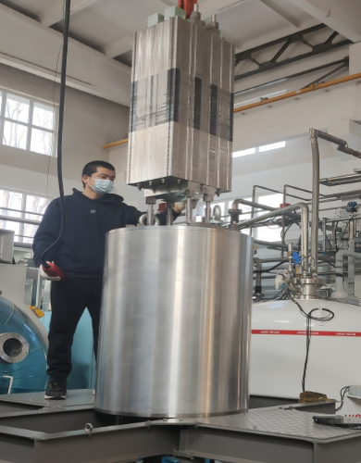
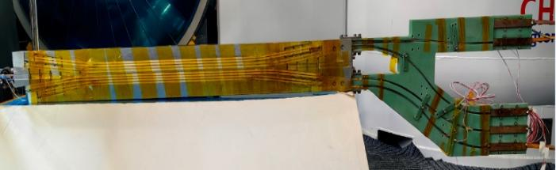
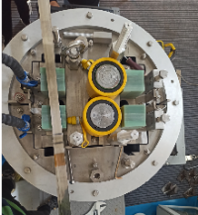
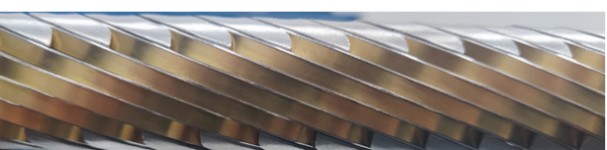
Development of the Model Dipole LPF3
16 T Model Dipole LPF3: Nb₃Sn 13 T (Common Coil with 55 mm gap) + HTS 3 T inserts (Block & CCT)
3

Slide 4
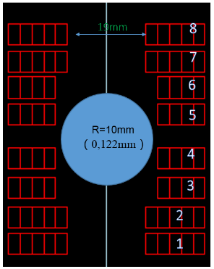
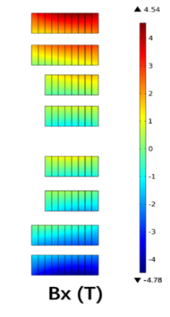
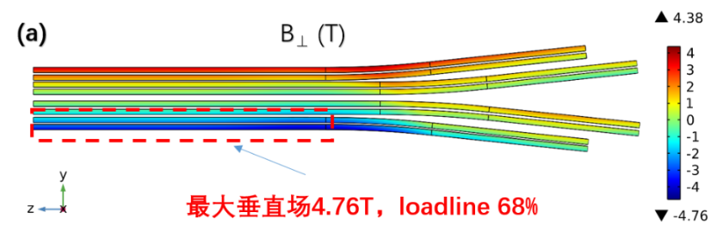
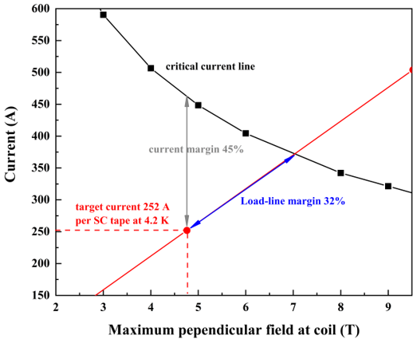
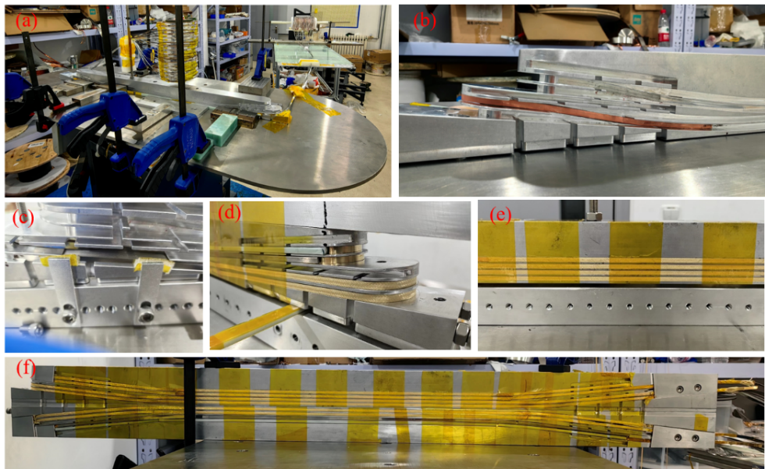
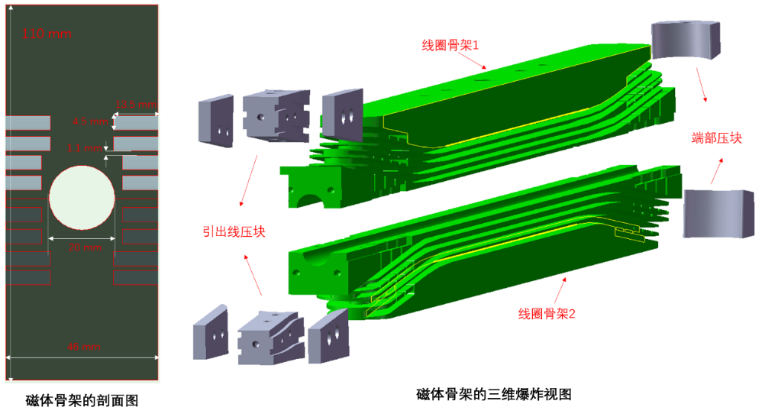
Development of the Model Dipole LPF3
The ReBCO block insert coils for LPF3
Ze Feng et al
Parameters | Values
L0 | 409.6 mm
L1 | 540.2 mm
Rhard | 800 mm
Aend | 6 °
R1 | 9.5 mm
Z1 | 120 mm
Coils winded with Insulated stacked ReBCO tapes
4

Slide 5
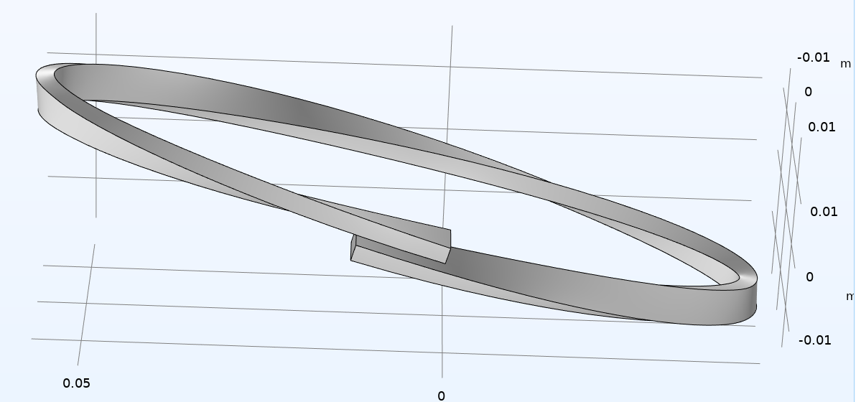

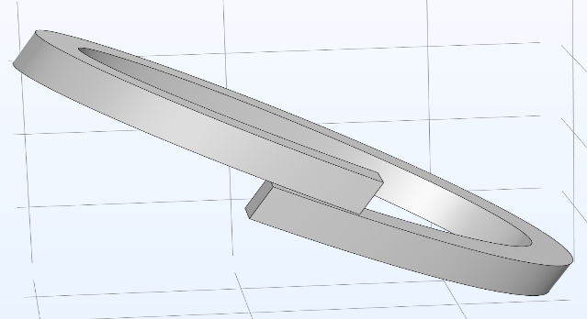
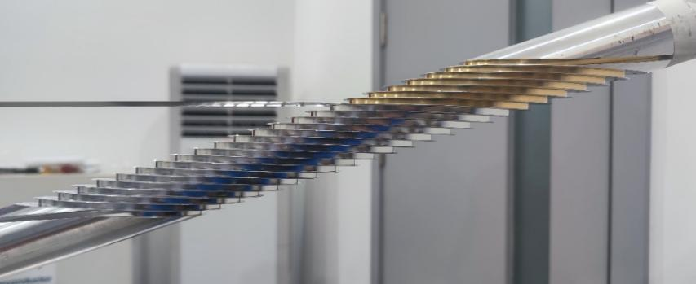
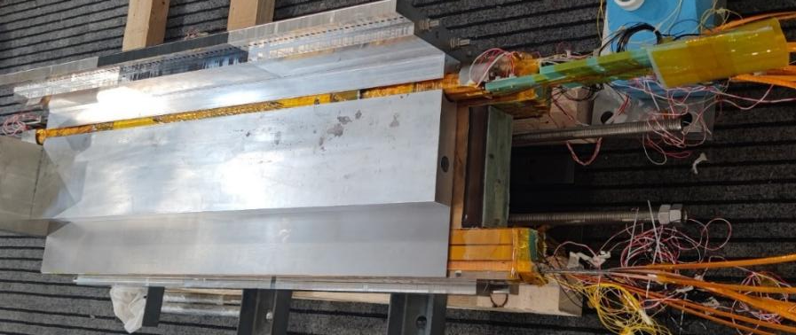
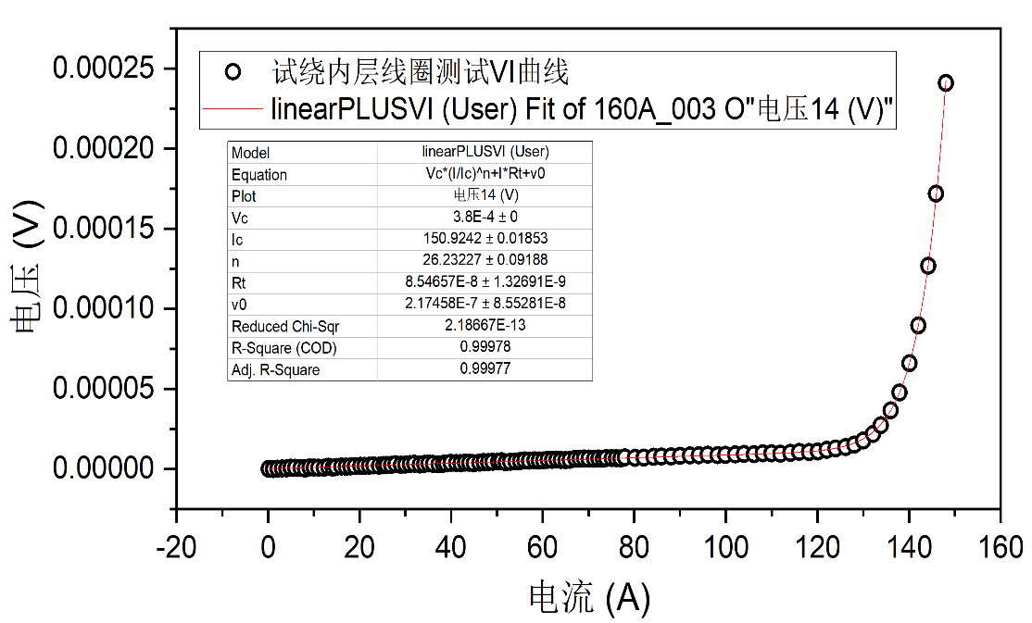
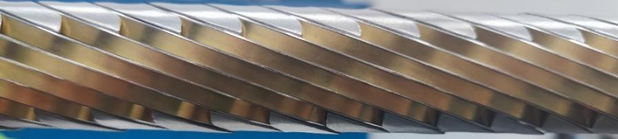
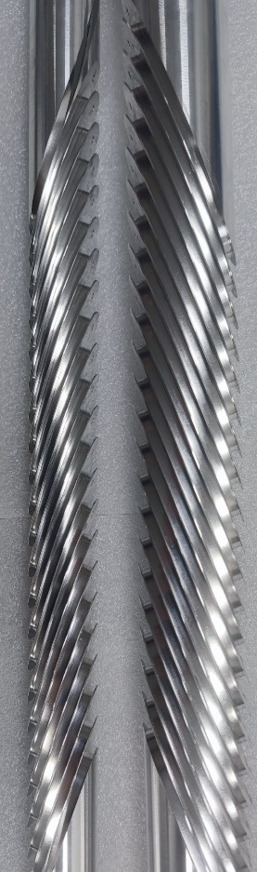
Development of the Model Dipole LPF3
The ReBCO CCT instert coils for LPF3
Rui Kang et al
典型CCT线圈结构示意
“斜螺线管”型CCT线圈结构示意
5

Slide 6
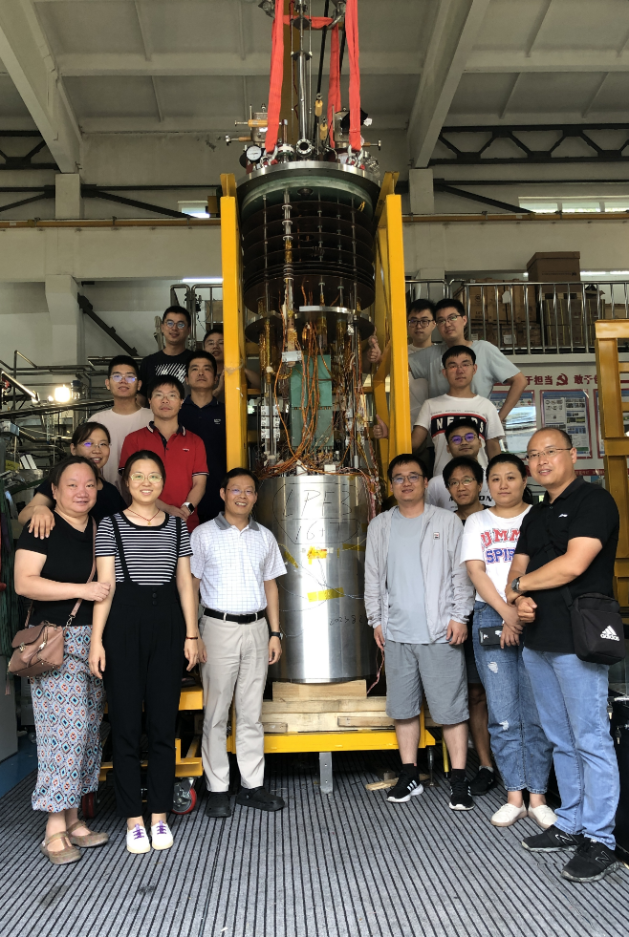
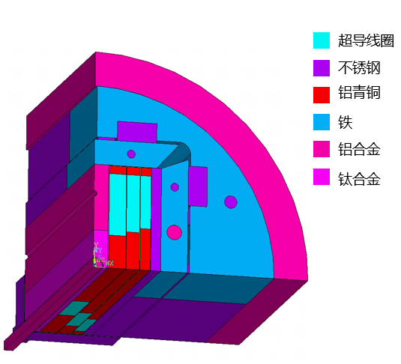
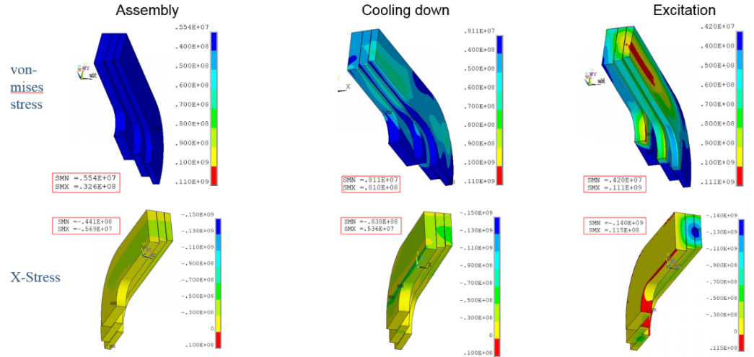
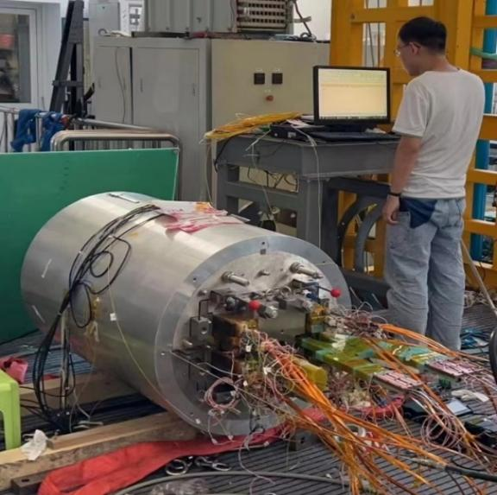
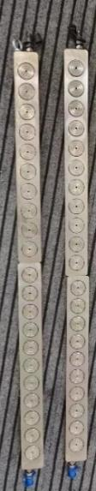
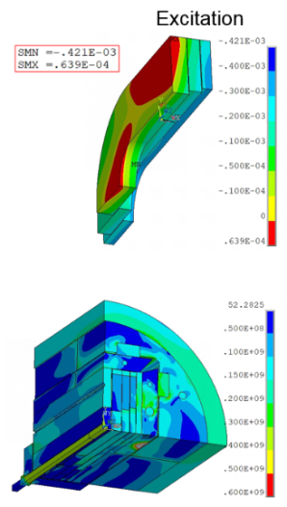
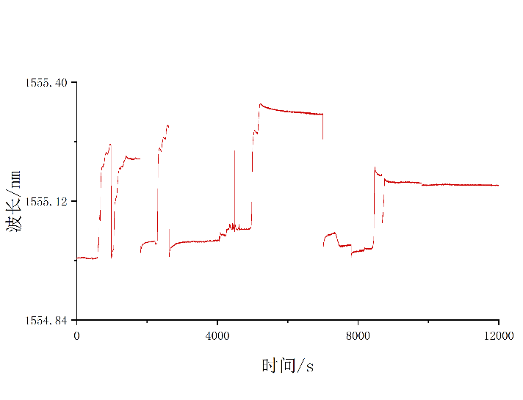
Development of the Model Dipole LPF3
Pre-stress and assembly of LPF3
Yingzhe Wang et al
Stress monitoring during
assembly with FBG
Pre-stress applied with commercial hydraulic jack
6
6
2023.8.29 Assembly completed

Slide 7
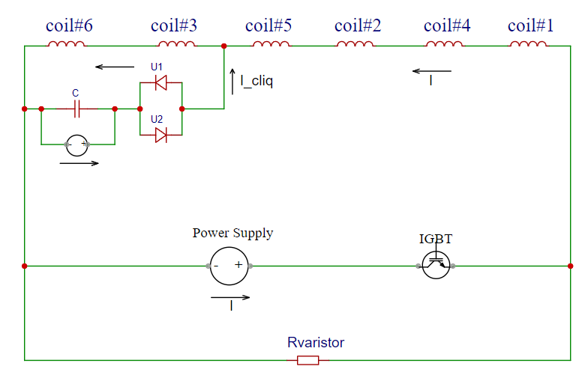
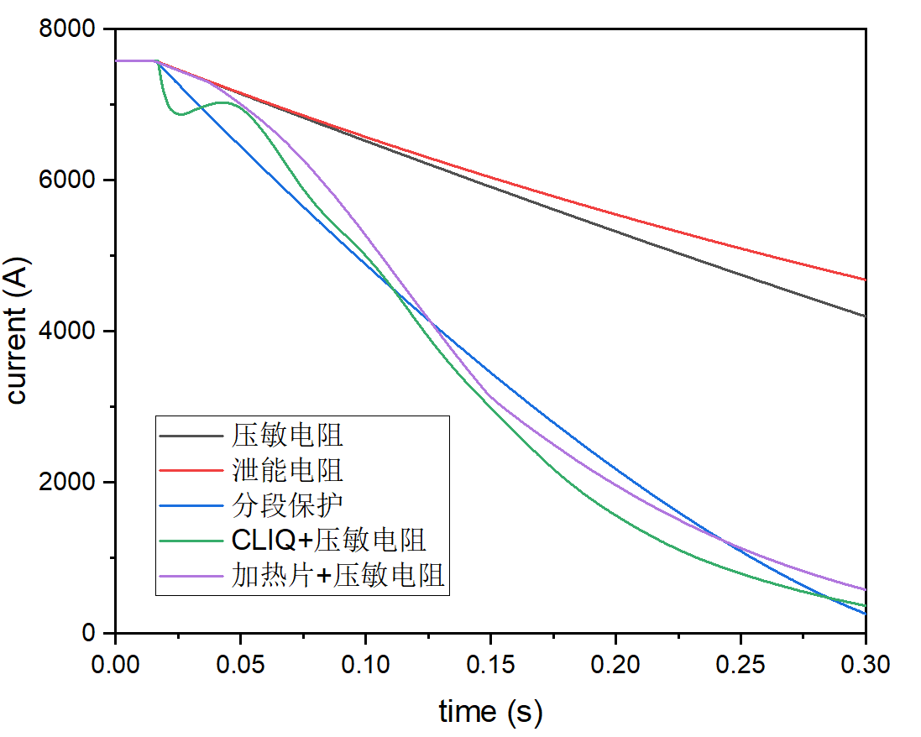
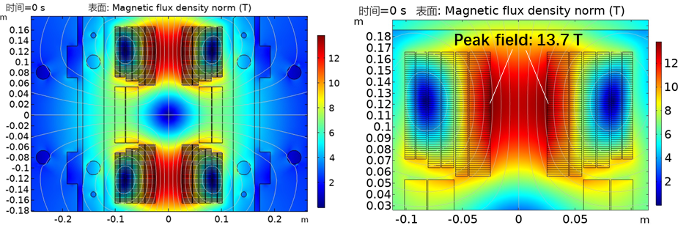
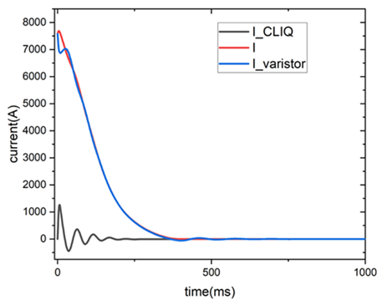
Development of the Model Dipole LPF3
Quench protection of LPF3
Jinrui Shi et al
Varistor plus CLIQ to protect the Nb₃Sn coils. The maximum hot spot is ~ 230 K
NI configuration plus dump resistor to protect the 2 HTS insert coils
Current decay curve at the operating current
7

Slide 8
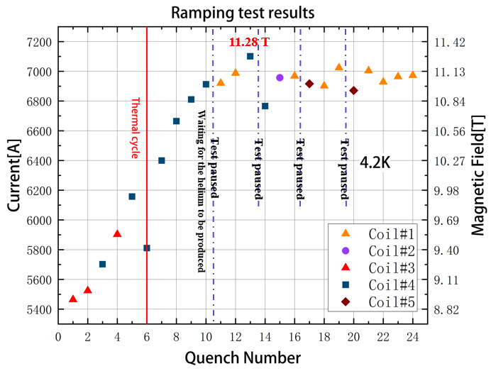
Development of the Model Dipole LPF3
Performance test in Sep to Dec 2023
Wei Li et al
The Nb₃Sn coils were trained firstly, maximum current reached ~85% of I_{op} in Dec 2023, but showed an unstable plateau at 11 T due to one of the outmost Nb₃Sn coil, probably due to insufficient pre-stress during assembly, and enhanced field on most inner Nb3Sn coils due to the HTS screen current!
HTS block coil was ramped independently to 100% of I_{op} at 9 T background field, with long time delay of field. Current leads failure limited the hold time of the I_{op} and the field
55 mm 双孔径
8

Slide 9
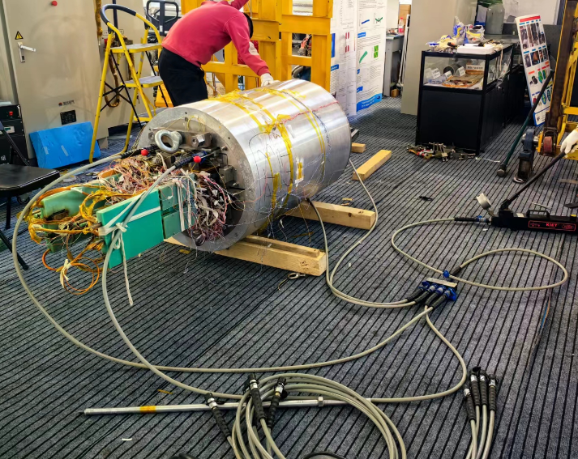
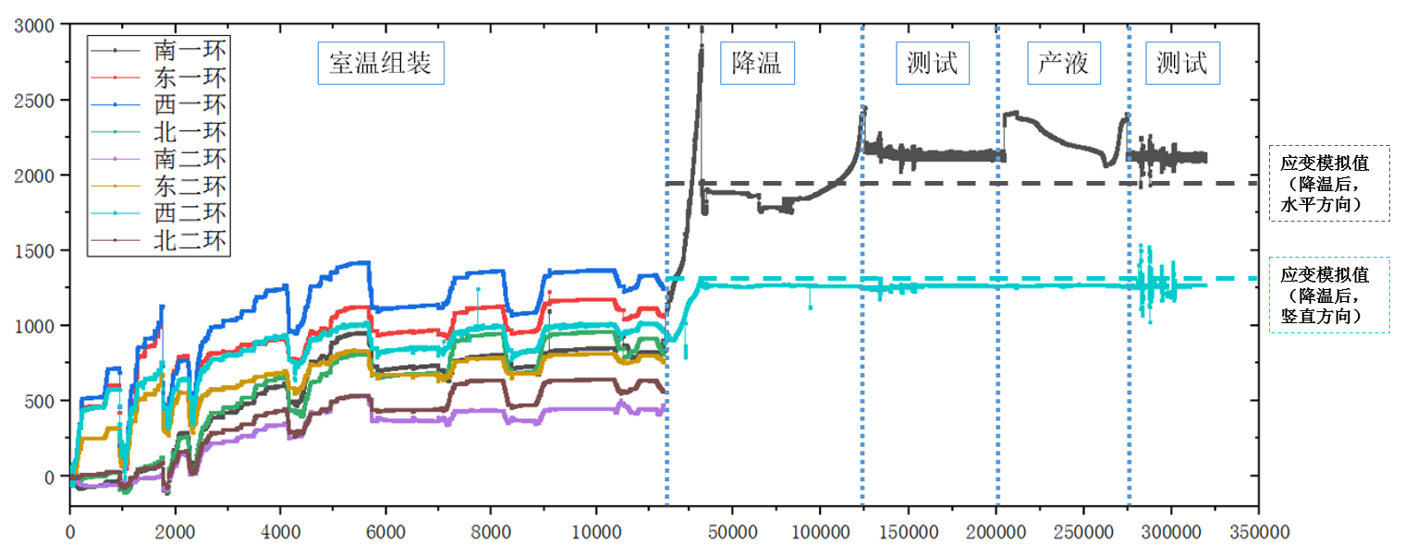
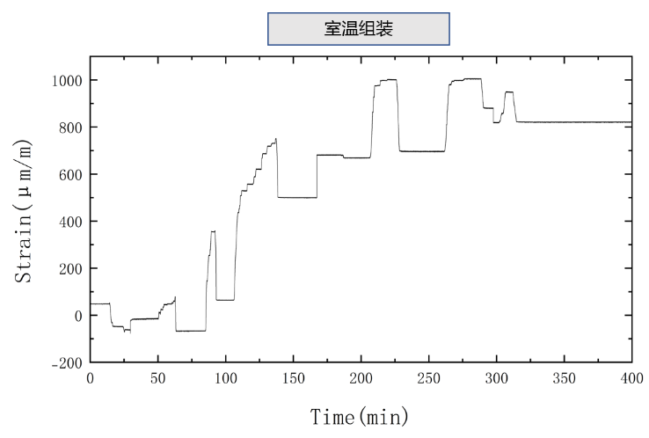


Development of the Model Dipole LPF3
Reassembly of the magnet with enhanced pre-stress in Jan 2024
Xin Chen et al
2024 年 1 月
应变片监测磁体组装、降温、励磁过程
光栅光纤监测磁体组装及测试过程
9

Slide 10



Development of the Model Dipole LPF3
Performance test in Feb 2024
The Nb₃Sn coils showed very unstable performance in the 6300-7000 A region due to one of the inner most coils, but finally passed this region and reached ~87% of I_{op} in the beginning of March 2024
HTS block coil was ramped independently to 120% of I_{op} to test its ultimate performance, burned one of the leads. Disassembly after test showed serious deformation of conductor at the hard bending section.
10

Slide 11












Development of the Model Dipole LPF3
New design and fabrication of the new Coils Jun to Oct 2024
Target field：10 T (LTS) + 6 T (HTS) with MI
Preliminary test results of the new HTS coils at 77K
AP: 75 mm
75 mm
11
Fabrication of the 2 new Nb₃Sn coils with OST wires
11

Slide 12



Development of the Model Dipole LPF3
Field delay of HTS coil significantly changed after magnet assembly
Stand-alone test at 77K
0.93 T @ 77 K，290A
Field delay ~12 s
Test after magnet assembly at 4.2K
0.32 T @ 4.2 K，100 A
Field delay ~58 min
Possibly due to the large pre-stress applied to the HTS coils
12

Slide 13



Development of the Model Dipole LPF3
Test of the LPF3-U magnet Nov. 2024 to Jan. 2025
The HTS coils subjected to several excitation tests in both self-field and 9 T background field, with a maximum excitation current of 2.5 kA (115 % of the design current) in 9 T background field, but generally degraded along with the training of LTS coils, and provided a magnetic field significantly below the design value with long delay.
HTS Stand-alone test @77 K
HTS Test after assembly @77 K
Training of LTS coils
1st HTS test with 9 T BG field
2nd HTS test with 9 T field
LTS training
3rd HTS test with 9 T field
1st HTS test with 9 T BG field
2nd HTS test with 9 T BG field
3rd HTS test with 9 T BG field
13

Slide 14



Development of the Model Dipole LPF3
Test of the LPF3-U magnet Nov. 2024 to Jan. 2025
Main challenges: The LTS coils are strongly coupled with the HTS coils in magnetic field and stress during LTS training. the HTS induced current enhance the field strength and stress of the adjacent LTS coils, and the frequent training quench of LTS cause irreversible degradation of the HTS coils.
Nb₃Sn coils reached 9.8 T, 98 % of the design value.
Coupling between HTS & LTS caused difficulties to the training of LTS
Most of quenches occured in the inner Nb₃Sn coils.
LTS still have potential for performance improvement. More R&D needed on training tests……
Common-coil dipole with 78-mm gap
2024.11.22
LPF3-U 磁体组装完成
14

Slide 15








Development of the Model Dipole LPF3
Disassembly of the HTS coils in Jan 2025
After disassembly, Serious damage of the outer HTS coils observed: conductor delamination, damage of layer insulation..., caused by strong coupling (between LTS and HTS) induced electromagnetic forces during the training of LTS
Damage in interturn between layers
After testing, the coil surface is not flat
Damage of layer insulation
Delamination
15

Slide 16

Development of the Model Dipole LPF3
Refabrication of the new HTS coils in Spring 2025
To reduce time delay of field, the layer insulation in the coil was replaced from stainless steel to G10
To reduce the impact of LTS quench to HTS, high-purity copper and HTS tapes were deployed around the HTS coil
16

Slide 17



Development of the Model Dipole LPF3
Test of the new HTS coils in Spring 2025
HTS coils produced 7.05 T at 1970 A at 4.2 K, exceeds the design magnetic field 6 T, and still did not quench
The magnetic field delay is reduced to 267s, even with very large applied pre-stress during magnet assembly
2 of 6 HTS coils damaged during the 1st quench of LTS when powering them together
Disassembly of the damaged HTS coils shows that the transition turn between the two layers seriously burned, where Kapton was adopted to insulate the coil with former
Stand-alone test of HTS coils at 4.2 K
Powering with LTS at 4.2 K
17

Slide 18




Development of the Model Dipole LPF3
Refabrication and test of the new HTS coils in Summer 2025
HTS coils were fabricated again with removing the kapton insulation around the transition section, and tested again in June stand-alone (1 of 6 coils damaged due to the power failure), and with Nb₃Sn in July 2025
HTS stand alone: 2159 A, >7 T in the aperture@ 4.2 K
Maximum field on the coil (calculated): ~10 T
Performance limited by a power failure: current discharged in 1 s
Power failure at 2159 A damaged 1 of 6 HTS coils
Resistive voltage appeared in #5 coil from ~800 A;
bypassing #5 coil for the following tests

Slide 19



Development of the Model Dipole LPF3
Refabrication and test of the new HTS coils in Summer 2025
5 HTS coils 1st powering with LTS: unexpected current ripple triggered the quench protection circuit, then #3 HTS coil quenched, and LTS was triggered after 1.355 s. After that, #2 HTS coil also quenched. HTS coils current decay: ~2.7 s
2nd HTS powering with Nb₃Sn at 4.2 K,
Quench at HTS 2049 A & LTS 5550 A (bypassing #5 HTS coil)
Voltage and current variations during the quench

Slide 20




Development of the Model Dipole LPF3
Refabrication and test of the new HTS coils in Summer 2025
2nd powering with LTS: #3 HTS coil quench at 1959A, and after 0.4156s, the LTS quench detection system triggered. The current decay time of HTS is 1.3 s, and LTS is 0.7718 s;
2nd HTS powering with Nb₃Sn at 4.2K
Quench at HTS 1959 A & LTS 6130 A (bypassing #5 HTS coil)
Maximum field in the aperture >14 T, on the coil >16T
Voltage and current variations during the quench
Dipole field along the major axis
Field map within the aperture. The highest field in the HTS coil ~16.2T (calculated)
20

Slide 21






Development of the Model Dipole LPF3
Refabrication and test of the new HTS coils in Summer 2025
Power failure damaged coil (#5 coil) during the stand-alone test: conductor partially burned at the coil end
Quench at 14 T damaged coil (#3 coil) during powering with Nb₃Sn coils: conductor burned at the bending section
#5 coil
#3 coil inner
#3 coil outer
21

Slide 22
Summary
Hybrid model dipoles with LTS and HTS are being developed from 2021 at IHEP-CAS. ReBCO coil reached beyond 7 T dipole field in the aperture stand alone, and beyond 14 T in the aperture with Nb₃Sn at 4.2 K
New ReBCO coils to be fabricated and tested again by the end of this year
Key issue for ReBCO to be solved before really used in high field accelerator magnets: how to prevent degradation or damage during quench?
Still long way to go……
Thanks for your attention!
22

