Slide 1
E-CLIQ Quench Protection for High-Field Magnets – Part 2
Tim Mulder, 30-10-2025

Slide 2
Special thanks to:
927 Team
J.C. Perez, A. Haziot, N. Peray, C. Fernandes, F. Garnier, G. Maury, D. Cote and B. Fornes.
SM18 Team
G. Willering, M. Boczan, J.-L. Guyon and J. Feuvrier, V. Di Capua, M. Janitschke.
PCB Manufacturing
B. Mehl
Cryolab
P. Borges de Sousa
Machine Protection
A. Verweij, M. Wozniak, J. Dular, A. Glock, A. Barroso Del Rio, E. Schnaubelt and G. West.

Slide 3
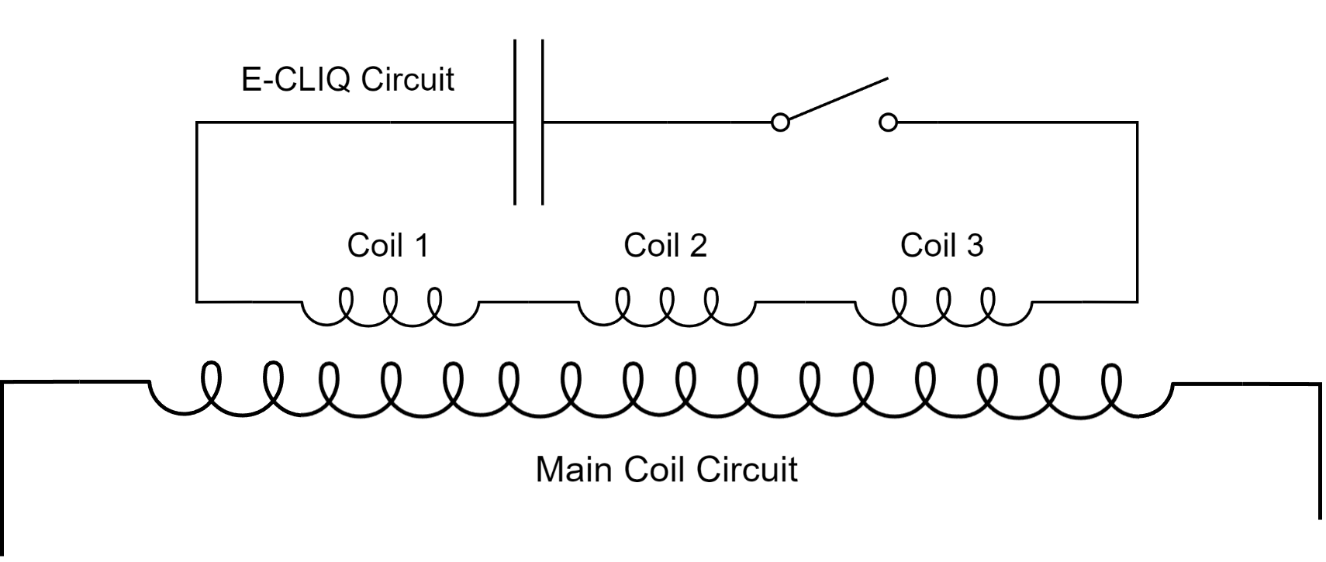
The Concept
External Coil Coupled Loss Induced Quench (E-CLIQ)
Inductive quench heater
✔ Set of compact resistive coils positioned near the main magnet coils.
✔ Loss generated directly inside the superconducting cables.
✔ Potential to be faster than resistive quench heaters.
✔ Thick insulation between magnet and E-CLIQ coils is possible.
✔ Low impedance separate electrical circuit.
✔ Small envelope, can withstand large mechanical preload.
✔ Can be designed for use with a power supply or with a capacitor bank.

Slide 4
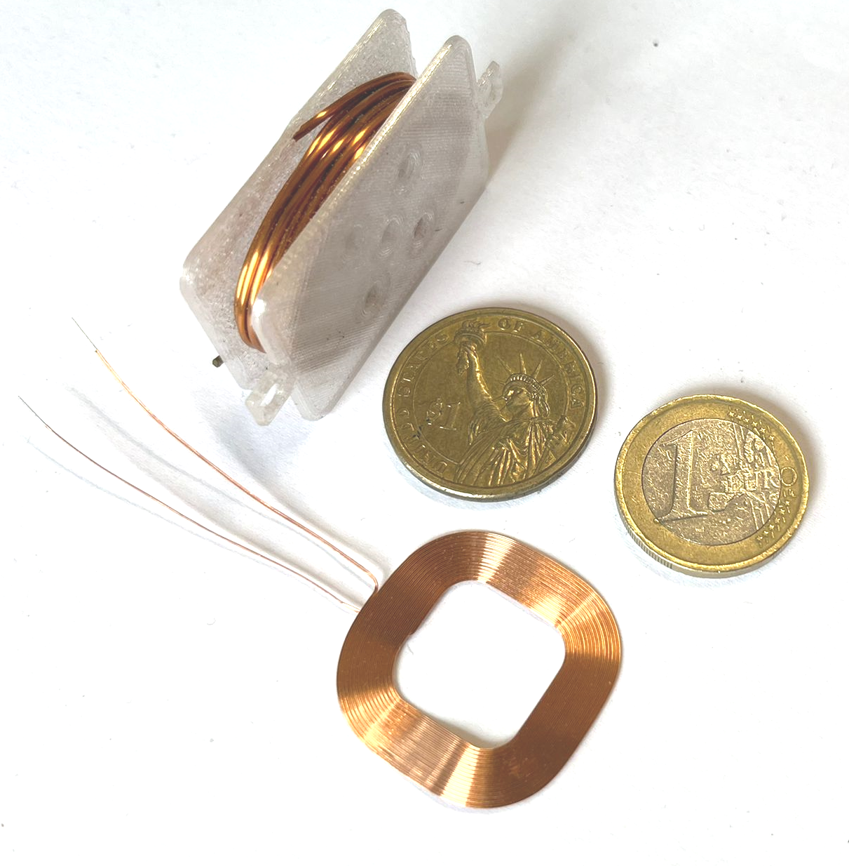
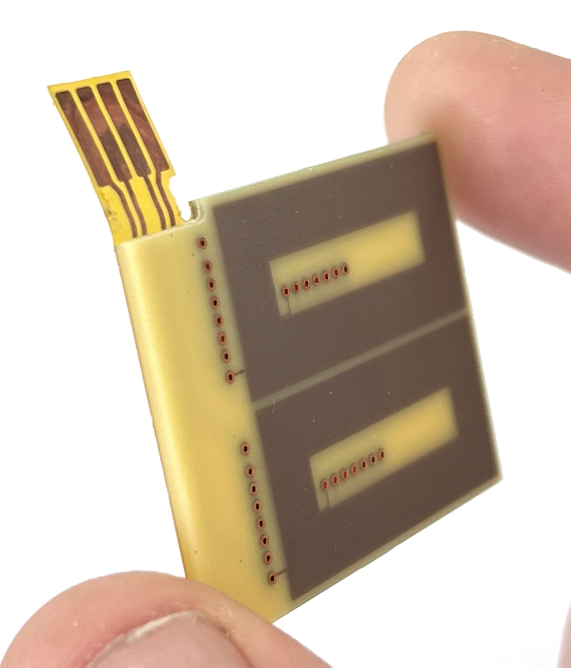
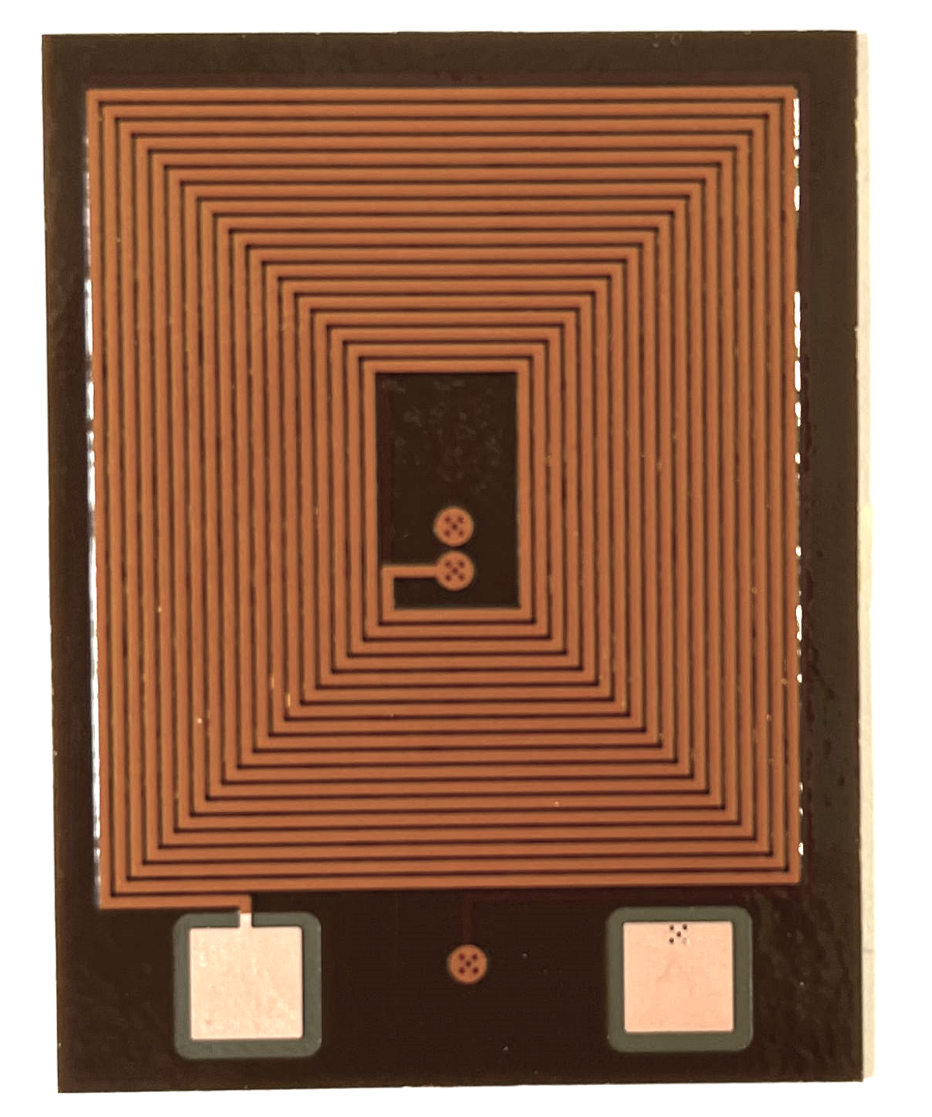
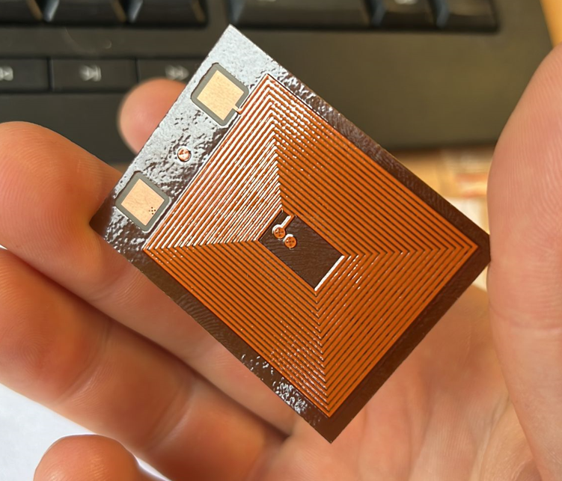
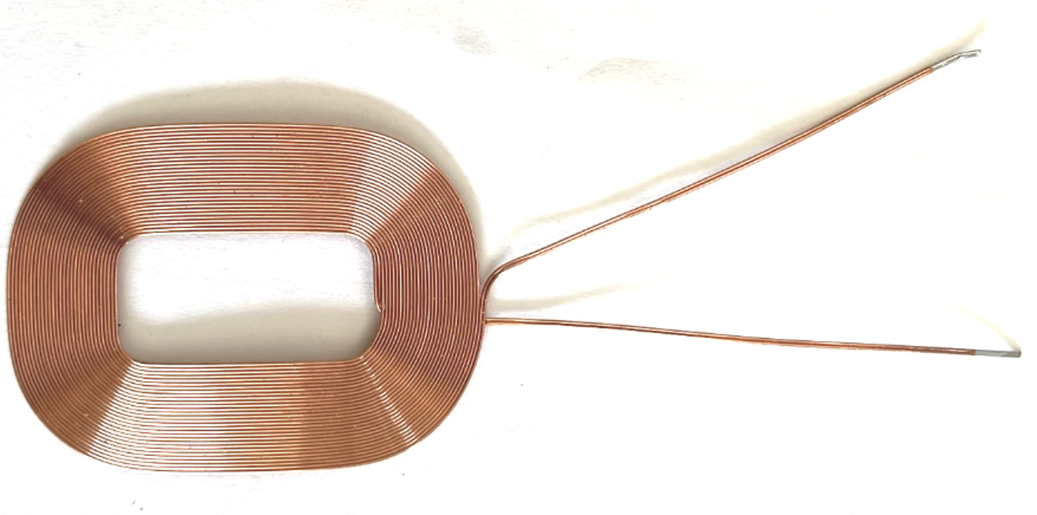

Compact E-CLIQ demonstrators
Non-flexible, very robust and easily mountable.
Development of 3 types of small demonstrators:
based on copper wound (thicker) coils,
based on, commercially available, inductive charging coils,
based on tracks on polyimide film.
Non-optimized,
yet quite flexible.
30.10.2025
Notes:
At CERN 3 different types of small E-CLIQ are in development.
The first is a very robust version based on copper wire wound on a former.
The second is based on commercially available inductive charging coils. They are very flexible, yet not optimized for high voltage discharges.
The last is a multilayer PCB track on Kapton film, designed for short high current, high voltage capacitor discharges.
The devices are designed as sets of a few in series strategically places around the magnet you wish to protect.

Slide 5
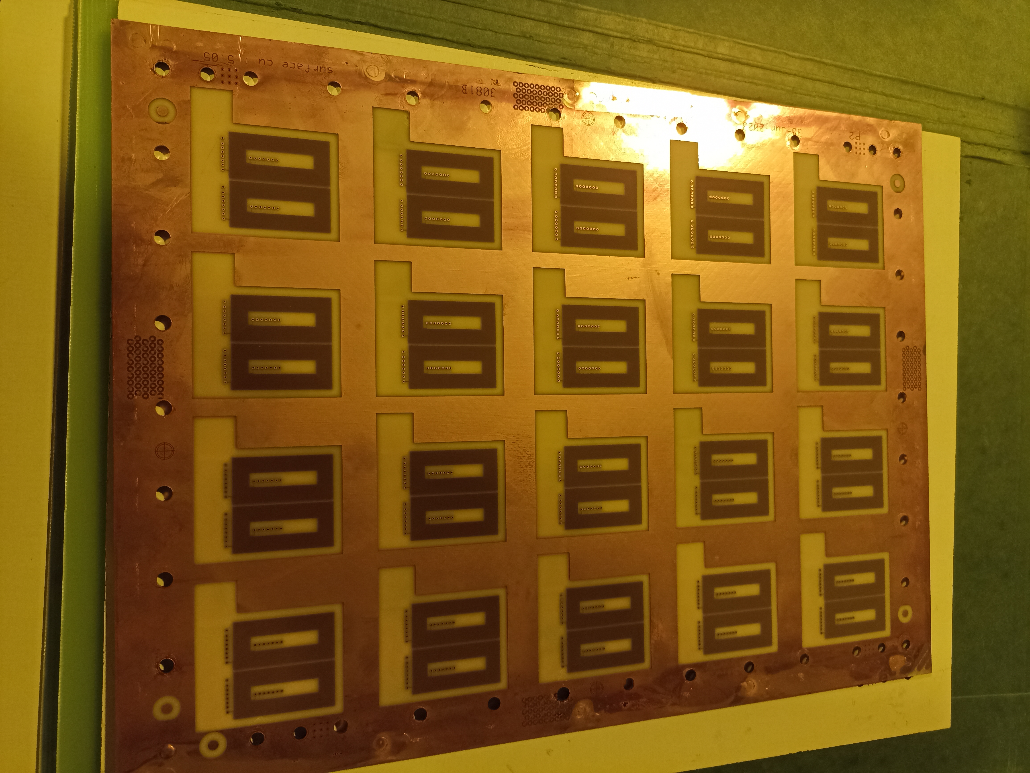
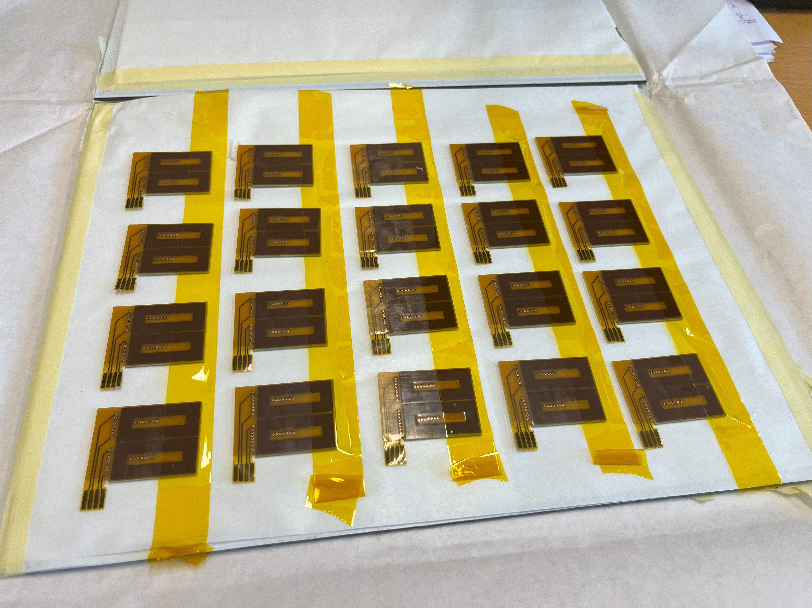
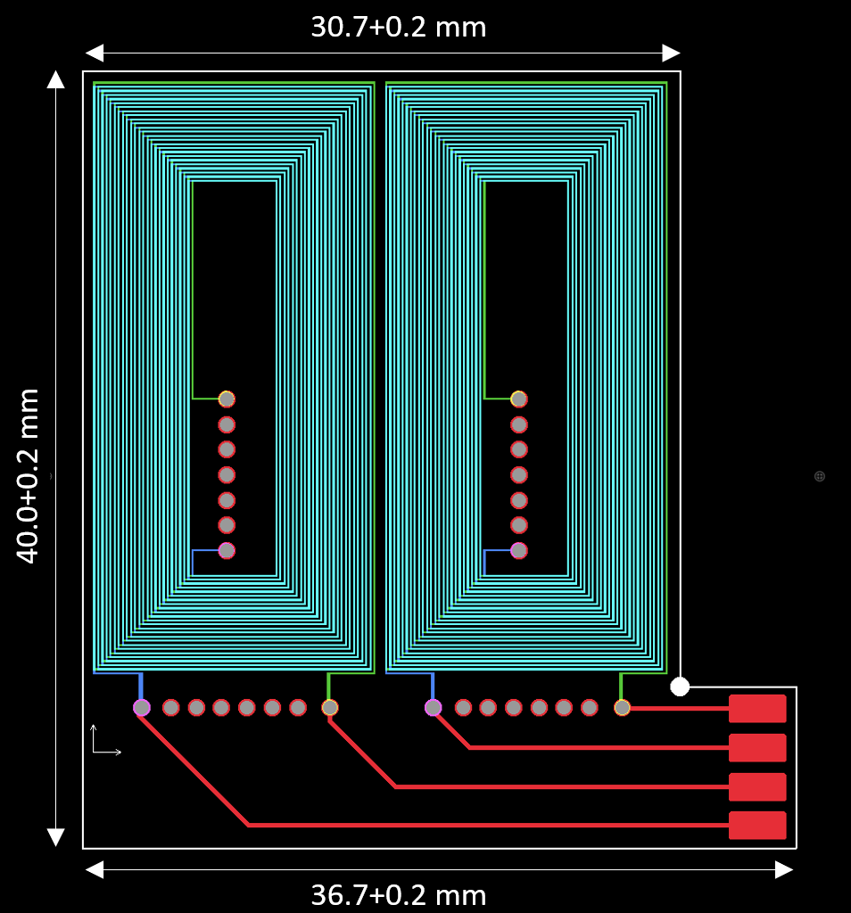
2nd Generation of E-CLIQ
 | Value | Unit
Layers | 14 | -
Turns | 24 | -
Inductance | 3.2 | mH
Magnetic Field | 0.05 | T/A

Slide 6
E-CLIQ testing on a Nb₃Sn Short Model Coil: Goals
Demonstrate E-CLIQ effectiveness as a quench protection tool.
Demonstrate its ability to initiate a quench from various placement positions.
Investigate the influence of signal amplitude and frequency.
Investigate if E-CLIQ can initiate a quench at various magnet currents.
Investigate effect of E-CLIQ positioning.
Quantify the input energy required to quench the coil.
Acquire data to validate simulation efforts.
Use measurement data, simulation data and lessons learned to scale up and produce a protection design for a full-sized magnet.

Slide 7
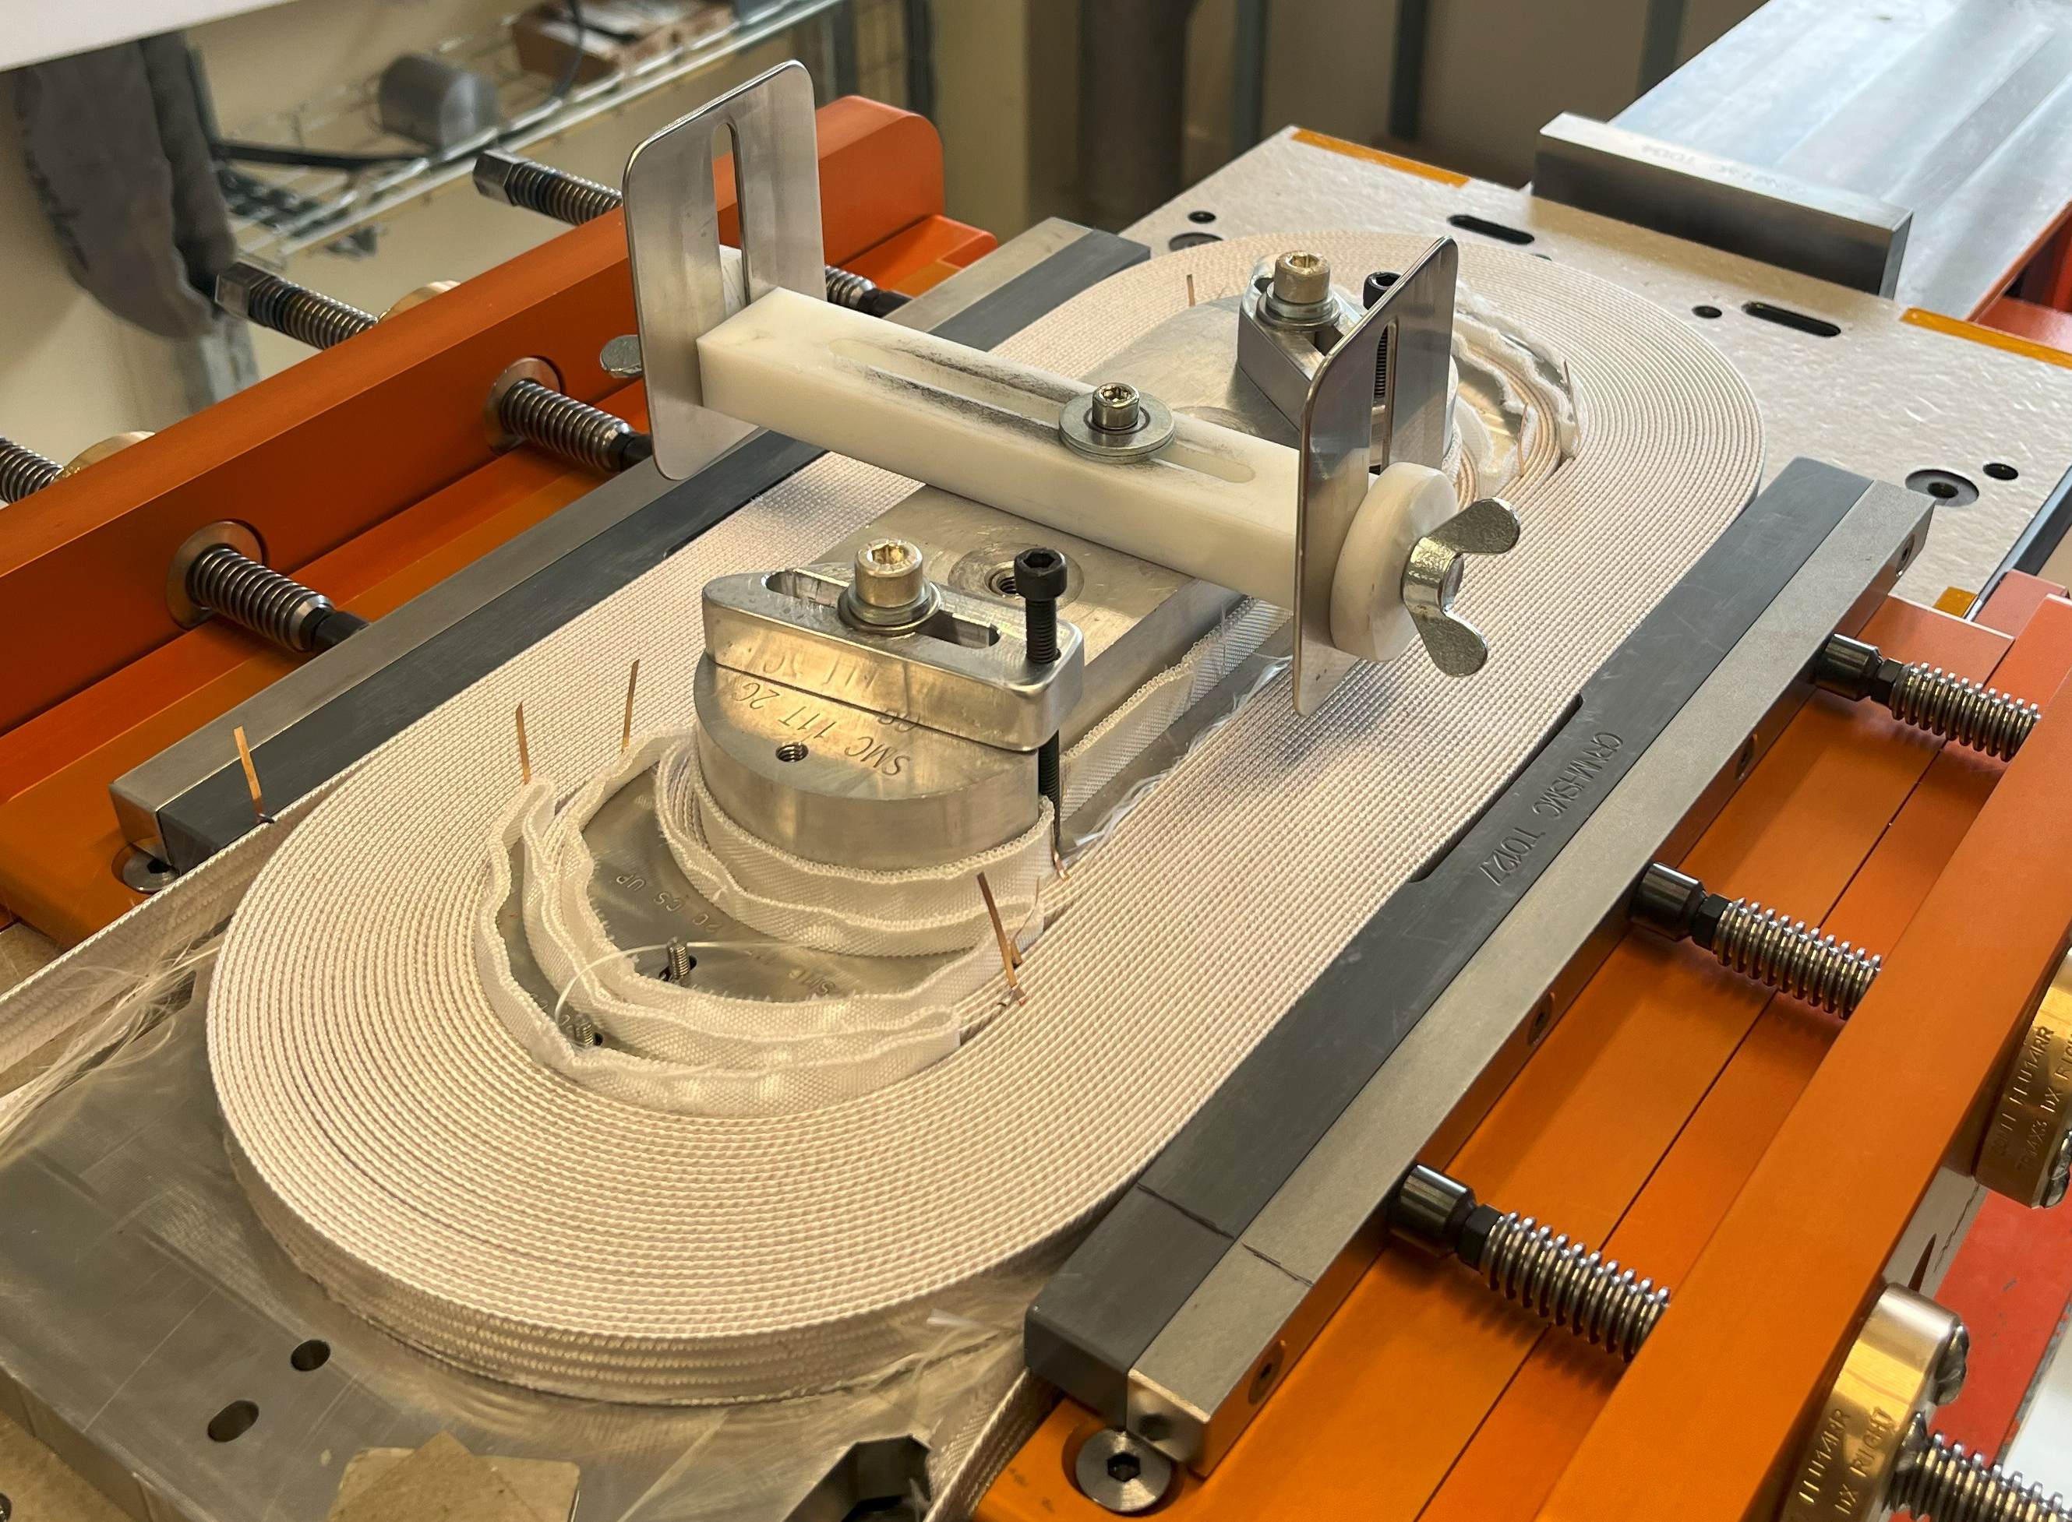
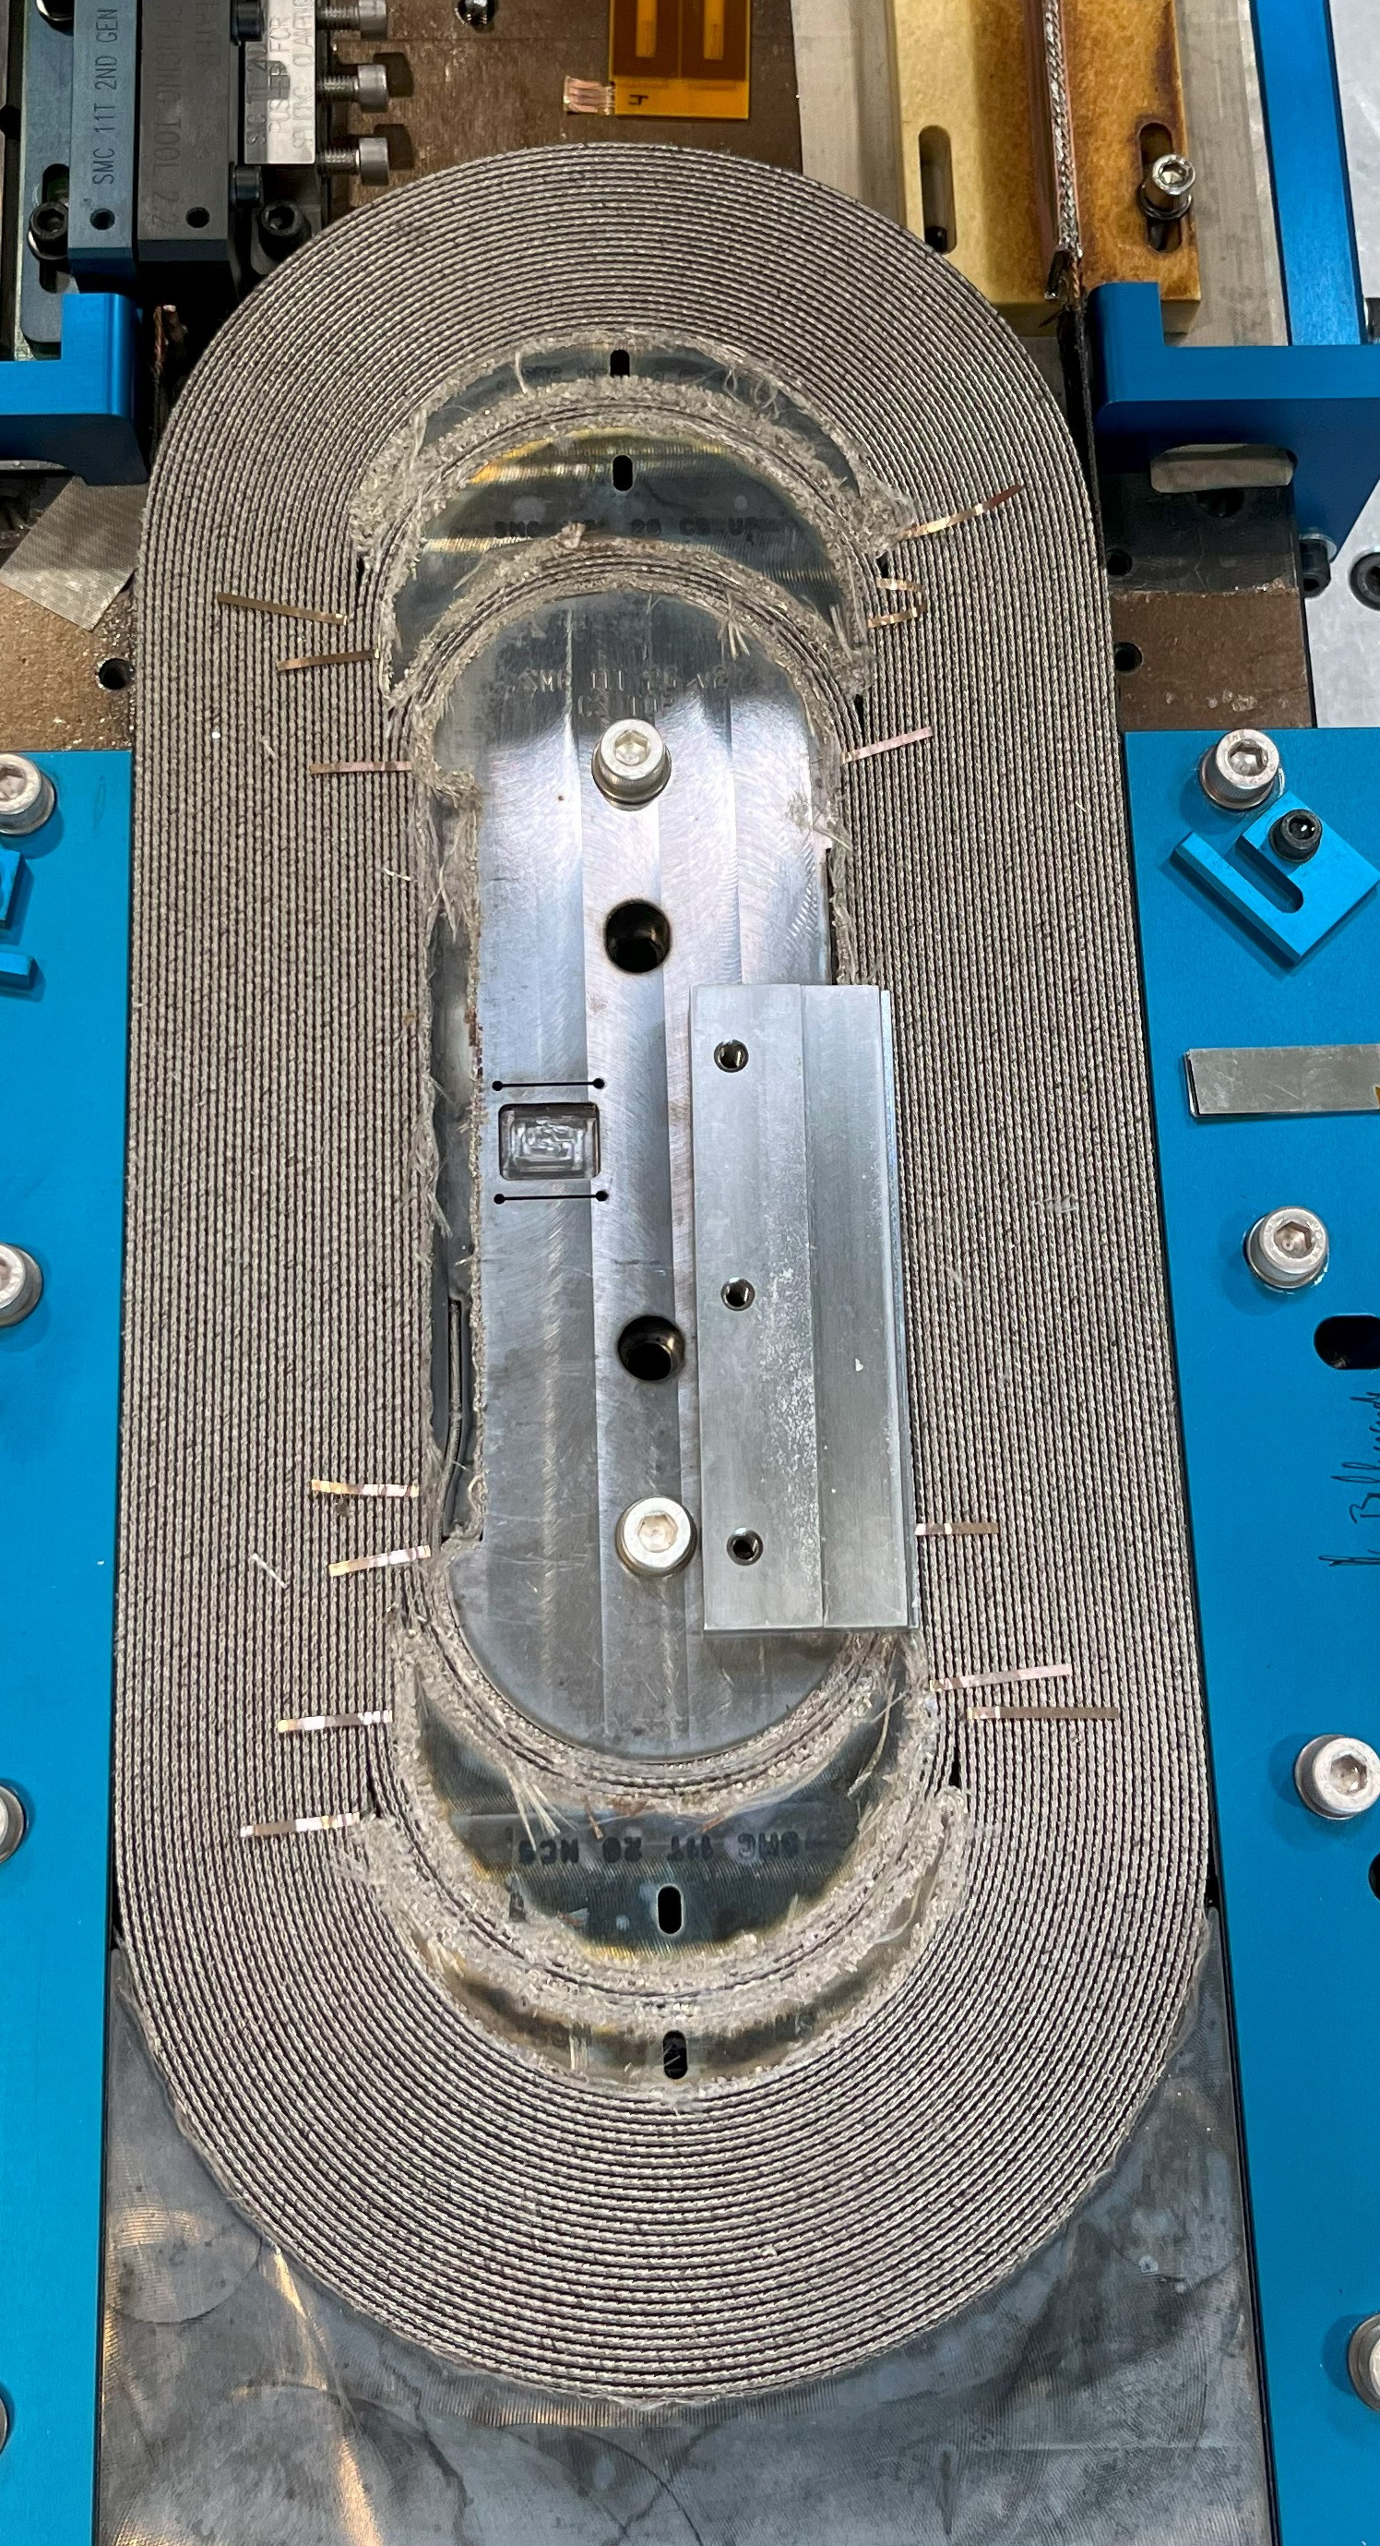
Short recap of the first test campaigns: Short Model Coil

Slide 8
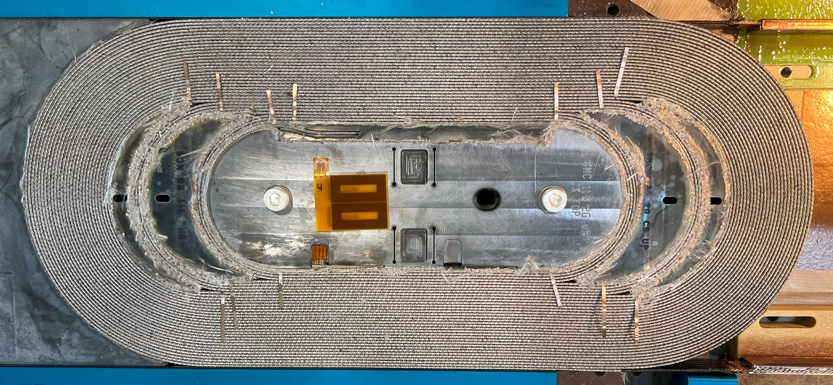
Insertion of the E-CLIQ coils (before impregnation)

Slide 9
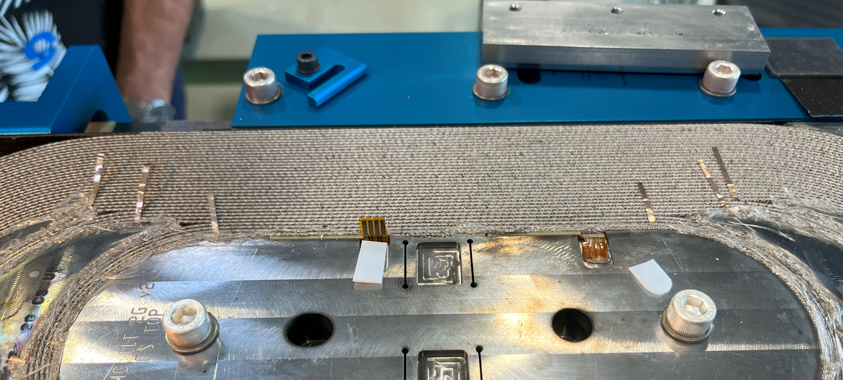
Insertion of the E-CLIQ coils (before impregnation)

Slide 10
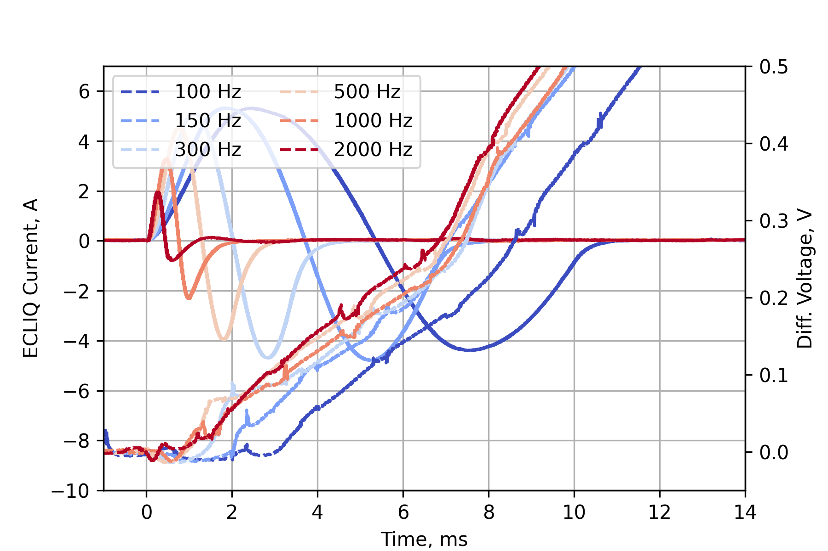
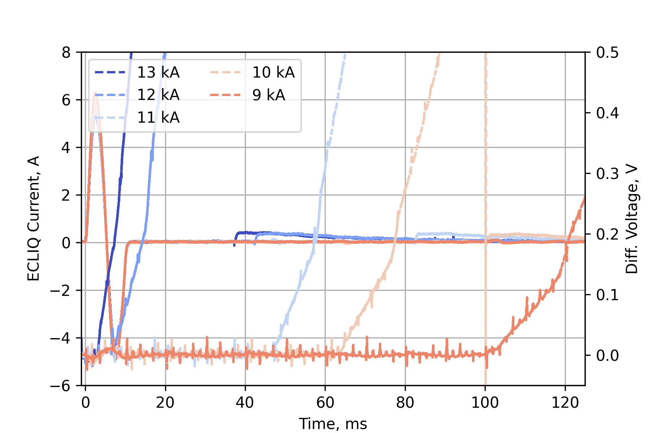
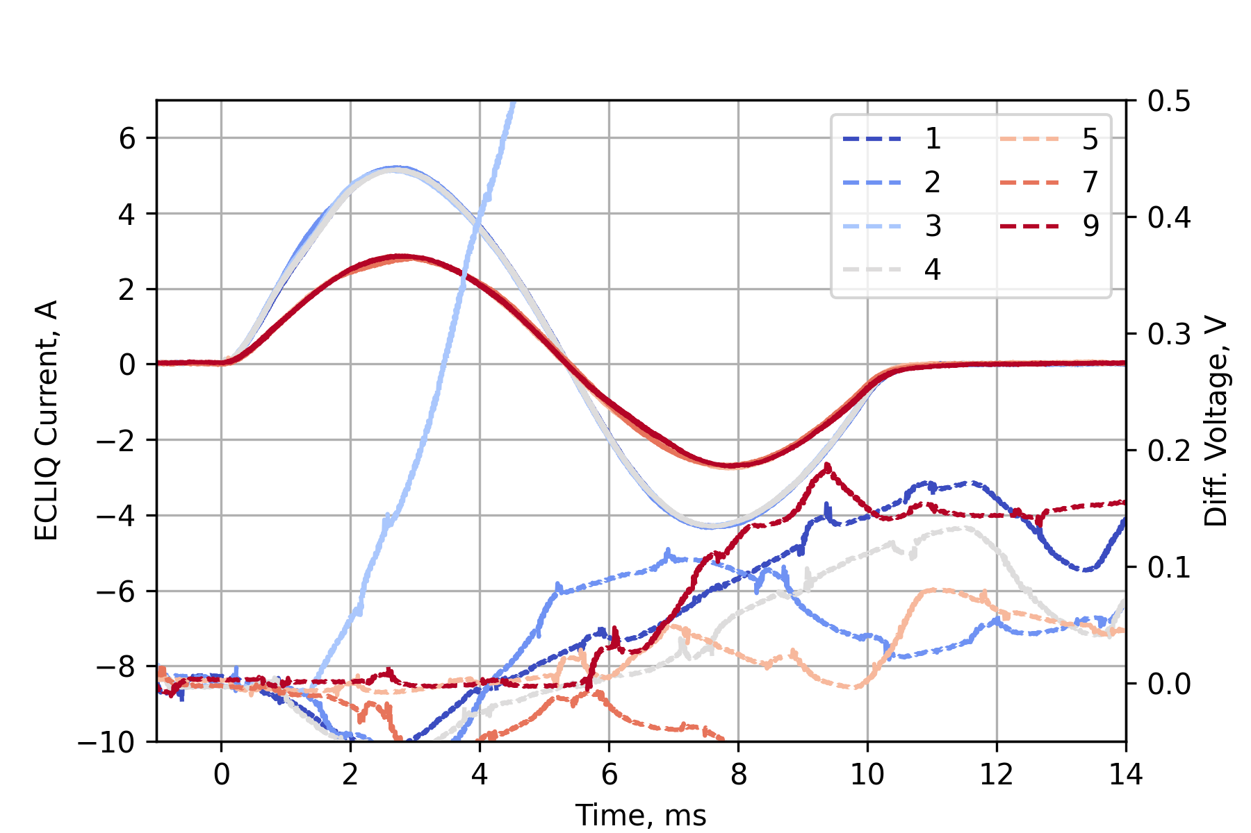
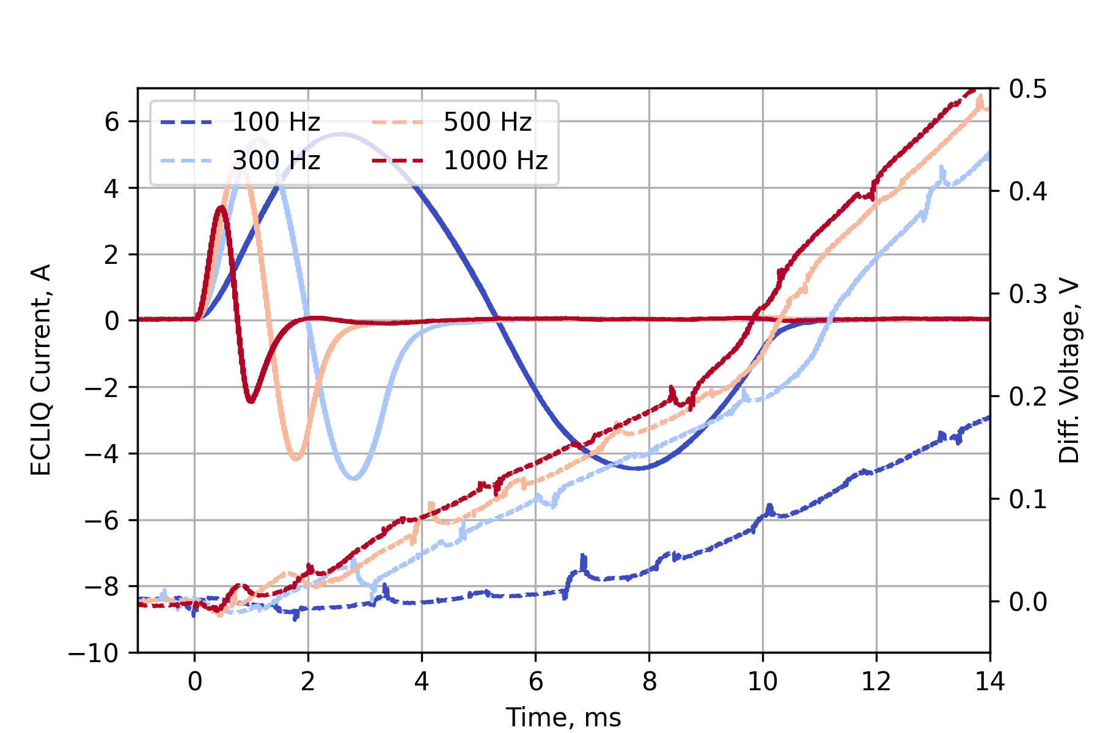
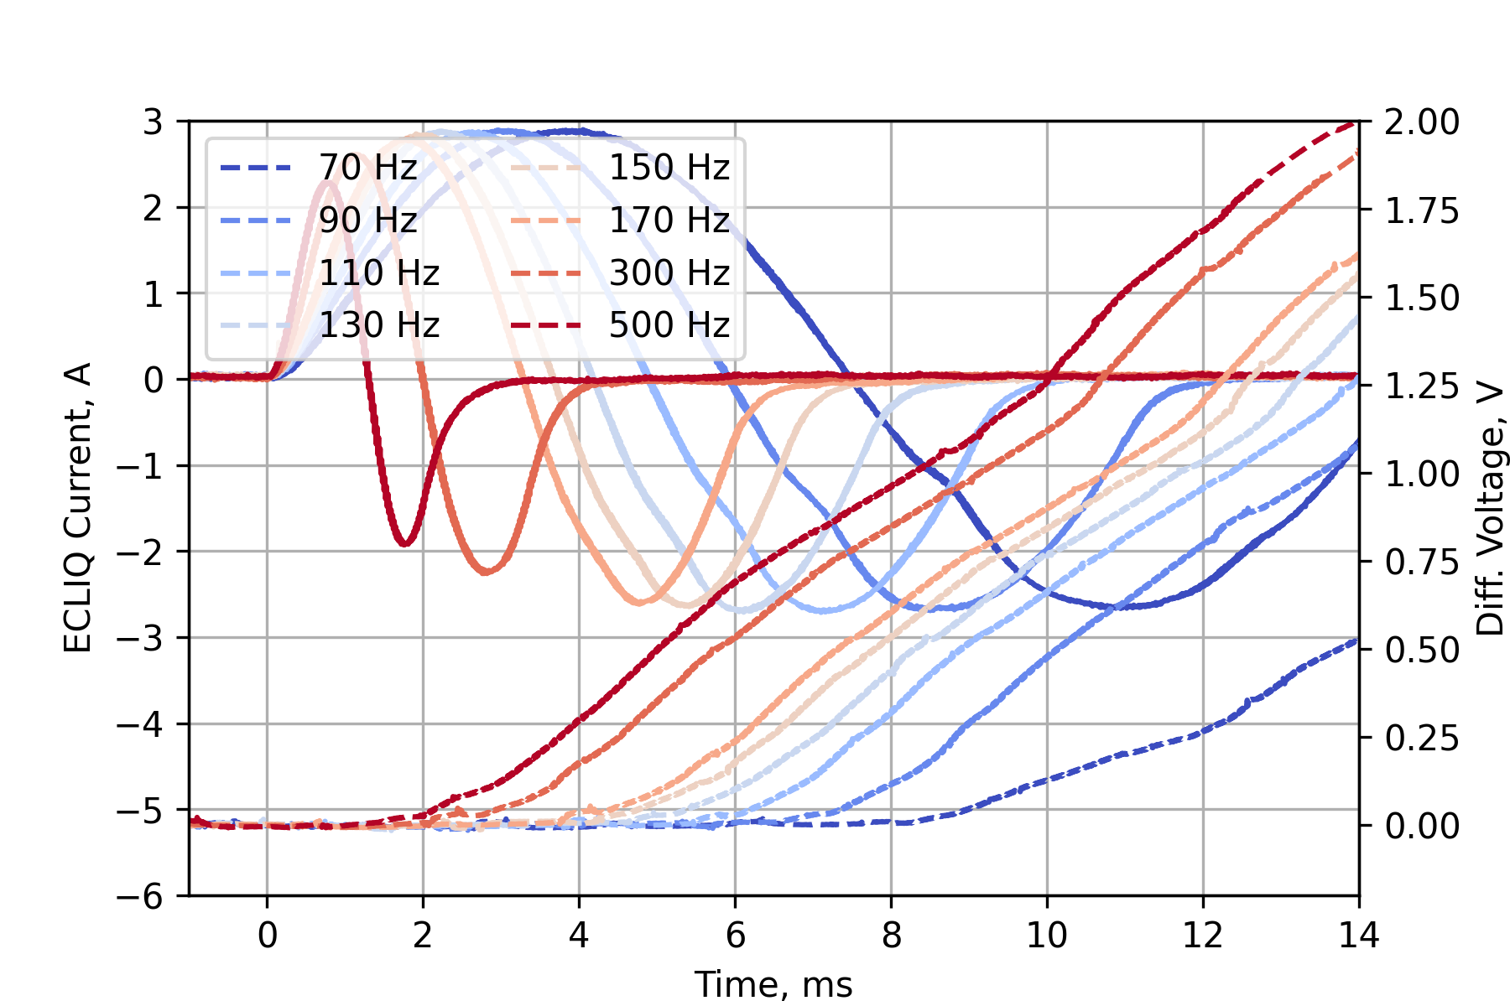
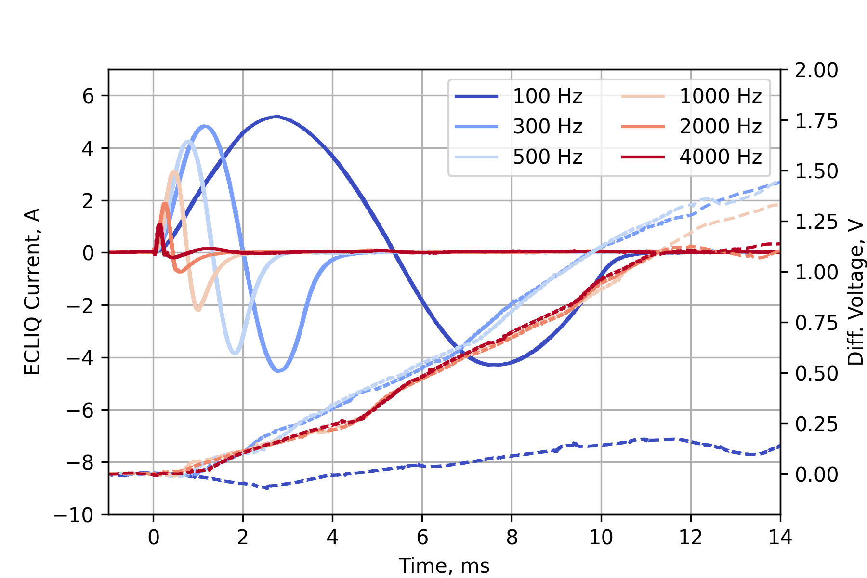
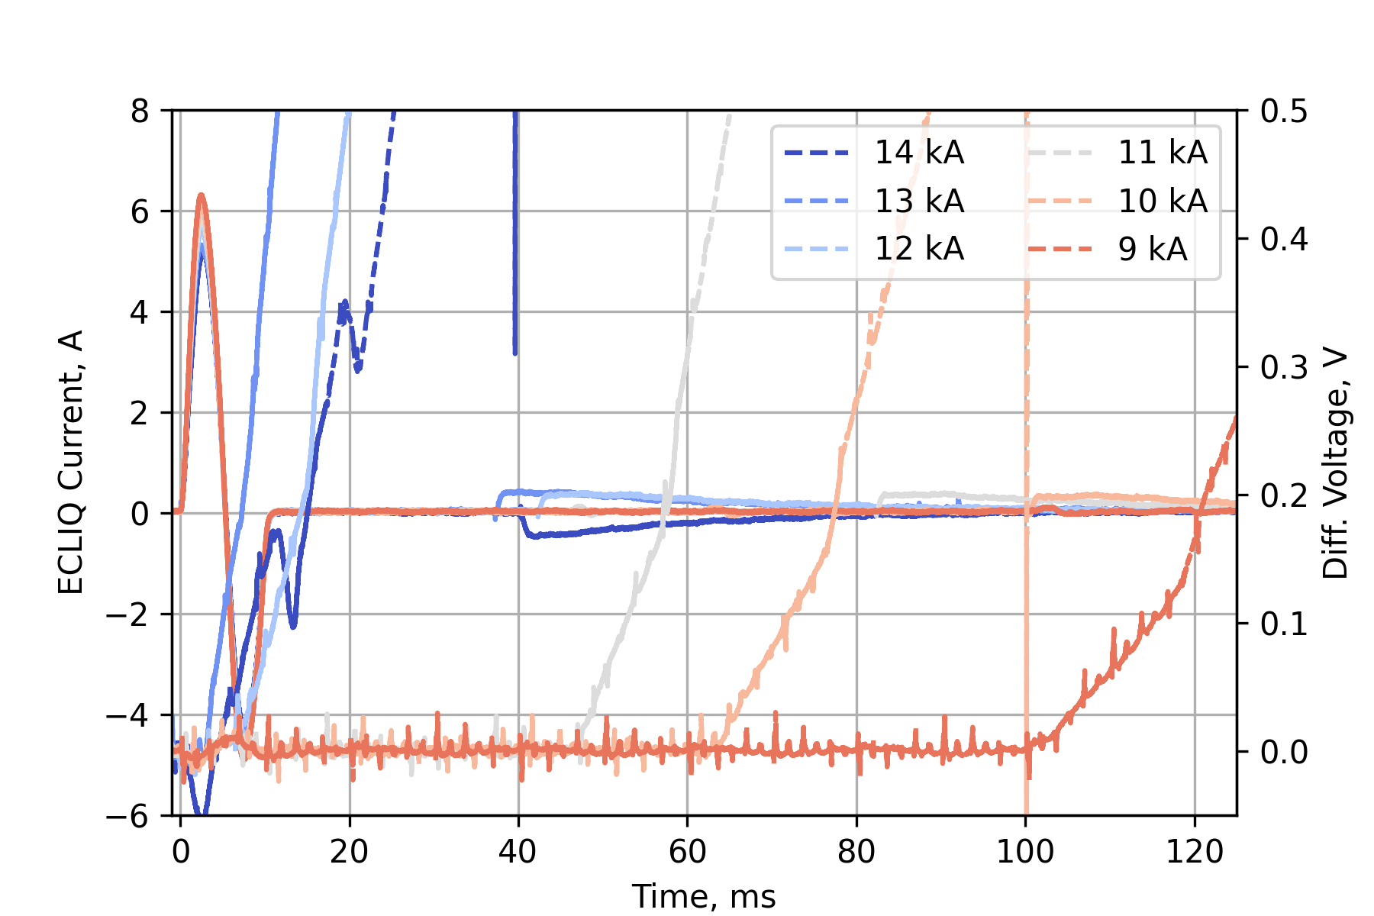
Short recap of the first test campaigns
Quench within 1 ms!
SMC108 (Feb 2025)
✓ 64 measurements at 4.5 K
✓ 12 measurements at 1.9 K
✓ E-CLIQ frequency of 70 Hz to 10 kHz
✓ Magnet current of 2.5 kA to 14 kA
✓ 7 different E-CLIQ configurations
SMC109 (March 2025)
✓ 27 measurements at 4.5 K
✓ E-CLIQ frequency of 50 Hz to 1000 Hz
✓ Magnet current of 12 kA to 14 kA
✓ 2 different E-CLIQ configurations

Slide 11
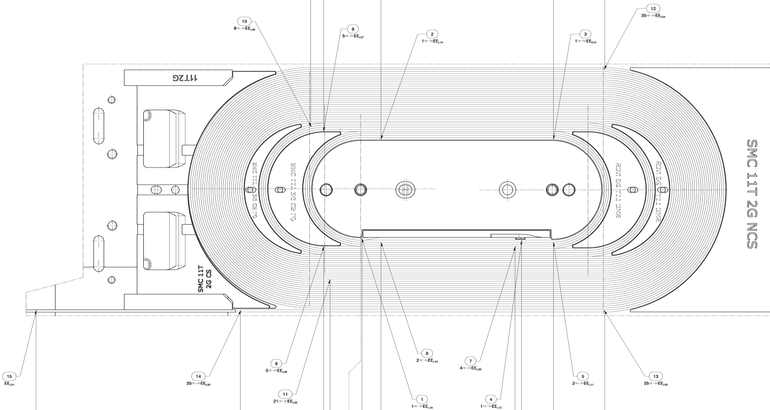
Latest Test: Placement of the E-CLIQ coils
Axial offset ~3 mm
On coil
Inner turns
Coil 8 (C8)
Coil 4 (C4)
Coil 2 (C2)
Middle and outer turns.
Larger number of turns, smaller area per turn

Slide 12
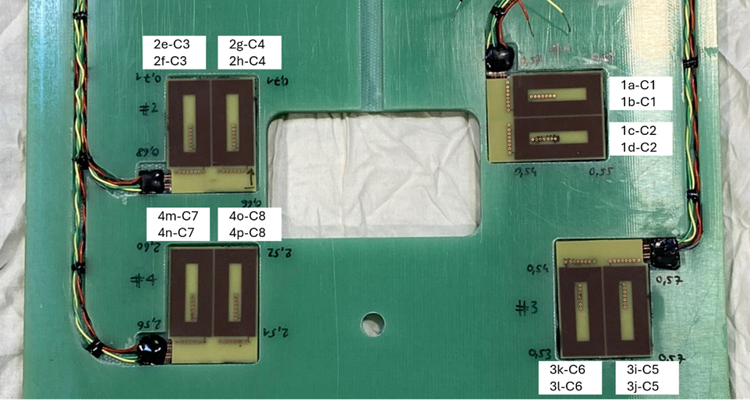
G-10 Mounting Plate

Slide 13
Placement of the E-CLIQ coils
Coil 8 (C8)
Coil 4 (C4)
Coil 2 (C2)

Slide 14
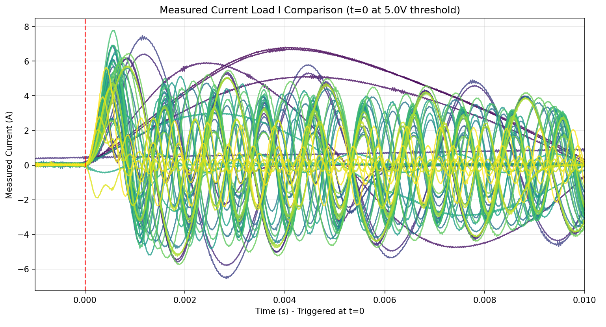
All E-CLIQ Activations
57 recorded activations → 47 recorded quenches
5 different E-CLIQ positions
E-CLIQ voltage up to 200 V and current up to 8 A.
Frequencies from 100 Hz to 3000 Hz.
Temperature of 4.2 K.
Magnet current between 12 and 14 kA – 2 training quenches

Slide 15
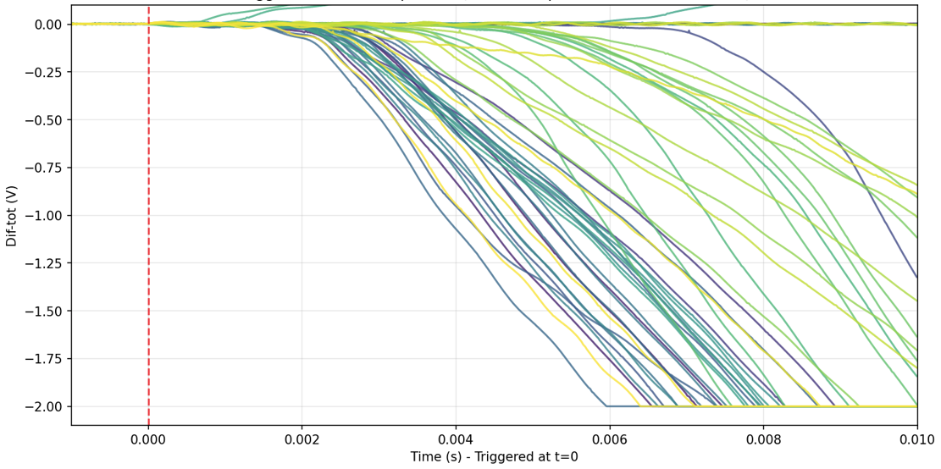
All Quenches in One Plot
Too many measurements to show individually.
Some selected representative measurements will be highlighted.

Slide 16
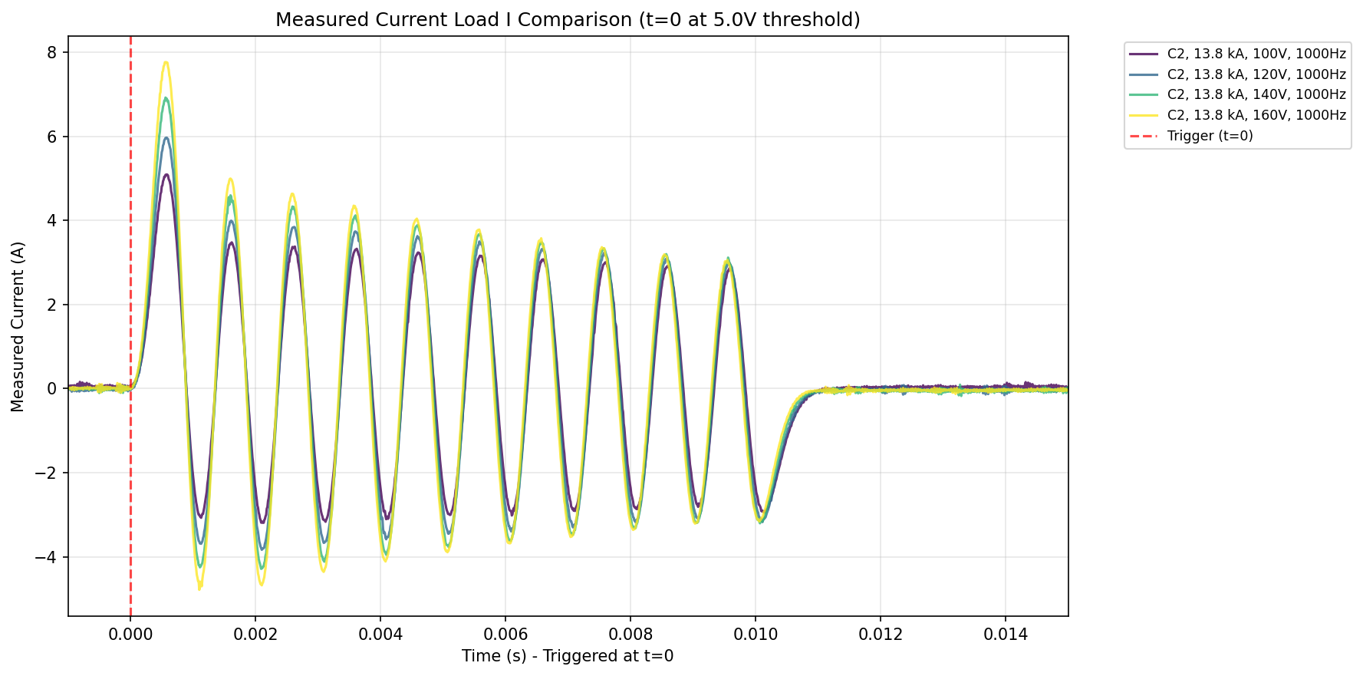
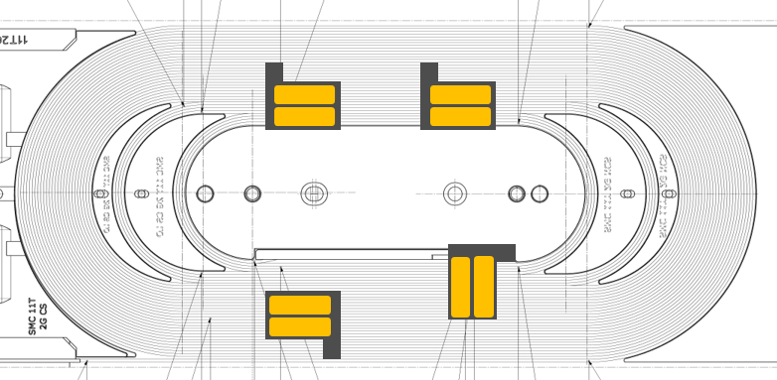
Measurements Explained
C2 → Coil nr. 2
13.8 kA → magnet current
100V → E-CLIQ excitation voltage
1000 Hz → E-CLIQ frequency
C2
E-CLIQ current decreases as the E-CLIQ coils heat up

Slide 17
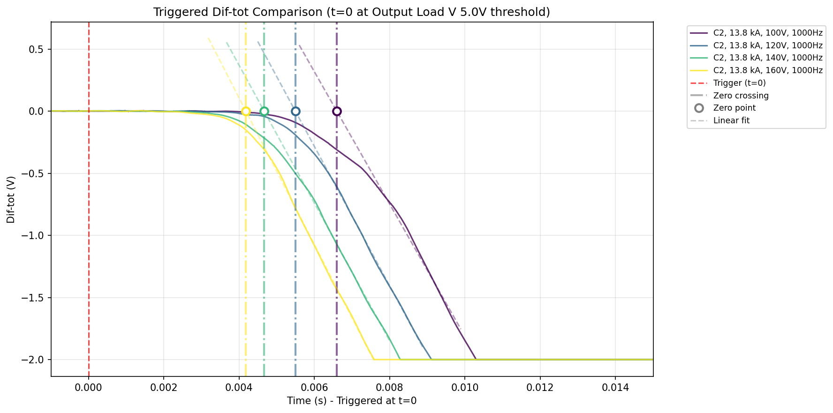
Zero-crossing time
Linear regression
Start point: 0.5 V
End point: +2.5 ms
Zero-point crossing for comparing simulation. Differential V observed earlier.
C2

Slide 18
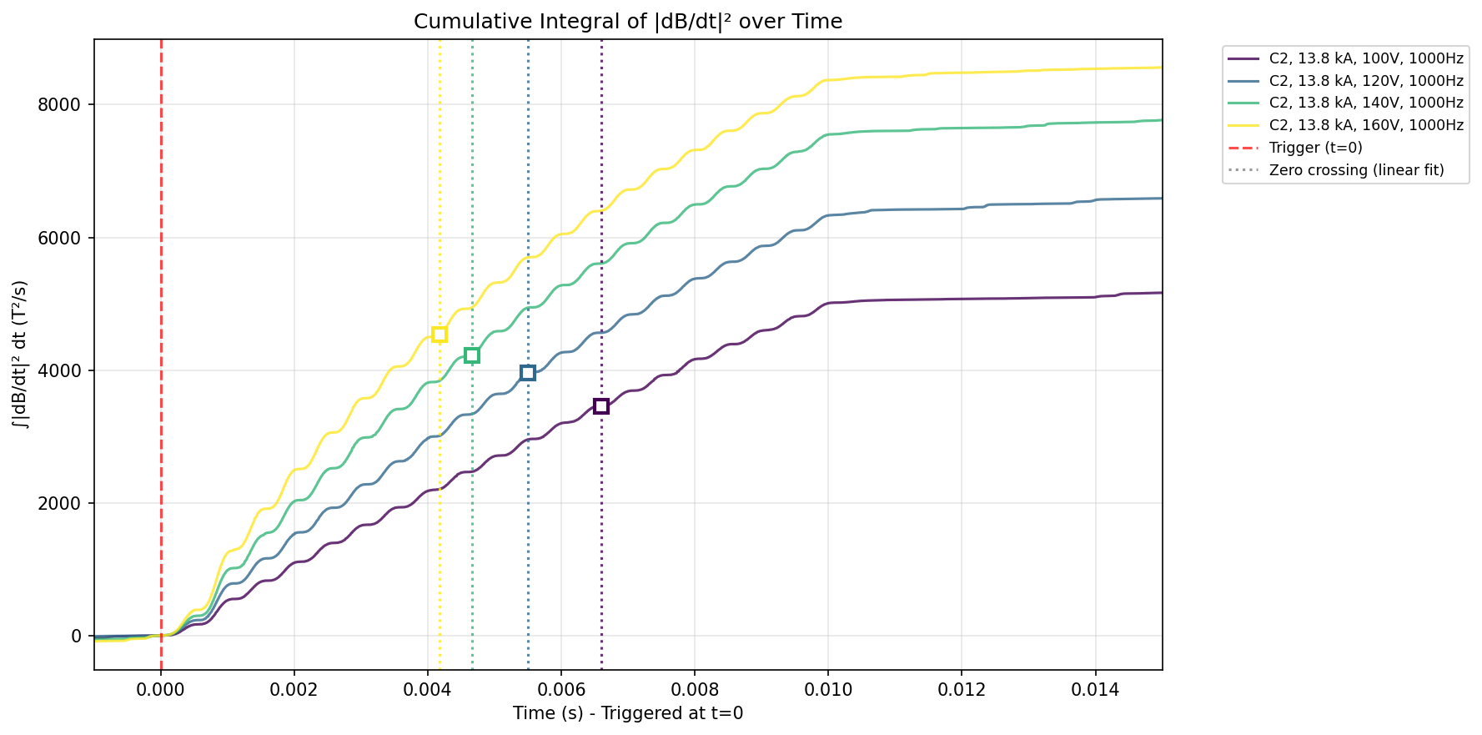
Integrated |dB/dt|²
C2
Integral of |dB/dt|² is associated coupling loss.
Hints that coupling loss is not a majority of the loss with the E-CLIQ coils in this position.

Slide 19
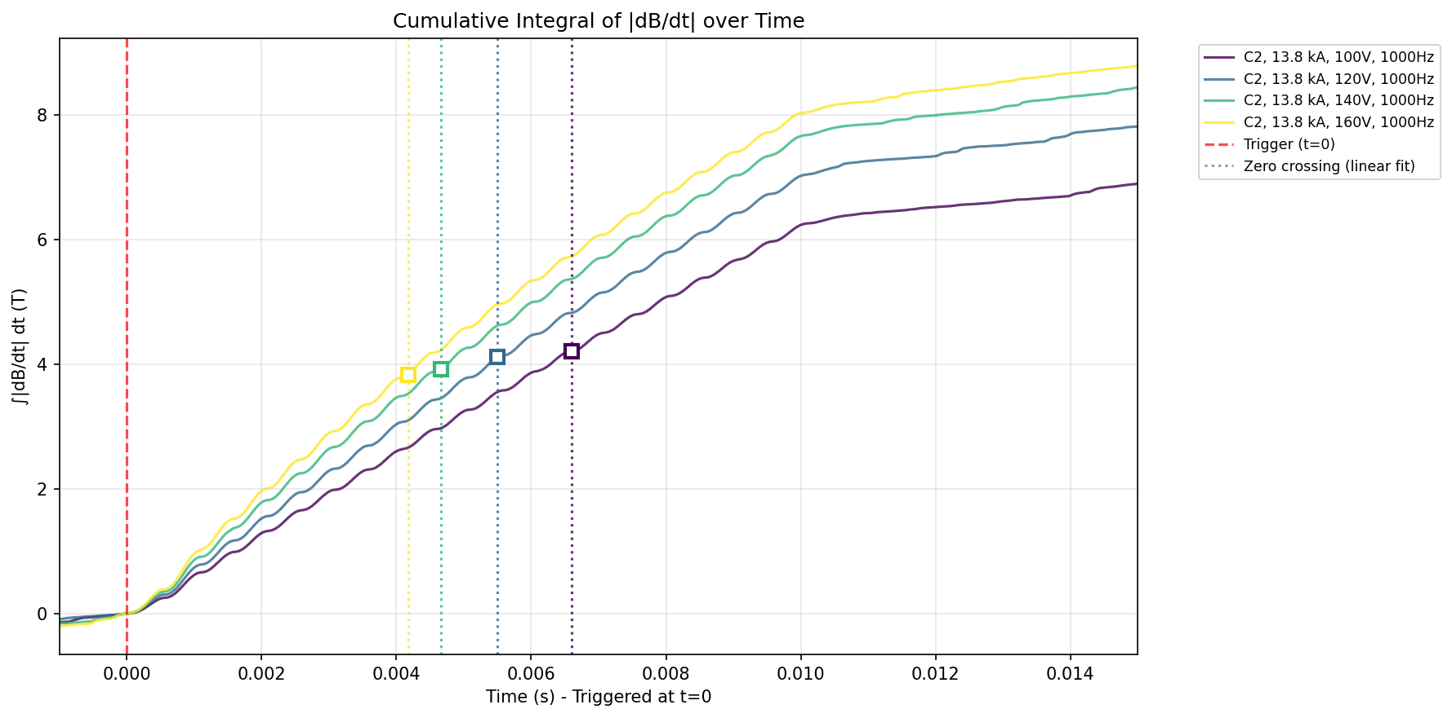
Integrated |dB/dt|
Slightly more energy needed due to outward heat flow.
C2
Integral of |dB/dt| is associated with hysteresis loss.
Hints hysteresis loss plays a role in this frequency range.

Slide 20
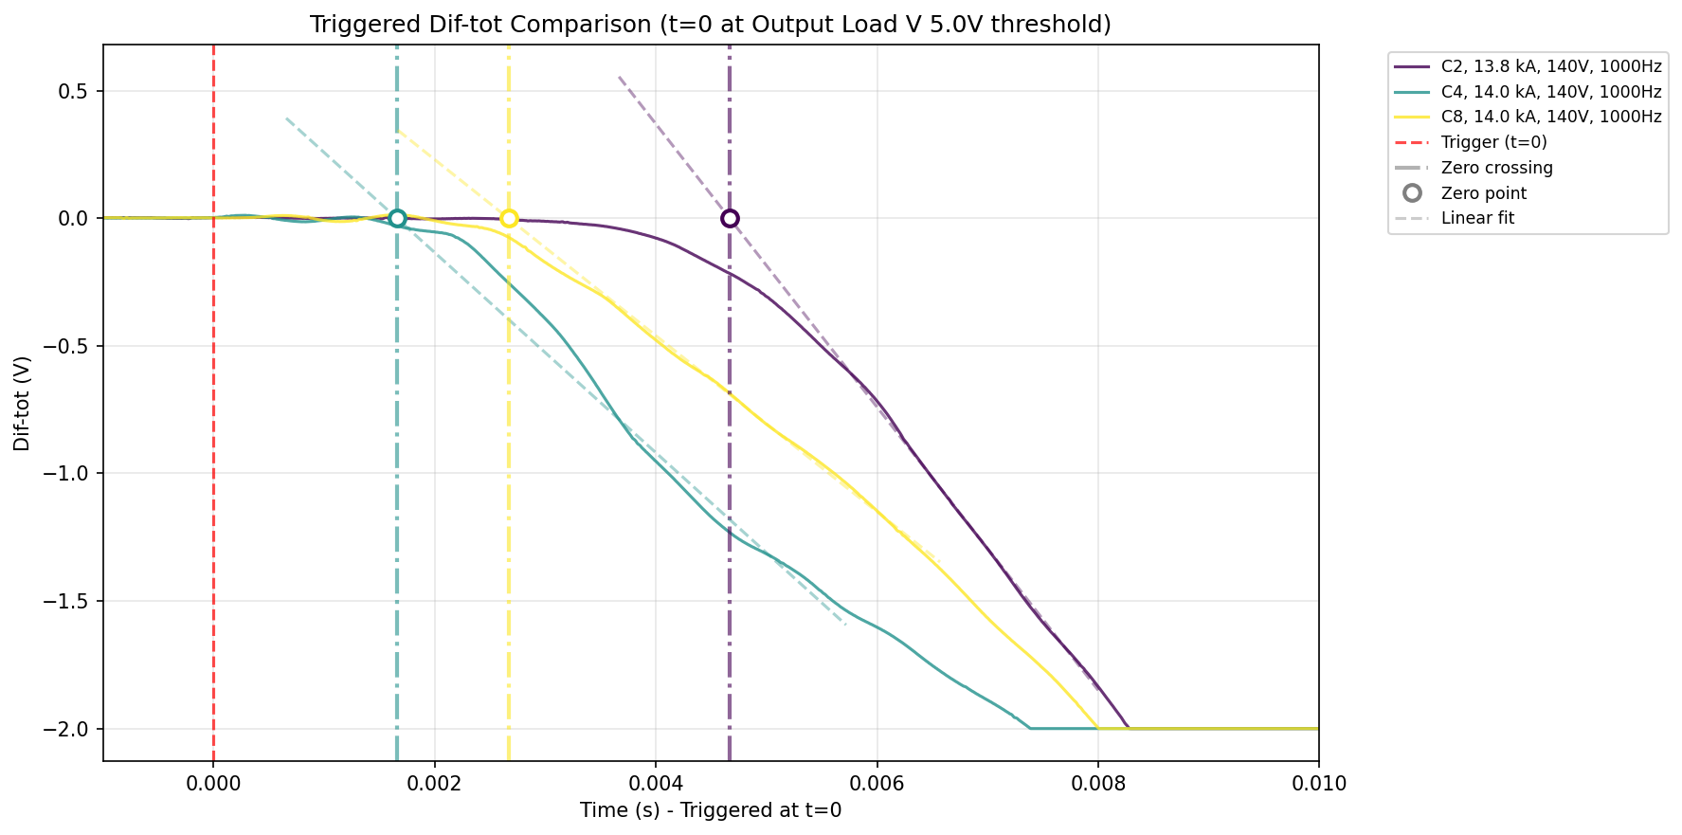
Comparison E-CLIQ positions
C4
C2
C8

Slide 21
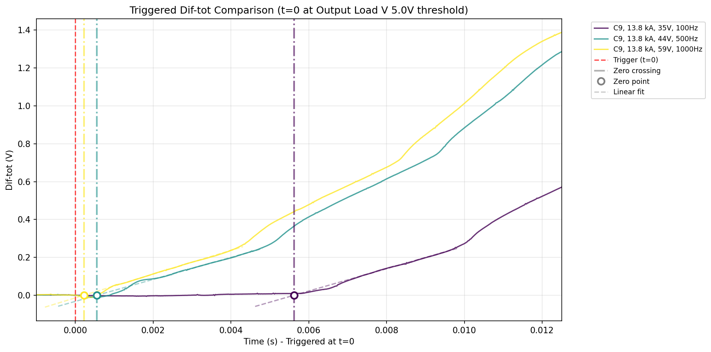
E-CLIQ from the previous test
C9

Slide 22
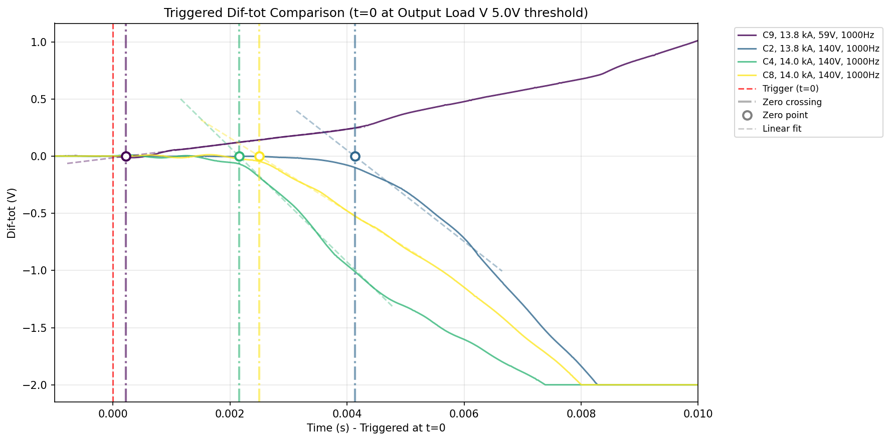
Normal zone size
Voltage slope at 13.8 kA:
C2: 550 V/s
C4: 350 V/s
C8: 300 V/s
C9: 120 V/s
C4
C2
C9
C8

Slide 23
Preliminary Measurement Conclusions
150 E-CLIQ tests were performed on two different SMCs during 3 campaigns
E-CLIQ in the bore hints main loss is hysteresis loss
E-CLIQ on the coil side also hints main loss is hysteresis loss
Fastest quench initiation: E-CLIQ in the bore < 1 ms
Fastest normal-zone growth: E-CLIQ on the coil sides
Quench down to 12 kA of magnet current within 8 ms after E-CLIQ activation.
Next:
Activation Energy, some numbers.
How does this compare to simulation?
AC loss simulation
Full magnet simulation

Slide 24
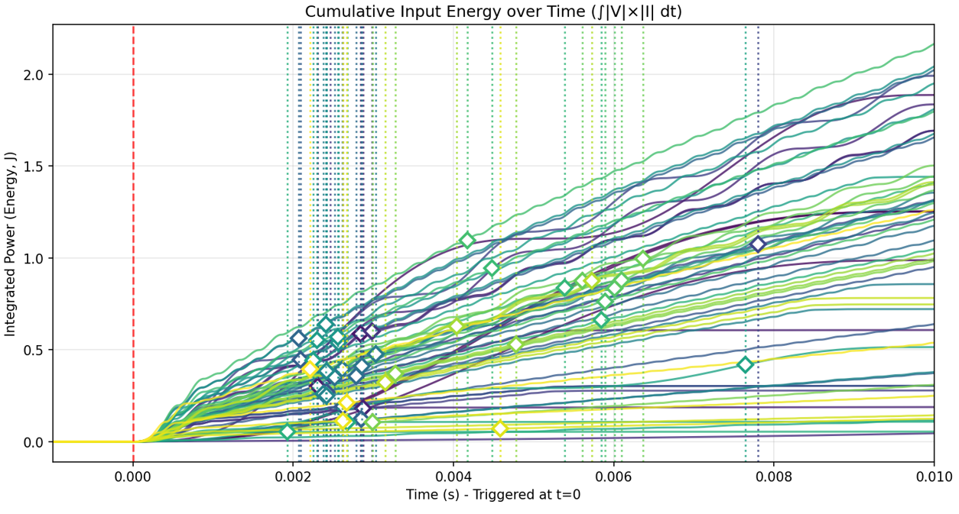
Energy needed
Most fast quench initiations < 1 J input energy

Slide 25
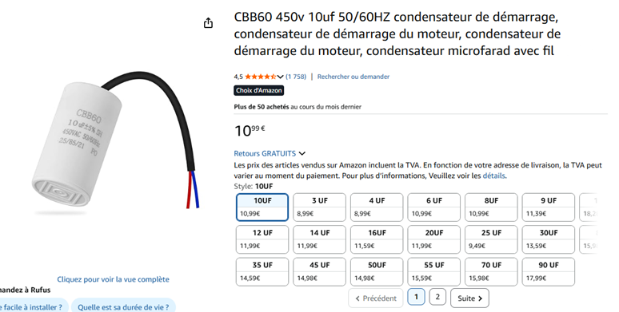
Some numbers
E-CLIQ frequency: 900 Hz.
Inductance 3.2 mH (inductance of the latest E-CLIQ coils).
900 Hz = 1 / (2π(C * 3.2 mH )^{0.5}) → C = 10 µF
E = 0.5 * 10 µF * (450 V)² = 1 J of stored energy.
Will these specific E-CLIQ coils work out of the box with such capacitor? → No
Protection circuit for a full-sized magnet multiple E-CLIQ coils would be connected in series.
Right ballpark of numbers, some modifications needed on the design, current and voltage requirements.

Slide 26

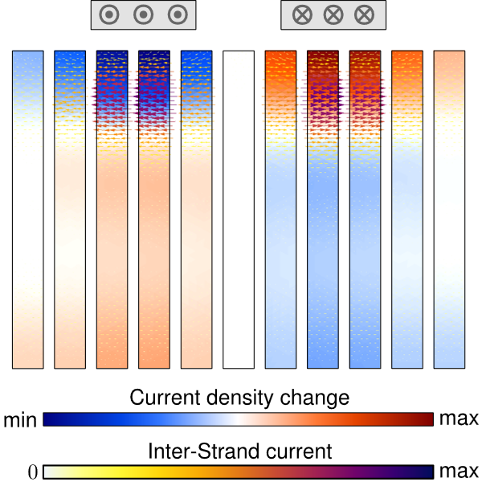
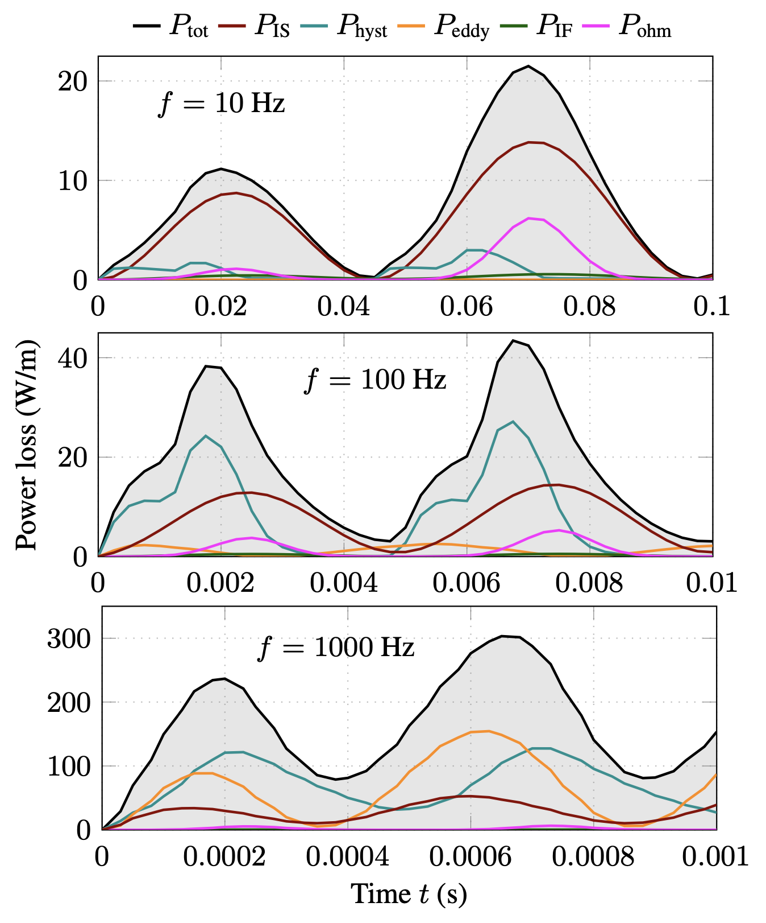
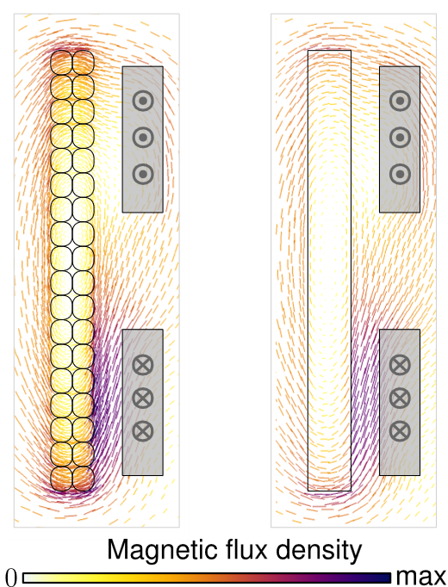
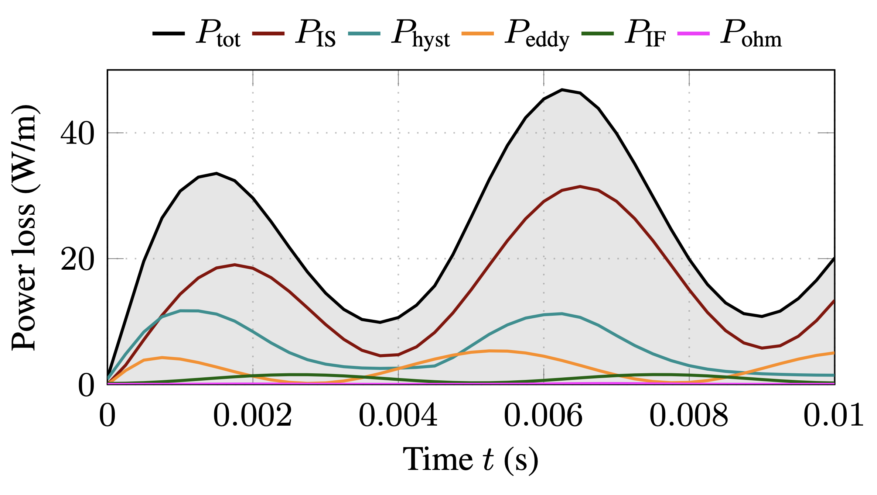

Finite Element Modelling - FiQuS
Excitation on SMC (preliminary results)
Cable homogenization accounting for all types of loss and magnetization: inter-strand (IS), inter-filament (IF), eddy, hysteresis, ohmic).
Assumption: 2D model (infinitely long E-CLIQ coil).
Homogenization
$f=100$ Hz
http://arxiv.org/abs/2510.24618
Dular et al., Distributed Inter-Strand Coupling Current Model for Finite Element Simulations of Rutherford Cables, 2025.

Slide 27
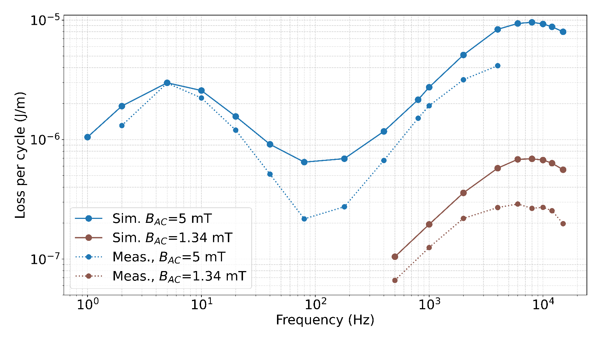
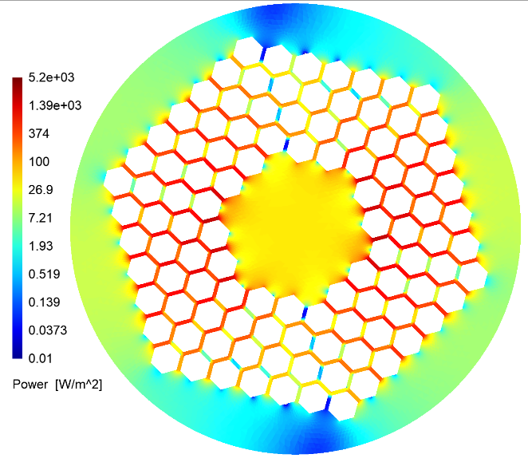
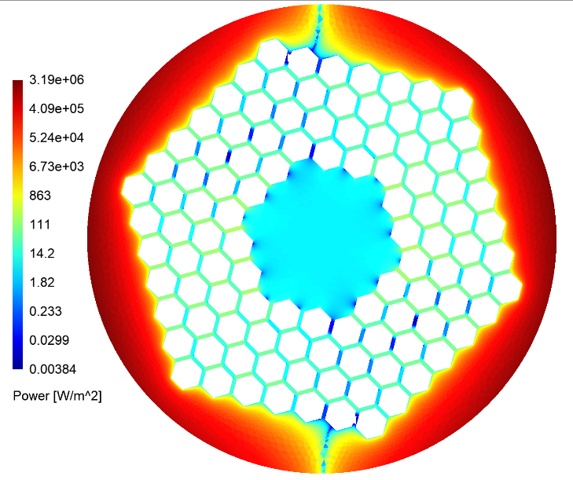
AC-Loss measurements
Slide from: M. Wozniak, AC Loss of Nb₃Sn Strands for High-Field Accelerator Magnets, presented at EUCAS 2025
RRR:
Core: 100
Interfila.: 100
Sheath: 100
ρ_{eff.} Nb:
5.1 10⁻⁸ Ω m
(10 x pure Nb)
Relatively good agreement. Note that the measured wire average RRR is 330

Slide 28
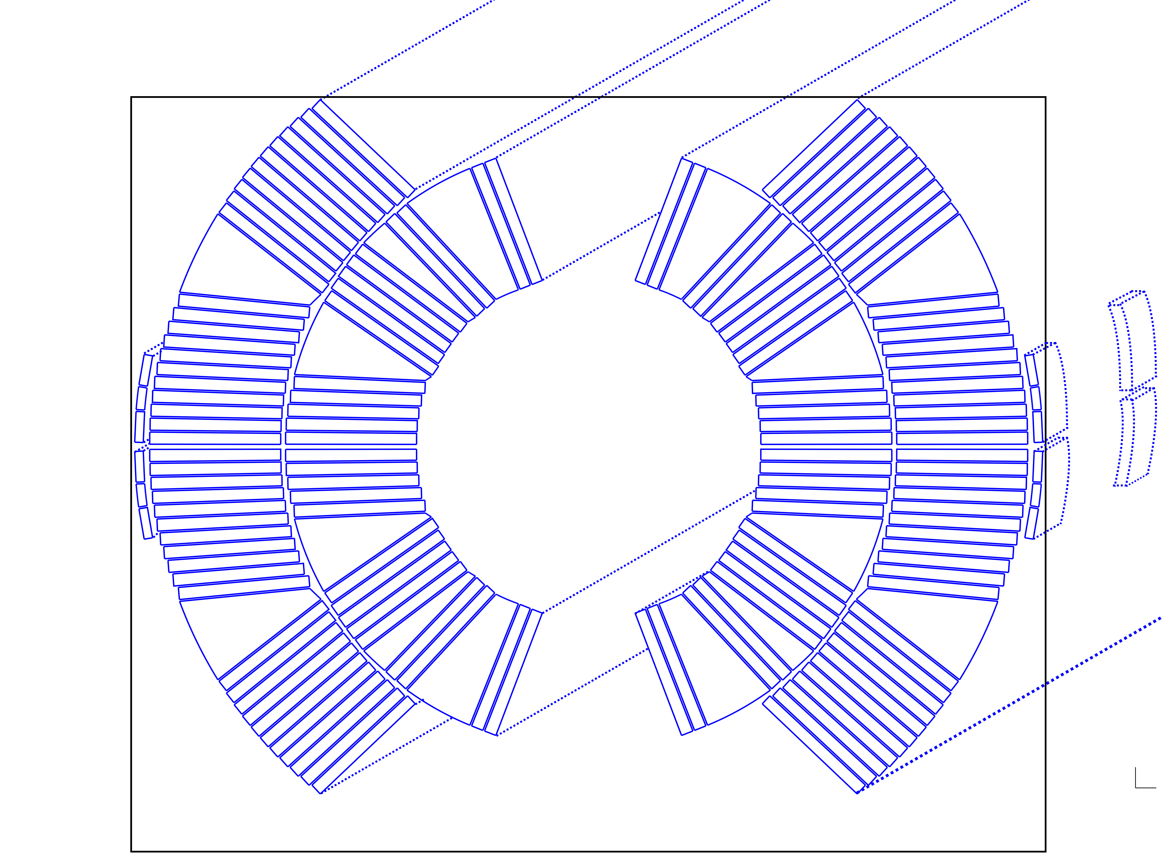
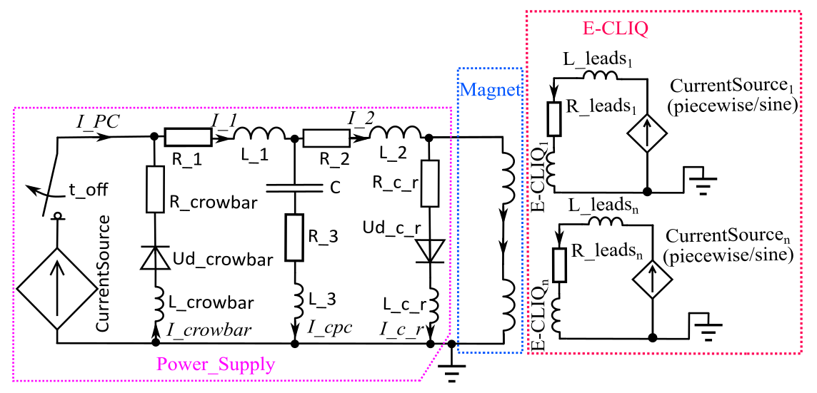

E-CLIQ implementation in FiQuS Multipole
Circuit schematic of powering and E-CLIQ coils in FiQuS
FalconD-C Nb₃Sn Cos-theta dipole model with E-CLIQ coils
Simulation capabilities:
2D Quasi-static electromagnetic simulation
2D+1D(Quench propagation) thermally-strongly coupled formulation
FE simulation with field-circuit coupling
AC loss model being implemented as we speak → full-scale magnets with E-CLIQ protection.
Block coil implementation soon → allows direct comparison against measured data.

Slide 29
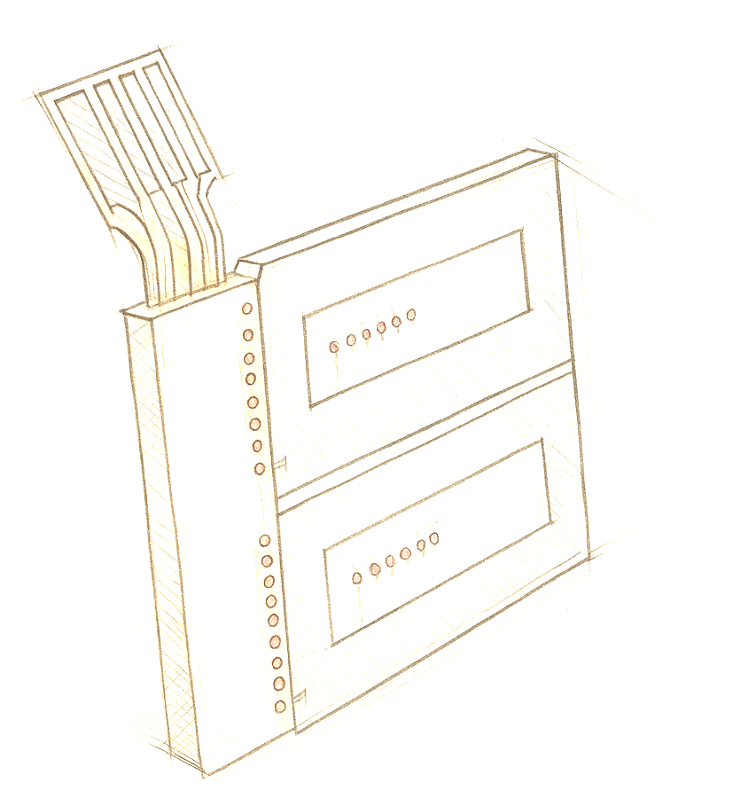
Summary and Outlook
Successfully demonstrated E-CLIQ as a method to initiate a quench an Nb₃Sn Short Model Coil:
  E-CLIQ on the broad side of the conductor: fast quench initiation.
  E-CLIQ on the narrow side of the conductor: fast normal zone growth.
Gathered significant amount of measurement data that can validated simulations tools and aid in the design of E-CLIQ protection circuits.
Next step is a lower inductance, higher current E-CLIQ design for a realistic full-scale magnet protection circuit.
New simulation tools allow evaluation of loss inside the conductor, placement options, E-CLIQ circuit variations and resulting transients inside of the magnets.

Slide 30
Questions?

