Slide 1
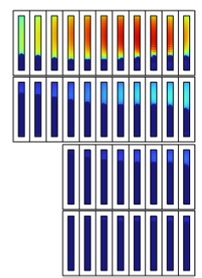
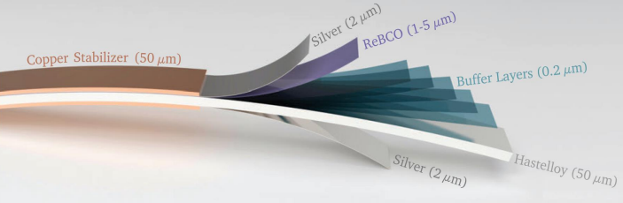
AC (ramp) losses in 14-20 T HTS accelerator dipoles: are they a problem?
Yes, for sure…
…but you get higher performance
Arjan Verweij, CERN – TE/MPE
With input from B. Auchmann, T. Mulder, J. van Nugteren,
P. Tavares Coutinho Borges de Sousa, D. Rinaldoni, D. Sotnikov, M. Wozniak

Slide 2
AC losses induced effects:
Increase of the global cryo power requirements
Increase of the temperature gradient in the coil, hence reducing temperature margin / stability
Increase of field distortions
Increase of current imbalance within the tape and between tapes, hence reducing stability
Note that for the LHC the effects of the AC-loss were mainly related to field errors,
which was mainly addressed by tuning and controlling:
the filament diameter (d_{fil}), to limit magnetisation loss
the inter-strand contact resistance (R_{c}), to limit inter-strand coupling loss
For HTS coils the situation is completely different…

Slide 3
AC losses depend on:
tape characteristics (geometry, J_{C}(B,T,angle), striation, inter-filament resistance)
conductor/cable layout (number of tapes, positioning of tapes, inter-tape resistance, …)
magnet design (turn positioning, alignment tapes with field, magnet ends layout, collar/yoke, …)
operating field
operating temperature
ramp conditions (ramp time, dI/dt(I) curve, …)
Calculating the AC (ramp) losses in 14-20 T HTS accelerator magnets is at the moment very premature, since the type of tape/cable/magnet is not yet defined.
Furthermore, even if AC induced effects cannot be sufficiently reduced, then there are still options to (partially) mitigate the consequences.

Slide 4
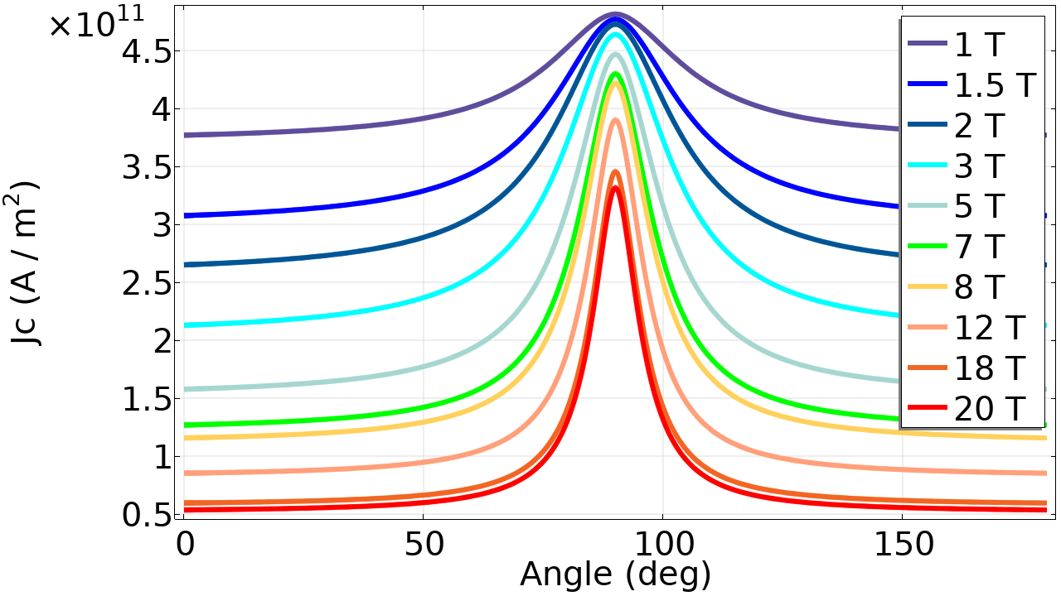
Case study:
14 T / 20 K HTS block dipole for which the AC (or ramp) losses were estimated by people from different Labs, and discussed in the HTS modeling WG (https://indico.cern.ch/event/1467688/)
Tape:
12 mm x 70 μm (2 um REBCO, 8 μm buffer layer, 40 μm substrate, 2x10 μm copper cladding)
J_{C}(B,T,angle) as in plot
Cable:
non-twisted tape-stack with 15 tapes
tapes soldered together with 20 μm thick layer
copper stabilizer
12 mm
1.35 mm
4.28 mm
14 mm

Slide 5
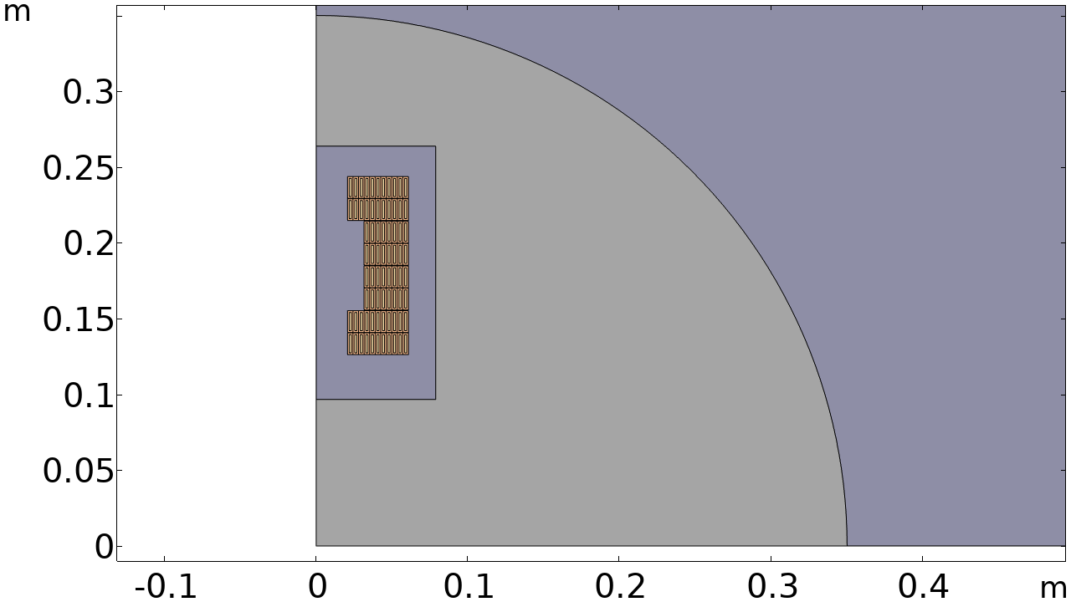
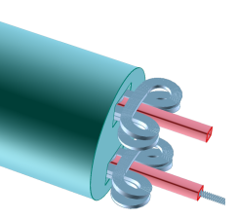
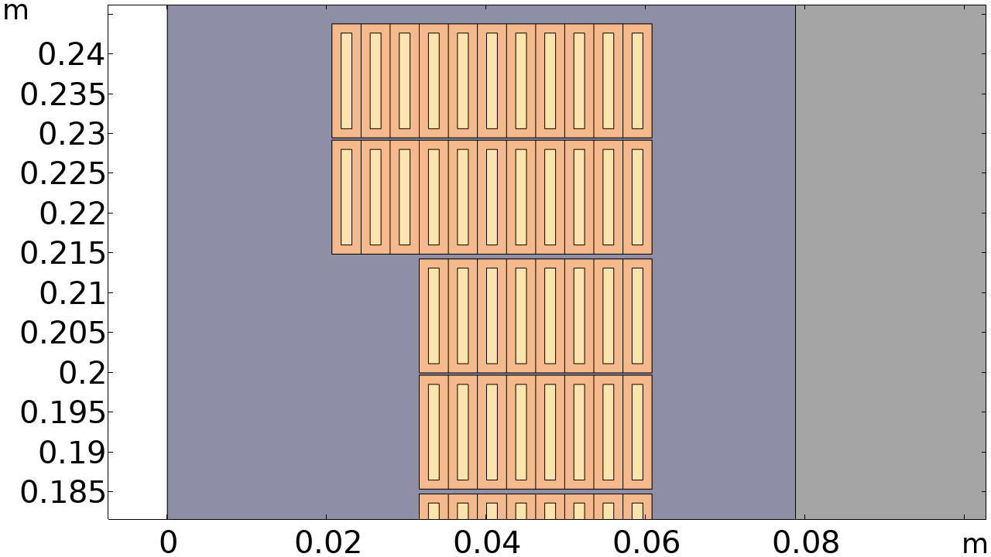
Block dipole magnet:
I_{op}=27850 A
I_{op}/I_{C}=80% (without current sharing)
B_{ce}=14 T
Magnet straight section=14 m
Ramp in 1200 s (similar as LHC) from 10%∙I_{op} to 100%∙I_{op}
B
Cloverleaf coil-ends

Slide 6
Coil ramp losses derived with different simulation codes for this 14 T dipole
Reference: 3rd HTS modeling WG (24/10/24): https://indico.cern.ch/event/1467688/
T [K] | Conductor | Sim. by | Q_{ramp} [kJ/m/cycle] * | P_{ramp} [W/m] *
20 | Non-insulated tapes | PSI | 62 | 26
20 | Non-insulated tapes | INFN | 68 | 28
20 | Insulated tapes | CERN | 21 | 9
20 | Non-insulated tapes | PSI/LBE | 46 | 19
4.5 | Non-insulated tapes | PSI/LBE | 40 | 17
* given per m of magnet length for a twin aperture 14 T dipole, not considering the first virgin cycle
AC losses in other metallic parts are much smaller and neglected.
For the moment let’s assume ramp losses of 50 kJ/m/cycle
PS: Ramp losses for the HTS@4.5K option are about 15% smaller (even though J_{C} is a bit larger) because the coil is more compact.

Slide 7
Comparison between FCC-HTS, FCC-Nb₃Sn and LHC-NbTi
P_{ramp,elec} and P_{ramp,FCC} are the required installed electrical powers (per m and for the entire FCC) for cooling.
Accel. | T [K] | Conductor | P_{ramp}* [W/m] | 1/COP_{real} *** [W/W] | P_{ramp,elec}* [W/m] | P_{ramp,FCC} [MW]
FCC, 90 km, 14 T | 4.5 | HTS | 13 | 230 | 3100 | 235
 | 20 | HTS | 17 | 50 | 830 | 64
 | 4.5 | Nb₃Sn | 3.3 ** | 230 | 765 | 59
 | 1.9 | Nb₃Sn | 3.3 ** | 830 | 2760 | 213 *****
LHC, 27 km, 8.4 T | 1.9 | Nb-Ti | 0.3 | 830 | 250 | 5 ****
* Values given per m of arc length in the tunnel
** Target value based on 10 kJ/m/cycle. Note that the actual Nb₃Sn conductor would give about 20 kJ/m/cycle.
Using Artificial Pinning Centres might reduce J_{C} at lower fields. Hybrid Nb3Sn/Nb-Ti magnets might also reduce the losses.
*** COP=Coeff of Performance (strongly temperature dependent). These are realistic values for a future large collider.
**** This represents about 10% of the total cryo power for the LHC (about 40 MW).
***** In line with TE-CRG estimate [see L. Delprat https://edms.cern.ch/document/3352224/1 ]

Slide 8
Ramp losses as compared to other losses
Values given per m of arc length in the tunnel
 |  | Static and dynamic losses at 40-60 K |  |  | Static and dynamic losses at low T |  |  | Ramp losses at low T |  |  | Total
T [K] | Conductor | P_{BS} [W/m] | P_{BS,elec} [W/m] | P_{BS,FCC} [MW] | P_{SD} [W/m] | P_{SD,elec} [W/m] | P_{SD,FCC} [MW] | P_{ramp} [W/m] | P_{ramp,elec} [W/m] | P_{ramp,FCC} [MW] | P_{tot,FCC} [MW]
4.5 | HTS | 43 | 540 | 42 | 1.4 | 320 | 24 | 13 | 3100 | 235 | 301
20 | HTS | 43 | 540 | 42 | 1.4 | 66 | 5 | 17 | 830 | 64 | 111
4.5 | Nb₃Sn | 43 | 540 | 42 | 1.4 | 320 | 24 | 3.3 | 765 | 59 | 125
1.9 | Nb₃Sn | 43 | 540 | 42 | 1.4 | 1140 | 88 | 3.3 | 2760 | 213 | 343
HTS@4.5K: probably not the right way to go
HTS@20K and Nb₃Sn@4.5K: seems acceptable.
Nb₃Sn@1.9K: very large P_{ramp,FCC} but could still be feasible with “heat buffering” (see slide 11).

Slide 9
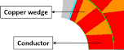
Heat extraction from the coil
As a first rough estimate I assume a single turn with heat flow via the thin cable edge.
 | Nb₃Sn | HTS
Insulation | 0.1 mm CTD101K | 0.5 mm Kapton
k | 0.045 W/K/m @ 4.5 K | 0.05 W/K/m @ 20 K
Average AC loss per turn | 5.5 mW/m | 70 mW/m
Assumed max AC loss in most exposed turn at end of ramp to 14 T | 10 mW/m | 500 mW/m *
Cooling surface | 1.5 mm x 1 m | 4.28 mm x 1 m
Resulting DT | 15 mK | 1.2 K
* Loss is maximum at the end of the ramp and strongly concentrated in ‘upper deck’

Slide 10
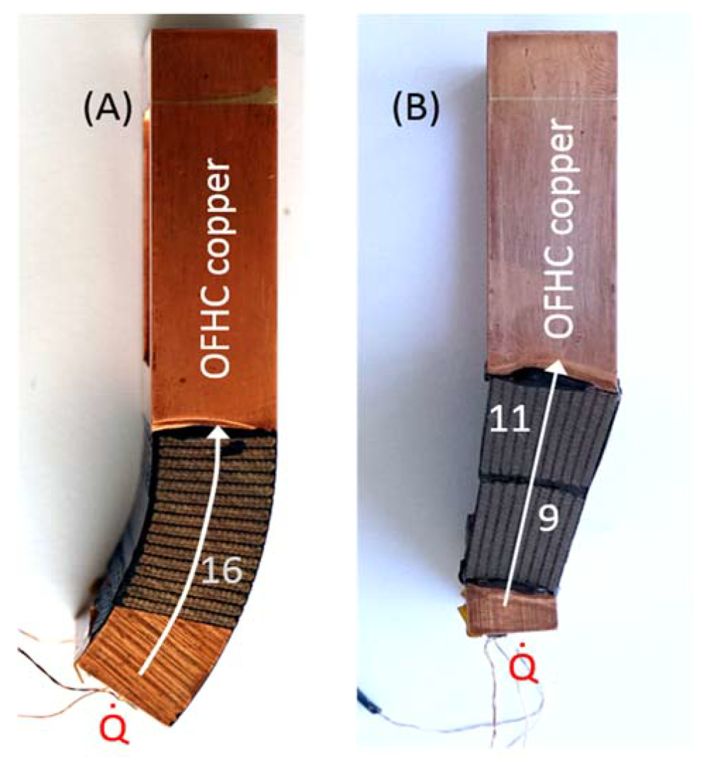
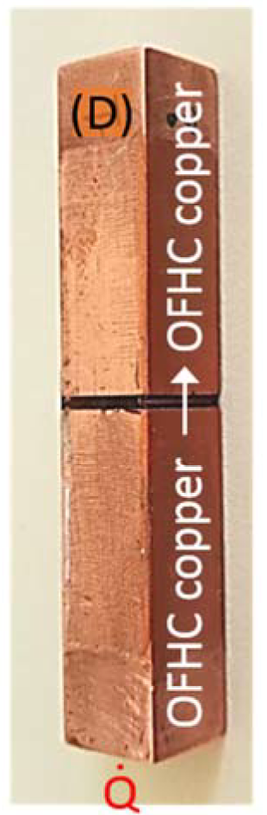
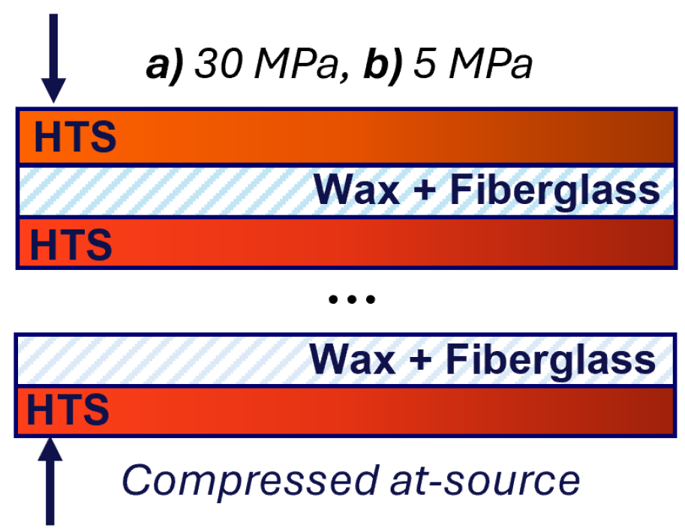
Heat extraction from the coil
P. Tavares Coutinho Borges de Sousa & CERN Cryolab
Thermal conductivity measurements on Nb₃Sn and HTS samples at CERN cryolab.
Nb₃Sn in 2 directions
CTD101K
HTS layers
A proper 3D electro-thermo-magnetic transient simulation of the magnet, is then needed to obtain the temperature distribution in a coil during a ramp.

Slide 11
Heat buffering: Nb₃Sn @ 1.9 K
Ramping losses occur only for a few hours per day, so the average cryo requirements could be much smaller if (part of) these losses could be buffered.
Of course, this only works if there is sufficiently good heat extraction from the coils (see before).
Ramp losses: about 1200 s*3.3 W/m=4000 J per meter of tunnel.
At 1.9 K, heat buffering should mainly come from the superfluid helium.
We can use the enthalpy of helium between 1.9 to 2.1 K, equal to 168 J/liter, to buffer the ramp losses.
This then requires 4000/168=24 liter of helium per meter.
Assuming that we ramp about 4 hrs per day, the effective ramp losses can be reduced to about 40 MW.
Heat buffering at 4.5 K is also possible but requires subcooled helium.
 |  | Ramp losses at low T |  |  | Total
T [K] | Conductor | P_{ramp} [W/m] | P_{ramp,elec} [W/m] | P_{ramp,FCC} [MW] | P_{tot,FCC} [MW]
4.5 | HTS | 13 | 3100 | 235 | 301
20 | HTS | 17 | 830 | 64 | 111
4.5 | Nb₃Sn | 3.3 | 765 | 59 | 125
1.9 | Nb₃Sn | 3.3 | 2760 | 213→40 | 343→170

Slide 12
Heat buffering: HTS @ 20 K
Ramp losses: about 1200 s*21 W/m=25 kJ per m of magnet.
At 20 K, heat buffering should mainly come from metallic magnet components.
Of course, this only works if there is sufficiently good heat extraction from the coils and small temperature gradient in the metal.
Assuming:
1500 kg of metal per meter,
allowed temperature increase during the ramp of 2 K,
Cp=5 J/K/kg,
then we can buffer: 1500*5*2=15 kJ.
The effective ramp losses can therefor
be reduced to about 26 MW.
 |  | Ramp losses at low T |  |  | Total
T [K] | Conductor | P_{ramp} [W/m] | P_{ramp,elec} [W/m] | P_{ramp,FCC} [MW] | P_{tot,FCC} [MW]
4.5 | HTS | 13 | 3100 | 235 | 301
20 | HTS | 17 | 830 | 64→26 | 111→73
4.5 | Nb₃Sn | 3.3 | 765 | 59 | 125
1.9 | Nb₃Sn | 3.3 | 2760 | 213→40 | 343→170

Slide 13

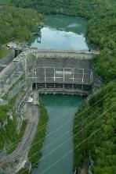
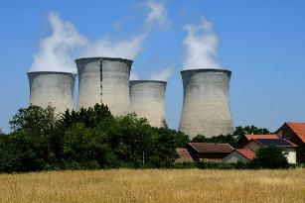
Putting 100 MW into perspective
Consumption:
100 MW is the average consumption of 50’000-100’000 households
Actual CERN consumption is 150 MW average or 1.3 TWh per year (=1/3 of Geneva)
Production:
1 km² full of solar panels: about 30 MW
The Genissiat hydro-electric plant: on average 200 MW
A large nuclear power plant: about 1 GW
Cost:
The yearly cost of an average 100 MW (for CERN, assuming 50 CHF/MWh) is 44 MCHF.
20 years of operation with an average 100 MW would cost 880 MCH (<2% of the construction cost of the FCC + operational cost during 20 years).
It is clear that any R&D aimed at reducing AC loss would certainly pay off.

Slide 14
Losses for higher fields
HFM-PUB-RPT-0267 v.1 "Deliverables KE5943 / PSI-D2.1”, EDMS 3028682 (J. van Nugteren, B. Auchmann, D. Sotnikov)
 |  | Static and dynamic losses at 40-60 K |  | Static and dynamic losses at low T |  | Ramp losses at low T |  | Total
B [T] | Conductor | P_{BS} [W/m] | P_{BS,FCC} [MW] | P_{SD} [W/m] | P_{SD,FCC} [MW] | P_{ramp} [W/m] | P_{ramp,FCC} [MW] | P_{tot,FCC} [MW]
14 | HTS | 43 | 42 | 1.4 | 5.1 | 17 | 64 (→26) | 111 (→73)
16 | HTS | 65 | 63 | 1.4 | 5.2 | 31 | 116 (→60) | 184 (→128)
18 | HTS | 97 | 94 | 1.5 | 5.4 | 55 | 204 (→120) | 303 (→219)
20 | HTS | 142 | 137 | 1.5 | 5.6 | 91 | 337 (→230) | 480 (→373)
Losses at 40-60 K (dominated by synchr. radiation) scale by about B⁴
Ramp losses scale by about B⁴-B⁵
There is certainly room for higher fields, especially if heat buffering is possible (values between brackets) and/or ramp losses can be reduced. One could also operate an accelerator a few months/year at –for example- 18 T and the rest of the year at 14 T.

Slide 15
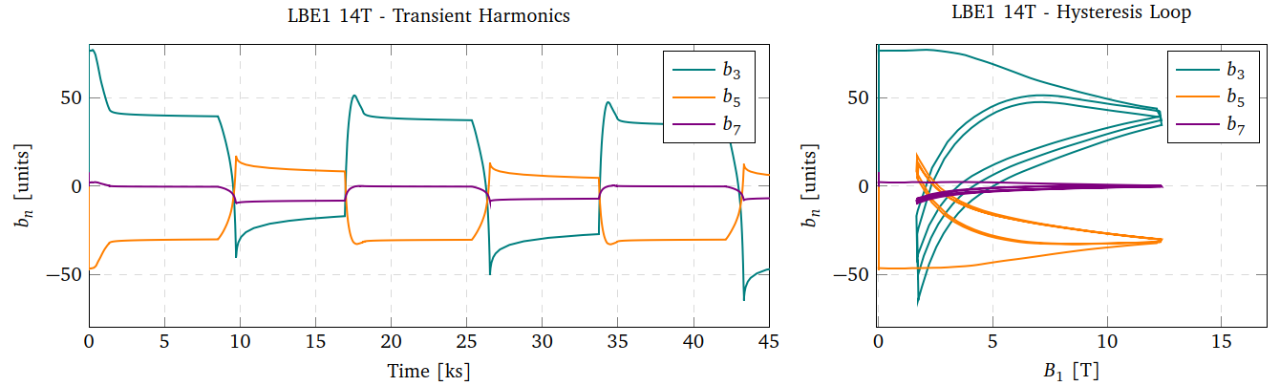
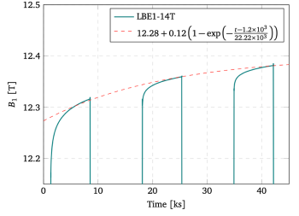
Field distortions
HFM-PUB-RPT-0267 v.1 "Deliverables KE5943 / PSI-D2.1”, EDMS 3028682 (J. van Nugteren, B. Auchmann, D. Sotnikov)
Field distortions are about (difference current plateaus):
b3: 60 units
b5: 20 units
b7: 10 units
and not always reproducible….
Large drift in dipole field, order of 0.1%/hr

Slide 16
Sum-up
Ramp losses have been studied for a specific case, namely a 14-T HTS block coil with stacked untwisted tapes. Simulations show significant AC loss induced effects:
Increase of the global cryo power requirements
Increase of the temperature gradient in the coil, hence reducing stability
Increase of field distortions
There are certainly possibilities to reduce the losses (smaller tapes, striation, smaller ramp rate, coil design, …), but, the calculated losses might also be much underestimated, especially due to 3D effects related to the non-twisted tapes.
AC losses in 14-20 T HTS accelerator dipoles: are they a problem?
Yes, for sure… but you get higher performance [today, slide 1]
Yes, it is a problem, but first rough estimates indicate that it is not a show-stopper [today, slides 9, 12, 15]
Yes, but we can correctly quantify them and -despite their presence- we can operate an accelerator [hopefully for a future HiTAT]

Slide 17
Required R&D
AC loss, stability, current sharing, thermodynamics, and quench protection are all closely related phenomena.
These were studied for 10s of years for LTS. Understanding and optimization of ReBCO for use in high-field FCC-hh accelerator magnets requires a lot of structured R&D (on top of R&D related to mechanical requirements, delamination, stress/strain etc):
1. Tape R&D
Optimum tape characteristics
Is striation needed? If so, how to tune/control the inter-filament resistance?
2. Cable R&D
Development of several multi-tape cable types (order 10 kA), key to wind high-field accelerator magnets.
Do we need twisting and/or transposition? [see also talk A. Ballarino]
Do AC loss and stability depend on the magnet length, especially for non-twisted cables?
How to tune/control the inter-tape resistance to obtain a good balance between stability and coupling loss?
How much copper is needed for stability [nice paper: https://doi.org/10.1109/TASC.2025.3532246] and protection?
3. Magnet and accelerator R&D
Coil/magnet design (block/common-coil/…, grading, operating current, tape alignment)
What field errors can be tolerated to run the FCC with stable beams? (reproducibility is key)
Do we need quench protection?

Slide 18
Required R&D
4. Simulation of AC losses and stability
Further development of electro-magneto-thermal tools (at CERN/TE-MPE we plan to have several validated 3D codes of a full HTS coil by next year)
Correct implementation of all physics (3D-effects, anisotropy, twisting, …)
Validation/agreement with experiments
Speed-up of the models (e.g. homogenisation)
5. Experimental work & validation with simulations
Magnetization/loss/stability measurements on single tapes and cables (!!!), at various [B, T, α], and for different lengths
Measurement of inter-tape resistance
Measurement of loss and field-errors on pancakes and racetracks
6. Cryo R&D
Can we operate at 20 K, with sufficiently small thermal gradients over the magnet cross-section, along the magnet length, and along an entire string of magnets?
Do we need cooling channels (forced flow) or cooling fins?
How to buffer the ramp losses in most efficient way?

