Slide 1

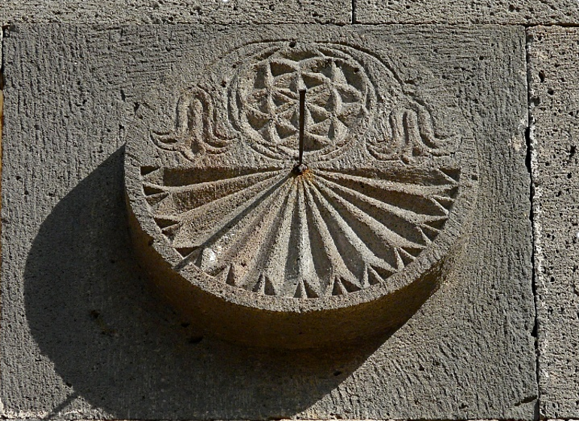
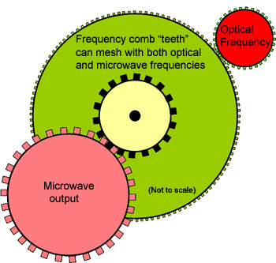


Radio Frequency Timer: Test Studies with the Silver Photocathode
Simon Zhamkochyan
For RF Timer Collaboration
Notes:
1
1
A. Margaryan, YerPhI RICH-2007 October 20

Slide 2
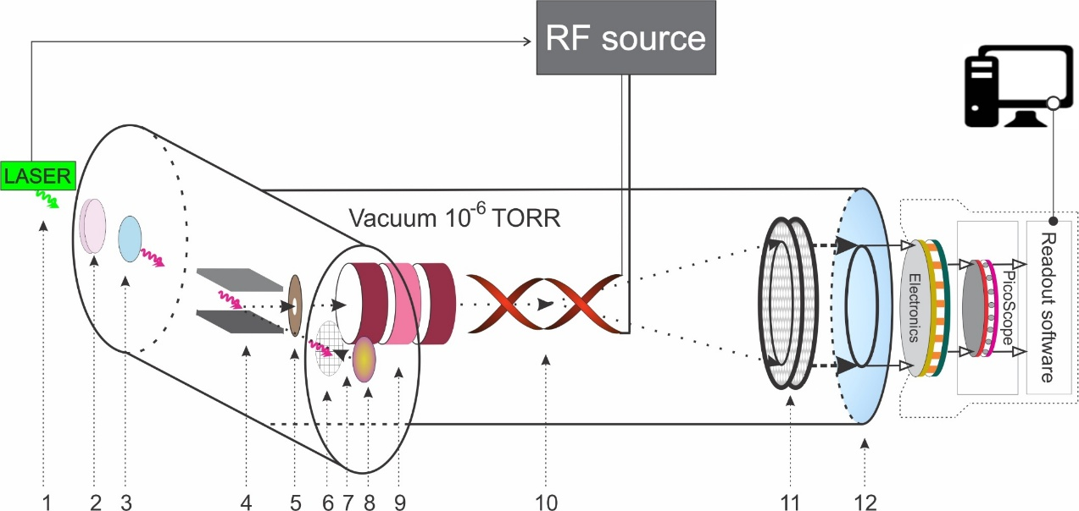
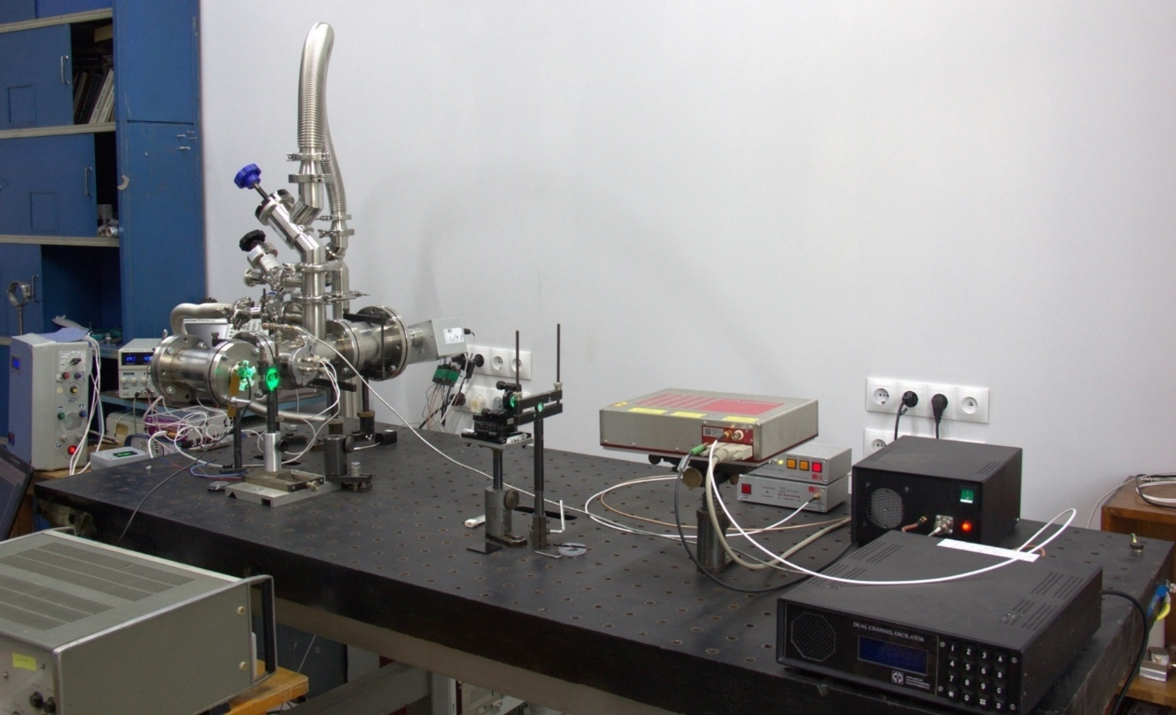
Time Resolved Photo-Electron Detection System
RF generator/synthesizer
500 -1000 MHz
RF Timer
fs Laser
RF amplifier
1-laser photon pulse; 2-nonlinear crystal; 3-quartz window; 4-magnet; 5-collimator; 6-accelerating electrode; 7-photoelectron; 8-photocathode; 9-electrostatic lens; 10-RF deflector; 11-MCP detector; 12- delay line anode
Laser: NKT ORIGAMI; Repetition rate: 40 MHz; Wavelength: 515.4 nm, halved to 257.7 nm; Photon bunch length: 166 fs
RF Source includes low pass filter, RF generator, RF synthesizer and RF amplifier
Photocathode: a thin gold layer, deposited on a Mylar

Slide 3
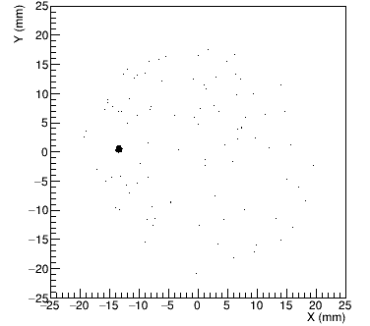
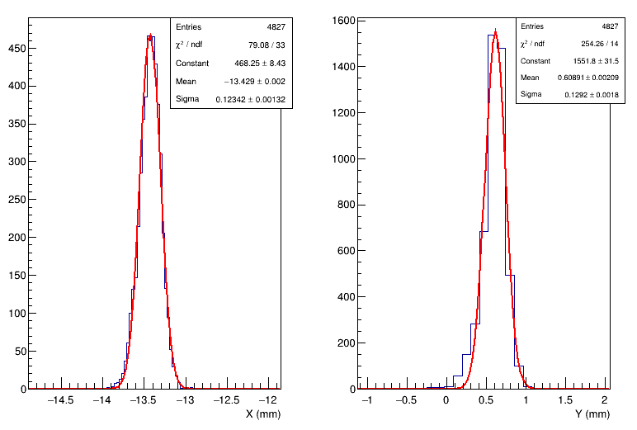
Focusing mode (no RF applied)
The photoelectrons can be focused to ~120 µm spot at any point of the PSD area.

Slide 4
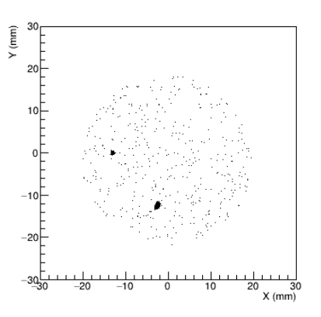
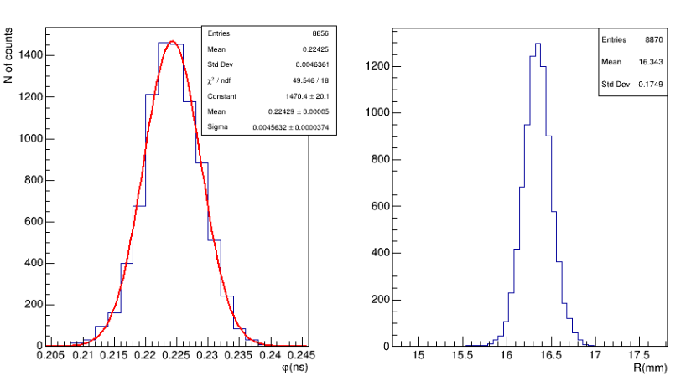
Time measurements at 480 MHz scanning frequency
A total time resolution of ~4.5 ps was measured at 480 MHz scanning frequency

Slide 5
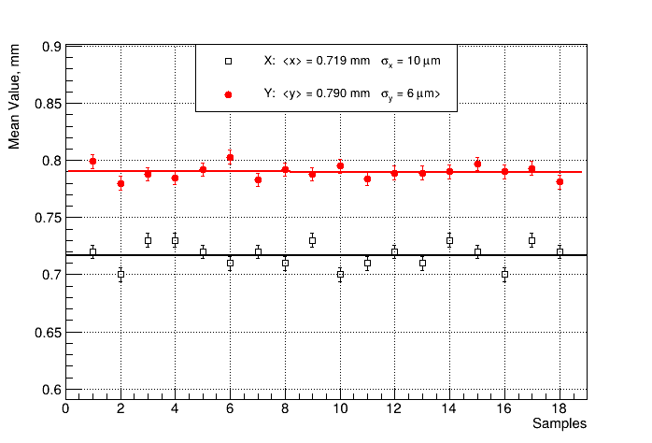
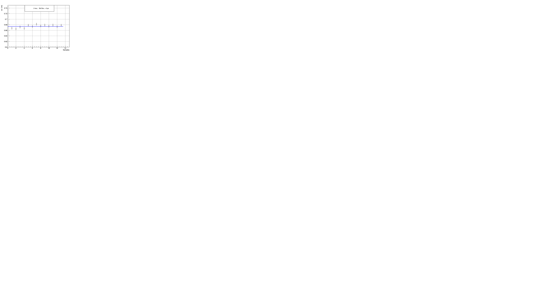
Stability
Focus mode (no RF)
Time measurements with 480 MHz RF
Coordinate stability of ~10 μm/hour in focus mode corresponds to ~200 fs/hour in time units.
The main instability component comes from laser and RF synchronization, and is less than few ps/hour.
Short term stability is less than 200 fs/min.

