Slide 1
BGC regular meeting
09/15/2025
D. Butti

Slide 2

Introduction
UV fluorescence lines involve ionic transitions Ne⁺, which “feel” the beam field and drift before emitting light
→ the distribution of the emitters is broader than the distribution of the beam (i.e. space-charge effect)
Space-charge needs to be considered when retrieving beam size with UV configuration
→ so far, semi-empirical approach: we included space-charge in the resolution term derived from the visible configuration which only involves neutral transitions Ne* (i.e. self-calibration)
Dedicated code(s) exist to independently simulate space-charge effects in BIFs (i.e. BGC) and IPMs (i.e. BGI)
→ perform simulations to fill this gap and find evidence of what observed experimentally… hopefully.
Started with the most common and user friendly Virtual-IPM
Warning: I’ve bee using this code for < 2 weeks, take all the following as very preliminary and open to discussion!

Slide 3
Initial conditions

Slide 4


General parameters
1.2 ns σ
25 ns
Using the built-in model for bunched Gaussian beams with circular buffer to simulate an infinite train of LHC bunches (i.e. no gaps)
circular train
So far, only protons at injection (450 GeV) and flat-top (6800 GeV) considered.
Evolution in energy ramp and ion beams next in the pipeline.
Only neon (M=20.18 u.a.) considered. Main interest for Ne⁺ (UV fluorescence) but simulations with neutral Ne (VIS fluorescence) performed for crosscheck, with lifetimes of 6 ns and16 ns respectively.
Typical simulation time is 100 ns, in 10⁴ time steps.
Using built-in model for gas jet, characterized by thermal motion in 3 directions and net velocity along jet direction
$$v_{y}=v_{jet}+v_{thermal}(T)$$
$$v_{y,z}=v_{thermal}(T)$$

Slide 5
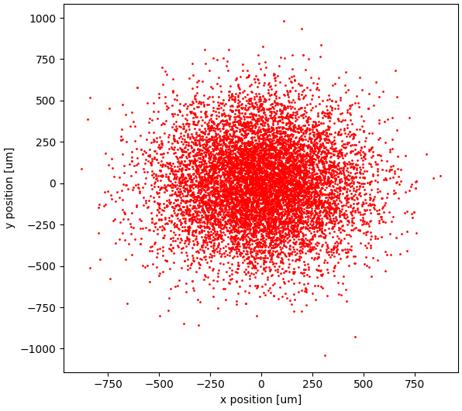
Position distribution of emitting species
Using the built-in model for gas jet, species are generated with the same transverse distribution as the beam.
Typical simulation 10⁵ particles
Round beams assumed so far (not bad approximation for LHC)
Curtain is purely 1D, i.e. XY, Z=0. Actual 3D jet distribution will require custom input coordinates

Slide 6
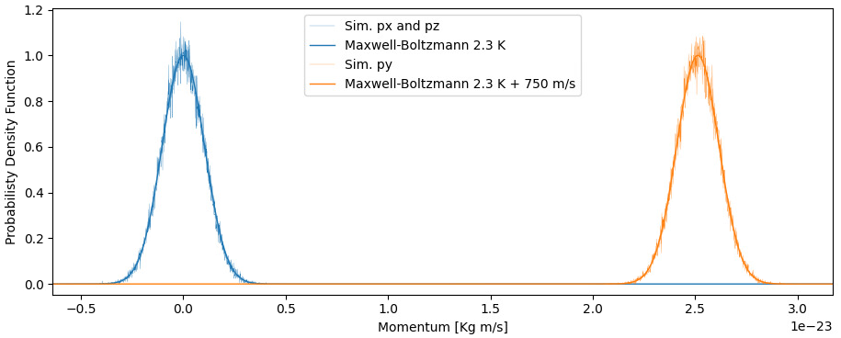
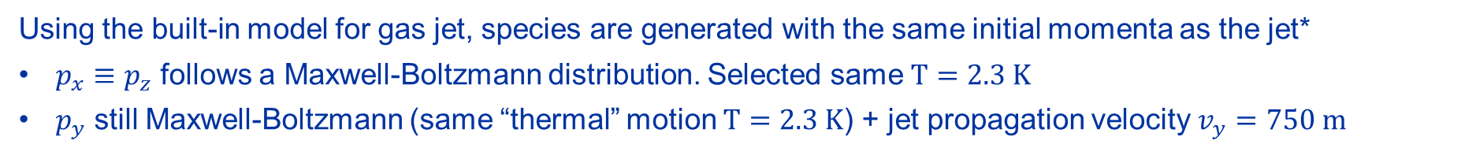
Momenta distribution of emitting species
Using the built-in model for gas jet, species are generated with the same initial momenta as the jet*
$p_{x}≡p_{z}$ follows a Maxwell-Boltzmann distribution. Selected same $T=2.3 K$
$p_{y}$ still Maxwell-Boltzmann (same “thermal” motion $T=2.3 K$) + jet propagation velocity $v_{y}=750 m$
Momentum distributions created by
Virtual-IPM compared to theoretical models described above
*gas dynamics numbers from Oliver’s input (TBC if still valid in present setup).

Slide 7
Particle tracking

Slide 8

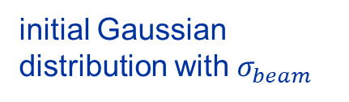
Assessing profile broadening
Goal of these simulations is to assess the profile broadening due to drift of emitting species between location of beam interaction and fluorescence emission.
particle tracking
initial Gaussian distribution with $σ_{beam}$
distribution of actual source seen by BIF
fit
obtain an effective image width $σ_{img}$
Assuming both final profile is still approximately Gaussian, broadening can be modelled as an additive term to the variance of the distributions
$$σ_{img}^{2}≝σ_{beam}^{2}+σ_{PSF}^{2}$$
where $σ_{PSF}$ is the usual Point Spread Function which characterizes the image distribution from a filament beam
NB: in real-life, this $σ_{PSF}$ is only one of the components of the total Point Spread Function, along with optical resolution (and jet thickness correction, when necessary)

Slide 9
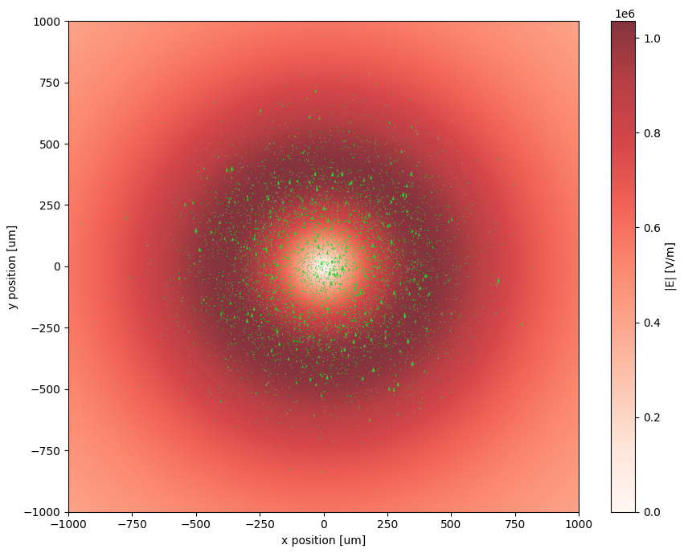
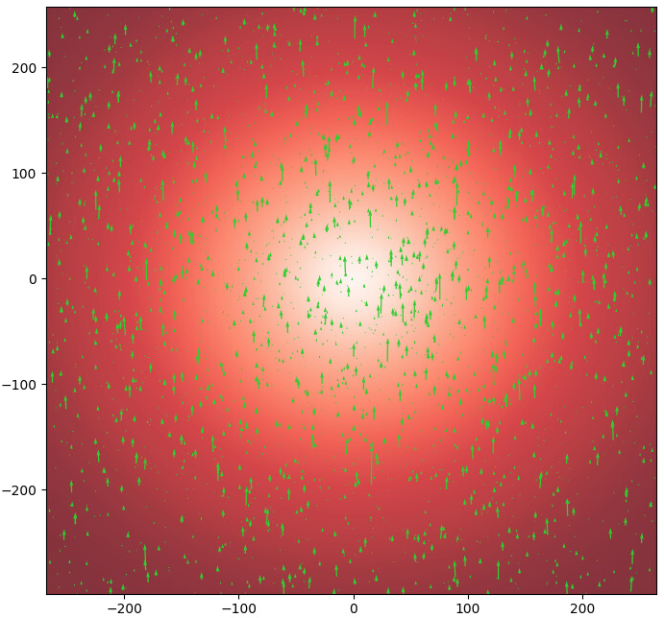
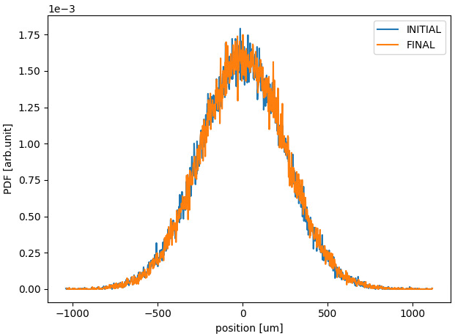



Drift of neutral Ne* species
Drift of neutral Ne* driven by free gas propagation. Atoms mostly moving in jet direction with minor transverse drift due to thermal motion. Profile broadening entirely negligible.
$$σ_{beam}=250 μm$$
$$σ_{img}≈250 μm$$
$$→σ_{PSF}≈0 μm$$

Slide 10
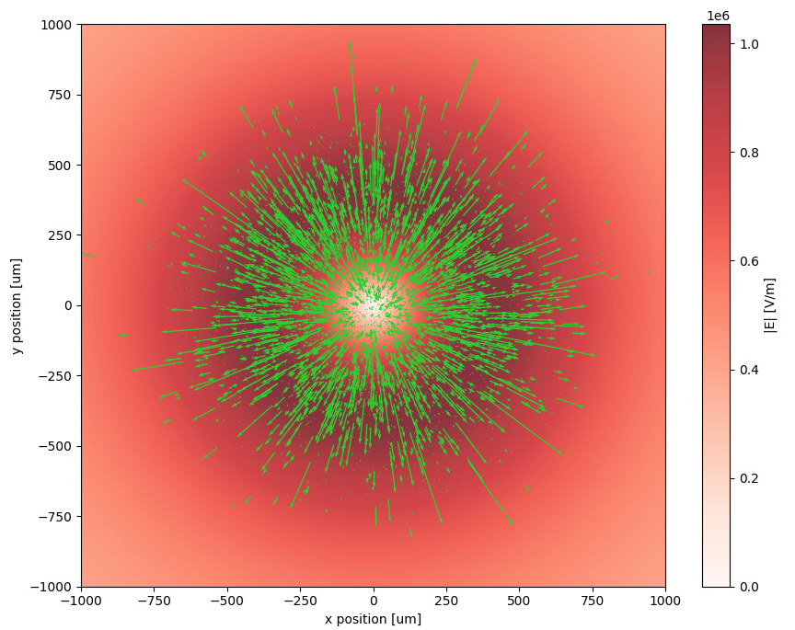
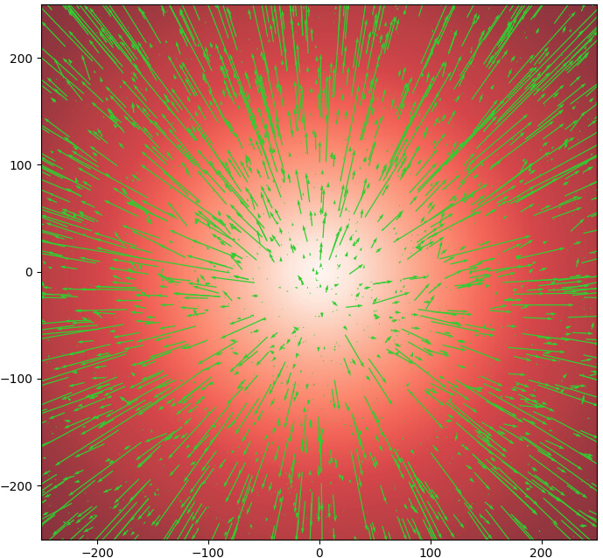
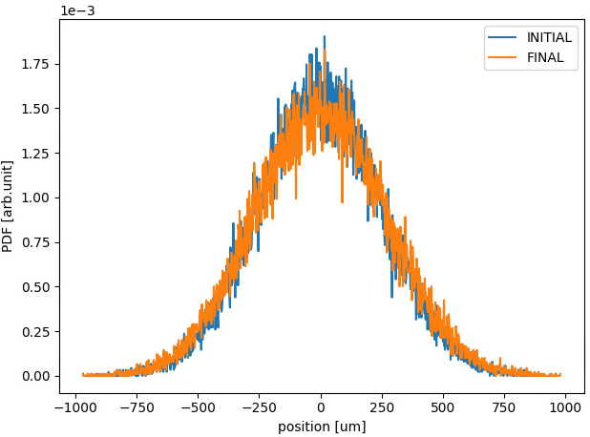



Drift of charged Ne⁺ species
Drift of ionic Ne⁺ driven by ions-beam field repulsion. Drift of emitting species clearly visible, with marginal contribution from initial gas jet distribution. Profile broadening apparent.
$$σ_{beam}=250 μm$$
$$σ_{img}≈273 μm$$
$$→σ_{PSF}≈110 μm$$

Slide 11
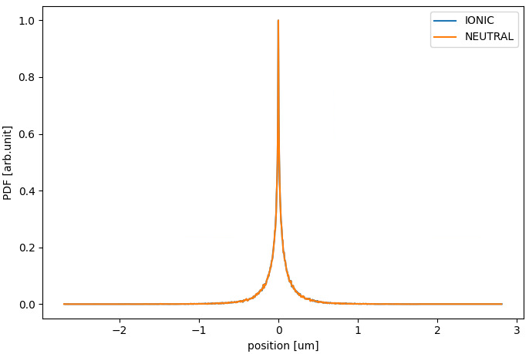
Final z position distribution
Not fully expected outcome in longitudinal direction, where broadening is totally negligible and with no difference between neutral and ionic species.
If this is an artefact:
my mistake in simulation setup
Virtual-IPM does not actually consider longitudinal drift in particle tracking under beam field
If this is physical:
bunch passing induces push-pull forces with no net longitudinal displacement
ultra-relativistic beam has purely transverse field
…anything else

Slide 12
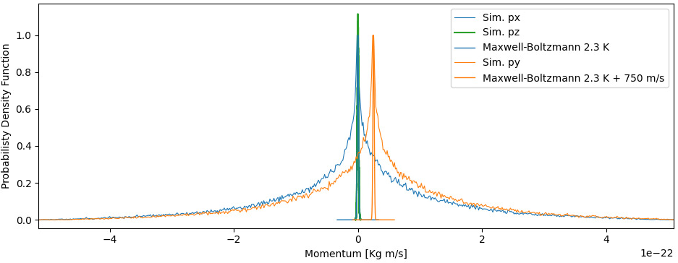
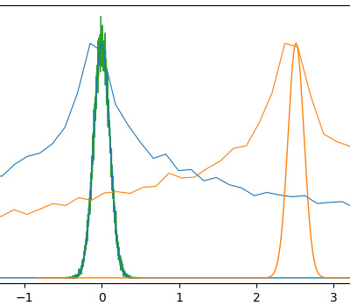
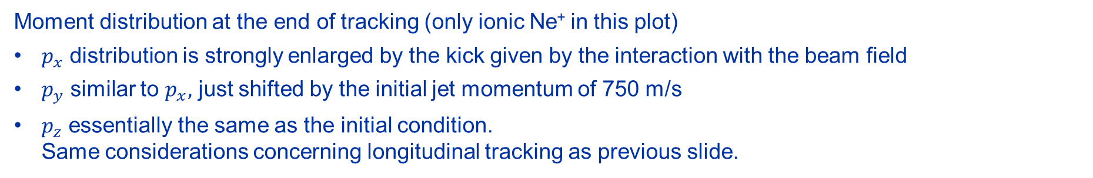
Final momenta distribution
Moment distribution at the end of tracking (only ionic Ne⁺ in this plot)
$p_{x}$ distribution is strongly enlarged by the kick given by the interaction with the beam field
$p_{y}$ similar to $p_{x},$ just shifted by the initial jet momentum of 750 m/s
$p_{z}$ essentially the same as the initial condition.
Same considerations concerning longitudinal tracking as previous slide.
Momenta distributions propagated by
Virtual-IPM compared to theoretical models

Slide 13
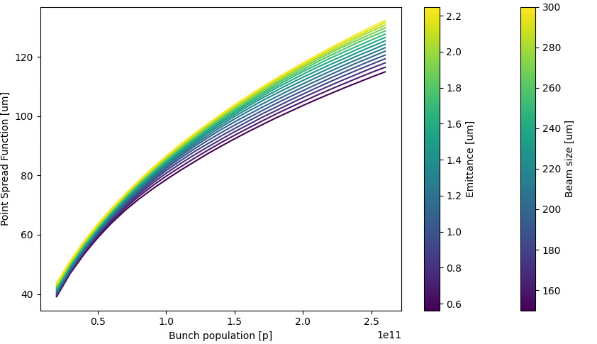
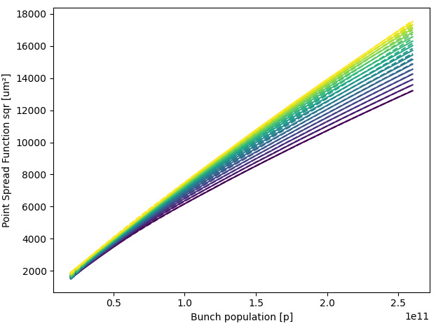
Point Spread Function at flat-top
LHC range
LHC range
Performed parameter scan to cover wide range of beam intensities and sizes
Found significant dependence (expected) on population but not critical change w.r.t. beam size, which is good!
Taking the $σ_{PSF}^{2}$, all curves are well fitted by
$$σ_{PSF}^{2}=a+b⋅N_{bunch}+c\sqrt{N_{bunch}}$$
and in most of the region of interest for LHC, the linear term only is already a good approximation for the fit

Slide 14
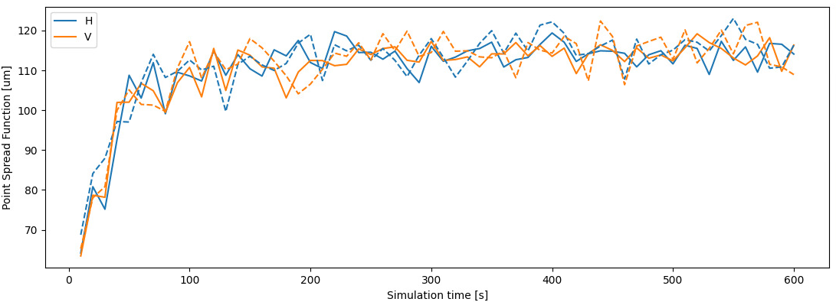
Simulation time
Tried also a scan of the simulation time, which to my understanding is the time allowed for particle tracking
We have transient which reaches a stationary condition around 100ns, which is likely a 4x25ns bunch passages to make sure multiple bunches are well treated.
Not really expected the fluctuation of the results, much larger than all other parameters scan, and not dependent on the granularity of the statistical simulation parameters. To be investigated further…
coarse params (10000 particles and 10000 time steps)
-- fine params (x10 more)

Slide 15
Conclusion
Simulation of space-charge effects in UV configuration underway using Virtual-IPM
Tools mostly setup, need some time to launch systematic parameter scans and implement missing features (e.g. full 3D curtain distribution)
Results generally look credible, more in depth investigations necessary for some specific aspcts (e.g. dependence on simulation time)
Benchmark with actual experiments will follow

