Slide 1



Experience from Glasgow
Emanuele Simili (ScotGrid Glasgow) for the GridPP Technical Meeting - Hardware procurement, Fri. 3rd October 2025
Notes:
GridPP Technical Meeting - Hardware procurement
Experience from Glasgow by Emanuele Simili (ScotGrid Glasgow), emanuele.simili@glasgow.ac.uk

Slide 2
My (limited) sample
I had access to a limited set of platforms, including hardware we have at Glasgow site (which might be outdated), borrowed machines, benchmarks that we ran remotely at vendors’ sites, and a few donated data points ☺
So … my hardware rating is far from complete, but I can share my data and methodology so anyone can expand.
☺ thx joe Ball
News: with the latest HEPiX Benchmarking Suite (v3), sites can upload both their Score and various other figures (CPU, RAM, Power, …). So, it is now possible to retrieve (some) HS23/W info from the HEP-Score DB !
https://w3.hepix.org/benchmarking/scores_HS23.html
1/42
Notes:
(Limited) list of hardware
+
HEP-Score DB (thx Domenico): https://w3.hepix.org/benchmarking/scores_HS23.html
Note: click on the HS23/Watt column to bring the machines with such figures on top of the list.

Slide 3
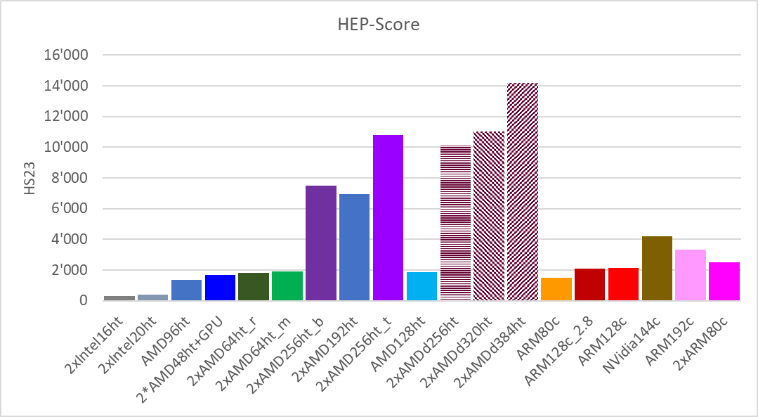
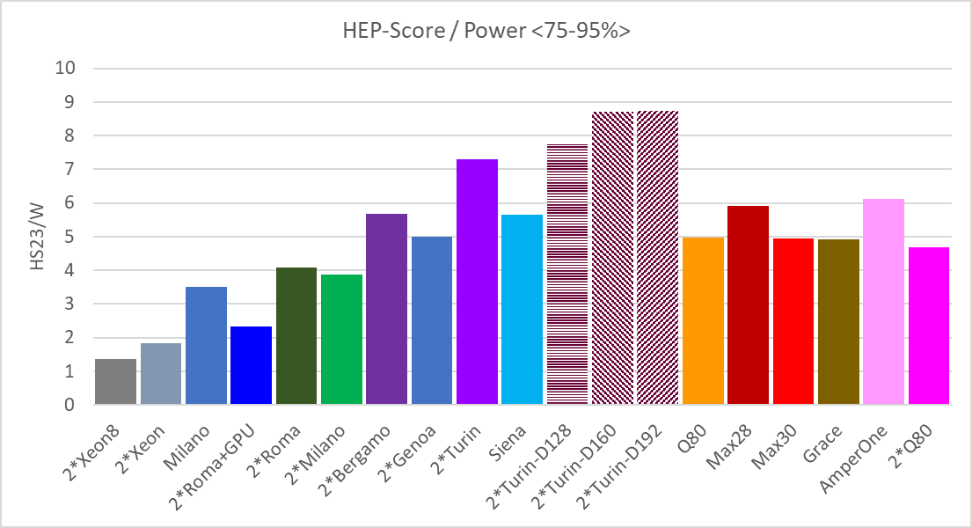
Performance/Watt (ARM vs. x86)
To account for the shape of HEP-Score workloads, we calculate the Figure of Merit (FoM) as: HS23/Power<75-95%>
With this, we can see how various machines compare against each other.
Last generation x86 largely outperforms ARM chips in both performance (HS23) and power efficiency (HS23/Watt)
With the latest HEPiX Benchmarking Suite (v3), sites can upload both the HEP-Score(s) and various other figures (CPU, RAM, Power, …).
So … it should soon be possible to retrieve HS23/W info from the HEP-Score DB.
2/42
Notes:
HS23 & HS23/Watt

Slide 4
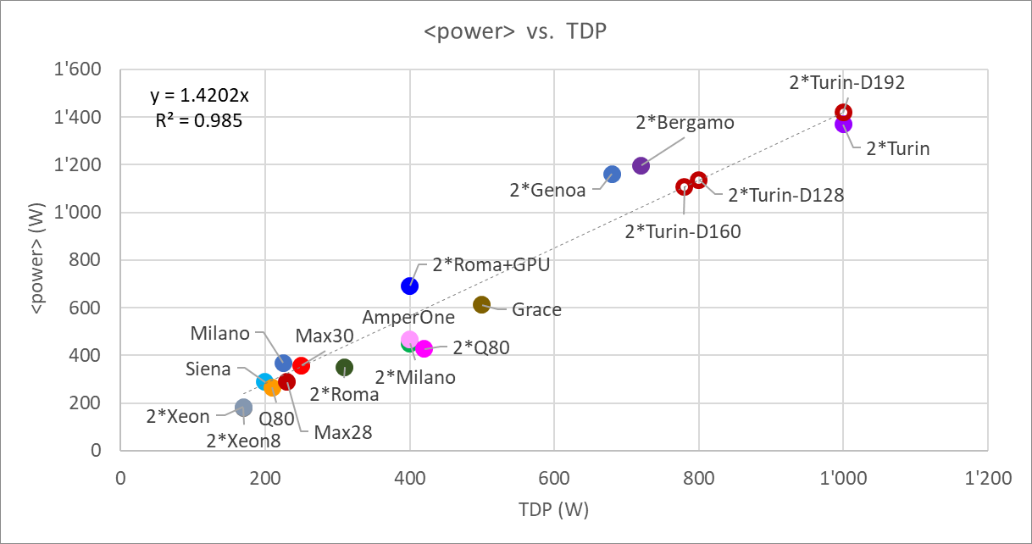
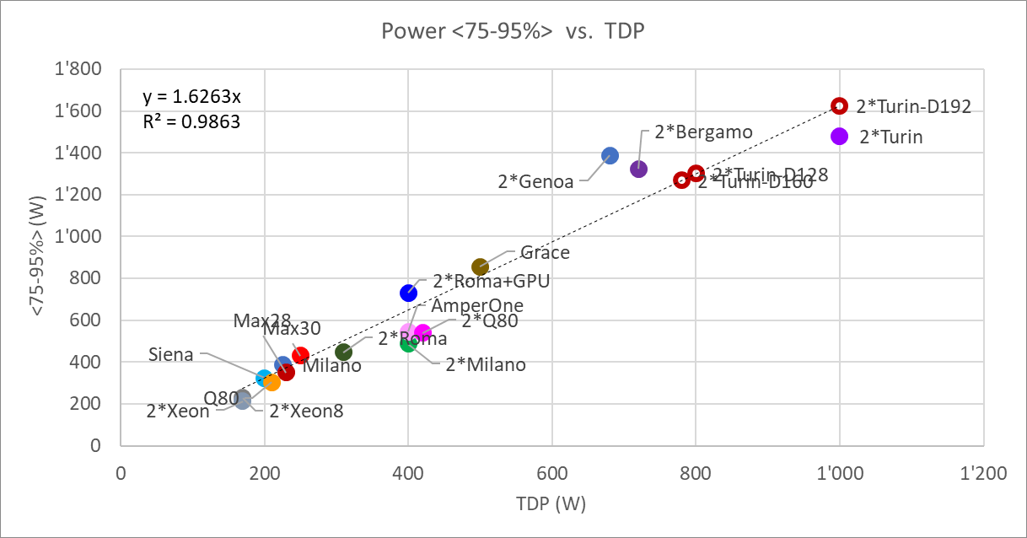
What if no IPMI?
What if, for any reason, we do not have access to IPMI of our hardware?
The measured <power> is more or less linear with the nominal TDP of the CPU(s), with some obvious deviations, since there is a lot more hardware around the CPU …
Average Power:
<Power> = 1.42 * TDP with R² = 0.985
<power> vs. TDP
Or, if you prefer, the 75-95% quantile Power:
<75-95%> = 1.63 * TDP with R² = 0.986
3/42
Notes:
TDP as a proxy for power metrics.
R2 = 1 – ( Sum(y_i – f(x_i)) / Sum(y_i – <y_i>) )

Slide 5
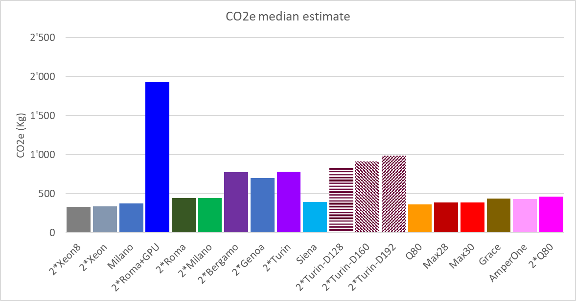
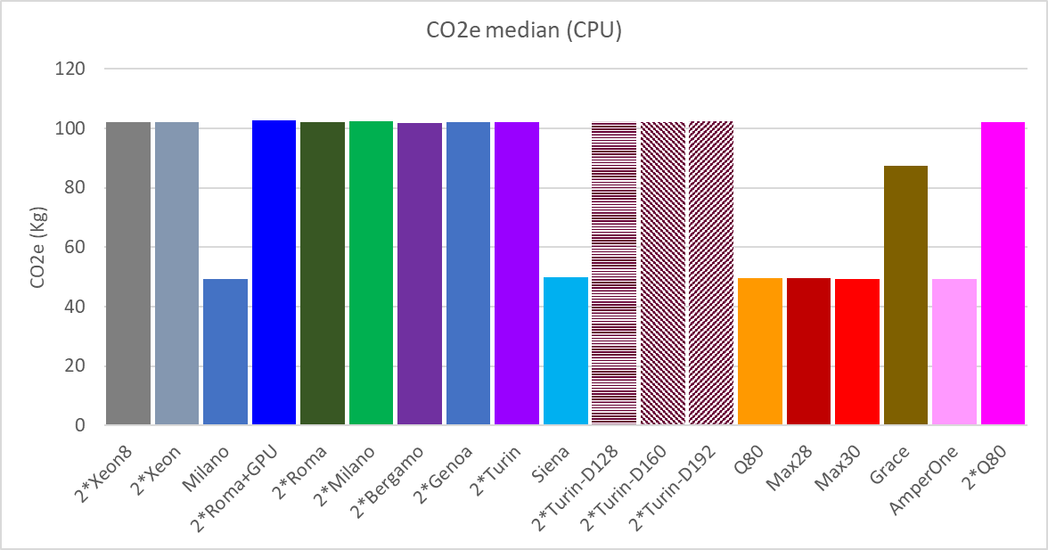
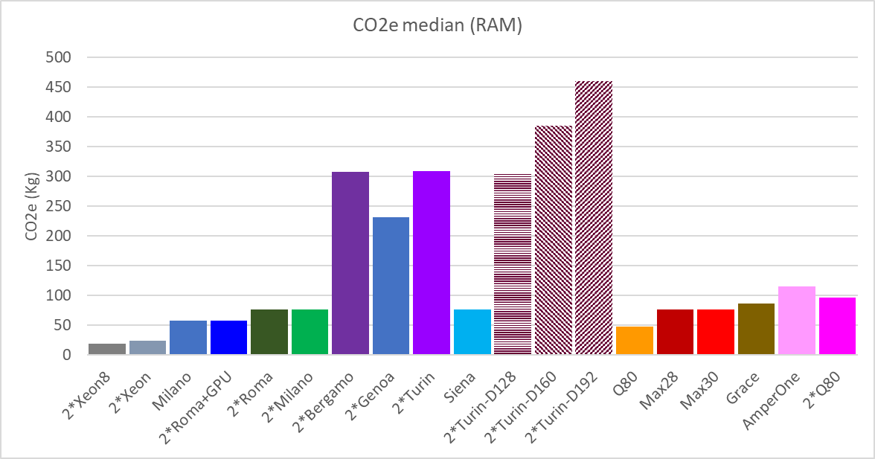
What about Embodied CO₂e
At the last NetDRIVE workshop (https://uknetdrive.org/), we had some discussions about Embodied/Embedded CO₂-equivalent of IT hardware … so, I decided to make an attempt - with some help from ChatGPT *
Note: this is a very rough attempt, but it can become a lot more specific by giving more details about the components (e.g., SSD is far more CO2e than HDD). From this, it looks like modern x86 machines have very similar CO2e.
CPU
RAM
4/42
Notes:
Embodied CO2e
* About ChatGPT (5 mini + thinker): I am not in a position to assess the quality of these data, but with the little experience I had in Life-Cycle Analysis, I could be easily fooled to believe these are legitimate. Plus, I got tons of reference (including over 10 papers, and some online calculation tools, e.g. https://www.climatiq.io/). Maybe this A.I. assistant is good at something?

Slide 6
end
Notes:
end

