Slide 1
SHiP Putty preliminary report
Polymer laboratory – D.Beaujoint resp. R.Piccin
17.09.2025

Slide 2
Goal
The objective of this project is to design a putty formulation that ensures:
Cryogenic resistance to withstand low-temperature environments.
Extended pot life (≥24h) for the resin–filler system to allow flexible processing.
Low-temperature curing to facilitate easy and efficient application.
Enhanced thermal conductivity (k) for optimal heat transfer.
(Optional) A soft and removable system, enabling easy disassembly or rework when required.

Slide 3
Material
  Resin : MY750 + Jeffamine D400
  System: liquid, impregnating epoxy with low glass transition temperature (80°C)
  Curing: high-performing, polyamine-cured epoxy for cryogenic and radiation applications
  Processability: very low viscosity, long pot-life, easy to handle
  Safety: non-carcinogenic, very low toxicity, solvent-free, no volatiles on cure
  Fillers:
  Al2O3 – Alumina 105SFP (Sulzer /Mecto) [1] [2]
  AlN - Aluminium nitride powder (Goodfellow) [3]
  Si – Silice CARBOSIL TS 720 [4]
  BN – Boron Nitride HPF 325 [3]

Slide 4
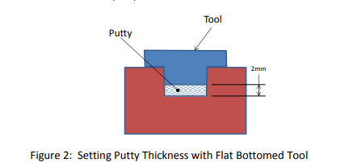
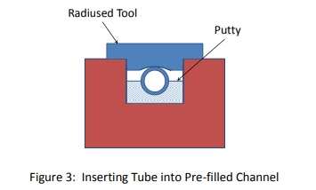
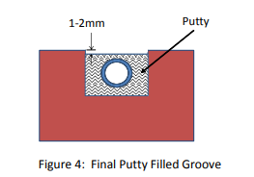
Application guideline – Previous work at ITER
Cleaning procedure:
Scrub grooves with nylon pad and water based cleaner
Wipe surfaces with clean pre-saturated wipe and let it sit 5min.
Wipe off cleaner using dry, lint-free cloth.
Repeat steps 2–4 until cloth shows no contamination.
Perform Water Break Test (ASTM F22): clean surface → water spreads as thin film; contaminated surface → water beads.
If test fails, repeat steps 1–6.
Putty application:
Roll putty into ~8 mm stick and place into channel.
Flatten to ~2 mm layer with flat-bottom tool (tap if needed for flow).
Smooth peaks with flat metal strip.
Place tube into channel and press by hand.
Compact tube with flat/radiused tool until 0.5 mm wire touches channel bottom.
Apply vibratory tool with hand pressure along tube length to compact fully.
Ensure putty covers ~half the tube after compaction.
Fill remaining groove with putty until 1–2 mm from top, fully covering tube and wire.
Wipe off any excess putty from surfaces.

Slide 5
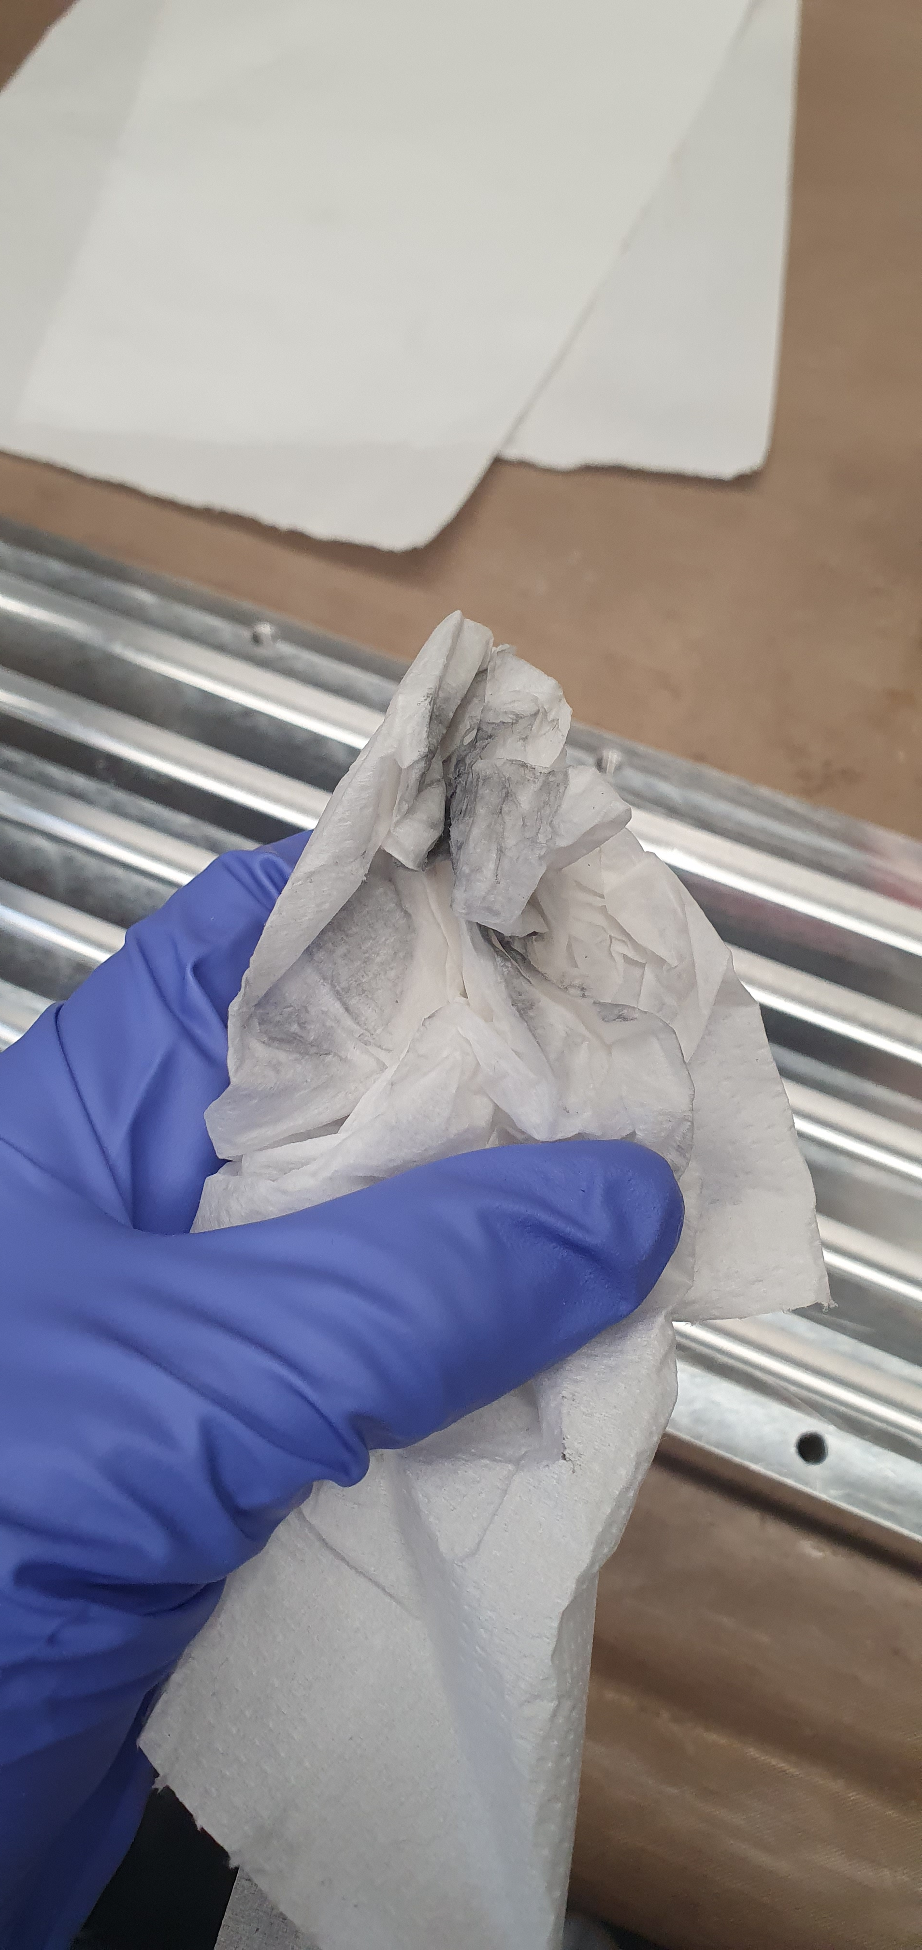
Application guideline - Cleaning procedure
Clean the grooves with ethanol – acetone – ethanol and lint-free cloth until the cloth is free from residues.
If visible resides remains, remove them with scotchbrite and repeat previous process
Other cleaning method can be considered:
Plasma
Ultrasound
Cleanliness can be control with contact angle measurement only on the flat surface, groove geometry doesn’t allow it

Slide 6
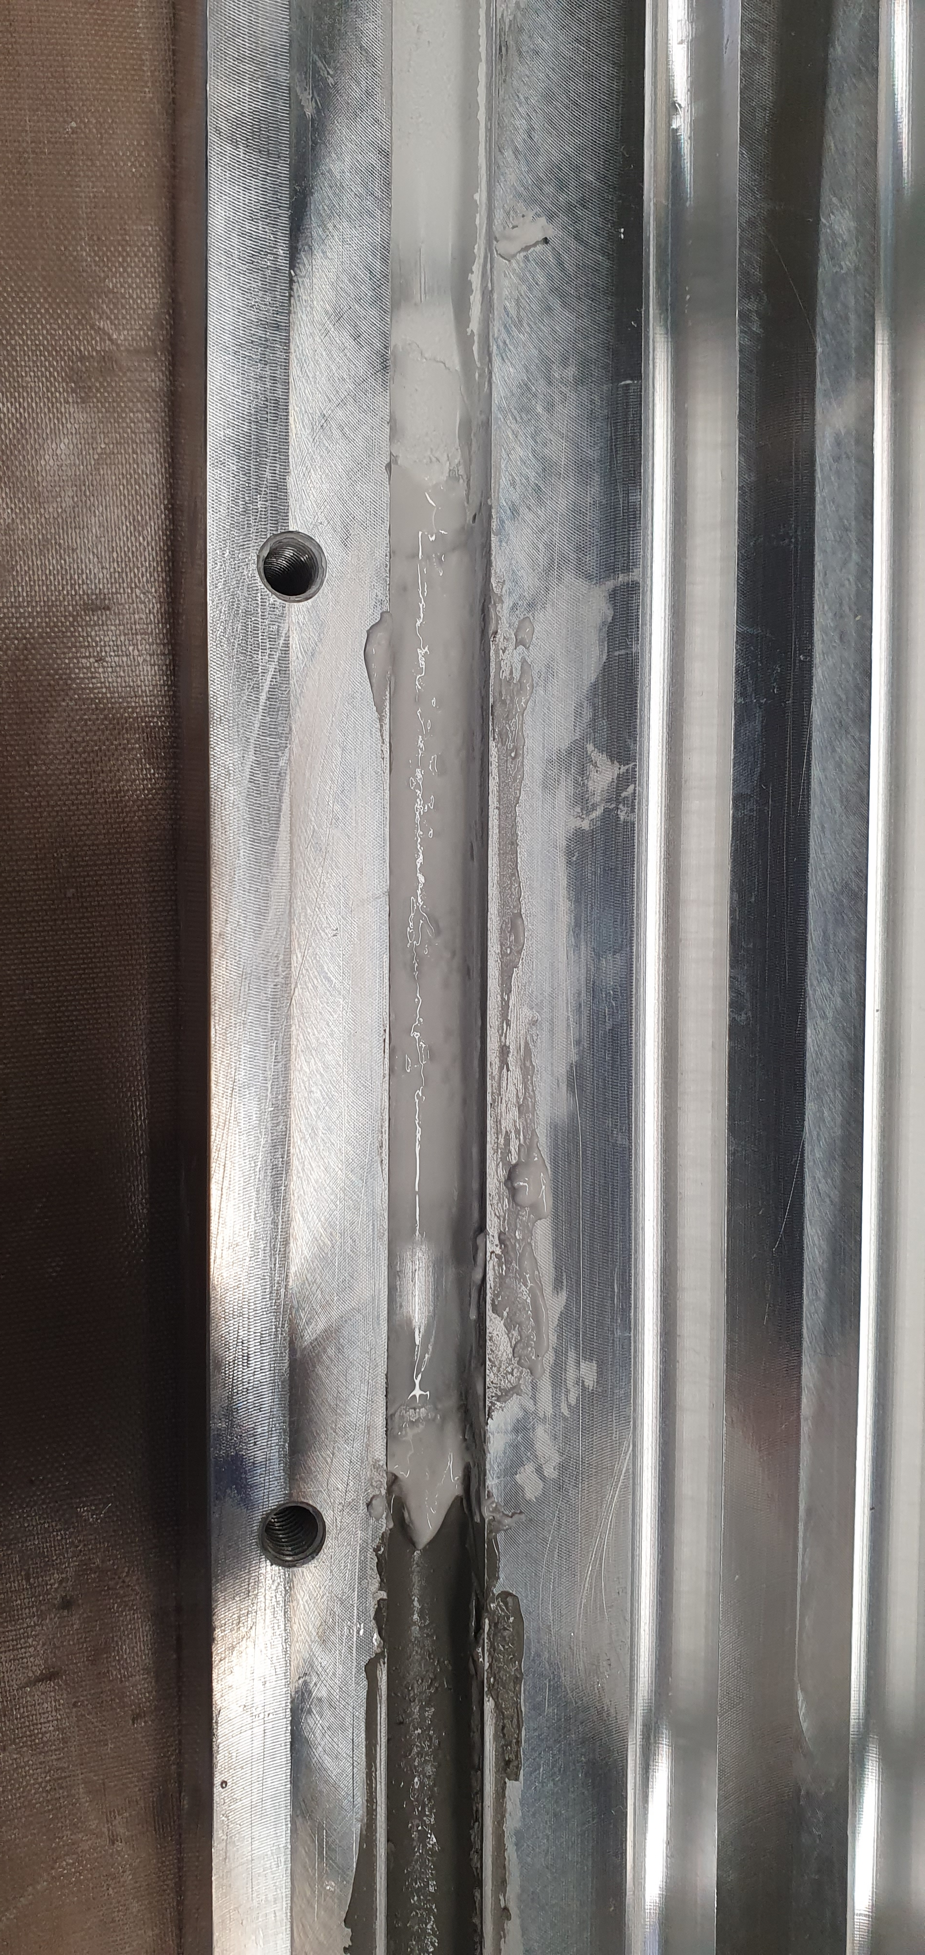
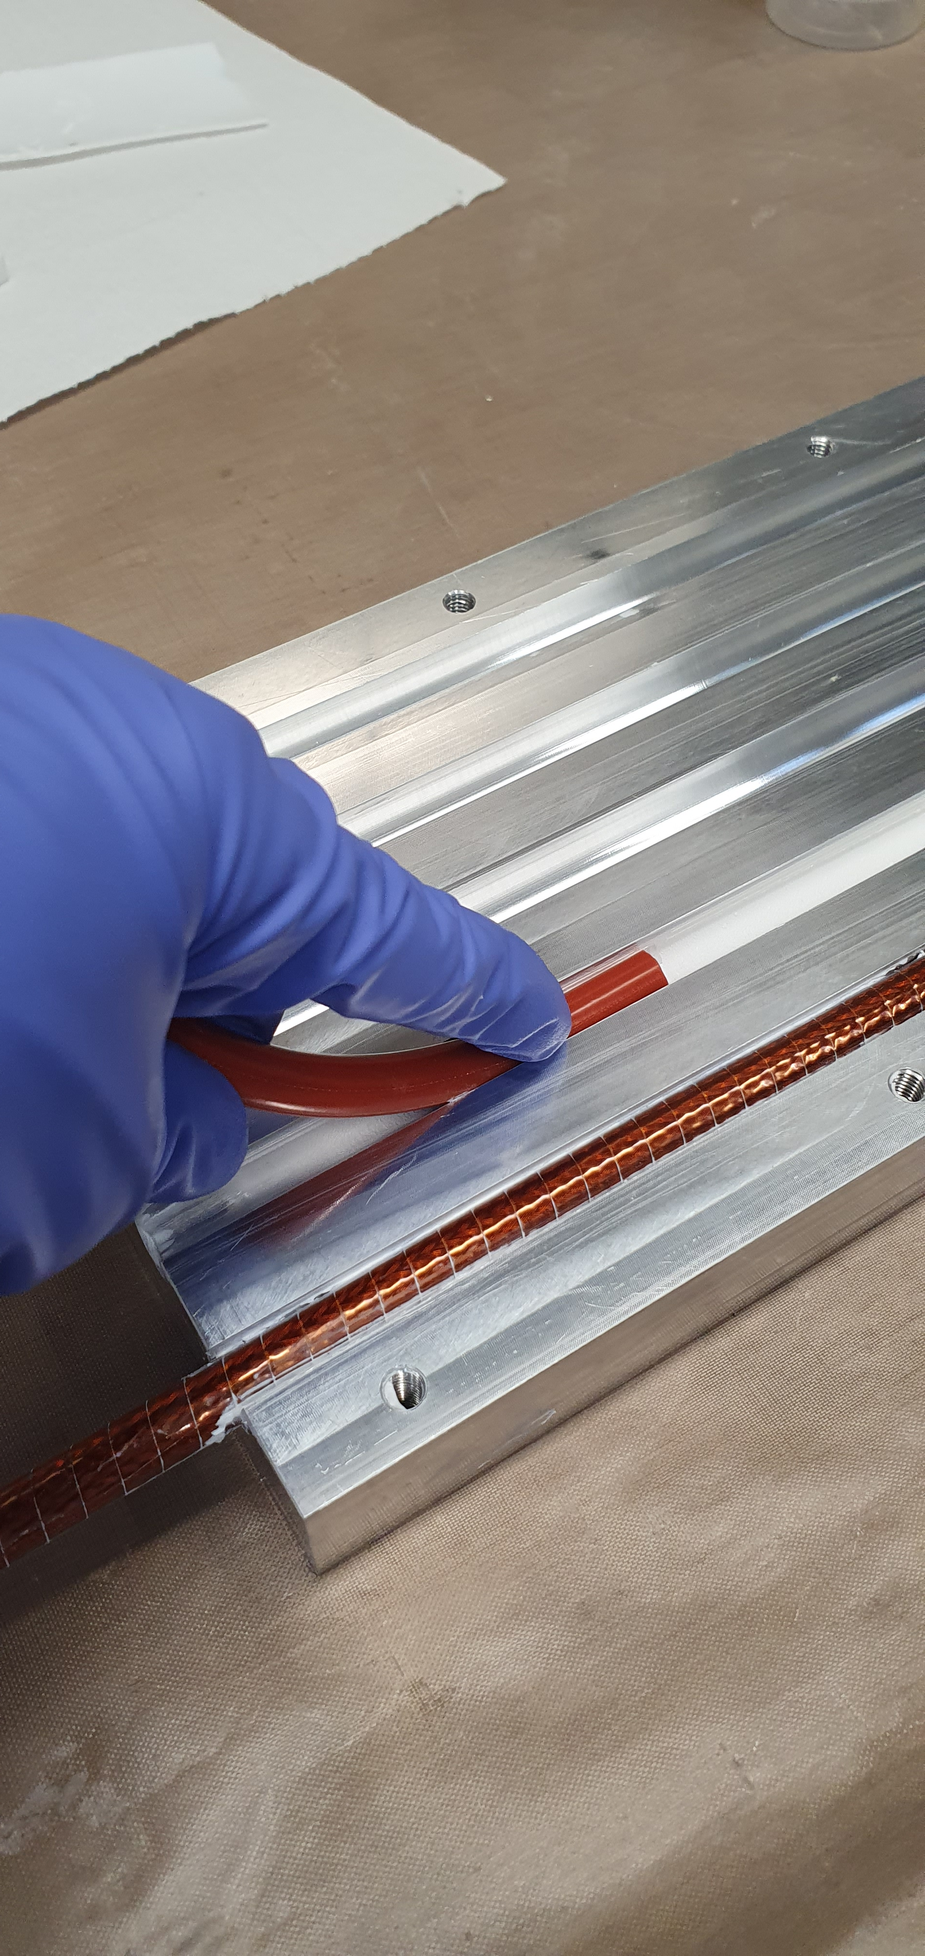
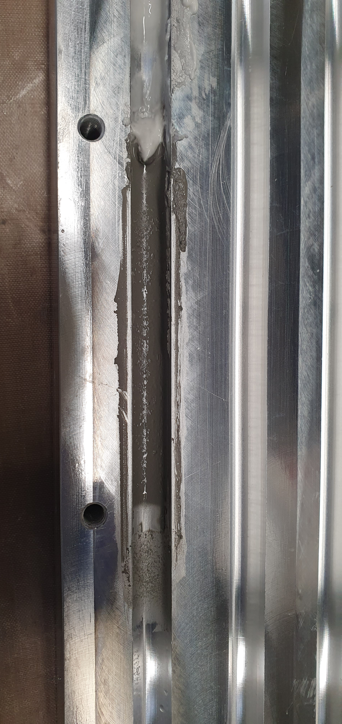
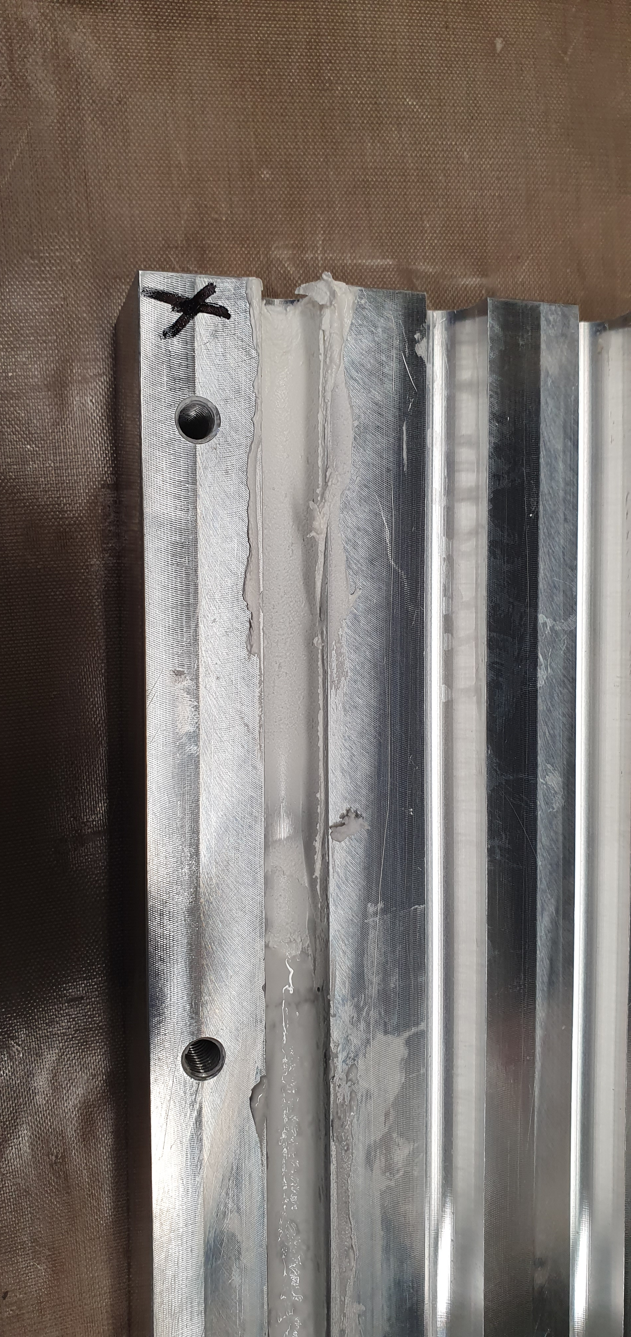
Application guideline – Putty applictaion
Al2O3
Few gaps and empty “dots”
Good for short work time, high flow
AlN
Good spread ability, few empty dots only
Homogeneous
Very moderate flow
BN
Good spread ability
Very homogenous
No flow
Putty application with silicone joint

Slide 7
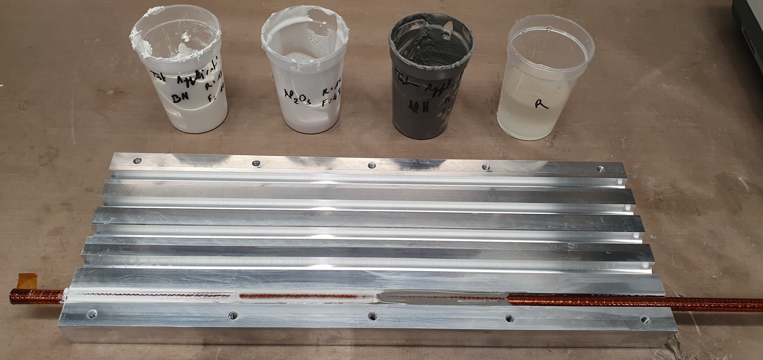
Application testing

Slide 8
Preliminary results
 | Al2O3 Alumina 105SFP (Sulzer /Mecto) | AlN Al nitride powder (Goodfellow) | BN BN- HFM 325 | Al2O3+Sil Sulzer+Carbomat TS720 Comat | Resin only MY750+D400 | Comments
Filler/ resin ratio in mass | 308% | 230% | 112% | 77 + 2% | na
Particule size (µm) | 31 | 0-50 | 0-60 | 31 + NC | na
Application ease Homogeneity of the putty spread | Medium | High | High | High | High | Low : Peeling of material Medium : Small gaps/holes High: Homogenous
Thixotropy Will the putty flow to the bottom of the groove after application | Low | Medium | High | High | Low | Flow speed Low < 5 min Medium >5min <30min High > 45min
Pot life How long will the putty be usable/spreadable before curing | ≥6h
Several resin/filler ratio have been experimented to find the right viscosity/thixotropy compromise

Slide 9
Questions
  How is the thermal conductivity (k) measurement performed?
  Is it necessary to reopen the mold after impregnation and closing?
  For the thermal contraction measurement, what sample dimensions and specifications are required?
  How should we proceed when working with different groove sizes (9.7 mm and 10 mm diameter)?

Slide 10
References
  Kim, S.-K.; Koo, Y.-J.; Kim, H.S.; Lee, J.-K.; Jeong, K.; Lee, Y.; Jung, E.Y. Fabrication and Characterization of Al₂O₃-Siloxane Composite Thermal Pads for Thermal Interface Materials. Materials 2024, 17, 914. https://doi.org/10.3390/ma17040914
  Ouyang Y.; Bai L;, Tian H.; Li X. Recent progress of thermal conductive ploymer composites: Al₂O₃ fillers, properties and applications, Composites Part A: Applied Science and Manufacturing Volume 152, January 2022, 106685. https://doi.org/10.1016/j.compositesa.2021.106685
  Subhash L. Shindé, Jitendra S. Goela, High Thermal Conductivity Materials, Springer, 2006. https://doi.org/10.1007/b106785
  Saba Lotfizadeh, Tapan Desai, Themis Matsoukas; The thermal conductivity of clustered nanocolloids. APL Mater. 1 June 2014; 2 (6): 066102. https://doi.org/10.1063/1.4880975

