Slide 1
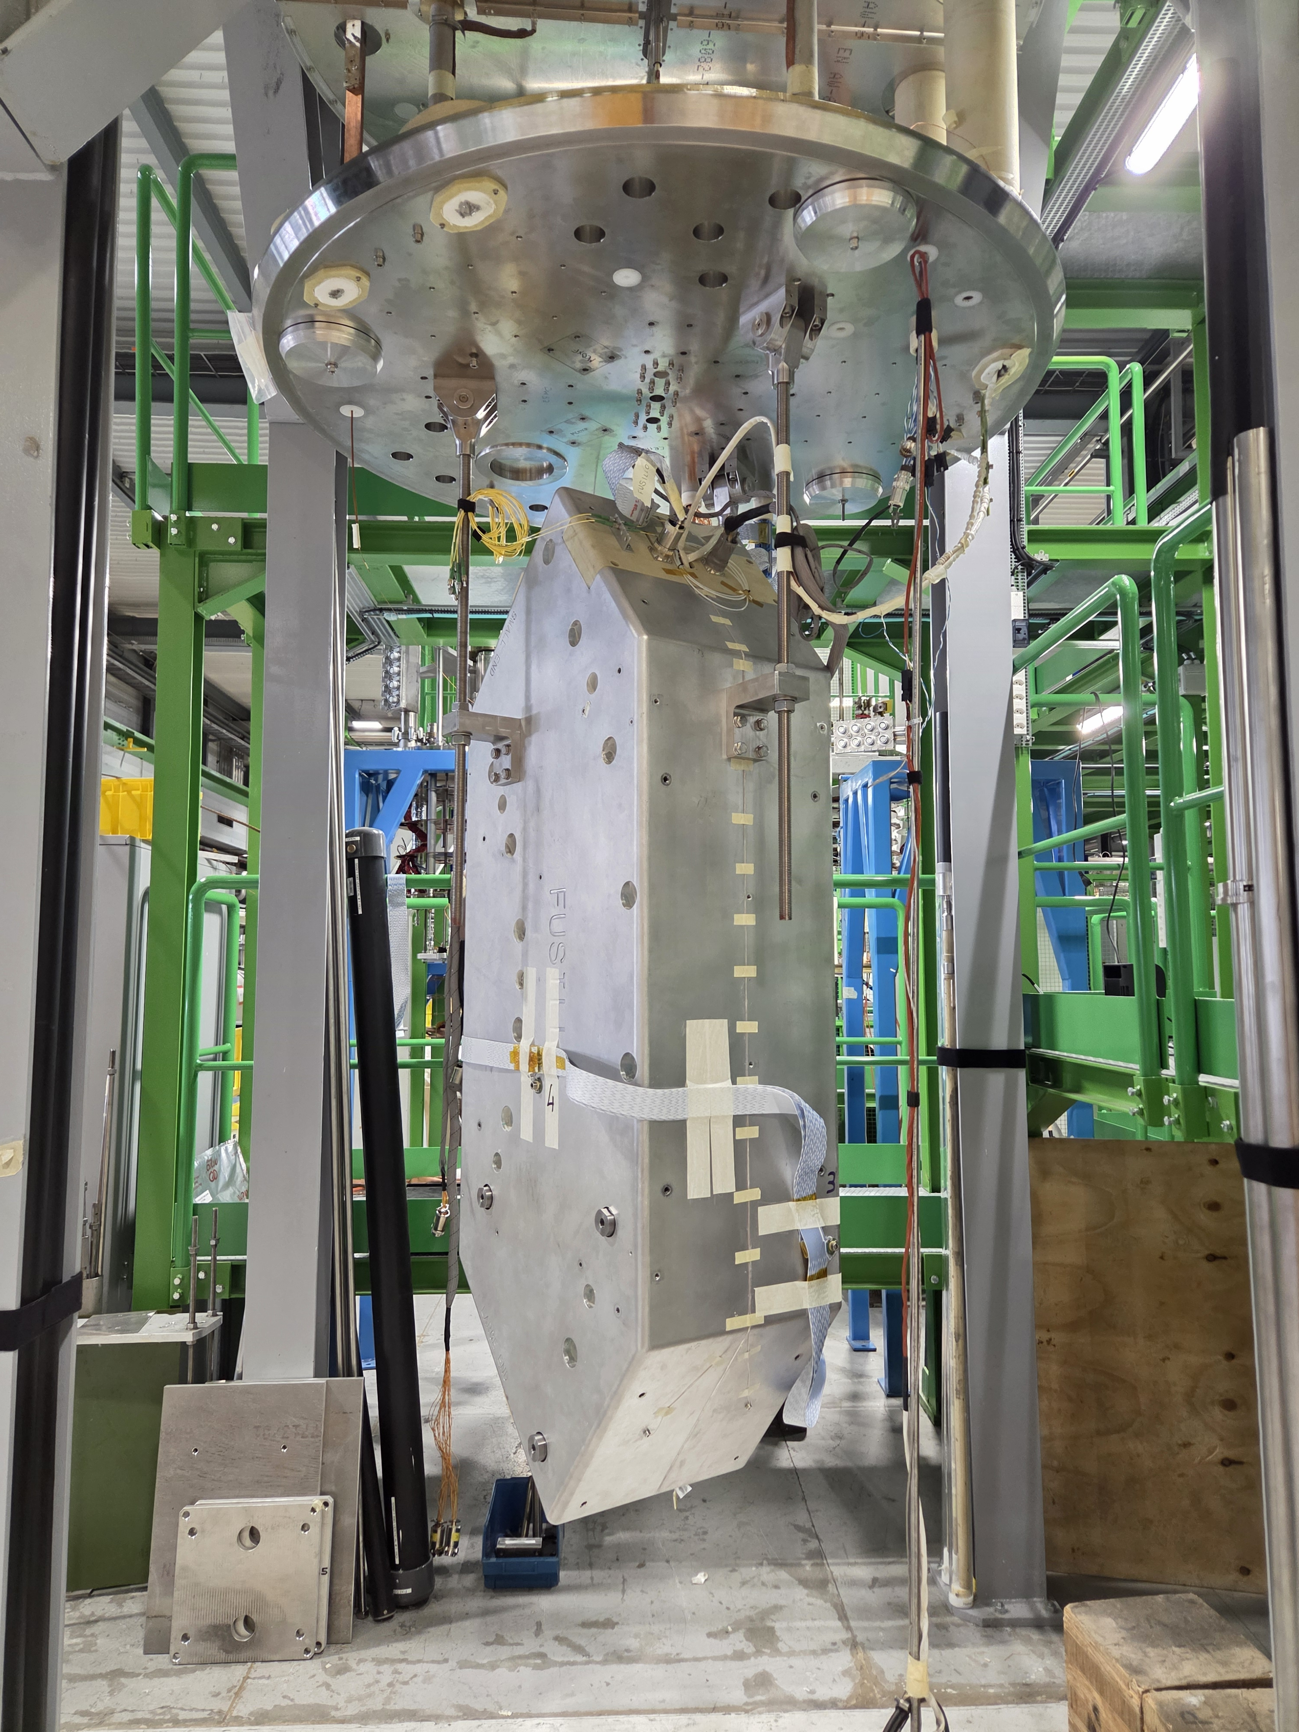
Fusillo Demonstrator cold test results
V. Di Capua, G. Willering, F. Mangiarotti, M. Janitschke, A Haziot, M. Wozniak, J.L. Guyon,.
Date: 17/09/2025

Slide 2
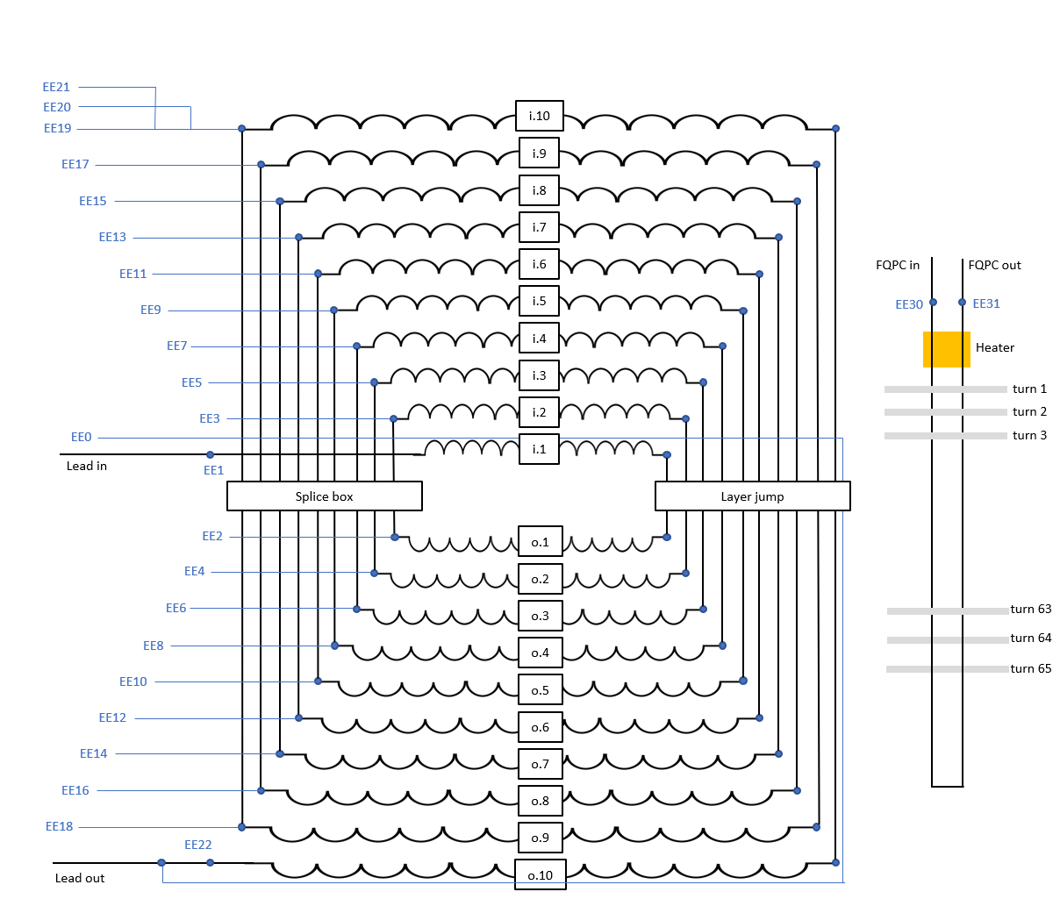
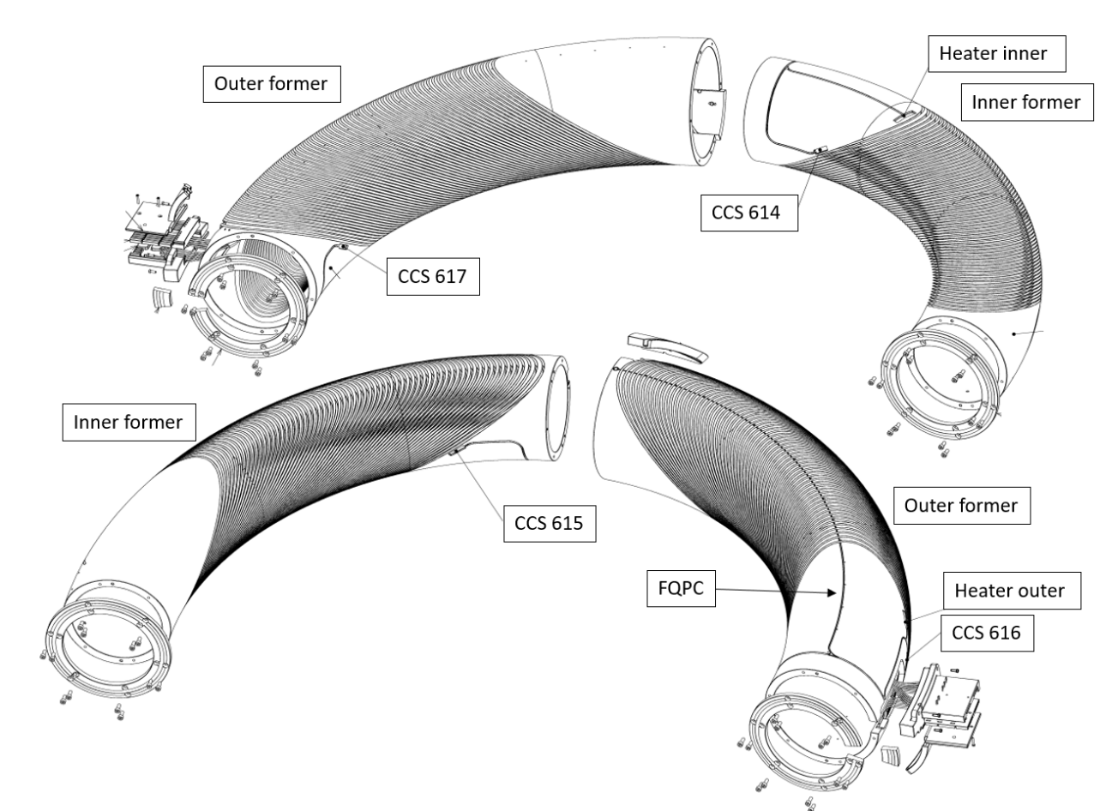
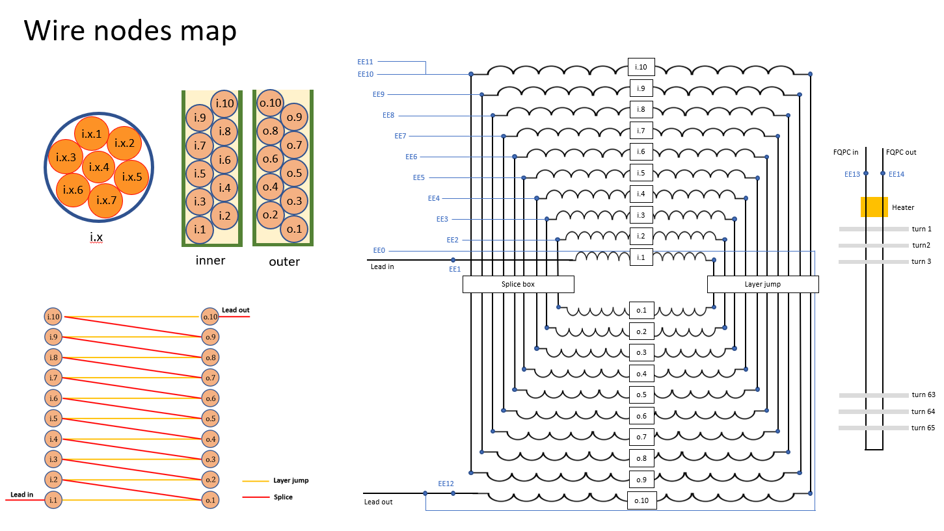
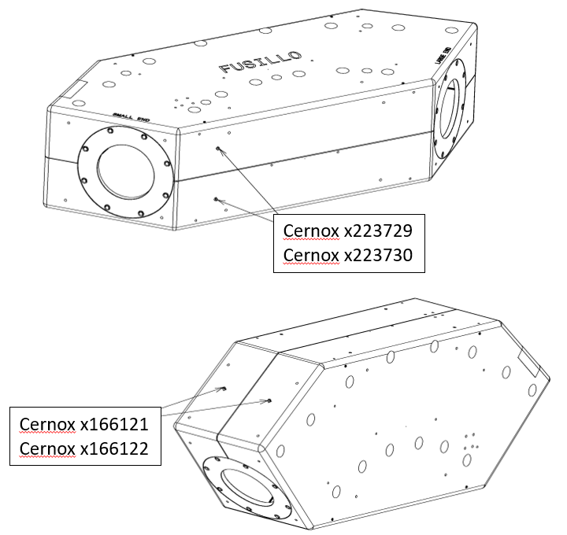
Naming and conventions
Optic fiber
Cold powering parameters: | Unit | 1.9 K | 4.5 K
Nominal Current | A | 288 | 288
Ultimate current | A | 308 | 308
Short sample limit | A | 592 | 431
Bore field at nominal current | T |  | 3.00
Peak field at nominal current | T |  | 3.61
Bore field at Iss | T | 6.17 | 4.50
Peak field at Iss | T | 7.43 | 5.41
Nominal ramp rate | A/s | 1 | 1
Nominal stored energy | kJ | 391
Inductance | mH | 9400
Load line parameters |  | 3.61 T ; 287.5 A
Maximum QI, hotspot temperature | kA²s, K | 29, 300
Baseline protection |  | 2 x varistors Metrosil 8606(150 kJ, 475 V, 470 A)

Slide 3
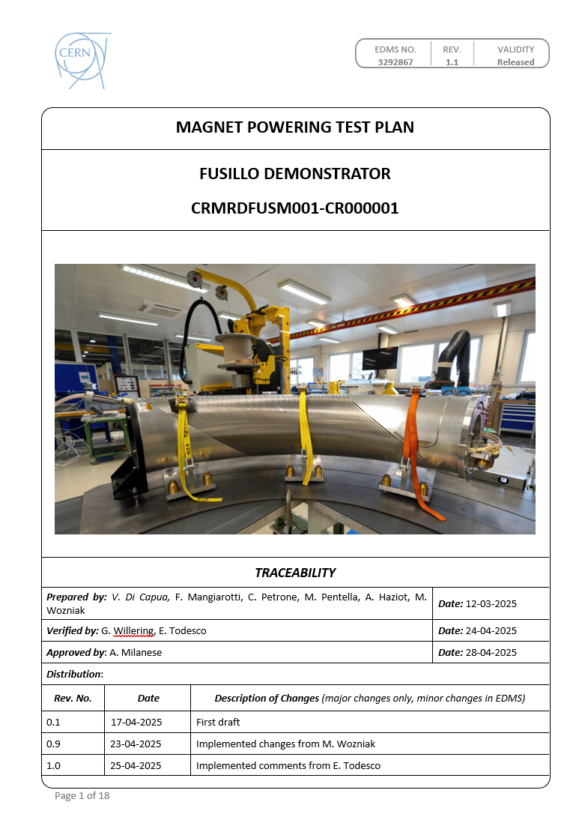
Test plan
300 K
  HV tests (500V): PASSED
4.5 K
  HV tests (1.5 kV): PASSED
  Protection verification.
  Training.
  Splices.
  Magnetic measurements.
  Magnet heaters.
  FQPC stand alone.
  Magnet and FQPC in series.
1.9 K
  Training.
Thermal cycle
4.5 K
  HV tests (1.5 kV): PASSED
  Training verification.
Test plan available on EDMS: 3292867

Slide 4
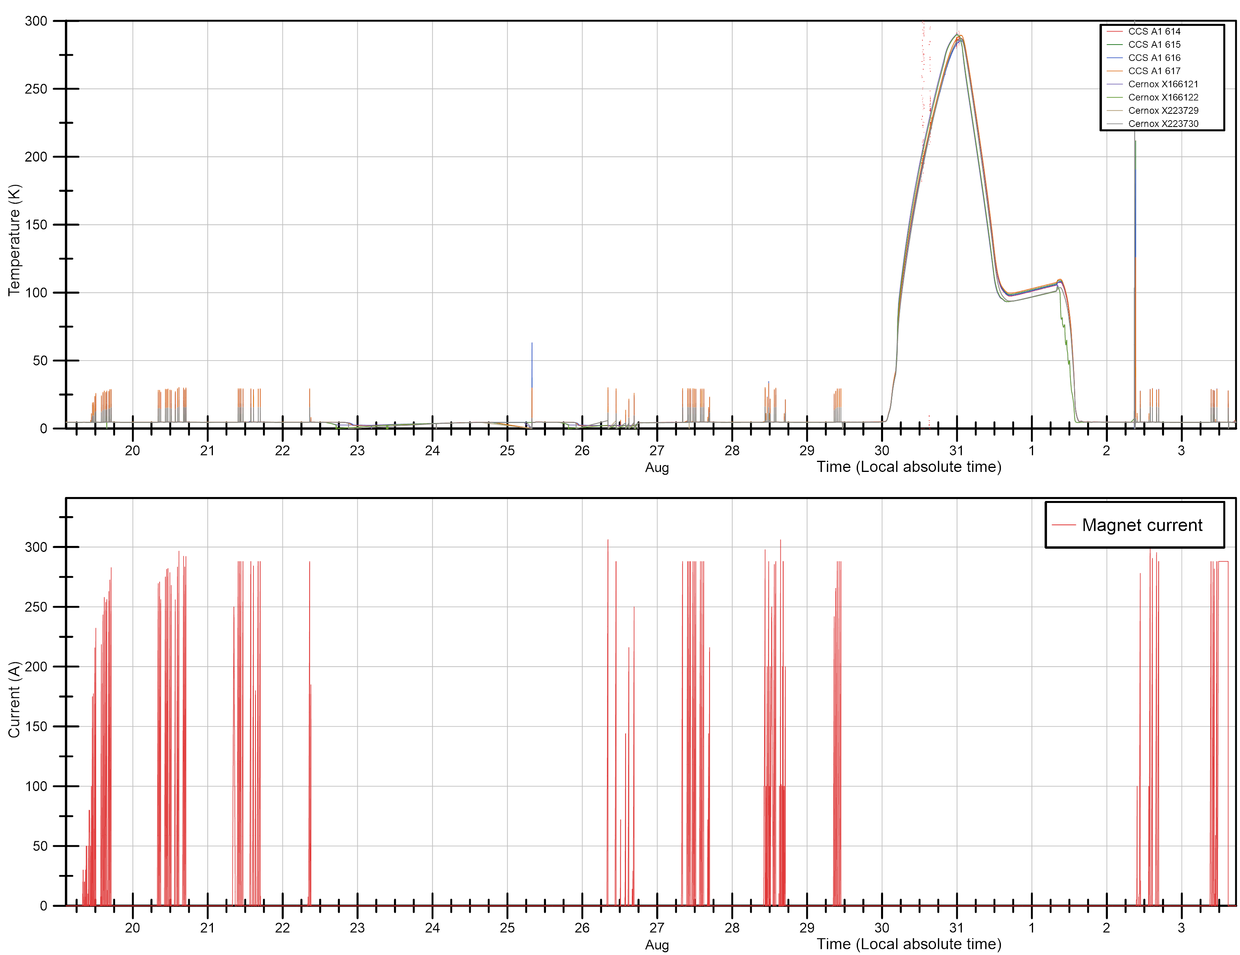
Powering overview
4.5 K
1.9 K
4.5 K
4.5 K
Tests executed from the 19/08/2025 to the 3/09/2025
A total of nine days of powering.
One thermal cycle.
A few (four) interruptions due to cryogenic limitations.
For all tests, a ramp rate of 0.25 A/s have been used given the high inductance (~10 H).

Slide 5
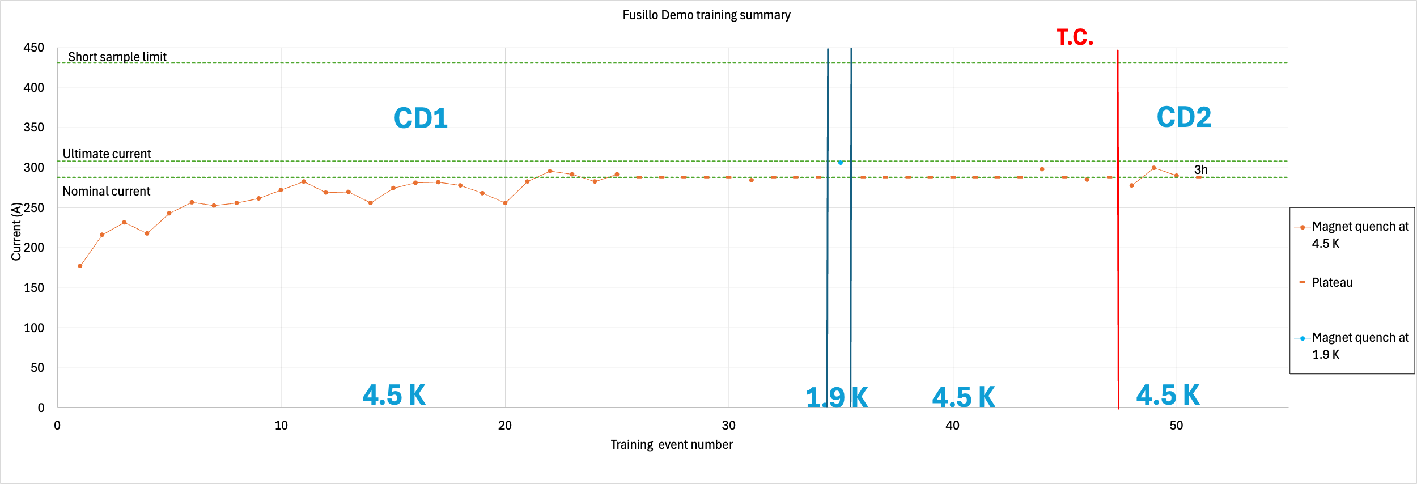
Training summary
22 Quenches to reach nominal current (288 A)
Non monotonic training.
Good memory after thermal cycle (only one quench to go above nominal).
Maximum current reached at 1.9 K: 306 A (3.19 T).
Maximum current reached in the second cool down at 4.5 K: 300 A (3.1 T).

Slide 6
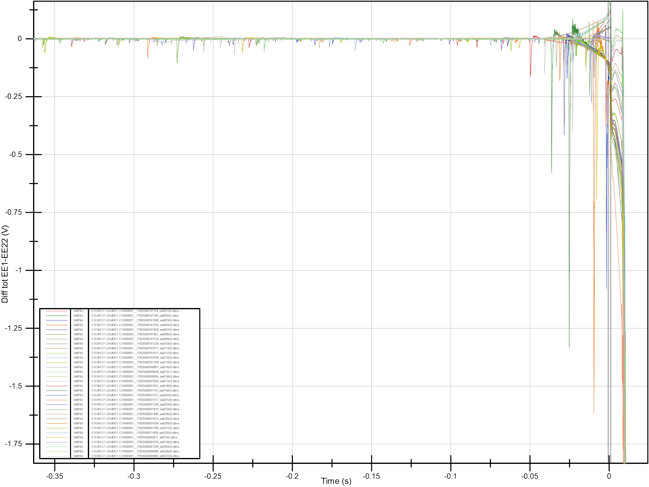
Quench signature
  For all the quenches at both 4.5 and 1.9 K the signature is similar.
  In all cases several movements are present for the whole ramp.
  The quenches are always preceded by a precursor.

Slide 7
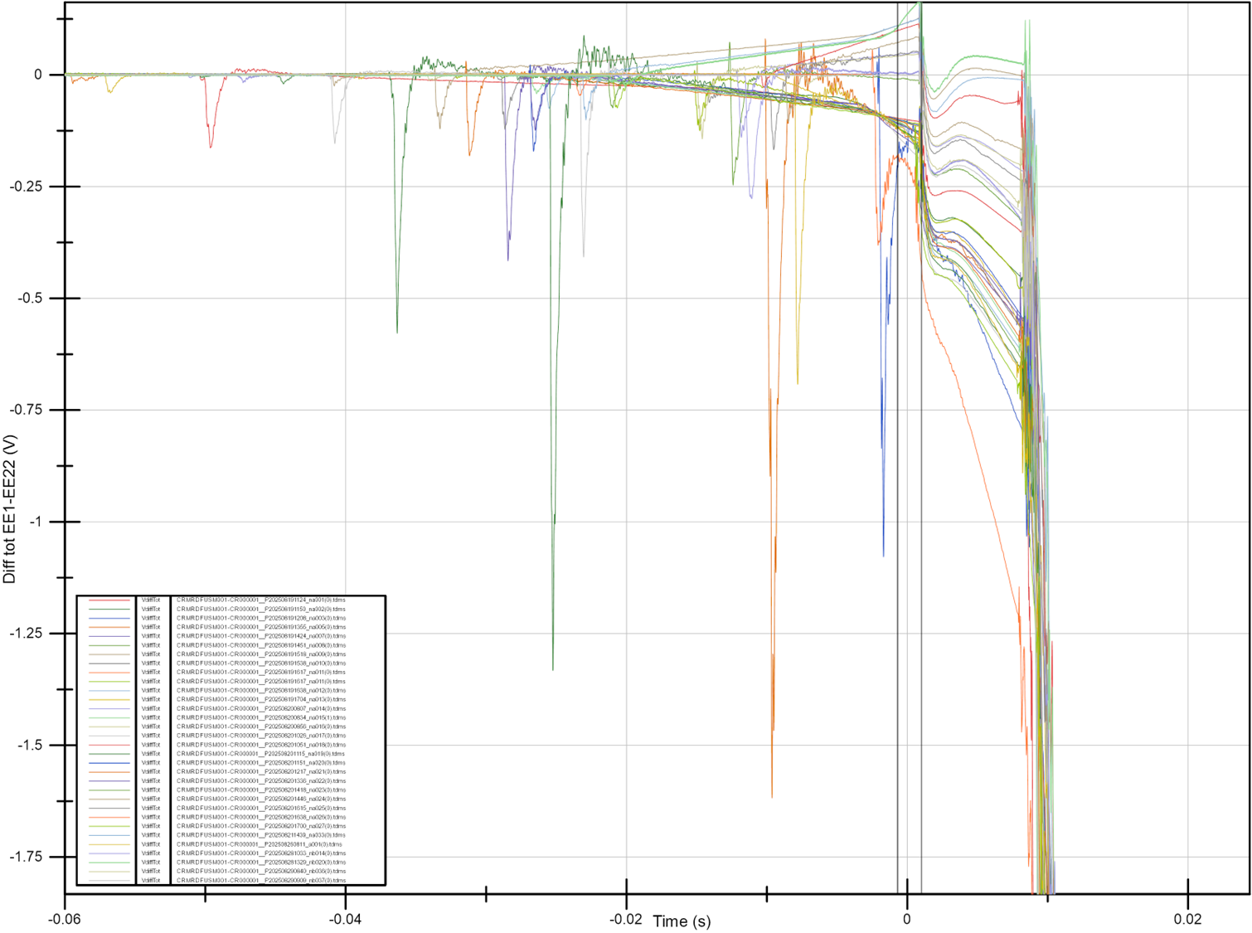
Quench signature
  For all the quenches at both 4.5 and 1.9 K the signature of the quenches look similar.
  Precursors are in all cases negative on the total differential signal build a:
    (EE01-EE11)- (EE22-EE11)

Slide 8
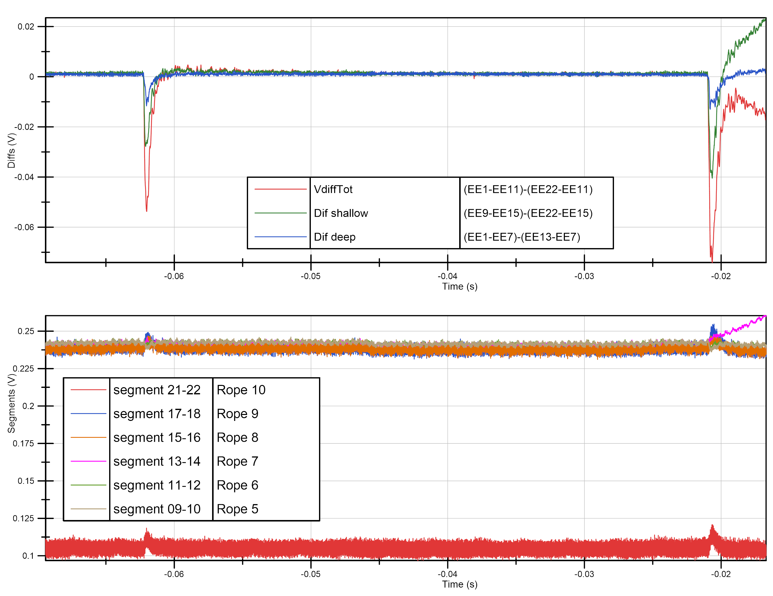
Quench signature
I= 292 A; B=3.04 T
  Contribution to the diff tot mainly due to the diff shallow
  Movements are originating in rope 9, 10, and partially 8.
  Movement causing inductive voltage spikes.
  Local inductance change due to changes in coil geometry causing an energy redistribution.
  May or not trigger a quench.
Transients and Coil Displacement in Accelerator Magnets-G.Willering

Slide 9
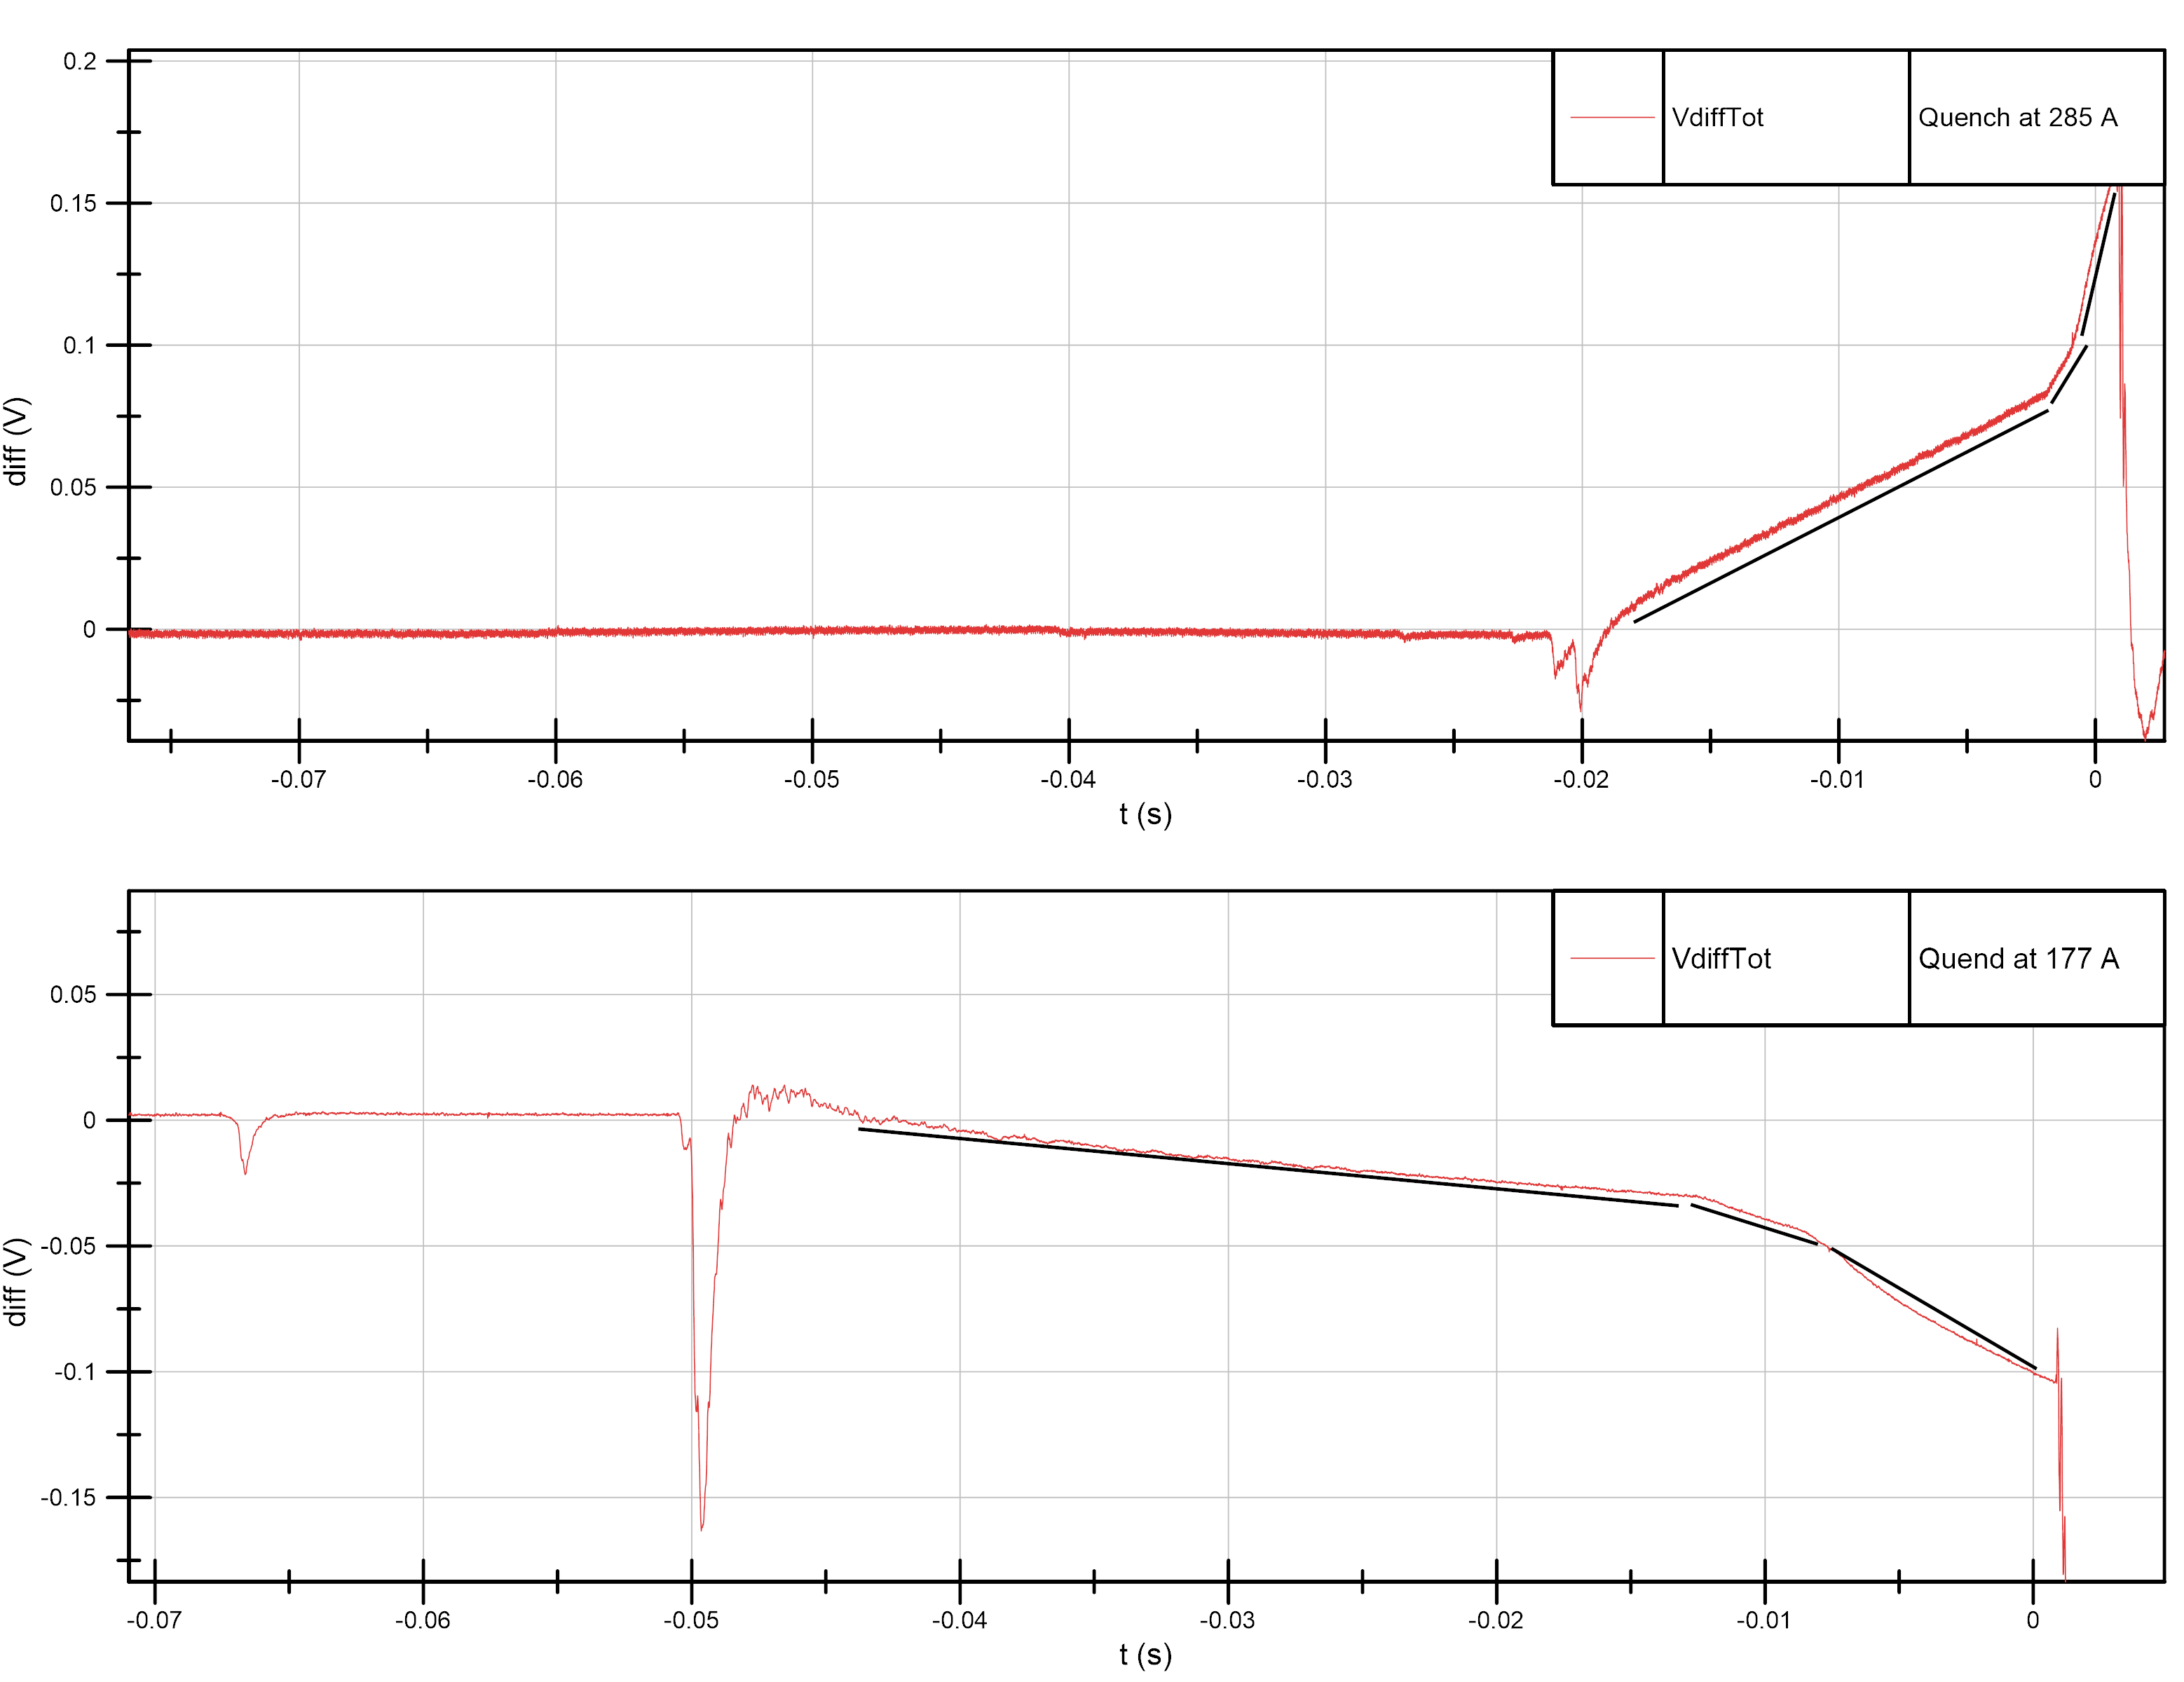
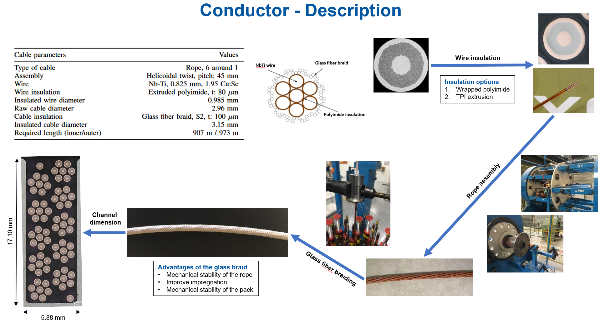
Quench propagation
  Quench propagation looks to be “quantized”.
  The slope of voltage build up at the start of the quench depends on the current.
  Higher current => higher slope.
  Slope grows by an integer number of the base slope and saturate at ~7 times the base slope.
  Intra rope propagation.
  No evidence of inter rope propagation.
B=2.99 T
B=1.85 T

Slide 10
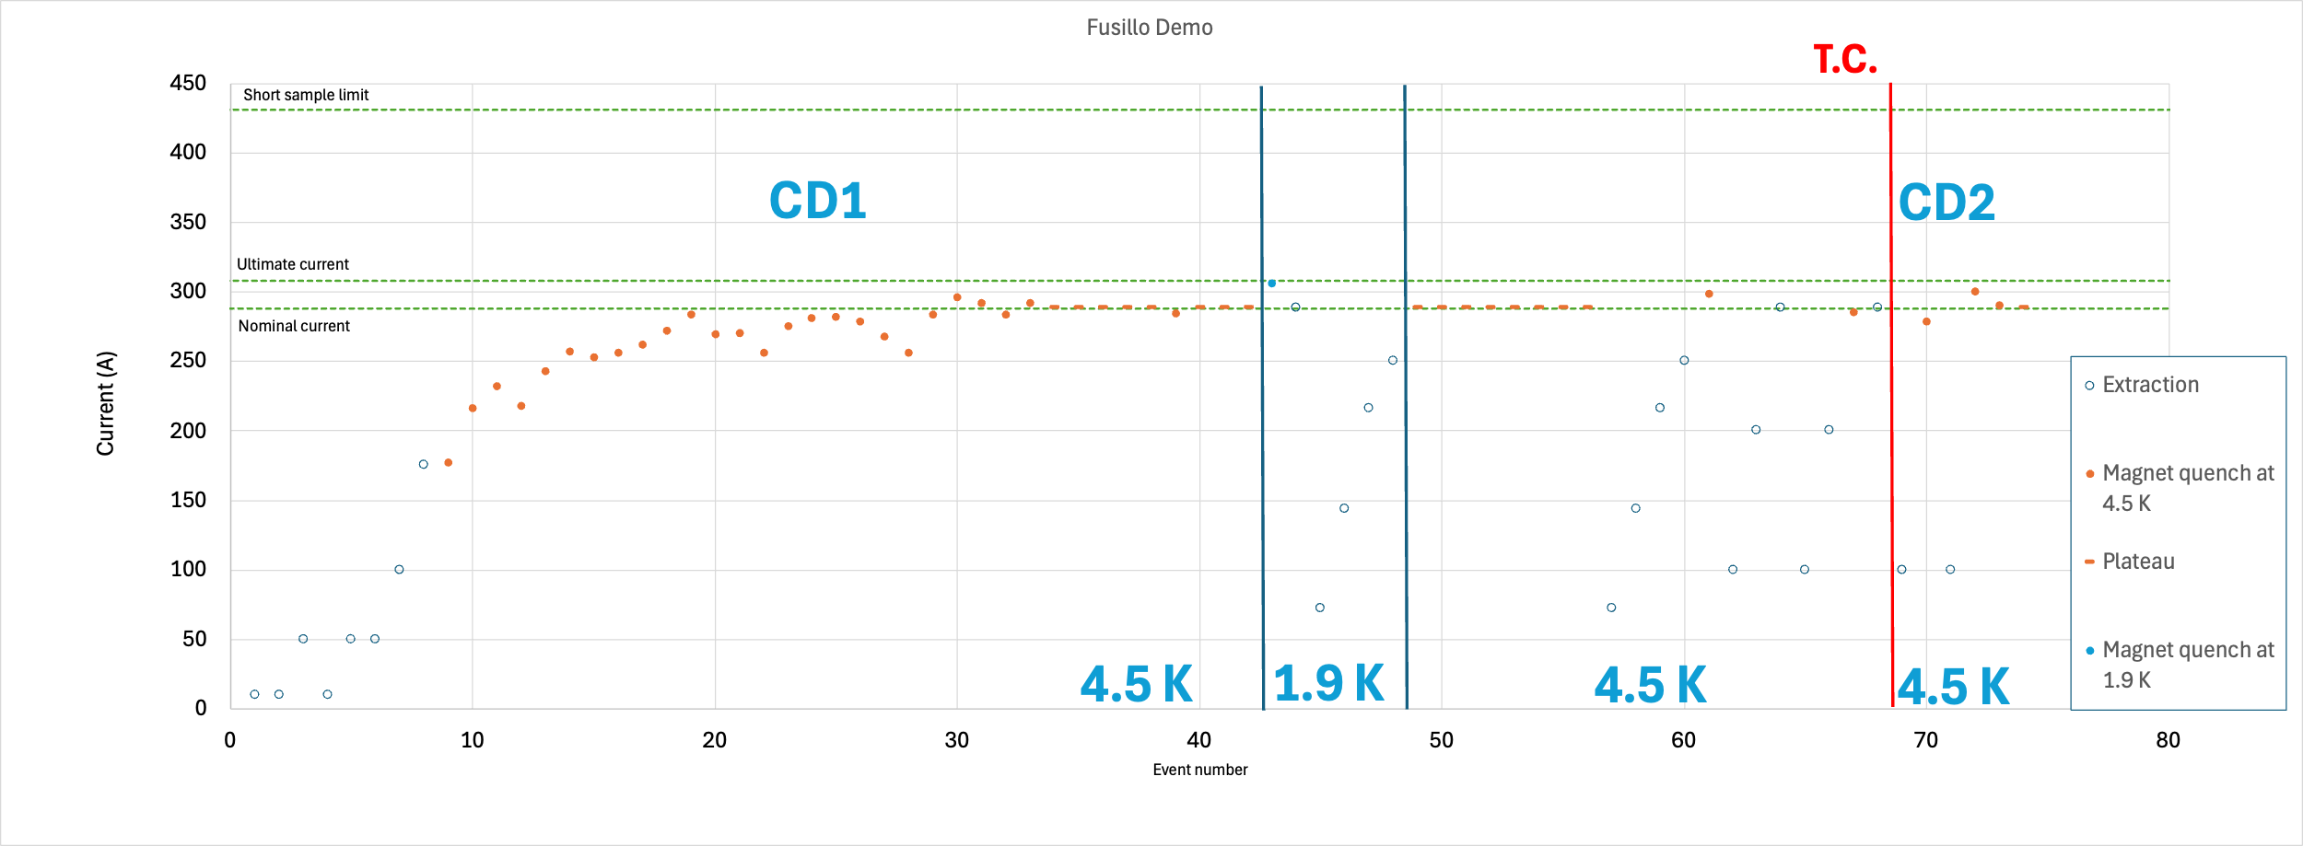
Training summary + extractions

Slide 11
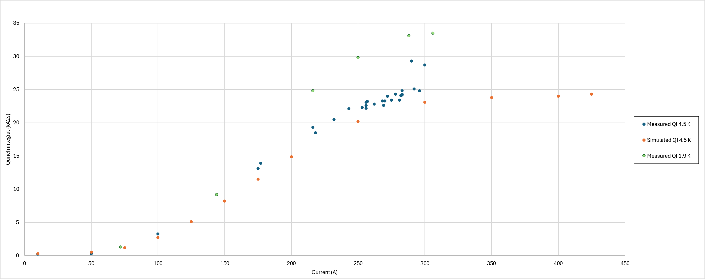
Quench integral
Good match between the measured QI values at 4.5 K and simulations.
Discrepancy between the QIs at 4.5 and 1.9 K particularly for current above 200 A.
Limit of 30 kA²s passed during the first quench at 1.9 K at 306 A (33 kA²s).
Limit set considering a hot spot temperature of 300 K in adiabatic conditions (conservative limit).
Later simulations considering He cooling could relax this limit, giving for 33 kA²s an hot spot temperature around 200 K
M.Wozniak

Slide 12
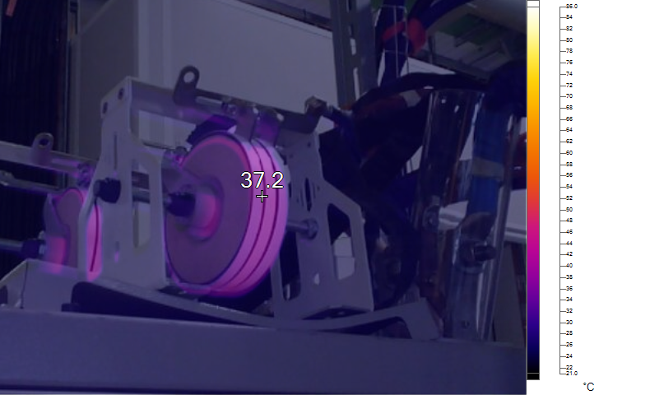
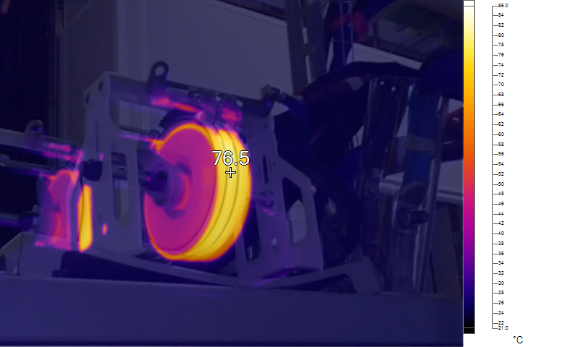
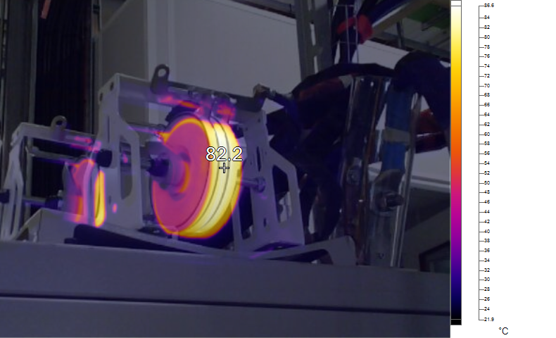
Quench integral
2 x varistors Metrosil 8606(150 kJ, 475 V, 470 A)
Dissipated power for extraction at 288 A is ~ 45 kJ per varistor.
Inconsistencies between measured QI values for the same quench or extraction current could be explained by the temperature increase of the two varistors.
Temperature rises from room temperature to 87 degree Celsius in case of quenches/extractions in rapid succession.
Reduced performance of the varistors plates.
For future uses of these varistors a forced air cooling will be put in place to have more stable conditions across tests.

Slide 13
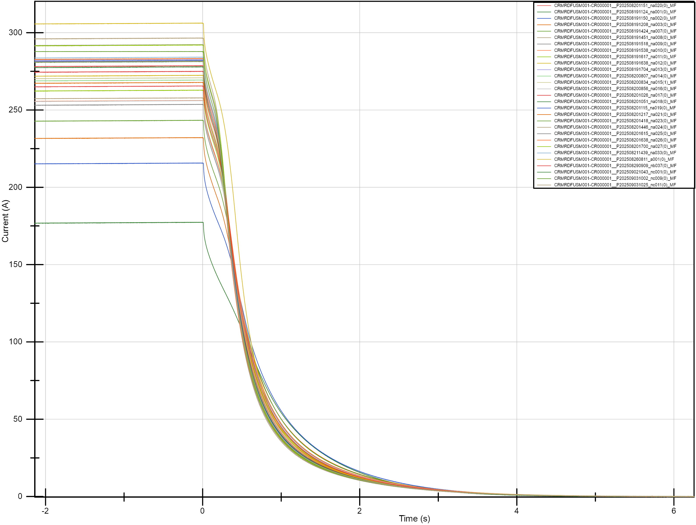
Quench current decay
1.9 K
4.5 K
The current decay at 1.9K highlights a reduced quench back contribution to the current decay.
Higher cooling power of superfluid helium could explain the reduced quench back.

Slide 14
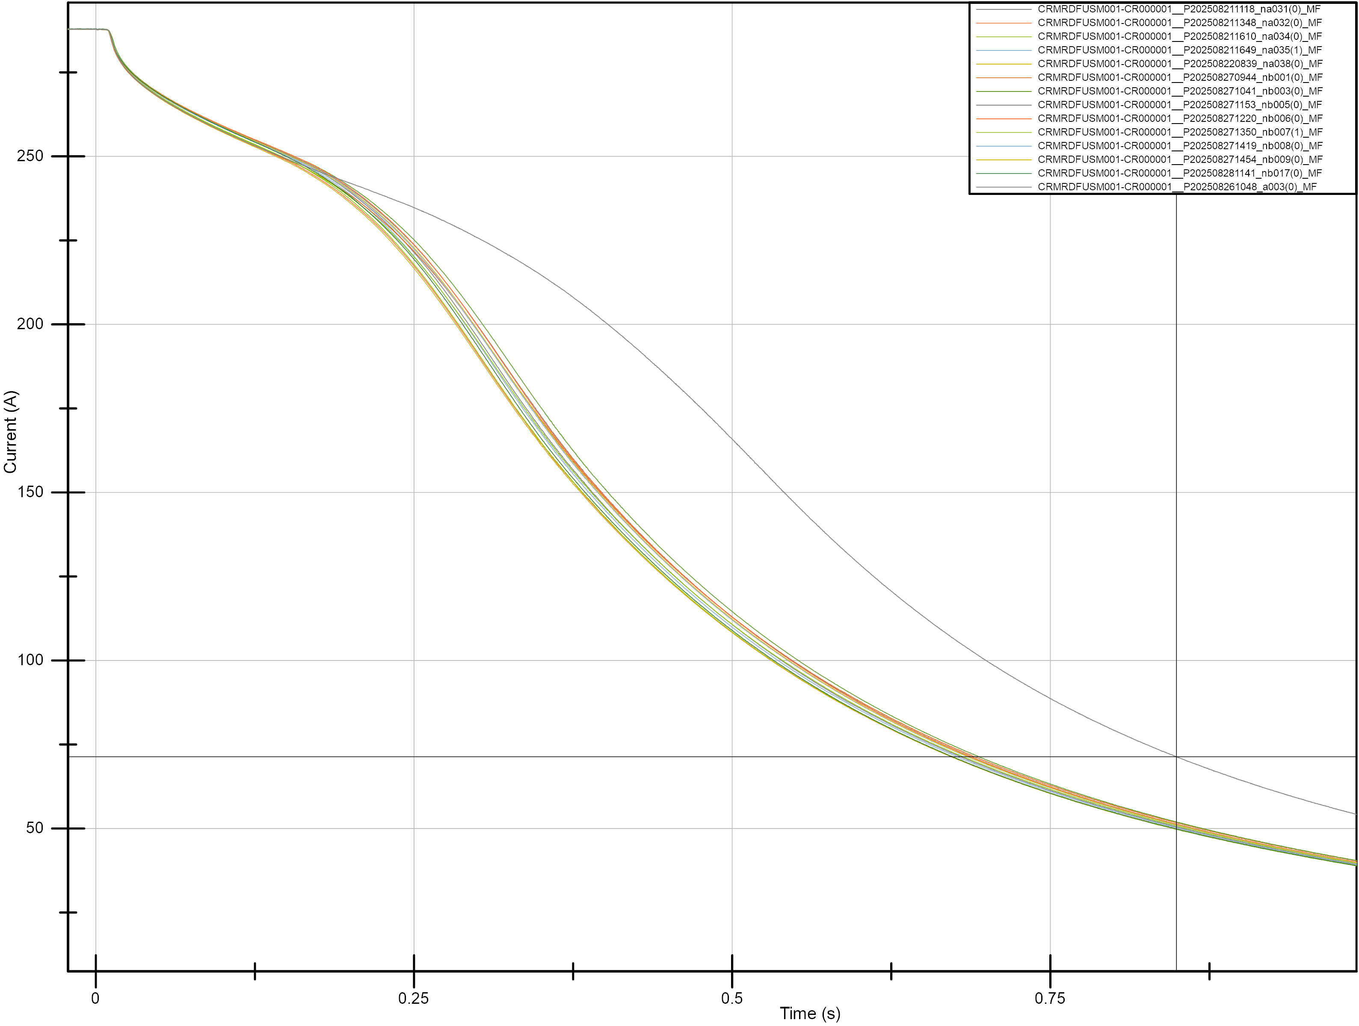
Extraction current decay
Triggered extractions from nominal current (288A and 3.00 T).
Trigger at 0 s.
First 200 ms dominated by the varistors
  Same behavior both at 4.5 K and 1.9K.
  Spread due to the temperature variation of the varistors from cycle to cycle.
After ~200 ms quench back becomes predominant.
Reduced quench back at 1.9 K => higher QI
1.9 K
4.5 K

Slide 15
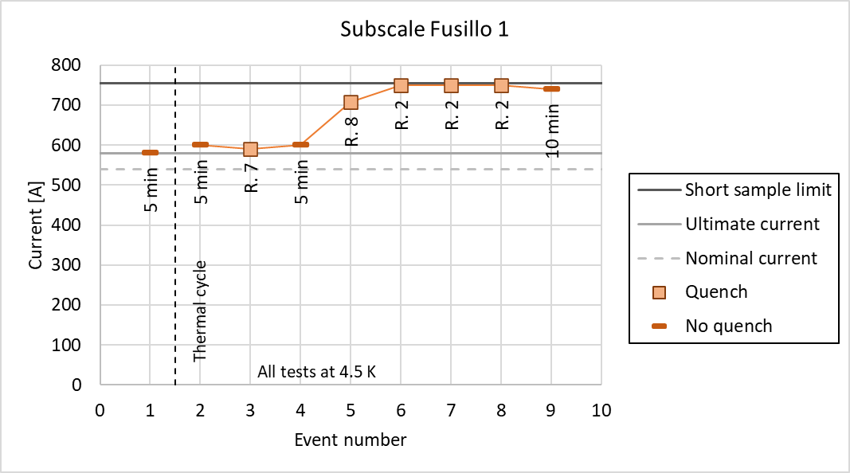
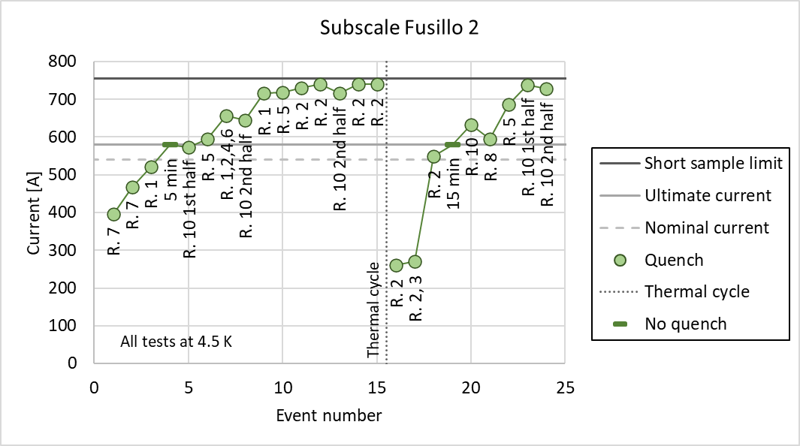
Comparison with previous subscales
Slower training compared to first two subscales.
Better memory after the thermal cycle compared to the second subscale.
Holding nominal current for 3 hours without any quench.

Slide 16
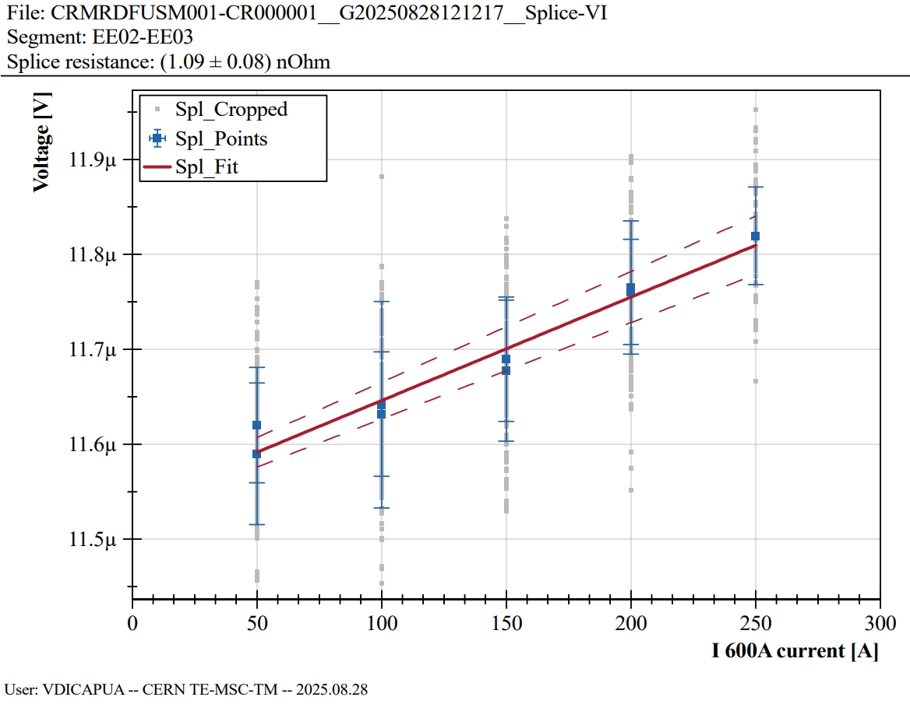
Splice resistance measurements
  10 of the 70 splices measured individually.
  Measured values are compatible with the expected value of 1.2 nOhm per splice and in line with the previous subscales.
Voltage taps | R (nOhm) | std (nOhm)
EE02-EE03 | 1.1 | 0.1
EE04-EE05 | 1.1 | 0.1
EE06-EE07 | 0.94 | 0.1
EE08-EE09 | 1 | 0.1
EE10-EE11 | 1.2 | 0.1
EE12-EE13 | 1.1 | 0.1
EE14-EE15 | 1 | 0.1
EE16-EE17 | 1.1 | 0.3
EE18-EE19 | 0.9 | 0.2
EE20-EE21 | 0.95 | 0.2

Slide 17
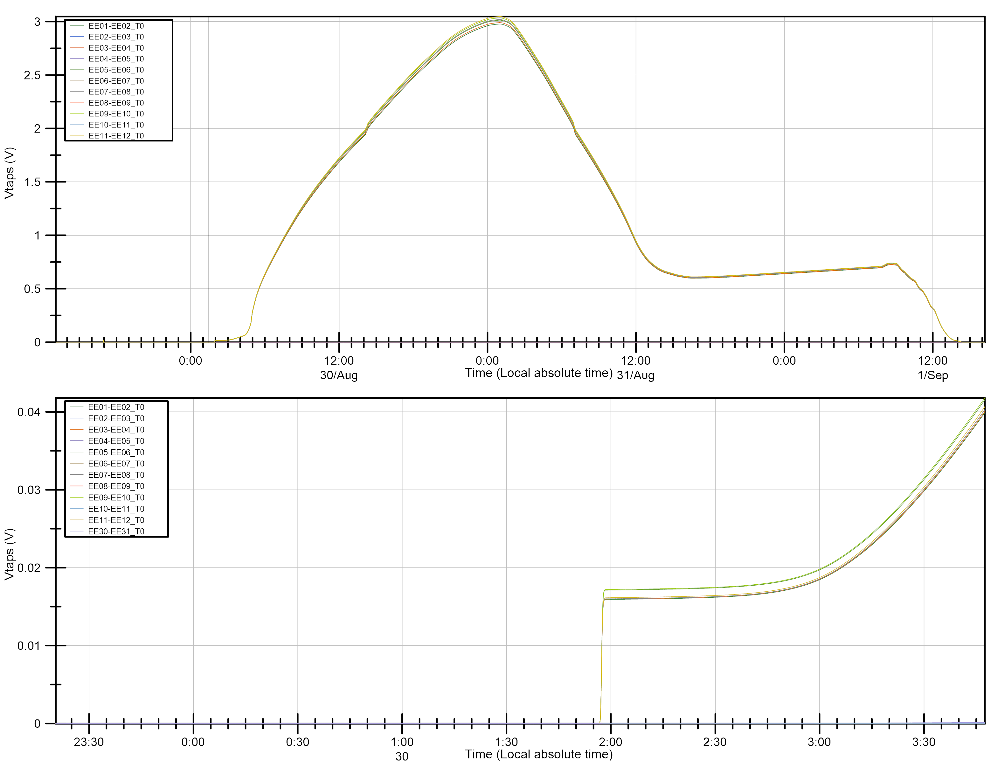
RRR
 | R_room | R_transition | RRR
 | Ohm | Ohm | -
EE01-EE02 | 62.0 | 0.32 | 193
EE03-EE04 | 62.3 | 0.33 | 191
EE05-EE06 | 62.8 | 0.35 | 180
EE07-EE08 | 62.9 | 0.33 | 193
EE09-EE10 | 63.3 | 0.34 | 183
EE11-EE12 | 63.5 | 0.33 | 193
EE13-EE14 | 63.9 | - | -
EE15-EE16 | 64.1 | 0.33 | 193
EE17-EE18 | 64.6 | 0.36 | 181
EE19-EE20 | 36.9 | 0.19 | 194
EE21-EE22 | 27.8 | 0.14 | 192
EE01-EE22 (Full magnet) | 636.0 | 3.4 | 189

Slide 18
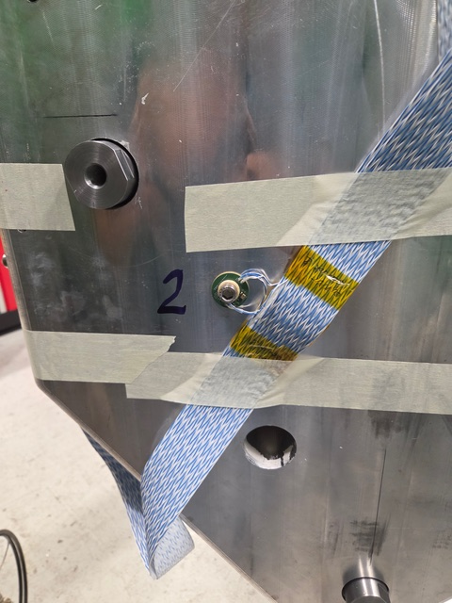
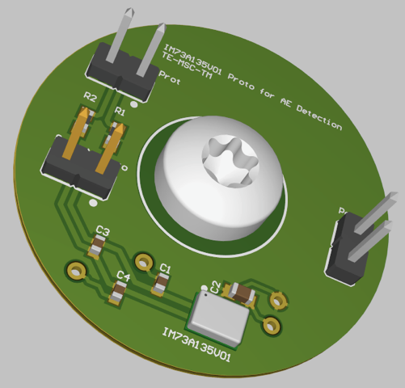
Acoustic emission measurements with MEMS
  Acoustic emission sensors based on commercial MEMS microphones (IM73A135V01).
  Custom PCB to facilitate the integration and the mechanical coupling with magnets’ structure.
  Microphones already tested at cold both at 4.5 and 1.9 K.
  First use of these sensors on a superconducting magnet.
Five microphones installed.
One lost during the magnet handling.
Sope of the test was:
  To verify the mechanical coupling and stability over thermal cycles.
  To identify needs and limitations of the sensors and of the data acquisition system.

Slide 19
Acoustic emission measurements with MEMS
  Microphone have been acquired at 50 and 100 kHz for most of the ramps during the different phases of the tests.
  In all conditions the four microphones were able to measure mechanical vibrations.
  Very good mechanical coupling with magnet structure.
  Correlation with events on the differential voltage of the magnet.

Slide 20
Acoustic emission measurements with MEMS
  Quenches captured by all the microphones.
  Quench detected by the microphones even before protection’s trigger.
  Deeper analysis of the data is still ongoing to fully understand the limit of these sensors and their potentiality.

Slide 21
Conclusions
  Magnet reached nominal current at 4.5 K in 22 quenches.
  Ultimate current reached at 1.9 K.
  Slower training but better memory after thermal cycle compared to previous subscales.
  Splices resistance and RRR within expected values an in line with subscales.
  All quenches with similar signature and preceded by precursors generated by displacement of ropes 8,9, and 10.
  Intra rope quench propagation, no inter rope propagation within observation time (max 50ms).
  First test of the acoustic emission sensors based on MEMS technology shows promising results.

Slide 23
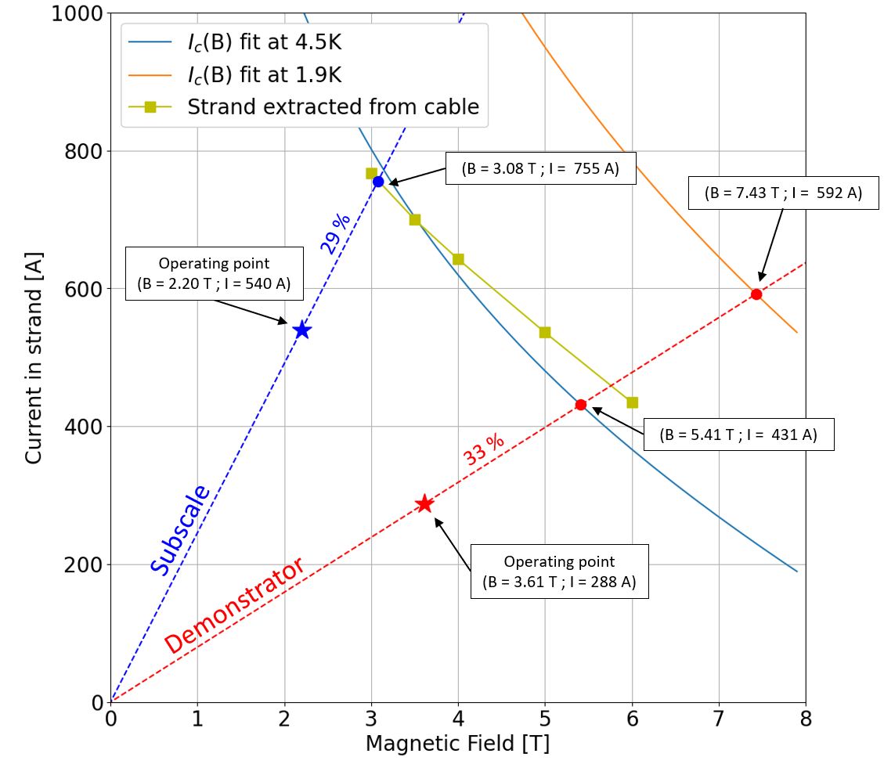
Appendix

Slide 24
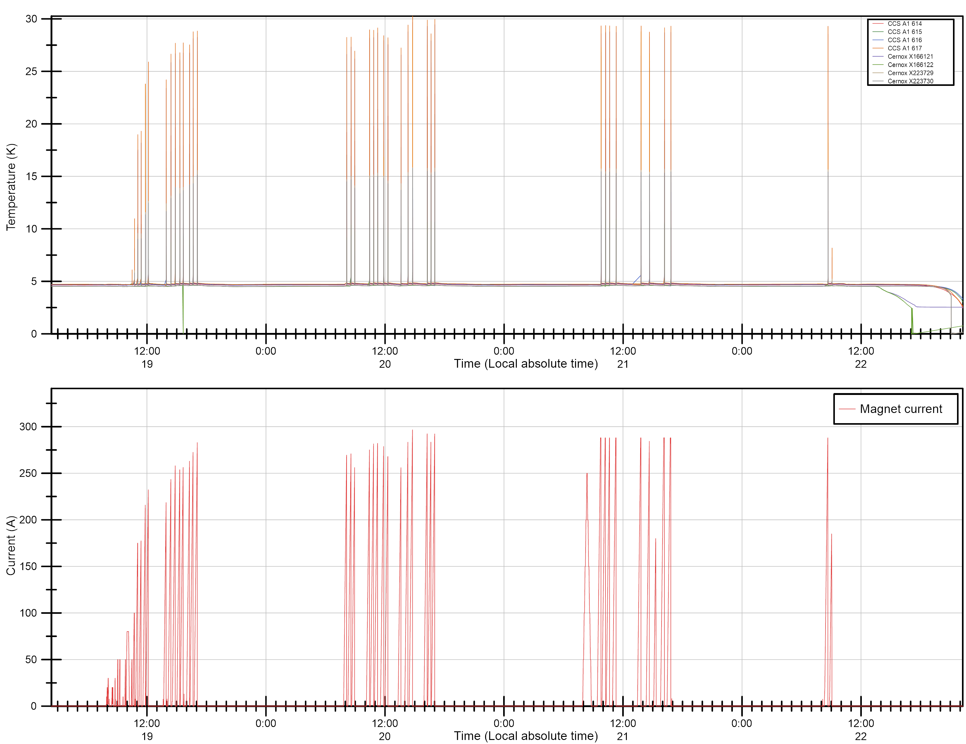
Powering Overview 4.5 K 19-22/08/2025
Protection verification.
Training (slow).
Splices.
Magnetic measurements.
Decision taken to go to 1.9 K for a faster training.

Slide 25
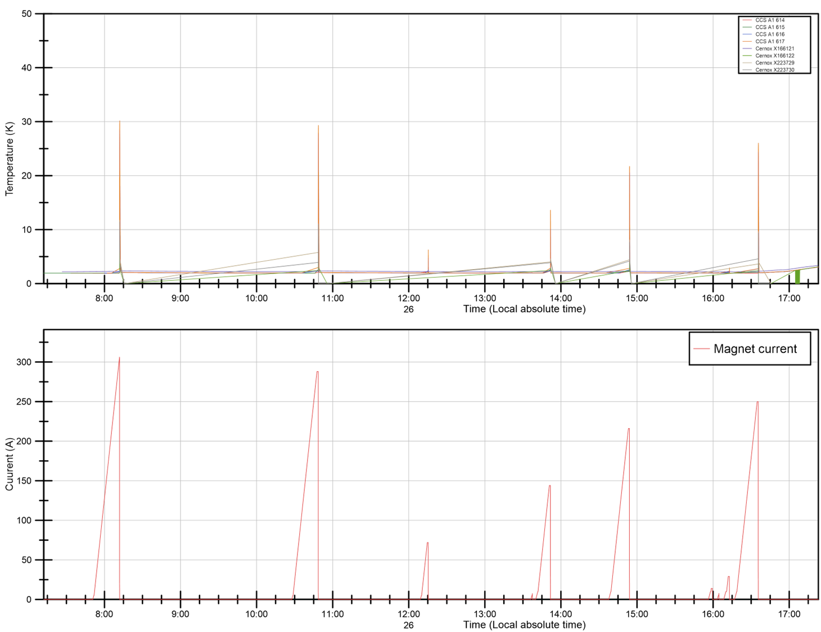
Powering Overview 1.9 K 26/08/2025
Training.
QI limit reached (~ 33 kA²s) at 306 A.
Low current extraction to extrapolate QI curve.

Slide 26
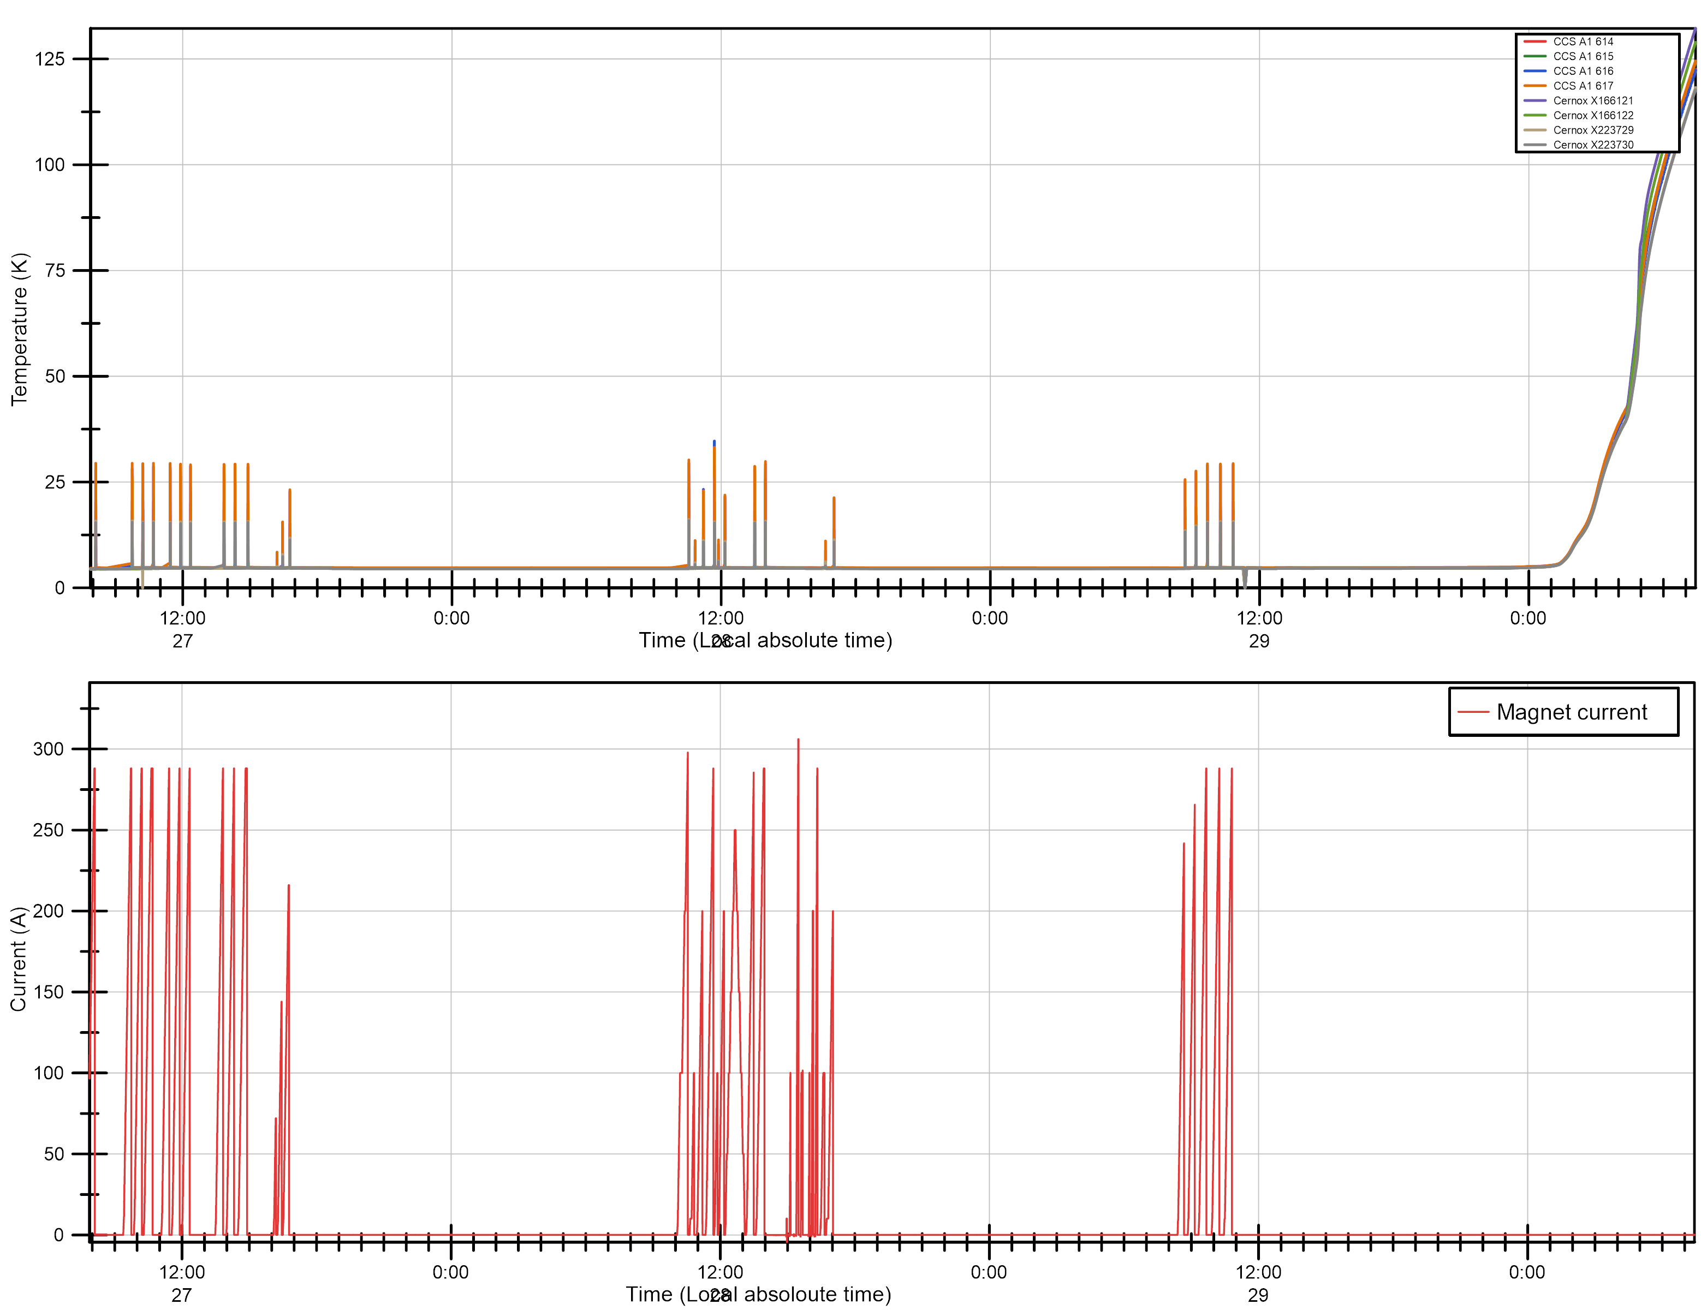
Powering Overview 4.5 K 27-29/08/2025
Magnetic measurements: 18 dedicatyed extractions at nominal current.
Splices.
Middle point extractions to complete the QI curve.
Heater studies.
FQPC studies.

Slide 27
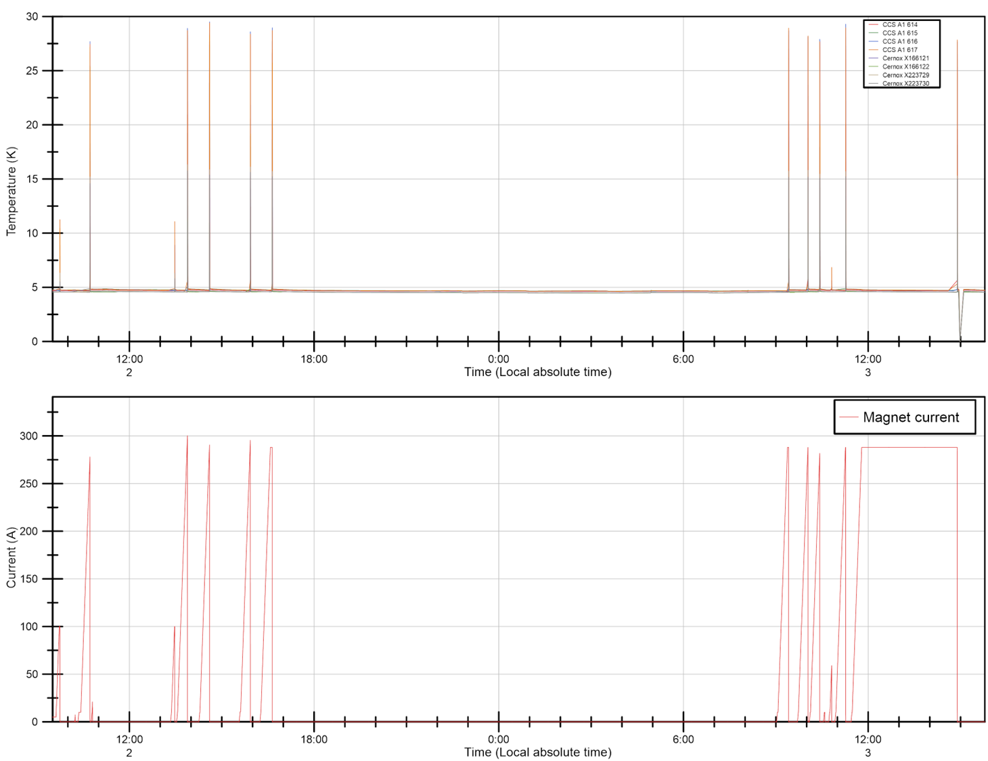
Powering Overview 4.5 K 2-3/09/2025
Training verification after thermal cycle.
2 remaining FQPC test from previous cool down.
Holding current test at nominal current (288A) for three hours.
Slow power abort for the FQPC studies.

