Slide 1

Oscilloscope setup for upcoming DRD3 TB
(proposal)
Joaquim Piñol
Stefano Terzo
Sebastian Grinstein

Slide 2
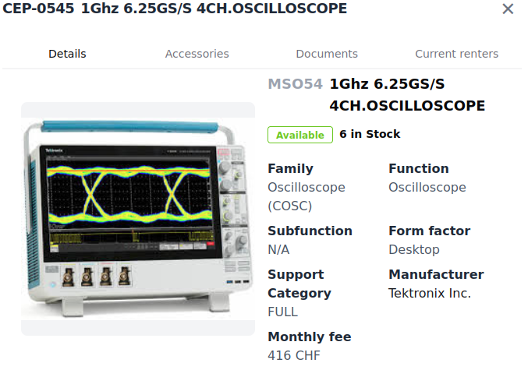
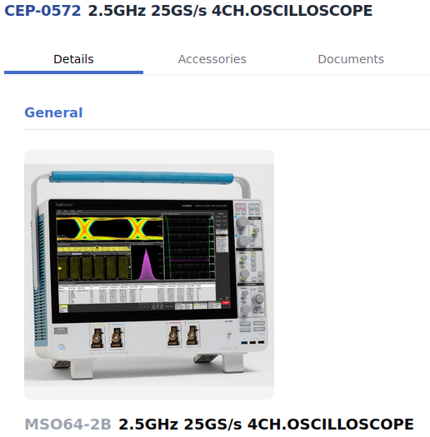
Proposed oscilloscopes
Pros:
- EUDAQ2 producer for MSO58LP available (from HGTD)
- Good BW and sampling rate
- Available at CERN e-pool (6 of them!)
- Could be possible to use several in parallel to
increase amount of channels
Cons:
- Only 4 channels (need to confirm parallel use possibility)
- Price?
Alternatives - MSO64-2B:
- Better BW and sampling rate
- Available at CERN e-pool (2 units)
- Could be possible to use several in parallel to
increase amount of channels
Cons:
- Producer could require some more changes (probably not much)
- 50% more exopensive

Slide 3
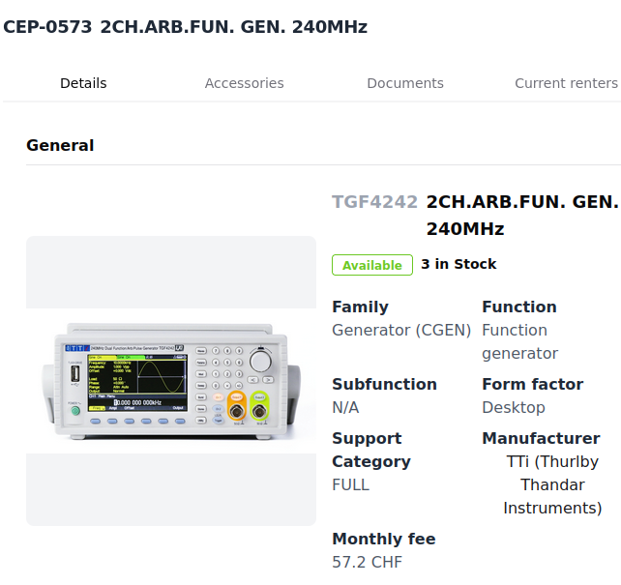
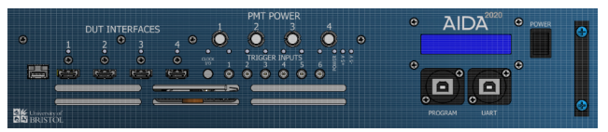
Other equipment needed
Waveform generator:
- Needed to produce the Busy signal of the oscilloscope
that feeds the TLU. It allows to stop the datataking during
the time the oscilloscope is storing the events (about 10s)
- Same model from HGTD currently available at e-pool
HDMI to Lemo adapter board:
- HDMI connects to the TLU and allows us to:
- Get a Lemo output to trigger the scope
- Input the oscilloscope Busy signal from the
wave geneerator as Lemo
AIDA TLU:
- 6x lemo input triggers:
- We’ll probably use a single one
- 4 HDMI trigger/busy interfaces, we’ll use 2:
- Telescope
- Oscilloscope (one or multiple)

Slide 4
Nice to have equipment
MCP:
- Discussions ongoing to get one, still not clear if it will happen
- Backup plan to use a 1,3*1,3mm LGAD (quite small in active size)
- Backup to use speciallized PMTs, relatively good timing and size but particle rate concern
Detector for triggering with good spatial resolution:
- CROC detector
HV source with producer / remote control:
- Would allow us to do IV scans at TB conditions

Slide 5
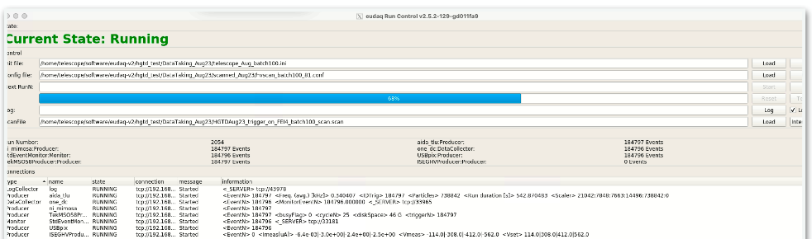

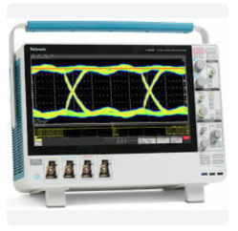
Proposed setup overview
Telescope 6x planes
DUT 1
DUT 2
Time ref
Pions
Pions
EUDAQ2
Osci producer
Telescope producer
HDMI to LEMO
AIDA TLU

Slide 6
MiniCactusV2 TB setup
Joaquim Piñol
Stefano Terzo
Sebastian Grinstein
(Material from past presentations from Philippe Schwemling and Archie Hanlon)

Slide 7
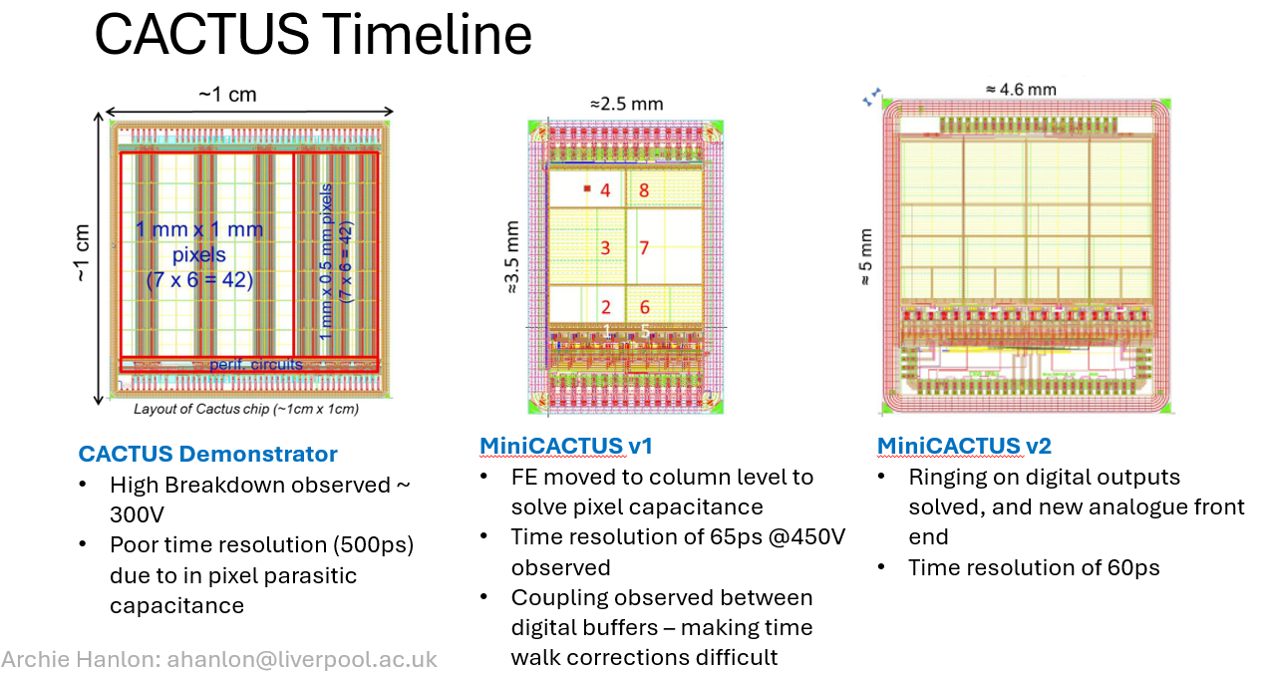
Cactus devices, now testing MiniCACTUSv2

Slide 8
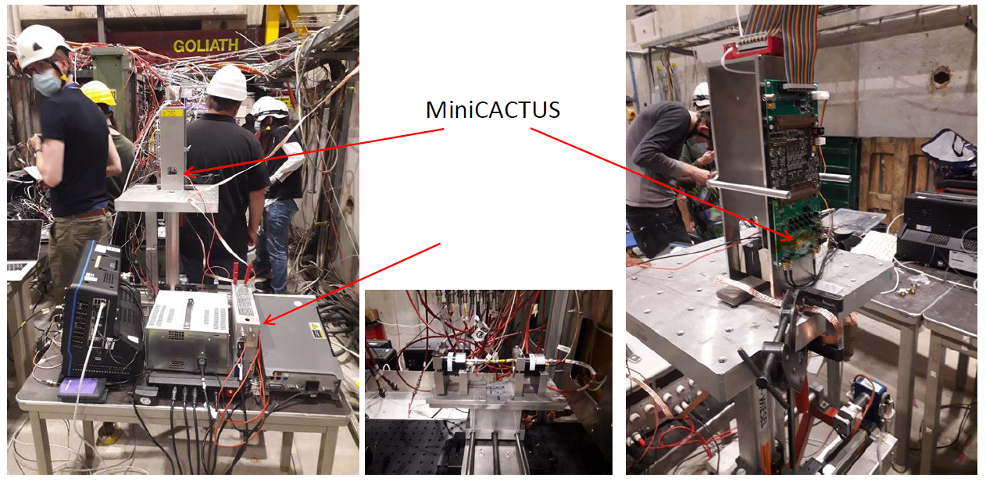
Setup overview (last year TB 2024)
From P. Schwemling

Slide 9
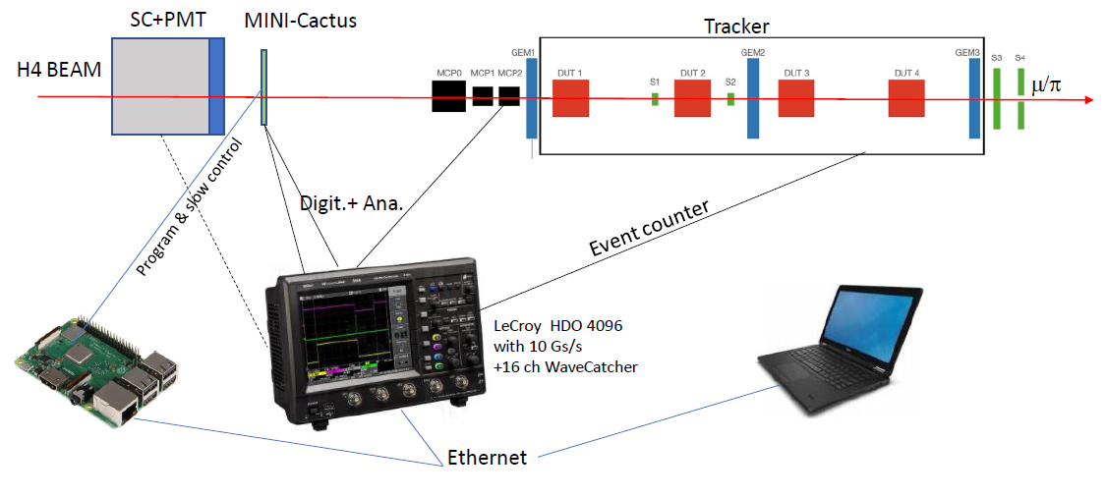
Setup overview (last year TB 2024)
From P. Schwemling

Slide 10
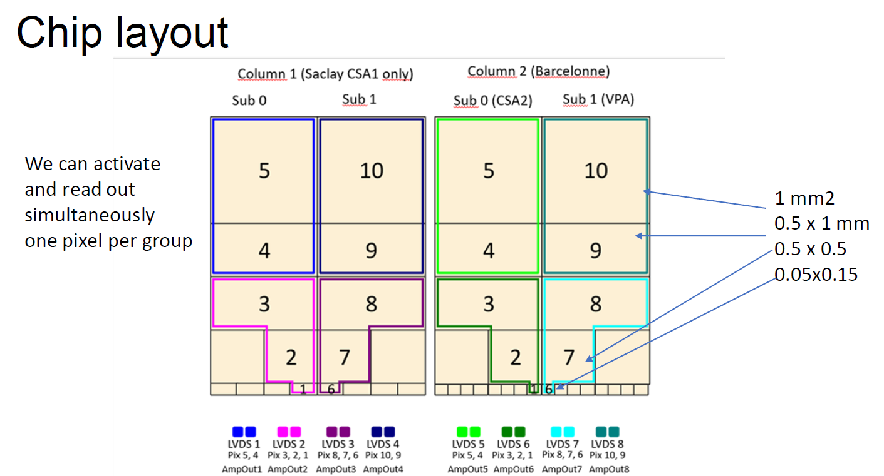
Setup overview (last year TB 2024)
From P. Schwemling
Each LVDS group has a differnet physical channel output (digital and analog) and
can be configured to read 2 or 3 channels (non-simultaneously)

Slide 11
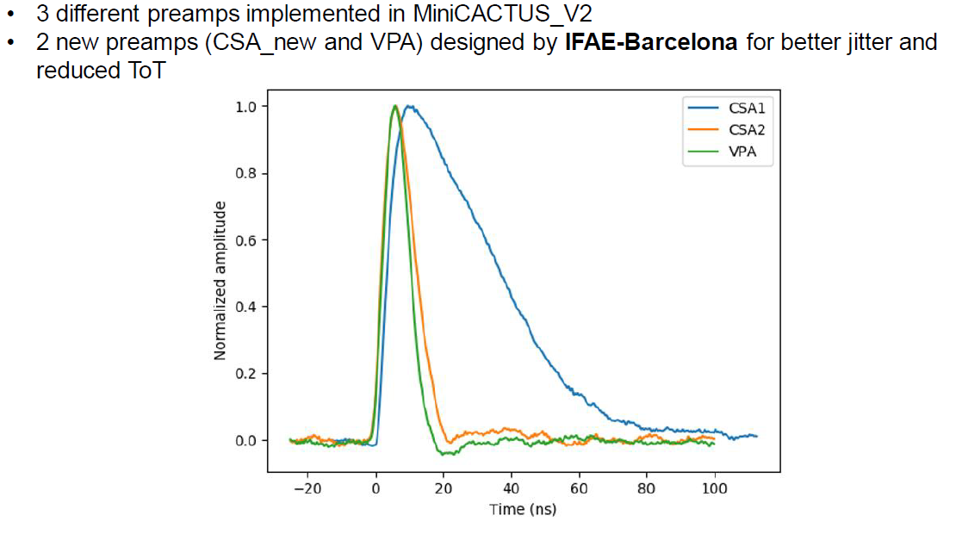
Analog output rise/fall time comparison Col1 / Col2
From P. Schwemling
This has to be taken into account to determine max rate acceptable

