Slide 1
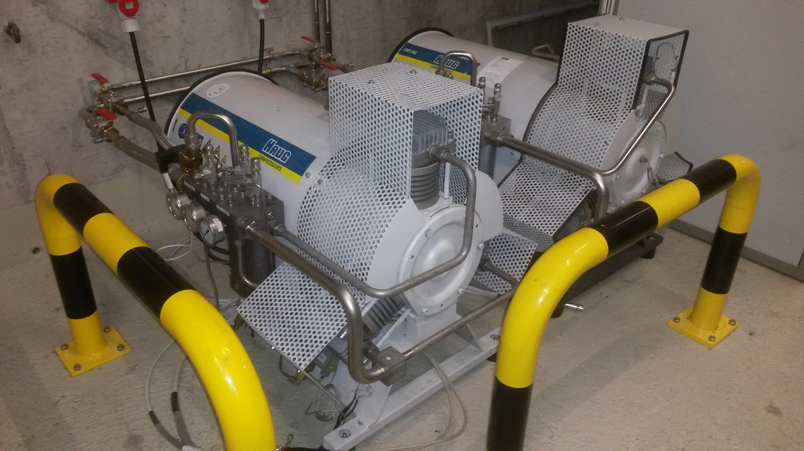
ALICE LS3 GAS OPERATIONS
TPC pumps maintenance
Pumps to send to manufacturer x 2
Checks and replace used pieces

Slide 2
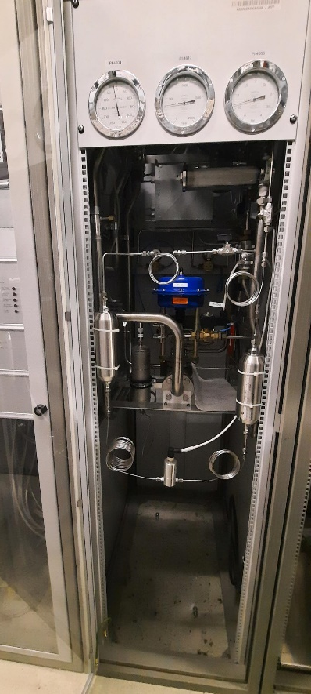
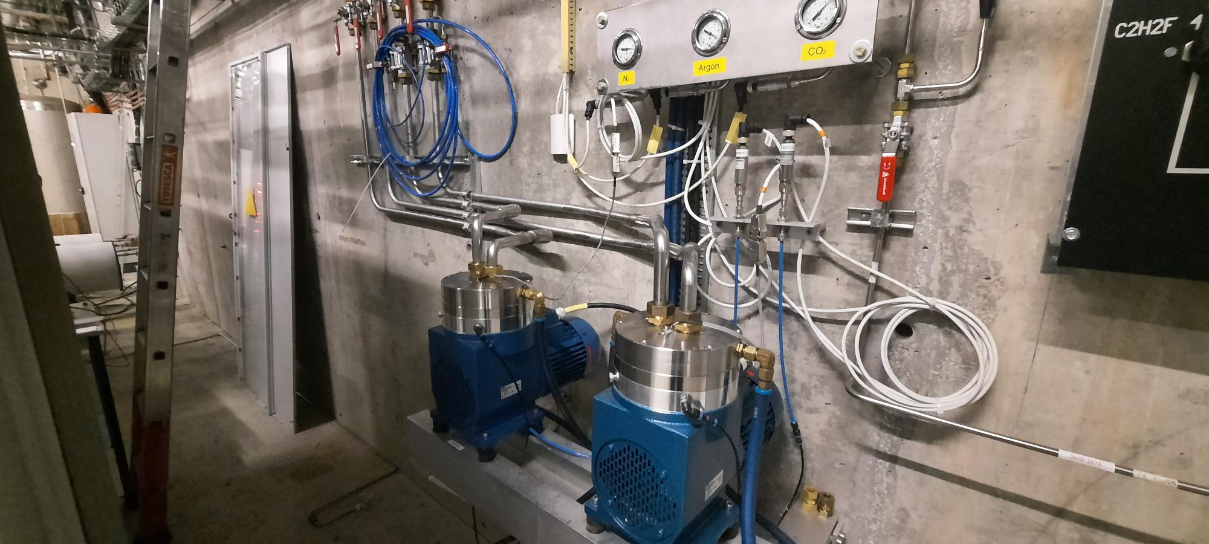
ALICE LS3 GAS OPERATIONS
TOF Filters operations
Filter change / improve places

Slide 3
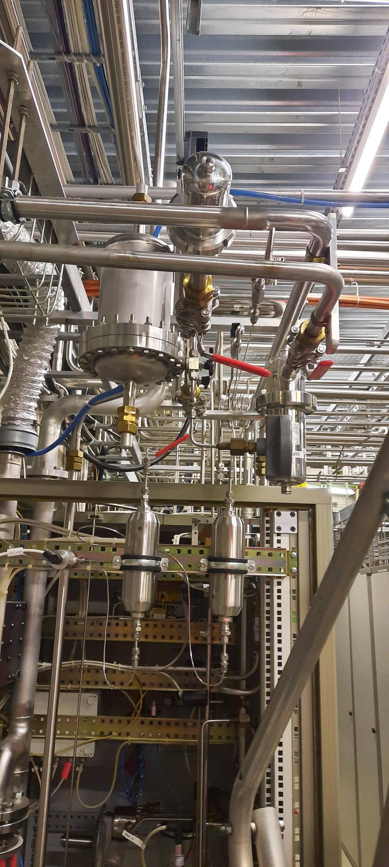
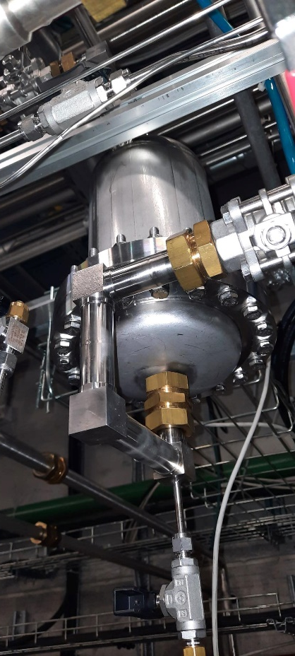
ALICE LS3 GAS OPERATIONS
TPC Filters operations
Filter change / improve instalation

Slide 4
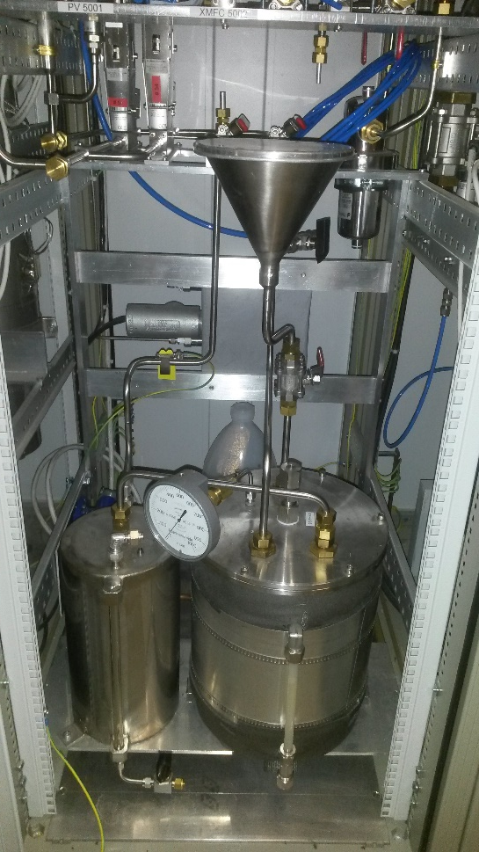
ALICE LS3 GAS OPERATIONS
Humidifier MID
MID humidifier filling improvement

Slide 5
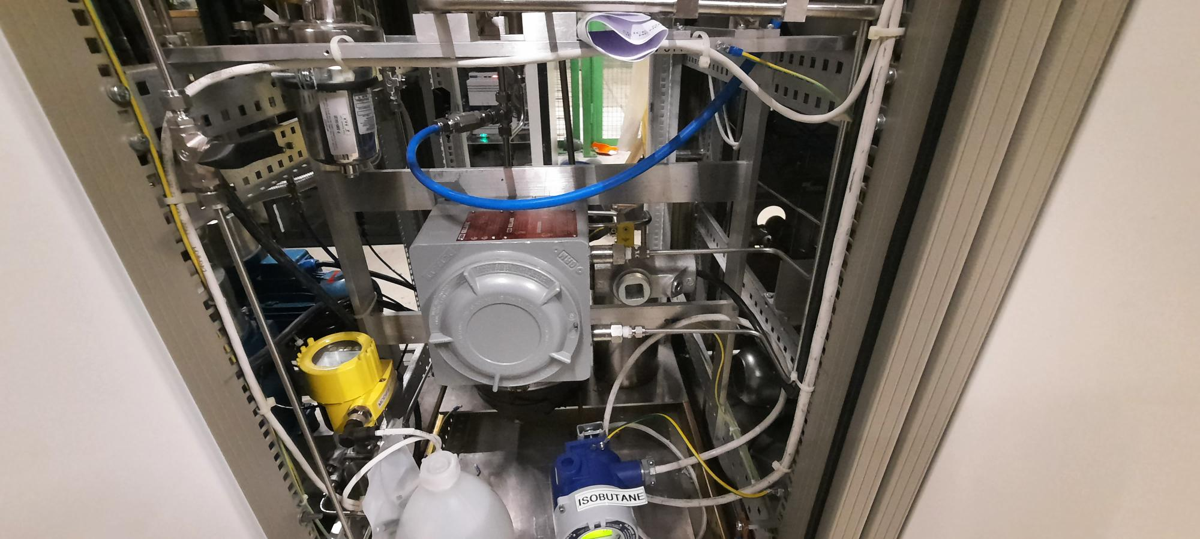
ALICE LS3 GAS OPERATIONS
Analysis check and calibrations
MID humidifier dewpoint

Slide 6
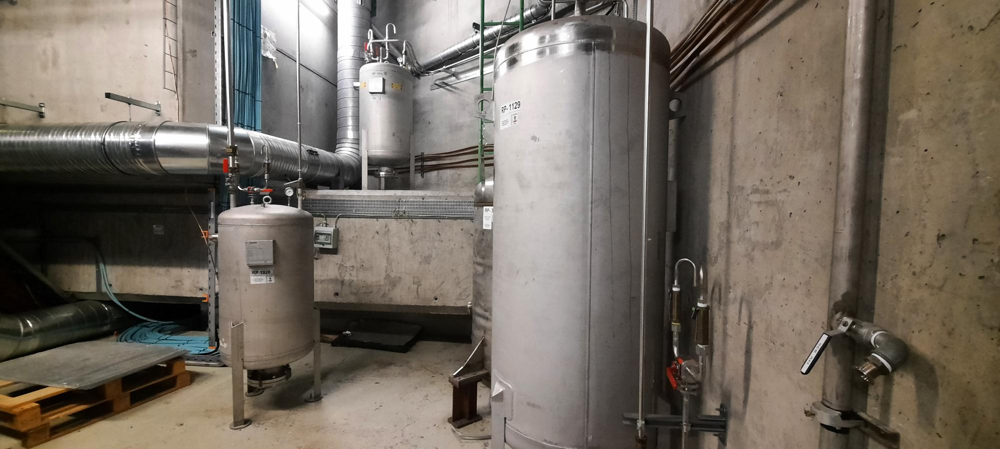
ALICE LS3 GAS OPERATIONS
Buffers and volumes pressure tests
TPC / TRD / MID / TOF buffers

Slide 7
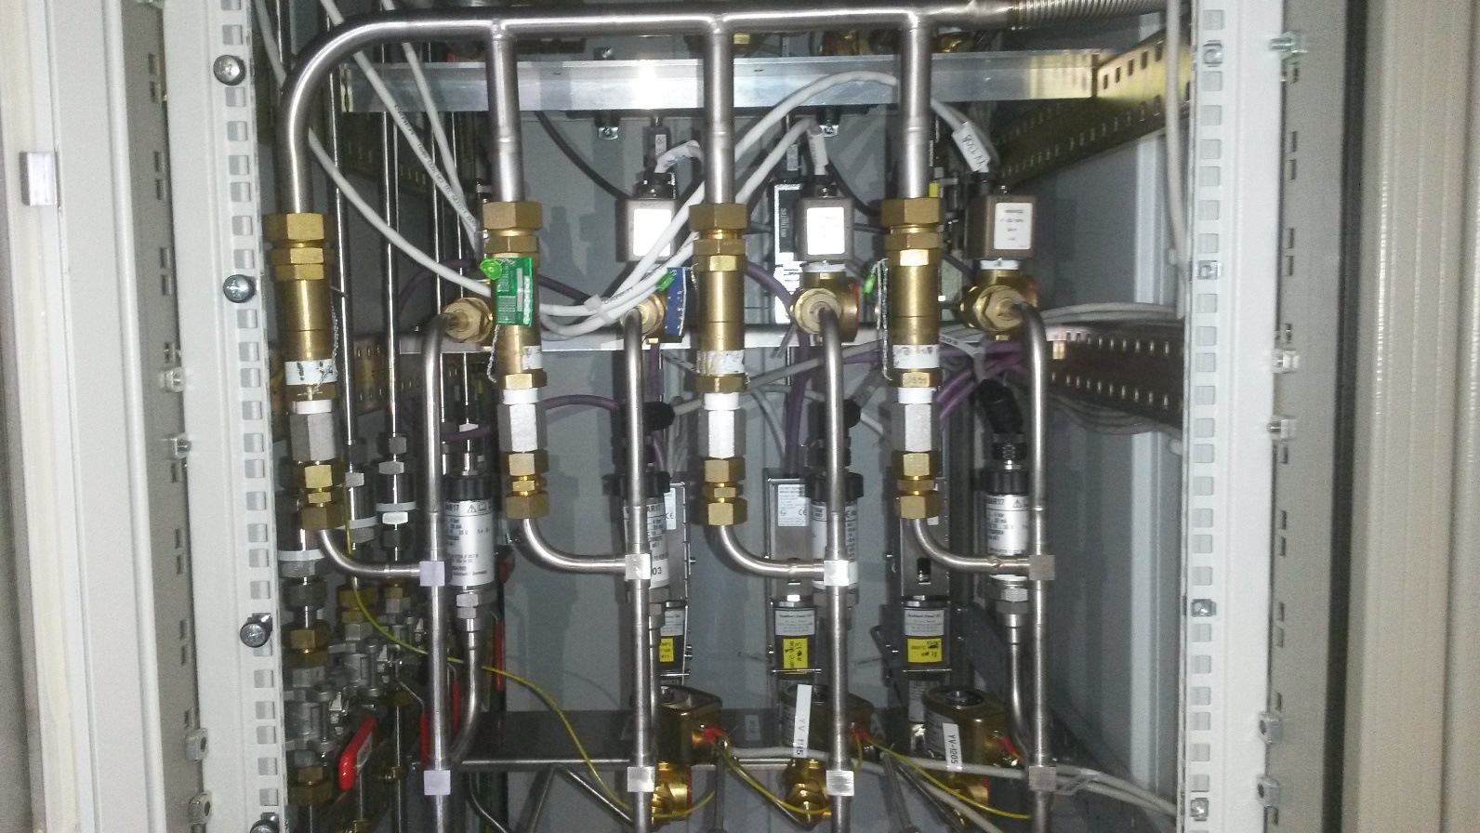
ALICE LS3 GAS OPERATIONS
SAFETY VALVES checks

Slide 8
ALICE LS3 GAS OPERATIONS
Electrical part
Grounding checks
Power supplies checks
Connections checks
Disjunctors checks
Drawings improvement
…….

