Slide 1


Integrating GPU Workloads in HEPScore
Concept and Status
Robin Hofsaess (CERN), Domenico Giordano (CERN),
on behalf of the HEPiX Benchmarking Group
01.10.2025
NOT OFFICIAL - generated with AI

Slide 2
Overview
GPU Workloads for HEPScore
The Process of Integrating GPU Workloads
Status and First Results
Next Steps
Summary

Slide 3
GPU Workloads for HEPScore

Slide 4
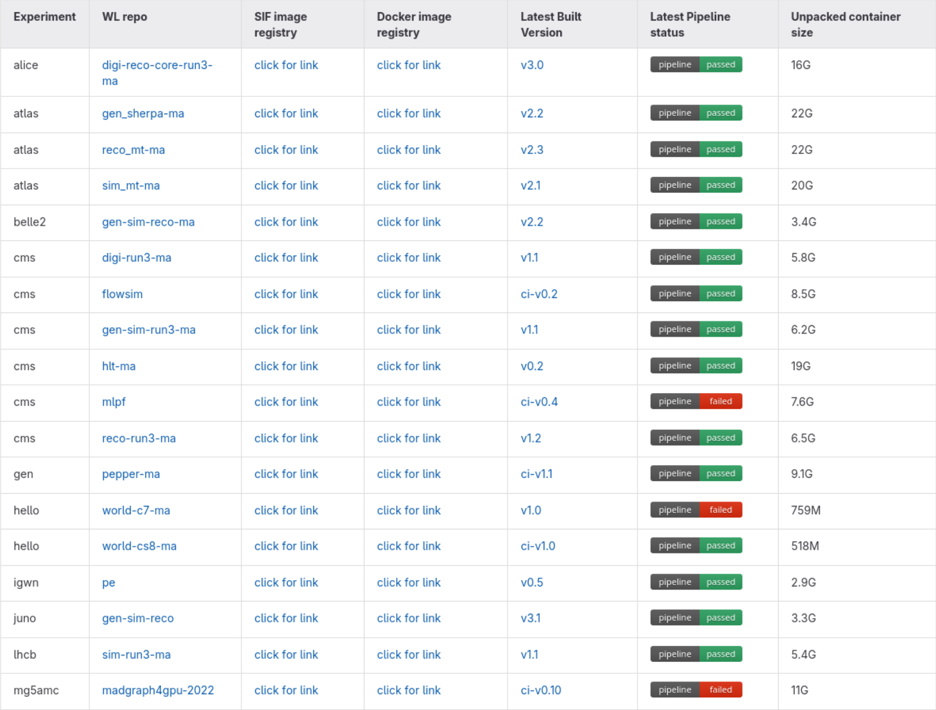
Workload Overview
GPU Workloads for HEPScore
30.06.2025
hep-workloads
What is running inside HEPscore
GPU
Click me for all the details!
Workload list

Slide 5
Workload Overview
GPU Workloads for HEPScore
01.10.2025
Workload | Type
CMS-HLT-GPU | Reconstruction
Pepper-GPU | Simulation
CMS-Flowsim-GPU* | Inference
CMS-MLPF-GPU* | Training
Madgraph-GPU | Simulation
Alice-O2-GPU | Reconstruction
Synthetic-GPU | Synthetic+ML(?)
ET-RIFT | --External--
CMS-HLT-MA | Reconstruction
madgraph4gpu-2022 | Simulation
CMS-HGCAL** | Inference
Several new revisions and completely new contributions!
Many thanks to the experts providing the WLs and support!
* ML-based WLs
** Candidate, to be evaluated

Slide 6
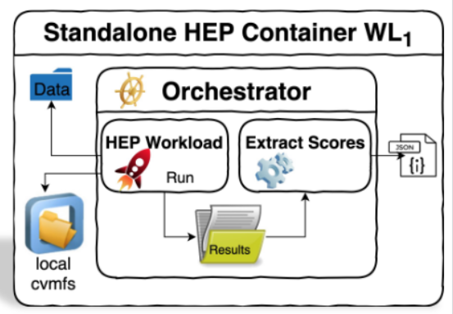
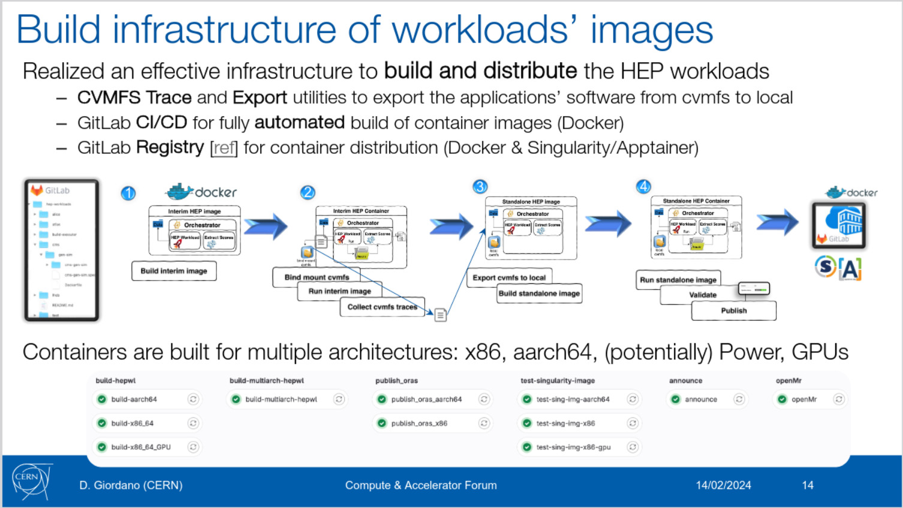
GPU Workload Concept
GPU Workloads for HEPScore
GPU workloads are part of the standard framework
The general concept is similar to CPU:
  GPU workloads are created as individual container images
  We utilize the available build infrastructure
More details:
Domenico’s presentation

Slide 7
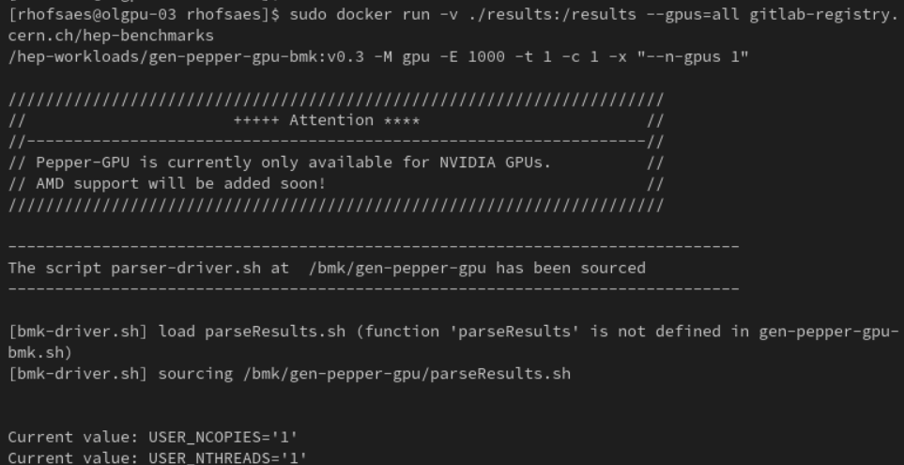
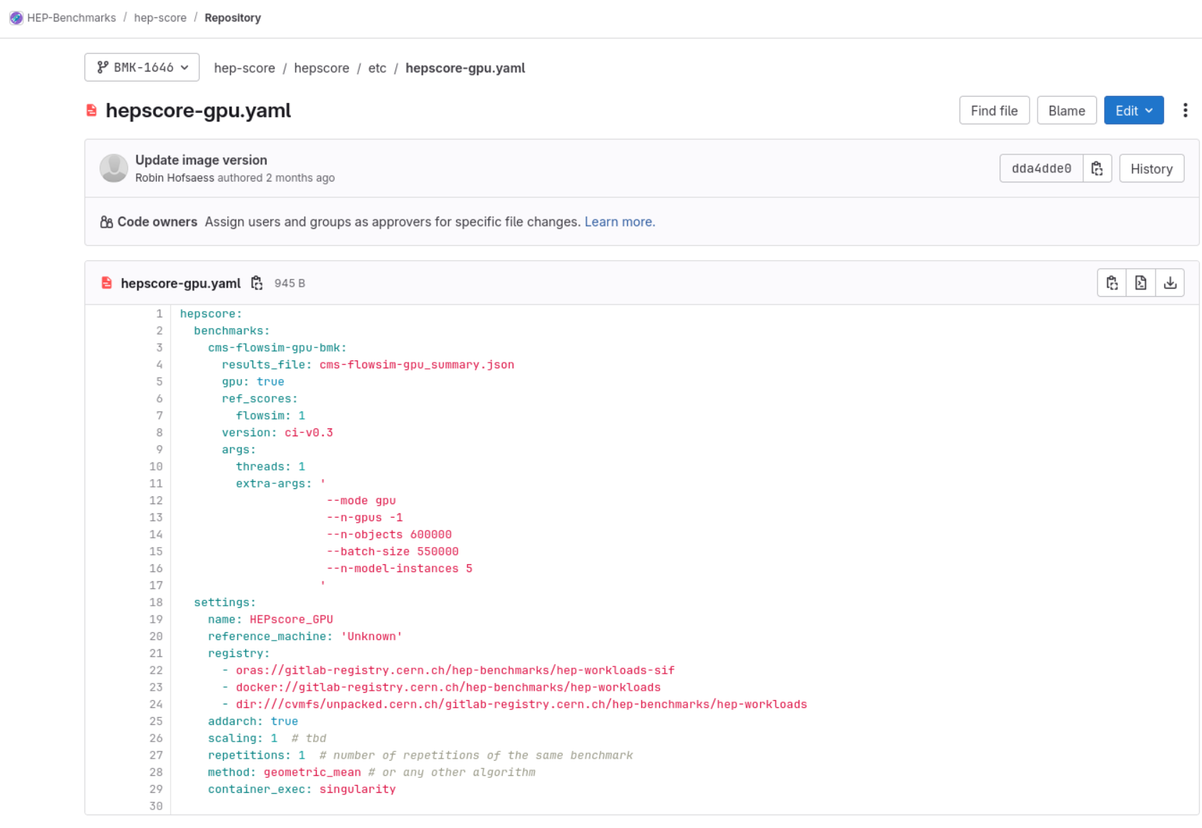
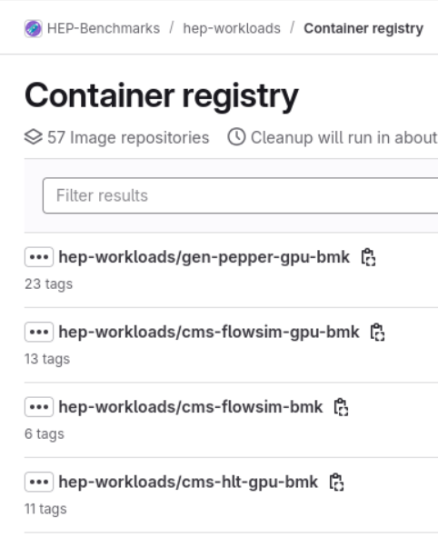
Running GPU Workloads
GPU Workloads for HEPScore
The containers can be executed directly (with docker/apptainer)
or as part of HEPScore

Slide 8
The Process of Integrating GPU WLs

Slide 9
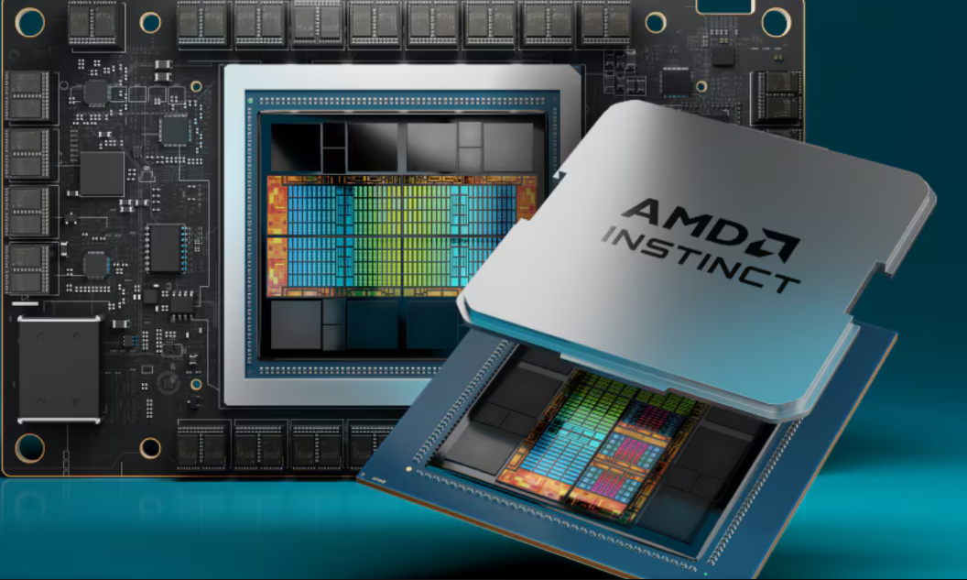
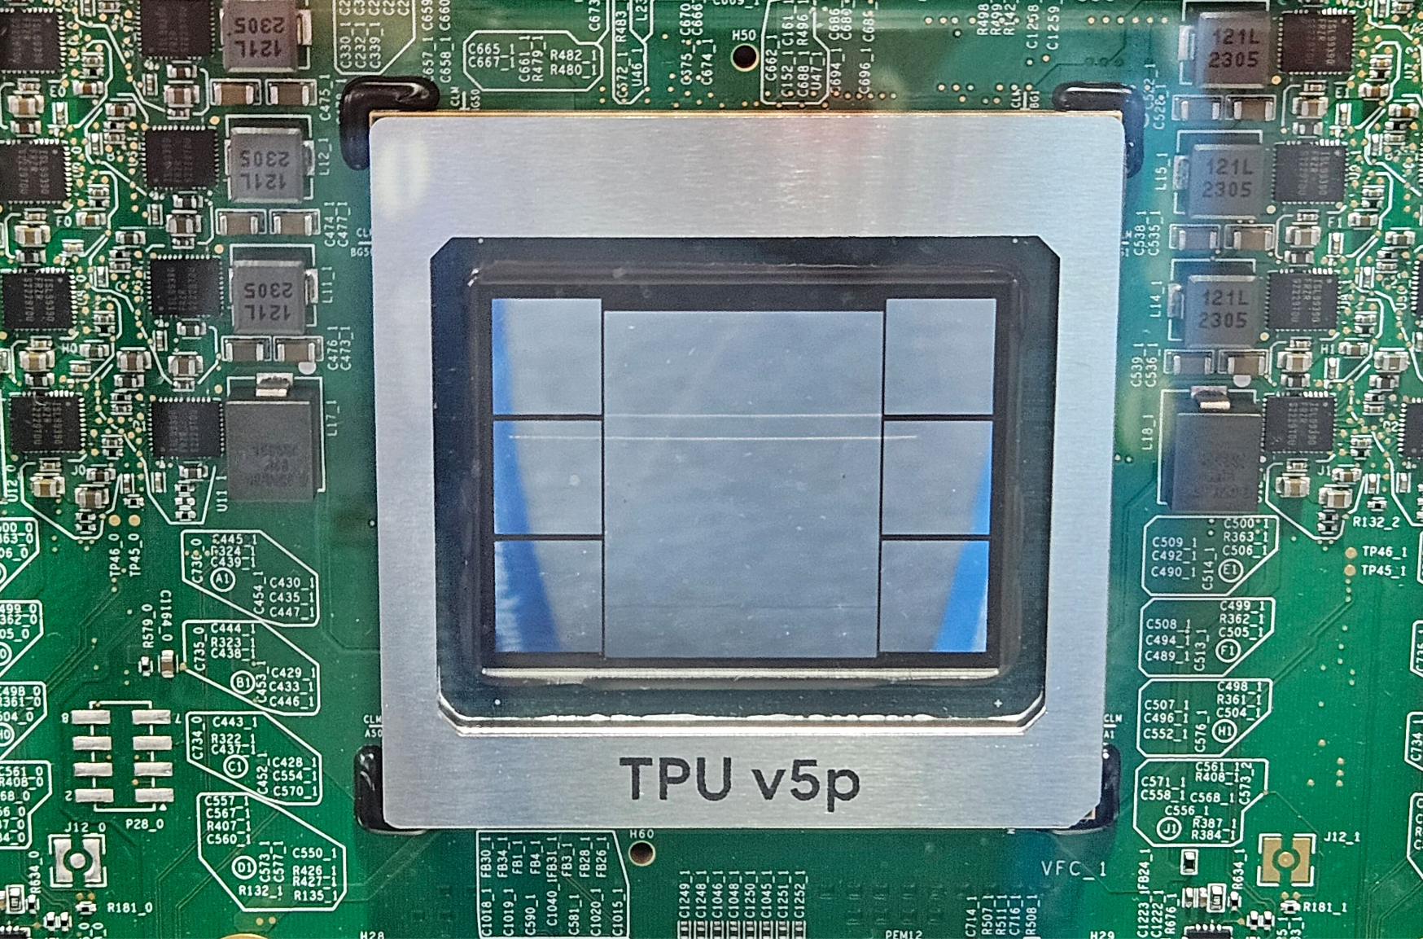
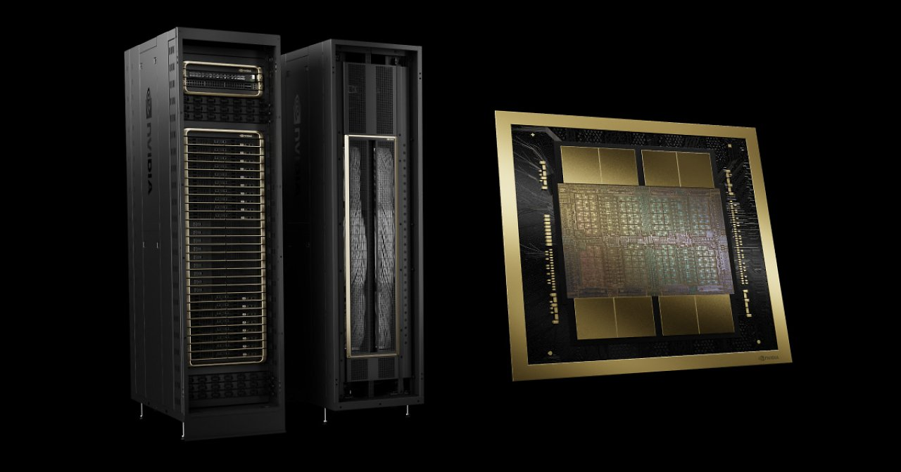
Challenges
The Process of Integrating GPU Workloads
GPU (systems) strongly differ, depending on the focus (AI, compute, …)
Additional requirements (drivers, SW packages, …)
Lot’s of development (and progress!) ongoing -> moving target
GPU applications are less deterministic due to high parallelism
  Careful calibration and validations are required
GPUs are used way more heterogeneously than CPUs
Source: AMD
Source: computerbase / Google
Source: pcgameshardware / Nvidia

Slide 10
Heterogeneous GPU Workloads
The Process of Integrating GPU Workloads
GPUs are used way more heterogeneously than CPUs:
  The machine utilization highly depends on the payload
  Different configurations are possible
GPU applications are often highly optimized for a given infrastructure
  We need to find valid and broadly representative working points
We try to include many different kinds
CPU
01 | 02 | 05 | 06 | 09 | 10 | 13 | 14
03 | 04 | 07 | 08 | 11 | 12 | 15 | 16
17 | 18 | 21 | 22 | 25 | 26 | 29 | 30
19 | 20 | 23 | 24 | 27 | 28 | 31 | 32
CPU
01 | 02 | 05 | 06 | 09 | 10 | 13 | 14
03 | 04 | 07 | 08 | 11 | 12 | 15 | 16
17 | 18 | 21 | 22 | 25 | 26 | 29 | 30
19 | 20 | 23 | 24 | 27 | 28 | 31 | 32
CPU
01 | 02 | 05 | 06 | 09 | 10 | 13 | 14
03 | 04 | 07 | 08 | 11 | 12 | 15 | 16
17 | 18 | 21 | 22 | 25 | 26 | 29 | 30
19 | 20 | 23 | 24 | 27 | 28 | 31 | 32
GPU
GPU
100%
…

Slide 11
Heterogeneous GPU Workloads: Example Conf
The Process of Integrating GPU Workloads
hepscore-gpu.yaml
For our WLs, we will aim for a comparable configuration and execution:
As close as possible to the real-world
(production) application
Runtime: ~10min
Close to 100% load on GPU
Ideally, 1C <-> 1GPU
  (As independent as possible)
If possible: can also run on CPU only
Score:
  Event-based: throughput (ev/s) normalized to a reference server/GPU
CPU
01 | 02 | 05 | 06 | 09 | 10 | 13 | 14
03 | 04 | 07 | 08 | 11 | 12 | 15 | 16
17 | 18 | 21 | 22 | 25 | 26 | 29 | 30
19 | 20 | 23 | 24 | 27 | 28 | 31 | 32
GPU
100%
Other configs for different workload types might follow!

Slide 12
The Integration Process
The Process of Integrating GPU Workloads
We approach teams and ask for GPU contributions to HEPScore
Experts provide payload, data, instructions, and support
(First) testing and evaluation of the payload
Development part
Building images in our CI Infrastructure
Integrating the payload:
The development part
Creating a WL concept
Data analysis part
Testing and QA
Full evaluation and analysis of the WL
Pre-release versions:
Validation and extended studies
Future
Integration into HEPScore
Creating default HEPScore configuration(s)
Reference measurements/ calibration

Slide 13
If it would be that easy…
The Process of Integrating GPU Workloads
Full madgraph example in backup
Maybe changes are required/
things are not working (as expected)
We approach teams and ask for GPU contributions to HEPScore
Experts provide payload, data, instructions, and support
(First) testing and evaluation of the payload
Update for the payload available
Rebuilding on
every change
Unexpected
results
Building images in our CI Infrastructure
Integrating the payload:
The development part
Creating a WL concept
Ask for help
Restart for the next one
Repeating for
every dev
version
Consult the
experts
Problems found
Changes required
Results not as expected/desired
Testing and QA
Full evaluation and analysis of the WL
Pre-release versions:
Validation and extended studies
Future
Integration into HEPScore
Creating default HEPScore configuration(s)
Reference measurements/ calibration

Slide 14
How to improve?
The Process of Integrating GPU WLs

Slide 15
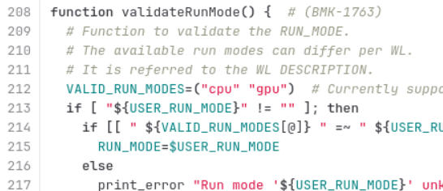
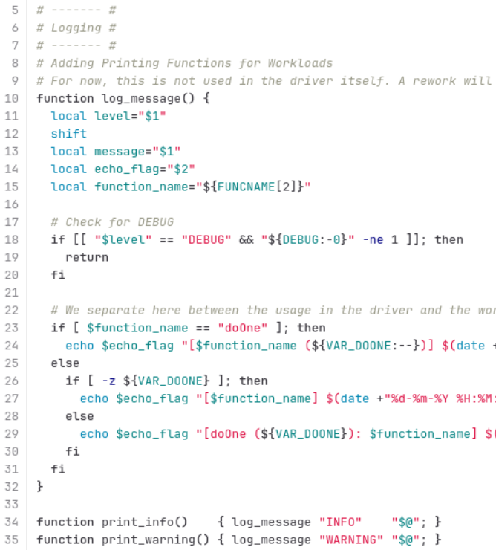
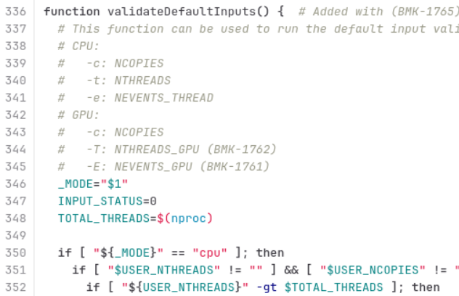
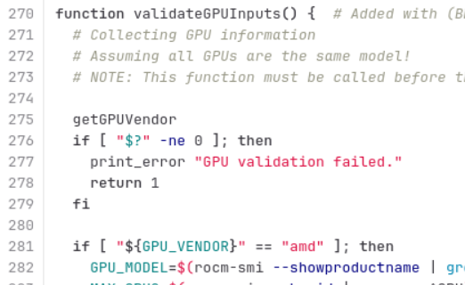
Process Optimization: Unified Concept
The Process of Integrating GPU Workloads
For a consistent implementation, a standardized GPU WL concept has been introduced
This includes a consistent structure, input validation, and logging for all WLs
function doOne(){}
1) Print copy config
2) Write inputs to file
3) Standard
function validateInputArguments(){}
1) handle EXTRA_ARGS
2) validateRunMode
3) validateGPUInputs
4) validateDefaultInputs
5) WL-specific adaptations
WL Structure:
1) Set defaults
2) input validation
3) doOne
4) clean workdir (opt)

Slide 16
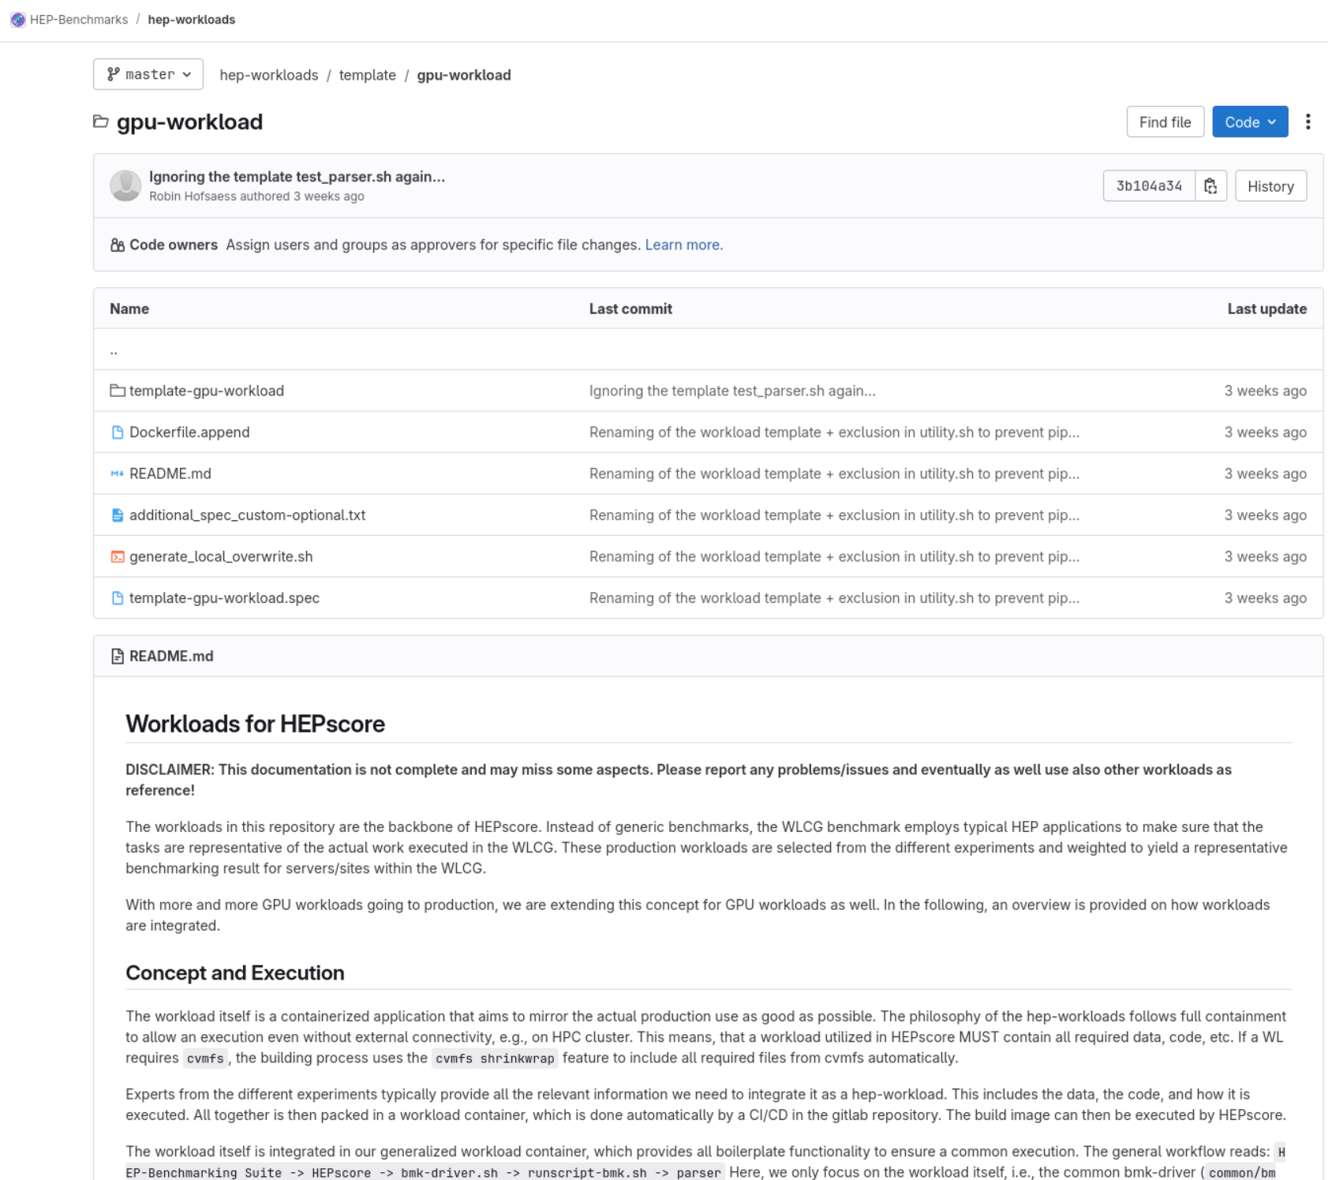
Providing a (GPU) Workload Template
The Process of Integrating GPU Workloads
A (GPU) workload template is available
It explains the concept and how (GPU) workloads are structured
Additionally, C&P templates are provided
Future plan: It should be integrated as a fully functioning WL to demonstrate the functionality and simplify the creation of new WLs

Slide 17
Status and First Results

Slide 18
CMS-HLT-GPU
Status and First Results
hep-workloads/cms-hlt-gpu
The workflow reads RAW CMS data and executes the CMS-HLT as
in production end of 2024
CMSSW: CMSSW_15_0_7, GT: 150X_dataRun3_HLT_v1
Two versions were provided by the expert:
  Full HLT run config
  GPU part only -> default for our WL
  (Allows speed up studies)
Score: ev/s
Thanks to Andrea Bocci!
apptainer run --nv -B ./results:/results \ oras://gitlab-registry.cern.ch/hep-benchmarks/hep-workloads-sif/cms-hlt-gpu-bmk:ci-v0.2 \
-M gpu -c 1 -T 4 -E 50000 -x ‘--n-gpus 1 –instances-per-gpu 6’

Slide 19
CMS-HLT-GPU: Configuration
Status and First Results
CPU
01 | 02 | 05 | 06 | 09 | 10 | 13 | 14
03 | 04 | 07 | 08 | 11 | 12 | 15 | 16
17 | 18 | 21 | 22 | 25 | 26 | 29 | 30
19 | 20 | 23 | 24 | 27 | 28 | 31 | 32
CPU
01 | 02 | 05 | 06 | 09 | 10 | 13 | 14
03 | 04 | 07 | 08 | 11 | 12 | 15 | 16
17 | 18 | 21 | 22 | 25 | 26 | 29 | 30
19 | 20 | 23 | 24 | 27 | 28 | 31 | 32
GPU
How it works:
  N copies of the WL are spawned
  Several instances of CMSSW per copy (just as in production)
  ‘--instances-per-gpu’: Number of instances is limited by the GPU memory (and CPU threads, if enforced)
Threads per copy/instance has to be investigated
75000 events available – can easily be extended
…
Configurable parameters:
Number of copies (<-> GPUS)
Number of instances per GPU
Number of threads per instance
Number of events (< 75000)
Config version

Slide 20
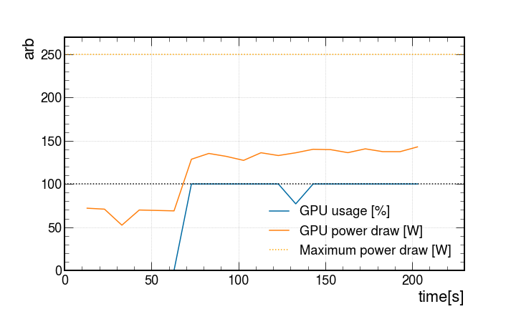
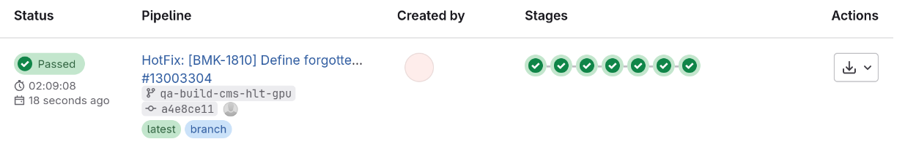
CMS-HLT-GPU: Evaluation
Status and First Results
Found a bug recently (on our side) :(
Fixed yesterday
  (Learned a lot about our infrastructure)
First results show some issues
  High failure rate (~10%)
  Valid and stable working point needs to be found
  Studies are running
not (yet) at max
initialization phase
New release version will be available in the next days!

Slide 21
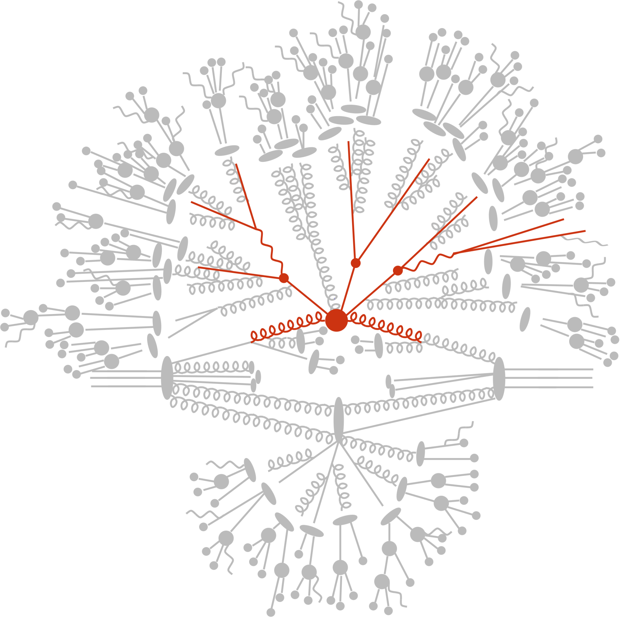
GEN-PEPPER-GPU
Status and First Results
hep-workloads/gen-pepper-gpu
PEPPER: Parton-level event generator
Highly scalable and runs efficient on CPU and GPU
For the WL, we have tested and integrated different
physics processes:
  pp->tt->jjj (current default in v0.3)
  gg->tt->ggg (will be the new default in v0.4, see next slides)
Score: ev/s
E. Bothmann, ACAT25
Thanks to Enrico Bothmann!
apptainer run --nv -B ./results:/results \ oras://gitlab-registry.cern.ch/hep-benchmarks/hep-workloads-sif/gen-pepper-gpu-bmk:v0.3 \
-M gpu -x ‘--n-gpus 1’

Slide 22
GEN-PEPPER-GPU: Configuration
Status and First Results
CPU
01 | 02 | 05 | 06 | 09 | 10 | 13 | 14
03 | 04 | 07 | 08 | 11 | 12 | 15 | 16
17 | 18 | 21 | 22 | 25 | 26 | 29 | 30
19 | 20 | 23 | 24 | 27 | 28 | 31 | 32
GPU
How it works:
  1 core per copy, 1 copy per GPU
  Total events=NEvents*NBatches
  Number of threads is fixed to 1, unless MPI is used
The process needs to be complex enough to load the entire GPU
  We decided for gg->tt->ggg for default, as it provides a very stable throughput (see next slide)
100%
Configurable parameters:
Number of copies (<-> GPUS)
Number of events
Number of batches
Process
Seed offset
}
total events

Slide 23
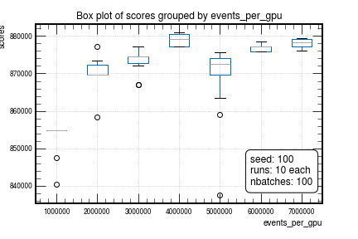
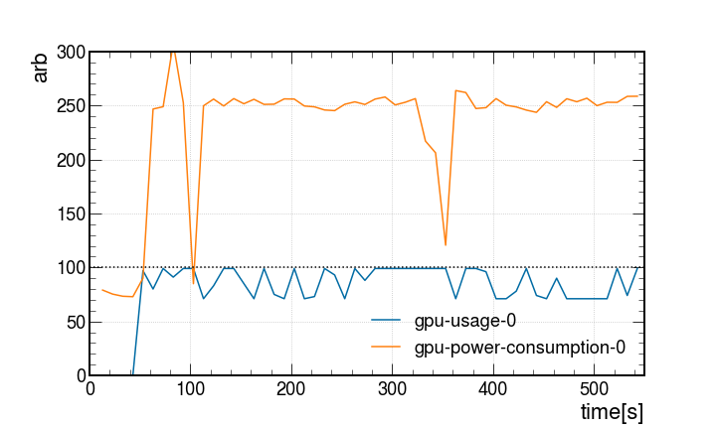
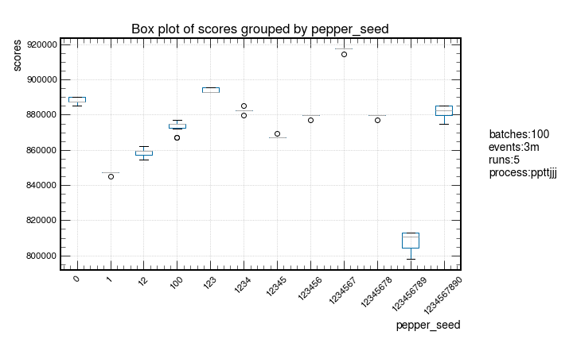
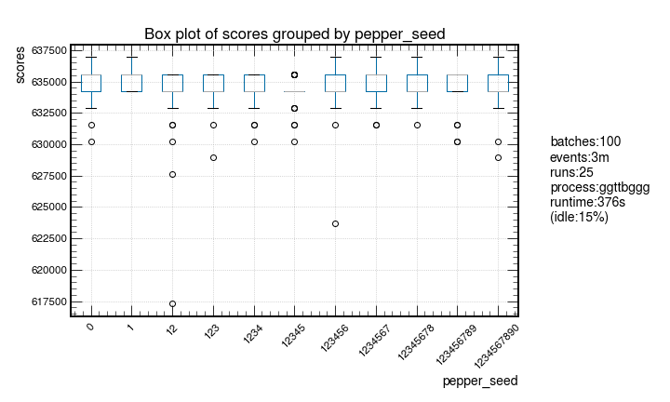
GEN-PEPPER-GPU: Evaluation (NVidia A100)
Status and First Results
Process evaluation
PRELIMINARY
PRELIMINARY
GPU utilization
NEvents evaluation
Current default Working Point (GPU):
Process: ggttggg
Fixed seed offset: 0
Number of batches: 100
Number of events per batch: 3m
PRELIMINARY

Slide 24
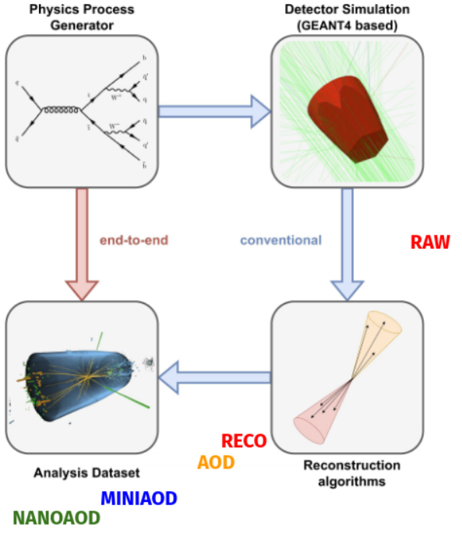
CMS-FLOWSIM-GPU
Status and First Results
hep-workloads/cms-flowsim-gpu
The WL replicates the inference step of CMS Flashsim
  Repo
  Paper
ML-based end-to-end simulation (Pytorch) for an arbitrary number of reconstructed particle jets starting from a collection of generator-level jets
Score: ev/s
Source: A. Rizzi, CHEP24
Thanks to Francesco Vaselli!
apptainer run --nv -B ./results:/results \ oras://gitlab-registry.cern.ch/hep-benchmarks/hep-workloads-sif/cms-flowsim-gpu-bmk:v0.1 \
-M gpu -x ‘--n-gpus 1’

Slide 25
CMS-FLOWSIM-GPU: Configuration
Status and First Results
CPU
01 | 02 | 05 | 06 | 09 | 10 | 13 | 14
03 | 04 | 07 | 08 | 11 | 12 | 15 | 16
17 | 18 | 21 | 22 | 25 | 26 | 29 | 30
19 | 20 | 23 | 24 | 27 | 28 | 31 | 32
GPU
How it works:
  1 core per copy, 1 copy per GPU
  Total events=NObjects*NModel
  Number of threads is fixed to 1 for GPU, and flexible for CPU
100%
Configurable parameters:
Number of copies (<-> GPUS) – Scales score independent / linear
Number of objects – Scales runtime and GPU usage
Batchsize – Scales GPU memory
Number of model instances – Scales runtime and GPU usage

Slide 26
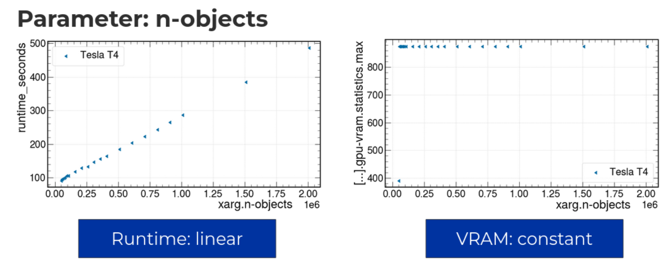
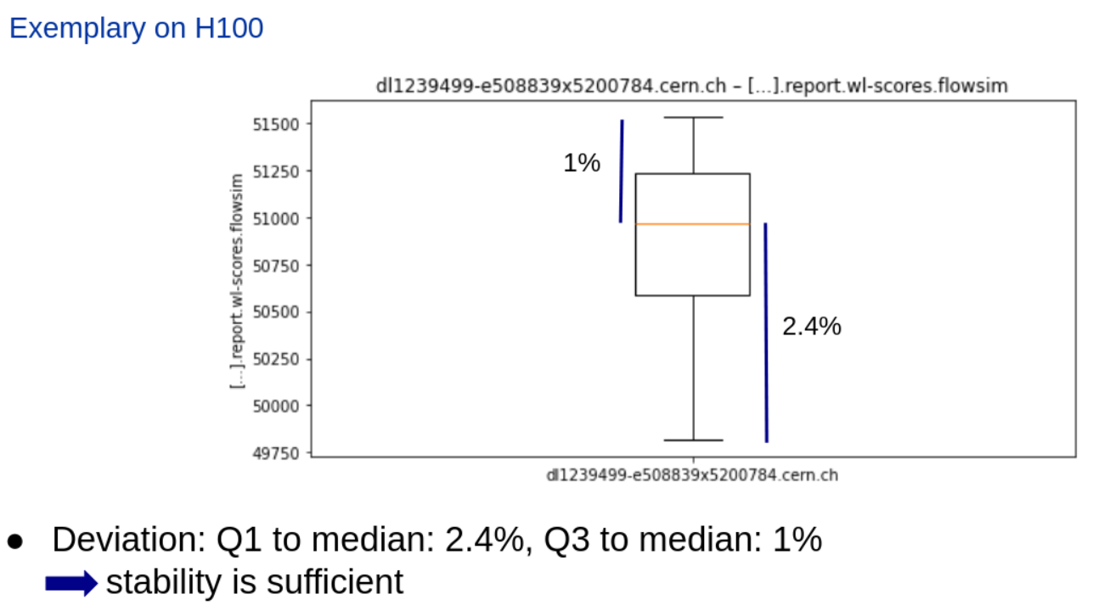
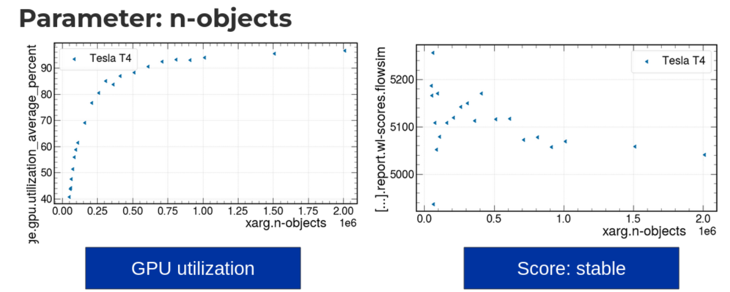
CMS-FLOWSIM-GPU: Evaluation (NVidia T4/H100)
Status and First Results
Details were presented: here
PRELIMINARY
PRELIMINARY
PRELIMINARY
PRELIMINARY
PRELIMINARY
Current default Working Point (GPU):
Number of objects: 600000
Batchsize: 550000
N model instances: 5 / 10

Slide 27
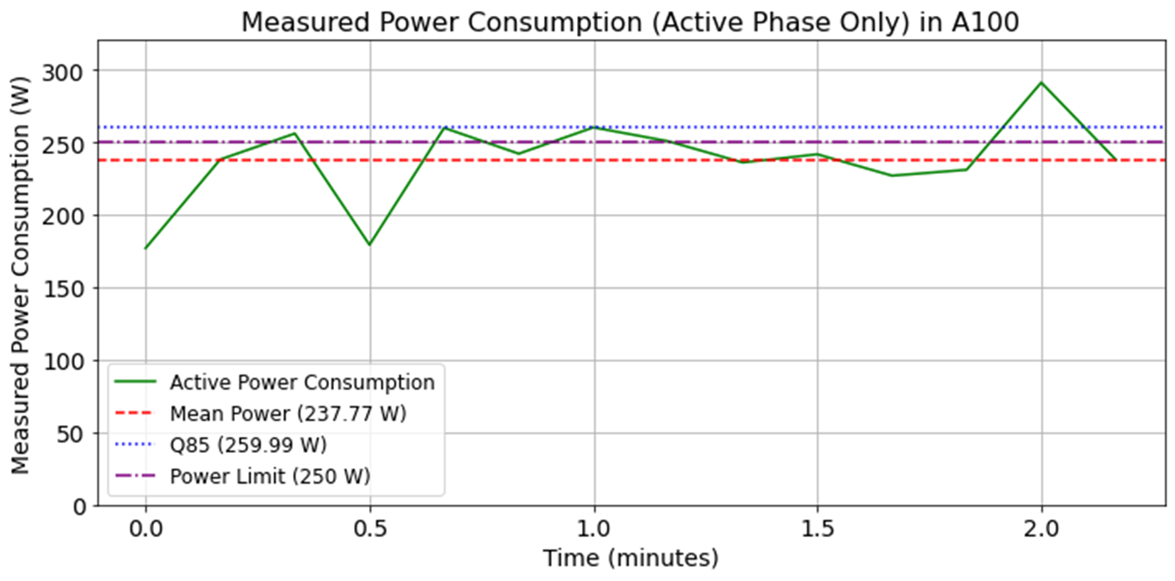
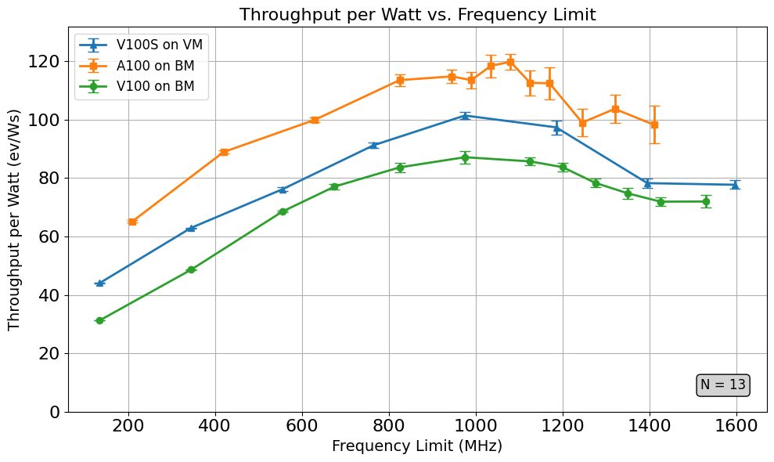
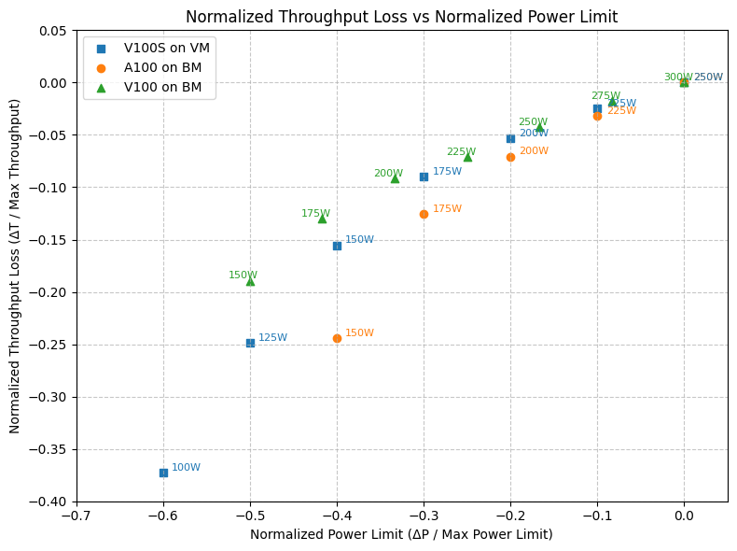
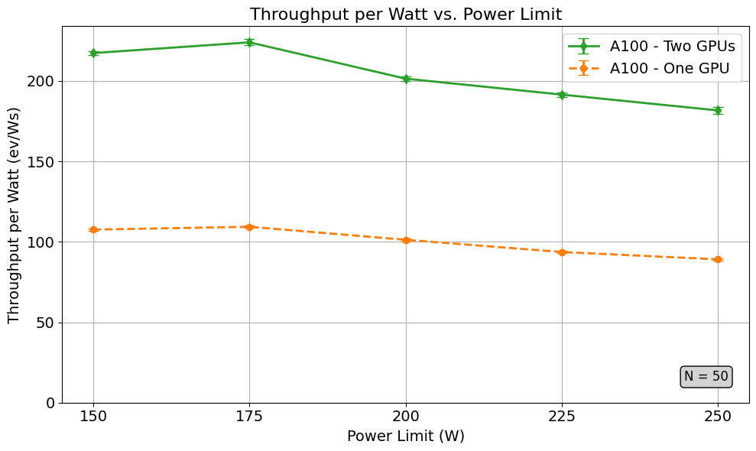
CMS-FLOWSIM-GPU: Summer Student Project
Status and First Results
A preliminary version of the CMS-Flowsim-GPU WL has been used by Sana Babayan for a GPU power efficiency study
PRELIMINARY
Results were presented: here

Slide 28
GEN-MADGRAPH-GPU
Status and First Results
Will be (pre)released soon!
The WL implements the leading-order event generation on GPU with Madgraph5 v3.6.2
For the benchmark payload, precompiled binaries for different backends are used
A first implementation is available and a preliminary configuration was found with direct payload tests
Score: ev/s
Will be released soon
Thanks to Daniele Massaro and Zenny Wettersten!
Implementing the benchmark took ~1 week for:
Understanding the workload: What is it doing and how can we use it?
Concept creation: What to run, how to configure, …
Implementation
Testing/qa
Full example in backup!

Slide 29
GEN-MADGRAPH-GPU: Configuration
Status and First Results
CPU
01 | 02 | 05 | 06 | 09 | 10 | 13 | 14
03 | 04 | 07 | 08 | 11 | 12 | 15 | 16
17 | 18 | 21 | 22 | 25 | 26 | 29 | 30
19 | 20 | 23 | 24 | 27 | 28 | 31 | 32
GPU
How it works:
  1 core per copy, 1 copy per GPU
  Number of threads is fixed to 1 for GPU
  and CPU (see paper)
  Total events=gpuBlocksPerGrid*gpuThreadsPerBlock*gpuIterationsPerEvent
For the process, the same as for
pepper-gpu is used (gg_ttxggg)
  Studies will be conducted soon
100%
Configurable parameters:
Number of copies (<-> GPUS)
Number of events
Process
Backend (cuda, avx512, …)

Slide 30
GEN-MADGRAPH-GPU: Evaluation
Status and First Results
Brand new – no completed study yet
Preliminary Working Point (GPU):
Process: gg_ttxggg
NEvents: 7864320
(1024*30*256*1)

Slide 31
Others: Overview
Status and First Results
THANKS!
Alice-O2-GPU:
  Gabriele Cimador (UNITO/CERN) and David Rohr (CERN) have provided a working example
  A first prototype version of the WL is in development
ET-RIFT: as presented here
  The workload was provided by Georgy Skorobogatov (UPC)
  Under evaluation
Synthetic:
  We are working on a synthetic CUDA benchmark + looking for available ones
Desiderata:
  ATLAS SIM (as presented here), CMS HGCAL, ...
Notes:
Now: first version in a few days

Slide 32
Next Steps

Slide 33
Next Steps
Future
Integration into HEPScore
Creating default HEPScore configuration(s)
(Reference measurements)
Identifying a reference machine
Calibration and extended studies
Creating HEPScore configs for GPU workloads:
  Classic HEP workloads, AI based, other
  A preliminary config is available in a dev branch
Release a new version of HEPScore including those configs
Notes:
All those questions need to be answered, some together with the expert, some due to own investigation.
This ofc can be challenging. One thing we stumbled on was: How to ideally run the payload?

Slide 34
Summary

Slide 35
Summary
Integrating GPU Workloads in HEPscore
✅ – (pre-)released
(✅) – development version
❌ – no release yet
Workload | Type | Status | Current Version
CMS-HLT-GPU | Reconstruction | Pre-Release, in validation | ✅ v0.1
Pepper-GPU | Simulation | Pre-Release, in validation | ✅ v0.3
CMS-Flowsim-GPU* | Inference | Pre-Release, in validation | ✅ v0.1
CMS-MLPF-GPU* | Training | To be updated | ❌ --
Madgraph-GPU | Simulation | To be released soon | (✅) ci-v0.1
Alice-O2-GPU | Reconstruction | In development | ❌
Synthetic-GPU | Synthetic+ML(?) | In development | ❌
ET-RIFT | --External-- | To be evaluated | (✅) ci-v0.1
CMS-HLT-MA | Reconstruction | Previous version, deprecated | ✅
madgraph4gpu-2022 | Simulation | Previous version, deprecated | ✅
CMS-HGCAL** | -- | Candidate, to be evaluated | --
* ML-based WLs
Excellent progress on track with the WG plans!
** Candidate, to be evaluated

Slide 36
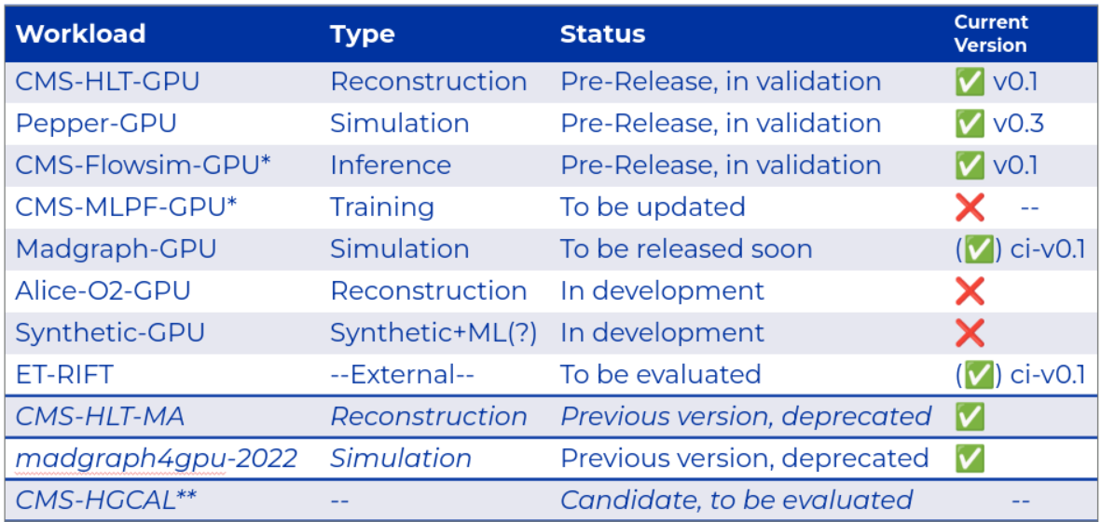
Summary
Integrating GPU Workloads in HEPscore
New streamlined and unified GPU WL concept, greatly simplifying the integration of new workloads
  ~ 1 week depending on the complexity
GPU WL Template available
12 workloads:
  9 GPU WLs, of which
    3 pre-released
    4 in development
    1 to be investigated
  1 template, 1 candidate
  2 deprecated
Excellent progress on track with the WG plans!
Further contributions are very welcome!
Notes:
Now: first version in a few days

Slide 37
Backup/Additional

Slide 38
Parameter Overview
Status and First Results
-e: Events per thread (total: <val>*#threads*#copies)
-E: Events per GPU (total: <val>*#threads*#copies)
-t: Number of threads per copy
-T: Number of threads per GPU copy
-c: Number of copies
-M: Mode (cpu/gpu)
-x: Extra Arguments (see WL descriptions)
apptainer run --nv -B ./results:/results \ oras://gitlab-registry.cern.ch/hep-benchmarks/hep-workloads-sif/<WL-NAME> \
-e/-E <int> -t/-T <int> -c <int> -M {cpu,gpu} -x ‘--n-gpus <int>, --debug <int>, <WL-SPECIFIC>’
Notes:
Now: first version in a few days

Slide 39
Example:
Integrating Madgraph
The Process of Integrating GPU WLs

Slide 40
Example: Madgraph5
The Process of Integrating GPU Workloads
Not working as intended:
Seeking support
1) Implement and test the WL
With the instructions provided by the
expert, I have created a (containerized)
testing environment locally, reflecting
the future deployment
Experts provide payload, data, instructions, and support
First evaluation of the payload
Providing a workaround
for the first prototype
Building the software caused problems:
I was not able to reproduce the initial instructions
The expert helped me to investigate the issue
No immediate solution/ explanation was found
Solution:
The expert provided a workaround for a first WL prototype
Notes:
Example Challenges for the individual steps
NOW, WE ARE ABLE TO RUN THE WL AND THINK OF A CONCEPT

Slide 41
Example: Madgraph5
The Process of Integrating GPU Workloads
May needs
several iterations!
(First) evaluation of the payload
Creating a WL concept
2) Evaluating the WL for creating a concept:
What does the payload?
How the WL loads the machine?
  1C <-> 1 GPU, <N>C <-> 1 GPU, multi-GPU?
  What is possible, what is preferred?
  (How) Can we max out the load?
How can we steer the WL?
  What is configurable in general? And how?
  Which inputs we should use for GPU? For scaling what?
  What WL-specific input validations are required (e.g. limited # of events)?
  What physics process to use?
What can be used as a performance metric?
Does it support other (GPU) architectures?
How the payload execution can be integrated ideally into our framework?
Re-evaluate
Running a gridpack
Standalone binaries
  Compile and run each copy VS pre-build and execute?
Notes:
All those questions need to be answered, some together with the expert, some due to own investigation.
This ofc can be challenging. One thing we stumbled on was: How to ideally run the payload?

Slide 42
Example: Madgraph5
The Process of Integrating GPU Workloads
(First) evaluation of the payload
Creating a WL concept
Running a gridpack
Standalone binaries
Easy to ship
Very close to real world
Execution is simple
Many different processes can be provided in advance
Lot’s of investigation required to make it work
Not easily steerable: Might require a recompilation for different WL configurations
Steerable, more flexible execution
Many different processes can be provided in advance
Not fully representing the event generation (only |M| calculation)
(More expertise required to set up)
Notes:
All those questions need to be answered, some together with the expert, some due to own investigation.
This ofc can be challenging. One thing we stumbled on was: How to ideally run the payload?

Slide 43
Example: Madgraph5
The Process of Integrating GPU Workloads
Development part
Building images in our CI Infrastructure
Integrating the payload:
The development part
Creating a WL concept
3) Integrating the payload into our framework (hep-workloads)
After deciding for input variables, the input validation needs to be adapted
The payload execution is implemented in the RunScript (<WL>-bmk.sh)
A parser is provided, which digests the payload’s logs and parses the results
Pushing to the qa-build-<WL> branch triggers the gitlab CI resulting in the workload images being build
Notes:
All those questions need to be answered, some together with the expert, some due to own investigation.
This ofc can be challenging. One thing we stumbled on was: How to ideally run the payload?

Slide 44
Example: Madgraph5
The Process of Integrating GPU Workloads
Data analysis part
Testing and QA
Full evaluation of the WL:
Calibration and analysis
Pre-release versions:
Validation and extended studies
4) Testing and evaluating the workload
At first, all functionality is tested
  Found problems/bugs require rebuild
  Repeating as required …
After qa, the WL needs to be calibrated, i.e. finding a (default) working point that:
  guarantees a stable execution
  fully loads the GPU
  provides a stable score
Building images in our CI Infrastructure
Integrating the payload:
The development part
Problems found
Typically needs several iterations!
Testing and QA
This can again require concept changes!
Notes:
All those questions need to be answered, some together with the expert, some due to own investigation.
This ofc can be challenging. One thing we stumbled on was: How to ideally run the payload?

Slide 45
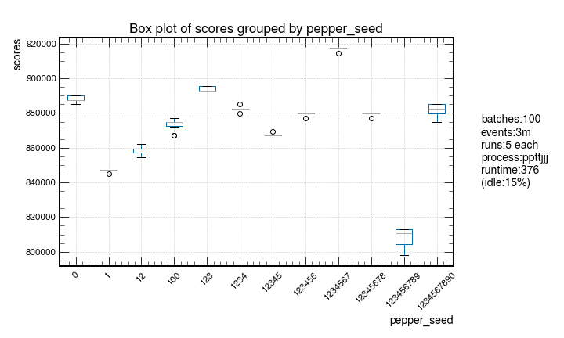
Interlude: Pepper Evaluation
The Process of Integrating GPU Workloads
Goal: Finding a stable working point for pepper-gpu
Initial physics process (as recommended by the expert): pp->tt->jjj
Workload steering parameters:
  # of events (-e: cpu/-E: gpu)
  # of batches (--n-batches)
  generator seed offset (--seed)
The score fluctuates O(10)% with varying seeds

Slide 46
Interlude: Pepper Evaluation
The Process of Integrating GPU Workloads
Building images in our CI Infrastructure
Integrating the payload:
The development part
Creating a WL concept
Changes required
Testing and QA
Full evaluation of the WL:
Calibration and analysis
New revision of the WL (pre-release version v0.3):
Another process is added: gg->tt->ggg
  Single subprocess of the initial one
  Still a physics motivated result, but
  more simple!
Stable result for different seeds ✅

Slide 47
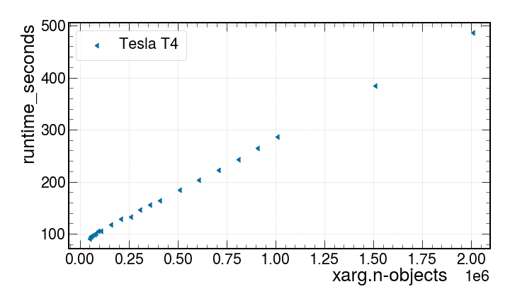
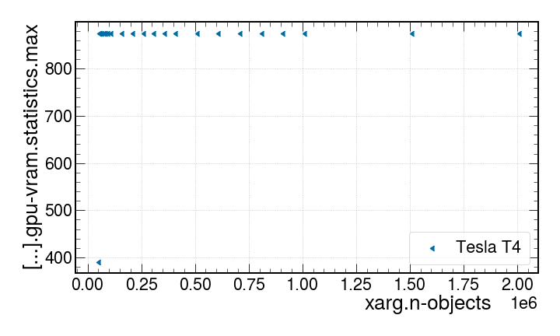
Interlude II: FlowSim Working Point Calibration
The Process of Integrating GPU Workloads
Parameter: n-objects
Runtime: linear
VRAM: constant
Notes:
2nd example: For flowsim, this was more straight forward…

Slide 48
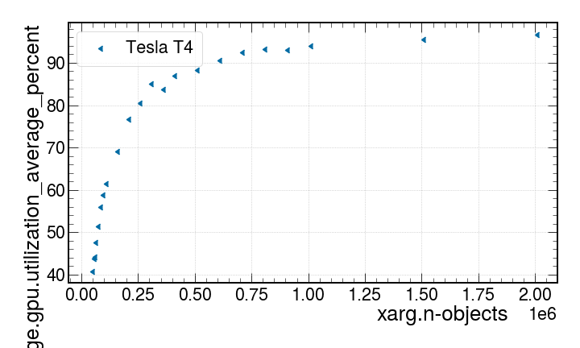
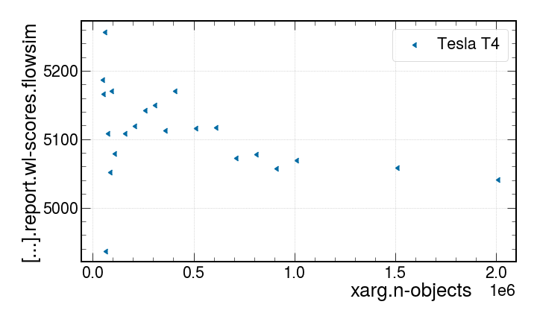
Interlude II: FlowSim Working Point Calibration
The Process of Integrating GPU Workloads
Parameter: n-objects
GPU utilization
Score: stable
Notes:
2nd example: For flowsim, this was more straight forward…

Slide 49
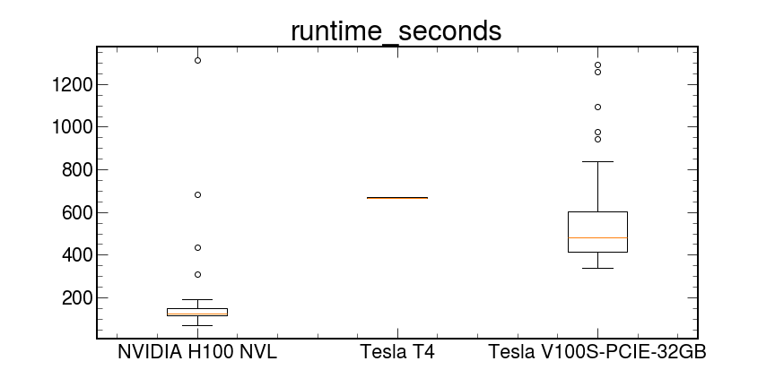
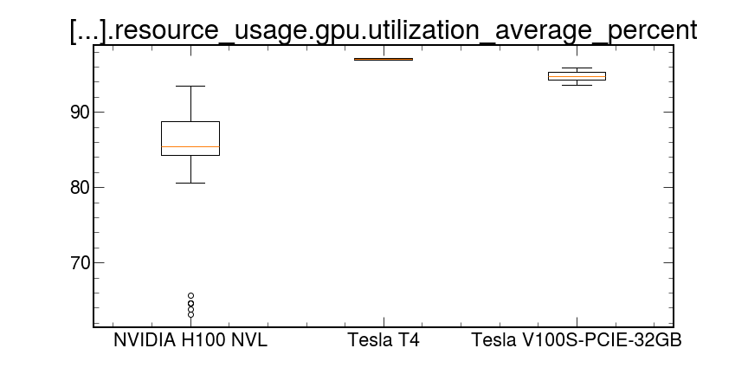
Example: Madgraph5
The Process of Integrating GPU Workloads
Data analysis part
Testing and QA
Full evaluation of the WL:
Calibration and analysis
Pre-release versions:
Validation and extended studies
5) Validation (Ongoing)
The pre-release version is thoroughly tested on different machines (and GPUs) with the evaluated default working point
Extended studies, e.g., (gpu) power consumption – see our summer student project (report available soon)
Flowsim (example, pre-liminary)
Notes:
All those questions need to be answered, some together with the expert, some due to own investigation.
This ofc can be challenging. One thing we stumbled on was: How to ideally run the payload?

Slide 50
Example: Future
The Process of Integrating GPU Workloads
Future
Integration into HEPScore
Creating default HEPScore configuration(s)
(Reference measurements)
6) Future steps
Validation on a reference machines
Creating a HEPScore config for the
GPU workload
  A preliminary config is provided, but not merged yet
  In the future, we might provide different gpu configs (AI, classic, ...)
Integrate into HEPScore prod version
Notes:
All those questions need to be answered, some together with the expert, some due to own investigation.
This ofc can be challenging. One thing we stumbled on was: How to ideally run the payload?

Slide 51
Concept: Deriving a Total GPU Score
execute
compare
weighting
Workload 1
Score: ev/s
Score: ev/s
Relative Score
Job Mix Share
Workload 2
other?
other?
Relative Score
Job Mix Share
GPU Score
...
...
...
...
...
Workload X
Score: ev/s
Score: ev/s
Relative Score
Job Mix Share
Reference Machine

Slide 52
Parameter Scans of GPU Workloads
Each workload is steered with different input parameters, e.g. number of processed events, complexity of the simulated process, epochs, …
Required changes on the HEPscore benchmarking suite
To find feasible configurations for the available workloads, I did different parameter scans on different GPU machines:
Goal: Full utilization, stability of results, decent runtime, …
openlab GPU machine:
GPU: T4
VRAM: 16GB
CPU: Xeon(R) Silver 4110 -
2S/8C/16T
Memory: 6x32 DDR4 2133 MHz
TOpAS (KIT):
GPU: V100s
VRAM: 32GB
CPU: AMD EPYC 7702 - 2S/64C/128T
Memory: 32x32 DDR4 3200 MHz
H100 (NGT):
GPU: H100
VRAM: 96GB
CPU: AMD EPYC 9654 - 2S/96C/192T
Memory:16x64 DDR5 4800MHz

