Slide 1






Funded by the European Union (EU). Views and opinions expressed are however those of the author only and do not necessarily reflect those of the EU or European Research Executive Agency (REA). Neither the EU nor the REA can be held responsible for them.
Update on wakefield and beam loading studies in the 6D cooling
Carmelo Barbagallo, Alexej Grudiev, CERN
Thanks to: Elias Metral (CERN), Haipeng Wang and Robert Rimmer (Jefferson Lab)
MC RF sub-WG on RF systems for Muon Cooling Meeting
30 September 2025, CERN

Slide 2
Outline
Introduction
The rectilinear cooling channel of the Muon Cooling Complex
Wakefield contributions for non-ultrarelativistic beams
Wake potential decomposition
Wakefield in multi-cell cavities and beam pipe
Wake potential dependency on test-particle transverse offset
Comparison between multi-cell cavities with and without windows
Beam loading studies
Compensation and mitigation strategies
Conclusions
References:
[1] D. Li et al., The Normal Conducting RF cavity for the MICE experiment, Proceedings of PAC09, Vancouver, Canada
[2] H. Wang, Short-range Wakefield in a Flat Pillbox Cavity Generated by a Sub-relativistic Beam Bunch, PAC 2001
[3] C. Barbagallo et al., Conceptual RF Design and Modelling of an RF Cavity for the Muon Cooling Complex, IPAC 2024
[4] C. Barbagallo et al., Beam Loading in RF Cavities for the Rectilinear Muon Cooling Channel, IMCC and MuCol Annual meeting 2025
[5] J. N. Corlett, RF Accelerating Structures for the Muon Cooling Experiment, PAC99, New York, USA

Slide 3
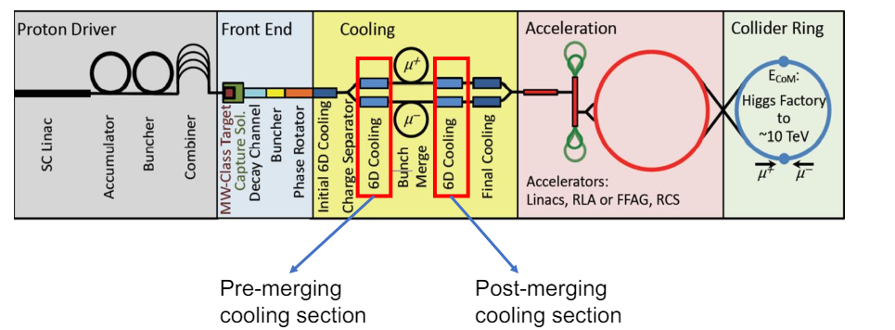
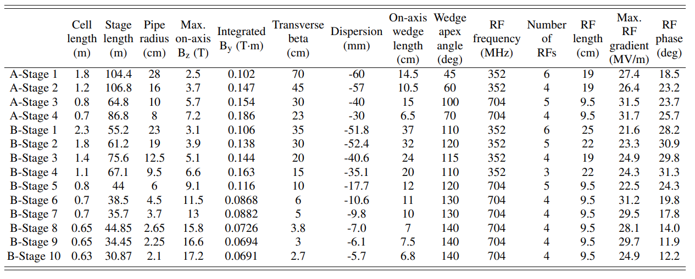
Motivation of the study
Study the beam loading, its compensation and mitigation strategies for the RF cavities across the 15 stages of the Muon Cooling rectilinear channel
Beam dynamics input parameters: R. Zhu and C. Rogers (https://doi.org/10.1103/PhysRevAccelBeams.28.041003)
R. Zhu, https://doi.org/10.1103/PhysRevAccelBeams.28.041003
Pre-merging cooling section (A-stages)
Post-merging cooling section (B-stages)

Slide 4
RF cavity cell – Pre-Merging section
Parameter | Unit | Stage 1 | Stage 2 | Stage 3 | Stage 4
f₀ | MHz | 352 | 352 | 704 | 704
L_{cav} | mm | 190 | 190 | 95 | 95
R_{i} | mm | 240 | 160 | 100 | 80
β | - | 0.923 | 0.894 | 0.894 | 0.901
t_{w} | um | 120 | 70 | 45 | 40
E_{nom} | MV/m | 27.4 | 26.4 | 31.5 | 31.7
Parameter | Unit | Value
β_{coupling} | - | 1.2
f_{b} | Hz | 5
ƞ_{g} | - | 0.7
ƞ_{M} | - | 0.9
Beam dynamics parameters
Constant parameters
Parameter | Unit | Stage 1 | Stage 2 | Stage 3 | Stage 4
Q₀ | - | 3.055E+04 | 3.142E+04 | 2.202E+04 | 2.221E+04
t_{f} | us | 31.203 | 32.087 | 11.248 | 11.345
DF | - | 1.17E-04 | 1.21E-04 | 4.27E-05 | 4.31E-05
R/Q (β) | Ω | 171.726 | 149.684 | 160.358 | 150.206
P_{diss} | MW/cavity | 4.245 | 4.342 | 2.056 | 2.213
P_{diss,Be}/P_{diss} | - | 0.377 | 0.085 | 0.201 | 0.085
E_{peak,Cu} | MV/m | 11.720 | 23.249 | 20.802 | 27.873
E_{peak,Be} | MV/m | 27.383 | 26.511 | 31.507 | 31.829
Higher power dissipation on the lower frequency cavity (factor 2)
Higher E_{peak} on the Be windows
Total plug power for RF systems: from 90 kW to 470 kW depending on the considered stage
RF cavity parameters
These parameters will be included in the MuCol milestone Consolidated Parameter Document by 31st October 2025
Parameter | Unit | Stage 1 | Stage 2 | Stage 3 | Stage 4
P_{g} | MW/cavity | 5.094 | 5.210 | 2.468 | 2.655
DFg | - | 1.56E-04 | 1.61E-04 | 5.67E-05 | 5.73E-05
N_{cav} | - | 348 | 356 | 405 | 496
P_{g,tot} | MW | 1772.680 | 1854.910 | 999.416 | 1317.100
P_{ave,g,tot} | kW | 277.092 | 297.874 | 56.701 | 75.408
P_{plug,tot} = P_{g,ave,tot}/ƞ_{G}ƞ_{M} | kW | 439.828 | 472.816 | 90.002 | 119.696
Power
Peak power = Total cost
Average power = Power consumption

Slide 5
RF cavity cell – After-Merging section
Parameter | Unit | Stage 1 | Stage 2 | Stage 3 | Stage 4 | Stage 5 | Stage 6 | Stage 7 | Stage 8 | Stage 9 | Stage 10
f₀ | MHz | 352 | 352 | 352 | 352 | 704 | 704 | 704 | 704 | 704 | 704
L_{cav} | mm | 250 | 220 | 190 | 220 | 95 | 95 | 95 | 95 | 95 | 95
R_{i} | mm | 210 | 190 | 125 | 95 | 60 | 45 | 38 | 28 | 23 | 20
β | - | 0.886 | 0.885 | 0.887 | 0.886 | 0.889 | 0.888 | 0.887 | 0.884 | 0.881 | 0.884
t_{w} | um | 100 | 80 | 50 | 45 | 30 | 20 | 20 | 20 | 10 | 10
E_{nom} | MV/m | 21.2 | 21.7 | 24.9 | 24.3 | 22.5 | 28 | 28.5 | 27.1 | 29.7 | 24.9
Beam dynamics parameters
Parameter | Unit | Stage 1 | Stage 2 | Stage 3 | Stage 4 | Stage 5 | Stage 6 | Stage 7 | Stage 8 | Stage 9 | Stage 10
Q₀ | - | 3.912E+04 | 3.556E+04 | 3.147E+04 | 3.594E+04 | 2.226E+04 | 2.224E+04 | 2.223E+04 | 2.222E+04 | 2.221E+04 | 2.221E+04
t_{f} | us | 39.954 | 36.323 | 32.148 | 36.710 | 11.366 | 11.360 | 11.354 | 11.347 | 11.344 | 11.341
DF | - | 1.505E-04 | 1.370E-04 | 1.213E-04 | 1.382E-04 | 4.327E-05 | 4.308E-05 | 4.308E-05 | 4.308E-05 | 4.308E-05 | 4.308E-05
R/Q (β) | Ω | 183.698 | 170.470 | 141.266 | 154.019 | 140.852 | 137.398 | 136.872 | 137.386 | 138.114 | 139.029
P_{diss} | MW/cavity | 2.678 | 2.807 | 4.068 | 3.918 | 1.182 | 1.885 | 1.969 | 1.786 | 2.144 | 1.506
P_{diss,Be}/P_{diss} | - | 0.230 | 0.164 | 0.031 | 0.009 | 0.026 | 0.007 | 3.075E-03 | 8.316E-04 | 3.160E-04 | 1.552E-04
E_{peak,Cu} | MV/m | 12.162 | 15.251 | 26.175 | 27.732 | 24.116 | 33.288 | 35.250 | 34.670 | 38.528 | 32.506
E_{peak,Be} | MV/m | 21.250 | 21.757 | 24.429 | 22.823 | 22.027 | 26.514 | 25.981 | 22.885 | 23.268 | 18.343
RF cavity parameters
Parameter | Unit | Stage 1 | Stage 2 | Stage 3 | Stage 4 | Stage 5 | Stage 6 | Stage 7 | Stage 8 | Stage 9 | Stage 10
P_{g} | MW/cavity | 3.214 | 3.368 | 4.882 | 4.701 | 1.419 | 2.262 | 2.363 | 2.143 | 2.573 | 1.807
DFg | - | 2.077E-04 | 2.097E-04 | 1.611E-04 | 1.843E-04 | 5.734E-05 | 7.703E-05 | 6.130E-05 | 6.154E-05 | 5.712E-05 | 5.720E-05
N_{cav} | - | 132 | 185 | 240 | 167 | 275 | 220 | 160 | 284 | 208 | 188
P_{g,tot} | MW | 424.189 | 623.071 | 1171.612 | 788.601 | 390.138 | 497.655 | 378.007 | 608.535 | 535.127 | 339.778
P_{ave,g,tot} | kW | 88.101 | 130.682 | 188.801 | 145.328 | 22.369 | 35.349 | 23.173 | 37.449 | 30.566 | 19.434
P_{plug,tot} = P_{g,ave,tot}/ƞ_{G}ƞ_{M} | kW | 139.843 | 207.432 | 299.684 | 230.679 | 35.506 | 56.109 | 36.783 | 59.443 | 48.517 | 30.848
Power

Slide 6
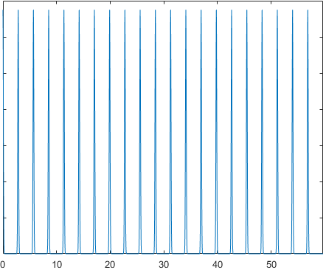
Beam dynamics parameters Pre-merging section
R. Zhu et al., https://doi.org/10.1103/PhysRevAccelBeams.28.041003)
Bunch train structure – N_{bunch} = 21
Beam dynamics parameters – Before merging section
Parameters | Unit | Stage 1 | Stage 2 | Stage 3 | Stage 4 | Description
p_{z} | MeV/c | 253 | 211 | 211 | 219 | Longitudinal momentum
E_{tot} | MeV | 274.18 | 235.98 | 235.98 | 243.16 | Muon energy
β_{r} | - | 0.923 | 0.894 | 0.894 | 0.901 | Relativistic beta
σ_{z} | mm | 95.44 | 59.51 | 32.97 | 22.41 | Longitudinal bunch length
Q_{b,tot} | C | 7.69e-06 | 5.79e-06 | 4.88e-06 | 4.18e-06 | Total bunch charge
I_{b,ave} | A | 3.85E-05 | 2.89E-05 | 2.44E-05 | 2.09E-05 | Average beam current
t_{b} = 1/352 MHz
Normalized beam current
Number of filled buckets = 21
Bunch repetition rate = 352 MHz (2.84 ns between two bunches), Train repetition rate = 5 Hz (0.2 s between two trains)
Few of micro-Coulomb charge, few of micro-Ampere average beam current
Transverse beam size (σ_{x}=σ_{y}~ R_{i}/3) -> New values sent by Ruihu yesterday
Time [ns]

Slide 7
Beam dynamics parameters Post-merging section
The 21 bunches merges into 1 single bunch that is accelerated through the different stages
Micro-Coulomb level charges
Micro-Ampere level beam current
Transverse beam size (σ_{x}=σ_{y}~ R_{i}/3)
R. Zhu et al., https://doi.org/10.1103/PhysRevAccelBeams.28.041003)
Beam dynamics parameters – After merging section
Parameters | Unit | Stage 1 | Stage 2 | Stage 3 | Stage 4 | Stage 5 | Stage 6 | Stage 7 | Stage 8 | Stage 9 | Stage 10 | Description
p_{z} | MeV/c | 201 | 201 | 203 | 202 | 205 | 204 | 203 | 200 | 197 | 200 | Longitudinal momentum
E_{tot} | MeV | 227.965 | 227.079 | 228.851 | 227.965 | 230.627 | 229.739 | 228.851 | 226.194 | 223.546 | 226.194 | Total muon energy
β_{r} | - | 0.8861 | 0.8852 | 0.8870 | 0.8861 | 0.8889 | 0.8880 | 0.8870 | 0.8842 | 0.8813 | 0.8842 | Relativistic beta
σ_{z} | mm | 56.583 | 57.053 | 41.219 | 36.128 | 27.714 | 23.639 | 21.806 | 20.967 | 19.603 | 19.642 | Longitudinal bunch length
Q_{b} | C | 2.98E-06 | 2.54E-06 | 2.27E-06 | 1.98E-06 | 1.78E-06 | 1.59E-06 | 1.41E-06 | 1.31E-06 | 1.15E-06 | 9.78E-07 | Total bunch charge
I_{b,ave} | A | 1.49E-05 | 1.27E-05 | 1.13E-05 | 9.92E-06 | 8.91E-06 | 7.96E-06 | 7.04E-06 | 6.53E-06 | 5.74E-06 | 4.89E-06 | Average bunch current

Slide 8
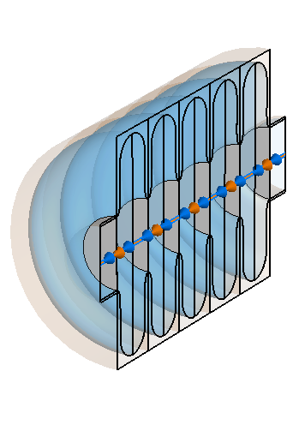
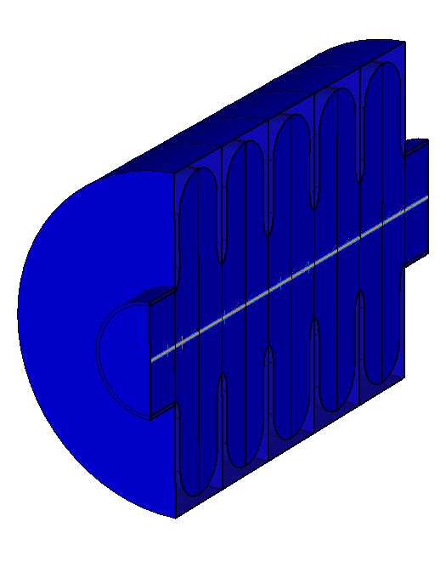
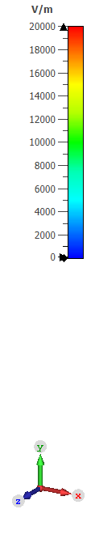
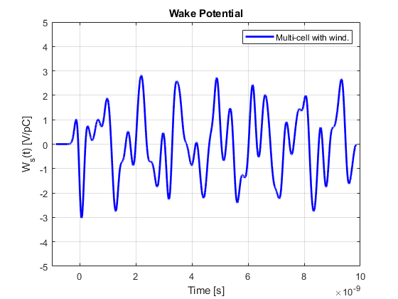
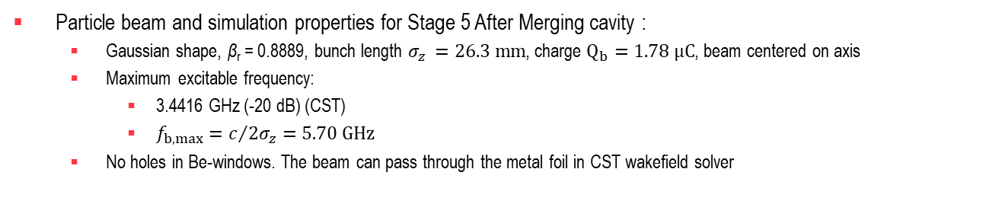
Wakefield on multi-cell cavity with Be-windows for Muon Cooling
5-cell cavity with Be-windows (STAGE B5)
E-field
R_{i} = 190.77 mm
Be windows
R_{BP} = 60 mm
L_{BP} = 575 mm
Particle beam and simulation properties for Stage 5 After Merging cavity :
Gaussian shape, β_{r} = 0.8889, bunch length $σ_{z }=26.3 mm$, charge $Q_{b}=1.78 μC$, beam centered on axis
Maximum excitable frequency:
3.4416 GHz (-20 dB) (CST)
$f_{b,max}=c/{2σ_{z}}=5.70 GHz$
No holes in Be-windows. The beam can pass through the metal foil in CST wakefield solver

Slide 9
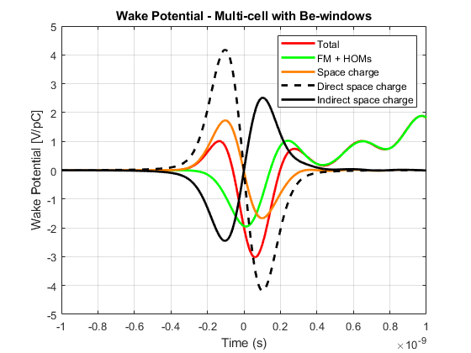
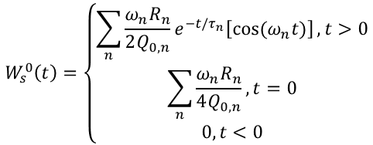
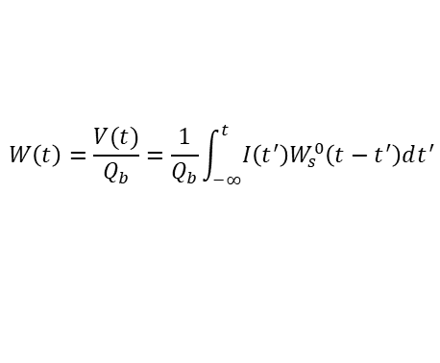
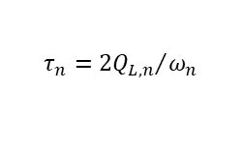

Wake potential decomposition for non-ultrarelativistic beams
The total wake potential of an RF cavity can be decomposed as sum of the wakefields (FM + HOMs) and space charge fields
Total wake potential
Ref: IMCC BD-CE meeting Monday 25/08/2025 (https://indico.cern.ch/event/1577996/)
$$W^{tot}\left(t\right)=W_{FM}\left(t\right)+W_{HOMs}+W^{ISC}\left(t\right)+W^{DSC}(t)$$
Eigenmode wake potential
Space-charge wake potential
Reconstructed wake potential (Eigenmode solver) → It does not include space charge effect
$$W\left(t\right)=\frac{V(t)}{Q_{b}}=\frac{1}{Q_{b}}\int_{−∞}^{t}{I\left(t^{′}\right)W_{s}^{0}\left(t−t^{′}\right)dt^{′}}$$
with
$$I\left(t′\right)=\frac{Q_{b}}{\sqrt{2π}σ_{t}}e^{−{t^{′}}^{2}/2{σ_{t}}^{2}}$$
$$W_{s}^{0}\left(t\right)=\left\{\begin{aligned}\sum_{n}{\frac{ω_{n}R_{n}}{2Q_{0,n}}e^{−t/τ_{n}}\left[cos⁡(ω_{n}t)\right]}, t>0 \\ \sum_{n}{\frac{ω_{n}R_{n}}{4Q_{0,n}}}, t=0 \\ 0, t<0\end{aligned}\right.$$
with
$$τ_{n}={2Q_{L,n}}/{ω_{n}}$$
Short-range wake
Long-range wake
$W_{FM}\left(t\right)$ and $W_{HOMs}\left(t\right)$are resonant effects (cavity dependent) → very good agreement between eigenmode and wakefield solution in long-range wake
$W^{ISC}(t)$ is the image charge contribution: space charge field bouncing off the cavity walls and coming back as a wake (cavity dependent)
$W^{DSC}(t)$ is the Coulomb field of the bunch in free space (cavity independent)
Aim of the study: separate the space-charge wake potential $W^{ISC}\left(t\right) and W^{DSC}(t)$ in a multi-cell cavity with and without Be-windows
(see IMCC BD-CE meeting Monday 25/08/2025 (https://indico.cern.ch/event/1577996/))
Notes:
Space charge effect is predominant in the short-range wake regime

Slide 10
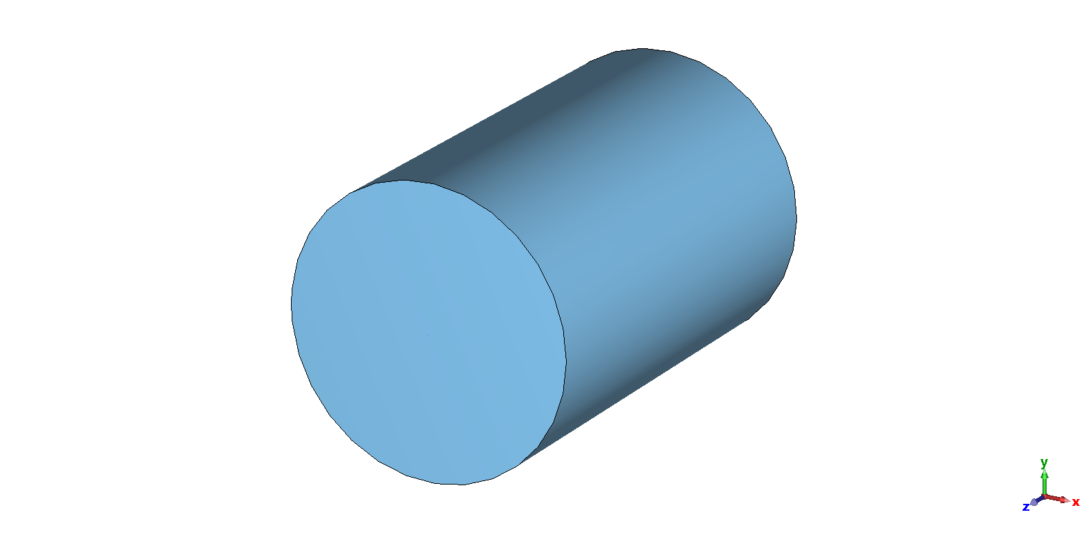
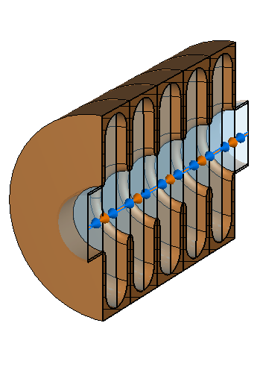
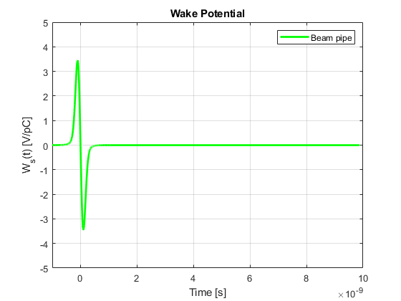
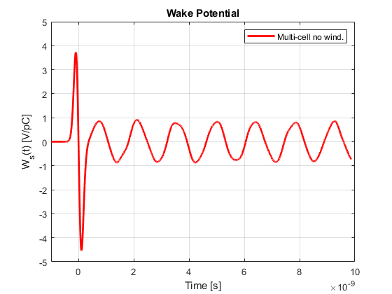


Wakefields in multi-cell cavities and beam pipe
IMCC BD-CE meeting Monday 25/08/2025 (https://indico.cern.ch/event/1577996/)
PEC beam pipe
5-cell cavity with Be-windows
5-cell cavity without Be-windows
Calculations are performed in CST Studio Suite 2025 (wakefield solver)
Be windows
R_{i} = 190.77 mm
R_{i} = 190 mm
R_{BP} = 60 mm
L_{BP} = 575 mm
L_{BP} = 575 mm
Short-range wake (dominated by space charge)
Short-range wake dominated by space charge
Long-range wake (higher wake amplitude due to field confinement)
The total wake potential is given solely by the space charge wake
Long-range wake (lower wake amplitude compared to cavity with windows)
$$W_{z,BP}=W_{z,BP}^{SC}=W_{z,BP}^{ISC}+W_{z,BP}^{DSC}$$
$$W_{z}=W_{z }^{FM}+W_{z}^{HOMs}+W_{z}^{SC}$$
$$W_{z}=W_{z }^{FM}+W_{z}^{HOMs}+W_{z}^{SC}$$
What is the strategy that we can implement to separate the ISC and DSC wake potentials for a multi-cell cavity?
10

Slide 11
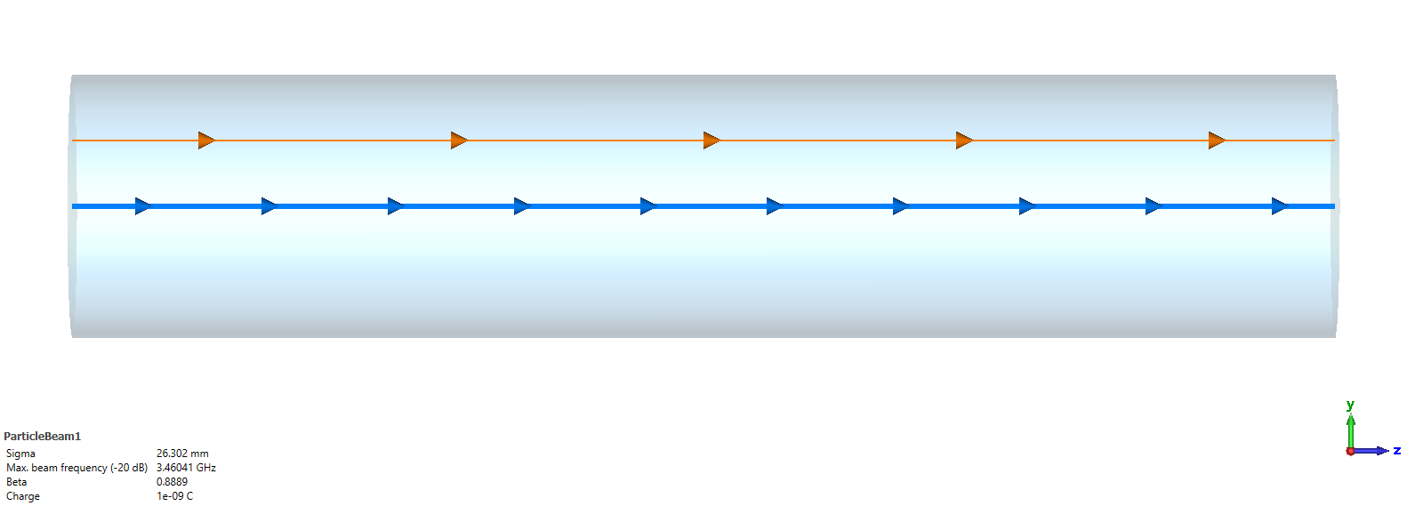
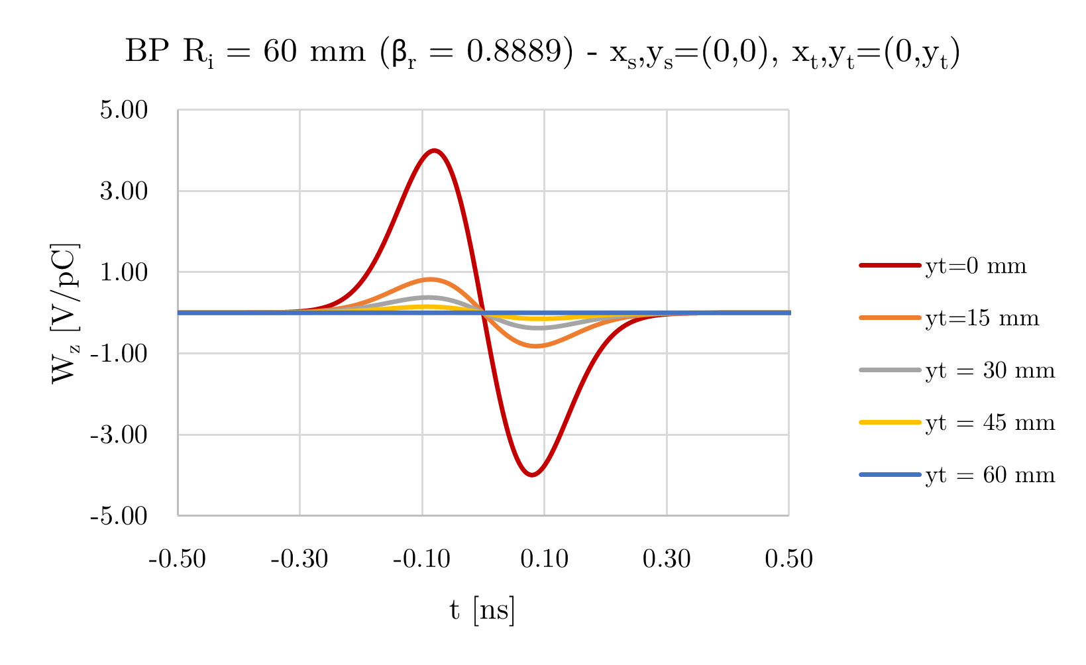
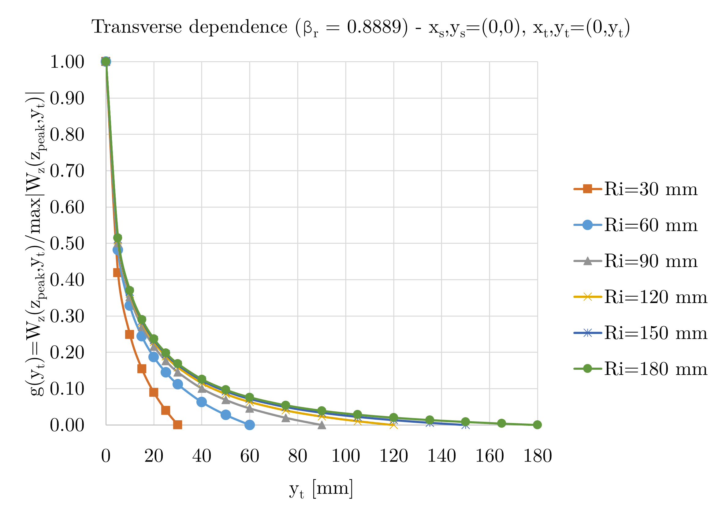

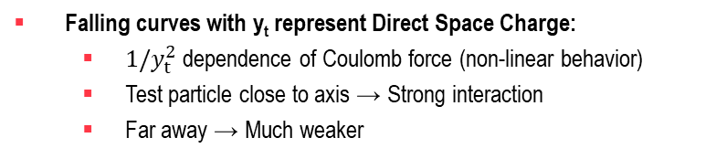
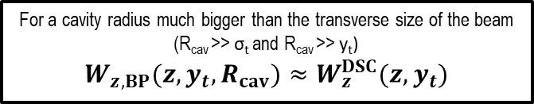
Beam pipe wake potential
Test particle (t)
R_{i}
$$W_{z}\left(z_{peak},y_{t}=0 mm\right)=max\left|W_{z}\left(z_{peak},y_{t}\right)\right|$$
Transverse offset y_{t}
$$W_{z}\left(z_{peak},y_{t}=15 mm\right)$$
Source particle (s)
$$W_{z,BP}\left(z,y_{t},R_{i}\right)=W_{z,BP}^{DSC}\left(z,y_{t}\right)+W_{z,BP}^{ISC}\left(z,R_{i}\right)$$
Falling curves with y_{t} represent Direct Space Charge:
$1/y_{t}^{2}$ dependence of Coulomb force (non-linear behavior)
Test particle close to axis → Strong interaction
Far away → Much weaker
IMCC BD-CE meeting Monday 25/08/2025 (https://indico.cern.ch/event/1577996/)
Difference between curves for different radii R_{i} are due to Indirect Space Charge (vertical shift):
For small R_{i}, the boundary constraints the fields more strongly, so ISC (image charges) is stronger
For large R_{i}, beam pipe walls are far away, so ISC contribution becomes weaker
$\sim 1/y_{t}^{2}$ (DSC)
For a cavity radius much bigger than the transverse size of the beam (R_{cav} >> σ_{t} and R_{cav} >> y_{t})
$$W_{z,BP}(z,y_{t},R_{cav})≈W_{z}^{DSC}(z,y_{t})$$
ISC

Slide 12
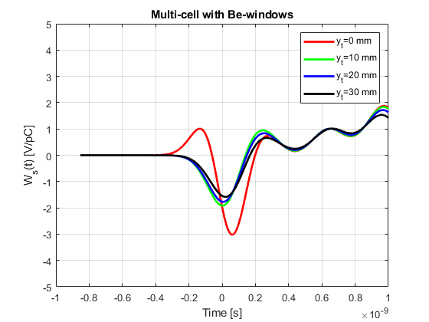
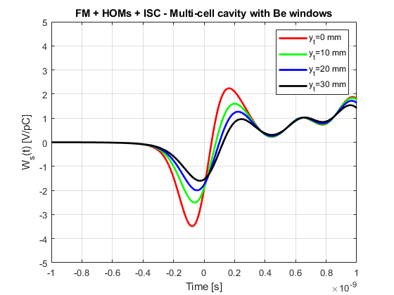
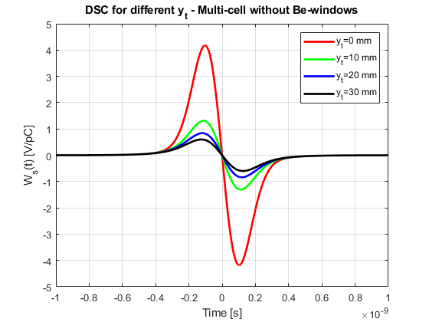
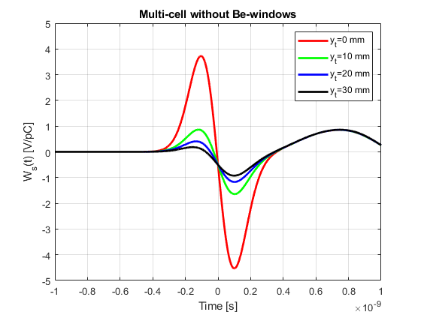
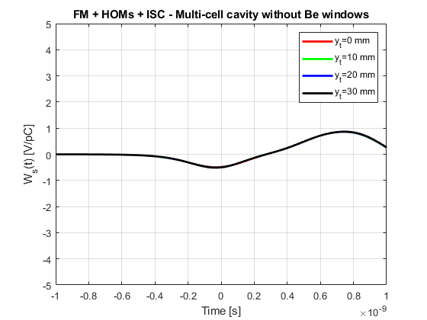

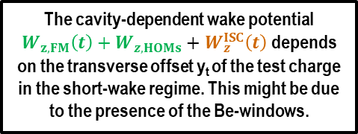




Wake potential dependency on test-particle transverse offset
Direct space charge for different y_{t}
$$W_{z}^{tot}\left(t\right)$$
$$W_{z}^{DSC}(t)$$
Non-linear dependence of wake potential on transverse offset y_{t} of the test charge in the short-wake regime
First-peak on the short-range wake disappears when test-charge is offset (it might be due to Be-window presence)
-
=
Non-linear dependence of wake potential on transverse offset y_{t}
Non-linear dependence of wake potential on transverse offset y_{t} of the test charge in the short-wake regime
$$W_{z}^{FM}\left(t\right)+W_{z}^{HOMs}\left(t\right)+W_{z}^{ISC}(t)$$
$$W_{z}^{tot}\left(t\right)$$
The cavity-dependent wake potential $W_{z,FM}\left(t\right)+W_{z,HOMs}+W_{z}^{ISC}\left(t\right)$depends on the transverse offset y_{t} of the test charge in the short-wake regime. This might be due to the presence of the Be-windows.
Longitudinal wake potential does not depend on the test-particle transverse offset!
Non-linear dependence of wake potential on transverse offset y_{t} of the test charge in the short-wake regime
$$W_{z}^{FM}\left(t\right)+W_{z}^{HOMs}\left(t\right)+W_{z}^{ISC}(t)$$

Slide 13
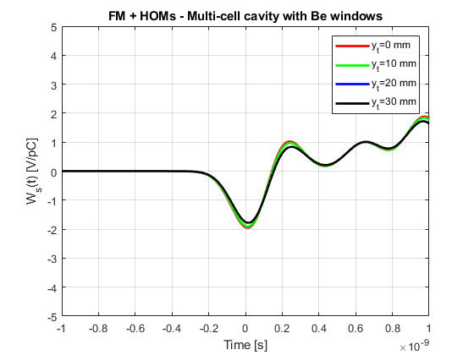
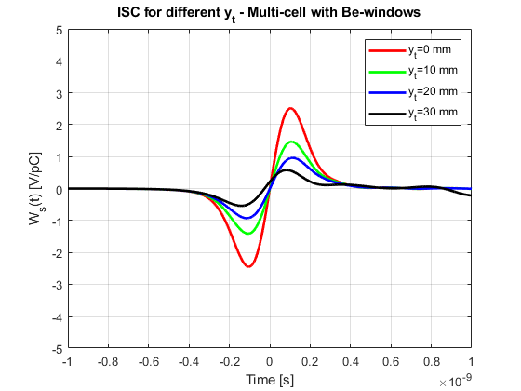
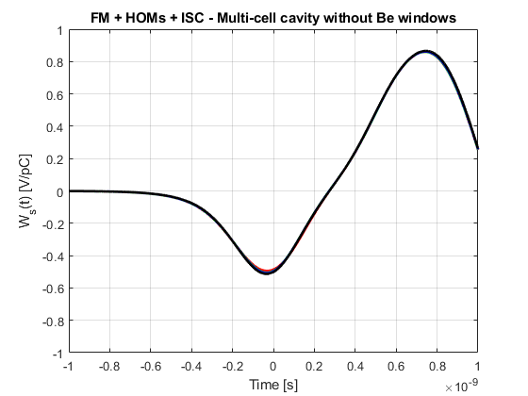
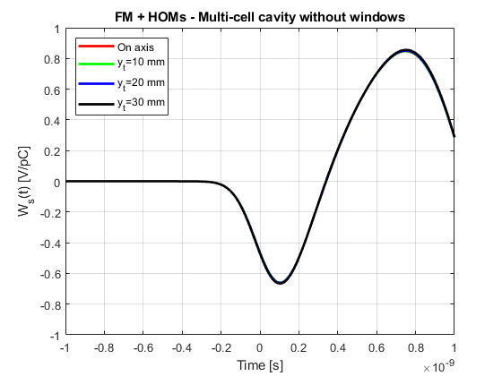
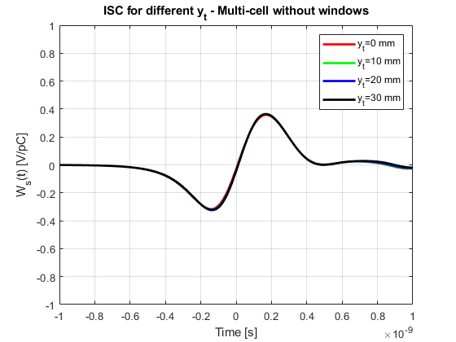






Wake potential dependency on test-particle transverse offset
$$W_{z}^{FM}\left(t\right)+W_{z}^{HOMs}\left(t\right)$$
$$W_{z}^{ISC}(t)$$
Non-linear dependence of wake potential on transverse offset y_{t} of the test charge in the short-wake regime
Non-linear dependence of wake potential on transverse offset y_{t} of the test charge in the short-wake regime
-
=
Some ripples above 30 mm offset
Difference might be due to mode-R/Q sensitivity, i.e., broad (TM₀₁₀) or narrow (TM_{020,}TM₀₂₁) radial E-field profile
Non-linearity maybe due to the presence of Be-windows
$$W_{z}^{FM}\left(t\right)+W_{z}^{HOMs}\left(t\right)+W_{z}^{ISC}(t)$$
$$W_{z}^{ISC}(t)$$
Longitudinal wake potential does not depend on the test-particle transverse offset!
-
=
Longitudinal wake potential does not depend on the test-particle transverse offset!
$$W_{z}^{FM}\left(t\right)+W_{z}^{HOMs}\left(t\right)+W_{z}^{ISC}(t)$$
$$W_{z}^{FM}\left(t\right)+W_{z}^{HOMs}\left(t\right)$$
13

Slide 14
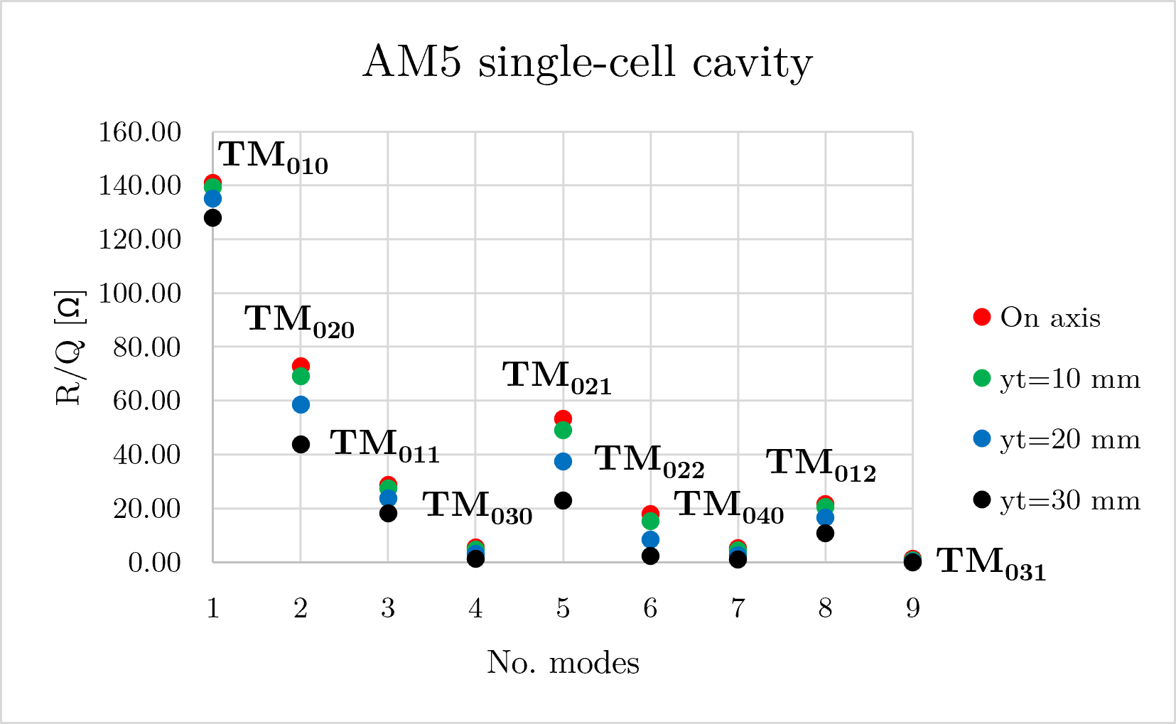
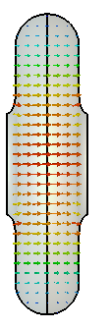
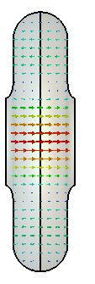
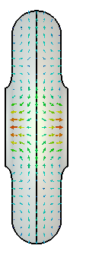

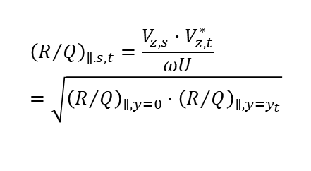
Reasons for wake potential dependency on test-particle transverse offset
$$W_{z}^{F}\left(t\right)+W_{z}^{HOMs}\left(t\right)$$
Generalized R/Q formula for off-axis particles is the product of the source and test voltages normalized by the product of frequency and stored energy
$${\left(R/Q\right)}_{∥.s,t}=\frac{V_{z,s}∙V_{z,t}^{∗}}{ωU}=\sqrt{{\left(R/Q\right)}_{∥,y=0}⋅{\left(R/Q\right)}_{∥,y=y_{t}}}$$
Difference might be due to mode-R/Q sensitivity, i.e., broad (TM₀₁₀) or narrow (TM_{020,}TM₀₂₁) radial E-field profile
s=source particle, t=test particle
$$W_{z}^{ISC}(t)$$
The combined FM + HOMs longitudinal wake potential in a multi-cell cavity with Be-windows depends on test-particle’s transverse offset due to mode-R/Q dependency on the radial E-field profile.
Be-windows might contribute to the difference between ISC wake potential curves for different test-particle offsets. ISC wake potential is independent from the transverse offset on the cavity without Be-windows, as in an ideal pillbox cavity
Non-linear dependence of wake potential on transverse offset y_{t} of the test charge in the short-wake regime
Some ripples above 30 mm offset
The cavity wake potential $W_{z,FM}\left(t\right)+W_{z,HOMs}$, which depends on the transverse offset y_{t} of the test charge, will be compensated in the cavity with Be-windows.
Non-linearity maybe due to the presence of Be-windows

Slide 15
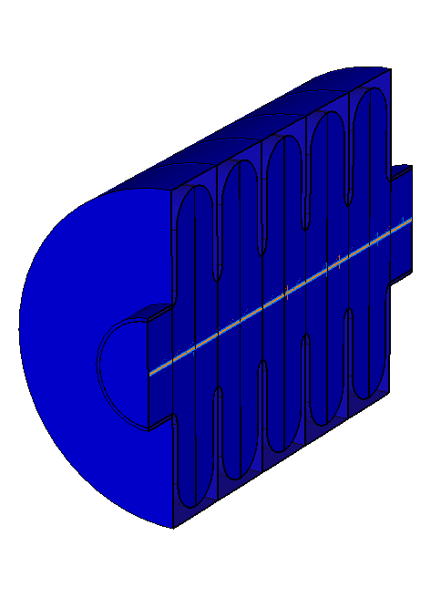
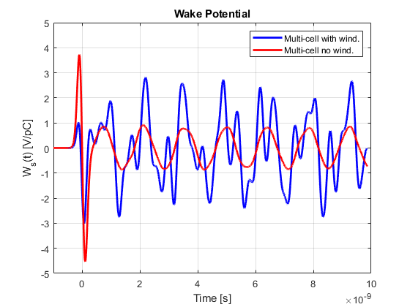
Field monitors in 5-cell cavity with and without Be-windows
5-cell cavity with Be-windows
5-cell cavity without Be-windows
Multi-cell cavity with Be-windows:
Be-windows increase the wake potential amplitude in the long-range wake regime
The wakefields ring for a longer time in the 5-cell cavity with Be-windows
Be-windows might act as a damper on the short-range wake regime
Parameter | Unit | Window | No Window
f₀ | MHz | 704 | 704
Q₀ | - | 2.23E+04 | 2.25E+04
TTF | us | 0.90 | 0.99
R/Q (β) | Ω/cell | 140.85 | 79.71
E_{acc} | MV/m/cell | 20.26 | 22.41
P_{diss} | MW/cell | 1.18 | 2.53
E_{peak}/E_{acc} | - | 1.19 | 2.18
Multi-cell cavity without Be-windows:
Offer higher TTF
R/Q is reduced compared to cavity with Be-window, resulting in higher peak power but lower induced voltage in the long-range wakefield
Higher E-field on cavity iris, higher risk of RF-breakdown
Notes:
Investigation of possible beam pipe modes

Slide 16
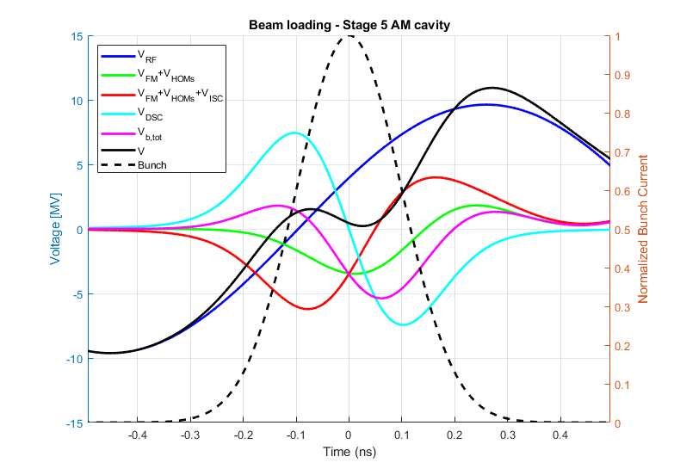
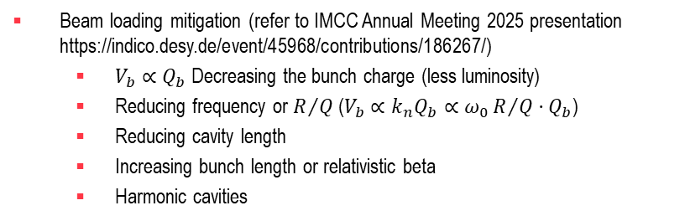
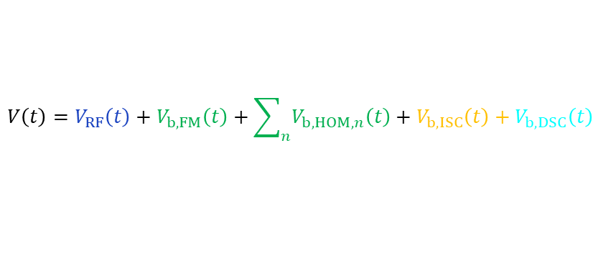
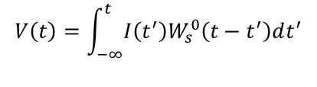


Beam loading
Induced voltage by a general current (Gaussian bunch) – Convolution of the wake potential with beam current
$$V_{b,tot}\left(t\right)$$
Voltage seen by the beam
Total beam loading
$$V\left(t\right)=\int_{−∞}^{t}{I\left(t^{′}\right)W_{s}^{0}\left(t−t^{′}\right)dt^{′}}$$
$$V\left(t\right)=V_{RF}\left(t\right)+V_{b,FM}\left(t\right)+\sum_{n}{V_{b,HOM,n}\left(t\right)}+V_{b,ISC}\left(t\right)+V_{b,DSC}\left(t\right)$$
Total cavity-dependent beam loading
$$V_{b,cav}\left(t\right)$$
Cavity independent beam loading
Beam loading compensation
Increasing RF voltage (refer to IMCC Annual Meeting 2025 presentation https://indico.desy.de/event/45968/contributions/186267/)
Inductive insert for the direct space charge component
Beam loading mitigation (refer to IMCC Annual Meeting 2025 presentation https://indico.desy.de/event/45968/contributions/186267/)
$V_{b}∝Q_{b}$ Decreasing the bunch charge (less luminosity)
Reducing frequency or $R/Q$ ($V_{b}∝k_{n}Q_{b}∝ω_{0}R/Q⋅Q_{b}$)
Reducing cavity length
Increasing bunch length or relativistic beta
Harmonic cavities

Slide 17
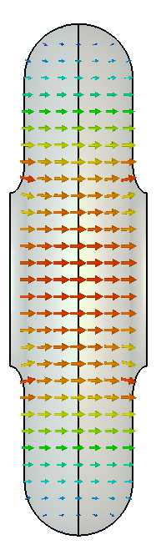
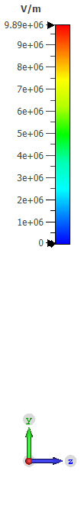



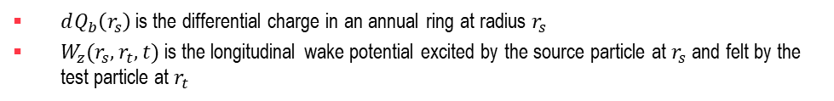
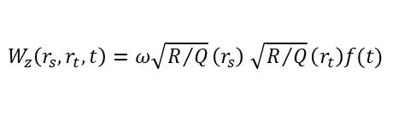
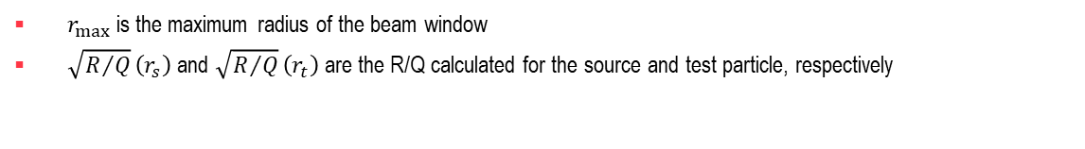
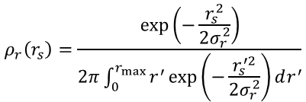
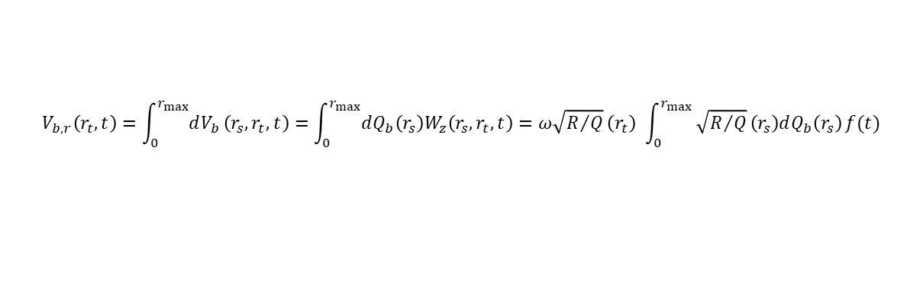

Including transverse beam size in the beam loading (cavity with Be-windows)
Differential induced voltage from an annular source ring at radius r_{s} acting on a test particle r_{t}
$$dV_{b,r}\left(r_{s},r_{t},t\right)=dQ_{b}\left(r_{s}\right)W_{z}(r_{s},r_{t},t)$$
r_{max}
$dQ_{b}\left(r_{s}\right)$is the differential charge in an annual ring at radius $r_{s}$
$W_{z}(r_{s},r_{t},t)$ is the longitudinal wake potential excited by the source particle at $r_{s}$ and felt by the test particle at $r_{t}$
r_{t}
Test particle (t)
r_{s}
Source particle (s)
$W_{z}\left(r_{s},r_{t},t\right)=ω\sqrt{R/Q}\left(r_{s}\right)$ $\sqrt{R/Q}\left(r_{t}\right)f(t)$
For a radially symmetric Gaussian beam, the differential charge is
$$dQ_{b}\left(r_{s}\right)=Q_{b}2πr_{s}ρ_{r}\left(r_{s}\right)dr_{s}$$
with $ρ_{r}\left(r_{s}\right)$ the normalized radial charge density
$$ρ_{r}\left(r_{s}\right)=\frac{\exp\left(−\frac{r_{s}^{2}}{2σ_{r}^{2}}\right)}{2π\int_{0}^{r_{max}}{r^{′}\exp\left(−\frac{r_{s}^{′2}}{2σ_{r}^{2}}\right)dr^{′}}}$$
The total induced voltage for a single mode seen by a test particle at will be r_{t}
$$V_{b,r}\left(r_{t},t\right)=\int_{0}^{r_{max}}{dV_{b}}\left(r_{s},r_{t},t\right)=\int_{0}^{r_{max}}{dQ_{b}\left(r_{s}\right)W_{z}\left(r_{s},r_{t},t\right)}=ω\sqrt{R/Q}\left(r_{t}\right) \int_{0}^{r_{max}}{\sqrt{R/Q}\left(r_{s}\right)dQ_{b}\left(r_{s}\right)}f(t)$$
$r_{max}$ is the maximum radius of the beam window
$\sqrt{R/Q}\left(r_{s}\right)$ and $\sqrt{R/Q}\left(r_{t}\right)$ are the R/Q calculated for the source and test particle, respectively
$$F_{⊥}\left(σ_{r}\right)$$
Transverse form factor

Slide 18






Including transverse beam size in the beam loading
The finite-beam modal wake potential and induced-voltage will be given by
$$W_{z}^{finite}\left(r_{t},t\right)=ω\sqrt{R/Q}\left(r_{t}\right)F_{⊥}\left(σ_{r}\right){ F}_{∥}\left(σ_{z}\right)f(t)$$
$$V^{finite}\left(t\right)=\int_{−∞}^{t}{I\left(t^{′}\right)W_{z}^{finite}\left(t−t^{′}\right)dt^{′}}$$
${ F}_{∥}\left(σ_{z}\right)=exp(−\frac{1}{2}{\left( ωσ_{z}⁄β_{r}c\right)}^{2})$ is the longitudinal form factor
$F_{⊥}\left(σ_{r}\right)=\int_{0}^{r_{max}}{\sqrt{R/Q}\left(r_{s}\right)dQ_{b}\left(r_{s}\right)}$ is the transverse form factor (equal to 1 for pencil beam, i.e., $σ_{r}=0$ )
The finite transverse beam size has a small effect on the fundamental mode (TM010), since its fields are nearly uniform across the beam aperture.
HOMs have stronger radial dependence of their fields and R/Q, so the averaging over a finite transverse bunch distribution suppresses their effective wake excitation.

Slide 19





Beam loading (FM+HOMs) for 5-cell cavity with Be-windows – Stage AM5
$$V\left(t\right)=V_{RF}\left(t\right)+V_{FM}\left(t\right)+\sum_{n}{V_{HOM,n}\left(t\right)}$$
Including transverse form factor (σ_{z} = 27.7 mm, σ_{r} = 20.0 mm)
Including transverse form factor (σ_{z} = 27.7 mm, σ_{r} = 20.0 mm)
Parameter | Unit | Value
V_{RF} | MV | 9.63
V_{b}(t=0) | MV | 3.22
V_{b,max}(t=2.2 ns) | MV | 4.84
V_{b}/V_{RF} | - | 0.33
V_{b,max}/V_{RF} | - | 0.50
P_{diss} | MW | 5.91
E_{peak} | MV/m | 24.12
Parameter | Unit | Value
V_{RF} | MV | 9.63
V_{b}(t=0) | MV | 1.96
V_{b,max}(t=2.2 ns) | MV | 3.41
V_{b}/V_{RF} | - | 0.20
V_{b,max}/V_{RF} | - | 0.36
P_{diss} | MW | 5.91
E_{peak} | MV/m | 24.12
Parameter | Unit | Value
V_{RF,L} | MV | 13.5
V_{RF,L}/V_{RF} | - | 1.41
P_{diss}’ | MW | 11.72
E_{peak}’ | MV/m | 33.96
ΔV_{spread} | MV | 1.27
ΔV_{spread}/V_{RF} | - | 0.13
Parameter | Unit | Value
V_{RF,L} | MV | 13.3
V_{RF,L}/V_{RF} | - | 1.38
P_{diss}’ | MW | 11.26
E_{peak}’ | MV/m | 33.29
ΔV_{spread} | MV | 0.53
ΔV_{spread}/V_{RF} | - | 0.05
- 1.5 %
- 39 %
- 2.1 %
- 30 %
- 3.9 %
- 39 %
- 1.9 %
- 28 %

Slide 20



Beam loading (FM+HOMs+ISC) for 5-cell cavity without Be-windows – Stage AM5
$$V\left(t\right)=V_{RF}\left(t\right)+V_{FM}\left(t\right)+\sum_{n}{V_{HOM,n}\left(t\right)}+V_{ISC}(t)$$
Parameter | Unit | Value
V_{RF} | MV | 9.63
V_{b}(t=0) | MV | 0.86
V_{b,max}(t=2.2 ns) | MV | 1.62
V_{b}/V_{RF} | - | 0.09
V_{b,max}/V_{RF} | - | 0.17
P_{diss} | MW | 12.75
E_{peak} | MV/m | 48.81
Parameter | Unit | Value
V_{RF,L} | MV | 10.29
V_{RF,L}/V_{RF} | - | 1.07
P_{diss}’ | MW | 14.58
E_{peak}’ | MV/m | 52.20
ΔV_{spread} | MV | 0.14
ΔV_{spread}/V_{RF} | - | 0.01

Slide 21
Beam loading for 5-cell cavity with and without Be-windows – Stage AM5
Multi-cell cavity with Be-windows
Multi-cell cavity without Be-windows
Parameter | Unit | Value
V_{RF,L} | MV | 13.3
V_{RF,L}/V_{RF} | - | 1.38
P_{diss}’ | MW | 11.26
E_{peak}’ | MV/m | 33.29
ΔV_{spread} | MV | 0.53
ΔV_{spread}/V_{RF} | - | 0.05
Parameter | Unit | Value
V_{RF,L} | MV | 10.29
V_{RF,L}/V_{RF} | - | 1.07
P_{diss}’ | MW | 14.58
E_{peak}’ | MV/m | 52.20
ΔV_{spread} | MV | 0.14
ΔV_{spread}/V_{RF} | - | 0.01
The required RF voltage to compensate beam loading in cavity with windows is 29% higher than cavity without windows
The dissipated power is lower in the cavity with window by 23% and the peak electric field by 36% compared to the cavity without Be-windows
The peak electric field is higher than 50 MV/m (ultimate field) in the cavity without Be-window (high risk of RF breakdown)

Slide 22






Beam loading per cavity cell summary
352 MHz
704 MHz
FM+HOMs
352 MHz
704 MHz
FM+HOMs
Before merging: higher FM and HOM beam-induced voltage on the 704 MHz cavities than 352 MHz cavities
After merging:
Stage 1 shows the highest FM and HOM beam-induced voltage among the 352 MHz cavities
Stages 6 and 7 exhibits the highest FM and HOM beam loading among the 704 MHz cavities

Slide 23






Voltage compensation and resulting power per cavity cell
The required RF voltage increase to compensate FM + HOMs beam loading (at t=0): factor 1.15 to 2 across BM cavities (largest in 2 & 4). Factor 1.16 to 1.38 across AM cavities.
The dissipated and required peak powers increase with the square of the voltage. Less than 6 MW dissipated in the AM stages. Higher dissipation in stages 2 and 4 of BM.
Notes:
Fig 3, 10, 5

Slide 24




Surface electric field
After FM and HOMs beam loading compensation, the surface electric field magnitude on Cu walls and Be windows overpasses the max E-field of 30 MV/m in the majority of the stages. The ultimate field of 50 MV/m is overpassed on stage 4 BM and stage 9 AM.
Potential risk of RF breakdown in the majority of the stages!

Slide 25
Conclusions
Wakefield analysis for RF cavities of the rectilinear muon cooling channel:
The wake potential was decomposed using a combination of CST wakefield and eigenmode solutions, showing consistent agreement between the two solvers in the long-wake regime.
The indirect space-charge wake potential depends on transverse particle offset in the presence of Be-windows, whereas no such dependence is observed for the cavity without Be-windows
Beam loading is high for the studied cavity and needed compensation
The FM+HOMs induced voltage, which depends on the transverse offset y_{t} of the test charge, was compensated
Transverse beam size dependence was included in the derived wake potential, showing higher mitigation for HOMs
The required RF voltage to compensate beam loading in Stage B5 cavity with windows is 29% higher than cavity without windows
Cavity with Be-windows
The required voltage for beam loading compensation is higher by a factor of 1.5 to a factor 2 in the analyzed cavities
The surface electric field magnitude overpasses the maximum E-field in most of the stages (high-risk of RF breakdown)
Space charge considerations:
Space charge effect is predominant in the studied cavities and needs special treatment by using beam dynamics simulation codes
Beam dynamics simulations are need to assess the effects of the beam loading on the entire cooling channel

Slide 26
Thank you
for your attention

Slide 27




HOM Monopole modes – Stage 5 Post-merging
Boundary conditions and symmetry planes
H_{t}=0
E_{t}=0
TM₀₂₀
TM₀₂₁
TM₀₁₁
TM₀₂₂
TM₀₁₂
H_{t}=0
TM₀₃₁
TM₀₃₀
TM₀₄₀
TM₀₃₀
TM₀₄₀
TM₀₂₁
TM₀₁₂
TM₀₂₀
TM₀₁₁
TM₀₂₂
TM₀₁₂
TM₀₁₀
TM₀₂₀
TM₀₁₀
TM₀₂₁
TM₀₃₁
TM₀₃₁
TM₀₃₀
TM₀₄₀
TM₀₁₁
TM₀₂₂

Slide 28





Mitigation strategies
Increasing the bunch length
Lowering the relativistic beta
Lowering the total charge
Decreasing the cavity length
Changing the cavity frequency
Beam loading mitigation:
Optimizing beam parameters can help reduce space charge effects.
Shorter cavities reduce space charge wake potential and long-range wakefield (R/Q is reduced).
352 MHz cavity with the same length of 704 MHz cavity helps to mitigate only long-range wakefield.
352 MHz cavity mitigates beam loading, but only for the long-range wakefield. In the short-range, it results in higher space charge due to the longer cavity length.

Slide 29












Beam pulse shape and RF cavity fields
$$|E|/{|E|}_{max}$$
$$|H|/{|H|}_{max}$$
$$V_{nom} =2. 14 MV$$
$$V=V_{nom}·e^{−\frac{ωt}{2Q_{L}}}$$
$$1$$
$$1$$
$$0.8$$
$$0.8$$
$$0.6$$
$$0.6$$
$$V=V_{nom}$$
$$0.4$$
$$0.4$$
_{Bunch train}
$$0.2$$
$$0.2$$
$$t_{b}=0.1 us$$
$$0$$
$$0$$
$$t_{f}$$
$$V=V_{nom}\frac{2β_{c}}{1+β_{c}}\left(1−e^{−\frac{ωt}{2Q_{L}}}\right)$$
E-field
H-field
Filling time and injection time
Duty factor
Optimization in CST:
maximize the R/Q*Q₀ to reduce the surface losses on the cavity walls and windows
lower the peak surface electric field to prevent the risk of RF-breakdown
$$t_{f}≈\frac{2Q_{L}}{ω_{0}}ln\left(\frac{2β_{c}}{β_{c}−1}\right)=t_{inj}$$
$$DF=\frac{P_{ave}}{P_{diss}}=\frac{\int{P\left(t\right)dt·f_{rep}}}{V_{acc}^{2}/(R/Q·Q_{0})}$$
Voltage profile was calculated considering the coupling factor β_{c}=1.2
DF used to compute the average power dissipation

