Slide 1
Results from POLAB & HV in 2025 and Outlook for the end of the year
Roland Piccin (TE-MSC-SMT) on behalf of POLAB & HVLAB
30/9/2025

Slide 2
Content
CERN-Wide Service
HFM
Infrastructure and Investments
Conclusions

Slide 3
CERN-wide service

Slide 4
CERN-wide service
Up to June 2025, 60 Jobs across 6 Departments. Particularly, TE, EP and BE.
~ 40 % of the activities requested by MSC group
Large number of diverse activities:
Coil impregnations for SMT
Construction of functional components (casting, gluing, 3D, …)
Troubleshooting and repairs for HL-LHC and not only
Projects
ITER Collaboration Agreement (IA24) on High Voltage Engineering
CERN Wide Service 1st semester report
(S. Clement EDMS 3328884)

Slide 5
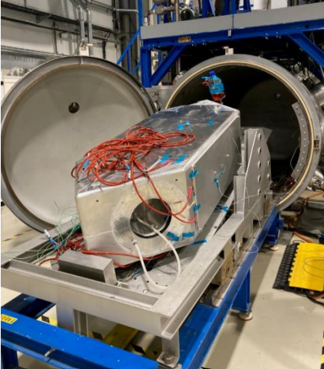
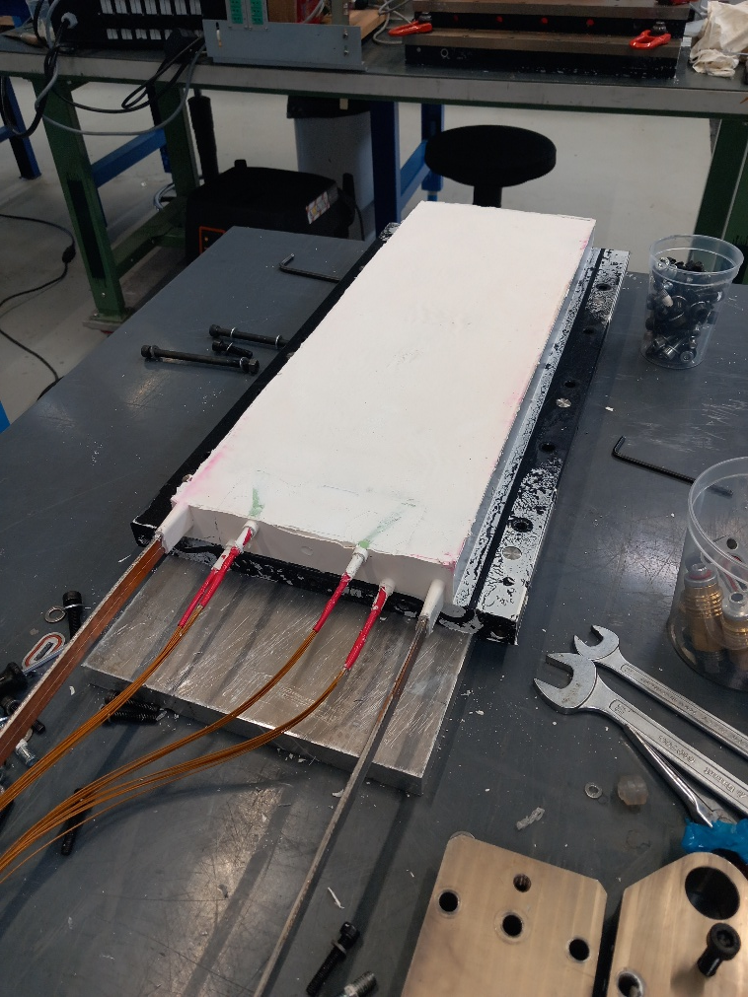
CERN-wide service
Up to June 2025, 60 Jobs across 6 Departments. Particularly, TE, EP and BE.
~ 40 % of the activities requested by MSC group
Large number of diverse activities:
Coil impregnations for SMT
Remaining main VPI jobs for 2025:
1) MCBRD AP10b
2) SMC QXF 301
CERN Wide Service 1st semester report
(S. Clement EDMS 3328884)
SMC 110 Wax
Fusillo

Slide 6
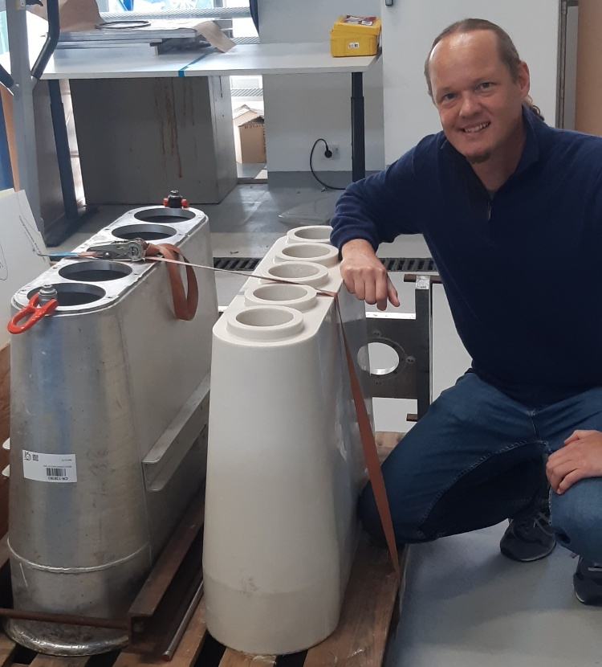
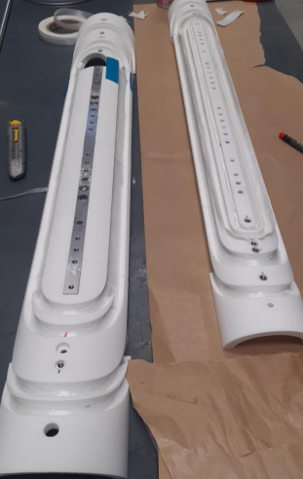
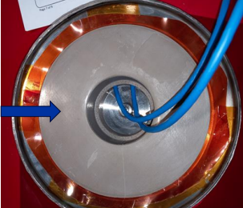
CERN-wide service
Up to June 2025, 60 Jobs across 6 Departments. Particularly, TE, EP and BE.
~ 40 % of the activities requested by MSC group
Large number of diverse activities:
Coil impregnations for SMT
Construction of functional components (casting, gluing, 3D, …)
CERN Wide Service 1st semester report
(S. Clement EDMS 3328884)

Slide 7
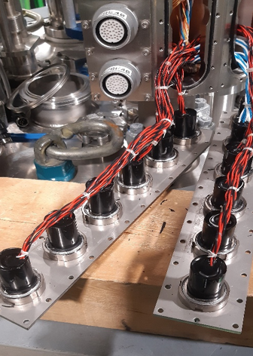
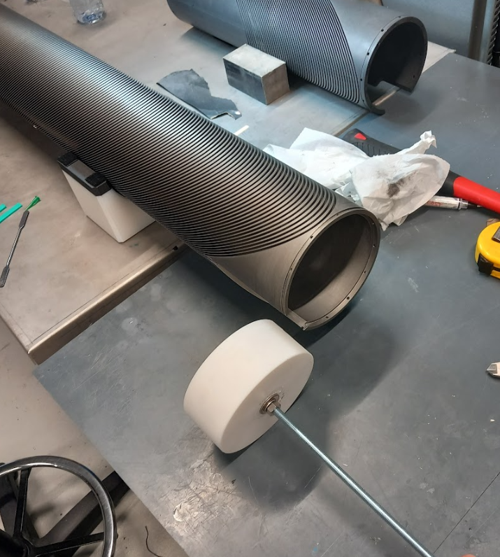
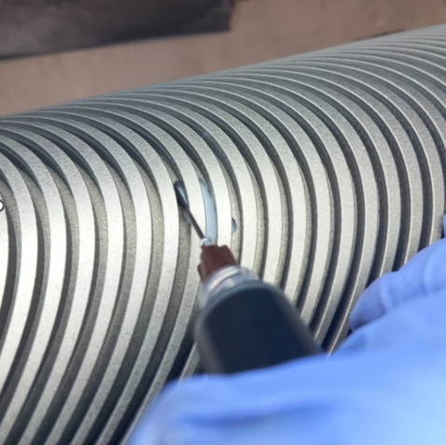
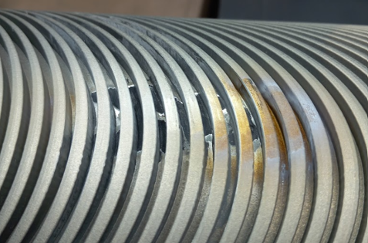
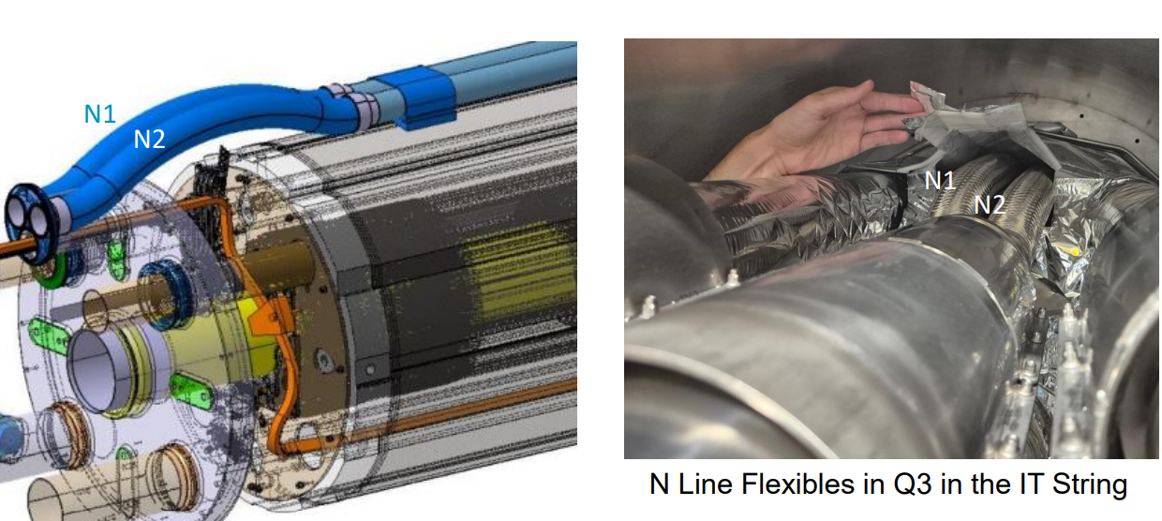
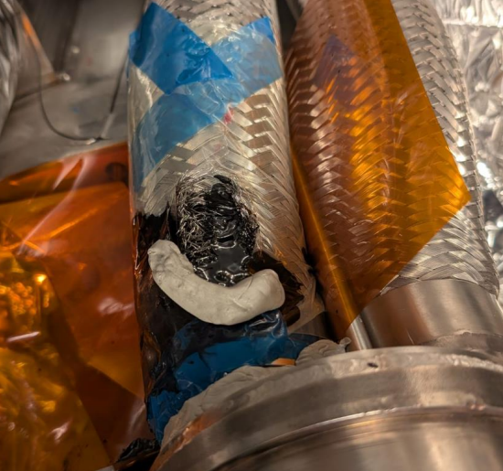
Troubleshooting and Repairing
Reparation of MCBRD external former (AP10b) (C. Urscheler EDMS 3254924)
HV connectors for SM18 long-test station (S. Clement EDMS 3328884)
Repair of leak in N-Line bellow near Q3 (link)

Slide 8
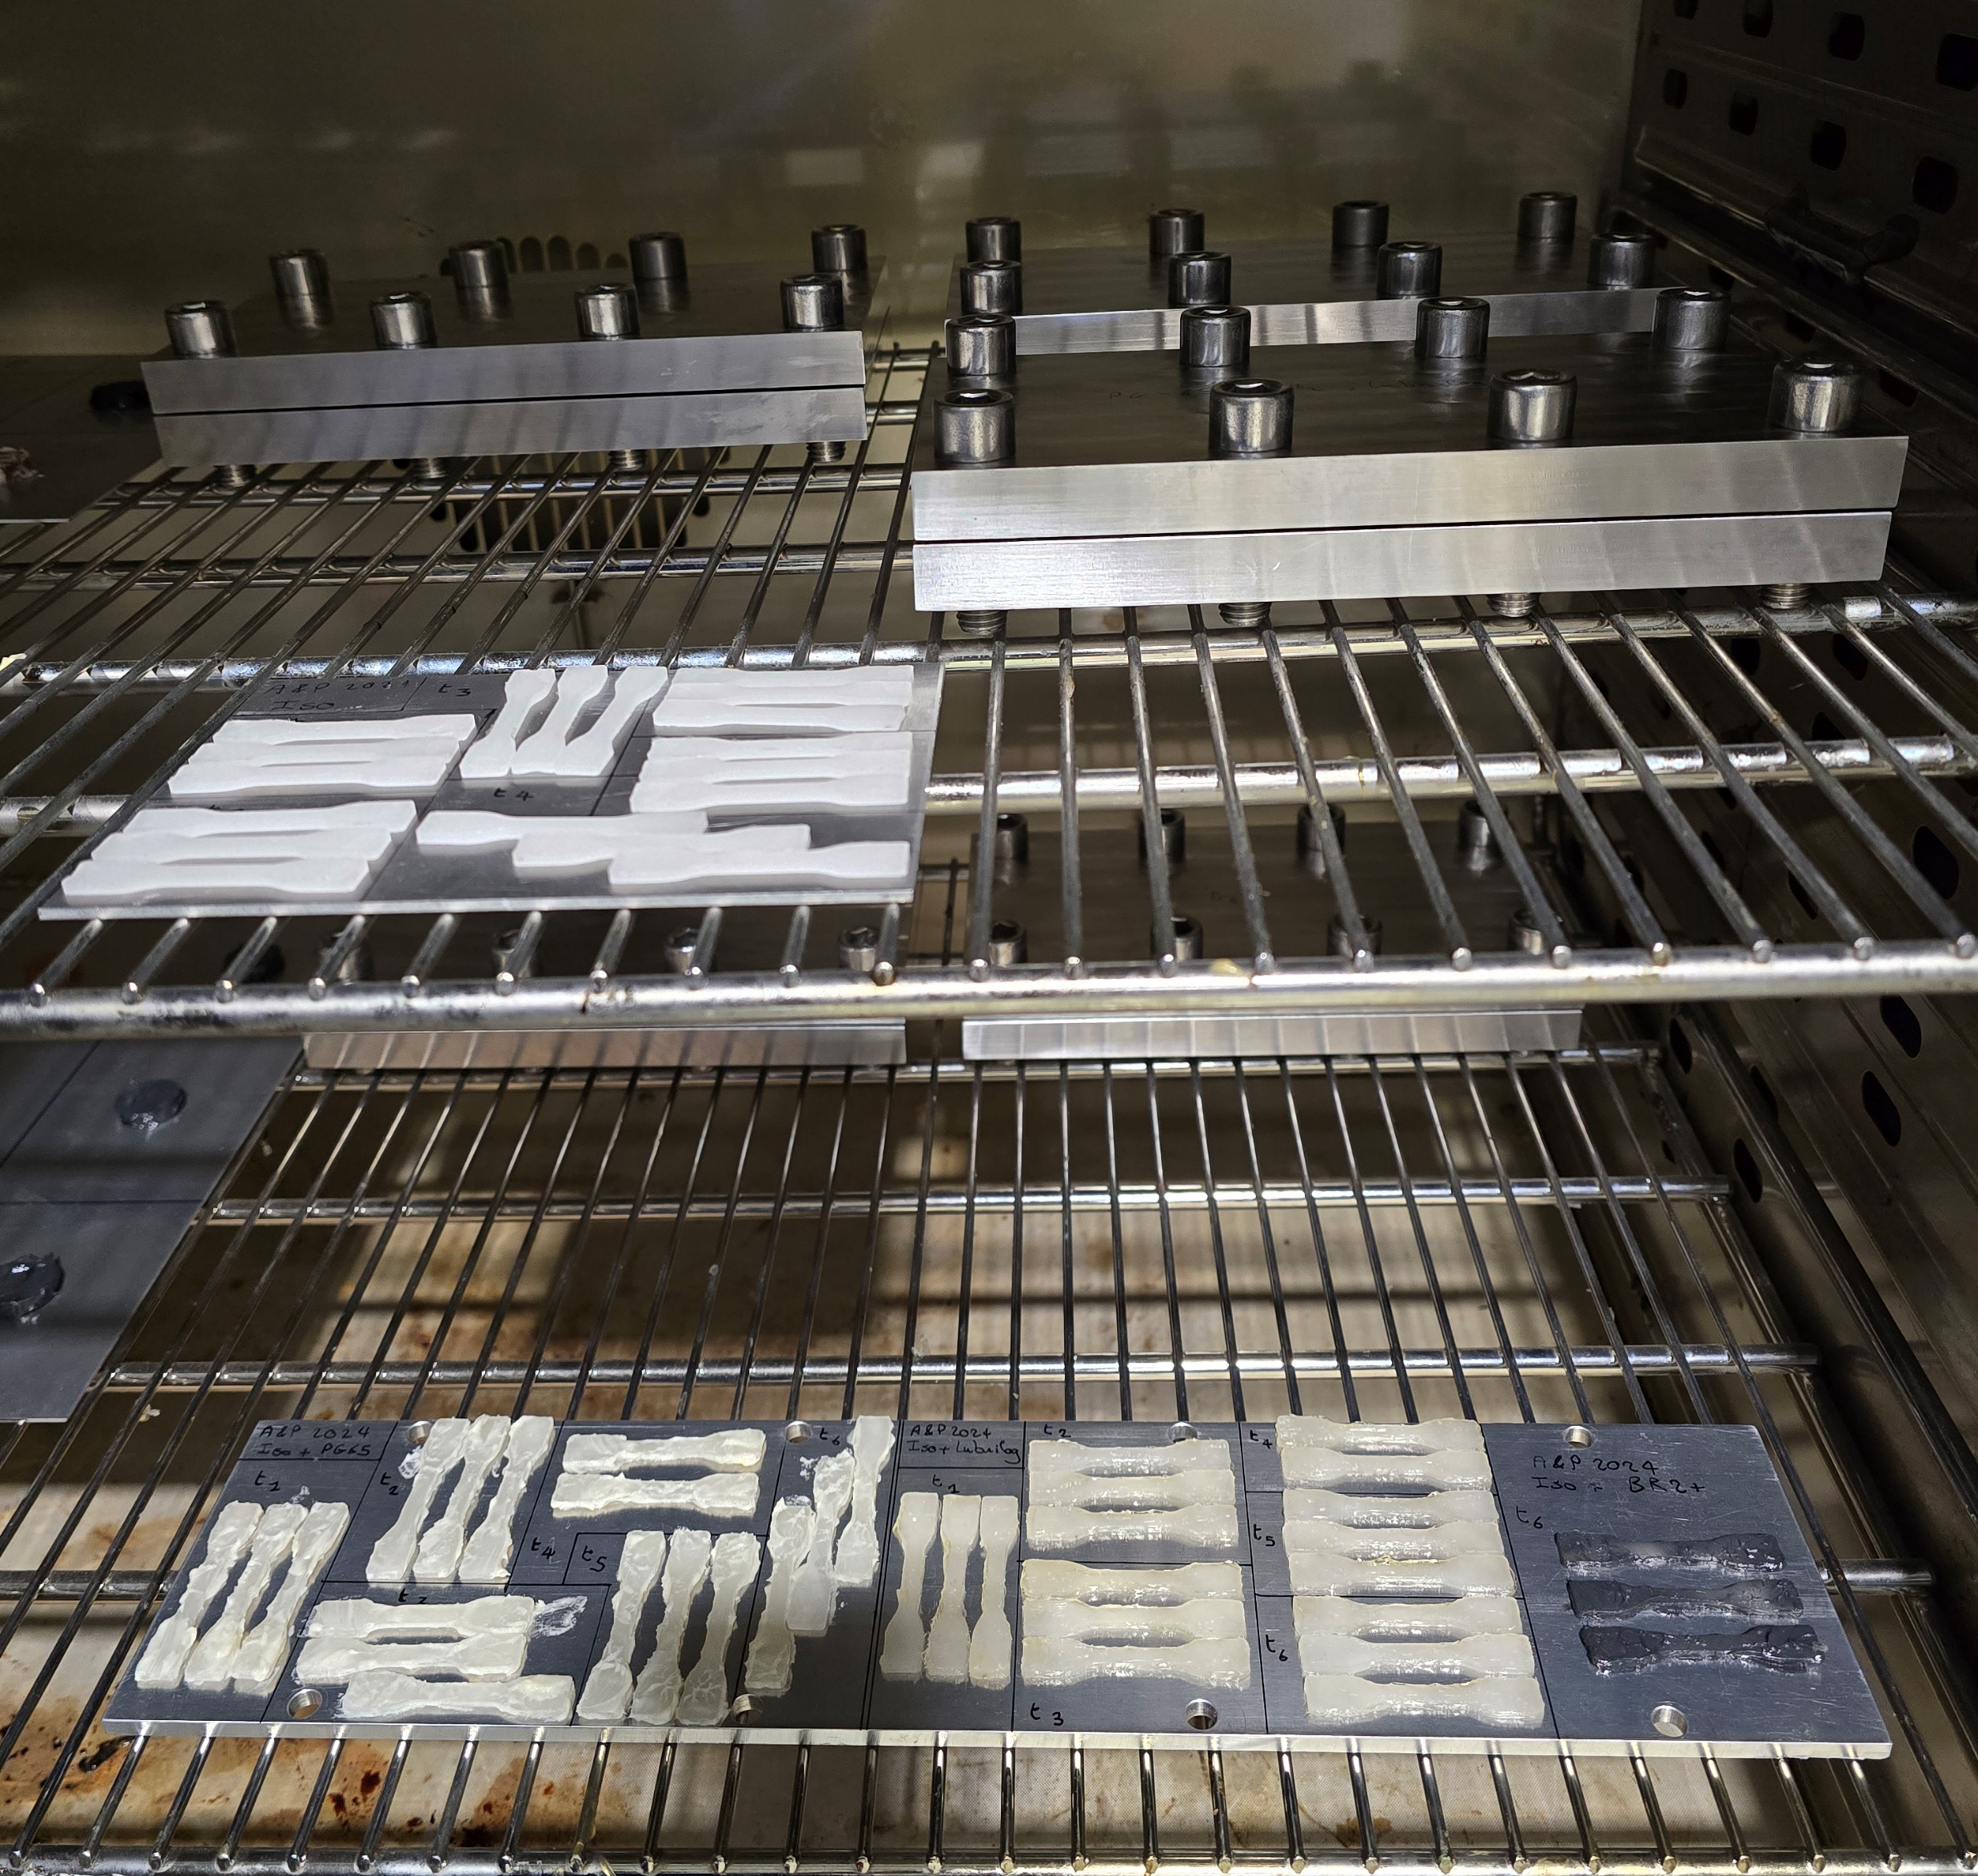
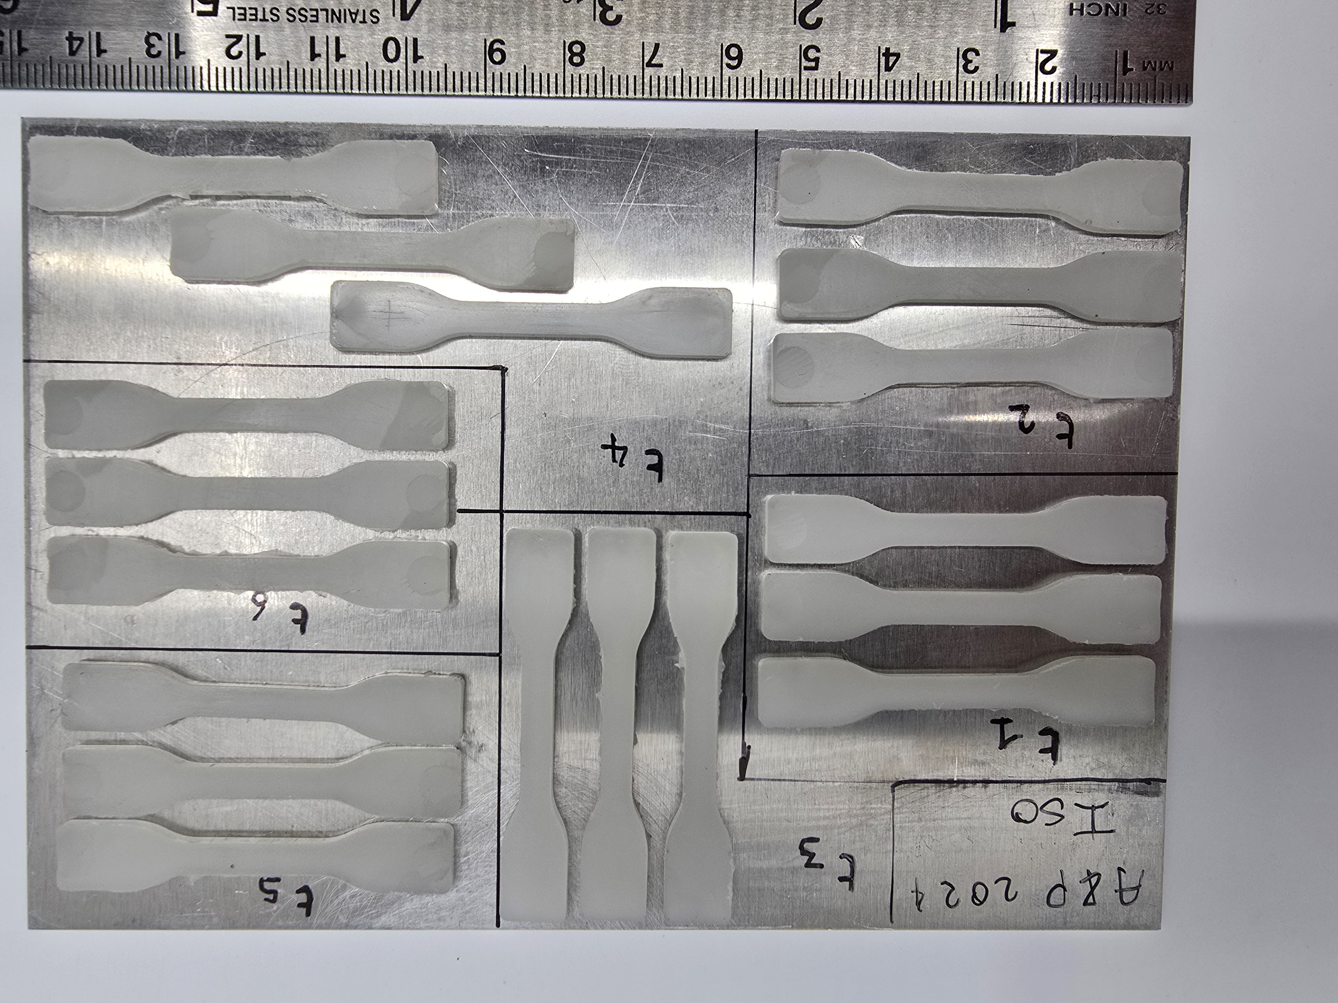
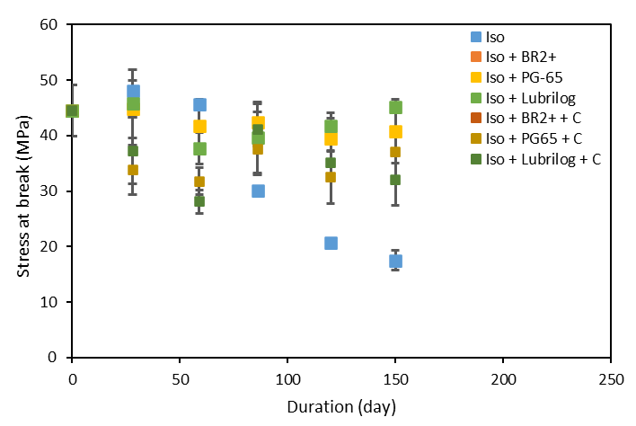
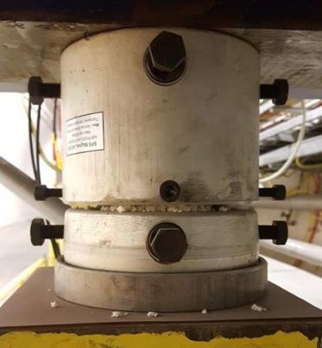
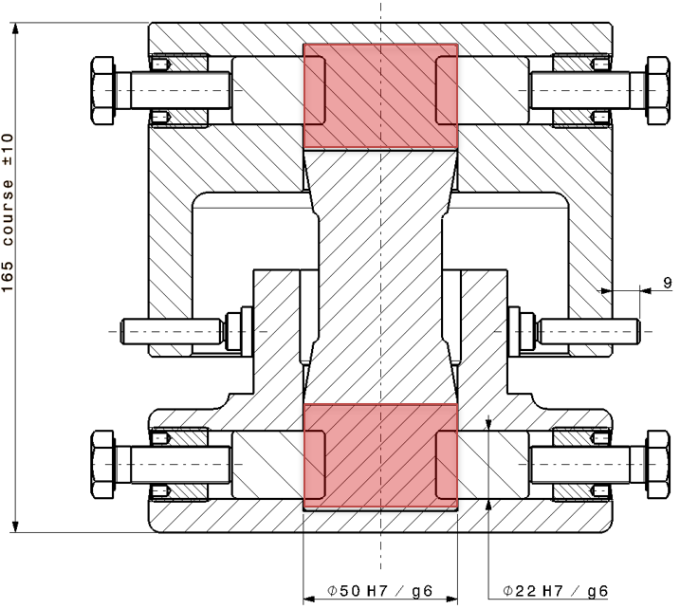
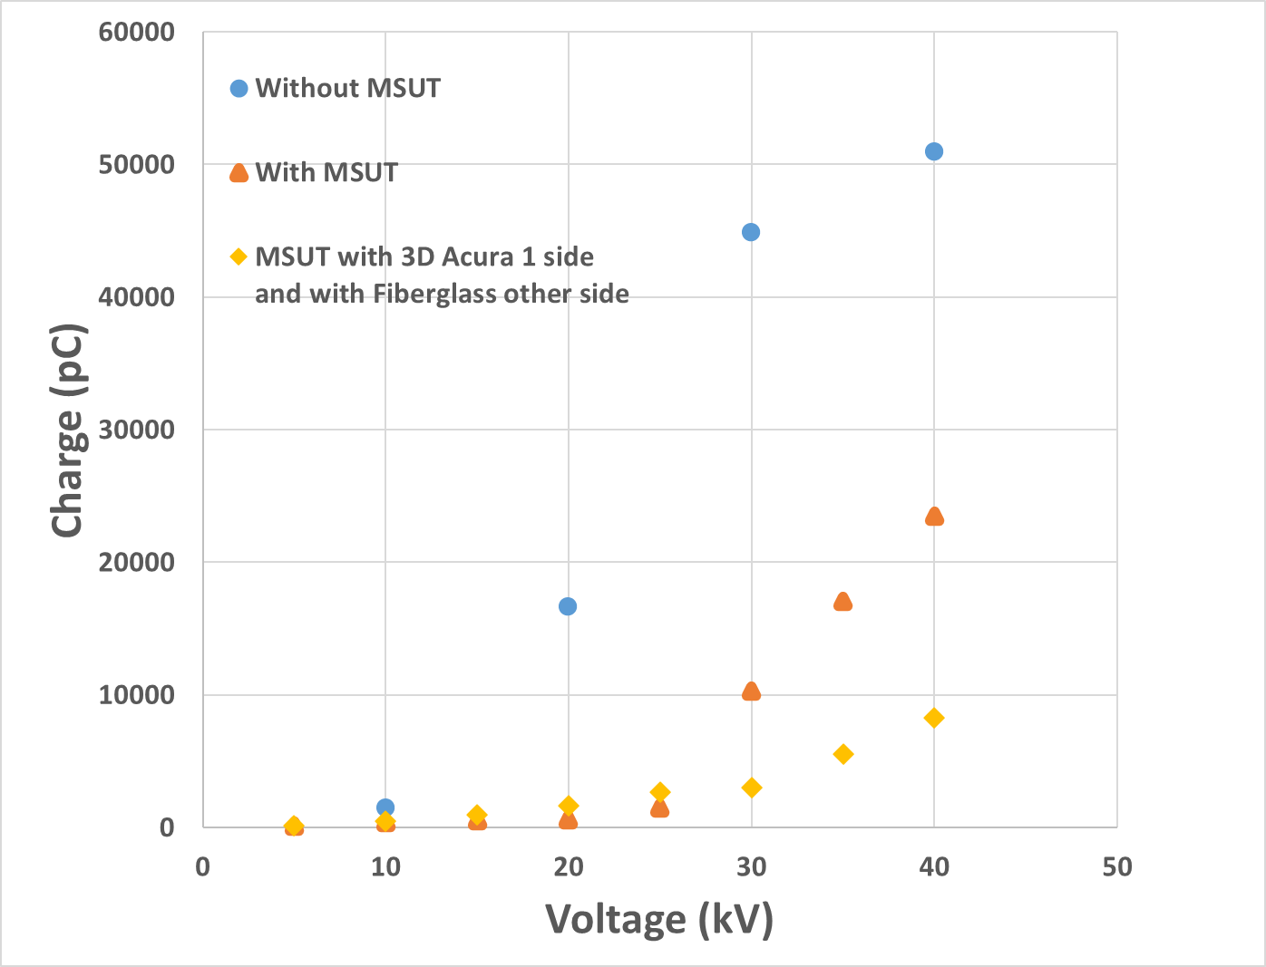
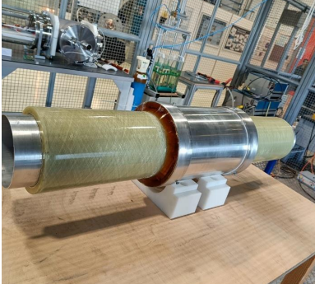
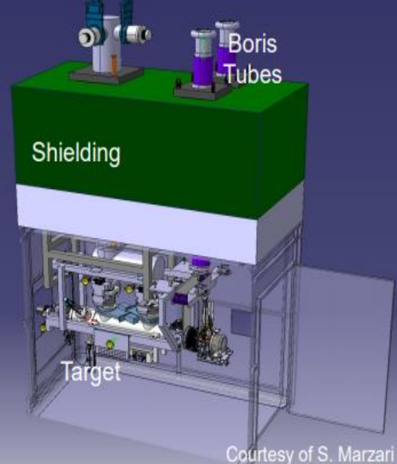
Highlights on Projects
PU Jack Task Force (BE, MME, MSC, SY, VSC) – Q4 2025 (95% completed)
Ageing study of Polyurethane jacks used on LHC magnet alignment
Drafting of material specifications
ISOLDE Beam Dump Replacement – IBDRS - Boris Tube (SY) link
Construction and HV testing of Boris Tube Prototype v.2 (P. Chaganti et al. EDMS 3245399) Q1 2025
Construction and HV testing of Boris Tube Prototype v.3 (P. Chaganti et al. EDMS 3331965) Q3 2025
v.4 (continue through Q4 2025 and 2026)
(V. Schenk)

Slide 9
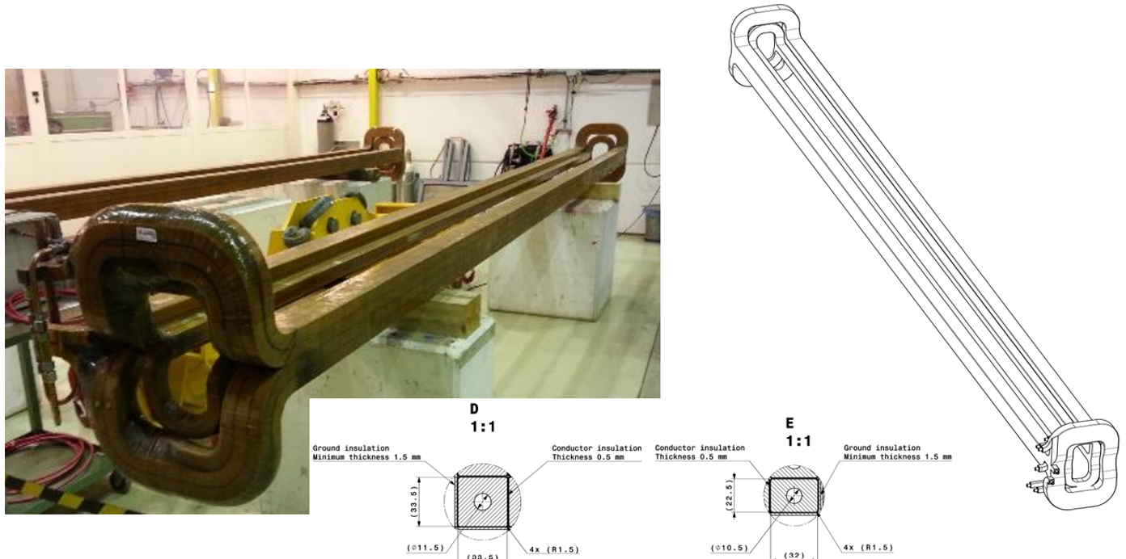
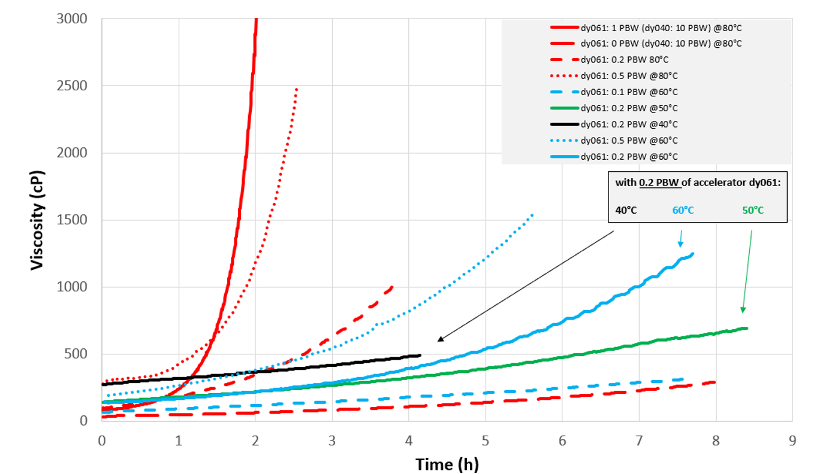
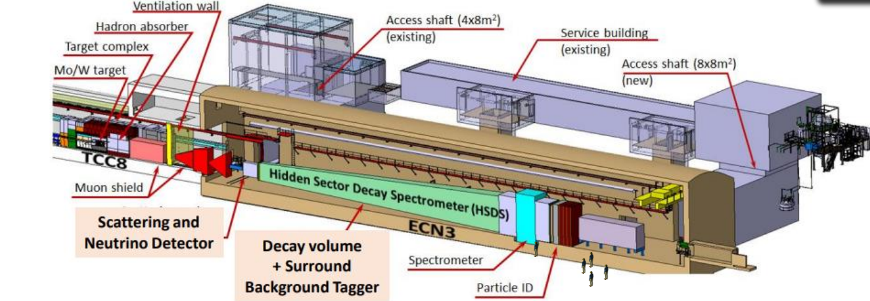
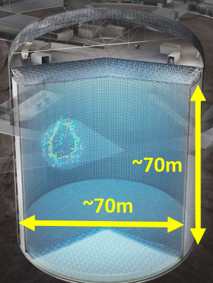
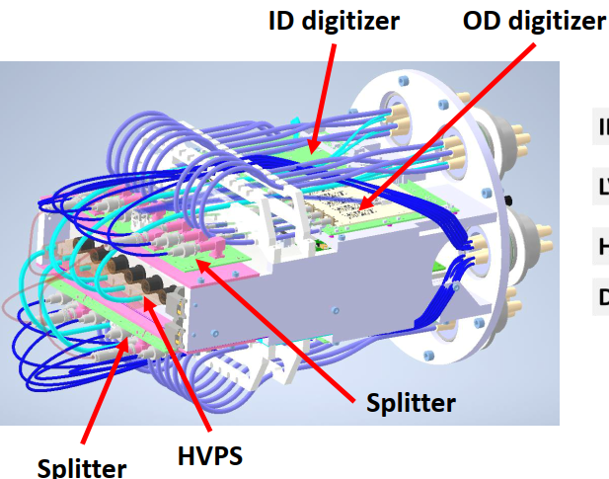
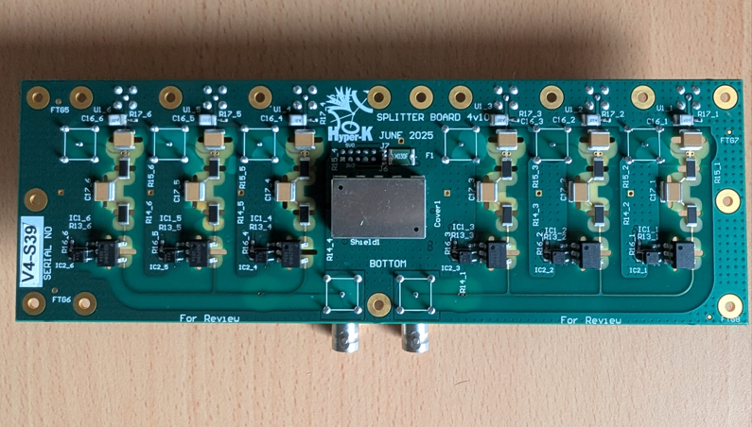
Highlights on Projects
PS Booster and Dipole MBB Projects (MSC-NCM)
Rheology and optimization of epoxy systems with different accelerators (C. Urscheler EDMS 3016367)
Final Report - Q4 2025
SHiP Spectrometer (TE-CRG, -HDO, -MSC)
Design & testing of high thermal conductivity putty (D. Beaujoint link) - Q4 2025
TPC Hyperkamiokande
Development of HV splitter module casting procedure and HV validation in vacuum – Q4 2025

Slide 10
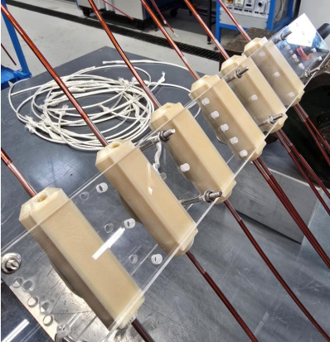
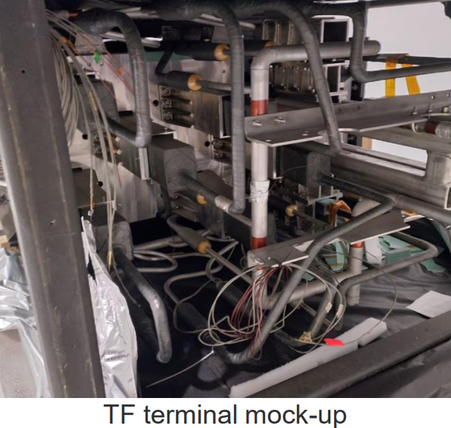
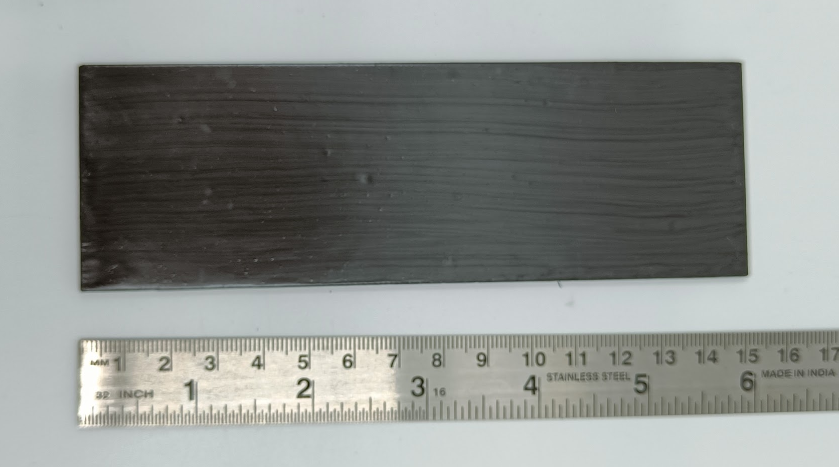
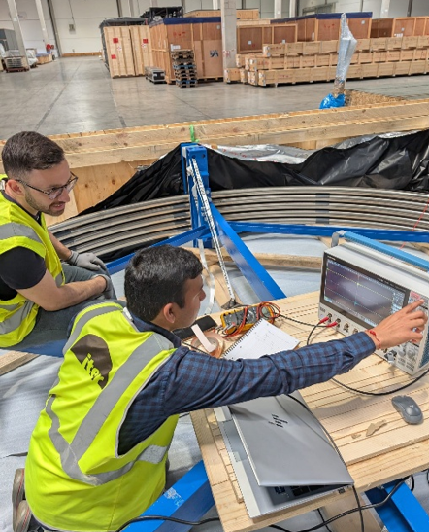
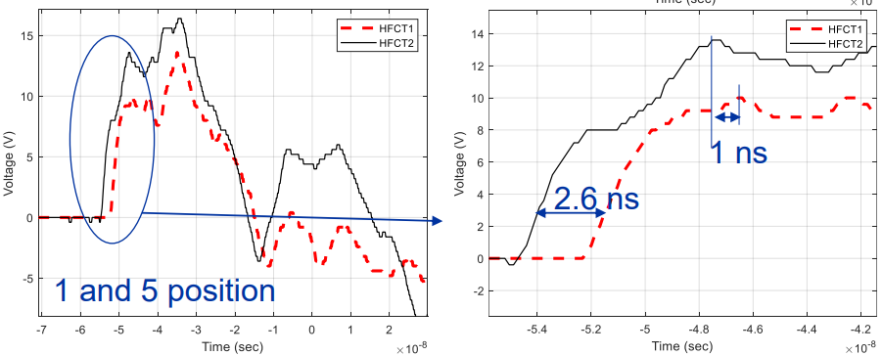
ITER Collaboration Agreement IA24
Support ITER in the areas of high voltage engineering and insulating materials: material testing; special tests; inspection of failures to assist in root cause diagnosis; fabrication of samples and special replacement parts.
Deliverables | Expected Date | EDMS
Report No. 1 | March 2024 | 3059720
Report No. 2 | September 2024 | 3157920
Report No. 3 | March 2025 | 3284247
Report No. 4 | September 2025 | 3356211
Report No. 5 | March 2026
Report No. 6 | September 2026
Report No. 7 | March 2027
Report No. 8 | September 2027
Report No. 9 | March 2028
Report No. 10 | September 2028
Design and Qualification of Repair Methods for 30 kV Voltage Tape Wires
Report for Q4 2025
(V. Schenk et al EDMS 3343054)
Surface resistivity measurement of conductive paints at 4.5 K
Q3 2025
P. Chaganti et al. EDMS 3349297
IVC Cable Fault Localization
Q2 2025
P. Chaganti et al. EDMS 3313552

Slide 11
HFM

Slide 12
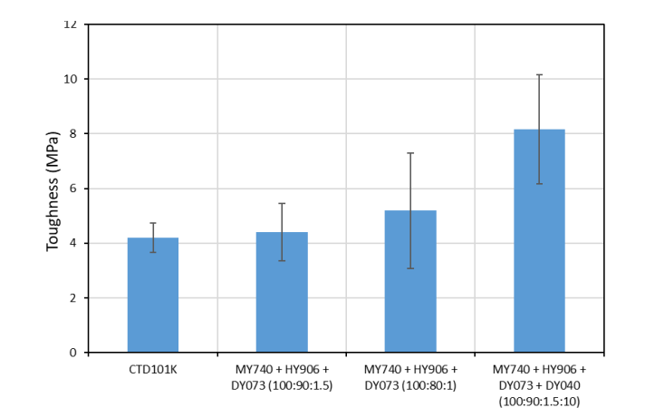
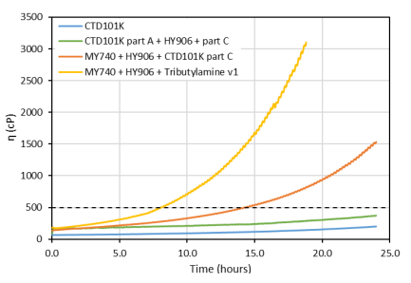
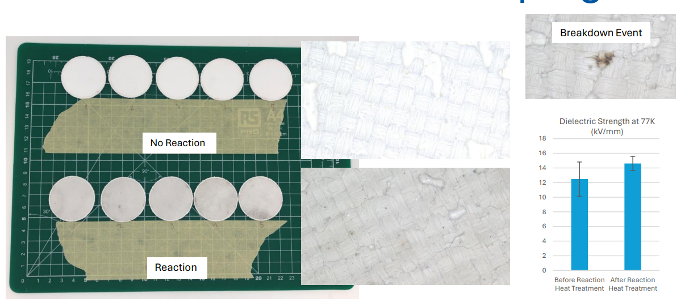
Overview of R&D activities WP4.3
V. Schenk Indico/EDMS 3340687
Impregnation systems
SMC with filled wax
Beyond POLAB mix
Processes
De-sizing
Insulation Systems
Dielectric Coatings
Interlayer for BOND
Cable Insulation for FCC-hh MQ
POLAB Radiation Program
Highlight on Wax and cold irradiation facility
J. Osuna, N. Lusa et al Indico

Slide 13
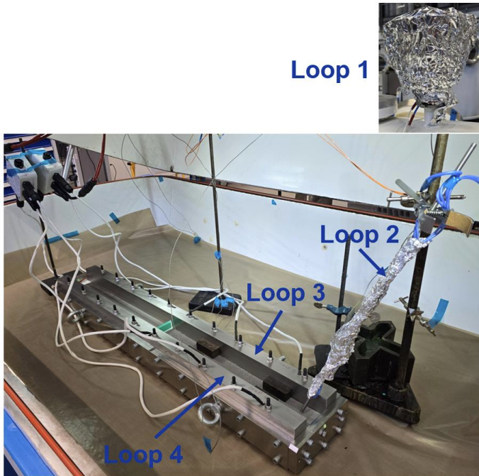
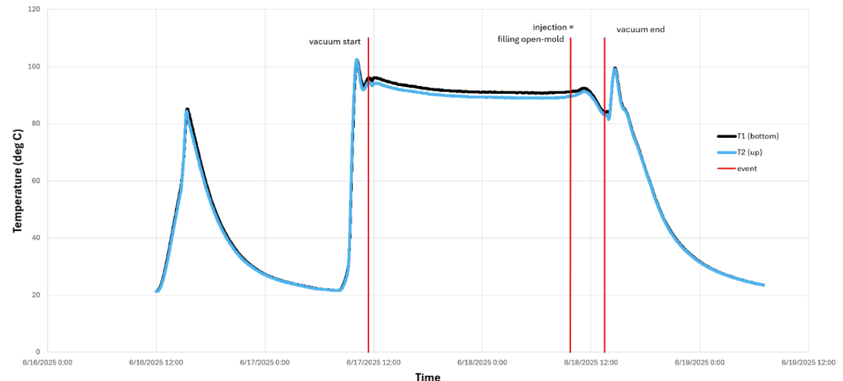

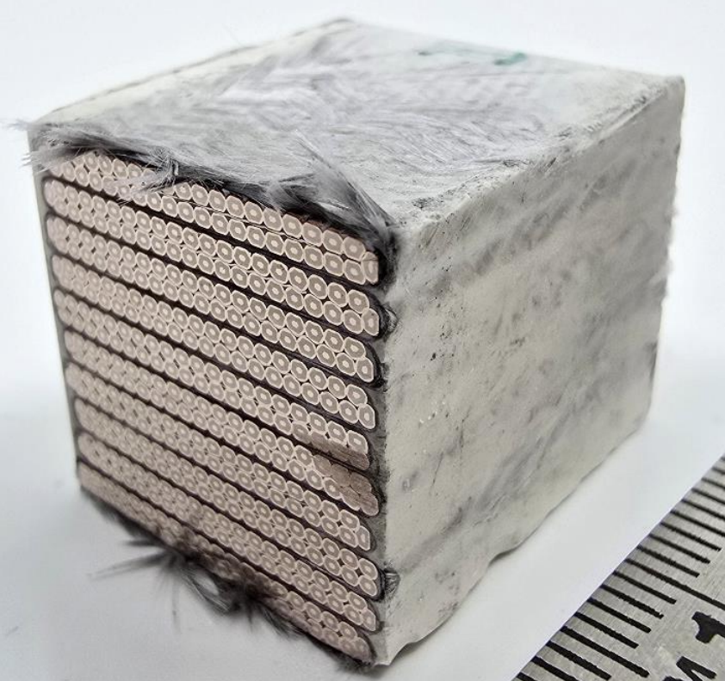
SMC 110 with Filled Wax (HFM WP3.4)
The filled (alumina particles) wax recipe and processing parameters have been provided by A. Brem (PSI). Q2 2025
New 8-loop temperature control system prototype developed with support from BE-ICS team. Q3 2025
Tuning and optimization of the impregnation process was tested in the modular impregnation set-up (C. Urscheler/ V. Schenk EDMS 3312895) Q3 2025
SMC110 impregnation successful. 1st Non-Stress Managed Coil Impregnated with Filled Wax. Q3 2025
SMC 110 test in Q4 2025
Possible next steps after testing (for discussion):
Impregnation with Filled Epoxy (similar techniques)
Filled wax for future SMT projects, both stress-managed (e.g. Fusillo) or again SMC (for reproducibility), RMM, MQXFs, …

Slide 14
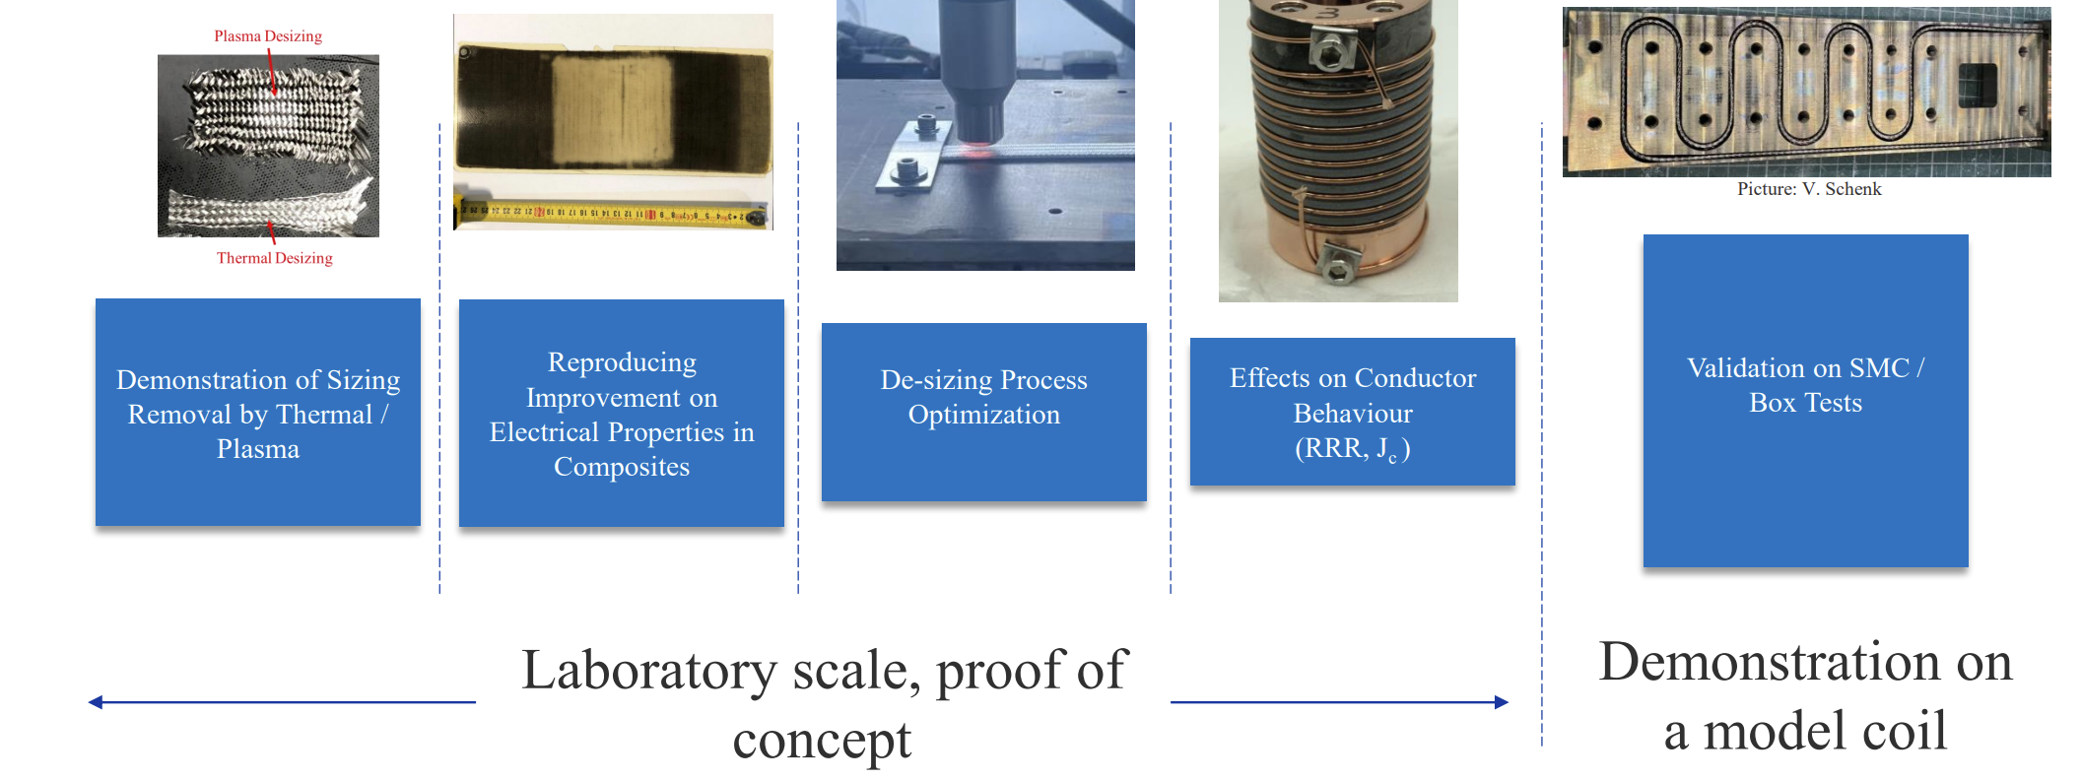
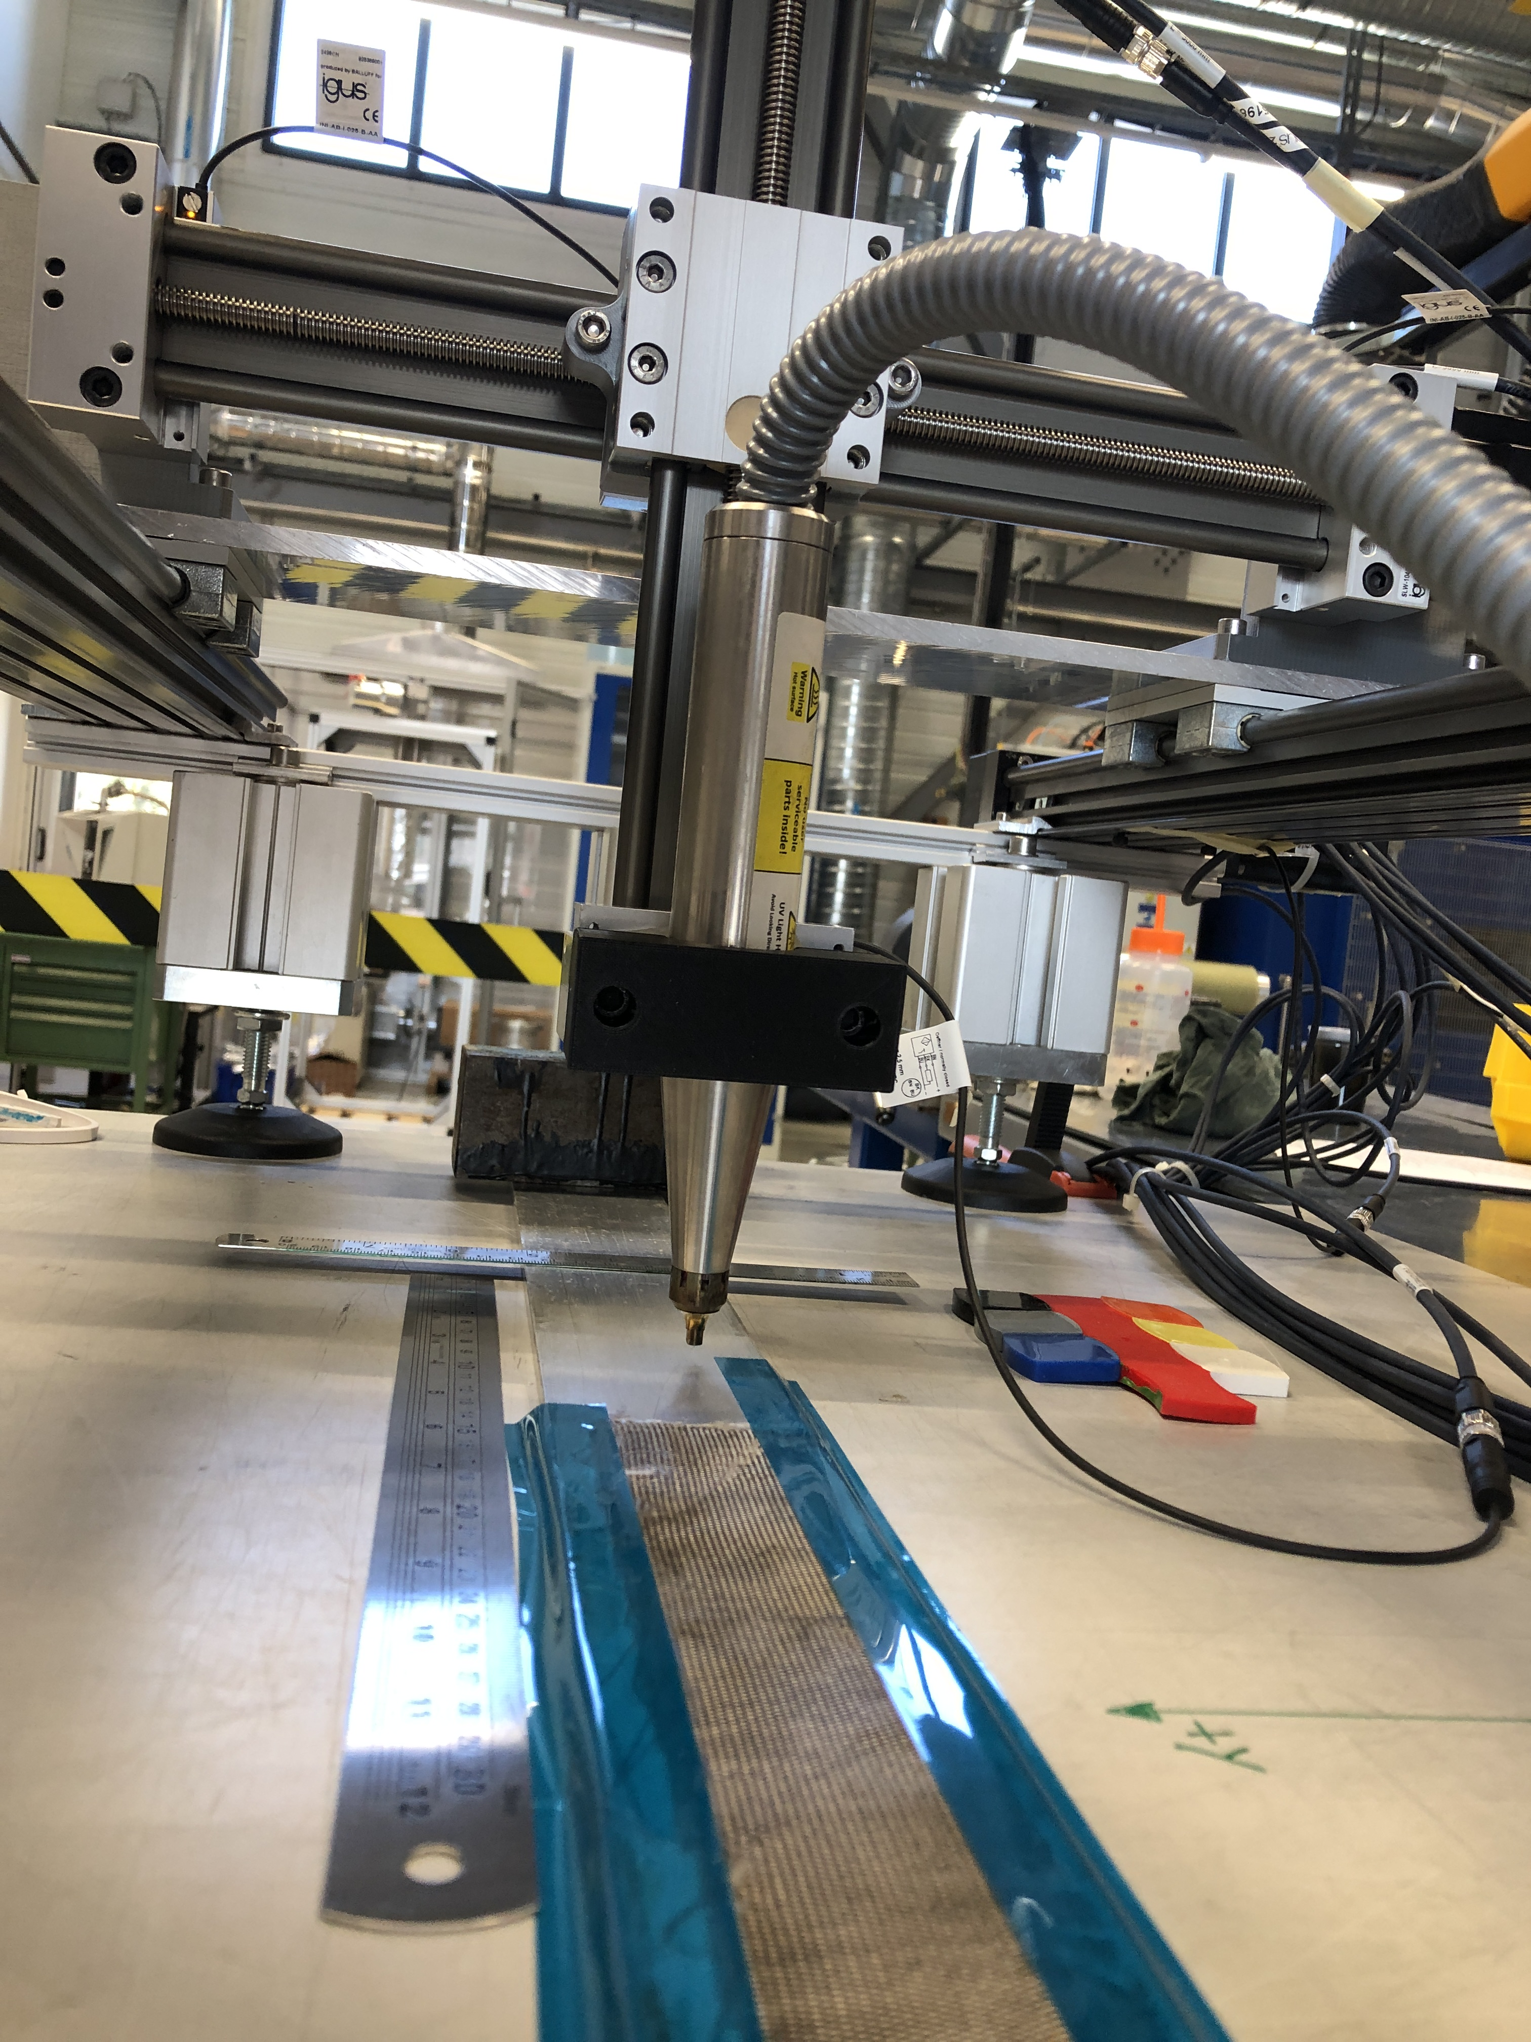
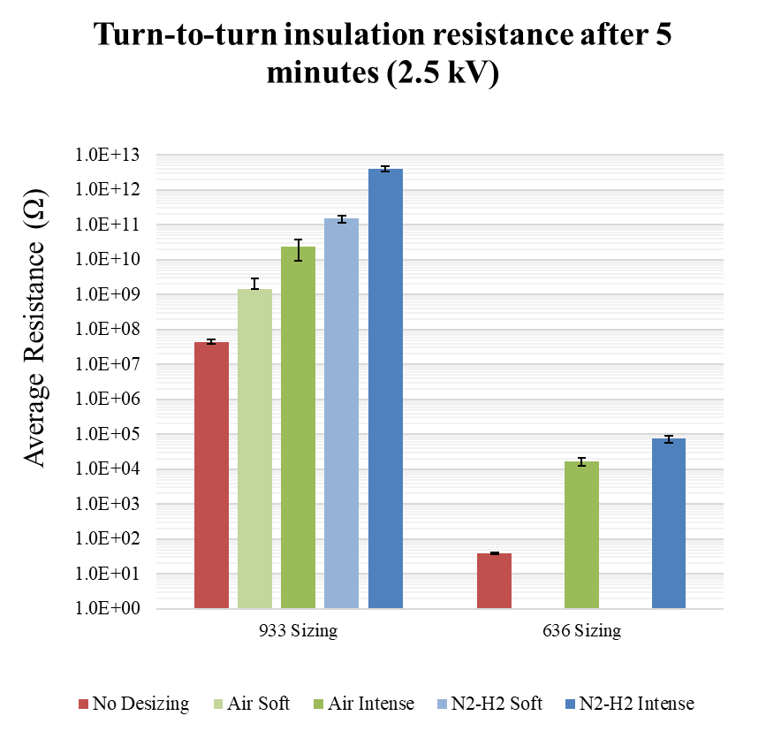
De-sizing for Enhanced Electrical Insulation
Completed
2024
Q2 2025
Q3 2025
Q3 2025
Lab phase completed -> See Enhancement of Nb3Sn Cable Electrical Insulation through Thermal and Plasma Treatments (J. Osuna et al. link):
Thermal and Plasma de-sizing proved considerable enhancement of the dielectric withstand
Plasma method prioritized for the implementation in the coil manufacturing

Slide 15
De-sizing for Enhanced Electrical Insulation
Completed
2024
Q2 2025
Q3 2025
Q3 2025
Implementation phase
Validation on BOX -> Q1 2026
Leasing of Plasma Treatment Fixture -> Q4 2025 – Q1 2026
Application on SMC QXF -> 2026 - to be planned with A. Hazot

Slide 16
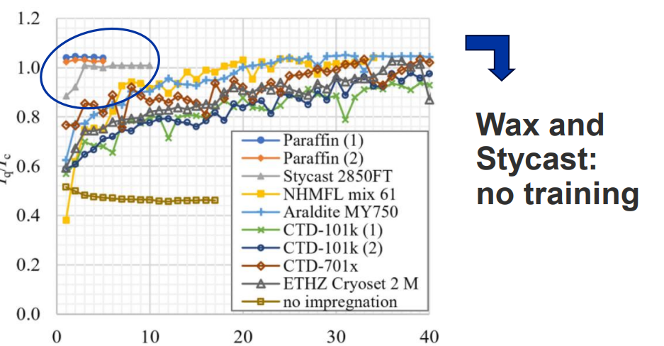
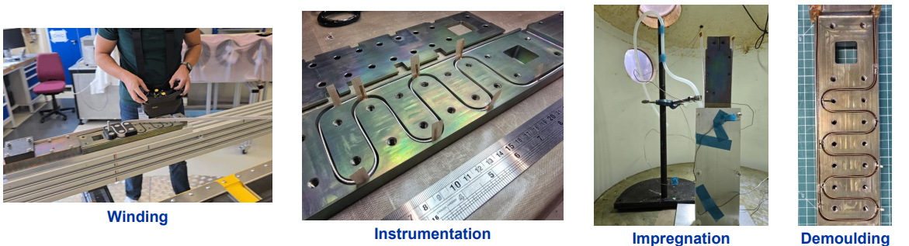
POLAB BOX Program
The BOX (BOnding eXperiment), a subscale test facility, was developed to study the performance limitations in superconducting accelerator magnets. The POLAB joined the BOX program which has started through a collaboration between Twente University and PSI.
For complete overview and status update see link (V. Schenk et al., September 2025):
Technology Transfer PSI-CERN May 2025
Built 1st POLAB BOX E1* August 2025
Electrical Tests E1* September / October 2025
Test BOX 1 (Reference BOX) December 2025
DOI 10.1109/TASC.2023.3267051
*BOX E1 set the electrical test parameters for all other BOXES
R. Piccin - SMT section meeting

Slide 17
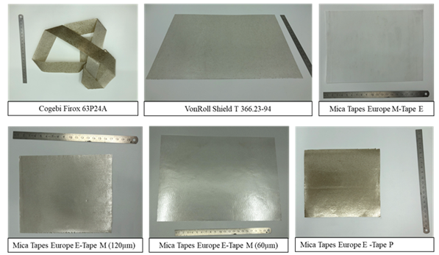
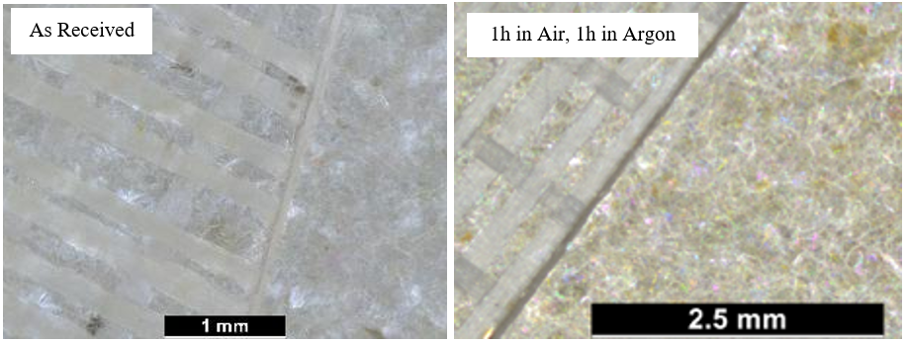
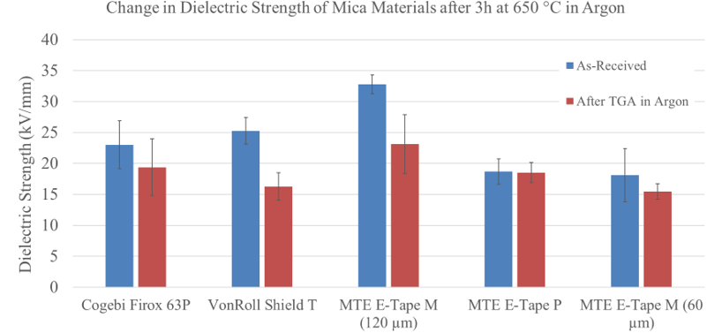
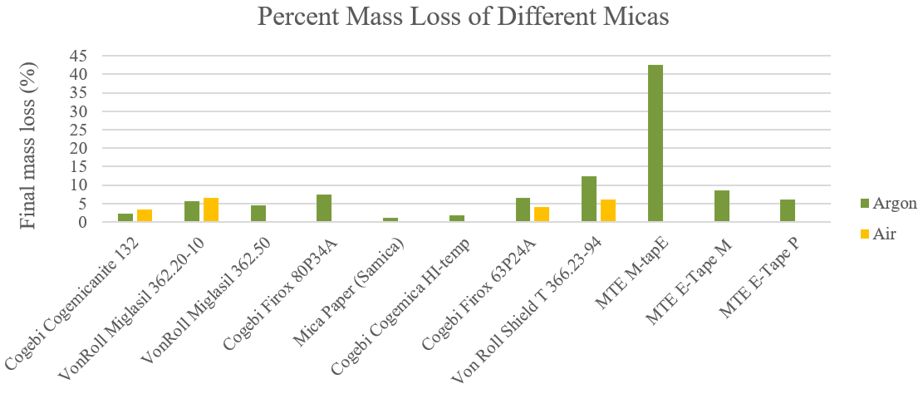
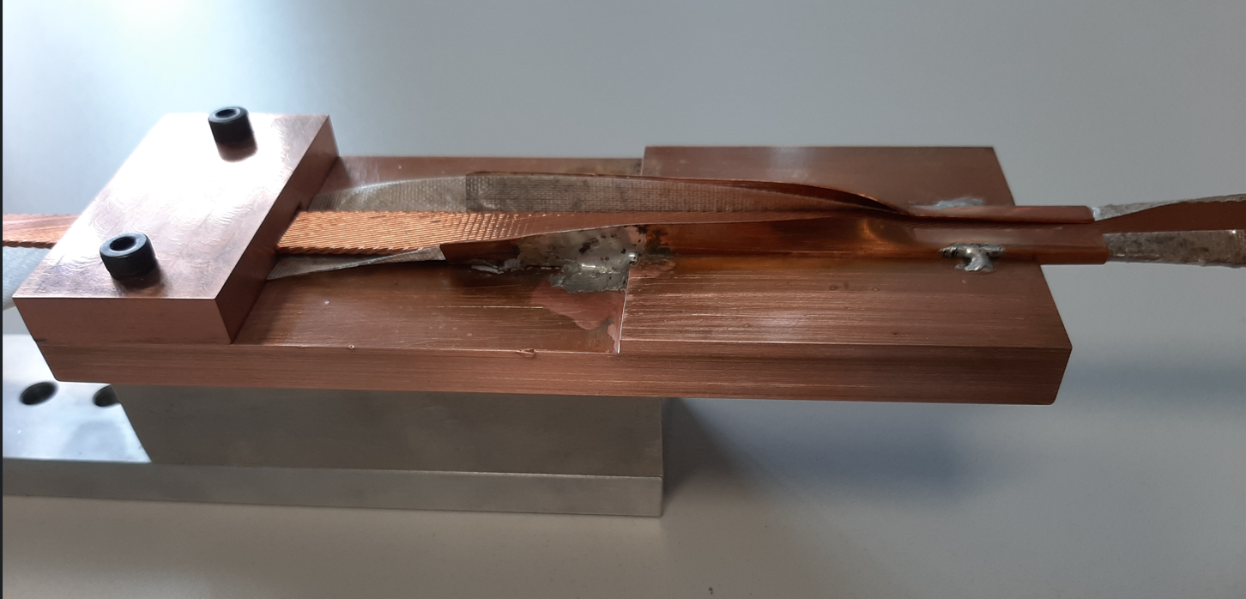
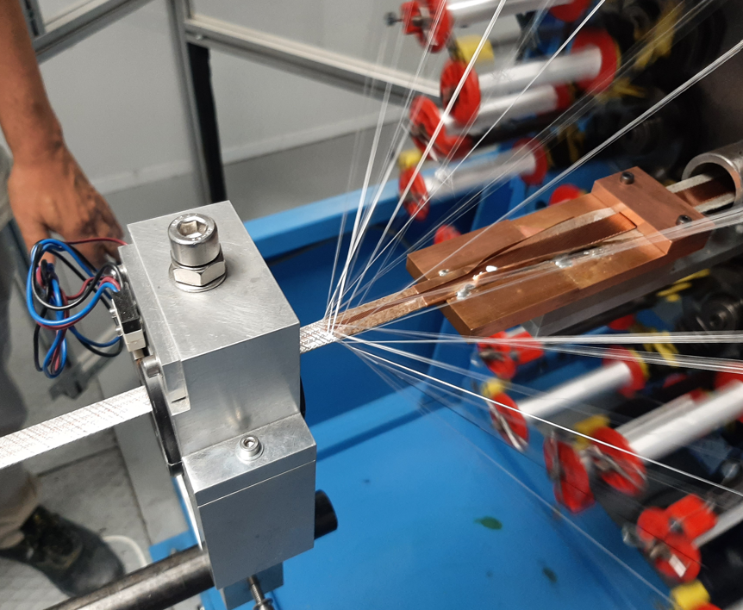
FCC-hh MQ Insulation Development
The baseline cable insulation layout for FCC-hh MQ cable is Mica tape + S2 Glass braid. Selected Mica is Cogebi Firox (avaialble in CERN stock). Alternative products have been studied.
Extensive study of MICA tapes completed (J. Osuna EDMS 3355232):
Market survey
Electrical and thermal characterization before-after heat treatment
MTE E-Tape M good alternative to Cogebi Firox available in 60µm
Design and construction of MICA tape un-winder and insertion tooling
1st Insulation trial at CGP in September 2025. Thickness measurement on-going.
F. O. Pincot

Slide 18
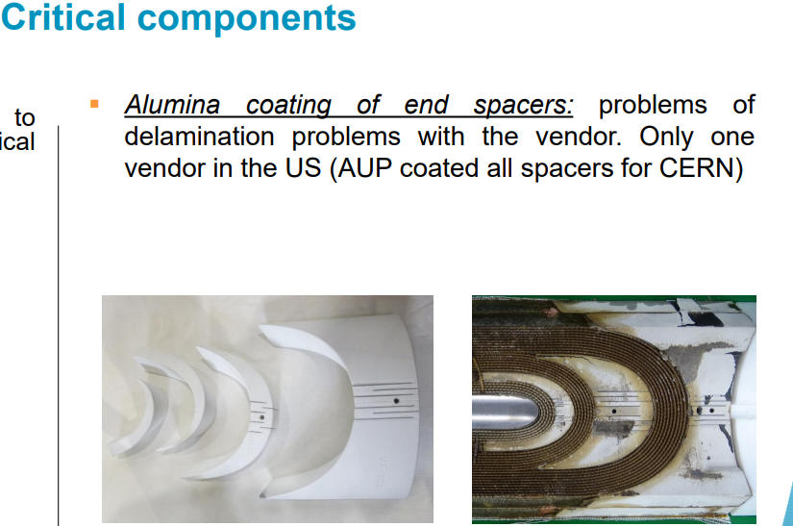
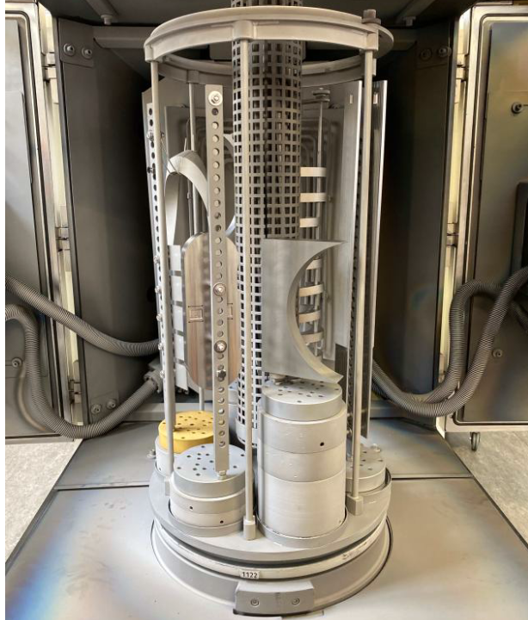
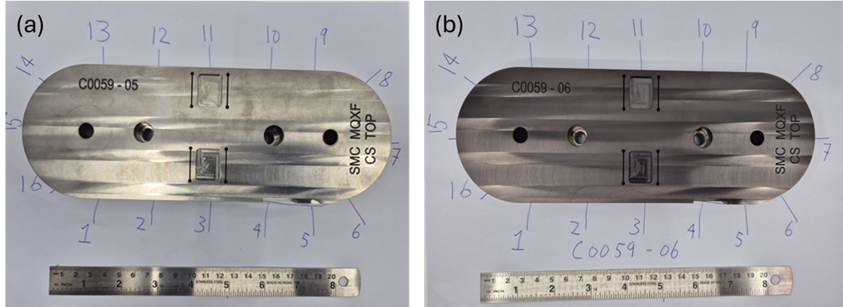



Dielectric Coatings
Towards qualification of Al2O3 coatings by reactive sputtering for use in Nb3Sn magnets (C. Scheuerlein et al. link)
HFM Forum: Feedback from MQXF (S. Izquierdo Bermudez link)
Plasma spraying of MQXFB
Al2O3 reactive sputtering
SMC spacers coated by Al2O3 reactive sputtering
Outlook 2025/2026:
Qualify dielectric ceramic coatings for use in superconducting magnets (withstand > 1kV in LHe/LN2)
Al2O3 coatings produced by reactive sputtering Q1 2026
Ceramic paints PSI developed (Aremco Glass-Coat SGC4000-HT) Q1 2026
Comparison with Al2O3 coatings produced by plasma spraying (MQXF)
Radiation hardness, adhesive strength, thickness process control END 2026
In-coil validation: SMC, BOND, FALCON-D (to be discussed)

Slide 19




POLAB Radiation Program
Cold Irradiation Facility set-up is advancing. Commissioning at IRRAD Q2/3 2026
Ten different wax (list in annex) types including pure natural and synthetic waxes, wax mixtures and wax composites, have been exposed to ⁶⁰Co gamma irradiation in ambient air with an approximate dose rate of 2 kGy/h, in collaboration with PSI.
Preliminary DSC results and visual aspect of irradiated wax samples suggest that doses in the order of 1 MGy absorbed in ambient air have a moderate effect on all examined wax types.
DSC analysis after 10 MGy is ongoing. Detailed analysis of the results of air irradiated waxes will be available by the end of 2025.
Irradiations at cryogenic temperature will be performed on few selected samples.
L. Wolf - Design Study April 2025 (link)
Insert assembly in POLAB
Presentation of preliminary results to HFM forum Q1 2026
Slide from C. Scheuerlein

Slide 20
Procurement & Infrastructure

Slide 21

Cable Insulation Contract
Start-up meeting (DR10087323) January 2024
Market Survey completed September 2024
Green from Spec Committee for Dispatching January 2025
Foreseen signature of the contract February 2025 *
Amendment with CGP singed till December 2025 August 2025
Sourcing / Market Inquiry (in contact with 5 new, 2 refused) December 2025
Price Enquiry Q1 2026
New Contract Q2 2026
* Withdrawal of the qualified bidder
HFM pipeline to complete by 2025
HL-LHC ULs completed!!
Project | UL | Status | Delivery
M-Bond | C11uc0518A (Cu) | Inspection (NC) | 180
BOND | Braiding test | 10stacks measurement | 927
MQ-FCC-hh | Braiding test | 10stacks measurement | 927
SMC-QXF | C07oc0520A | Ready to start braiding | CGP
SMC-QXF | C07oc0525A | Wait braiding | CGP
FalconD | C01uc0519A | Wait braiding | CGP
FalconD | C01uc0519B | Wait braiding | CGP
CERN Box | C06OC0492A Part 2 | Ready to start braiding | CGP
PSI Box | C06OC0492A Part 1 | Wait unbraiding | 927
UL manufacturing status:
MQXF : 5xUL 3851m
Eurosig : 2xUL 800m
FalconD : 2xUL 328m
SMC : 2xUL 370m
M-Bond : 1xUL 845m (NC)
PSI cable box : 1xUL 90m (NC)
CERN cable box 1xUL 60m (NC)

Slide 22
Insulation Braiding Machine
Start-up meeting (DR10061986) January 2024
Technical specification validated June 2024
1st offers received October 2024
2nd offers received January 2025
Issue of PO foreseen February 2025
Desing Review June 2025
Order Options (suction system & tape insert) August 2025
Delivery Q4 2025 April 2026*
*new date after ordering the options
Braiding area to be confirmed -> October 2025

Slide 23

Telstar Upgrade
Upgrade of the control system of the Telstar impregnation facility in collaboration with BE/ICS. Integration multiple measurements and controls into one system and synoptic.
Kick off meeting March 2024
Engineering and Development November 2024
Start of refurbishment December 2024
End of commissioning FebruaryMarch 2025

Slide 24





3D Scanner
New Scanner 3D Creaform HandySCAN Sliver E
Rapid Prototyping
Reverse Engineering
Metrology
MQXFS spacer scan (Courtesy V. Schenk)
Training of SMT personnel in August 2025
On-going procurement of computer and accessories + Preparation of Scan Zone by December 2025
(Courtesy O. Choisnet)

Slide 25
Summary…
Up to June we delivered ~60 jobs across 6 CERN departments. We are engaged in many diverse and stimulating jobs and projects across CERN.
Progress on vacuum impregnation: Fusillo in new Telstar machine, completed SMC110 impregnation with filled wax, preparing AP10b
ITER IA24 agreement: HV engineering, materials testing, and repair methods
Progressed on key R&D fronts: de-sizing for Nb₃Sn cables, FCC-hh insulation, dielectric coatings, POLAB BOX program
Strengthened infrastructure: Telstar upgrade, new 3D scanner, braiding line procurement
Expanded irradiation program: wax tests with PSI, setup of cold irradiation facility underway

Slide 26
… And Way Forward
Top priorities for the end of year:
Vacuum impregnation of MCBRD AP10b in Telstar
Complete cable insulation manufacturing of HFM in the pipeline
Complete market survey (including visits) to cable insulation companies
Decide the area for the braiding line in 927
HFM WP4.3 milestones for Q4 2025:
Set-up Plasma Treatment Area
1st BOX test at Twente
Results on Wax Irradiation
Points for enlarged discussion:
Impregnation systems for SMT projects: POLAB mix, Particle Charged Systems (Wax/Epoxy), Polyurethane, etc. There is no unique answer. Depends on magnet-type: Arc, Inner Triplet, conduction cooled. etc.
Are there Electrical Design Criteria for HFM magnets? We should set realistic test voltages already in this preliminary phase.

Slide 27

Thank you

