Slide 1
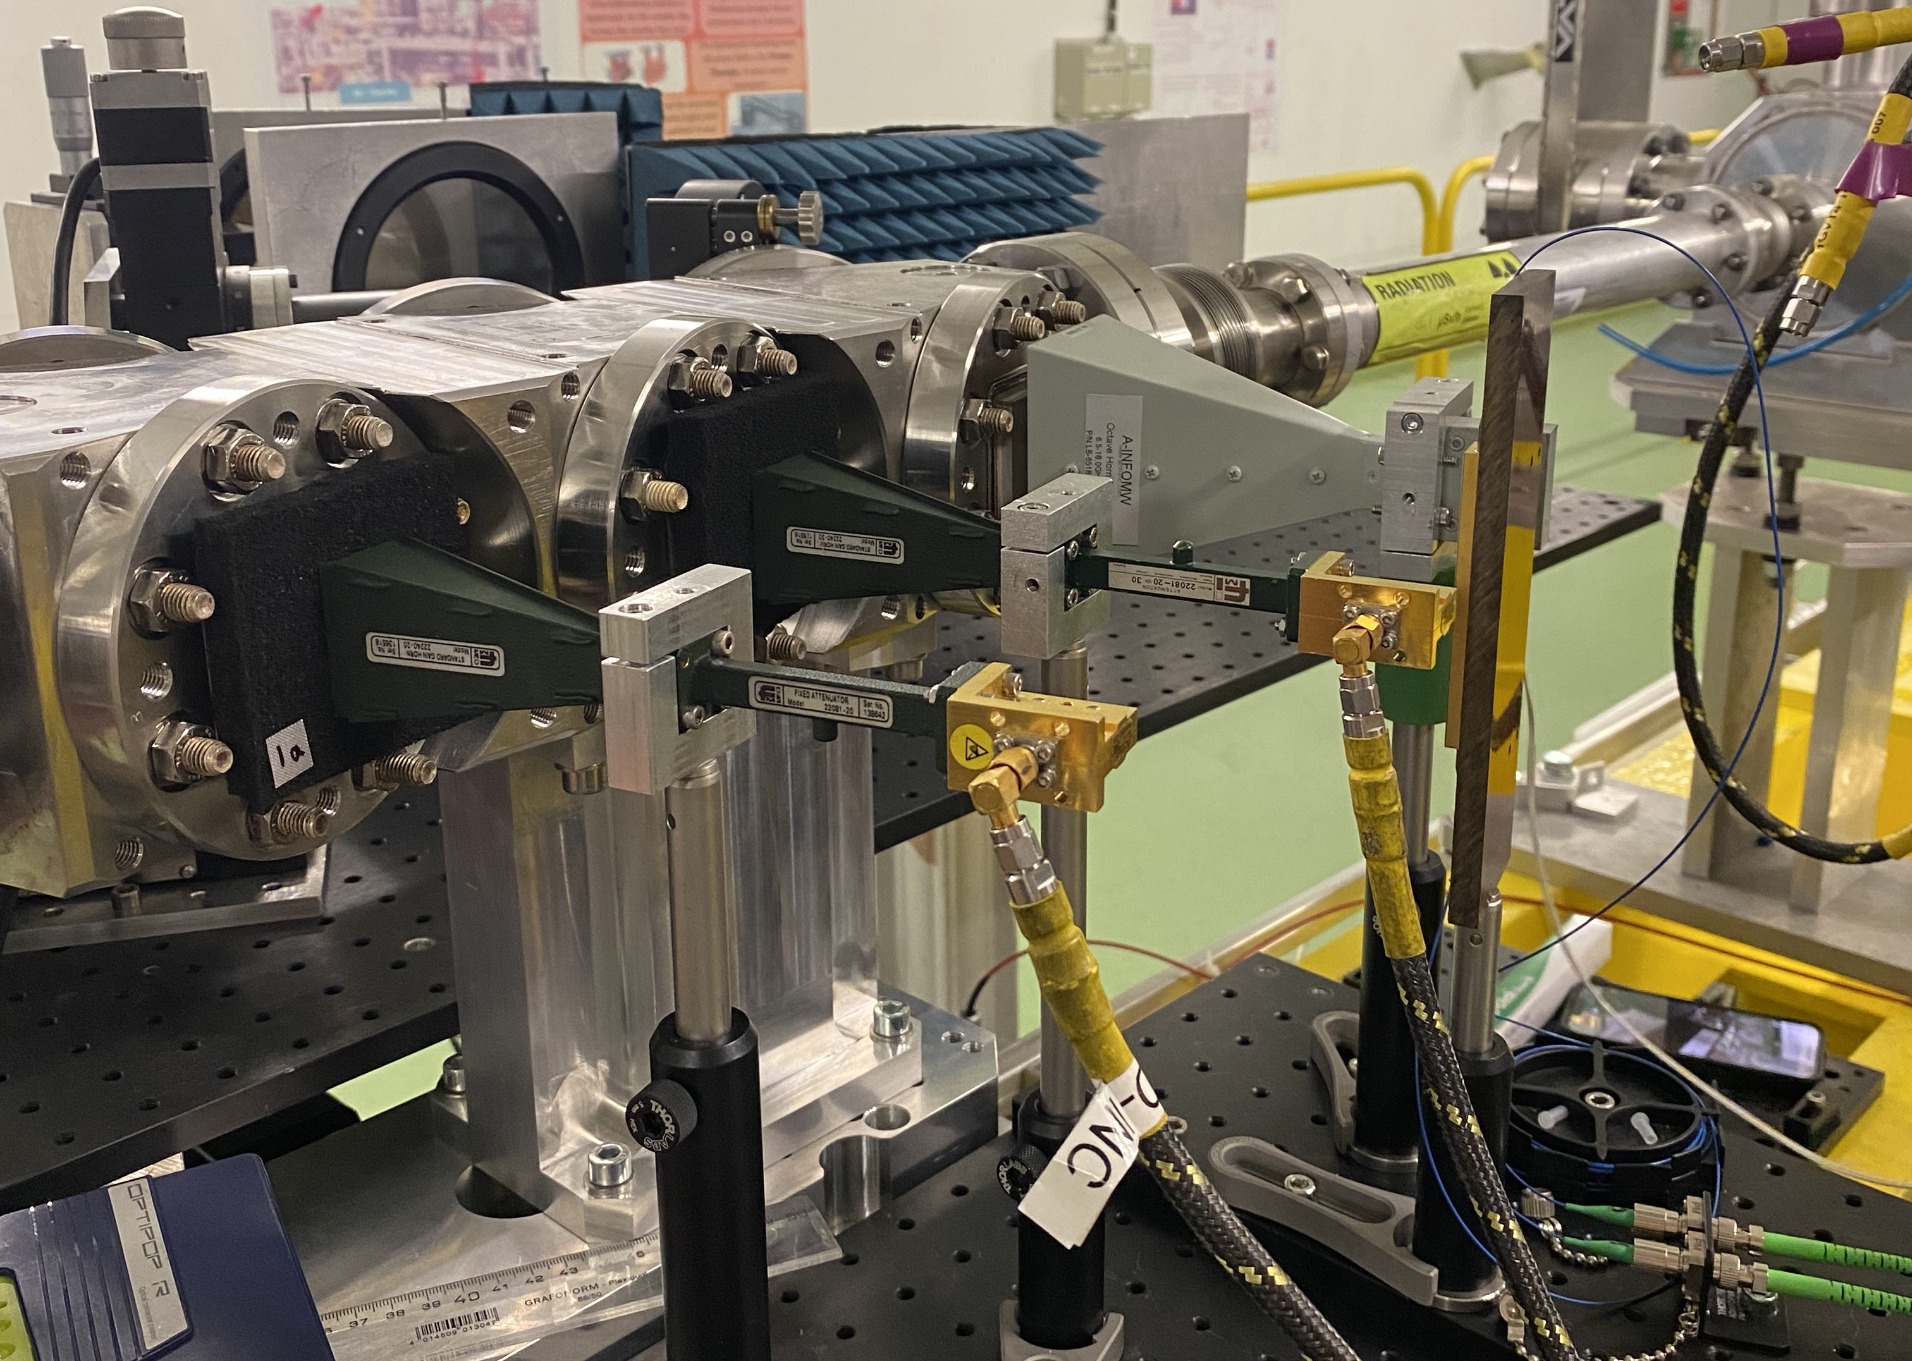
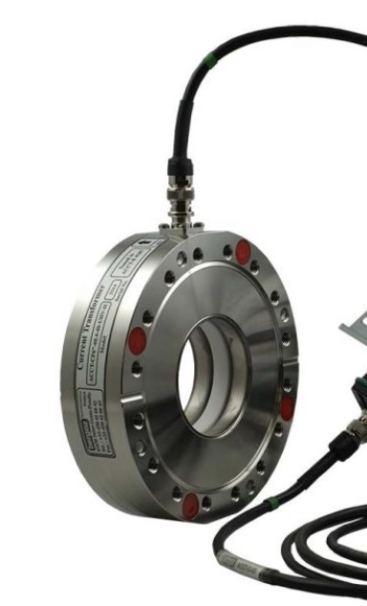
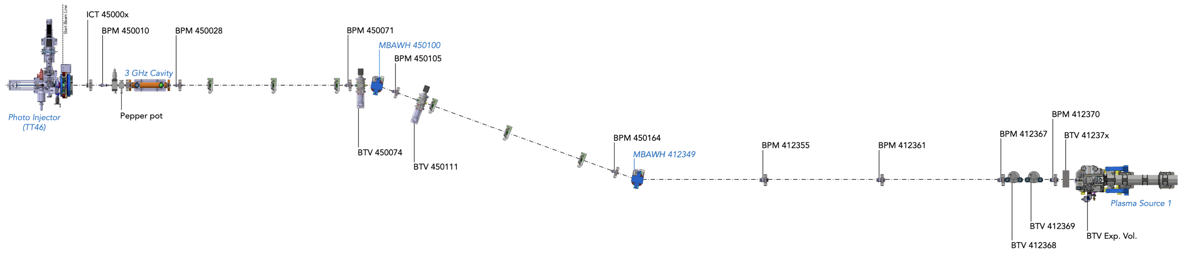
Bunch length diagnostic location options
18 MeV line
Coherent ChDR bunch length monitor, 50 mm ID and 450 mm long close to ICT (40 mm long) and BPM (207 mm)
1b
1a
1d
1c
1a
No space
1b and 1c
How does bunch length change along the line?
Any issues you see with locations 1b and 1c?
Both locations need BPM and ICT close by.
If option 1b then BPM and ICT to be added. Don’t need FC
If option 1c then ICT to be added. Could keep FC
Open points
Have the positions of BTVs before plasma 1 already been confirmed and will they stay here? (movement of the two rotational BTVs and switch of order BTV 41237x with BPM 412370)

Slide 2
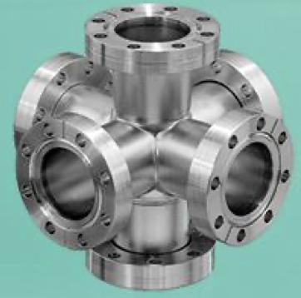
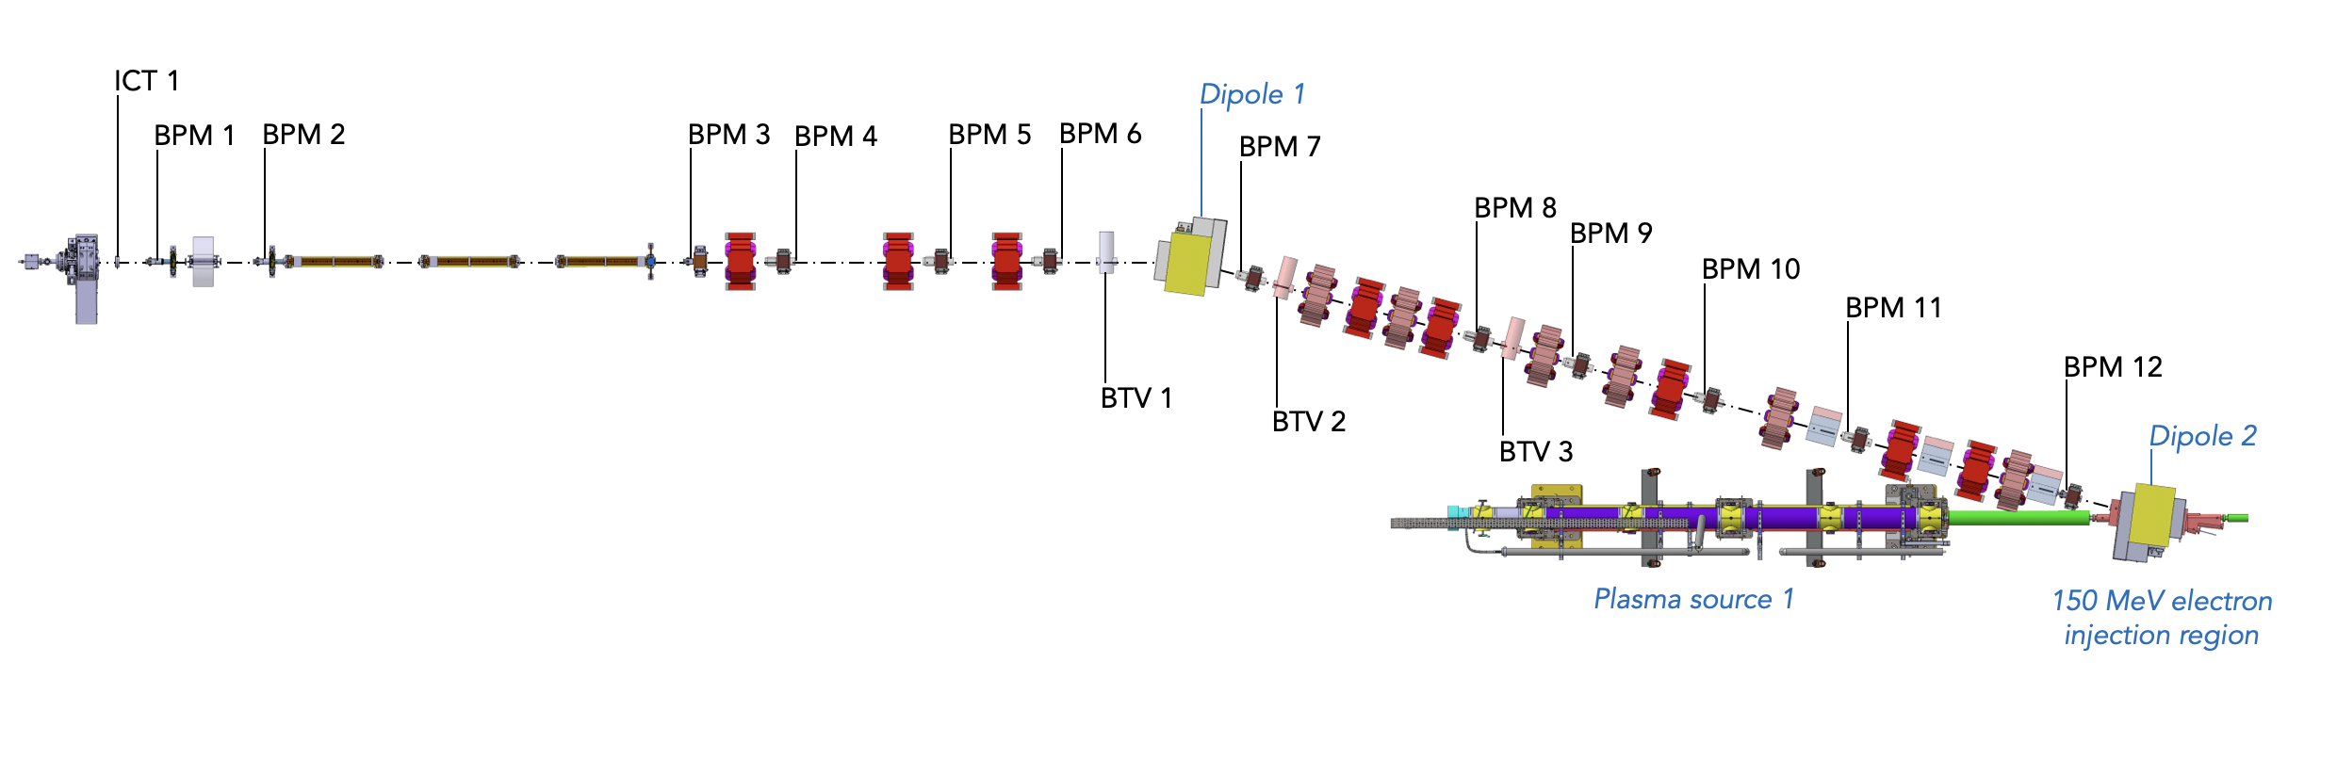
Bunch length diagnostic location options
150 MeV line
Need online, non-interceptive measurement before and after dogleg
2x EO – 2a and 4a (during commissioning) – e.g. DN40CF 6-way cross, flange-to-flange 125 mm, don’t need ICT
1x SR (3a) – port already integrated in the injection region beam pipe
2a
3a
4a
Bunch length:
What is the bunch length at 2a? (Could we also use the streak camera for offline measurement during commissioning?)
Do you see any issues with any of these locations?
Open points
Keep BPM 3 or 4?
Any news for fixing magnet locations? And if BTV3 can be moved to 40 mm ID location? Is there a deadline for fixing magnet locations?
Are you still considering a BTV4? (in which location?)
Location of second ICT?

