Slide 1
^{AWAKE Collaboration Meeting} ^{CERN, 15 – 17 October 2025}
Edda Gschwendtner, CERN

Slide 2
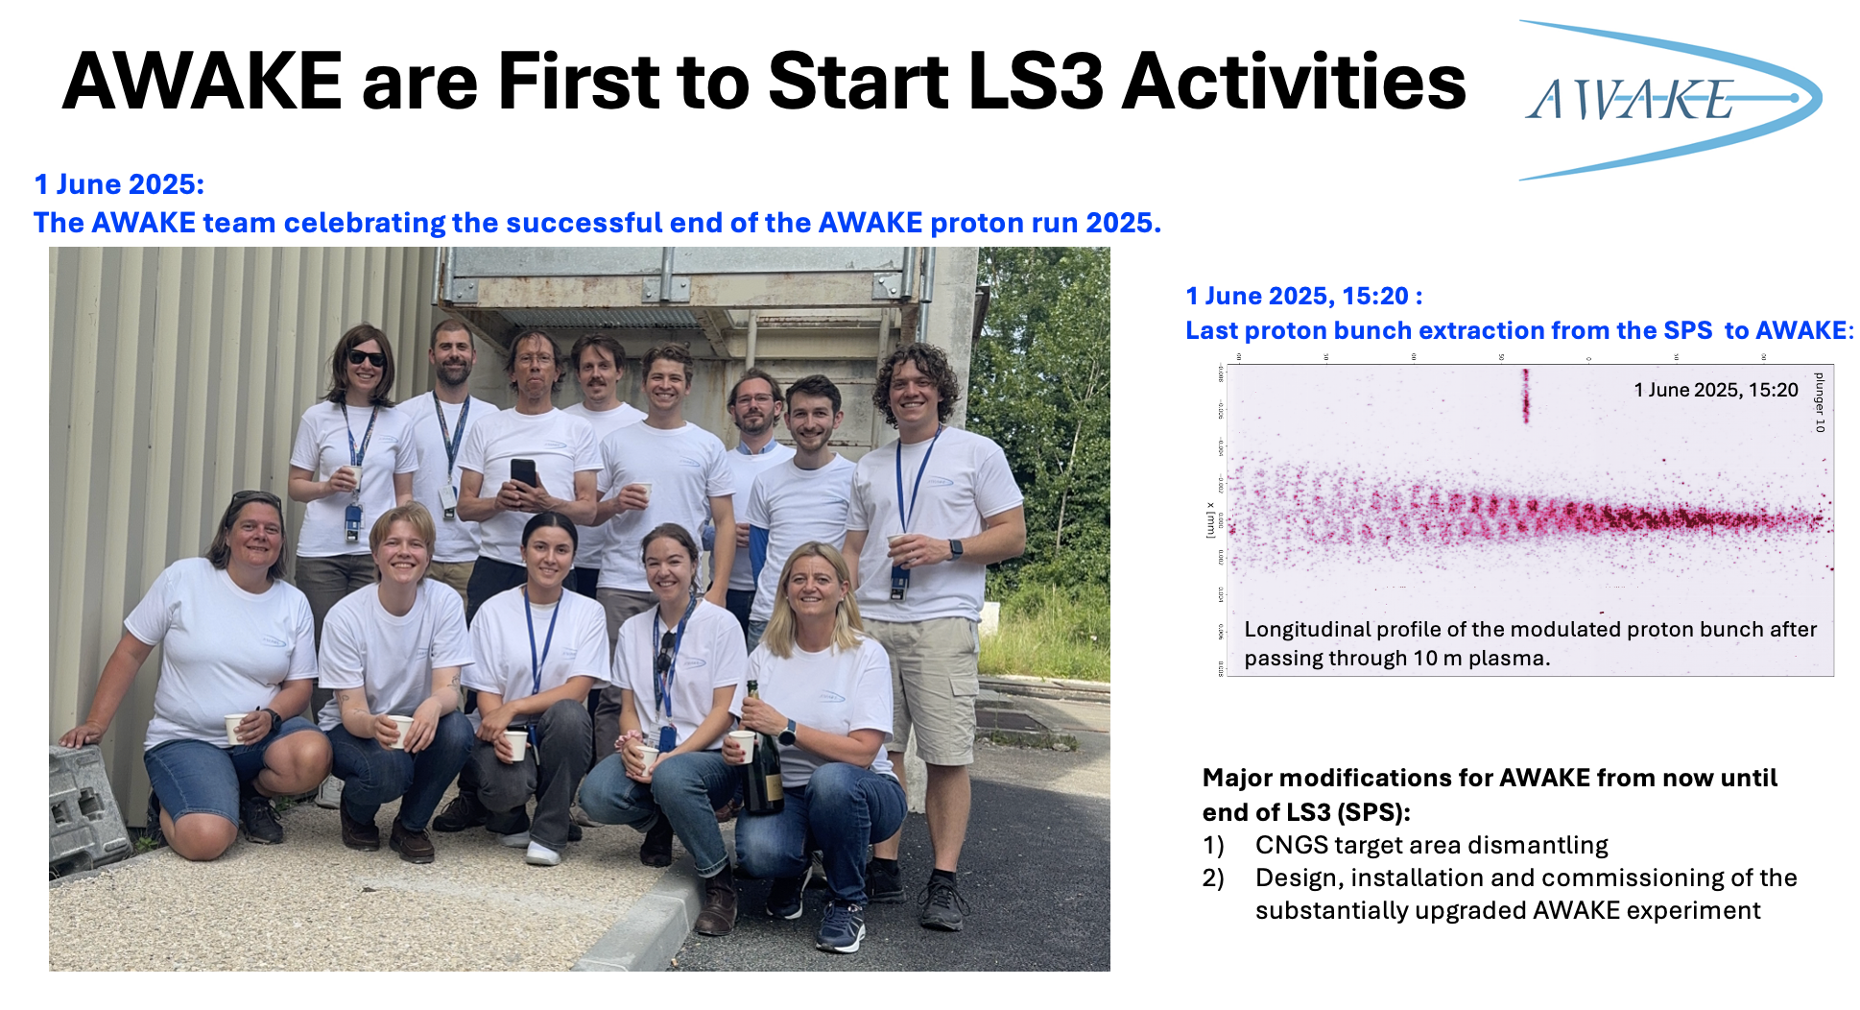
News

Slide 3
AWAKE Master Schedule
Enormous progress since the last AWAKE Collaboration Meeting!

Slide 4
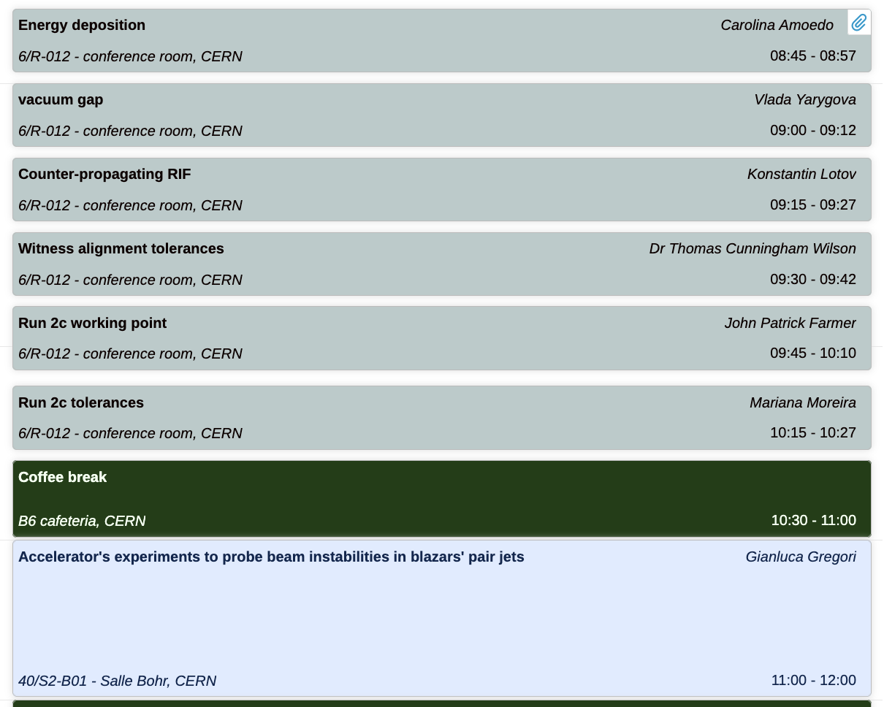
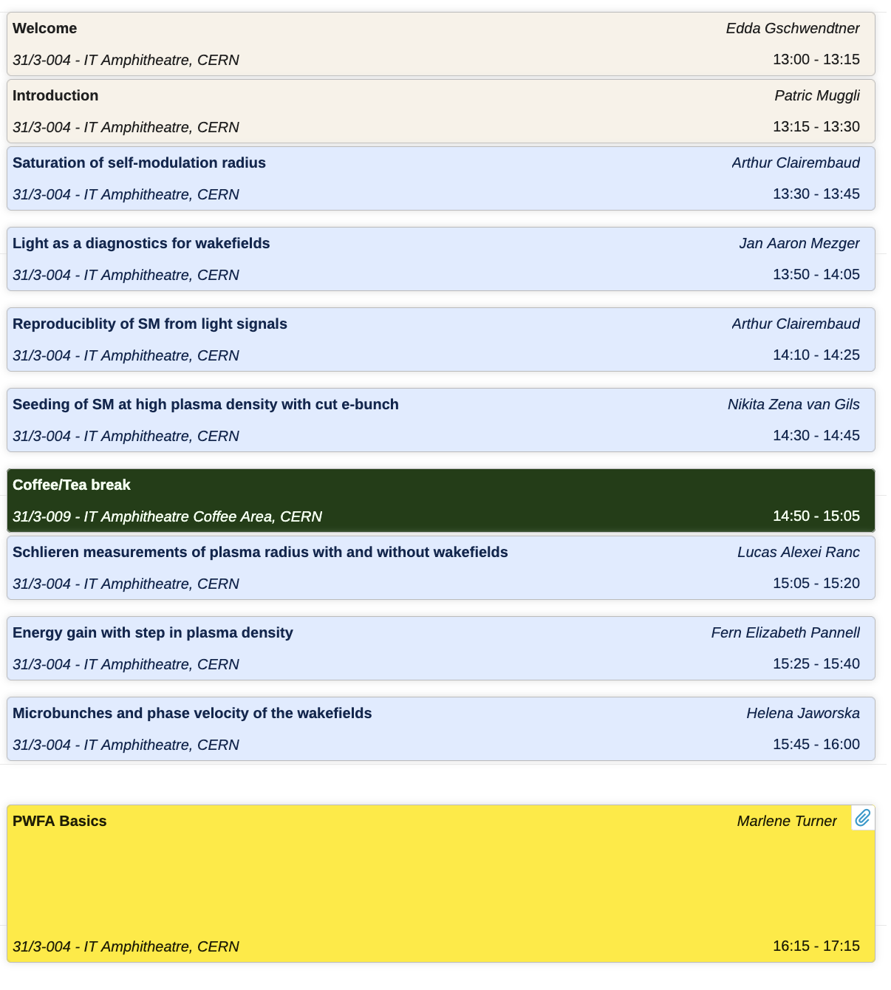
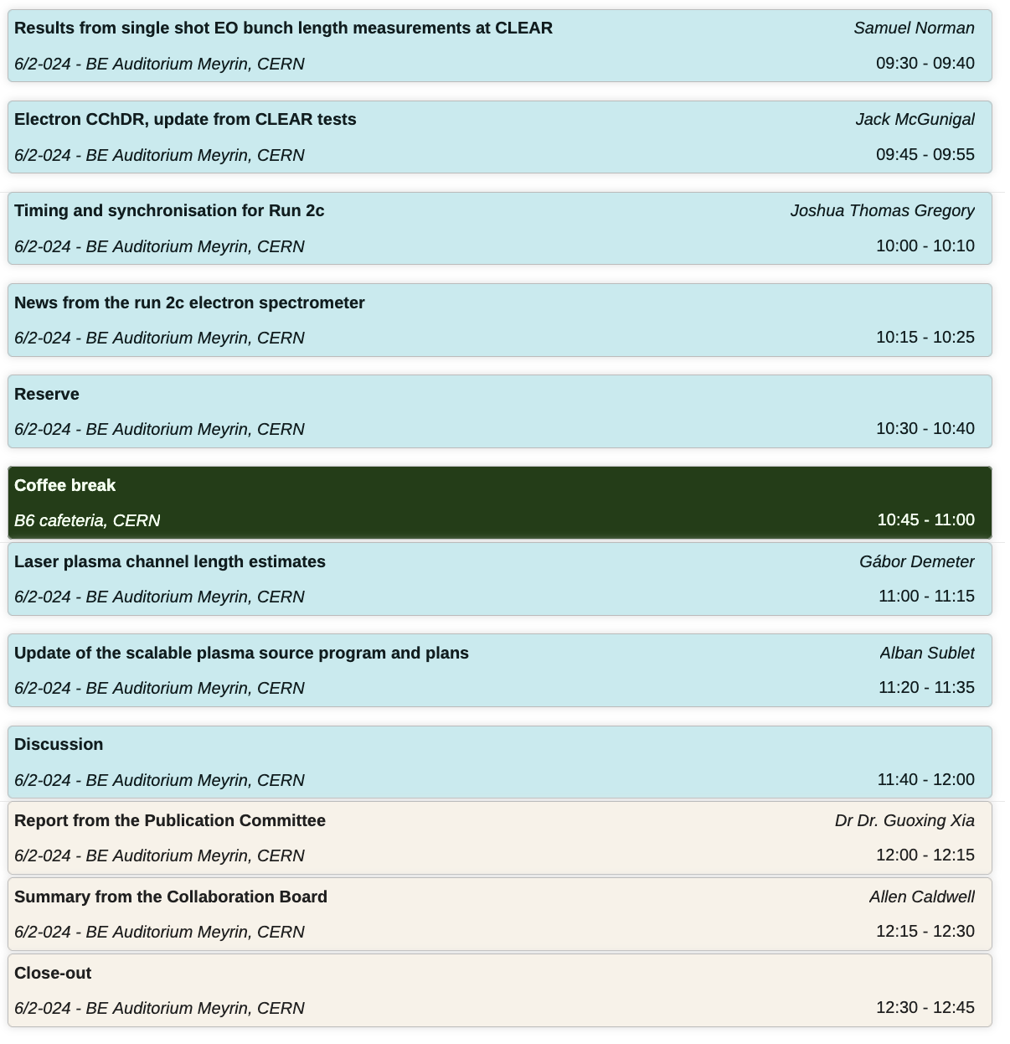
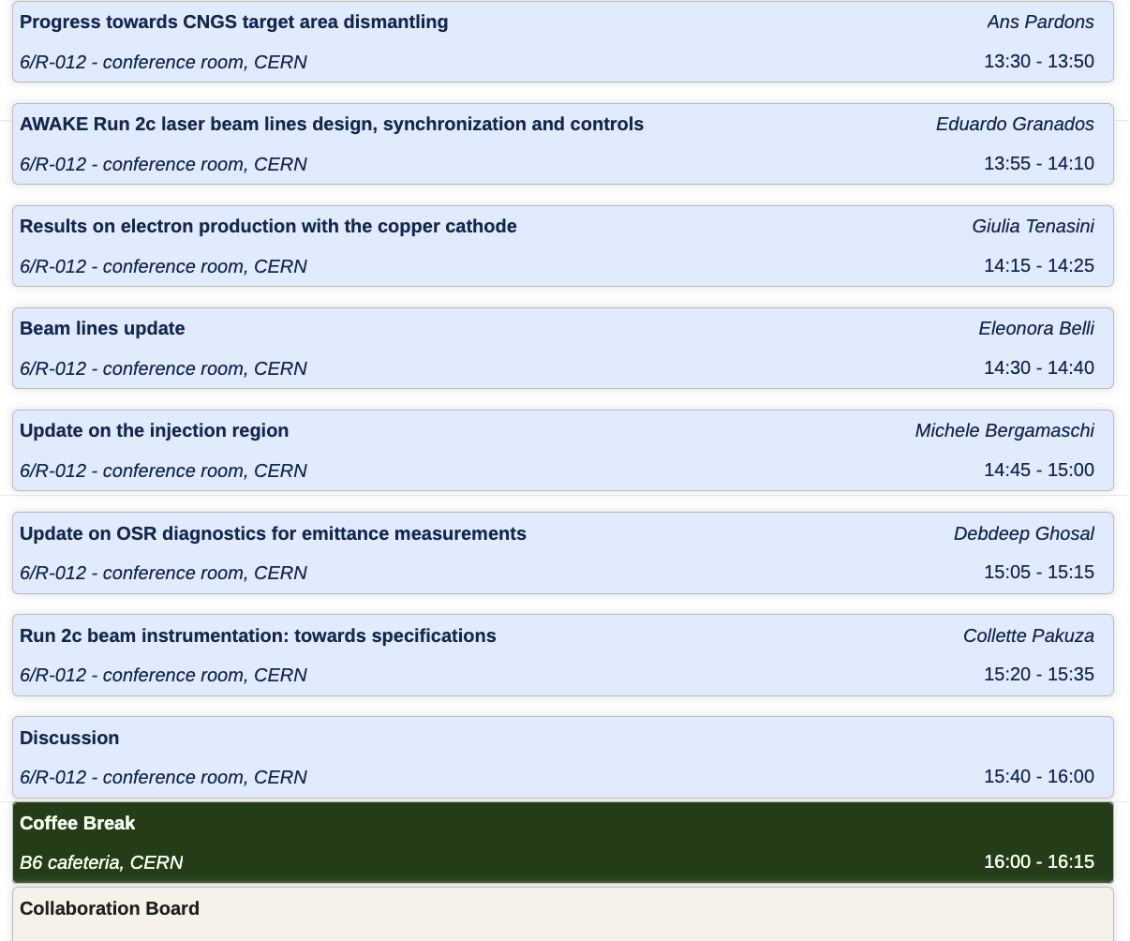
Agenda
Thu, 16 Oct 2025
Wed, 15 Oct 2025
Simulations
Fri, 17 Oct 2025
Group Photo
Run 2c
Run 2b results
CERN ATS Seminar
Run 2c
Tutorial PWFA Basics
Collaboration Dinner

Slide 5
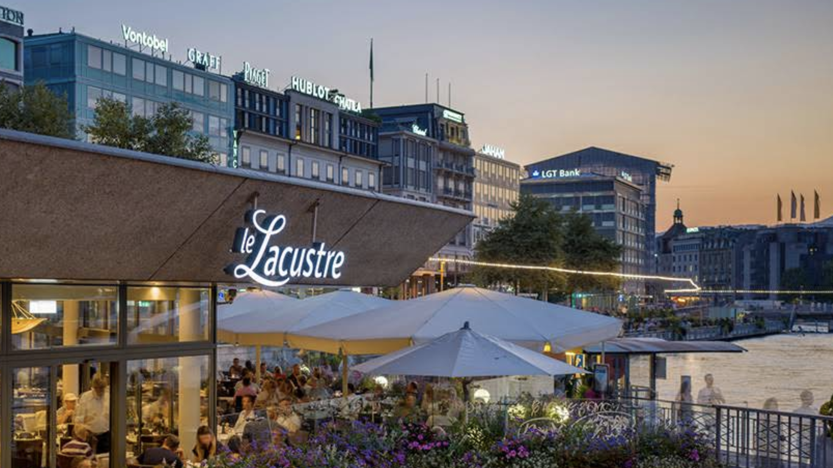
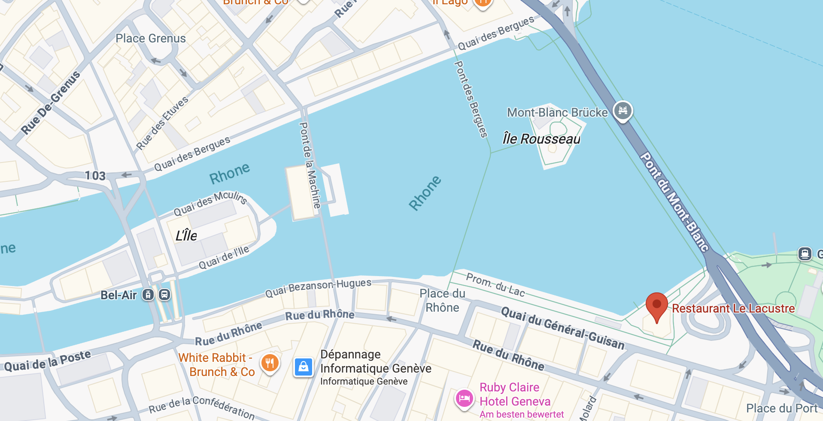
Collaboration Dinner
Le Lacustre Quai du Général-Guisan 5 CH-1204 Genève Tél : +41 22 317 40 00
Tram 18
Take the tram 18 from CERN to Bel-Air
walk to Le Lacustre

