Slide 1
Run 2c beam instrumentation: towards specifications
Collette Pakuza on behalf of AWAKE BI
AWAKE Collaboration Meeting
15-17 October 2025

Slide 2
Overview
Since last collaboration meeting, a lot of work and discussions to define the functional specifications of the instruments:
BI Internal Review (https://indico.cern.ch/event/1560227/)
Diagnostics injectors
Diagnostics upstream plasma source 1 (https://indico.cern.ch/event/1586161/)
Diagnostics downstream plasma source 2 (https://indico.cern.ch/event/1578633/)
Bunch length diagnostic location proposal (https://indico.cern.ch/event/1593037/)
Infrastructure requirements
Continued Coordination and Scheduling meetings (https://indico.cern.ch/event/1572531/)
Continued AWAKE Instrumentation meetings (https://indico.cern.ch/event/1583073/)
Continued Electron Spectrometer meetings (https://indico.cern.ch/event/1583466/)
Today, summary of instruments for Run 2c
The instruments as it stands
What still needs to be addressed
Focusing on instruments upstream of 2nd plasma source

Slide 3
Instruments for the 18 MeV electron line and common line with protons

Slide 4
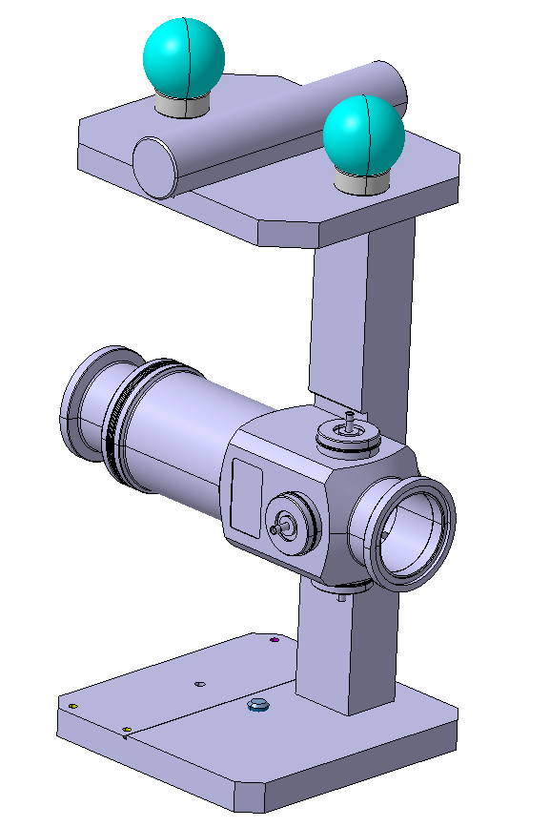
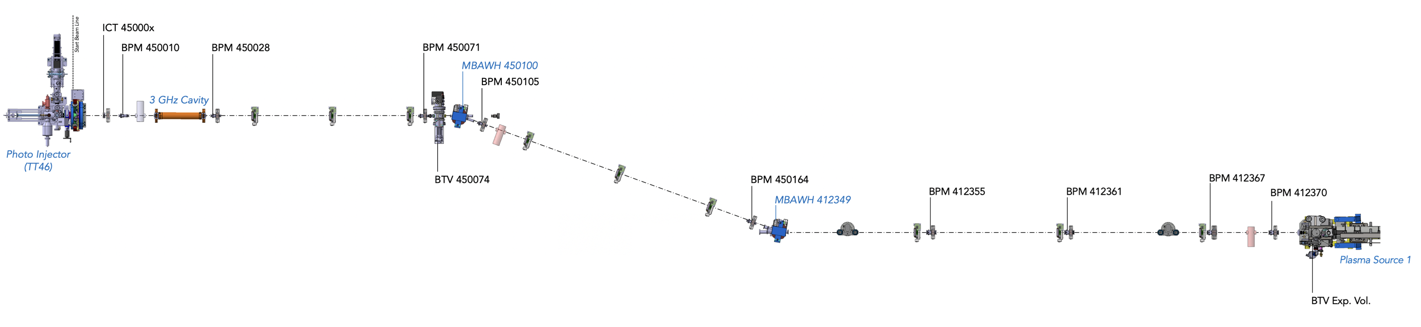
BPMs
Table 1. Summary of stripline BPMs for the 18 MeV line.
BPM Diameter/mm | Length/mm | Number of Units | Existing | Confirmed
40 | 207 | 5 | Yes | Yes
60 | 207 | 4 | Yes | Yes
40 | 207 | 1 | Yes | No
For most of the BPMs: number and location well-defined
Re-use 5x40 mm and 4x60 mm-diameter, 207 mm-long stripline BPMs (existing)
Exact location of last BPM (412370) (No.9) needs to be updated from Eleonora’s MAD-X file in the official layout
Stripline BPM
207 mm
60 mm beam pipe aperture
1
2
3
4
5
6
7
8
9
40 mm beam pipe aperture
Layout for illustrative purposes, order of instruments up to date but exact locations are not

Slide 5
BPMs
Table 1. Summary of stripline BPMs for the 18 MeV line.
BPM Diameter/mm | Length/mm | Number of Units | Existing | Confirmed
40 | 207 | 5 | Yes | Yes
60 | 207 | 4 | Yes | Yes
40 | 207 | 1 | Yes | No
For most of the BPMs: number and location well-defined
Re-use 5x40 mm and 4x60 mm-diameter, 207 mm-long stripline BPMs (existing)
Exact location of last BPM (412370) (No.9) needs to be updated from Eleonora’s MAD-X file in the official layout
Potentially +1 BPM (No.10) near second quadrupole if we put a coherent bunch length monitor in this location as the instrument is sensitive to bunch charge and position (this BPM will come from one of our existing spares)
Stripline BPM
207 mm
10
60 mm beam pipe aperture
1
2
3
4
+1 BPM for coherent bunch length diagnostic
5
6
7
8
9
40 mm beam pipe aperture
Layout for illustrative purposes, order of instruments up to date but exact locations are not

Slide 6
BPMs
Table 1. Summary of stripline BPMs for the 18 MeV line.
BPM Diameter/mm | Length/mm | Number of Units | Existing | Confirmed
40 | 207 | 5 | Yes | Yes
60 | 207 | 4 | Yes | Yes
40 | 207 | 1 | Yes | No
For most of the BPMs: number and location well-defined
Re-use 5x40 mm and 4x60 mm-diameter, 207 mm-long stripline BPMs (existing)
Exact location of last BPM (412370) (No.9) needs to be updated from Eleonora’s MAD-X file in the official layout
Potentially +1 BPM (No.10) near second quadrupole if we put a coherent bunch length monitor in this location as the instrument is sensitive to bunch charge and position (this BPM will come from one of our existing spares)
Common line: problem of measuring electron beam position in the presence of protons at the nominal proton bunch charge
Proposal of using a ChDR pick-up coupled to an EO modulator for time-resolved measurements
From 23rd Instrumentation meeting: presentation on the results of such a system at CLEAR and HiRadMat
The possibility and suitability of this for AWAKE application needs to be further discussed
Stripline BPM
207 mm
10
60 mm beam pipe aperture
1
2
3
4
Common line
+1 BPM for coherent bunch length diagnostic
5
6
7
8
9
40 mm beam pipe aperture
Layout for illustrative purposes, order of instruments up to date but exact locations are not

Slide 7
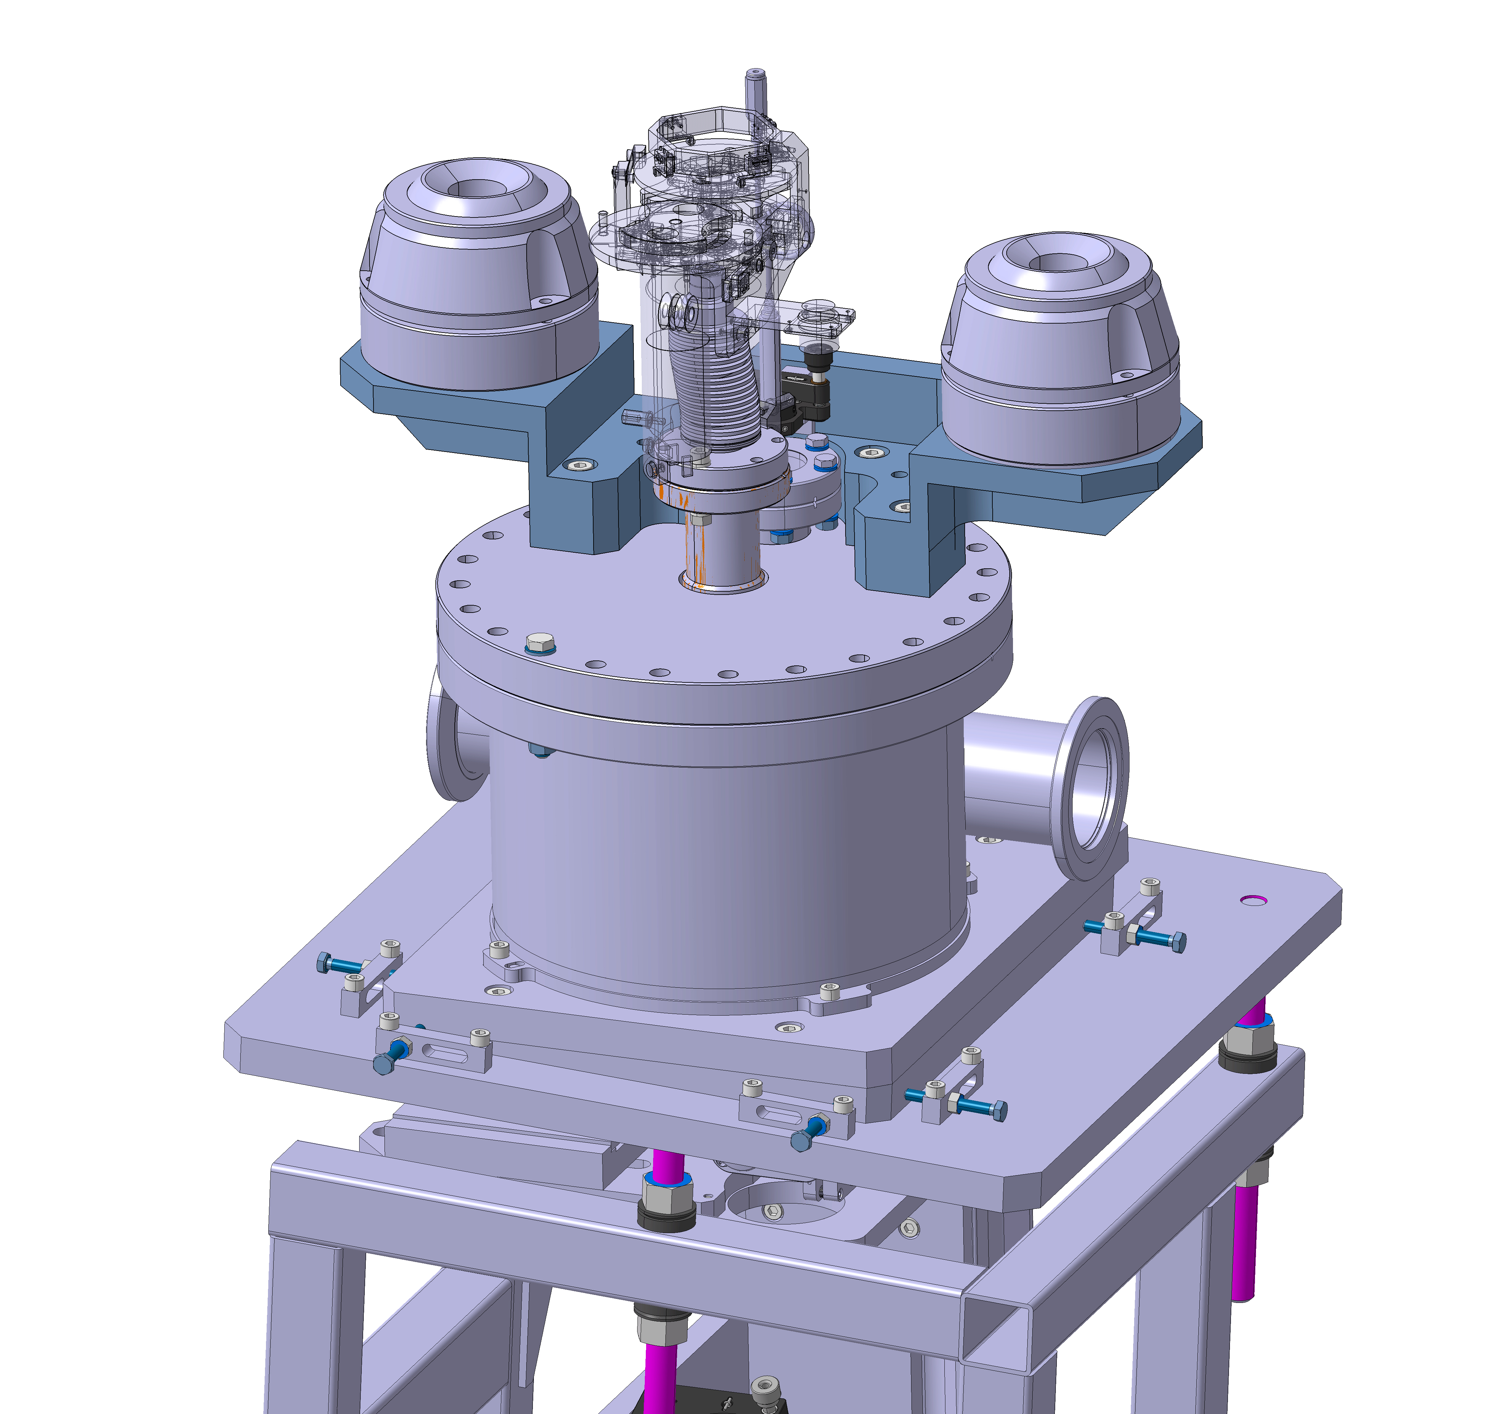
BTVs (1)
CTF linear-type
OTR, YAG and replacement chamber
LHC rotational-type
OTR, Chromox
For now, 3 BI BTVs will be re-used from run 2b in this line:
BTV 450074 (No.2) – CTF linear-type with OTR, YAG and replacement chamber – for position, emittance (quad scans) measurements and offline bunch length measurements with streak camera
BTV 4 and 5 – LHC rotational-type with OTR and Chromox – for proton and laser alignment
From previous runs, there were some doubts about the position reproducibility of these rotational BTVs – these have been removed from TT41 to building 867 where they will undergo alignment checks
1
2
3
60 mm beam pipe aperture
4
5
6
7
40 mm beam pipe aperture
Layout for illustrative purposes, order of instruments up to date but exact locations are not

Slide 8
BTVs (2)
2 new BI BTVs with single YAG screen will be installed:
Location No.1 replacing the pepper pot
After first dipole (No. 3) – for position and energy measurements
MPP/GWA screens may be replaced or modified:
No.6 (previously known as BTV54) still need to decide if we keep or replace with new BI BTV
BTV Exp. Vol. (No.7) where the actuator may be replaced by BI (as requested by the Experimental Team)
Exact positions of BTVs 4, 5 and 6 to be updated from Eleonora’s MAD-X file in the official layout
Table 2. Summary of BI BTVs for 18 MeV and common line.
BTV type | Diameter/mm | Number of Units | Existing | Confirmed
CTF linear | 40 | 1 | Yes | Yes
LHC rotational | 60 | 2 | Yes | No, awaiting alignment checks
New single-screen | 40 | 2 | No | Yes
New single-screen | 60 | 1 | No | No
1
2
3
60 mm beam pipe aperture
4
5
6
7
40 mm beam pipe aperture
Layout for illustrative purposes, order of instruments up to date but exact locations are not

Slide 9
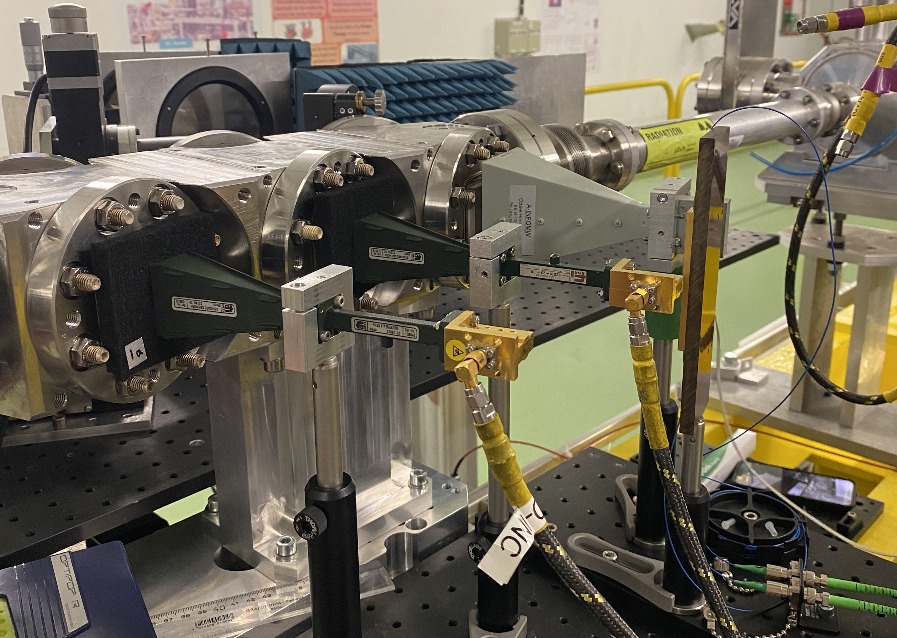

Bunch length
ChDR bunch length monitor installed at CLEAR.
Few options for bunch length diagnostics (presented by institutes in the BI Review, 4 July)
Since the Coherent ChDR bunch length monitor is 450 mm-long, propose to install this in the 18 MeV line where there is more available space in location before the dogleg (1a)
During commissioning, the instrument can be moved to a location before plasma source 1 (e.g. 1b) for verifying bunch length after dogleg
Then for operation, moved back to 1a for online measurement even when proton bunches are present (not possible at location 1b)
Instrument requires an ICT and BPM close by for normalization, and space for transitions (instrument aperture 50 mm)
A proposal, the locations need to be verified and agreed by the institutes
Jack McGunigal’s talk tomorrow on results from CLEAR
60 mm beam pipe aperture
1a
1b
40 mm beam pipe aperture
Layout for illustrative purposes, order of instruments up to date but exact locations are not

Slide 10
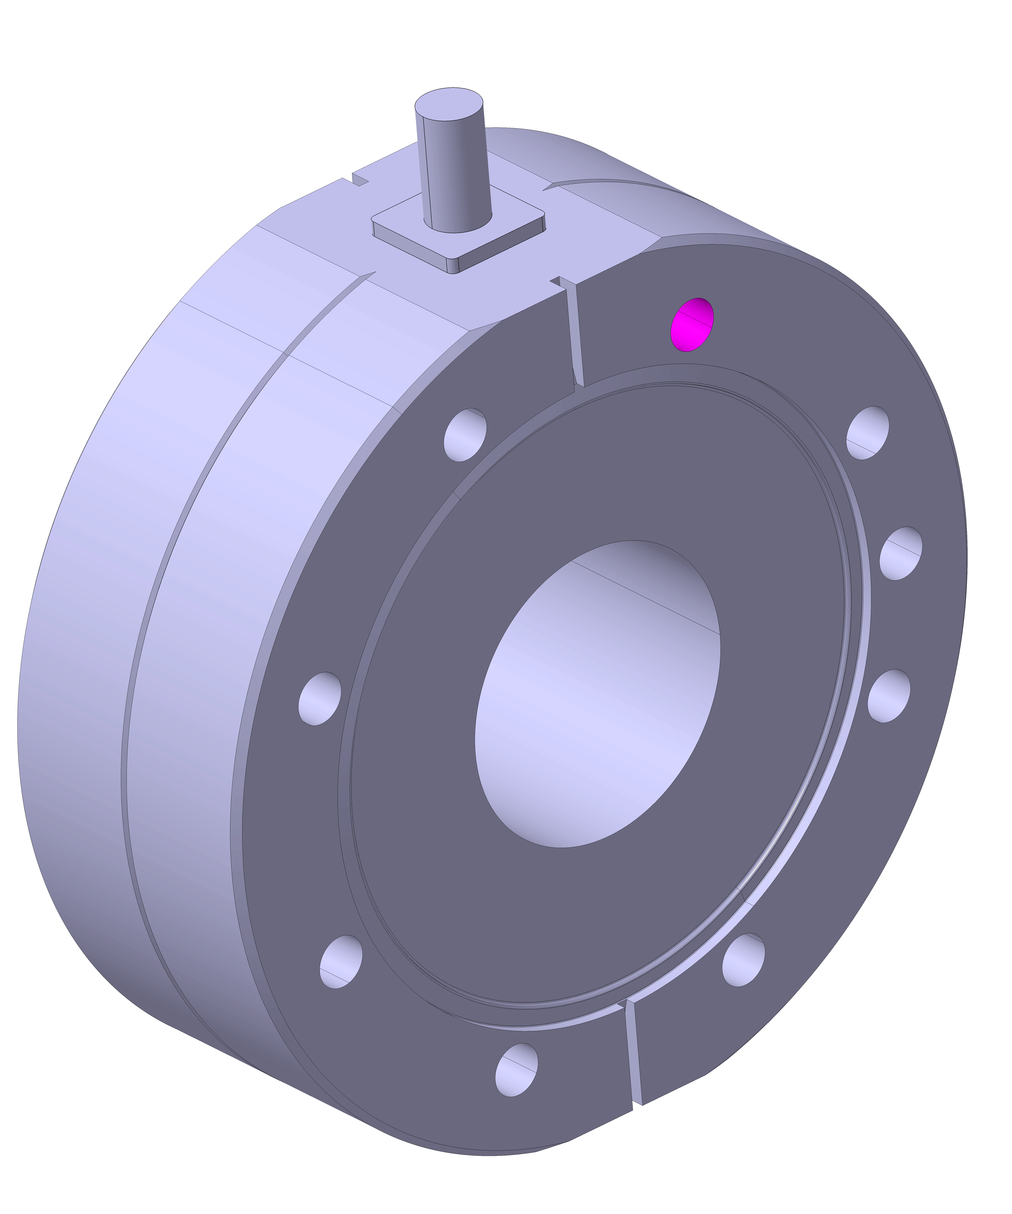
Bunch charge
Well-defined 38 mm aperture ICT at the gun (No.1)
+1 38 mm ICT before dogleg for coherent bunch length monitor signal normalization (No.2), if this is installed then no need for Faraday cup after first dipole
During commissioning: re-use existing 60 mm ICT before plasma source 1 (No.3)
60 mm beam pipe aperture
1
2
3
40 mm beam pipe aperture
Layout for illustrative purposes, order of instruments up to date but exact locations are not

Slide 11
Instruments for the 150 MeV electron line

Slide 12
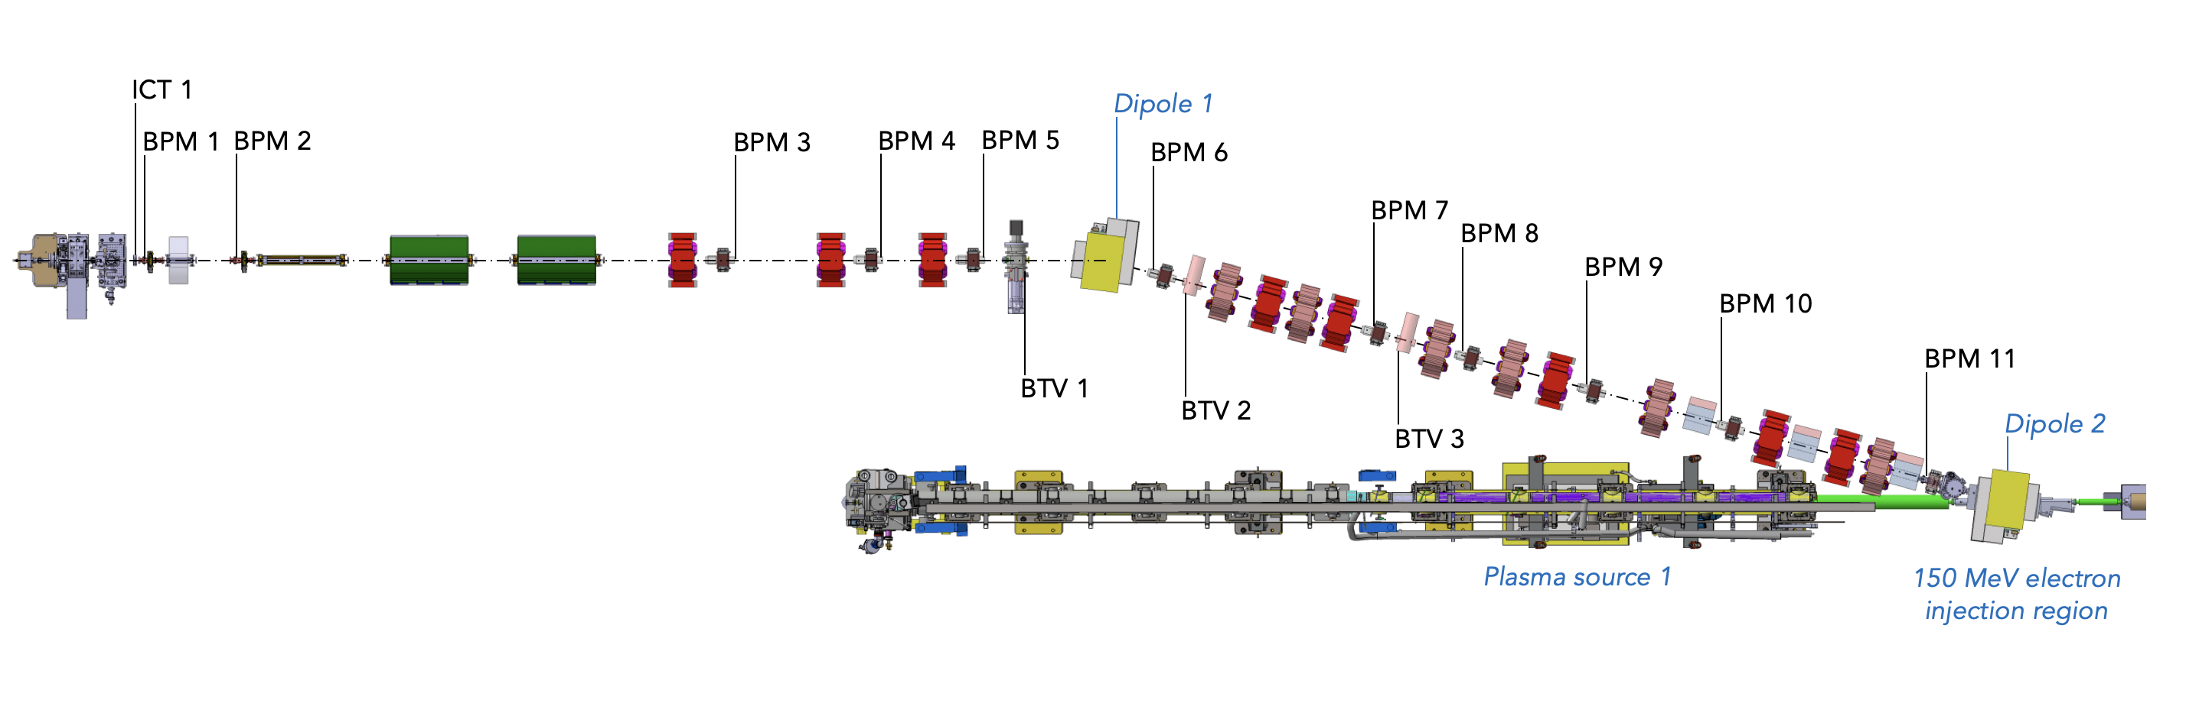
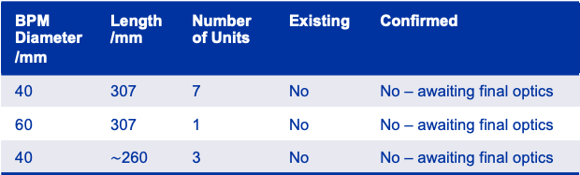
BPMs (1)
News: updated specifications means that magnet positions and hence instrument positions are not frozen
I will present the status as now – quantity of instruments will likely remain unchanged but location, and aperture, may change
BPMs 3-10 will be the new 307 mm-long stripline BPMs designed to accommodate for longer corrector length:
7x 40 mm and 1x 60 mm aperture at large beta region (BPM 7)
If possible, try to avoid the 60 mm one-off design during the optics update for budget and time reasons
Table 3. Summary of stripline BPMs for the 150 MeV line.
BPM Diameter/mm | Length/mm | Number of Units | Existing | Confirmed
40 | 307 | 7 | No | No – awaiting final optics
60 | 307 | 1 | No | No – awaiting final optics
40 | $\sim$260 | 3 | No | No – awaiting final optics
Layout for illustrative purposes, order of instruments up to date but exact locations are not

Slide 13
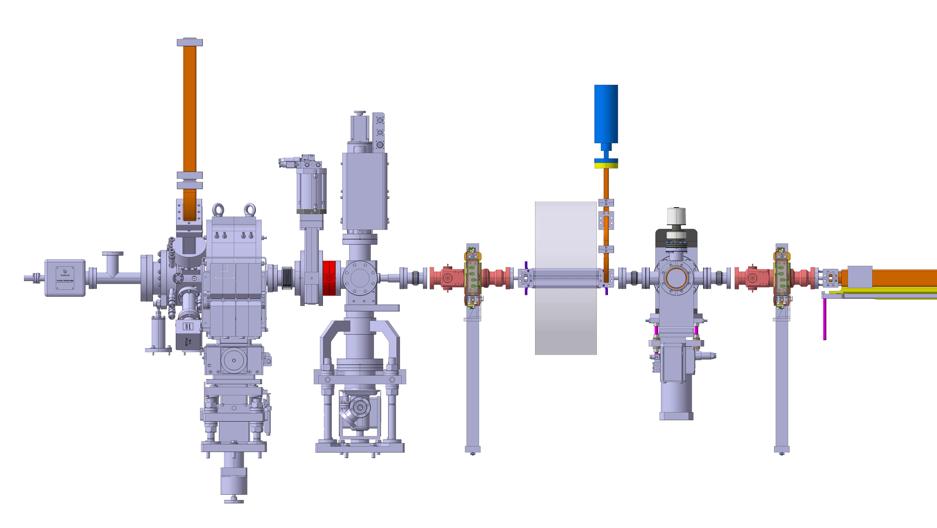
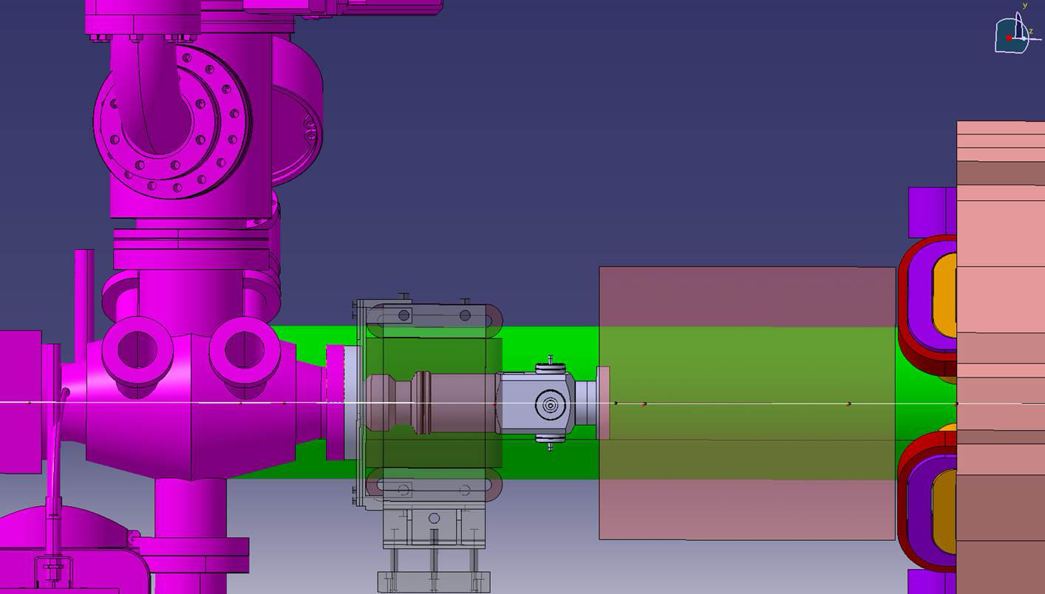
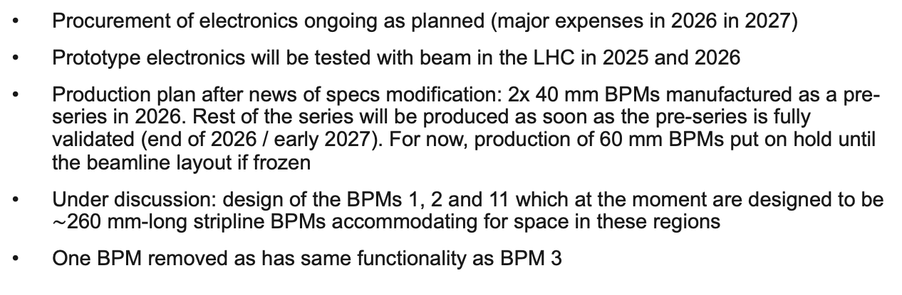

BPMs (2)
BPM 1
BPM 2
Procurement of electronics ongoing as planned (major expenses in 2026 in 2027)
Prototype electronics will be tested with beam in the LHC in 2025 and 2026
Production plan after news of specs modification: 2x 40 mm BPMs manufactured as a pre-series in 2026. Rest of the series will be produced as soon as the pre-series is fully validated (end of 2026 / early 2027). For now, production of 60 mm BPMs put on hold until the beamline layout if frozen
Under discussion: design of the BPMs 1, 2 and 11 which at the moment are designed to be $\sim$260 mm-long stripline BPMs accommodating for space in these regions
One BPM removed as has same functionality as BPM 3
BPM 11
Table 3. Summary of stripline BPMs for the 150 MeV line.
BPM Diameter/mm | Length/mm | Number of Units | Existing | Confirmed
40 | 307 | 7 | No | No – awaiting final optics
60 | 307 | 1 | No | No – awaiting final optics
40 | $\sim$260 | 3 | No | No – awaiting final optics
Layout for illustrative purposes, order of instruments up to date but exact locations are not

Slide 14
BTVs (1)
BTV 1 will be a multi-screen linear BTV used in run 2b in 18 MeV line so that both lines are equipped with multi-screen BTV
BTV 2 and 3 will be 40 mm and 60 mm aperture versions of the new BI BTV with single YAG screen respectively
Again, try to avoid 60 mm aperture version if possible in the new optics
Possibly another 40 mm BTV in space after BPM 9 – to be seen after optics have been updated
Another expansion volume screen before entrance into dipole 2 vacuum chamber which may require BI actuator
Table 4. Summary of BI BTVs for 150 MeV and common line.
BTV type | Diameter/mm | Number of Units | Existing | Confirmed
CTF linear | 40 | 1 | Yes | Yes
New single-screen | 40 | 1 (maybe 2) | No | No
New single-screen | 60 | 1 | No | No
1
2
3
4
Layout for illustrative purposes, order of instruments up to date but exact locations are not

Slide 15
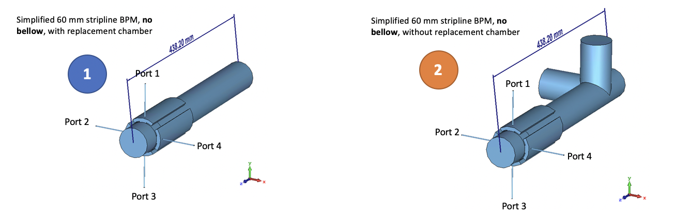
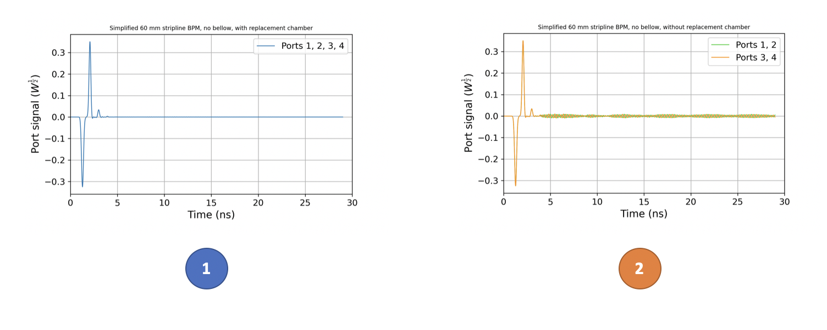
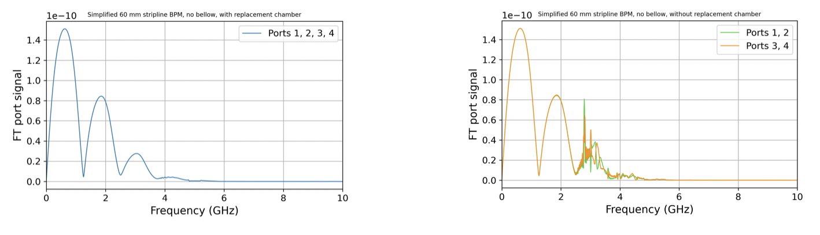
BTVs (2)
Beampipe aperture: 60mm
Simulation bandwidth: fmax = 20 GHz
Bunch sigma = 100 ps
Bunch charge = 200 pC
BPM+BTV model
For the new BI BTV design: question about the need for replacement chamber and its effect on the BPM signal
Simulations have been done with and without the replacement chamber
This is the worst-case scenario if the beampipe aperture does not exceed 60 mm and the BPM-BTV distance does not go any shorter
BPM sensitive to the effect of replacement chamber
However since signal filtering done at lower frequencies, not an issue for BPM electronics -> no replacement chamber needed for stripline BPM operation
Generated wakefields could be an issue for close by high-frequency and EO pick-ups – ideally simulated with real beam (but very computationally heavy for such short bunches)
At the moment, we don’t see the need to make a bigger and more complex design with the replacement chamber but we keep in mind that the HF and EO monitors should be placed as far away as possible from BTVs without replacement chambers
With replacement chamber
Without replacement chamber
Notes:
Is it issue for ChDR bunch length monitor?

Slide 16
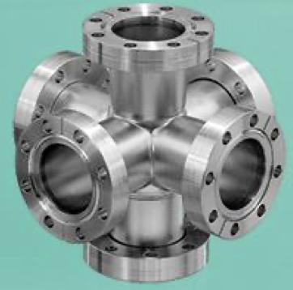
Bunch length
Space before Dipole 1
Requirement: online, non-destructive measurement before and after the dogleg
EO bunch length monitor offers this capability – see Sam Norman’s talk tomorrow on resultsof EO measurements from CLEAR
Propose to have one of these monitors in space before the dogleg (1a)
If electrons can be propagated after plasma 2 (to be checked from optics), a second EO monitor would be useful
This can be used first on the test bench during commissioning (1b), cross-calibrated with the Coherent synchrotron radiation diagnostic (U. Liverpool) (2) and then moved to after plasma 2 during operation (provided there is space)
Otherwise, 1x EO monitor used interchangeably before and after dogleg during commissioning
DN40CF 6-way cross
Flange-to-flange 125 mm
1a
2
1b
Layout for illustrative purposes, order of instruments up to date but exact locations are not

Slide 17
Bunch charge
Well-defined 38 mm ICT at the gun
Potentially one existing Faraday cup after Dipole 1 since no other charge measurement close by
Another 38 mm ICT either installed in the line if there is space (needed for Coherent synchrotron radiation diagnostic) or used only during commissioning
2
1
3
Layout for illustrative purposes, order of instruments up to date but exact locations are not

Slide 18
Instruments for the proton line

Slide 19
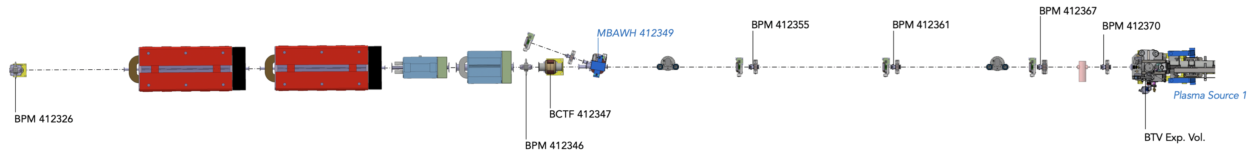
Upstream plasma 1
BPMs:
Well-defined number and locations
19 proton button BPMs up to plasma source 2 (BPM 412346 being the last of the 19)
In addition the stripline BPMs can also be used for proton position measurements
BTVs:
2x rotational BTVs for laser and proton alignment into plasma 1, distance between made as large as possible
Charge:
Keep existing BCTF 412347 before 18 MeV injection dipole
Spectrum:
Considering EO BPM or Coherent ChDR diagnostic in space before 18 MeV injection dipole – needs further discussions

Slide 20
Summary
Work ongoing:
Defining diagnostics after plasma source 2
Use of BLMs to be addressed
Cabling request to be updated and finalised
Cameras running scenarios to be defined
Ongoing discussions on stepper motors
Conclusions:
Almost full functional specifications for the 18 MeV and common line upstream of plasma 1
150 MeV line not yet frozen – end of this year
Once proposals are agreed by the experiment and institutes, specs will be published
Revise cost estimation based on changes
Propose readiness dates for instruments to be installed
Planning can be updated accordingly

Slide 21
Thank you for your attention!
Questions?

