Slide 1



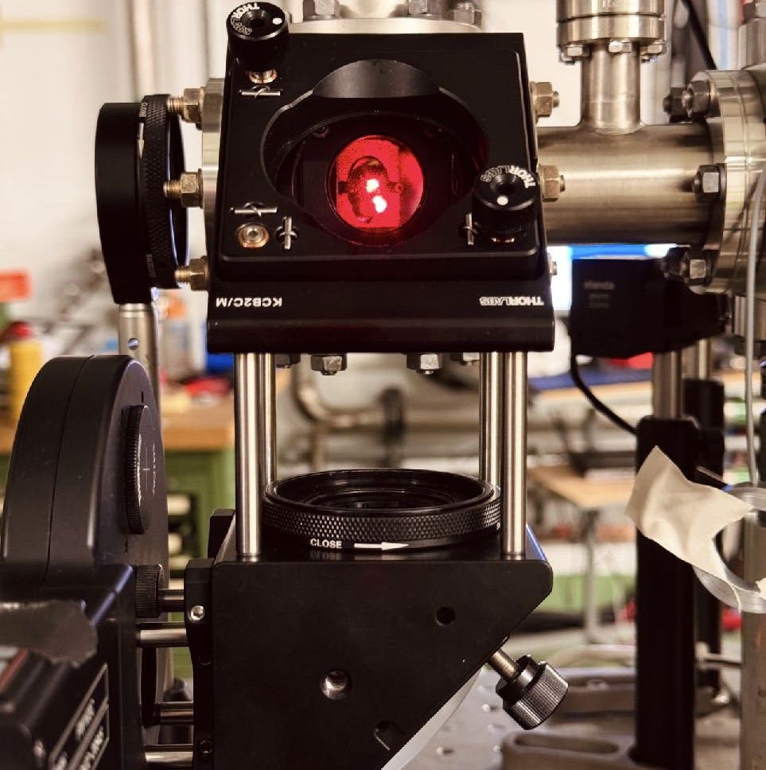






Update on Emittance diagnostics
AWAKE collab meet
Debdeep Ghosal, J. Wolfenden, C. Welsch
16th Oct., ‘25

Slide 2
Overview
Key points…
Emittance measurement
Overview of 2024 and update on 2025 (Experiment/Simulation/Analysis)
Outlook
dghosal@liverpool.ac.uk
debdeep.ghosal@cockcroft.ac.uk

Slide 3

Emittance measurement
Advantages of Pepper-pot & Corresponding Optical Mapping
- Single shot (over multi-shot Quad scans)
- Phase space mapping
Lower energy-limitation of Slit/pinhole scans & pepper-pot
—> Possible solution: Optical version
K
screen
Quad
σ²
K
dghosal@liverpool.ac.uk
debdeep.ghosal@cockcroft.ac.uk

Slide 4
Emittance measurement
Advantages of Pepper-pot & Corresponding Optical Mapping
- Single shot (over multi-shot Quad scans)
- Phase space mapping
Lower energy-limitation of Slit/pinhole scans & pepper-pot
—> Possible solution: Optical version
K
screen
Non-/minimally invasive optical radiation sources can be used (OTR, OSR)
Increase in Divergence resol. with energy, Real-time monitoring…
Advantage of 4D transverse phase space reconstruction
Quad
σ²
K
dghosal@liverpool.ac.uk
debdeep.ghosal@cockcroft.ac.uk

Slide 5

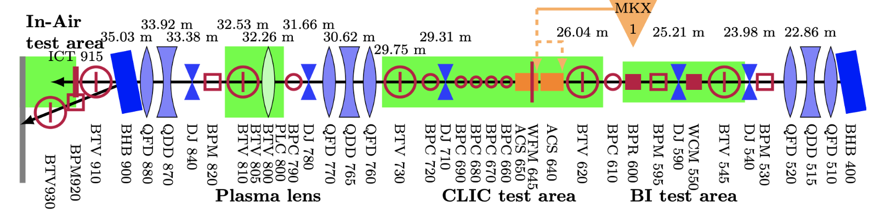
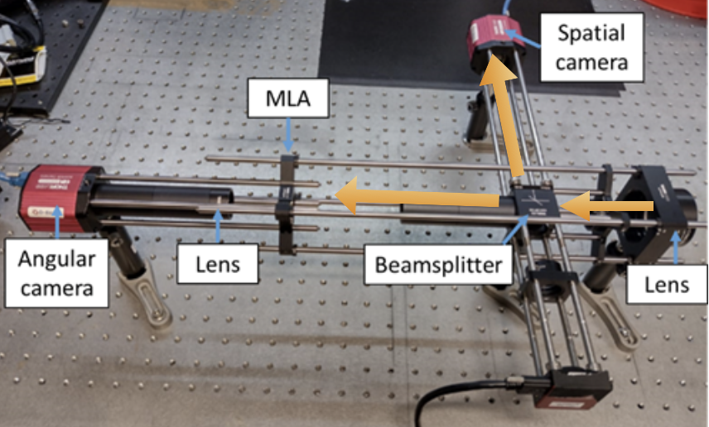

Status of Emittance measurement
OTR + OSR (@CLEAR (’24 & ’25) demonstrated
dghosal@liverpool.ac.uk
debdeep.ghosal@cockcroft.ac.uk

Slide 6
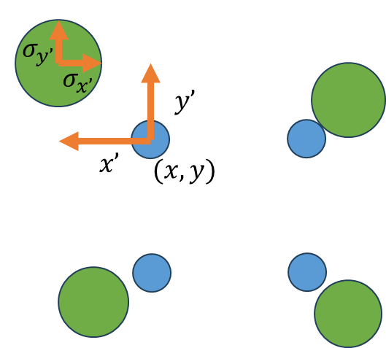
Status of Emittance measurement
OTR + OSR (@CLEAR (’24 & ’25) demonstrated
dghosal@liverpool.ac.uk
debdeep.ghosal@cockcroft.ac.uk

Slide 7
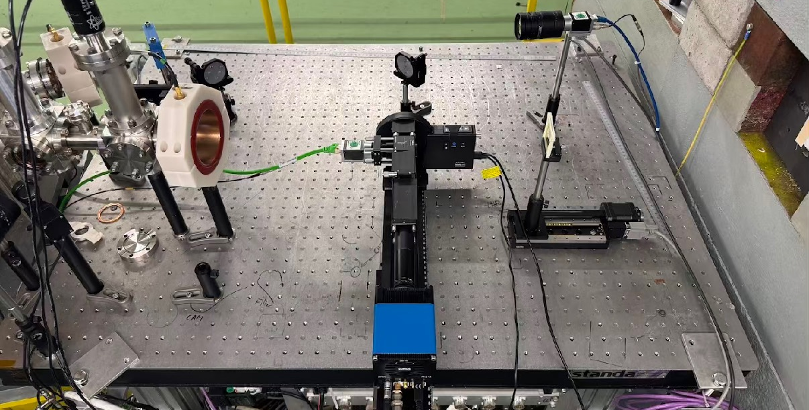
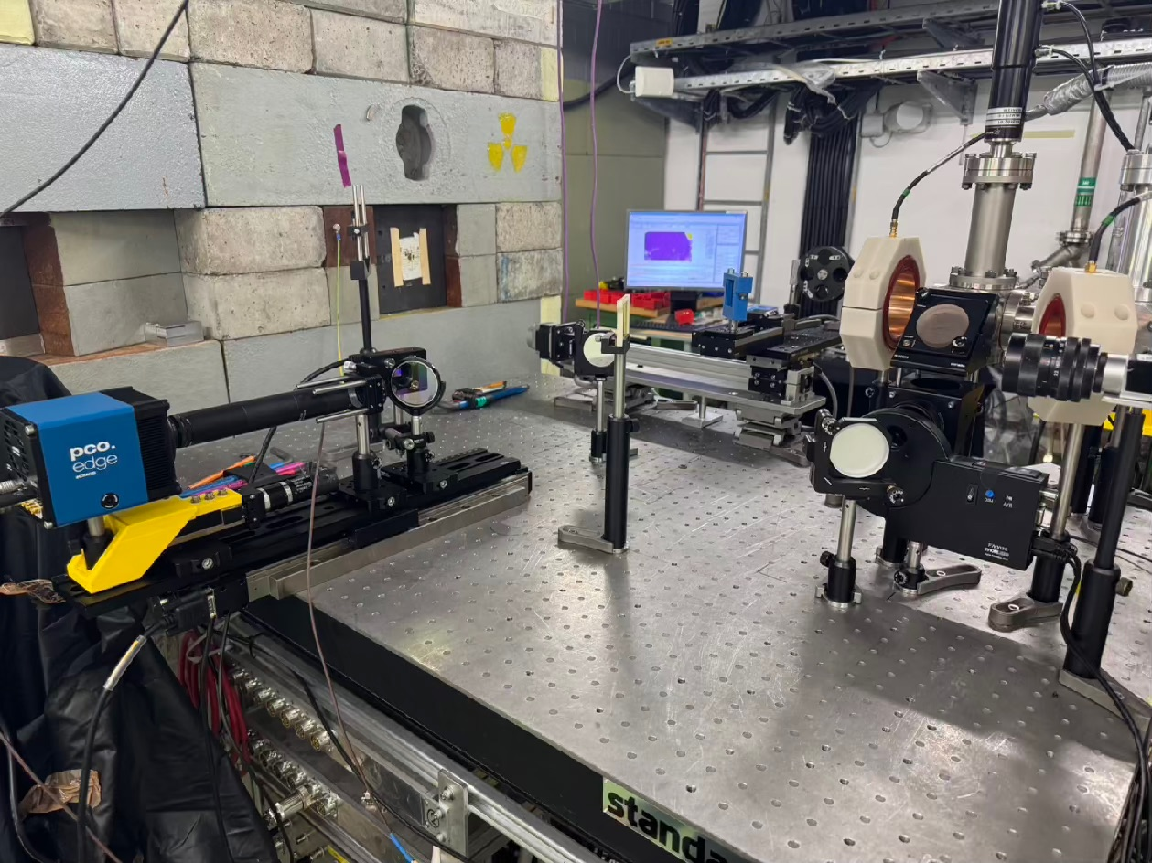
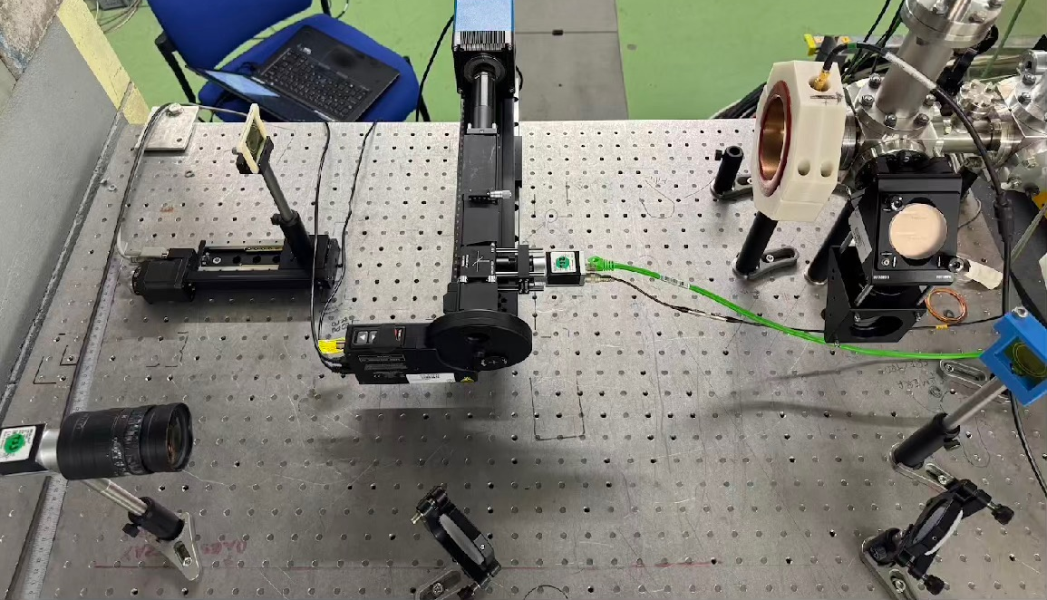
Emittance measurement
OSR (@CLEAR (’24 & ’25) demonstrated
Spatial
Beam path
Parameters | Values
E (MeV) | 198 ± 5
Q (nC) | 0.1 - 2
ΔE | 1.5-2 %
MLA
Benchmarked Emittance | Values
εx (mm.mrad) | 16 ± 2.6
εy (mm.mrad) | 4.5 ± 0.7
Angular
dghosal@liverpool.ac.uk
debdeep.ghosal@cockcroft.ac.uk

Slide 8
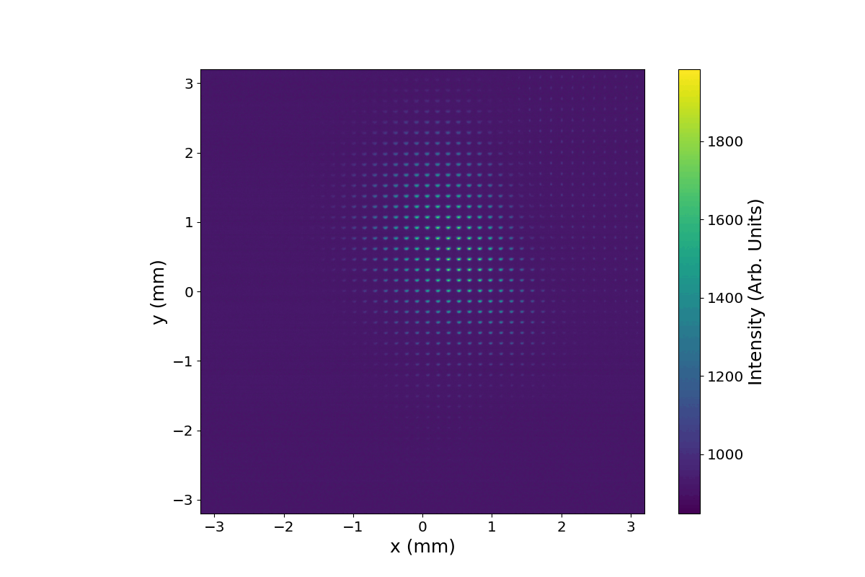
Emittance measurement
OSR (@CLEAR (’24 & ’25) demonstrated
Spatial
Beam path
Parameters | Values
E (MeV) | 198 ± 5
Q (nC) | 0.1 - 2
ΔE | 1.5-2 %
MLA
Benchmarked Emittance | Values
εx (mm.mrad) | 16 ± 2.6
εy (mm.mrad) | 4.5 ± 0.7
Angular
dghosal@liverpool.ac.uk
debdeep.ghosal@cockcroft.ac.uk

Slide 9
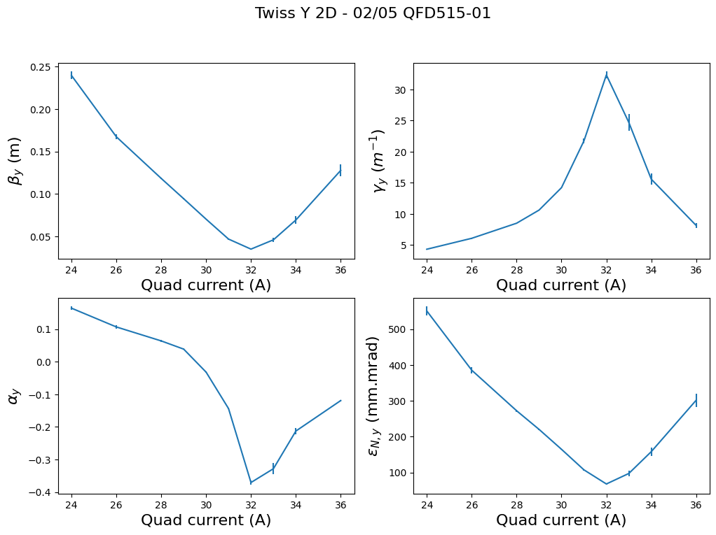
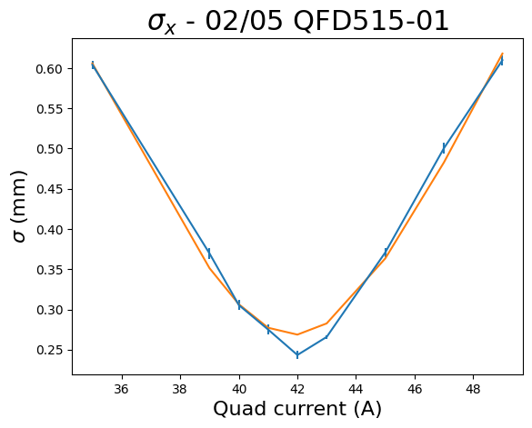
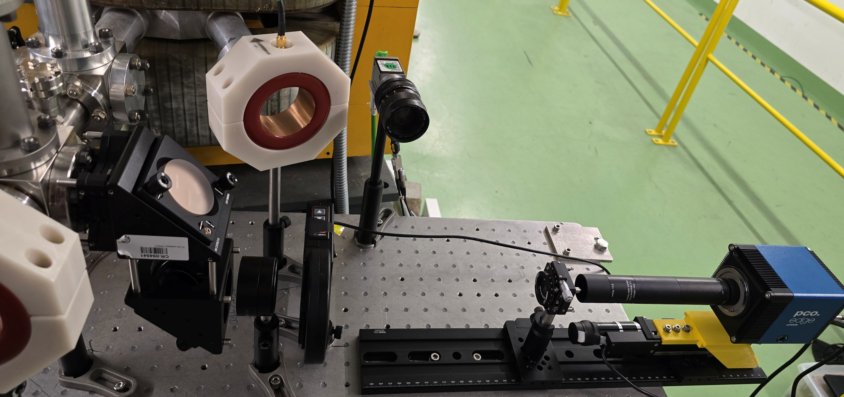
Emittance measurement
OTR (@CLEAR (’24 & ’25) demonstrated
Initial proof of principle results looked promising
Twiss patterns to be checked for resolution limit behavior
(error in the actual hardware misalignment or beam characteristics!)
Simulation study to define resol. limit
Wide dataset range (700pC to 2.2nC @200 MeV)
Quad scanning to feasible/reliable range
Sufficient for PoC measurements
dghosal@liverpool.ac.uk
debdeep.ghosal@cockcroft.ac.uk

Slide 10

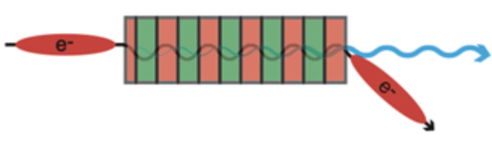
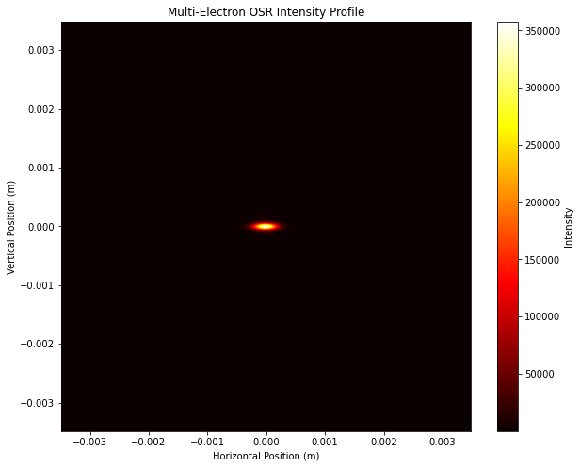
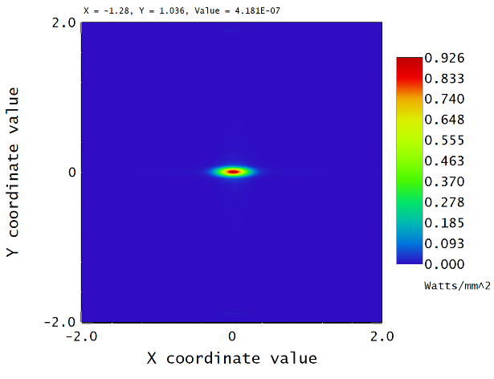
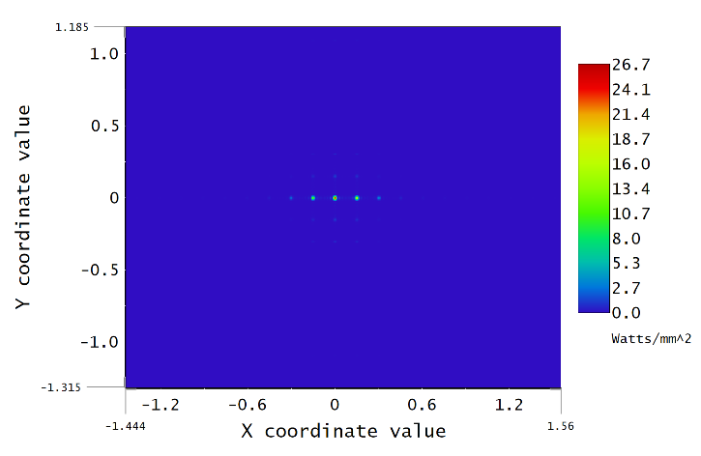
OSR Simulation
SRW <—> Zemax (Full end-to-end integration) with parametric scans
Image plane MLAfocal Plane
dghosal@liverpool.ac.uk
debdeep.ghosal@cockcroft.ac.uk

Slide 11
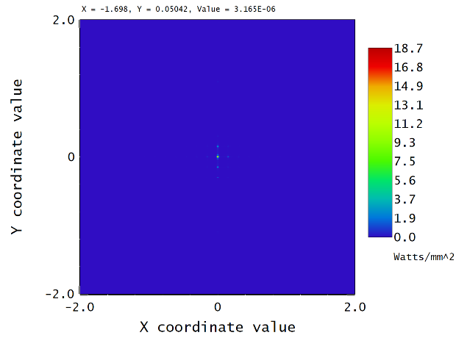
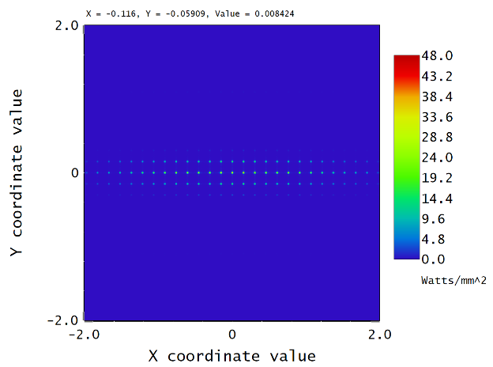
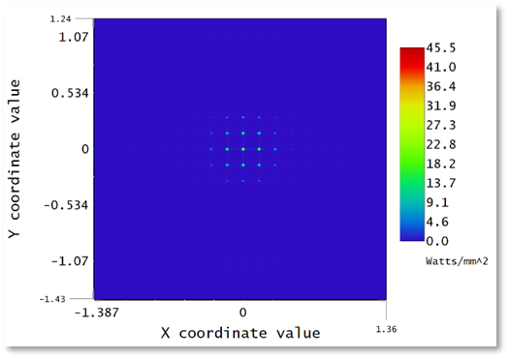
OSR Simulation
SRW <—> Zemax (Full end-to-end integration) with parametric scans
Image plane MLAfocal Plane
dghosal@liverpool.ac.uk
debdeep.ghosal@cockcroft.ac.uk

Slide 12
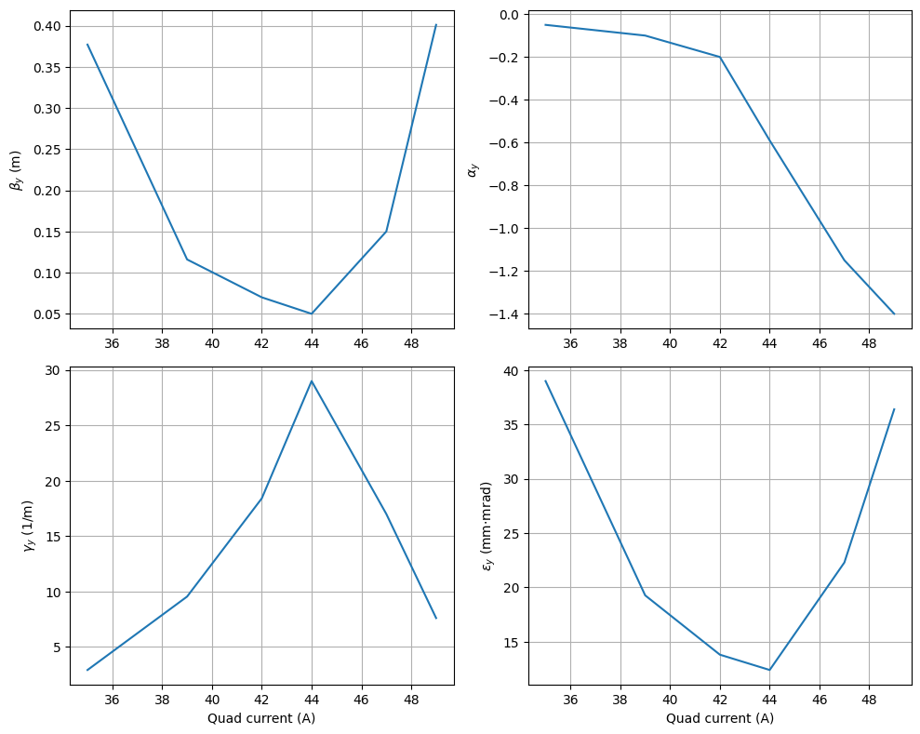
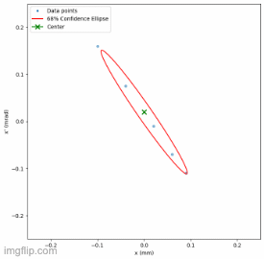
OSR Simulation
SRW <—> Zemax (Full end-to-end integration) with parametric scans
Image plane MLAfocal Plane
dghosal@liverpool.ac.uk
debdeep.ghosal@cockcroft.ac.uk

Slide 13
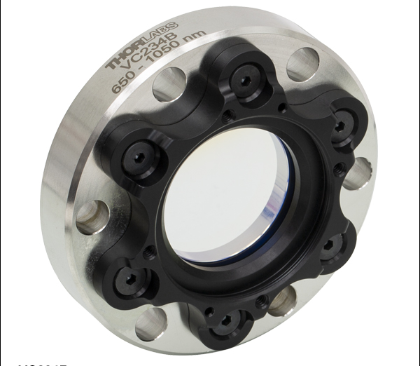
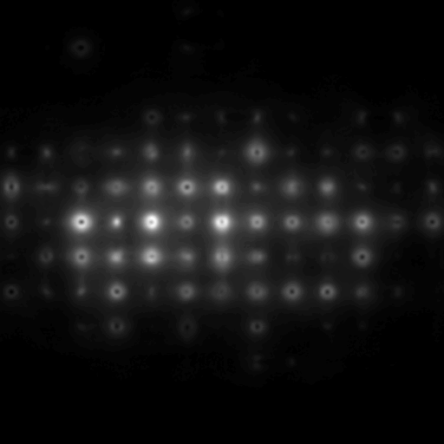
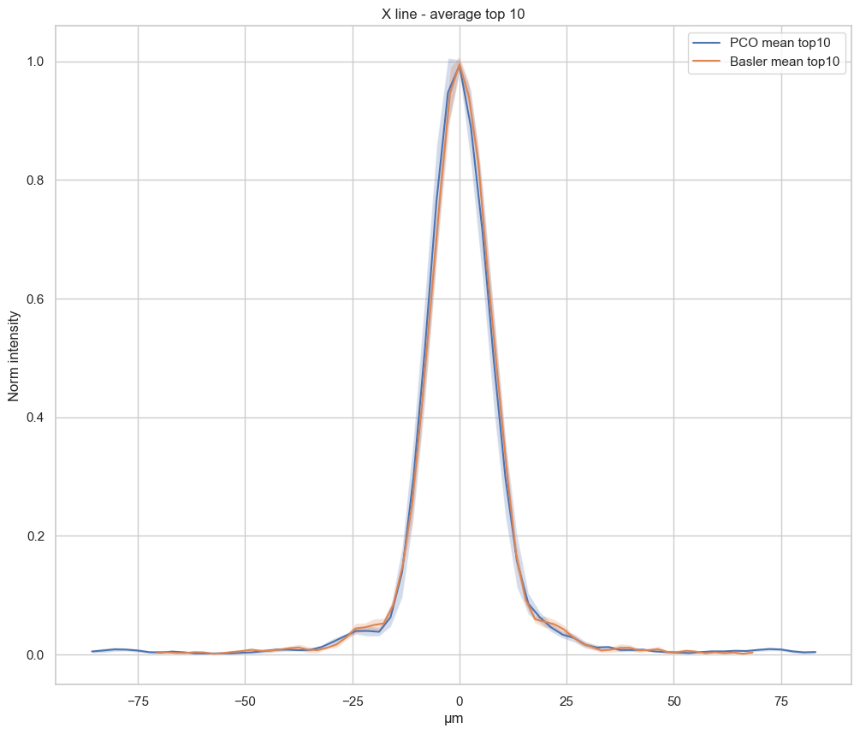
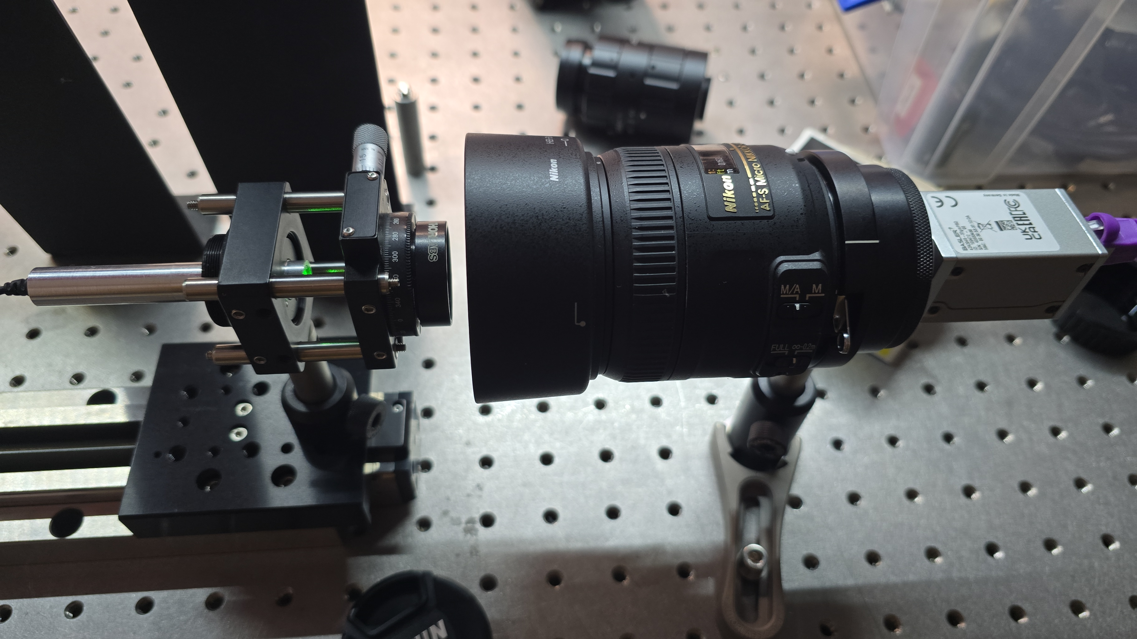
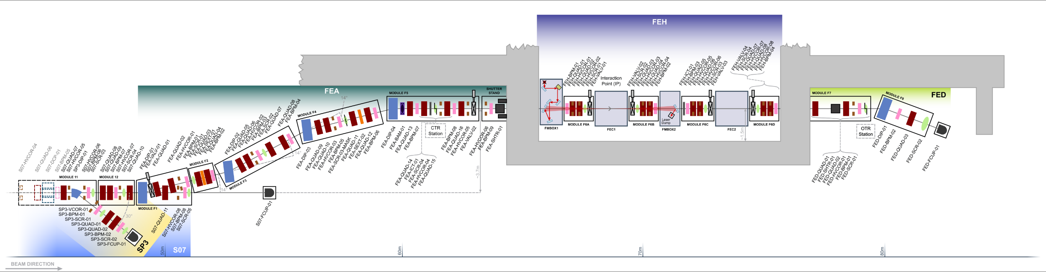
Equipment Status for run-2c and other Updates
System design and beamtime
Thorlabs
PCO Edge 26 (~£10k) to Basler ace2 a2A2048-37gmPRO (~£370) Camera comparison carried out
Much smaller sensor (not relevant), comparable resolution, slightly worse noise floor
DN63 CF finalized with Nicolas, Marlene… (more angular acceptance)
OTR quad scan simulation —> sampling issue almost resolved
Installation and beamtime (OTR) at CLARA confirmed in Feb/March; OSR to follow later…
OSR
Joe
Source: CLARA
OTR
dghosal@liverpool.ac.uk
debdeep.ghosal@cockcroft.ac.uk

Slide 14

To Wrap up!
Outlook…
While in contact with Marlene and Nicolas, UoL to lead the final stages of development and integration in collab. with CERN BI + UCL
OSR simulation is at the final stage
DN63 CF flange (4.50" OD) decided for the window
Installation and confirmed beamtime OTR (and also possibly OSR later on) at CLARA, Daresbury
A new PhD recruitment in place, already receiving applications (possible LTA during commissioning, integration for run-2c)
Emittance
Long. Profile
dghosal@liverpool.ac.uk
debdeep.ghosal@cockcroft.ac.uk

Slide 15

Thank you!

Slide 16
Back up!
dghosal@liverpool.ac.uk
debdeep.ghosal@cockcroft.ac.uk

Slide 17
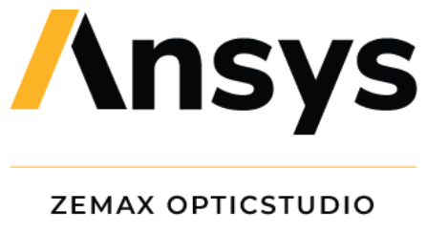
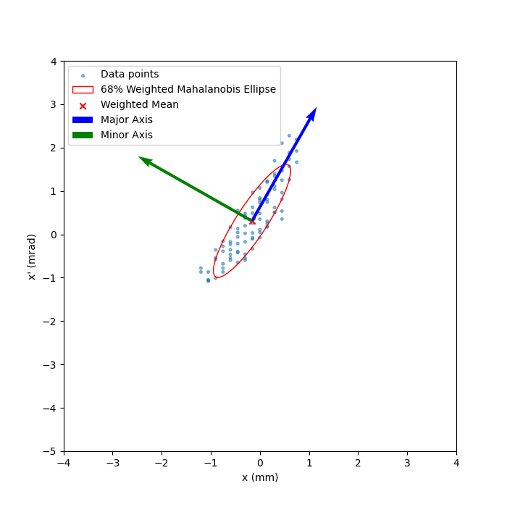
OSR Simulation
SRW & Zemax
https://github.com/ochubar/SRW
SRW is a comprehensive software toolkit developed (by O. Chubar & P. Elleaume, @ESRF) for simulating the emission, propagation, and interaction of SR with materials.
Fast computation of SR emitted by relativistic electrons in mag. field of arb. configuration
SR wavefront propagation
Simulation of experiments involving SR
Python-based API
Accurate Field computation
Zemax is used to simulate the optical path for OSR collection and imaging
Helpful with ray tracing, PoP and spot size analysis
SRW
Zemax
B
e⁻
SR
Detector
dghosal@liverpool.ac.uk
debdeep.ghosal@cockcroft.ac.uk

