Slide 1
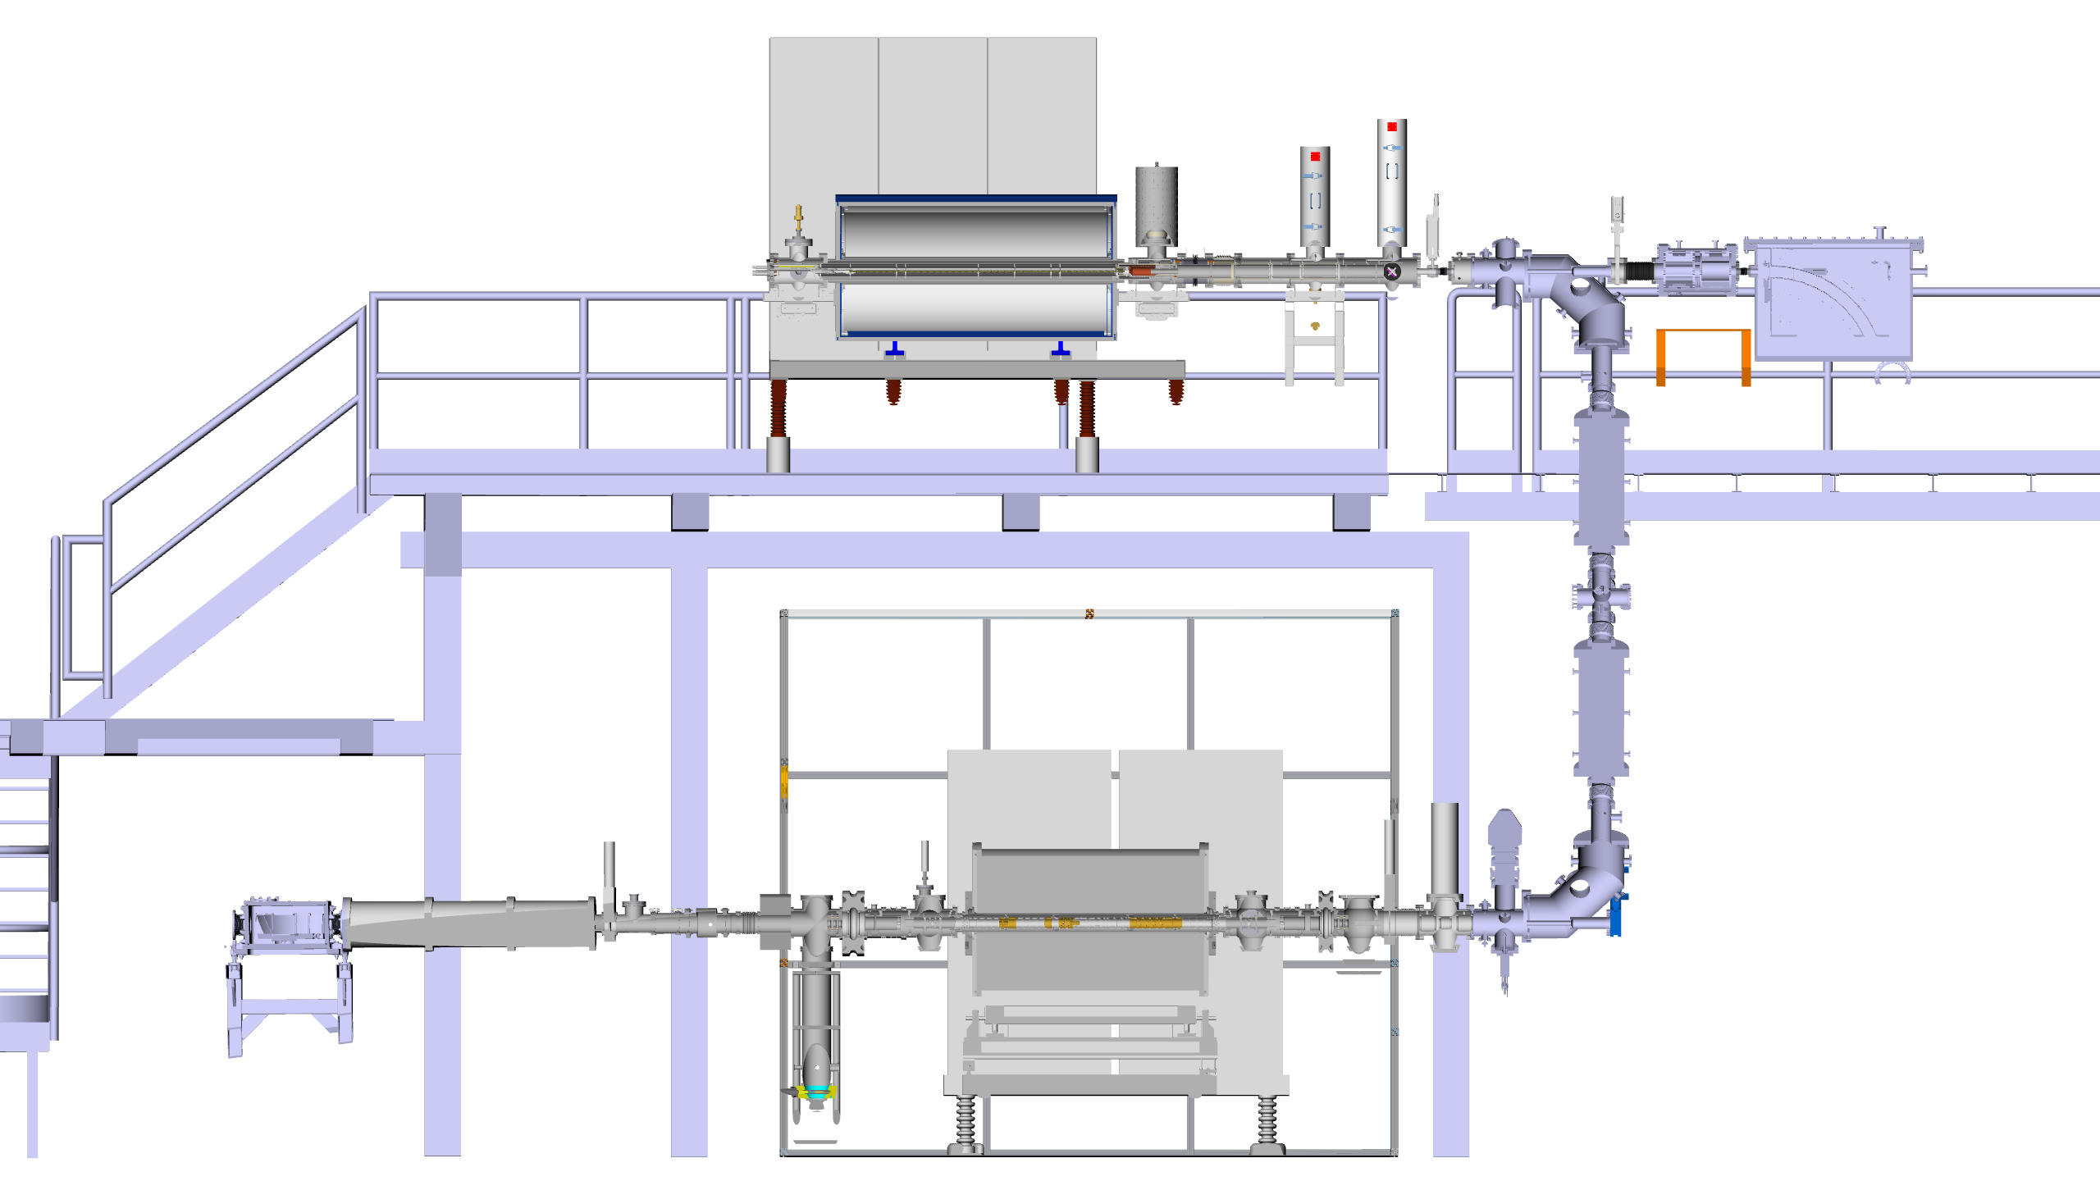
CLS of radioactive HCI from REXEBIS
REXEBIS
(very compact)
CLS beamline
Eventually vertically?
No full design, no funding yet
Construction @ ISOLDE
earliest 2028
But first ideas are exchanged
→ Fredrik Wenander
REXTRAP

Slide 2
