Slide 1
VERTICAL CORES COORDINATION MEETING HL-LHC
SCE-PPM D. Rodriguez, C. Paillot
26.09.2025

Slide 2
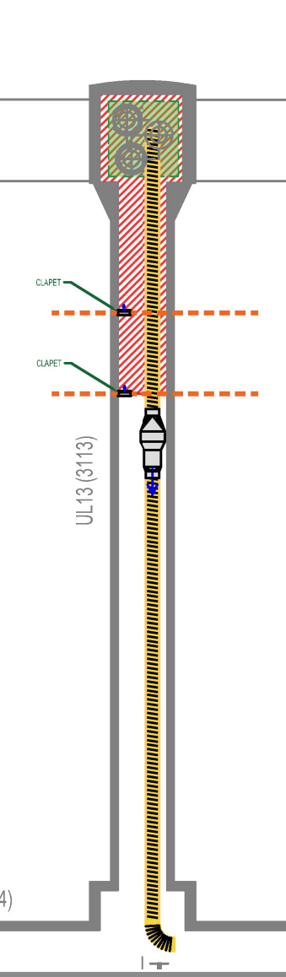
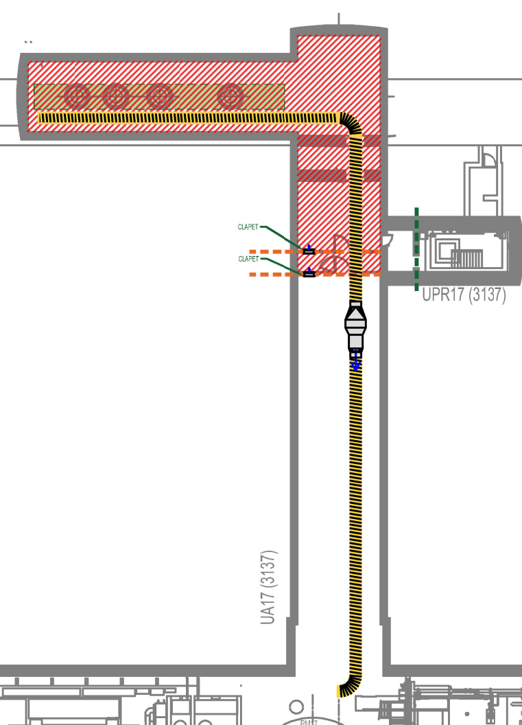
Ventilation
Ventilation concept with drawings and description has been shared with EN/CV and their comments have been provided to the contractor
Existing doors will be used in UA. New doors in UPR shall be installed before the works.
Some modifications proposed to the site installation: one big SAS on LHC. Once the ventilation concept is approved, it will be discussed with HL and LHC coordination

Slide 3
Electricity
One electrical cabinet per gallery to power the machine on each worksite
Intermediate sockets already installed will be used to move the machine. The contractor is verifying that the current distribution is sufficient.
Exact details on power supply and consumption will be shared with EN/EL

Slide 4
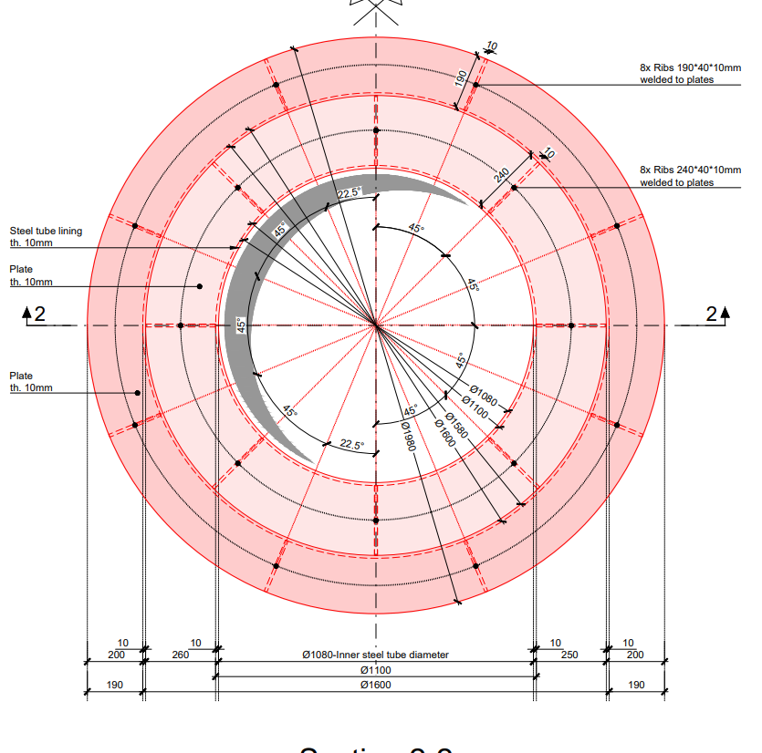
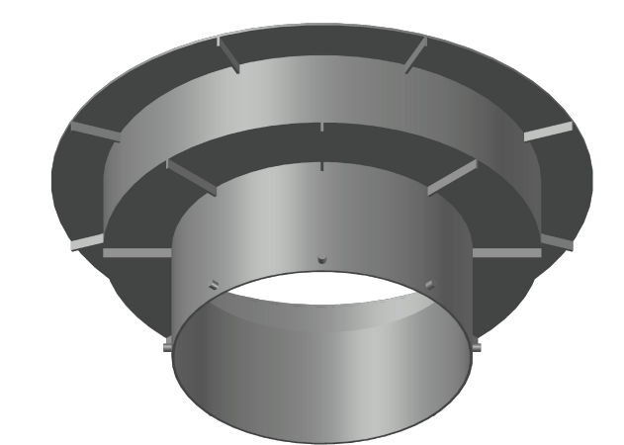
Transport
The 2 big machines design will be finalised by the end of September
Technical data sheets will be shared as soon as they become available
Metallic lining of the lower part of the LHC will be the biggest element, dimensions will be shared with contractor.

Slide 5
Transport
The 2 big machines design will be finalised by the end of September
Technical data sheets will be shared as soon as they become available
Metallic lining of the lower part of the LHC will be the biggest element, dimensions will be shared with contractor.
Works organization:
EN/HE intervention will take place once per day, except on major transport days (machines, concrete, etc.), which will be defined in advance.
The storage area will be enlarged to provide extra buffer space, as the contractor will be working in two shifts.
Estimates of the waste generated per day will be shared with transport.
Meeting will be organised with contractor and transport on 09/10 to clarify these points.

Slide 6
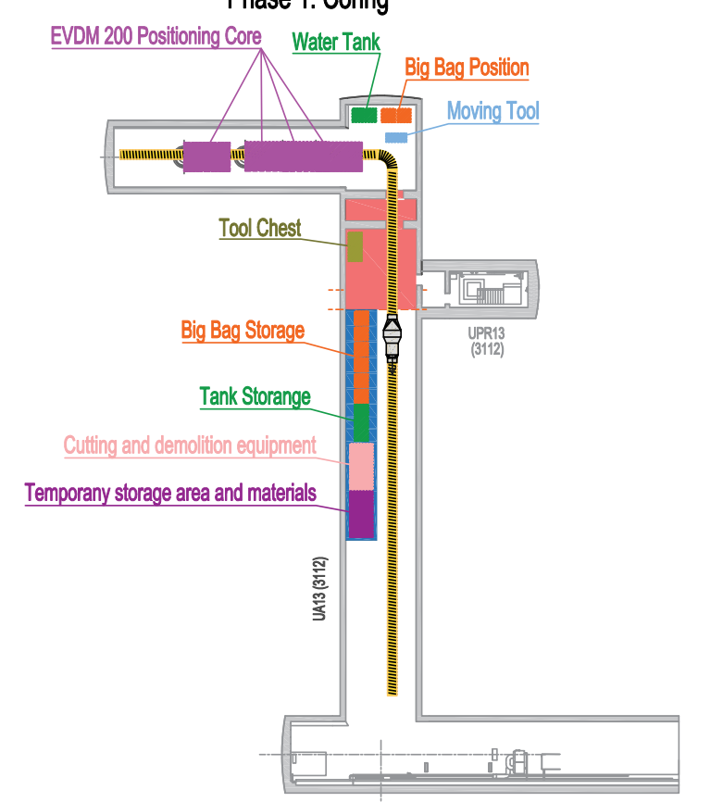
Site installation
Contract currently working on the site installation and storage distribution.
Particularly tight on UA galleries, where compatibility with current equipment shall be addressed.

Slide 7
Field tests
Surface tests (ISR area)
Equipment will be tested in the ISR where molasse rock is very close to surface. To select the most performant combination of coring tools and analyze the performance of the excavation bucket.
To be carried out in October 2025 (06/10 to 11/10)
Underground field test (HL-LHC)
Real test is planned to be carried out during YETS, including excavation and lining
Depth to be defined to ensure safety of LHC and compatibility of phase 2 from LHC. (RP constraints?)
Location confirmed at Point 1 UA17
Commencement date: mid-January

Slide 8
Nest steps
Advance on the construction design of the vertical cores and methodology definition → Regular discussions are organized between SCE and contractor
Final design and methodology shall be provided by the end of October.
If necessary, it will be updated after field tests.
Finalise ventilation concept → EN/CV comments sent to contractor
Meeting with transport on 09/10
Field test in ISR from 06/09. Let us know if you are interested in coming on site.
LHC condition visit on November TS
Organisation of field test during YETS: critical to be well prepared for this test.

Slide 10
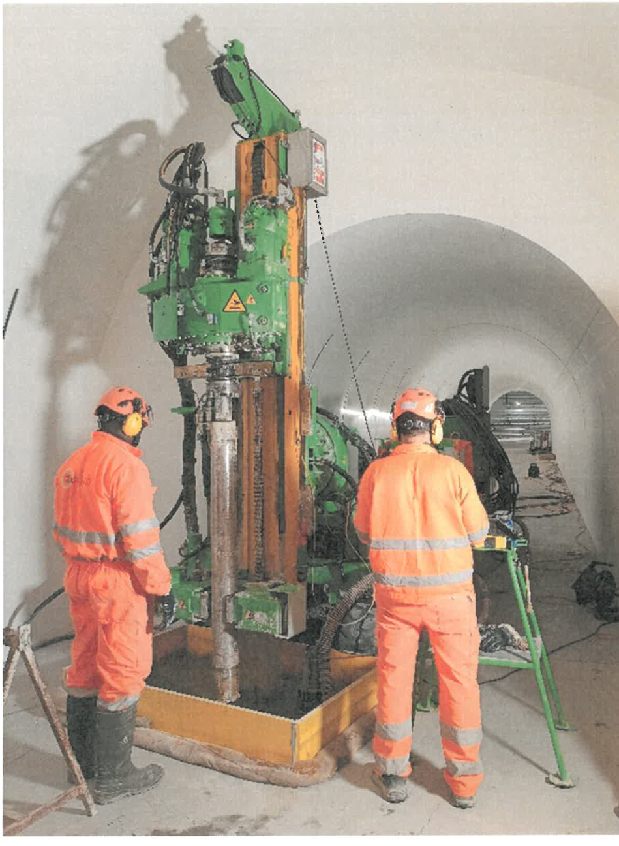
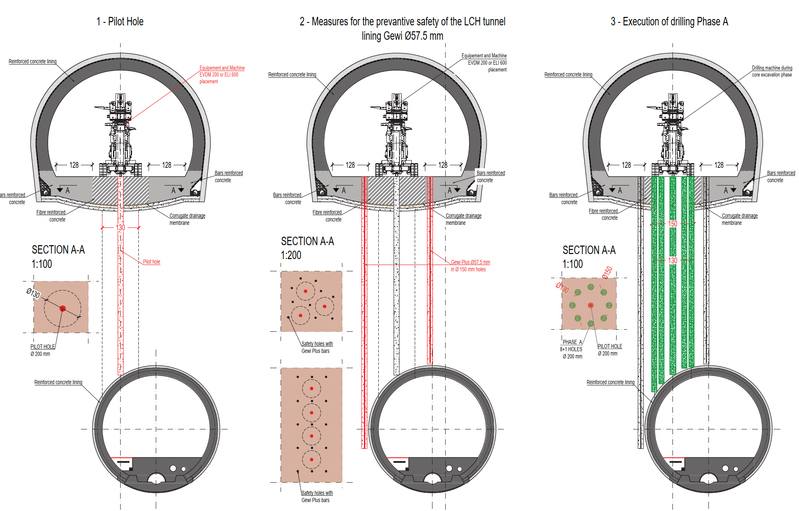
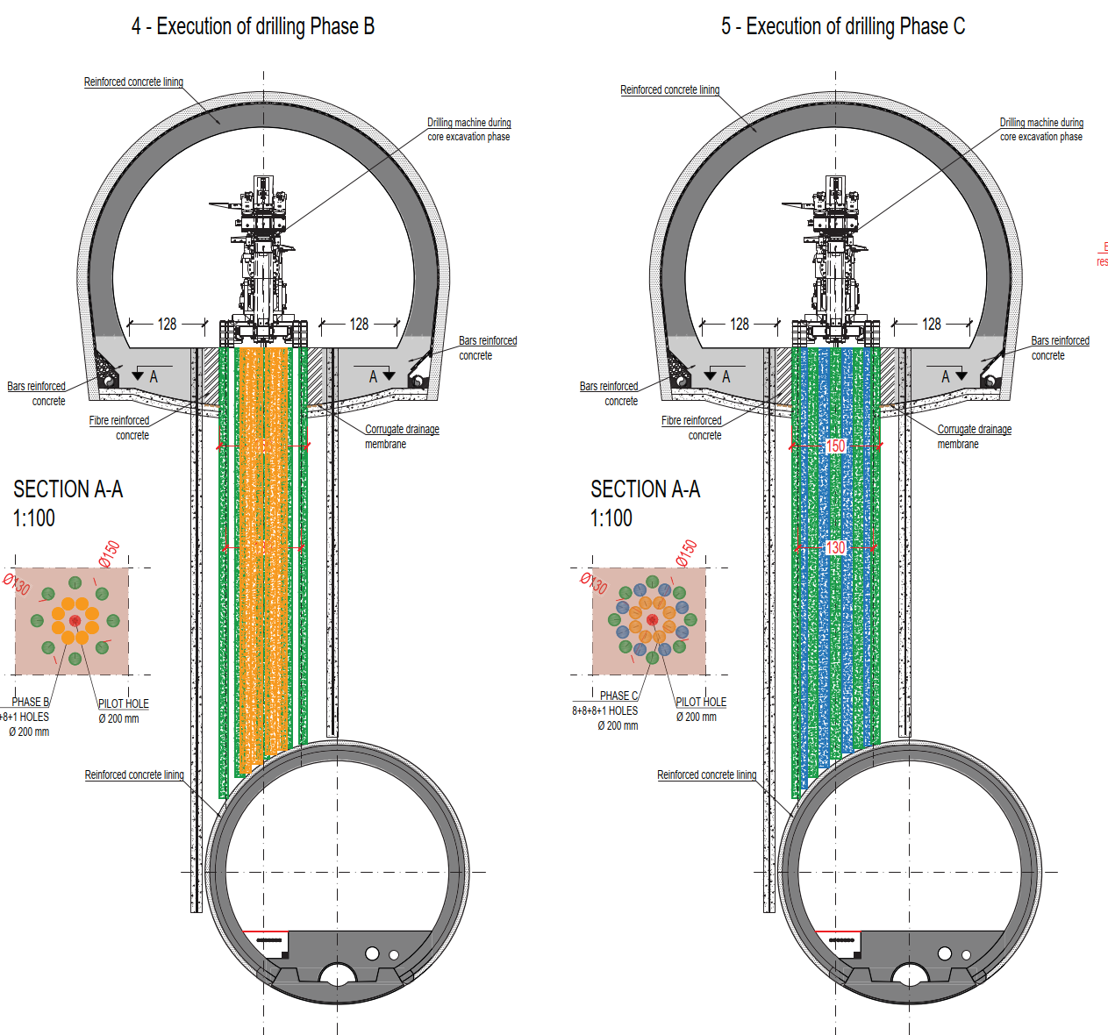
Methodology
Phase 1 (HL): Coring of the vertical cores from HL galleries

Slide 11
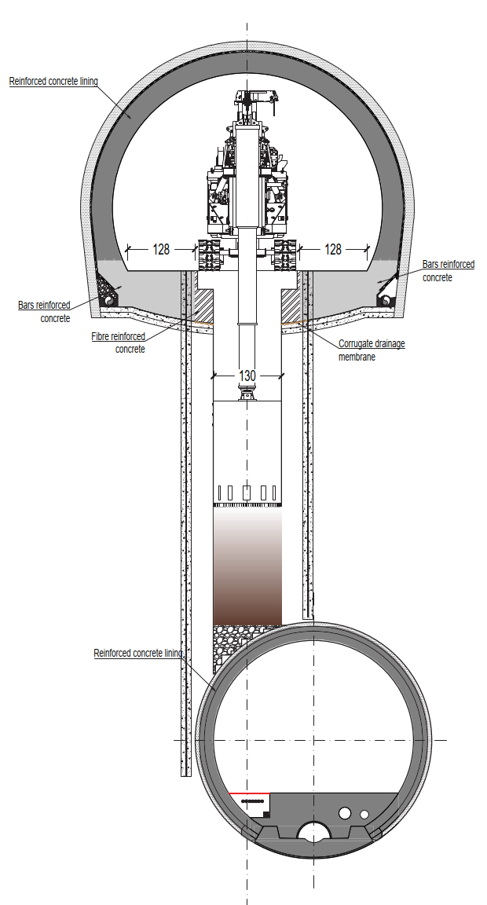
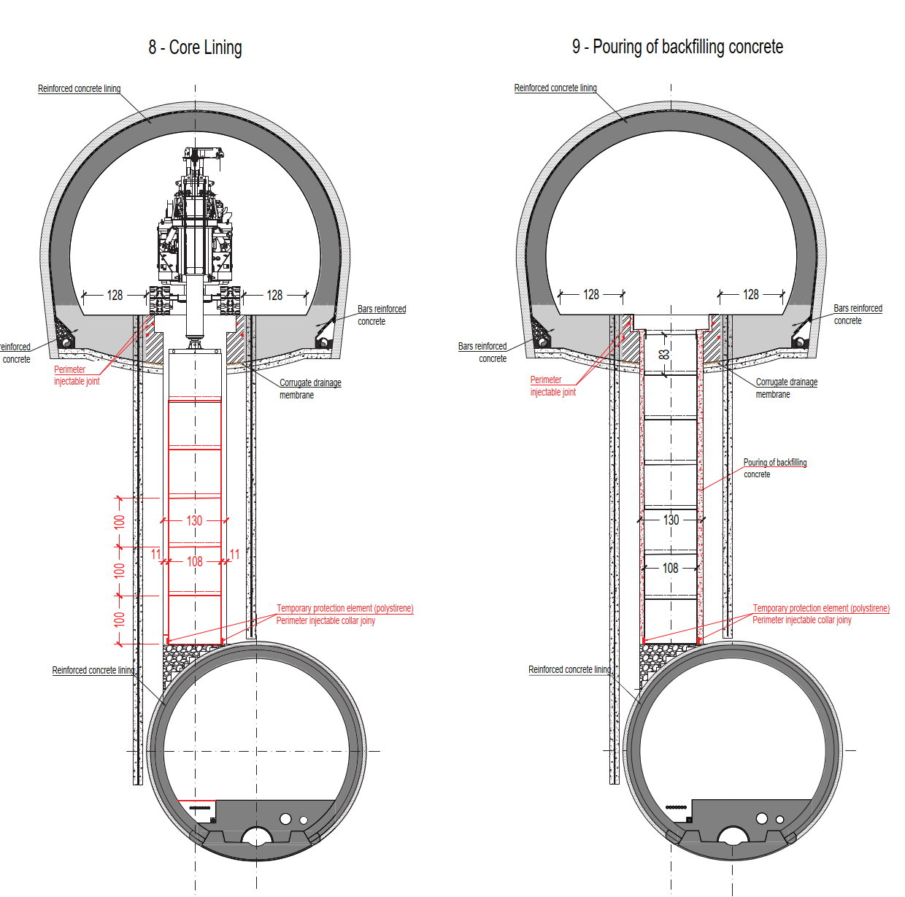
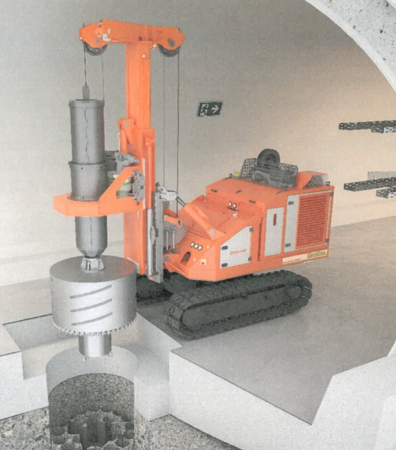
Methodology
Phase 1 (HL): Emptying of the remaining soil after coring and installation of metallic lining

Slide 12
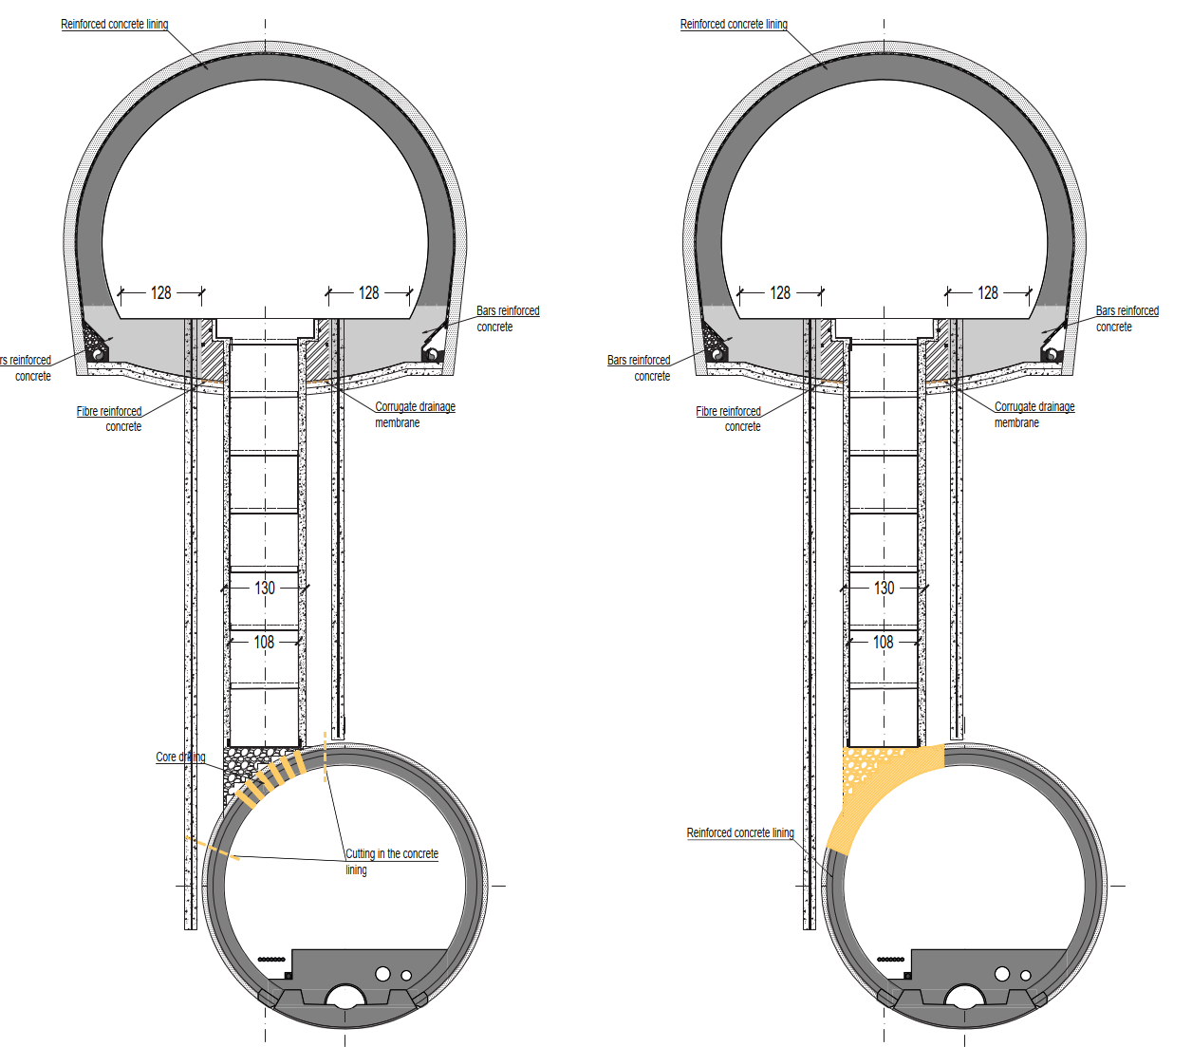
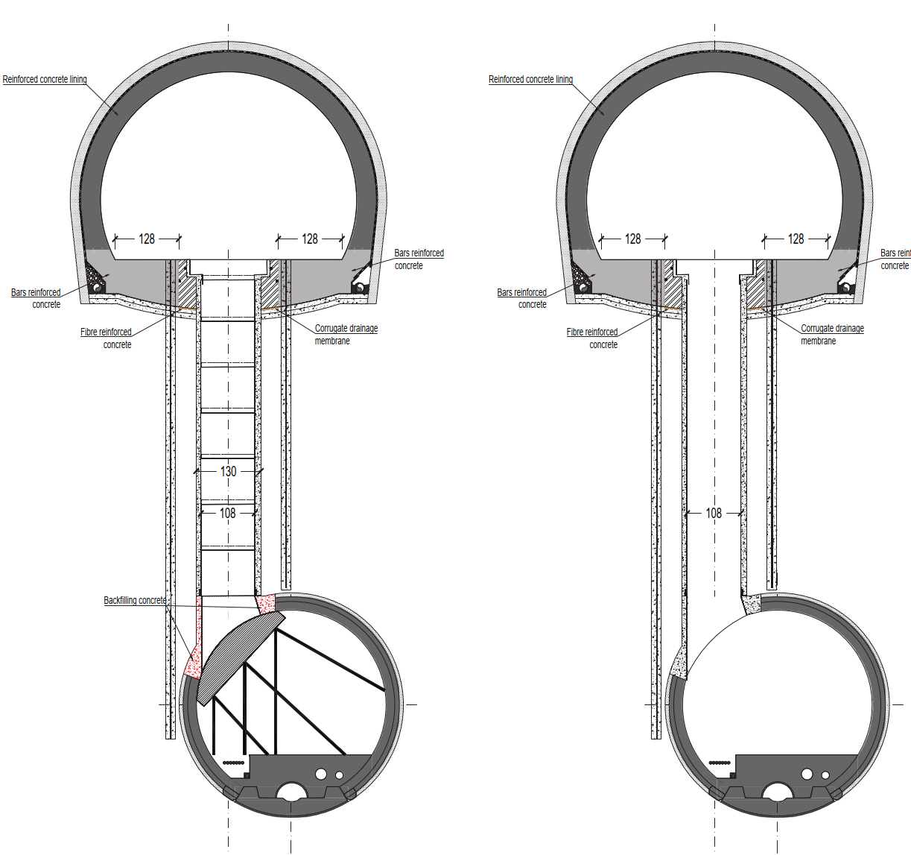
Methdology
Phase 2 (LHC): Excavation and lining of the remaining part from LHC

Slide 13
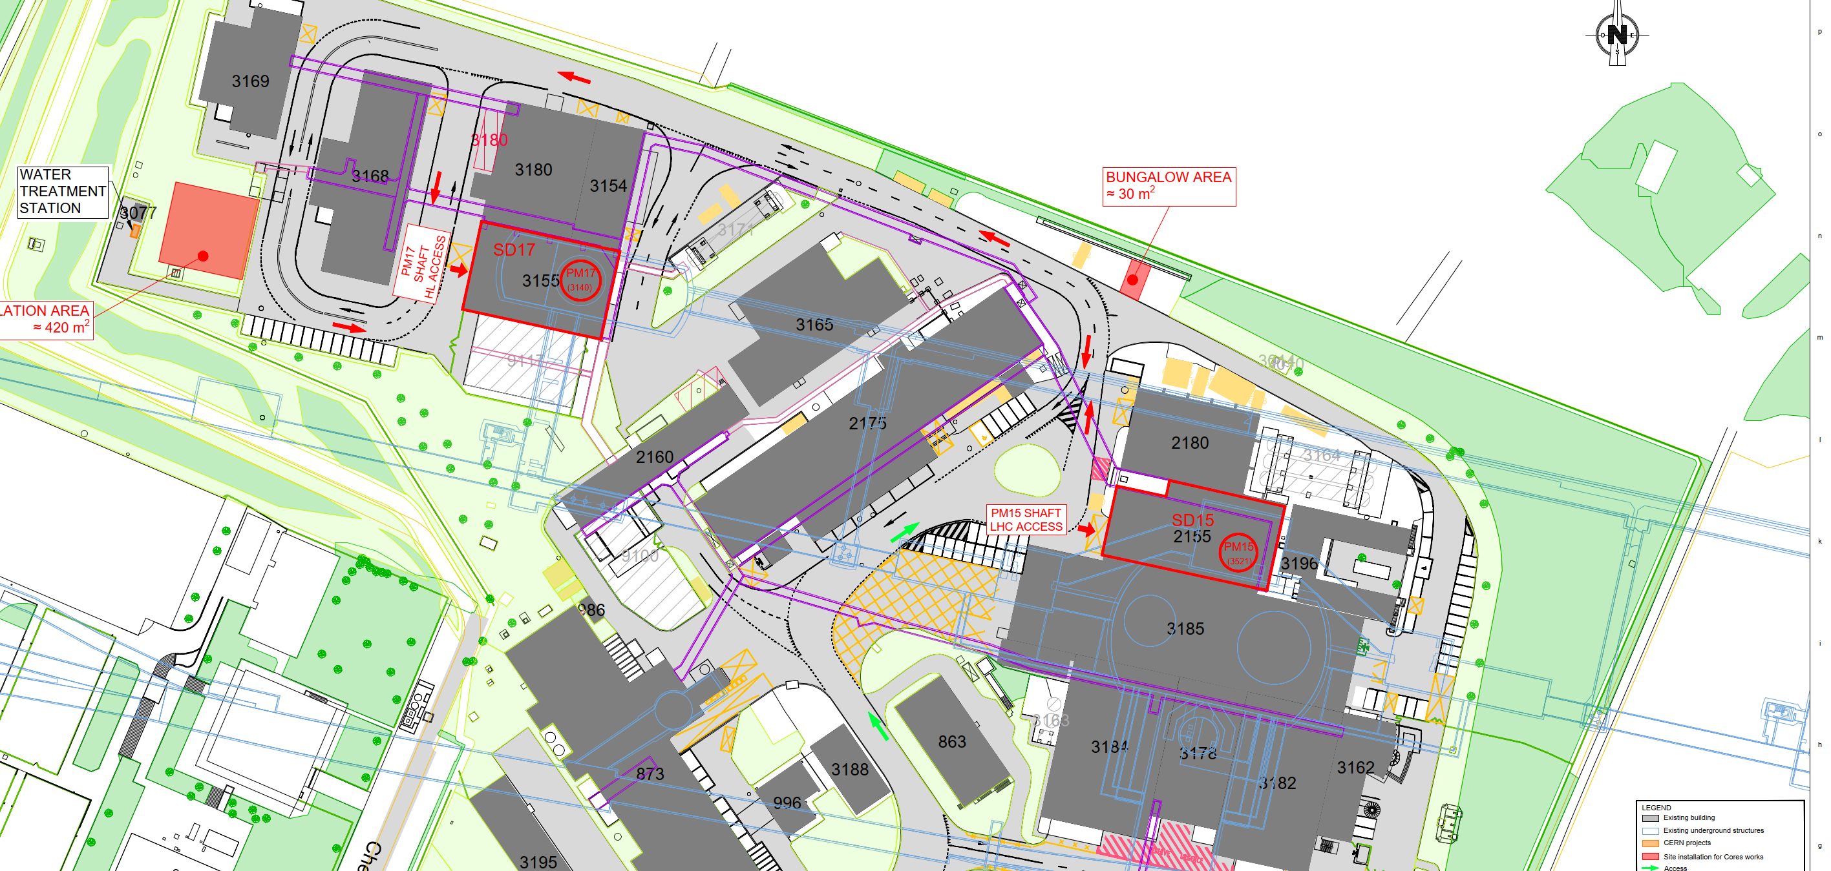
Surface site installation P1
Underground personnel access from building 3155 (SD17) to HL and LHC. LHC access via UPR personnel stairs in UA galleries.
Punctual access might be allowed directly to LHC from building 2155 (SD15) via a personal access door equipped with an eye scanner

Slide 14
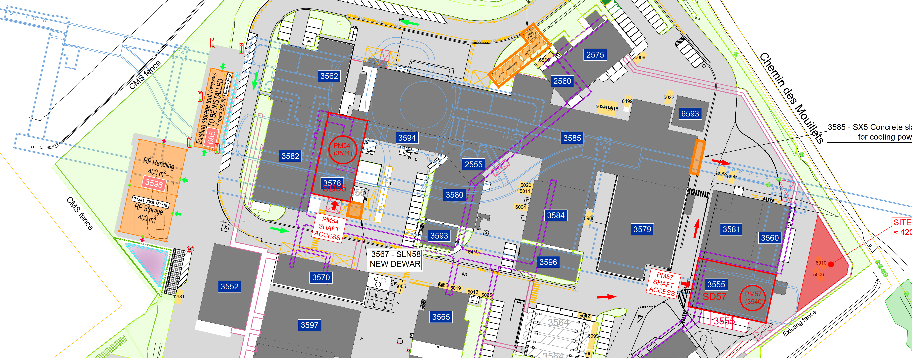
Surface site installation P5
Underground personnel access from building 3578 (SD55) to HL and LHC. LHC access via UPR personnel stairs in UA galleries.
Punctual access might be allowed directly to LHC from building 3555 (SD57) via a personal access door equipped with an eye scanner

Slide 15
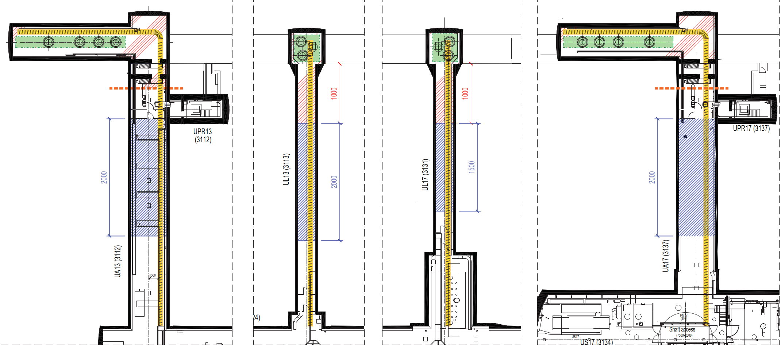
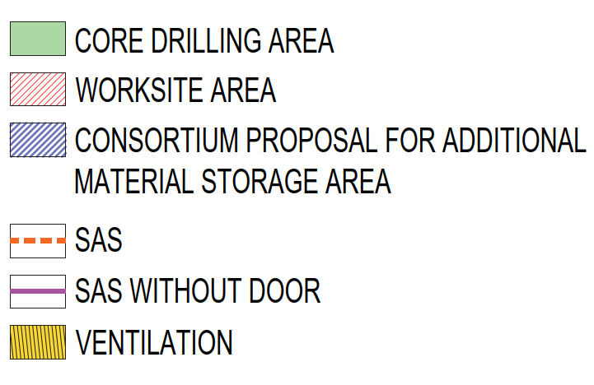
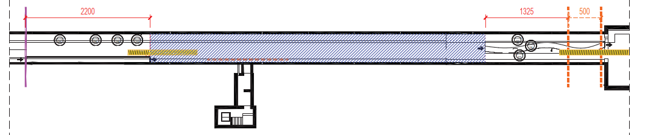
Site installation underground
HL-LHC
LHC

