Slide 1
FINAL LIST OF METRICS
AUROC
AUPRC
ANOMALY SCORE DISTRIBUTION (TAIL ANALYSIS)
F1-SCORE
RECONSTRUCTION ERROR/LOG-LIKELIHOOD → ANOMALY SCORE
INFERENCE TIME AND MODEL SIZE
CALIBRATION SCORE
TOP-K PRECISION
ASIMOV SIGNIFICANCE
AUEP
CLs
VISIBLE CROSS SECTION

Slide 2
DECISIONS TO MAKE
% signal events with respect to total dataset to simulate real data: 5%
percentile tail value: tried [90,…,99]
Sum(weights) or counts events
mix_loss or mse. Tried three approached
APPROACH 1: MIX LOSS
APPROACH 2: MSE
APPROACH 3: MSE
Train: using all features
Eval: Only continuous features
Train: Using all features. Treat everything as continuous
Eval: Using all features.
Train: Only continuous features
Eval: Only continuous features

Slide 3
TRADE-OFF
Approach | Pros ☺ | Cons ☹
Mix Loss (train all, eval cont.) | Most realistic training, proper loss per feature type, latent captures all info, realistic reconstruction | Can’t combine losses into one metric (different scales); evaluation limited to continuous
MSE 1 (train all, eval all) | Simple pipeline; one metric | Discrete features mis-modeled
MSE 2 (train cont., eval cont.) | Simple pipeline and realistic training, interpretable | Ignores discrete features
Important: NF can only work with continuous features. Not possible to do something like mix_loss.
Notes:
MSE: Measures squared error between continuous variables.
BCE: Measures binary classification loss — not a distance.
CE: Measures probability misclassification — not a reconstruction in value space.

Slide 4
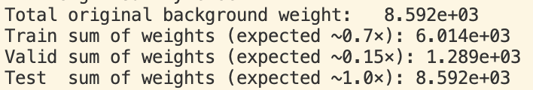
FIXING DETECTED ISSUES
Results incorrect due to improper rescaling and usage of signal sample x Not rescaling weights at all
x Using all the signal sample
☹ Not rescaling weights at all
☺ Now rescaled to data Split proportions (70% train, 15% valid, 15% test)
Using all the signal sample:
test dataset = test background + all signal regions
Now filtered by a single signal region (GG_1300_200) and then computed mean ± std across all signal regions.
Test dataset = test background + one signal region
Notes:
tail_purity = what % of the tail is actually signal (precision)
tail_recall = what % of all signal events end up in the tail (recall)

Slide 5
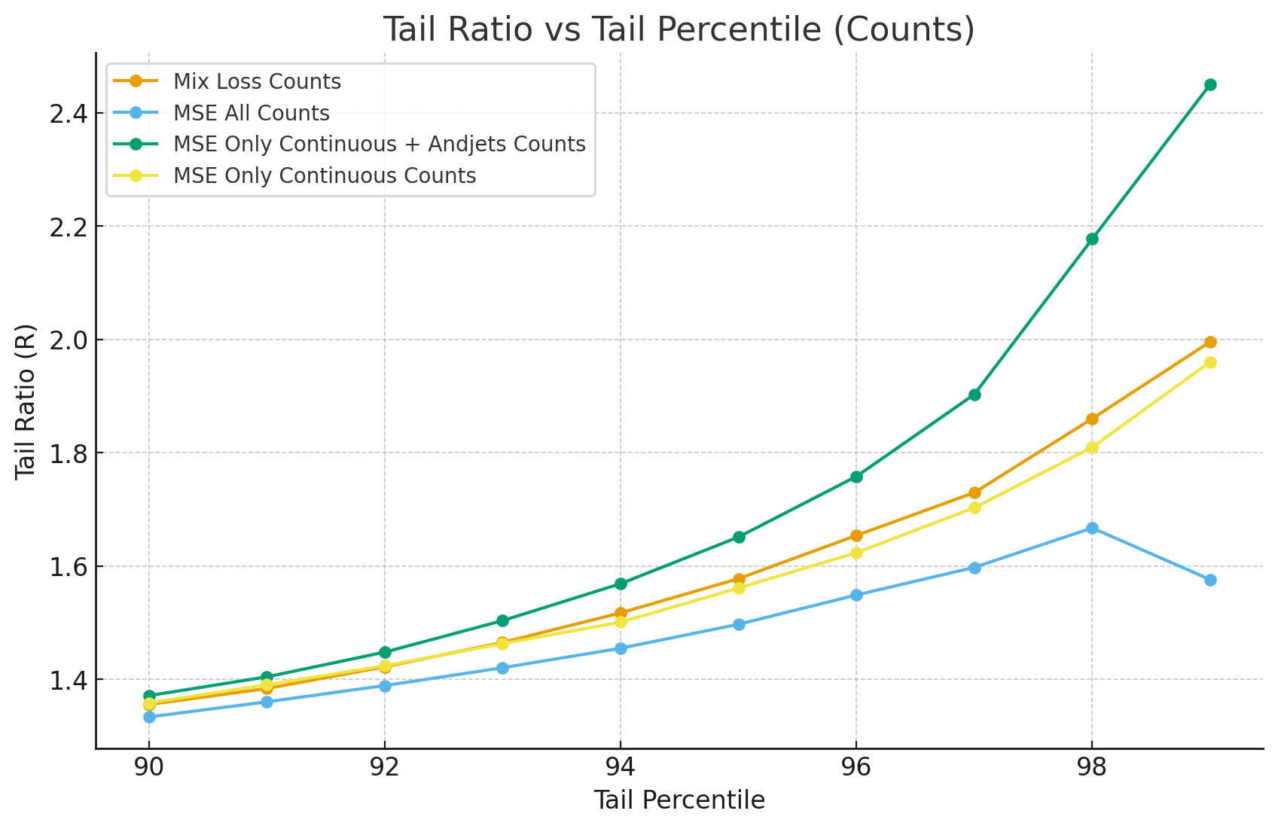
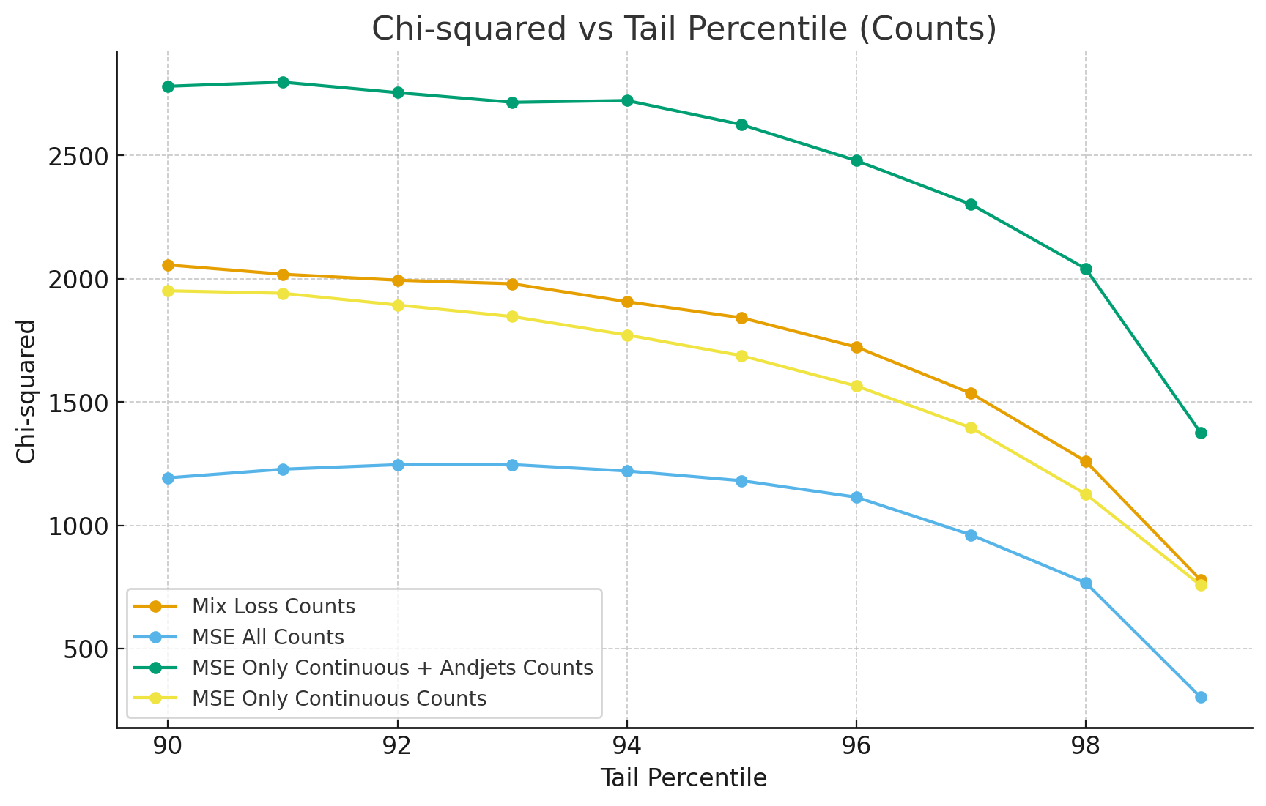
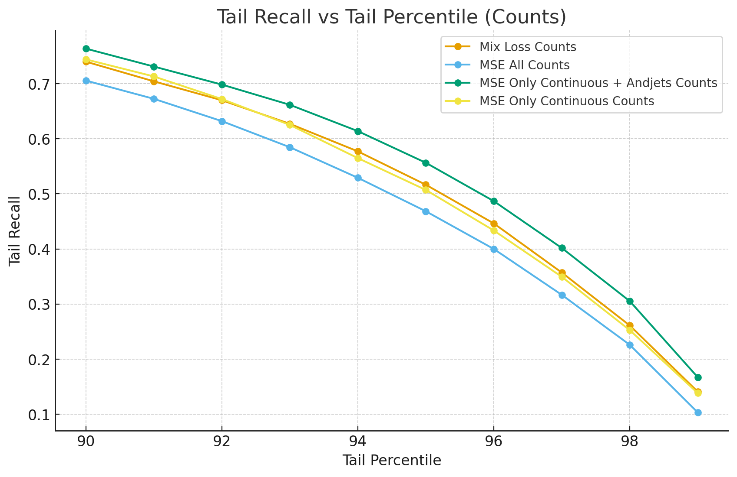
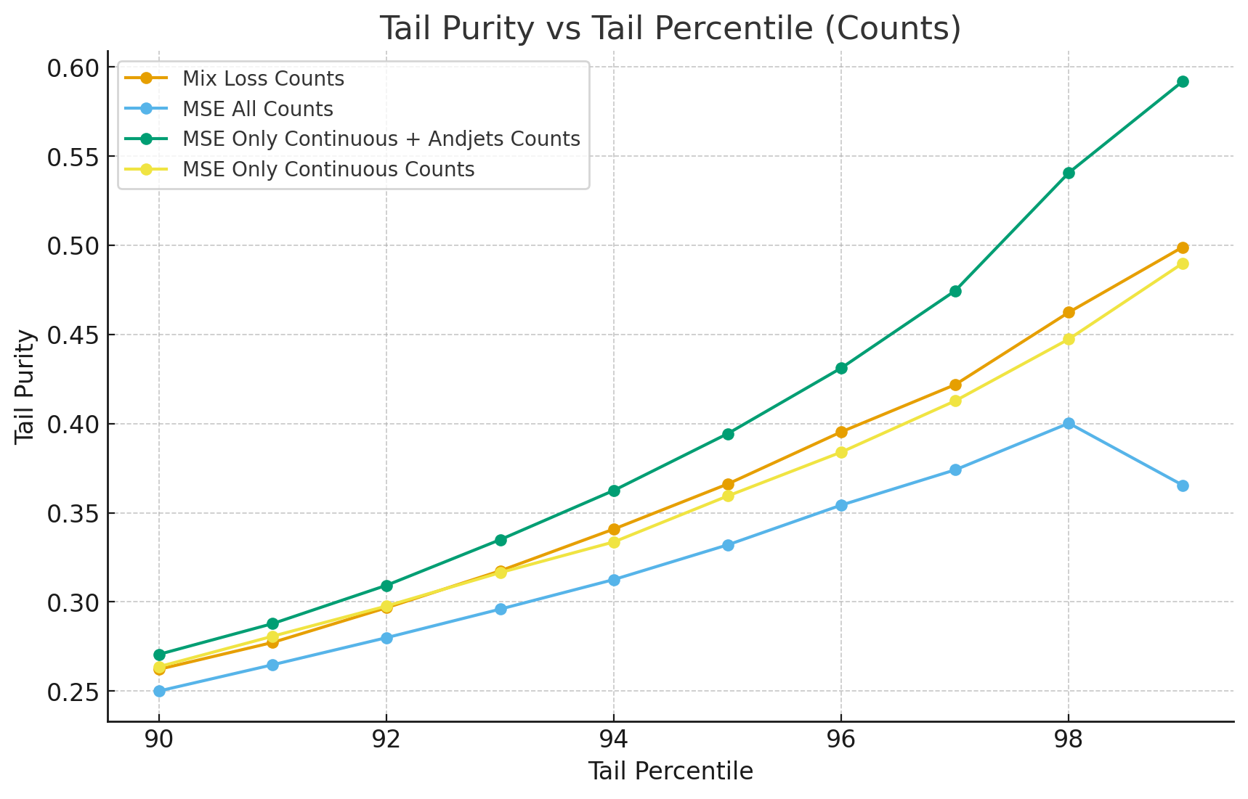
RESULTS COUNTS RESCALING for GG_1300_200
MSE only cont.
AUROC:0.9372
AURPC:0.3450
MSE only cont. + jet
AUROC: 0.9439
AURPC: 0.4138
Mix Loss
AUROC: 0.9385
AUPRC: 0.3495
MSE all
AUROC: 0.9322
AUPRC: 0.2891
Notes:
tail_purity = what % of the tail is actually signal (precision)
tail_recall = what % of all signal events end up in the tail (recall)

Slide 6
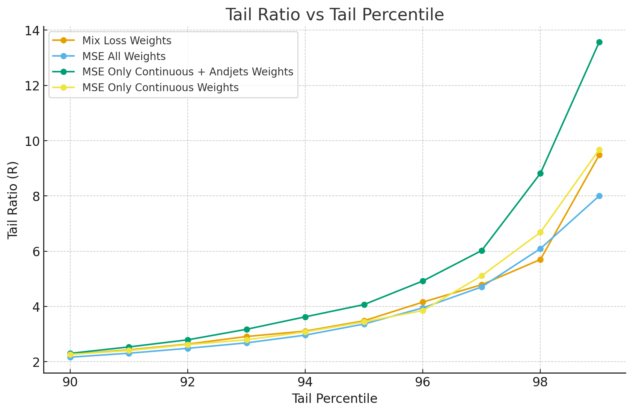
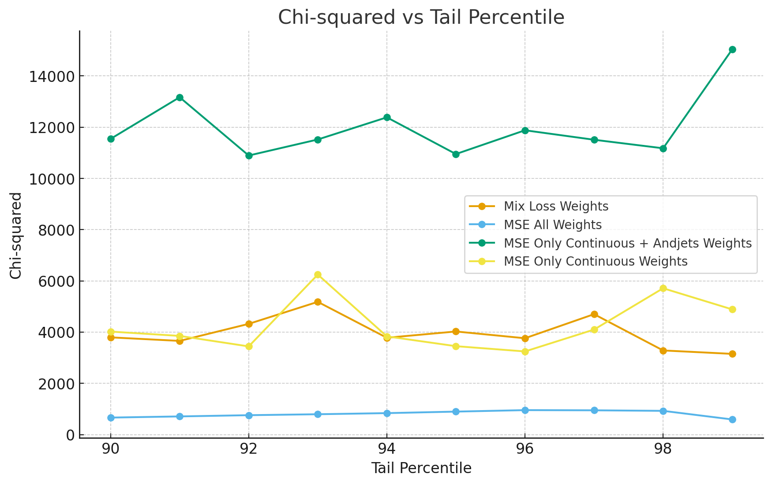
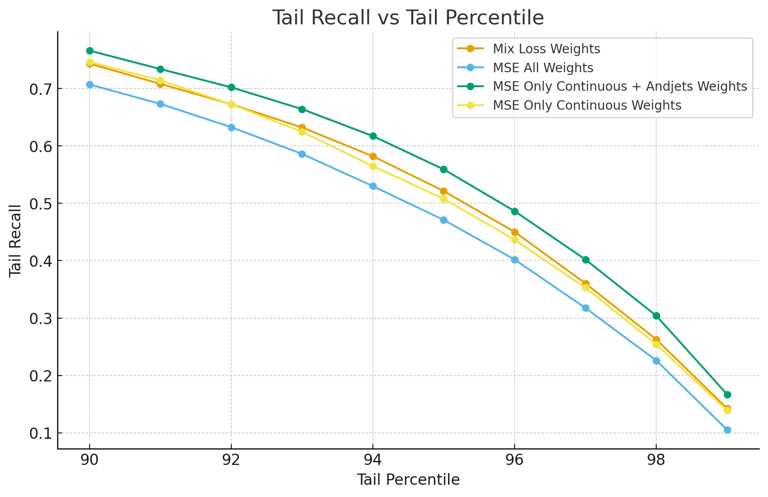
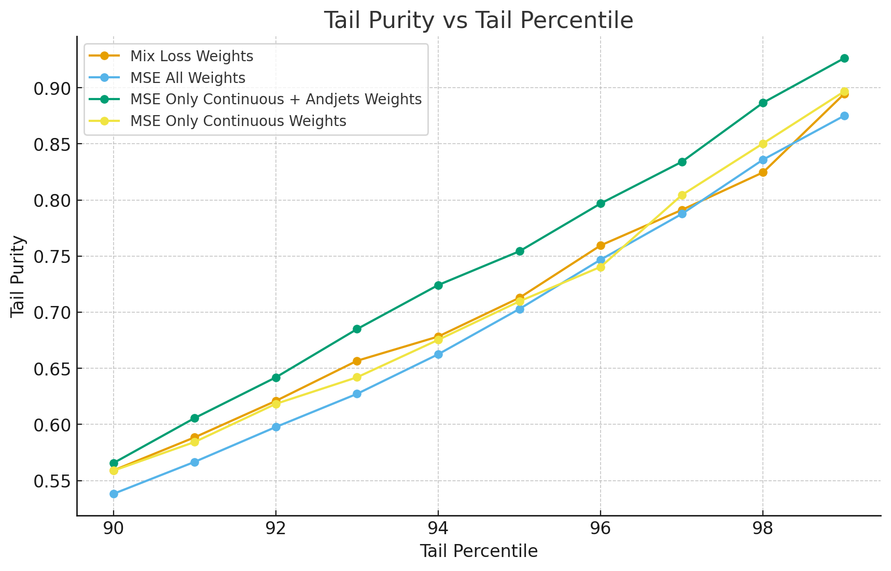
RESULTS WEIGHTS RESCALING for GG_1300_200
MSE only cont.
AUROC: 0.9516
AURPC: 0.6839
MSE only cont. + jet
AUROC: 0.9570
AURPC: 0.7302
Mix Loss
AUROC: 0.9513
AUPRC: 0.6819
MSE all
AUROC: 0.9468
AUPRC:0.6475
Notes:
tail_purity = what % of the tail is actually signal (precision)
tail_recall = what % of all signal events end up in the tail (recall)

Slide 7
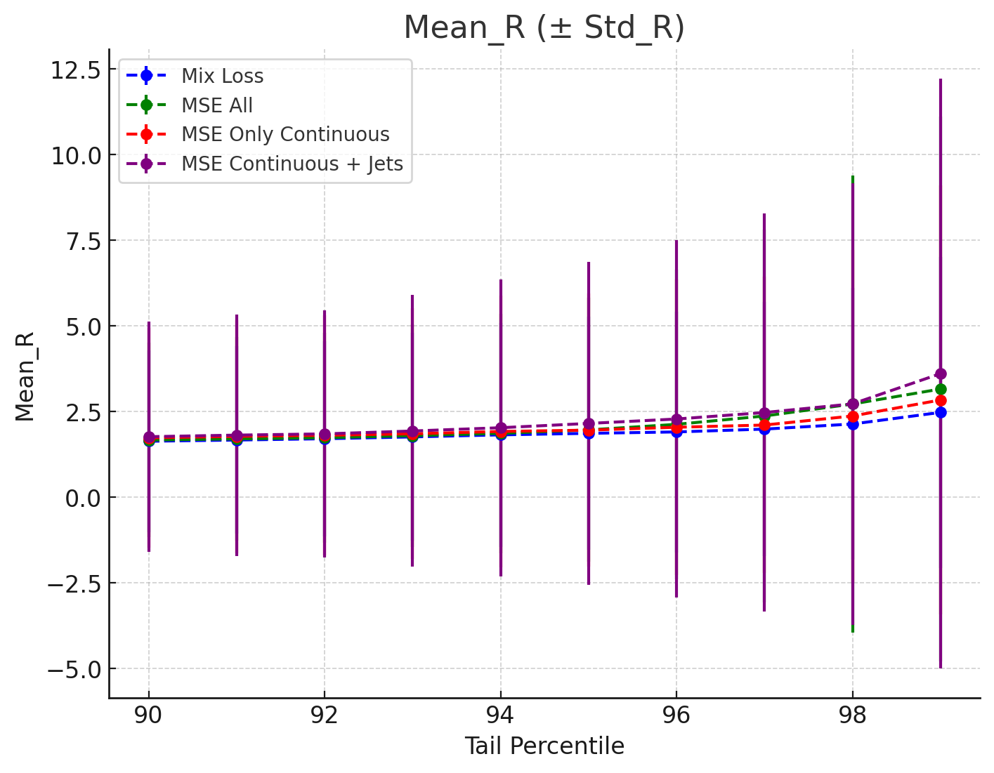
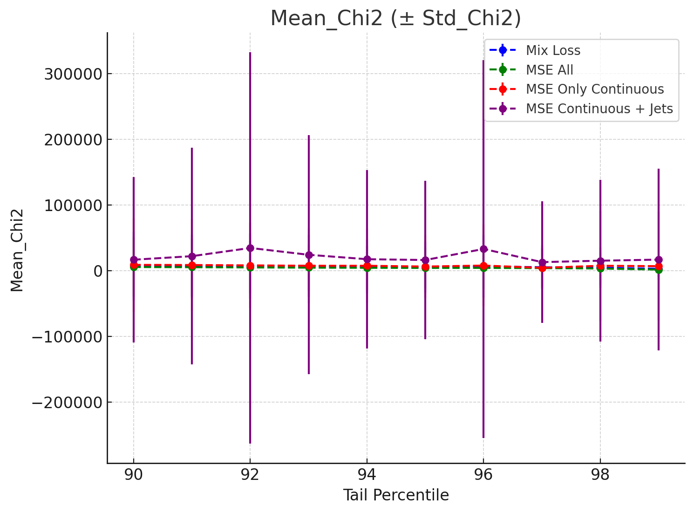
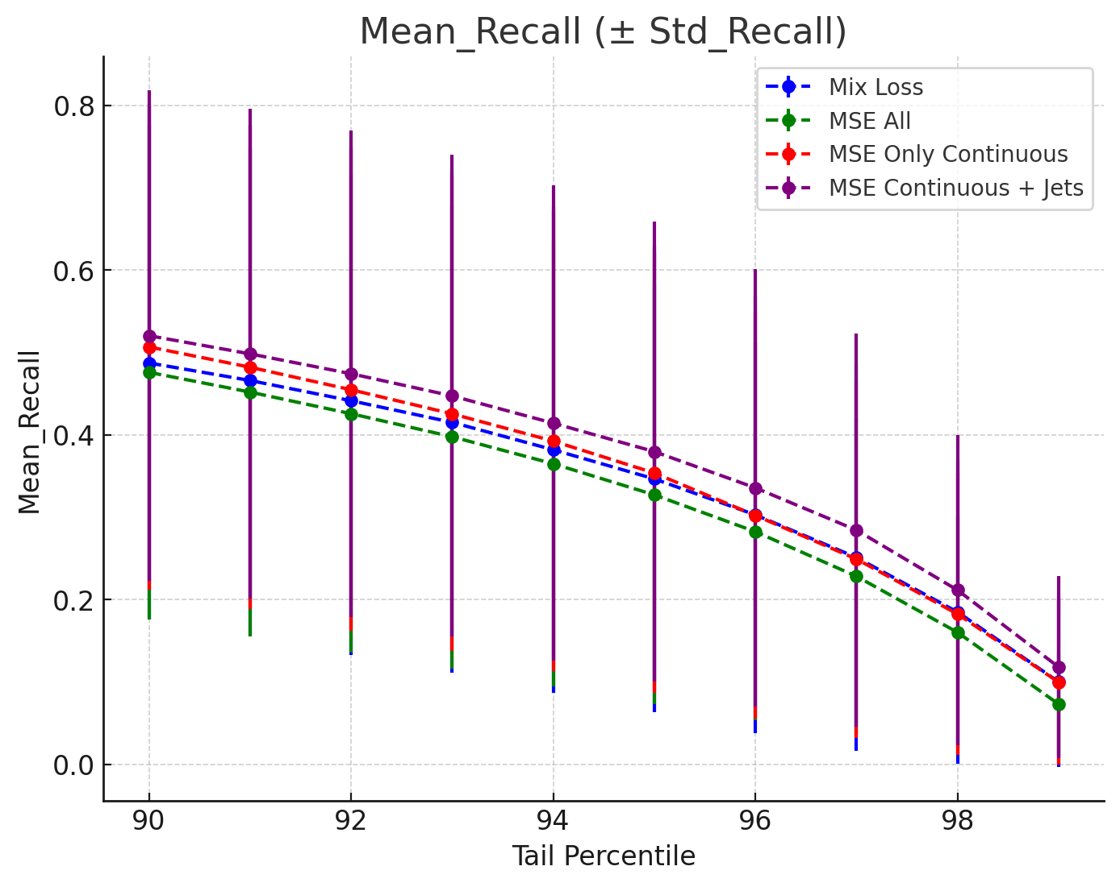
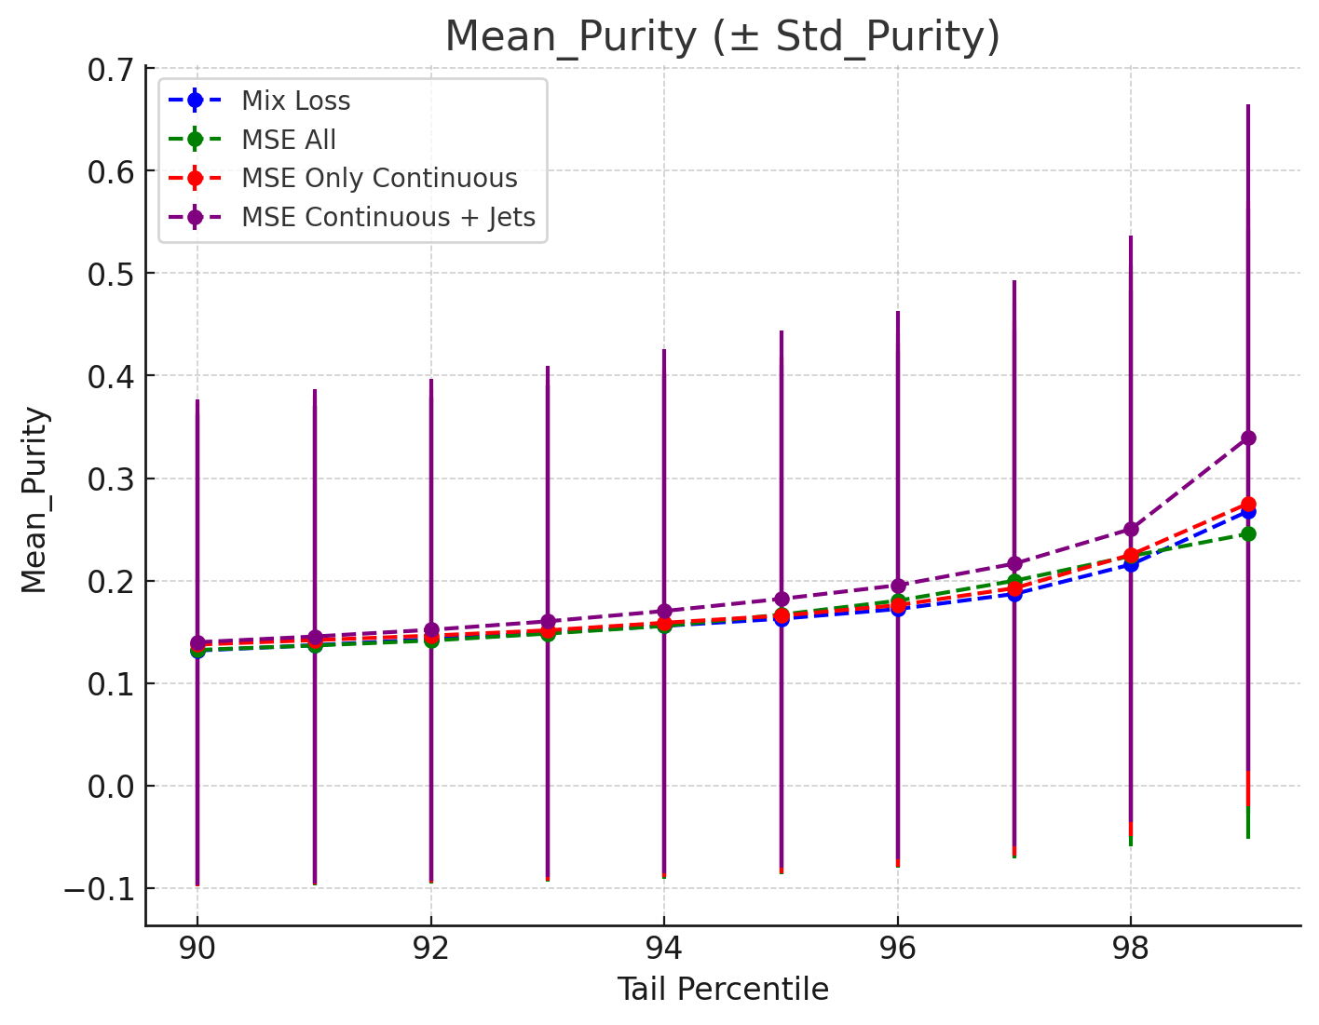
RESULTS WEIGHTS RESCALING ALL
MSE only cont.
AUROC: 0,825 +- 0,163
AURPC: 0,188 +- 0,234
MSE only cont. + jet
AUROC:0,833 +- 0,154
AURPC:0,235 +- 0,248
Mix Loss
AUROC:0,825 +- 0,155
AUPRC:0,197 +- 0,235
MSE all
AUROC: 0,822 +- 0,164
AUPRC:0,158 +- 0,230
Notes:
tail_purity = what % of the tail is actually signal (precision)
tail_recall = what % of all signal events end up in the tail (recall)

Slide 8
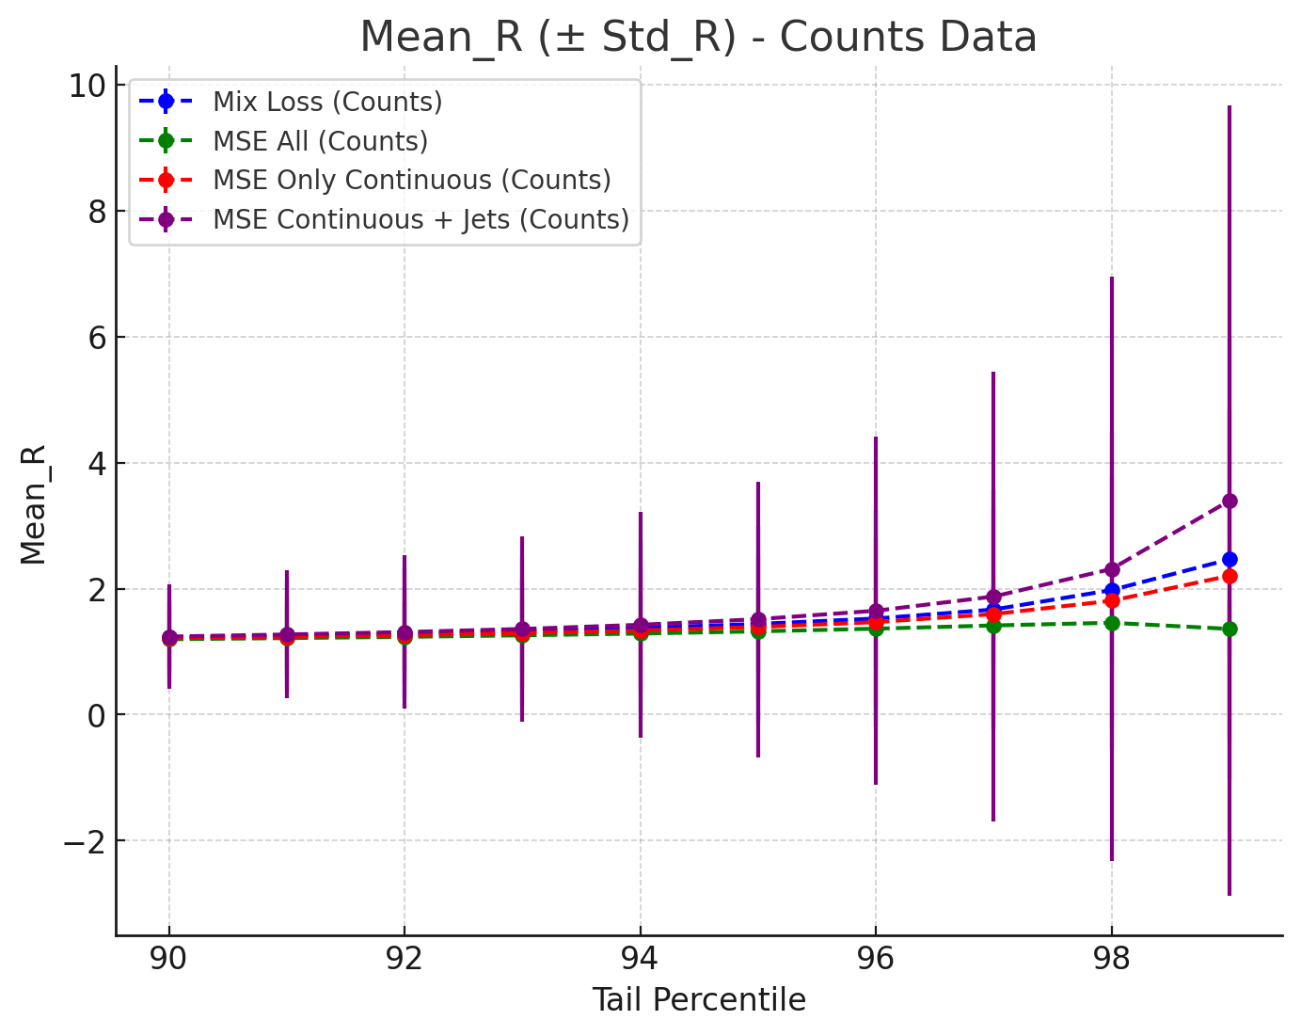
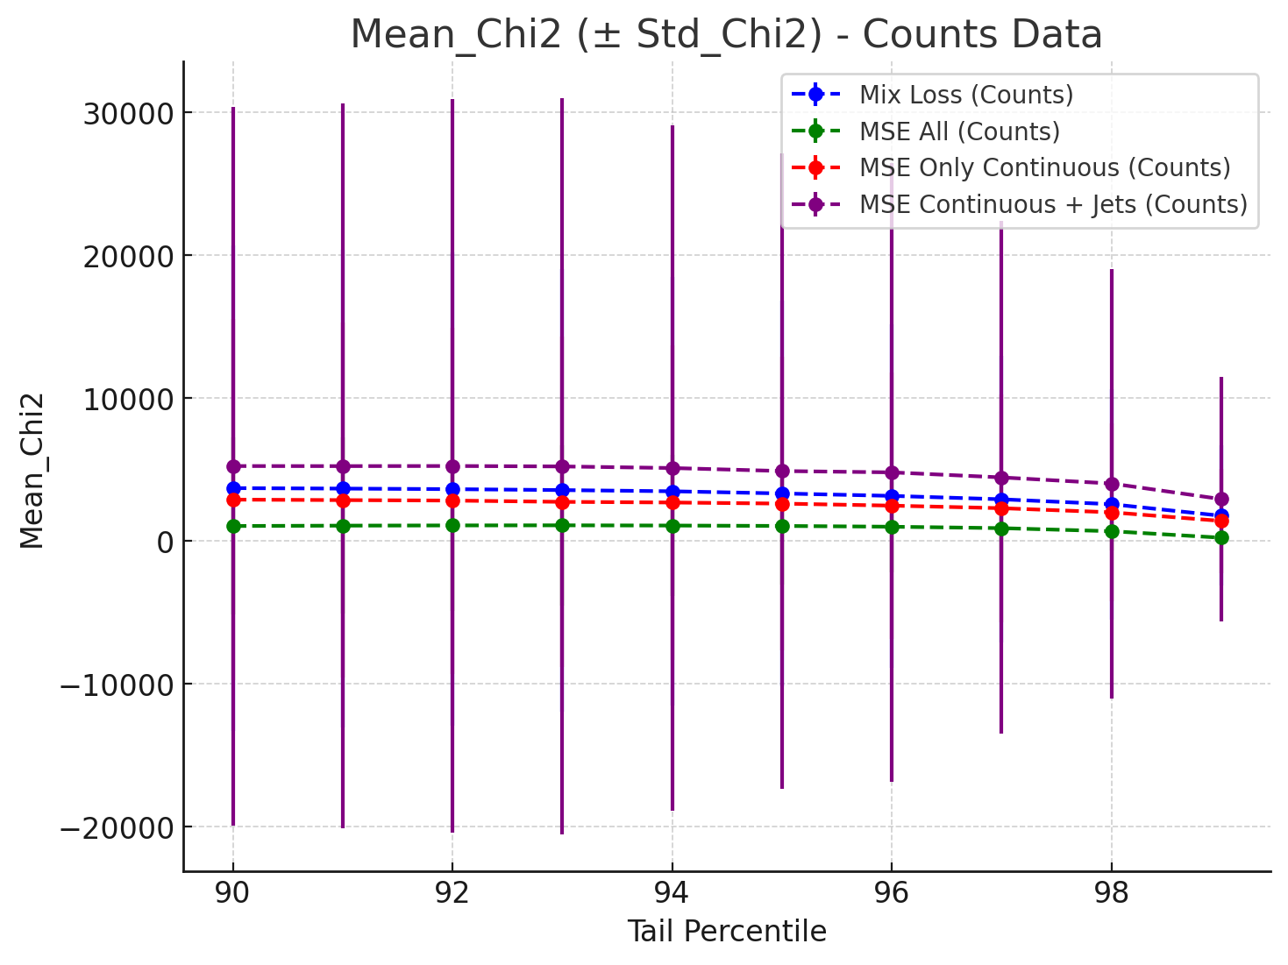
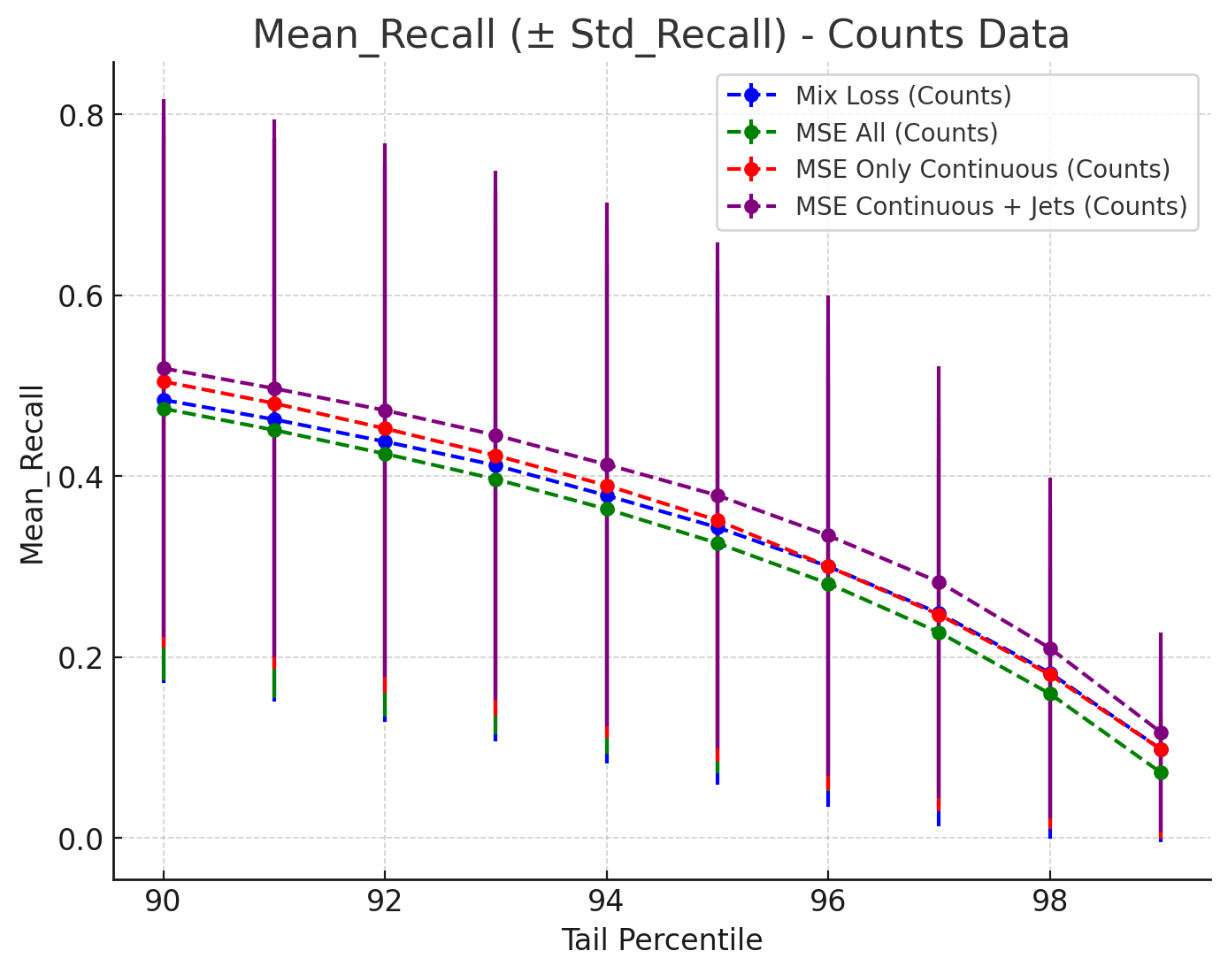
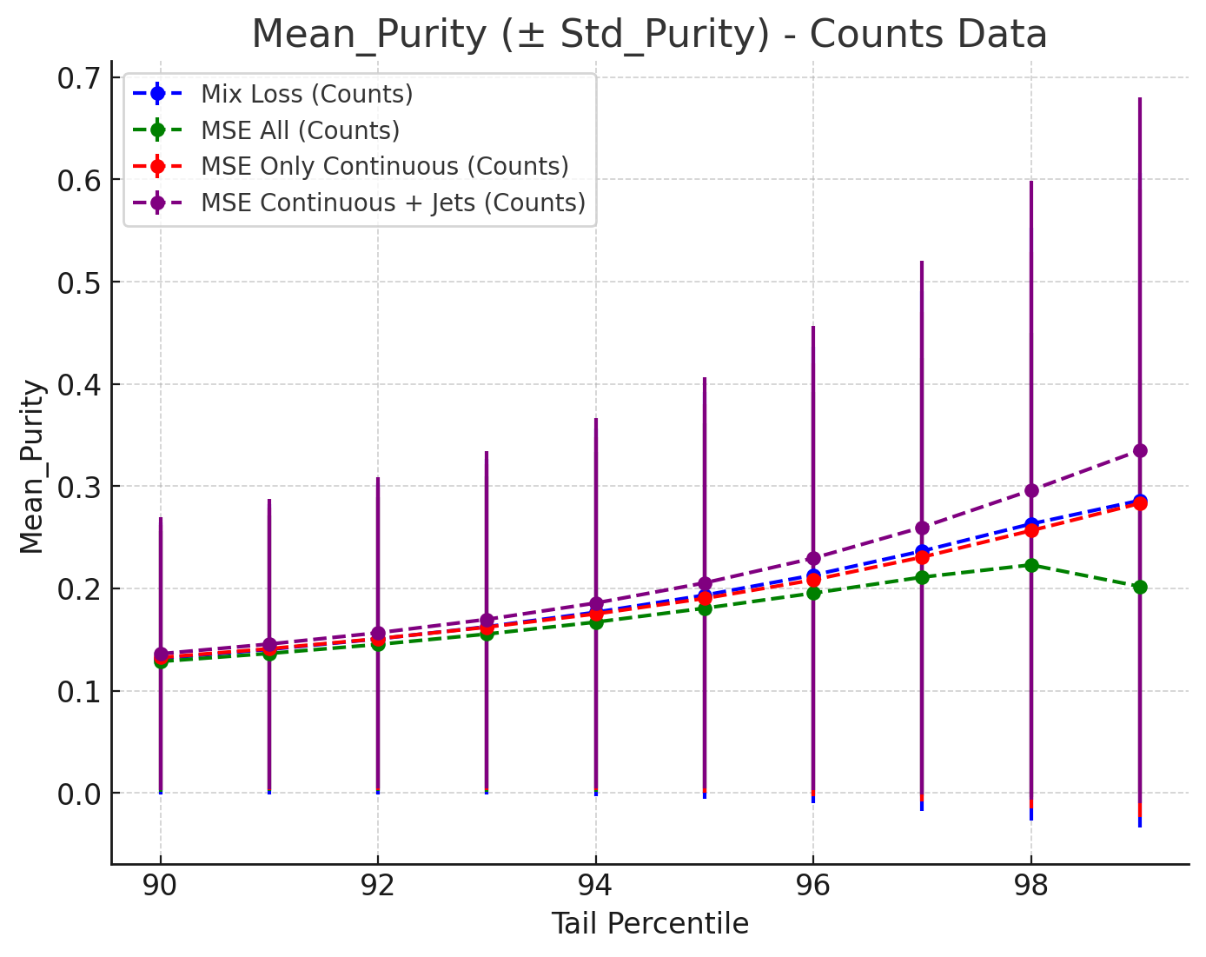
RESULTS COUNTS RESCALING ALL
MSE only cont.
AUROC: 0,810 +-0,162
AURPC:0,213 +- 0,240
MSE only cont. + jet
AUROC:0,821 +- 0,152
AURPC:0,248 +- 0,272
Mix Loss
AUROC:0,814 +- 0,153
AUPRC:0,220 +- 0,256
MSE all
AUROC:0,810 +- 0,159
AUPRC:0,168 +- 0,178
Notes:
tail_purity = what % of the tail is actually signal (precision)
tail_recall = what % of all signal events end up in the tail (recall)

Slide 9
CONCLUSION AND NEXT STEPS
Best approach: MSE only with continuous including jet_n and jet_b_btag.
Next Steps
Compute the other metrics using this only approach
See how to include this integer features in NF architecture
Write the report

Slide 10
QUESTIONS OR COMMENTS

