Slide 1
Hybrid FODO –
Mismatch between energy and magnetic ramp
L. Soubirou, A. Chance
35th meeting on HEMAC discussions – 14/10/2025

Slide 2
Hybrid FODO limitations
1.

Slide 3
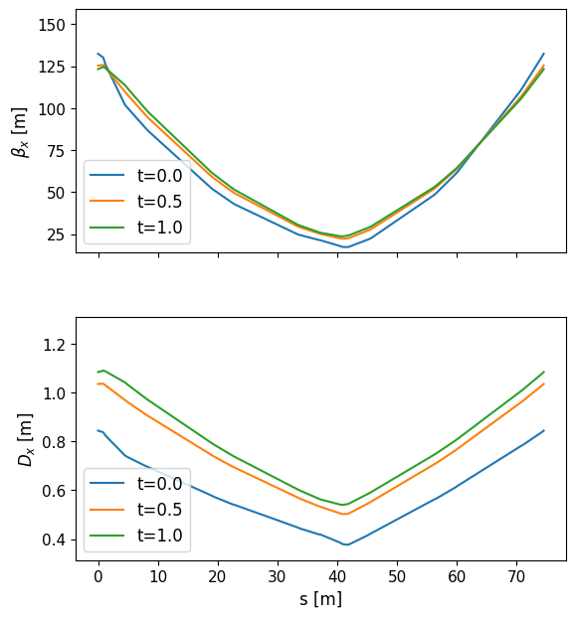
Hybrid FODO optics change
Normalized time
Injection : t=0
Extraction : t=1
CERN RCS 3
First, quadrupole gradients are computed for a FODO design in thin lens approximation.
Observe change of optics with energy change during the acceleration.
    Thin lens approximation is not respected + asymmetric quadrupoles.
How to mitigate this problem ?
Evolution of optics with time when the gradients are computed with the thin lens approximation.

Slide 4
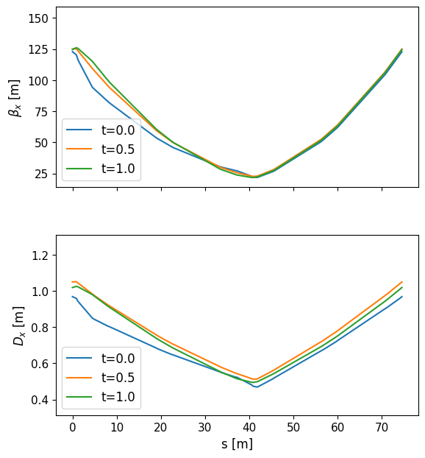
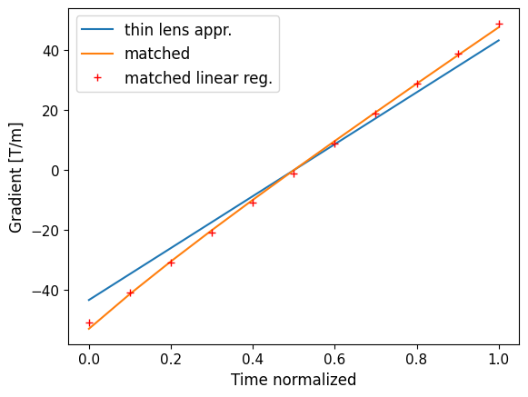
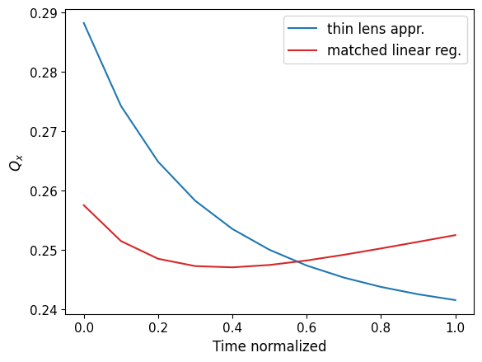
Hybrid FODO optics change
Starting point : gradient computed with thin lens approximation.
Matching of the quadrupole strength to achieve µ_{x} = 90° for different energies of the ramp.
Linear regression of the quadrupole gradient to minimize the tune change during acceleration.
CERN RCS 3
Avant correction
Après correction

Slide 5
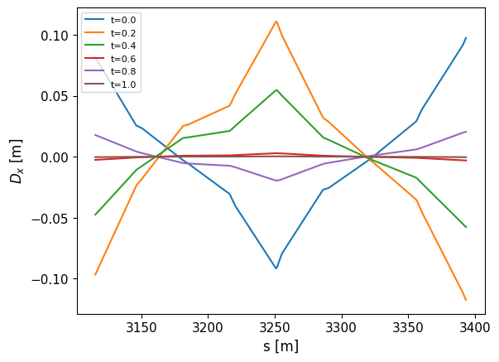
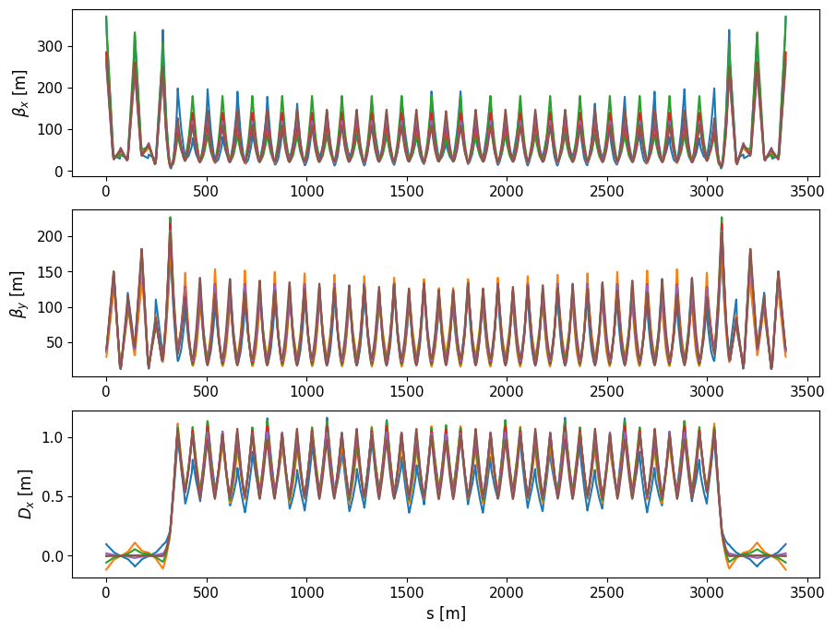
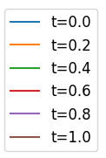
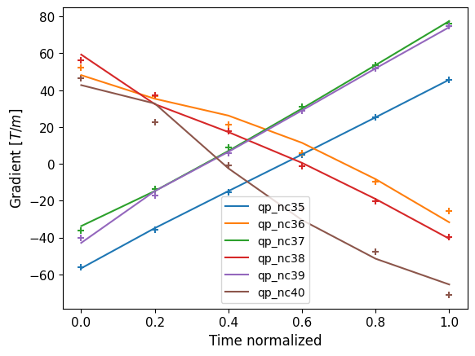
How to suppress D_{x} with a varying µ_{x} ?
Matching of the dispersion suppressor at different energies with multiple families of quadrupoles (qp_nc35..40).
Linear regression of the quadrupole gradients.

Slide 6
Conclusion n°1 : Hybrid FODO limitations
The phase advance of the Hybrid FODO cell is not constant with energy increase.
The quadrupole gradient ramp was optimized to minimize the tune change during acceleration.
Tentative to design the « best possible » dispersion suppressor in a HFODO lattice : we still have residual dispersion in the RF insertions.
    Consequences of accelerating with dispersion in the cavities are yet to be studied.

Slide 7
Mismatch between energy and magnetic ramp
2.

Slide 8
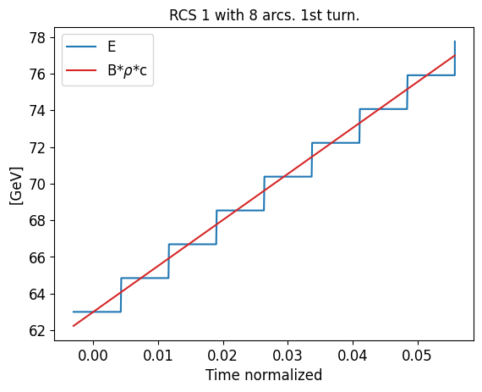
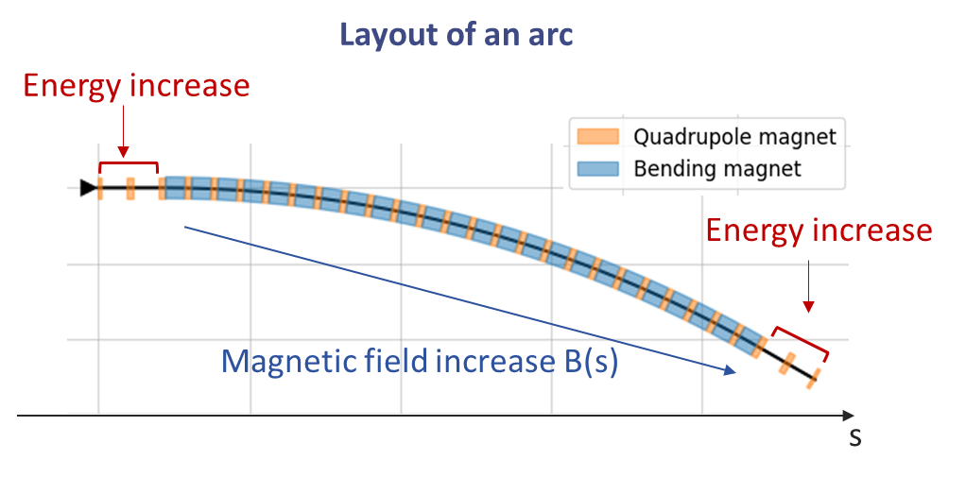
Mismatch description
Usually, the variation of B(t) in the arcs is negligeable compared to the energy increase.
NOT the case for the RCS !
It concerns all pulsed elements : error on k₀ of dipoles, k₁ of quadrupoles…
For 8 arcs in RCS 1, the error on the dipole field is up to 3% on the first arc.
RCS 1 with 8 arcs. 1st turn.

Slide 9
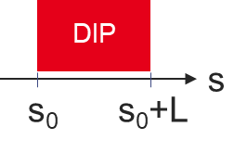
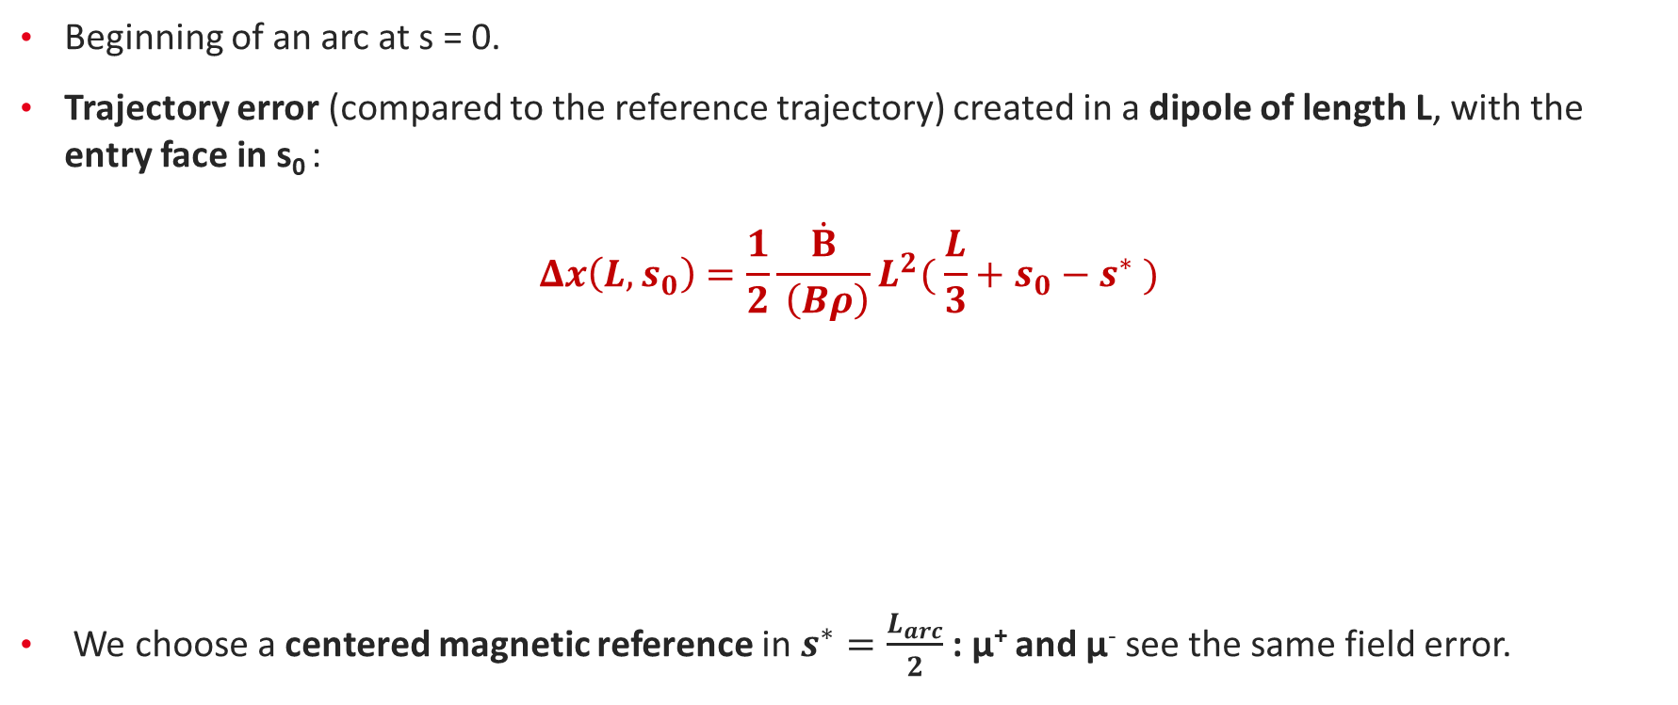
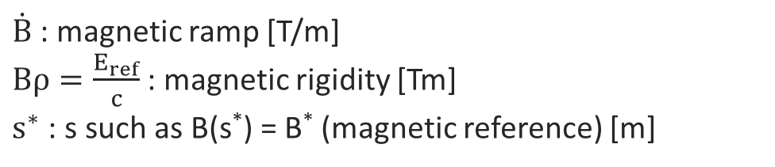
Analytical model : trajectory error in a dipole
Beginning of an arc at s = 0.
Trajectory error (compared to the reference trajectory) created in a dipole of length L, with the entry face in s₀ :
$$Δx\left(L, s_{0}\right)=\frac{1}{2}\frac{\dot{B}}{ \left(Bρ\right)}L^{2}( \frac{L}{3}+s_{0}−s^{∗} )$$
We choose a centered magnetic reference in $s^{∗}=\frac{L_{arc}}{2}$: µ⁺ and µ⁻ see the same field error.
$\dot{B}$ : magnetic ramp [T/m]
$Bρ=\frac{E_{ref}}{c}$ : magnetic rigidity [Tm]
$s^{∗}$ : s such as B(s*) = B* (magnetic reference) [m]

Slide 10
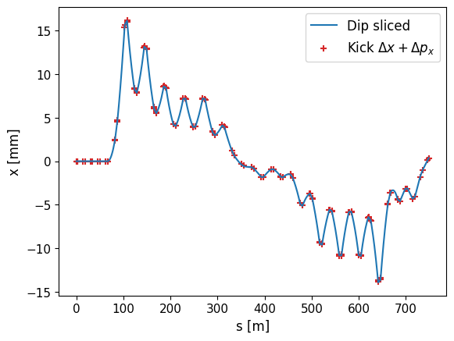
Test of the trajectory model in Xsuite
Test on a realistic arc with only errors on the k₀.
Numerical method:
    Dipoles are sliced.
    Each slice has an increasing k₀ ∝ B_{dip}, and h = h* (reference bending).
Model method:
    Dipoles are without error k₀ = h*.
    Error on the trajectory are added with the elements:
      - Δx : xt.XYShift
      - Δx’ : xt.YRotation
RCS1 avec 8 arcs. 1er arc.
Comparison of the two methods with tracking: good agreement !

Slide 11
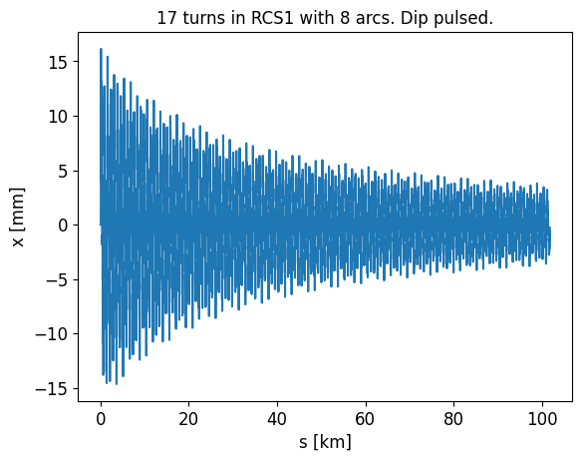
Trajectory error from start-to-end
Oscillations of the beam trajectory in each arc.
Adiabatic damping due to the acceleration.
Maximum trajectory excursion is achieved in the first arcs !

Slide 12
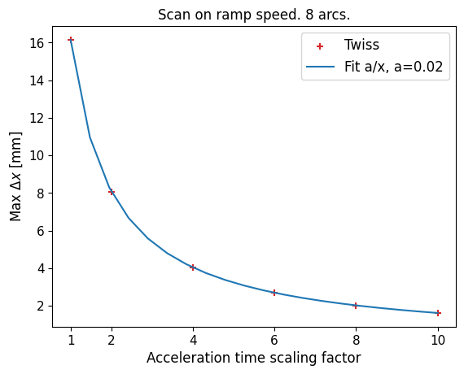
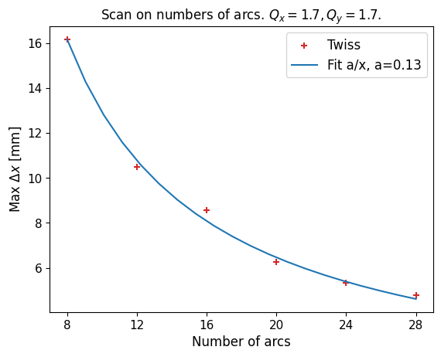

Trajectory error : scaling laws
Ramp $\dot{B}$or acceleration speed.
RF distribution on n_{arc} sections.
Scan on a longer acceleration time: $t=t_{acc}∗f$.
Optics homogeneisation by fixing Q_{x} et Q_{y} by adding a xt.LineSegmentMap object.

Slide 13
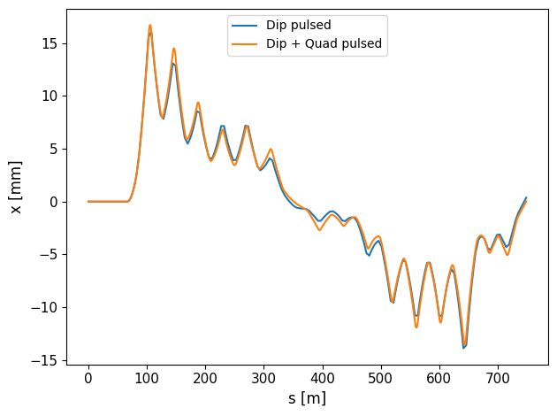
Error in the dipoles and quadrupoles
Displacement caused by the dipole error k₀ → feed-down in the quadrupoles → change of trajectory.
The error on k₀ is dominant on the trajectory change.
+ Energy mismatch in the quadrupoles: the beam sees a focusing error on k₁.

Slide 14
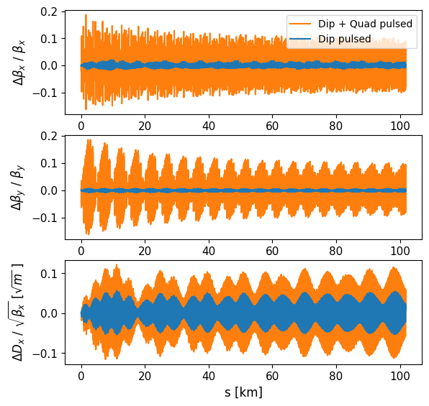
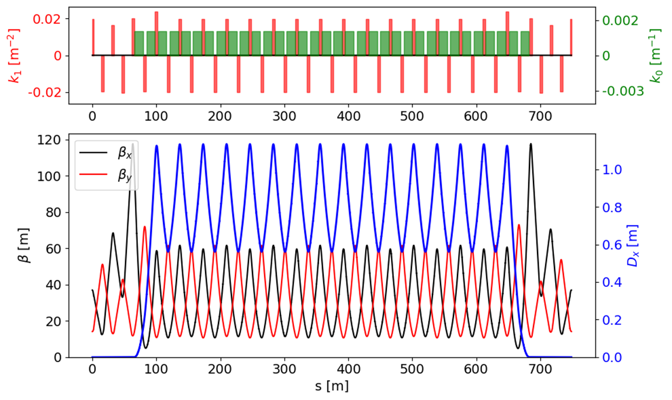
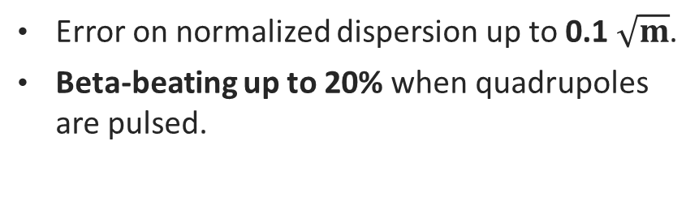
Impact on the optics
Comparison of optics without and with errors on the dipoles and quadrupoles:
  Pulsed dipoles : error on k₀.
  Pulsed dipoles and quadrupoles : error on k₀ and k₁.
Nominal optics of 1 arc (RCS1, 8 arcs)
Error on normalized dispersion up to 0.1 $\sqrt{m}$.
Beta-beating up to 20% when quadrupoles are pulsed.

Slide 15
Conclusion and perspectives
  Study of the trajectory error due to the energy - magnetic ramp mismatch.
  Scaling laws (ramp and RF distribution) deducted from the analytical model.
  Work ongoing on an analytical model to predict the perturbation on optics functions.
  Tracking studies to estimate the emittance blow-up.
  Only studied on a normal RCS (RCS1), to be studied on hybrid RCS.

