Slide 1




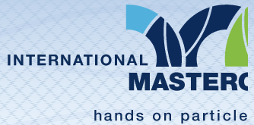
Particle therapy masterclass
University of Tetova
Therapy planing of C-Phantom & Liver
Nermine muradi, university of tetova
Arba memedi, SHMKM Nikolla shtejn
Mediha Ajdini, maarif international schools
Gerti demiri, shmk kiril pejçinoviq

Slide 2
Table of content
C PHANTOM
LIVER
COMPARISON FOR PHOTON AND PROTON/CARBON THERAPY FOR C-Phantom
COMPARISON FOR PROTON AND CARBON ION THERAPY FOR LIVER

Slide 3
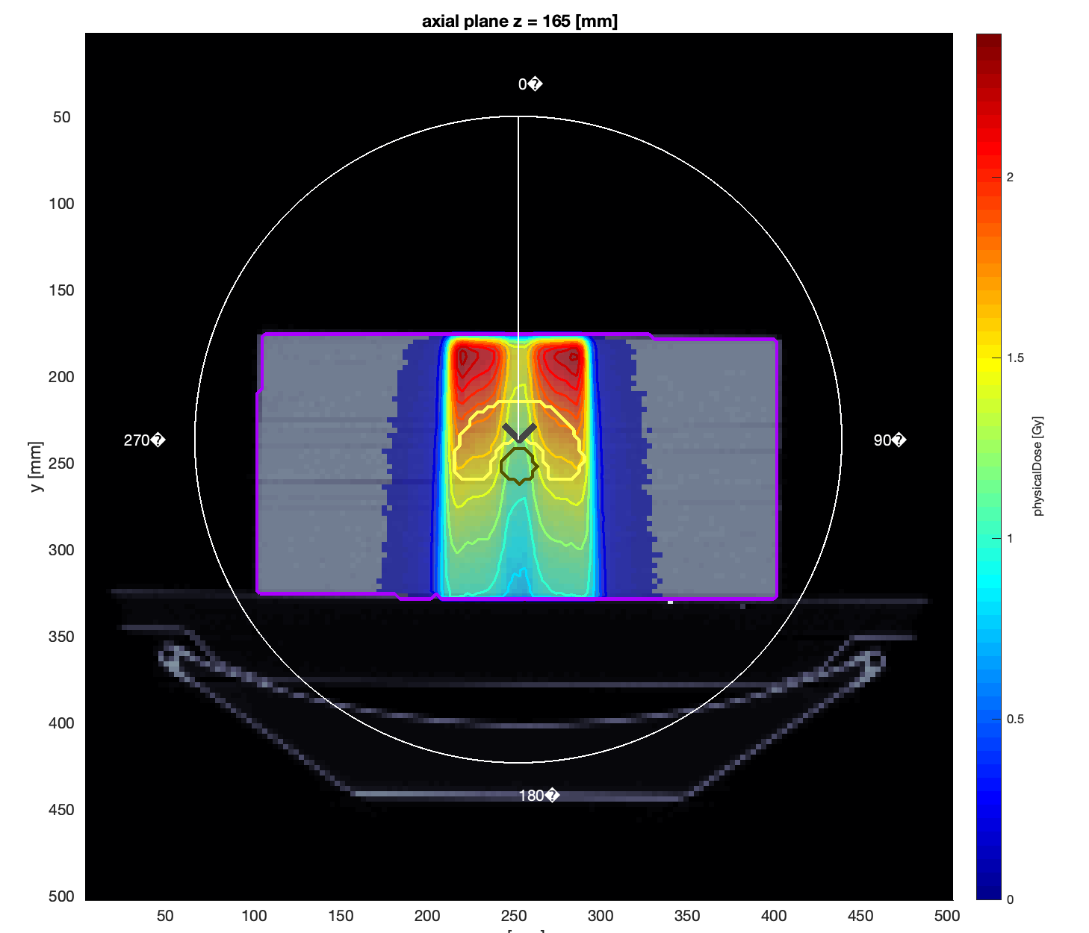
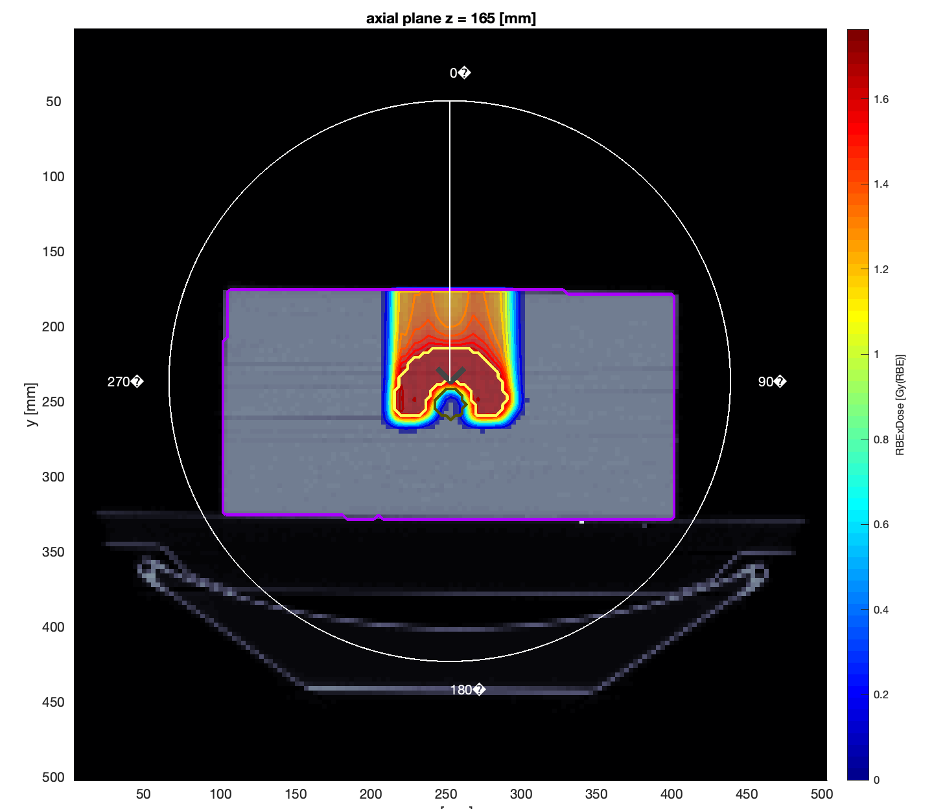
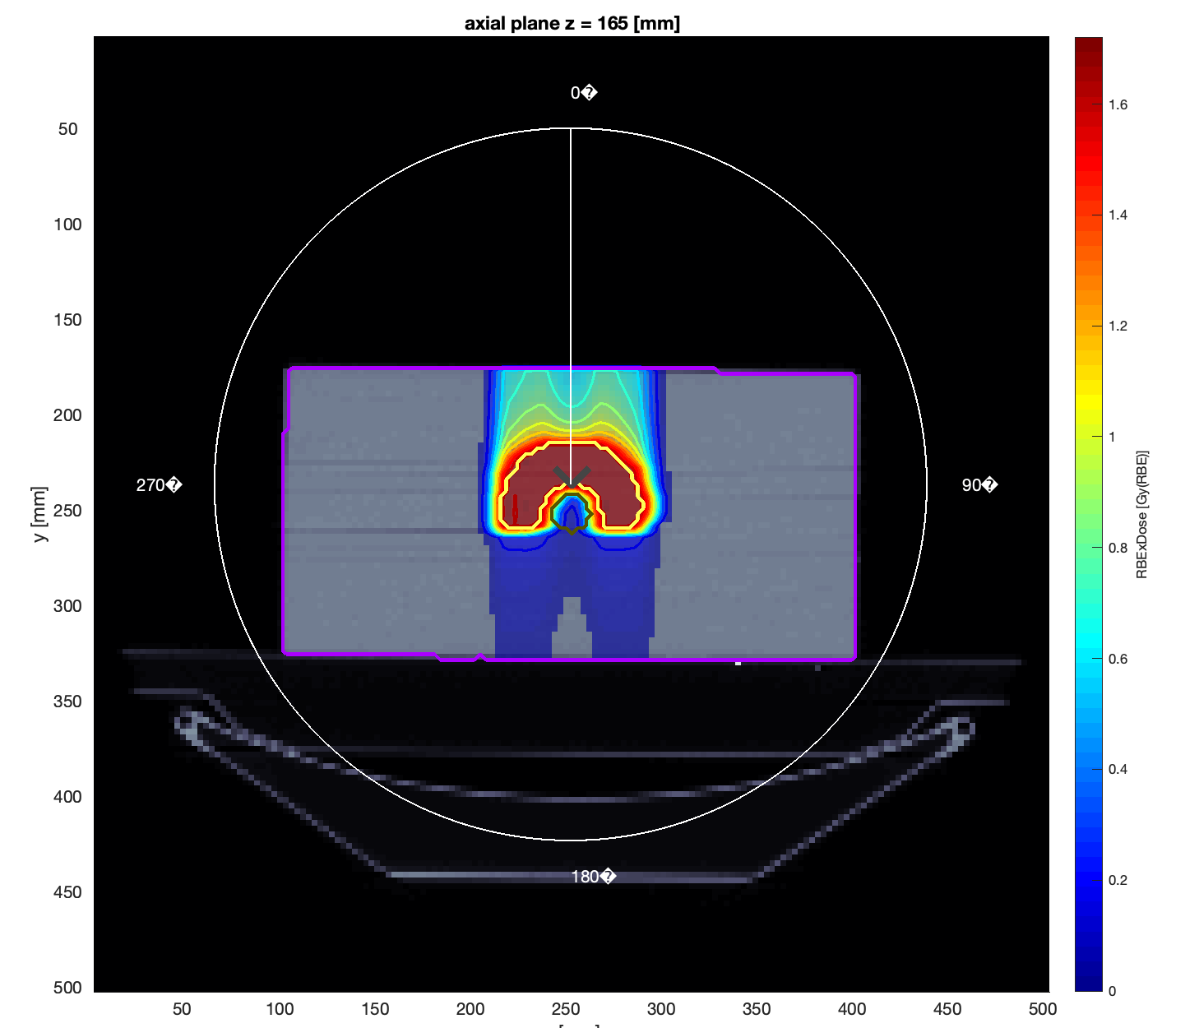
C phantom – 1 angle
Photons
Protons
Carbon ions

Slide 4
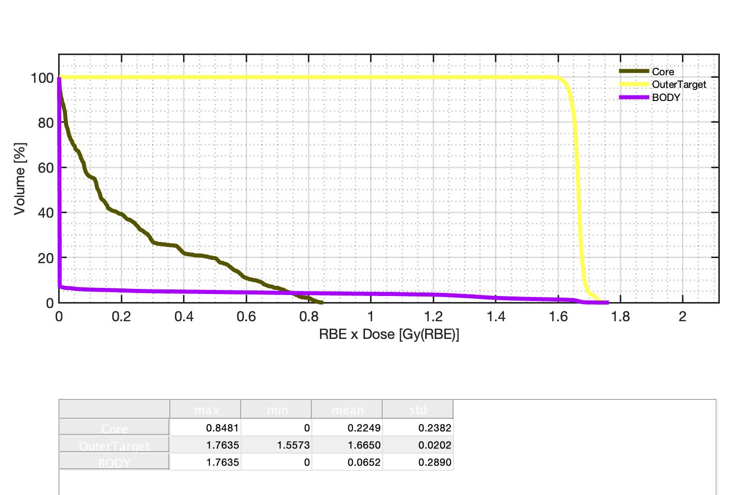
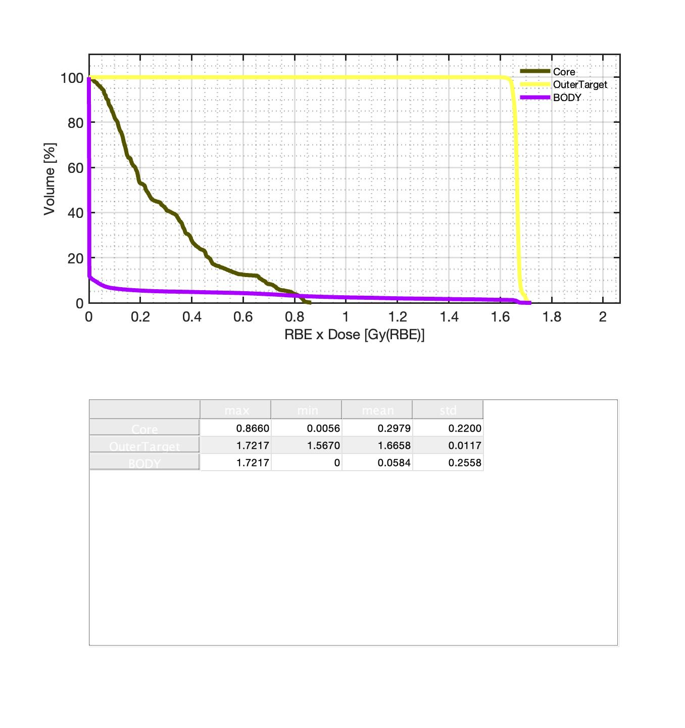
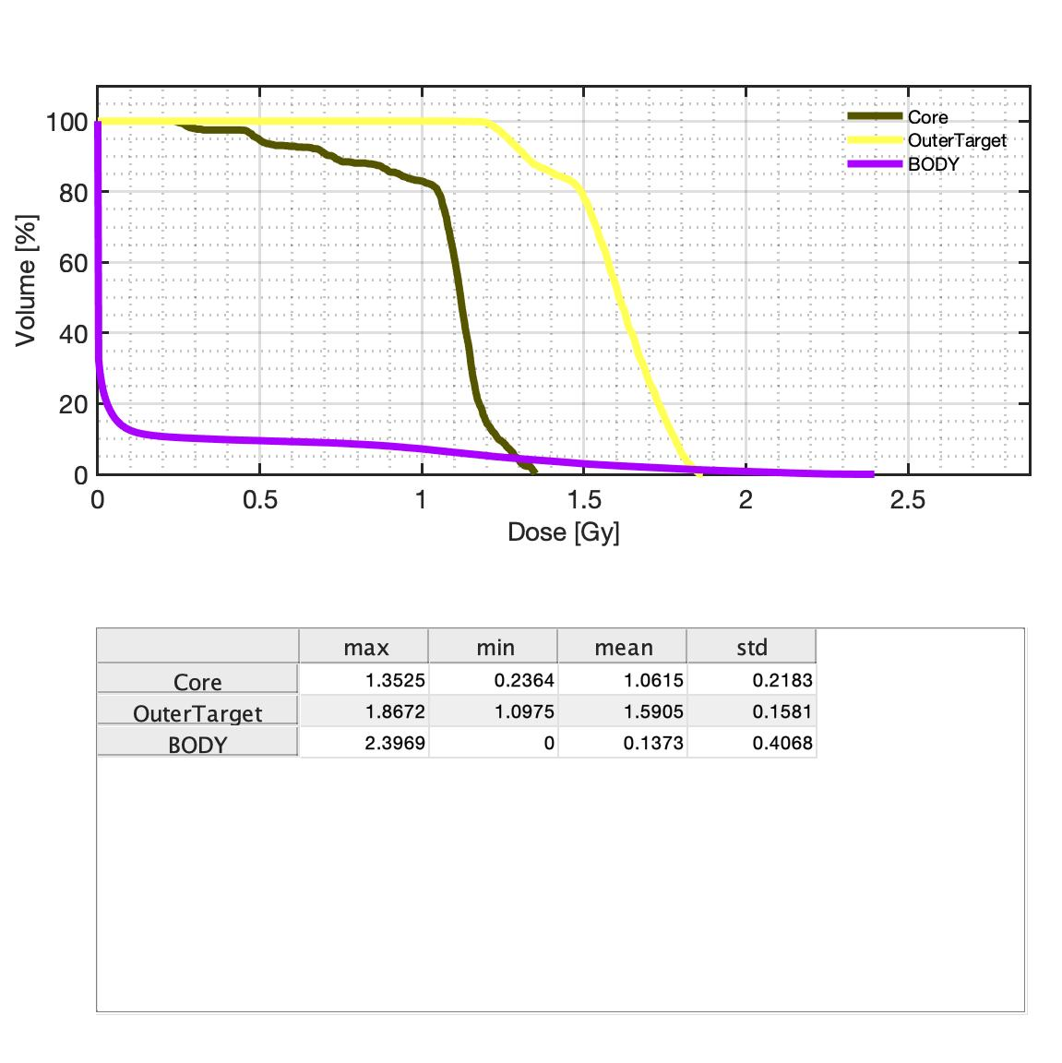
C phantom – 1 angle
Photons
Protons
Carbon ions

Slide 5
C phantom – 1 angle - DVH
 | photons | protons | carbon
Core | 1.0615 | 0.2232 | 0.2975
Outer Target | 1.5905 | 1.6651 | 1.6658
Body | 0.1372 | 0.0653 | 0.0581

Slide 6
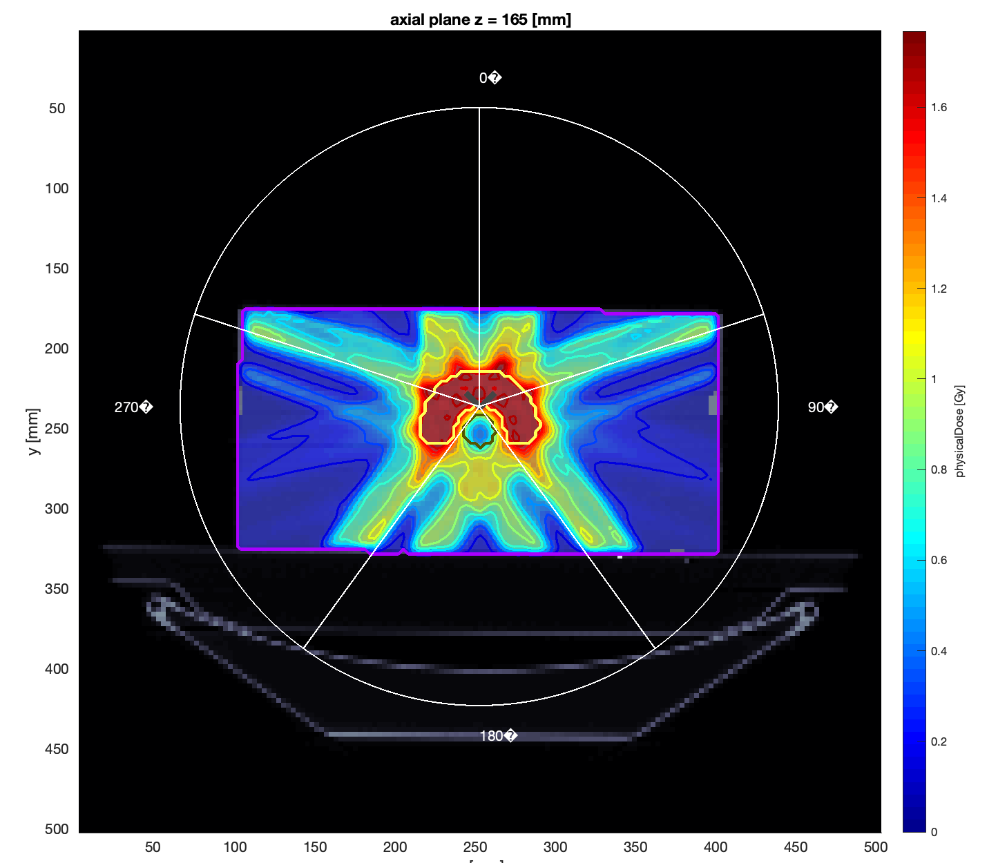
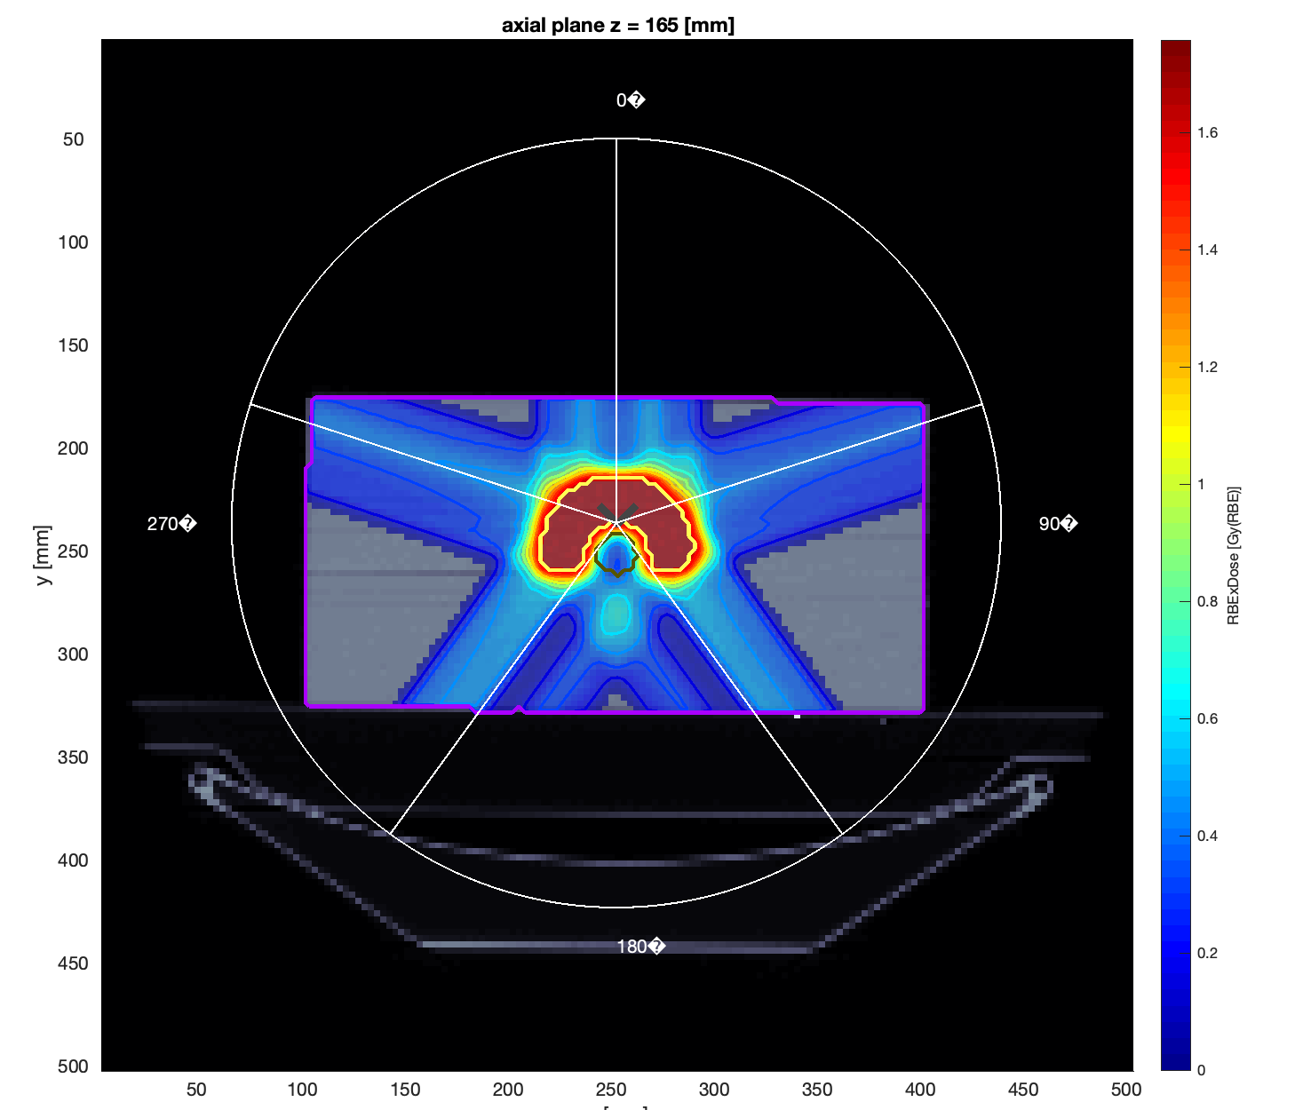
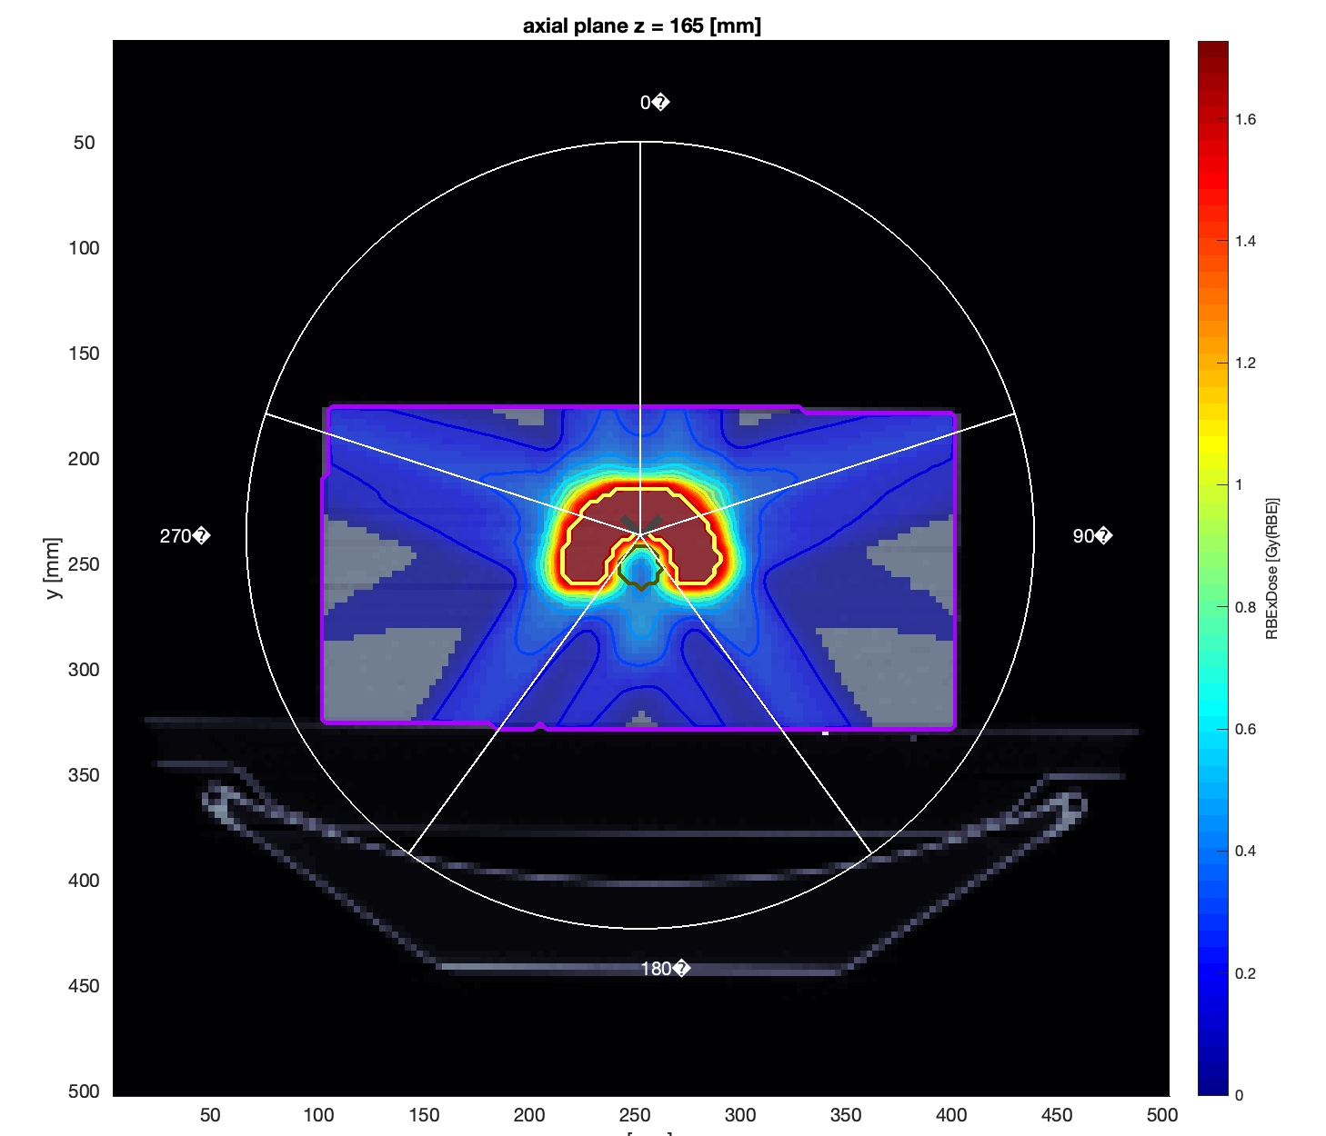
C phantom – 5 angle
Photons
Protons
Carbon ions

Slide 7
C phantom – 5 angle - DVH
 | photons | protons | carbon
Core | 0.5883 | 0.4429 | 0.5220
Outer Target | 1.6642 | 1.6656 | 1.6662
Body | 0.1693 | 0.0995 | 0.0880

Slide 8
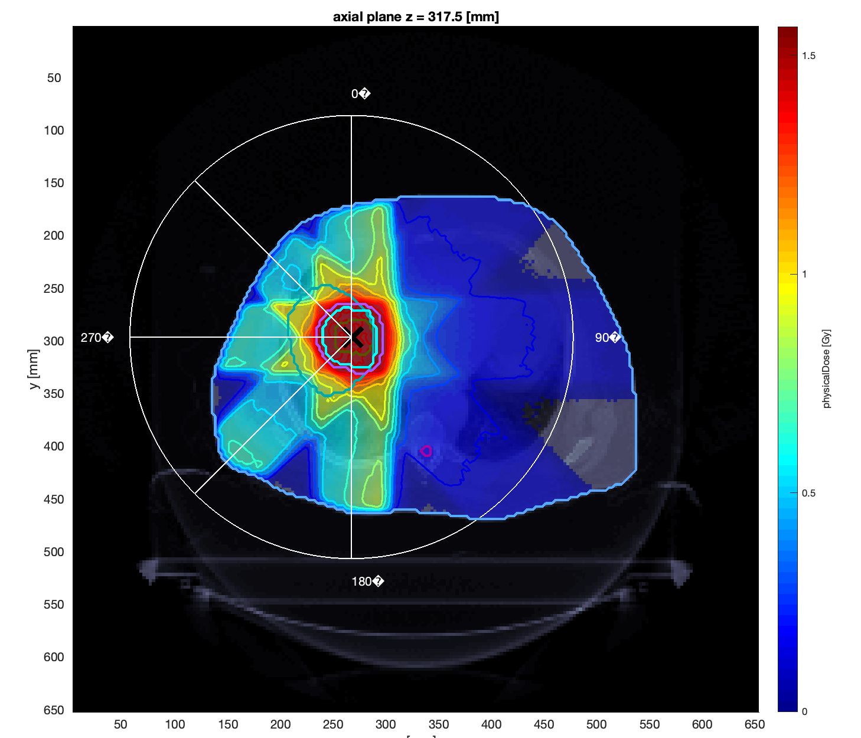
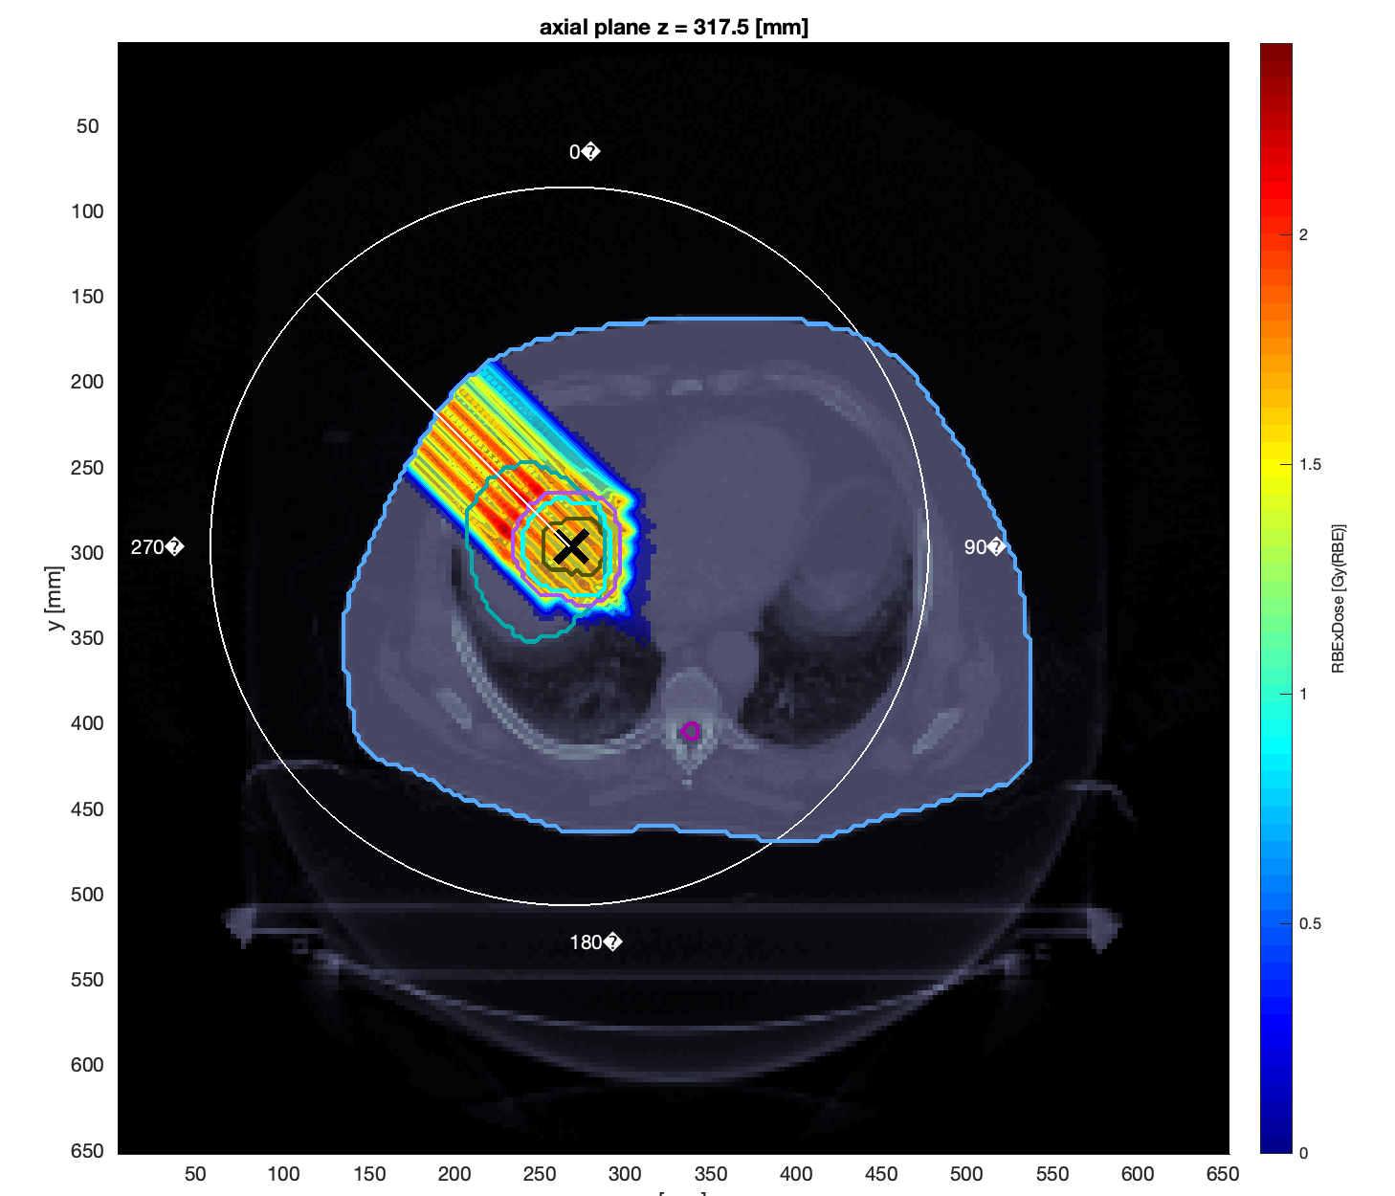
LIVER
Photons – 5 angles
Proton 1 angle = 315 degree

Slide 9
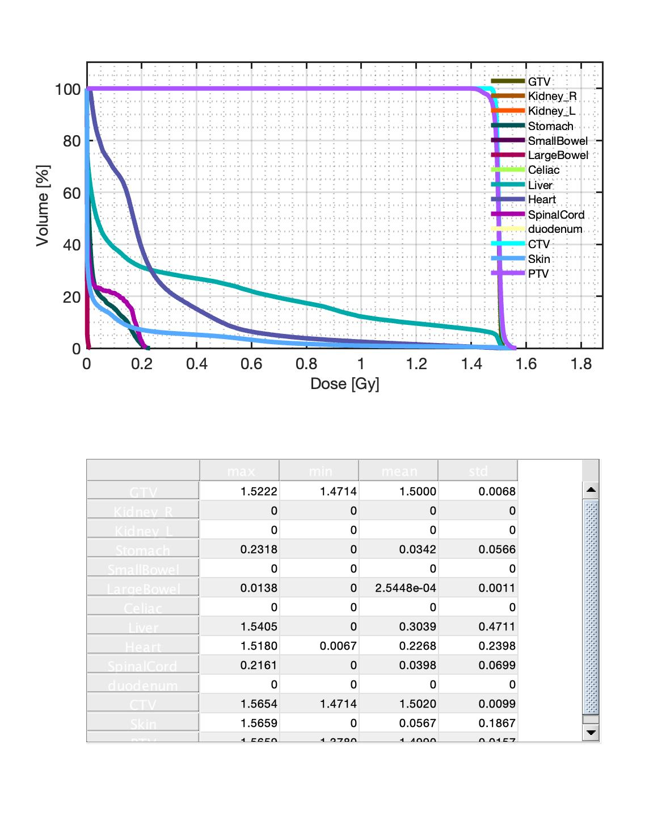
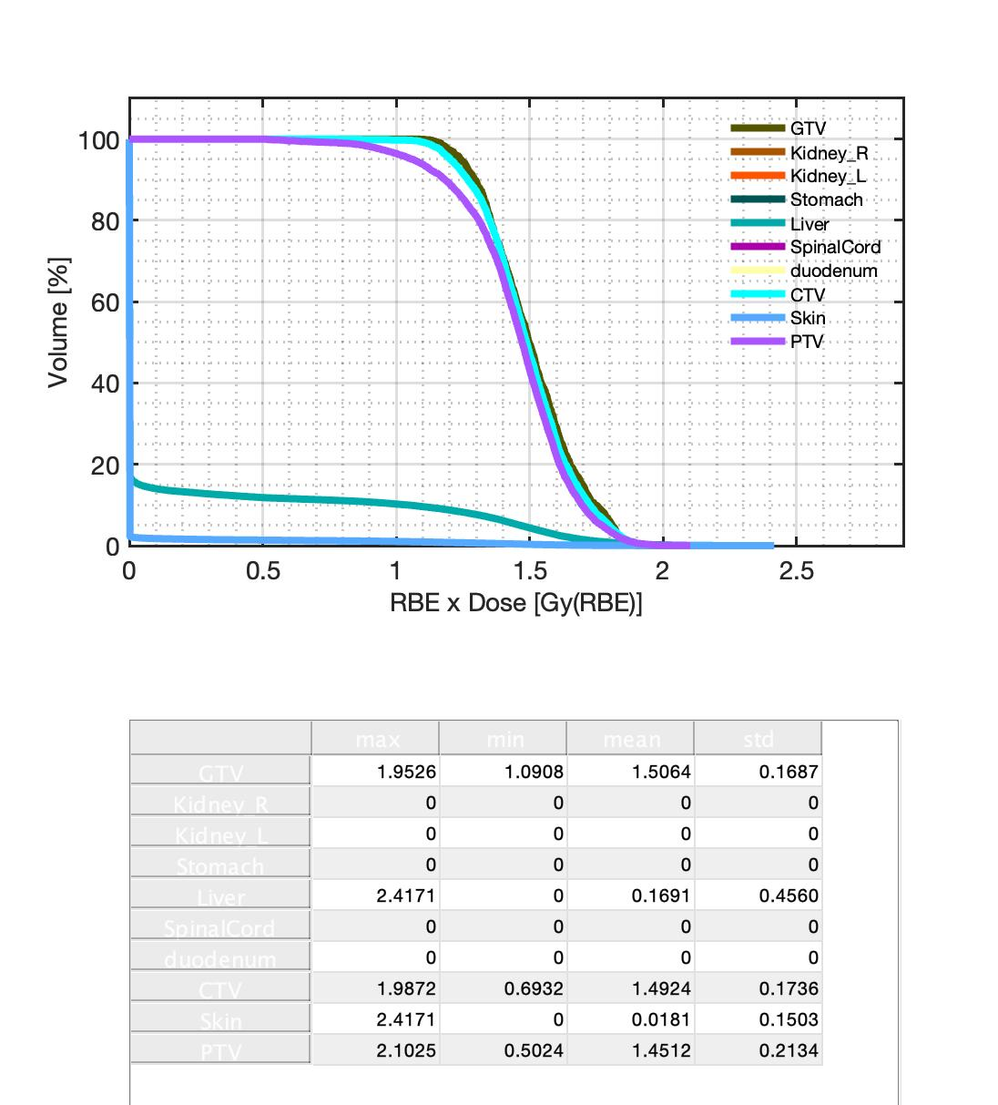
LIVER
Photons – 5 angles
Proton 1 angle = 315 degree

Slide 10
Thank you for your attention

