Slide 1





Proton extraction studies
3rd October 2025
J. Mańczak, D. Calzolari, S.Candido R. Franqueira Ximenes, A.Lechner, G. Lerner

Slide 2
Outline
Proton early extraction – evaluating a possibility of extracting most of the spent protons before the chicane. For the moment, the studies are focusing on 10 GeV protons, two options identified:
8-degree target tilt
6-degree target tilt

Slide 3
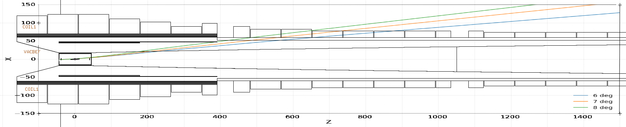
Early proton extraction - main idea
Only tested with the baseline graphite rod of 80 cm.
The azimuth rotation always 120 deg (applied after the tilt) to direct the beam away from the chicane in the horizontal plane.
HTS front-end magnet layout to be rearranged, two possible approaches:
Extract as early as possible
Extract at smaller angle along the tapered region and bring farther magnets closer to the beam axis

Slide 4
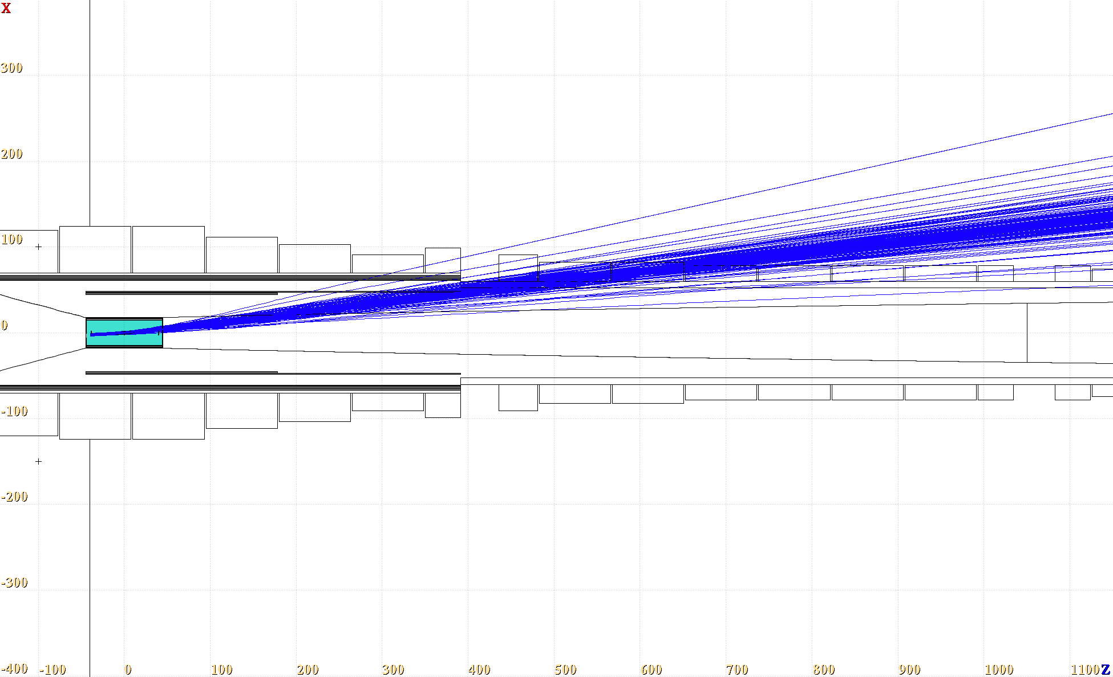
8-degree target tilt extraction
Gaussian beam and realistic target vessel
Protons E_kin > 9 GeV

Slide 5
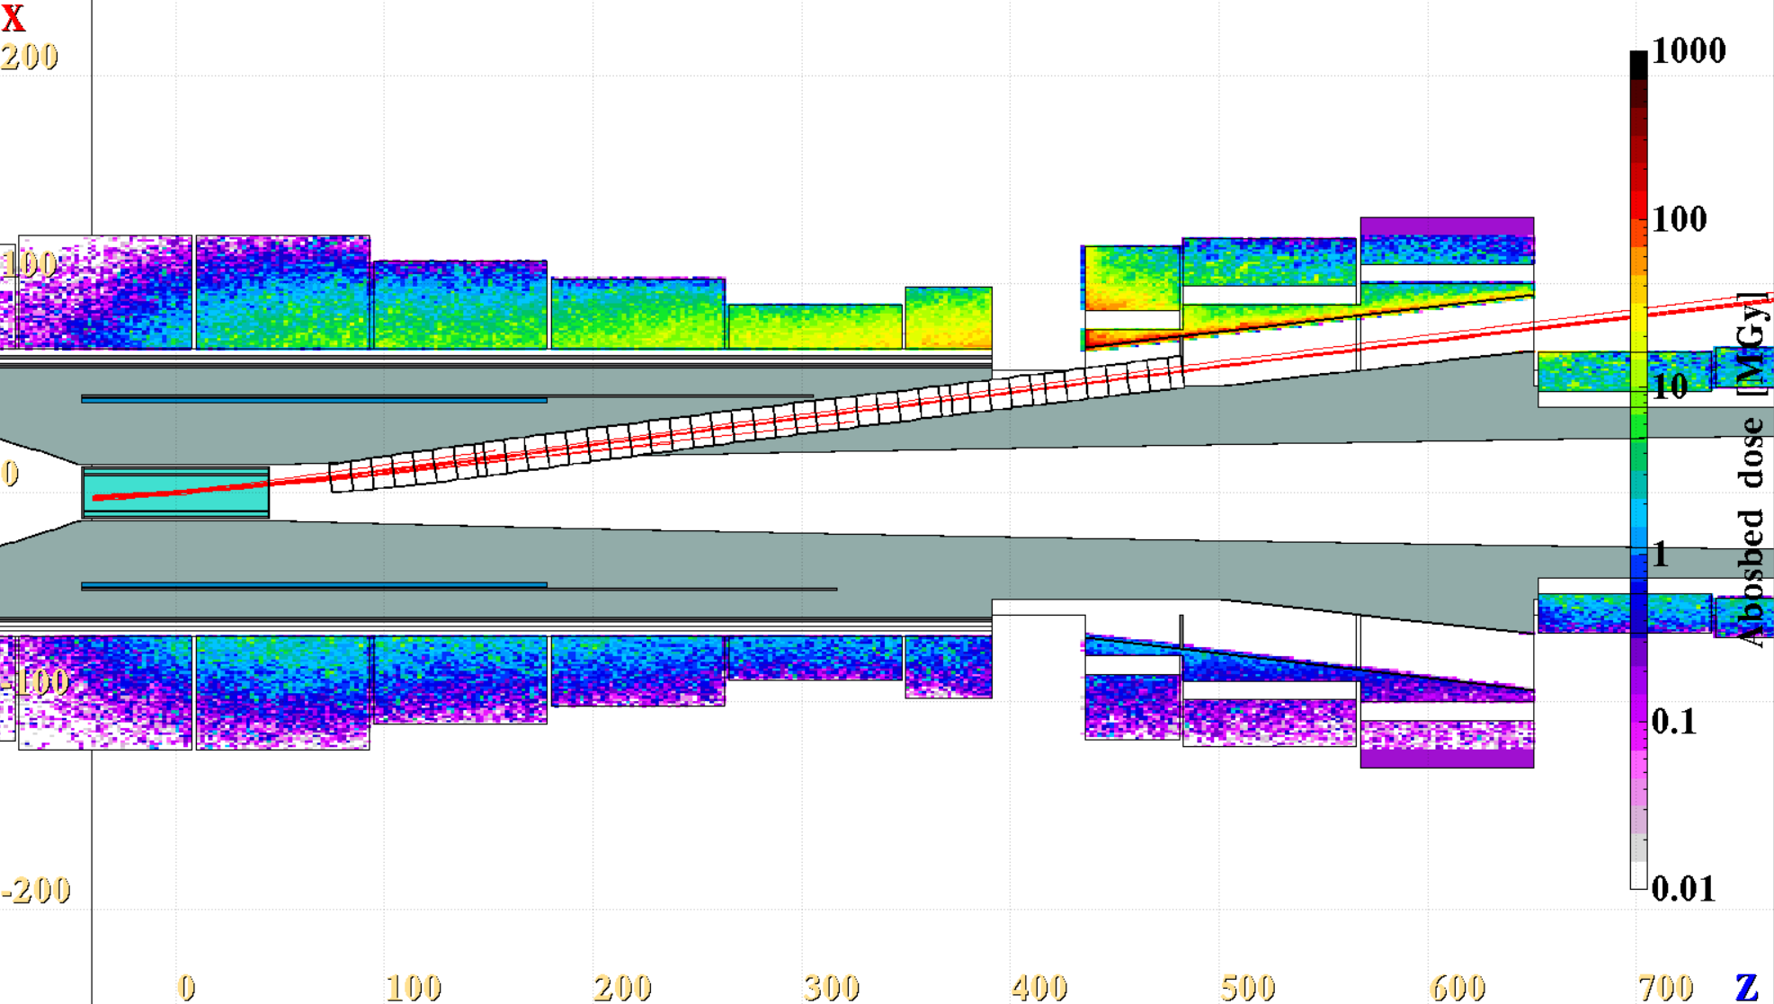
8-degree target tilt extraction
Max yearly Abs dose
~60 Mgy/year
Protons with Ekin > 9.9 GeV

Slide 6
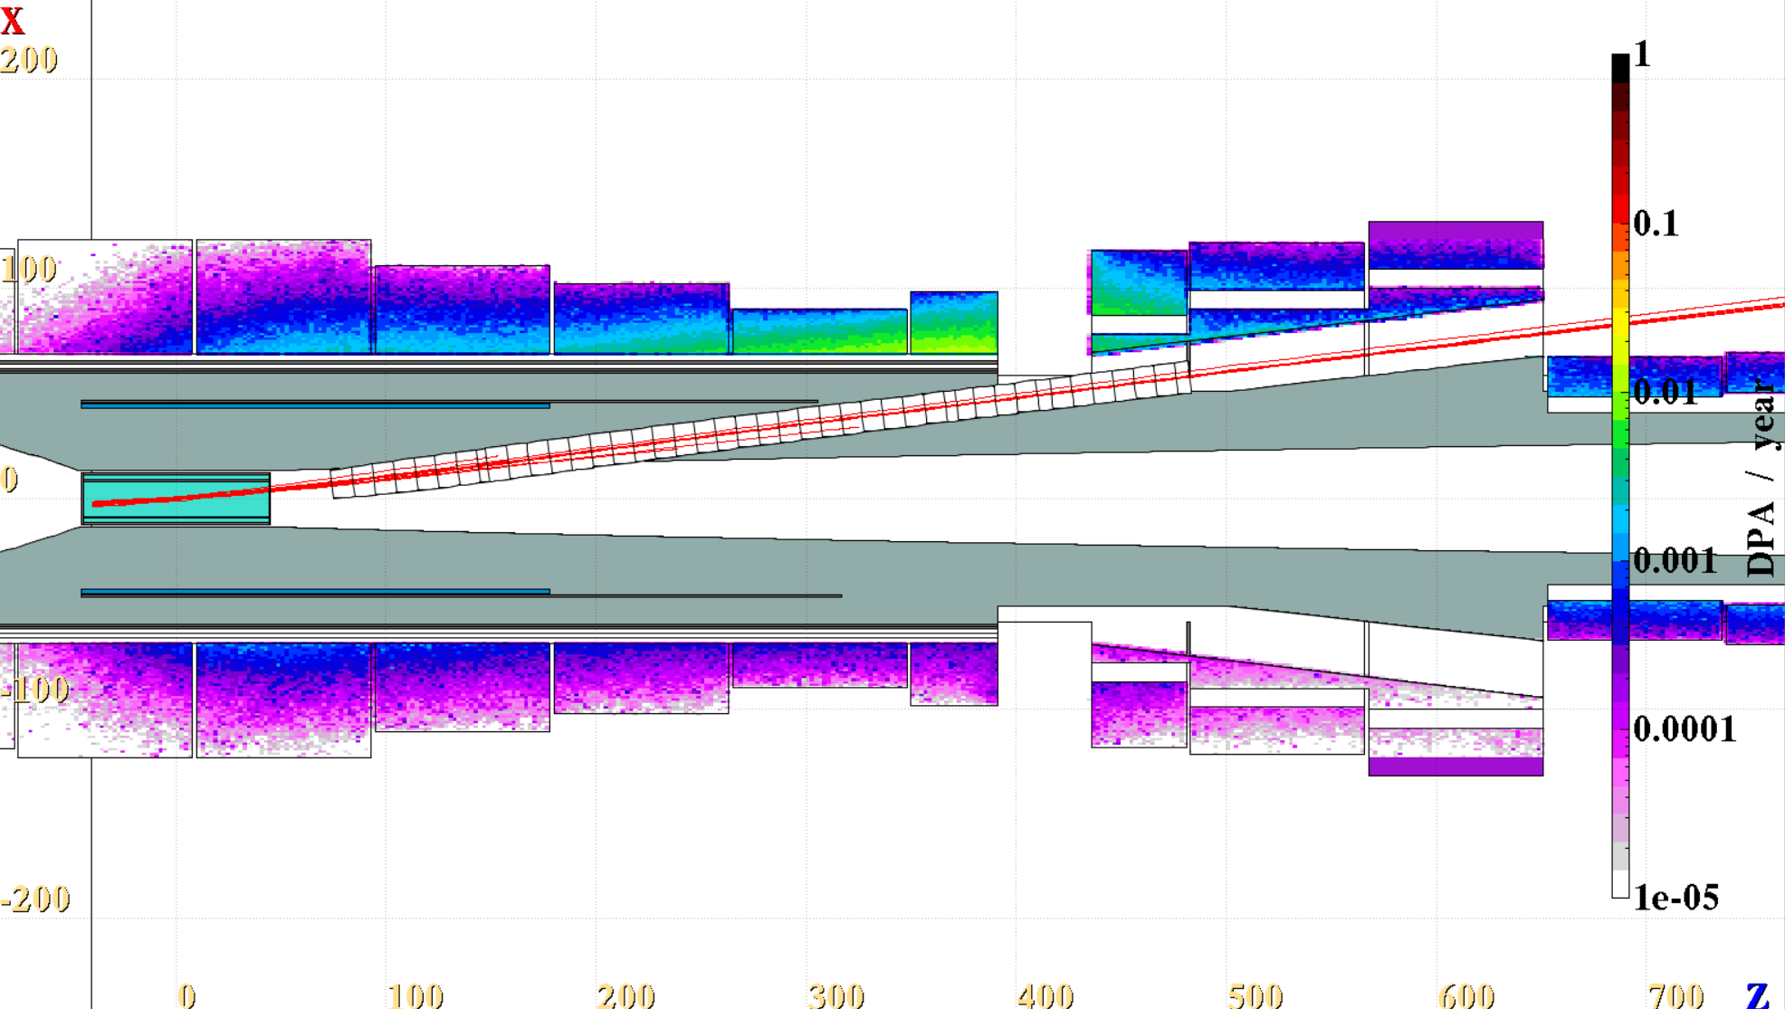
8-degree target tilt extraction
In the coils, peak
DPA/year ~ 1e-2!
Ext channel radius = 8 cm
Max diameter
2.2 m
Protons with Ekin > 9.9 GeV

Slide 7
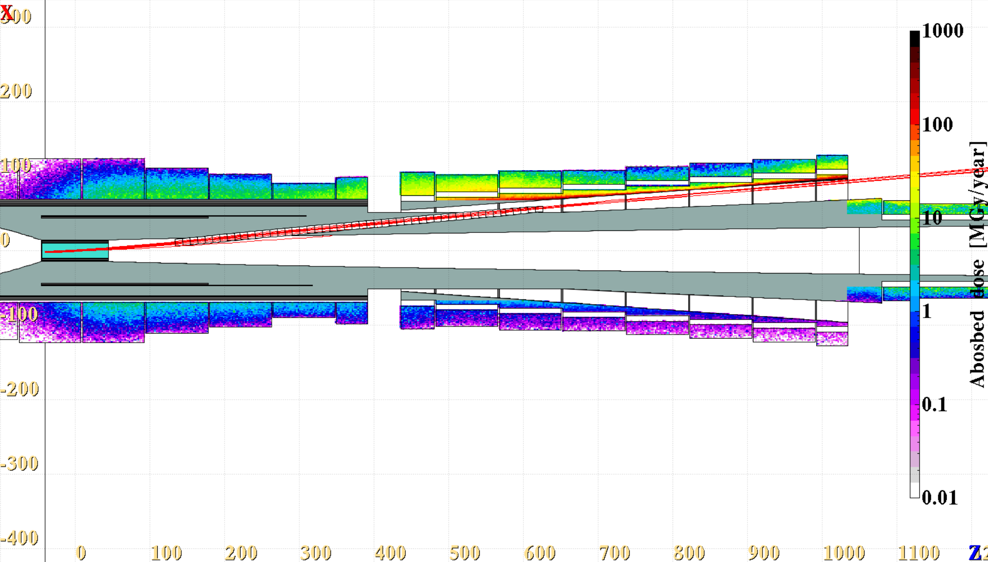
6-degree target tilt extraction
Abs. dose in the coils peaks at ~30 MGy/year
Shileding
Ext channel radius = 5 cm
Protons with Ekin > 9.9 GeV

Slide 8
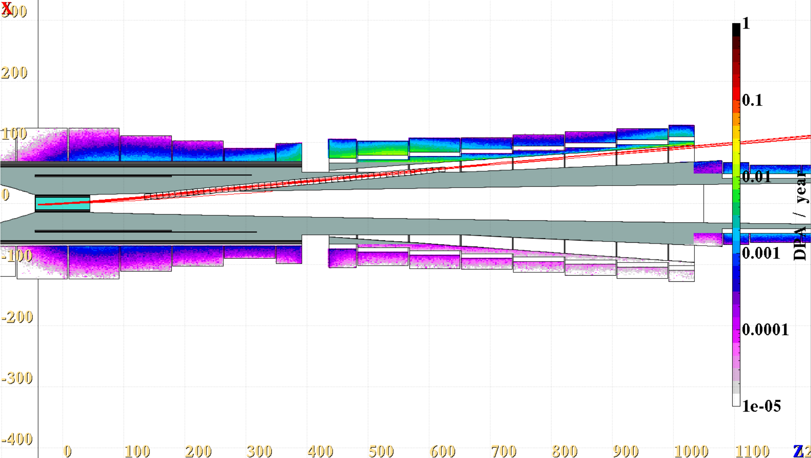
6-degree target tilt extraction
In the coils, peak
DPA/year ~ 1e-2!
Shileding
Max diameter
2.2 m
Ext channel radius = 5 cm
Protons with Ekin > 9.9 GeV

Slide 9
Conclusions – early extraction
Early proton extraction is challenging; more studies are needed.
The FLUKA model might be too simplistic, e. g no cryostats included outside of the HTS magnets.
Input from magnet experts would be very useful to channel the optimization efforts!

