Slide 1


DRD4 test beam preparation overview
03-10-2025
Sune Jakobsen (CERN EP-DT-DI)
3rd DRD4 Collaboration Meeting

Slide 2

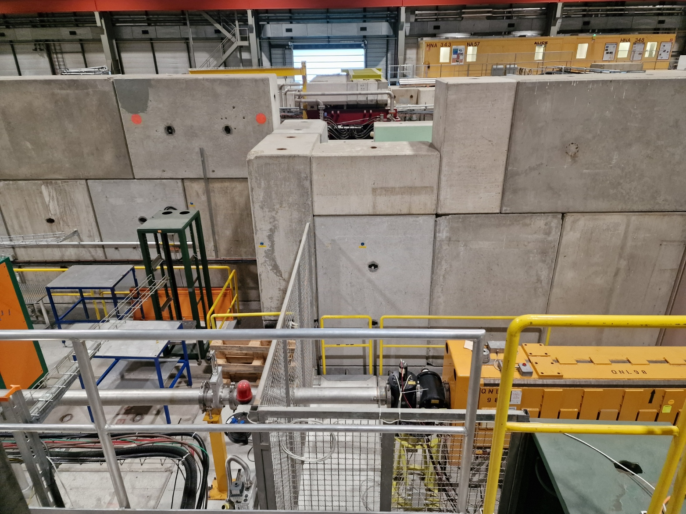
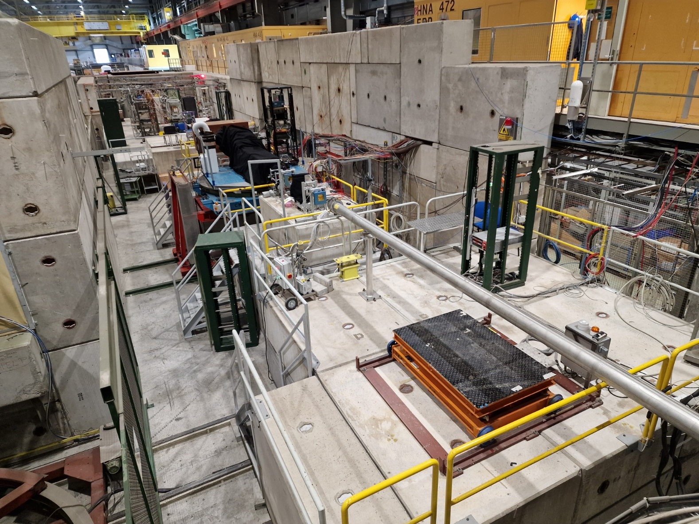
Locations Beam setup Practical information
DRD4 test beam 2025 - Locations
4 DRD groups have originally confirmed participation:
Small scintillators and scintillating fibers (ETH).
RICH detector (WP3) - CANCELED (parts not ready)
RICH detector (CN). – CANCELED (dedicated test beam slot)
FPMT and CEPC-HCAL, ECAL and MUON detector (CN).
Two zones will be used at H8 with another parasitic group (QFIB) in-between:
Zone PPE138
Zone PPE158
Zone PPE168
Beam
Detectors ETH
1m x 1m
QFIB
FPMT
Calorimeter
1 m x 1m
1 m
1 m
Control room: 887-1-Q40 or 887-1-Q43
Control room: 887-1-Q70 or 887-1-Q67
DRD4 test beam preparation DRD4 test beam preparation overview 03-10-2025
Sune Jakobsen
2/4

Slide 3
Locations Beam setup Practical information
DRD4 test beam – Beam setup
Beam types to be prepared:
180 GeV muons
20, 50, 100, 150 and 180 GeV pions
The beam type should be discussed and agreed between the groups, but I suggest to start with muons.
Beam size in PPE 138:
10 mm x 10 mm (detector is 5 mm x 5 mm)
Beam size in PPE 168:
“As small as possible”
Particles per spill: Up to 10⁶, but aim for ~3*10⁵.
Access can be agreed between the groups (mainly matters for PPE138), but a starting point could be 10:00-11:00 and 18:00-19:00 daily
DRD4 test beam preparation DRD4 test beam preparation overview 03-10-2025
Sune Jakobsen
3/4

Slide 4
Locations Beam setup Practical information
DRD4 test beam - Practical information
Please ask for access to the control rooms.
Every person participating in the test most have:
CERN Dosimeter
Safety shoes
Helmet
The groups before DRD4 will have cleared the zones by 11:00 on 15/10, so we start installation then.
So far there was no request for handling/transport support.
Request for zone 138:
One 2D table: 40 cm x 100 cm, 100 kg
SPS warning signals to the zone (from the control room)
Request for zone 168:
One 2D table: 100 cm x 100 cm, 100 kg
There will be a safety inspection after the setup is FULLY ready and before first beam.
Suggested time for safety inspection: 16:00
Please bring EVERYTHING needed including e.g. long power cables, power distribution, grounding cables, adaptors, cables, parts to adjust position etc.
DRD4 test beam preparation DRD4 test beam preparation overview 03-10-2025
Sune Jakobsen
4/4

