Slide 1
TCC8 Dismantling
Additional AW calculations to estimate the TFA waste classification as certain items can be classified as such → List_of_Beamline_elements_v7.xlsx
Preliminary estimates of the disposal costs based on conservative and simplified assumptions:
  1st approach based on volume before treatment and waste class.
  2nd approach based on max. volume, mass and H-3 activity per container.
  Documented in EDMS 3364808 (under verification).
Refining the disposal cost estimate requires a detailed packaging concept → packaging of each waste item needs to be addressed (similarly to CNGS).

Slide 2
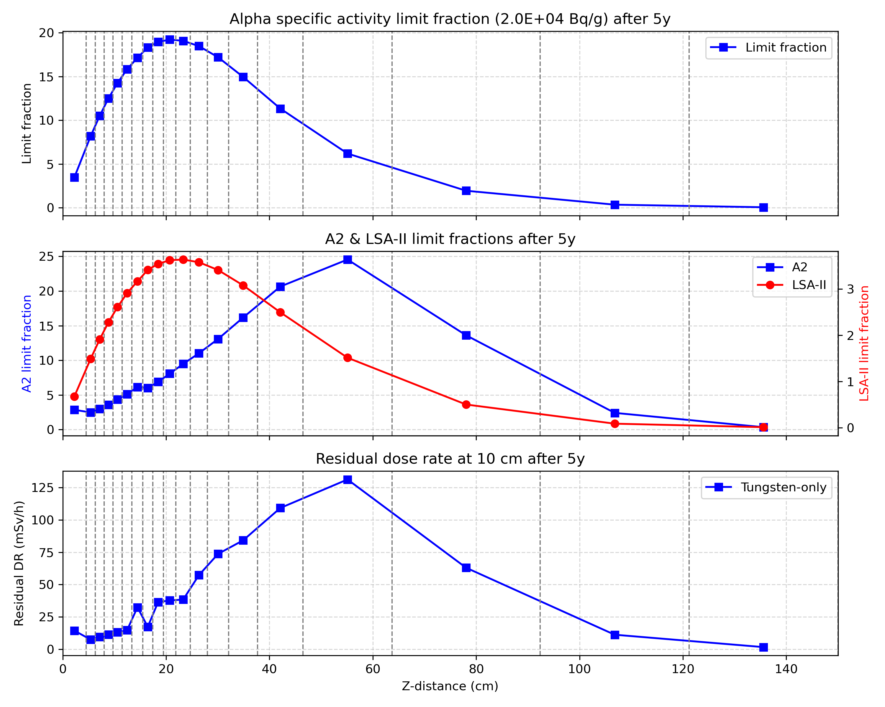
BDF Target – Disposal Study
AW Creator calculations (Python script available for batched calculations) to produce radiological quantities relevant for transport and disposal (thanks James for the fluence spectra).
Python script to process the AW results and compute the radiological quantities of groups of blocks.
Two optimisation algorithms tested to identify the best cutting positions (3 cuts, 4 block groups) → still under discussion.
Next steps: 1) Adding Inconel to the characterisation calculations. 2) Discussing with PSI applicable activity limits for KC-T12 containers.

