Slide 1

HI-ECN3 FIRIA updates
Rahul Kallada, Oriol Rios
20.10.2025
EDMS

Slide 2
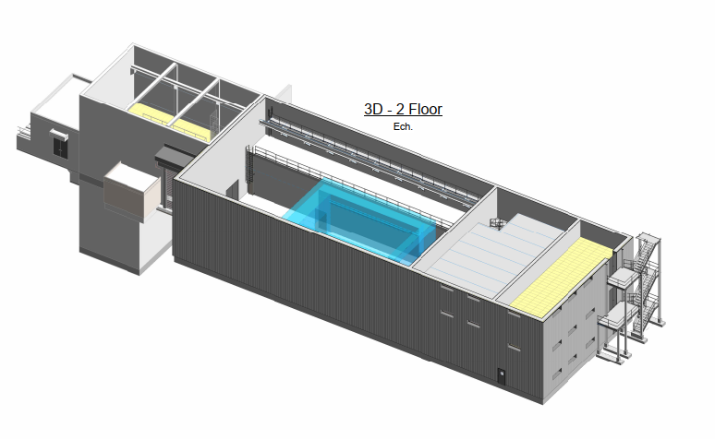
Service Building – 754

Slide 3
Smoke extraction – alternate proposals
Current design – Full smoke extraction in multiple areas
Two proposals for optimisation
  No extraction in handling hall, telemanipulator zone and EN-CV Level 1+2
  Temperature –rated ventilation system capable of extracting hot smoke upto a certain temperature (circa 200 °C)
Advantages
  Simplified ventilation system and safety matrix
  Cost effective

Slide 4
Environmental Dispersion
Pavol shared the report on the target aerosol filter analysis
  Negligible dose rates even with full inhalation of the radionuclide inventory – 0.29 mSv
  Report being checked. Comments to be provided
The environmental dispersion model is being prepared for Prevessin
  Currently, all stability classes can be modelled
  SLAM cases will be run soon

Slide 5
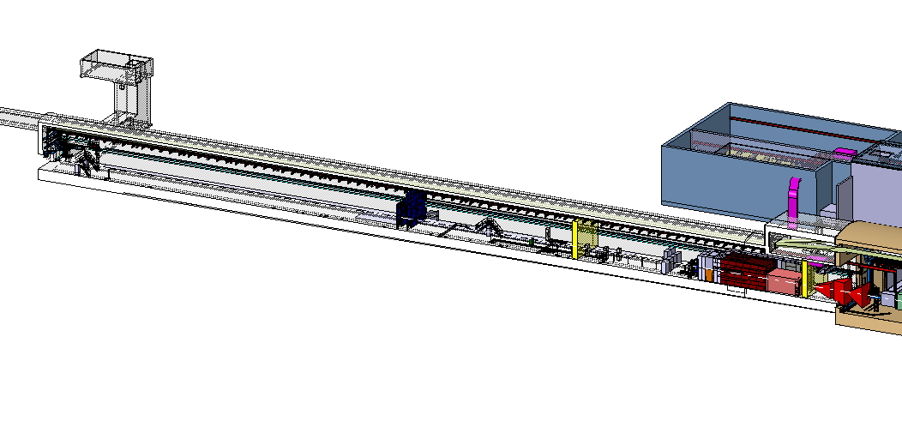
Beam Dump Facility

Slide 6
FIRIA report – Simulation status
Simulations being performed with more realistic, less conservative scenarios
  MHS epoxy coil
  2.0 MW design fire @ 2.0 m from the confinement wall
  Muon Shield Magnet fire
Improving the ventilation modelling to ensure the flow is captured precisely

Slide 7
Confinement wall re-evaluation
Proposal to reduce fire resistance of the confinement walls
EI 30 is the minimum fire resistance
TCC8 upstream wall = EI 30
ECN3 wall = EI 60 (subject to SHiP fire safety analysis)

Slide 8
HI-ECN3 Global Safety Matrix
Still being discussed with EN-AA
DETECTION |  | UNDERGROUND AREAS |  |  |  |  | SURFACE BUILDINGS
 |  | TDC85 | TCC8 upstream | Target Area | SHiP | GHN300 | 912 | 754 | 911 | 918
 | TDC85 | C | E | - | - |  | E | - | - | -
 | TCC8 upstream | E | C | E | E |  | E | - | - | -
 | Target Area | - | E | C | E |  | E | E? | E | E
 | SHiP | - | - | E | C |  | - | E? | E | E
 | GHN300 | - | - | - | - | C | - | - | - | -
E = Evacuation
C = Compartmentalisation (Doors, Dampers, Ventilation stop, Lift) + Evacuation
E? = Unclear if evacuation is required

Slide 9
Liquid Scintillator actions
Identify and categorize fire loads in SHiP
Create fire scenarios and probable propagation scenarios to the LS
Refine the fire scenarios
Check if compartmentalisation of the LS is possible?
Determine the retention volumes for the LS?
Is pumping out of LS required?

Slide 10
Open Action – FSE
A document on smoke extraction is in preparation
Statement regarding the sprinkler consolidation to be prepared
Document describing the areas where:
  PBD for trays would be used
  Fire rated trays are required

