Slide 1
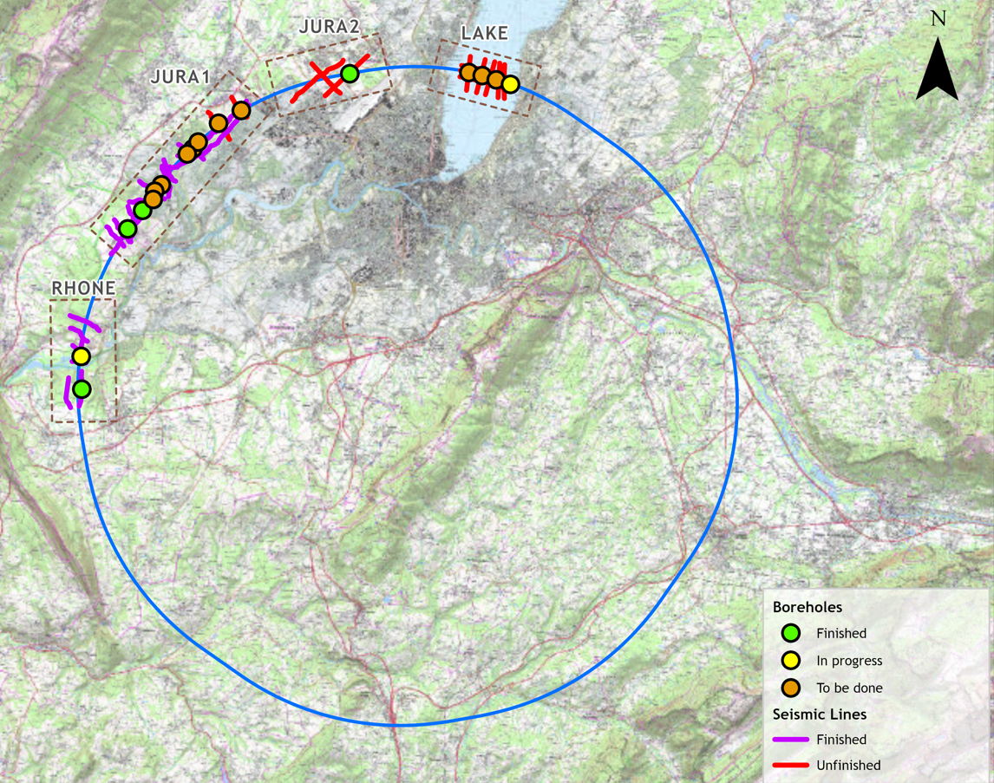

Current Status GEOTEC-IOI
Total Scope
60km geophysics
16 fully and partially cored boreholes
Status
Four boreholes complete and two are ongoing
Works in France have permits and are almost complete
Last borehole in Rhone ongoing
Permits granted for Lake section
Still awaiting permits for CH Jura section- to be granted imminently
Works have begun on the lake (Lake_4)
Terrestrial boreholes in Switzerland (to begin shortly)
Geophysics approximately 60% complete
Status as of 06.10.2025

