Slide 1
Nb-Ti Hybrid Block Coil Designs
- From concepts to BOND-H -
Ariel Haziot
HFM Forum
October 9th, 2025

Slide 2
Context
In high field magnets (above 12 T) wound with high amounts of Nb₃Sn, the cost is mostly driven by the price of the conductor, thus impacting significantly the cost of future accelerator using this technology.
Material grading is the concept of replacing an expensive conductor by a cheaper one in lower field regions where the performances of the original conductor are not required.
Nb-Ti is a good candidate to replace Nb₃Sn in field region below 8.5 T. It can carry up to 1500 A/mm² at 10.5 T for a price 7-10 times lower than Nb₃Sn.

Slide 3
Outline
The BOND Case – Recap from last HFM Forum
BOND-H(ybrid)
Short Model Coil Validation

Slide 4
2. The BOND Case
Hybrid Concepts for Block Coil 14 T Dipole Magnets
Presented at MT29, July 2025
A. Haziot, end E. Todesco, Nb₃Sn/Nb-Ti Hybrid Concepts in Block for High Field Dipole Magnets, IEEE Trans. Appl. Supercond., Accepted

Slide 5
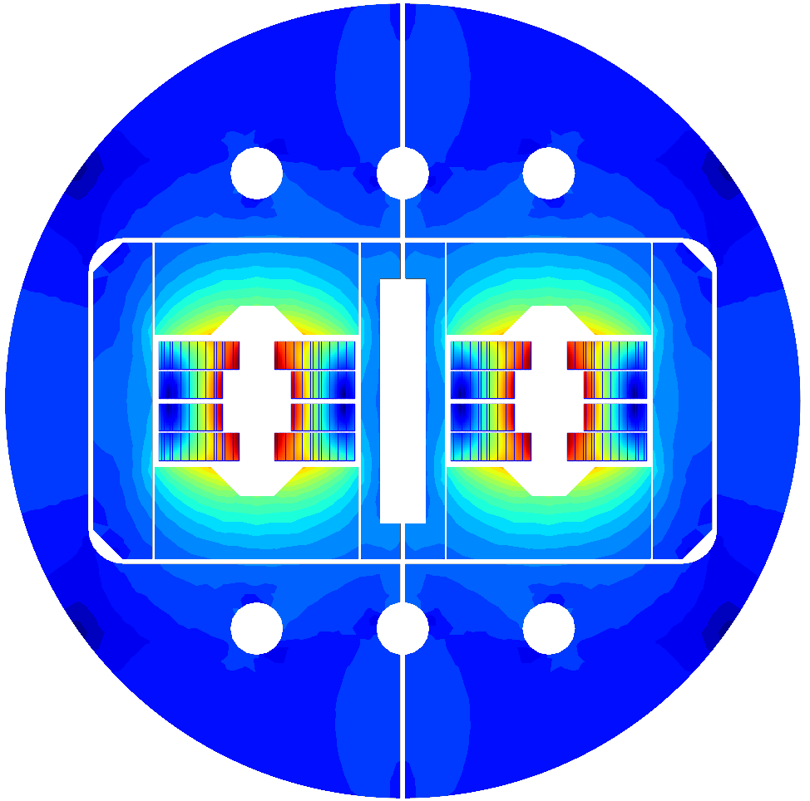
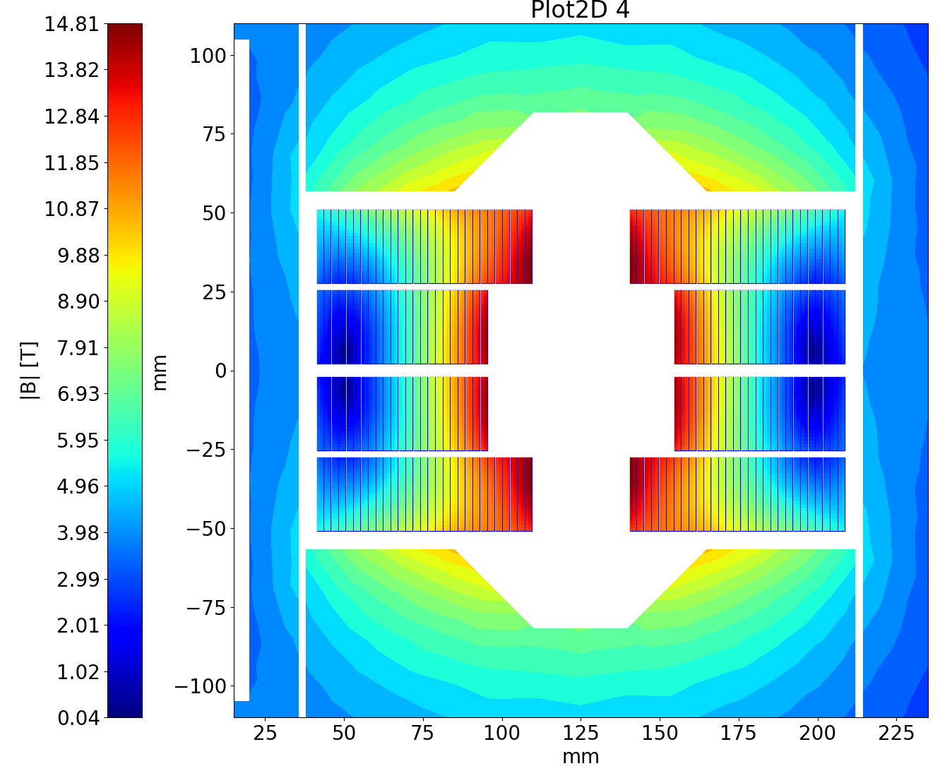
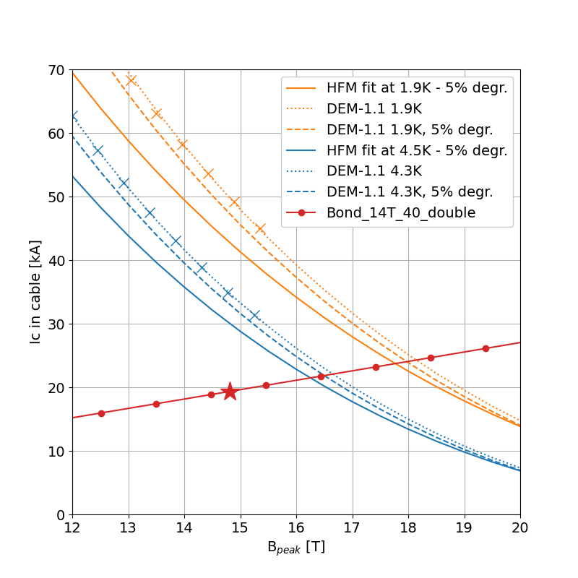
The BOND Case
BOND: Baseline with Nb₃Sn
The block coil design used for this case study is the BOND double aperture magnet:
Double aperture of 50 mm
2 double layers Nb₃Sn coils per aperture
14 T bore field with 20% margin at 1.9 K
Operational parameters
Current (I_{nom}) | (kA) | 19.34
Peak Field | (T) | 14.81
Short sample current @ 1.9 K | (kA) | 23.66
Short sample current @ 4.2 K | (kA) | 21.20
Short sample field @ 1.9 K | (T) | 17.8
Short sample field @ 4.2 K | (T) | 16.0
j overall | (A/mm²) | 348
j strand | (A/mm²) | 509
j superconductor | (A/mm²) | 967
j copper | (A/mm²) | 1074
Loadline fraction @ 1.9 K | (%) | 81.7
Loadline fraction @ 4.5 K | (%) | 91.2
Stored energy/m | (MJ/m) | 2.064
Inductance/m | (mH/m) | 10.24
Overall Parameters
Aperture | (mm) | 50
Field | (T) | 14.0
Number of apertures | (adim) | 2
Distance between apertures | (mm) | 250
Yoke outer diameter | (mm) | 700
Coil design
Insulated cable surface (one aperture) | (mm²) | 12746
Equivalent coil width | (mm) | 56.9
Coil efficiency | (T mm / A) | 0.00077
N. layers | (adim) | 2
N. turns/pole | (adim) | 52
J.C. Perez et al., Conceptual Design of BOND: A 14 T Dipole for FCC-hh, IEEE Trans. Appl. Supercond. 35, 4002506 (2025)

Slide 6
The BOND Case
Conductor choice
Conductor parameters |  | Nb₃Sn |  | Nb-Ti
Strand diameter | (mm) | 1.10 |  | 1.10
Layout |  | RRP 162/169
Effective filament diameter | (µm) | 64 |  | 7
Jc at 4.2 K and 16 T | (A/mm²) | 1200
Cu/NonCu ratio |  | 0.9 |  | 1.0
No. of strands in cable |  | 40 |  | 40
Bare cable width | (mm) | 23.045 |  | 23.275
Bare cable thickness | (mm) | 1.98 |  | 2.0
Bare cable width (reacted) | (mm) | 23.275
Bare cable thickness (reacted) | (mm) | 2.06
Insulation thickness | (mm) | 0.150 |  | 0.150
Insulated cable width (reacted) | (mm) | 23.575 |  | 23.575
Insulated cable thickness (reacted) | (mm) | 2.36 |  | 2.3
A strand | (mm²) | 0.950 |  | 0.950
A sc | (mm²) | 0.500 |  | 0.475
A cu | (mm²) | 0.450 |  | 0.475
The Nb₃Sn cable in BOND is made of 40 DEM-1.1 strands of 1.1 mm.
For this conceptual study, a hypothetical Nb-Ti conductor was considered:
1.1 mm strand
cable identical to the BOND cable
A more realistic conductor using LHC 01 strands (1.065 mm) will be considered in the next part.

Slide 7
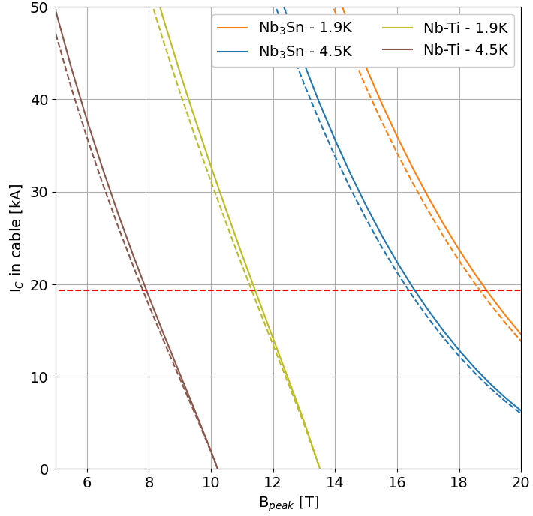
The BOND Case
The Low Field Region – Criteria for Nb-Ti
Same current as in BOND: 19.34 kA
Field region suitable for using Nb-Ti with 20% margin on the loadline.
20% margin seems a suitable value for impregnated Nb-Ti, but a discussion on this criteria should be addressed.
Critical surfaces are defined in the references below.
20%
19.34 kA
B, Auchmann, et al. “High Field Magnet Programme – European Strategy Input”, arXiv:2504.16885 (2025)
L. Bottura., A Practical Fit for the Critical Surface of NbTi, IEEE Trans. Appl. Supercond. 10, 1054 (2000)

Slide 8
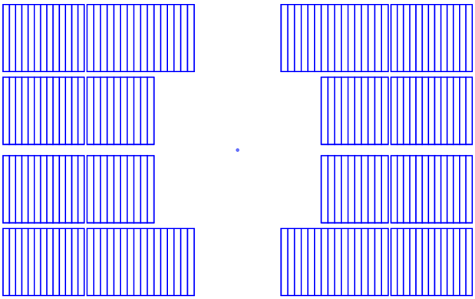
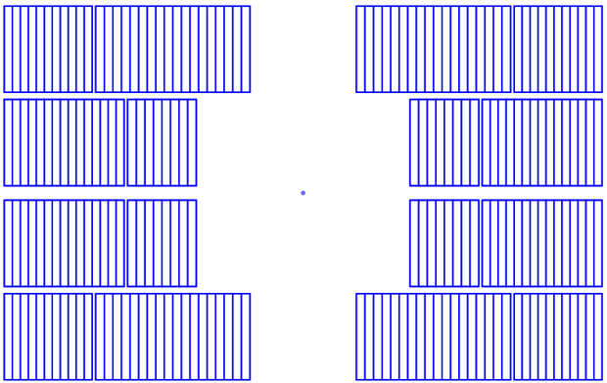
The BOND Case
2 options for the Nb-Ti blocks
Flat coil
Stepped coil
Easier for fabrication
Less Nb-Ti turns
Optimal use of the low field region
More Nb-Ti turns

Slide 9
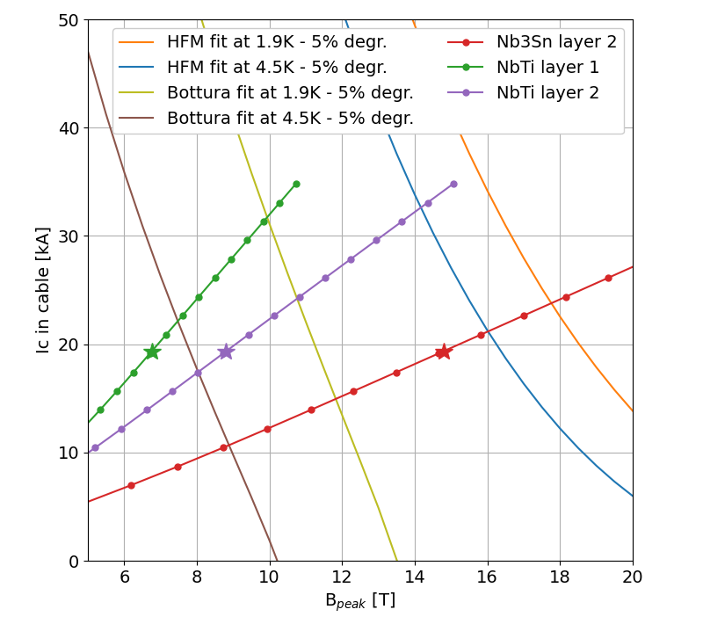
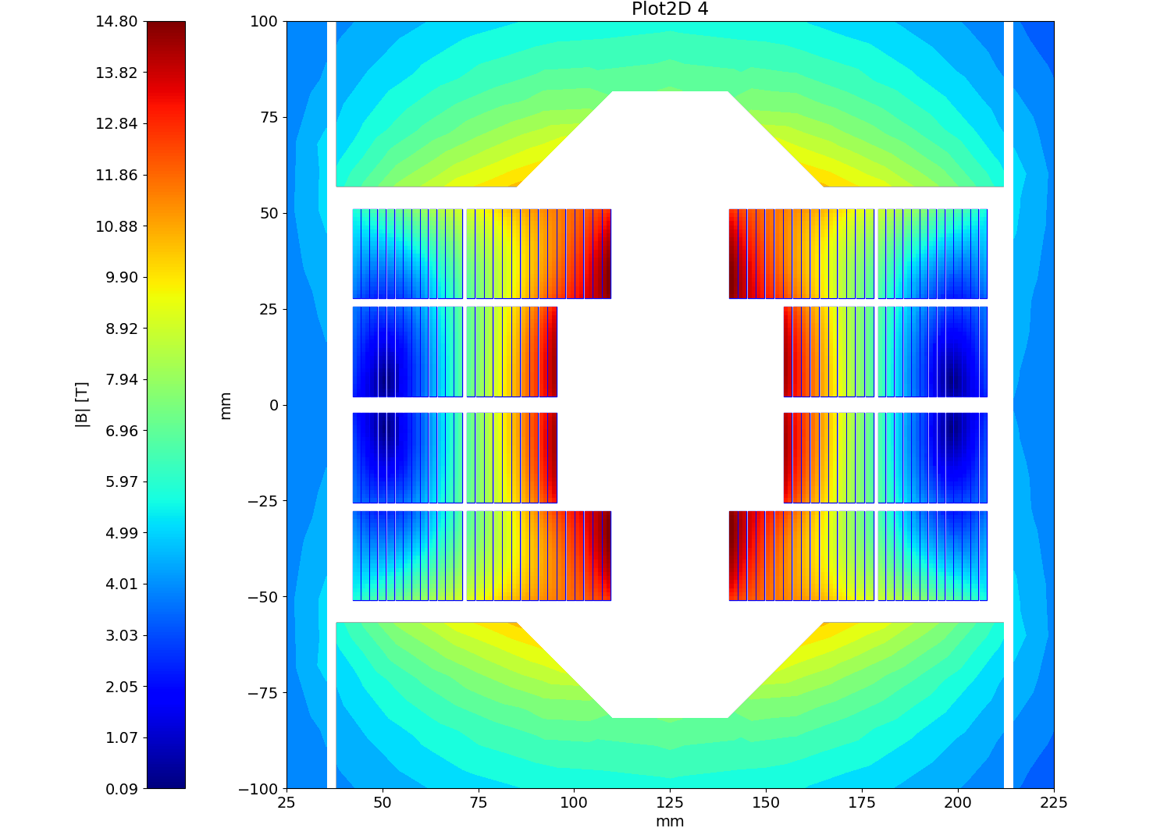


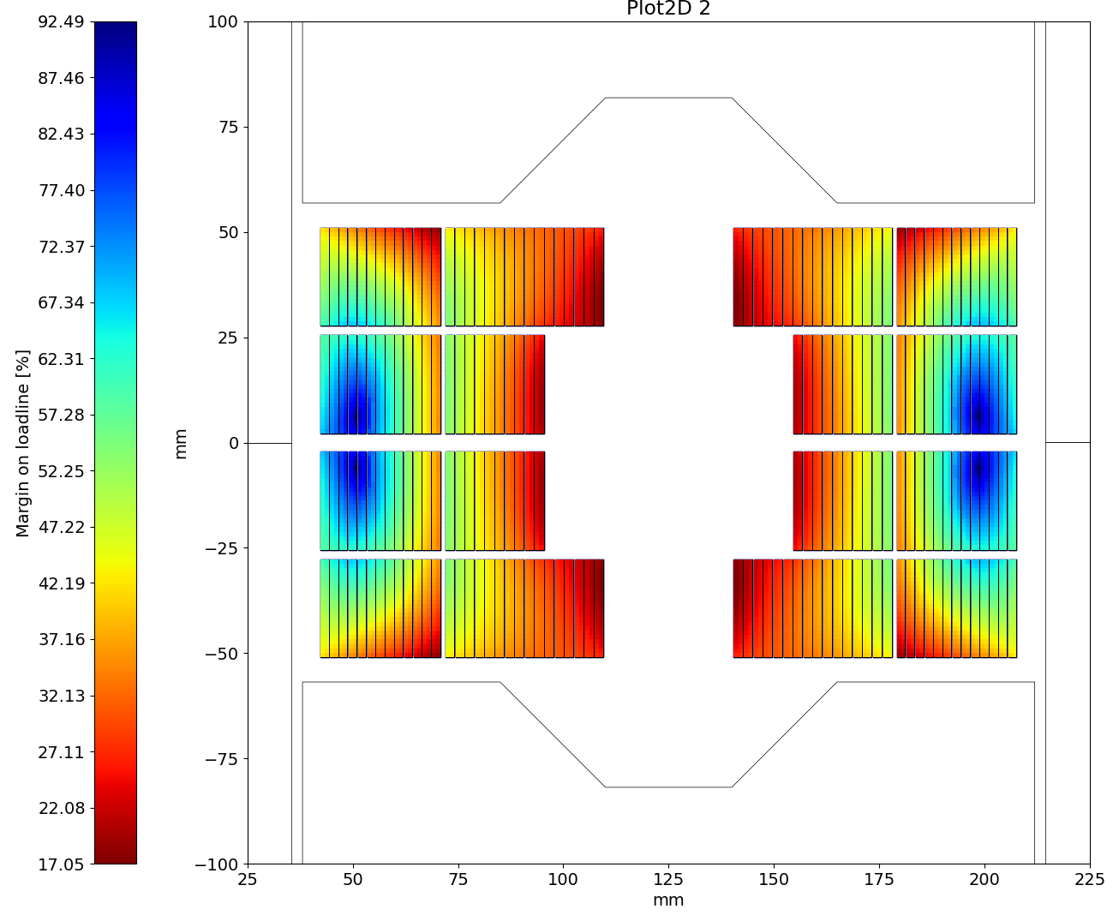
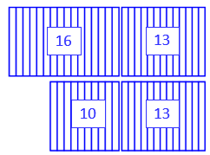
The BOND Case
14 T Flat version
Magnetic Field
Nb₃Sn: 26 turns (10+16)
Nb-Ti: 26 turns (13+13)
Nb₃Sn ratio: 50 %
At nominal, loadline fractions are:
81.8% on the Nb₃Sn
80.5% on the Nb-Ti
Limited by the Nb₃Sn at 23.65 kA
Margin on the loadline
Nb₃Sn
Nominal current | [kA] | 19.34
SS field at 1.9 K | [T] | 17.8
SS current at 1.9 K | [kA] | 23.65
Loadline fraction | (%) | 81.8
Nb-Ti layer 1
Nominal current | [kA] | 19.34
SS field at 1.9 K | [T] | 9.9
SS current at 1.9 K | [kA] | 31.65
Loadline fraction | (%) | 61.1
Nb-Ti layer 2
Nominal current | [kA] | 19.34
SS field at 1.9 K | [T] | 10.8
SS current at 1.9 K | [kA] | 24.03
Loadline fraction | (%) | 80.5

Slide 10
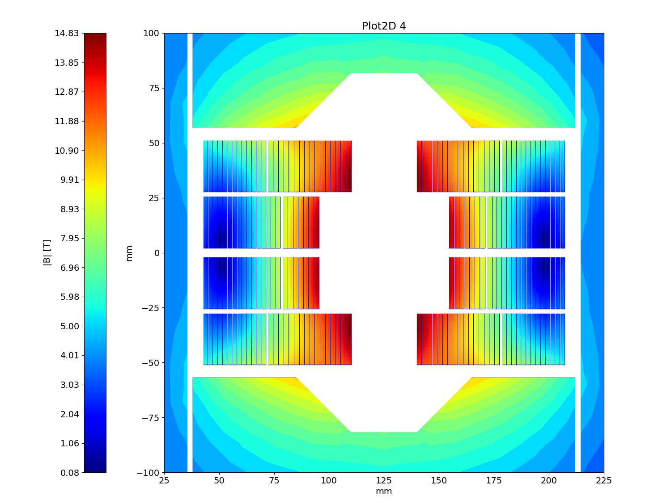
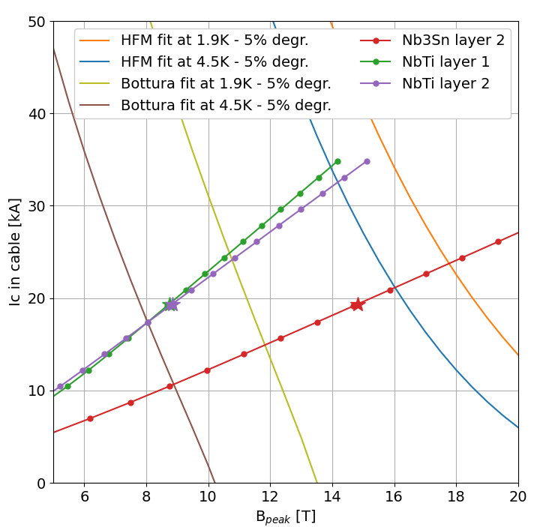
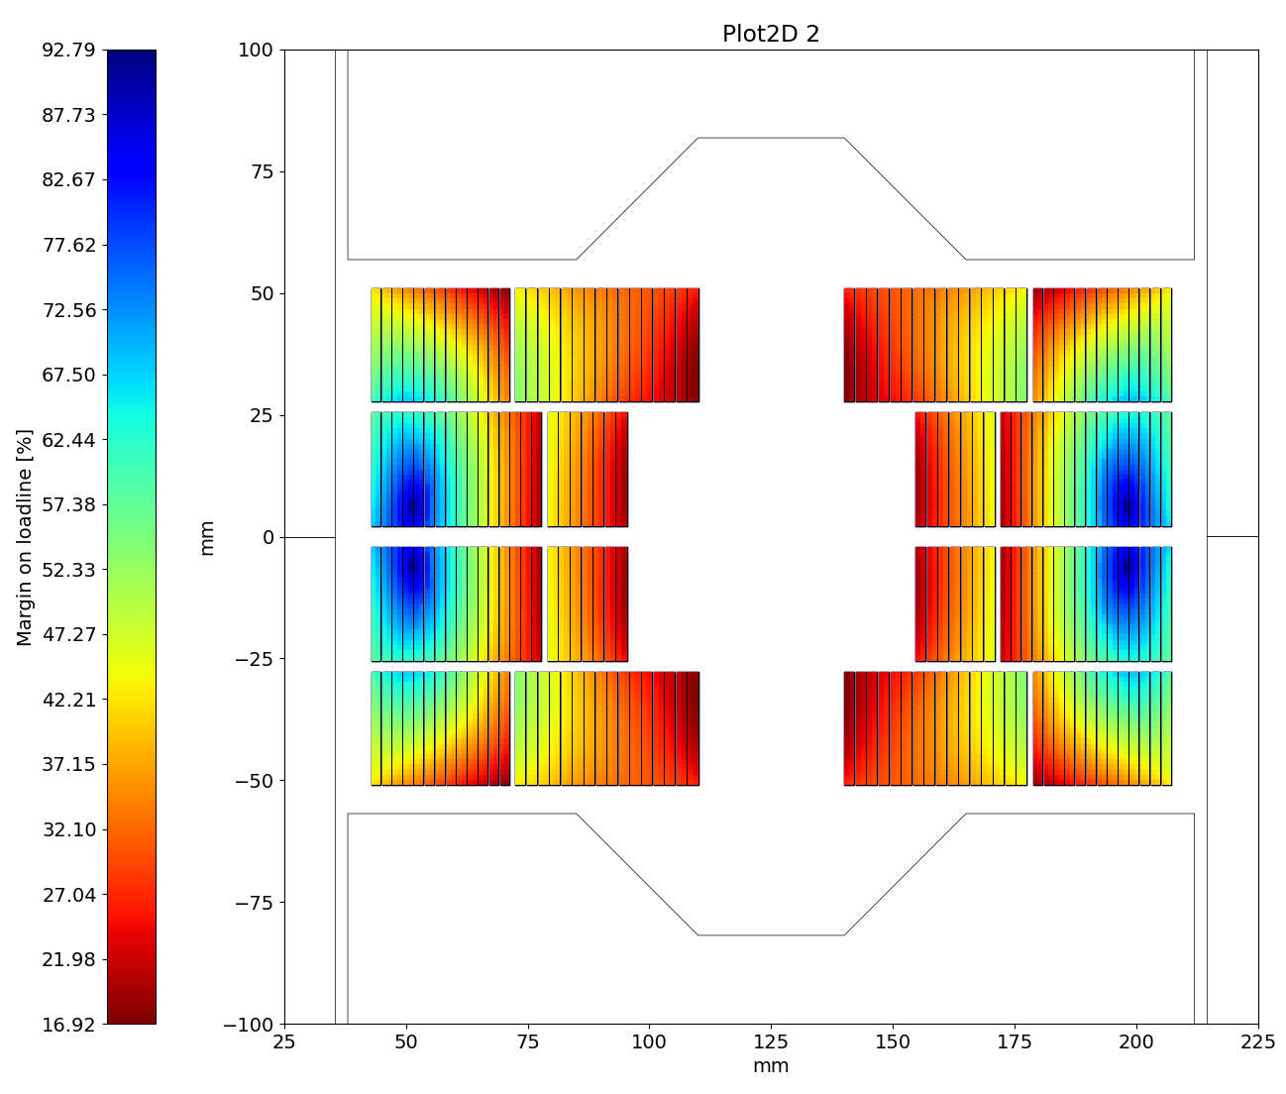
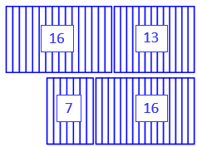
The BOND Case
14 T Stepped version
Magnetic Field
Nb₃Sn: 23 turns (7+16)
Nb-Ti: 29 turns (16+13)
Nb₃Sn ratio: 44 %
At nominal, loadline fractions are:
81.8% on the Nb₃Sn
80.6% on the Nb-Ti
Limited by the Nb₃Sn at 23.65 kA
Margin on the loadline
Nb₃Sn
Nominal current | [kA] | 19.34
SS field at 1.9 K | [T] | 17.8
SS current at 1.9 K | [kA] | 23.63
Loadline fraction | (%) | 81.9
Nb-Ti layer 1
Nominal current | [kA] | 19.34
SS field at 1.9 K | [T] | 10.7
SS current at 1.9 K | [kA] | 24.79
Loadline fraction | (%) | 78.0
Nb-Ti layer 2
Nominal current | [kA] | 19.34
SS field at 1.9 K | [T] | 10.8
SS current at 1.9 K | [kA] | 23.99
Loadline fraction | (%) | 80.6

Slide 11
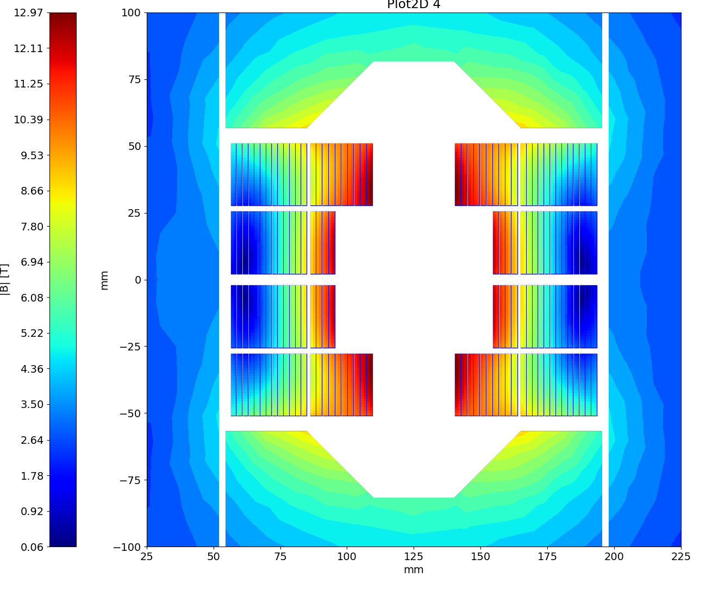
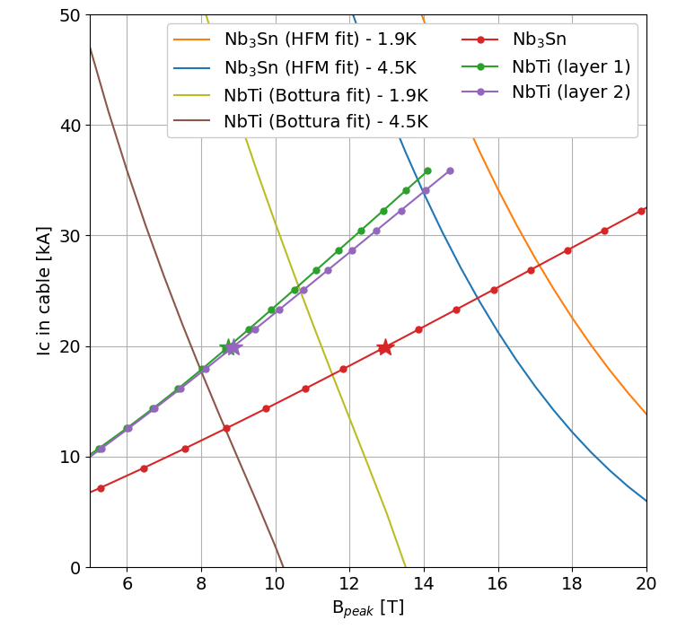
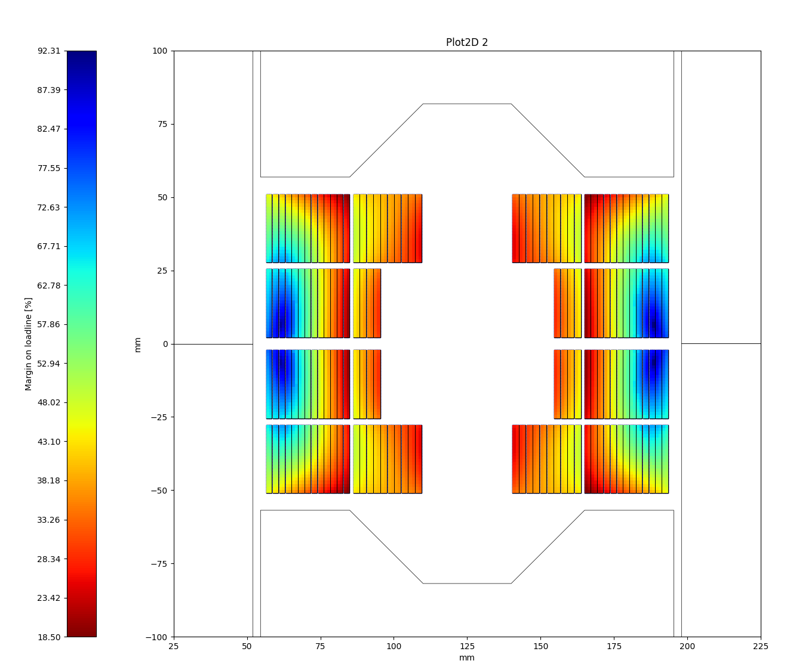
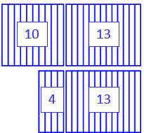
The BOND Case
12 T Flat version
Magnetic Field
Nb₃Sn: 14 turns (4+10)
Nb-Ti: 26 turns (13+13)
Nb₃Sn ratio: 35 %
At nominal, loadline fractions are:
73.0% on the Nb₃Sn
80.0% on the Nb-Ti
Limited by the Nb-Ti at 24.91 kA
Margin on the loadline
Nb₃Sn
Nominal current | [kA] | 19.92
SS field at 1.9 K | [T] | 17.1
SS current at 1.9 K | [kA] | 27.27
Loadline fraction | (%) | 73.0
Nb-Ti layer 1
Nominal current | [kA] | 19.92
SS field at 1.9 K | [T] | 10.6
SS current at 1.9 K | [kA] | 25.38
Loadline fraction | (%) | 78.5
Nb-Ti layer 2
Nominal current | [kA] | 19.92
SS field at 1.9 K | [T] | 10.7
SS current at 1.9 K | [kA] | 24.91
Loadline fraction | (%) | 80.0

Slide 12
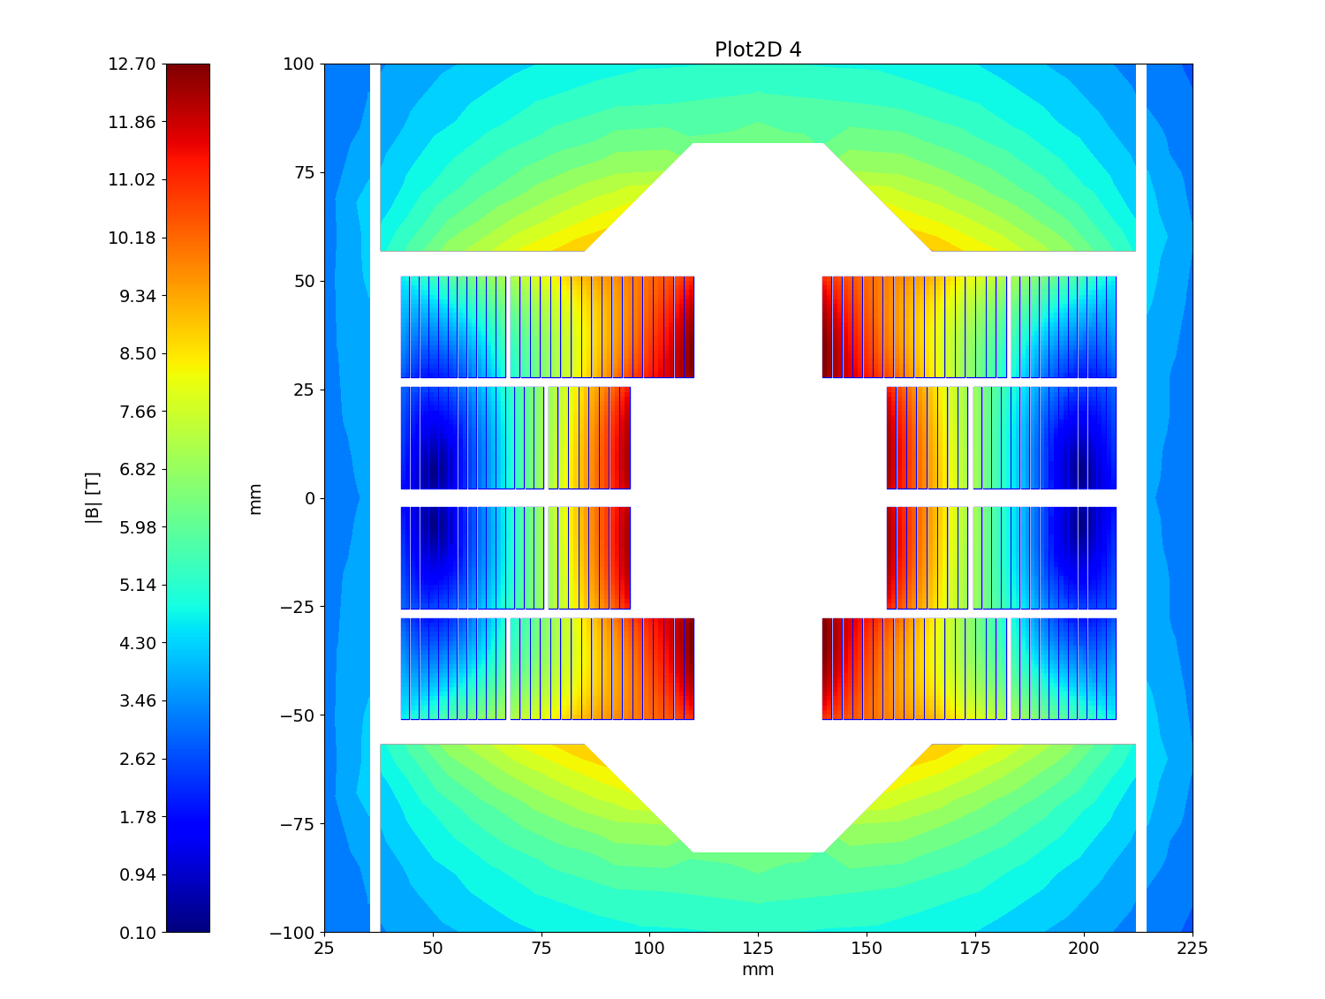
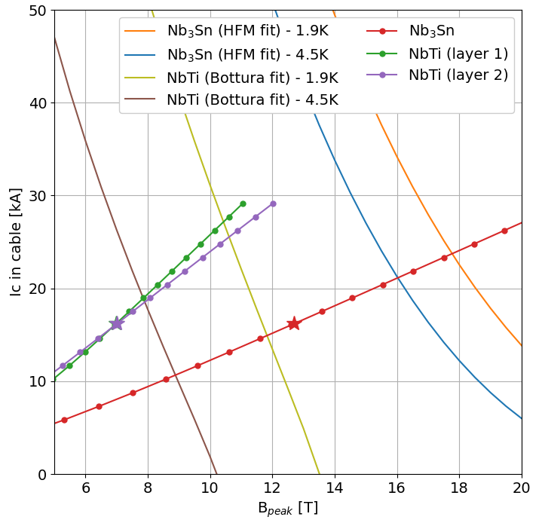

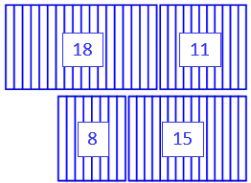
The BOND Case
12 T Stepped version at 4.5 K
Magnetic Field
Nb₃Sn: 24 turns (8+18)
Nb-Ti: 26 turns (15+11)
Nb₃Sn ratio: 50 %
At nominal, loadline fractions are:
77.1% on the Nb₃Sn
87.9% on the Nb-Ti
Limited by the Nb-Ti at 18.43 kA
Margin on the loadline
Nb₃Sn
Nominal current | [kA] | 16.20
SS field at 4.5 K | [T] | 16.0
SS current at 4.5 K | [kA] | 21.02
Loadline fraction | (%) | 77.1
Nb-Ti layer 1
Nominal current | [kA] | 16.20
SS field at 4.5 K | [T] | 7.9
SS current at 4.5 K | [kA] | 18.95
Loadline fraction | (%) | 85.5
Nb-Ti layer 2
Nominal current | [kA] | 16.20
SS field at 4.5 K | [T] | 7.9
SS current at 4.5 K | [kA] | 18.43
Loadline fraction | (%) | 87.9

Slide 13
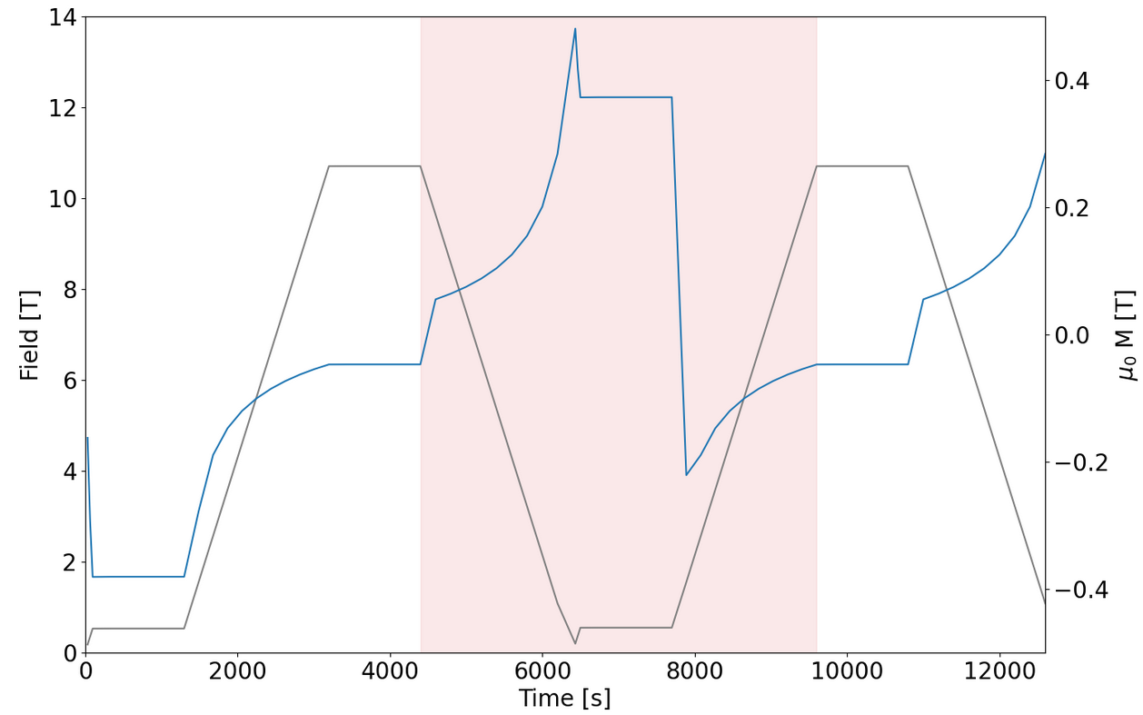
The BOND Case
AC-losses considerations
Calculation interval
Beam dump
Collision
AC-losses are calculated over a typical current cycle in the LHC:
Ramp down from nominal to reset (100 A) of 10 A/s
Injection plateau of 20 min at 1 kA
Ramp up to nominal of 10 A/s
Calculation is done over the second cycle to account for magnetization.
Today the target in HFM for the loss during this cycle is 10 kJ/m.
Reset
current
Injection
B, Auchmann, et al. “High Field Magnet Programme – European Strategy Input”, arXiv:2504.16885 (2025)

Slide 14
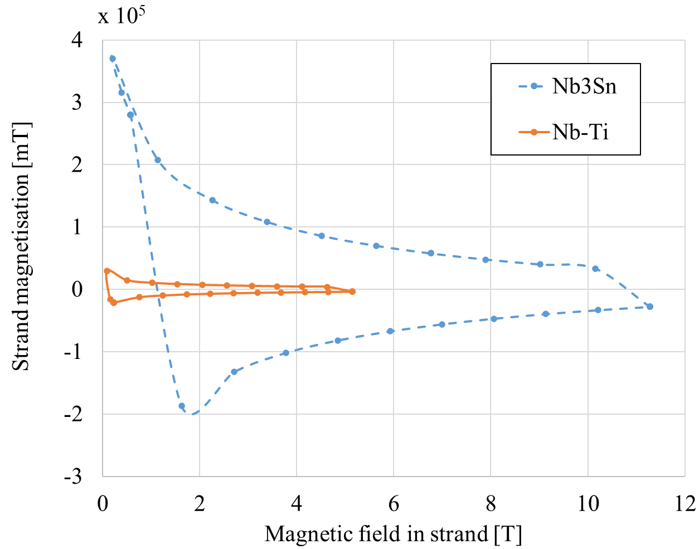
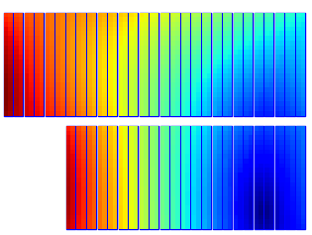
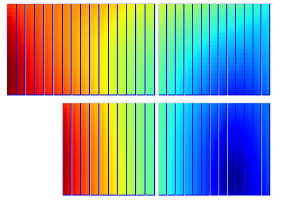
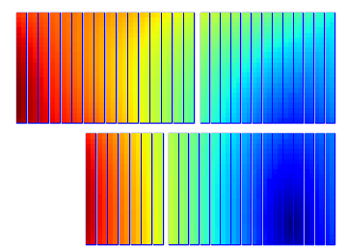
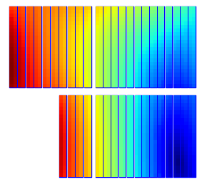
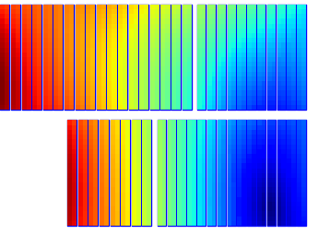
The BOND Case
AC-losses considerations
Strand parameters |  | Nb₃Sn | Nb-Ti
Strand diameter | [mm] | 1.10 | 1.10
Strand twist pitch | [mm] | 121 | 115
Effective filament diameter | [µm] | 64 | 7
Filament twist pitch | [mm] | 19 | 15
Crossover resistance (R_{c}) | [µΩ] | 30 | 30
Adjacent resistance (R_{a}) | [µΩ] | 0.3 | 0.3
Filling factor in strand | [mm] | 0.5 | 0.5
Results from the simulations
 |  | BOND | Hybrid 14 T Flat | Hybrid 14 T Stepped | Hybrid 12 T Flat | Hybrid 12 T at 4.5 K
Persistent current losses | [kJ/m] | 24.216 | 14.879 | 13.485 | 8.147 | 14.058
Interfilament coupling current losses | [kJ/m] | 0.009 | 0.007 | 0.006 | 0.003 | 0.005
Interstrand coupling current losses | [kJ/m] | 0.343 | 0.352 | 0.351 | 0.182 | 0.244
Total cable losses | [kJ/m] | 24.569 | 15.238 | 13.842 | 8.332 | 14.308

Slide 15
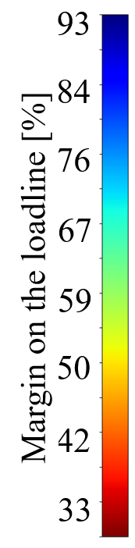
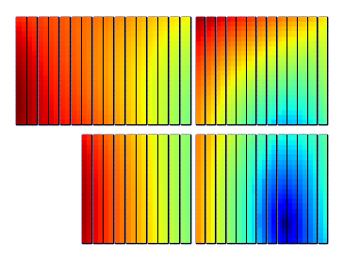
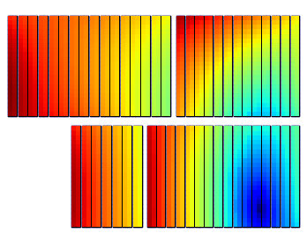
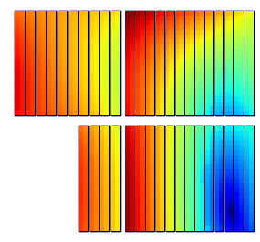
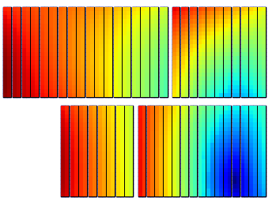
The BOND Case
Summary table
Nb₃Sn
Nb-Ti
Nb₃Sn
Nb-Ti
Nb₃Sn
Nb-Ti
Nb₃Sn
Nb-Ti
16
13
16
13
10
13
18
11
10
13
7
16
4
13
8
15
Coil design |  | BOND | Hybrid 14 T Flat | Hybrid 14 T Stepped | Hybrid 12 T Flat | Hybrid 12 T at 4.5K
Nb₃sn Insulated cable surface (one aperture) | (mm²) | 11 572 | 5 786 | 5 119 | 3 116 | 5 786
NbTi Insulated cable surface (one aperture) | (mm²) | 0 | 5 394 | 6 016 | 5 394 | 5 394
Nb₃sn ratio to BOND | (%) | 100 | 50 | 44 | 27 | 50
Operational parameters
Current | (kA) | 19.34 | 19.34 | 19.34 | 19.92 | 16.20
Peak Field on Nb₃Sn | (T) | 14.8 | 14.8 | 14.8 | 13.0 | 12.7
Short sample current @ 1.9 K on Nb₃Sn | (kA) | 23.66 | 23.65 | 23.63 | 27.27 | 21.02
Short sample field @ 1.9 K on Nb₃Sn | (T) | 17.8 | 17.8 | 17.8 | 17.1 | 16.0
Loadline fraction @1.9 K on Nb₃Sn | (%) | 81.7 | 81.8 | 81.9 | 73.0 | 77.1
Peak Field on NbTi 1st layer | (T) |  | 6.8 | 8.7 | 8.7 | 7.0
Short sample current @ 1.9 K on NbTi 1st layer | (kA) |  | 31.65 | 24.79 | 25.38 | 18.95
Short sample field @ 1.9 K on NbTi 1st layer | (T) |  | 9.9 | 10.7 | 10.6 | 7.9
Loadline fraction @1.9 K on NbTi 1st layer | (%) |  | 61.1 | 78.0 | 78.5 | 85.5
Peak Field on on NbTi 2nd layer | (T) |  | 8.8 | 8.8 | 8.9 | 7.0
Short sample current @ 1.9 K on NbTi 2nd layer | (kA) |  | 24.04 | 23.99 | 24.91 | 18.43
Short sample field @ 1.9 K on NbTi 2nd layer | (T) |  | 10.8 | 10.8 | 10.7 | 7.9
Loadline fraction @1.9 K on NbTi 2nd layer | (%) |  | 80.5 | 80.6 | 80.0 | 87.9
AC-losses over a full cycle | (kJ/m) | 24.6 | 15.2 | 13.8 | 8.3 | 14.3
AC-losses ratio | (%) | 100 | 62 | 56 | 34 | 58
Loadline at 4.5 K

Slide 16
3. BOND-H
A Realistic Case with the LHC 01 Strand

Slide 17
BOND-H
LHC 01: an “on the shelf” conductor
Conductor parameters |  | Nb₃Sn DEM-1.1 |  | Nb-Ti LHC 01
Strand diameter | (mm) | 1.10 |  | 1.065
Layout |  | RRP 162/169
Effective filament diameter | (µm) | 64 |  | 7
Jc at 4.2 K and 16 T | (A/mm²) | 1200
Cu/NonCu ratio |  | 0.9 |  | 1.6
No. of strands in cable |  | 40 |  | 42
Bare cable width | (mm) | 23.045 |  | 22.650
Bare cable thickness | (mm) | 1.98 |  | 1.90
Bare cable width (reacted) | (mm) | 23.275
Bare cable thickness (reacted) | (mm) | 2.06
Insulation thickness | (mm) | 0.150 |  | 0.150
Insulated cable width (reacted) | (mm) | 23.575 |  | 22.950
Insulated cable thickness (reacted) | (mm) | 2.36 |  | 2.2
A strand | (mm²) | 0.950 |  | 0.891
A sc | (mm²) | 0.500 |  | 0.343
A cu | (mm²) | 0.450 |  | 0.548
The Nb₃Sn cable in BOND is made of 40 DEM-1.1 strands of 1.1 mm.
For the Nb-Ti, we consider using a cable of 42 LHC 01 strand:
1.065 mm strand
1.6 Cu/NonCu ratio
The high amount of copper in the Nb-Ti dramatically increases the current density in the superconductor.

Slide 18
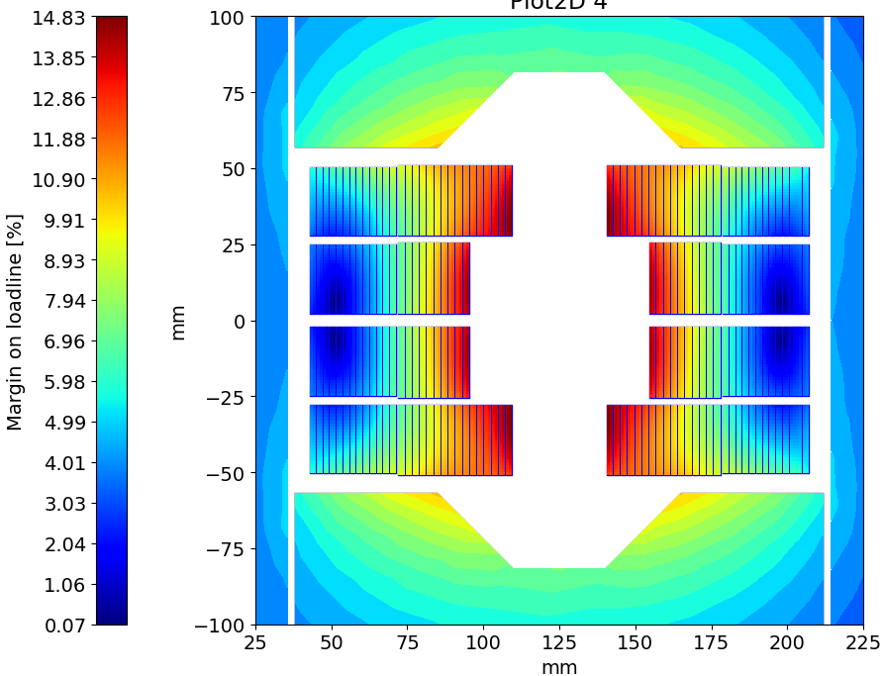
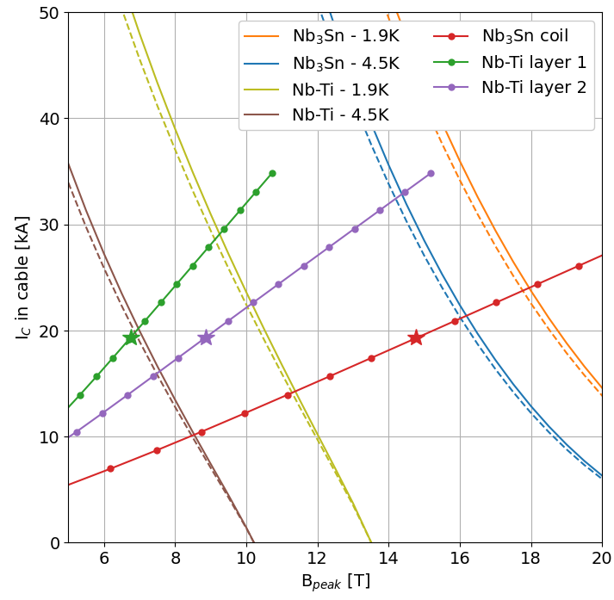
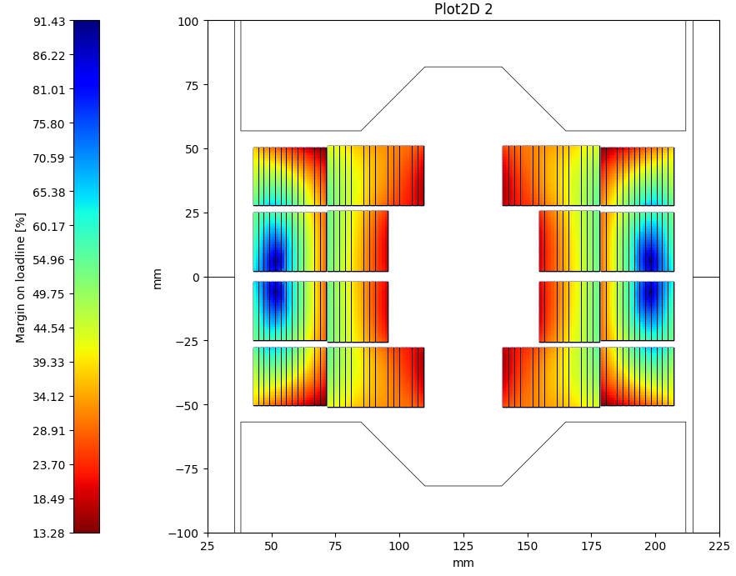
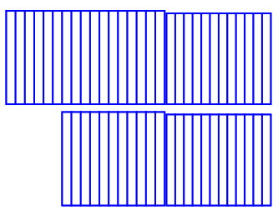
BOND-H
14 T flat version with LHC 01
Magnetic Field
Nb₃Sn: 28 turns (11+17)
Nb-Ti: 26 turns (13+13)
Nb₃Sn ratio: 50 %
At nominal, loadline fraction are:
81.8% on the Nb₃Sn
86.8% on the Nb-Ti
Limited by the Nb-Ti at 22.22 kA
Margin on the loadline
Nb₃Sn
Nominal current | [kA] | 19.34
SS field at 1.9 K | [T] | 17.8
SS current at 1.9 K | [kA] | 23.65
Loadline fraction | [%] | 81.8
Nb-Ti layer 1
Nominal current | [kA] | 19.34
SS field at 1.9 K | [T] | 9.1
SS current at 1.9 K | [kA] | 28.56
Loadline fraction | [%] | 67.6
Nb-Ti layer 2
Nominal current | [kA] | 19.34
SS field at 1.9 K | [T] | 10.0
SS current at 1.9 K | [kA] | 22.22
Loadline fraction | [%] | 86.8
16
13
10
13

Slide 19
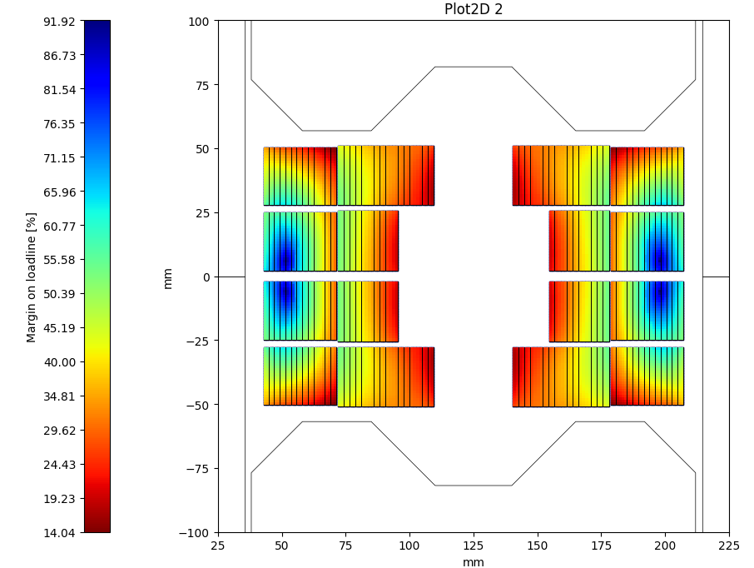
BOND-H
Gaining margin on the Nb-Ti
Tools to reduce the peak field on the upper Nb-Ti layer:
Optimization of the shape of the yoke to force the flux lines in the iron away from the Nb-Ti upper block.
gain 1-2% on the loadline
Reduce the number of Nb-Ti turns.
gain ~2% per turn
We are limited by the field target of 14 T and the field homogeneity in the aperture.

Slide 20
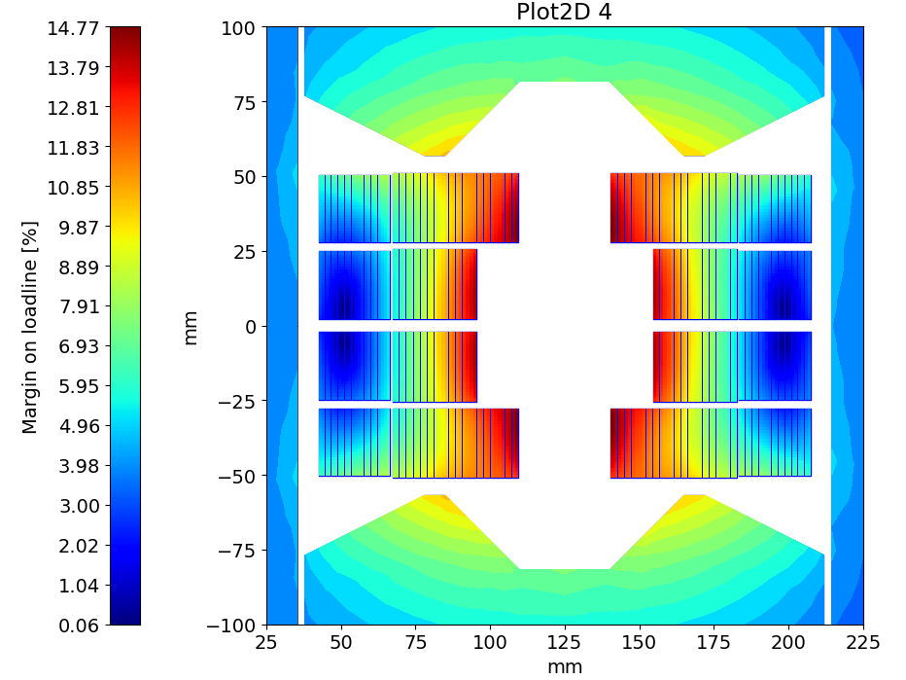
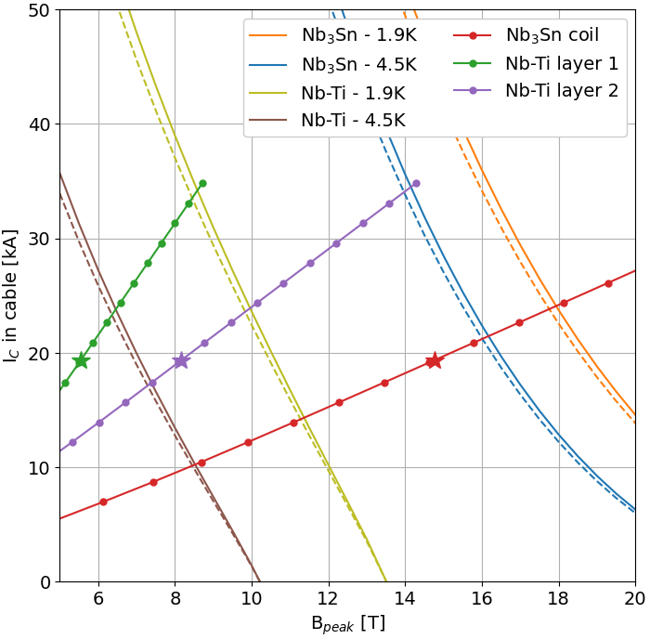
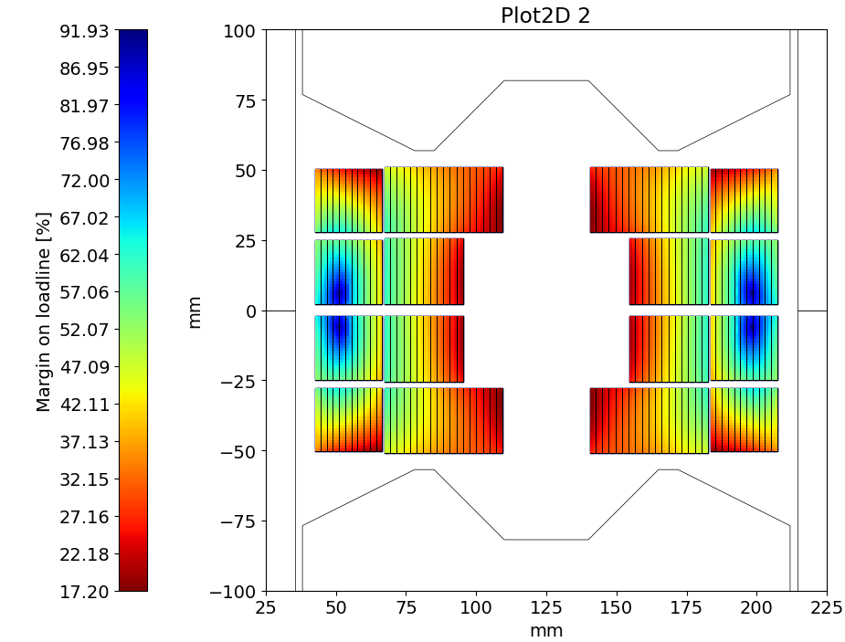
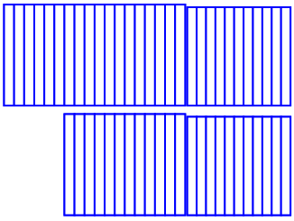
BOND-H
Optimized LHC 01 version
Magnetic Field
Optimization: iron pockets and 2 turns less
Nb₃Sn: 30 turns (12+18)
Nb-Ti: 22 turns (11+11)
Nb₃Sn ratio: 58%
At nominal, loadline fractions are:
81.8% SS on both Nb₃Sn and Nb-Ti
Limited by the Nb-Ti at 23.58 kA
Margin on the loadline
Nb₃Sn
Nominal current | [kA] | 19.34
SS field at 1.9 K | [T] | 17.8
SS current at 1.9 K | [kA] | 23.65
Loadline fraction | [%] | 81.8
Nb-Ti layer 1
Nominal current | [kA] | 19.34
SS field at 1.9 K | [T] | 8.5
SS current at 1.9 K | [kA] | 33.52
Loadline fraction | [%] | 57.6
Nb-Ti layer 2
Nominal current | [kA] | 19.34
SS field at 1.9 K | [T] | 9.8
SS current at 1.9 K | [kA] | 23.58
Loadline fraction | [%] | 81.8
18
11
12
11

Slide 21
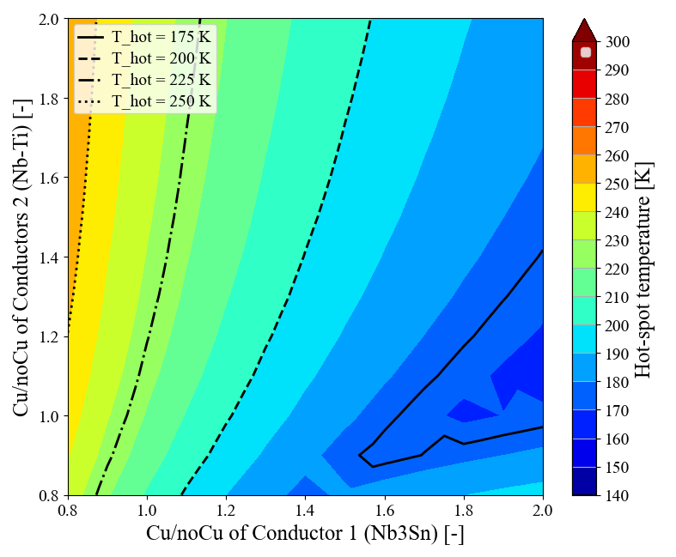
BOND-H
Hot-spot simulations
Courtesy of E. Ravaioli
Based on the “14 T flat” non optimized design.
Hot spot calculation has been performed for a 14.3 m long magnet as a function of the copper amount in the Nb₃Sn and the Nb-Ti.
In this design, hot spot reaches ~240 K.
A Nb-Ti strand with less copper should allow to gain 10-20 K.
LHC 01 version
Ideal version

Slide 22
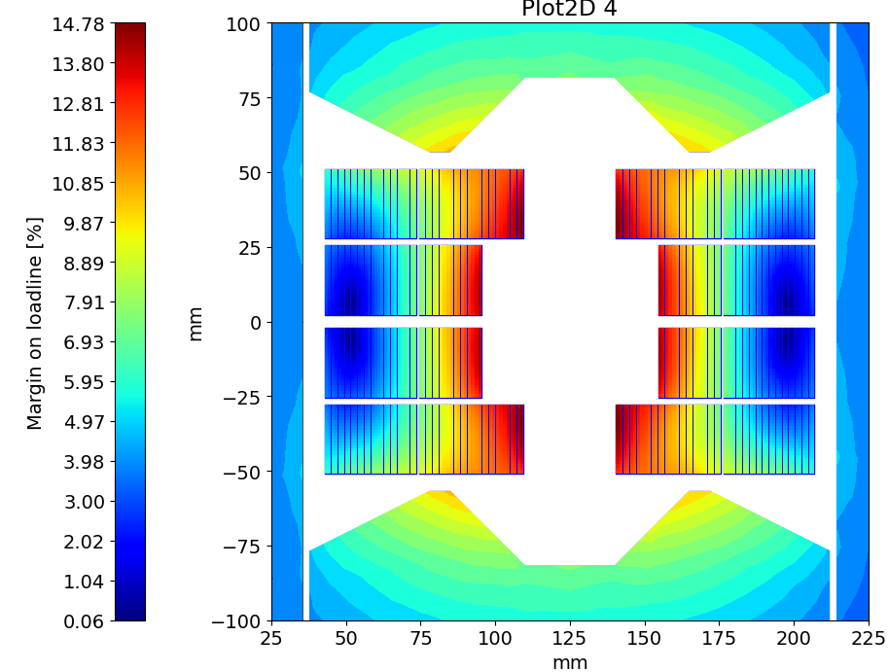
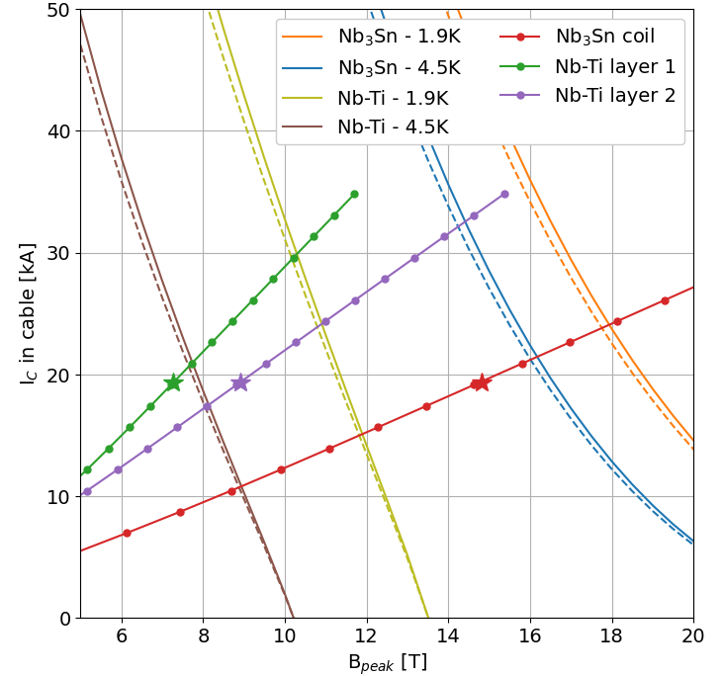
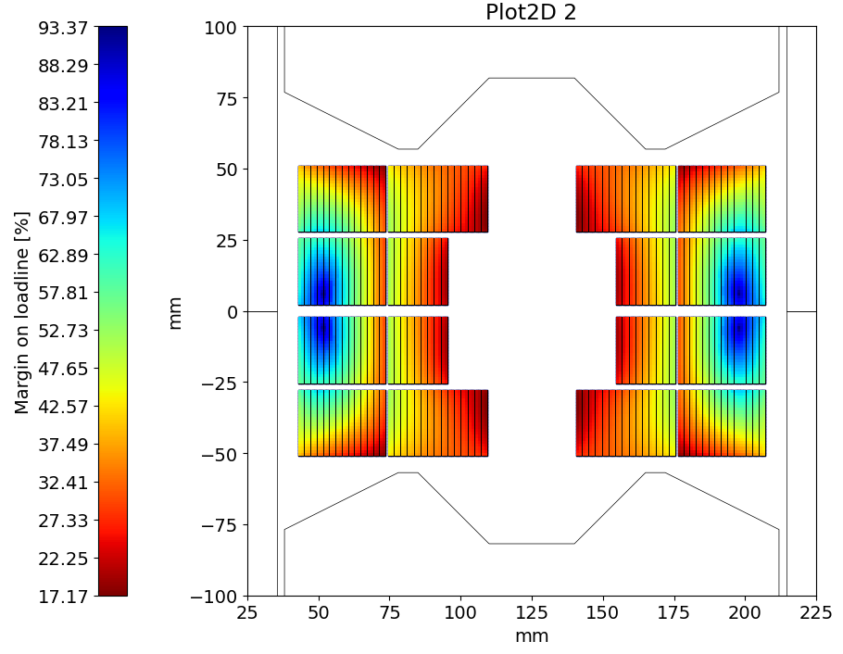
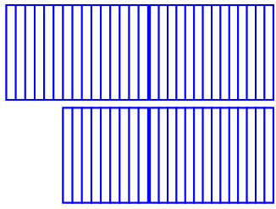
The BOND Case
14T – Ideal version
Magnetic Field
Nb₃Sn: 24 turns (9+15)
Nb-Ti: 28 turns (14+14)
Nb₃Sn ratio: 46%
At nominal, loadline fraction are:
81.8% on the Nb₃Sn
80.1% on the Nb-Ti
Limited by the Nb₃Sn at 23.65 kA
Margin on the loadline
Nb₃Sn
Nominal current | [kA] | 19.34
SS field at 1.9 K | [T] | 17.8
SS current at 1.9 K | [kA] | 23.65
Loadline fraction | [%] | 81.8
Nb-Ti layer 1
Nominal current | [kA] | 19.34
SS field at 1.9 K | [T] | 10.2
SS current at 1.9 K | [kA] | 29.48
Loadline fraction | [%] | 65.6
Nb-Ti layer 2
Nominal current | [kA] | 19.34
SS field at 1.9 K | [T] | 10.9
SS current at 1.9 K | [kA] | 24.15
Loadline fraction | [%] | 80.1
15
14
9
14

Slide 23
BOND-H
Summary table
Nb₃Sn
Nb-Ti
Nb₃Sn
Nb-Ti
18
11
15
14
12
11
9
14
LHC 01 version
Ideal version
Conductor parameters |  | Nb₃Sn DEM-1.1 |  | Nb-Ti Ideal | Nb-Ti LHC 01
Strand diameter | (mm) | 1.10 |  | 1.10 | 1.065
Layout |  | RRP 162/169
Effective filament diameter | (µm) | 64 |  | 7 | 7
Cu/NonCu ratio |  | 0.9 |  | 1.0 | 1.6
No. of strands in cable |  | 40 |  | 40 | 42
Bare cable width (r) | (mm) | 23.275 |  | 23.275 | 22.650
Bare cable thickness (r) | (mm) | 2.06 |  | 2.06 | 1.90
Insulation thickness | (mm) | 0.150 |  | 0.150 | 0.150
Insulated cable width | (mm) | 23.575 |  | 23.575 | 22.950
Insulated cable thickness | (mm) | 2.36 |  | 2.36 | 2.2
A strand | (mm²) | 0.950 |  | 0.950 | 0.891
A sc | (mm²) | 0.500 |  | 0.475 | 0.343
A cu | (mm²) | 0.450 |  | 0.475 | 0.548
Coil design |  | LHC 01 version |  |  | Ideal version
 |  | Nb₃Sn | Nb-Ti |  | Nb₃Sn | Nb-Ti
Insulated cable surface / aperture | (mm²) | 5341 | 6073 |  | 6676 | 4443
Nb₃sn ratio to BOND | (%) | 58 |  |  | 46
Operational parameters
Current (I_{nom}) | (kA) | 19.34 |  |  | 19.34
Peak Field | (T) | 14.8 | 8.2 |  | 14.8 | 8.9
Short sample current @ 1.9 K | (kA) | 23.65 | 23.58 |  | 23.65 | 24.15
Short sample field @ 1.9 K | (T) | 17.8 | 9.8 |  | 17.8 | 10.9
j overall | (A/mm²) | 348 | 383 |  | 348 | 348
j strand | (A/mm²) | 509 | 517 |  | 509 | 509
j superconductor | (A/mm²) | 967 | 1323 |  | 967 | 1018
j copper | (A/mm²) | 1074 | 840 |  | 1074 | 1018
Loadline fraction @ 1.9 K | (%) | 81.7 | 82.0 |  | 81.7 | 80.1

Slide 24
3. Short Model Coil Validation

Slide 25
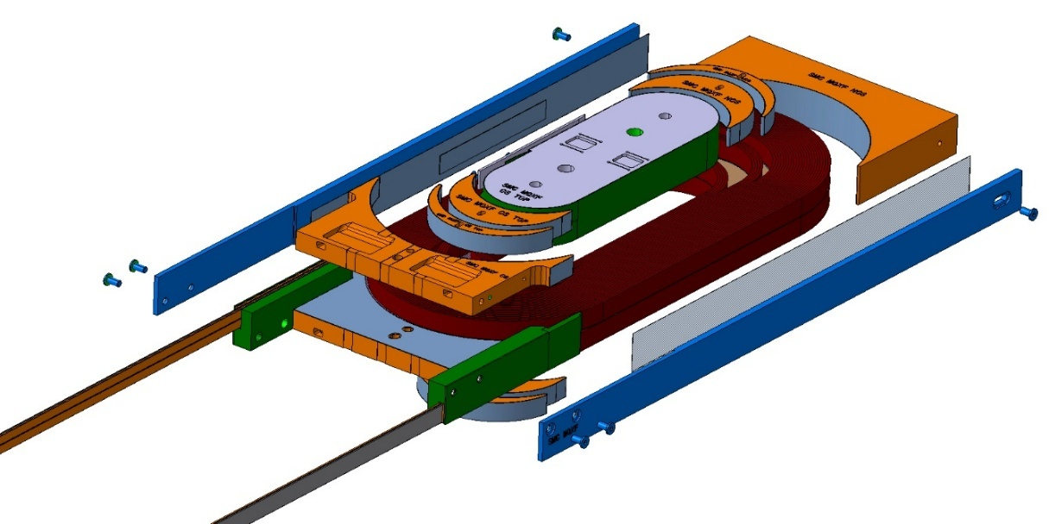
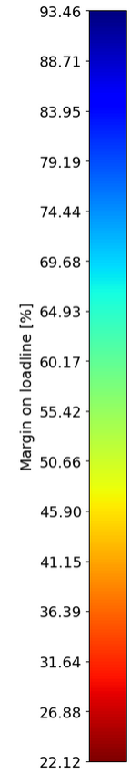
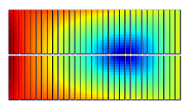

Short Model Coil Validation
Hybrid racetrack coil
The Short Model Coil (SMC) assembly has been designed as a test bench for short racetrack coils wound with Nb₃Sn cable.
SMC MQXF uses a cable made of 32 MQXF strands in a double pancake racetrack coil of 31 turns.
A similar cable made of 35 LHC 02 strands could be used to make a hybrid version with:
Nb₃Sn coil of 15 turns
Nb-Ti coil of 15 turns
Conductor parameters |  | Nb₃Sn |  | Nb-Ti
Strand diameter | (mm) | 0.850 |  | 0.825
Layout |  | RRP 108/125
Effective filament diameter | (µm) | 55 |  | 7
Cu/NonCu ratio |  | 1.2 |  | 1.9
No. of strands in cable |  | 32 |  | 35
Bare cable width | (mm) | 14.7 |  | 14.75
Bare cable thickness | (mm) | 1.525 |  | 1.48
Bare cable width (reacted) | (mm) | 14.88
Bare cable thickness (reacted) | (mm) | 1.59
Insulation thickness | (mm) | 0.150 |  | 0.150
Insulated cable width (reacted) | (mm) | 15.18 |  | 15.05
Insulated cable thickness (reacted) | (mm) | 1.89 |  | 1.78
A strand | (mm²) | 0.567 |  | 0.535
A sc | (mm²) | 0.258 |  | 0.184
A cu | (mm²) | 0.310 |  | 0.350
SMC MQXF
SMC-H
30
15
16

Slide 26

Short Model Coil Validation
Magnetic design
SMC-H is always limited by the Nb-Ti due to higher filed on the last turns.
The Nb₃sn operates at 90% when the Nb-Ti is at short sample limit, limited at 17 kA.
The hybrid SMC includes 48% of Nb₃Sn.
Coil design |  | SMC MQXF | SMC H
Nb₃sn Insulated cable surface (one aperture) | (mm²) | 3558 | 1725
Nb-Ti Insulated cable surface (one aperture) | (mm²) | 0 | 1714
Nb₃sn ratio | (%) | 100 | 48
Operational parameters
Current | (kA) | 18.93 | 17.00
Short sample current @ 1.9 K on Nb₃Sn | (kA) | 18.93 | 18.93
Short sample field @ 1.9 K on Nb₃Sn | (T) | 14.0 | 14.0
Loadline fraction @1.9 K on Nb₃Sn | (%) | 100 | 90.0
Short sample current @ 1.9 K on Nb-Ti | (kA) |  | 17.00
Short sample field @ 1.9 K on Nb-Ti | (T) |  | 8.7
Loadline fraction @1.9 K on Nb-Ti | (%) |  | 100
SMC MQXF
SMC-H
31
15
16

Slide 27



Short Model Coil Validation
Engineering of SMC-H
Courtesy of T. Poszwa
Engineering design for the coil is already advanced.
After winding and reacting the Nb₃Sn coil, an internal splice allows the connection to the Nb-Ti cable.
The head spacers are diluting the peak fields in the turn and allocate the internal splice.
A mock-up is manufactured to test and develop this specific splice.
After splicing, the Nb-Ti wound around the Nb₃Sn coil, and the coil is fully impregnated.
A mechanical model should validate this structure.

Slide 28
Conclusion
Material grading is a great way to reduce conductor cost in high field magnets by replacing the Nb₃Sn by Nb-Ti in the low field regions of the coils.
The case study of BOND generating 14 T at 1.9 K, shows that 50 % or more of the Nb₃Sn could be replaced by Nb-Ti in this block coil design, improving Ac-losses as well.
A realistic design is proposed based on the available LHC 01 strand with 58% Nb₃Sn.
A hybrid short model racetrack magnet with internal splices is under development with an engineering design on-going.

Slide 30








BOND-H
Optimizing the yoke
original
10/10
20/20
30/30
40/40

Slide 31




BOND-H
Optimizing the yoke
original
40/40
40/10
40/20

Slide 32






BOND-H
Removing turns
removing 1 Nb-Ti turn
removing 2 Nb-Ti turn
original
40/20
40/20
40/20

Slide 33




BOND-H
Ideal version
original
Iron optimized
adding 1 Nb-Ti turn

Slide 34


The BOND Case
14T – LHC 01 version 12-turns
Magnetic Field
Nb₃Sn: 28 turns (11+17)
NbTi: 26 turns (12+12)
Nb₃Sn ratio: 54 %
Loadline at 1.9 K: below 82 %, limited by the Nb₃Sn coil.
Margin on the loadline
Nb₃Sn
Nominal current | [kA] | 19.34
SS field at 1.9 K | [T] | 17.8
SS current at 1.9 K | [kA] | 23.65
Loadline fraction | (%) | 81.8
NbTi layer 1
Nominal current | [kA] | 19.34
SS field at 1.9 K | [T] | 8.8
SS current at 1.9 K | [kA] | 31.00
Loadline fraction | (%) | 62.4
NbTi layer 2
Nominal current | [kA] | 19.34
SS field at 1.9 K | [T] | 9.9
SS current at 1.9 K | [kA] | 23.10
Loadline fraction | (%) | 83.7
17
12
11
12

