Slide 1
Update on longitudinal impedance simulation of SPS-TECA goniometer
H. Pommerenke for the Impedance Team
Impedance Working Group #106
07-Oct-2025

Slide 2
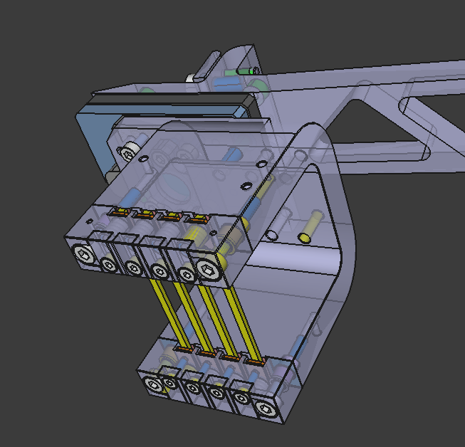
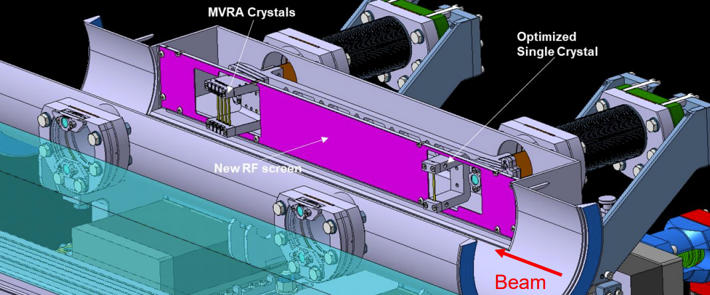
Context
Installation of new crystal assemblies inside the TECA.41777 in SPS LSS4
References: L.S. Esposito https://indico.cern.ch/event/1578706/
ECR: [pending], EMDS [pending]
“install new optimized crystal assemblies during the YETS 2025-26 to reduce the losses in LSS2 during the SPS slow extraction to the North Area and test their performance during MD in 2026.” (ECR draft)
L.S. Esposito

Slide 3
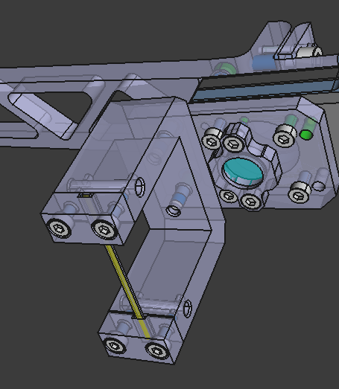
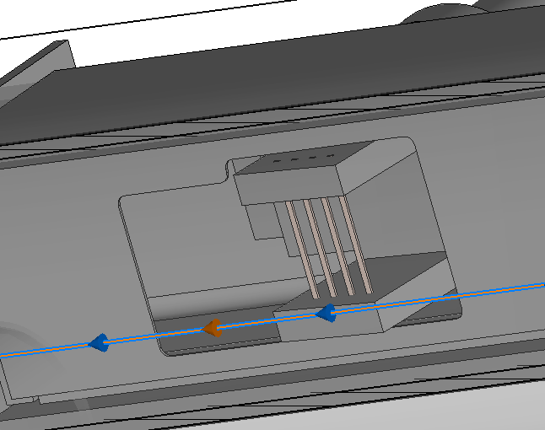
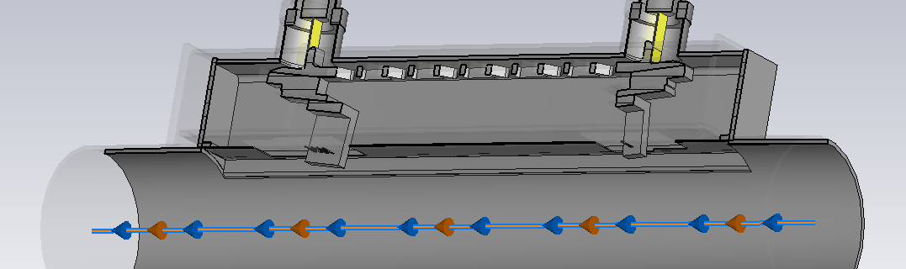
Changes in geometry
Before: 2 identical crystal holders
After:
  downstream crystal holder: 1 → 4 crystals
  Larger openings in RF shield necessary
  → expect higher coupling to shielded volume

Slide 4
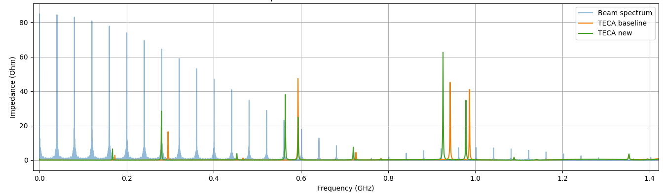
Impedance simulation
CST longitudinal impedance simulation (bunch σ = 44 mm/c = 0.15 ns)
Slight worsening of spectrum, but still ok for beam (exact frequency of peaks hard to simulate)
Modes shift downwards by ~15 MHz because of higher coupling through shield
Split in two because of asymmetry in RF shield
~50 % higher impedance and on beam spectral line

Slide 5
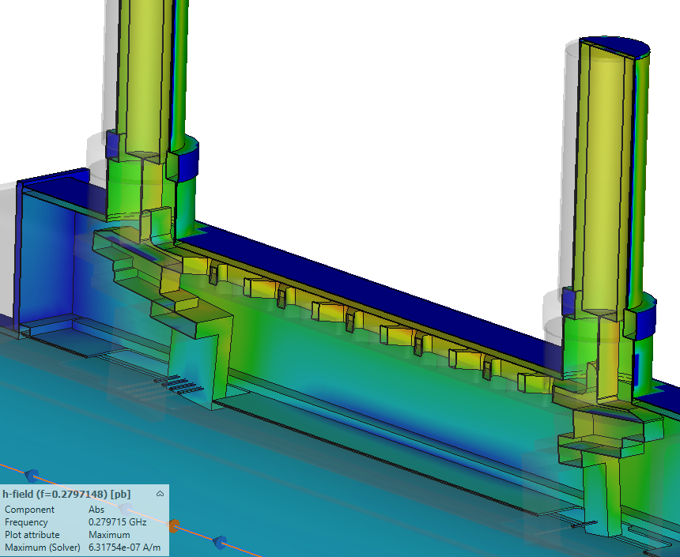
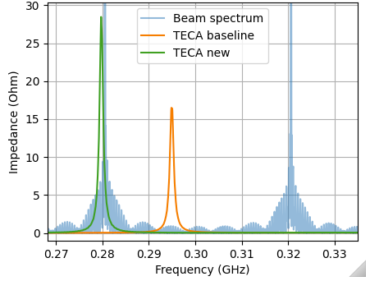
Impedance simulation
280 MHz

Slide 6
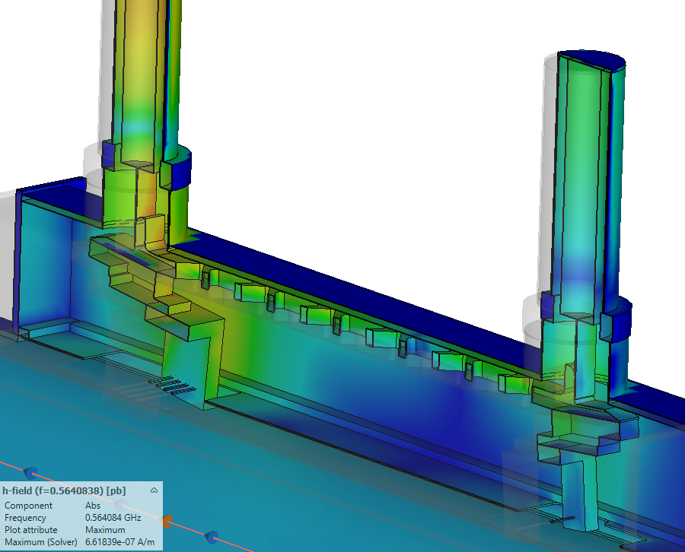
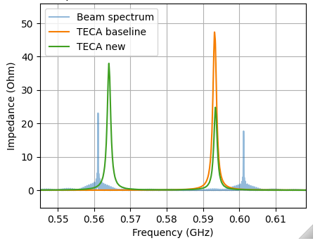
Impedance simulation
564 MHz

Slide 7
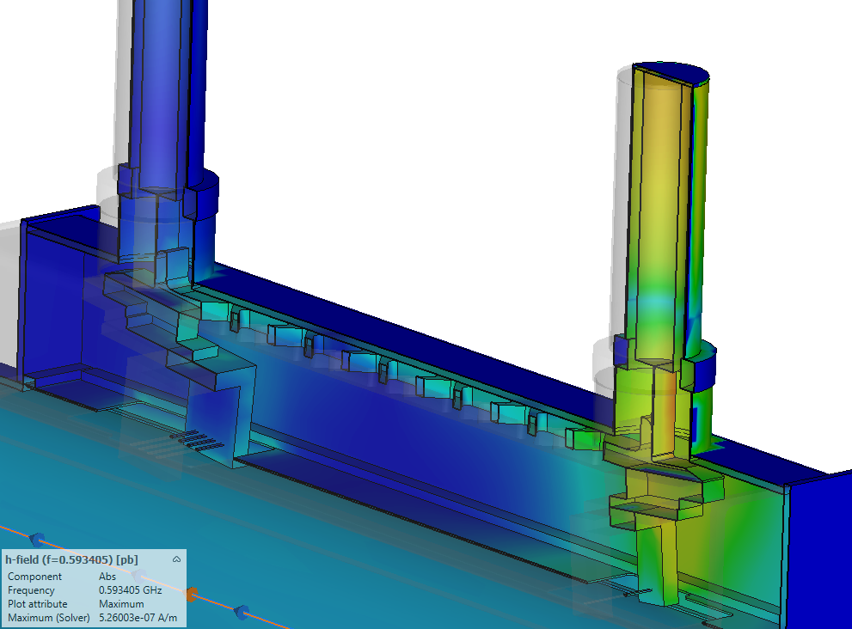
Impedance simulation
593 MHz

Slide 8
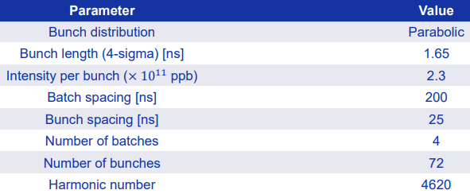
RF power loss
Assuming SPS-LIU beam
Straight-forward calculation taking raw CST results:
0.6 W → 9 W (x15 power loss)
but this depends on exact position of impedance peaks
Worst-case scenario evaluated (C. Zannini): 30 W total, 0.1 W on crystal
→ Still OK ??

