Slide 1

Carpenter: items, assemblies, circuits and test plans
2025.10.08 -- F. Mangiarotti

Slide 2
Nomenclature

Slide 3
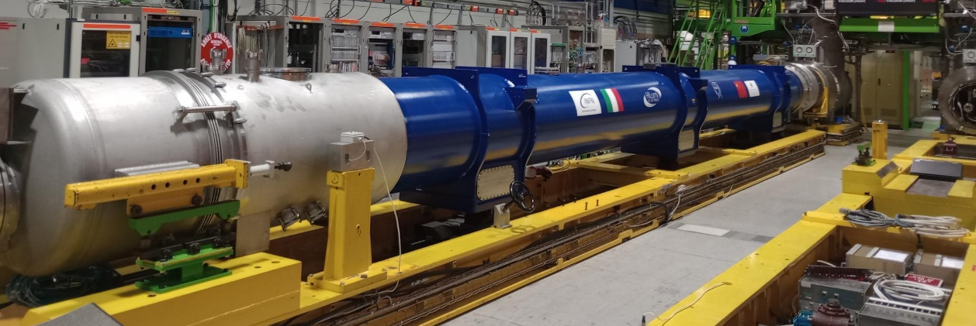
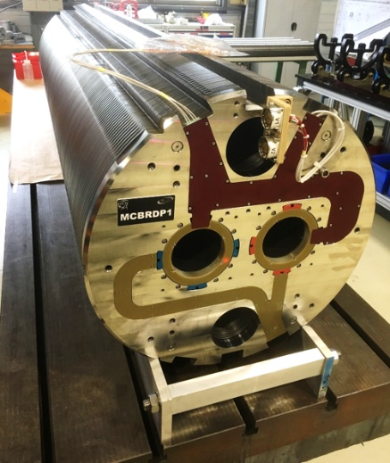
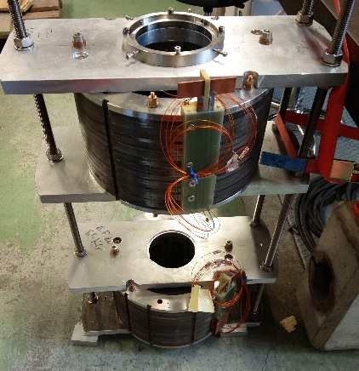
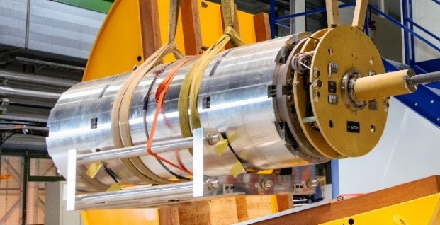
Item
Item
Item
Item
A magnet is an item
Typical item properties: weight, length, diameter, maximum Delta-T
Item types: Magnet, Diode, Sc Link
Item
Item
Item
Item

Slide 4
Assembly
Assembly
An assembly is how we test items
The assembly can be a cold mass or an ad-hoc collection of items
Assembly types: horizontal magnet, vertical magnet, diode, Sc Link
Assembly
Assembly
Assembly

Slide 5
Circuit
Circuit
Circuit
Circuit
Circuit
Circuit
A circuit is what we power
Circuit type = Item type
QH are “part” of the circuit
Circuit
Circuit
Circuit
Circuit
Circuit

Slide 6
Circuit – Item – Assembly
Assembly can have many items
Items in one assembly can appear in another assembly
E.g. we test the D2 proto with some correctors, but those correctors can be installed in a future D2 cold mass
Items can have many circuits – e.g. MCBRD, MCBXF
Different items can have the same circuit
E.g. MCBRDP1 and MCBRDP3 share one of the two circuits (reassembled)
MQXFS7a, S7b, S7c etc all have the same circuit (coil pack assembly)
MQXFS6a and S6b have different circuit (coils were changed)

Slide 7
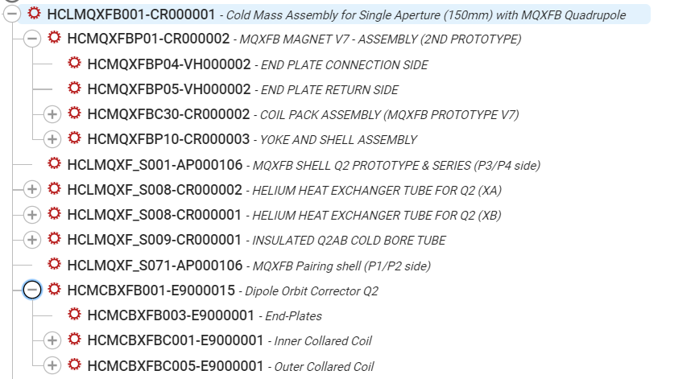
Example Q2 from MTF
Assembly (LMQXFB…)
Item (MQXFB…)
Circuit (MQXFB…)
Item (MCBXFB…)
Circuit (MCBXFB_I#)
Circuit (MCBXFB_O#)

Slide 8
What name to use
 | Assembly name | Item name | Circuit(s) name(s)
Main dipole | From cryostat | From cryostat | From collared coil
HL LHC cryomagnets | From cold mass | From magnet | From collared coil or coil pack
MCBXF (vertical) | From magnet | From magnet | From collared coil
MQXFS | From magnet | From magnet | From magnet
SMC | From magnet | From magnet | From coil
If you are unsure, we can see this together.

Slide 9
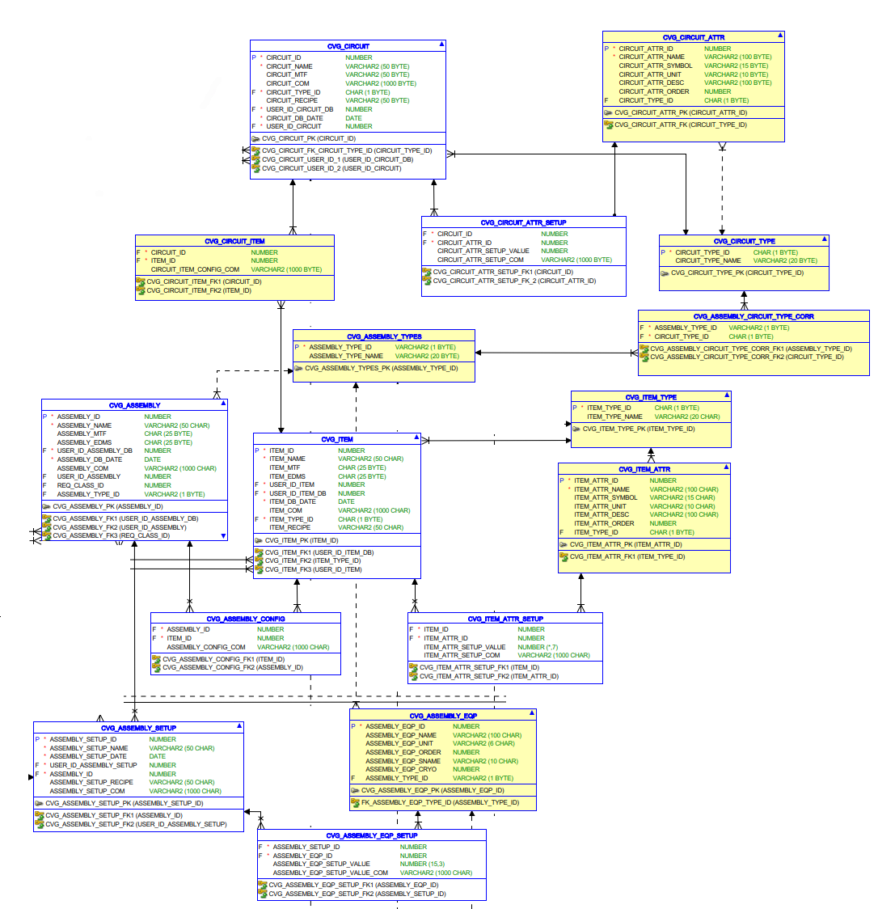
How does this look in the DB
Circuit
Circuit
properties
A bit complicated but it kinda works
There is one additional level: Assembly setup
This is how we test the assembly
E.g. with or without anticryostat
E.g. additional sensors (fiber optics, MM, SSW, acoustic sensors)
Circuits in item
Assembly
Item
Items in assembly
Item
properties
Assembly
setup
Test plan
Assembly setup properties

Slide 10
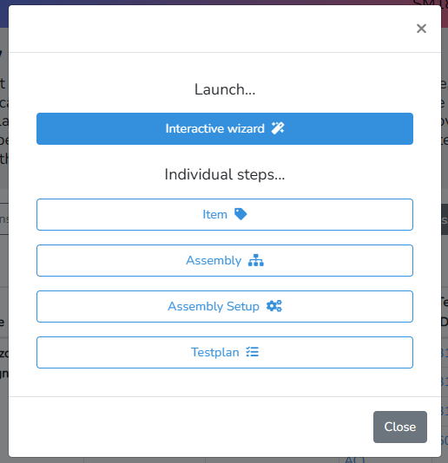
In Carpenter
Circuit
Wizard does everything
Circuit
properties
Circuits in item
Assembly
Item
Item
Assembly
Assembly setup
Items in assembly
Item
properties
Test plan
Assembly
setup
Test plan
Assembly setup properties

Slide 11
CVG <-> DIAdem connection
CVG DB
Carpenter
DIAdem

Slide 12
Workflow
Items, Circuits, Assembly, Test plan created in Carpenter
Data is stored in the database Carvings (CVG)
CVG data is accessed from DIAdem
DIAdem output includes Circuit_ID retrieved from CVG
DIAdem output (txt) file is uploaded to Carpenter
Carpenter parses txt file into CVG

Slide 13
How to automatically identify what is what?
Example situation: D2 assembly
MBRD magnet with one circuit
MCBRD magnet with two identical circuits: AP1 and AP2
Another MCBRD magnet with two identical circuits: AP1 and AP2
How to differentiate the magnets and the circuits?
Solution:
“circuit-item comment”: describes the functional position of the circuit in the item (e.g. “AP1”, “AP2”, “Inner”, etc). Mandatory if the item has more than one circuit.
“item-assembly comment”: describes the functional position of the item in the assembly (e.g. “MCBRD.A”, “MCBRD.B”, etc). Mandatory if the assembly has more than one item.

Slide 14
Item-Assembly and Circuit-Item comments
Circuits can have different C-I comment in different Items
Items can have different I-A comment in different Assemblies

Slide 15

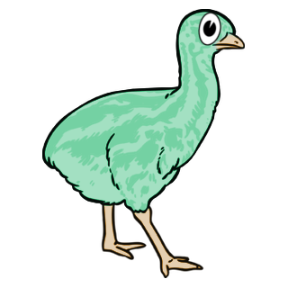

How does DIAdem exploit these comments?
 | OAQ | EMU | DMM-Blender
1. Find Assembly in CVG matching name or MTF | Using file name | From user input | Using file or folder name
2. Load magnet parameter file | Yes | Yes | No
3. Propose potential circuits | From magnet parameter + CVG information | From magnet parameter + CVG information | Only from CVG information
Notes | If 2+ circuits have QH (e.g. Q1) the signals need to be defined in the magnet parameter file | QH linked to circuits are proposed based on the magnet parameter file | No magnet parameter file needed because all required information is in CVG

Slide 16
Example parameter files
Q2
D2
Circuit identifier for DIAdem users
Item-Assembly comment
Circuit-Item comment

Slide 17
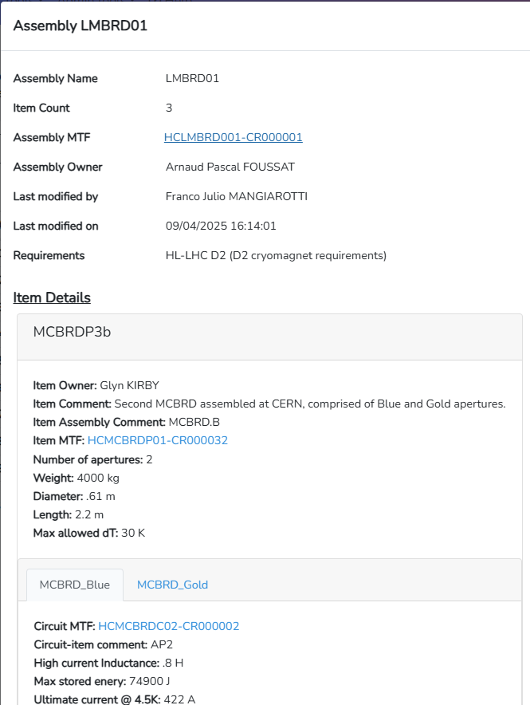
Example parameter files
Example matching a given circuit (MCBRD_Blue) from a given assembly (LMBRD01) via comments

Slide 18
Example parameter files
Q1/Q3
MQXFA.A QH signals
MQXFA.B QH signals
This is just to show how OAQ knows which QH signals correspond to which circuit in the Q1/Q3 (and similar) cases

Slide 19
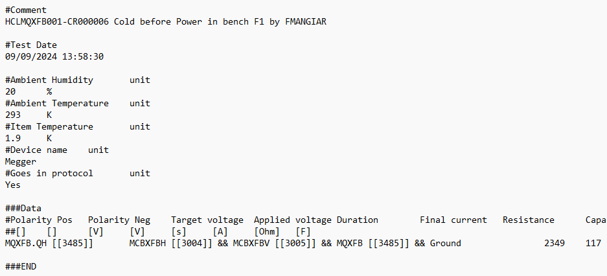
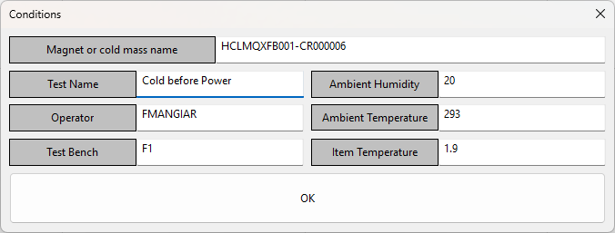
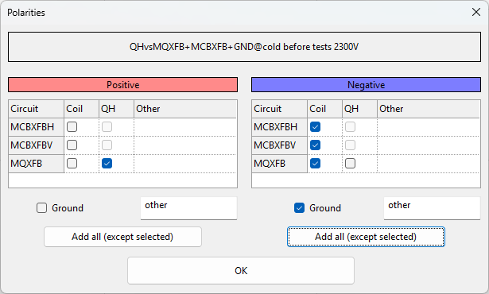
Example workflow for EMU
Input assembly name
IDs matched from DB
Options from parameter file

Slide 20

How to solve specific situations

Slide 21
Some situations that can happen
 | Situation | What to use | Pay attention to
1 | New cold mass with new magnets | Wizard | Choose the right names
2 | New cold mass with existing magnets | Wizard | Choose the right existing items
3 | New magnet iteration (RMM1x, MQXFS4x) | Wizard | Use the right existing circuit
4 | Re-test a magnet or a cold mass, in the same way | New test plan | Choose the right assembly setup
5 | Re-test a magnet or a cold mass, but differently (e.g. adding MM shaft or anticryostats) | New assembly setup, then new test plan | Choose the right assembly for the assembly setup, then the right setup for the new test plan
Always: pay attention to Item-Assembly comment and Circuit-Item comment

Slide 22
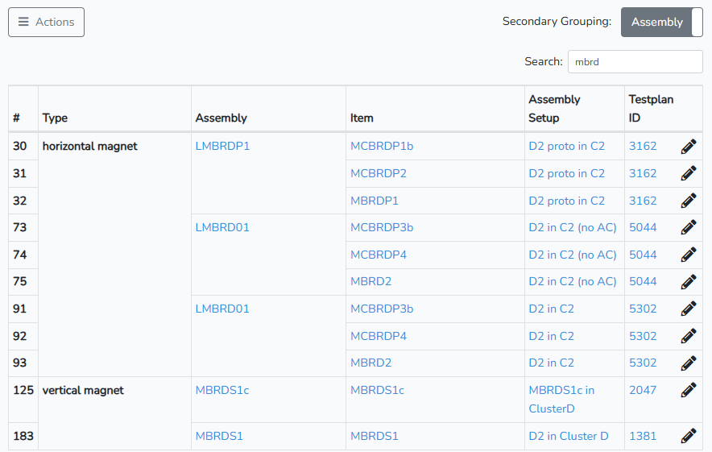
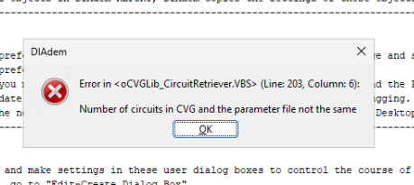
Example problem: double cold mass
Two cold masses (assemblies) with the same name and MTF code (Case 5 before).
Since DIAdem matches file names with assembly name or MTF, it finds two matches and has an error:
Only solution: manually edit entries in CVG and remove one of the assemblies

Slide 23
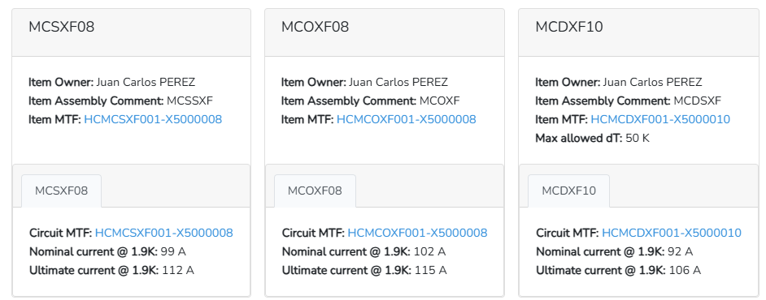
Example problem: item-assembly comment
In the CP there were two magnets with the item-assembly comment “MCSXF”, when one should have been “MCSSXF”
This was difficult to find because there are 9 items…
Once it was found, it was easy to change via Carpenter

