Slide 1
Update on LHCb requirements
G. Corti (CERN), N. Watson (Birmingham)

Slide 2
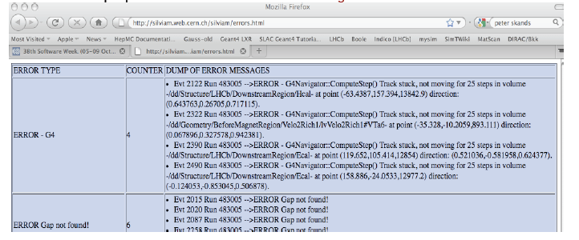
Tracing problems in production
Crashes and aborted events impact mass production
  Protection introduced to protect from stuck particles and ping-pong effects
Important to trace back reason of crashes and problems not leading to crashes (events or tracks aborted) during production
  Impossible to look through ~50k jobs log files/day
  Detect G4 errors at level of jobs during production and combine them for statistics
  Retrieve full dump or error messages together with Run and Event Number to fully reproduce them and investigate them
Would be greatly facilitated by standardization of error messages
Understand this will be available in G4 9.5

Slide 3
Signature of Physics Builders
In LHCb the physics lists are built at run time via a templated factory mechanism instanciating the Physics Builders
But we also want to be able to have some configuration when constructing them and not duplicate code
It would be very useful to have a uniform fixed signature for all the physics constructors, as far as the argument types are concerned. In other words, different constructors can take different arguments as far as the physical meaning of them is concerned, but all the signatures would have the same set of argument types.
  e.g. Builder(string, string, int, float, double)

Slide 4
EM Physics
Investigating some of the new physics lists proposed in 9.4 and in the next version 9.5
  Will provide feed back and/or new requirements.
We are currently investigating some puzzling aspects of the dedicated physics list provided to us by G4 for Multiple Scattering
  But we are not ready to report it as we would like to understand better what is happening. Will discuss with the Geant4 experts in EM physics how to proceed in our investigation.

