Slide 1
Open Quantum Institute Advisory Committee
16th October 2025
15:00 – 17:30
Hybrid

Slide 2
Welcome from the AC Chairs

Slide 3




OQI Advisory Committee – renewal / composition
Joachim Mnich (OQI Advisory Committee-Co-Chair, Director for Research and Computing, CERN)
Marieke Hood (OQI Advisory Committee-Co-Chair, GESDA Executive Director Impact)
Alain Labrique (Director of Digital Health and Innovation at WHO)
Anousheh Ansari (CEO, XPRIZE Foundation)
H.E. Mr. Arindam Bagchi (Ambassador, Permanent Mission of India to the United Nations Office)
Barry Sanders (Professor Scientific Director, Quantum City, University of Calgary)
H.E. Mr. Bilal Ahmad (Ambassador, Permanent Mission of Pakistan to the United Nations Office)
H.E. Ms. Claudia Fuentes Julio (Ambassador, Permanent Mission of Chile to the United Nations Office)
Cornelius Hempel (Group Head, ETH Zürich – PSI Quantum Computing Hub)
H.E. Ms. Désirée Schweitzer (Ambassador, Permanent Mission of Austria to the United Nations Office)
Diederick Croese (Director Centre for Quantum & Society, QDNL)
Dominik Heinrich (Director, Innovation Division, World Food Programme (WFP))
Elica Kyoseva (Director of Quantum Algorithm Engineering, NVIDIA)
Francesco Petruccione (Professor, Stellenbosch University)
H.E. Ms. Francisca Mendez (Ambassador, Permanent Mission of Mexico to the United Nations Office)
Genya Crossman (IBM Quantum)
George Popescu (Head of Quantum Computing Laboratory, University Politehnica of Bucharest)
H.E. Mr. James Waweru (Ambassador, Permanent Mission of Kenya to the United Nations Office)
Julia Thiele (EMEA Business Development and Go-To-Market Strategy for Quantum Computing at AWS)
Manfred Plank (Group Head of Quantitative Risk Modelling, UBS)
Marco Gilli (President, Compagnia di San Paolo Foundation)
Matthias Christandl (Professor for Quantum Computing, University of Copenhagen)
Matthias Troyer (Technical Fellow and CVP, Microsoft Quantum)
Nitin Arora (Lead, Stakeholders Interaction Unit, UN Climate Change Secretariat (UNFCCC))
H.E. Mr. Omar Zniber (Ambassador, Permanent Mission of Morocco to the United Nations Office)
Ozge Aydogan (Director, SDG Lab)
H.E. Mr. Paul Bekkers (Ambassador, Permanent Mission of Kingdom of the Netherlands to the United Nations Office)
Philippe Chomaz (Executive Scientific Director, Commissariat à l’énergie atomique et aux énergies alternatives (CEA))
Prince Osei (Acting President, African Institute for Mathematical Sciences (AIMS))
Rosario Fazio (Director of the Trieste Institute for Quantum Technologies (TQT), Abdus Salam International Centre for Theoretical Physics (ICTP))
Ryan Babbush (Head of Quantum Algorithms, Google)
Sana Odeh (Professor of Computer Science, New York University)
Simon Plant (Deputy Director for Innovation, National Quantum Computing Centre)
H.E. Mr. Tovar Da Silva Nunes (Ambassador, Permanent Mission of Brazil to the United Nations Office)
Urbasi Sinha (Professor, Raman Research Institute)
H.E. Mr. Vincenzo Grassi (Ambassador, Permanent Mission of Italy to the United Nations Office)
Vincenzo Savona (Professor of Theoretical Physics of Nanosystems, Ecole Polytechnique Fédérale de Lausanne)
Vladimír Bužek (Professor, Institute of Physics, Slovak Academy of Sciences)
( Removed: Massamba Thioye, Mira Wolf-Bauwens)

Slide 4
Agenda
15:00 – 15:05 | Welcome from the AC Chairs
15:05 – 15:25 | Institutional Update
15:25 – 15:45 | Strategic input from AC
15:45 – 16:00 | A1: Status update
16:00 – 16:15 | Strategic input from AC
16:15 – 16:30 | A3: Status update
16:30 – 16:45 | Strategic input from AC
16:45 – 17:00 | A4: Status update
17:00 – 17:15 | Strategic input from AC
17:15 – 17:30 | Closing remarks and next meetings of the Advisory Committee

Slide 5
Institutional Update
Tim Smith, Marieke Hood

Slide 6
OQI presentation to CERN Council, June 2025
2 presentations, to the subordinate Scientific Policy Committee, and the Full Council
Very short presentations of 10 minutes
The first time OQI has been presented since the approval of the Pilot phase at CERN
No time to properly address questions
Feedback
Noted progress
Noted OQI’s potential to increase CERN’s impact/visibility beyond Particle Physics
Need to sharpen the arguments on OQIs positive impact on CERN
Have to deliver message about meaningful impact, articulating what is meaningful
Questions:
Understand synergies with QTI, with experiments, with education programmes
Why not targeting more approaches useful to physics such as quantum simulation and PDEs
How do we define success of a use case and what will be the outcomes
Differentiation with industry or national approaches

Slide 7
Institutional Response
Strategic strengthening of team:
OQI/QTI link (Yacine): seek synergies in algorithms, bring QTI expertise in OQI evaluations
A3 project support (Marina): boost hackathon management, enabling exploring educational activities
Next formal opportunity to present to Council will be the time for decision
Need to prepare and send supporting documents in advance
Actually two decisions: CERN Council and GESDA’s Board on reconduction of OQI at CERN
Latest June 2026, probably March 2026
Key role evaluation will play:

Slide 8
Launch of the OQI Evaluation
Evaluation of OQI will inform decision, need report to be ready for CERN Council of March 2026
Task force proposed framework for the evaluation - was sent with agenda
Goals of the evaluation:
assess if OQI has fulfilled the objectives assigned for its pilot
consider whether its mission and scope continue to be relevant and/or if objectives should be revised in view of the evolving quantum technology, stakeholder and diplomacy context
identify conditions for the continued success of OQI in its post-pilot phase
Report to be validated by the Advisory Committee
Evaluation will provide inputs for the strategic positioning of OQI post-pilot
Governance and scaling model of OQI post-pilot
Key considerations:
Expansion to quantum adjacent AI
Potential for further internationalization and regional adaptation of OQI activities
Sustainable funding and business model
Interlinking with national initiatives

Slide 9
Strategic input and Discussion
Feedback on Council observations and possible actions
Feedback on Evaluation Framework
Objectives
Evaluator group
Considerations post pilot

Slide 10
A1 Status Update
Catherine Lefebvre

Slide 11

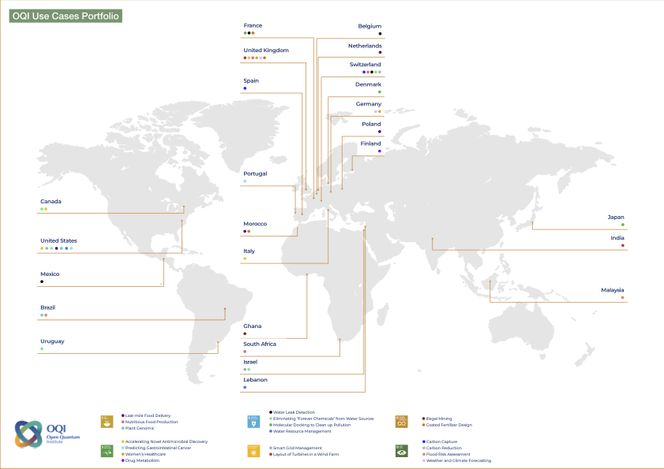
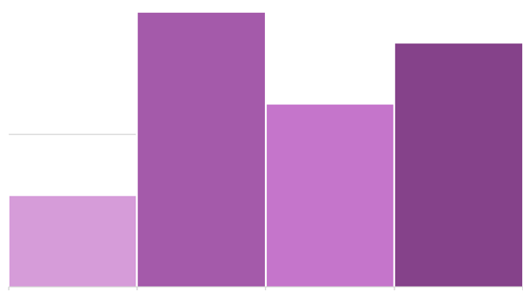




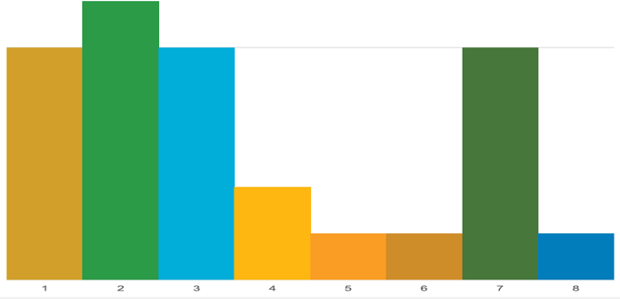








A1 - Key operational updates
5
Linear Syst. of Eqns.
Machine Learning
Optimisation
Quantum Simulation
Quantum Approaches
5
SDG Focus

Slide 12
A1 - Key operational updates
 | Status Pilot Oct. 2025 (Total) | Status & activities since last AC meeting (June - October 2025) | Outputs October 2025 | Milestone March 2026 | Projected outputs March 2026
Ideation | 26 ideas | - Continued effective triage | Online repository | - 1-2 new ideas featured in the repository - Sourcing new ideas and experts | Online repository
 | 19 outlines | - 6 outlines featured in the 2025 Use Case White Paper (Focus mostly on chemistry, and two on partial differential equations) | - 2025 Use Case White Paper - Use case workshop (15 October) | - 1-2 ongoing use case outlines (incl. with QTI) | - Draft outlines
Proof of concept | 9 proposals | - 3 proposals underway - 4 proposals re-evaluated after a 3-month extension phase (3 selected to move to Phase 3) | - Full proposals - Evaluation report of scientific and impact panels - Knowledge share session on resource estimation with MIT | - 3 full proposals evaluated with the scientific and impact panels | - Full proposals - Evaluation report of scientific and impact panels - Knowledge share sessions
 | 5 simulations | - 4 ongoing simulations - 1 simulation finalized and evaluation if advance to Phase 4 | - Internal and external (open) reports → arXiv paper - Github codes (open) | - 3-5 ongoing simulations | - Internal and external (open) reports → arXiv papers - Github codes (open)
 | 0 QPU implementation | - Continued alignment with A2 partner in support + projected need |  | - 4 finalized QPU implementation | - Internal and external (open) reports → arXiv papers - Github codes (open)
Methodology | Use Case Framework | - Application Framework Workshop (15 October): validation by 12 leading quantum hubs - Draft of Regime of Advantage Framework: compendium of 20 problems - Impact Framework under validation with impact committee - Draft of the A3 educational module | - Revised Framework (online and printed) - Regime of Advantage Framework paper (compendium) - Impact Framework | - Feedback from sci. committee on the compendium - Testing of the impact tool (workshops) - Refinement educational module | - arXiv paper on the Regime of Advantage Framework - Online tool of the Impact Framework - Educational module online

Slide 13

A1 - Key guidance for next steps
Summary Key Takeaways
Pipeline on track to meet the objective of 4-6 proof of concept
OQI work is contributing to progress the field with methodological framework, validated by scientific and impact committees, and by 12 world leading national and regional quantum hubs
Feedback and Advice
For the pilot
Process: continuous improvement of pipeline efficiency and quality toward QPU implementation
Substantial effort to establish a pipeline: should we already prepare the post-pilot pipeline (proposed approach/ timeline for that)?
Post-Pilot
Balance of the portfolio and scaling of activities
Include latest AI powered quantum development?

Slide 14
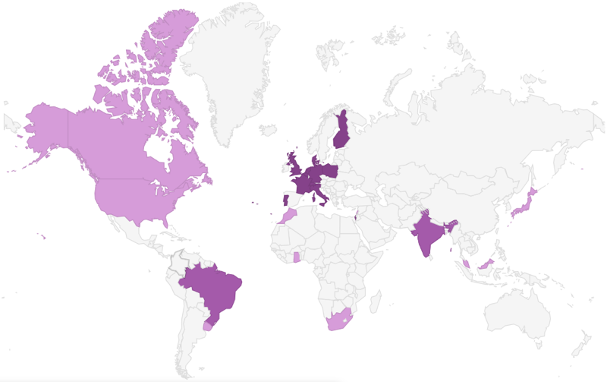
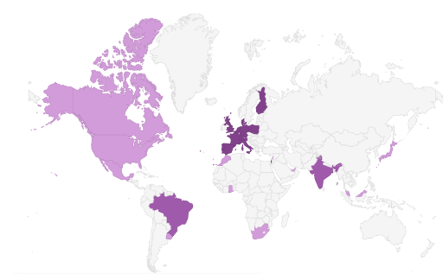
A1 - Key messages for the CERN Council
Scientific relevance
Rigorous methodology, validated by scientific and impact committees, and by 12 world leading national and regional quantum hubs
Open-source outputs/products
Application Framework
Regime of advantage paper
Impact framework tool
Educational module
Reports (from use cases)
Publications (from use cases)
Codes (from use cases)
Use Case Repository
Use Case White Papers
etc
b. Targets set by the Council Note
(on track)
c. Relevance for CERN
QTI / OQI Collaboration: 1 joint-staff + use case
Geographical distribution of the use case teams (contributing to the global OQI diplomatic / societal relevance)
New model for PPP
 | Target | Status October 2025 | Projection December 2026
Number of use case explored | 20+ | 19 | ~21
Number of completed proof of concepts | 4-6 | 9 PoC (4 concluded 5 ongoing) | ~15 PoC (>half to simulation + QPU)
non-CERN Member
CERN Associate Member
CERN Member

Slide 15
A1 - Strategic input and Discussion
Feedback/suggestions on:
Operational plan for 2026
Evaluation criteria
Strategic messages for the CERN Council

Slide 16
A3 Status Update
Martin Gastal

Slide 17

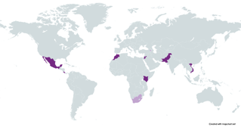

A3 - Key 2025 operational updates
 | Hackathons | Quantum Diplomacy Game | Educational Consortium Engagement | Internship program | Regional Events
Activities since last AC meeting and until end 2025 | 6 successful hackathons: Lebanon, NYUAD, Ghana, CERN, Thailand, Egypt, Uruguay 2 more to happen in 2025 Greece, CERN OQI methodology: Continuous improvement using feedback from participants/hosts & Educational Consortium | 14 QDG events either facilitated or supported 4 more to happen in 2025. | Online touchpoint in May 2025 In-person workshop on OQI hackathon methodology in October 2025 Online workshop (TBC) in December 2025 | Pilot launched for Industry: OQI gathers CVs of hackathon winners and recommends for interviews in partner Tech companies. Coaching of students to prepare interviews 3 Interns in the OQI team 2 Interns for A1 2 Interns for QTI | 2 Regional Events took place: Philippines, Morocco 2 more to happen in 2025: Malaysia, Kenya
Key results | 415+ participants, 320 certificates of pre-hackathon training by QWorld, providing students with key skills in quantum computing Launch of Quantum strategy design for Egypt during hackathon | 500+ participants 13 facilitators trained | 55+ institutions (17 official members of OQI), with 80+ experts. | 4 partner companies confirmed (Alice & Bob, Multiverse Computing, PasQal, Quandela) 1 participant to the Lebanese hackathon selected by Multiverse Computing | Growth of regional ecosystem through events linking grassroot initiative, institutions, and government with a special focus on SEA in 2025.
Ongoing | Two post-Hackathon programs being confirmed with partner institution: WISER and ICTP Selection of the 7 future hosts in 2026: Full support - Morocco, Mexico, Costa Rica, Kenya, Vietnam, Pakistan, and SESAME Inspired: Palestine, Armenia, South Africa | Training Program for facilitators launched | First Pilot run of Use Case Sourcing scheme with Kenya: Detection of contaminated food | Adding Sherbrooke Uni to the list of partners hosting interns Discussions with Calgary Uni to send AIMS students to CERN in autumn 2026 | 1 Regional Event confirmed in 2026: Brazil

Slide 18
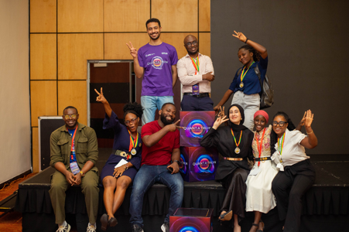
A3 - Key questions for evaluation
Hackathons | Quantum Diplomacy Game | Educational Consortium | Educational Repository | Internship program
Number of: Successfully organised supported or inspired events Certifications delivered during pre-hackathon training Organisations having partnered with OQI to provide post-hackathon opportunities Students having benefited directly from an OQI facilitated opportunity post Hackathon Recurring events : locally or regionally (from 2025 to 2026) Partners in the Educational Consortium mobilised for the events Additional outputs resulting from the event showing the regional ecosystem is being developed | Number of: Diplomacy games organised Participants Geographic Diversity (continents/countries) | Number of members and organisations involved Percentage members involved in at least 1 OQI activity | Delivery of an online searchable repository with quality resources (QC courses) | Number of: Partner host organisations, public and private Students interviews facilitated (selected)
 | Regional Events | Foundational training | New initiatives
 | Impact on regional cooperation or QC strategy roadmaps | Online version of the Qplaylearn tool based on A1 methodology Number of certificate delivered New resources developed by Q2 2026 | Launch of a “Kick-start Curriculum Design” initiative in pilot mode in 2026 Propose a concept of OQI QC schools/bootcamps with identified partners for the post-pilot phase in Q2 2026 Launch Alumni network

Slide 19
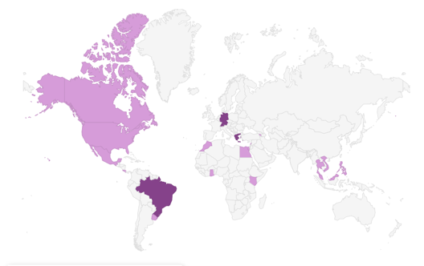




A3 - Key messages for the CERN Council
1- Bridging quantum divide with a global presence and a strong focus on quantum underserved regions
2- Sharing knowledge resulting from OQI activities
Foundational training :
Online release of use case guideline methodology (Qplaylearn)
New educational product will be developed from the new A1 resources
Use case idea sourcing: Assist teams from the Global South to produce high quality/impact Use Case ideas for submission to A1
OQI complements existing areas of collaboration between CERN Associate MS and aspiring MS.
3- Growth of regional and local ecosystems through OQI’s activities
4- Tailoring OQI activities to fit into CERN programs
Exploring Quantum Computing Schools or bootcamps following the existing model of CERN computing schools
Support partner universities to develop their first QC curriculum
Search for Use Cases that could be mutually beneficial for QTI and OQI
Workshop on national Quantum Strategy in parallel to the Egypt hackathon
Focus in SEA in 2025 : Strong implication of the local government and discussions on regional roadmap. Similar efforts are planned in LATAM for 2026, and first steps towards a focus on sub-Saharan Africa in 2027

Slide 20
A3 - Strategic input and Discussion
Feedback/suggestions on:
Operational plan for 2026
Evaluation criteria
Strategic messages for the CERN Council

Slide 21
A4 Status Update
Maricela Muñoz

Slide 22

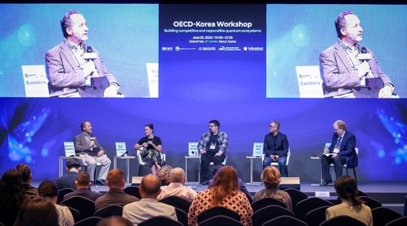
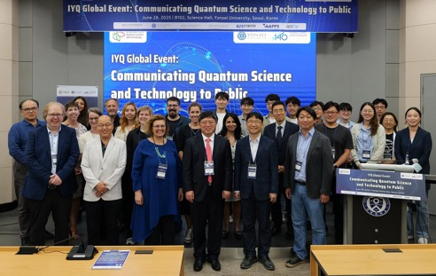
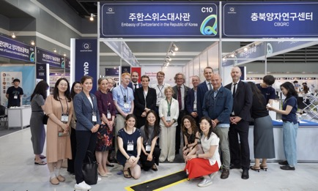
A4 - Key operational updates
Key collateral: Quantum Diplomacy Intelligence Report 2025-2026, co-written with relevant International Organizations
Published Deep-Dives: Quantum Security with UNIDIR, Quantum Divide with UNESCO, and Quantum and the Future of labour with ICT ILO
Advanced draft to be published soon: IP and Human Rights (awaiting WIPO’s commentary)
15+ speaking engagements focused on quantum diplomacy since last AC meeting:
incl. in Geneva: ITU Quantum for Good (3 panels), UNODA, UNECE, Geneva Security Debate
incl. other global platforms: G7 (Canada, June), World Bank (USA, June), IGF (Norway, July), QuantumKorea & OECD ASEAN (South Korea, June), UNESCO (Thailand/ online, June), G20 (South-Africa, Sept.) UNSAB (NYC, Aug. and Sept.) UNGA (NYC, Sept.), IDB (Sept.) UN Security Council briefing (Nov.)
20+ individual diplomatic exchanges, foundational briefings and collaborations with UN Permanent Missions and country delegations
incl. Brazil, Chile, Costa Rica, Council of Europe, Côte d’Ivoire, France, India, Japan, Kazakhstan, South Korea, Lithuania, Mexico, Mongolia, Pakistan, Qatar, Slovenia, South Africa, Türkiye, UK

Slide 23
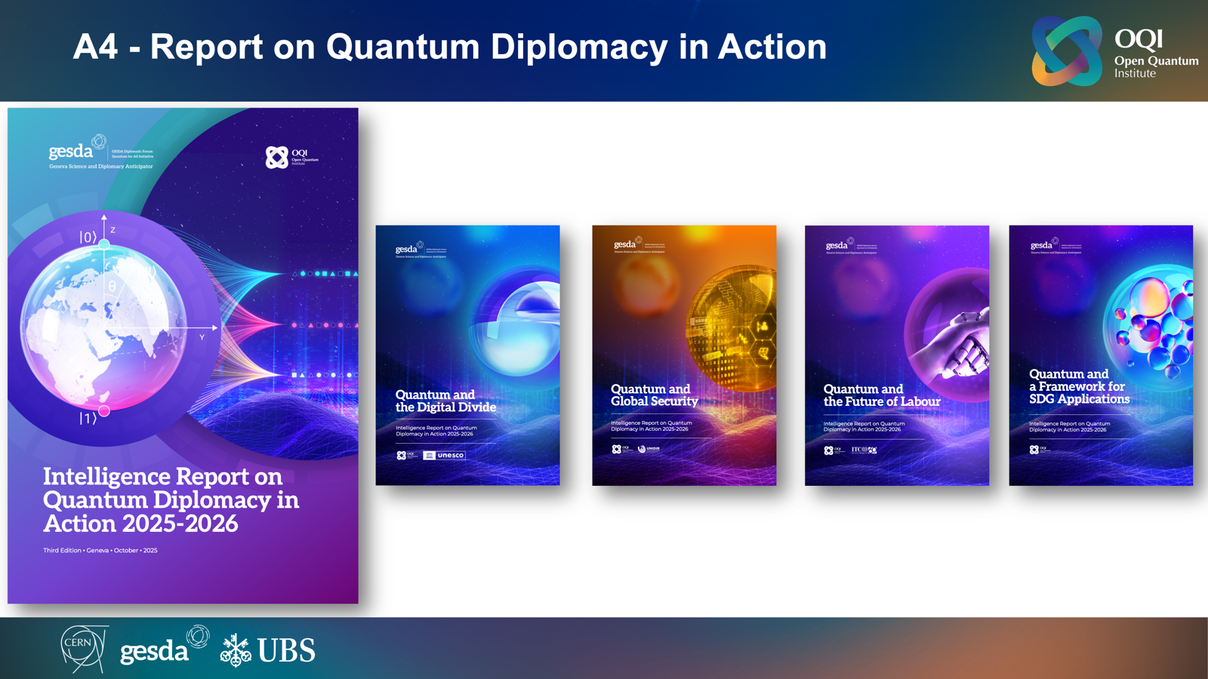
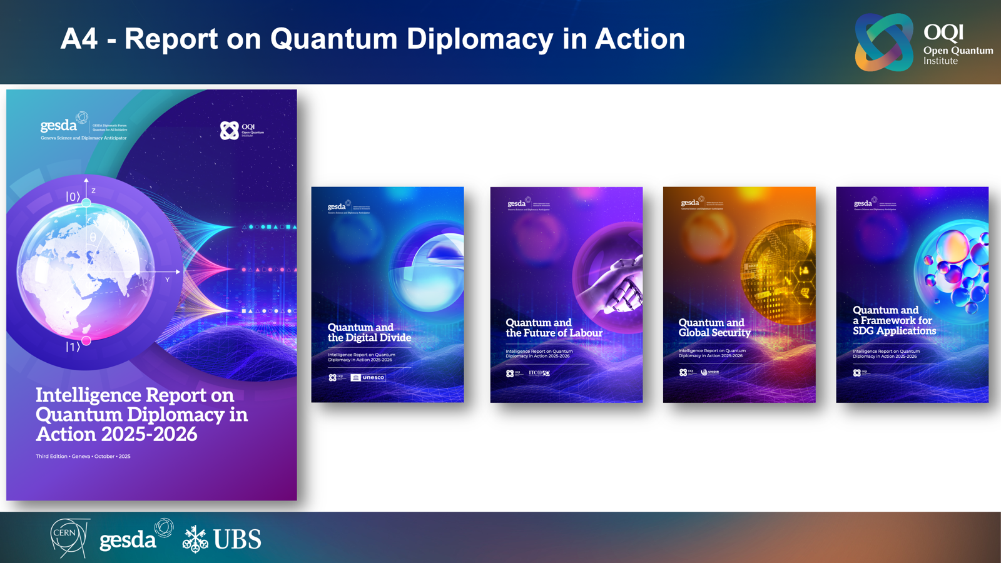
A4 -
few photos

Slide 24
A4 - Strategic input and Discussion
Plan for the Conference Quantum Diplomacy in Action
Provisional date: spring 2026 (last week April/ first week May)
Target audience: PMs in Geneva, governmental and international experts (from all sectors)
Proposed format: 1 day, with lightning talks, followed by moderated break-outs
Preparation and engagement: 2-3 focus groups to sketch proposals of concrete actions, based on insights of the Deep-Dives and recommendations by the AC
Feedback
Date: provisionally 4th May
Format
Key topics
Participants

Slide 25
Closing remarks
and next meetings of
the Advisory Committee

Slide 26
Closing Remarks
Recap of main decision points of the meeting
Proposed dates for next meetings:
Aligned, with lead time for strategic input, to CERN Council sessions (in March and June)
To review the evaluation results
February 26th ?
May 8th or 28th ?
October 15th or 22nd ? (GESDA Summit tbc)

