Slide 1
Cable routing proposal

Slide 3
Cable bending tooling proposal

Slide 4
Step 1

Slide 5
Step 2

Slide 6
Step 3

Slide 7
Step 4 – twist to match

Slide 8
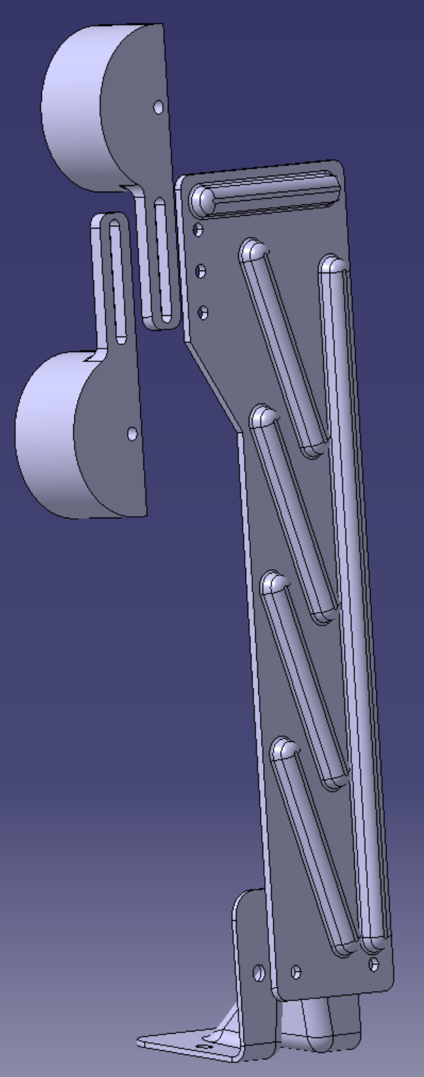
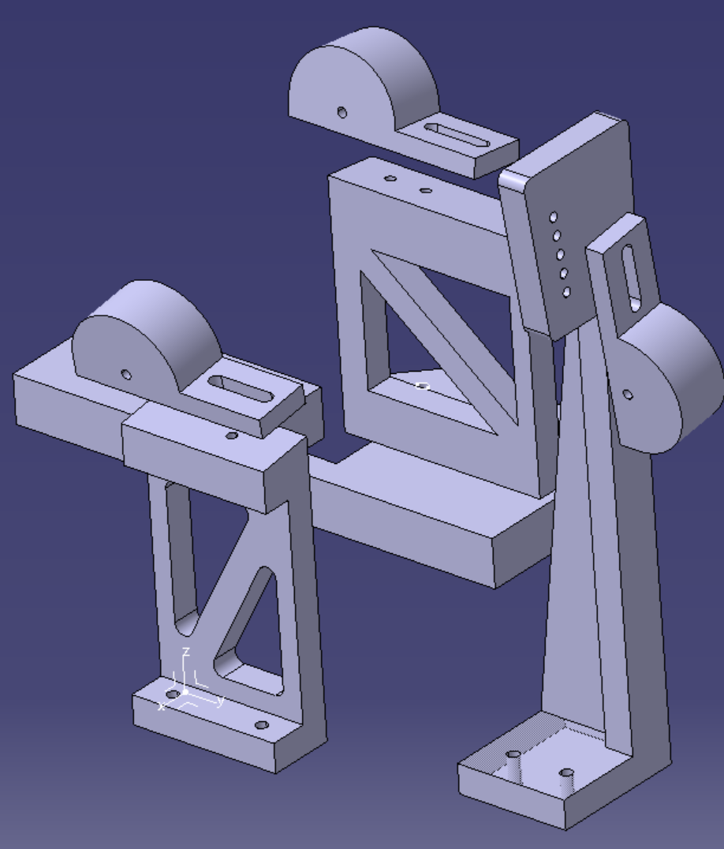
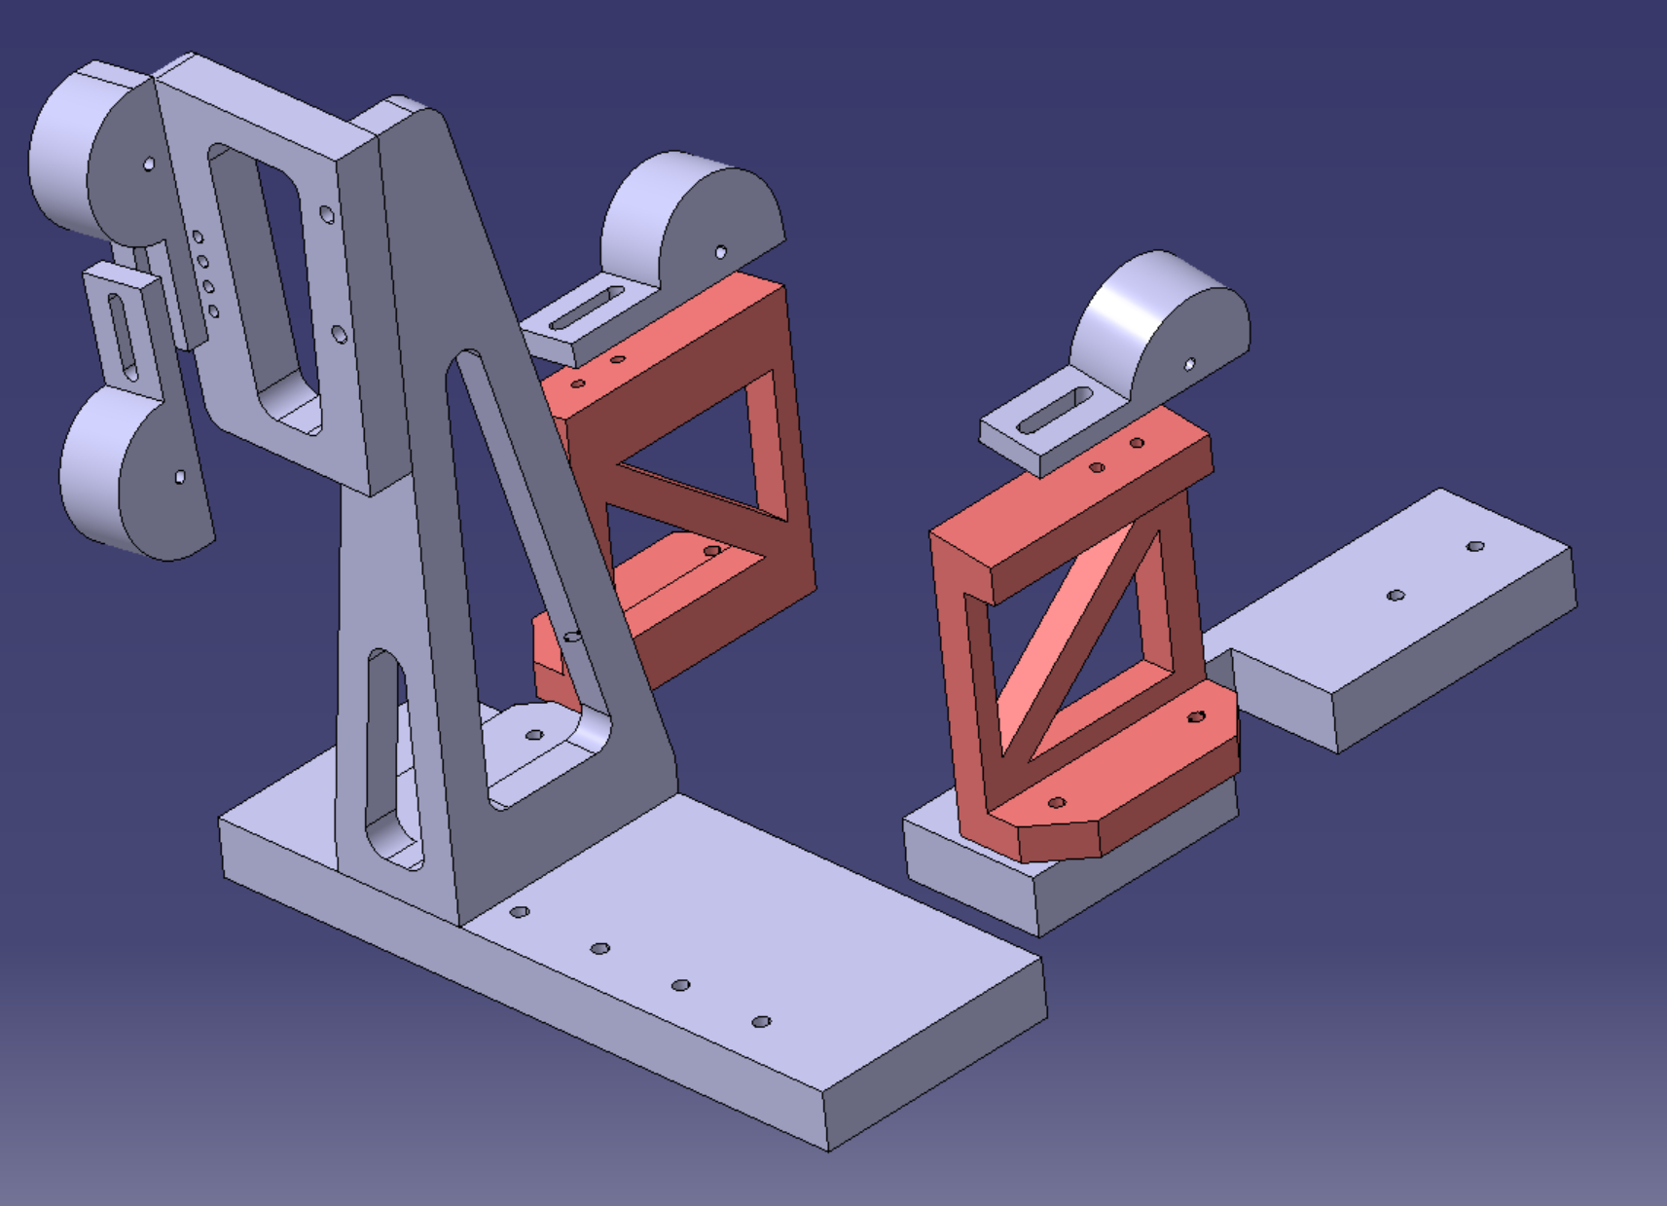
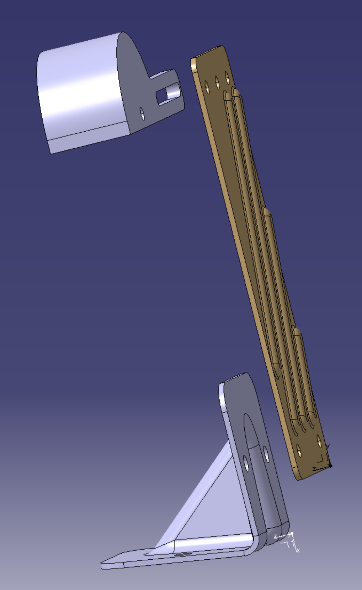
3 options
Option 1
Option 2
No main base-plate and lighter than 1
Option 3
2mm sheet metal

Slide 9
Step 1

Slide 10
Step 2

Slide 11
Step 3

Slide 12
Step 4 – twist using plyers to match

Slide 13
Fewer parts option (also no base plate)
Step 1

Slide 14
Step 2

Slide 15
Step 3

Slide 16
Step 4 – twist using plyers to match

Slide 17
Step 1
Sheet metal option – recommended

Slide 18
Step 2

Slide 19
Step 3

Slide 20
Step 4 – twist using plyers to match

Slide 21
Back-up to sheet metal (machined part)

