Slide 1
Beam transmutation in light-ion collisions
John Jowett, GSI & CERN
Credits:
CTE simulations: Natalia Triantyfallou, Roderik Bruce
FLUKA/XSUITE simulations: Andre Donadon Servelle
AAMCC simulations: Savva Savenkov, Aleksandr Svetlichnyi, Ekaterina Vasyagina, Igor Pshenichnov,
RELDIS simulations: Igor Pshenichnov, Chiara Oppedisano
Useful discussions: Chiara Oppedisano, Spencer Klein, Jürgen Schukraft, Anthony Timmins, and others in ALICE, Maciej Supinski

Slide 2
Motivation
We pointed out in 2021 that, since
  the charge-to-mass ratios of ¹⁶O and lighter nuclei with A=2Z (¹⁴N, ¹²C, …, ⁴He, ²H) are identical and
  the nuclear binding energies are small at the top of the Periodic Table
  any such nuclei produced in collisions with the same momentum per nucleon/charge would have a magnetic rigidity close to that of the beam and might circulate in the LHC rather than being lost in the dispersion suppressors or on momentum collimators.
An effective transmutation, contaminating the ¹⁶O or ²⁰Ne beams as the fill progresses
Would not apply in Pb-Pb
Such nuclei can be produced as spectators in electromagnetic dissociation (EMD) or hadronic fragmentation processes
Quantitative estimates were previously given (LPC meetings) based on various models and luminosity scenarios

Slide 3
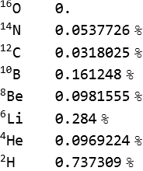
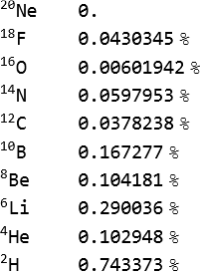
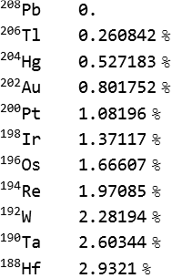
Rigidity shifts of outgoing spectator nuclei (if γ unchanged)
O-O
Ne-Ne
Pb-Pb
But the collision products have some momentum distribution around these values …

Slide 4
LHC momentum acceptance in the light-ion runs
In order to circulate in the beam, fragments (Z₁,A₁) must have a fractional change of magnetic rigidity with respect to the central particle of the original beam (Z₀,A₀) smaller than the momentum acceptance of the LHC
In the light-ion runs, this value was defined by RF voltage (bucket) and was smaller than momentum cut from momentum collimation in IR3.

Slide 5
Simulations of spectator fragment production
Abrasion-Ablation Monte Carlo for Colliders (AAMCC) for hadronic fragmentation
  Results from the authors (via Chiara Oppedisano) for 5.36 TeV O-O and Ne-Ne
RELDIS for electromagnetic dissociation (EMD) processes
  Previous use in ALICE and for early LHC collimation studies
  Results from the authors (via Chiara Oppedisano) for 5.36 TeV O-O (not Ne-Ne)
FLUKA for both hadronic and EMD processes
  Past and present use for LHC collimation studies
  Coupled to XSUITE for tracking in the accelerator lattice
  Results for hadronic, EMD in 5.36 TeV O-O, Ne-Ne (also p-O) from ADS
Collider Time Evolution (CTE) for beam intensity and luminosity evolution
  Results from NT and RB for initial conditions of fills (also logged data from LHC)
Similar results from Trajectum (see W. van der Schee talk)

Slide 6
Method
Momentum distributions of fragments (> 10⁶ events) for EMD and hadronic from selected Monte-Carlo simulations
Momentum distributions are wide so some fragments are lost and do not circulate: we should not use inclusive cross-sections
Compute rigidity-shift distribution to determine which stay in the beam momentum acceptance
Normalised to overall hadronic cross-section, we compute effective cross sections for capture of each fragment to circulating beam
Beam-capture cross-sections are combined with intensity and luminosity evolution of main beam to predict evolution of beam contamination by captured fragments

Slide 7
O-O prediction example

Slide 8
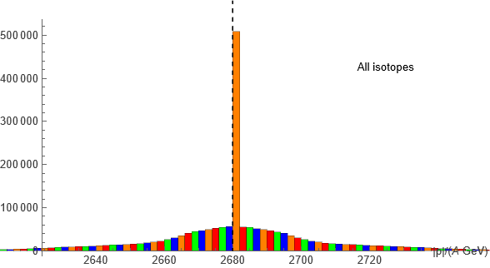
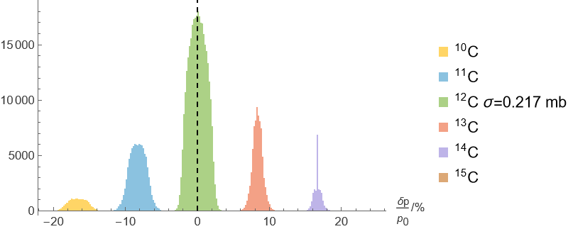
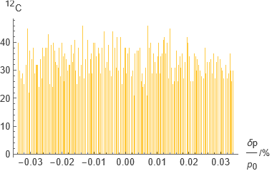
RELDIS: EMD fragments of ¹⁶O, O-O 5.36 TeV
Momentum per nucleon distribution of all fragments around the beam value.
Rigidity shift distribution of the carbon fragments.
Only a small fraction of the ¹²C fragments have a non-zero cross-section for capture to the beam.
Beam capture cross-section

Slide 9
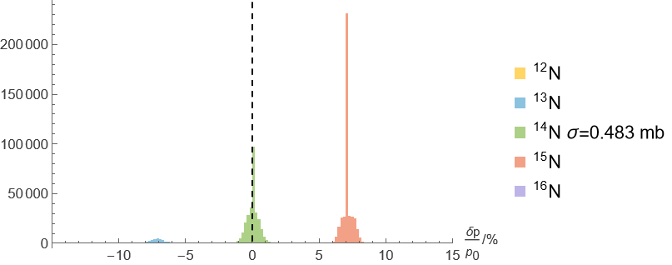
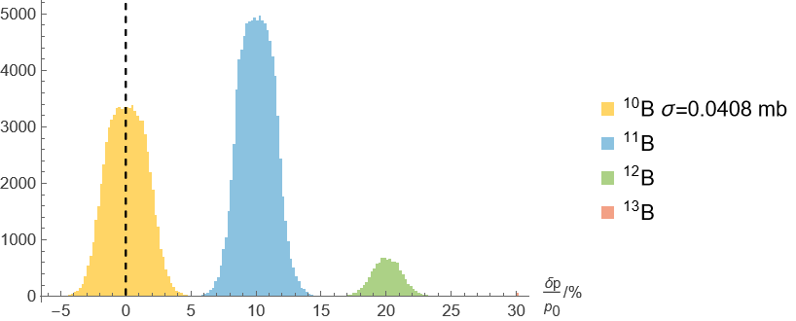
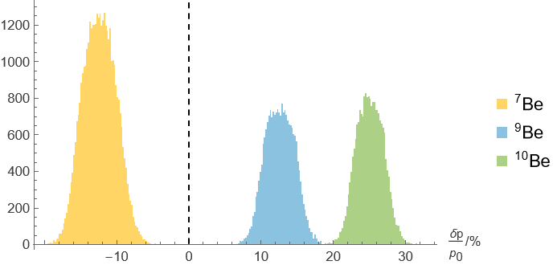
RELDIS: rigidity of EMD fragments of ¹⁶O, O-O 5.36 TeV
x% of ¹⁴N circulate
x% of ²H circulate

Slide 10
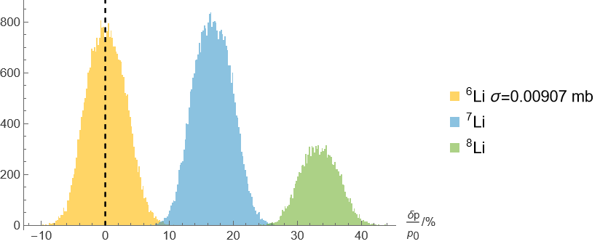
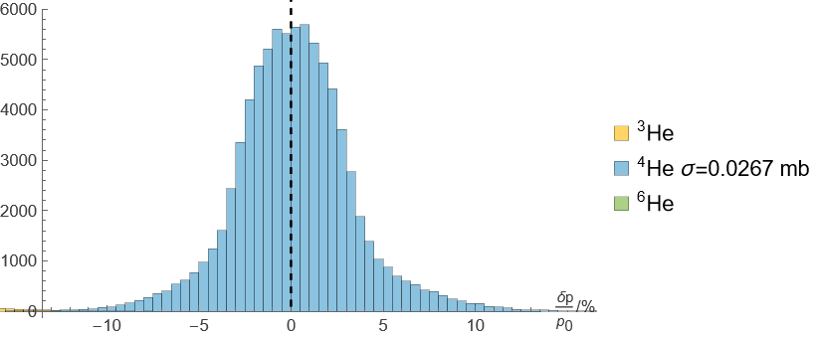
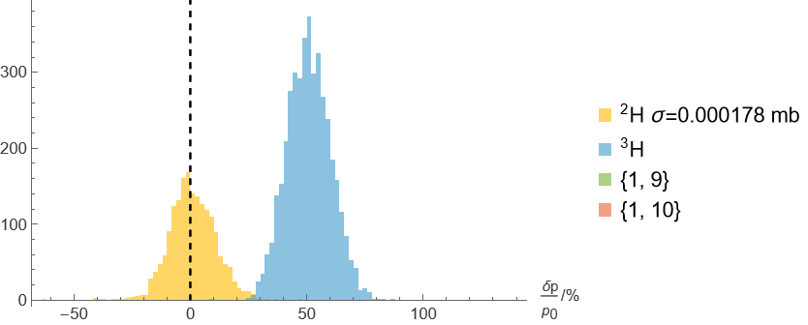
RELDIS: rigidity of EMD fragments of ¹⁶O, O-O 5.36 TeV
x% of ¹⁴N circulate
x% of ⁴He
circulate
x% of ²H circulate
Only a small fraction of the isotopes can circulate. These are almost entirely those with A=2Z (except Be).
α particles dominate!

Slide 11
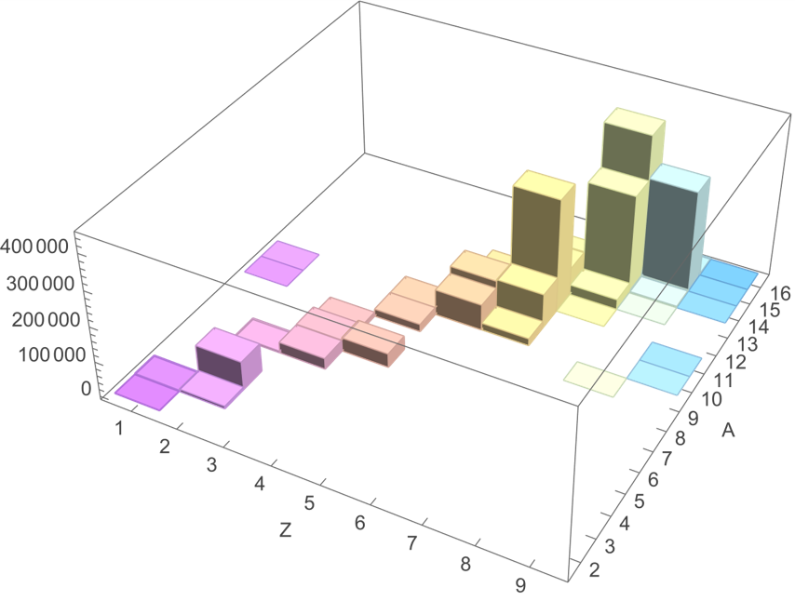
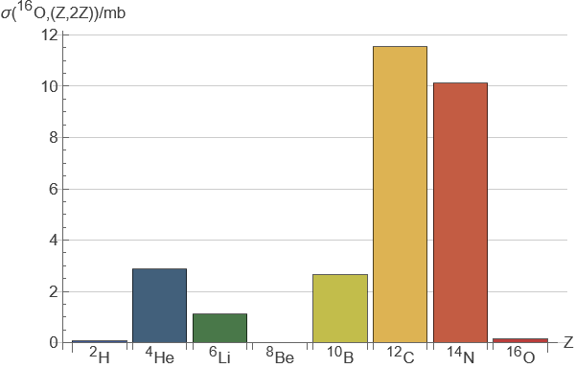
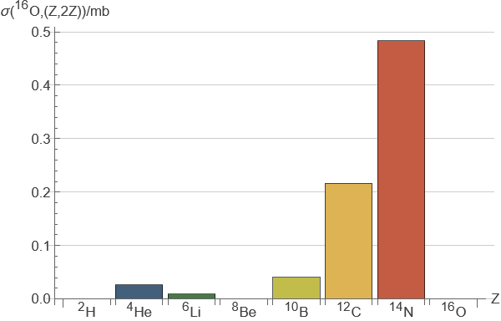
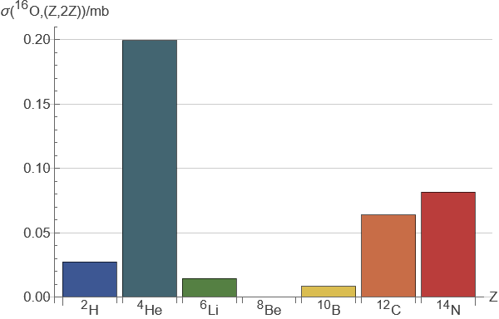
RELDIS: EMD fragments of ¹⁶O, O-O 5.36 TeV
All fragments (RELDIS 10⁶ events)
All fragments (RELDIS)
Cross-section for capture (RELDIS)
Cross-section for capture (FLUKA)

Slide 12
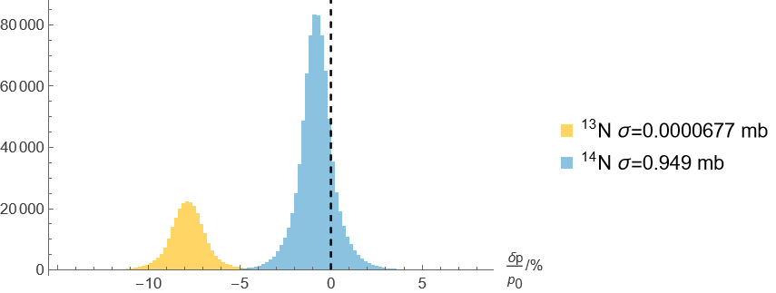
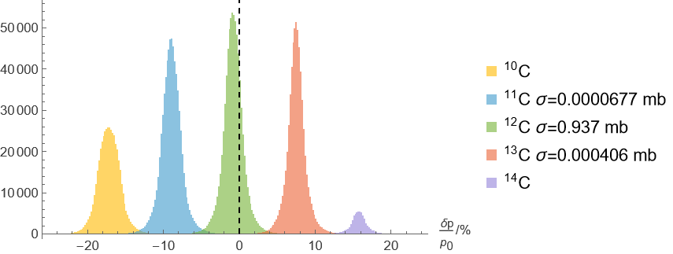
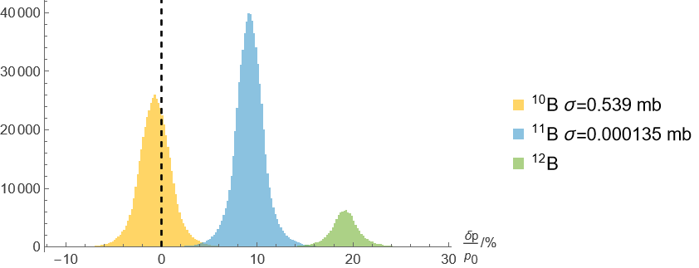
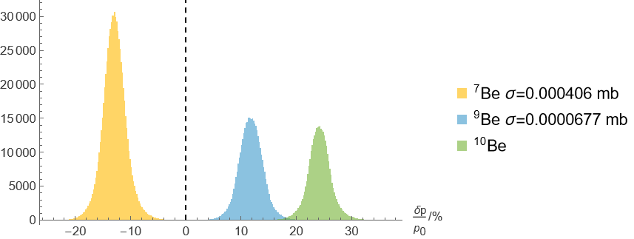
AAMCC: rigidity of hadronic fragments of ¹⁶O, 30% α-clustering, O-O 5.36 TeV
0.6% of ²H circulate

Slide 13
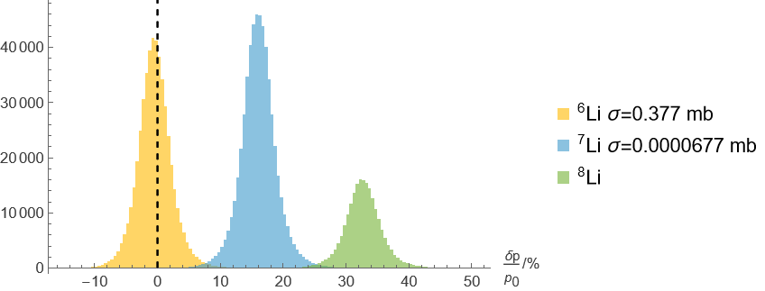
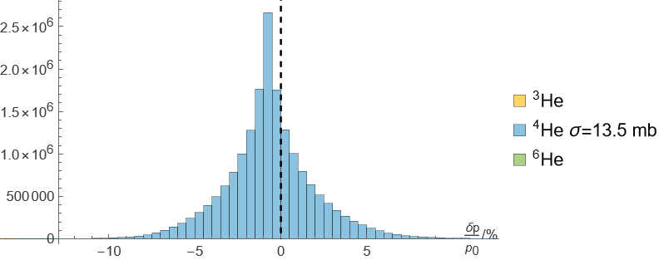
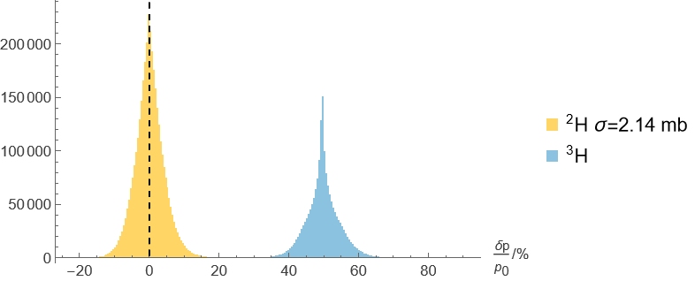
AAMCC: rigidity of hadronic fragments of ¹⁶O, 30% α-clustering, O-O 5.36 TeV
1% of ⁴He
circulate
0.6% of ²H circulate
Only a small fraction of the isotopes can circulate. These are almost entirely those with A=2Z (except Be).
α particles dominate!

Slide 14
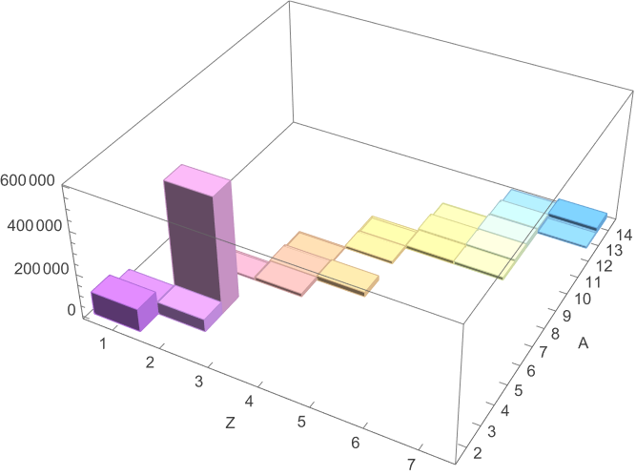
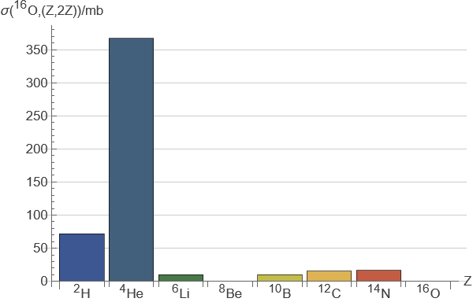
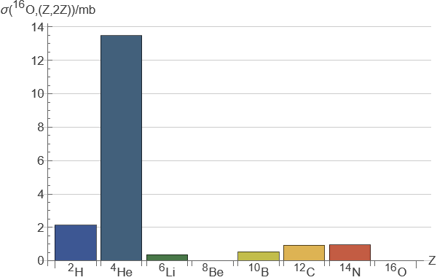
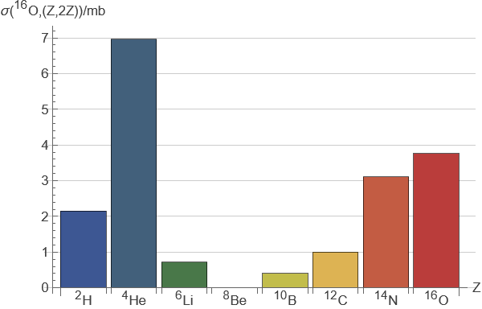
AAMCC: hadronic fragments of ¹⁶O, O-O 5.36 TeV
All fragments (AAMCC 10⁶ events)
All fragments(AAMCC)
Cross-section for capture (FLUKA)
Cross-section for capture (AAMCC)

Slide 15
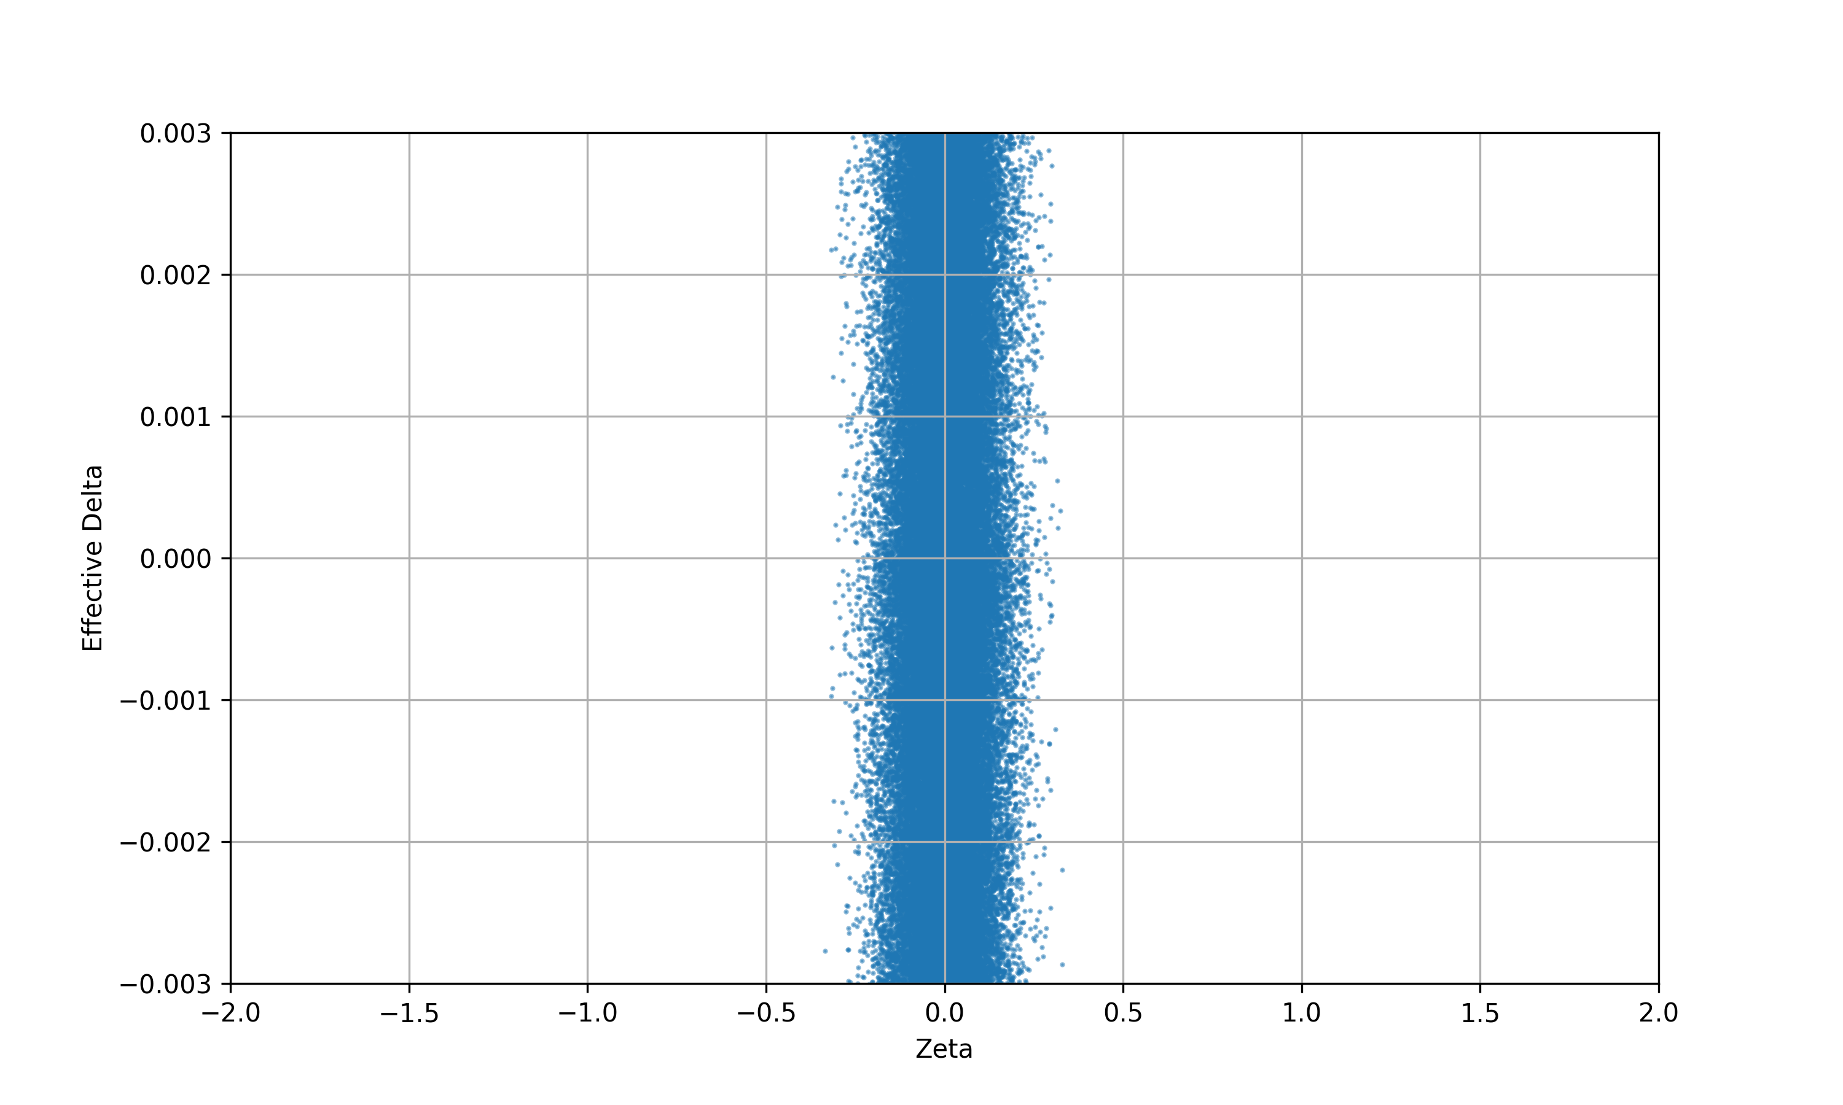
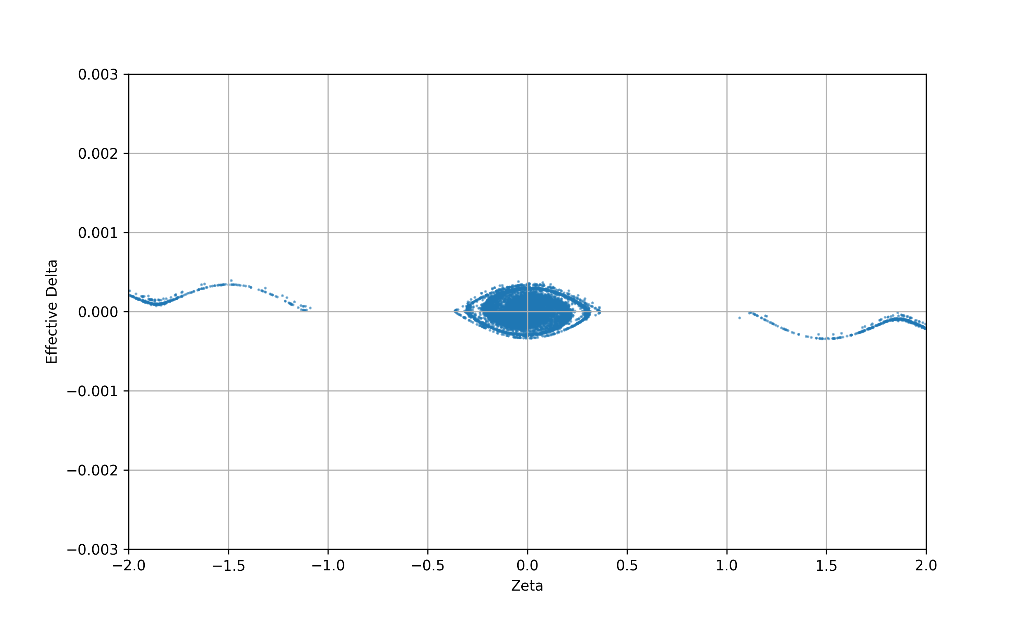
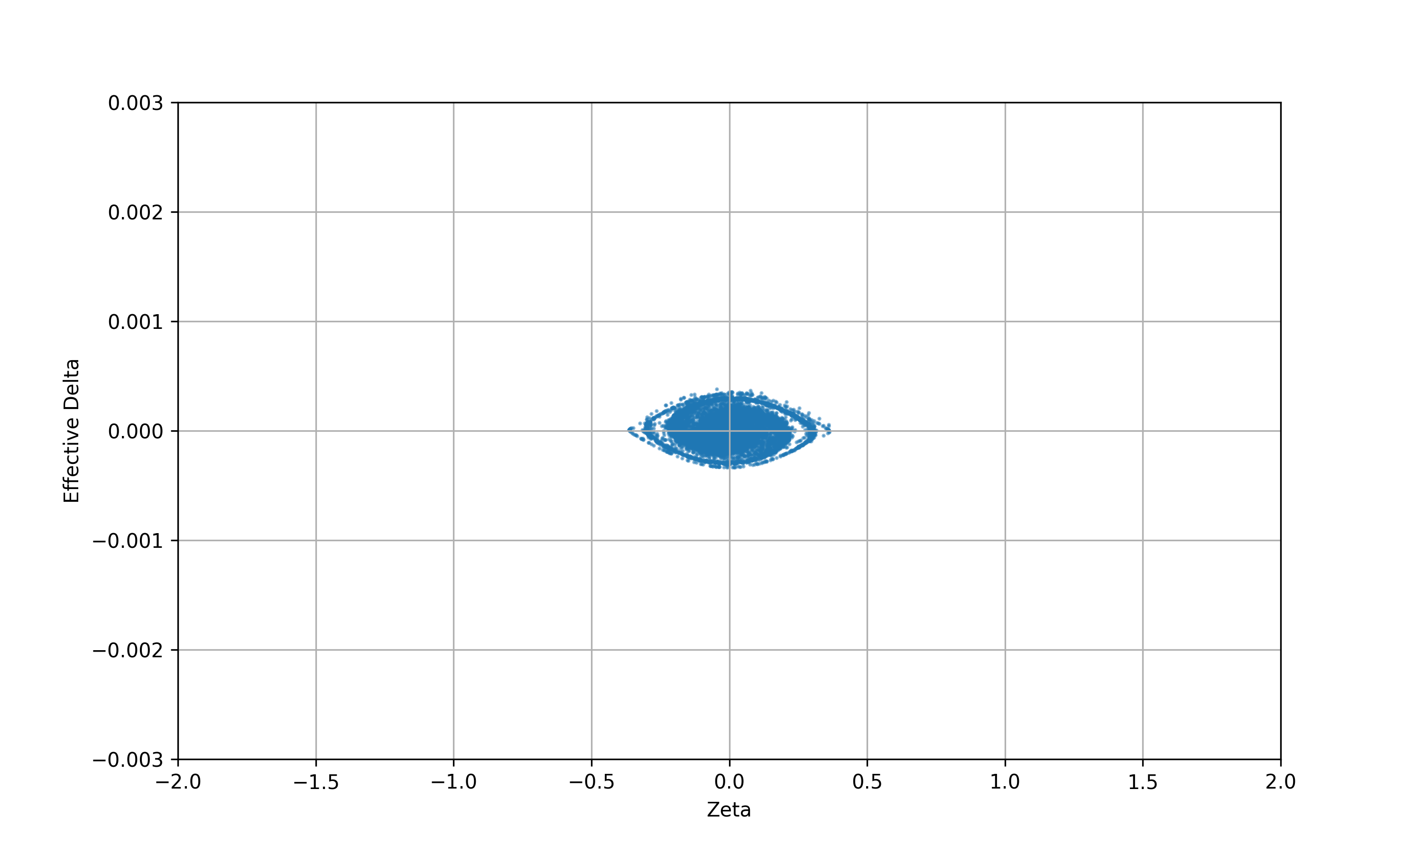
XSUITE tracking from FLUKA (had), longitudinal phase space
Initial fragments
After 1000 turns of LHC
Plots show the rigidity shift “Effective Delta” vs. conjugate time coordinate (in m)
Manual cut on initial after 1000 turns

Slide 16
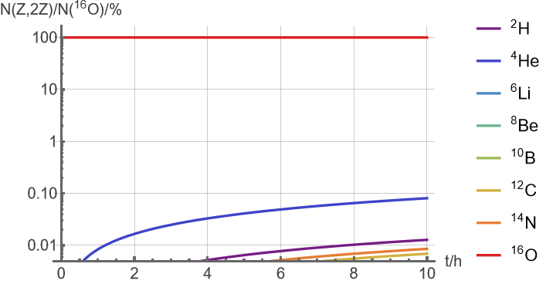
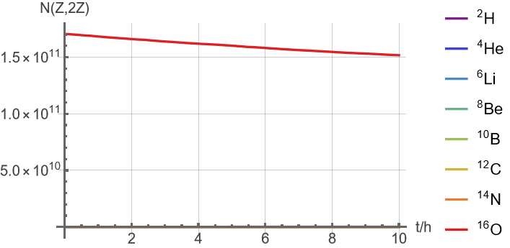
O-O RELDIS EMD, AAMCC had, scenario OO_62b_fill_10804_26Aug2025
Total beam intensities,
same expressed as fraction of ¹⁶O intensity

Slide 17
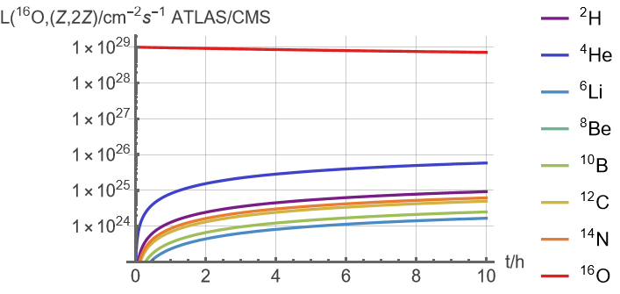
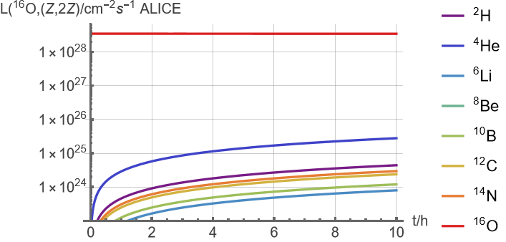
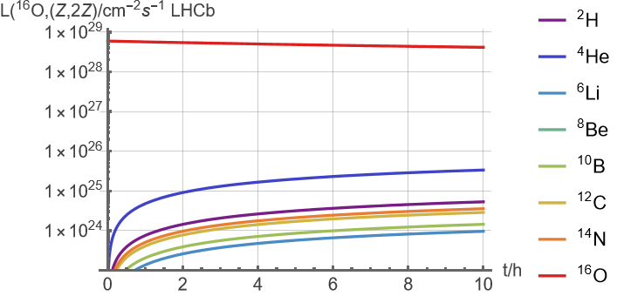
O-O RELDIS EMD, AAMCC had, scenario OO_62b_fill_10804_26Aug2025
Hybrid collision luminosities in each direction with ¹⁶O (total is twice this, except for O-O).

Slide 18
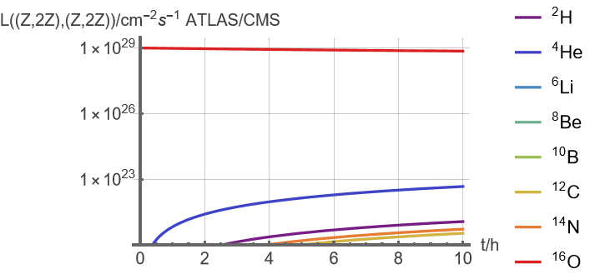
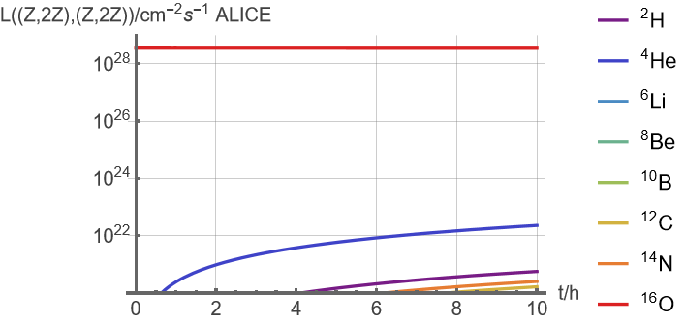
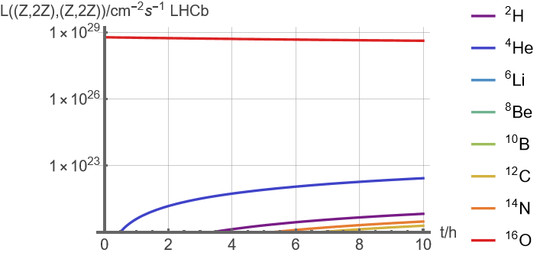
O-O RELDIS EMD, AAMCC had, scenario OO_62b_fill_10804_26Aug2025
Collision luminosities of A=2Z isotopes with themselves

Slide 19
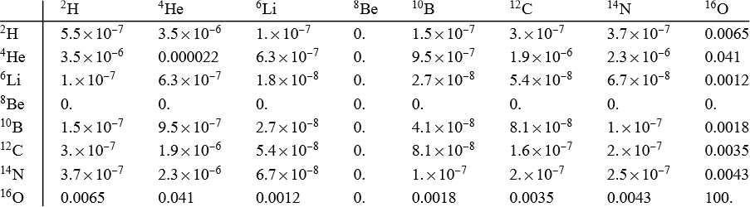
O-O RELDIS EMD, AAMCC had, scenario OO_62b_fill_10804_26Aug2025
Hybrid integrated collision luminosities with ¹⁶O as a percentage of integrated luminosity of ¹⁶O - ¹⁶O. Luminosities of Z-O and O-Z, although equal, are reported separately.
ALICE, fractional integrated luminosities at 10. h

Slide 20
Ne-Ne prediction example

Slide 21
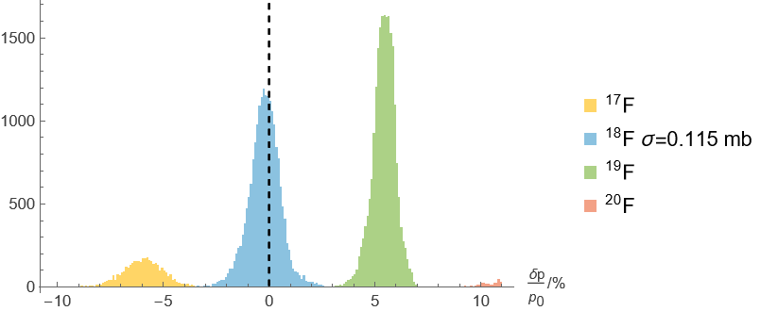
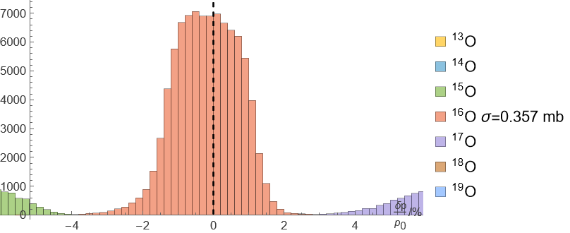
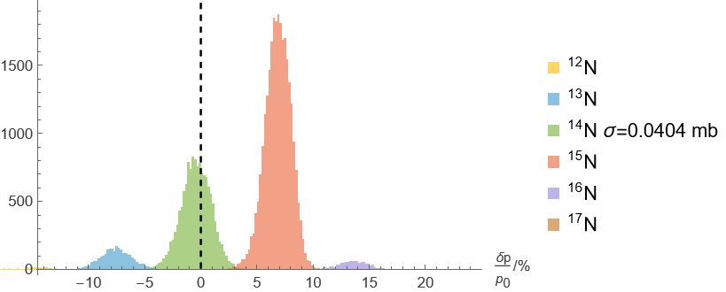
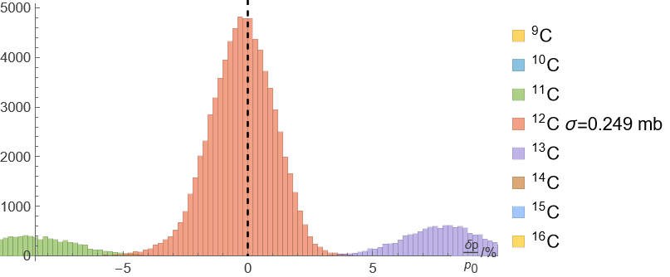
FLUKA: rigidity of EMD fragments of ²⁰Ne, Ne-Ne 5.36 TeV
x% of ¹⁴N circulate

Slide 22
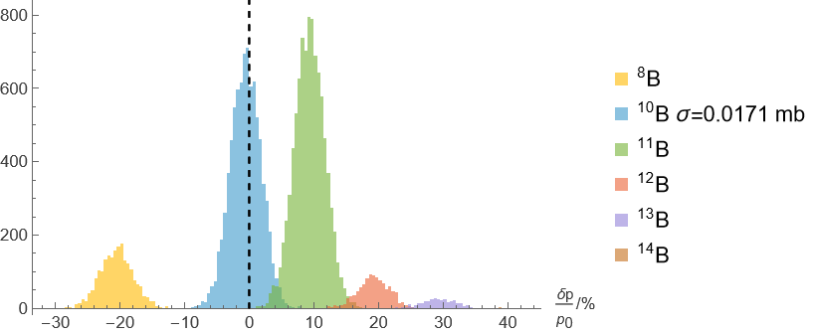
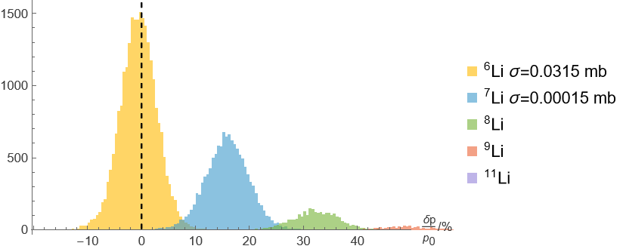
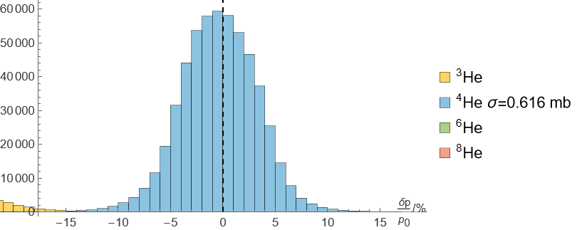
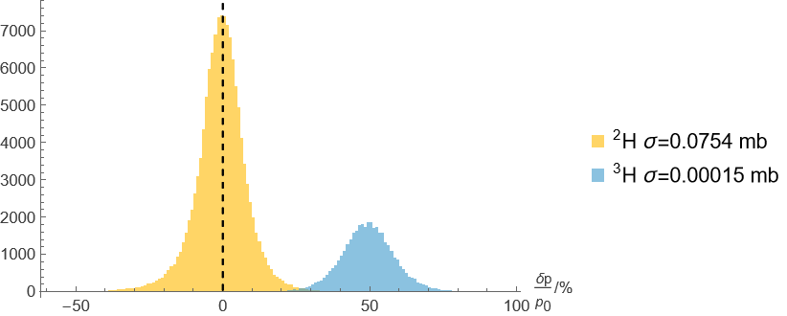
FLUKA: rigidity of EMD fragments of ²⁰Ne, Ne-Ne 5.36 TeV
Be skipped to save space on slide

Slide 23
FLUKA: rigidity of EMD fragments of ²⁰Ne, Ne-Ne 5.36 TeV
Cross-section for capture (FLUKA)
(no RELDIS data for Ne)

Slide 24
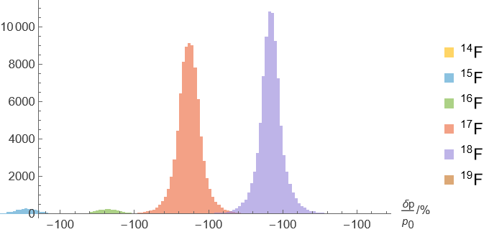
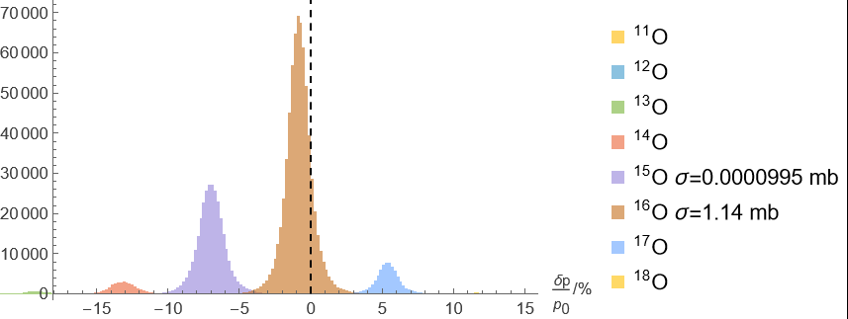
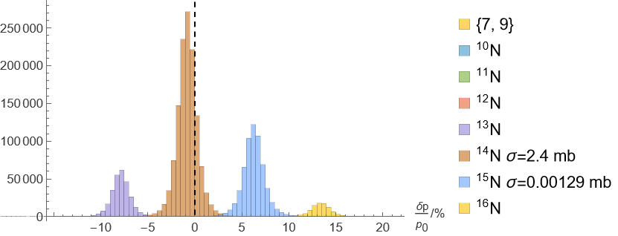

AAMCC: rigidity of had fragments of ²⁰Ne, 100% α-clustering, Ne-Ne 5.36 TeV

Slide 25




AAMCC: rigidity of had fragments of ²⁰Ne, 100% α-clustering, Ne-Ne 5.36 TeV
Be skipped to save space on slide

Slide 26




AAMCC: hadronic fragments of ²⁰Ne, Ne-Ne 5.36 TeV
All fragments (AAMCC 10⁶ events)
All fragments(AAMCC)
Cross-section for capture (FLUKA)
Cross-section for capture (AAMCC)

Slide 27


Ne-Ne FLUKA EMD, AAMCC clustering 100%, scenario NeNe_62b_fill_10813
Including upper limit of O contamination of Ne beam from the ion source (Maciej Supinski)
Total beam intensities,
same expressed as fraction of ¹⁶O intensity

Slide 28



Ne-Ne FLUKA EMD, AAMCC clustering 100%, scenario NeNe_62b_fill_10813
Hybrid collision luminosities in each direction with ¹⁶O (total is twice this, except for O-O).

Slide 29

Ne-Ne FLUKA EMD, AAMCC clustering 100%, scenario NeNe_62b_fill_10813
Hybrid integrated collision luminosities with ¹⁶O as a percentage of integrated luminosity of ¹⁶O - ¹⁶O. Luminosities of Z-O and O-Z, although equal, are reported separately.
ALICE, fractional integrated luminosities at 10. h

Slide 30

Comparison with experiment
Although there is no evidence of an enhancement of He–O induced low-multiplicity events as the O-O fill progresses, there is an apparent enhancement in Ne-Ne collisions.
This could be interpreted as due to ~ 2 % of ⁴He nuclei in the ²⁰Ne beam.
This would be clearly inconsistent (factor ~ 20), with the model predictions shown in previous slides.
Would require much larger cross-section for ⁴He fragment production together with a drastic narrowing of their momentum distribution and shifting of its peak to the right rigidity value.
Can this be explained by a better model of the bowling-pin structure of Ne ? One α-particle peeling off with just the right momentum shift ( ~ -0.1 %) ?

Slide 31
Conclusions and outlook
Contrary to initial expectations, the predicted level of contamination of the oxygen and neon beams in the LHC runs with lighter isotopes is very small, according to the momentum distributions from the AAMCC, RELDIS and FLUKA event generators
An exception is the possible initial contamination of the Ne beam with ¹⁶O from the ion source.
This appears to be incompatible with ALICE multiplicity measurements which indicate a potential contamination of about 2 % in the Ne-Ne fills
Thanks to all the contributors to this talk!

Slide 32
BACKUP SLIDes

Slide 33

Other nearby isotopes of Pb

Slide 34


α-clustering in the nuclear structure of ¹⁶O
Nucleus can be regarded as 4 α-particles (⁴He nuclei) arranged in a tetrahedral structure
Enhances production of α-particles in hadronic fragmentation reactions
Simulations have been done for three levels of clustering: 0, 30% and 100%
The 30 % case is tentatively considered “realistic”
See eg A. Svetlichnyi , The 6th international conference on particle physics and astrophysics (29 November 2022 - 2 December 2022)
https://doi.org/10.3390/physics5020027

Slide 35

Initial contamination of beam with 16O from ion source (Maciej Slupinski)
To sum up, when the LHC was filled, the O4+ contamination was between 0 and 0.6% (which is the uncertainty range of our instrumentation).
I take a pessimistic 0.6% of 16O in both LHC beams in the following.

Slide 36
References on RELDIS and AAMCC models
Nuclear multifragmentation induced by electromagnetic fields of ultrarelativistic heavy ions,
I.A. PshenichnovI.N. MishustinJ.P. Bondorf, A.S. Botvina A.S. Ilinov, Phys.Rev.C 57 (1998) 1920-1926
+ many others
Clustering in Oxygen Nuclei and Spectator Fragments in ¹⁶O–¹⁶O Collisions at the LHC, A. Svetlichnyi, S. Savenkov, R. Nepeivoda, I. Pshenichnov, MDPI Physics 5 (2023) 2, 381-390
+ others

Slide 37
Hadronic cross sections from AAMC, ²⁰Ne-²⁰Ne at 5.36 TeV
From : <aleksandr.svetlichnyy@phystech.edu> Sent:Thursday,5 June 2025 21:59
Subject:Re:Transmutation of O beam and Ne beam Attachments:charge_0.9.png
…
Ekaterina tuned the AAMCC model to achieve reasonable agreement with the data.
The main issue was the lack of high-quality data on relativistic ²⁰Ne projectile fragmentation. We therefore compared the AAMCC to the ²²Ne+emulsion data. The comparison is on following slide.
Please note that the underestimation for Z=9 and 10 may be related to the EMD in the nuclear emulsion. As with oxygen, overestimation of He production can be seen. The clustered state of ²²Ne is represented by a clustered 20Ne plus two valence neutrons.
Next, I prepared the production of the ²⁰Ne-²⁰Ne collision at the same energy as OO.
Two types of nuclear density parameterisation were employed:deformed ²⁰Ne and clustered ²⁰Ne.Both were tuned to describe the nuclear density profile data for ²⁰Ne.
These are new results which have not yet been reported. Ekaterina is currently preparing a report for the conference,after which we will prepare a paper on Ne fragmentation. If you need to cite something,please cite the same papers as for oxygen.
…

