Slide 1
MD3 Preparation: BLM Thresholds
Sara Morales, Belen Salvachua
2025-10-09 MD3 Preparation – adhoc BLMTWG

Slide 2
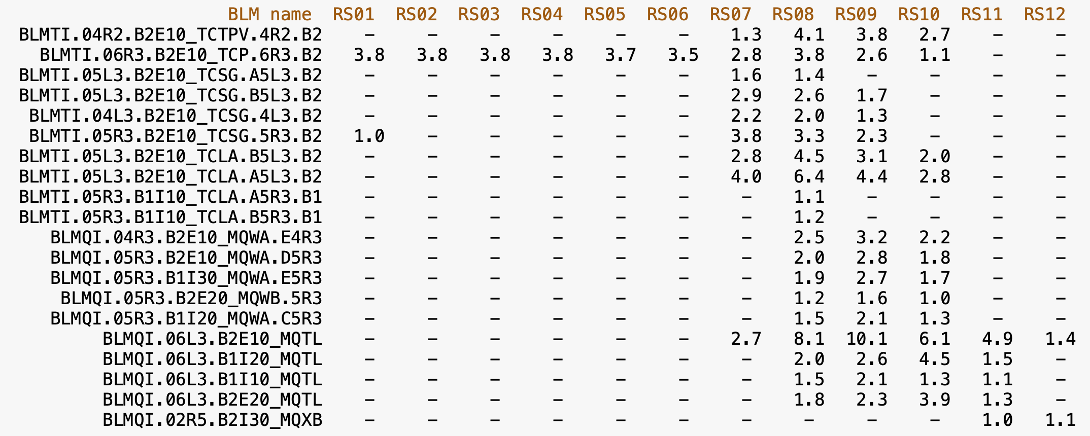
Scaling from start-of-ramp fills

Slide 3
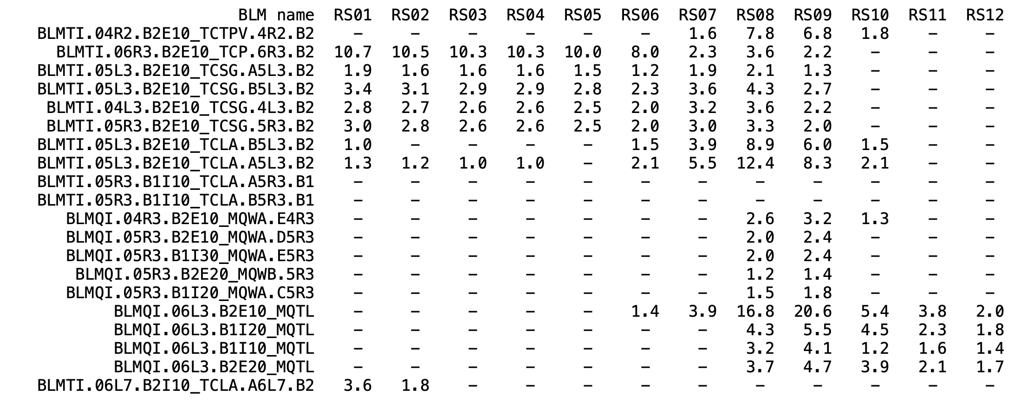
Scaling from Pilot Beam Test
Already see that we might need a factor 2 higher thresholds. However, due to the uncertainty on the beam intensity (only a pilot) the factors used on the MD2 were those of the start-of-ramp – which were also more conoservative -

Slide 4
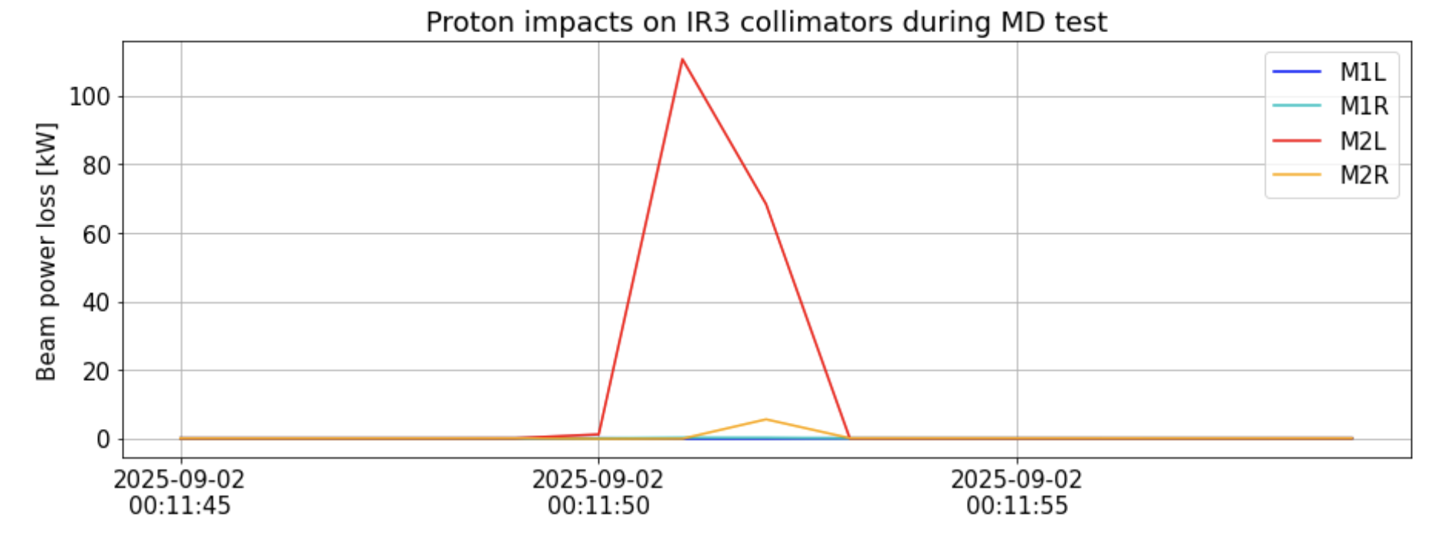
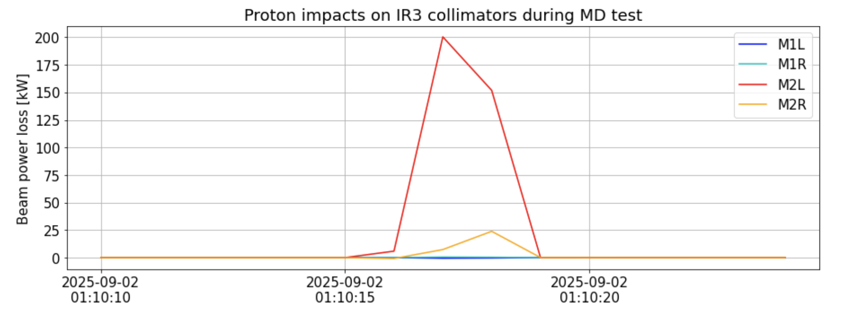
Analysis after the MD2
Two cases analysed where a different pattern was found at the TCLAs:
2025-09-02 00:11:51 110 kW
2025-09-02 01:10:15 200 kW

Slide 5
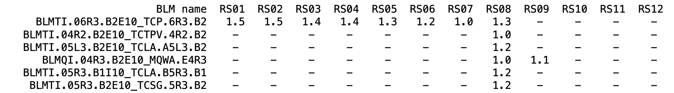
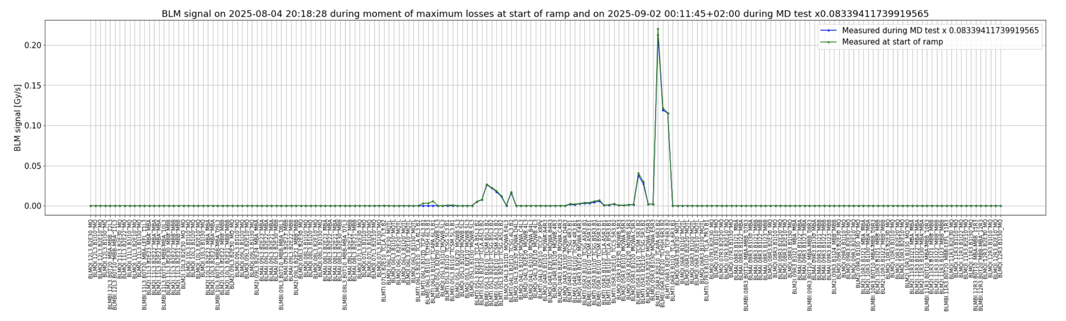
2025-09-02 00:11:51 110 kW
Very good agreement with loss scaling.
An additional factor of 1.5 on BLM threshold increase would already allow 600 kW
BLMs of Beam 1

Slide 6
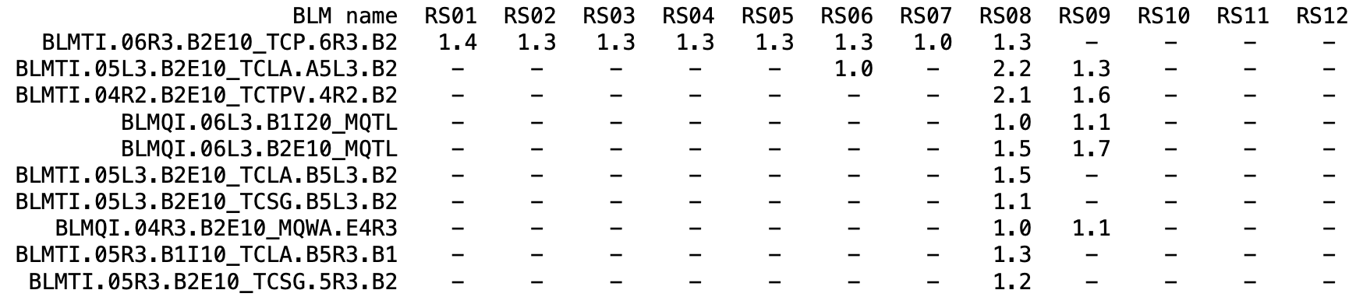
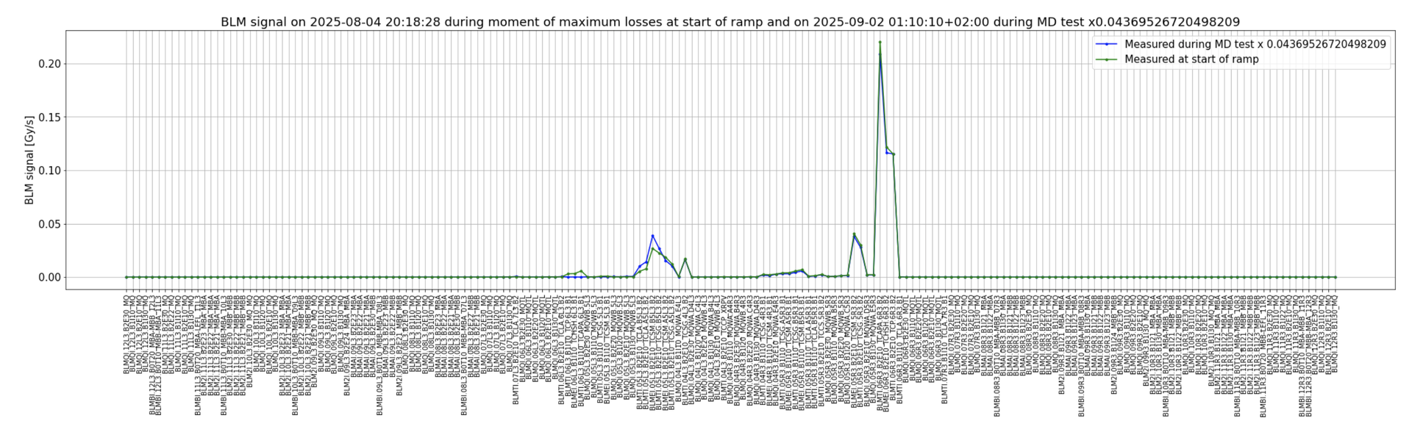
2025-09-02 01:10:15 200 kW
Deviation of the loss pattern
BLMs of Beam 1

Slide 7
New Family | BLM | Old MF | New MF | New MT Correction | MD Appl.Thr. RS09 [Gy/s] | Comment
THRI_TCTVA_QT25 | BLMTI.04R2.B2E10_TCTPV.4R2.B2 | 0.2 | - | AD_HOC_FACTOR_CORRECTION EL1-EL3 RS07-10= 8.6 | 0.0374 | 4.4e-2 ions / multiplied by 2.2
THRI_3_TCP_QT25 | BLMTI.06R3.B2E10_TCP.6R3.B2 | 0.4 | 1.0 | SCALE_CORRECTION = 2.2 | 15.053 | MT IP7 = 10.1 (proposal above IR7 thresholds)/ multiplied by 1.4
THRI_3_TCSG_QT25 | BLMTI.05L3.B2E10_TCSG.A5L3.B2 | 0.4 | - | AD_HOC_FACTOR_CORRECTION EL1-EL3 RS07-10 = 4.6 | 3.66 | MT IP7 TCSG HI 2.09 @ INJ 3.02 @ FT / multiplied by 1.2 / including RS10
 | BLMTI.05L3.B2E10_TCSG.B5L3.B2
 | BLMTI.04L3.B2E10_TCSG.4L3.B2
 | BLMTI.05R3.B2E10_TCSG.5R3.B2
THRI_TCLA_QT25 | BLMTI.05L3.B2E10_TCLA.B5L3.B2 | 0.4 | - | AD_HOC_FACTOR_CORRECTION EL1-EL3 RS07-10= 14.1 | 1.6192 | MT IP7 TCLA HI 5.77 @ INJ 5.16 @ FT /multiplied by 2.2
 | BLMTI.05L3.B2E10_TCLA.A5L3.B2
 | BLMTI.05R3.B1I10_TCLA.A5R3.B1 ?
 | BLMTI.05R3.B1I10_TCLA.B5R3.B1 - new
THRI.IP3_MQW_QT25 | BLMQI.04R3.B2E10_MQWA.E4R3 | 0.4 | - | AD_HOC_FACTOR_CORRECTION EL1-EL3 RS08-RS10 = 3.52 | 0.1639 | MT IP7 0.267 @ INJ 0.467 @ FT /multiplied by 1.1
 | BLMQI.05R3.B2E10_MQWA.D5R3
 | BLMQI.05R3.B1I30_MQWA.E5R3
 | BLMQI.05R3.B1I20_MQWA.C5R3
 | BLMQI.05R3.B2E20_MQWB.5R3
THRI.IP3.P1_MQTL_QT25 | BLMQI.06L3.B2E10_MQTL | 0.4 | - | AD_HOC_FACTOR_CORRECTION EL1-EL3 RS07-RS12 = 17.2 | 0.02601 | MT IP7 0.00383 @ INJ 0.00738 @ FT /multplied by 1.7
 | BLMQI.06L3.B1I10_MTQL
THRI.IP3.P2_MQTL_QT25 | BLMQI.06L3.B1I20_MQTL | 0.333 | - | AD_HOC_FACTOR_CORRECTION EL1-EL3 RS08-10 = 4.4 | 0.005632 | MT IP7 0.00383 @ INJ 0.00166 @ FT /multiplied by 1.1
 | BLMQI.06L3.B2E20_MQTL
2025-10-09 Settings

Slide 8
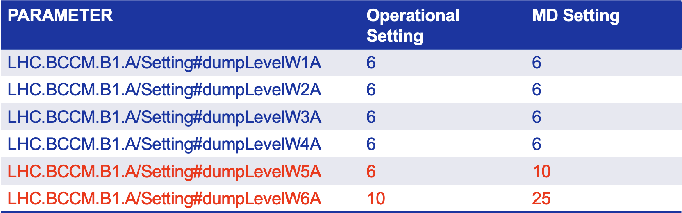
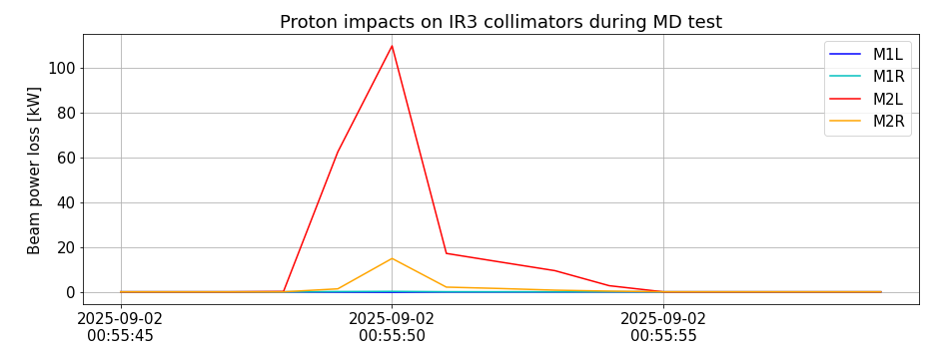
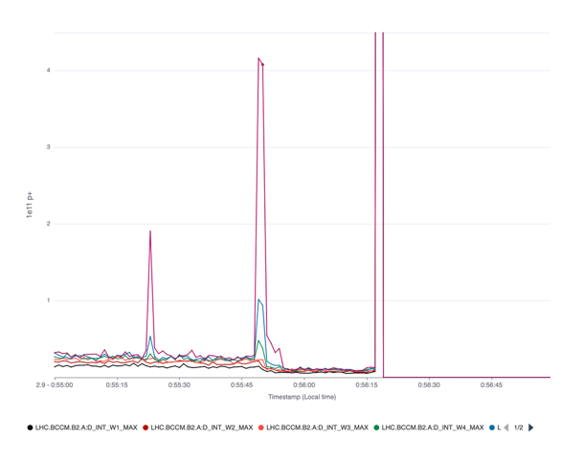
Proposal of changes - BCCM settings
T.Levens
Check on event during MD2: 2025-09-02 00:55:42 This case we achieved 110 kW in IR3
Needs to be scaled to 500 kW in IR3 => factor 600/110 = 5.5 wrt this attempt/event. Measurements of BCCM:
4.16e11 in W6
1.02e11 in W5
0.48e11 in W4
W3..1 are in the noise.

Slide 9
Back-up

Slide 10
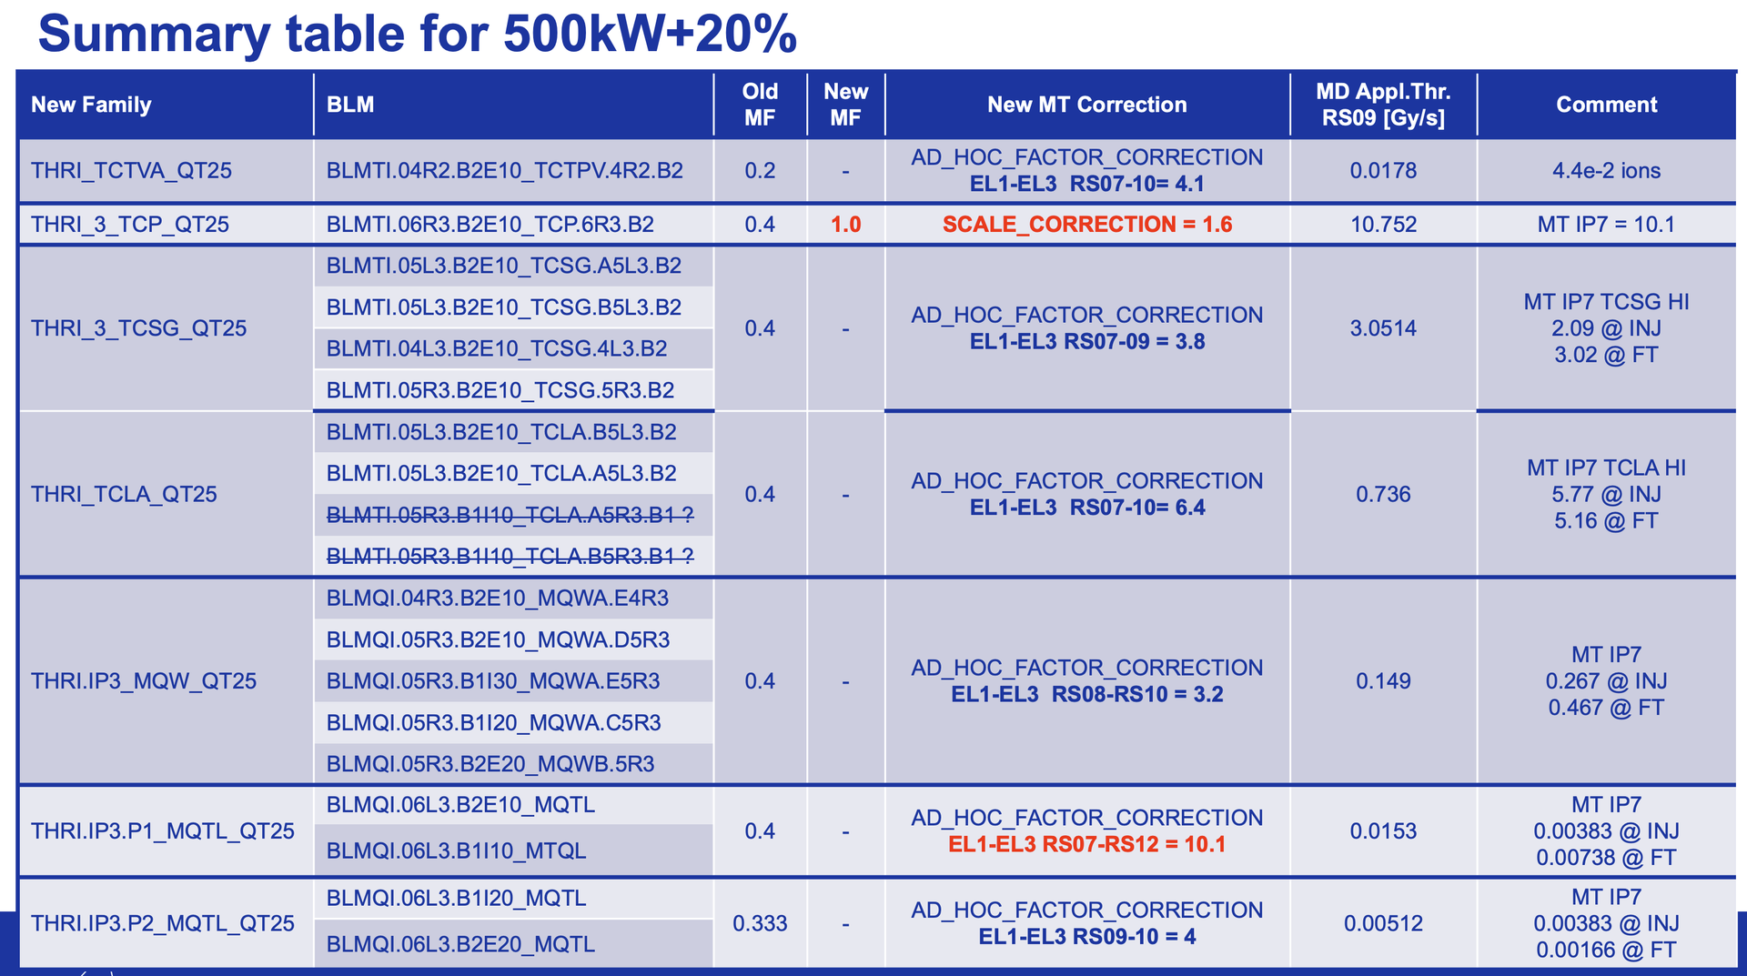
Used for 01-09-2025 test

