Slide 1
SM18 vertical test bench planning
2025.10.07

Slide 2
Update since last meeting
Cluster D | HFM | Siegtal | Long | Diode
MCBXFB07 – finished | MQXFS8b – finished | SMC108-eCLIQ – finished | Sushi – finished | DR_FFC01_06 – finished
MCBRD06 – finished | MQXFS4f – finished | SMC109-eCLIQ – finished | MSCB 399, 386 – finished | IT-diode 1 – finished
MCBRD05 – finished | Fusillo – finished | HO session 5 – finished | MSCB 396, 385 – finished | IT-diode 2 – finished
MCBXFA2 – finished | RMM1e – ready for test | PSI SubSMCC 2 – finished | MQ #1 – Finished | IT-diode 3 – finished
MCBRD07 – finished |  | MCTXF3 – finished | MQ #2 – finished | HR_FFC01_01 – finished
MCBXFB08 -- finished |  | SMC 108b – finished |  | IT-diode 4 – finished
MCBXFA3 – finished |  |  | MQ #3 | IT-diode 5 – finished
 | RMM1e |  | LMF Splices x2-3? | DR_FFC01_20 – CD2 ongoing
MCBRD08 | RMM2
MCBRD11 | HD3 | PSI SMACC |  | HR_FFC01_02 ?
MCBRD09 | MBHSP107 with Beam Scr | CEA R2D2 |  | CEA HTS racetrack
MCBXFB09 | Ciemat ISAAC | CHIC – probably 2026 |  | HTS common coil
MCBRD10 | MQXFS4g… | SMC 106 |  | LHC quad diodes 1
 | MQXFS9 | SMC 110 |  | LHC quad diodes 2
 |  | FalconD LMK1
In red: new since last meeting
In gray: foreseen later this year

Slide 3
Planning last few weeks before end-of-year
This week
November
December
 | Week 41 | Week 42 | Week 43 | Week 44 | Week 45 | Week 46 | Week 47 | Week 48 | Week 49
Long |  | LMF | Splices |  |  | MQ #3 | MQ #3
HFM | RMM1e |  |  | MQXFS4 | MQXFS4 |  | RMM2 | RMM2
Diode | DR_20 | CEA | Narsil |  |  | HTS CC | HTS CC
Siegtal |  |  |  | SMC 110 |  |  | LMK1 |  | R2D2
ClusterD |  |  |  | MCBXFB09
This planning makes full use of the 20 kA power converter
We should have other magnets waiting for tests (e.g. MQ #3, CEA R2D2), we would prepare them in case we finish fast with other magnets.
DR_20 should finish today (Tuesday) to start RMM1e. LMF splices take half a day of the 20 kA PC but they require a cryostat full of liquid helium.
Shutdown starts
Preparation
Stand-by
Test

Slide 4
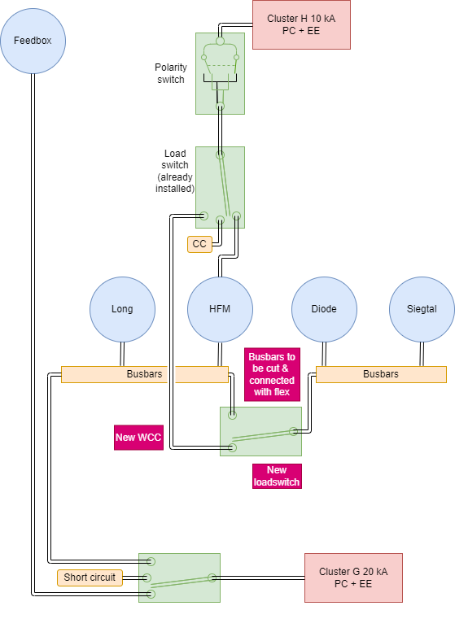
Announcing: works in Cluster G
For the new 10 kA connection to Siegtal and Diode we will need ~8 weeks shutdown in Cluster G.
Cluster D will continue operating during this time.
We would like to start in December but most likely this will be March-April.
Work to be done: cutting busbar (EN/MME), brazing water connection (NCM), installing new load switch and power links (MQA), PLC instrumentation wiring (EN/EL), new WCC (EN/EL), new PLC logic (MQA + BE/ICS), load switch remote commands (SY/EPC), probably something more

Slide 5
Magnets from SMT
In SM18:
MQXFS4h with different pre-load
MQ-2 from Tesla – warming up
RMM1e – cold going to 1.9 K
Expected to arrive this year:
MQ-3 from Tesla – next week
RMM2 with first version flat QA – December
MQXFS with ESC (9 with RRP coils?) -- next year
SMC 106 (Nov), 110 (Oct), 301 (2026, MQXF strand), 302
LMK1 (Falcon D mechanical mockup) – November (no powering, short test)
SubScale Fusillo wax ?
CCT-MCBY like magnet from Uppsala - 2026

Slide 6
Magnets from HSD
DR_FFC01_20: tests with spot heaters ongoing
Common Coil configuration (2 and 2): November 1st
20 mm apertures – integration of the MM shaft to be studied
Six coils no aperture (with flat QA): December
If not possible another DR magnet
Wider tape racetracks: next year

Slide 7
Magnets from WP3
MCBXFB09: next week – high priority
MCBXFA4: January
MCBRD11: mid-November
MCBRD08 (one trained coil): December/January
MCBRD09 (virgin coils): January
MCBRD10 (with trained coils): March
Boards with splices: two in SM18 (NCR DCM, N1 line trim), one in 6 weeks
EESD2 (phase 3): end of the year – tests fall to next year
MgB2 bending test

Slide 8
Magnets from collaborations
CEA – MI long racetrack HTS: at SM18
PSI – SubSMCC2 (with new ESC): end of the year ?
PSI – SMACC: 2026 ?
PSI – HTS racetracks: this year (October?)
CIEMAT – ISAAC: Feb 2026
CIEMAT – Poseidon: 2026 ?
LBNL – HD3: ? Tentative October
It could be interesting to have a multipole QA for this – on stand-by
CEA – HTS EuCARD2: ?
CEA – R2D2: arrival December 2025

