Slide 1
CERN-INTC-2011-050 ; INTC-P-314
Properties of low-lying intruder states in ³⁴Al and ³⁴Si
sequentially populated in beta-decay of ³⁴Mg
F. NEGOITA, N. Marginean et al. IFIN-HH, Bucharest, Romania
S. GREVY, B. Blank, J. Giovinazzo et al. CENBG, Bordeaux, France
P. Dessagne et al. IPHC, Strasbourg, France
T. Stora et al. ISOLDE/CERN
J.M. Daugas, L. Gaudefroy et al. CEA, DAM, DIF Arpajon, France
O. Sorlin, L. Caceres, J.C. Tomas et al. GANIL, France
J. Mrazek et al. INP, Rez near Prage, Czech Republic
S. Francoo et al. IPN-Orsay, France
Zs. Dombradi, D. Sohler et al. ATOMKI, Debrecen, Hungary
Summary:
Recent observation of 1⁺ isomer in ³⁴Al and 0₂⁺ isomer in ³⁴Si
Theoretical predictions on low-lying intruder states in A=34, Z=12-14 nuclei
Proposed experiment:
        Experimental set-up
        Normalization using LIST
        Expected results and beam time request

Slide 2
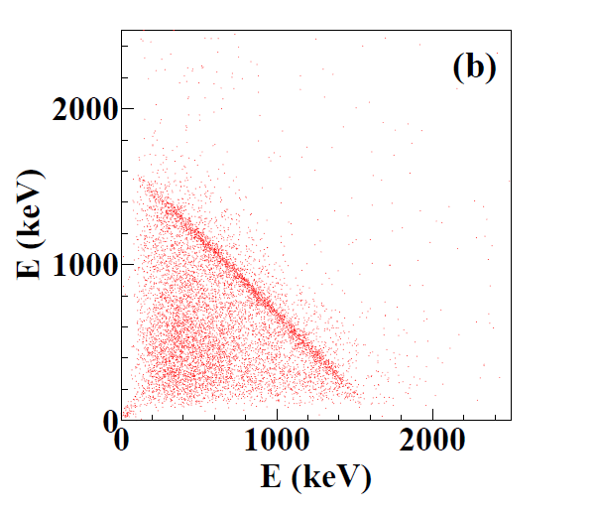
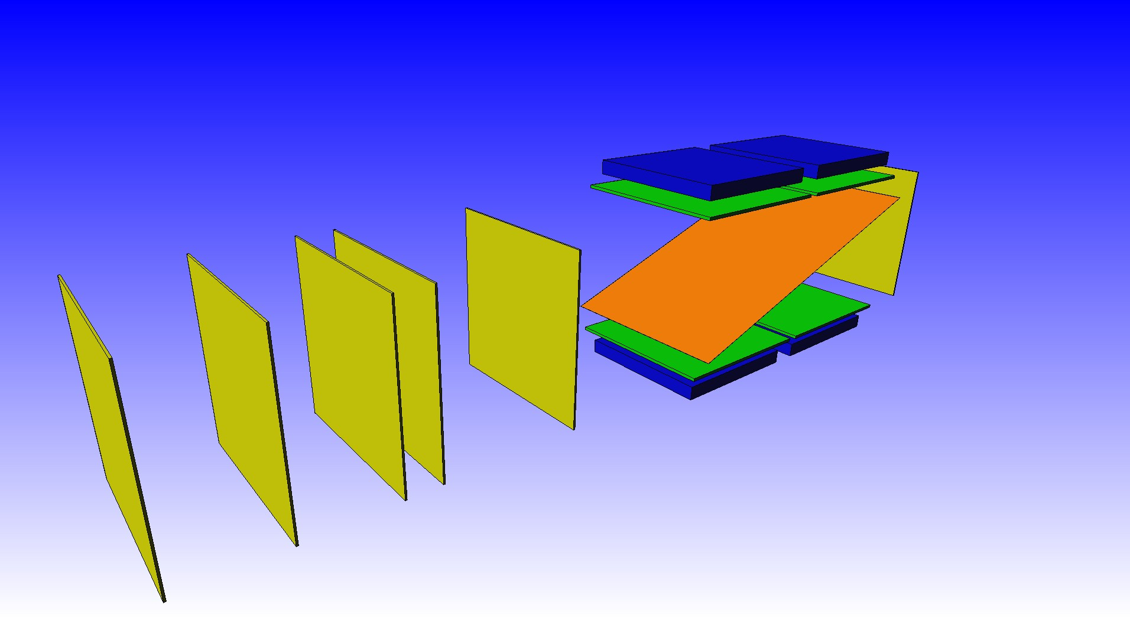
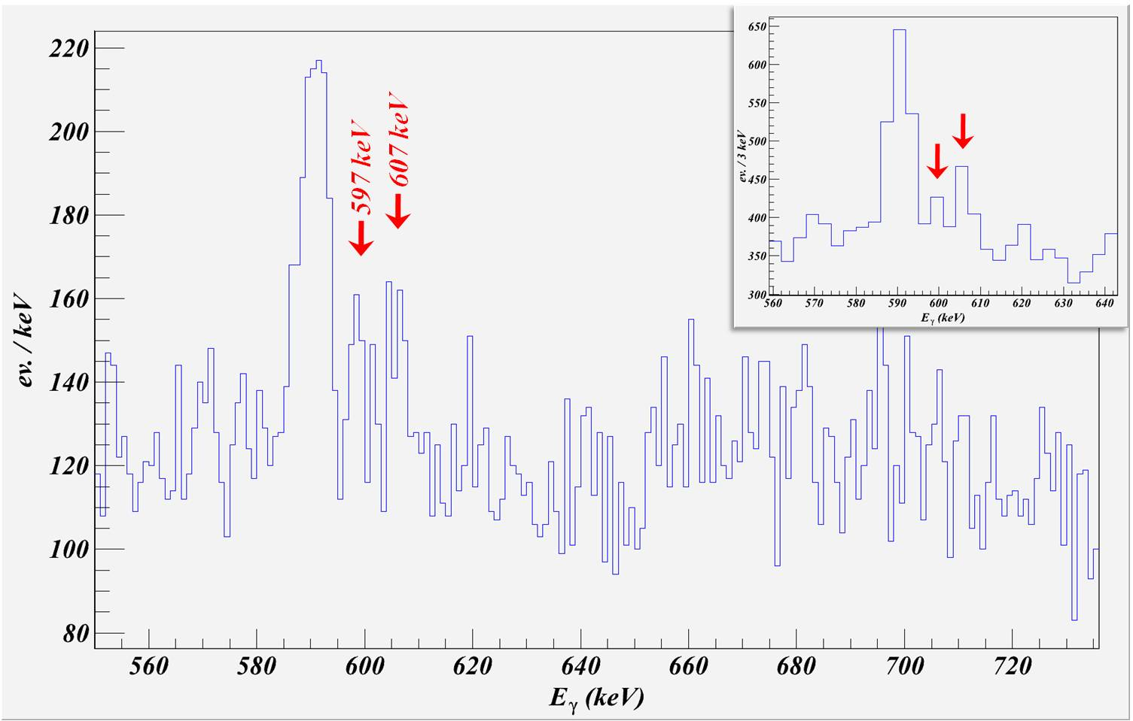
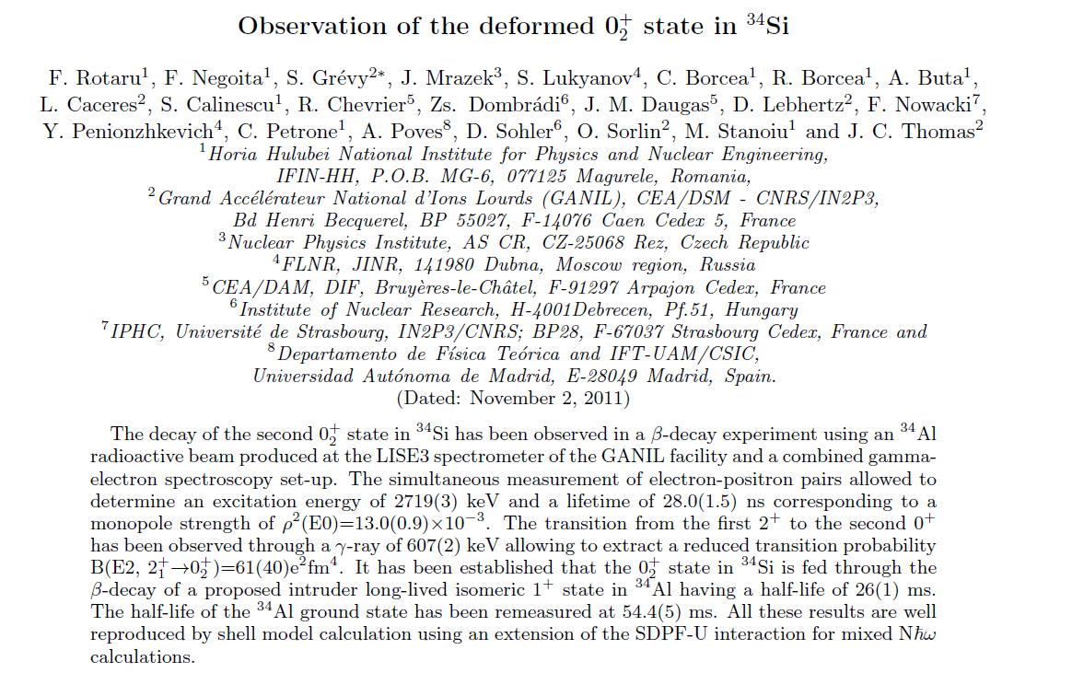
Recent results from GANIL: e⁺/e⁻ spectroscopy
Si(Li) (4,5mm)
mult _{Si} ≥ 3
Si (1mm)
(trigger β )
50 µm kapton
@ 20 grade
Eveto
XY
S. Grevy el al., ARIS 2011
F. Rotaru et al.,
Colloque GANIL 2011
+2 Ge clovers
³⁴Al
600 pps
beam degraders
and diagnostics
⁷⁴Ge (n,n’)
607 keV
Large error in
I₆₀₇/I₃₃₂₆
branching ratio
607
E2
2719 0₂⁺
τ=28(1) ns
ρ²(E0)=13(1)∙10⁻³
E0
(IPF 99%)
mult _{Si} ≥ 2

Slide 3
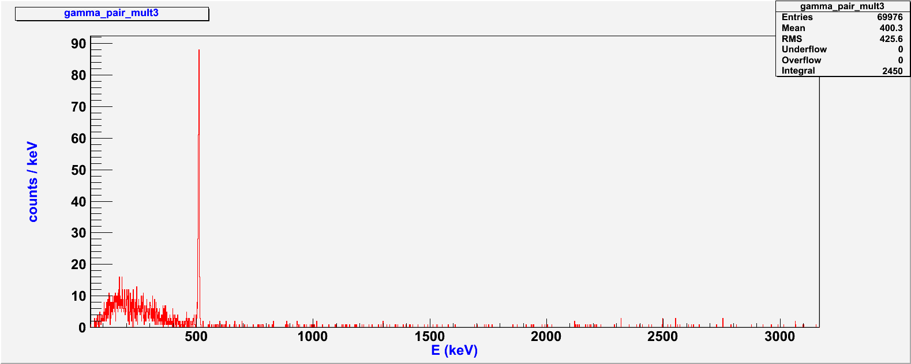
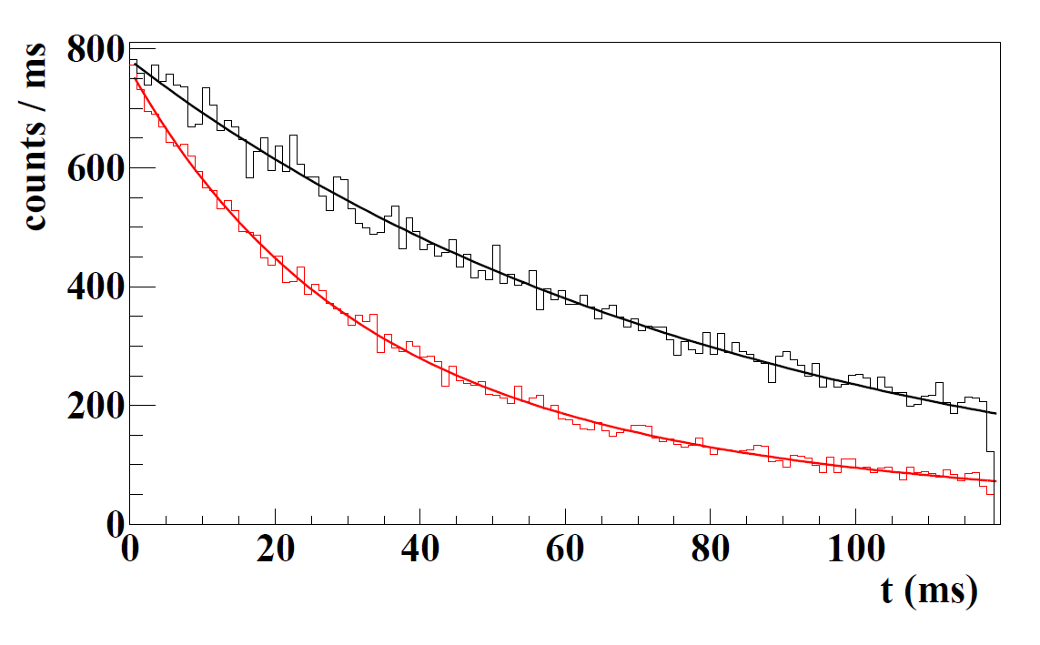
Recent results from GANIL: beta-times
Conclusion:
the 0₂+ isomer
is mainly directly populated in the
beta-decay of ³⁴Al
Gamma spectrum gated
by mult_{Si}≥3 events
4⁻
S. Nummela et al., PRC63(2001)044316
Gated beta-times spectra
Gate on 929 keV : 54.4 (5) ms
607
Gate on 551 keV : 26 (1) ms
2719 0₂⁺

Slide 4
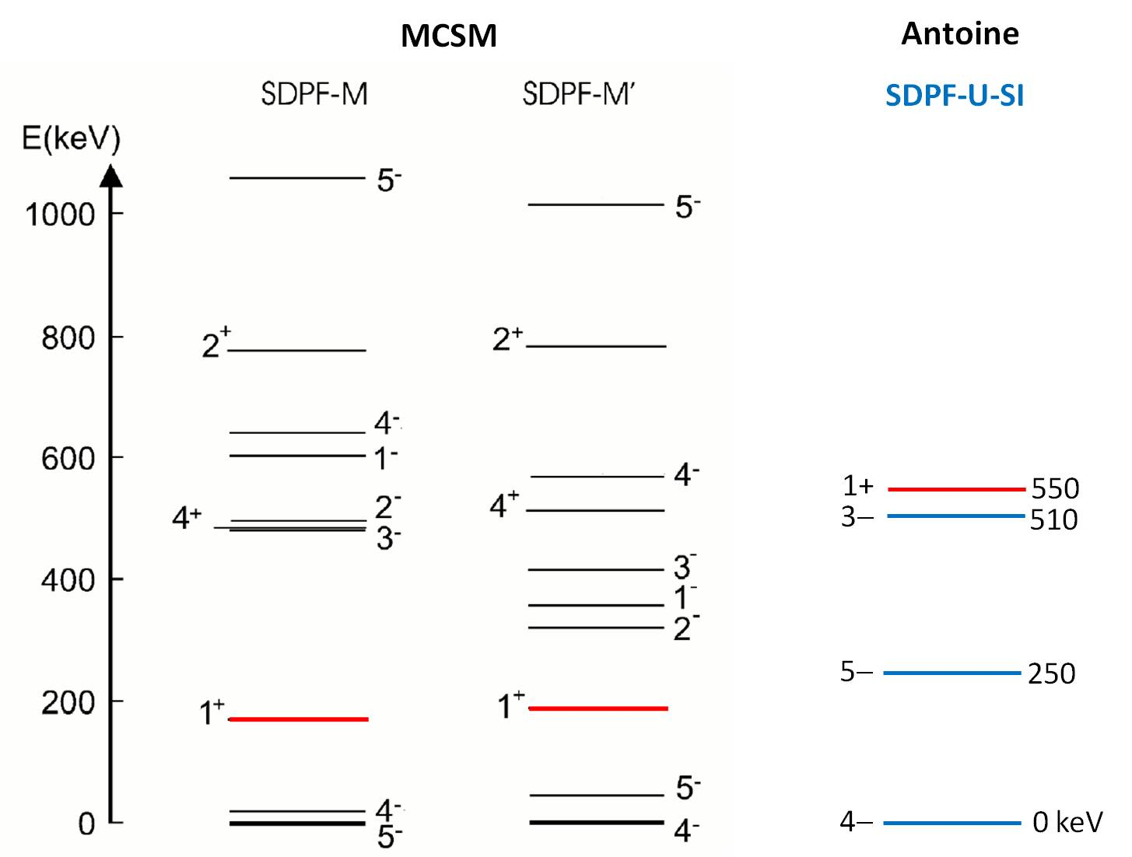
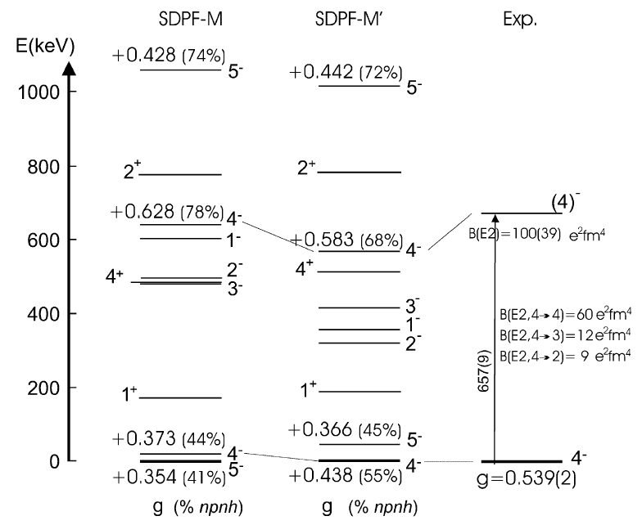
Theoretical predictions on ³⁴Al (Z=13, N=21)
f_{7/2}
Promotion of neutrons
across N~20 shell gap
generates intruder configurations
20
d_{3/2}
s_{1/2}
d_{5/2}
π
ν
P. Himpe et al.,
PLB658(’08)203
Monte Carlo Shell Model
ANTOINE
modif. SDPF-U-SI
~90% − 1ħω, ~10% − 2ħω
E3
46%
β − 54%
80% − 0ħω, 20% − 2ħω

Slide 5
³⁴Al and ³⁴Si interpretation
Antoine code → mixing 0ħω and Nħω (A. Poves)
SDPF-U-Si + non diagonal matrix elements <sd|H|pf>
+ adjustments to reproduce 0₂⁺ in ^{30,32}Mg
?
(1⁺) (26(1) ms)
1⁺ 550 keV
4⁻
(30 ms)
~90% - 1ħω, ~10% - 3ħω
br.(γ)=46%
(59 ms)
³⁴Al
4⁻
(54(1) ms)
³⁴Al
80% - 0ħω, 20% - 2ħω
≈
≈
Q₀(2₁+) = − 51.1 efm² → β = − 0.31
>50%
5330 (2₂+)
4970 (3-,4-,5-)
~5000
5-,3-,4-
4379 (3-,4-,5-)
4255 3−
<10%
3326 2₁+
3510 2₁+
7% - 0ħω, 86% - 2ħω
61(40)
67
2-level mixing:
cos²θ =0.22(9)
|β|= 0.29(4)
2719 0₂+
30%
2570 0₂+
5% - 0ħω, 86% - 2ħω
17(6)
11
0 0_{g.s.}+
10%
0 0_{g.s.}+
89% - 0ħω, 11% - 2ħω
³⁴Si
(I_{β})
³⁴Si
Experiment modif. SDPF-U-SI

Slide 6
Existing data on ³⁴Mg
The ³⁴Mg(N=22) nucleus is considered as the heaviest in the “island of inversion”.
Low 2⁺ energy: 660±1 keV [K.Yoneda et al., Phys. Lett. B 499, 233 (2001)]
Large B(E2, 0₁⁺(g.s.) → 2₁⁺) = 541±102 e²fm⁴ => strong deformation|β|~ 0.54
[H. Iwasaki et al., Phys. Lett. B 522, 227 (2001)]
[J.A. Church et al., Phys. ReV. C72, 054320 (2005)]
The β-decay study of ³⁴Mg ISOLDE [M. Langevin et al., Nucl. Phys. A414,151(1984)]
    set-up only for β-delayed neutron probabilities measurement
    life-time of 20±10 ms could be determined
    no gamma measured
    no P_{n}/P_{2n} neutron emission probabilities deduced
Q_{β}(³⁴Mg) =11.7 MeV
S_{2n}(³⁴Al) =2.47 MeV
S_{2n}(³⁴Al) =8.01 MeV
We assume that P_{n}+ P_{2n} = 40%+10%.

Slide 7
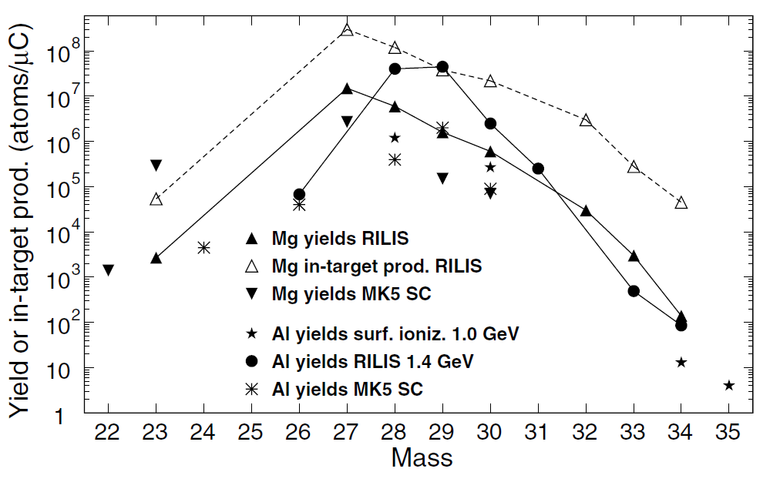
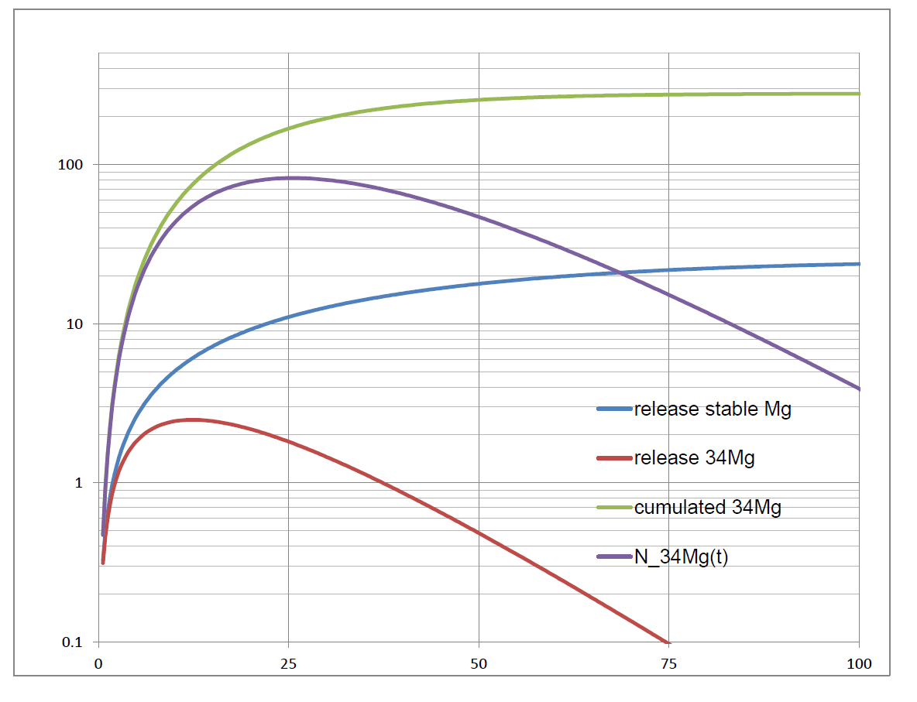
Proposed experiment: ³⁴Mg beam
Köster et al.,
NIMB204(2003)347
³⁴Mg yields: 140 ions/μC
I = 2 μA
Beam-on
(30 ms)
Beam-off (2.4 s – 30 ms)
200 cps
80 decays/sec.
during beam-off
Counts or counts/second
Time (ms)

Slide 8
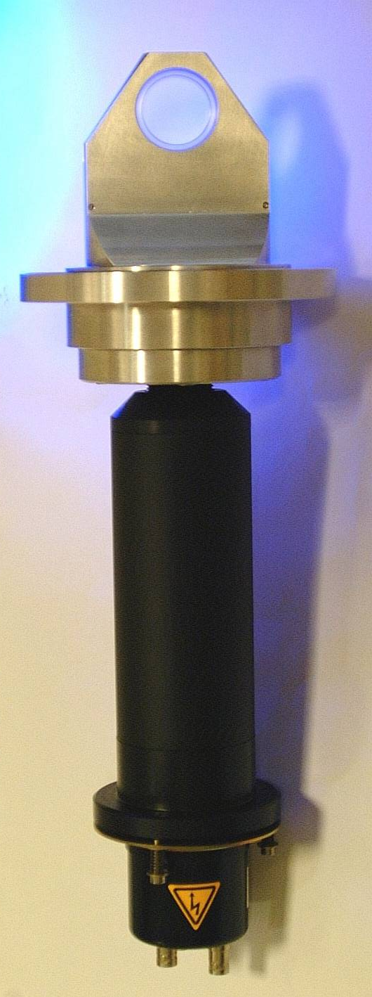
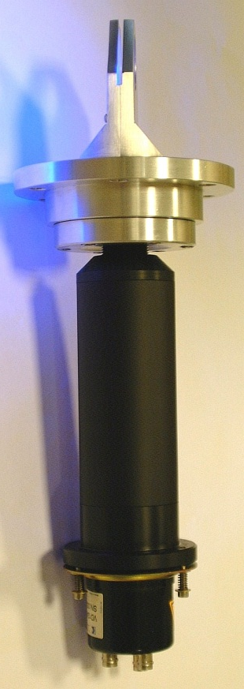
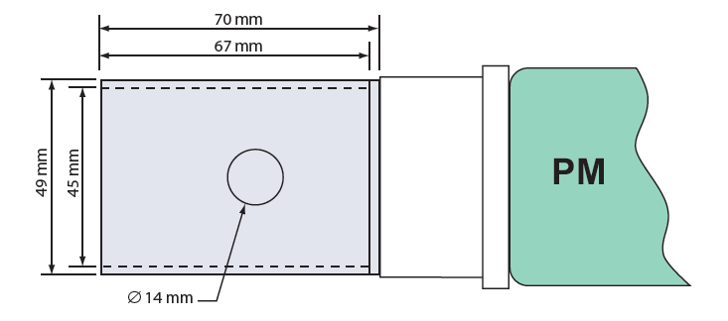
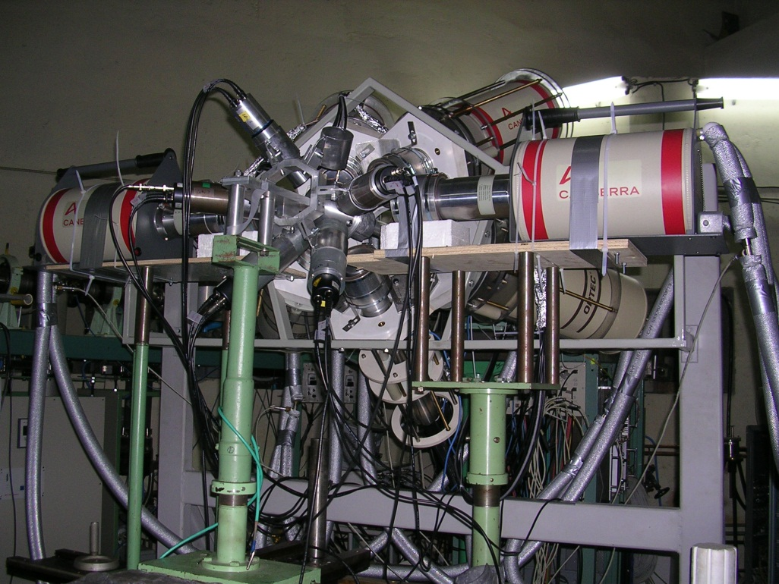
Proposed experiment: implantation set-up
L. Perrot, These
(Strasbourg, 2006)
and e⁺/e⁻ pairs
E0 / τ=28(1) ns
Increase
ε_{geom.} > 95%
ε_{geom.}~ 83% =>
ε=71(5)% for Q_{β}=7.5 MeV
4 Ge + 4 LaBr3 + 2 liquid scintillator detectors.
Energies: XIA 80 MS/s digitizers
Timing: β-trigger vs. LaBr3
β-trigger vs. E0 signal
(option: 2GS/s CAEN digitiser +
waveform transfer [0.4 MB/s])
Only internal triggers for all digitisers.
Dead time: ~5 μs/trigger
Readiness: summer 2012
TAC => XIA digitizers

Slide 9
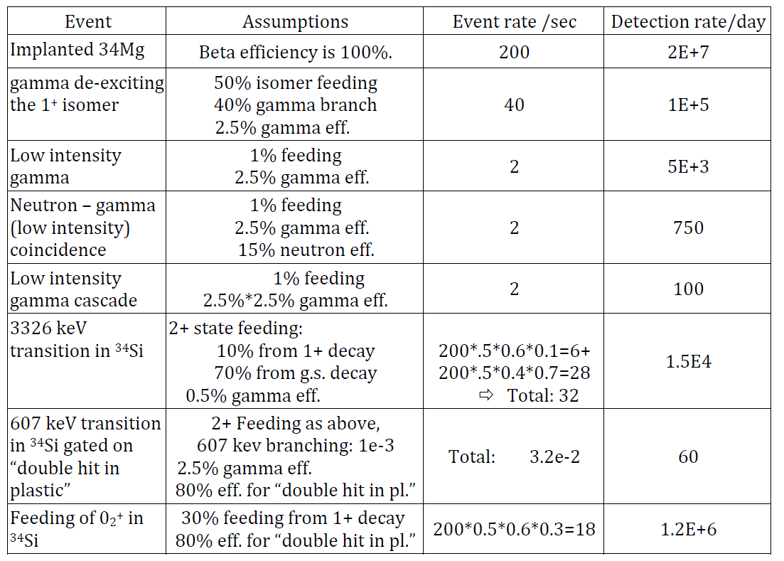
Proposed experiment: estimated counting rates

Slide 10
Normalization: LIST mode for isobars suppression
³⁴Mg
20(10) ms
~2E6 implanted ³⁴Mg in 2 days
50%?
10%?
0%?
40%?
³⁴Al^{m}
26(1) ms
40%?
³⁴Al_{g.s.}
54.4(5) ms
124 keV;28%
√
³³Al
41.7(2) ms
1941 keV;2.5%
³²Al
33.0(2) ms
1941 keV;12%
3042 keV;4.3%
5E3
counts
~180 counts
25?%
~150 counts
~40 counts (ε≈15%)
75?%
74%
26%
91.5%
8.5%
100%
³⁴Si
2.77(2) s
429 keV; 30%
1607 keV; 20%
³³Si
6.11(2) s
1847 keV; 75%
416 keV; 3.5%
³²Si
153 y
√
√
100%
100%
Numbers of nuclei obtained from gamma peaks
can be cross checked with beta-triggers counts
in a short time window: 0 ms < t_{β} < 300 ms
and
in a long time window: 300 ms < t_{β} < 2000 ms
Expected accuracy in N_{34Alm} is 10%.
³⁴P
12.43(8) s
2127 keV;25%
³³P
25.3(1) d

Slide 11
Expected results and beam time request
  First gamma-beta decay study of ³⁴Mg
  Excitation energy and gamma branching for 1⁺ β-isomer in ³⁴Al
  Propose a level scheme in ³⁴Al
  Decay scheme for 1⁺ β-isomer in ³⁴Al (absolute I_{β} using LIST)
  Placement/confirmation of normal configuration 2⁺ in ³⁴Si and its decay modes
  Higher accuracy in 2₁⁺ branching to 0₂⁺ and 0₁⁺(g.s.)
  Improve SM interactions for mixed Nħω calculation in sd-pf space
Beam time request: 21 shifts
  3 shifts for beam and electronics tuning
  12 shifts for ³⁴Mg at maximum intensity
  6 shifts for ³⁴Mg using LIST

