Slide 1



Collinear resonant ionization spectroscopy for neutron rich copper isotopes
ISOLDE INTC-P-316
Spokespersons: G. Neyens, M.M. Rajabali, K.U. Leuven
Local contact: K.T. Flanagan, Univ. Manchester
K.U. Leuven, Belgium: M.L. Bissel, I. Budincevic, R. Garcia-Ruiz, G. Neyens, J. Papuga, M.M. Rajabali
University of Manchester, U.K.: K.T. Flanagan, J. Billowes, B. Cheal, K.M. Lynch, T.J. Proctor
ISOLDE, CERN, Geneva, Switzerland: T.E. Cocolios, H.A. Khozani, K.M. Lynch, B. March, S. Rothe
MPI fur Quantenoptik, Garching, Germany: M. Hori, H.A. Khozani, A. Soter
University of Tokyo, Tokyo, Japan: T. Kobayashi
IPN-Orsay, France: F. Le Blanc, D. Verney
New York University, New York, USA: H.H. Stroke
Mainz University, Germany: K. Wendt
Belgian Research Initiative on eXotic nuclei

Slide 2
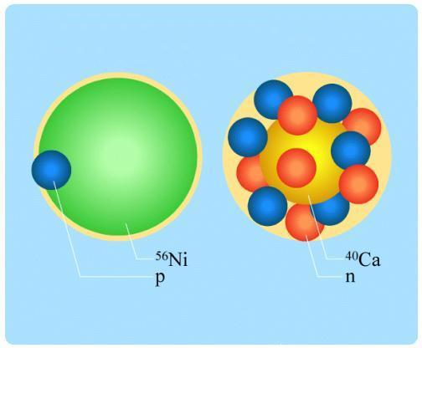
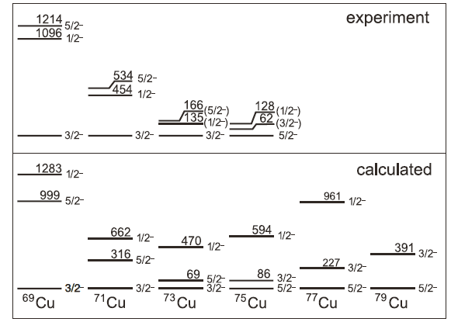
GENERAL MOTIVATION
Study magicity of Z=28 and N=50 in ⁷⁸Cu ( = ⁷⁸Ni + 1p -1n) ?
-n
p
⁷⁸Ni
Study evolution of single particle levels towards ⁷⁸Ni
Measure spins and moments of ^{76,77,78}Cu
K.T. Flanagan et al., PRL103, 142501 (2009)
odd-Cu g..s spins and moments
K.T. Flanagan et al., Phys. Rev. C 82, 041302(R) (2010)
72,74Cu g.s. spins and moments
(→ parity, wave function)
U. Koester et al., PRC84, 034320 (2011)
77Cu g.s. spin and magnetic moment
69
71
73
75
77
Search for long-lived isomers in ^{76,77,78}Cu and measure their spin and moments
→ possible spin-gap isomer in ⁷⁸Cu, related to neutron in νd_{5/2}

Slide 3
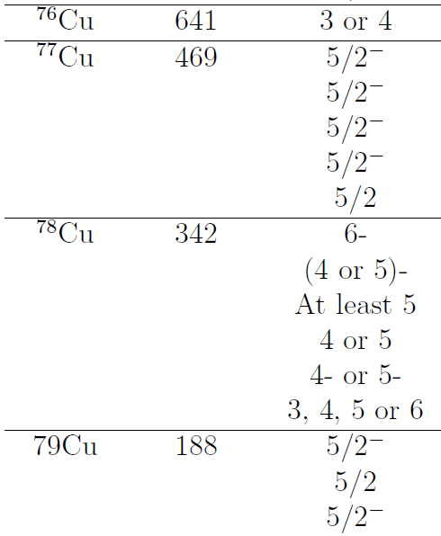
SPECIFIC MOTIVATION
Available decay spectroscopy information on ^{76,78}Cu isotopes is not conclusive !
Need firm ground state spin assignments to allow interpretation of spectroscopy data
(including Ni mother isotopes and Zn daughter isotopes)
β-decay J. Van Roosbroeck et al. Phys. Rev. C71, 054307(2005)
J.A. Winger et al., PRC 42, 954 (1990) 2 long-lived states
β-decaying isomer or not ?
β-decay
β-decay
β-decay
β-decay
Theory
ISLS
C. J. Gross et al. Acta Phys. Pol. B40, 447 (2009).
J. Van Roosbroeck et al. Phys. Rev. C71, 054307(2005).
N. Patronis et al. Phys. Rev. C80, 034307(2009).
J.A. Winger et al. Acta Phys. Pol. B39, 525(2008).
N. A. Smirnova et al. Phys. Rev. C69,044306(2004)
U. Koster et al. Phys. Rev. C84,034320(2011)

Slide 4
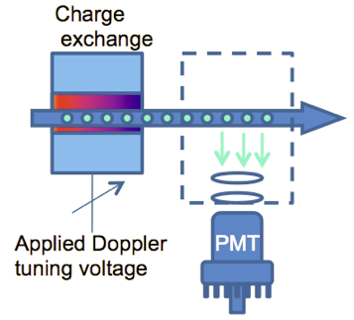
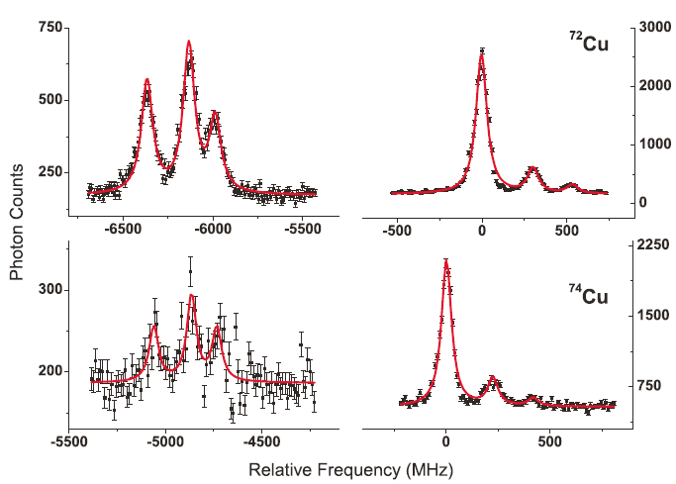
EXPERIMENTAL TECHNIQUE: CRIS
Collinear Resonance Ionization Spectroscopy
Combine the best of two methods:
- collinear laser spectroscopy → high resolution ( ~ 50 MHz)
BUT low detection efficiency: 1 photon /30.000 ions
reduce non-resonant photon background using bunched beams (ISCOOL)
Need > 10⁴ ions/s
⁷⁴Cu, I=2
Photon counts
3²P_{3/2}
1/2
3/2
Measure: • μ
• Q_{s}
• δ<r²>
• spin
5/2
325 nm
7/2
μ < 0
3²S_{1/2}
3/2
most intense line
5/2

Slide 5
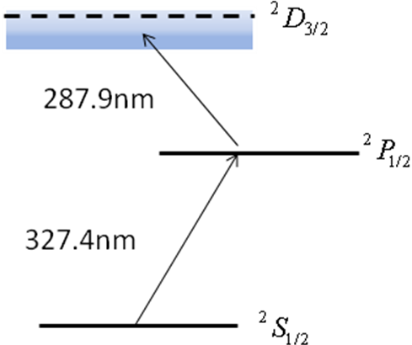
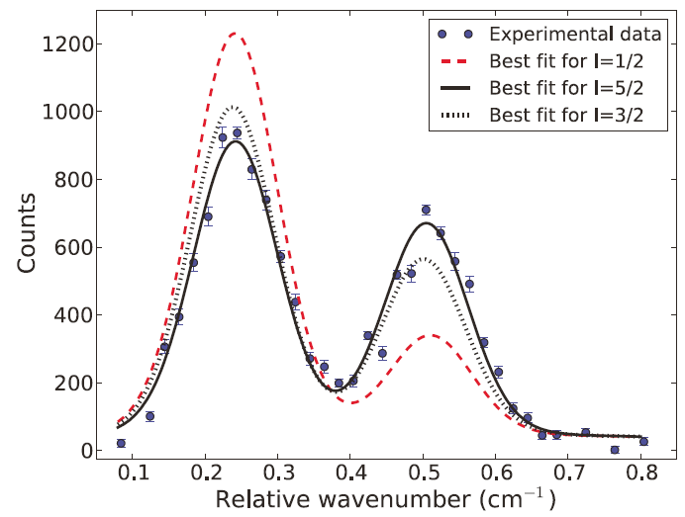
EXPERIMENTAL TECHNIQUE: CRIS
Collinear Resonance Ionization Spectroscopy
Combine the best of two methods:
- resonance ionisation spectroscopy → high detection efficiency (ions), low background
BUT low resolution (if done in-source)
Need < 10 ions/s
detect resonantly excited ions
77Cu – in-source
Measure: • μ
• (spin)
U. Koester et al., PRC84, 034320 (2011)

Slide 6
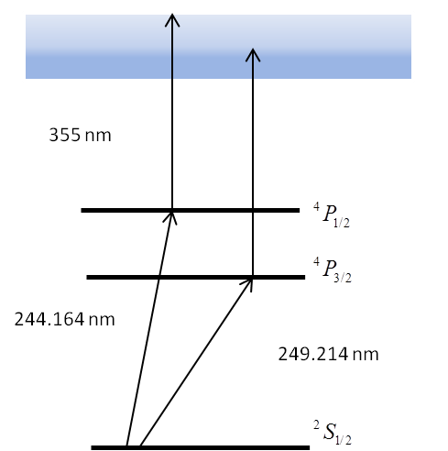
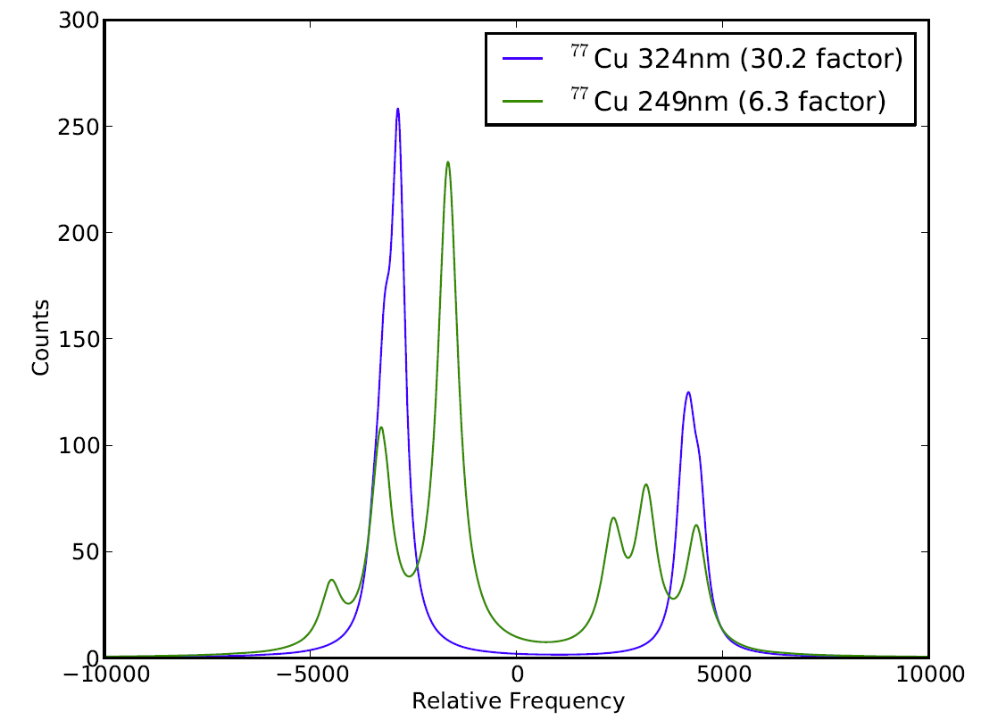
EXPERIMENTAL TECHNIQUE: CRIS
Collinear Resonance Ionization Spectroscopy
Combine the best of two methods:
- collinear laser spectroscopy → narrow linewidth due to acceleration to 40 keV
+ resonance ionisation spectroscopy → high detection efficiency, low background
Need < 10 ions/s
355 nm
77Cu – CRIS
⁴P_{1/2}
Assumed 300 MHz linewidth
due to frequency trippling after pulsed dye amplification
⁴P_{3/2}
244 nm
249 nm
Measure: • μ
• Q_{s}
• δ<r²>
• spin

Slide 7
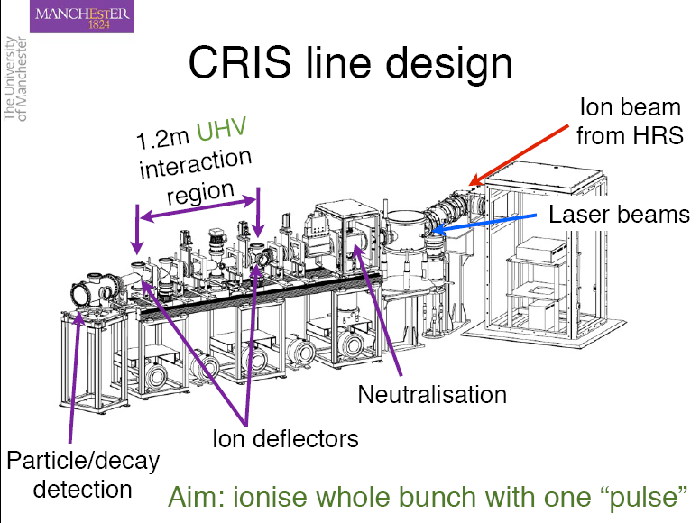
EXPERIMENTAL TECHNIQUE: CRIS
Collinear Resonance Ionization Spectroscopy
Pulsed ion beam from ISCOOL
two-step resonance ionisation
into continuum
355 nm
⁴P_{1/2}
⁴P_{3/2}
mcp-detector
+ β-decay
+ γ-decay
detection station
244 nm
249 nm
²S_{1/2}
Cu-I
CW pulsed amplified laser for resonant excitation
Pulsed laser beam for ionization

Slide 8
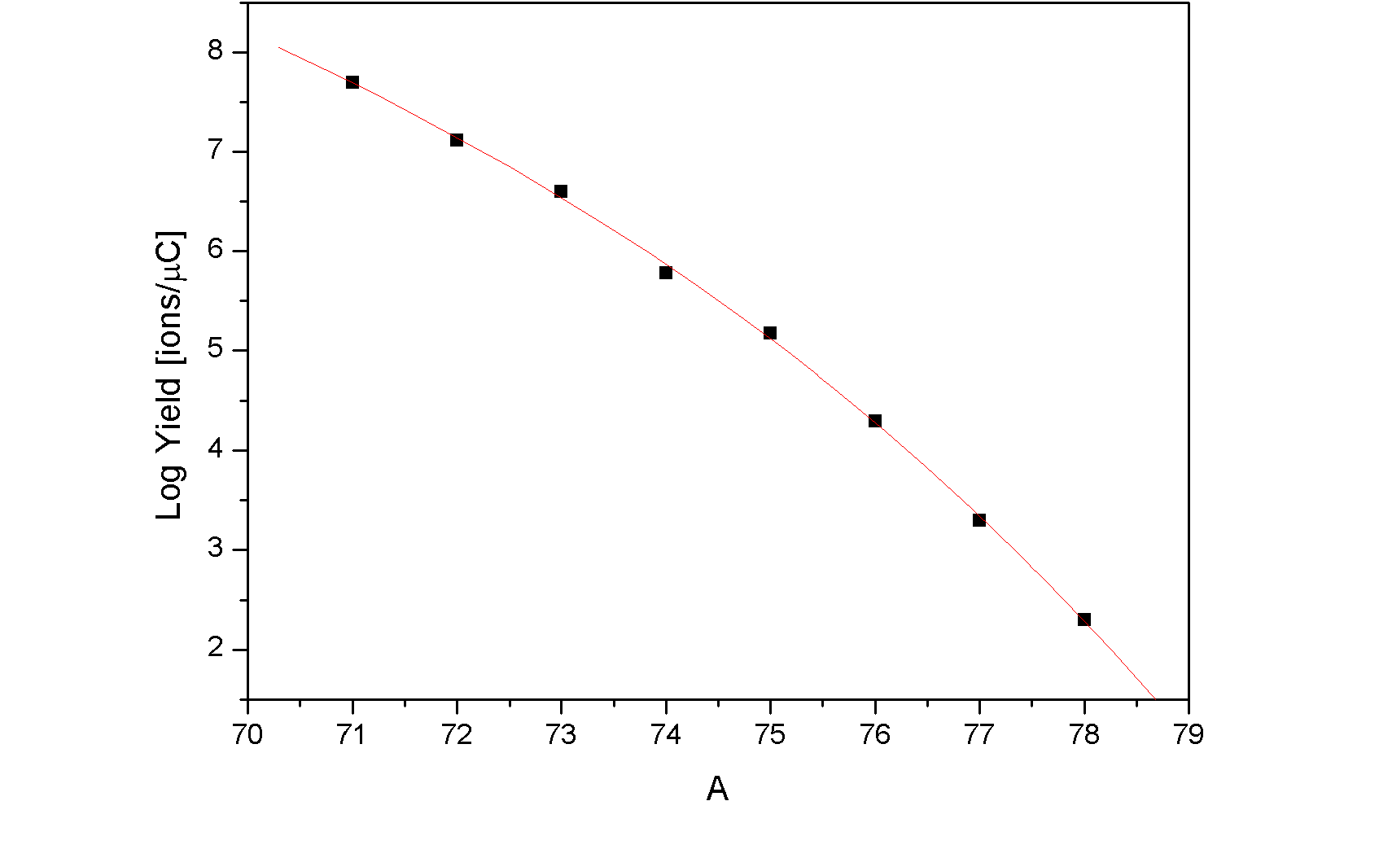
Cu PRODUCTION RATES
Limit for optical detection
~ 10⁴ ions/μC
Limit for CRIS
~ 10 ions/μC
⁷⁸Cu measured yield = 200 ions/μC ➔ accessible with CRIS method
⁷⁹Cu extrapolated yield = few ions/μC

Slide 9
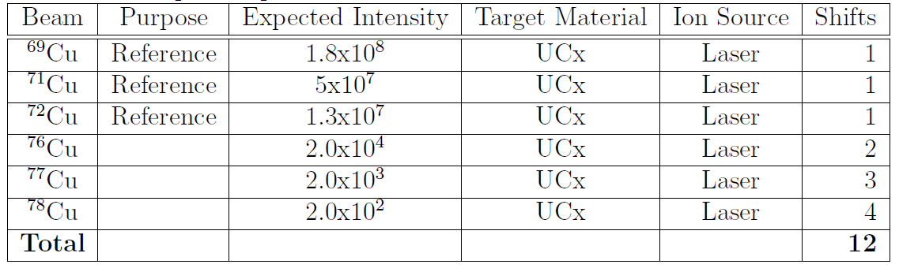
BEAM TIME request
2 shifts with stable ^{63,65}Cu prior to the run
12 shifts with radioactive Cu isotopes
To measure the hyperfine structure of ^{76,77,78}Cu
relative to that of ^{69,71}Cu and ⁷²Cu
➔ spins, magnetic moments, quadrupole moments, isotopes shifts

Slide 10
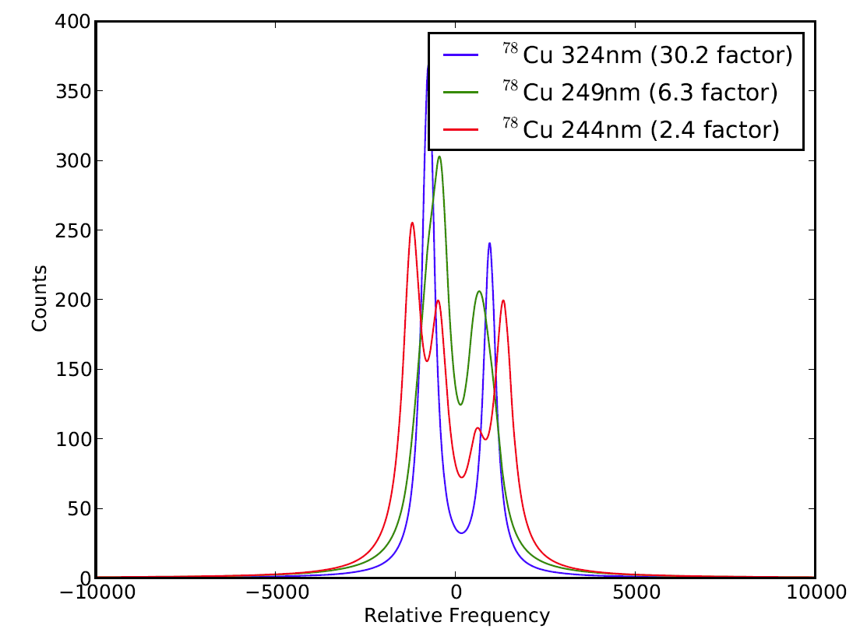
244 nm: μ and <δr²>
249 nm: Q (low precision)

Slide 11
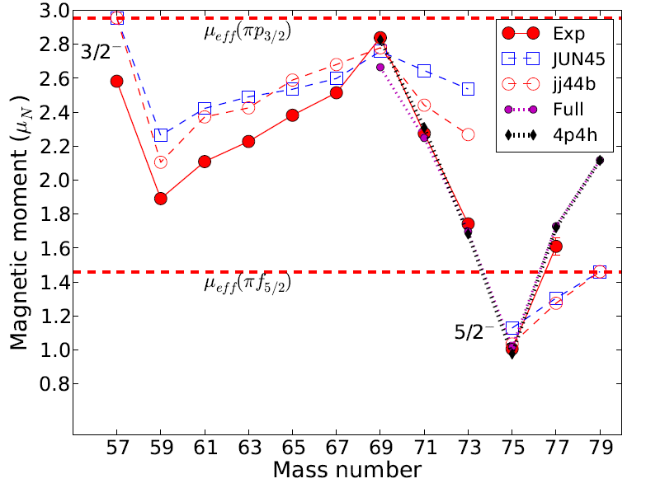
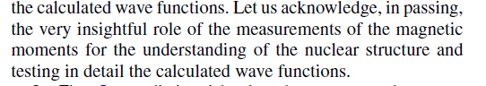
Honma
56Ni core
Brown
Sieja and Nowacki
48Ca core
PRC81, 061303(R),2010

Slide 12
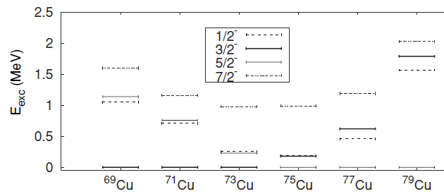
Consequences for spectroscopy – shell model tests
Assign spins to levels in ^{71,73,75}Cu:
Stefanescu et al. Phys. Rev. Lett. 100, 112502 (2008)
Daugas et al., Phys. Rev. C C 81, 034304 (2010)
Theories reproduce lowering of 5/2⁻ in ⁷⁵Cu
69
71
73
75
77
interaction starting from a ⁵⁶Ni core
(Flanagan et al., PRL 103, 142501,2009)
Brown, Lisetsky
jj44b
interaction starting from a ⁴⁸Ca core
(Sieja and Nowacki, PRC81 061303(R),2010)
The ½ level is lowered by openening N=28 shell
The 3/2- is pushed up by ~ 1 MeV in ⁷⁹Cu

Slide 13
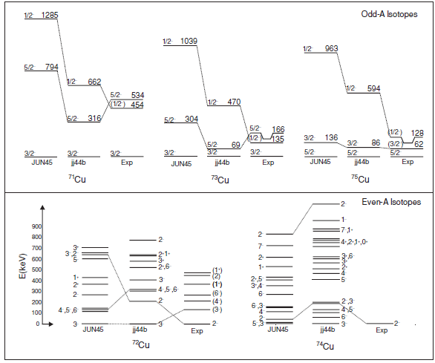

Slide 14
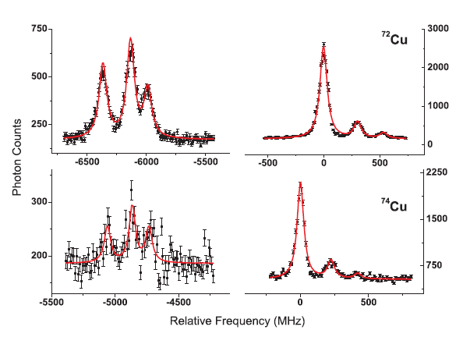
μ = -1.347 μ_{N}
FWHM=60 MHz
μ = -1.068 μ_{N}
FWHM=300 MHz
μ = -0.4 μ_{N}

