Slide 1
Neutron capture cross-section of ⁹³Zr
G.Tagliente, P.M.Milazzo, M. Barbagallo, E.Berthomieux, N.Colonna, C.Guerrero, F.Käppeler, C. Lederer, C.Massimi, M. Mastromarco, A. Mengoni and n_TOF collaboration
Spokepersons: G. Tagliente, P.M. Milazzo
Technical coordinators: E. Berthomieux

Slide 2
Scientific Motivations
Nuclear Technology
Nuclear Astrophysics

Slide 3
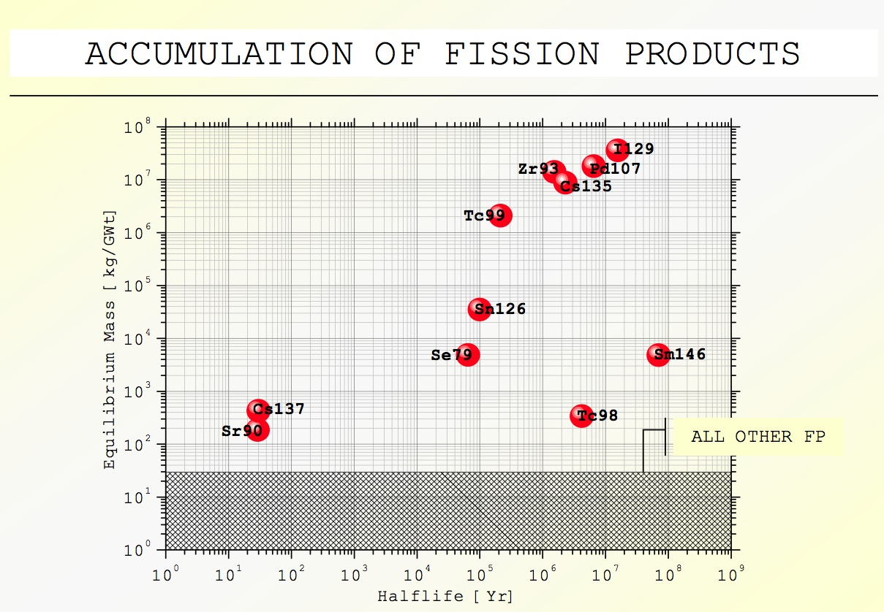
Nuclear Technology
PWR 33GWtd THM⁻¹ burnup
3 yr cooling spent fuel

Slide 4
Nuclear Technology
Partitioning and transmutation of nuclear wastes should make possible to reduce both the size of the repository for nuclear wastes and the long term risk. Fission products, such as ⁹³Zr , are considered as candidates for transmutation otherwise their very long half-lives necessitate storage in a repository for extremely long times.
Neutron capture cross section of ⁹³Zr, as well as other long-lived fission products, is required for transmutation studies, as well as for nuclear reactor design purposes.
Formal requests have been made for 5% uncertainties on capture cross sections of ⁹³Zr.

Slide 5
Nuclear Astrophysics
Abundances beyond Fe–ashes of stellar burning
BB
Fusion
Neutrons
s-processes n_{n} ~ 10¹⁰ n/cm³ site: low mass AGB stars
r-processes n_{n} ~ 10²² n/cm³ site: supernovae explosions
Fe
s
r
s
r

Slide 6
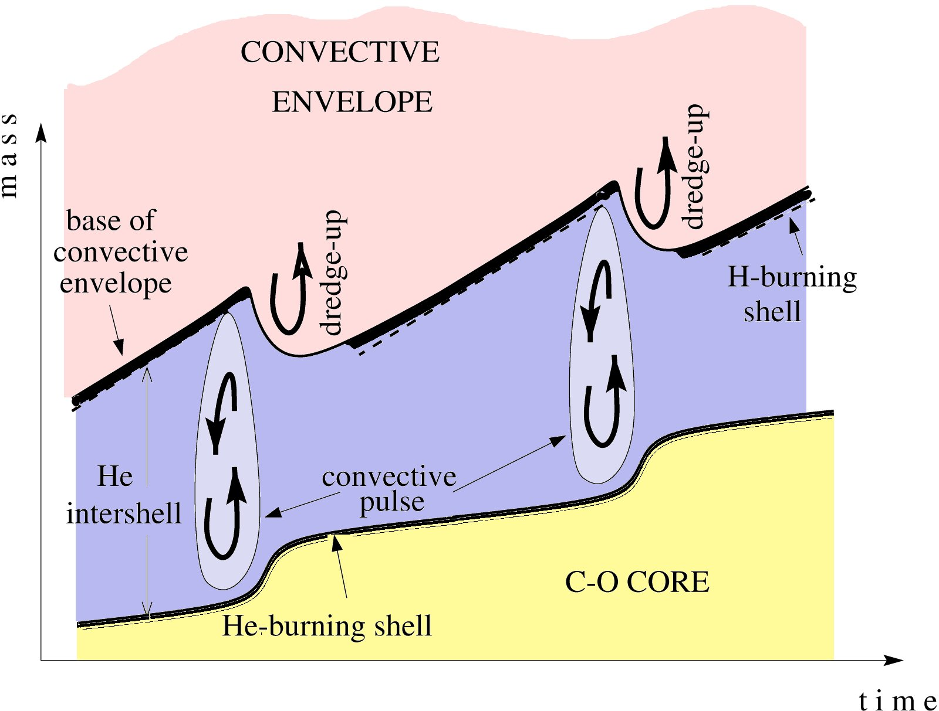
AGB Stars
Thermal Pulse Stellar model
¹³C(α,n)¹⁶O T~10⁸K N_{n}< 10⁷ n/cm³
²²Ne(α,n)²⁵Mg T>3.5 10⁸K N_{n}~10¹⁰-10¹² n/cm⁻³
neutron density
neutron density
time
mass coordinate (M)
time
proton diffusion
¹³C(α,n)¹⁶O
- C
²²Ne(α,n)²⁵Mg
Notes:
Low mass AGBsIntermediate mass AGBs
Lower temperature ~4.5 M Higher temperature
Larger intershell mass Smaller intershell mass

Slide 7
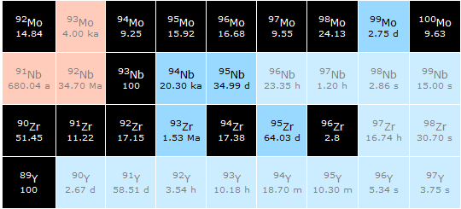

Slide 8
The Thermal Pulse Stellar model: the Zr case
Nucleus | N_{ʘ} Normalized to N(Si)=10⁶ atoms | N_{s}/ N_{ʘ}
⁹⁰Zr | 5.546 | 0.789
⁹¹Zr | 1.21 | 1.066
⁹²Zr | 1.848 | 1.052
⁹⁴Zr | 1.873 | 1.217
⁹⁶Zr | 0.302 | 0.842
There is some inconsistency using
the TP stellar model to calculate the N_{s}
abundances with values of the
Zr cross sections before n_TOF.
The uncertainty on the N is 10%
The uncertainty on Zr cross sections
ranges from 5% to 20% (depending on the isotopes).
There are discrepancies up to 50% on the results of some measurements
New measurements with high accuracy needed !

Slide 9
Zr measurements:INTC 2002-034/P163
Zr isotope samples
 | Isotopic content (%)
 | ⁹⁰Zr | ⁹¹Zr | ⁹²Zr | ⁹³Zr | ⁹⁴Zr | ⁹⁶Zr
⁹⁰Zr | 97.7 | 0.87 | 0.6 | - | 0.67 | 0.16
⁹¹Zr | 5.43 | 89.9 | 2.68 | - | 1.75 | 0.24
⁹²Zr | 4.65 | 1.62 | 91.4 | - | 2.03 | 0.3
⁹³Zr* | 1.5 | 19.0 | 20.0 | 20.0 | 20.0 | 19.0
⁹⁴Zr | 4.05 | 1.18 | 1.93 | - | 91.8 | 1.04
⁹⁶Zr | 19.41 | 5.21 | 8.2 | - | 8.68 | 58.5
Sample
Admixture: Hf, Na, Mg, Al ...
* Radio isotope (T_{1/2} =1.5x10⁶ year)

Slide 10
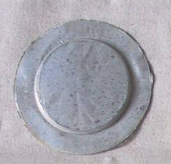
Zr measurements:INTC 2002-034/P163
 | ⁹⁰Zr | ⁹¹Zr | ⁹²Zr | ⁹³Zr | ⁹⁴Zr | ⁹⁶Zr | ¹⁹⁷Au | Pb
Mass (g) | 2.717 | 1.404 | 1.349 | 4.88 | 2.015 | 3.398 | 1.871 | 3.895
Thickness (cm) | 0,127 | 0,065 | 0,062 | 0,37 | 0,091 | 0,151 | 0.025 | 0.09
Chemical form | ZrO₂ | ZrO₂ | ZrO₂ | ZrO₂ | ZrO₂ | ZrO₂ | Metal | Metal
Enrichment (%) | 97.7 | 89.9 | 91.4 | 20.0 | 91.8 | 58.5 | 100 | Nat.
Samples 2.2 cm in diameter, 1 mm thick
Stable Zr isotopes encapsulated in 0.2 mm Al can
⁹³Zr isotope encapsulated in 0.2 mm Al + 0.2 mm Ti
Chemical form:ZrO₂
⁹³Zr isotope activity 92.5 MBq

Slide 11
Zr (INTC 2002-034/P163) publications
Neutron capture cross section of ⁹⁰Zr: bottleneck in the s-process reaction flow: G. Tagliente et al., PRC 77(2008)
Study of the ⁹¹Zr(n, γ) reaction up to 26 keV: G. Tagliente et al., PRC 78(2008)
The ⁹²Zr(n,γ) reaction and its implications on stellar nucleosynthesis: G. Tagliente et al., PRC 81(2010)
Neutron capture on ⁹⁴Zr: Resonance parameters and Maxwellian-averaged cross sections: G. Tagliente et al., PRC 84(2011)
⁹⁶Zr(n, γ) measurement at the n_TOF facility at CERN: G. Tagliente et al., PRC accepted

Slide 12
Results - ⁹³Zr yield
⁹³Zr
raw Yield
Natural radioactivity of the sample
Yield – nat. radioactivity of the sample
overall background

Slide 13
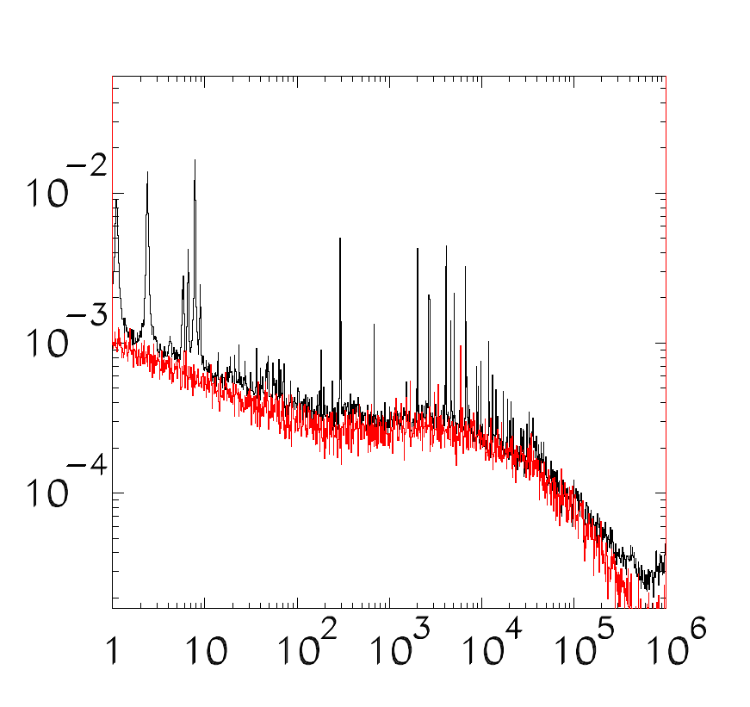
Results : MACS & experimental energy ranges
MaxwellianAveraged Cross Sections(MACS)
⁹²Zr
 | Energy range (keV) n_TOF
⁹⁰Zr | 0.01 - 66
⁹¹Zr | 0.01 - 26
⁹²Zr | 0.01 – 40
⁹³Zr | 0.01 – 8
⁹⁴Zr | 0.01 – 60
⁹⁶Zr | 0.01 – 37
Yield
0.01 – 8
E_{n}(eV)
⁹³Zr
The n_TOF data have to be
complemented with a data library
Jendl 3.3 and ENDF IV
Yield
E_{n}(eV)

Slide 14
MACS: results
The ⁹³Zr cross sections measured at n_TOF are 35% lower than the previous measurements
⁹³Zr
Prelimirary

Slide 15
MACS:@ 30 keV
MACS in mbarn
Isotope | KADoNiS | n_TOF
⁹⁰Zr | 21 ± 2
⁹¹Zr | 60 ± 8
⁹²Zr | 34 ± 6
⁹³Zr | 95 ± 10
⁹⁴Zr | 26 ± 1
⁹⁵Zr | 79
⁹⁶Zr | 10.7 ± 0.5
19.3 ± 0.9
63 ± 4
38 ± 3
65.1 ± 3
30.5 ± 2
18.9 ± 0.9
8.9 ± 0.5
KADoNIS: Karlsruhe Astrophysical Database of Nucleosyntheisin Stars

Slide 16
Astrophysical implication: Abundances
Nucleus | N_{ʘ} Normalized to N(Si)=10⁶ atoms | N_{s}/ N_{ʘ} % Old MACS | N_{s}/ N_{ʘ} % n_TOF MACS
⁹⁰Zr | 5.546 | 0.789 | 0.844
⁹¹Zr | 1.21 | 1.066 | 1.024
⁹²Zr | 1.848 | 1.052 | 0.981
⁹⁴Zr | 1.873 | 1.217 | 1.152
⁹⁶Zr | 0.302 | 0.842 | 0.321
Solar abundances, N, from Lodders 2009, accuracy 10%
The s-abundances, N_{s}, are calculated using the TP stellar model for low mass AGB star (1.5 - 3 M), accuracy 8%.
Old MACS are from the KADoNiS data base 2008. Since 2009 the databases has been update at the new n_TOF data, as the new data are relased.

Slide 17
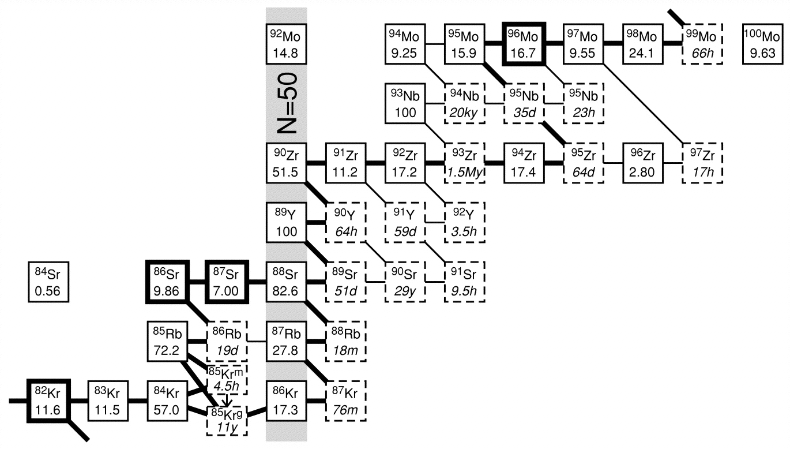
Astrophysical implication: Zr/Nb
A lower ⁹³Zr(n,γ) value means that more ⁹³Zr is produced. After radiogenic decay of ⁹³Zr more Nb will result.
The final result is ~50% more Nb!

Slide 18
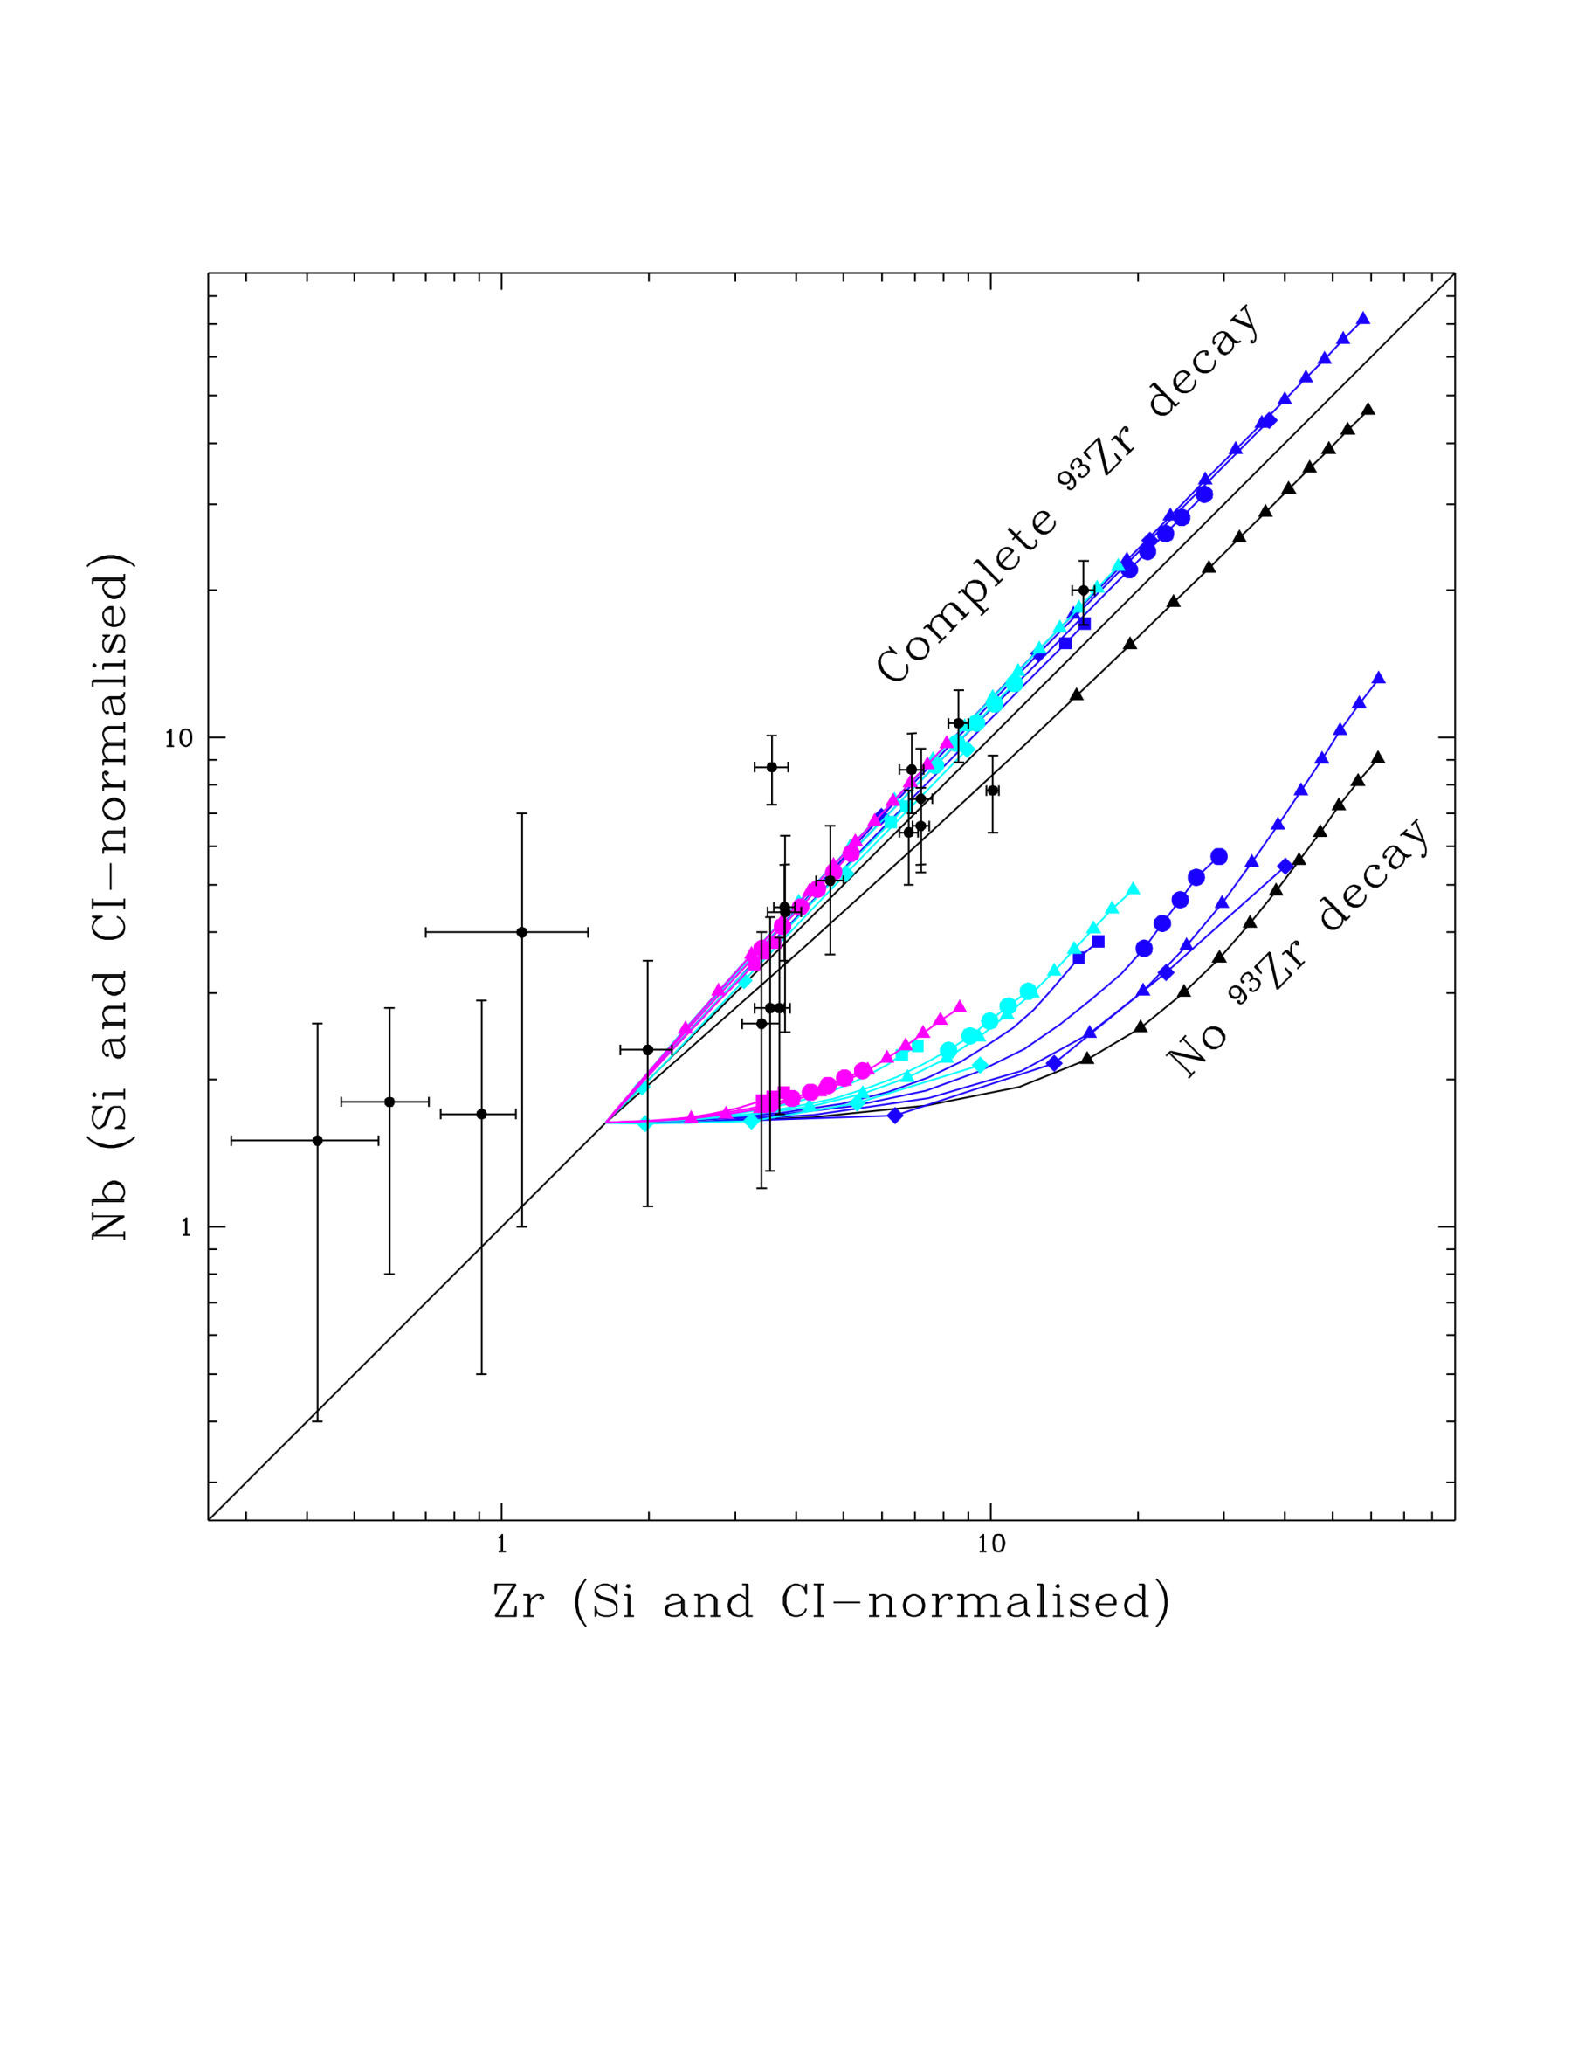
Elemental Nb and Zr abundances in SiC
Mass, Metallicity
1.8, 0.01 ~ 0.7 Z
3, 0.01 ~ 0.7 Z
3, 0.02 ~ 1.5 Z
3, 0.03 ~ 2 Z
Courtesy of M.Lugaro
old rate
M_{mix}(M)
0.002
0.0005
0.0002
With the new ⁹³Zr(n,γ) cross section the problem is solved.
BUT!!!
The data, specially for the ⁹³Zr, have to be confirmed with new data in a wider neutron energy range

Slide 19
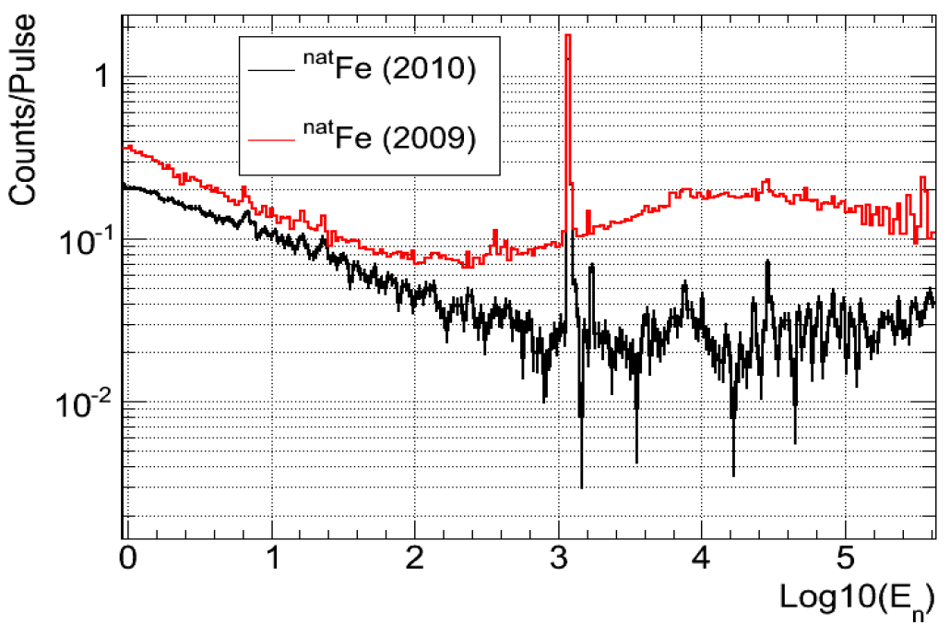
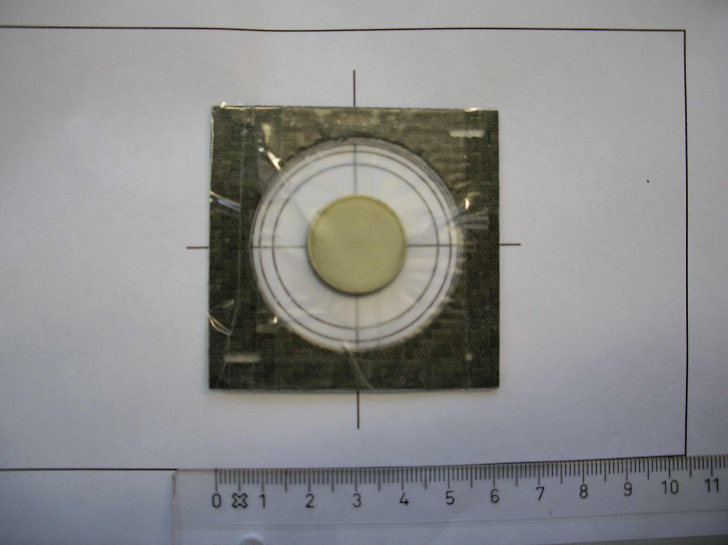
New ⁹³Zr capture measurement @ n_TOF
2009 new moderator (borated water: H₂0 + H₃BO₃ ): lower background
PEEK container (C₂₀H₁₂O₃)
2010 Upgrade experimental area in work sector of class A: easier to handle with unstable isotopes
⁶³Ni measurement (CERN-INTC 2010-067/INTC-P-283)

Slide 20
New ⁹³Zr capture measurement @ n_TOF

Slide 21
New ⁹³Zr capture measurement @ n_TOF
Detectors: C₆D₆
Samples
⁹³Zr
Pb, empty ⁹³Zr container: background
Au, ⁹²Zr : normalization
Goal: extend the measured cross section up to En ≈ 100 keV with an accuracy < 5%
Number of protons required : 3 x 10¹⁸

