Slide 1
Prototyping Thermal Control Tuning Unit for a Photonic μ-Ring Modulator
Paweł Kozłowski (EP-ESE-BE) BE Seminar Talk
15.10.2025

Slide 2
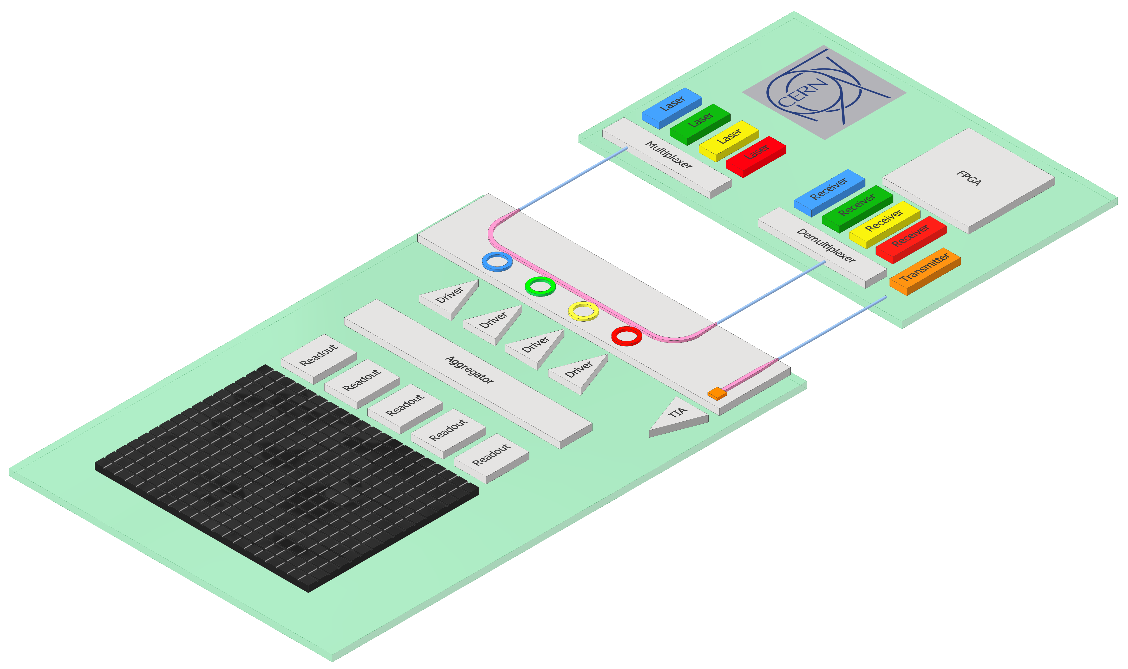


Silicon Photonics Links for Particle Detectors
Future particle detectors
  up to 100 Gbps per fibre (VTRx+ 10Gbps)
  Small size, high level of radiation tolerance (~10x compared to VTRx+)
  Low power
    Locate laser outside of radiation zone
Driver ASIC
  Co-packaged with the PIC
Single mode fibre
  Supporting long distance ~1km
Proposition for Opto-layer:
  Photonic Integrated Circuits (PICs)
WP6
  EP-ESE-BE/ME
Focus of the presentation
>> 100 m Single-mode fibre
PIC
Fiber coupler
FPGA
Modulator
Photodiode
OPTO
Particle sensor
ASIC
System concept under development in the
EP R&D WP6 project
Notes:
Future particle detectors require significantly higher data transmission rates—up to 100 Gbps—far exceeding the capabilities of current optical links such as VTRx+. Typically, detectors interface with electrical ASIC that control the optical transmitters, which in turn propagate the signal in optical domain. In the new system a key innovation is relocating the laser source outside the radiation zone, which enhances radiation hardness and improves power efficiency. Single-Mode Fiber enables long-distance transmission, allowing backend processing electronics to be located far from radiation areas. To enable efficient electronics-to-photonics data conversion, a Photonic Integrated Circuit (PIC) is proposed. It offers high-speed data transmission and enhanced radiation hardness, making it well-suited for deployment in high-energy physics environments.

Slide 3
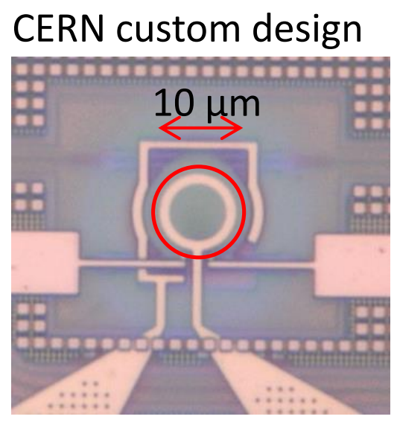
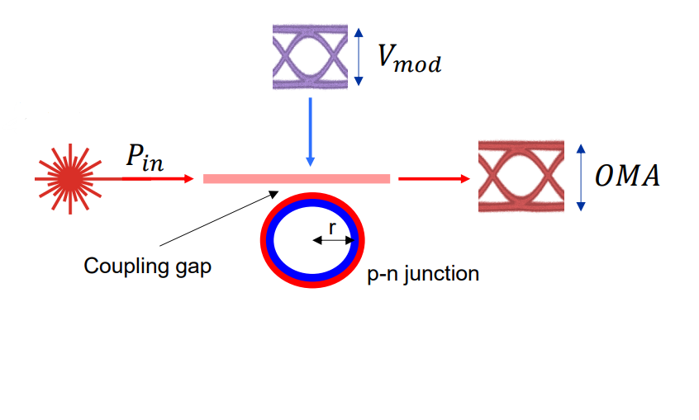
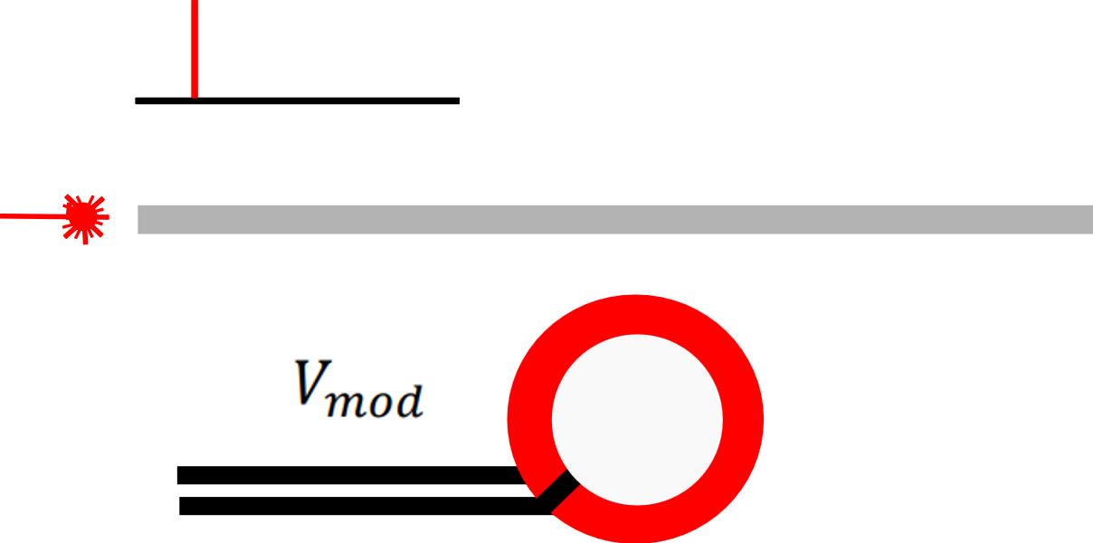
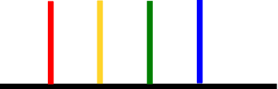

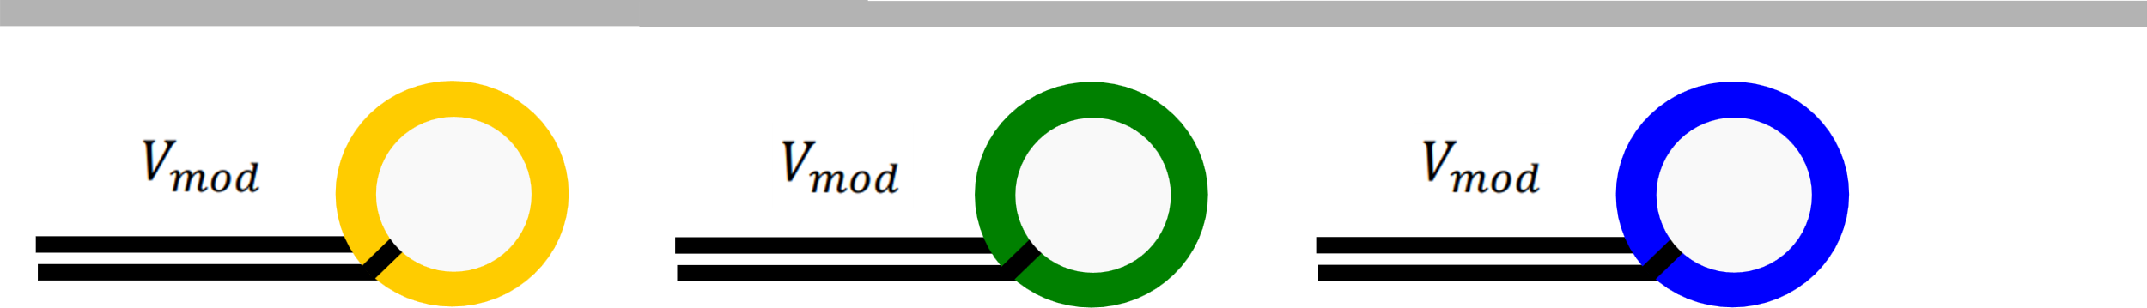
Silicon Photonics for Optical Readout of Particle Detectors
PIC based transmitter
  Micro-ring modulator (MRM)
  Fast electro-optic modulation by means of MRM
    CMOS silicon chip
    Modulating the beam over p-n junction embedded in the ring
    Intensity modulation of the optical power in the coupling region
  Wavelength Division Multiplexing (WDM)
Notes:
Plasma-dispersion effect
Optical phase modulation in the ring
Intensity modulation of the wave in the coupling region due to input and in-the-ring wave interference
By electro-optically modulating the ring resonator, electrical data is encoded into an optical signal.

Slide 4
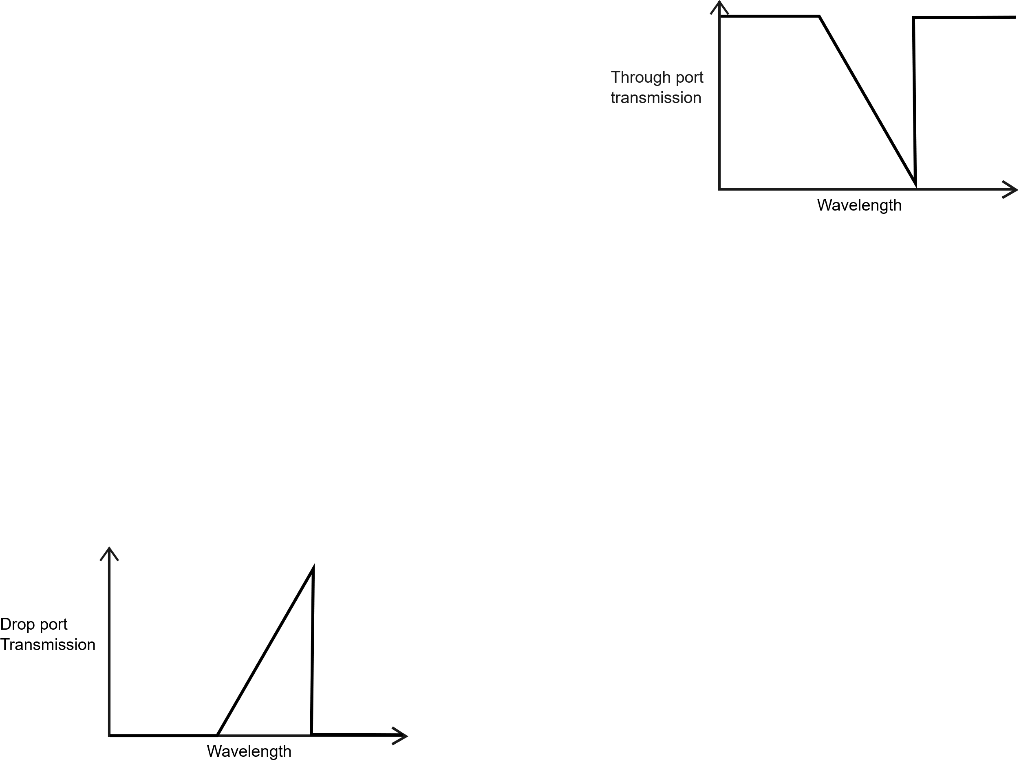
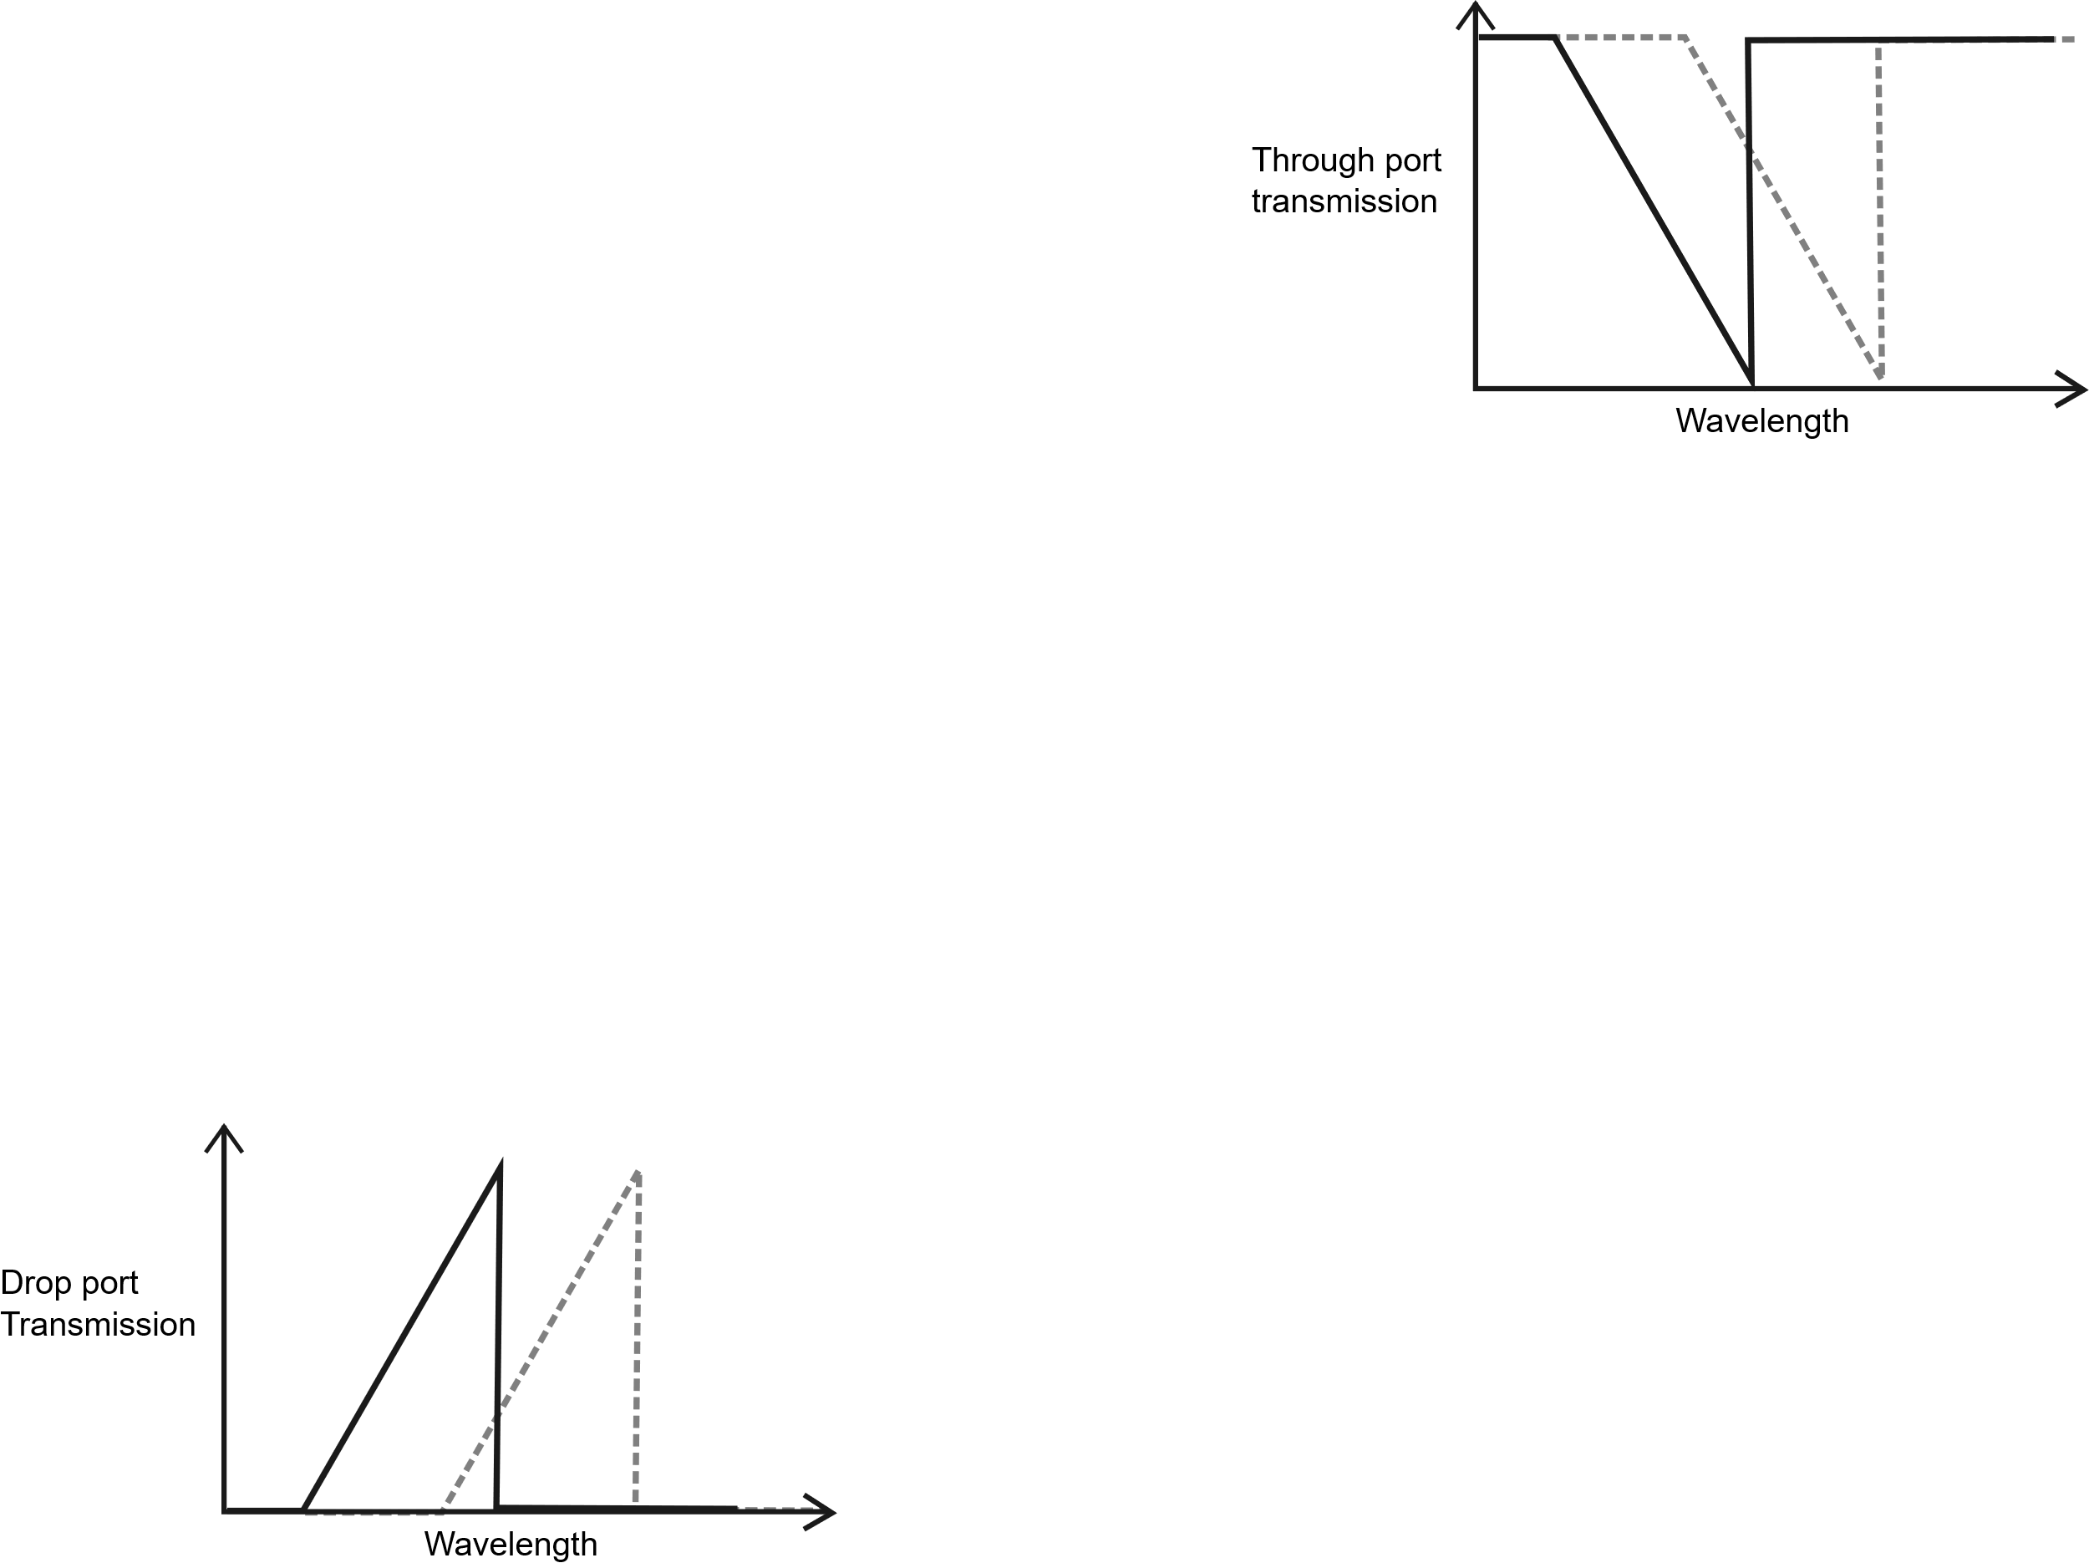
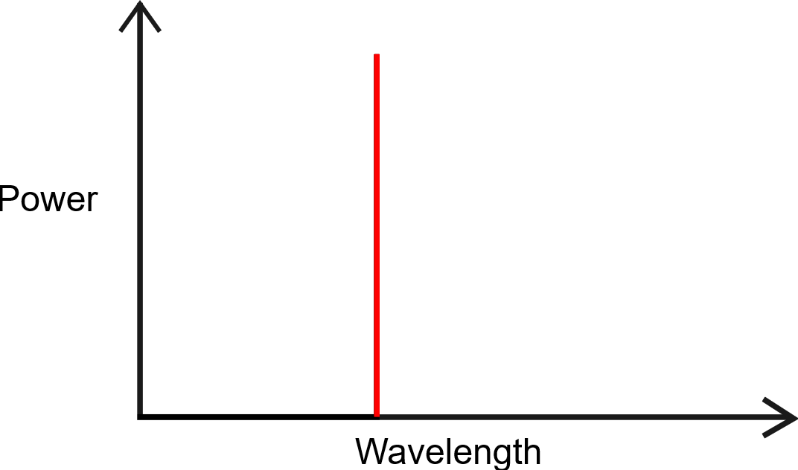
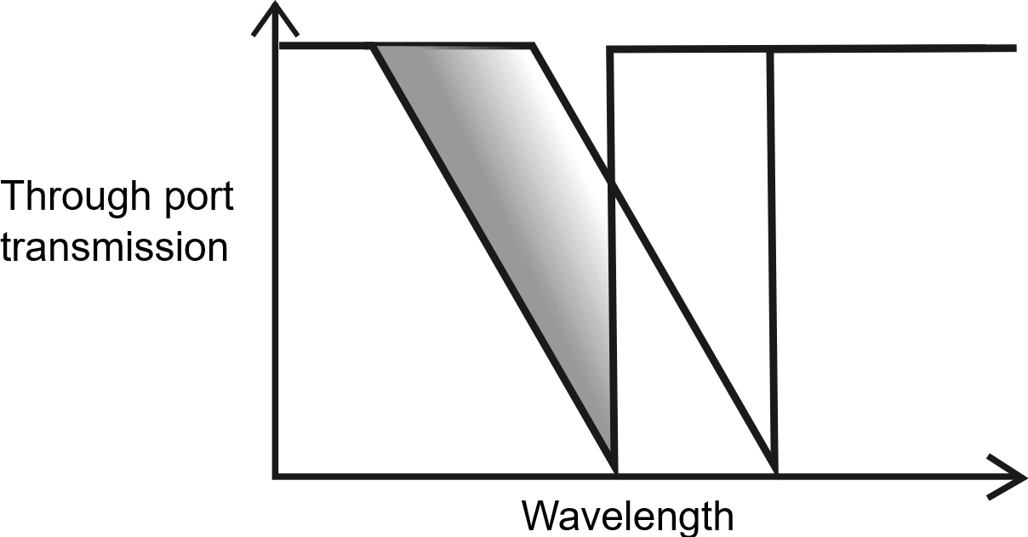
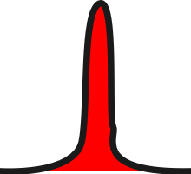

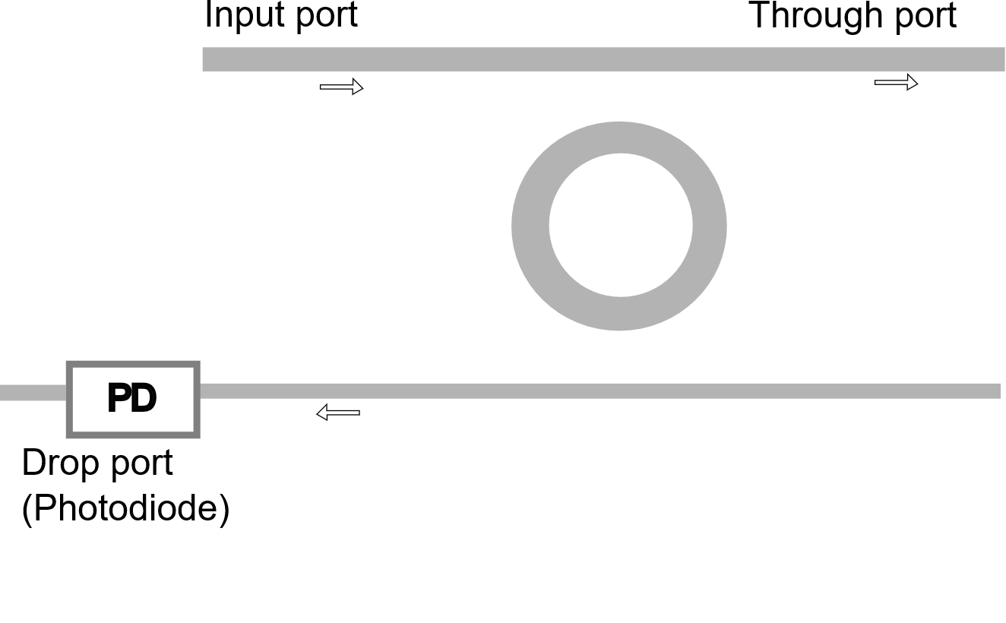




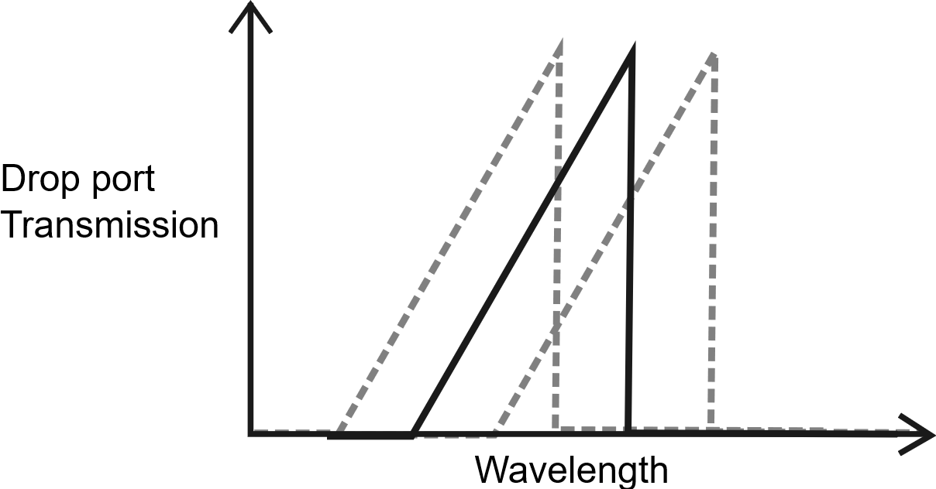

Micro-ring
Modulator
Resonator
λ-laser
b’1100
Gbps
kHz
Notes:
The diagram illustrates the previously introduced structure: the microring resonator. It features three ports, each accompanied by a representative diagram. Input Port: Shows a single-wavelength signal generated by a laser and propagating through the waveguide. Through Port: Displays a transfer function with filtering behavior, where certain wavelengths are attenuated or passed. Drop Port: Represents the complementary response to the through port, effectively forming an inverted version of the through port filter.
For the purpose of clarification of the topic, to visualize both time and frequency domain I will introduce a concept of intervals in which the incoming wave of specific wavelength is handled. Keep in mind: in reality, these changes occur rapidly and continuously, but visualizing them as intervals helps us better understand the underlying mechanisms.

Slide 5
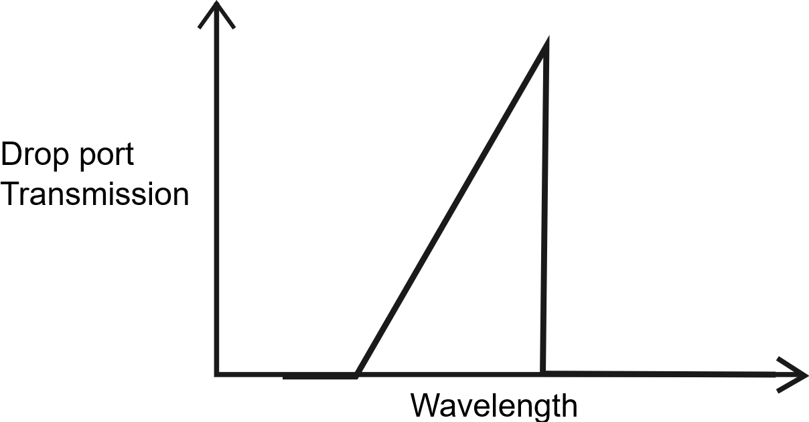

Micro-ring Modulator Control Loop
kHz

Slide 6
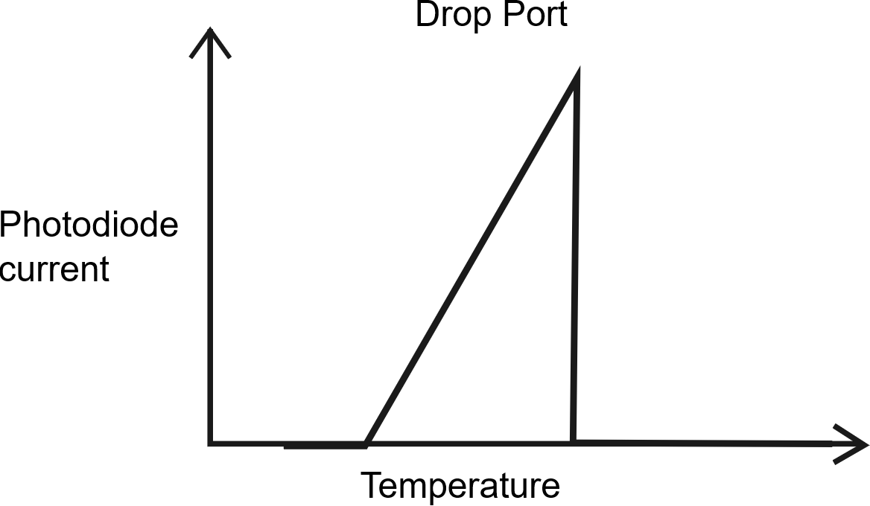
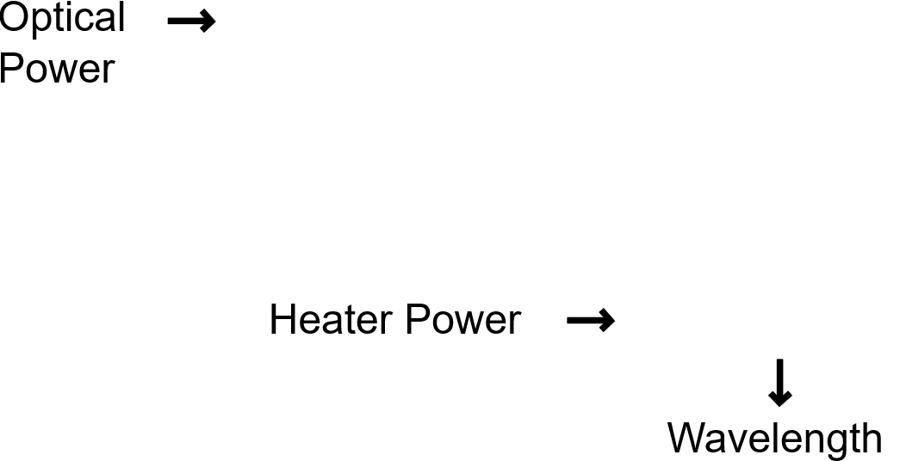
Control System Perspective
Conversion of physical quantities to ADC and DAC code
kHz
Notes:
Move operating point to the optimal modulation window by performing initialization procedure.
Keep the setpoint by counter-reacting against environmental changes.

Slide 7
Control System Perspective
Startup
kHz
Notes:
Move operating point to the optimal modulation window by performing initialization procedure.
Keep the setpoint by counter-reacting against environmental changes.

Slide 8
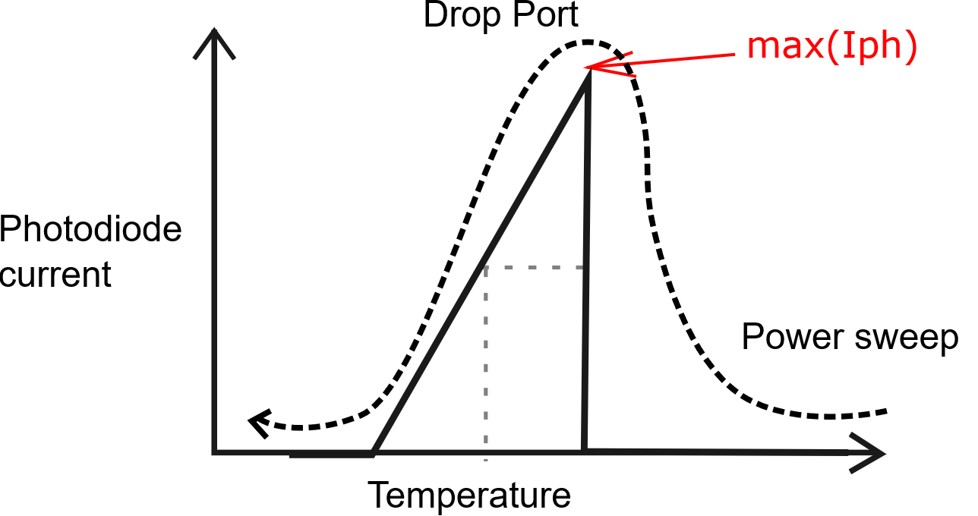
Control System Perspective
Startup
Initialization procedure
  Power/temperature sweep
  Find the setpoint that is offset from Max. photodiode value
  Mitigates process-induced variations
kHz
Notes:
Move operating point to the optimal modulation window by performing initialization procedure.
Keep the setpoint by counter-reacting against environmental changes.

Slide 9
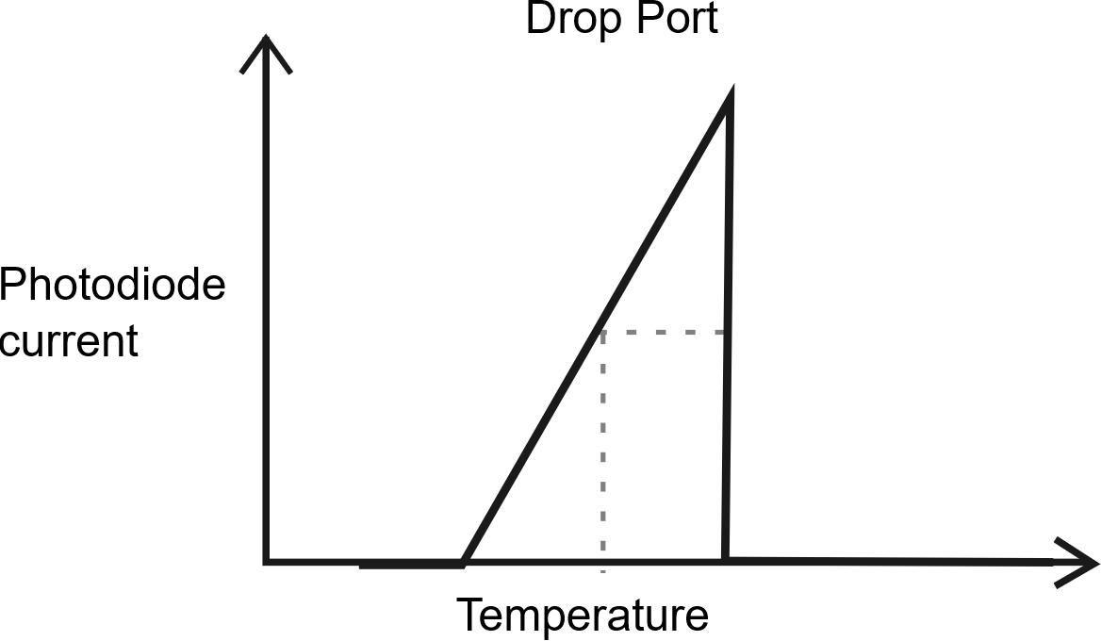
Control System Perspective
Startup
Initialization procedure
  Power/temperature sweep
  Find the setpoint that is offset from Max. photodiode value
  Mitigates fabrication process-induced variations
Run PID to keep the setpoint
  Counteract environmental disturbances
kHz
Notes:
Move operating point to the optimal modulation window by performing initialization procedure.
Keep the setpoint by counter-reacting against environmental changes.

Slide 10
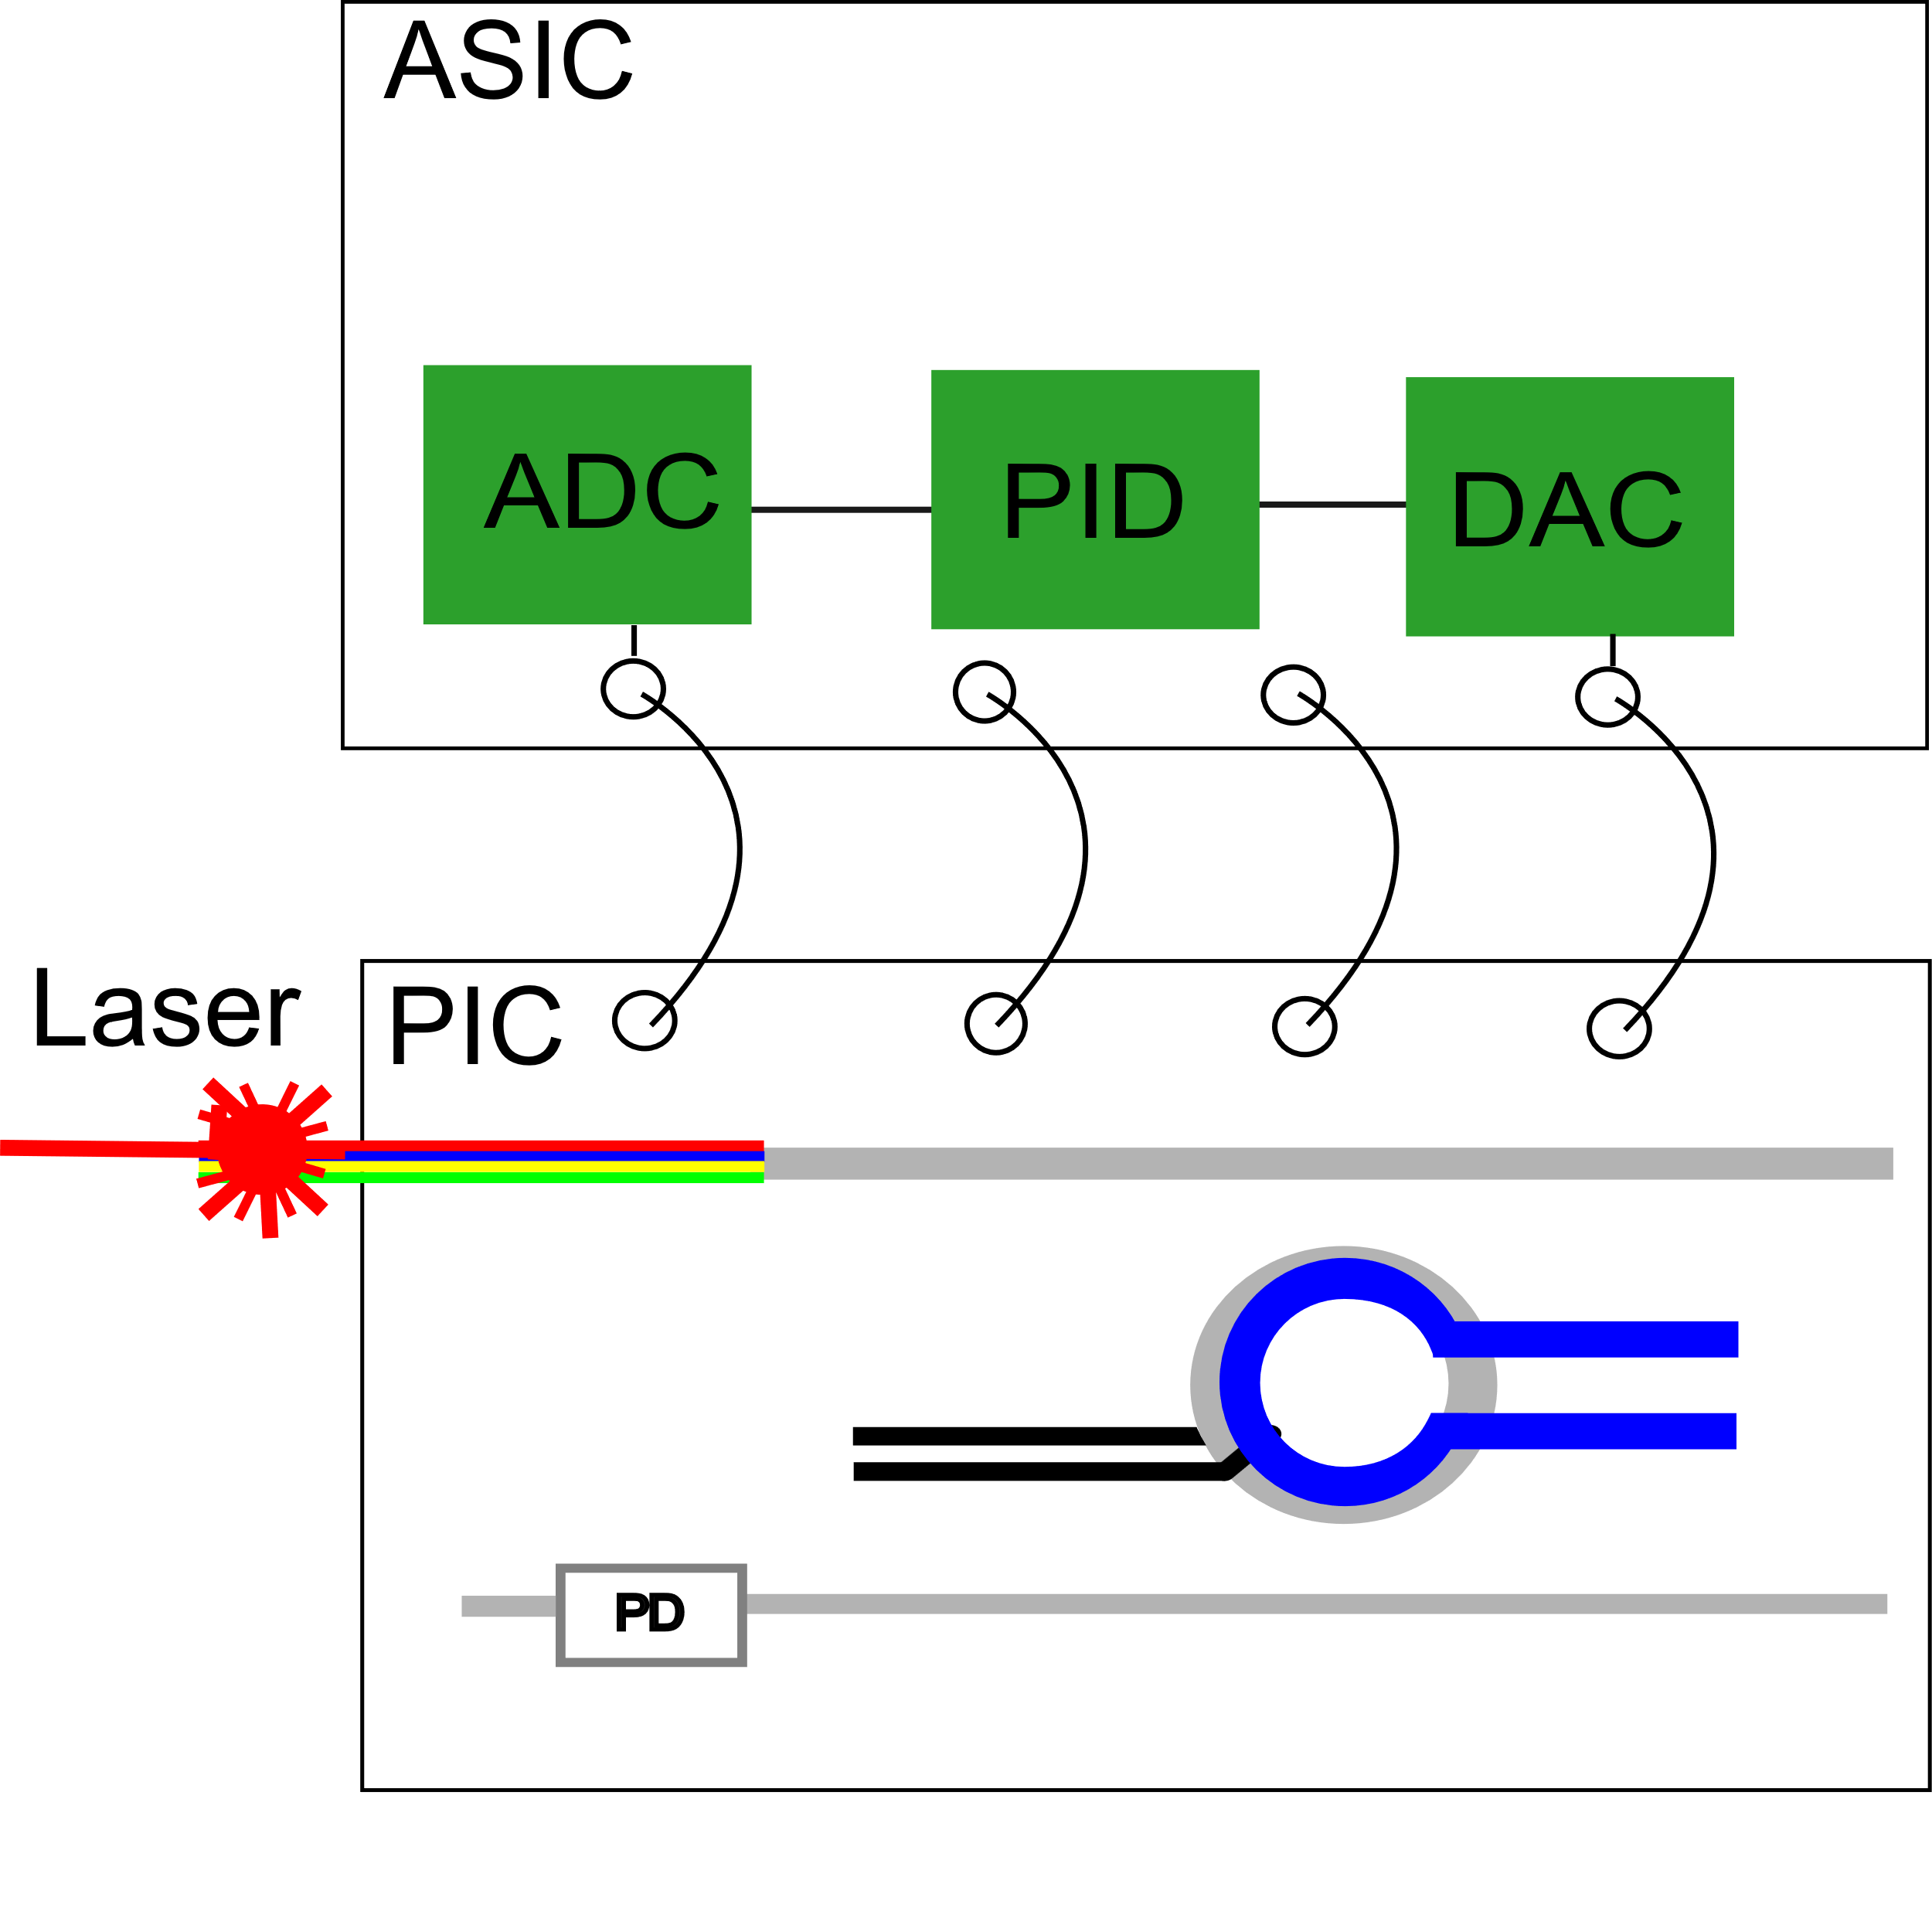
Prototyping the System with FPGA and discrete components
Ongoing SPRINT development controlling the PIC
  Temperature Control Unit
PIC + ASIC + control system
  Completeness of Multiphysics simulations
  Costly ASIC manufacturing runs
Notes:
Developing a system that validates and prototypes the thermal control unit for SPRINT ASIC
Starting from a prototype
Following the work done colleagues from u-electronics group and opto-team and updating the prototype system in parallel
Using FPGA and analog components for validating the ASIC implementation
Aim: enhancing the stability of data-carrying photonic signals through thermal tuning of a microring modulator.
10Gbit/s -> 25Gbit/s
WDM -> 100Gbit/s
FPGA fw
Sweep from 2V to 0
Finding max point
Offsetting it
Running PID
Slow switching off the heater
The filter is not really one filter. CIC is just for downsampling. A FIR is needed for the rest of filtering.
The update refers to change requirements (e.g. heater power)
PID - a control algorithm used in engineering to maintain a desired output by minimizing the error between a setpoint and a measured process variable

Slide 11
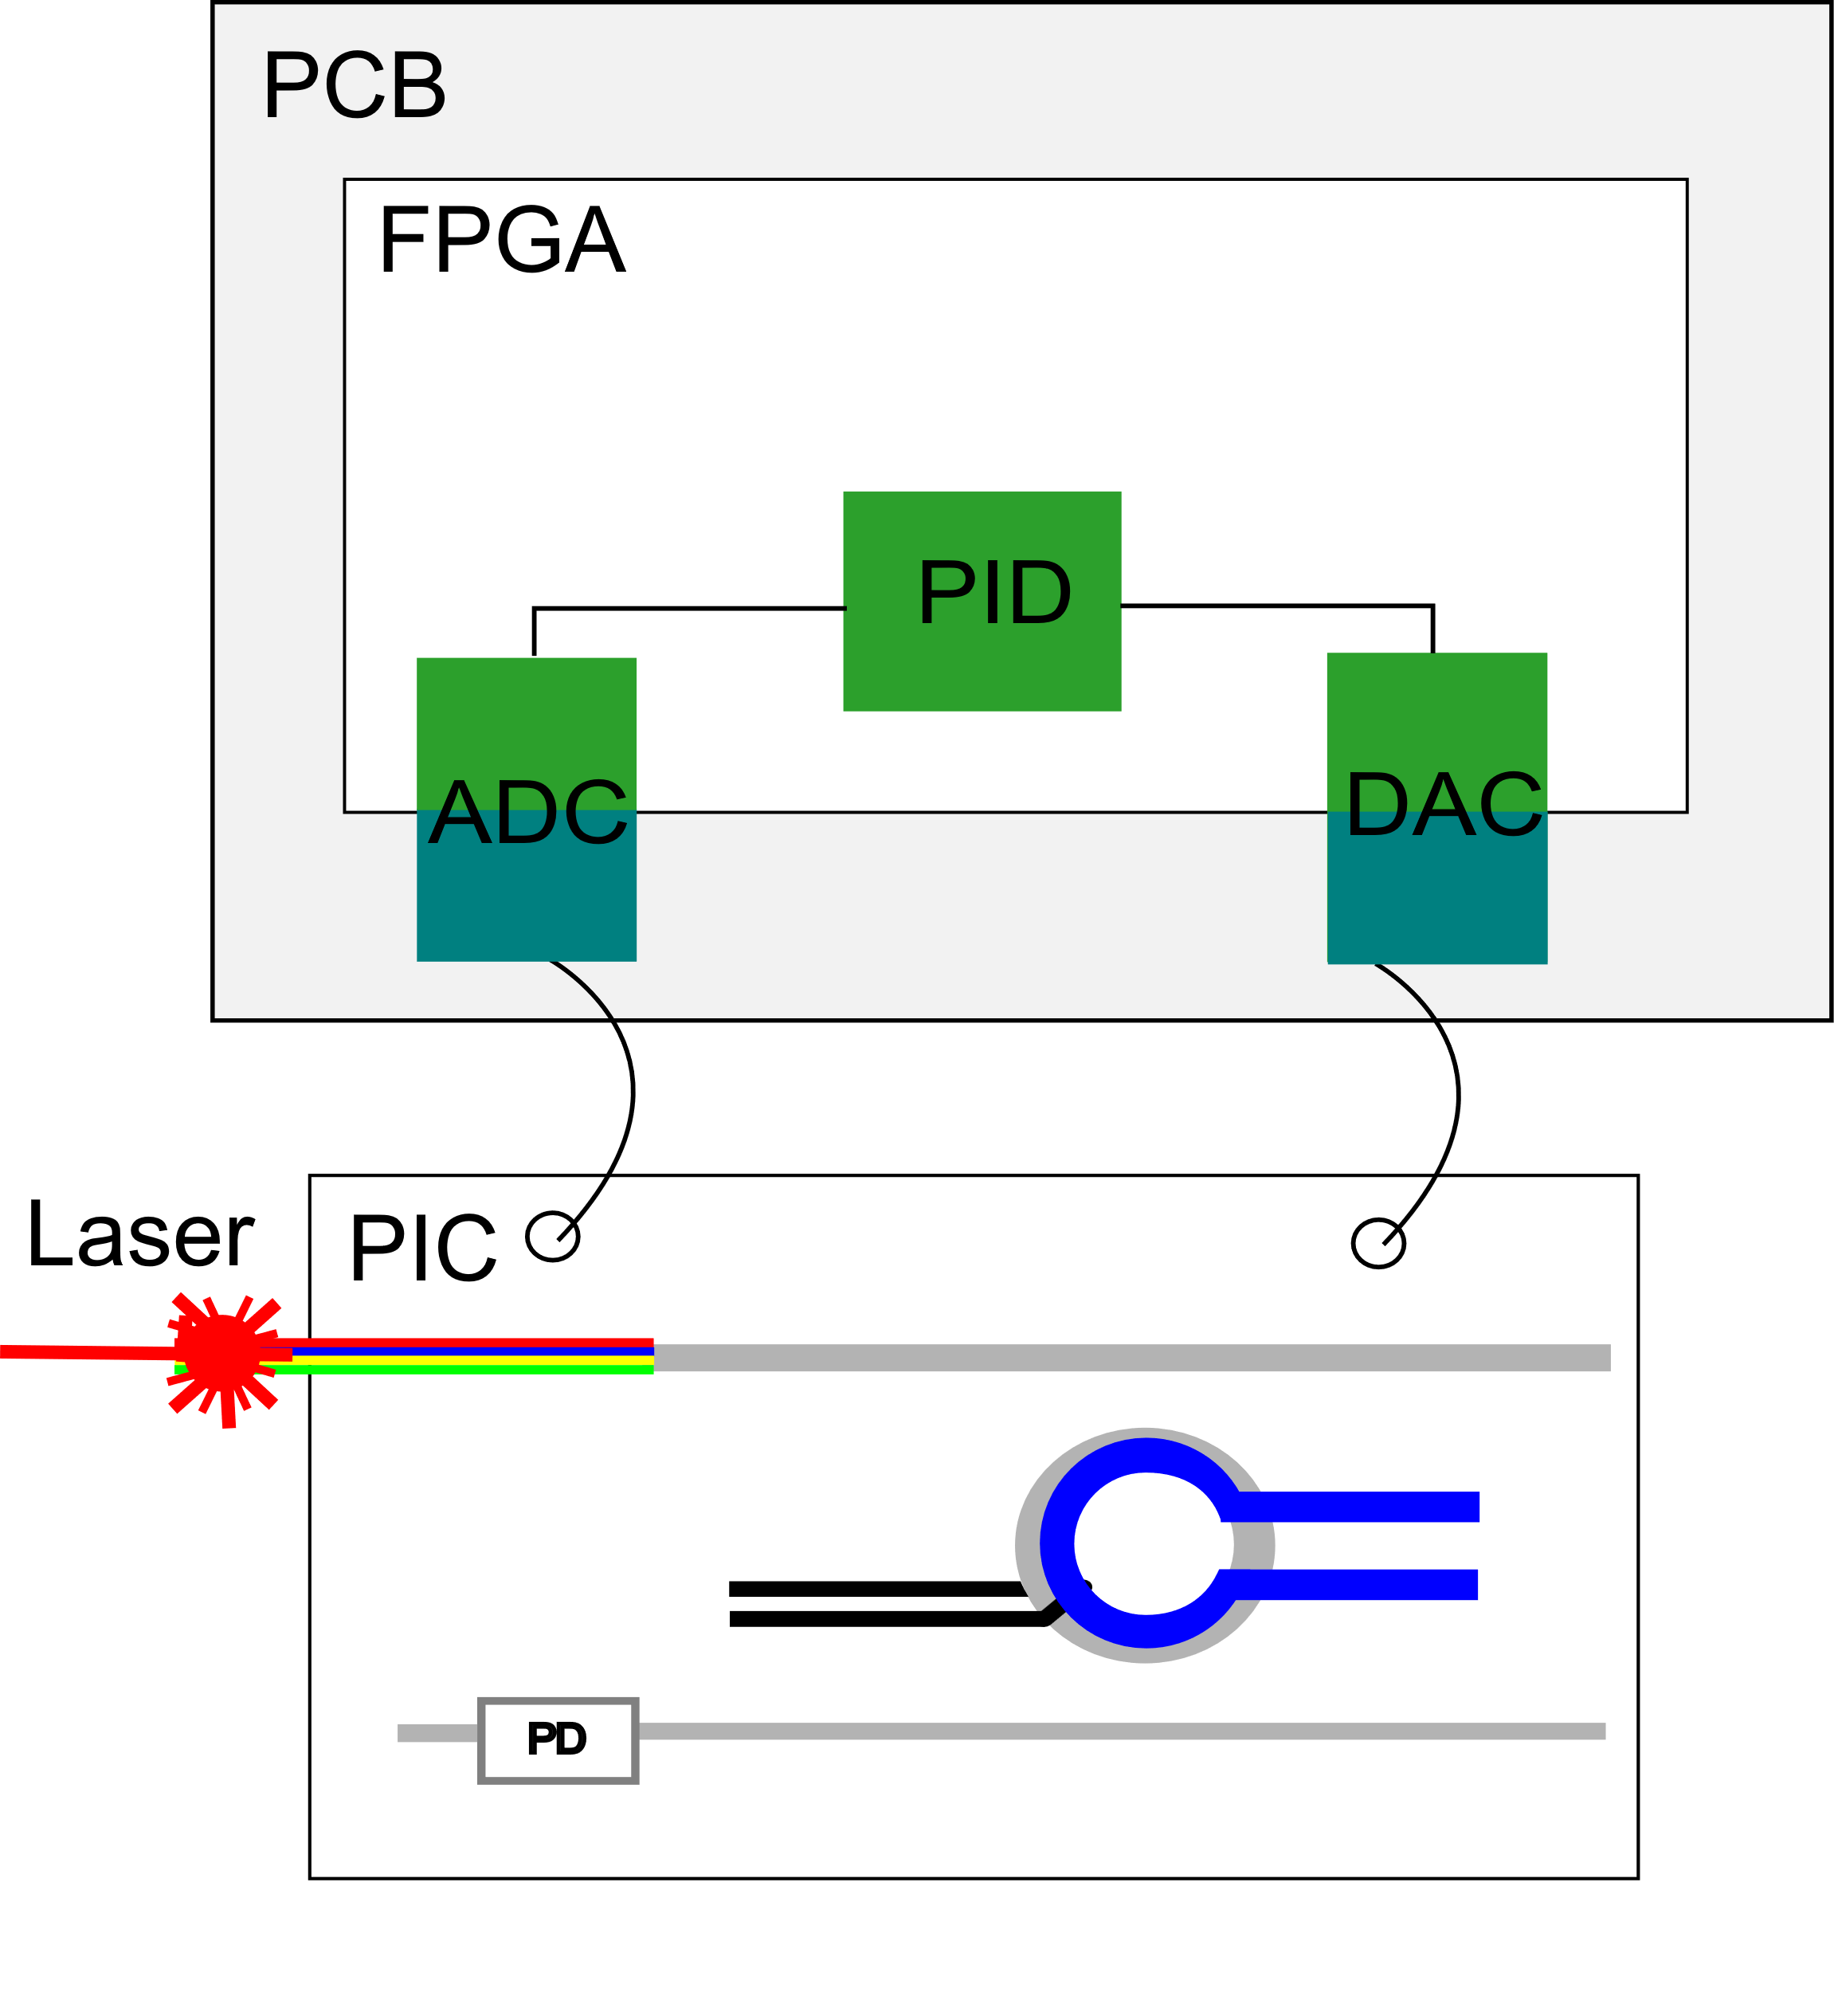
Prototyping the System with FPGA and discrete components
Ongoing SPRINT development controlling the PIC
  Temperature Control Unit
PIC + ASIC + control system
  Completeness of Multiphysics simulations
  Costly ASIC manufacturing runs
Develop a prototype
  FPGA
  Analog structures compatible with ASIC ADC and DAC
Notes:
Developing a system that validates and prototypes the thermal control unit for SPRINT ASIC
Starting from a prototype
Following the work done colleagues from u-electronics group and opto-team and updating the prototype system in parallel
Using FPGA and analog components for validating the ASIC implementation
Aim: enhancing the stability of data-carrying photonic signals through thermal tuning of a microring modulator.
10Gbit/s -> 25Gbit/s
WDM -> 100Gbit/s
FPGA fw
Sweep from 2V to 0
Finding max point
Offsetting it
Running PID
Slow switching off the heater
The filter is not really one filter. CIC is just for downsampling. A FIR is needed for the rest of filtering.
The update refers to change requirements (e.g. heater power)
PID - a control algorithm used in engineering to maintain a desired output by minimizing the error between a setpoint and a measured process variable

Slide 12
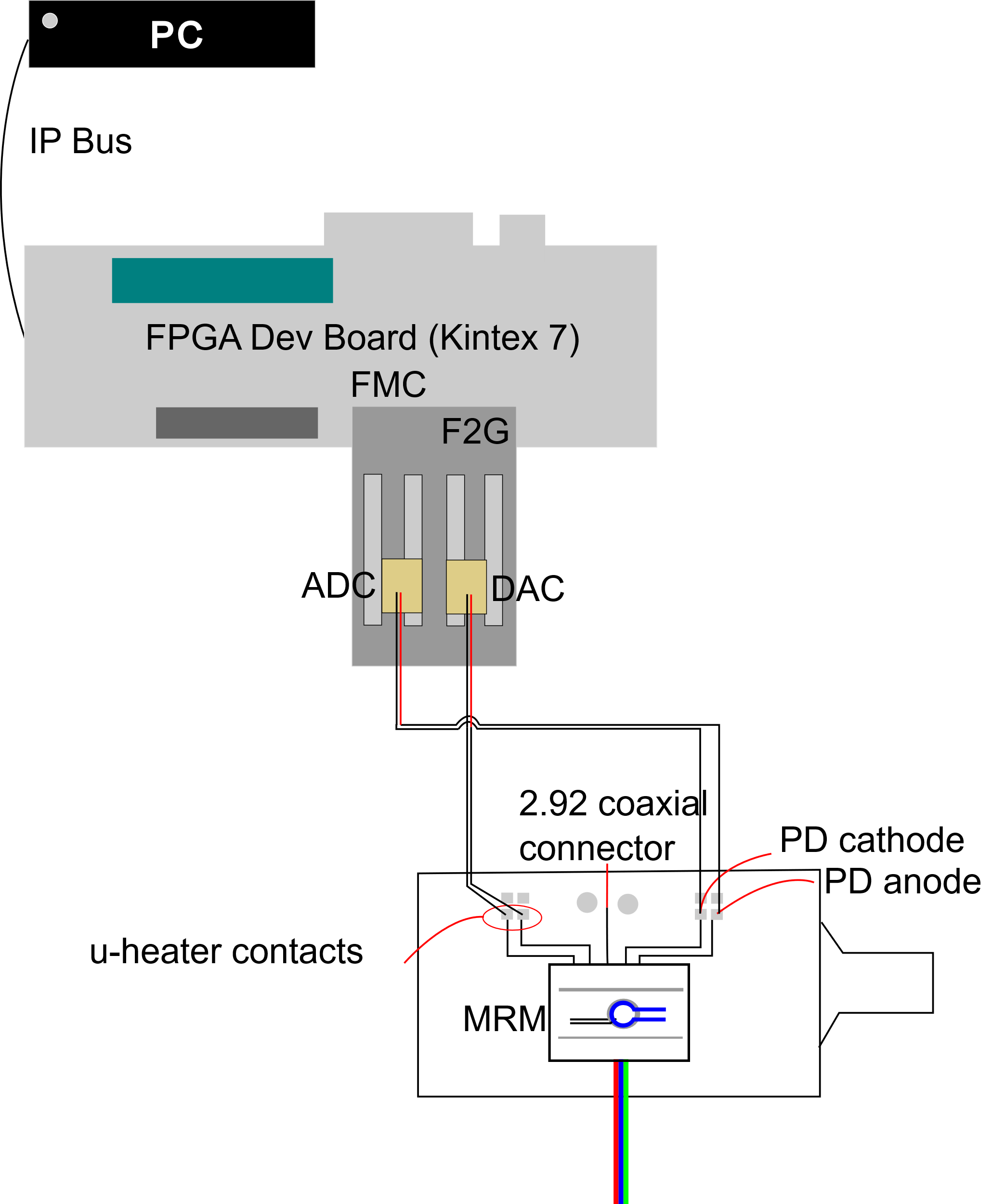
Prototyping the System with FPGA and discrete components
Ongoing SPRINT development controlling the PIC
  Temperature Control Unit
PIC + ASIC + control system
  Completeness of Multiphysics simulations
  Costly ASIC manufacturing runs
Develop a prototype
  FPGA
  Analog structures compatible with ASIC ADC and DAC
Using development board and IP Bus for fast prototyping
Aim: continue development of SPRINT with fast validation of the system
Notes:
Developing a system that validates and prototypes the thermal control unit for SPRINT ASIC
Starting from a prototype
Following the work done colleagues from u-electronics group and opto-team and updating the prototype system in parallel
Using FPGA and analog components for validating the ASIC implementation
Aim: enhancing the stability of data-carrying photonic signals through thermal tuning of a microring modulator.
10Gbit/s -> 25Gbit/s
WDM -> 100Gbit/s
FPGA fw
Sweep from 2V to 0
Finding max point
Offsetting it
Running PID
Slow switching off the heater
The filter is not really one filter. CIC is just for downsampling. A FIR is needed for the rest of filtering.
The update refers to change requirements (e.g. heater power)
PID - a control algorithm used in engineering to maintain a desired output by minimizing the error between a setpoint and a measured process variable

Slide 13
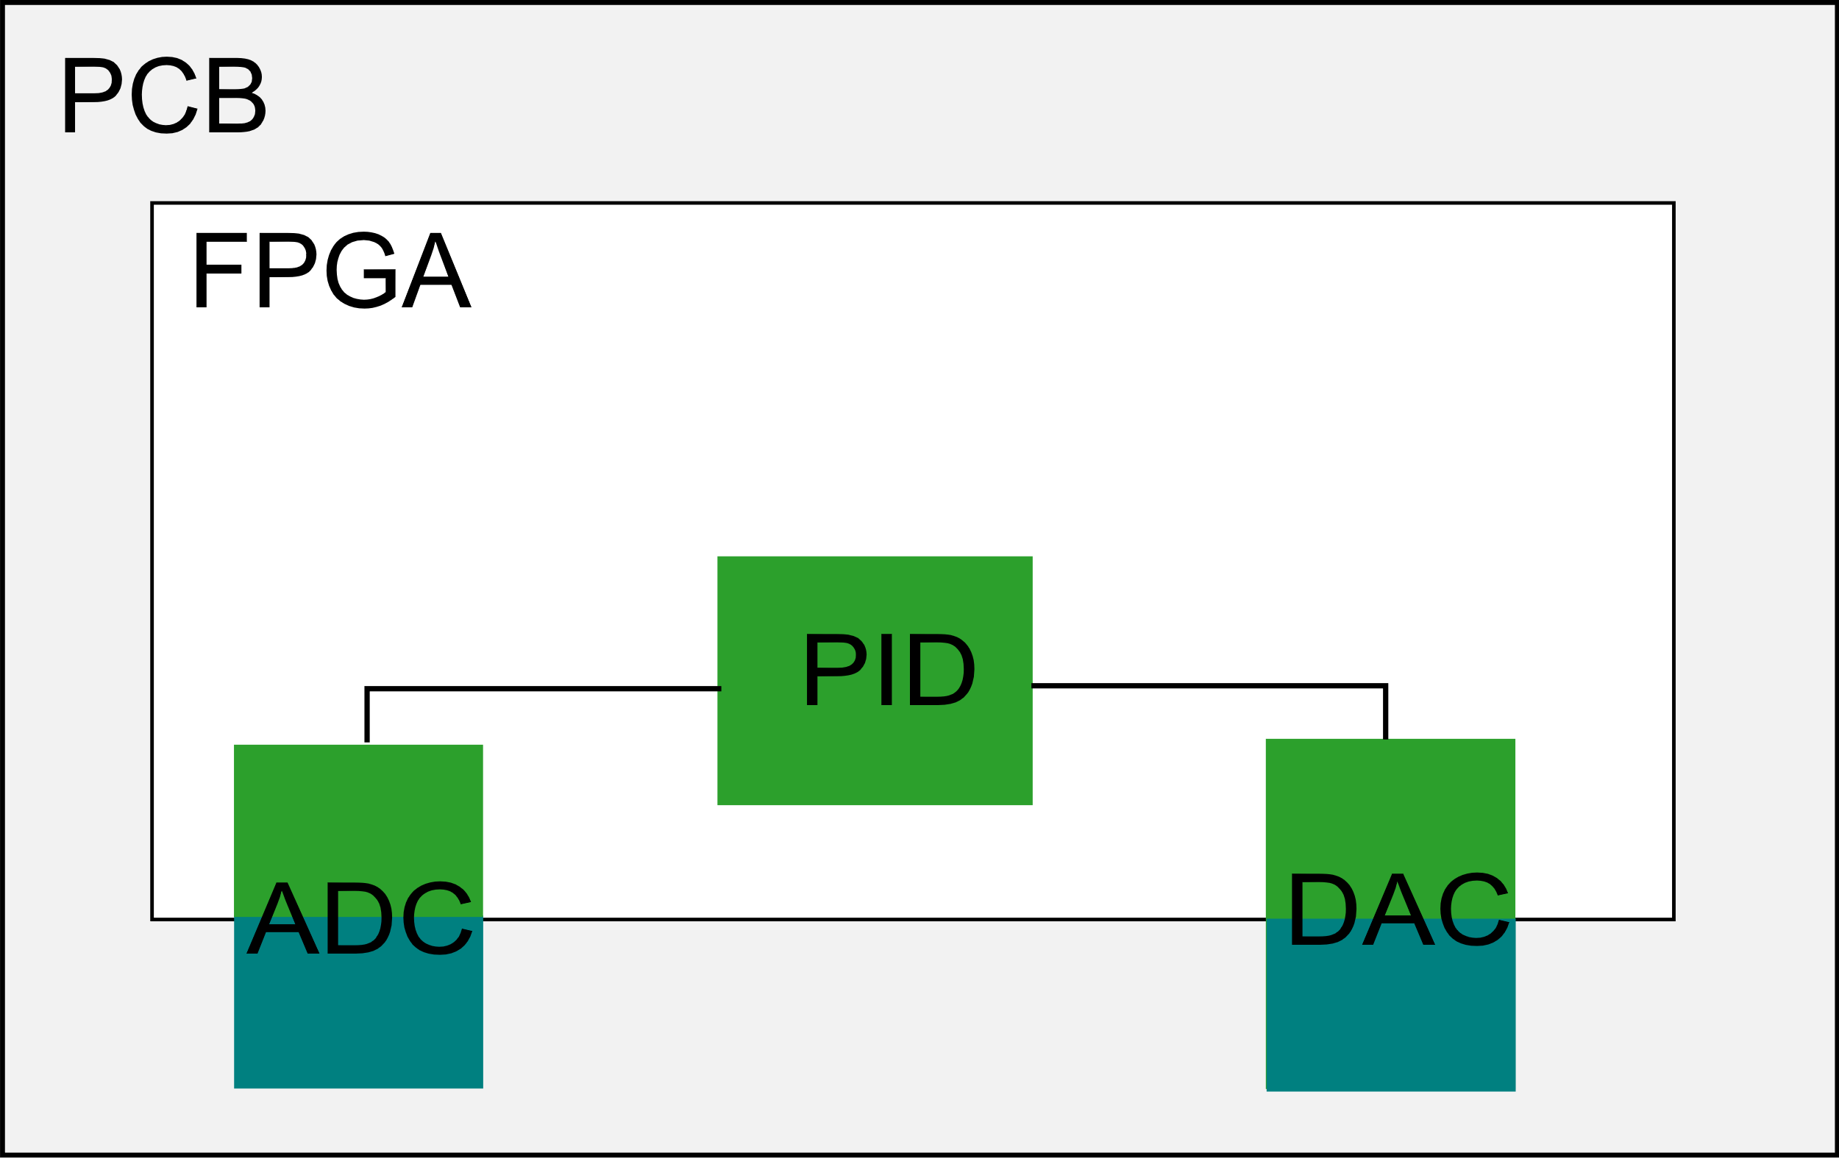

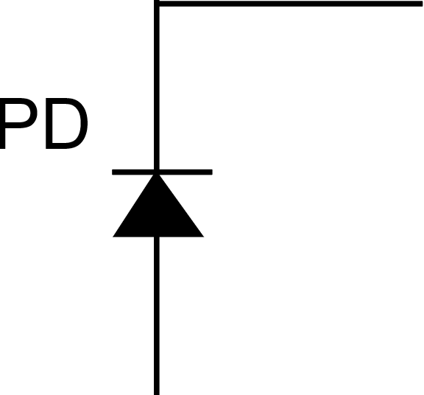
Choosing ADC type
Delta-Sigma
ADC
Characteristics
  Compact
  Precise
  Low speed
Aim:
  Measuring current from the photodiode
Notes:
Generating pulses and transforming a density of them over a filer to a proper value.
I could deliver here the whole derivation for the noise shaping (have a look into Gabriele Atzeni presentation, if someone is interested).

Slide 14
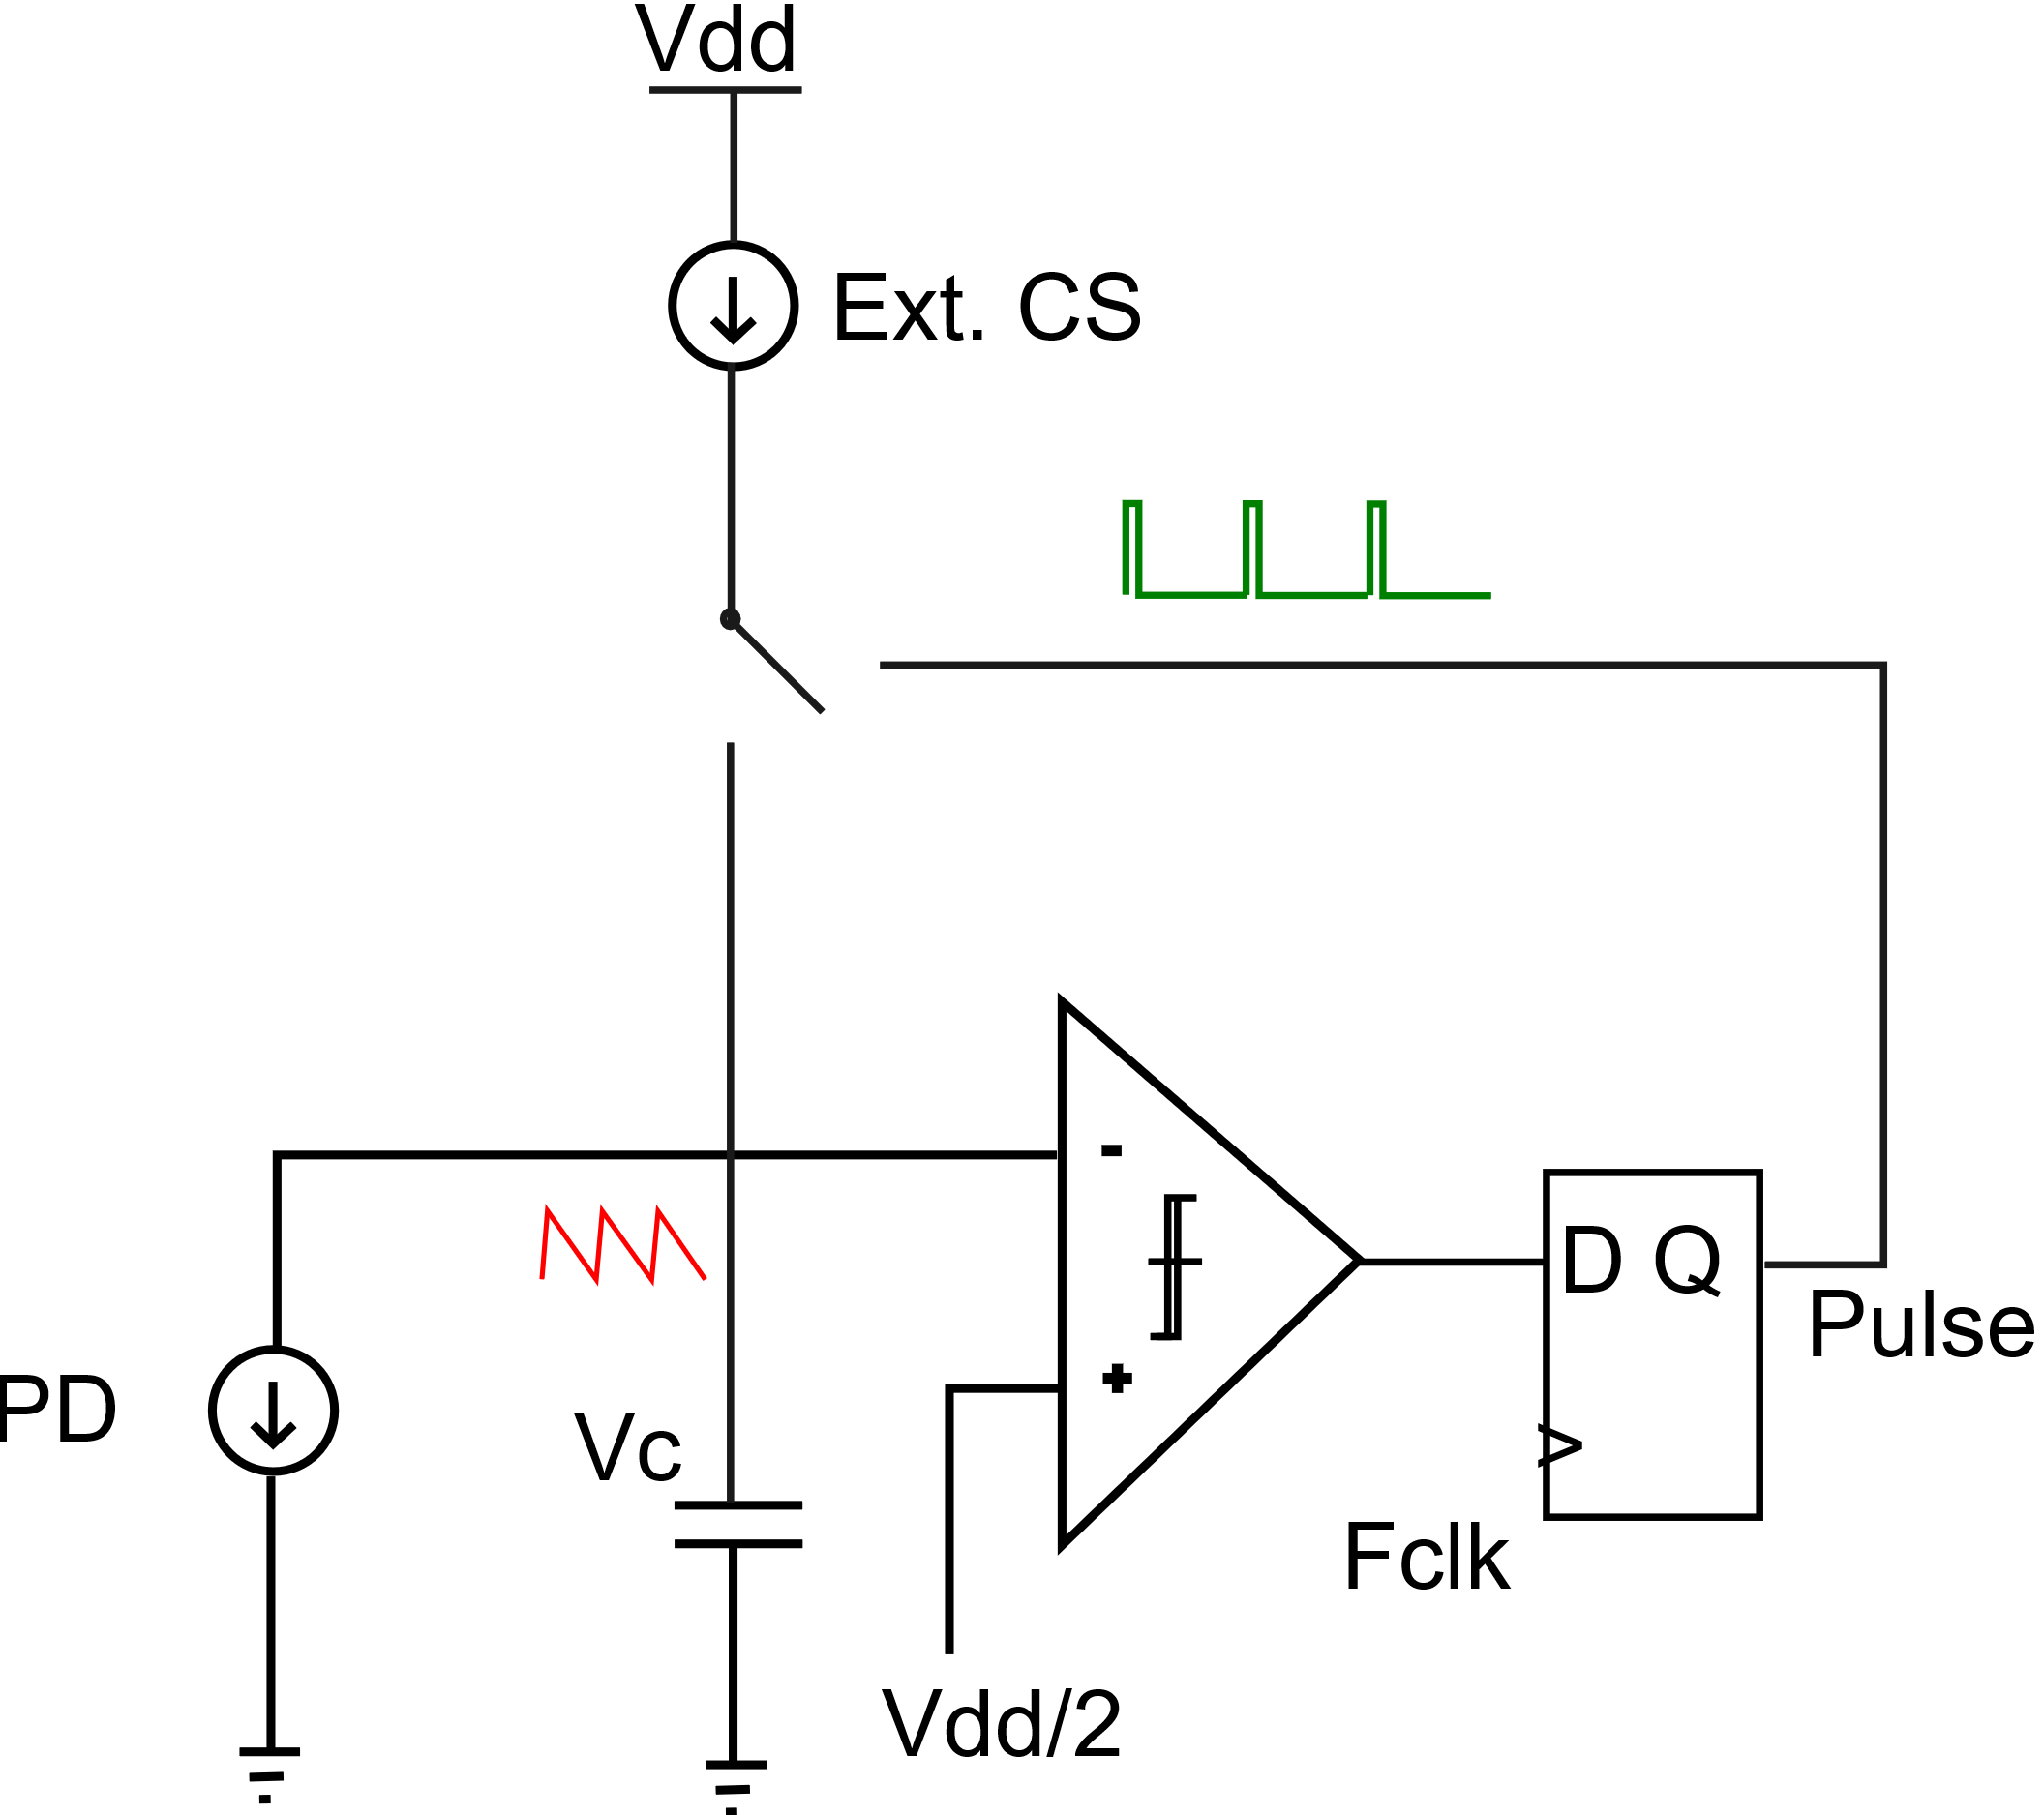
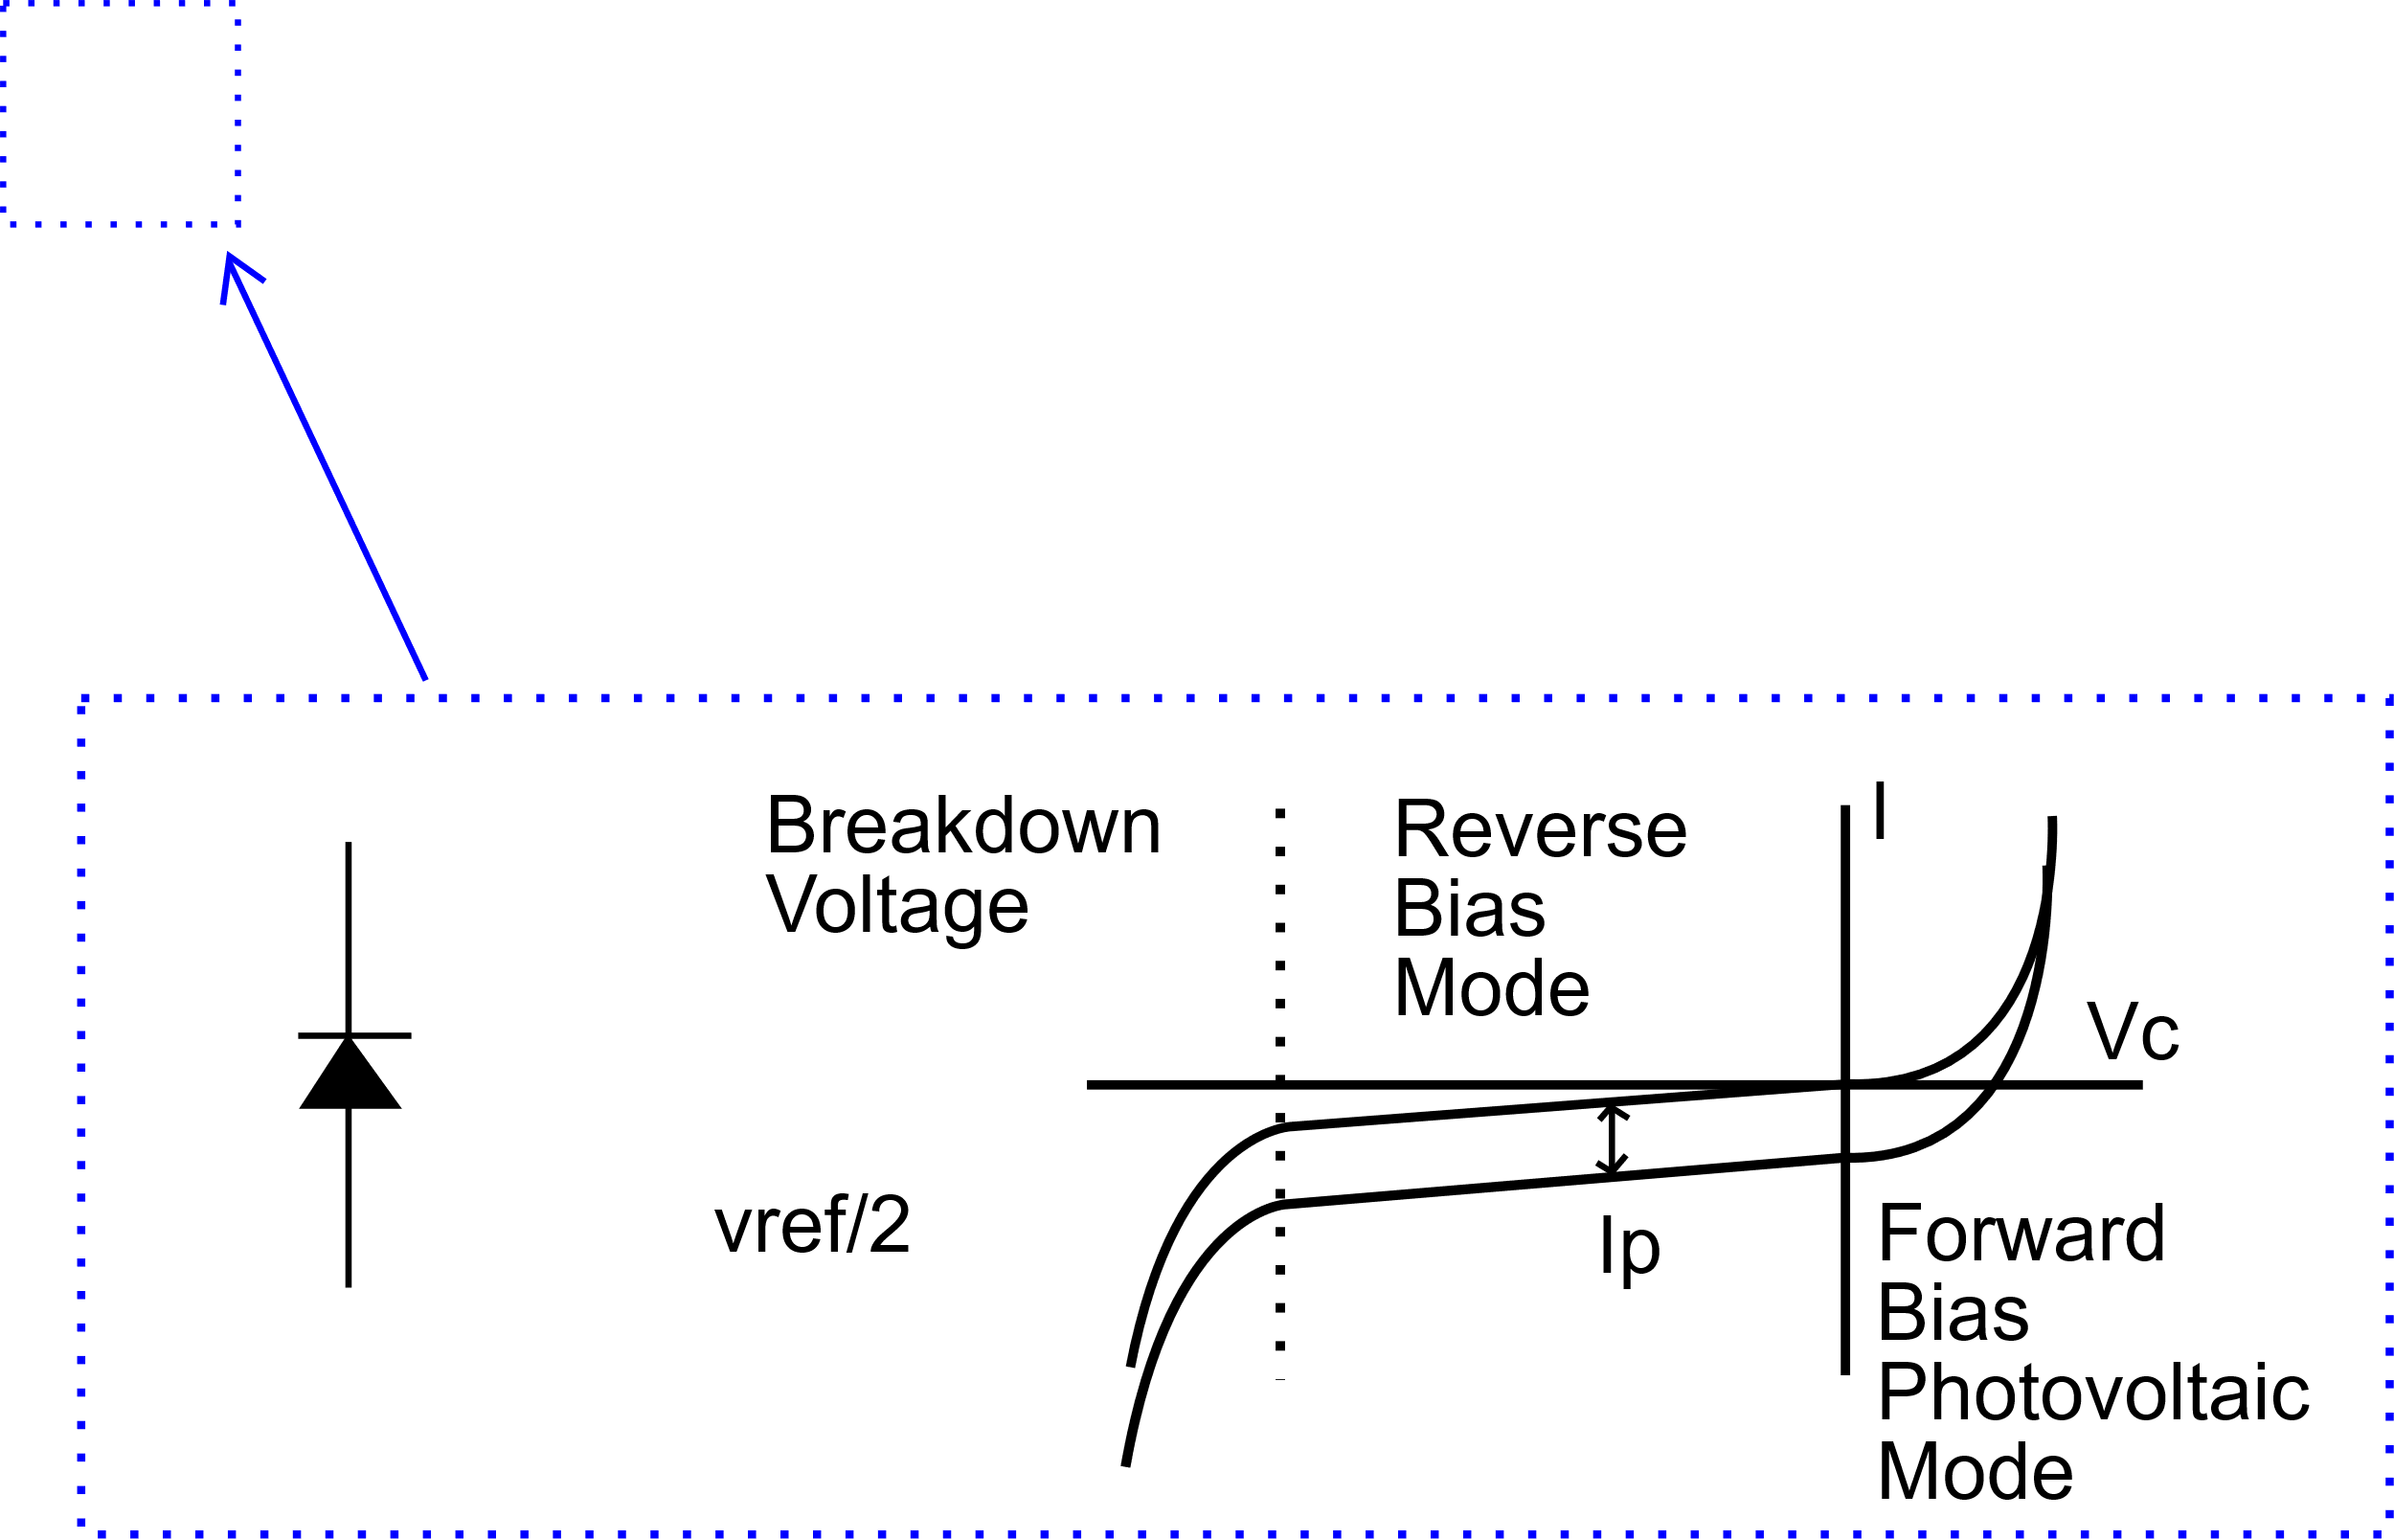
Delta-Sigma Modulator for ADC
Delta-Sigma
ADC
Aim:
  Measuring current from the photodiode
Notes:
Generating pulses and transforming a density of them over a filer to a proper value.
I could deliver here the whole derivation for the noise shaping (have a look into Gabriele Atzeni presentation, if someone is interested).

Slide 15
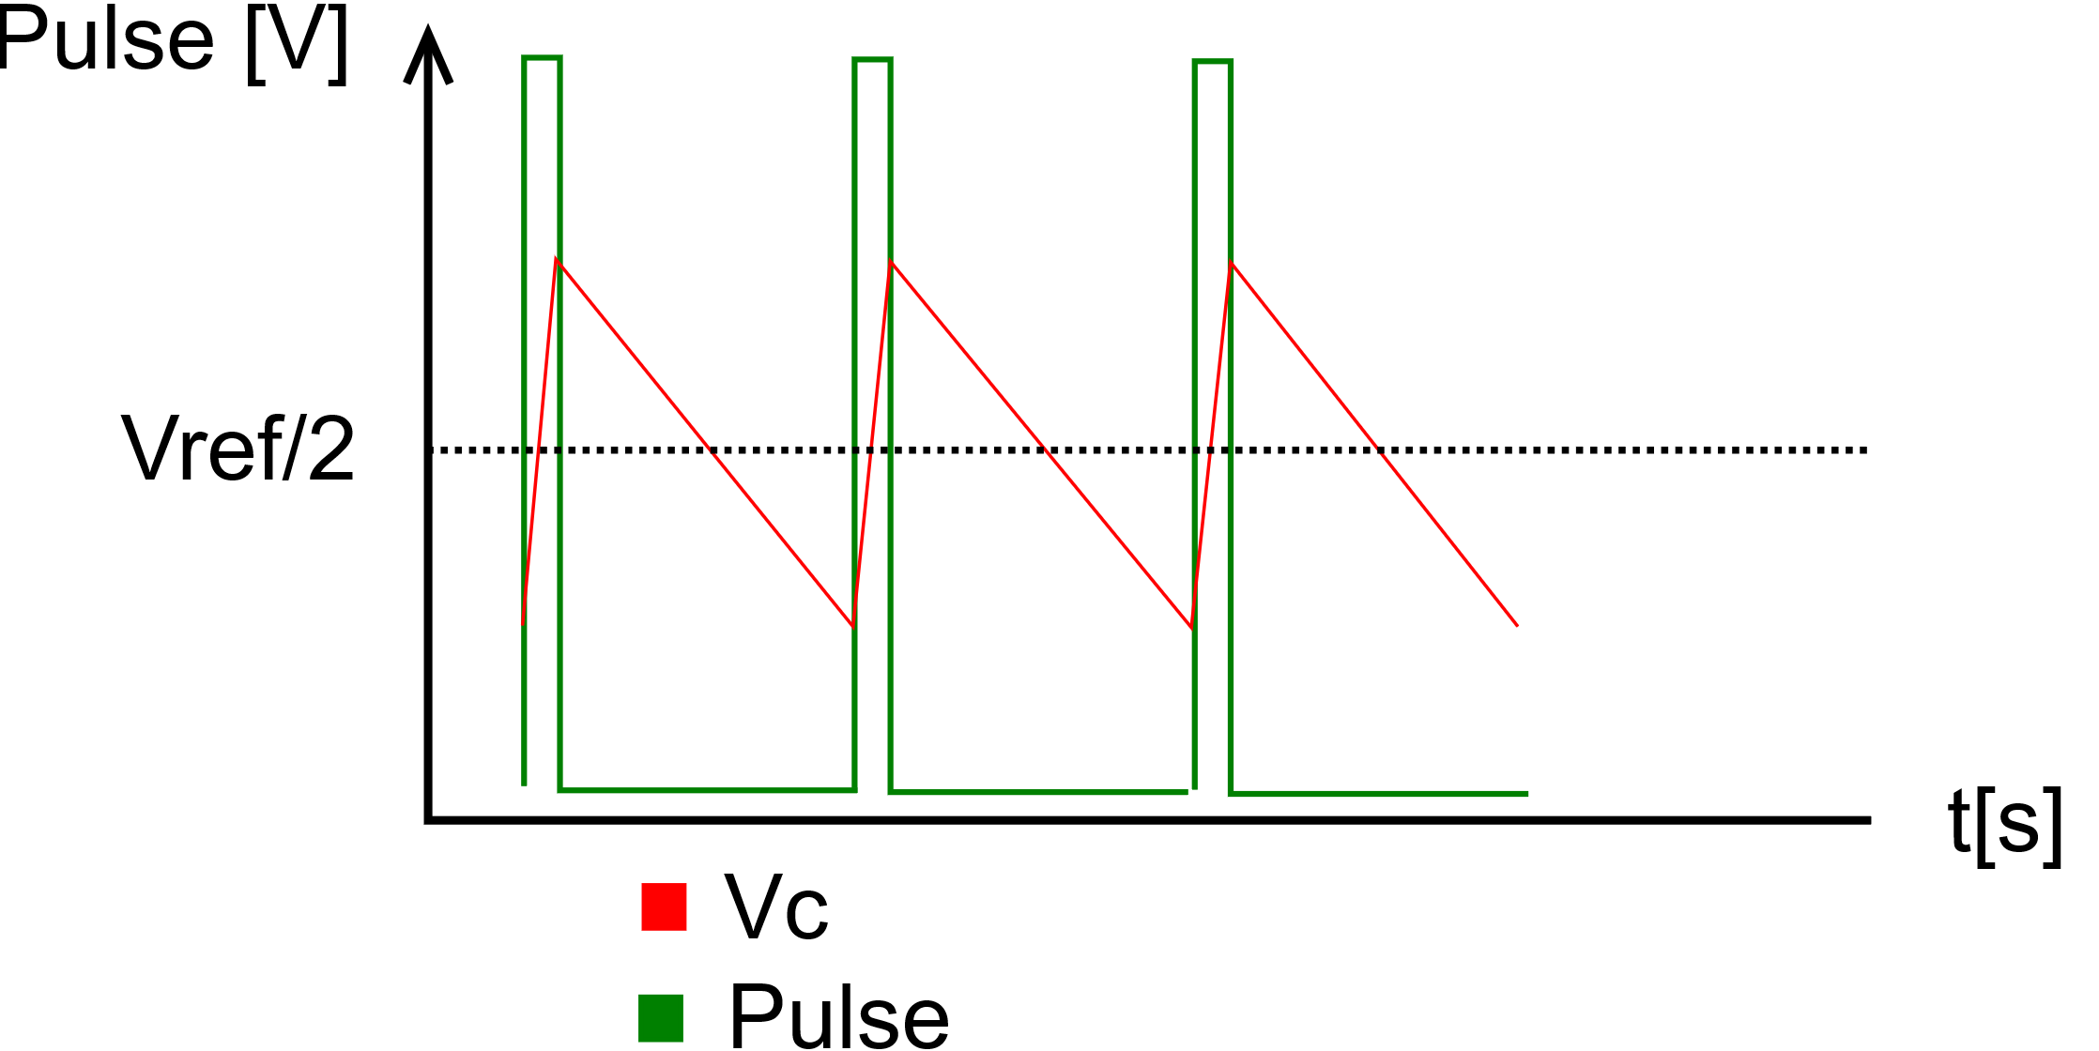
Delta-Sigma Modulator for ADC
Aim:
  Measuring current from the photodiode
Delta-Sigma loop (40MHz)
Pulse density modulation (almost)
Noise shaping
Notes:
Generating pulses and transforming a density of them over a filer to a proper value.
I could deliver here the whole derivation for the noise shaping (have a look into Gabriele Atzeni presentation, if someone is interested).

Slide 16

Delta-Sigma Modulator for ADC
Aim:
  Measuring current from the photodiode
Delta-Sigma loop
Pulse density modulation (almost)
Noise shaping
Notes:
Generating pulses and transforming a density of them over a filer to a proper value.
I could deliver here the whole derivation for the noise shaping (have a look into Gabriele Atzeni presentation, if someone is interested).

Slide 17
Delta-Sigma Modulator for ADC
Aim:
  Measuring current from the photodiode
Delta-Sigma loop
Pulse density modulation (almost)
Noise shaping
      Gabriele Atzeni seminar talk
Notes:
Generating pulses and transforming a density of them over a filer to a proper value.
I could deliver here the whole derivation for the noise shaping (have a look into Gabriele Atzeni presentation, if someone is interested).

Slide 18
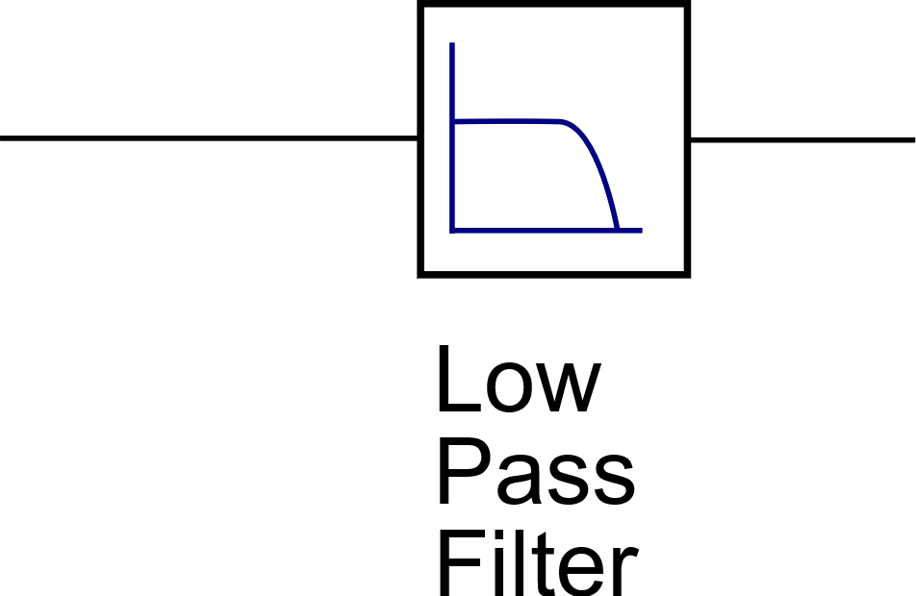
Delta-Sigma ADC
Aim:
  Measuring current from the photodiode
Delta-Sigma loop
Pulse density modulation (almost)
Noise shaping
      Gabriele Atzeni seminar talk
Adding a filter/integrator makes it Delta-sigma ADC
Final bandwidth 10kHz
Notes:
Generating pulses and transforming a density of them over a filer to a proper value.
I could deliver here the whole derivation for the noise shaping (have a look into Gabriele Atzeni presentation, if someone is interested).

Slide 19
Delta-Sigma ADC
Aim:
  Measuring current from the photodiode
Delta-Sigma loop
Pulse density modulation (almost)
Noise shaping
      Gabriele Atzeni seminar talk
Adding a filter/integrator makes it Delta-sigma ADC
Final bandwidth 10kHz
Use FPGA resources
FPGA

Slide 20
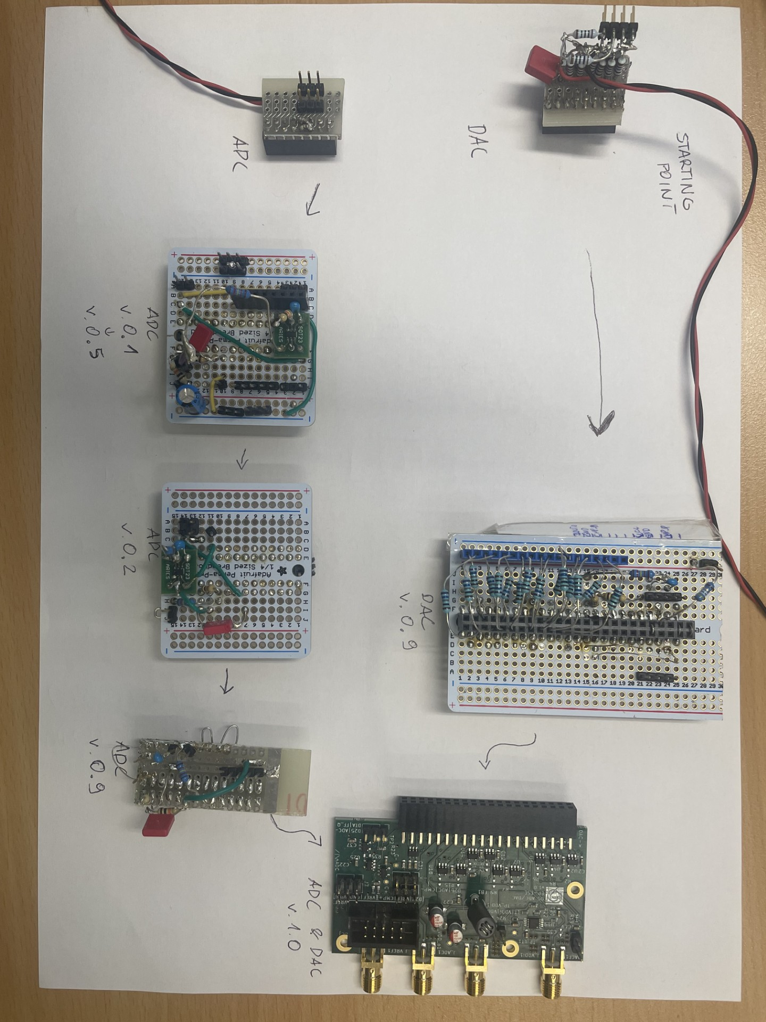
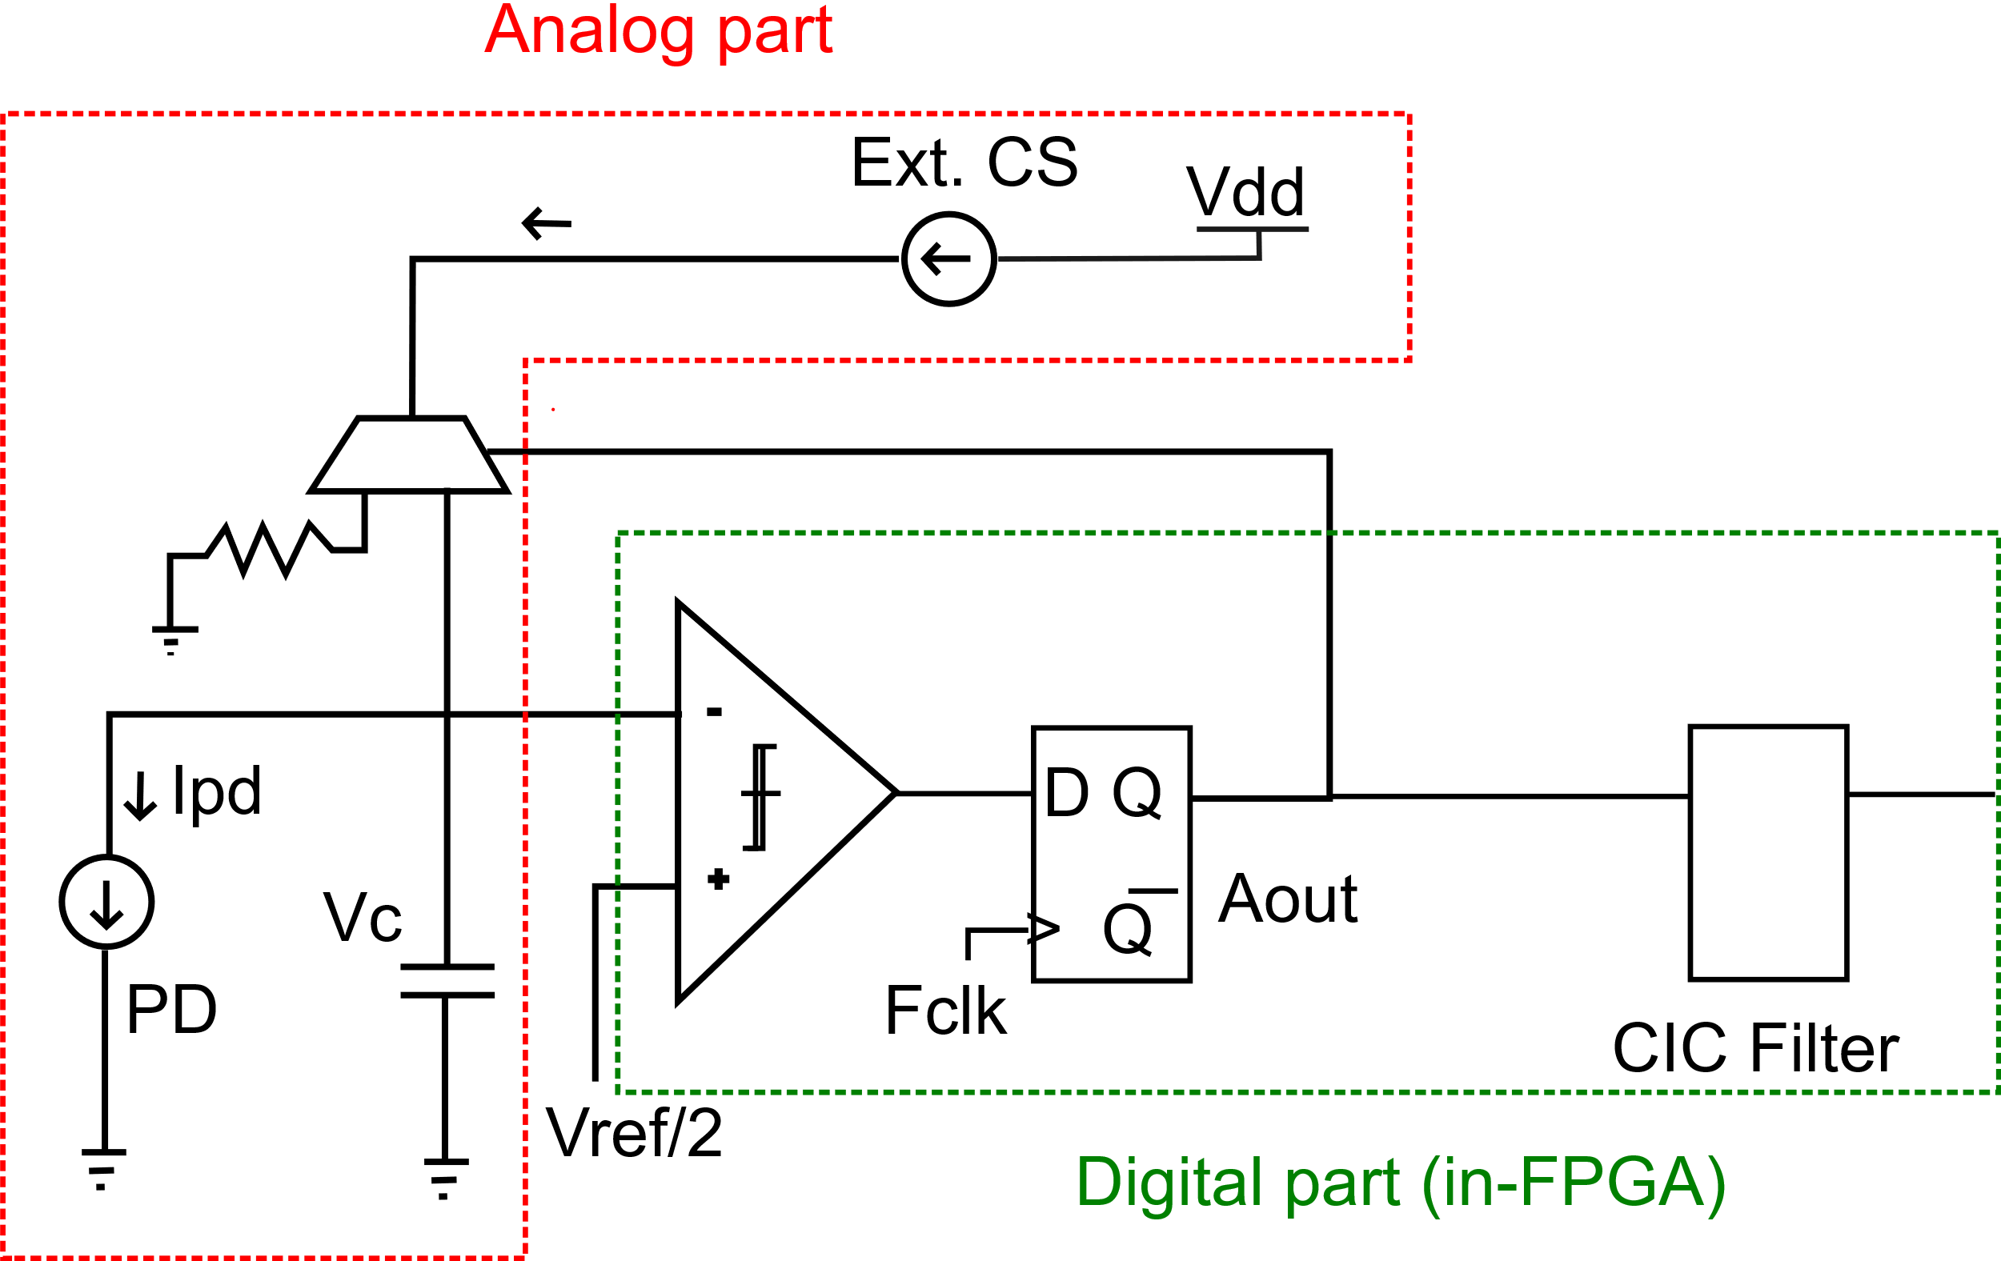
Delta-Sigma ADC – First Attempt
  Idea: emulate ASIC
  Current mirror + capacitor with current MUX + capacitor
Notes:
Observing a problem of too slow discharging causing a plateau in the middle of the range. If charges up too slowly to go up behind some voltge level to keep the ff out state the same for more than 1 clock cycle.
Doing a research of components available on the market
Building LTSpice proof of concept
Soldering board and testing in the lab
A frequency sweep proved that lower frequencies eliminate that problem
Fixing the MUX state to be always on
Dropping the idea of external current source
Switching directly in FPGA
The effect disappears
Further removing the MUX itself with no improvement
Should the output buffer switch between 0 and 1 or ‘Z’ and 1? -> 1,0

Slide 21
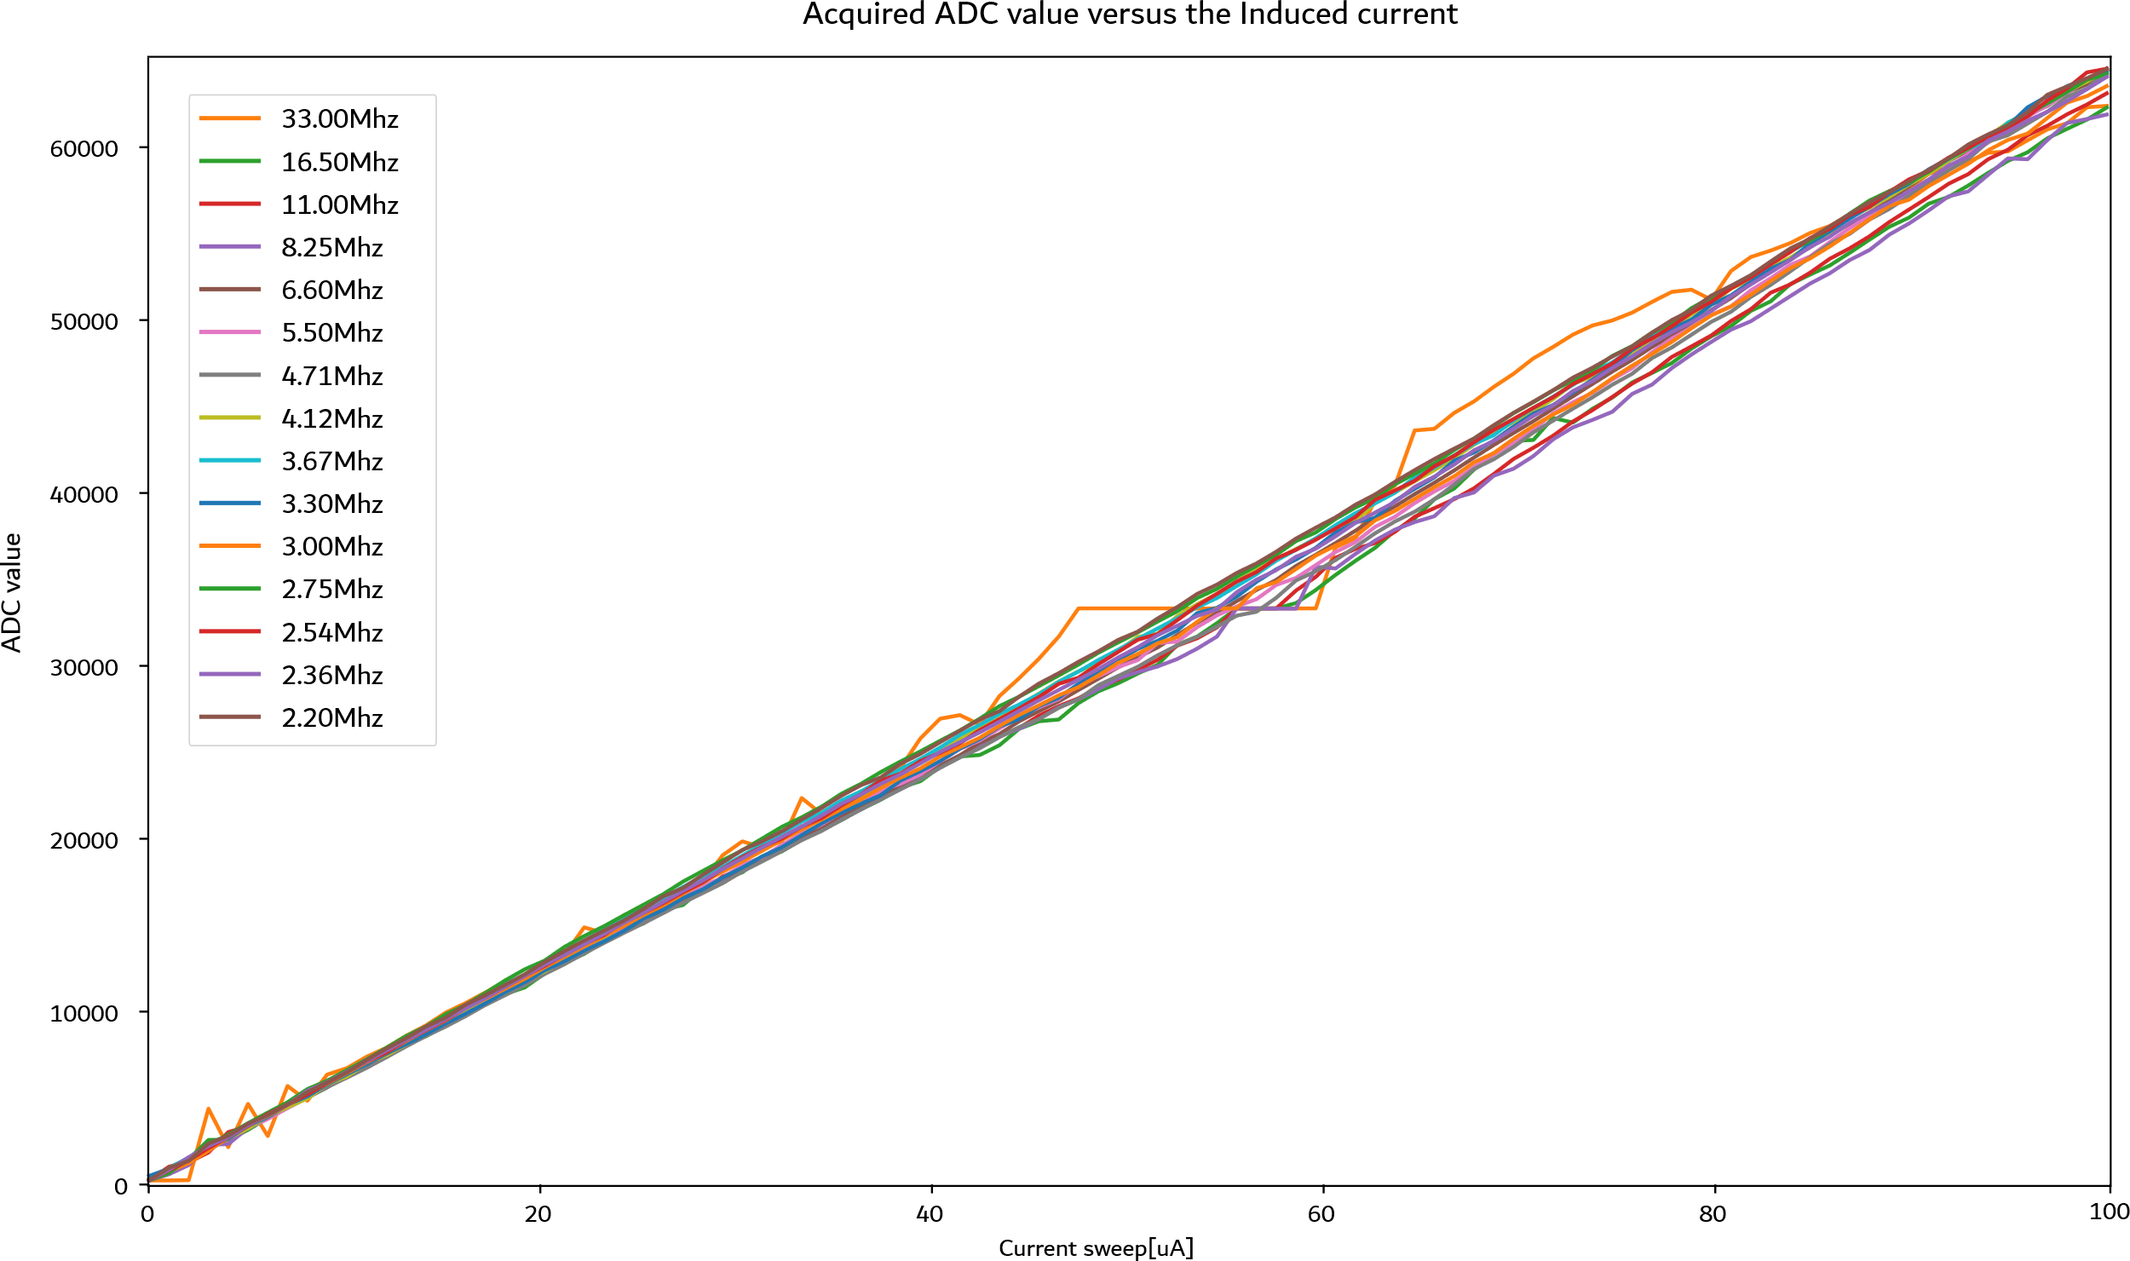

Delta-Sigma ADC – First Attempt
  Idea: emulate ASIC
  Current mirror + capacitor with current MUX + capacitor
  Limitation:
  Dynamic characteristics of the current source.
  Solution:
  Eliminate the MUX
Notes:
Observing a problem of too slow discharging causing a plateau in the middle of the range. If charges up too slowly to go up behind some voltge level to keep the ff out state the same for more than 1 clock cycle.
Doing a research of components available on the market
Building LTSpice proof of concept
Soldering board and testing in the lab
A frequency sweep proved that lower frequencies eliminate that problem
Fixing the MUX state to be always on
Dropping the idea of external current source
Switching directly in FPGA
The effect disappears
Further removing the MUX itself with no improvement
Should the output buffer switch between 0 and 1 or ‘Z’ and 1? -> 1,0

Slide 22
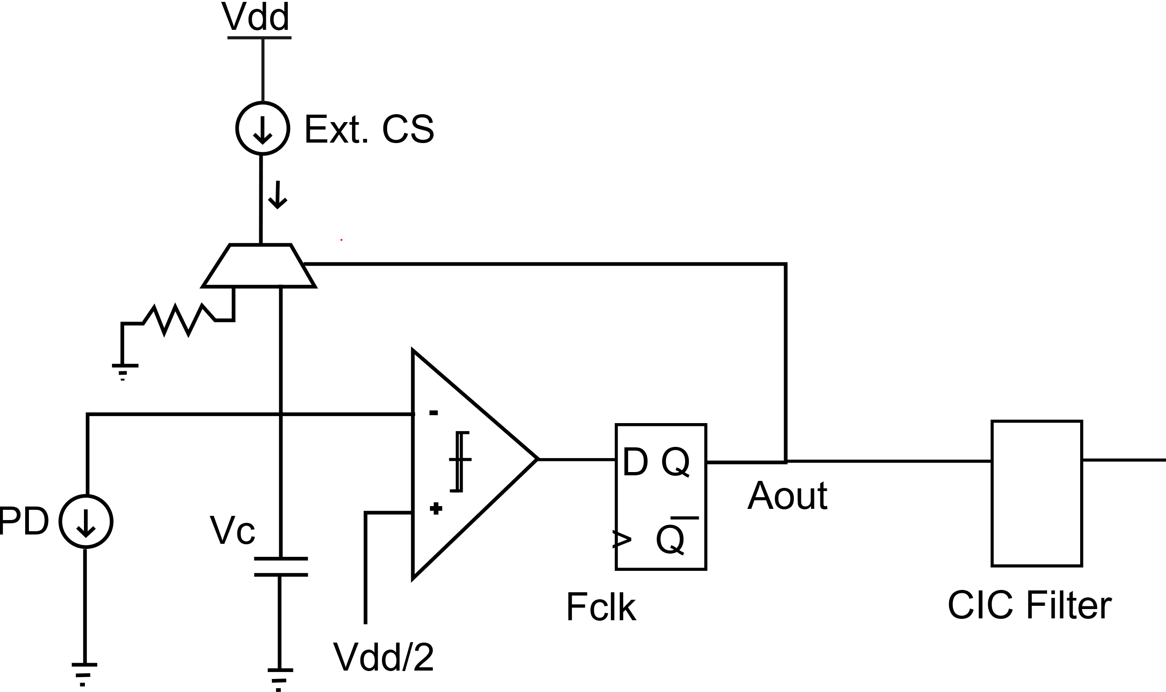
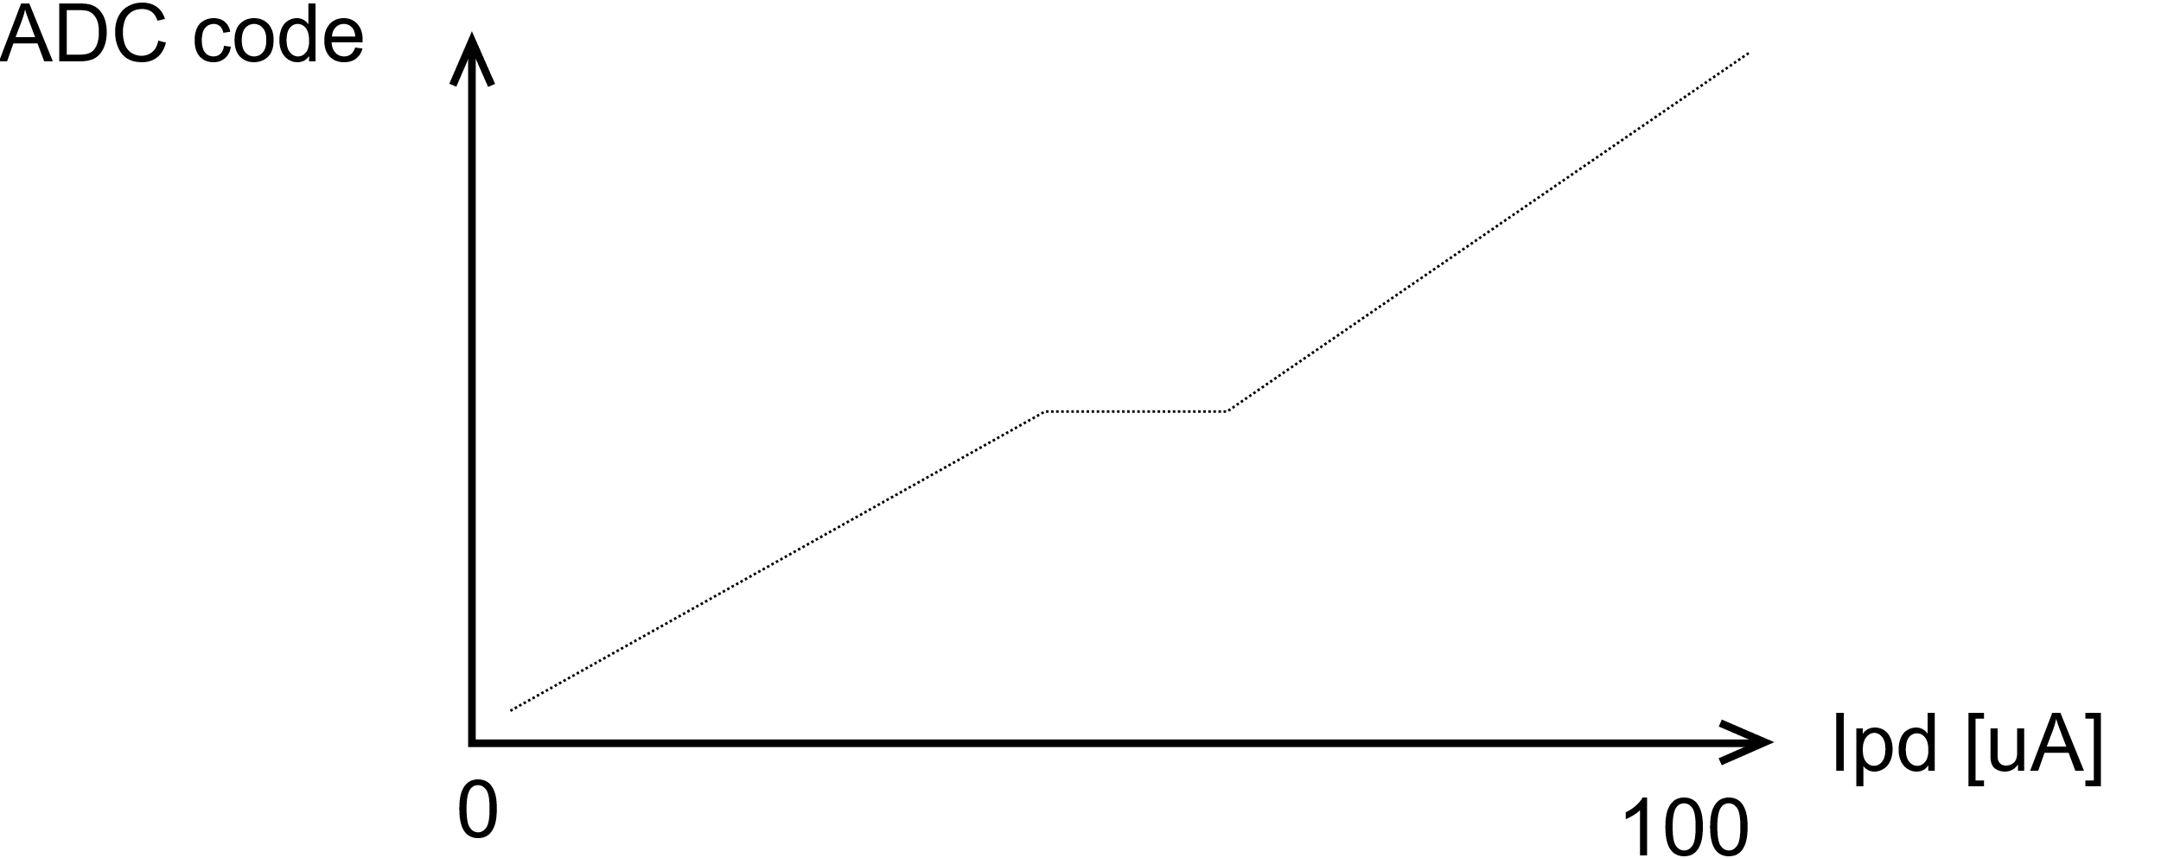
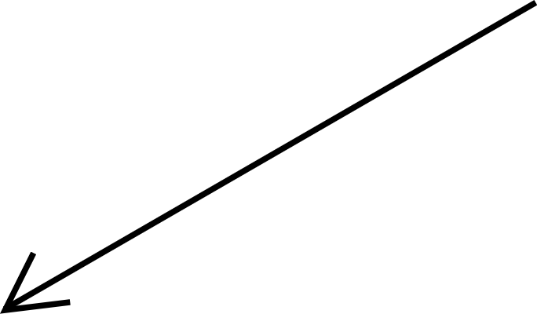
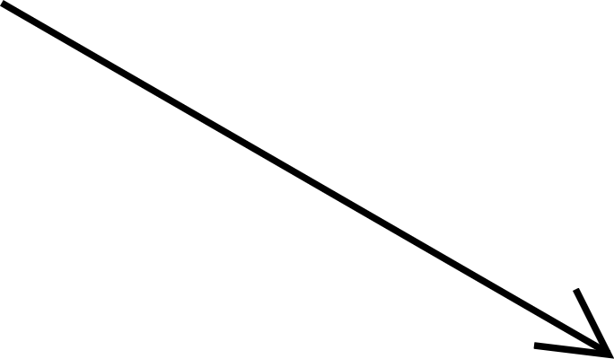
Design Space Exploration
Current steering
Notes:
Bipolar (0/1)
Higher range, worse quality
Worse linearity (due to capacitance in the buffer that discharges on top of the default cap)
Unipolar (‘Z’/1)
Even though the range is half of unipolar one it is better mimicking the final system, therefore that’s the way to go
Additional current sink during ‘0’ state
FPGA buffering problem – high state gets capacitor into floating mode, possible capacitance from the buffer
In addition a discrete transistor based current switch was considered (ADV301N)

Slide 23
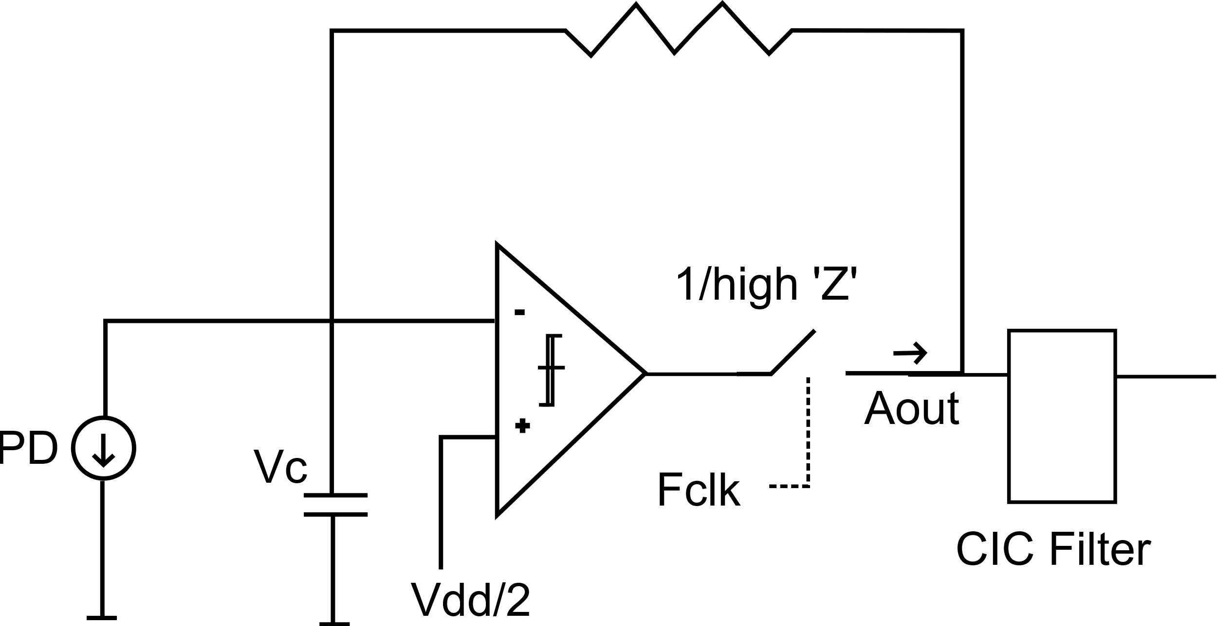
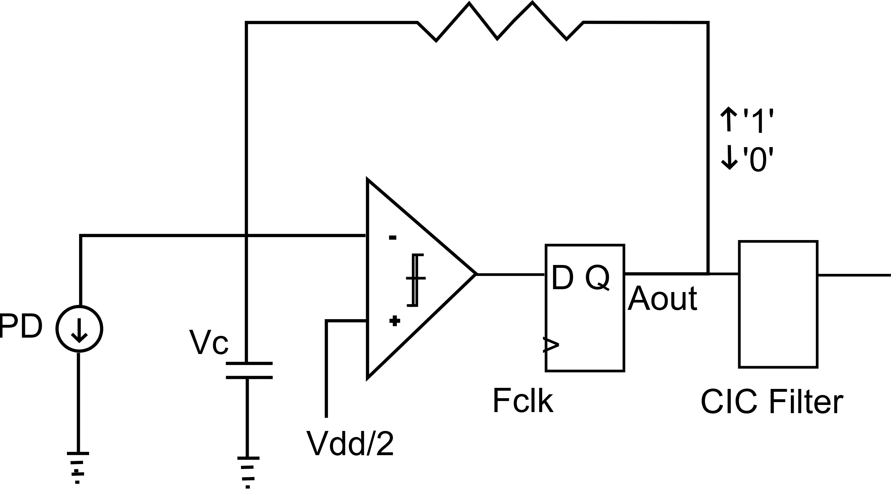
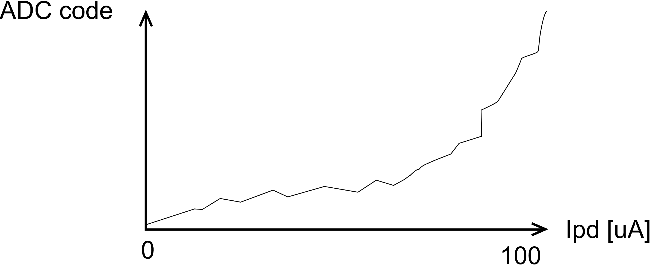
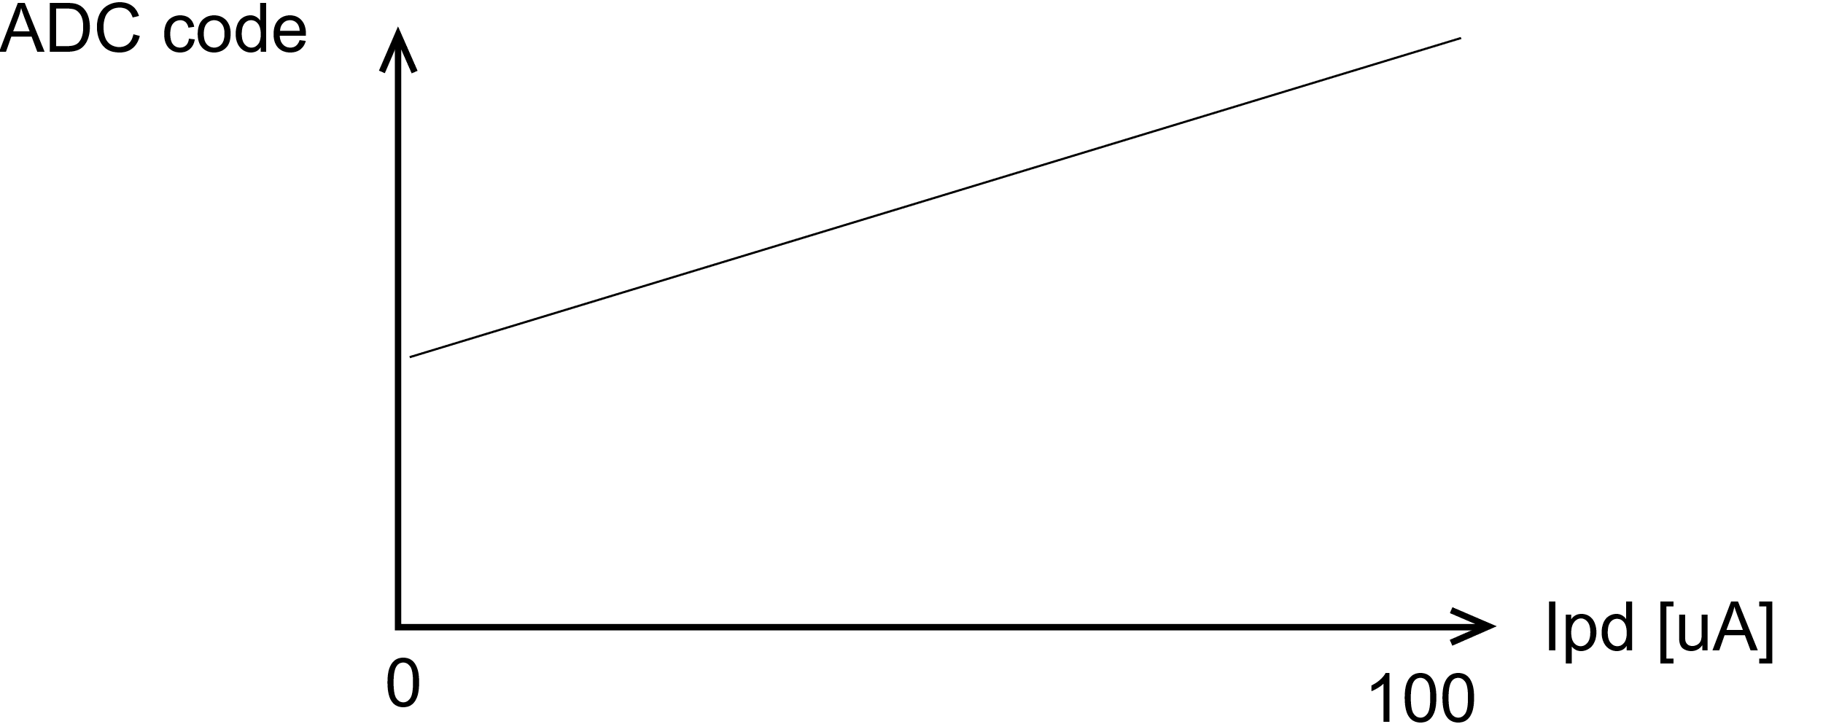
Design Space Exploration
Current steering
Resistor Driven
Unipolar
Resistor Driven
Bipolar
Notes:
Bipolar (0/1)
Higher range, worse quality
Worse linearity (due to capacitance in the buffer that discharges on top of the default cap)
Unipolar (‘Z’/1)
Even though the range is half of unipolar one it is better mimicking the final system, therefore that’s the way to go
Additional current sink during ‘0’ state
FPGA buffering problem – high state gets capacitor into floating mode, possible capacitance from the buffer
In addition a discrete transistor based current switch was considered (ADV301N)

Slide 24
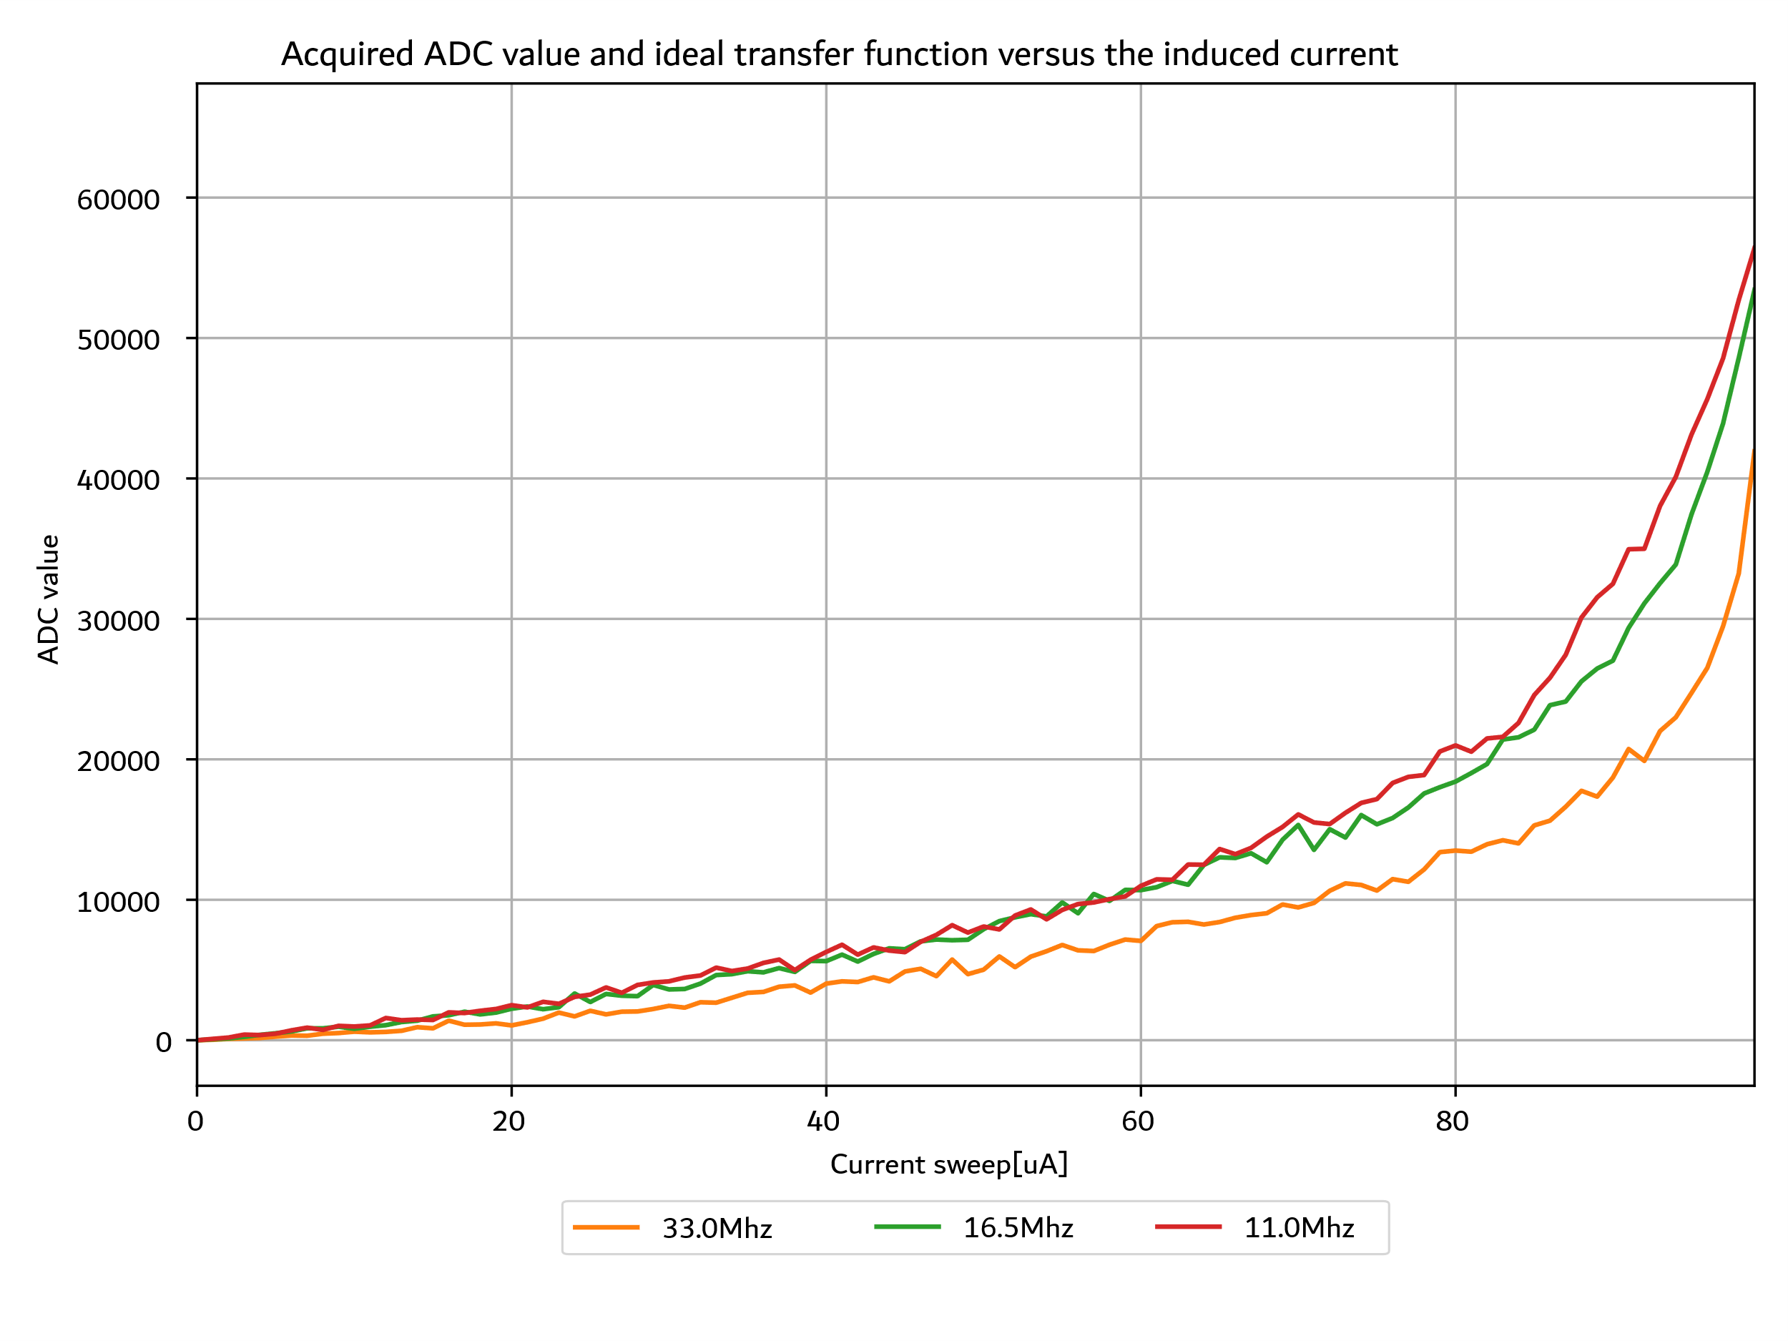
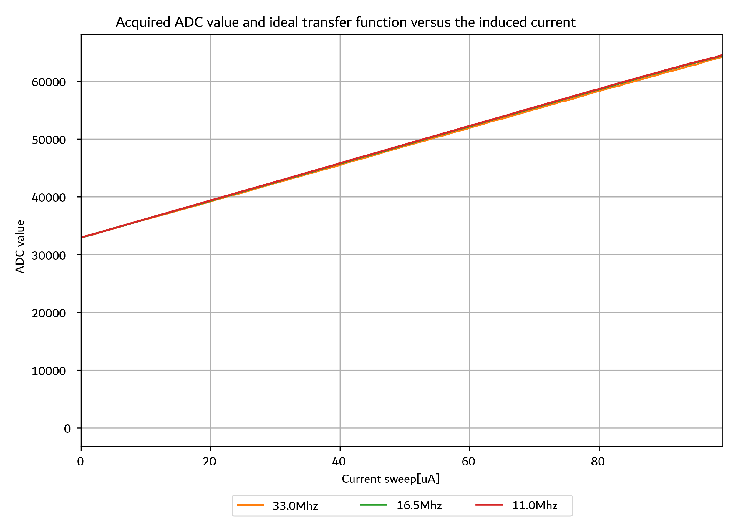
Design Space Exploration
Current steering
Resistor Driven
Unipolar
Resistor Driven
Bipolar
Notes:
Bipolar (0/1)
Higher range, worse quality
Worse linearity (due to capacitance in the buffer that discharges on top of the default cap)
Unipolar (‘Z’/1)
Even though the range is half of unipolar one it is better mimicking the final system, therefore that’s the way to go
Additional current sink during ‘0’ state
FPGA buffering problem – high state gets capacitor into floating mode, possible capacitance from the buffer
In addition a discrete transistor based current switch was considered (ADV301N)

Slide 25
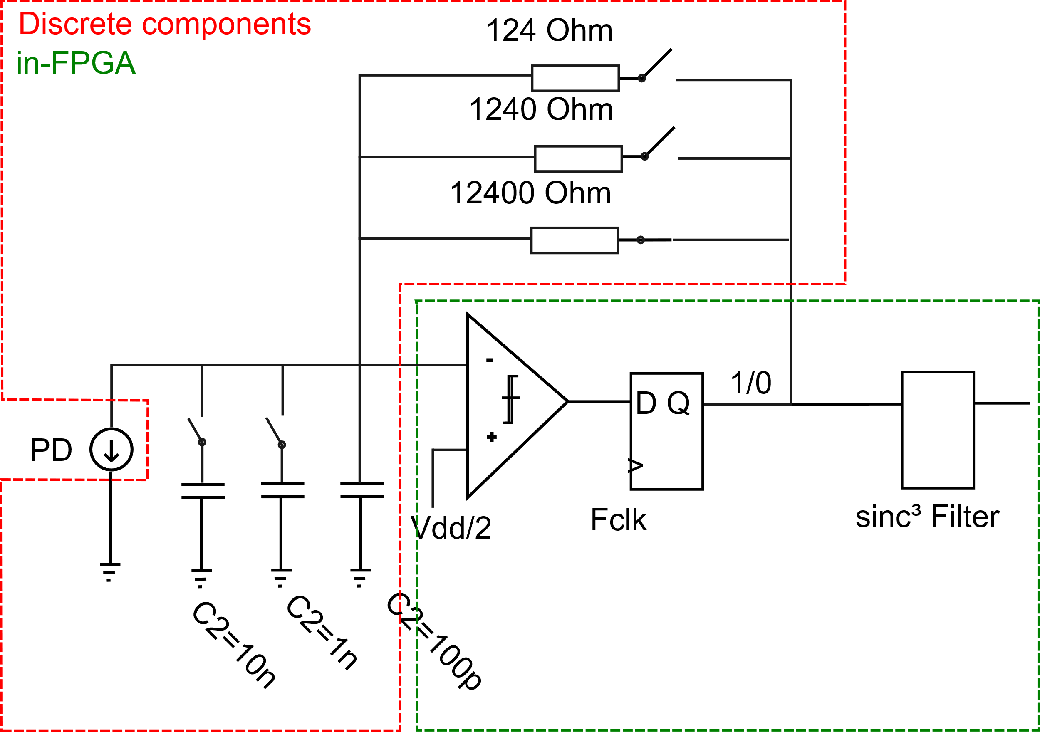
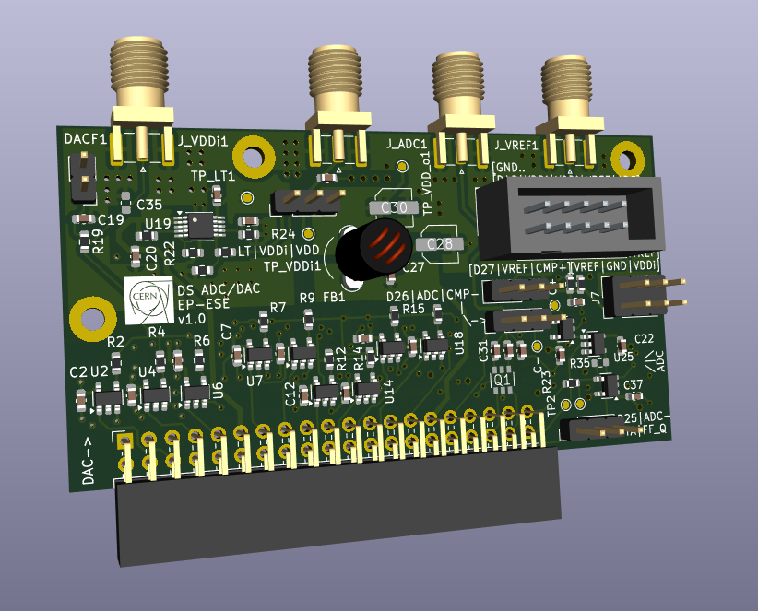
Delta Sigma ADC in Final PCB
  Bipolar, resistor driven approach
    Configurable gain (dynamic range)
  Configurable capacitance
  Isolating with buffers
Notes:
For the requirements investigation please refer to Gabriele Atzeni presentation.

Slide 26
Delta Sigma ADC in Final PCB
  Bipolar, resistor driven approach
    Configurable gain (dynamic range)
  Configurable capacitance
  Isolating with buffers
Notes:
For the requirements investigation please refer to Gabriele Atzeni presentation.

Slide 27
Delta Sigma ADC in Final PCB
  Bipolar, resistor driven approach
    Configurable gain (dynamic range)
  Configurable capacitance
  Isolating with buffers (lower parasitics)
Notes:
For the requirements investigation please refer to Gabriele Atzeni presentation.

Slide 28
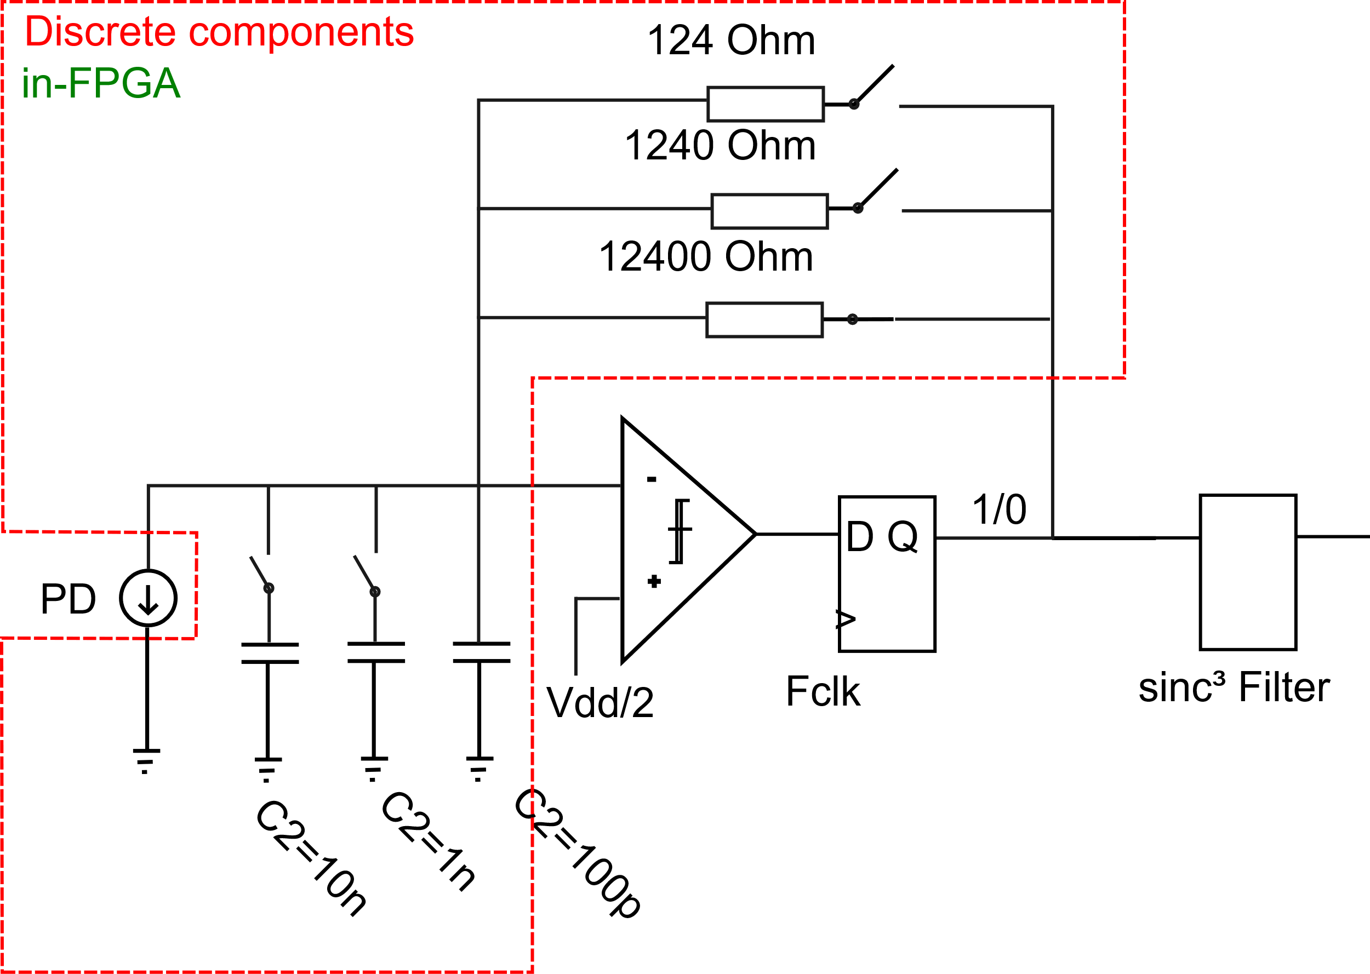


Delta Sigma ADC in Final PCB
  Bipolar, resistor driven approach
    Configurable gain (dynamic range)
  Configurable capacitance
  Isolating with buffers (lower parasitics)
  External DS loop (even lower parasitics)
Notes:
For the requirements investigation please refer to Gabriele Atzeni presentation.

Slide 29
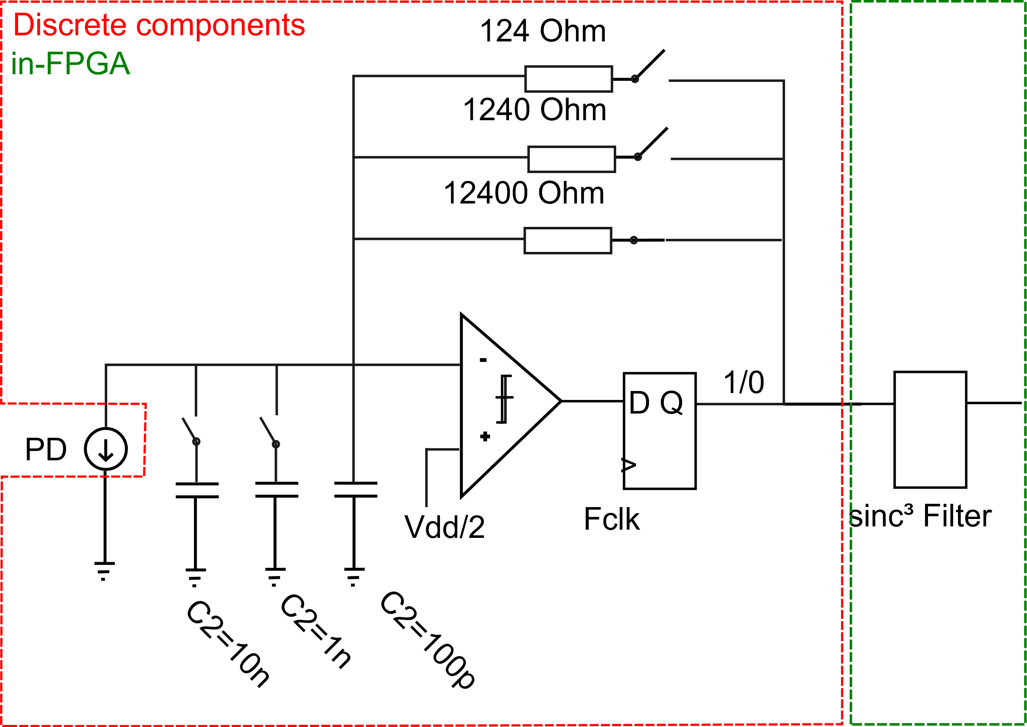
Delta Sigma ADC in Final PCB
  Bipolar, resistor driven approach
    Configurable gain (dynamic range)
  Configurable capacitance
  Isolating with buffers (lower parasitics)
  External DS loop (even lower parasitics)
Notes:
For the requirements investigation please refer to Gabriele Atzeni presentation.

Slide 30


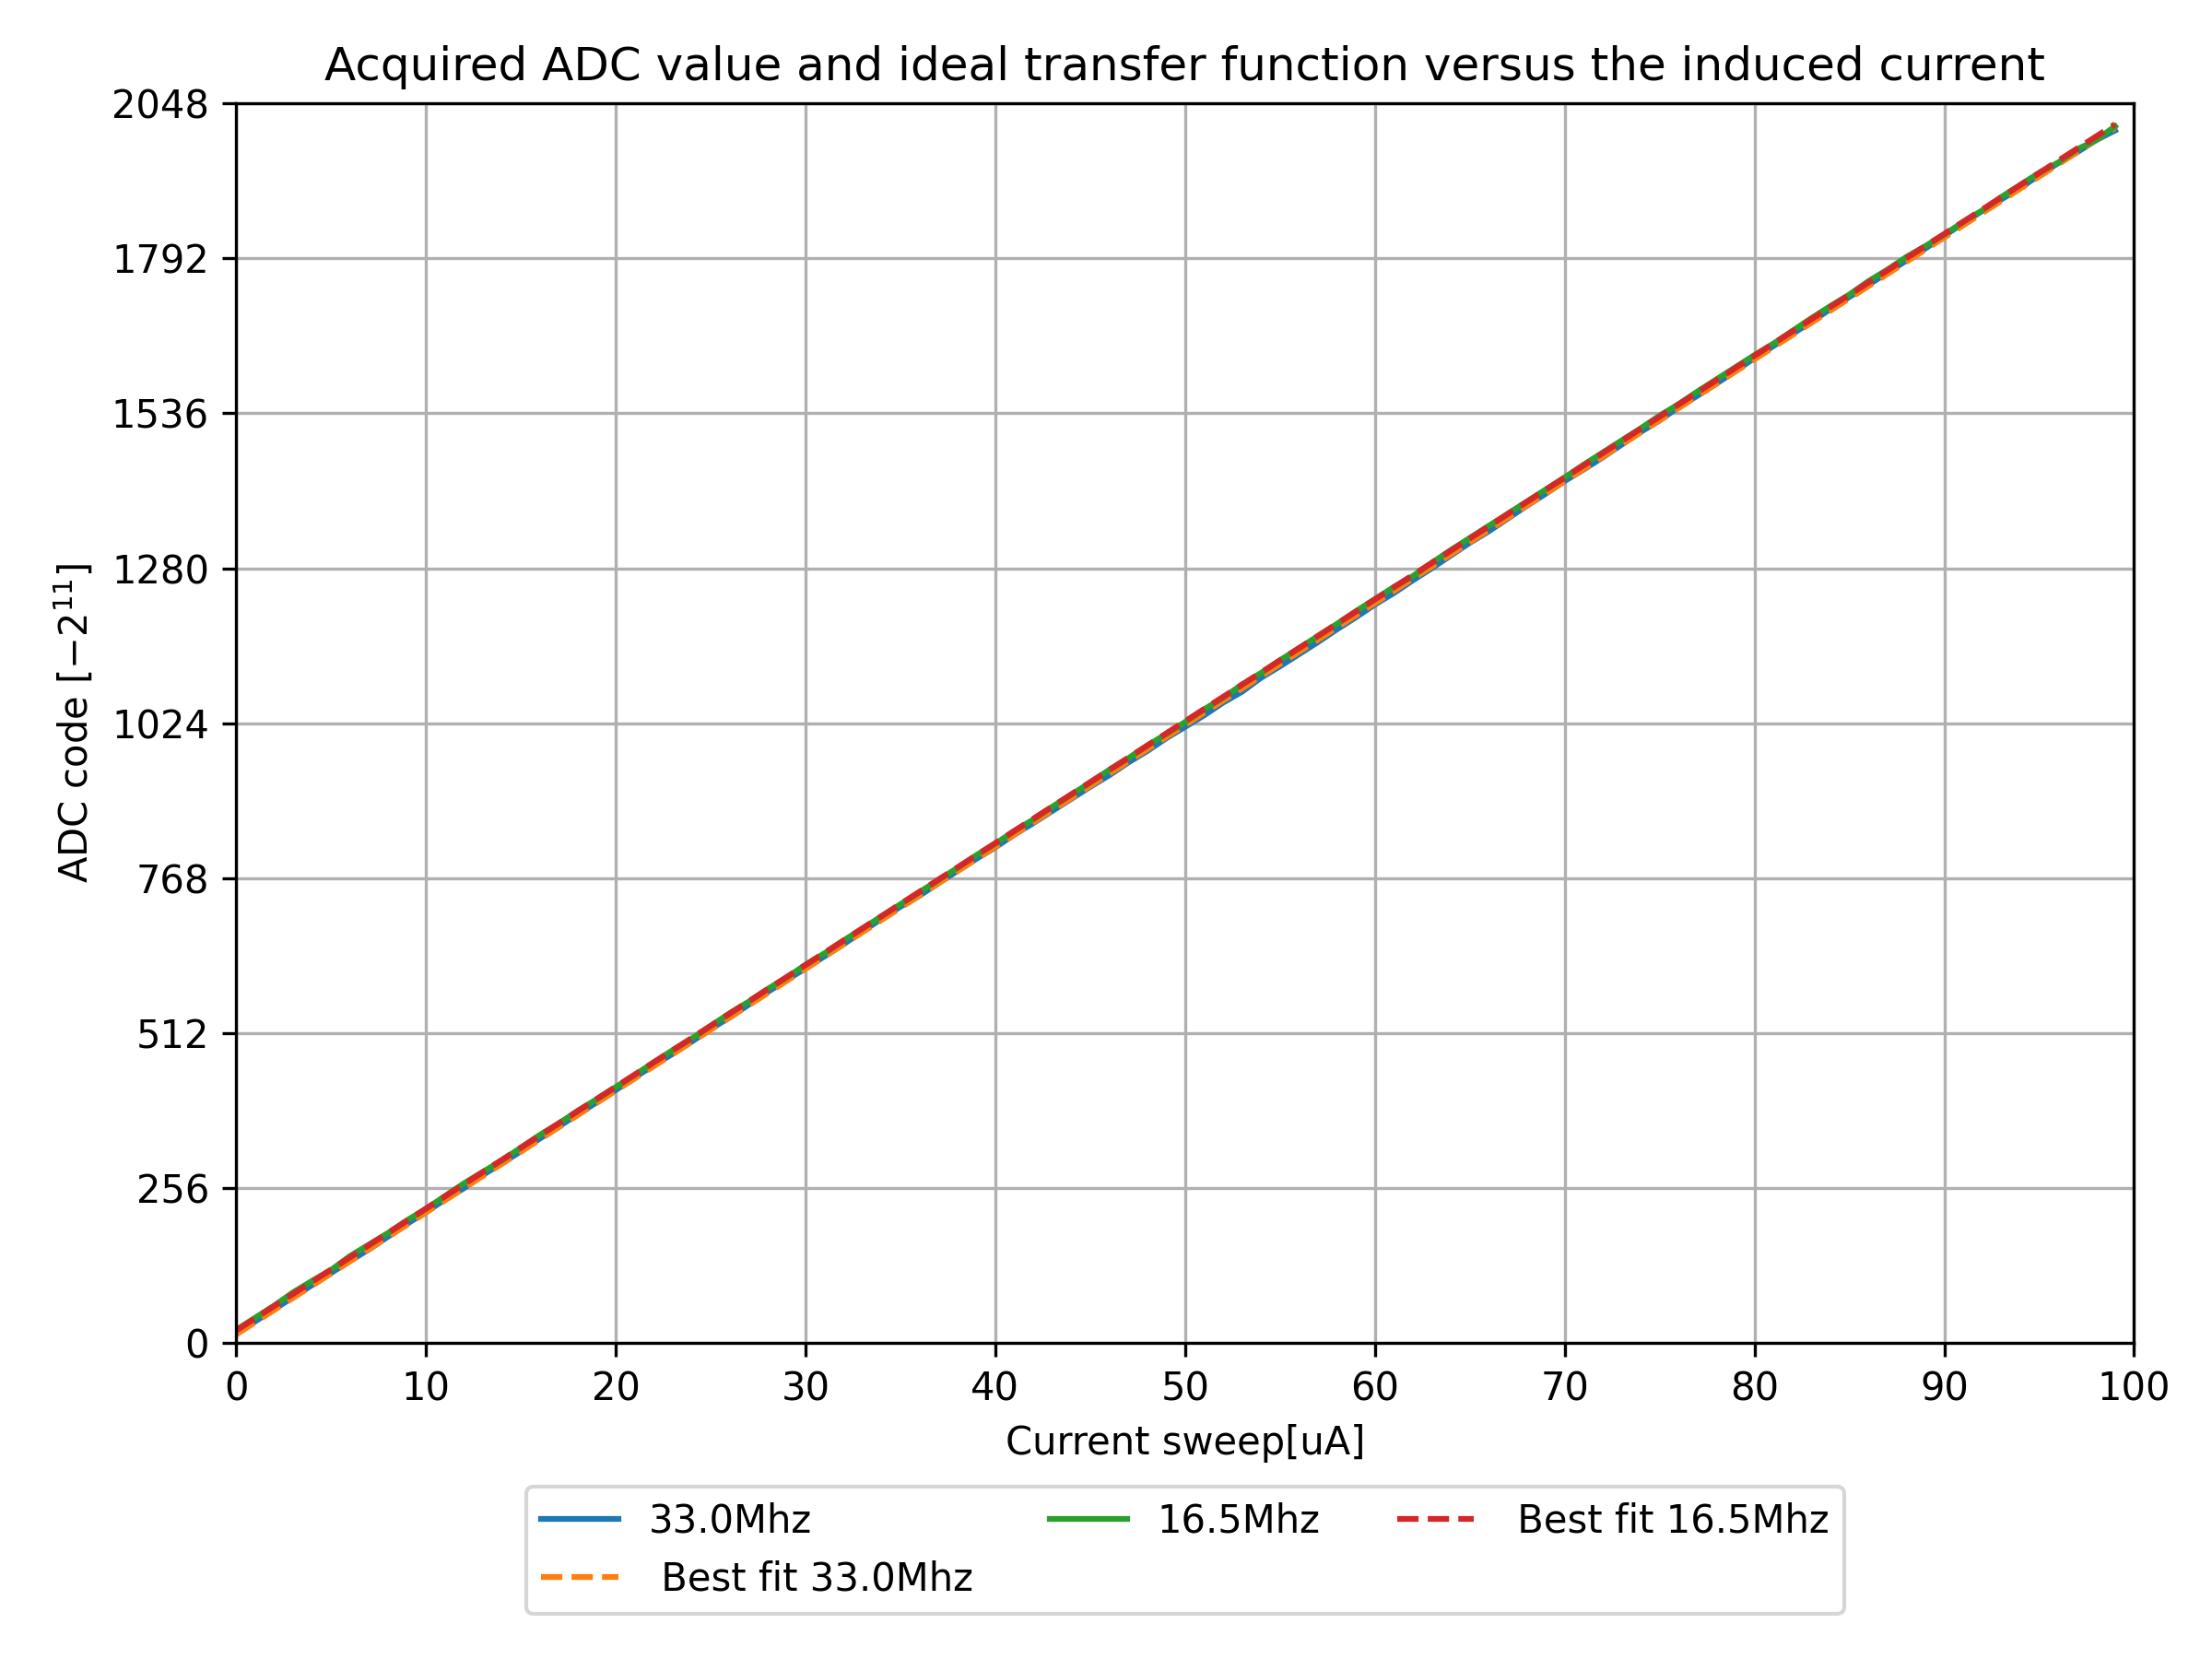
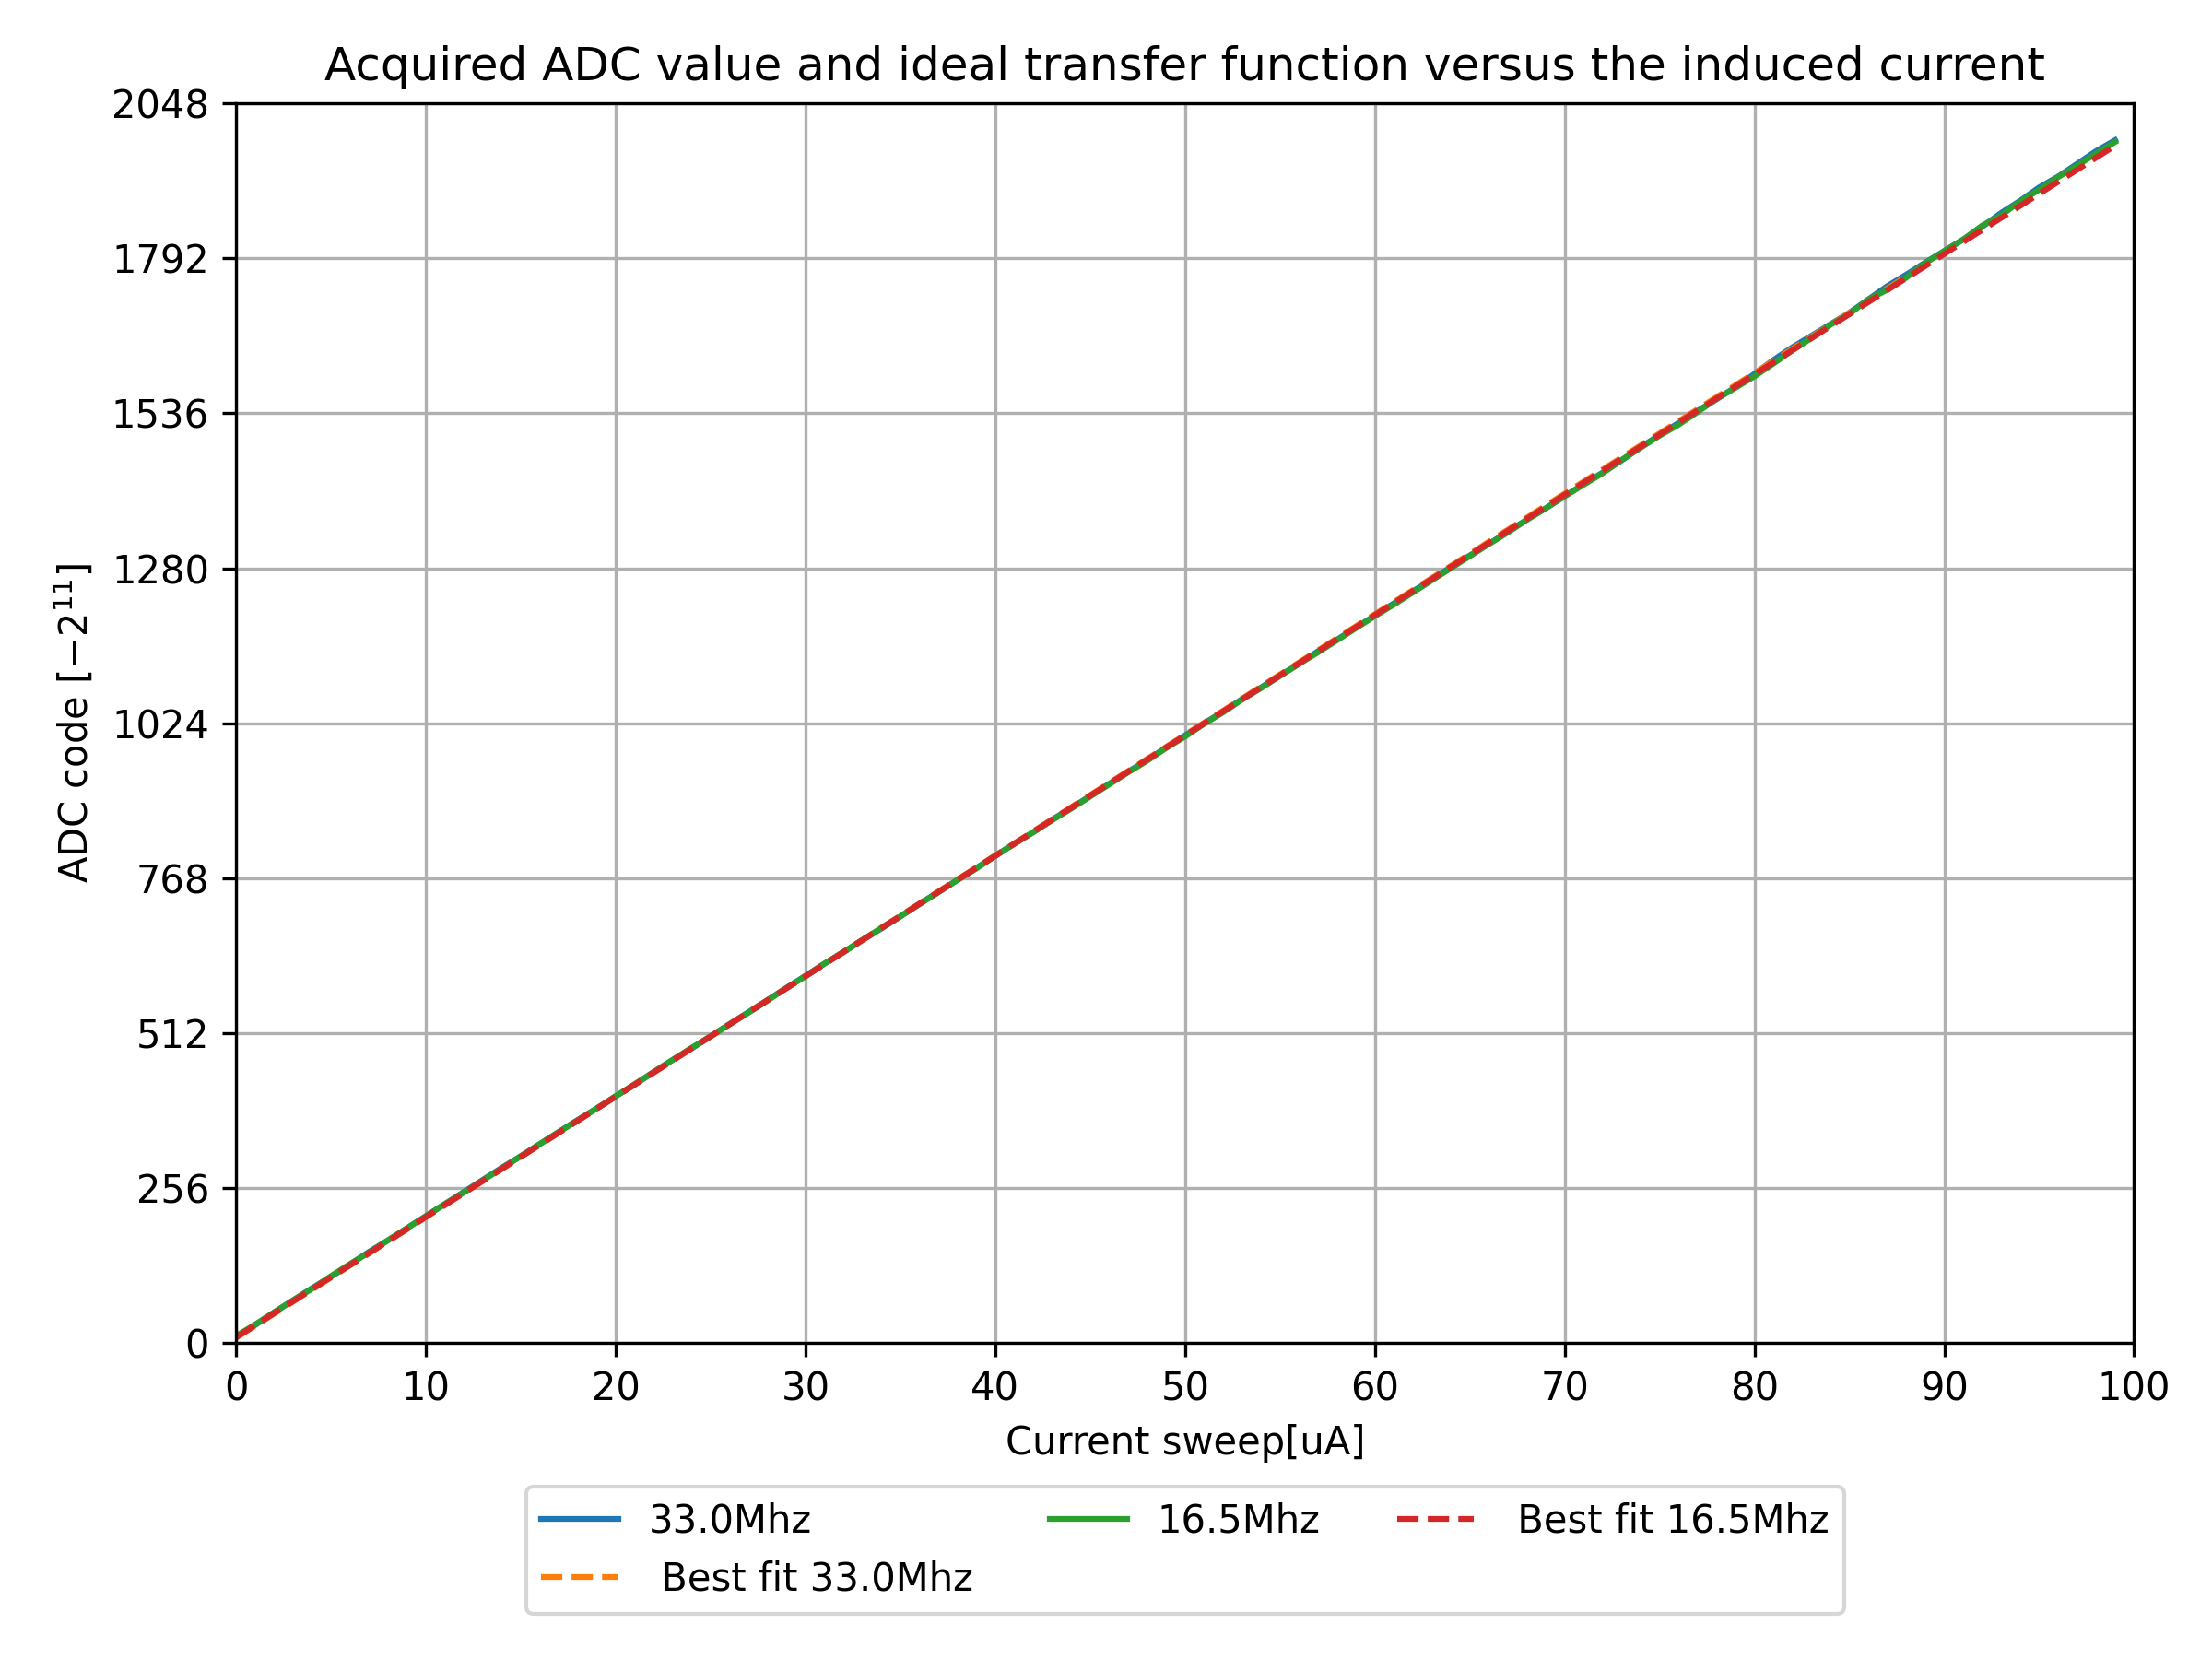
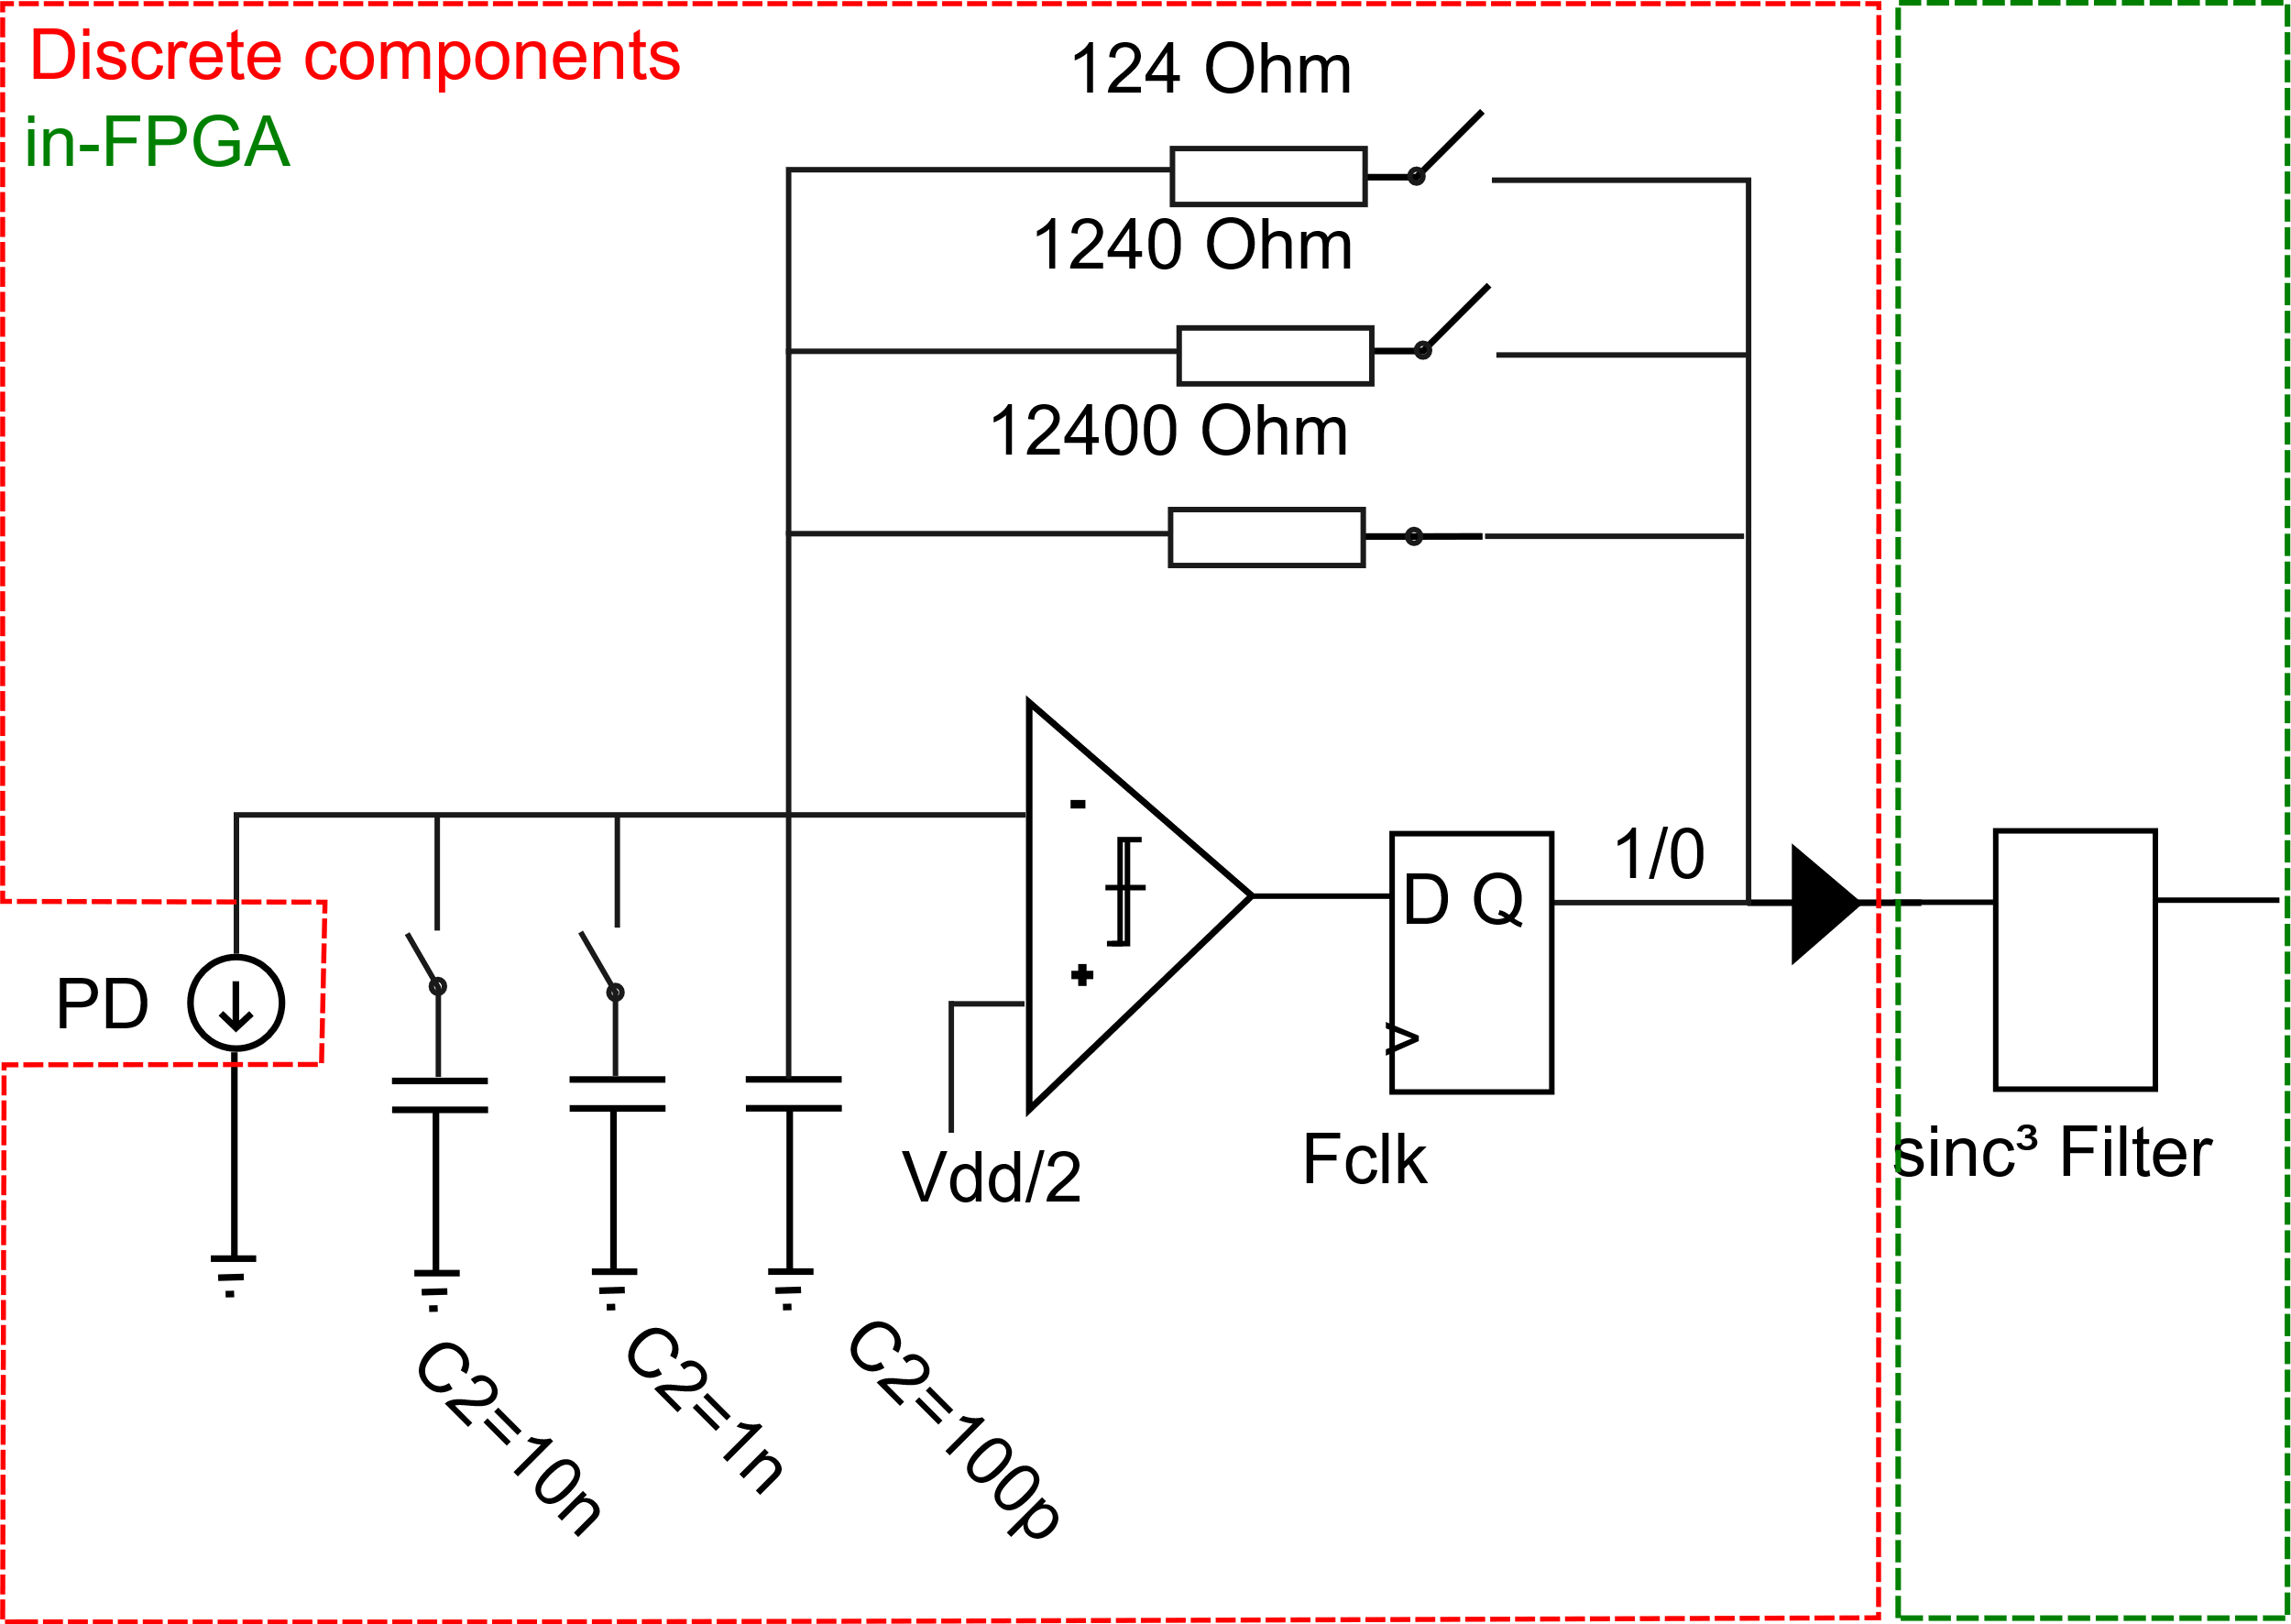
Delta Sigma loop – FPGA or ICs?
FPGA driven loop
Disc. components driven loop

Slide 31
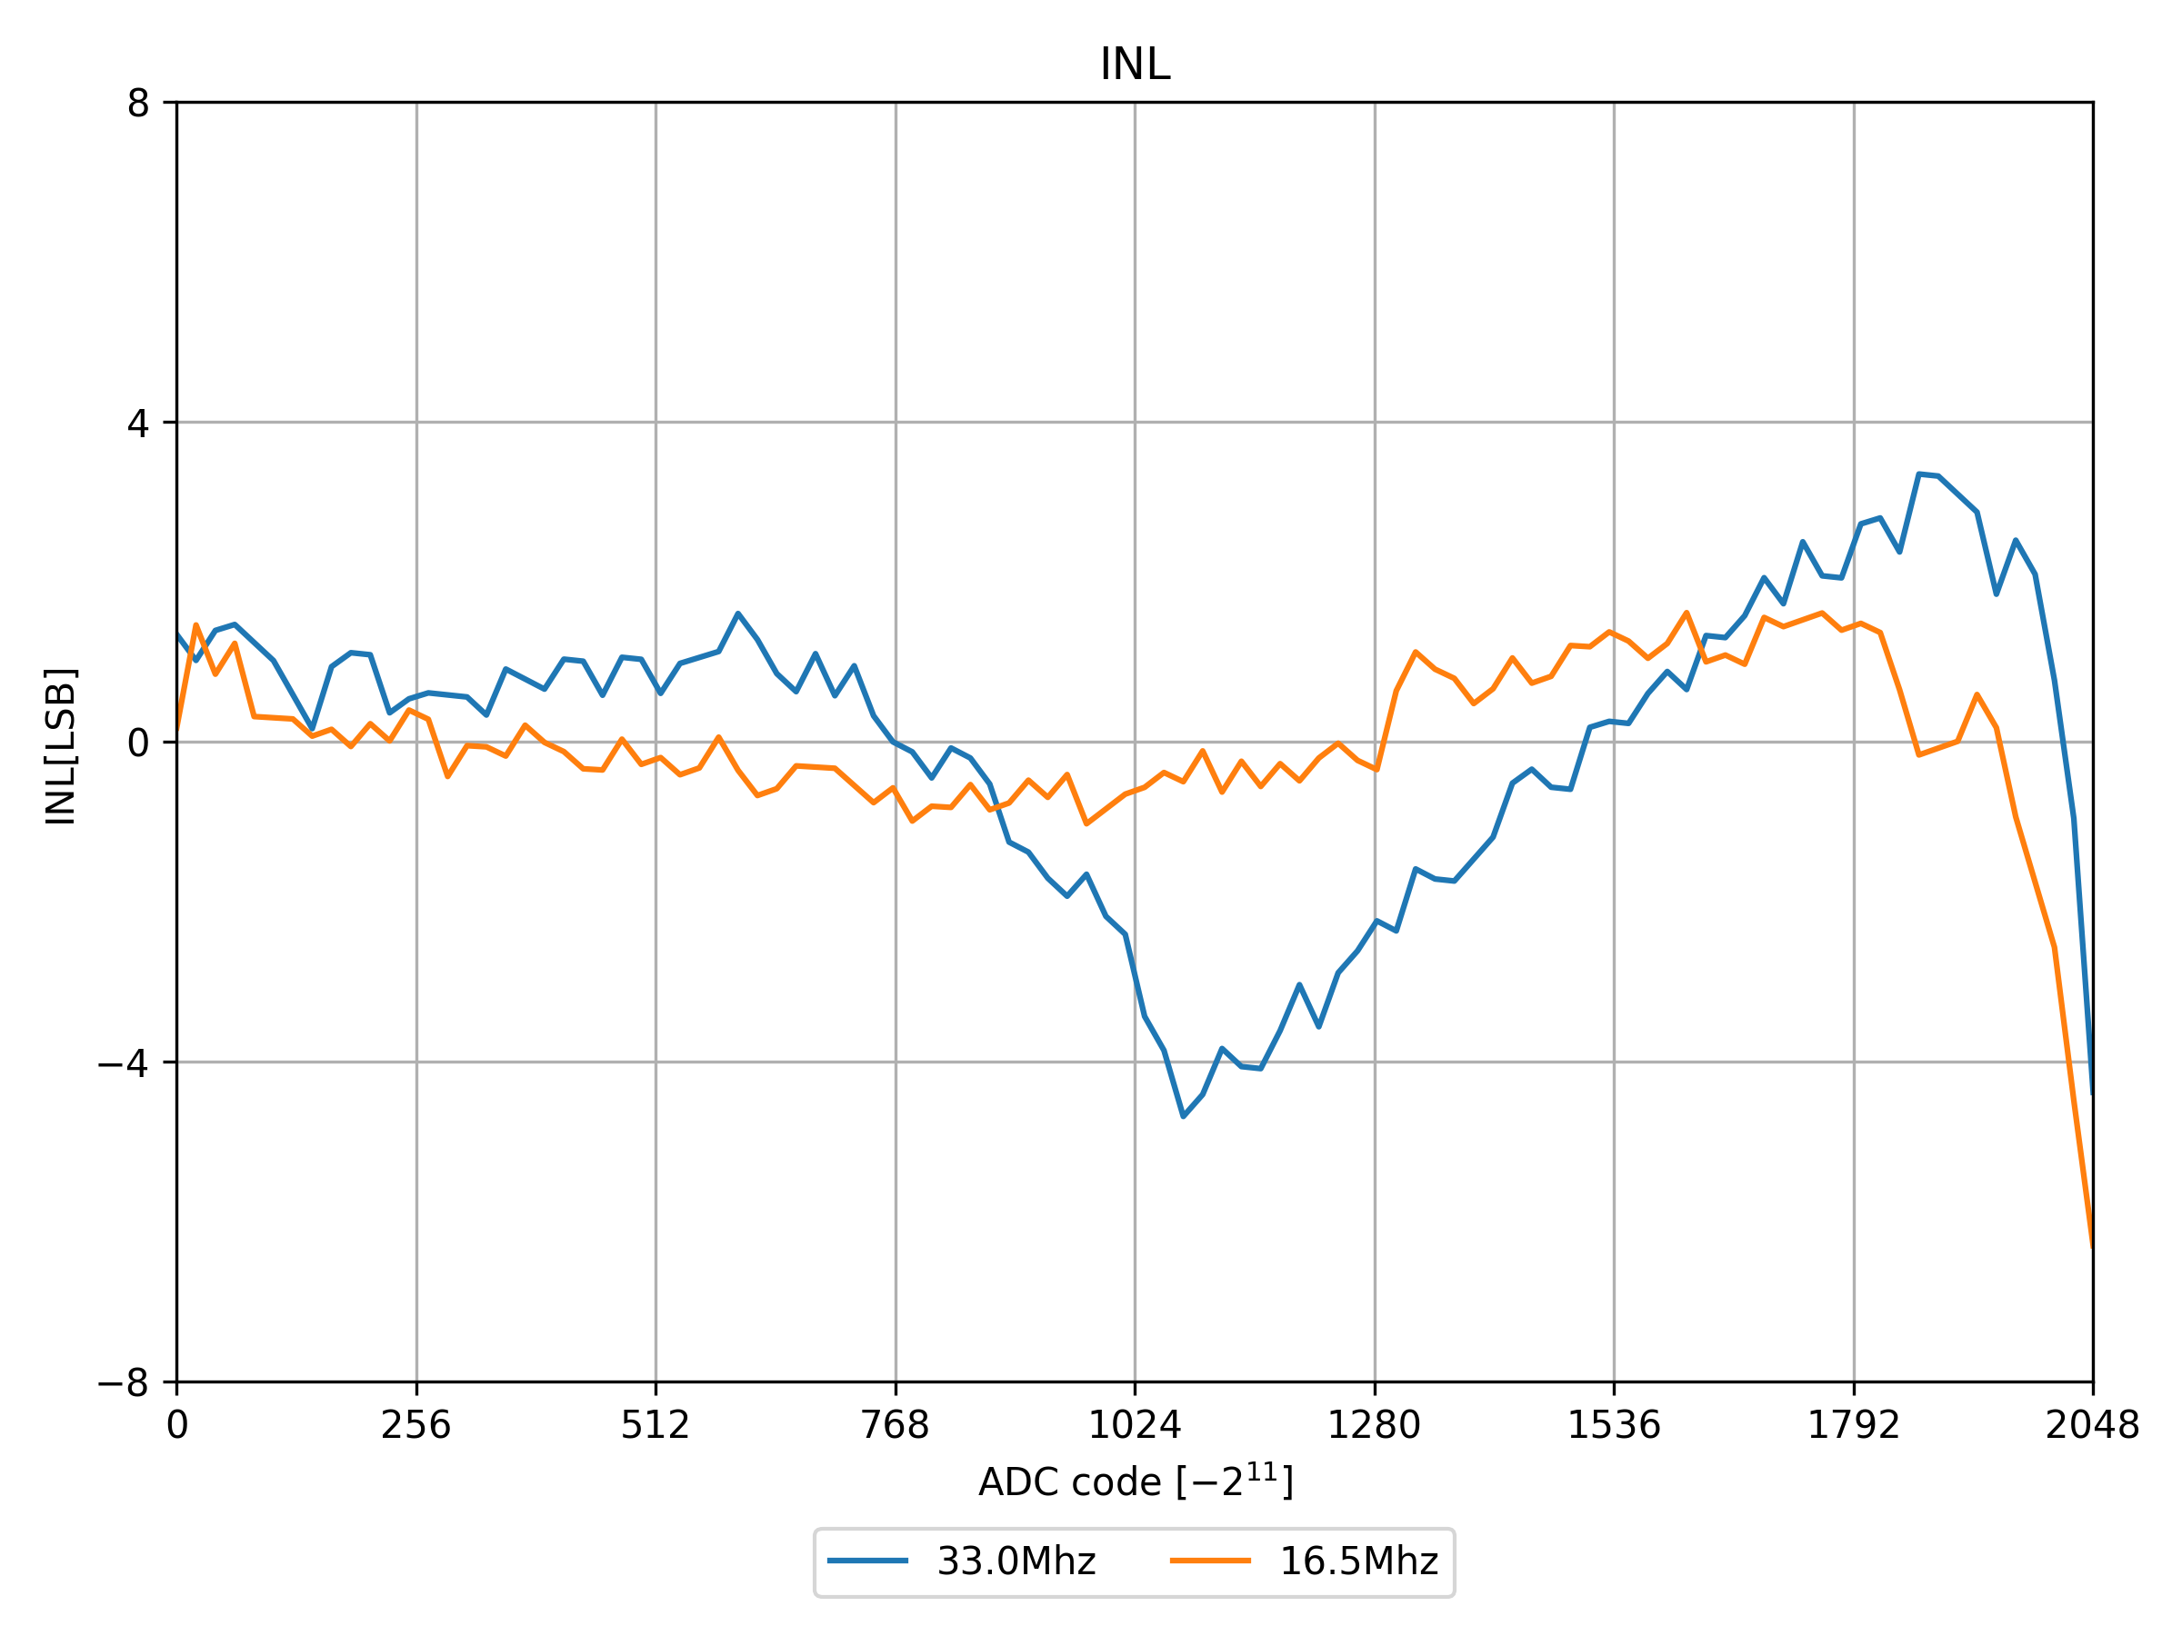
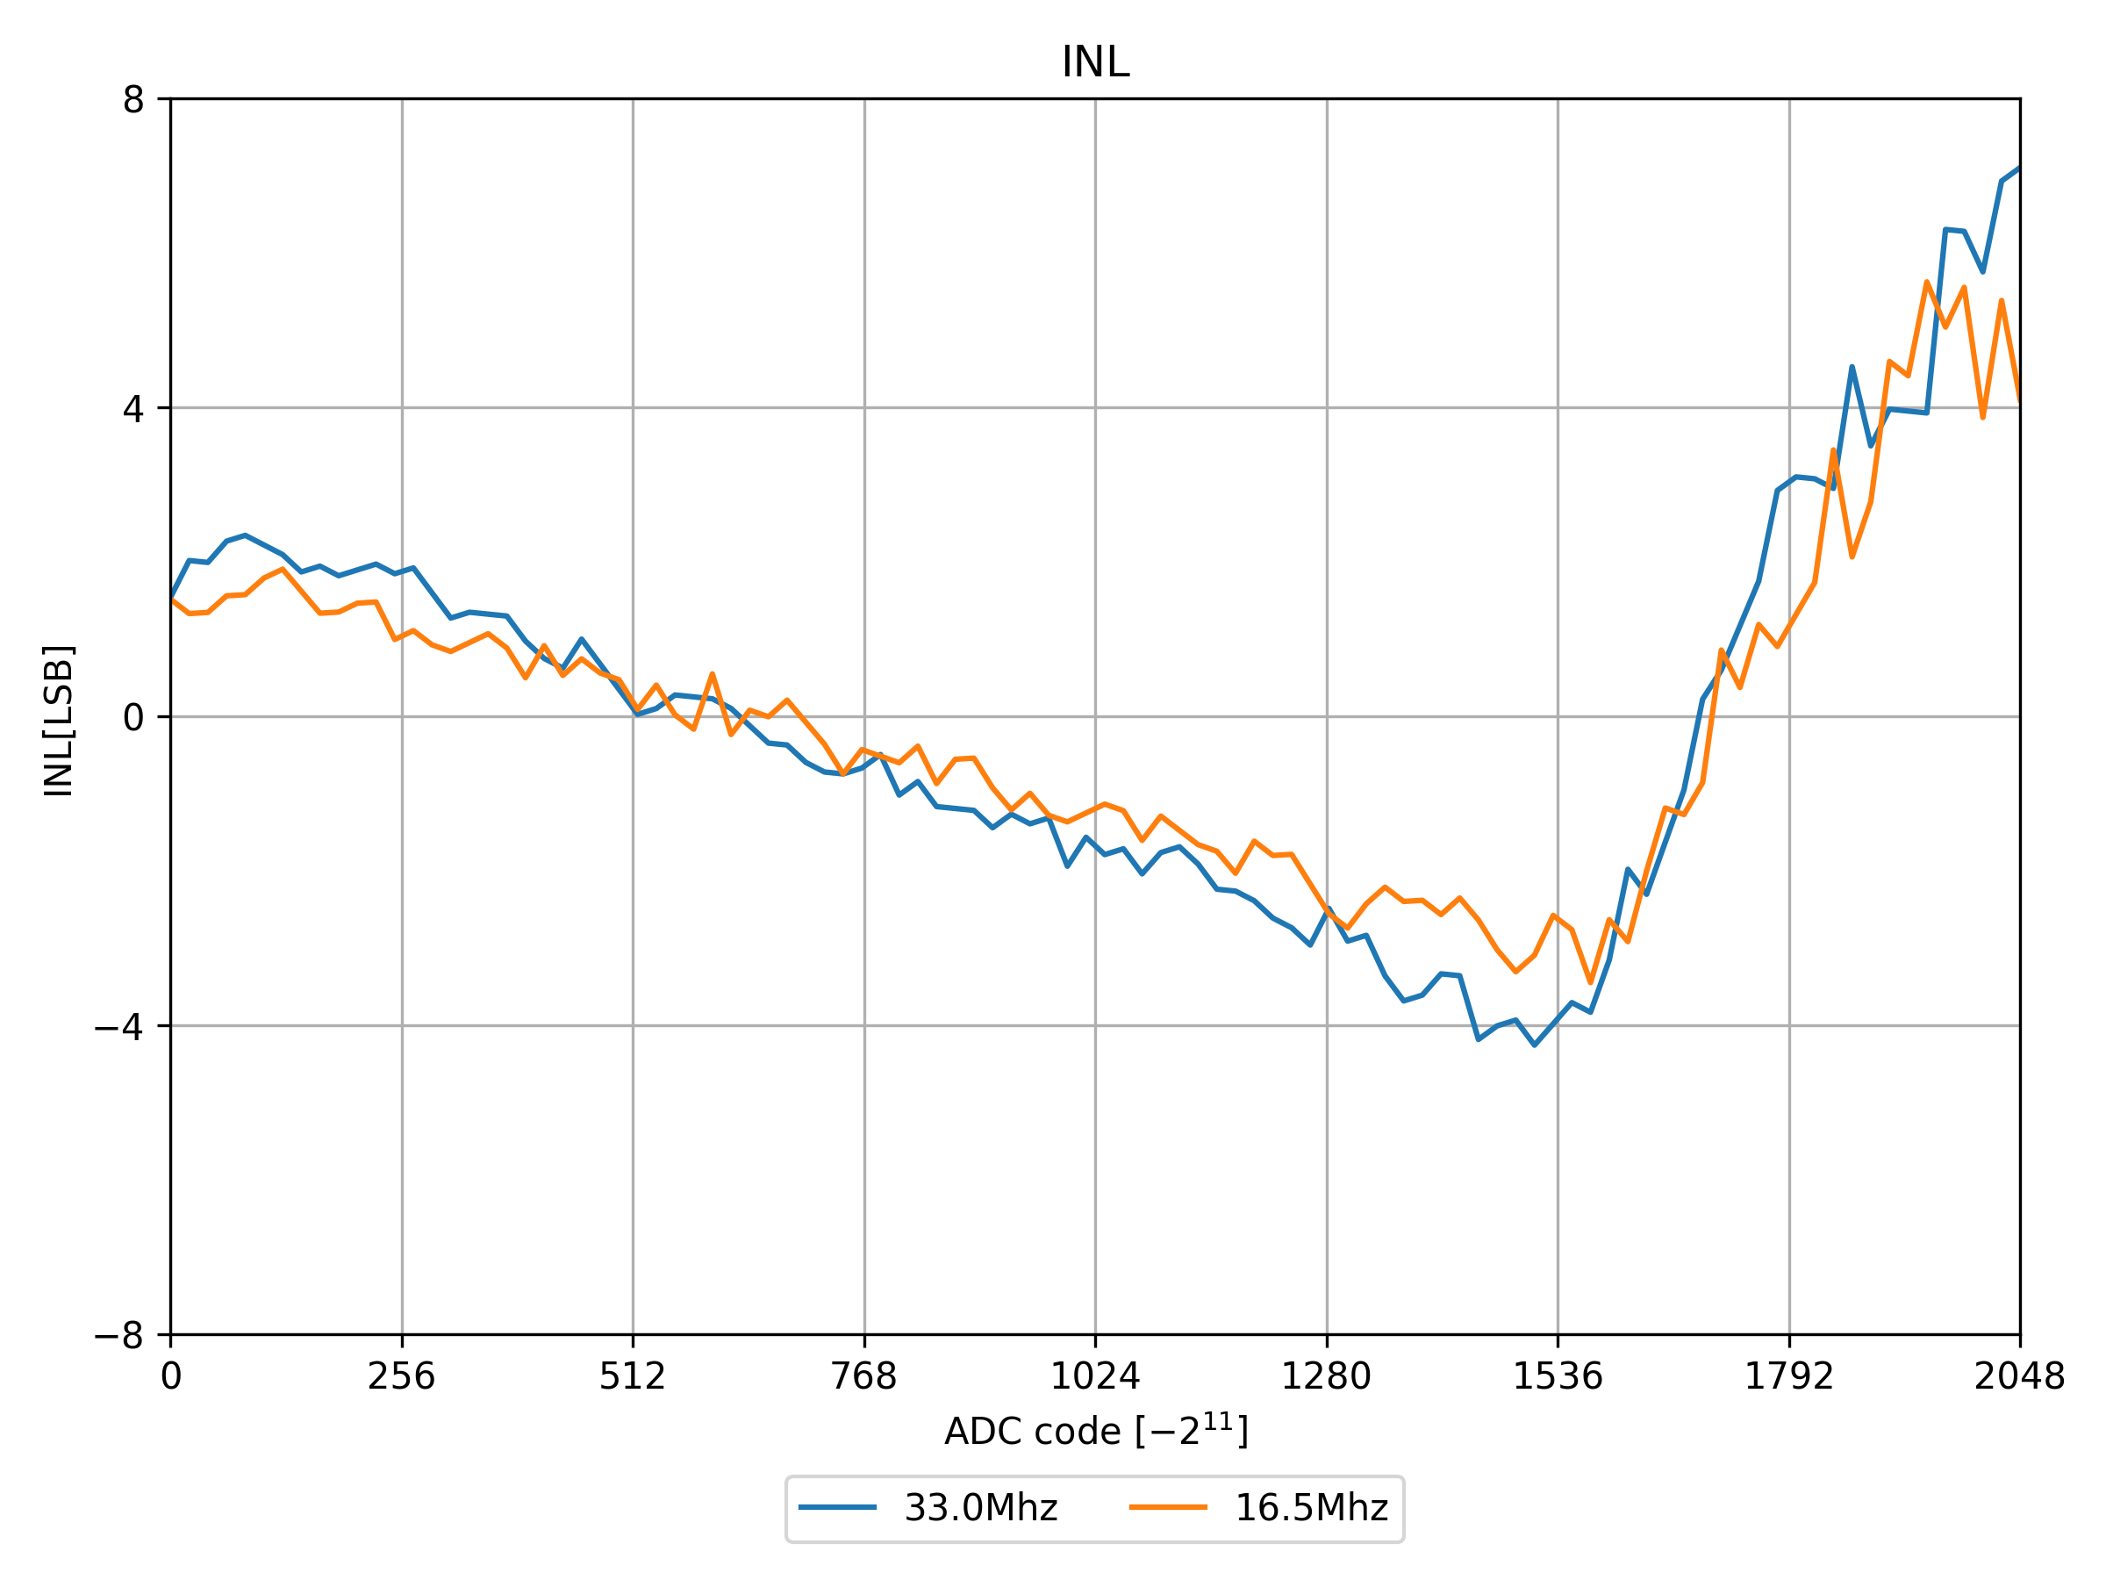
Delta Sigma loop – FPGA or ICs?
FPGA driven loop
Disc. components driven loop

Slide 32
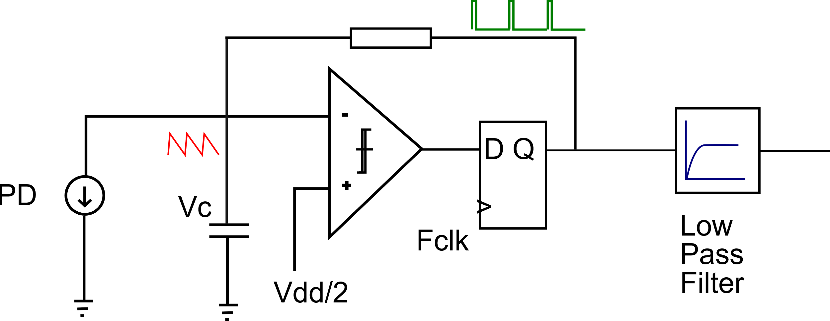




Comparison of INLs - Capacitance
Discrete components driven Delta Sigma ADC loop
Larger capacitor
  lower SDM noise, for ASIC more space
  different RC time constant (nonlinearity)
  Stronger filtering behaviour – up to 10khz (max 1.3nF)
  Closer to the comparator noise ( )
Higher capacitance (in that range), better INL
Adjust depending on
scenario
100pF 1.1nF 10.1nF
Notes:
Optimisation problem:
higher capacitor – lower noise (more stable voltage), for asic more space
filtering behaviour – up to 10khz (max 1.3nF)
By having smaller capacitor, we are further away from the comparator noise
1. Signal-to-Noise Ratio (SNR) Improves Initially
With a larger capacitor, the voltage changes slowly, and the signal may be buried in comparator noise.
As you reduce the capacitor, the signal becomes more dynamic and easier to distinguish from noise.
This improves INL (Integral Non-Linearity) and DNL (Differential Non-Linearity).
2. Beyond a Threshold, Non-Idealities Dominate
If the capacitor is too small, the system becomes:
Too sensitive to jitter
More prone to overshoot and ringing
Affected by parasitic capacitance and layout imperfections
The comparator may start reacting to glitches or high-frequency noise, degrading precision.
3. Mismatch with Sampling Rate
The RC time constant must be well-matched to the sampling frequency.
Too small a capacitor → RC time constant too short → system may not settle properly between samples.
📈 INL Behavior Explained
Initial improvement: Better signal swing, clearer quantization.
Later degradation: Increased noise sensitivity, instability, and non-linear charge/discharge behavior.
✅ What You Can Do
Sweep capacitor values and plot INL/DNL vs. capacitance.
Simulate noise and jitter effects to find optimal operating point.
Consider adding damping or bandwidth-limiting to avoid instability at low capacitance.

Slide 33

TCU Prototype vs ASIC
PCB/FPGA implementation:
ASIC implementation:
ADC
ADC (with/without FPGA in the loop)
Limiting parasitic capacitance with buffers
Bipolar (resistor) driven approach -> Resistor and capacitor-based integrator
11 bits for unipolar operation
33Mhz DSM
ADC
Very low capacitance
Current driver approach -> Capacitor and current source-based integrator
12 bit
40Mhz DSM
Notes:
Making the design more reproducible and closer to the ASIC reality (less capacitance, more resistors), isolating with buffers

Slide 34


DAC in Final PCB

Slide 35
DAC in Final PCB
  Multiple levels
    Thermometric encoding
    16 levels bring 4 bits of resolution

Slide 36
DAC in Final PCB
  Multiple levels
    Thermometric encoding
    16 levels bring 4 bits of resolution
    External buffering

Slide 37


DAC in Final PCB
  Multiple levels
    Thermometric encoding
    16 levels bring 4 bits of resolution
  A flavor of delta sigma modulation (DSM)
    additional 12 bits
DSM

Slide 38
DAC in Final PCB
  Multiple levels
    Thermometric encoding
    16 levels bring 4 bits of resolution
  A flavor of delta sigma modulation (DSM)
    additional 12 bits
  Dynamic element matching (DEM)
    Circulating the outputs to average out the resistance
DEM

Slide 39
DAC in Final PCB
  Multiple levels
    Thermometric encoding
    16 levels bring 4 bits of resolution
  A flavor of delta sigma modulation (DSM)
    additional 12 bits
  Dynamic element matching (DEM)
    Circulating the outputs to average out the resistance
  DAC Requirements
    100uW resolution
    About 9.6 bits
    0-80mW range
    Monotonic transfer function
      To be ensured by DEM

Slide 40

DAC in Final PCB
  Multiple levels
    Thermometric encoding
    16 levels bring 4 bits of resolution
  A flavor of delta sigma modulation (DSM)
    additional 12 bits
  Dynamic element matching (DEM)
    Circulating the outputs to average out the resistance
  DAC Requirements
    100uW resolution
    About 9.6 bits
    0-80mW range
    Monotonic transfer function
      To be ensured by DEM
Next slide

Slide 41



DAC in Final PCB
  Expected: non-linear, but monotonic at least

Slide 42


Problem: Discontinuities (Power)
  Expected: non-linear, but monotonic at least
  Switching SDM algorithms (Strong, lower priority region)
  Unknown source
  (Weak ~100uW, high significance region)

Slide 43



Characterizing PIC
Setpoint

Slide 44
Final PCB 1.0 (DAC and ADC)
PCB/FPGA implementation:
ASIC implementation:
ADC (with/without FPGA in the loop)
Adding buffers to remove capacitance
Bipolar (resistor) driven approach -> Resistor and capacitor-based integrator
11 bits for unipolar operation
33Mhz DSM
ADC
Very low capacitance
Current driver approach -> Capacitor and current source-based integrator
12 bit
40Mhz DSM
+ linear regulator
DAC
DAC
16 levels implemented with resistors 4bits
Thermometric encoding
Additional 12 bits provided by DSM
16 bits resolution in total
DAC
64 levels implemented with transistors 6bits
Thermometric encoding
Additional 10 bits provided by DSM
16bits resolution in total
Notes:
Making the design more reproducible and closer to the ASIC reality (less capacitance, more resistors), isolating with buffers

Slide 45

Current State of The Thermal Tuning System and Prospective for Future Developments
  Status
  Reaching a final shape of ADC and DAC
  Characterizing ADC & DAC
  Some discontinuities in DAC transfer function
  ADC effective bits : 9 with 10.1nF cap
  The PID loop has been closed and tried
  Plan
  Focusing on PID – studying stability and performance
  Resolving the issue of DAC discontinuities or at least understanding them
  Testing with real data
  Developing a system with 4 MRR for WDM

Slide 46
Thank You

Slide 47



The system under operation

Slide 48

The system under operation

Slide 50

No Tuning vs Poor Tuning vs Proper Tuning

Slide 51

Comparison of INLs - Capacitance
FPGA driven Delta Sigma ADC loop
100pF 10.1nF

Slide 52

Delta-Sigma ADC loop with generic components
Keeping the same voltage from the voltage source during discharging the capacitor.
External components
Digital output reflecting the current with a frequency of
digital signal.
Charging/discharging
pattern
FPGA
Notes:
Flexible – one could even imagine a compiler that could implement architecture based on certain requirement

Slide 53

Evolution of PCBs
Notes:
ADC:
1. Starting from a topology performing internal current sourcing to the MUX based current switching
2. Changing pins, mitigating MUX problems by eliminating multiplexing (0.1->0.2) and upgrading 0.1 to 0.5 by allowing user to choose one of the 3 modes including external current source switching.
3. Not only eliminating multiplexing but also the multiplexer on the path
4. Propagating the design to the final board by isolating it with the buffers and adding a version of ADC based exclusively on external IC components
DAC
Starting with 10 bit dac + internal FPGA output tristate buffers
Increasing the number of bits to 18 and keep using the internal buffers with DAC 0.9. Also used to verify the pin layout (different standards of pins, different levels) while waiting for manufacturing the final PCB v.1.0. Successful verification.
Removing buffers from FPGA gateware, placing them on PCB 1.0.

Slide 54
Evolution of PCBs
Notes:
ADC:
1. Starting from a topology performing internal current sourcing to the MUX based current switching
2. Changing pins, mitigating MUX problems by eliminating multiplexing (0.1->0.2) and upgrading 0.1 to 0.5 by allowing user to choose one of the 3 modes including external current source switching.
3. Not only eliminating multiplexing but also the multiplexer on the path
4. Propagating the design to the final board by isolating it with the buffers and adding a version of ADC based exclusively on external IC components
DAC
Starting with 10 bit dac + internal FPGA output tristate buffers
Increasing the number of bits to 18 and keep using the internal buffers with DAC 0.9. Also used to verify the pin layout (different standards of pins, different levels) while waiting for manufacturing the final PCB v.1.0. Successful verification.
Removing buffers from FPGA gateware, placing them on PCB 1.0.

Slide 55
Evolution of PCBs
Notes:
ADC:
1. Starting from a topology performing internal current sourcing to the MUX based current switching
2. Changing pins, mitigating MUX problems by eliminating multiplexing (0.1->0.2) and upgrading 0.1 to 0.5 by allowing user to choose one of the 3 modes including external current source switching.
3. Not only eliminating multiplexing but also the multiplexer on the path
4. Propagating the design to the final board by isolating it with the buffers and adding a version of ADC based exclusively on external IC components
DAC
Starting with 10 bit dac + internal FPGA output tristate buffers
Increasing the number of bits to 18 and keep using the internal buffers with DAC 0.9. Also used to verify the pin layout (different standards of pins, different levels) while waiting for manufacturing the final PCB v.1.0. Successful verification.
Removing buffers from FPGA gateware, placing them on PCB 1.0.

Slide 56

DAC implementation

Slide 57


Problem: Discontinuities

Slide 58


Non-monotonicity zoom in

Slide 59

Digital simulation Mash2

Slide 60





Capacitor discharging problem (Unipolar)
  Discharges way longer than expected
    Investigating the parasitics based on the damped frequency and RC discharge time constant
  Checking different capacitor values and different implementations of S-D ADC
  Result : order of few uH and few nF
  Conclusion: isolate the ADC with buffers
$$L= \frac{f_{1}^{2}−f_{2}^{2}}{4∗π^{2}f_{1}^{2}f_{2}^{2}(C_{2}−C_{1})}$$
$$C_{p}=\frac{f_{2}^{2}c_{2} −f_{1}^{2}c_{1}}{f_{1}^{2}−f_{2}^{2}}$$
Notes:
The PD simulator (current sink) set to -5 uA (For unipolar and external CS case) and 95uA For bipolar mode. This is done to separate pulses from each other to see the discharging pattern.
Unipolar way

Slide 61

Pulsing patterns

Slide 62

WDM

Slide 63



Micro-ring
Modulator
Resonator
λ-laser
b’1100
Gbps
kHz

