Slide 1

First large-scale production of MgB₂ round wire: the Superconducting Links for the HL-LHC Project at CERN
Invited oral presentation at EUCAS 2025
17th European Conference on Applied Superconductivity
21-25 September 2025, Porto
Amalia Ballarino, CERN
Amalia Ballarino¹, Gianni Grasso², Simon Hopkins¹, Matteo Tropeano² Christian Barth¹, Algirdas Baskys¹
¹ CERN, ²ASG Superconductors

Slide 2
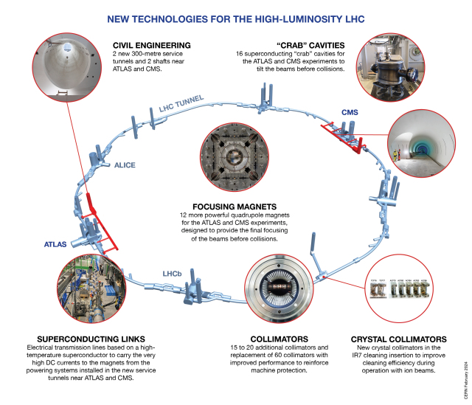
HL-LHC: Extending the Physics Reach of LHC
High Luminosity LHC (HL-LHC) physics goals:
Increase integrated luminosity by a factor of 10 beyond LHC design value
Extend the LHC lifetime by 15+ years
HL-LHC is a technology driver

Slide 3
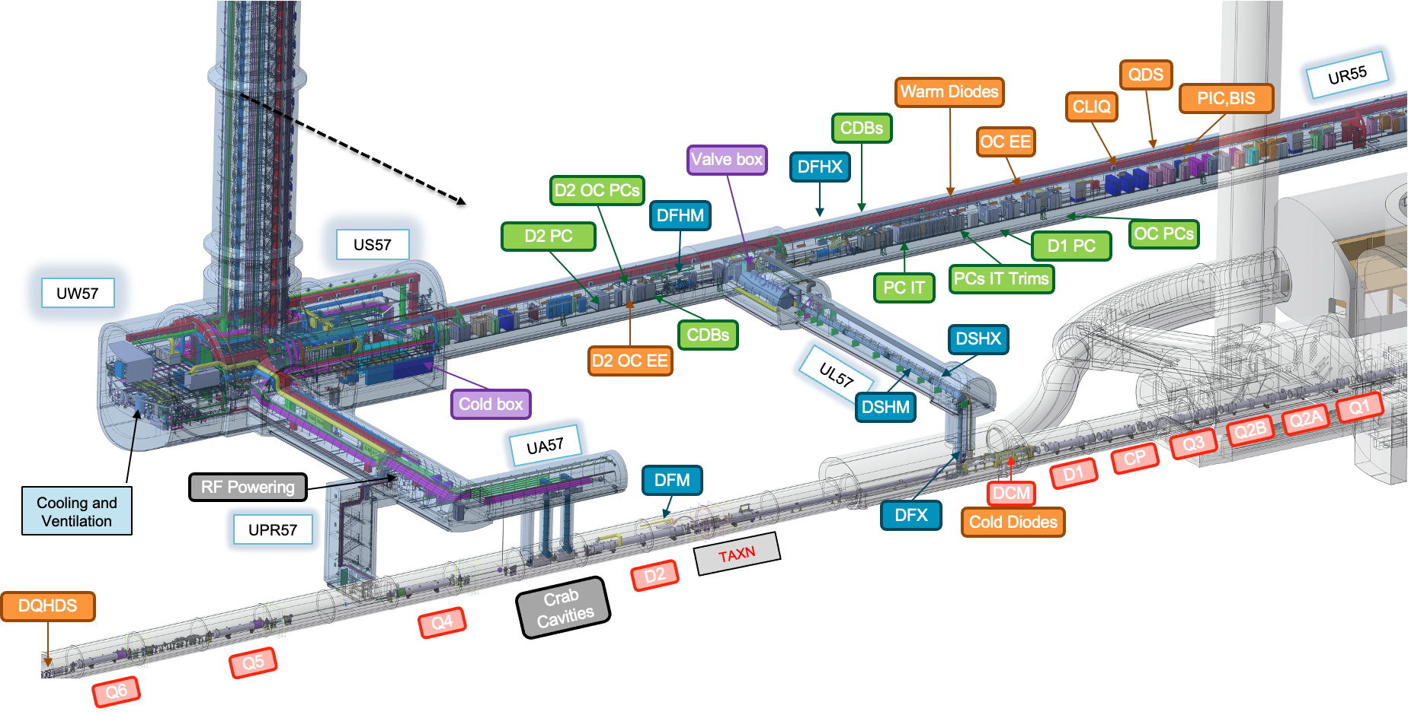
LHC Underground
New underground galleries and surface buildings for technical infrastructure finished

Slide 4
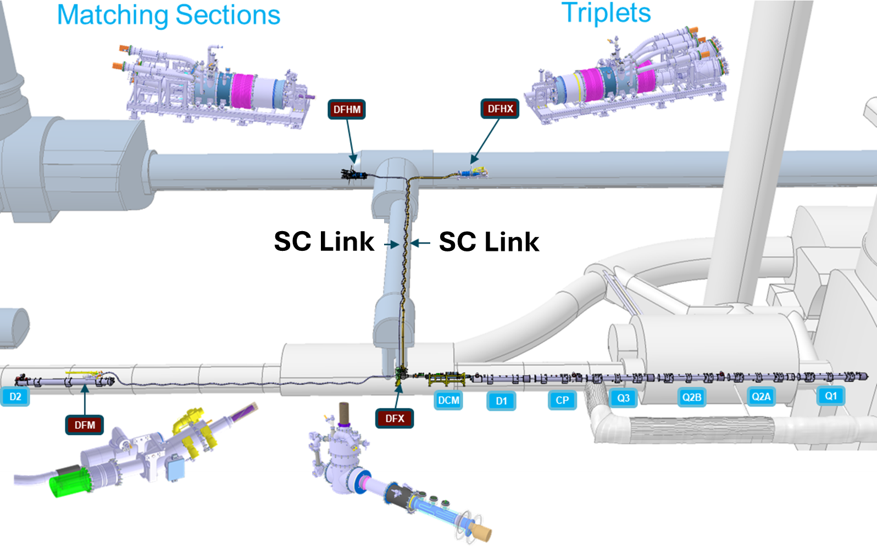
Superconducting Transmission
8+2 Systems
Two types
120 m long
|40| kA DC
70 m long
|120| kA DC

Slide 5
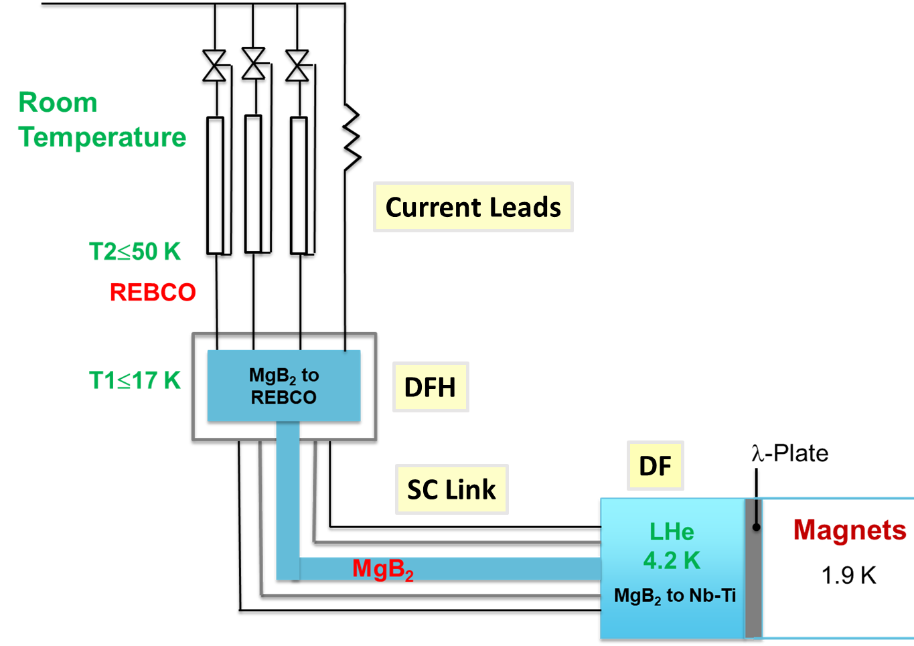
MgB₂ for Superconducting Transmission
Nb-Ti challenging – small temperature margin, constraints in vertical path cooling
MgB₂: affordable cost for large procurement. Low field (< 1 T) application. Advantages:
Operating conditions: up to ∼ 25 K with helium gas cooling, offering > 5 K temperature margin
Conductor: round wire – not yet industrialized. React & Wind technology
System benefits: simplified cryostats and cryogenic control, higher heat loads acceptable, lower cryogenic cost
System capability: up to 120 kA DC
with < 5.5. g/s helium gas flow

Slide 6
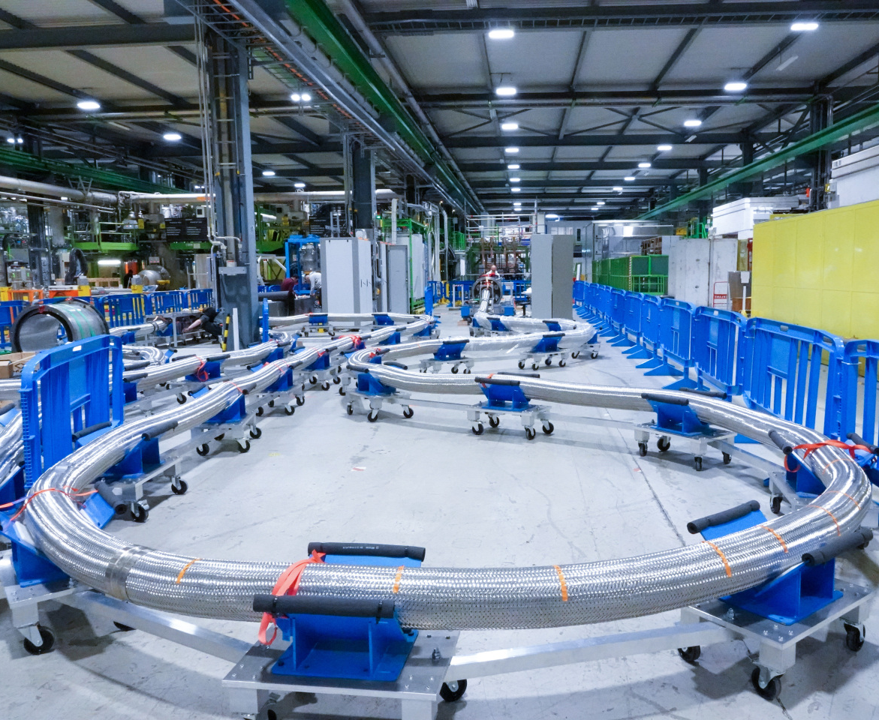
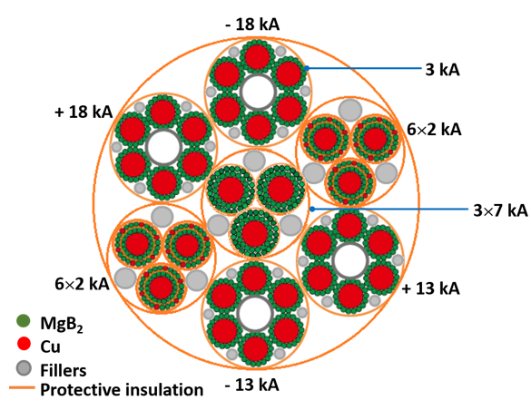
The HL-LHC Superconducting Link Configuration
Φ ∼ 90 mm
Bending radius ≥ 2 m
∼|120| kA DC

Slide 7
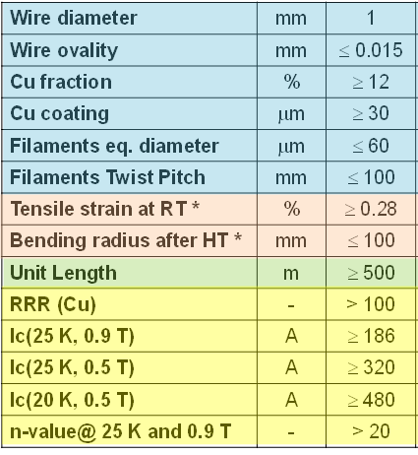
Targets for Development of MgB₂ wire
Layout, composition
and dimensions
Mechanical properties
Unit lengths
Electrical properties
* Ic degradation < 3 %
Targets defined according to the estimated requirements
of the HL-LHC Cold Powering Systems

Slide 8

MgB₂ Conductor for HL-LHC
Early CERN studies of MgB₂ wire for HL-LHC electrical transmission systems: ex-situ MgB₂ available only as tape; used by ASG in MRI cryogen-free magnets. In-situ wire availability was also investigated
R&D conductor focus: round ex-situ MgB₂ wire enabling adoption of React & Wind technology; multiple iterations → final design
Industrialization: wire layout/composition chosen → pilot run at ASG → large-scale production at ASG
2016: HL-LHC approved by the CERN Council
2008-2016
2017-2019
2020-2021
R&D & Industrialization ~ 150 km
Pilot Production ~ 400 km
Series Production ~ 1000 km
2018: Adoption of MgB₂
technology for HL-LHC
TOT ∼ 1550 km

Slide 9
R&D Phase: Key Developments
Development of round wire layouts, definition/reduction of filament size, introduction of twisting of filaments
Reduction of thickness of Monel 400 matrix
Increasing filling factor
Reducing splice resistance
Study on the impact on wire workability and mechanical properties
Improvement of J_{c}
Optimizing powder packing density
Enhancing grain boundary pinning (∼ 1 T)
Increasing purity of B powder
Introducing Nb barrier
Implementation of copper stabilizer
Definition and implementation of copper coating
Scale up of billet volume by a factor ∼ 10 to enable industrial scale production (series billet ∼ 13 km of wire)

Slide 10

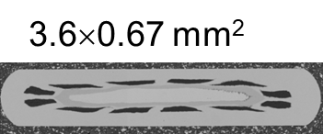
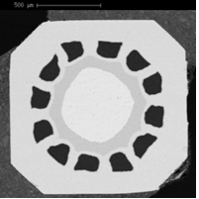
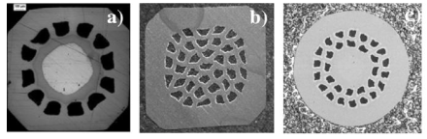
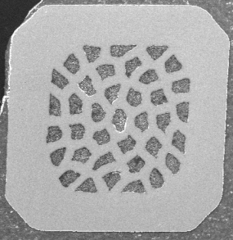
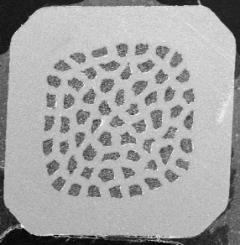
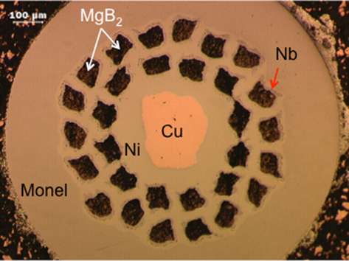
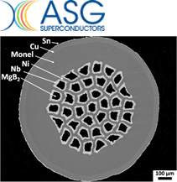
Evolution of Wire Layout
MgB₂ ex-situ tape available before launching the R&D for HL-LHC
High powder density achieved through uniaxial pressure and flat rolling. 12 filaments in Ni matrix and Fe/Cu core
a)
c)
Intermediate MgB₂ ex-situ wire layouts
Octagonal wire: Ni matrix, Cu stabilizer at the centre (a)
Quasi-square wires: Monel® matrix, Ni barrier around the filaments (b)
Round wire: Monel® matrix, Ni barrier (c)
b)
b)
c)
Final multi-filamentary MgB₂ ex-situ wire
Alternating wire drawing and groove rolling to increase powder packing density, improve microstructure, and obtain regular multifilament cross-sections. Explored 12, 19, 30 and 37 filament configurations with twist pitches ranging from 30 to 300 mm.
Final wire: Φ = 0.995 ± 0.02 mm, 37 filaments (Φ_{eq} ≤ 60 μm)
Twist pitch: 85 ± 15 mm

Slide 11
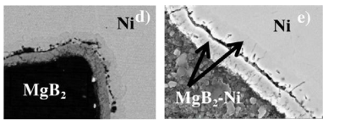
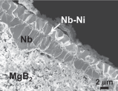
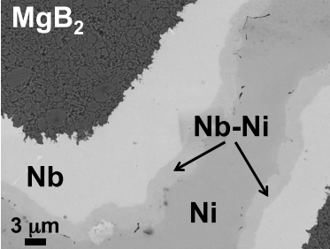
Wire Composition
Ni barrier separated from MgB₂ with Nb. Intermetallic compounds (MgNi₂, Mg₂Ni, and MgB₂Ni_{2.5}) formed during heat treatment lead to the formation of microcracks compromising mechanical properties and electrical resistance of splices. Nb final thickness ∼ 10 μm
Cu stabilizer around the Monel®: reduces hot-spot temperature and facilitates electrical splices. Electrochemical deposition used as “post-processing” method. In-line process depositing
∼ 30 μm of pure Cu (RRR ≥ 100)
Electrochemical deposition of Sn-Ag alloy (Stay-Brite ®, 96% Sn and 4% Ag) onto the copper to avoid oxidation and ensure long term stability of inter-strand resistance in cables. Resilience to oxidation and good solderability – it facilitates electrical splices. Final thickness: ∼ 3 μm
Nb barrier vs Ni
Porosity and detachments in between MgB₂-Ni reaction layers
The thin (∼ 2 μm) reaction layer at the Nb-Ni interface did not show brittleness

Slide 12
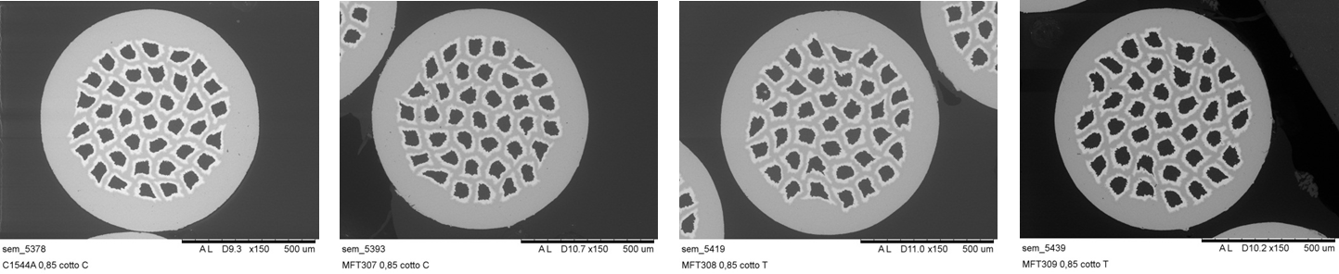
Reduction of Monel® Thickness
Initial thickness
-9%
-16%
-35%
Produced MgB₂ wires with Monel® thickness reduced from the original ∼ 115 μm to ∼ 78 μm. Further thickness reduction (∼ 50 %) resulted in mechanical degradation of the wire during the fabrication process
Final Monel® thickness: compromise with mechanical properties
Filling factor was increased from ∼16 % to ∼20 %
Splice resistance was reduced by ∼35 %. This is an important optimization in view of the high current (up to 18 kA) splices in the MgB₂ cables of the Cold Powering System

Slide 13
Optimization of Boron Powder (1/2)
Initially used typical amorphous B powder with a purity level of ∼ 95 wt%. Oxide impurities (mainly B₂O₃) are largely responsible for MgO formation during MgB₂ reaction
Implemented a high purity (99 wt% class range) amorphous boron powder to improve grain boundary connectivity. Main goal: reduce MgO formation, which tends to form an insulating layer at the MgB₂ grain surface, resulting in a limitation of current flow and reduction of transport properties
By using high purity boron powder, MgO content was reduced to a level below what is detectable by XRD (< 1–3 wt %)
Critical current density (J_{c}) improved by up to 30 %. Microstructural analysis revealed the absence of large agglomerates that may destroy the Nb barriers locally, like for lower purity powder. Je of the wire increased from 750 A/mm² to 1150 A/mm² at 4.3 K and 1 T
High purity B was adopted for the series wire
Carbon doped powders were prepared and used to manufacture 37 filament MgB₂ round wires. The process was however not implemented in the series wire because not effective in the relevant operating field range (< 1 T)

Slide 14
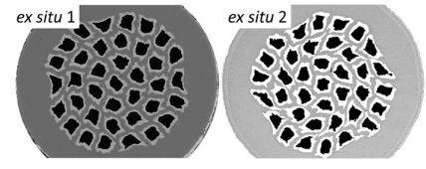
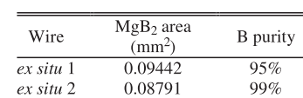
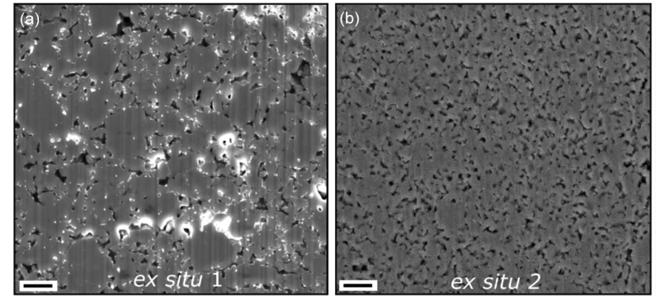
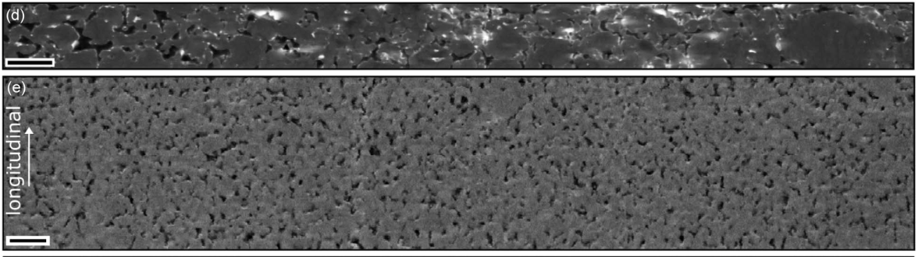
Optimization of Boron Powder (2/2)
Pore size ∼ 0.5–1 µm
Pore size <0.2–0.3 µm
Transverse cross section
Comparison of microstructure and porosity
Ex-situ 2: homogeneous microstructure
with smaller pore, consistently sized and distributed. Pores form a uniform network with a consistent microstructure – suggesting an isotropic distribution
Longitudinal cross section
Notes:
Ex-situ 2: smaller pores, more
homogeneously sized and distributed

Slide 15
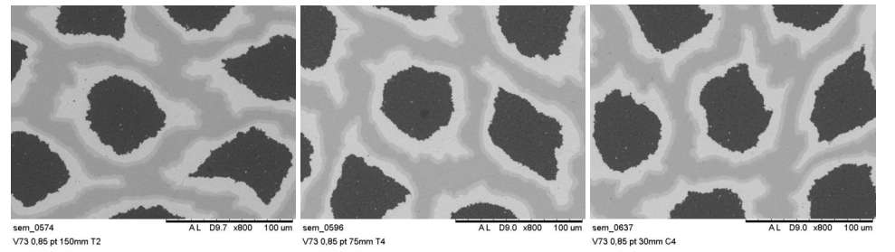
Filament Size and Twist Pitch
R&D wires: Φ_{eq} up to ∼ 130 μm. A 37-filament layout with Φ_{eq} = 60 μm was developed to meet mechanical and electrical requirements. Smaller Φ_{eq} were not investigated
Twist pitch (Tw) introduced during wire drawing to reduce AC losses during fast magnet discharge. Wires were produced with twist pitches ranging from 30 mm to 300 mm: 300 mm, 150 mm, 75 mm and 30 mm. No significant degradation (<20 % for the 30 mm pitch and not measurable for the other twist pitches) was observed over this wide range. The CERN specification 85 ± 15 mm was selected for the series production
Tw = 150 mm
Tw = 75 mm
Tw = 30 mm
Measured twist pitch of
series wire: 80 mm - 85 mm
SEM of MgB₂ wire with 1 mm diameter and 37 filaments

Slide 16
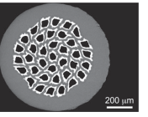
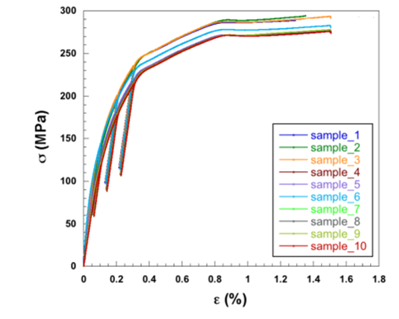
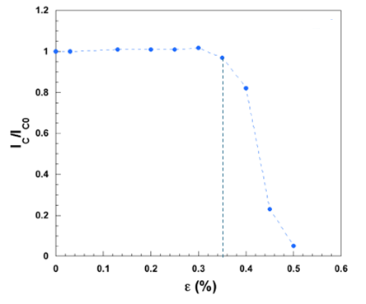
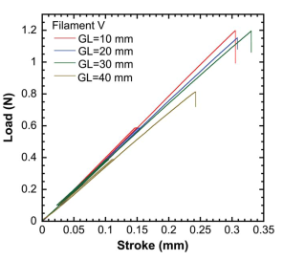


Mechanical Qualification (1/2)
Axial Tensile Tests on MgB₂ Wires
Room Temperature
3 T, 4.2 K
Tensile tests at RT
Room Temperature
ε | Ic/Ic0
0.35% | 0.05
E_{MgB2 filaments} ∼ 97 GPa
M. Sugano et al.,
IEEE Trans. Appl. Supercond. 22 (3) 4801004 (2015)
K. Konstantopoulou et al., Supercond. Sci. Technol. 29 084005 (2016)

Slide 17
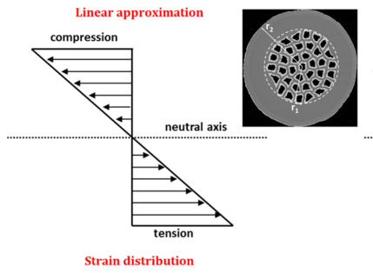
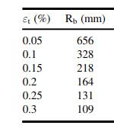
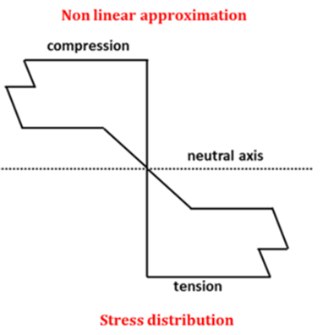
Mechanical Qualification (2/2)
Pilot production
Series
production
Specified Rb ≤ 100 mm
Industrialisation
All unit lengths
Shipment average
ε_{t} = Tensile strain in MgB₂ filaments
Rb = Bending radius of the MgB₂ wire
K. Konstantopoulou et al., Supercond. Sci. Technol. 29 084005 (2016)
Degradation of I_{c} on bending

Slide 18
Specification for Procurement of Series Wire
Parameter | Value
Diameter of MgB₂ wire | (0.995 ± 0.020) mm
Ovality of MgB₂ wire | ≤ 0.015 mm
Diameter of superconducting filaments | ≤ 60 µm
Filament twist pitch | (85 ± 15) mm
Filament twist direction | Right-handed screw
Critical current at 25 K and 0.9 T | ≥ 186 A
Critical current at 25 K and 0.5 T | ≥ 320 A
Critical current at 20 K and 0.5 T | ≥ 480 A
Bending radius (after final heat treatment) | ≤ 100 mm
Critical tensile strain at room temperature | ≥ 0.28 %
Copper fraction of the wire total cross section | ≥ 12 %
Stay Brite® on copper | (30 ± 5) µm
RRR of copper stabilizer (293 K and 40 K) | ≥ 100
n-value @ 25 K and 0.9 T | ≥ 20

Slide 19
QA and QC at ASG
+ Test methods/procedures
+ Certificates of conformity of raw materials and traceability of raw materials in billets
Geometrical
Electrical
Critical current
25 K, 0.9 T (B⊥)
25 K, 0.5 T (B⊥)
20 K, 0.5 T (B⊥)
Micro-structure
Eddy currents

Slide 20
Tests at ASG (1/2)
Requirement | Test Frequency
Minimum and maximum filament diameter | SEM images on one sample extracted from each extremity of every billet
Copper fraction | By an imaging method Measurement of one sample extracted from each extremity of every billet
Wire diameter | Continuous laser micrometer measurements
Wire twist direction | One sample from each wire unit length or billet (depending on the stage at which the twist is applied)
Wire twist pitch | Value verified after the setting of the twisting machine One sample extracted from each extremity of every unit length or billet (depending on the stage at which the twist is applied)
Bend test | SEM images on one sample extracted from each extremity of every billet
Wire surface condition | Contractor Quality Assurance Plan

Slide 21
Tests at ASG (2/2)
Requirement | Test Frequency
Wire critical current | Measurement of one sample extracted from the point of every wire unit length
Wire critical current after bending and straightening | Critical current measurement of one sample per unit length taken adjacent to the sample for critical current
Wire tensile strain | Critical current measurement of one sample per billet recommended
Residual Resistance Ratio | Measurement of one sample extracted from one extremity of each unit length before and after copper plating
Eddy current | Continuous control on each wire unit length

Slide 22
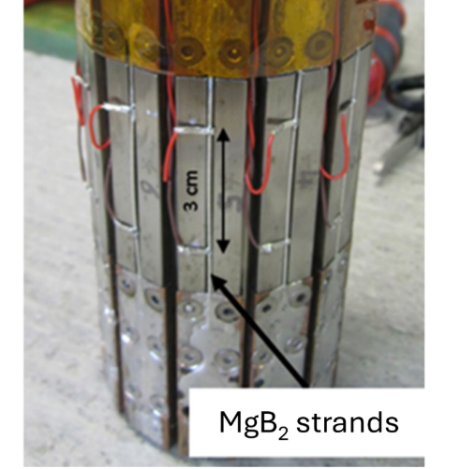
QC at CERN
Visual inspection
Critical current at 4.3±0.1 K and parallel fields:
I_{c}(4.3 K,1.5 T) ≥ 550 A
I_{c}(4.3 K, 2 T) ≥ 402 A
I_{c}(4.3 K, 3 T) ≥ 216 A
Frequency of I_{c} measurements – per unit length:
2 straight samples
3 samples after bending (100 mm)
10 straight samples per cool-down

Slide 23
Production Overview: Quantity and Unit Length
Industrialisation
Pilot production
Series production
Cumulative wire deliveries
Trend in average
unit length
Average unit length advanced from ~1 km on industrialisation
to ~2.5 km in series production

Slide 24
Production Overview: Quantity and Unit Length
Distribution of unit lengths during series production

Slide 25
Production Overview: Critical Current
Consistent performance of accepted series unit lengths
Average I_{c} 18 % above minimum requirement (at 4.3 K 1.5 T)
Average variability of I_{c} within billet ± 2.8 % (standard deviation/mean)
Pilot production
Series production
Performance distribution within each delivered batch (unit lengths from different billets)
Measurements at CERN at 4.3 K and 1.5 T

Slide 26
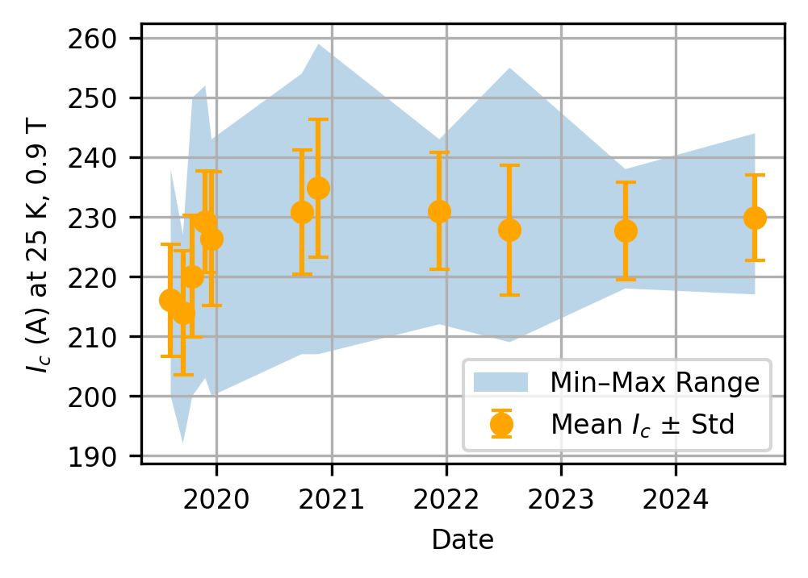
Production Overview: Critical Current
Data supplied by ASG match the trends of data collected at CERN, despite different testing conditions:
Average I_{c} 22 % above minimum requirement (at 25 K 0.9 T)
Average variability of I_{c} within billet ±3.4 % (standard deviation/mean)
Series production
Performance distribution within each delivered batch (unit lengths from different billets)
Measurements at ASG at 25 K and 0.9 T

Slide 27
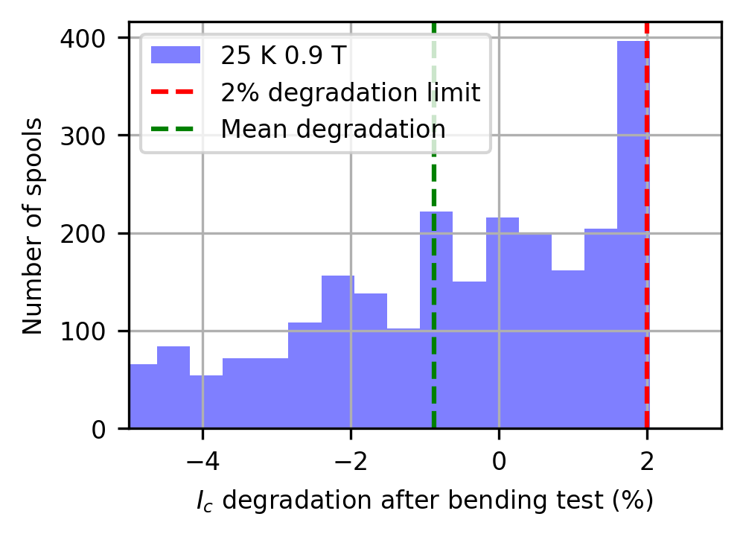
Production Overview: Bending Degradation
Average degradation on bending 0.49 %
Average degradation on bending -0.87 %
Distribution of I_{c} degradation on bending during series production
CERN Measurements
Distribution of I_{c} degradation on bending during series production
ASG Measurements
Each data represents a delivered batch (unit lengths from different billets)

Slide 28
Non-Conformities Identified at CERN (1/2)
In total, only ∼ 3 % of the series wire was identified as non-conform
Non-conformities identified during visual inspection
Surface staining/oxidation identified upon receipt on two spools
Identified causes:
Spool 1 (3.1 km): accidental contamination of the wire, after spooling, by an oxidizing agent (H₂SO₄) from the galvanic line → reviewed procedure
Spool 2 (2.98 km): discoloration of the wire on the second layer of the spool. Attributed to a contaminated cloth used during the final cleaning → reviewed procedure
Spooling problems identified upon receipt on four spools
Identified causes:
Spools 1, 2 and 3. Overlapping turns were generated during the final spooling process. Local plastic deformations (1 or 2 per spool) were identified and cut out → spooling procedure reviewed
Spool 4. A wire extremity opened during transport and several turns (∼ 30 m of wire) were loose and overlapping → packing procedure reviewed

Slide 29
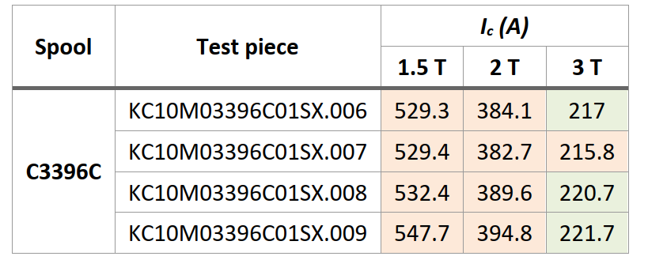
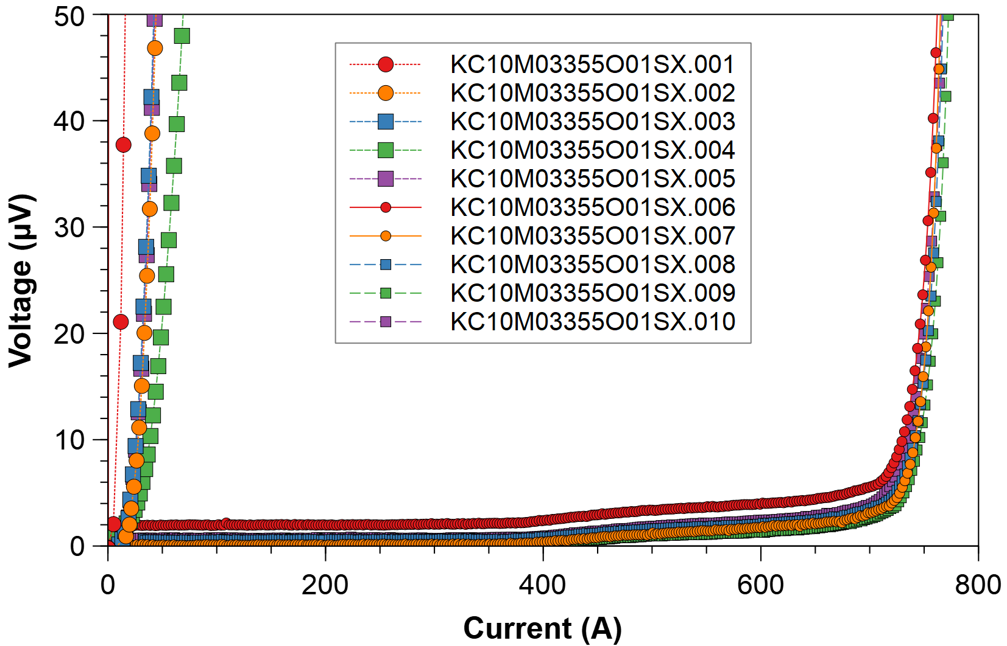
Non-Conformities Identified at CERN (2/2)
Non-conformities identified during Ic measurements
Critical current measured at CERN below specification
Identified causes:
Three spools from two different billets experienced excessive tension on the wire during re-spooling. It was adopted a new re-spooling line suitable for tape more than round wire
One spool underwent overheating during production process
One spool experienced degradation during handling at one extremity
Three spools from the same billet had systematically low I_{c}
C3355

Slide 30
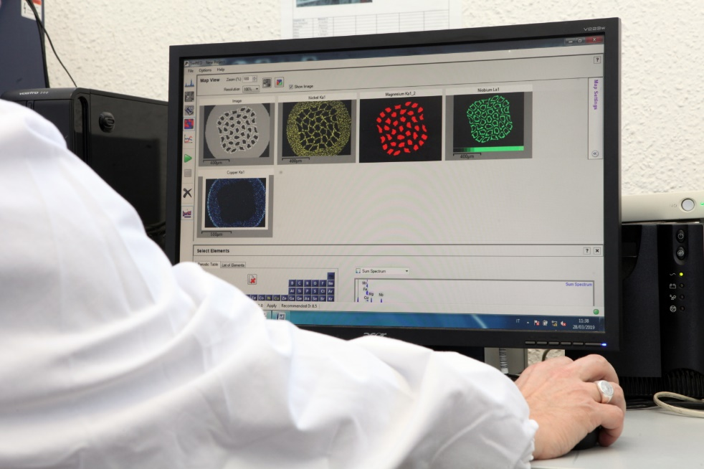
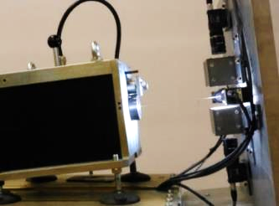
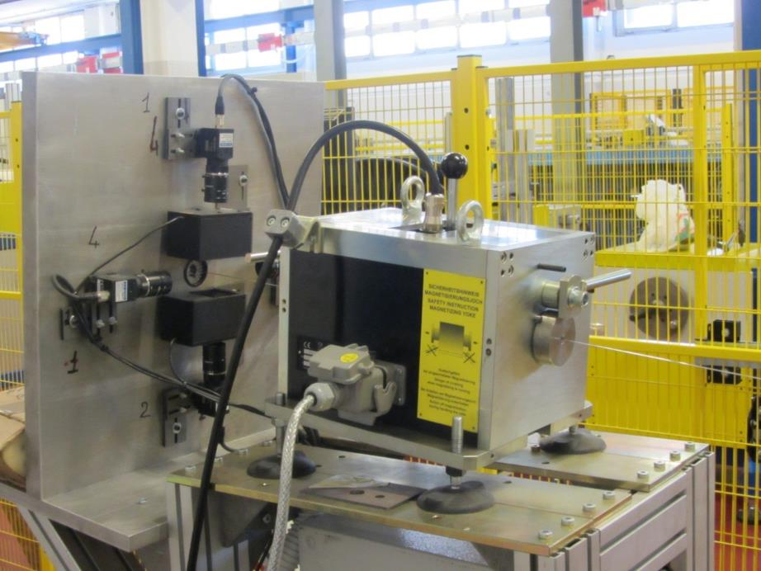

QA at ASG: Full Process Control
Image analysis
4 camera visual inspection
to check surface appearance
Advanced techniques for:
Incoming materials inspection
Real time monitoring (SCADA alerts)
Post-production statistical analysis
Dimensional Measurement
& Acquisition System
and statistical analysis
Eddy current detector and visual systems to check integrity of wires
QA Procedures defined and implemented to ensure full process control
from raw material to final wire
ASG Superconductors Proprietary & Confidential

Slide 31
QA at ASG – Inspection of Nb Tubes
Each batch of Nb tubes inspected according to the following control plan:
Integrity and adequacy of packaging
Presence of Certify 3.1 according to UNI EN10204 and correspondence of the values declared to the supply specification
Visual aspect 100% of the tubes (absence of internal and external imperfections, burrs, oxides, grease, oil, lubricants)
Statistical check on 2% of the tubes of the batch of:
Outer Diameter, measured with gauge: 21.70 ± 0.13mm
Thickness, measured with gauge: 2.4 ± 0.24mm
Length, measured with meter: 900 -0 + 3mm
Hardness 100% of the tubes: average of 5 measures each tube
Tensile tests on a tube representative of the batch (external laboratory)
Chemical composition 100% of the tubes using an XRF analyzer: 45 analyses for each tube (15 x 3 Axis)

Slide 32
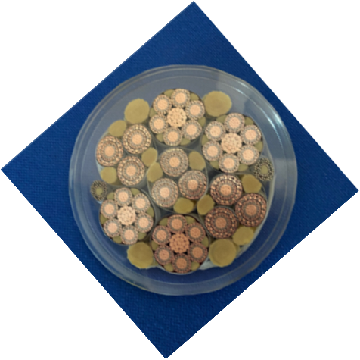
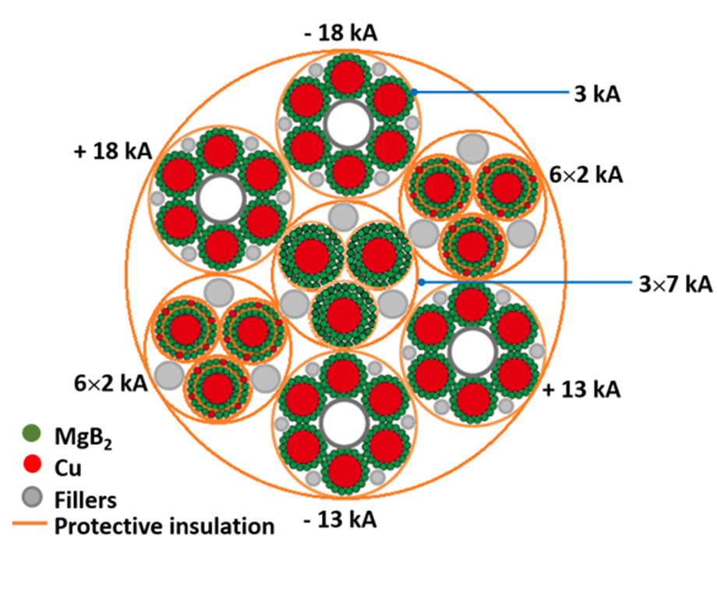
The Superconducting Link
Φ ∼ 90 mm, ∼ 25 kg/m

Slide 33
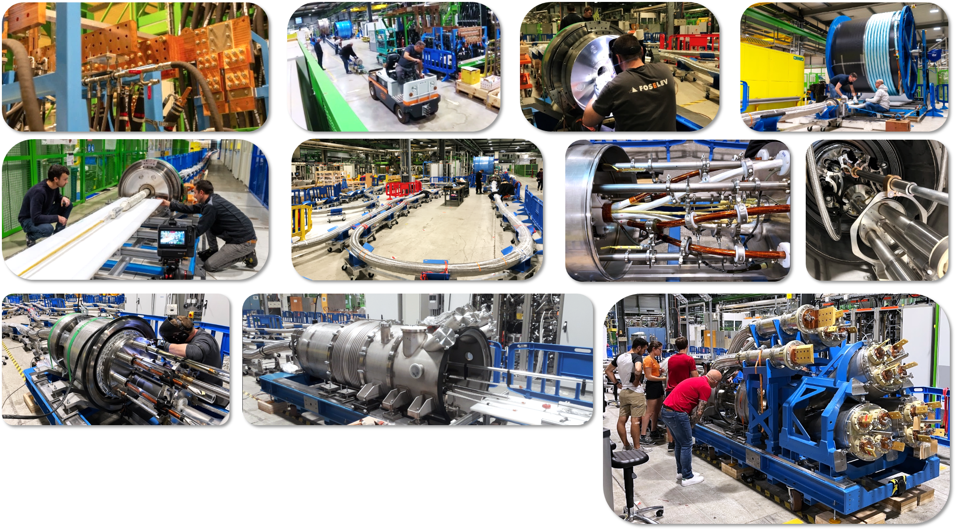
System Assembly

Slide 34
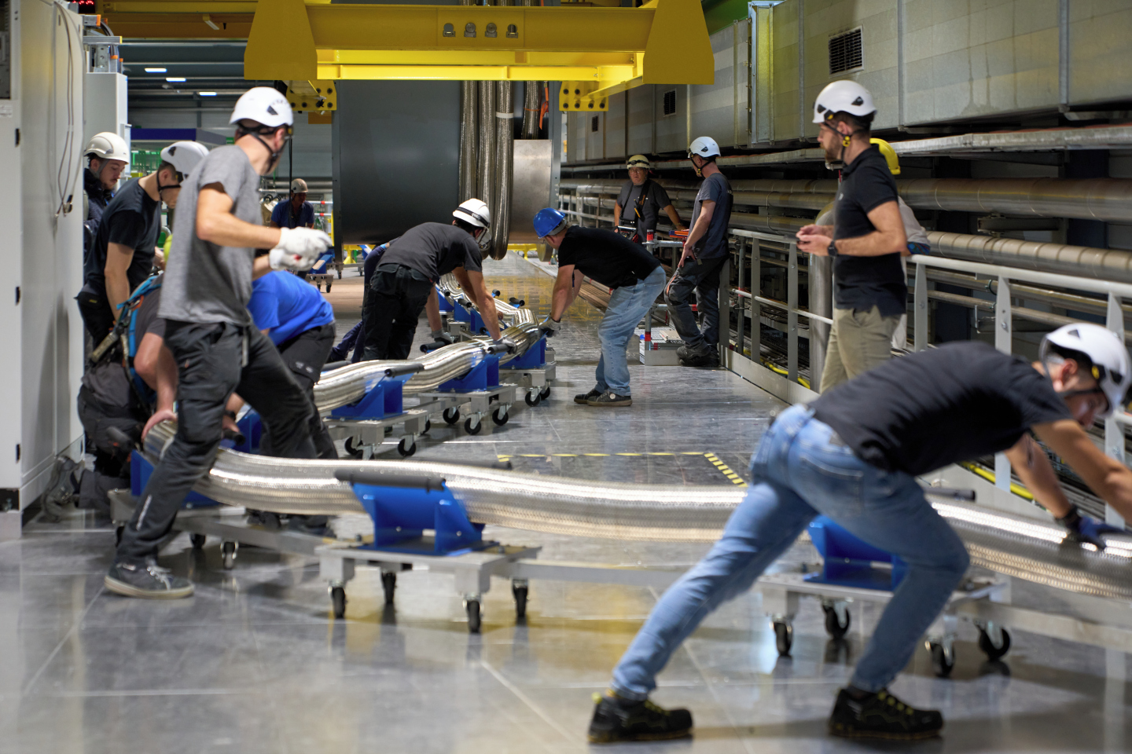
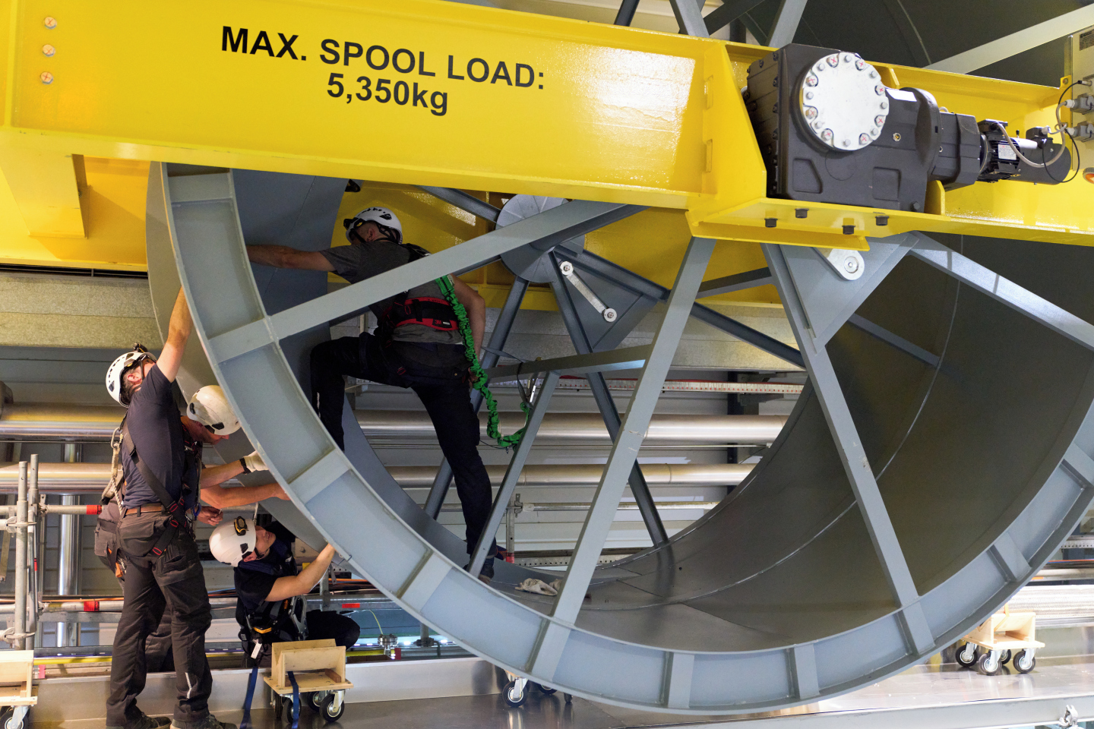
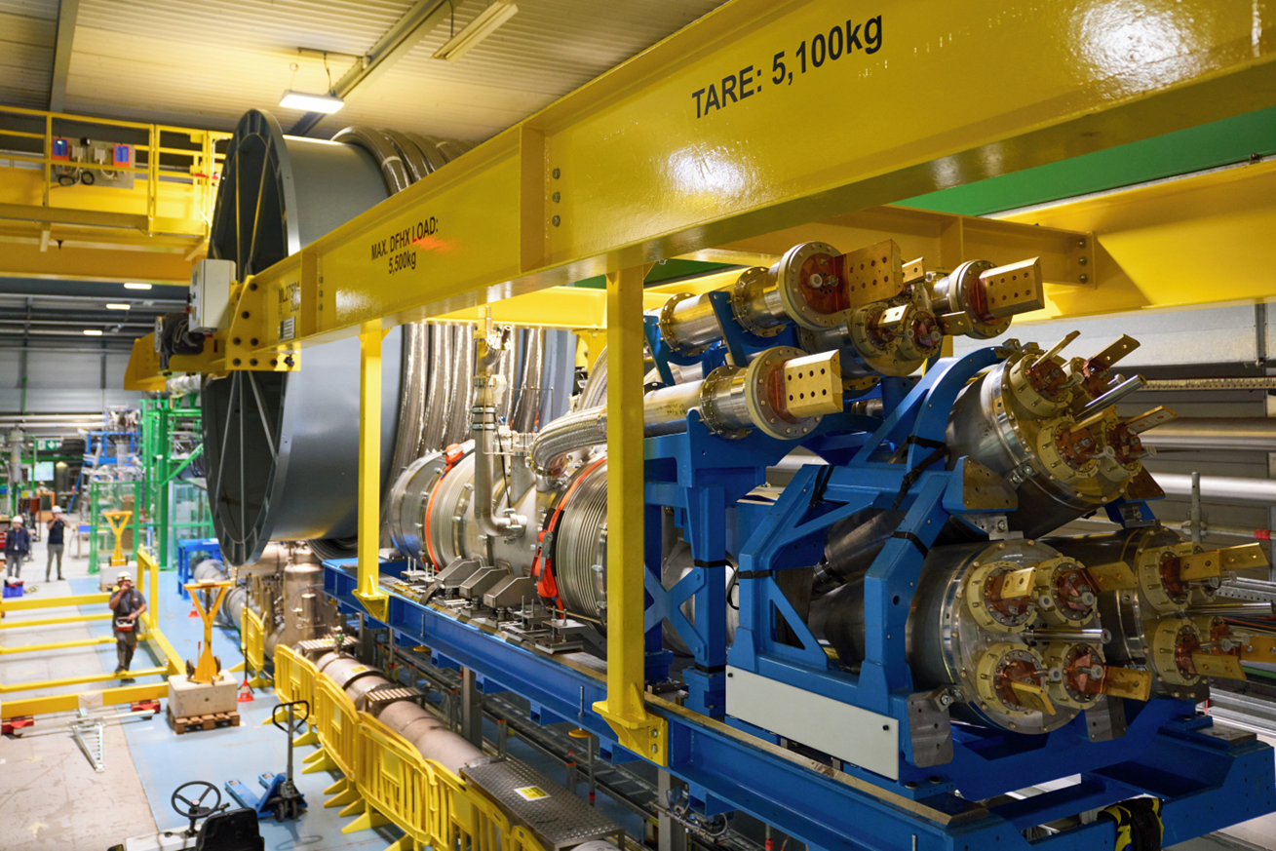
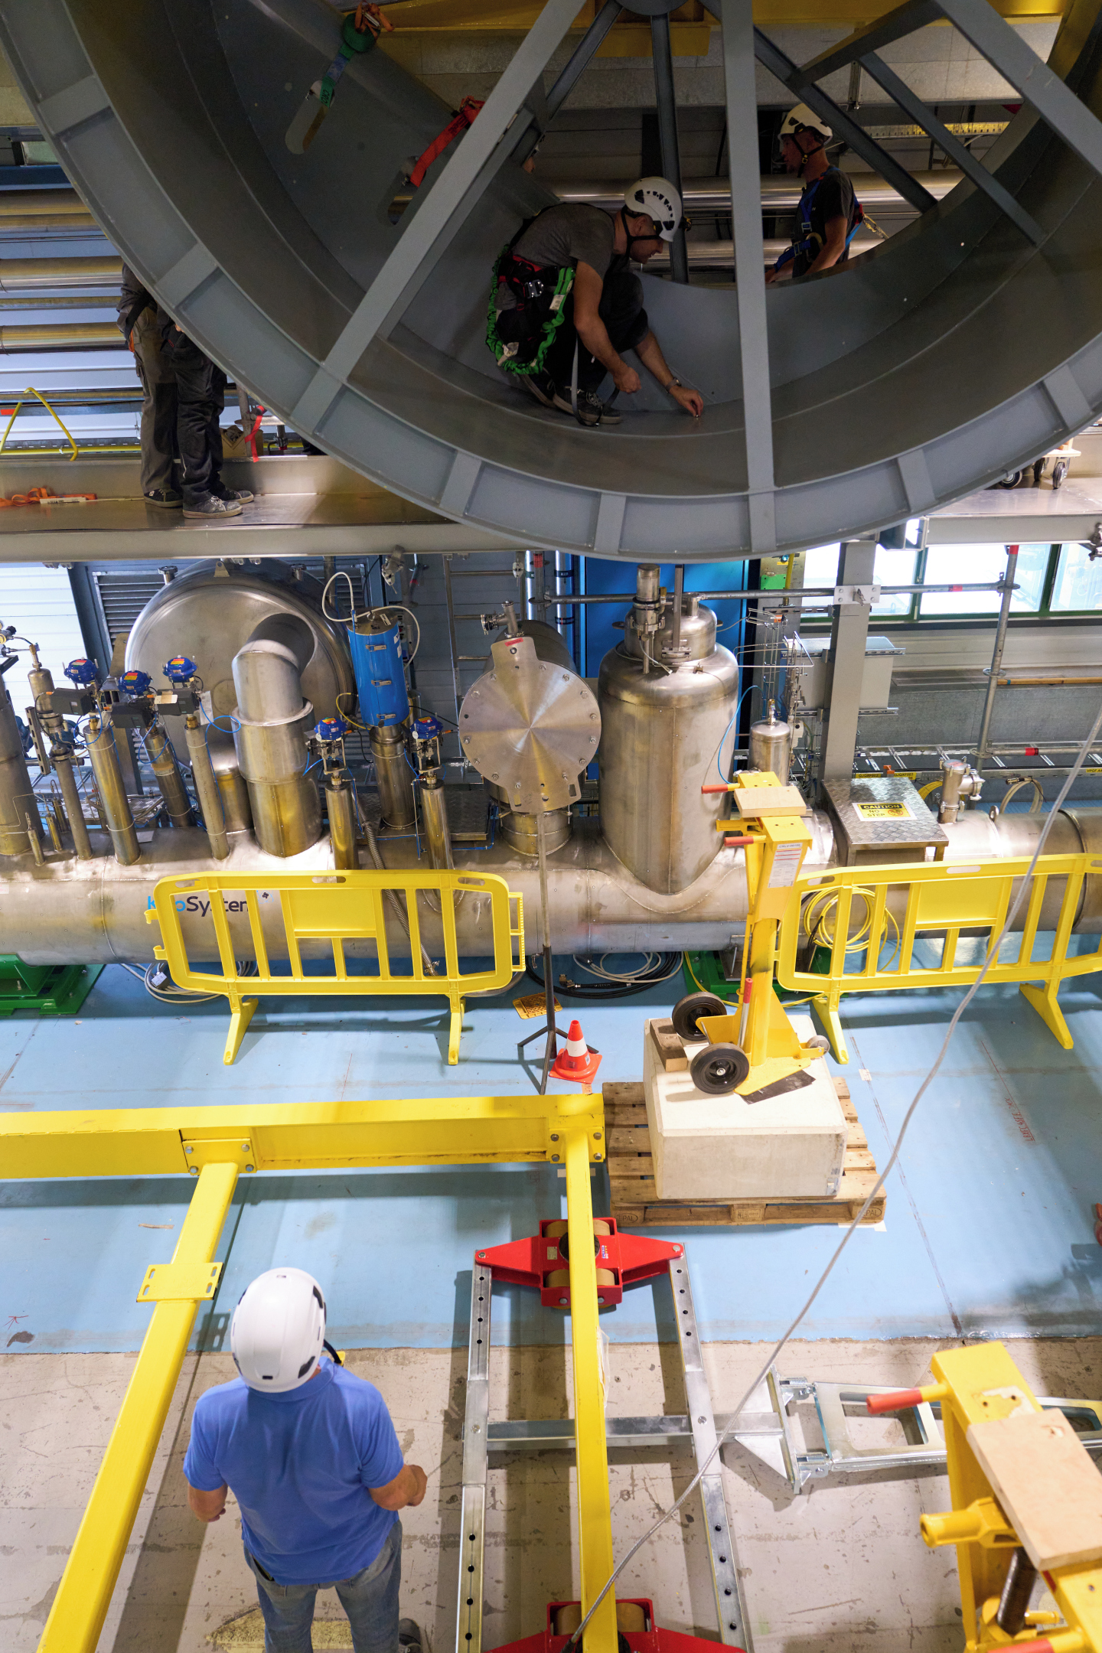
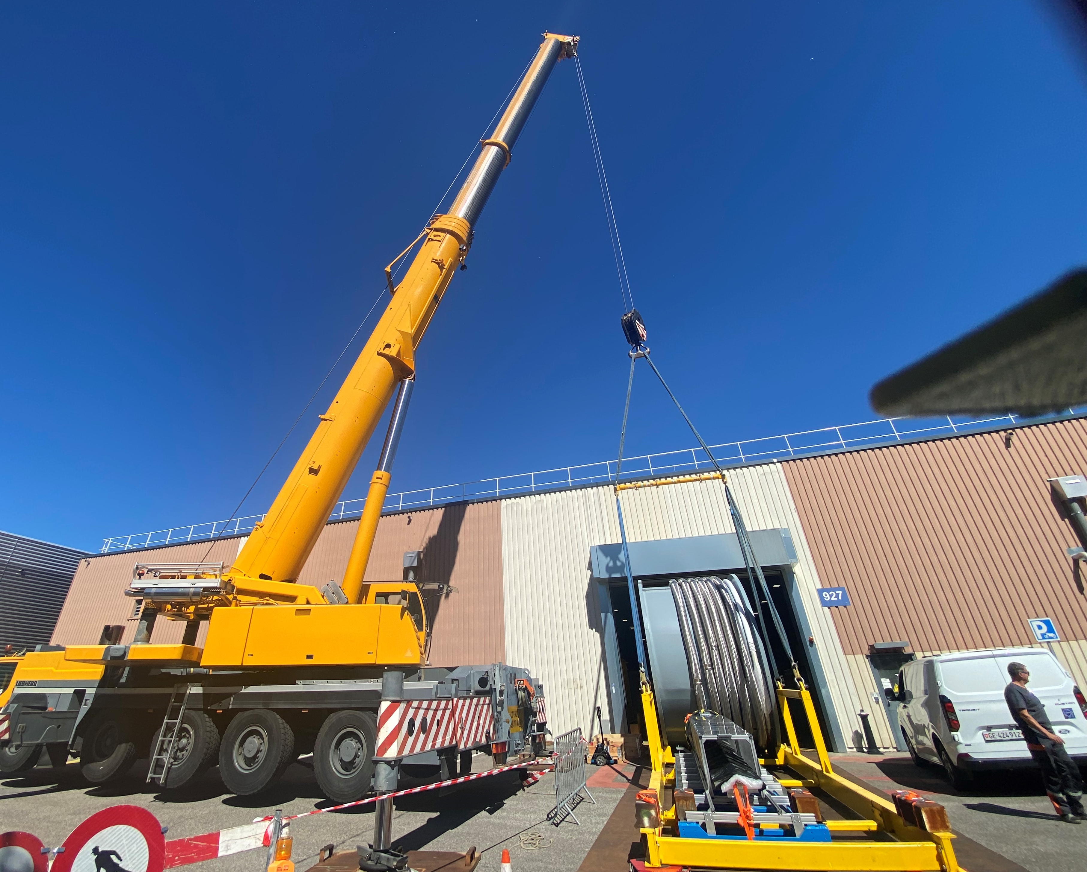
Transport and Installation
1-LO-IS, this conference

Slide 35
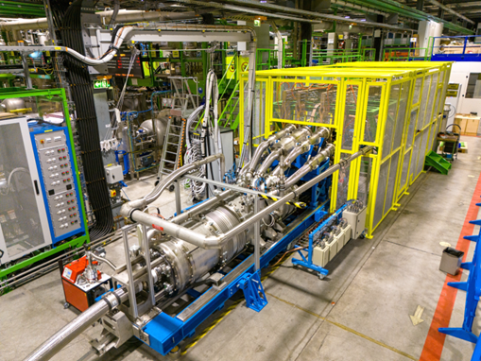
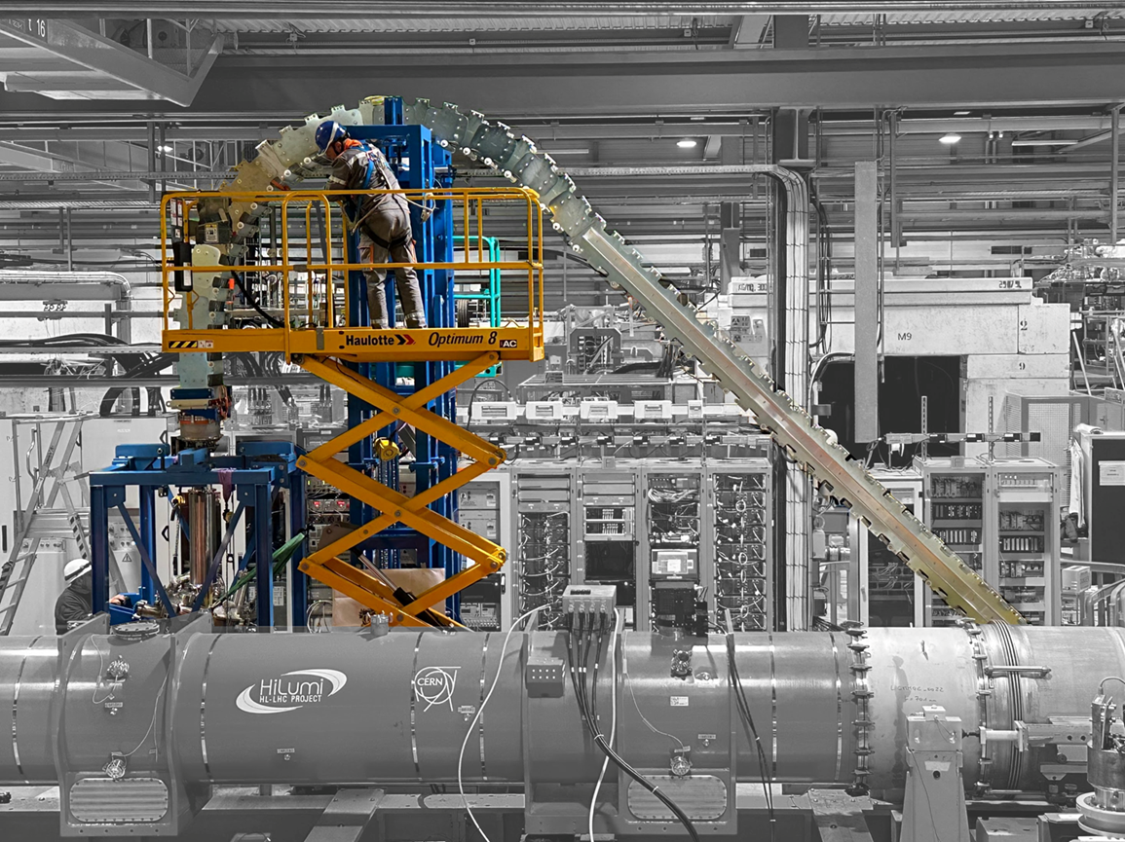
Validation of the Superconducting Link System
Bending radius ≥ 2 m
Construction and qualification at CERN

Slide 36
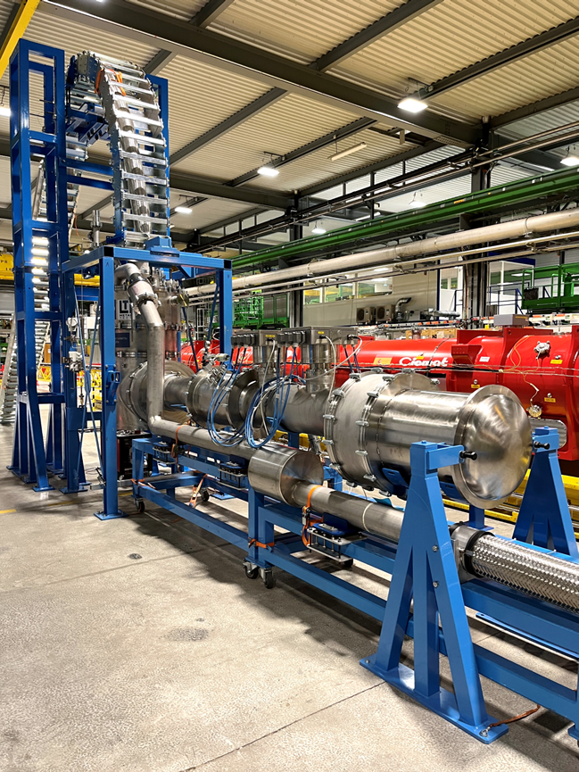
Validation of the Superconducting Link
Bending radius ≥ 2 m
DFX SOTON
Construction and qualification at CERN

Slide 37
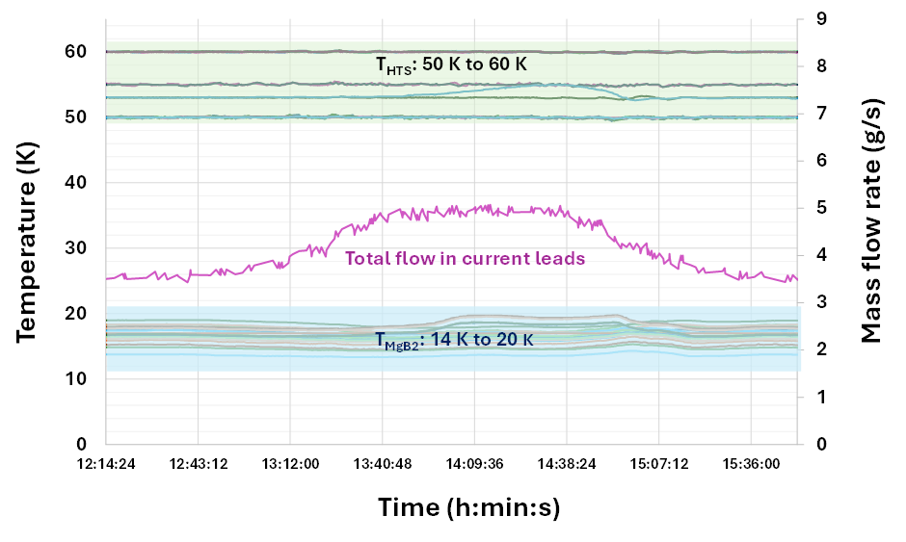
Validation of the Superconducting Link (2/2)
Scientific Reports volume 15, Article number: 20428 (2025)
Results confirm design
Validated at up to 94 kA* (maximum current delivered by power converters) with a He gas mass flow < 5 g/s. All splices are within expected range
94 kA, ∼ 5 g/s
* 15% above HL-LHC nominal current
REBCO to MgB₂, GHe @ 20 K
MgB₂ to Nb-Ti, LHe @ 4.5 K
High Current Splices
All splices within expected resistance range

Slide 38

EU funded HiLumi
Design Study
Approval of
HL-LHC Project
We are here
HL-LHC Operation
Run3 operation
Long Shutdown 3 will start in less than 1 year
Installation of Cold Powering Systems is from Q2 2028 to Q3 2029

Slide 39
Conclusions
A total quantity of 1550 km of MgB₂ wire was produced at ASG for the HL-LHC Superconducting Link at CERN. R&D was instrumental for developing a wire meeting the specified requirements. The R&D wire (∼ 550 km) was used by CERN for developing and studying prototype system components (high current cables and Superconducting Links). Short length cables (∼ 20 m) were produced at CERN. Series cabling was industrialized by CERN at ICAS
Series production (∼ 1000 km) was completed during ∼ 2 years (partially during the COVID period and associated restrictions). Average wire unit lengths of 2.5 km were produced, with maximum unit lengths of up to 4 km. Critical current values consistently above specification
Two Superconducting Link Systems for HL-LHC have been produced and successfully qualified at CERN. Other two are planned to be completed by end of 2025, with full production finishing in 2027
Installation of the Superconducting Link Systems in the HL-LHC underground is scheduled for Q2 2028. Commissioning of HL-LHC in Q1 2030

Slide 40
Thanks for your attention !
Acknowledgments: the ASG technical team, B. Bordini, the CERN technical team and in particular J. Hurte and P. Jacquot, CERN students and fellows, the CERN HL-LHC and ATS/TE management

