Slide 1


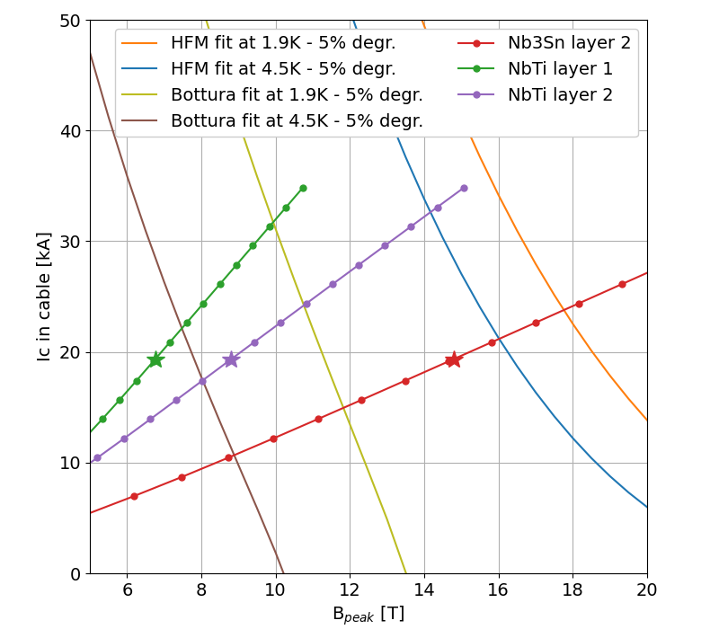
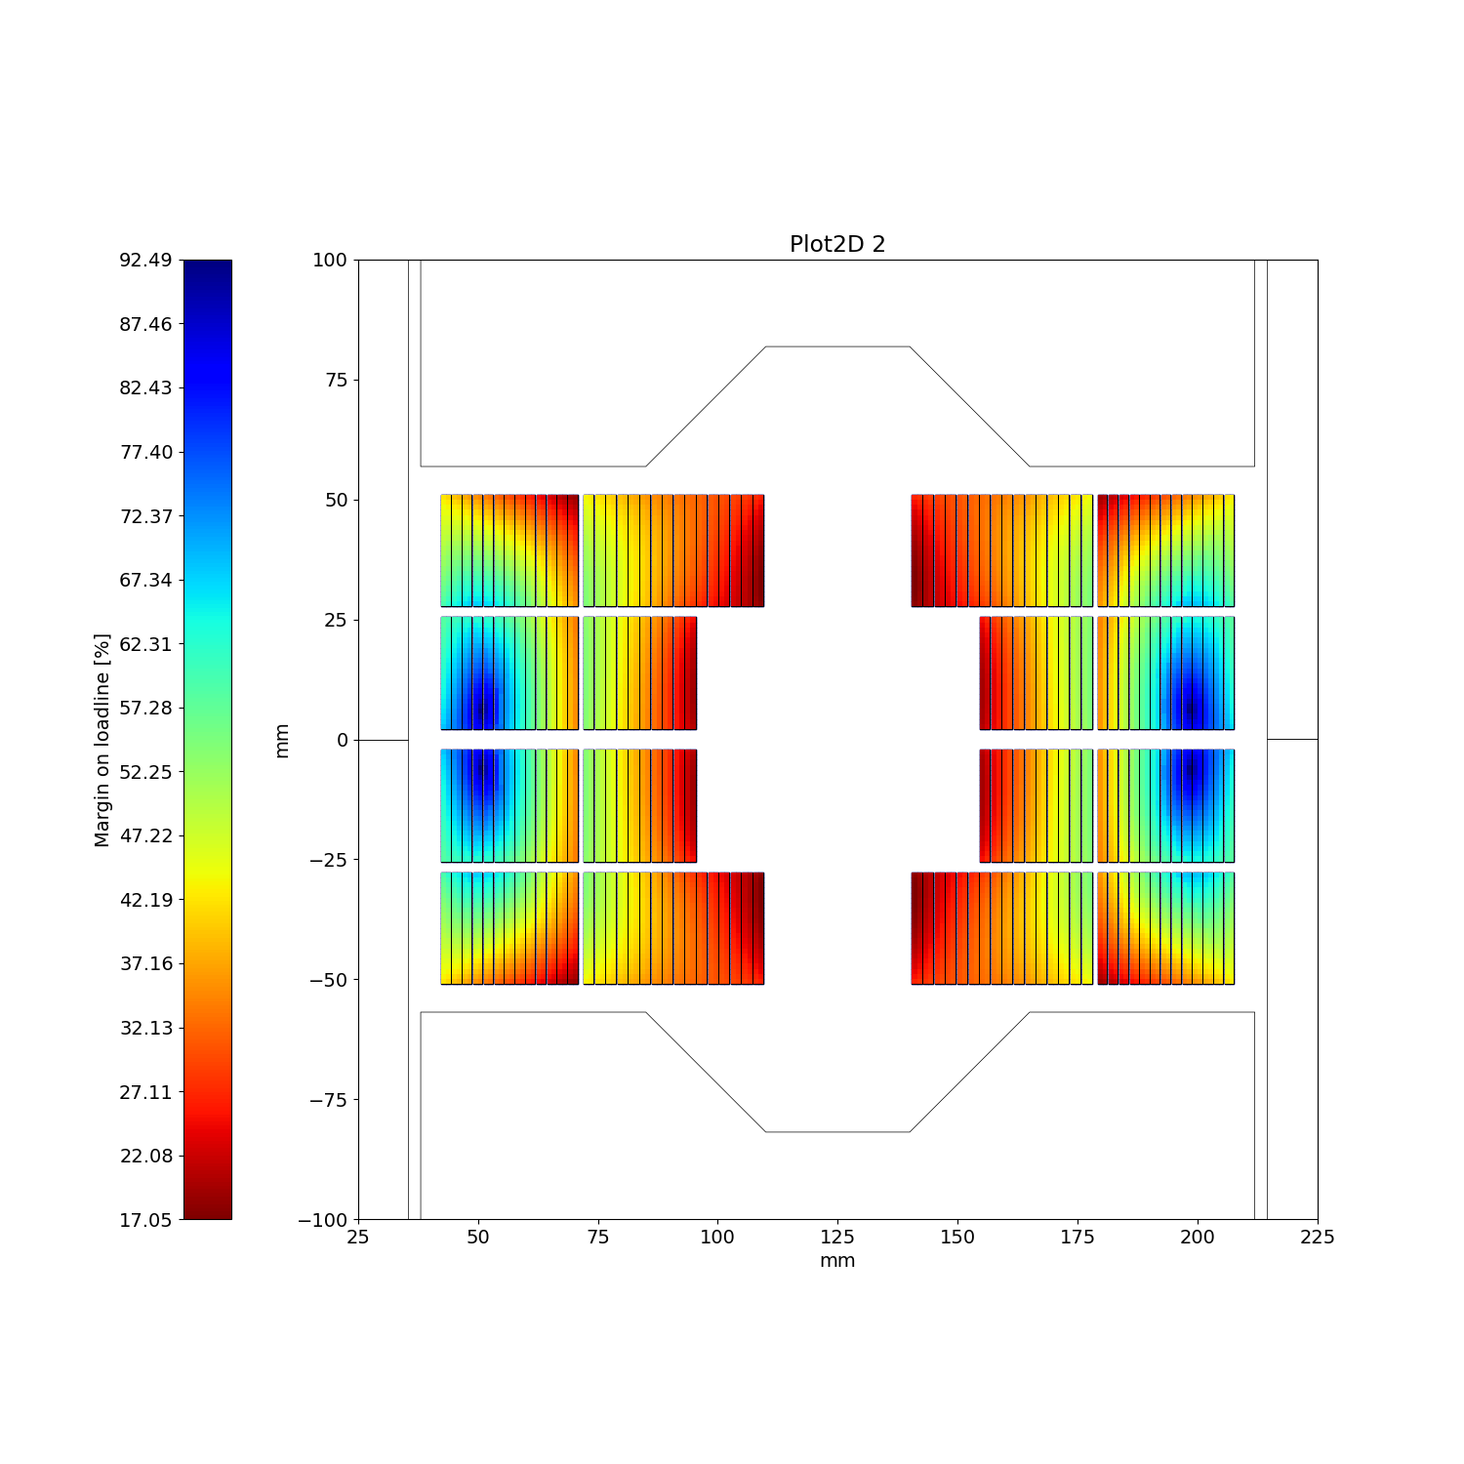
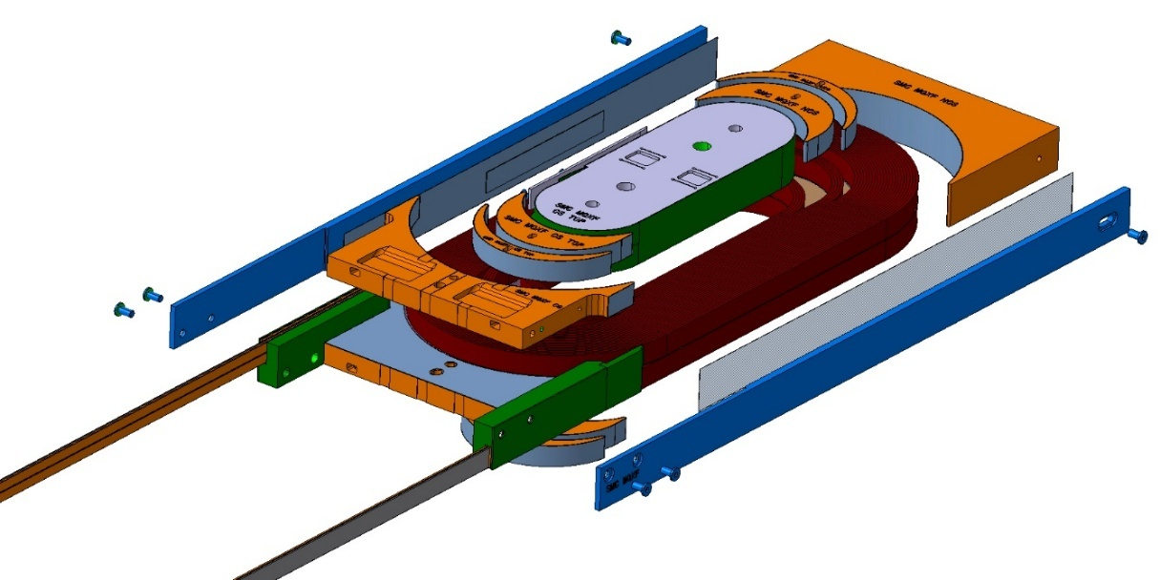
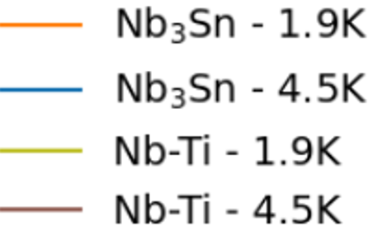
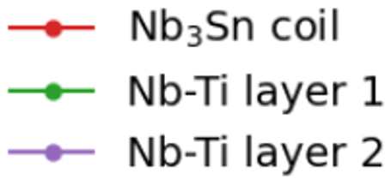
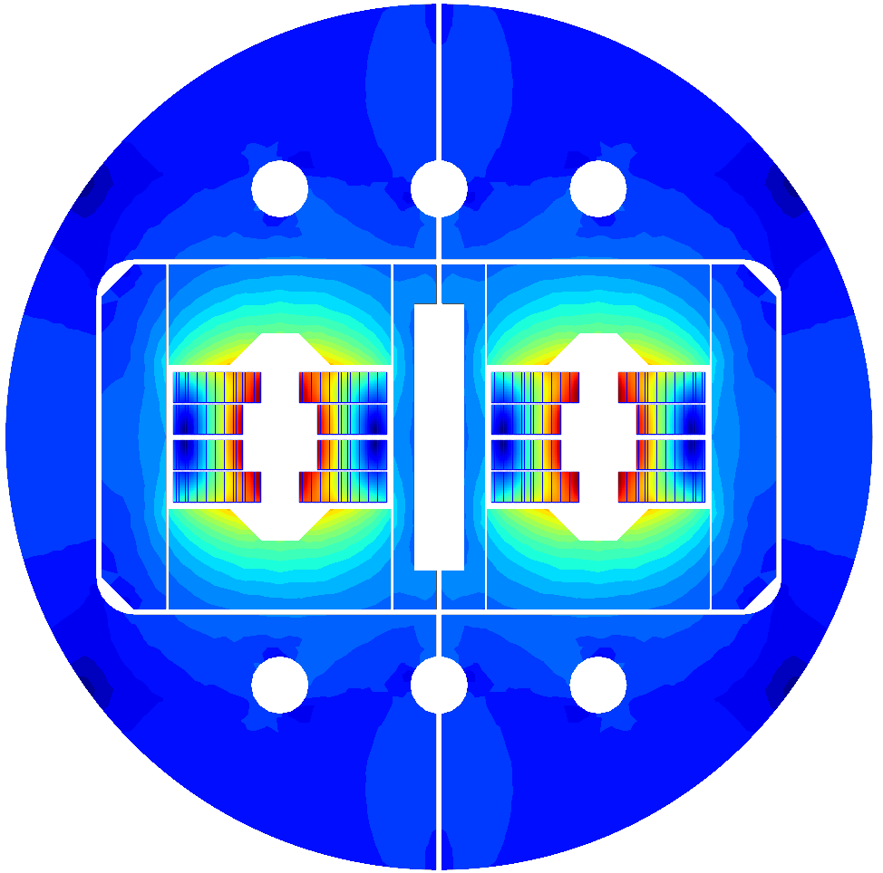
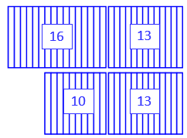
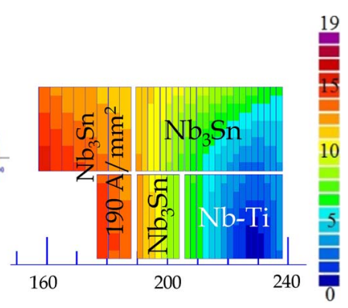
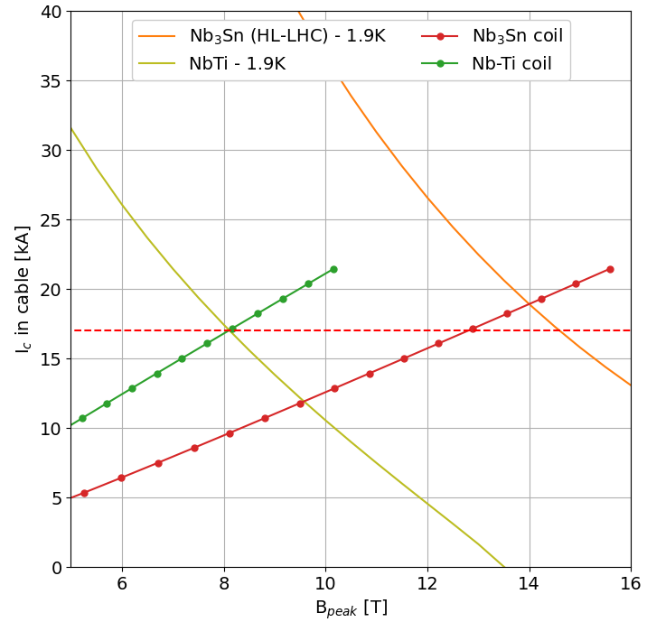
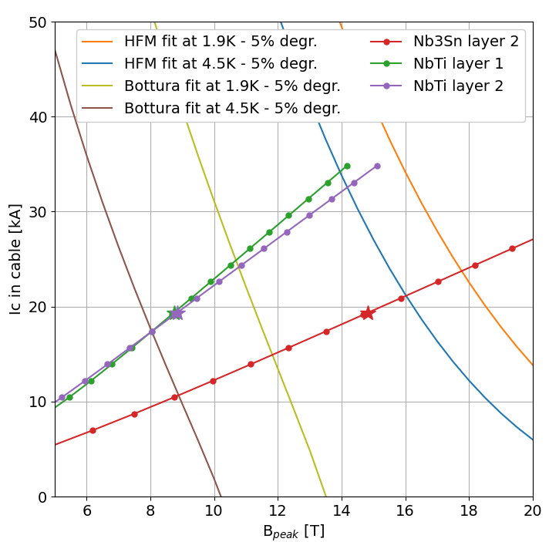
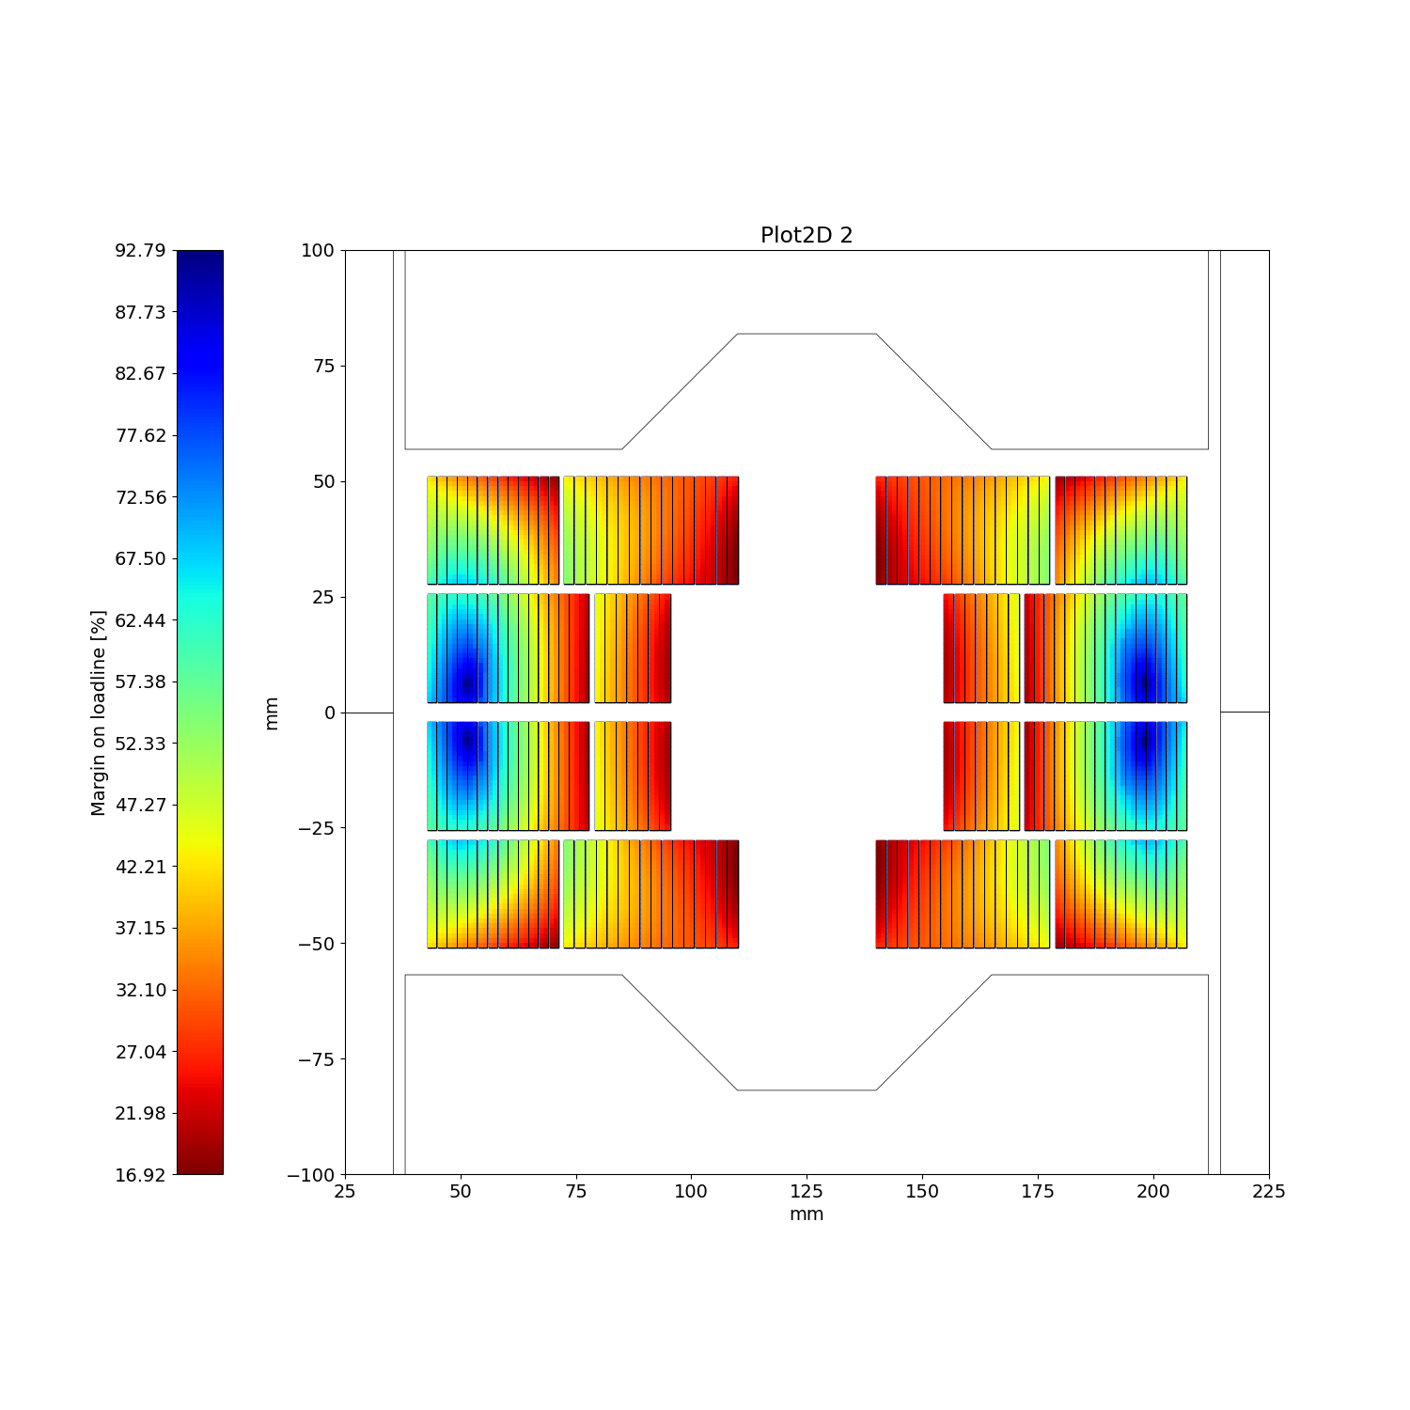
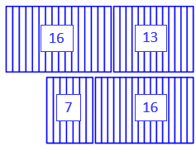
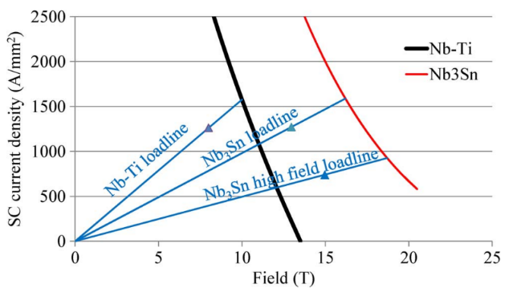
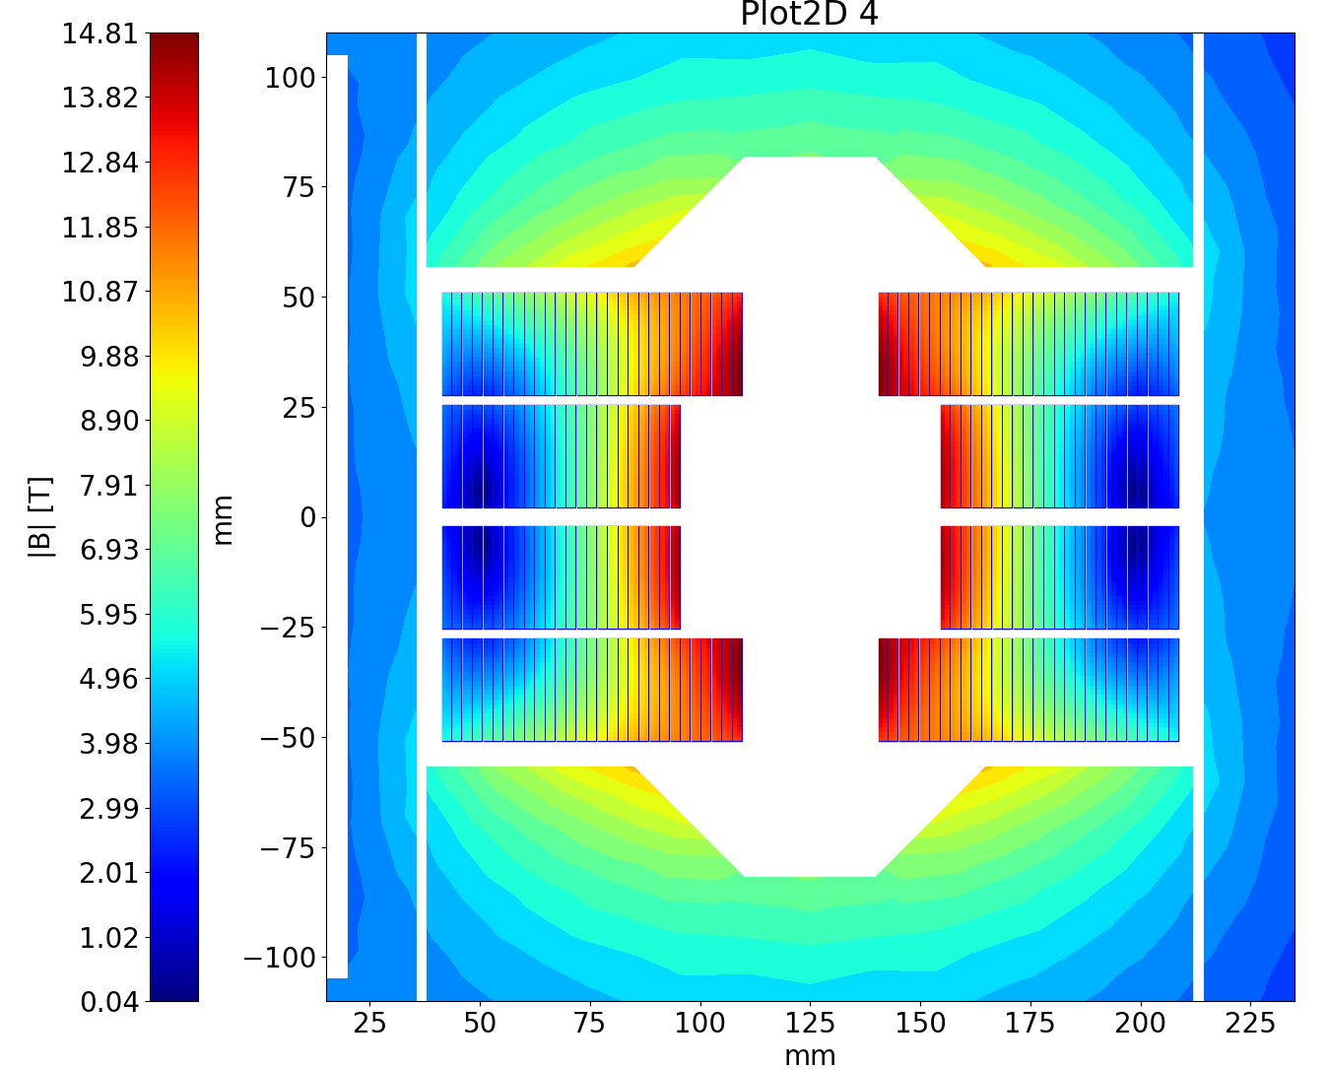
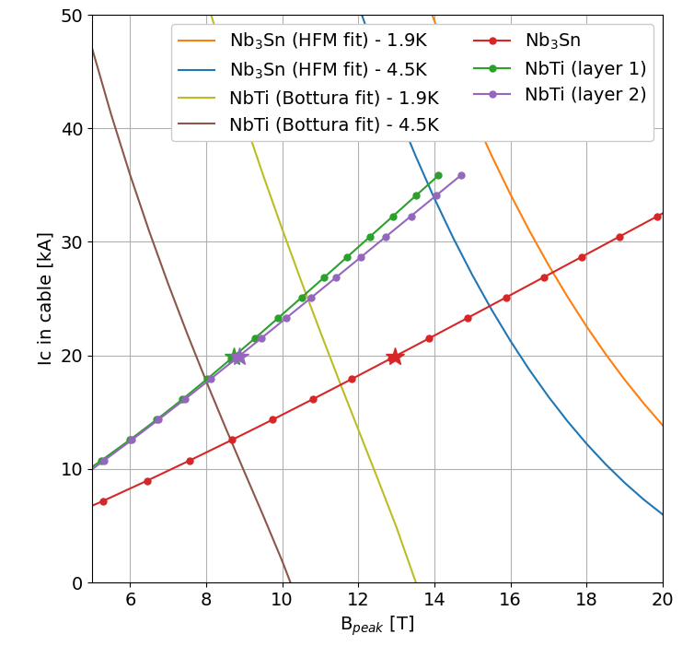
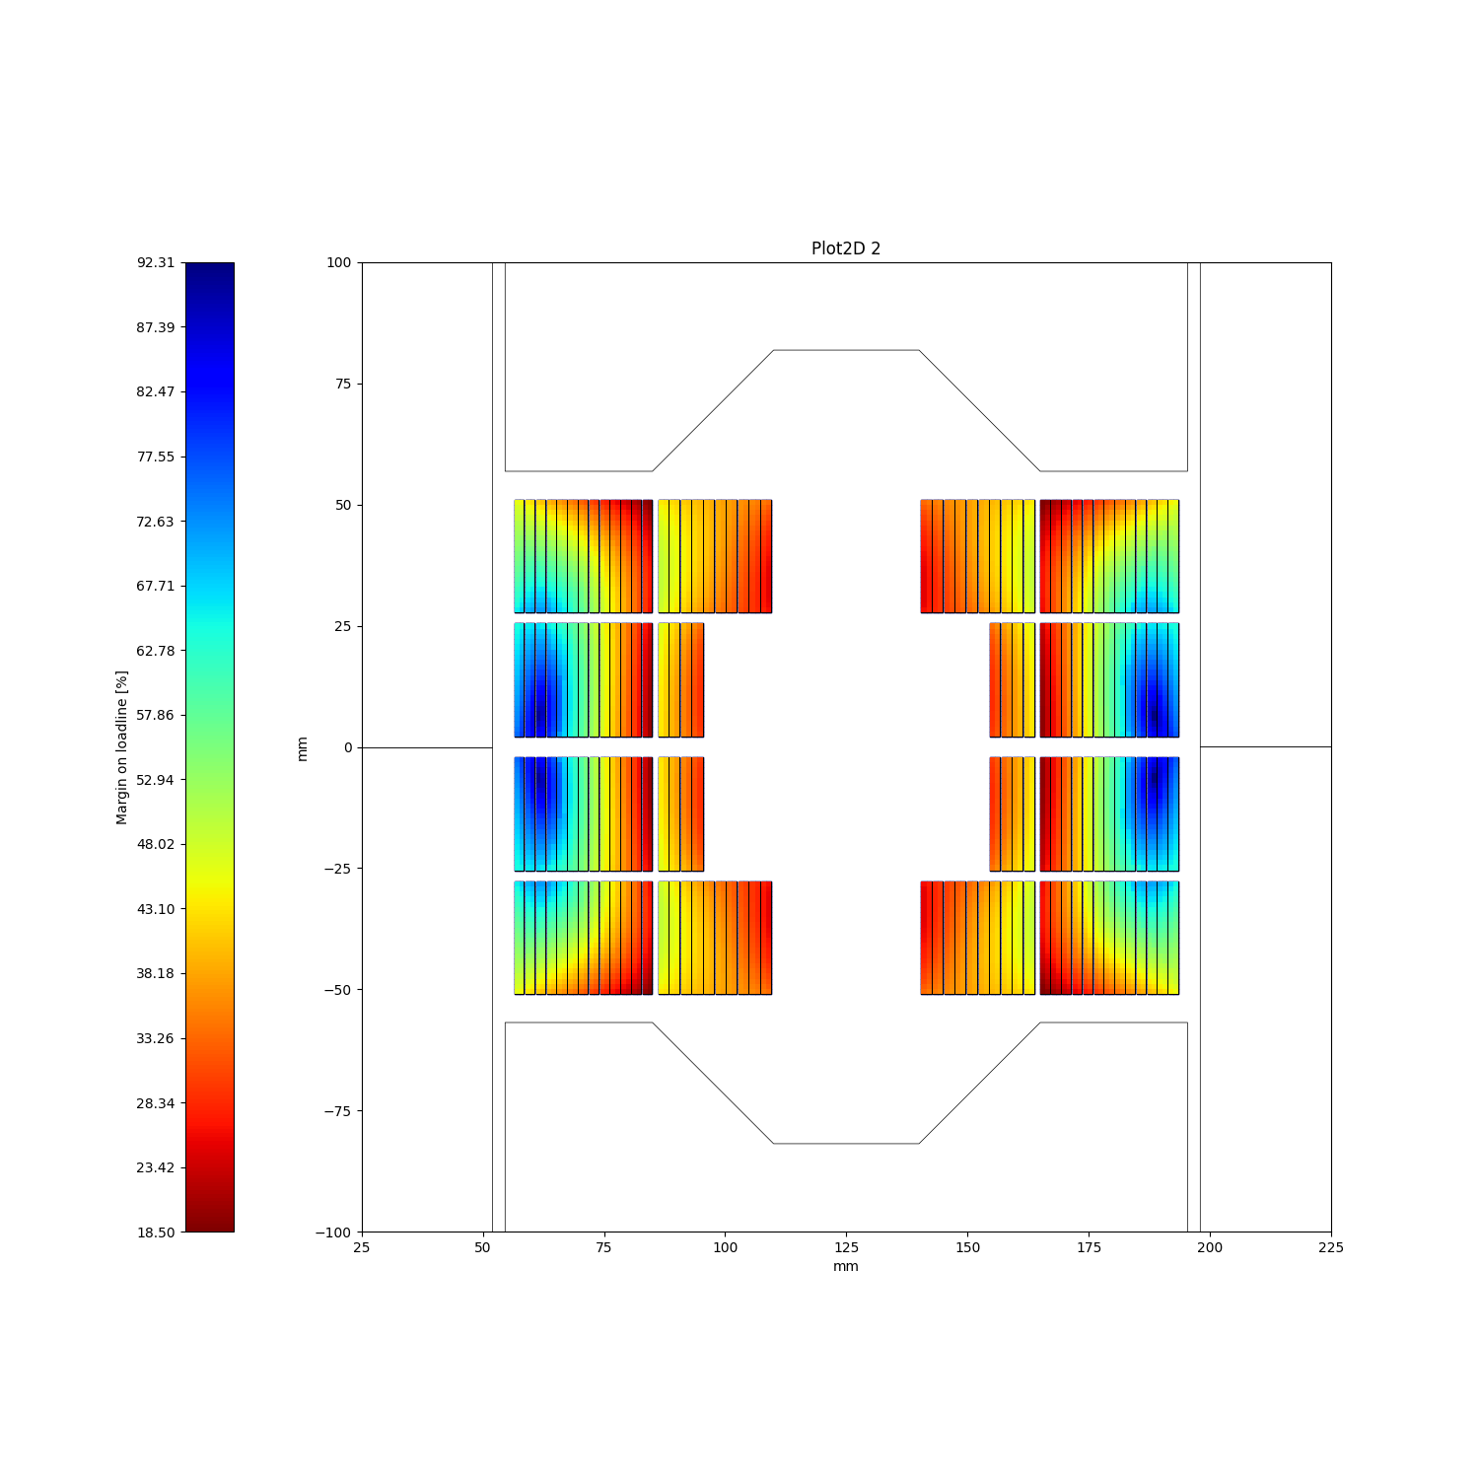
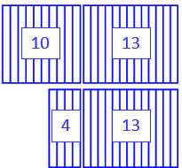
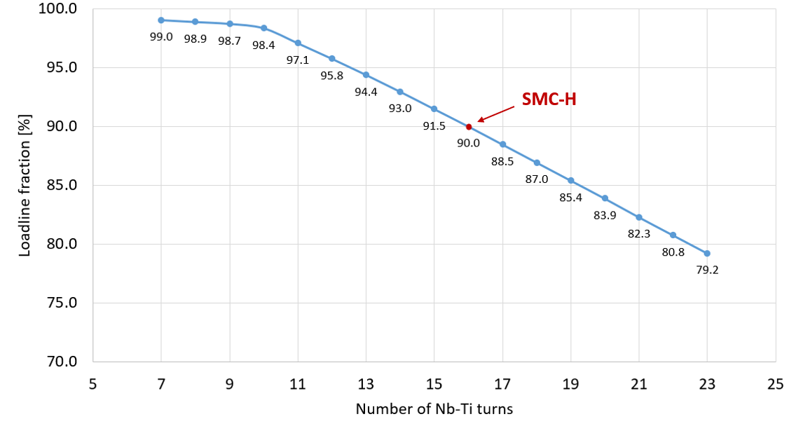
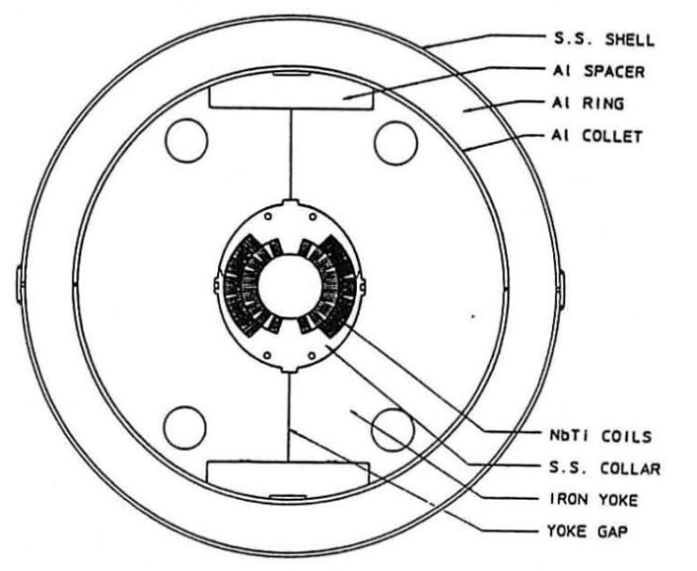
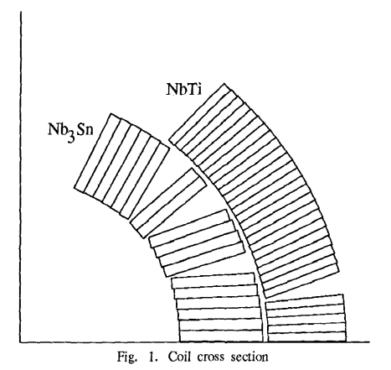
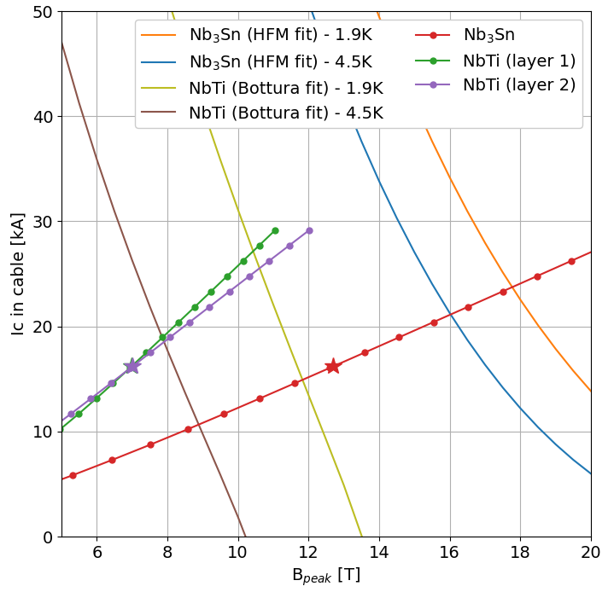

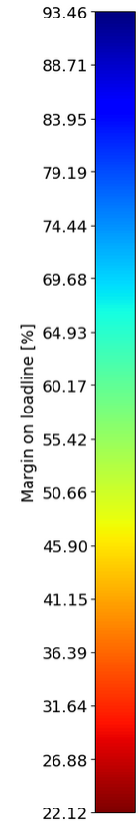
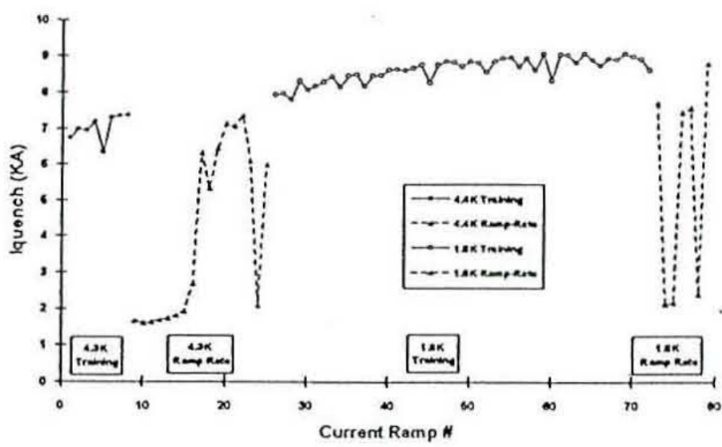
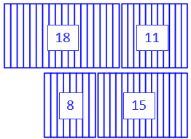
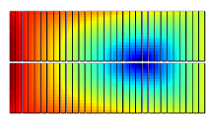
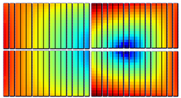
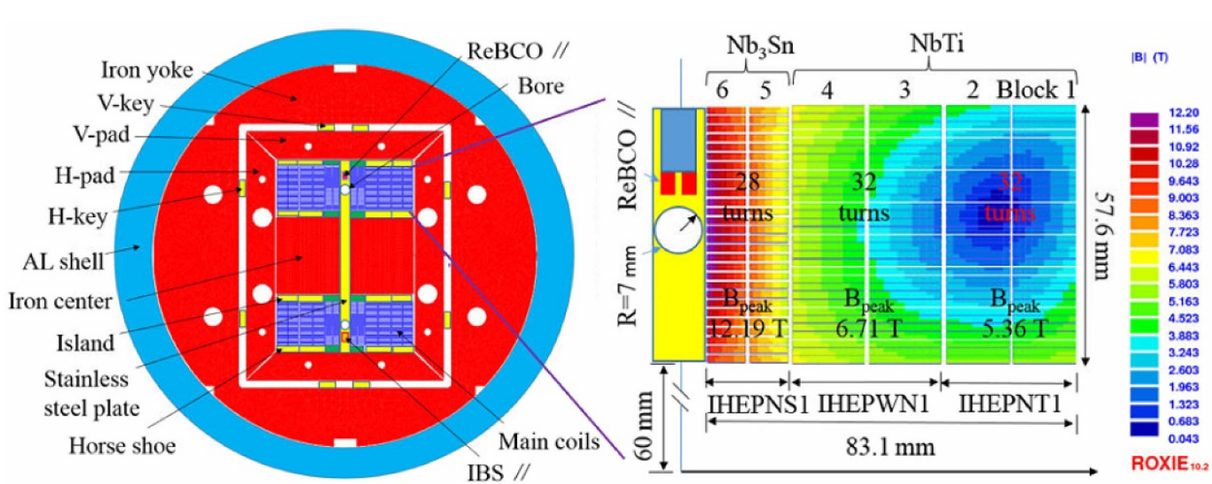
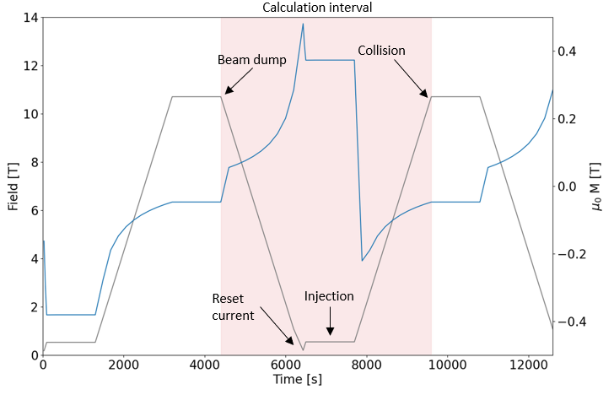
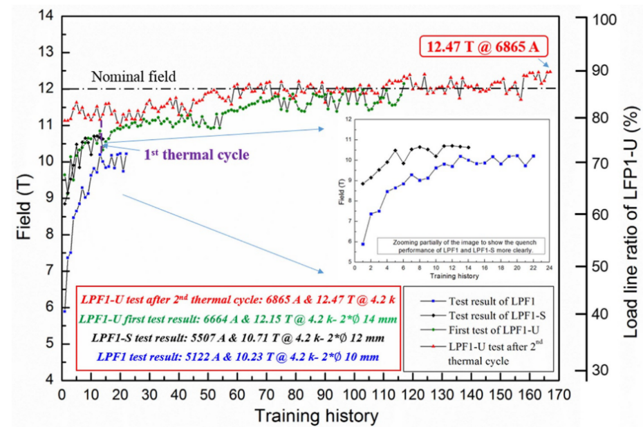
Nb₃Sn/Nb-Ti Hybrid Concept in Block Coils
for High Field Dipole Magnets
Ariel Haziot, and Ezio Todesco
CERN, European Organization for Nuclear Research, Switzerland
Presentation ID: Thu-Af-Po.01-02
As part of the High Field Magnet programme (HFM) at CERN, the Nb₃Sn block coil configuration is a candidate for the main dipole in future large hadron collider as FCC-hh. To reduce the cost, the use of material grading in the block coils is explored by using Nb-Ti conductor instead of Nb₃Sn in the external low field regions. Different designs are being investigated for dipoles with a target nominal field of 14 T and 12 T. The gain in conductor as well as in AC-losses are reported, together with consideration on operational
temperature (1.9 K vs. 4.5 K). Finally, the preliminary design of a Nb₃Sn/Nb-Ti Short Model Coil (SMC) is presented as a first proof of such a concept of hybrid technology in block coils.
I – Introduction
II – The BOND Case
III – SMC-Hybrid
Grading
Grading the current density, i.e. using larger current densities in the lower field region of dipole coils, is a design that has been used in several accelerator magnets with Nb-Ti (LHC dipoles) and Nb₃Sn (CERN-ELIN, MSUT, D20,…)
Assuming 50 % of the coil is at higher current density, this technique allows to reduce the mass of the conductor by 10 % with respect to a case that would use the same current density, and additional conductor to reach the same short sample field.
BOND
BOND Conductor Parameters | Nb₃Sn | Nb-Ti
Strand layout | RRP 162/169 | Custom
Strand diameter | 1.1 mm | 1.1 mm
Effective filament diameter | 64 µm | 7 µm
Filament twist pitch | 19 mm | 15 mm
Crossover resistance | 30 µΩ | 30 µΩ
Adjacent resistance | 0.3 µΩ | 0.3 µΩ
Cu/Non-Cu ratio | 0.9 | 1.6
Number of strands in a cable | 40 | 40
Strand twist pitch | 121 mm | 115 mm
Bare cable thickness (reacted) | 2.06 | 2.06
Bare cable width (reacted) | 23.275 | 23.275
Insulation thickness | 150 µm | 150 µm
14 T flat version
“BOND-H”
The Short Model Coil (SMC) assembly has been designed as a test bench for short racetrack coils wound with Nb₃Sn cable.
SMC MQXF uses a 32-strand cable from MQXF strands in a double pancake racetrack coil of 31 turns.
A similar cable made of 35 Nb-Ti strands (LHC 02) is considered for the hybrid, SMC-H.
Material Grading
For magnets requiring the use of Nb₃Sn (< 10 T), the use of Nb-Ti in accessible regions with adequate margin (< 8 T at 1.9 K) brings substantial saving.
The cheaper the material, the higher the interest so the current density should not be pushed too much.
For the HE-LHC a 15 T dipole using Nb-Ti in part of the coil was proposed. Since Nb₃Sn is 5 to 10 times more expensive than Nb-Ti, this design can reduce the conductor cost by 50 %.
Nb₃Sn
Nb-Ti
SMC Conductor Parameters | Nb₃Sn | Nb-Ti
Strand layout | RRP 162/169 | LHC 02
Strand diameter | 0.850 mm | 0.825 mm
Effective filament diameter | 55 µm | 7 µm
Cu/Non-Cu ratio | 1.2 | 1.9
Number of strands in a cable | 32 | 35
Bare cable thickness (reacted) | 1.59 | 1.48
Bare cable width (reacted) | 14.88 | 14.75
Insulation thickness | 150 µm | 150 µm
BOND Magnet Parameters | Unit | BOND
Aperture diameter | (mm) | 50
Intra-beam distance | mm) | 250
Number of turns per quadrant | - | 23 / 29
Insulated cable surface per aperture | (mm²) | 11572
Nominal current | (kA) | 19.34
Overall current density | (A/mm²) | 348
Bore field at I_{nom} | (T) | 14.0
Peak field at I_{nom} | (T) | 14.8
Loadline fraction at 1.9 K | (%) | 81.7
Short sample current at 1.9 K | (kA) | 23.66
Short sample peak field at 1.9 K | (T) | 17.8
Short sample current at 4.5 K | (kA) | 21.20
14 T stepped version
Coil design | Unit | SMC MQXF | SMC-H
Number of turns (Nb-Ti/Nb₃Sn) | - | 31 | 15 / 16
Nb₃sn insulated cable surface | (mm²) | 3 564 | 1 725
Nb-Ti insulated cable surface | (mm²) | 0 | 1 714
Nb₃sn ratio to SMC MQXF | (%) | 100 | 48
Operational parameters
Short sample current on Nb₃Sn | (kA) | 18.9 | 18.9
Short sample field on Nb₃Sn | (T) | 14.0 | 14.0
Short sample current on Nb-Ti | (kA) | - | 17.0
Short sample field on Nb-Ti | (T) | - | 8.1
E. Todesco et al., “Dipoles for high-energy LHC”, IEEE Trans. Appl. Supercond. 24, 4004306 (2014)
J.C. Perez et al., “Conceptual Design of BOND: A 14 T Dipole for FCC-hh”, IEEE Trans. Appl. Supercond. 35, 4002506 (2025)
Nb₃Sn
Nb-Ti
Limits of Nb-Ti
One can assume a critical surface at 1500 A/mm² and at 10.5 T for the Nb-Ti (LHC conductor).
It corresponds to a use of Nb-Ti with 1200 A/mm² at fields up to 8.5 T, keeping at 80 % loadline fraction.
More conservative condition than in the LHC dipoles (8.6 T peak field at 86 % of loadline fraction).
Nb-Ti accessible region
Same operating current as BOND (19.34 kA)
Operating loadline margin of 20 % for the Nb-Ti
Flat: Nb-Ti start at the same position on both layers
Stepped: more Nb-Ti turns on the lower layer
The stepped coil makes a more optimized use of the low field region with more Nb-Ti turns but introduces manufacturing complexity.
12 T flat version
Magnetic design of SMC-H
SMC-H is always limited by the Nb-Ti due to higher filed on the last turns.
We target a configuration for which the Nb₃sn operates at 90% when the Nb-Ti is at short sample limit: 15 (Nb₃Sn) / 16 (Nb-Ti) turns.
D19H at LBNL (1997)
Built from D19A, Nb-Ti cos-θ dipole generating 7.6 T at 4.35 K and 10 T at 1.8 K in a 50 mm bore
The Nb-Ti inner layer was replaced by Nb₃Sn (Nb₃Sn ratio: 42 %)
At 4.35 K: 7.56 T bore field (7360 A)
All quenches in the Nb-Ti coil
At 1.7 K: 8.99T (9092 A) bore field
Long training (40 quenches) limited by the Nb-Ti
Insufficient pre-loading on the Nb-Ti coil
Nb₃Sn
Nb-Ti
AC-losses considerations
Reducing Nb₃Sn content also lowers AC-losses during magnet operation:
smaller effective filament diameters (6 µm / 64 µm)
tighter filament twist pitch (4 mm / 19 mm)
We assume identical interstrand contact resistances for both cables—using LHC 01 Nb-Ti values, since no measured data exist for the Nb₃Sn cable.
AC-losses are calculated over a typical current cycle in the LHC:
Ramp down from nominal to reset (100 A) of 10 A/s
Injection plateau of 20 min at 1 kA
Ramp up to nominal of 10 A/s
The target in HFM for the loss during a cycle is 10 kJ/m.
12 T stepped version
at 4.5 K
Assembly option 1: Impregnated Nb-Ti
Better and simpler for mechanics
Careful winding: Nb-Ti is wound on reacted but not impregnated Nb₃Sn coil
Assembly option 2: Non-impregnated Nb-Ti
Allows a helium permeable insulation
Mechanically challenging: a harder Nb-Ti coil is required to limit the movements of Nb₃Sn
SMC MQXF
SMC-H
15
16
S. Caspi et al., “Design and Construction of a Hybrid Nb₃Sn Nb-Ti Dipole Magnet”, IEEE Trans. Appl. Supercond. 7, 547 (1997)
A. Lietzke et al., “Test Results on Nb₃Sn Dipole Magnets”, IEEE Trans. Appl. Supercond. 7, 739 (1997)
Nb₃Sn
Nb-Ti
IV – Conclusions
LPF1 at IHEP (2017-2023)
LFP1: Hybrid common coil with 2 Nb₃Sn and 4 Nb-Ti layers (Nb₃Sn ratio: ~25 %) :
10.2 T in a 10 mm aperture at 4.2 K (72% I_{SS})
Quenches in Nb-Ti outer coils
LFP1-S: LFP1 with higher pre-load,
10.7 T in a 12 mm aperture at 4.2 K (77% I_{SS})
Quenches in 1 Nb₃Sn coil, HF region
LFP1-U: New cables, new coils
12.5 T in a 14 mm aperture at 4.2 K (90% I_{SS})
Quenches in 1 Nb₃Sn coil, on a localized defect
Coil design | Unit | BOND | 14 T flat version | 14 T stepped version | 12 T flat version | 12 T stepped at 4.5 K
Nb₃sn Insulated cable surface (1 aperture) | (mm²) | 11 572 | 5 786 | 5 119 | 3 116 | 5 786
Nb-Ti Insulated cable surface (1 aperture) | (mm²) | 0 | 5 394 | 6 016 | 5 394 | 5 394
Nb₃Sn savings to BOND | (%) | 0 | 50 | 66 | 73 | 50
Operational parameters
Current | (kA) | 19.34 | 19.34 | 19.34 | 19.92 | 16.20
Peak field on Nb₃Sn | (T) | 14.8 | 14.8 | 14.8 | 13.0 | 12.7
Short sample current on Nb₃Sn | (kA) | 23.66 | 23.66 | 23.66 | 27.27 | 21.02
Short sample field on Nb₃Sn | (T) | 17.8 | 17.8 | 17.8 | 17.1 | 16.0
Loadline fraction on Nb₃Sn | (%) | 81.7 | 81.7 | 81.7 | 73.0 | 77.1
Peak field on Nb-Ti 1st layer | (T) | - | 6.8 | 8.7 | 8.7 | 7.0
Short sample current on Nb-Ti 1st layer | (kA) | - | 31.65 | 24.79 | 25.38 | 18.95
Short sample field on Nb-Ti 1st layer | (T) | - | 9.9 | 10.7 | 10.6 | 7.9
Loadline fraction on Nb-Ti 1st layer | (%) | - | 61.1 | 78.0 | 78.5 | 85.5
Peak field on Nb-Ti 2nd layer | (T) | - | 8.8 | 8.8 | 8.9 | 7.0
Short sample current on Nb-Ti 2nd layer | (kA) | - | 24.04 | 24.04 | 24.91 | 18.43
Short sample field on Nb-Ti 2nd layer | (T) | - | 10.8 | 10.8 | 10.7 | 7.9
Loadline fraction on Nb-Ti 2nd layer | (%) | - | 80.5 | 80.5 | 80.0 | 87.9
AC-losses over a full cycle | (kJ/m) | 24.6 | 15.2 | 13.8 | 8.3 | 14.3
AC-losses gain to BOND | (%) | 100 | 38 | 44 | 66 | 42
Material grading is an interesting way to reduce conductor cost in high field magnets replacing the Nb₃Sn by Nb-Ti in the low field regions of the coils.
The study of BOND (14 T at 1.9 K), shows that 50 % or more of the Nb₃Sn could be replaced thus practically reducing the cost of the conductor by 40 %.
The AC-losses per cycle due to the smaller filaments of Nb-Ti is also significantly reduced by 40 % approaching the HFM target.
More drastic options are considered at 14 T, 12 T, and 4.5 K with even less Nb₃Sn.
The implementation of a hybrid in the magnet platform SMC is presented along with technical choices of impregnating or not the Nb-Ti coil.
C. Wang et al., “Electromagnetic design, fabrication, and test of LPF1: A 10.2-T common-coil dipole magnet with graded coil configuration”, IEEE Trans. Appl. Supercond. 29, 4003807 (2019)
C. Wang et al., “Mechanical Design, Assembly, and Test of LPF1: A 10.2 T Nb₃Sn Common-Coil Dipole Magnet with Graded Coil Configuration”, IEEE Trans. Appl. Supercond. 29, 4000108 (2019)
C. Wang et al., “Development of superconducting model dipole magnets beyond 12 T with a combined common-coil configuration”, IEEE Trans. Appl. Supercond. 34, 065006 (2023)

