Slide 2
Resonant depolarization for FCC and spin tune determination with Xsuite
J. Wenninger
with the Xsuite support of G. Iadarola and insights from D. Barber

Slide 3
RDP kicker bump for FCC
RDP tracking
Horizontal polarization decay
Spin tune estimates in Xsuite

Slide 4
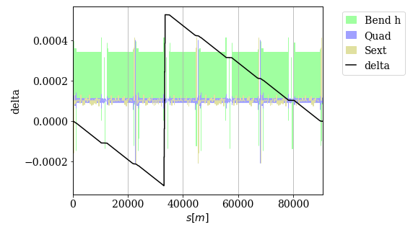
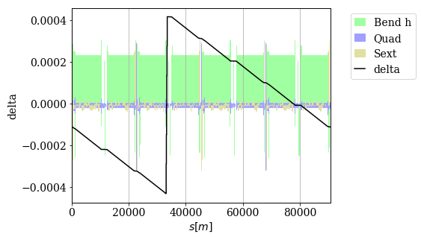
Xsuite feature
After tapering
Before fix
For the FCC lattices to be stable with radiation, tapering must be applied.
Xsuite before ~mid-July had a feature in the tapering:
  Instead of ensuring that the average energy offset from energy loss is ZERO over one turn, it set the energy offset to the value at the start of the sequence (s = 0): leads to a bias of the beam energy (average dp/p offset ≠ 0) and therefore also of the spin tune.
  Updated since end of July → average dp/p ~ 0.
Even after the change, a residual spin tune shift of δν_{s} ~7(5)×10⁻⁴ ⇔ 0.3(0.22) MeV is observed for the tapered GHC(LCC) machines → simulated RDPs are coherent with this shift (see later slides).
  Origin to be understood, definition of ‘average’ dp/p?
delta = dp/p
After fix

Slide 5
FCCee kicker bump tracking
Xsuite has a very nice features to install dynamic elements like RDP kickers and control their action turn by turn.
  Synchronization of the 3 (or more) kickers is straightforward and can easily be checked by observing the trajectory inside/outside the bump → see my presentation on Xsuite for LEP at the last meeting.
Tracking with quantum excitation and kickers bumping the particles up and down is stable: no issues with dynamic bumps during tracking, no particle losses due to the bump !
In this presentation polarization results on figures by default always refer to the average over all particles. The nominal machine spin tune is 103.45 unless stated otherwise.

Slide 6
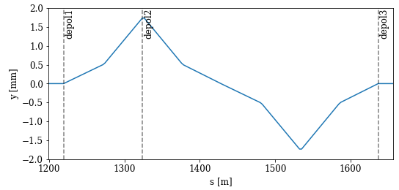

Kicker bumps for GHC
Pi-bump at the beginning of the arc, max kick of 10 μrad for the strongest of the 3 kickers, bump amplitude ~1.6 mm
Kicker location (begin of arc):
inline.insert_element(f'depol1', xt.Multipole(ksl=[0]), at='qd3.1') inline.insert_element(f'depol2', xt.Multipole(ksl=[0]), at='qd3.2') inline.insert_element(f'depol3', xt.Multipole(ksl=[0]), at='qd3.5')

Slide 7
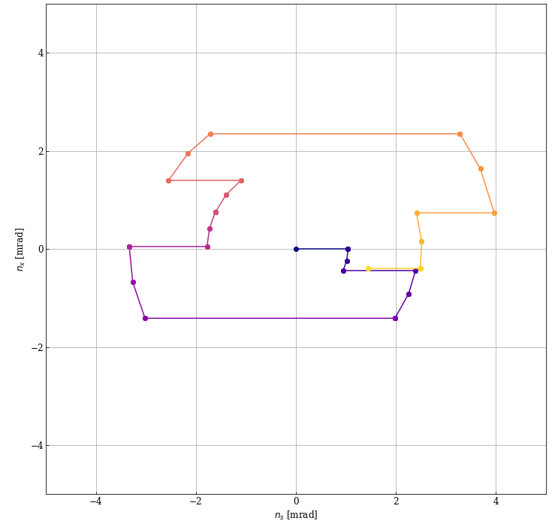
Kicker bumps for GHC
Evolution of the spin projection in X-S(Z) plane, from the start (dark blue) to the end of the bump (yellow)
For a kick of 10 μrad (from the strongest kicker), the polarization vector turns away from Y direction by 1.5 mrad over one passage.
There may be better solutions, no time spent on tuning this bump !
Bump start, first kicker
Bump end, last kicker

Slide 8
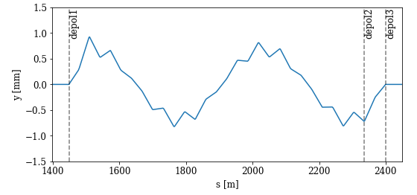
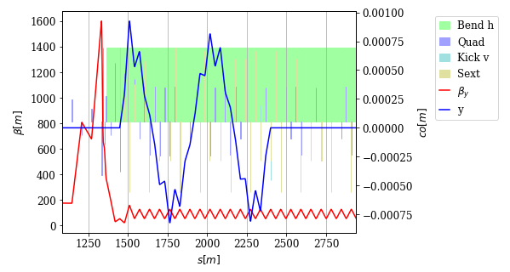

Kicker bump for LCC
Bump normalized to a max kick of 10 μrad for the strongest of the 3 kickers, bump amplitude ~1 mm.
Kicker location (begin of arc):
line.insert_element(f'depol1', xt.Multipole(ksl=[0]), at='qdm2r.0’)
line.insert_element(f'depol2', xt.Multipole(ksl=[0]), at='qd5a.4’)
line.insert_element(f'depol3', xt.Multipole(ksl=[0]), at='qd5a.5')

Slide 9
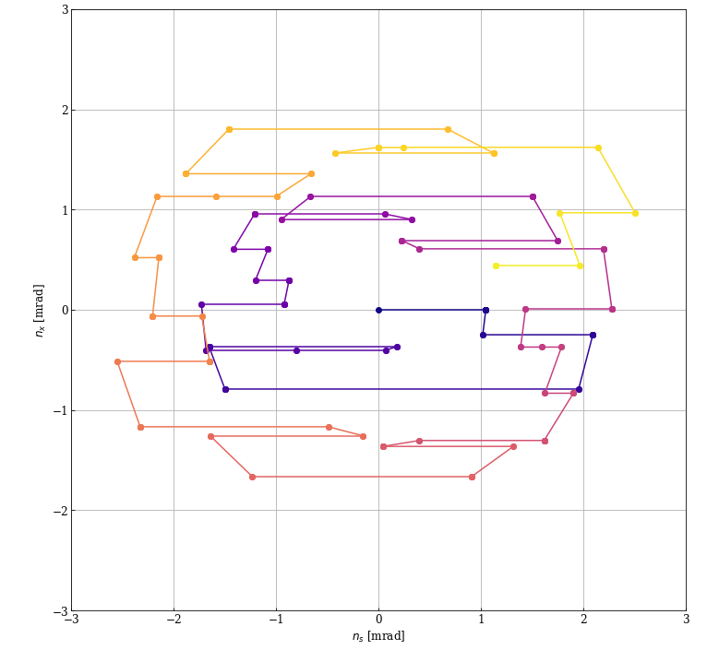
Kicker bump for LCC
Evolution of the spin projection in X-S(Z) plane, from the start (dark blue) to the end of the bump (yellow)
Bump end, last kicker
For a kick of 10 μrad (from the strongest kicker), the polarization vector turns away from Y direction by 1.22 mrad over one passage.
There may be better solutions, not much time spent on tuning this bump !
Bump start, first kicker

Slide 10
RDP kicker bump for FCC
RDP tracking
Horizontal polarization decay
Spin tune estimates in Xsuite

Slide 11
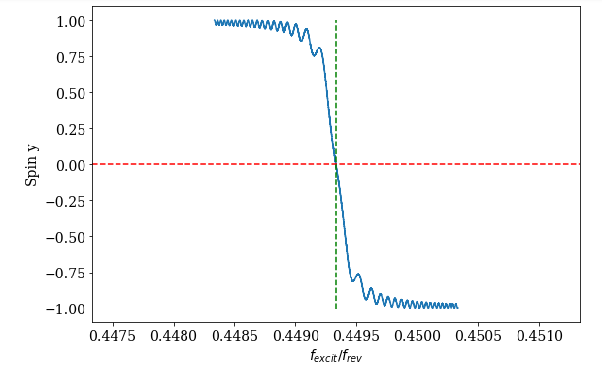
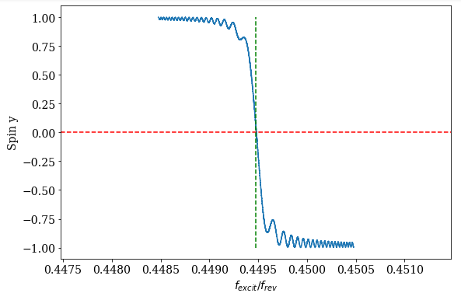
Comparison GHC - LCC
Conditions: single particle on CO, no quantum excitation.
  Kicker bump with nominal kick = 10 urad, scan Δν_{ο} = 0.002 over 75’000 turns.
Note the shift of the resonance wrt ν₀ = 0.45, the nominal spin tune without radiation !
GHC-LCC are equivalent (as expected).
GHC
Xsuite ν_{o} value
LCC
Xsuite ν₀ value

Slide 12
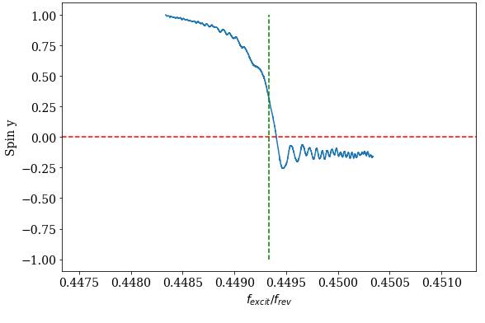
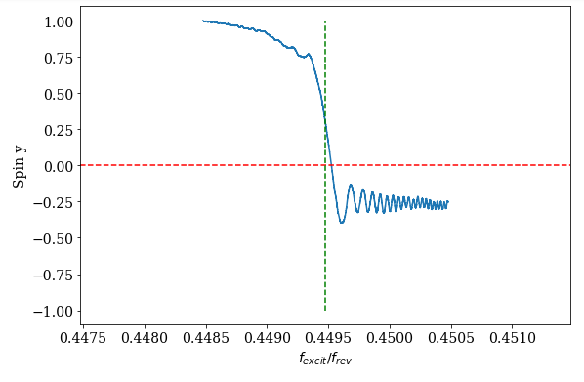
Comparison GHC – LCC
Conditions: 50 particles, quantum excitation on.
  Kicker bump with nominal kick = 10 urad, scan Δν₀ = 0.002 over 75’000 turns.
GHC-LCC are ~ equivalent. LCC a little bit cleaner?
Evolution of the vertical polarization vs applied kicker frequency
GHC
Xsuite ν₀ value
LCC
Xsuite ν₀ value

Slide 13
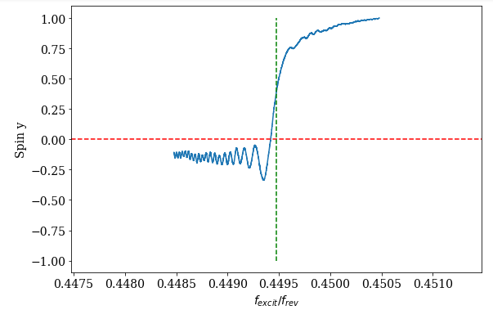
LCC forward / backward scans
Forward and backward scans – here for LCC – are consistent.
Evolution of the vertical polarization vs applied kicker frequency
Forward scan (high to low freq)
backward scan (low to high)
Xsuite ν₀ value
Xsuite ν₀ value

Slide 14

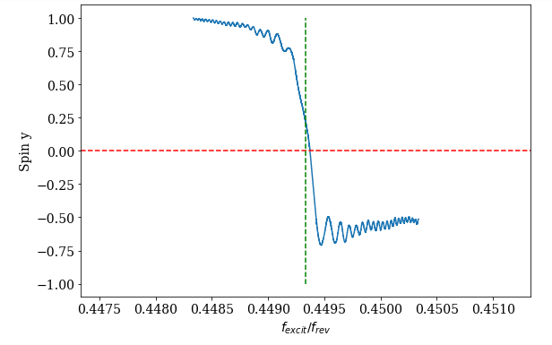
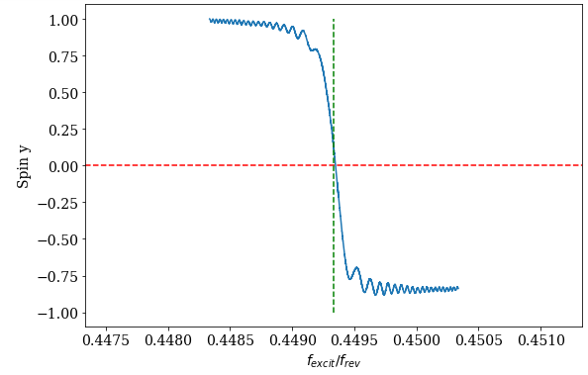
RDP for GHC – Qs dependance
As anticipated and highlighted by I. Koop, the synchrotron tune Qs and the spin modulation / decoherence index B play an important role.
For Q_{s} doubled (B_{s} halved) wrt nominal value, the depolarisation is ~as sharp as for a single particle on CO.
Evolution of the vertical polarization vs applied kicker frequency
Qs = 0.031 / Bs = 1.30 (V_{RF} = 99.5 MV)
Qs = 0.0457 / Bs = 0.88 (2 x V_{RF})
Qs = 0.0655 / Bs = 0.62 (4 x V_{RF})

Slide 15
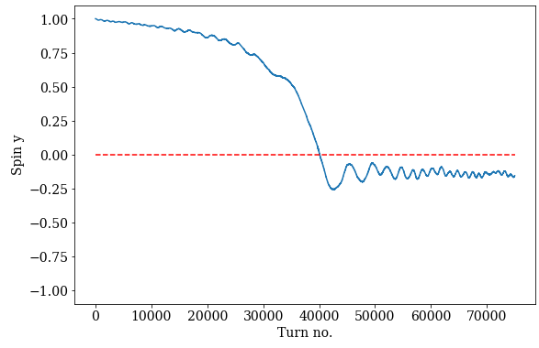
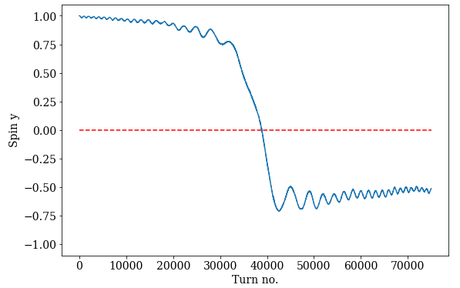
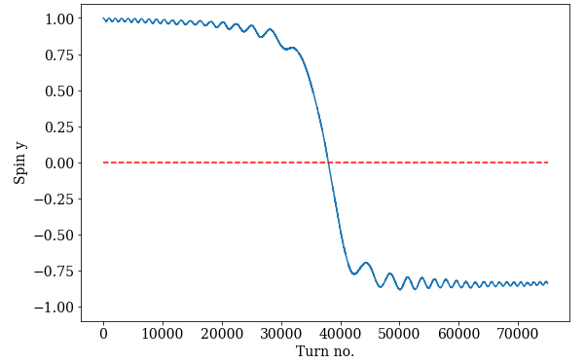
RDP for GHC – Qs dependance
For low(er) Qs, loss of vertical polarization already occurs before reaching the resonance due to the decoherence of the horizontal polarization component.
  The green band has the same width in all 3 cases – to guide the eye.
Evolution of the vertical polarization vs turn number
Qs = 0.031 / Bs = 1.30 (V_{RF} = 99.5 MV)
Qs = 0.0457 / Bs = 0.88 (2 x V_{RF})
Qs = 0.0655 / Bs = 0.62 (4 x V_{RF})

Slide 16
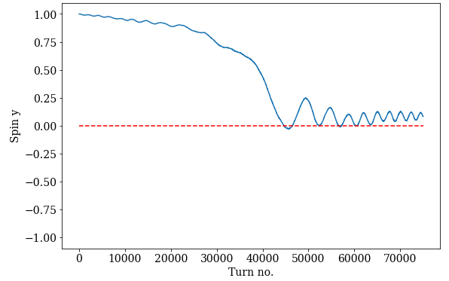
RDP for GHC – slower scan & lower kick
Qs = 0.031 / Bs = 1.30 (V_{RF} = 99.5 MV)
The kick can be reduced together with the scan speed, to relax requirements on the kicker strength.
  Due to the decoherence in the horizontal plane, the depolarization is not as clean.
  A better RDP quality could be obtained/restored for operation at higher Qs.
Kicker strength and scan speed halved

Slide 17
Polarimeter and scan accuracy
Based on the simulated scans, it would already be possible to estimate the potential accuracy based for the selected scan parameters assuming that we can get a 1 Hz polarization measurement (3000 turns, a guess for today).
An accuracy of < ±2000 turns (1s) on the X-axis (turn no.) should be achievable:
Δν₀ = 0.002 × 2000/75000 = ~5×10⁻⁵ or ΔE ~20 keV
This is a rough estimate, one can do better with a smarter analysis.
We should soon be able to obtain first estimates for polarimeter performance and to fold a measurement procedure into such results.

Slide 18
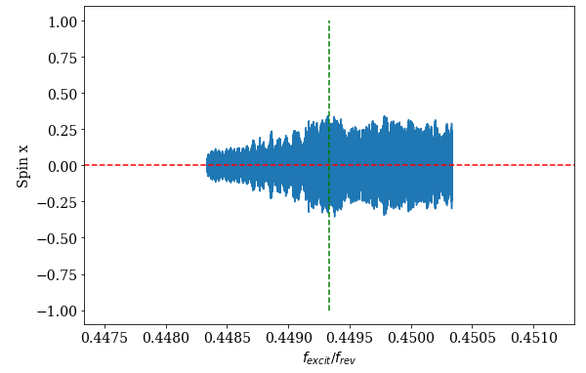
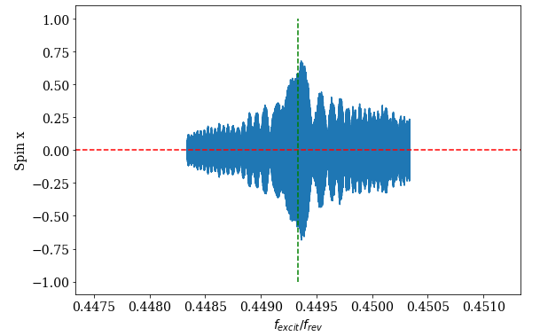
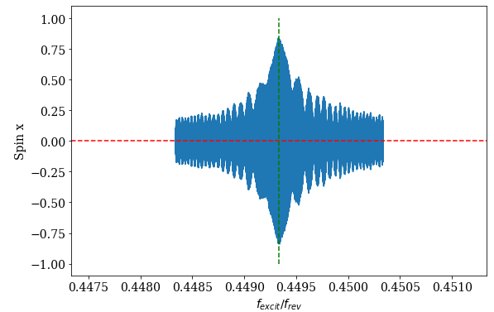
RDP for GHC – Qs dependance
For higher synchrotron tune and lower spin modulation index Bs, the horizontal component of the polarization ‘decoheres’ more slowly: important ingredient for clean depolarization !
→ Study decoherence of the horizontal polarization component
X (radial) polarization component vs applied kicker frequency
Qs = 0.031 / Bs = 1.30 (V_{RF} = 99.5 MV)
Qs = 0.0457 / Bs = 0.88 (2 x V_{RF})
Qs = 0.0655 / Bs = 0.62 (4 x V_{RF})

Slide 19
RDP kicker bump for FCC
RDP tracking
Horizontal polarization decay
Spin tune estimates in Xsuite

Slide 20
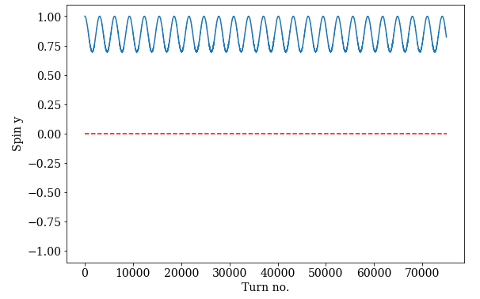
Decoherence test
GHC, single particle on CO, no quantum excitation
To observe the decoherence of the horizontal polarization use a constant excitation frequency instead of scanning the frequency
Set the excitation frequency to ν₀ – 0.003. The vertical polarization is modulated at a frequency corresponding to the excitation frequency difference to ν₀.
  Modulation ampl. depends on distance to resonance.
Inspired by a discussion with Y. Wu

Slide 21
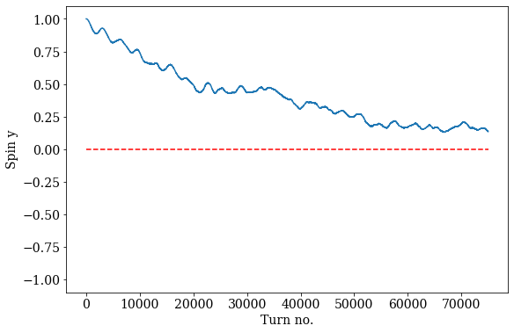
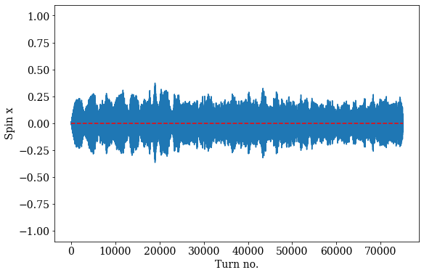
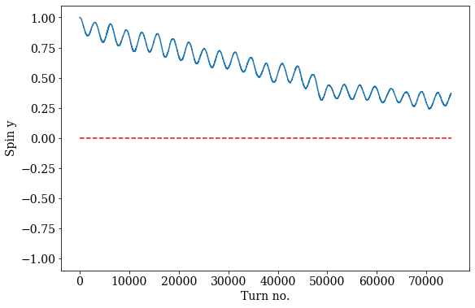
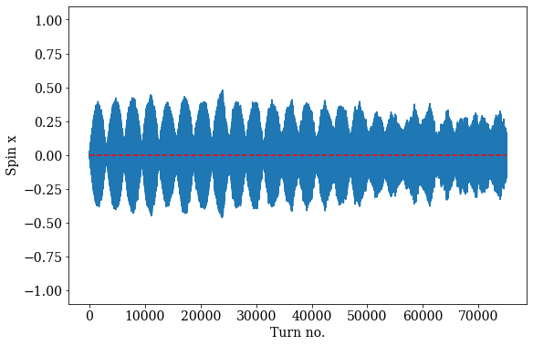
Decoherence test
GHC, 50 particles, quantum excitation on.
Polarization Y
~2 s
Polarization X
With radiation switched on, the vertical polarization degrades progressively due to the decoherence of the hor. polarization component.
Higher Qs is very beneficial for the preservation of the horizontal component !
Qs = 0.031 (V_{RF} = 99.5 MV)
~16 s
Qs = 0.0457 (2 x V_{RF})

Slide 22
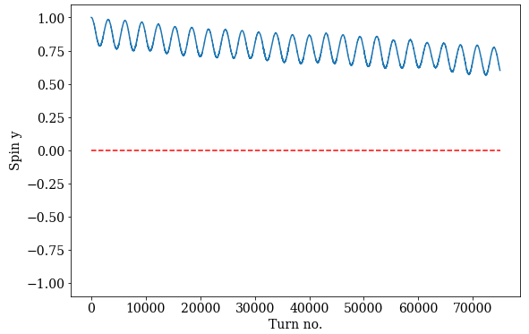
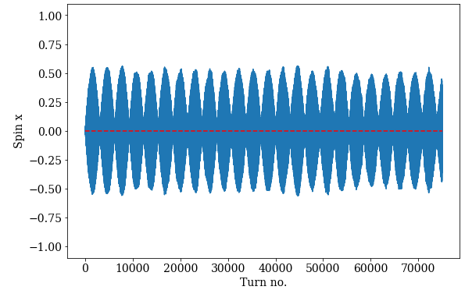
Decoherence test
GHC, 50 particles, quantum excitation on.
Polarization Y
~2 s
Polarization X
With radiation switched on, the vertical polarization degrades progressively due to the decoherence of the hor. polarization component.
Higher Qs is very beneficial for the preservation of the horizontal component !
Qs = 0.031 (V_{RF} = 99.5 MV)
> 25 s…
Qs = 0.0655 (4 x V_{RF})

Slide 23
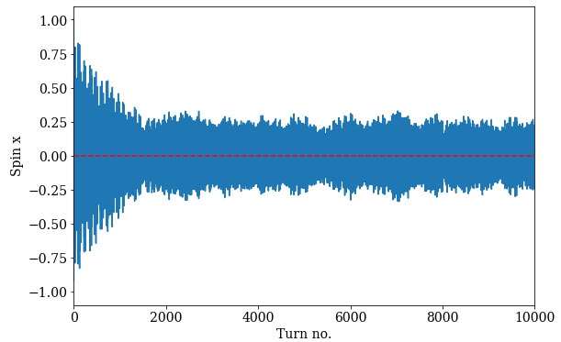
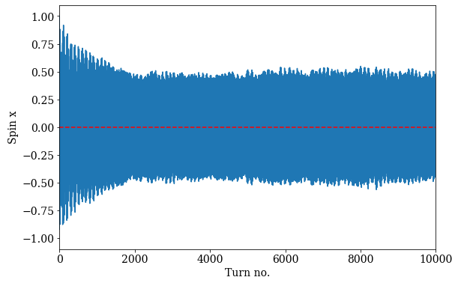
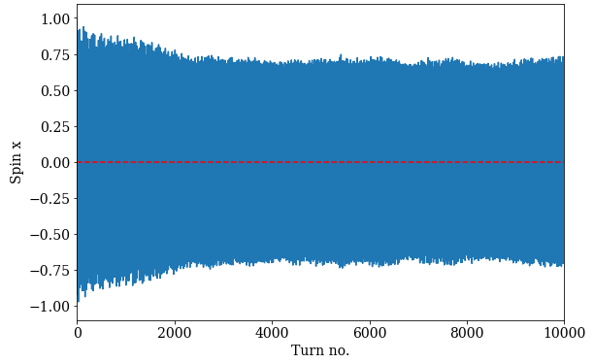
Decoherence test – pure hor. polarization
Launch all particles with spins aligned along the X axis (value = 1 on the plots), observe the evolution of the horizontal polarization component (average over all particles).
  GHC optics, 100 particles tracked for 10k turns, radiation on.
Rapid decay over 1000-3000 turns, followed by steady state (over many seconds, not necessarily until t = ∞).
  Steady state can be key ingredient for the free precession method → long measurement times !
Qs = 0.031 / Bs = 1.30 (V_{RF} = 99.5 MV)
Qs = 0.0457 / Bs = 0.88 (2 x V_{RF})
Qs = 0.0655 / Bs = 0.62 (4 x V_{RF})
1 → 0.73
1 → 0.50
1 → 0.25

Slide 24
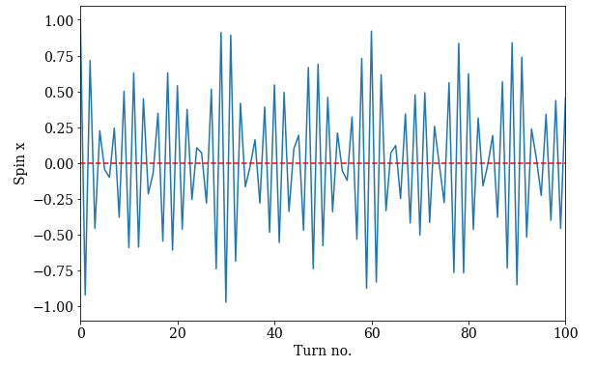
Decoherence test – pure hor. polarization
Zooming in on a few turns shows the modulation by the synchrotron period.
Zoom on first turns
Qs = 0.0655 / Bs = 0.62 (4 x V_{RF})
Modulated at the synchrotron period 1/Q_{s}

Slide 25
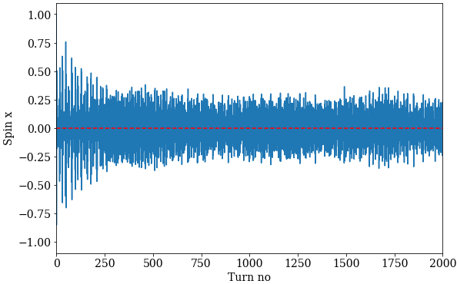
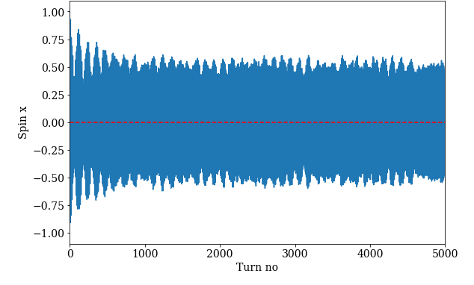
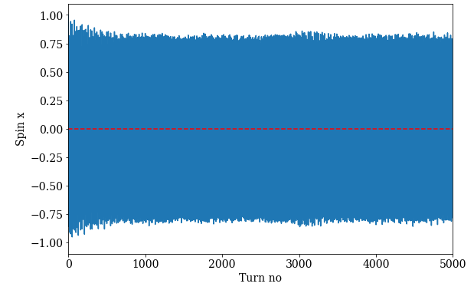
Decoherence test – pure hor. polarization LEP
Launch all particles with spins aligned along the X axis, observe the evolution of the horizontal polarization component (average over all particles) at LEP.
  100 particles tracked for 5k turns, radiation on.
Rapid decay over 250-1000 turns, then steady state (over many seconds, not necessarily to t = ∞).
Qs = 0.0625 / Bs = 1.19
Qs = 0.092 / Bs = 0.81
Qs = 0.162 / Bs = 0.46
1 → 0.8
1 → 0.50
1 → 0.25

Slide 26
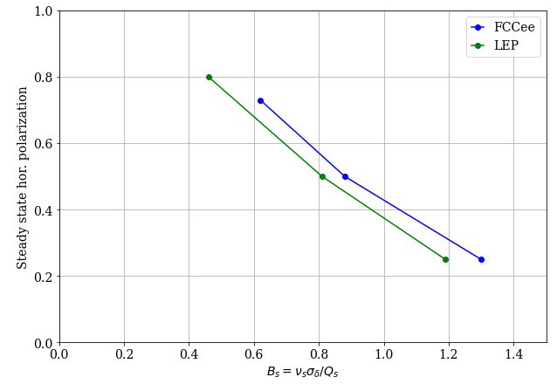
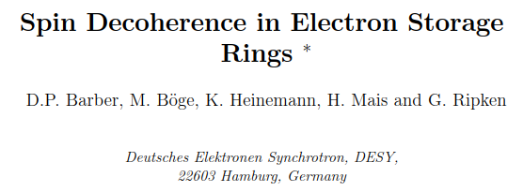
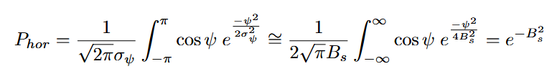
Residual hor. polarization
A paper by D. Barber et al from ~1994 estimates the spread of the hor. spin directions σ_{ψ} due to decoherence to be equal to √2B_{s} based on a Fokker-Planck approach for the linearized eq of motion (for this simulation configuration).
P_{hor}
and K. Heineman, arXiv:/physics/9709025
Assuming a gaussian profile of spin angles with σ_{ψ} = √2B_{s}, the horizontal polarization P_{hor} can be estimated:
Plotted against the spin mod. index B_{s}, the ‘steady-state’ hor. P is similar for LEP & FCC
(from the previous slides)
(*) Proceedings, 11th International Symposium on High-energy Spin Physics (SPIN 94) : Bloomington, USA

Slide 27
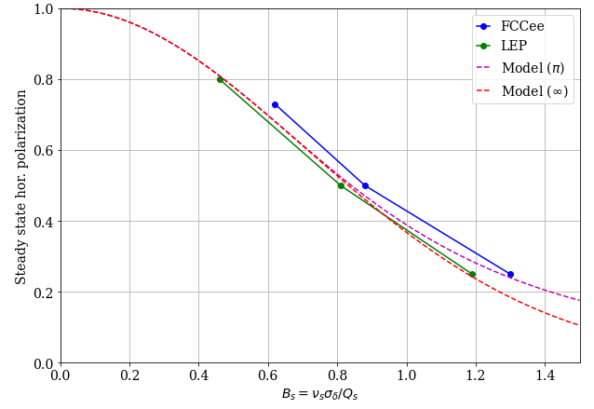
Residual hor. polarization
A paper by D. Barber et al from ~1994 estimates the spread of the hor. spin directions σ_{ψ} due to decoherence to be equal to √2B_{s} based on a Fokker-Planck approach for the linearized eq of motion (for this simulation configuration).
P_{hor}
and K. Heineman, arXiv:/physics/9709025
Assuming a gaussian profile of spin angles with σ_{ψ} = √2B_{s}, the horizontal polarization P_{hor} can be estimated:
‘Steady-state’ hor. polarization for LEP and FCC including the model for the decoherence.
Very good agreement !
(*) Proceedings, 11th International Symposium on High-energy Spin Physics (SPIN 94) : Bloomington, USA

Slide 28
RDP kicker bump for FCC
RDP tracking
Horizontal polarization decay
Spin tune estimates in Xsuite

Slide 29

Estimating the spin tune in Xsuite
To understand systematic errors on the spin tune (shifts wrt aγ), a first step is to compare different means of obtaining ν₀ from Xsuite. Check of the modelling !
Four estimators for ν₀ are compared on a sample of 100 LEP machines with misalignments.
The estimators in Xsuite:
ν_{0,4d} from the 1T-matrix with twiss4d(): ignores the longitudinal plane and radiation.
ν_{0,6d} from the 1T-matrix with twiss6d(): includes the longitudinal plane and radiation (average E loss).
ν_{0,delta} obtained from the beam energy: the reference energy γ_{ref} is corrected for the average energy deviation < δ >, obtained by integration of the local energy offset δ over the bends.
ν_{0,trk} obtained by particle tracking with radiation and quantum fluctuations from the FFT of the turn-by-turn horizontal polarization vector (particles launched with spin aligned along X axis).
  FFT with Blackman window, tune is estimated by a parabolic interpolation of the highest 3 FFT bins.

Slide 30
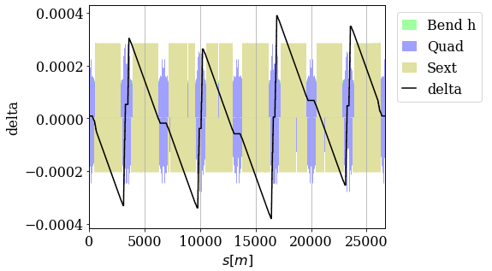
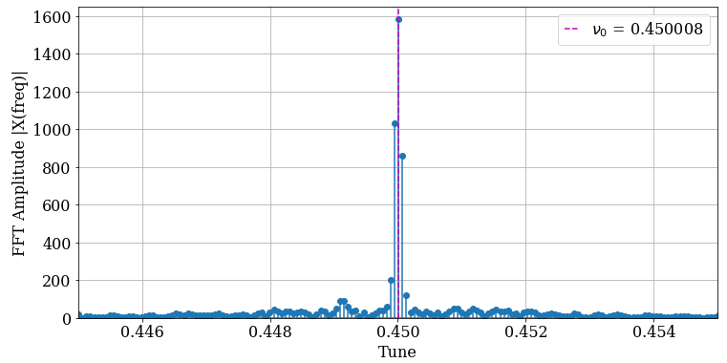
LEP ideal machine reference case
Energy sawtooth
Cross-check for the ideal LEP machine at a reference momentum corresponding to ν₀ = 101.45.
Estimator | Fractional ν₀
ν_{0,4d} | 0.449999
ν_{0,6d} | 0.449999
ν_{0,delta} | 0.449984
ν_{0,trk} | 0.450008
FFT from tracking 100 particles for 16k turns
The estimators agree within δν₀ ~1.5 × 10⁻⁵ (< 10 keV).
The results for ν_{0,trk} vary by a few × 10⁻⁶ (~ keV) when the number of turns or the FFT filters are changed.
The definition of ‘average beam energy’ has a significant impact on ν_{0,delta} : needs more checks and analysis. Averaging the energy sawtooth is not so straightforward.

Slide 31
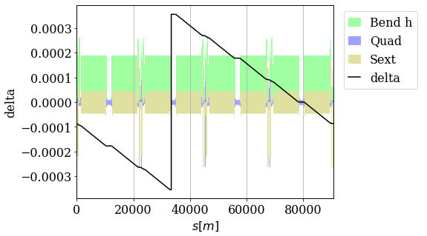
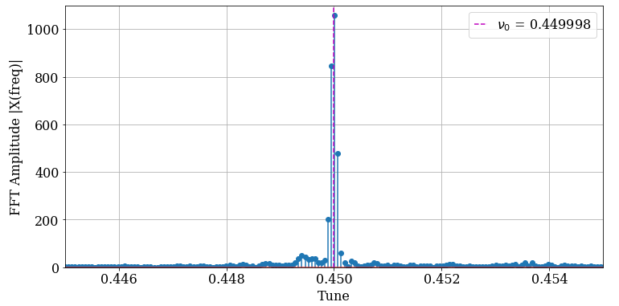
FCC - LCC ideal machine reference case
Energy sawtooth:
similar peak δ (~3 10⁻⁴) than for LEP
Cross-check for the ideal FCC machine / LCC optics at a reference momentum corresponding to ν₀ = 101.45.
Estimator | No tapering Fractional ν₀ | Tapering Fractional ν₀
ν_{0,4d} | 0.449999 | ---
ν_{0,6d} | 0.450000 | 0.449517
ν_{0,delta} | 0.449999 | 0.449516
ν_{0,trk} | 0.449998 | 0.449516
Very consistent !
FFT from tracking 100 particles for 16k turns
(no tapering)
With tapering ν_{0,6d} is consistently shifted to 0.449517, to be understood (see also previous slides on RDP).

Slide 32
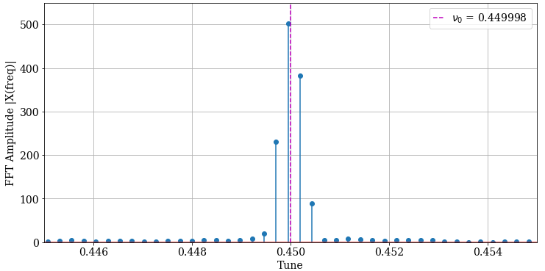
Simulation setup with imperfections
LEP is used for this study because the lattice is ‘forgiving’: representative misalignments can be introduced without destabilizing the lattice, avoiding lengthy correction procedures.
Simulation error setup, realistic for “good” LEP polarization conditions:
Quadrupole rms misalignment : 350 μm H, 180 μm V
BPM rms misalignment : 300 μm (H+V)
Orbit rms corrected to 0.4-0.5 mm H, 0.3-0.35 mm V
Ideal machine spin tune : 101.45
Interpolation with parabola
ν_{0,trk} is obtained by tracking 100 particles launched with spins in the horizontal direction, tracked over 4096 turns.
FFT with Blackman window, tune is estimated by a parabolic interpolation of the highest 3 FFT bins.
Example for a perfect machine with spin tune 101.45

Slide 33
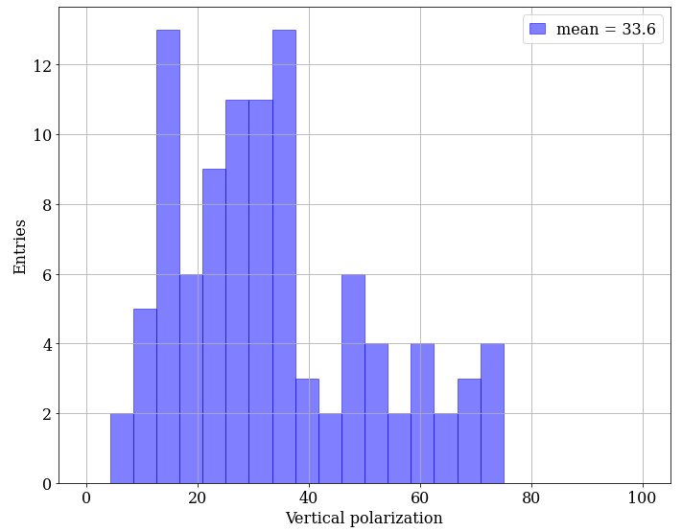
Polarization with imperfections
The predicted polarization level vary a lot for those 100 machines: from 5% to 75%.
Overall, a bit optimistic compared to actual observations where the typical polarization was ~20% for well corrected machine before HSM.

Slide 34
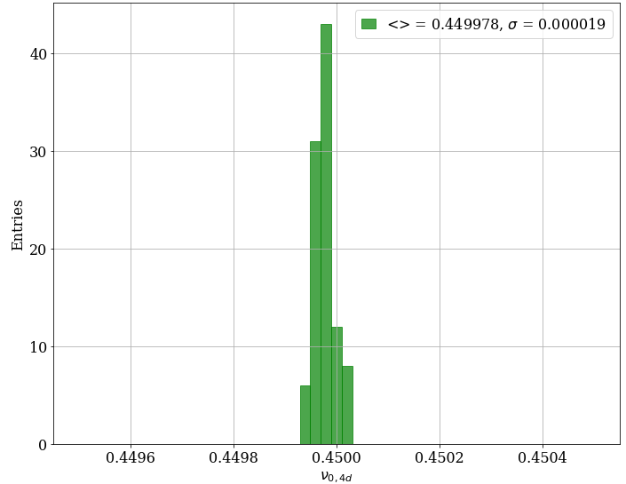
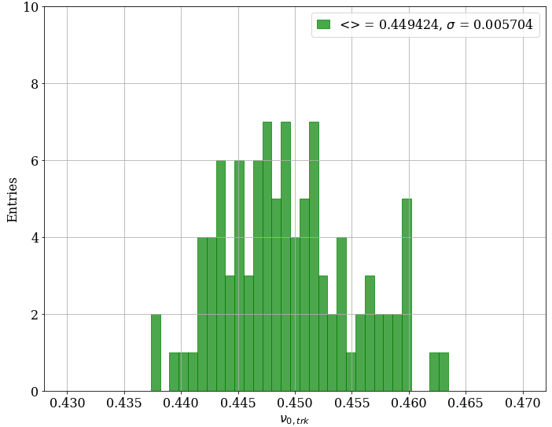
Spin tune estimators – realistic machine
While ν_{0,4d} differs significantly from the other estimators, as expected since it does not include all the physics, the three other estimators are very consistent, predicting energy changes of few MeV due to the misalignment + steering.
Note the difference in horizontal scale !
ν_{0,4d}
ν_{0,6d}
Perfect machine spin tune is 103.45

Slide 35
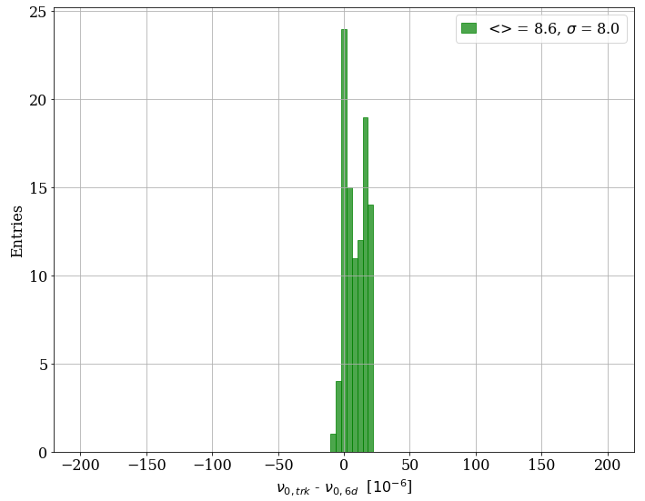
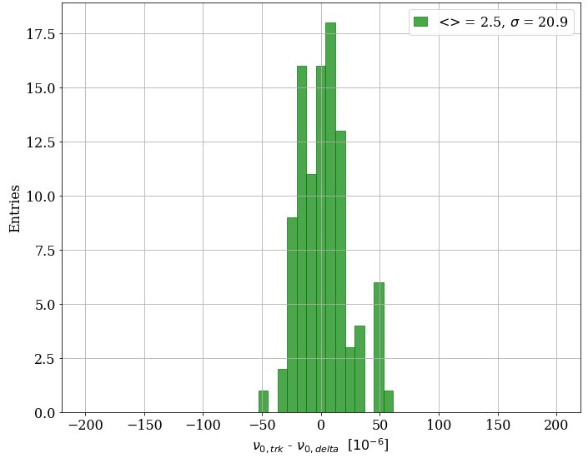
Spin tune estimator – realistic machine
The 3 estimators other than twiss4d are consistent within δν_{o} ~ ± 2 10⁻⁵ → ± 10 keV
FFT from tracking and 6d agree within δν_{o} ~ ± 10⁻⁵ → ± 4 keV
At the keV level they are clearly differences, refined analysis required (FFT with more turns etc).
ν_{0,trk} − ν_{0,6d}
ν_{0,trk} − ν_{0,delta}

Slide 36
Estimators and systematic spin tune shifts
If one considers that:
the spin tune from tracking ν_{0,trk} = <aγ> + δν_{sys} corresponds to the spin tune obtained by RDP and includes systematic spin tune shifts from orbit excursions etc,
ν_{0,delta} = <aγ> is the ‘exact’ energy estimator,
then their difference is an estimator for δν_{sys}.
This implies a typical systematic spin tune shift for LEP
Δν_{sys} ~ ± 2 10⁻⁵ ~ ± 10 keV
ν_{0,trk} − ν_{0,delta}
which is consistent with the estimates from LEP times.
Xsuite intrinsic systematic errors cannot be assessed of course !

Slide 37
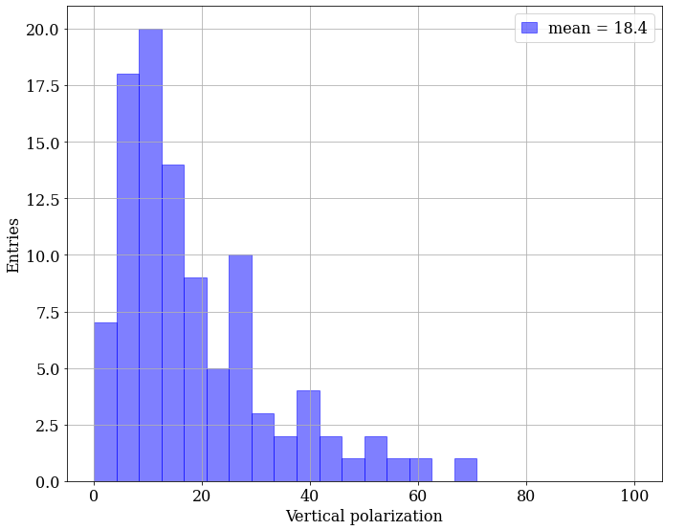


Spin tune estimator – degraded orbit
Polarization degrades
If BPM errors are increased to yield an average vertical orbit RMS ~0.62 mm:
ν_{o,trk} - ν_{o,6d} remains unchanged.
The rms of ν_{o,trk} - ν_{o,6d} increases (~3x) to 6×10⁻⁵.
ν_{0,trk} − ν_{0,6d}
ν_{0,trk} − ν_{0,delta}

Slide 38

Systematic spin tune shifts
Estimate for the systematic spin tune shift at LEP as a function of the vertical closed orbit rms
(CERN SL/94-71)
The systematic spin tune shifts due to vertical closed orbit errors were analyzed for LEP for the error estimates on the beam energy, see report CERN SL/94-71.
The error estimates of ~10 / 30 keV obtained with Xsuite for orbit rms values of ~0.3 / 0.62 mm are in good agreement with the 1994 simulations.
The total systematic error on the LEP beam energy due to all ‘kinds’ of systematic spin tune shifts was estimated to ±100 keV.
Xsuite simulation configurations
Vertical orbit rms

Slide 39
Summary
Successful first technical tests of RDP implementation in Xsuite at the Z.
  LCC – GHC are essentially equivalent at first sight, to be looked at further.
The first tests reveal again the importance of the spin modulation index and of Qs for the scan quality when crossing the resonance.
  Explore the option of operating at a higher Qs at the Z → informed X. Buffat.
Tracking studies on the decoherence of the horizontal spin component, closely related to the quality of RDP scans, agree well with a theoretical prediction from the DESY–HERA team.
To explore scan parameters and energy determination accuracies, it will be useful to convolute first polarimeter performance estimates to explore how to reconstruct the spin tune.
Different Xsuite spin tune estimators are consistent at the level of 10 keV.

Slide 41



Hor. polarization decay estimate
Back to a LEP note (thanks' D. Barber for reminding me of its existence!) that estimated analytically the decay of the horizontal polarization.
Result for the decay time τ_{d}:
τ_{e} : longitudinal damping time
B_{s} : spin mod. index
45 GeV
LEP: τ_{d} in the range 10-500 s.
FCC: τ_{d} in the range of hour(s).
→this note does not describe what happens in the short term for FCC (first few 1k turns)
→ much longer term, beyond the currently tracked number of turns !

