Slide 1
WP1 – 1.1 Detector and facility upgrades
1.1.3 Higher power target designs for neutron production for nuclear data
14/10/2025
Michael Bunce, National Physical Laboratory

Slide 2
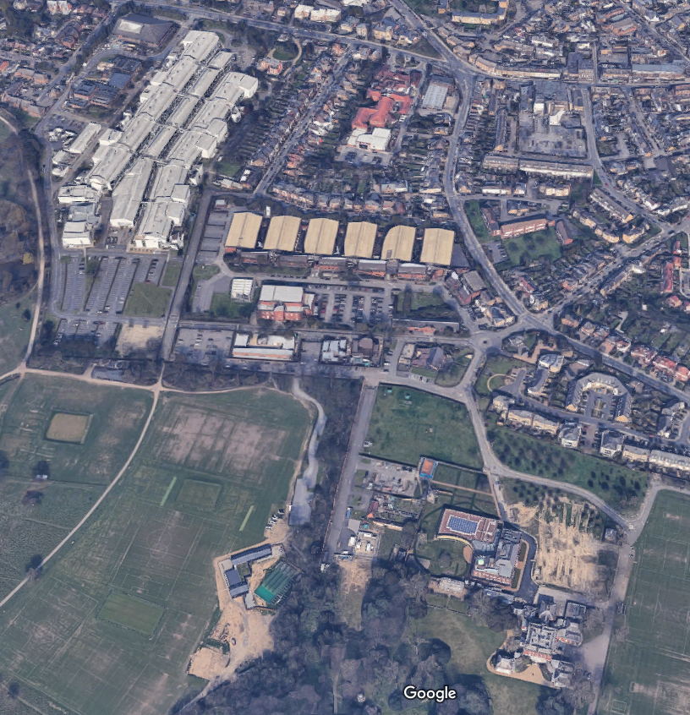
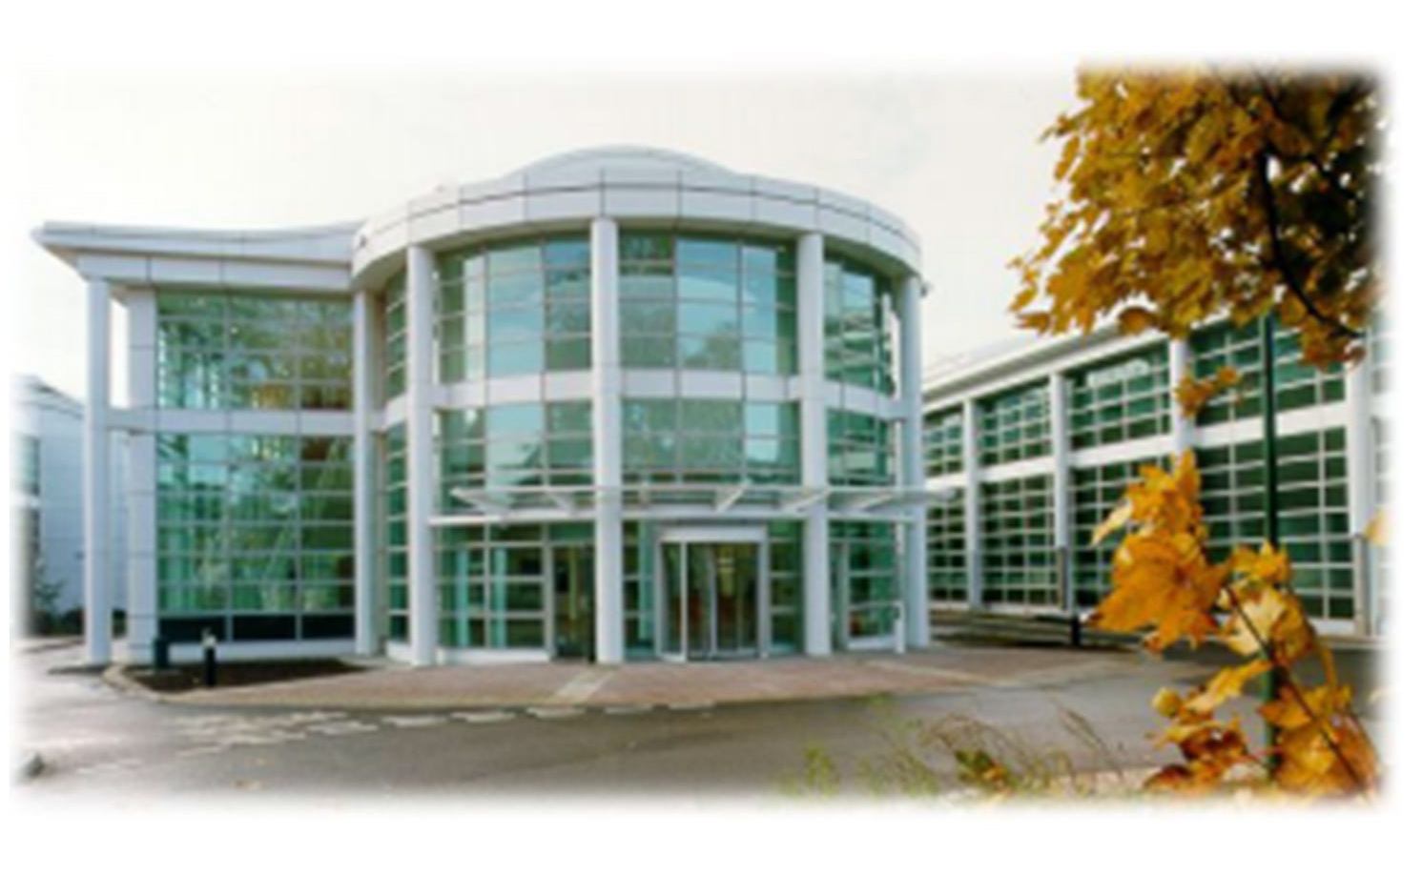
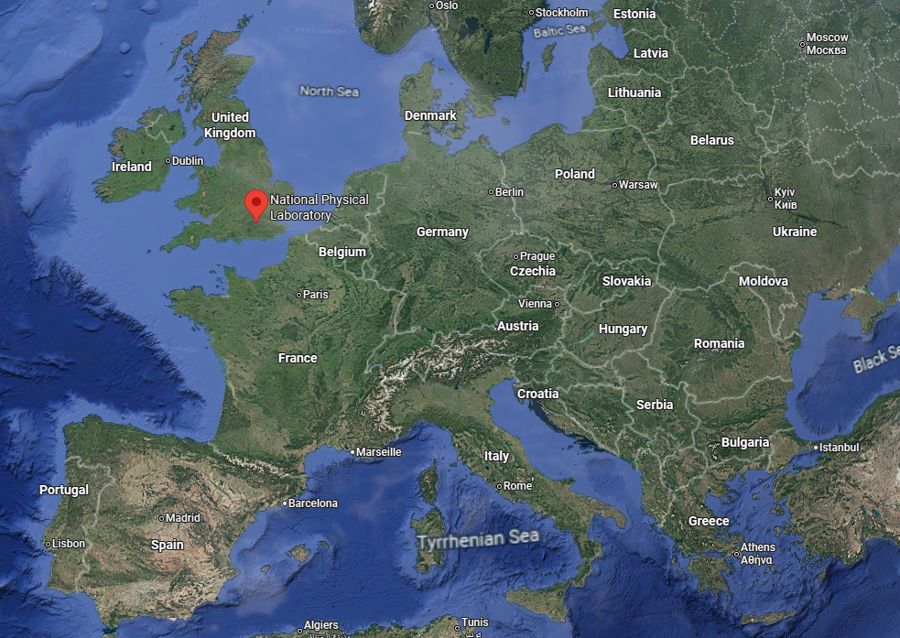
The National Physical Laboratory
The National Physical Laboratory (NPL) is the UK's National Measurement Institute, and is a world-leading centre of excellence in developing and applying the most accurate measurement standards, science and technology available
Owned by the Department for Science, Innovation & Technology
Over 1000 staff, 800 scientists, 400 laboratories and 200 researchers
Partnered with 200+ organisations and 80+ Universities

Slide 3
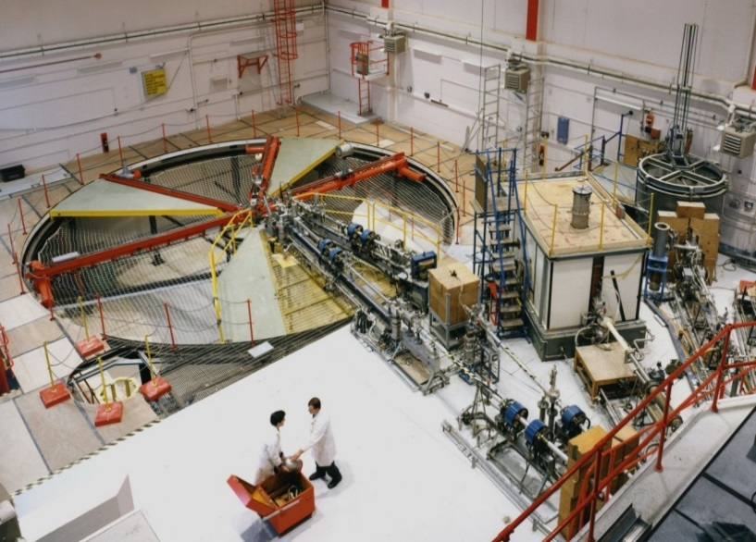
Neutron Metrology at NPL
Part of the Nuclear Metrology Group: 40-50 people
10 staff members in neutrons
Responsable for the maintenance and improvement of neutron standards
  Monoenergetic fluence and dose standards from a few keV to 20 MeV
  Thermal fluence and dose standards
  Radionuclide fluence and dose standards
  Measurement of neutron source emission rate

Slide 4
Neutron output
Neutron metrology typically is concerned with radiation protection level quantities:
  100s-1000s of neutrons per cm2 per s (at 1 m from the target)
  Maximum dose rates of 1 mSv/h
Nuclear data requires more neutrons
  Can move closer the neutron producing target → larger uncertainties for absolute measurement
  Can increase beam current → more heat → new target designs

Slide 5
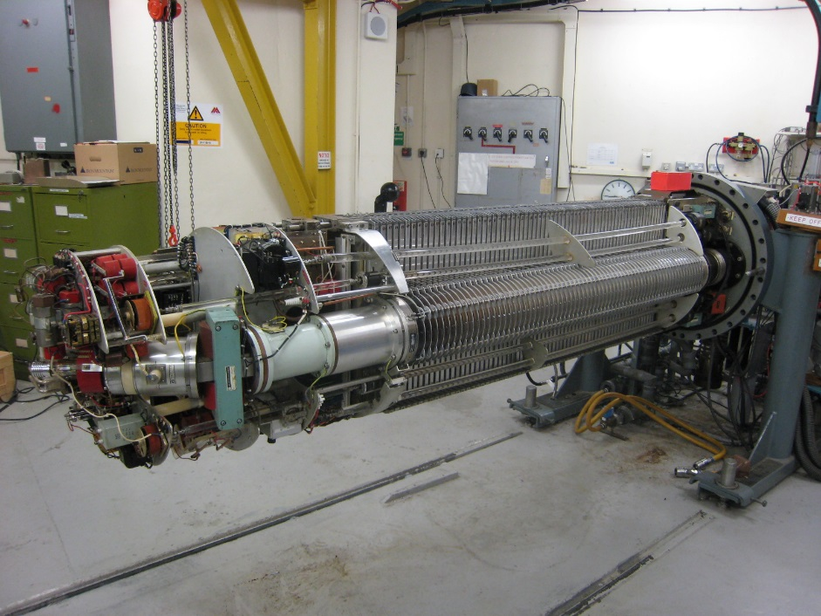
Current machine
Installed in the 1960’s
3.5 MV single ended VdG
Protons and deuterons
Energy range 500 keV to 3.5 MeV
Max beam current 80 µA
Typical beam current 3-20 µA
Compressed air cooling

Slide 6
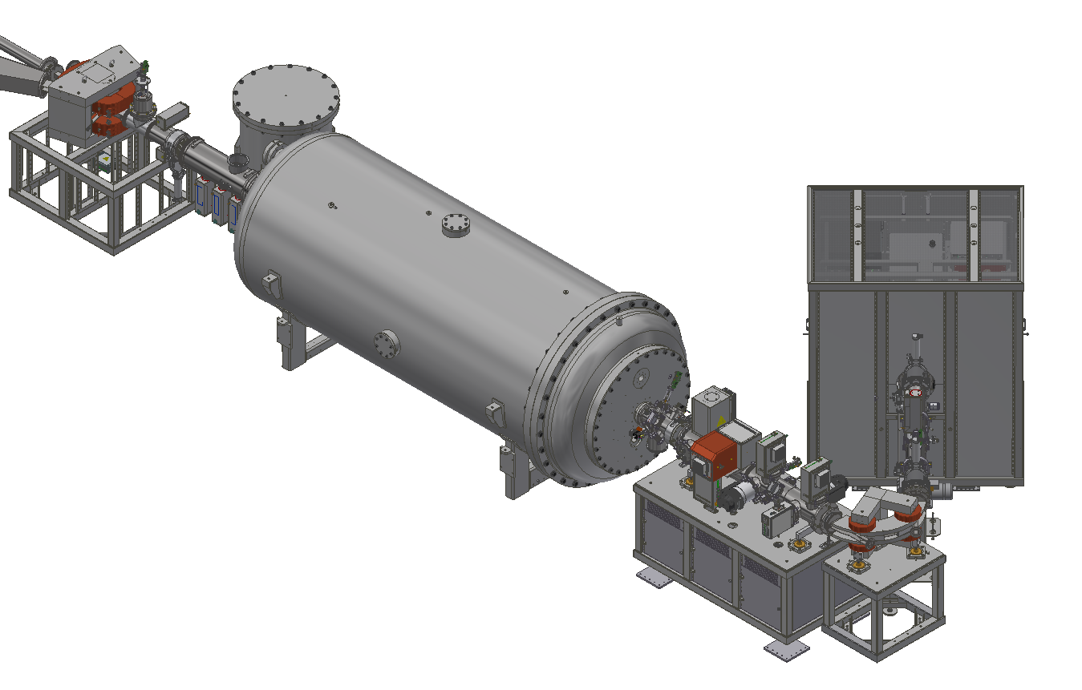
New machine
Multicusp ion sources
Species | Beam current (eµA) | Beam current (eµA) @ target
p | 500 | 450
d | 400 | 350
He | 020 | 18
To be installed in 2026
Protons, deuterons, helions
Energy range 200 keV to 4 MeV
Max beam current 450 µA
More stable
Pulsed → TOF
Automated operation
2 MV coaxial tandetron
Species | Pulse intensity (epC) | Average beam current (eµA) @ 4MHz
p | 4 | 16
d | 3 | 12
He | 0.5 | 2
Pulser and buncher
4 MHz to 125 kHz
(250 ns to 8 µs)
FWHM ~ 2 ns

Slide 7
Current limitations
For LiF targets we limit to ~ 50 W of beam power with compressed air cooling
  Max of new machine for Li(p,n) ~ 1 kW
For Ti-T and Ti-D targets we limit to ~10 W of beam power with compressed air cooling
  Max of new machine for T(p,n) ~ 1.4 kW
  Max of new machine for D(d,n) ~ 1.4 kW
  Max of new machine for T(d,n) ~ 0.9 kW

Slide 8
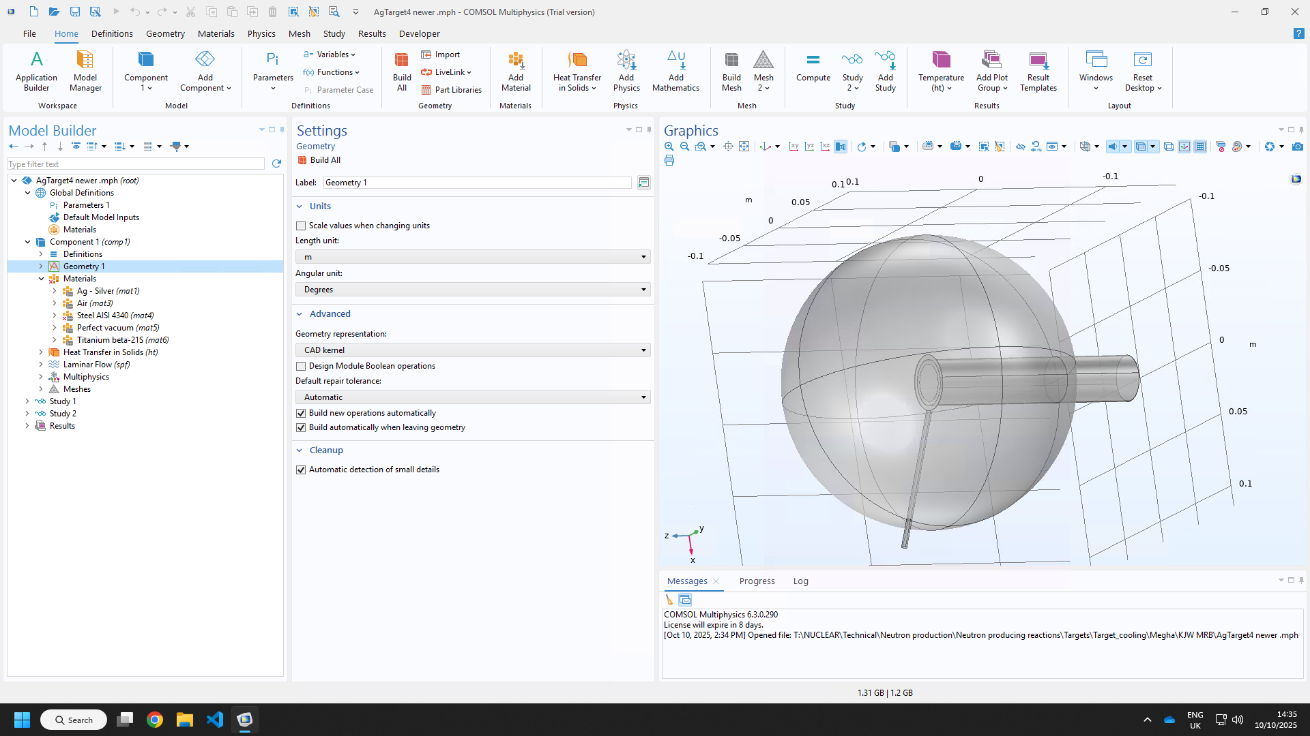
Modelling of targets
Using COMSOL 6.3
Modelling simplifed geometry
Including multiphysics:
  Heat transfer in solids and fluids
  Laminar flow
Begin with modelling extant targets
Move to water cooled designs
Radiation transport simulations required to determine effect of neutron field

Slide 9
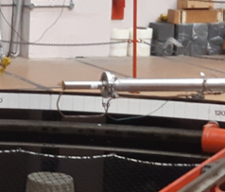
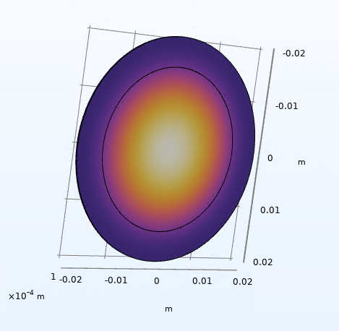
Modelling of targets
Air volume
Target
Heat source applied
Compressed air

