Slide 1
Rules of the Game
7 questions, each with 4 answers to choose from (A, B, C, D).
✔
Mark your answer on your answer sheet before the timer ends.
We will then reveal the correct answer.
✔
If you have answered correctly you may tick off the next energy level.
Let‘s see which energy level you can reach!

Slide 2
Set
Ready?
GO!

Slide 3
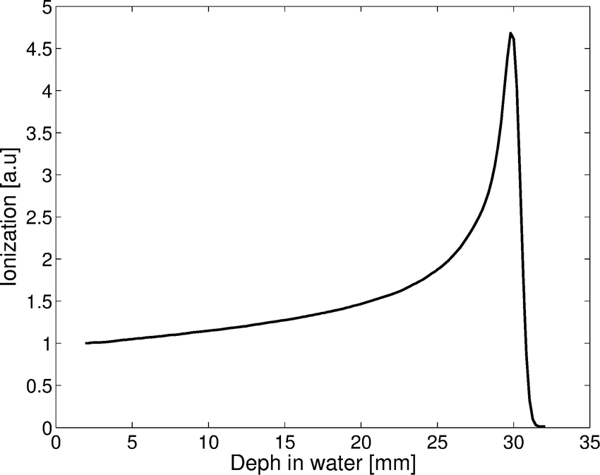

Which physical principle is
important for Hadron
Therapy?
STOP
1
A. Brad’s valey
B. Bragg valey
C. Bragg peak
D. Bill’s peak

Slide 4
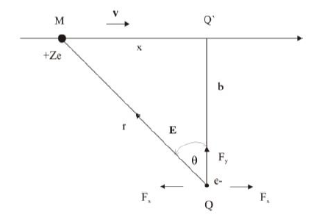
Which type of interaction is
dominant between proton/ion
beam with electrons from
molecules of human body?
STOP
2
A. Electromagnetic force
B. Weak force
C. Strong force
D. Gravitational force

Slide 5
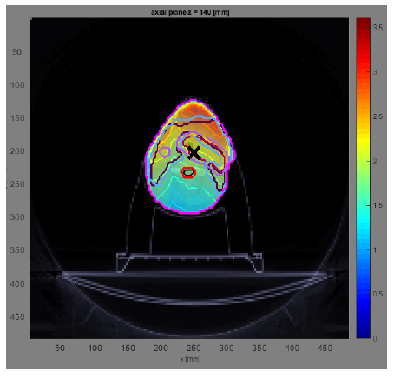
From the picture below, what
kind of particles create such dose distribution?
STOP
3
Protons
Photons
A.
B.
Carbon ions
Pions
C.
D.

Slide 6
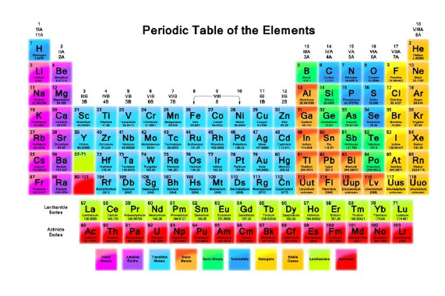
Most commonly used ions for
therapy?
STOP
4
A.
B.
Uranium ions
Argon ions
Oxygen ions
C.
D.
Carbon ions

Slide 7

What is the unit for absorbed
dose?
STOP
5
A. 1Joule
B. 1 Newton
1 Green
D. 1 Gray
C.

Slide 8
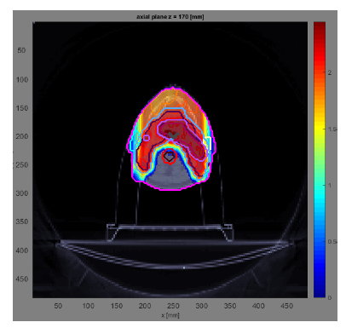
Dose on the critical organs using
proton/ion therapy instead of X-ray
therapy is:
STOP
6
A.
B.
bigger
smaller
equal
C.
D.
I don’t know

Slide 9
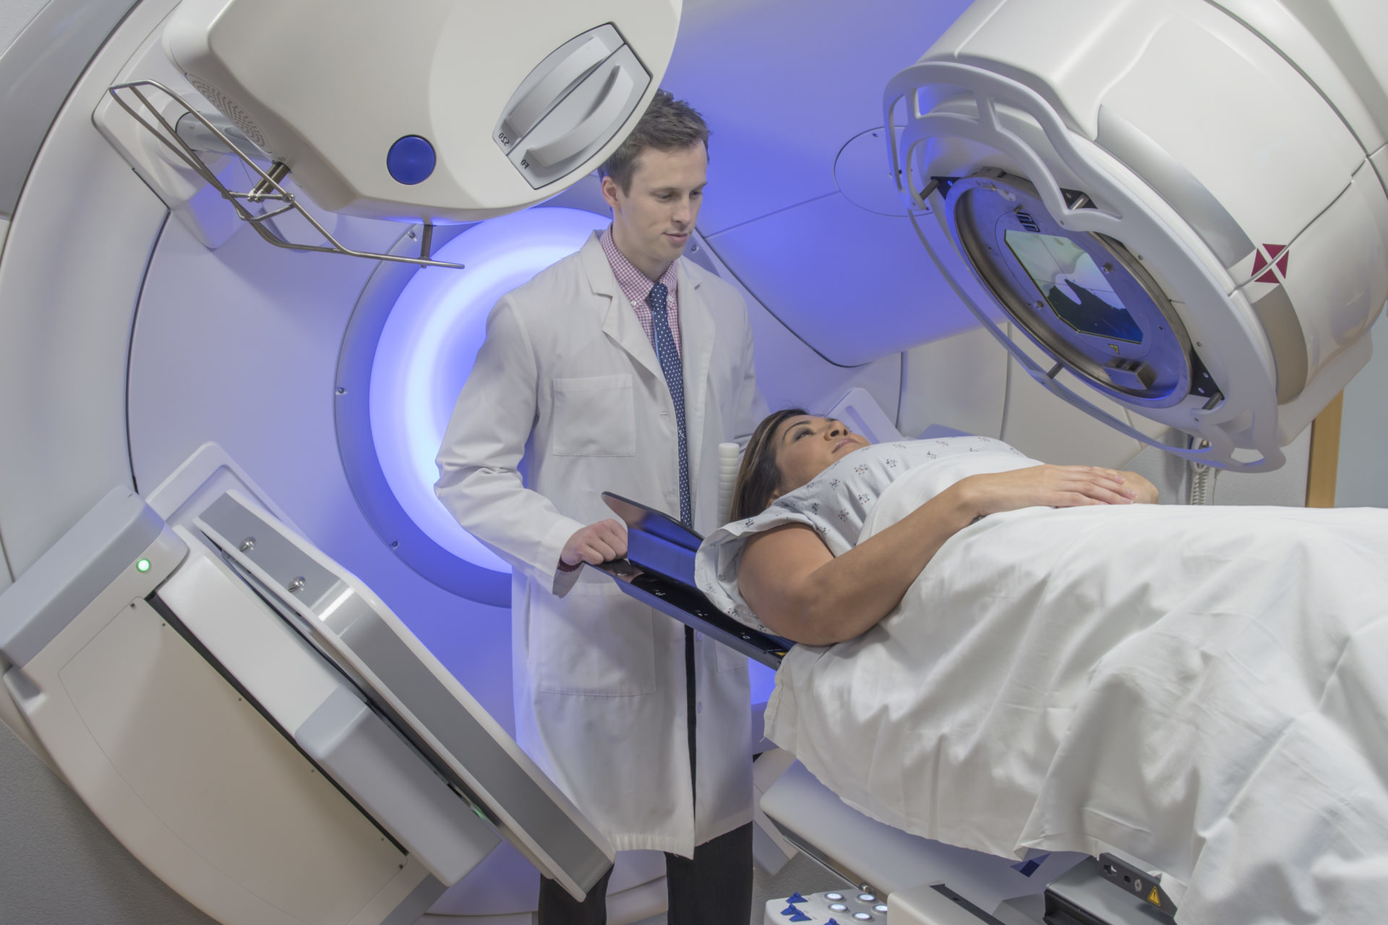
How do we call a treatment using ionizing radiation to kill cancer?
STOP
7
A. Radiotherapy
B. Radiodiagnostics
C. Radiophone
D. Radiology

Slide 10
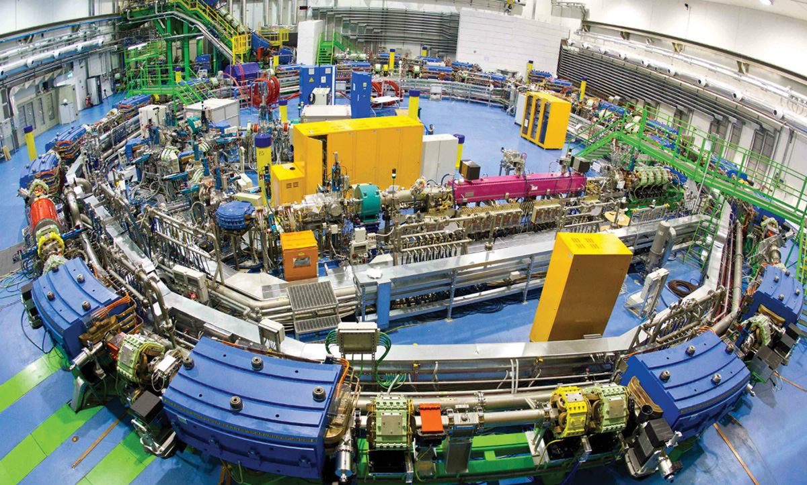
Synchotrons are used for accelerating
STOP
9
A. Photons
B. Heavy particles
C. The patient
D. I don’t know

Slide 11
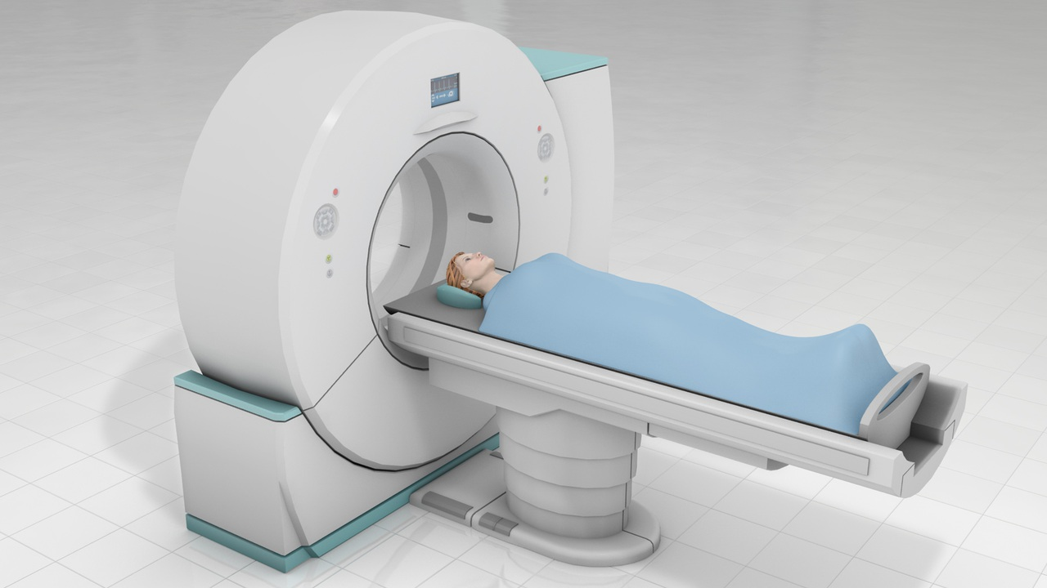
We use a CT machine for
STOP
10
B. Reducing background radiation
A. Radiation delivery
C. Shielding the OARs
D. Imaging

Slide 12
Which energy level did you reach?

