Slide 1

ET-PP WP8
Computing and data model
Report of activities
October 15 2025
Nadia Tonello, on behalf of WP8 and EiB

Slide 2
ET-PP WP8
Computing and data model
ET-PP WP8 Roadmap
Deliverables
D8.1 Computing and Data requirements
RP1 Changes requested:
Re-submitted 15-09-2025
D8.2 Computing and Data model
EC Due date: February 2026
Internal due date: End 2025
Currently In preparation
D8.3 Data access policy implementation guidelines
EC Due date: August 2026
Internal due date: May/June 2025
Milestones
M8.3 On site infrastructure, computing and data model
Jun 30 - Jul 01
M8.4 Low-latency and offline workflows
Due date: Dec 2025
M8.5 Data management access policy implementation
Due date: July 2026
October 15th 2025

Slide 3
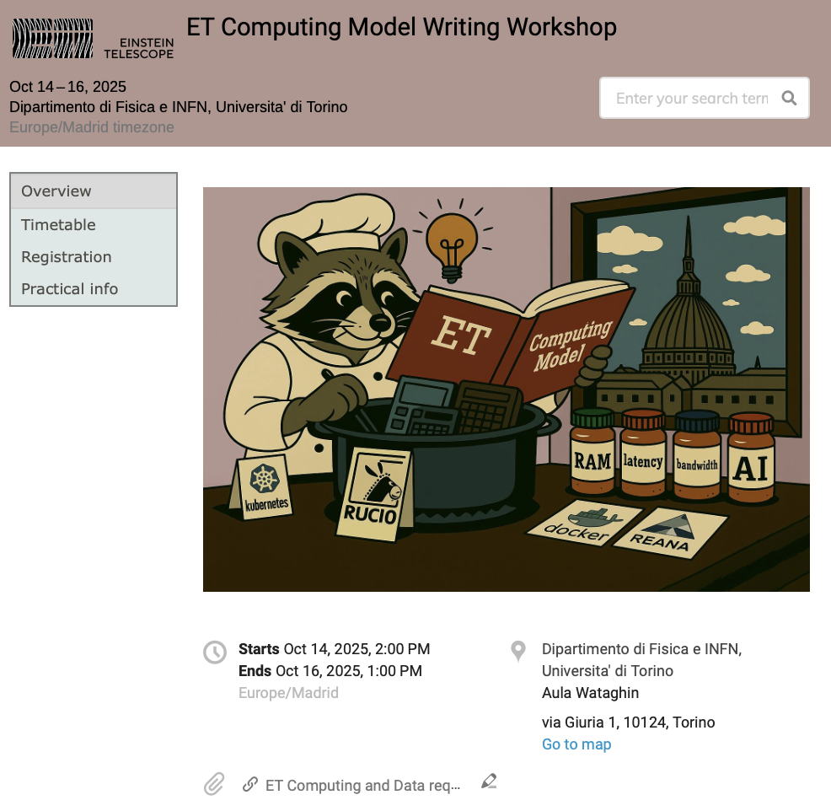
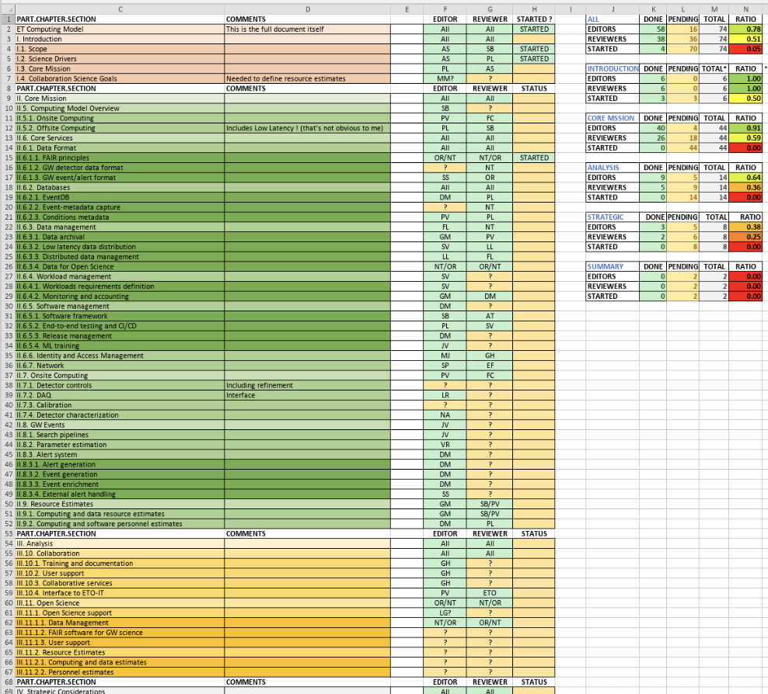
ET-PP WP8
Computing and data model
ET-PP WP8 D8.2 Computing and Data Model.
Collaborative document edition set up (Overleaf-CERN)
Torino workshop 14-16 October
Scope and structure
Editors list review
Discussion topics (such as collaboration services)
Writing sessions
Release to ET collaboration by the end of the year
October 15th 2025

Slide 4
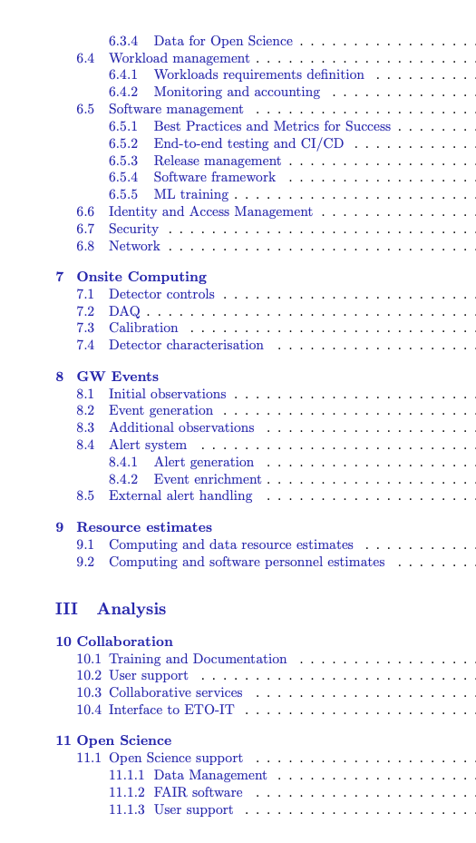
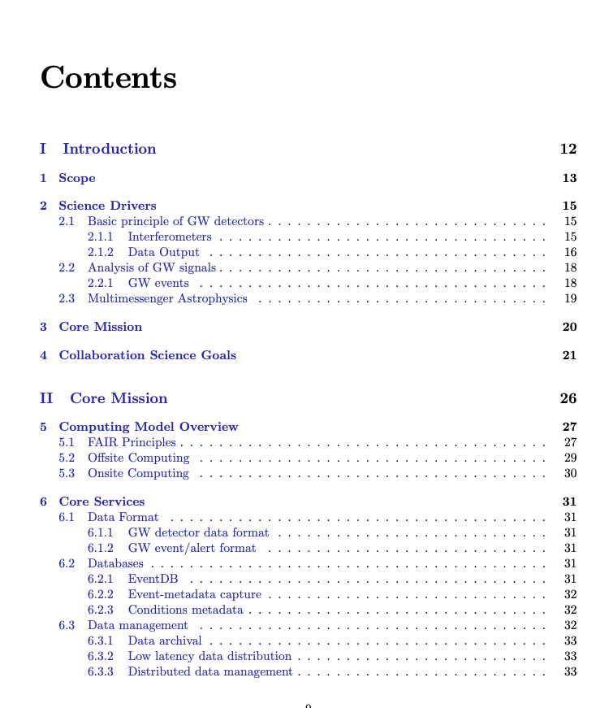
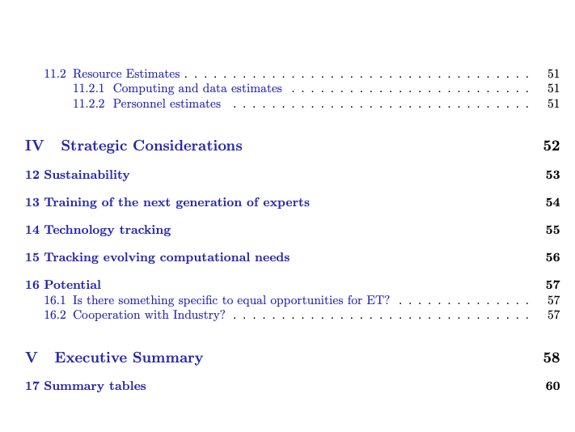
ET-PP WP8
Computing and data model
October 15th 2025

Slide 5
ET-PP WP8
Computing and data model
ET-PP WP8 EiB Activities (1/2)
1. Writing writing writing D8.2 Computing model
Get ready for WP8 internal reviewers (end October) assigned for every chapter
Needed feedback soon by external reviewers
2. OSCARS projects
MADDEN: Rucio data lake, testing ET data lake + mock CE data lake
Preliminary version is running for multi-RI storage access
Development needed to have bidirectional access ET-CE data lakes
ETAP: virtual research environment for ET, like CERN/ESCAPE-VRE
Jupiterhub + Reana + Rucio + monitoring + data management
October 15th 2025

Slide 6
ET-PP WP8
Computing and data model
ET-PP WP8 EiB Activities (2/2)
3. Code support to MDC OSB Div10 ongoing (C++ recoding proposal), sharing best practices for sw writing and management.
4. Glossary- controlled vocabulary to be prepared and provided for D8.3
Fundamental to define Metadata schema and data model:
- for ET real and simulated data (MDC)
- for [LVK] Gravitational Wave detectors analyze their data together”
5. New version of ETMD has been integrated with indigo IAM instance for ET (same as Virgo)
6. Multi messaging: 4th Astro-COLIBRI multi-messenger workshop 20-24 October Orsay, for providing input for the ET computing model
7. Collaboration with WP7 for workshop for industry engagement (computing session)
October 15th 2025

Slide 7
Thank you!
Nadia Tonello, on behalf of WP8 and EiB

