Slide 1

LHC perspectives for 2025 -2026
the end game - revisited
J. Wenninger
Observations 9 months after Chamonix
Acknowledgements to the OP, ABP, MPE, CRG, STI and VSC colleagues for inputs and inspirations

Slide 2
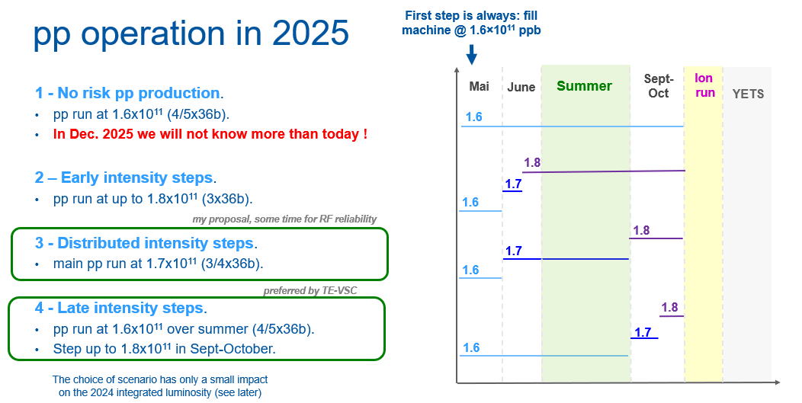
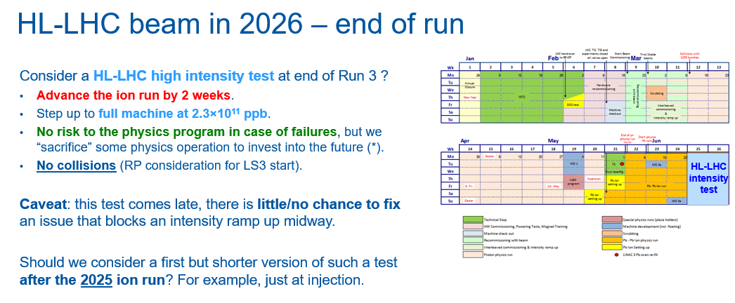
Roadmap to HL-LHC beams in LHC
Chamonix 2025 - dual approach:
Operation @ 1.8E11 ppb by end of 2025.
  Limited by dump protection (TCDS).
  Compromised by WMSIO.A6L2 failure for B1.
    Failure occurred before the intensity increase !!!
    Assume that this will be repaired during the YETS.
  Worries about TCLDs (B1 more than B2).
    To change or not to change…
HI test at the end of the 2026 run.
  Small print on some limited risk-taking before the HI test.

Slide 3
HI test limitations @ 2.3E11 ppb
Electron cloud heat load:
  Prevents ramping both beams at nominal HL intensity levels (≥ 2500b).
  Work-around:
    Single beam operation – not probing common vacuum chambers in IR2 and IR8.
    Lower energy operation: settling down around 3 TeV.
Dump protection damage (TCDS):
  Limited to 8b4e beams (max ~< 2000b).
    Or other variants with specific bunch intensity limits.
  Given the absence of asynchronous beam dumps in Run 3, we could take some risks over the two-week HI test and ignore this limitation.

Slide 4
Current scenarios
HI test options (for 2.3E11 ppb):
Nominal HL-LHC filling at injection.
  Intermediate (and mandatory) milestone, heating is limited by longer bunch length (1.3 – 1.4+ ns).
8b4e (or hybrid) beam at 6.8 TeV.
  Limited by the number of bunches, ~2200b for hybrid?
Nominal HL-LHC beam at ~ 3 TeV.
  Bunch length growth by IBS limits ‘heating efficiency’.
  Recent MD results with larger emittances: efficient fills of ~4-5 hours feasible.
  Nominal could mean Nx48b (and not 4x72b) → importance of probing 3 TeV e-cloud in MD4.
Single beam operation at high energy.
  Very interesting for e-cloud situation before LS3.
  Not sufficient for common beam region in IR2/8.
  Less efficient.

Slide 5
Intensity ramp up for HI test
Ramp up no bunches @ constant (max) bunch intensity
  Better for e-cloud / cryo: easier to extrapolate.
  A little bit easier for operation (inj + LHC) ??
Ramp up bunch intensity @ constant no of bunches
  Better for vacuum conditioning ?

Slide 6
Feedback from 2024/5 operation/MD
Even at constant beam intensity, elements can break after months of operation (6L2).
HI test cannot address this !
MD feedback: is going straight to 2.3E11 ppb – with fewer bunches – too ‘violent’?
I think that it is difficult to conclude.
If a problem is encountered, it is clearly difficult to scale it to the equivalent intensity at full beam.
Given 2025 observations, we should not start probing at the last minute in June 2026.
Strong (?) case for planning intermediate milestones.
Push for 1 day at end of 2025 ion run? Move the ion day to 2026 ?
  Limited to B2 since B1 cannot be reasonably pushed.
2026 intermediate milestones:
  After intensity ramp up, aim to fill the machine at injection with intensities > regular operation.
  MD1/2 intermediate heating power steps > regular operation.

Slide 7
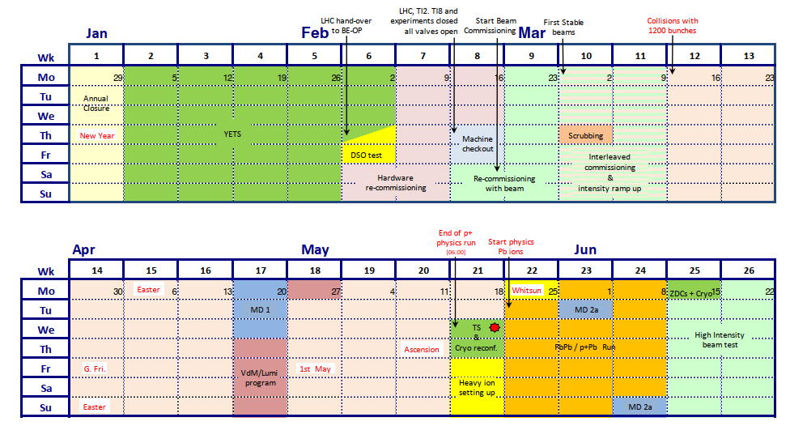
Intermediate steps in 2026 – for example
Begin the run with the usual intensity ramp up @ 1.7E11 (or 1.8E11) for physics production.
Possible milestones before HI test of June 2026 – heating above regular operation values:
Push intensity at injection towards 2.0E11 (standard 36b or 48/72b).
Push intensity at 3 TeV towards 2.0E11 (standard 36b or 48/72b).
If ok, consider further steps.
Plan intermediate milestones BEFORE MD1.
First step in W13 or W14.

