Slide 1
API change for the BLM thresholds GUI
B. Salvachua, SY-BI-BL
A. Tsounis, BE-CSS-CSA
263rd Machine Protectin Panel Meeting (LHC) – Joint with Collimation WG – 17/10/2025

Slide 2
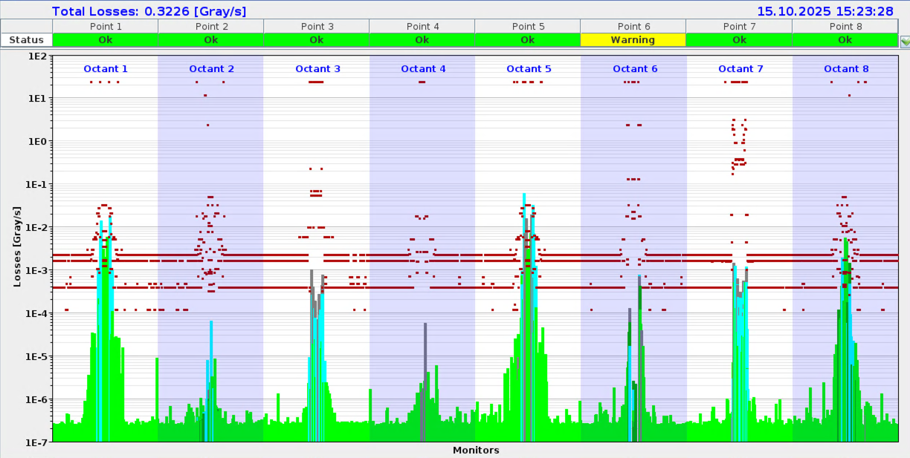
BLM Thresholds
Applied and Master BLM thresholds are a function of the beam energy and the integration time.
32 Energy Levels
12 Running Sums
LHC
→ 384 values
3599 BLMs Ionisation Chambers – most of them connected to the BIS - interlocked
BLM Monitors grouped into 141 BLM families – several monitors sharing the same Master Thresholds
Individual monitor thresholds are adjusted with a Monitor Factor (from 0 to 1)
Applied Thresholds [32,12] = Master Thresholds [32,12] x Monitor Factor

Slide 3
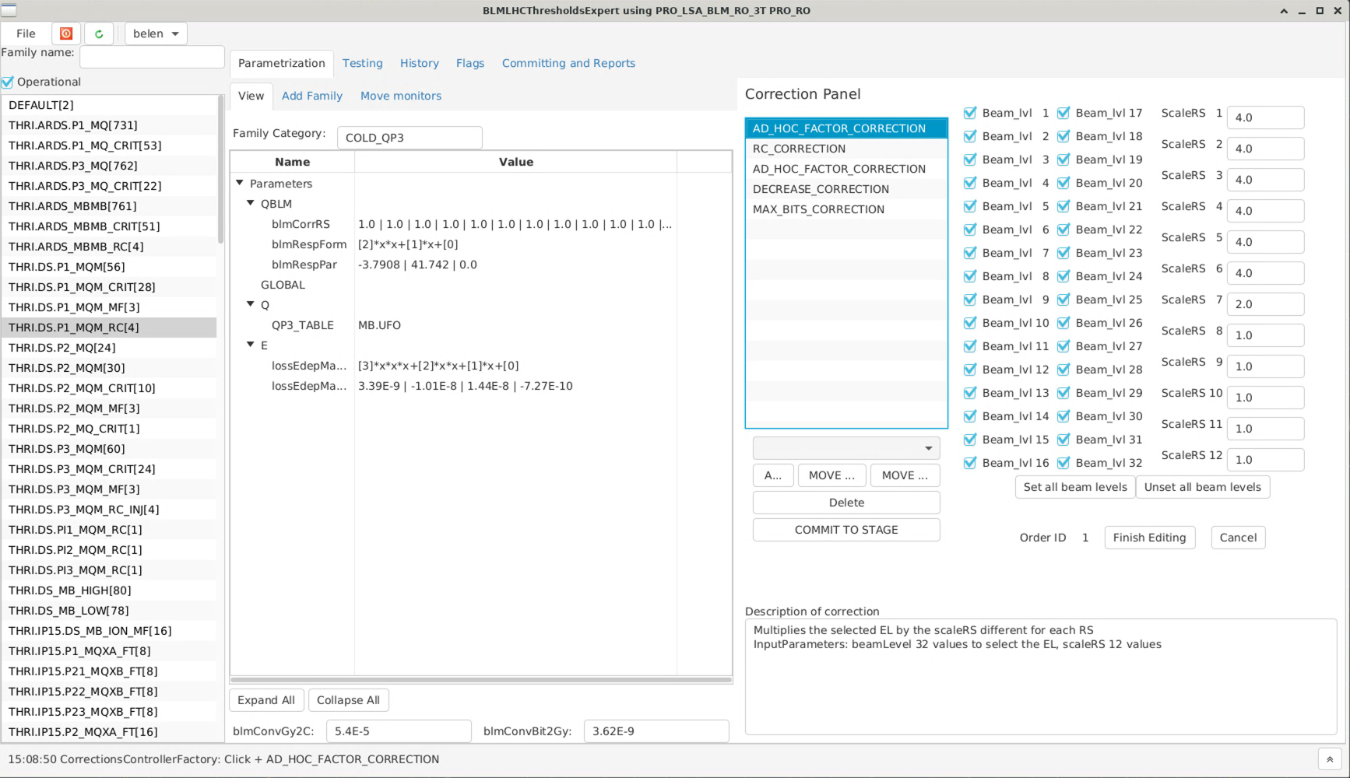
Present BLM Thresholds GUI
BLM families: contain the master thresholds
Thresholds Model Parameters
Thresholds Corrections
Functions that allow us to change the matrix of thresholds

Slide 4
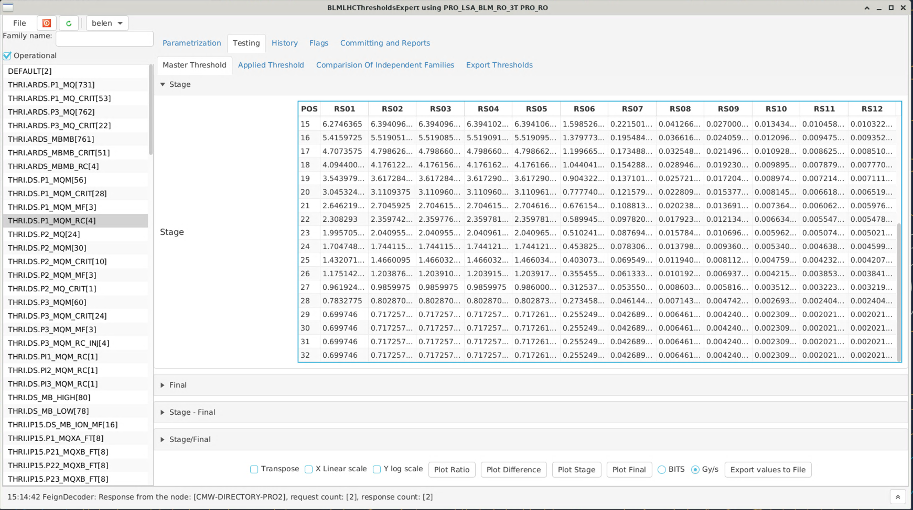
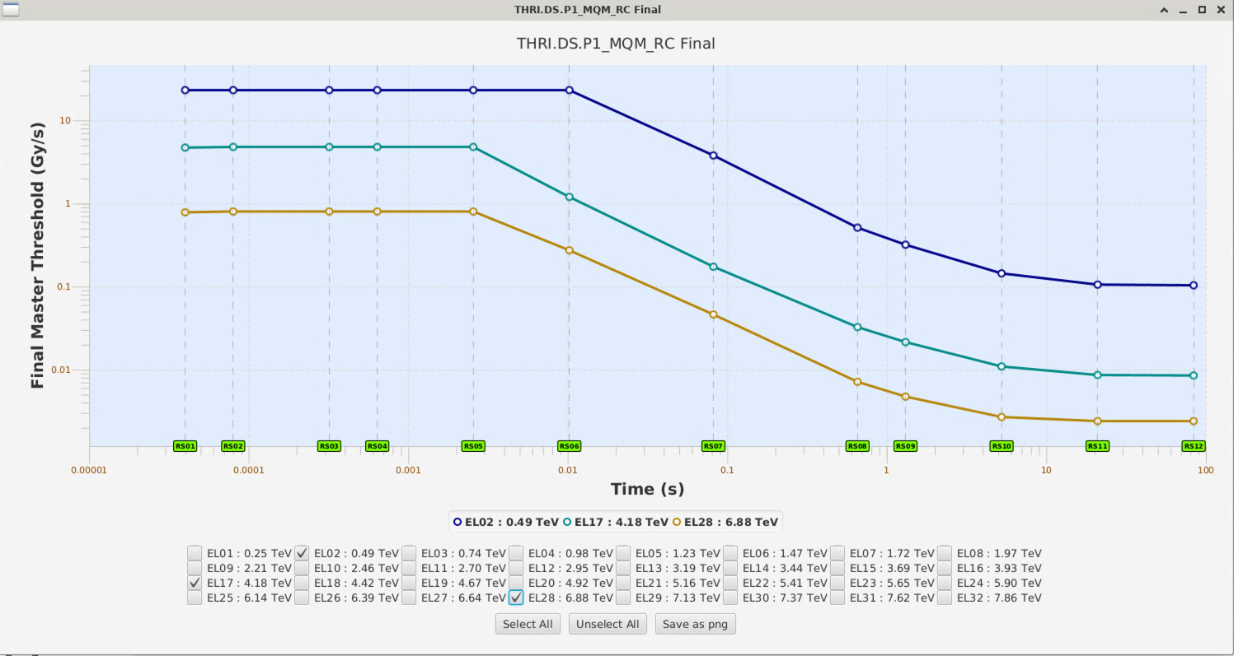
Present BLM Thresholds GUI
This tool allows to edit and visualise the millions of thresholds that we have in the LHC.
It is an essential tool for the management of the BLM thresholds and configuration.
It is in JavaFX
  Critical and a solution needs to be found for LS3
Connections to the Database done with RMI (Remote Method Invocation)
  Deprecated since 2020. This poses security risks.
Other issues are: missing functionality to ‘document’ , tag or revert changes
(will not be covered today)

Slide 5
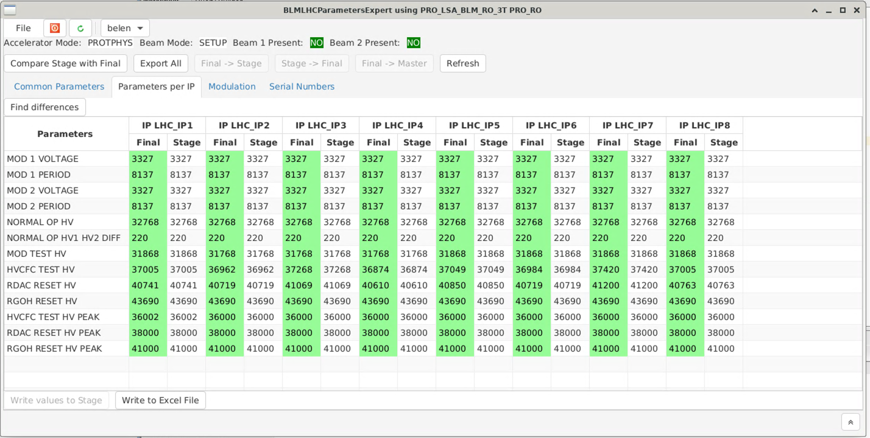
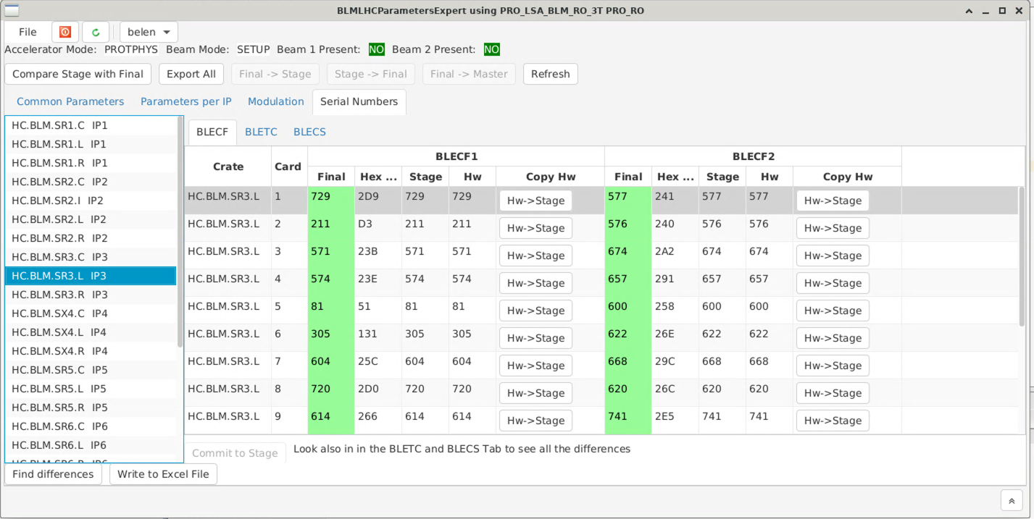
Similar problems on the Internal Parameters
BLM Combiner tables: hardware parameters of the BLM system, cards serial number, HV modulation limits, etc.
Different GUI with different MCS role
Important to test it in order to avoid the piquet to be blocked during an intervention

Slide 6
Migration from RMI to REST API
REST (Representational State Transfer) is the most common technology to do RPC (Remote procedure calls) in the WEB era. It is using HTTP to invoke server methods by passing the objects in the HTTP request body, usually as JSON strings
Most of Controls systems have been migrating over the last couple of years to REST
BLM server and client have been migrated out of RMI and into REST. However, the changes are quite extensive regarding the way the objects are serialised. Thorough testing have been carried out to ensure the new version does not have any regressions → but not programmatically (human testing)
Some small issues were discovered with the BI GUI applications when performing end-to-end testing between BI and CSS and were fixed as part of the migration to REST to improve the user experience.

Slide 7
Proposal
Deployment the migration to REST during the Technical Stop – day time
How can we guarantee that the upgrade can be safe and smooth?
Make a copy of the BLM tables (Thresholds and Combiner) before changes are deployed
CSS should ensure that a roll-back of settings is possible in case of issues.
Change Thresholds of at least 1 family and assign this thresholds to a new monitor.
  Go to the full chain of Commit to Final → Refresh Master → Generate LSA settings → Drive to Hardware.
  Existing BLM crontask will verify if the change is implemented in LSA.
  Existing BLM sanity checks will verify that the electronics have the same thresholds as in LSA settings.
Update 1 serial number and 1 flag: BLM connected, BIS connected, Masked, Resistor and Capacitor
  Test full chain similarly

